Slide 1
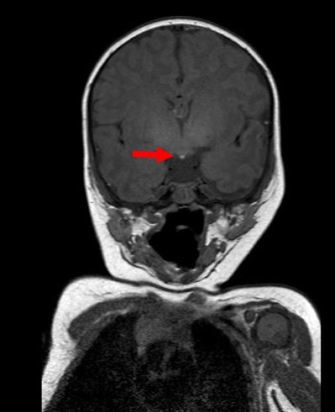
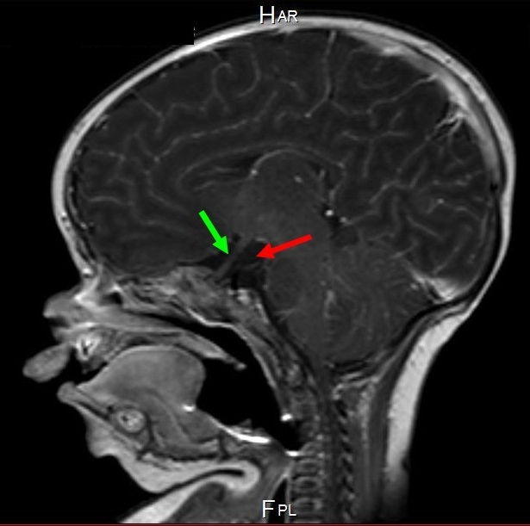
Congenital pituitary hypoplasia in two brothers : a new genetic form of combined pituitary hormone deficiency
Sara Moline ², Albert Beckers ³, Anne-simone Parent ¹
¹ Département de pédiatrie du CHU de Liège – Clinique Notre-dame des Bruyères
² Université de Liège (Ulg), étudiante en 4e master de médecine
³ Département d’endocrinologie du CHU de Liège
Introduction:
The development and differentiation of the pituitary involves a complex network of signaling molecules and transcription factors. Cases of congenital pituitary hypoplasia have led to the identification of some of those transcription factors and signaling molecules. However, many of those factors are still to be discovered.
We discuss the case of two brothers with congenital hypopituitarism and the genetic screening that we realized.
Case report:
At Birth
Non consanguineous parents
42 weeks of gestation
Caesarean for post term
At H4: severe hypoglycemia (15mg/dL)
Clinical exam:
Global hypotonia
Dysmorphic signs : retrognathism, low implanted ear, broad front, arched palate
Micropenis
Large and bulging anterior and posterior fontanelle
Neonatal evolution:
D2 : Icterus ( bilirubine max 18,3mg/dL)
D5 : Hyperthermia (38,5°C)
D6 : Suspicion of neonatal infection
D7 : cardio respiratory collapse
Persistance of severe hypoglycemia extremely difficult to control
Investigations:
Biological investigation : thyroid stimulating failure, growth hormone, adrenocorticotropic and gonadotropin deficiency. Prolactin in standards.
Radiological investigation : pituitary aplasia
Genetic investigation : Classical genes known to be associated with multiple pituitary deficiencies and pituitary hypoplasia (HESX1, LHX3, LHX4, SOX3 and PROP1) were sequenced and normal. A CGH array did not identify any abnormality. A whole-exome analysis was performed in the children and their parents. Currently, some variants was identified but none of them seems to lead to a mutation linked with the penotype of our patients.
T1 sequence + gadolinium in sagittal section : ectopic posterior pituitary in the floor of the third ventricule (red arrow).
T1 sequence in coronal section : absence of pituitary stalk and anterior pituitary (red arrow). Optic nerves (green arrow).
Discussion :
Currently, there is no molecular explanation for the pathology of these patients. However, other avenues still remain to be explored:
1) New genes that could be associated with multiple pituitary hormone deficiency : FGFR1, PROKR2 and GPR161
2) Germinal mosaïcism
3) New unrecognized mutation requiring futher analysis of the whole-exome sequencing.
Conclusion: We report here the exceptional case of two brothers from a non-consanguineous family presenting a pituitary hypoplasia. Currently, there is no molecular explanation for their pathology.
Even if the causes of the congenital multiple pituitary hormone deficiency remain largely unknown, their management requires the rapid establishment of a replacement therapy.
The genetic diagnosis is part of this management but an algorithmic approach base on phenotype to target the specific genes is unfortunatly severely limited.
It is necessary to continue the efforts in the comprehension of molecular bases of pituitary developement and in the genetic screening of patient with pituitary diseases to improve diagnostic tools and consider new therapeutic options.

