Slide 1
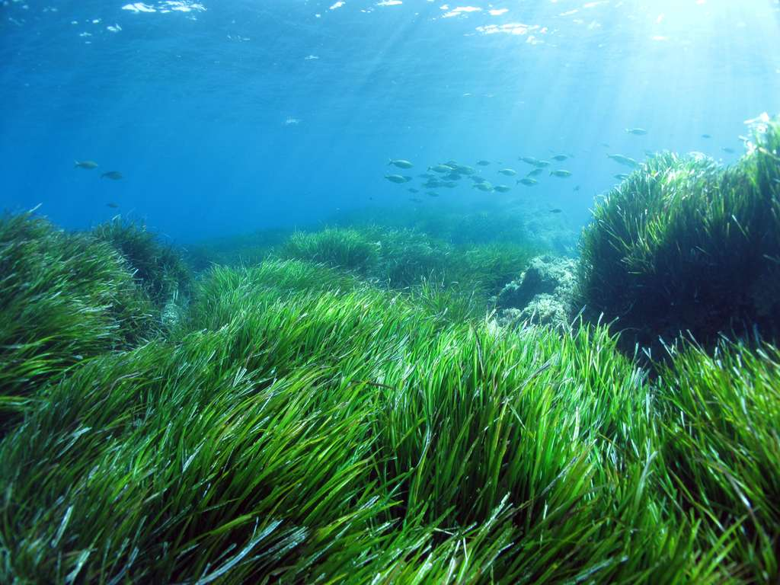
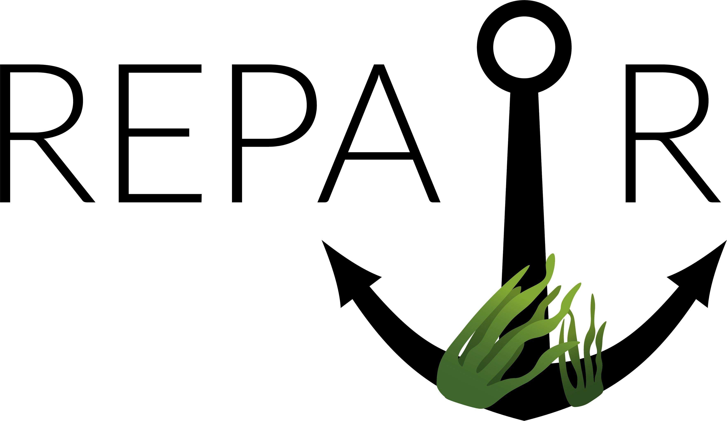

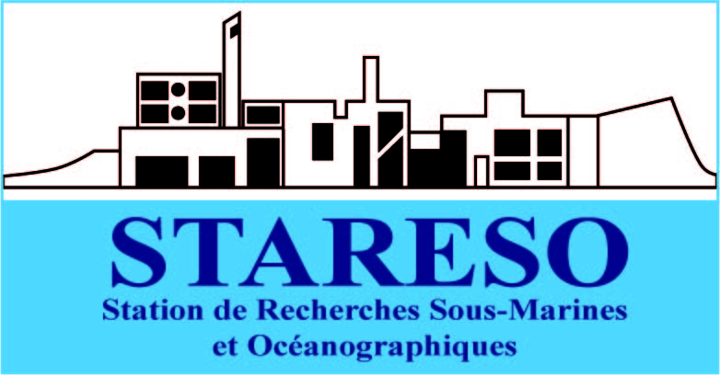
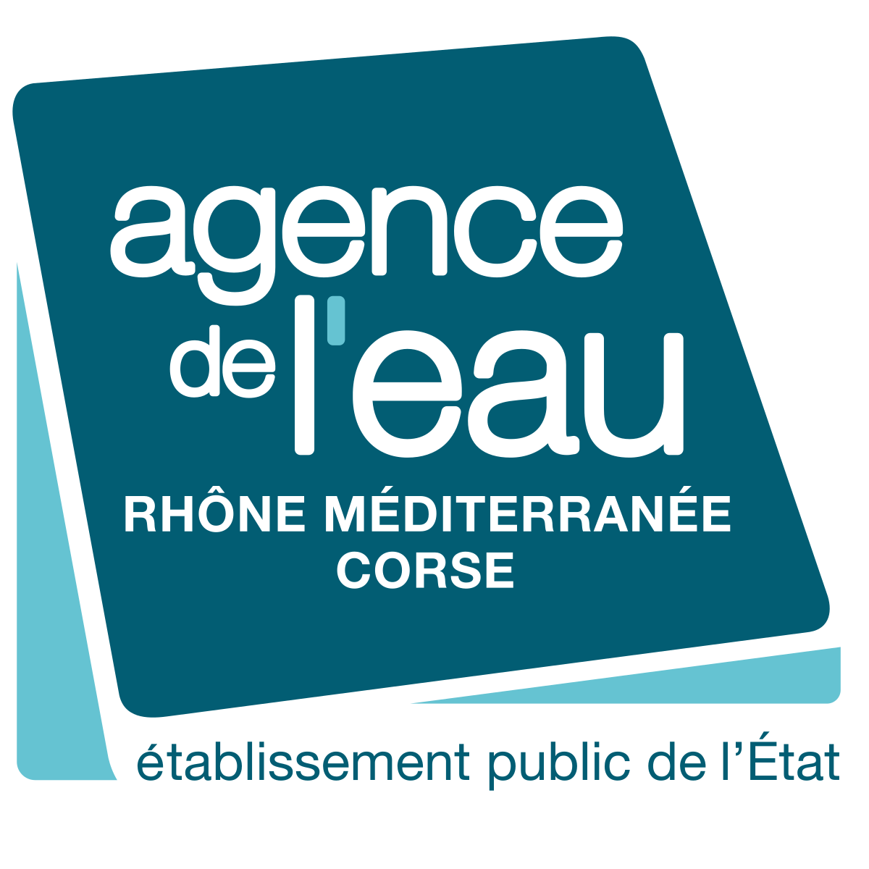

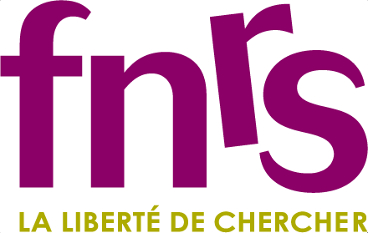

Restoration of anthropogenic patches in Posidonia oceanica meadows
Boulenger Arnaud
Gobert S., Marengo M., Fontaine Q., Lejeune P. et Goberville E.
Global Seagrass Nursery Network kick-off seminar
31st of March 2022

Slide 2
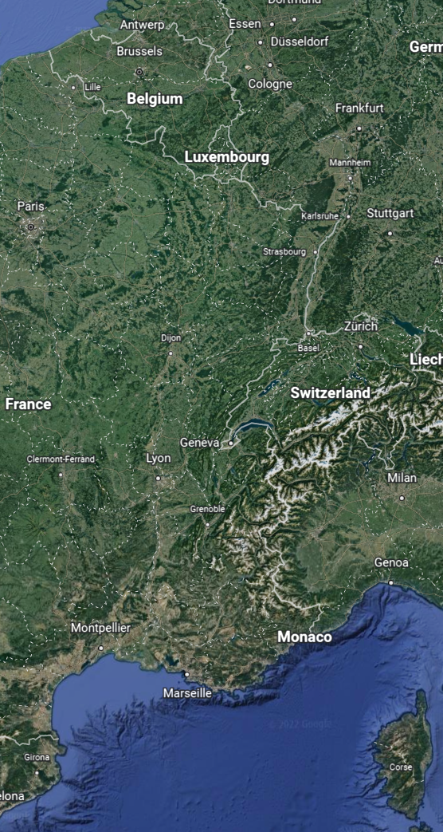
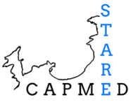
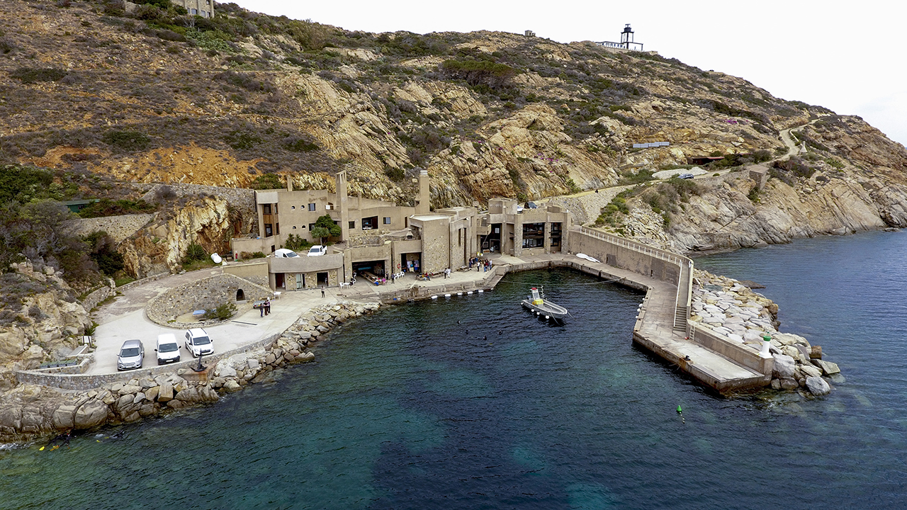

Partners of the project
Biological Oceanology lab (Head: Sylvie Gobert)
Spatio-temporal dynamics of seagrass meadows
Trace elements and nutrients
Ecosystem status
Ecological indices and diving sampling techniques
STARESO’s research institute (Dir.: Pierre Lejeune)
Founded in 1972
Long-term partnership with ULiège
STARECAPMED: Long-term study of the Bay of Calvi (1975)
EIA, climate change, biodiversity, fisheries,…
National Museum of Natural History
Partner for the geospatial modelling part of the project (Eric Goberville)
Notes:
STARECAPMED: a multidisciplinary program to establish a long-term study site for understanding the processes of evolution of coastal Mediterranean ecosystems in response to local and global anthropogenic pressures

Slide 3
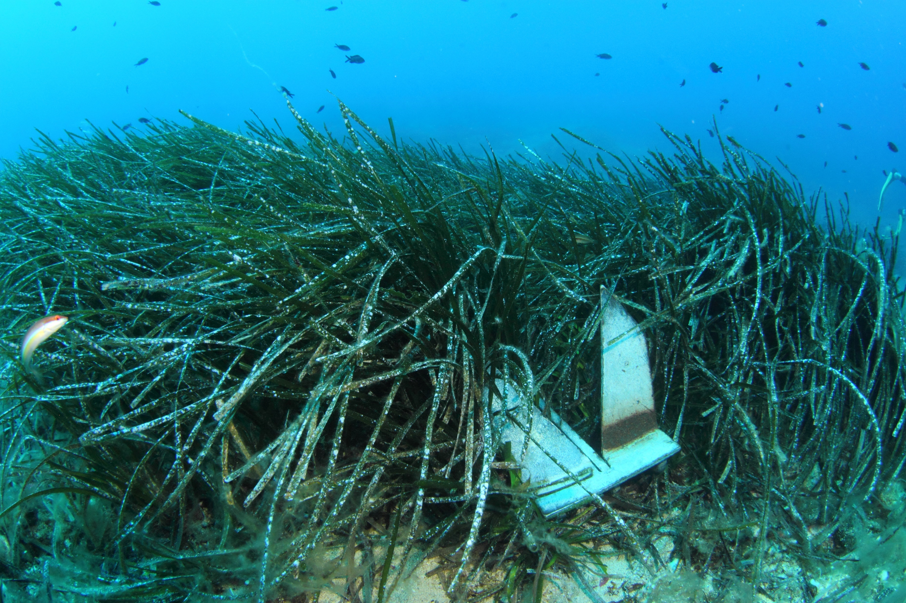
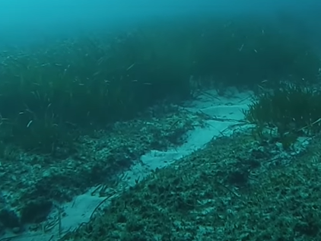
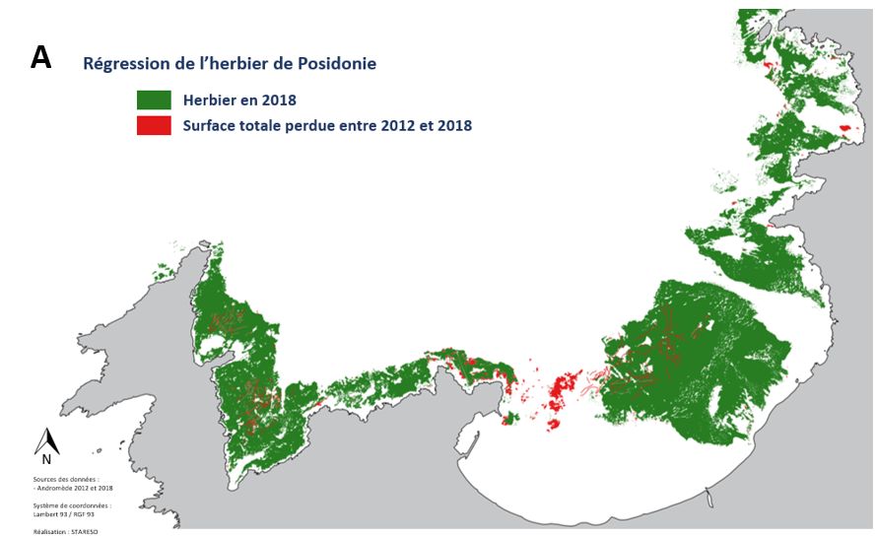
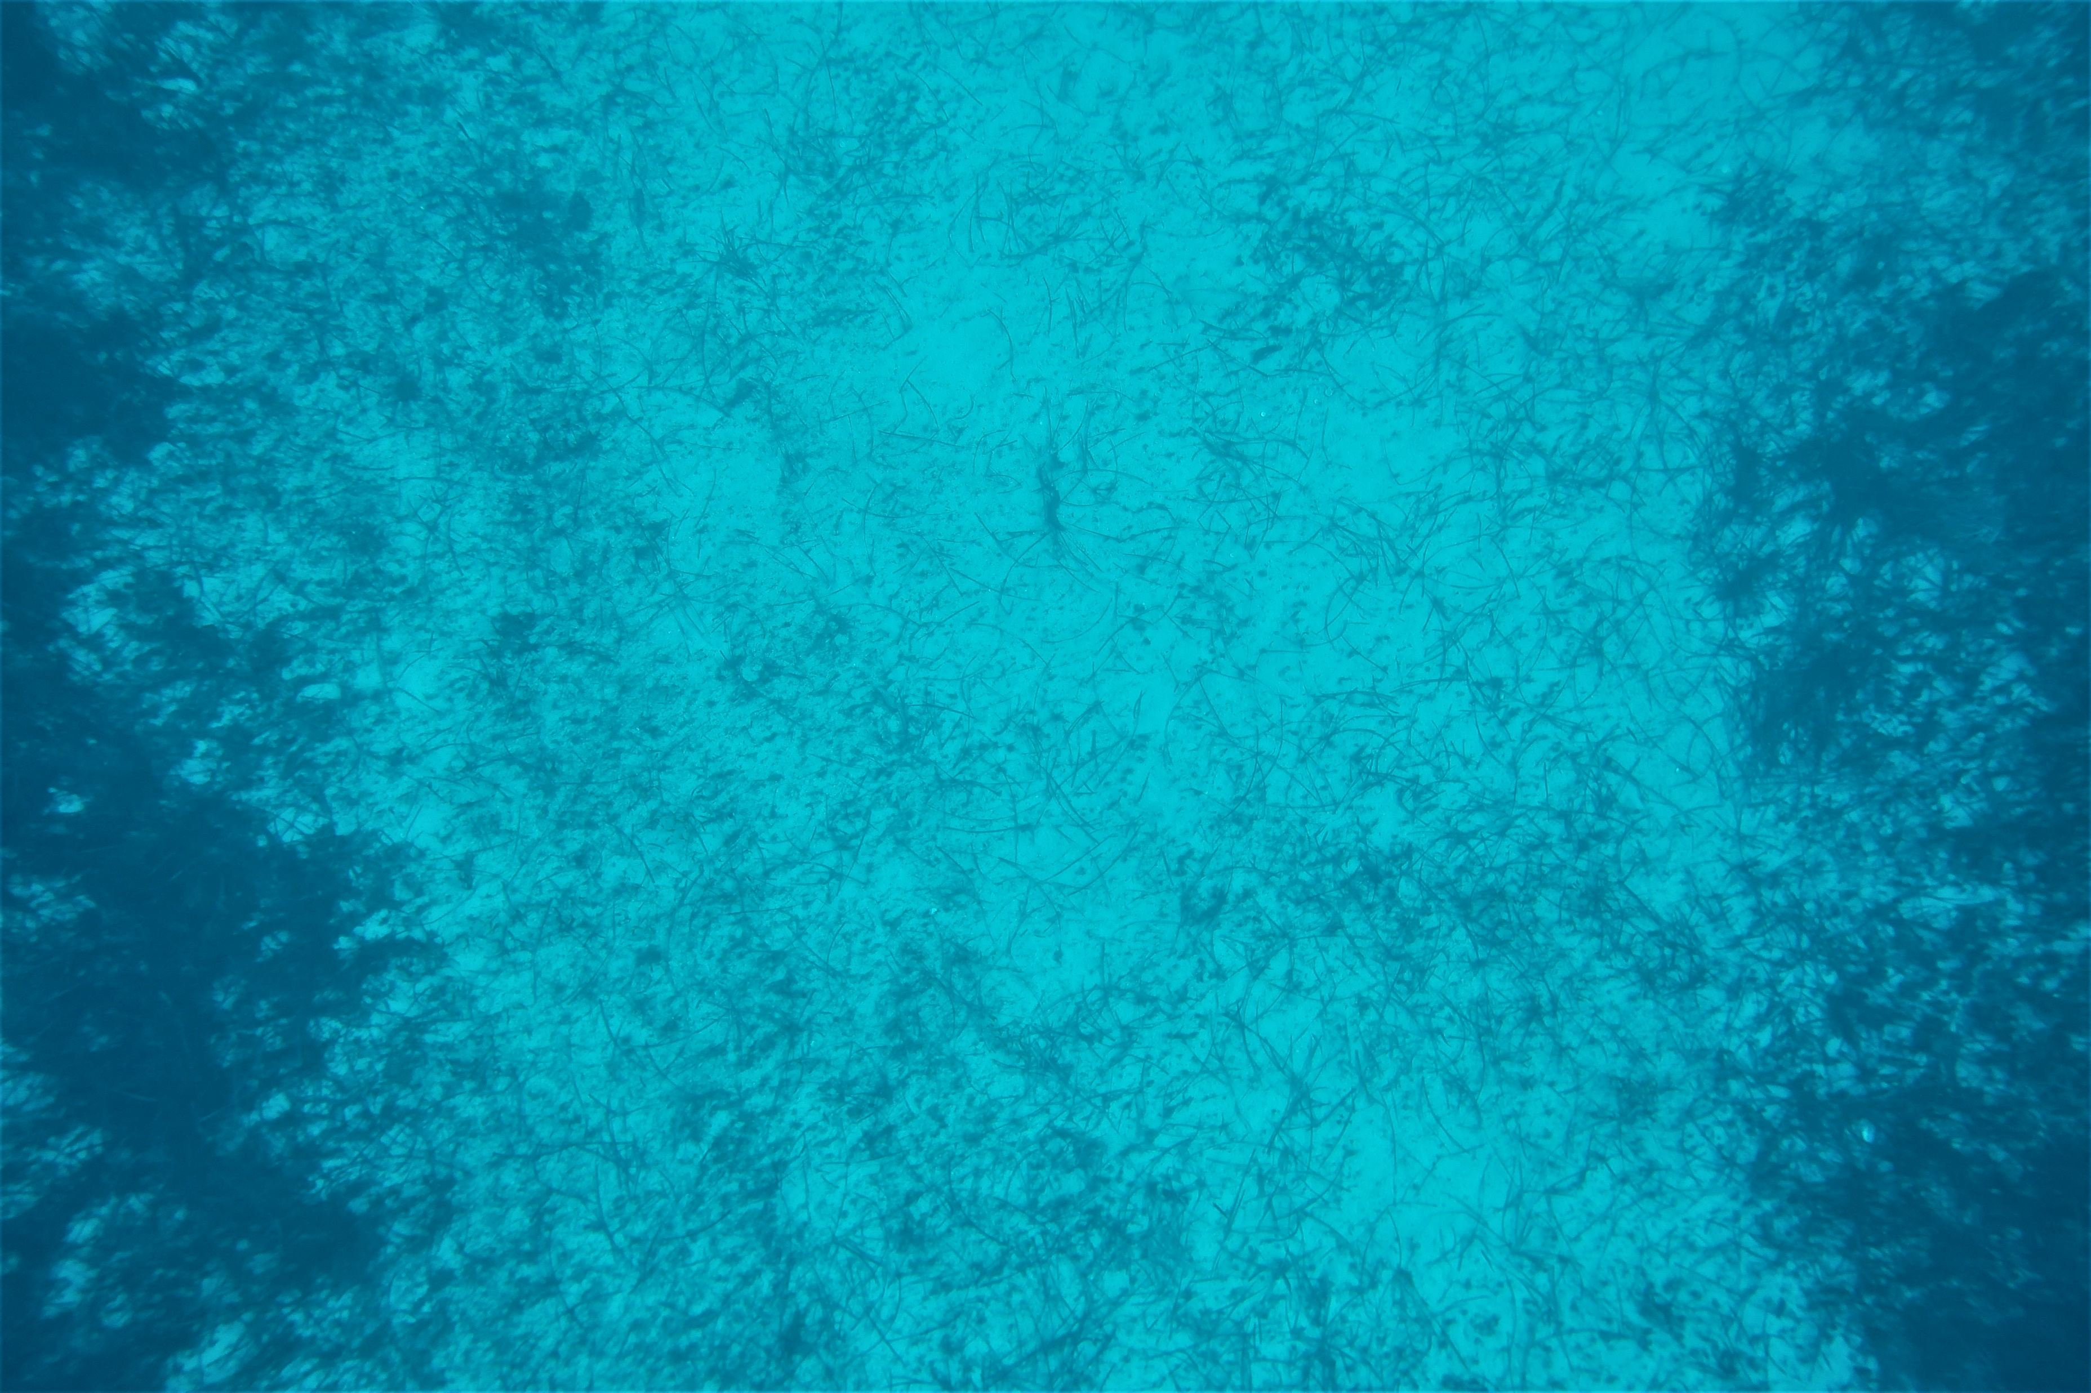
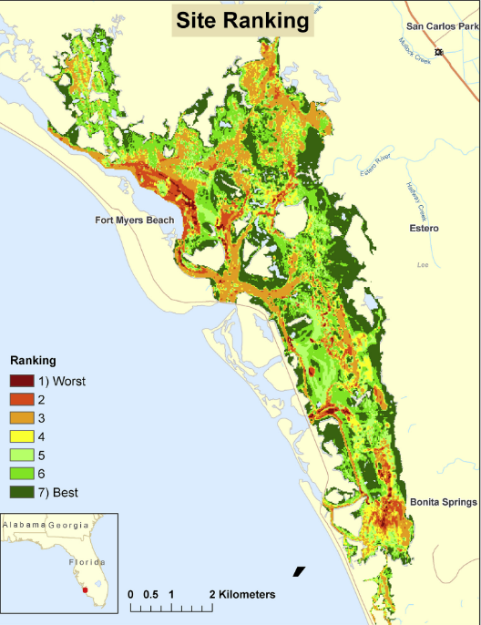
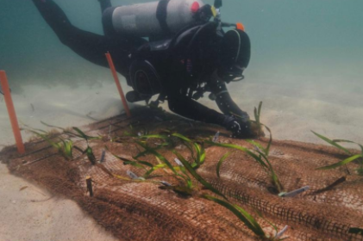
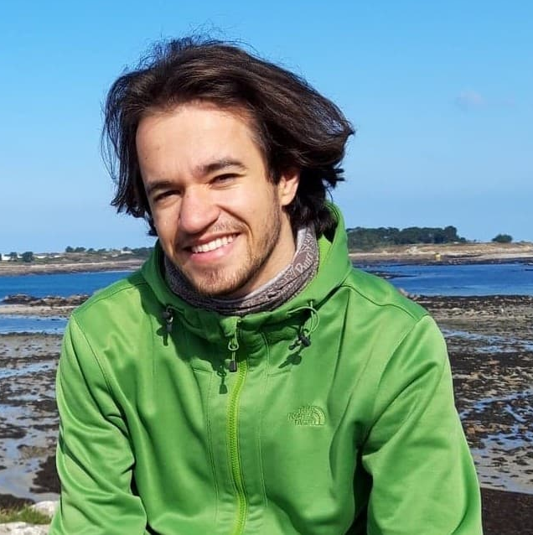
Posidonia oceanica in the French Mediterranean Sea
Regression of P. oceanica meadow in the Bay of Calvi
Seagrass meadow in 2018
Total surface lost between 2012 and 2018
8ha
(1,7%)
© Arnaud Abadie
Four-year project
(2021 – 2025)
PhD thesis of Arnaud Boulenger
Tan et al. 2020
Castejón Silvo et al., 2018
Hotaling-Hagan et al., 2017
FIELD TRIALS
LAB CULTIVATION
MODELLING
Notes:
Field study and experimental efforts will take place on P. oceanica meadows in the NW Mediterranean Sea, in the Bay of Calvi, Corsica (France). Thanks to the new French decree, the choice of France as the country for the experimentations is obvious because the impacts of anchoring on the seagrass meadows have now been ruled out. The Bay of Calvi is a perfect location to conduct this research project as healthy meadows are still present and can be used as seeds and shoots donors for the restoration experiments. Moreover, the Posidonia meadows in this area have already been mapped as well as their regression over the years and the anchoring pressure (Figure 1). Access to the area and facilities will be provided via the oceanographic research station STARESO which is a partner of the University of Liège

Slide 4
Posidonia oceanica in the French Mediterranean Sea
Regression of P. oceanica meadow in the Bay of Calvi
Seagrass meadow in 2018
Total surface lost between 2012 and 2018
8ha
(1,7%)
© Arnaud Abadie
Four-year project
(2021 – 2025)
PhD thesis of Arnaud Boulenger
Tan et al. 2020
Castejón Silvo et al., 2018
Hotaling-Hagan et al., 2017
FIELD TRIALS
LAB CULTIVATION
MODELLING

Slide 5
Posidonia oceanica in the French Mediterranean Sea
Regression of P. oceanica meadow in the Bay of Calvi
Seagrass meadow in 2018
Total surface lost between 2012 and 2018
8ha
(1,7%)
© Arnaud Abadie
Four-year project
(2021 – 2025)
PhD thesis of Arnaud Boulenger
Tan et al. 2020
Castejón Silvo et al., 2018
Hotaling-Hagan et al., 2017
FIELD TRIALS
LAB CULTIVATION
MODELLING

Slide 6
Posidonia oceanica in the French Mediterranean Sea
Regression of P. oceanica meadow in the Bay of Calvi
Seagrass meadow in 2018
Total surface lost between 2012 and 2018
8ha
(1,7%)
© Arnaud Abadie
Four year project
(2021 – 2025)
PhD thesis of Arnaud Boulenger
Tan et al. 2020
Castejón Silvo et al., 2018
Hotaling-Hagan et al., 2017
FIELD TRIALS
LAB CULTIVATION
MODELLING

Slide 7

Interests in joining the network
No system set-up yet
Castejón Silvo et al., 2018
LAB CULTIVATION
Main research interests:
Seed germination
Fundamental research on symbiosis (Max Planck Institute)
Bacterial enrichment with seeds and mature plants (Max Planck Institute)
Sharing ideas and collaborations !

