Slide 1
Public Private PartnershipS in Smart Cities
15th November 2022
Case studies of Mobility Infrastructure
Audrey Lebas, Smart City Institute (HEC Liège)

Slide 2
THE SMART CITY INSTITUTE
MISSIONS
Creation in 2015
Sustainable and Smart Cities/Territories → Management and Stategy
University of Liège, HEC Liège (Belgium)
Team of 15 – Multidisciplinarity
RESEARCH
TEACHING
INNOVATION
AWARENESS

Slide 3
RELEASE day!
Demystify the concepts
Review models/types
Introduce legal context
One size fits all
Exhaustive lists & technicalities

Slide 4
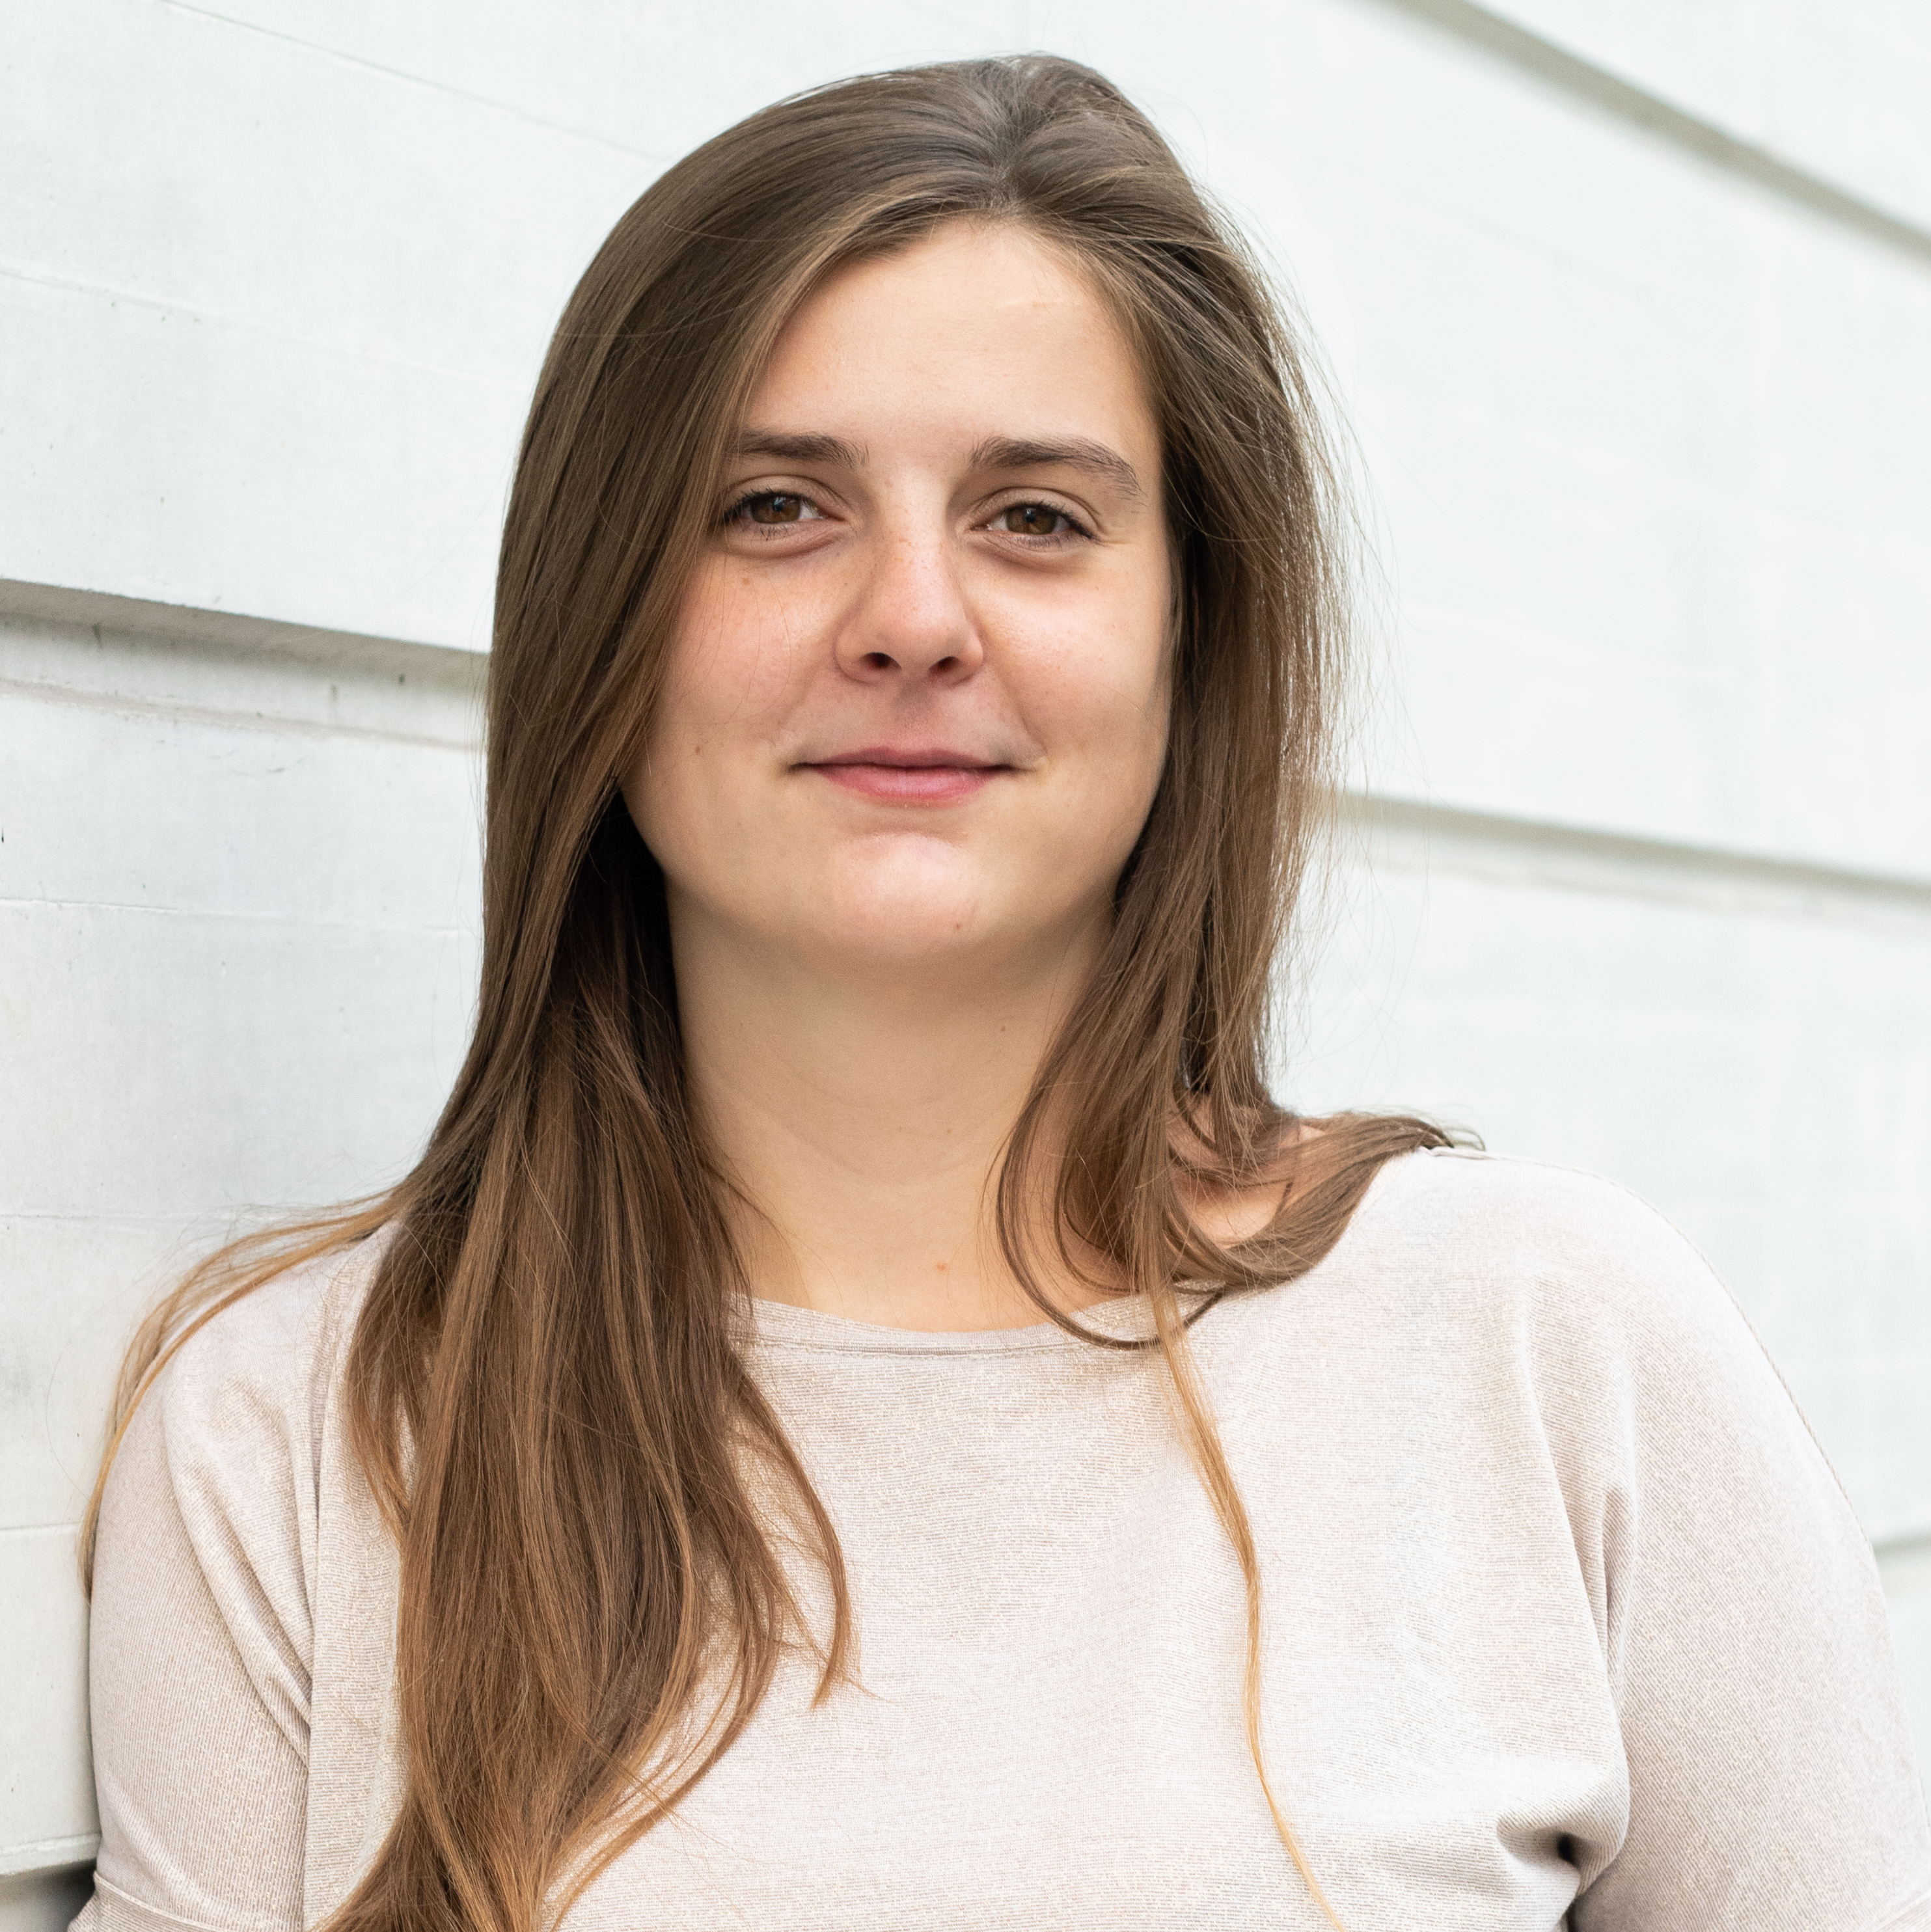
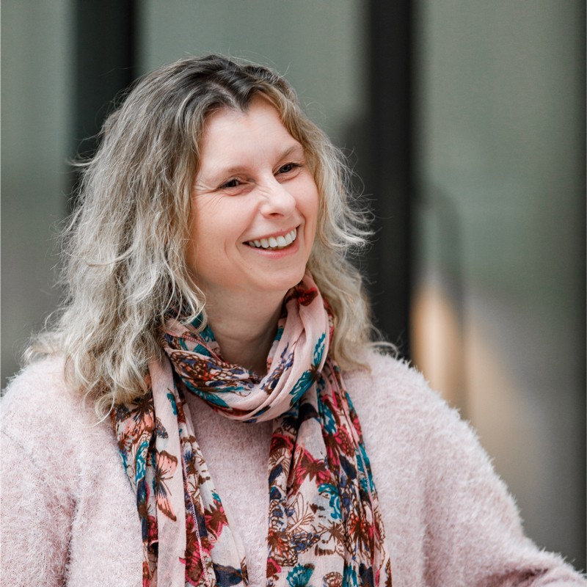
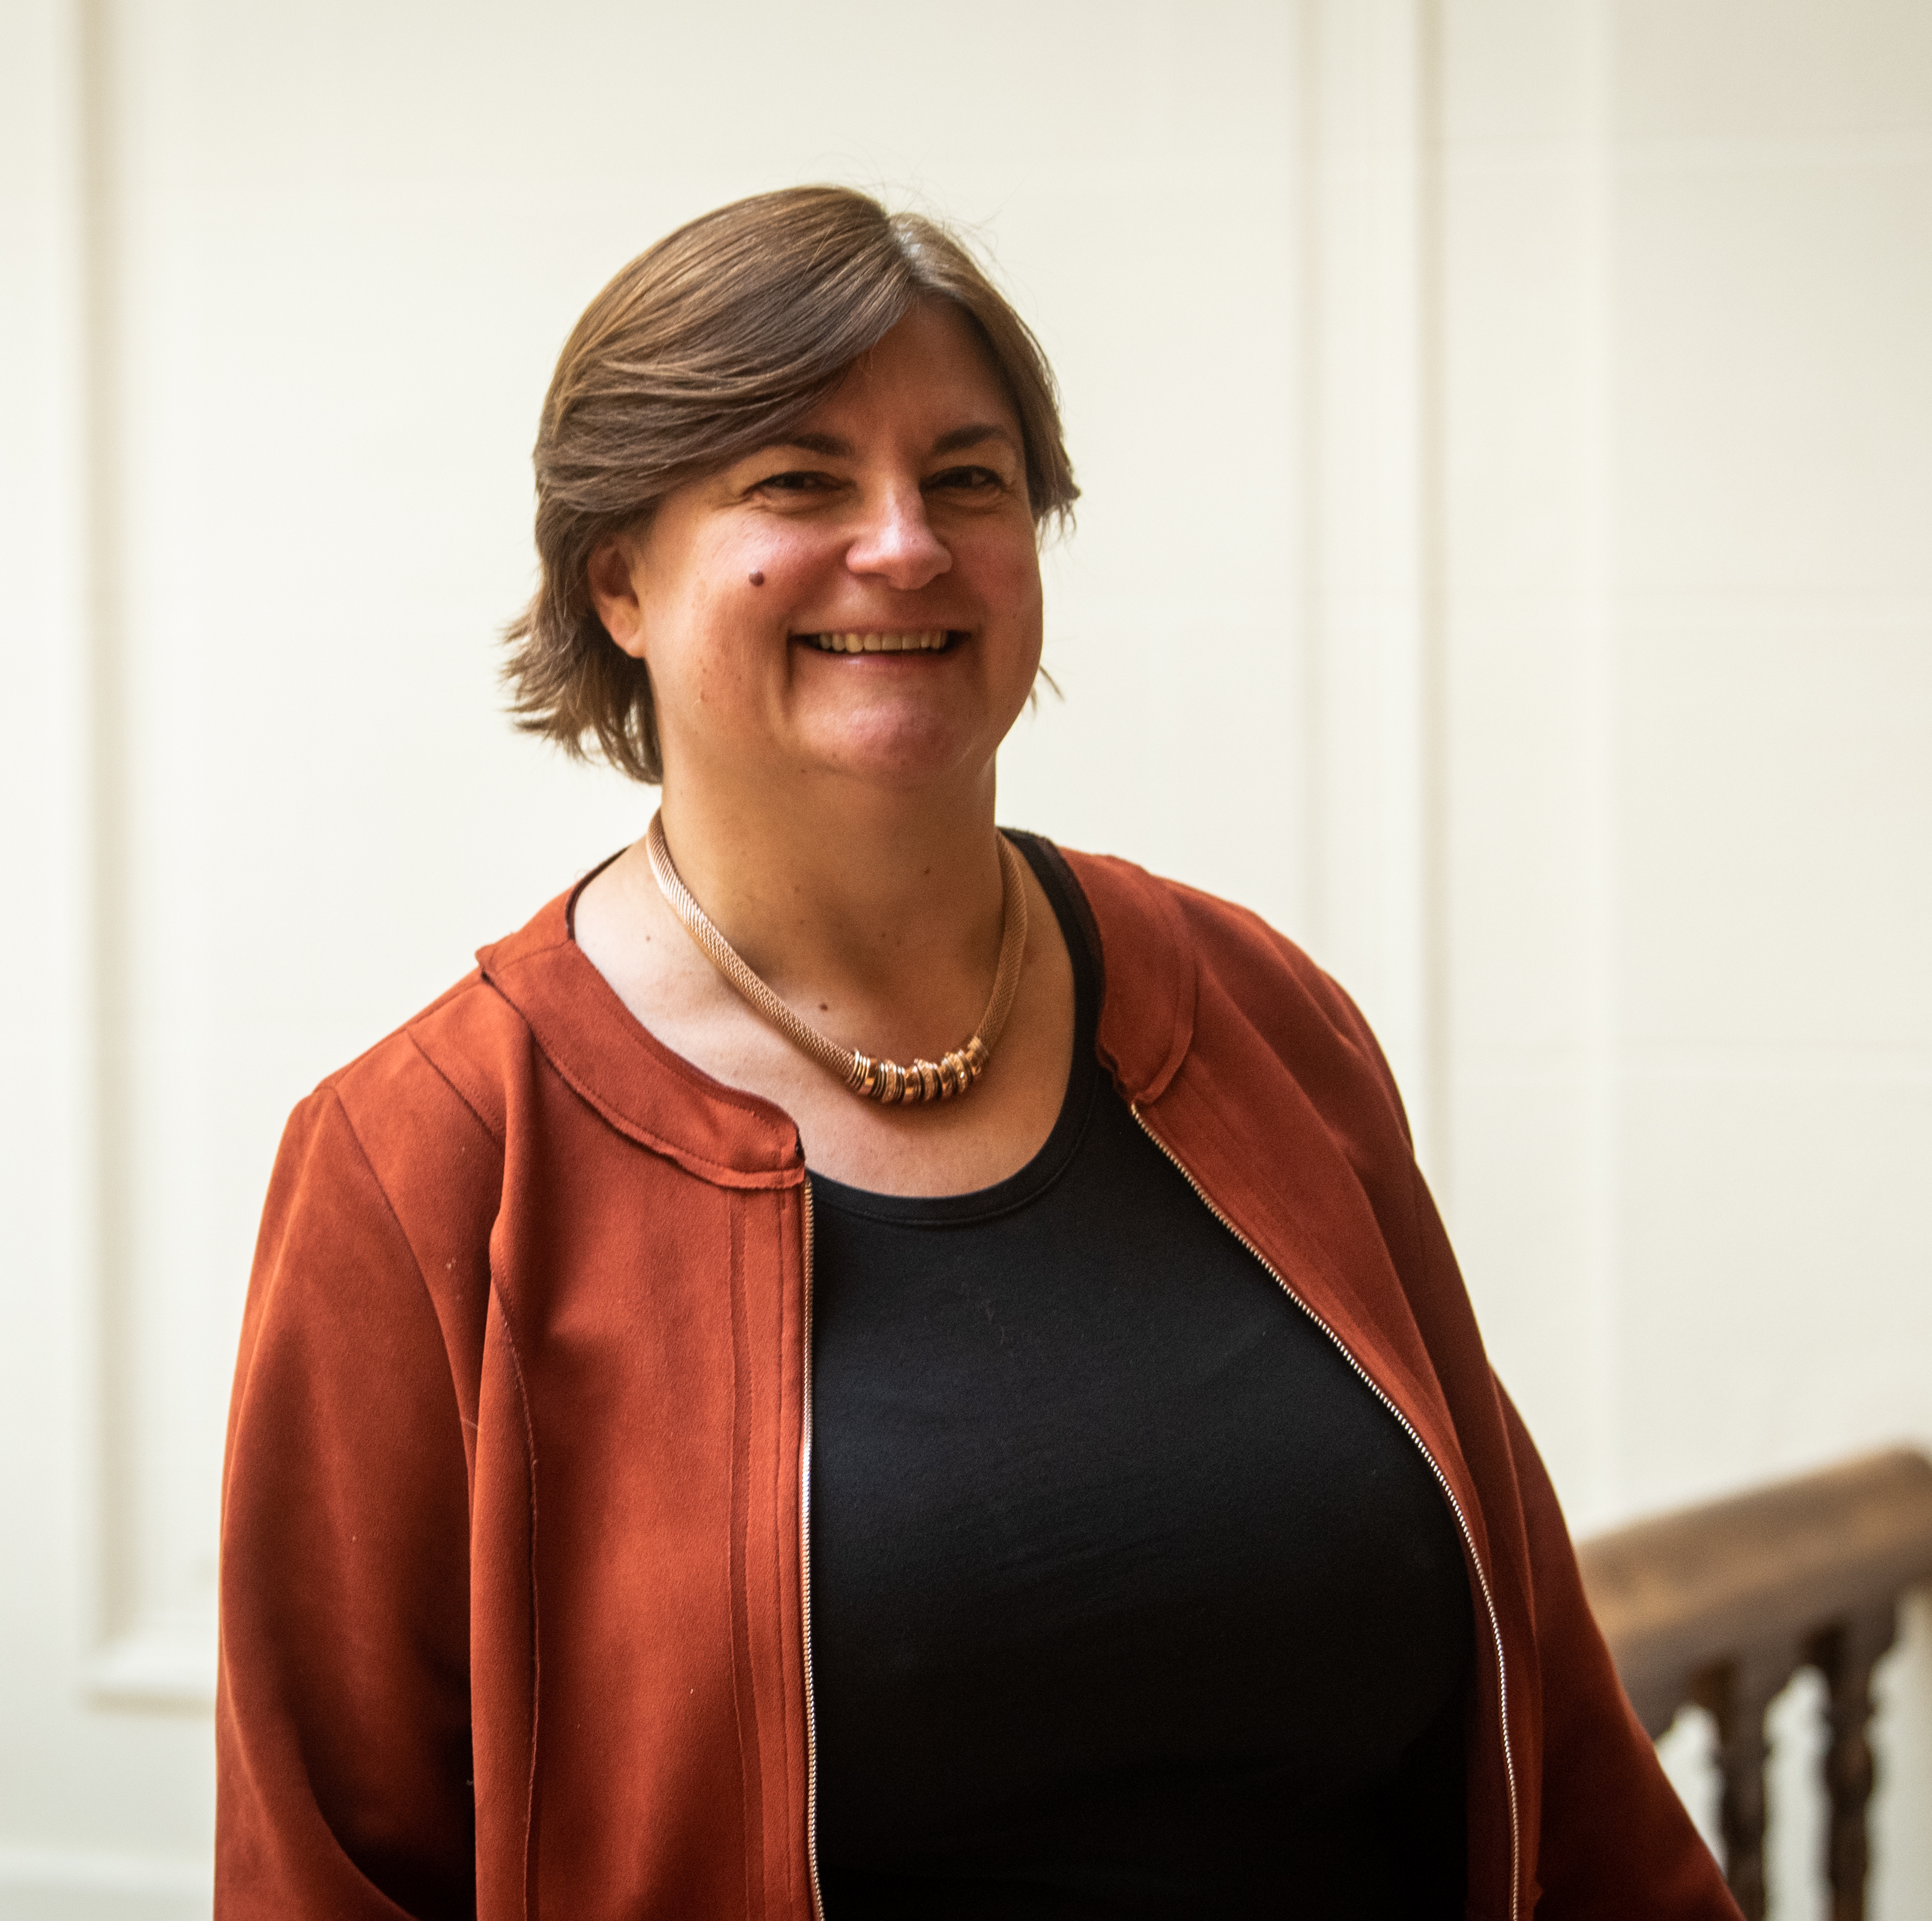
« Public private partnerships in Smart Cities:
the case of mobility infrastructure »
Moderator
Panelists
Audrey Lebas
Bénédicte Collard
Fabienne Roberti
Researcher
International partnership & relations coordinator
Smart City Institute (HEC ULIège)
Technical director
Luminus Cities
Smart City Referent SPI

Slide 5
Audrey Lebas audrey.lebas@uliege.be

Slide 6
Ressources gratuites
Images et pictos libres de droit
Pour les photos :
Freepik
Unsplash
Pixabay
Pexels
Pour les pictos :
Flaticon (possible de modifier la couleur sur le site)
Freepik
icones8

