Slide 1
François Pichault
LENTIC – University of Liège
Change and innovation processes
Notes:
1

Slide 2
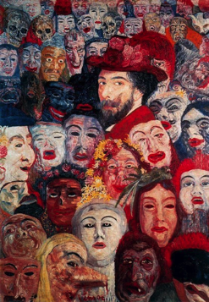
Self-portrait with masks (James Ensor)
Notes:
Risk #1: art-based intervention as lonely project, without collective engagement

Slide 3
Tribute to Jules Verne (Paul Delvaux)
Notes:
Risk #2: Distance between institutional actors and ordinary people (naked), artificial distinction between art producers and art consumers/users

Slide 4
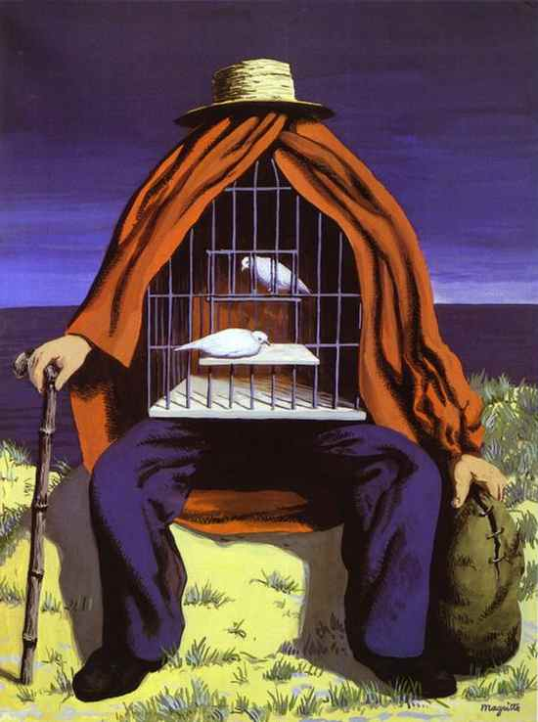
The therapist (René Magritte)
Notes:
Risk #3: No sustainable dynamic of innovation, no capacitation of actors

Slide 5
Skills needed to succeed in the implementation of sustainable cultural projects in urban regeneration
Capacity to obtain commitments to collective purposes from multiple stakeholders (artists, social movements and NGOs, public authorities, companies, citizens) and to maintain their engagement over time
Capacity to play as boundary spanners and to create collaboration between disconnected spheres (social, economic and cultural)
Capacity to create positive externalities for individuals, businesses and regions and propose new symbolic goods and services that are crucial for improving the area’s productivity, quality of life and attractiveness
=> Towards culture-led urban entrepreneurship

Slide 6
Conditions needed to create a link between CCTPs and urban areas : art-based interventions as innovation processes
Contextualization: understading the peculiarities of each context
Problematization: (re)definition of the problem
to be solved => possible redesign of the initial content
Interessment via the engagement of spokemen
in a steering committee and working groups
Convergence through obligatory passage
points: implementation of concrete
artifacts, communication
actions, continuous
evaluation
Extension: mobilization of newcomers in order to sustain the process in the long term
Source: Law J, Hassard J (eds.) (1999). Actor Network Theory and After. Blackwell, Oxford

Slide 7
Two ways of designing art-based interventions in the territory
INNOVATION STEPS | POLYSEMIC BRICOLAGE (CIVIC CITIES) Mar & Anderson (2010), Hjorth (2013) | POLYPHONIC INSTITUTIONAL WORK (FIERIS FEERIES) Leca et al. (2006)
Contextualization | Importation of an artistic approach as part of a public cultural action programme (top-down) | Emergence of an artistic approach in reaction to a urban regeneration plan (bottom-up)
Problematization | Culture-centric perspective: how to design prototypes likely to stimulate social transformation? | Socio-centric perspective: how to help citizens recover a sense of dignity and pride according to their cultural diversity?
Interessment | Polysemic works provided by artists and designers | Sociopolitical intentions pursued by social activists with polyphonic strategies taking account the various interests
Convergence | Ephemeral prototypes Inhabitants invited to express their reactions, some visits of public authorities, many administrative constraints | Parade every 2 years, Fieris as official emblems of the City Inhabitants receiving a role to play according to their skills, massive participation, public authorities want to inaugurate the first parade at the City Hall
Extension | No implementation of the proposals suggested via prototypes, new political majority, growing criticism against designers, growing tensions between artists and designers | 4 editions with more and more participation of inhabitants, strong support from public authorities, inclusion of disqualified neighborhoods in the Master plan, first concrete signs of urban renewal
Bobadilla, N., Goransson, M. & Pichault, F. (2018). Urban entrepreneurship through art-based interventions: unveiling a translation process, Entrepreneurship & Regional Development, 31(5-6), 378-399
Notes:
CC in Marseille, France and FF in Seraing, Belgium. The 2 cities in which they were developed have suffered from economic decline as a result of deindustrialization. In both contexts, local authorities have invested in improving the city image and promoting urban regeneration programmes. While art is a key component in both cases, artists played different roles. In one case, they worked with designers to explore new possibilities for urban spaces; in the other case, they were called to work with urban activists to provide professional support for a street parade and to foster stakeholder participation.

Slide 8
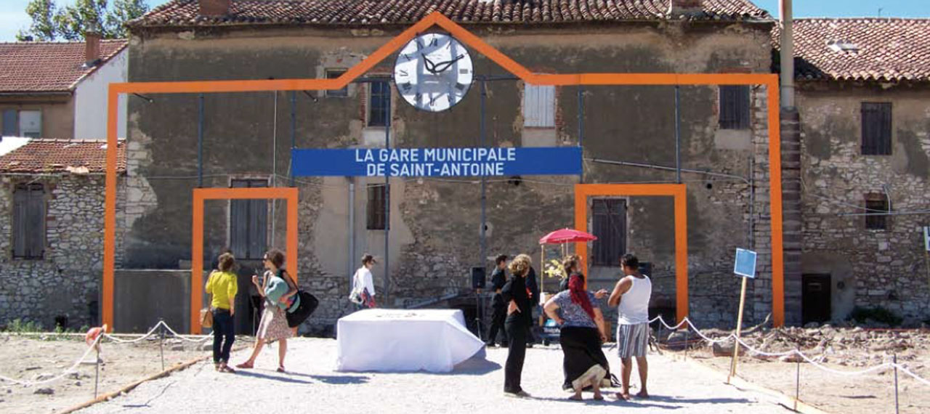
A prototype designed during the second workshop of Civic Cities

Slide 9
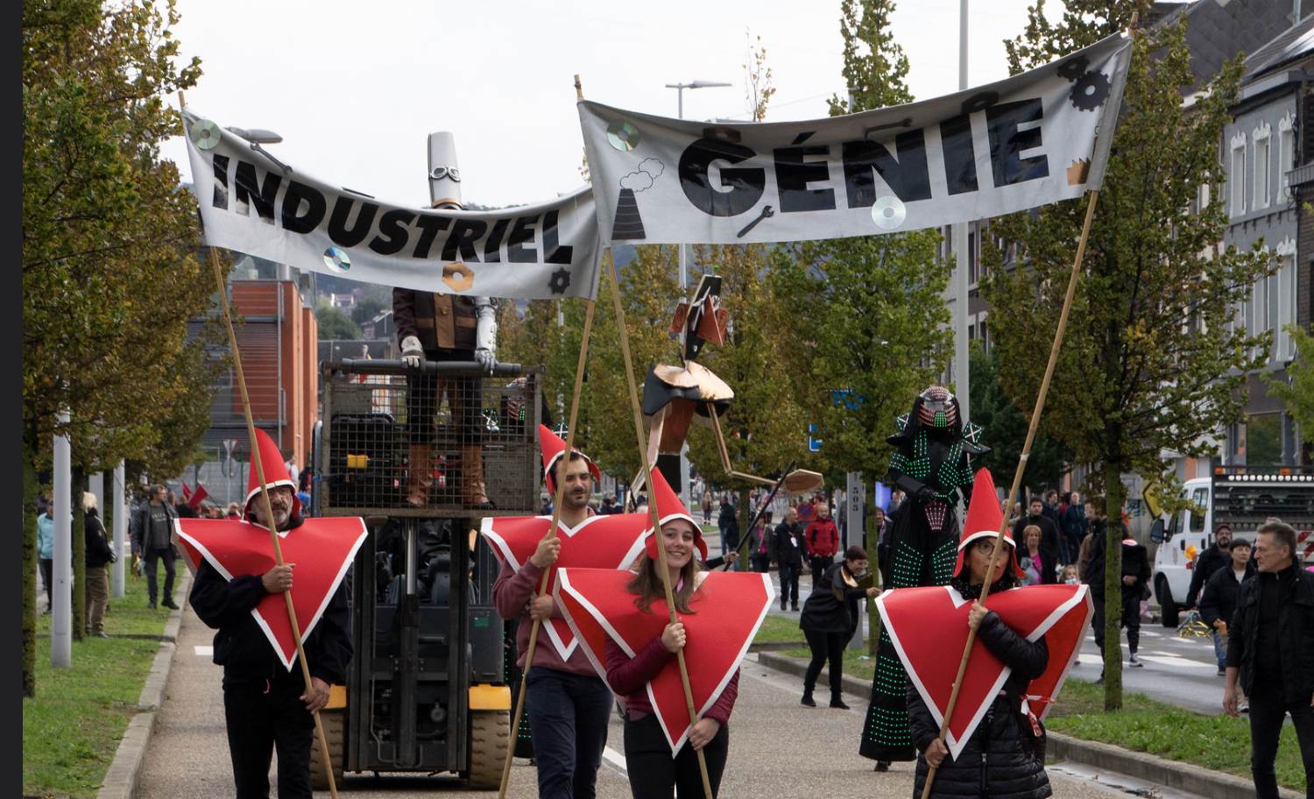
The Fieri Industry during the last edition of the parade (2022)

