Slide 1
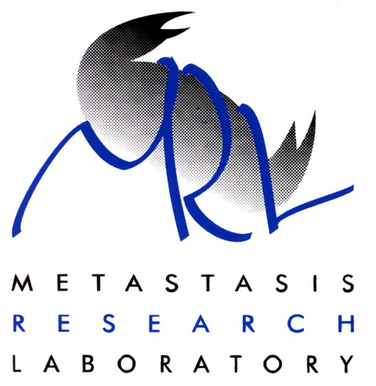
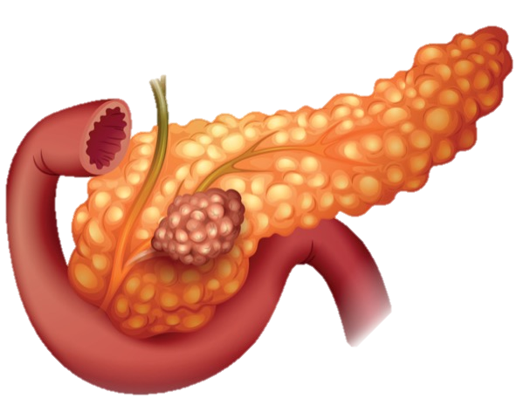
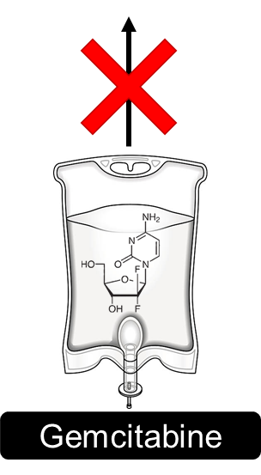
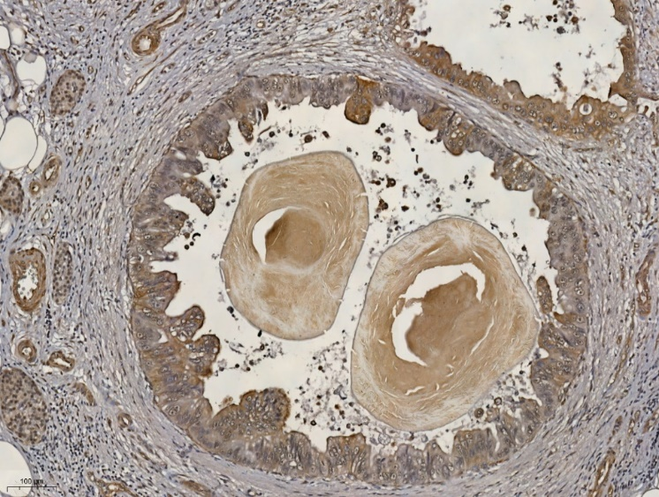
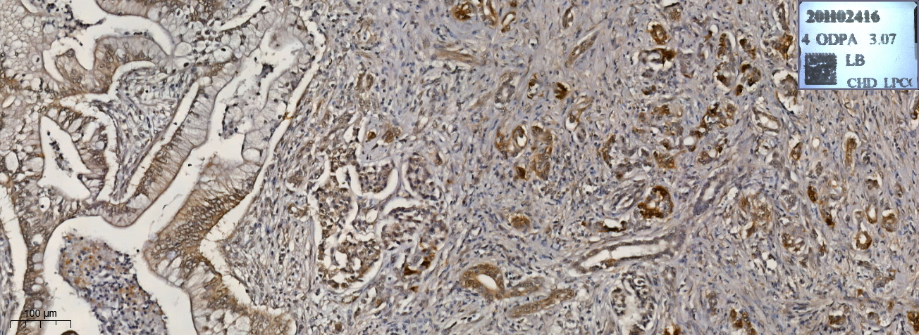
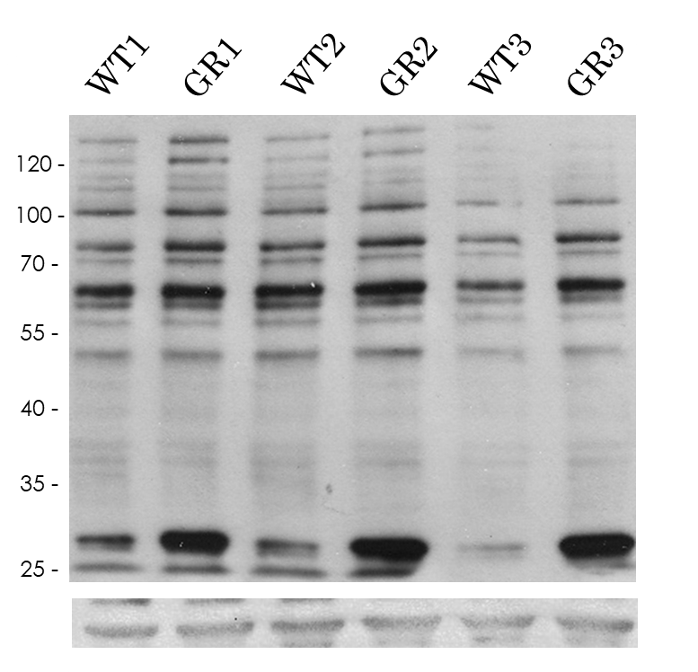
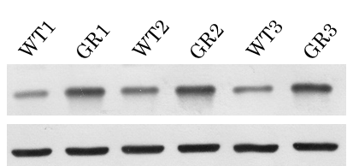
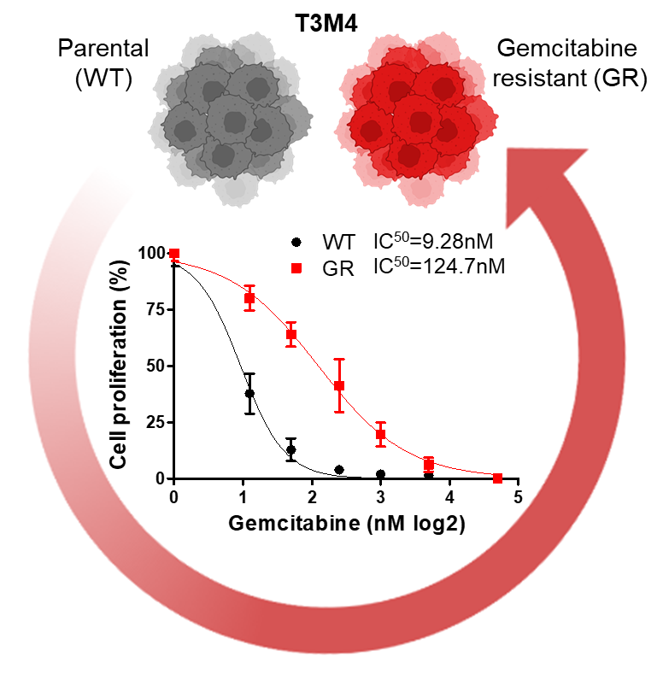
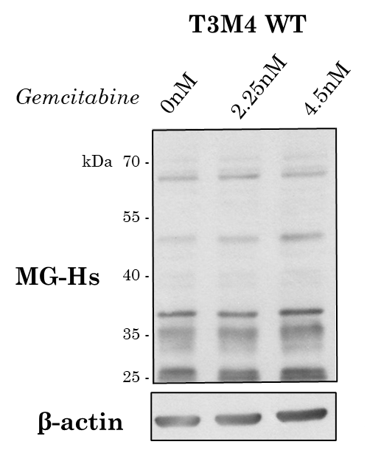
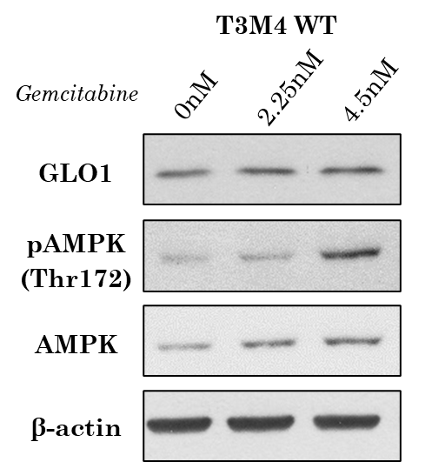
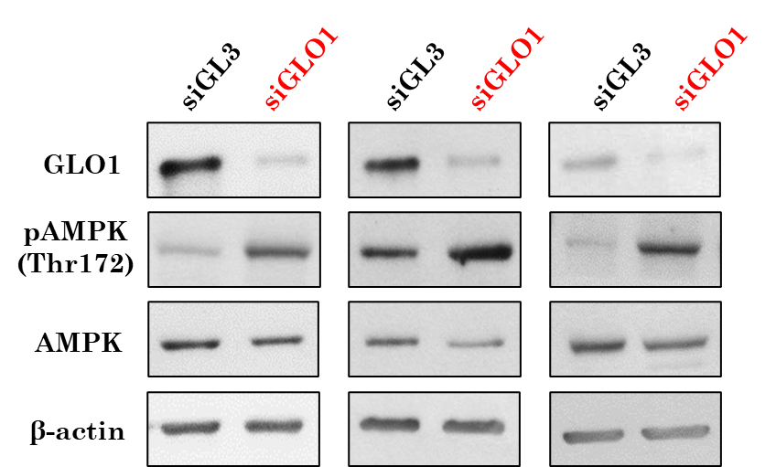
Role of MG stress in PDAC resistance to gemcitabine
Crake R¹, Gasmi I¹, Arsenijevic T², Agirman F¹, Maloujahmoum N¹, Peulen O¹, Van Laethem JL² and Bellahcène A
¹Metastasis Research Laboratory, GIGA-Cancer, University of Liège, Belgium ² Department of Gastroenterology, Hepatopancreatology, and Digestive Oncology, Hôpital Erasme, Université Libre de Bruxelles, Brussels
Rebekah.crake@uliege.be
1. Background
Pancreatic ductal adenocarcinoma (PDAC) is a lethal disease, with a poor 5-year survival rate of ~9^{% 1,} and resistance to gemcitabine chemotherapy often occurs within weeks of treatment onset ².
Aberrant energetic metabolism, namely enhanced aerobic glycolysis, is recognized as an important hallmark of PDAC ³. Interestingly, enhanced glycolysis has been associated with gemcitabine resistance in PDAC cells ⁴.
Methylglyoxal (MG) is spontaneously generated during glycolysis, and chemically modifies proteins, lipids and nucleotides, forming MG-adducts, resulting in cellular dysfunction and mutagenicity ⁵.
Free MG can be detoxified through the glyoxalase system (involving GLO1/2 enzymes ⁶.
Cellular dysfunction
& mutagenicity
Gemcitabine
resistance??
2. MG stress is present in PDAC tumours
6. MG stress is increased in gemcitabine resistant PDAC cells
A)
B)
Figure 2. Preliminary IHC for argpyrimidine (ArgP) MG adducts in pancreatic lesions. We demonstrated positive staining in both A) pancreatic intraepithelial neoplasia (PanIN) and B) human PDAC lesions. 10X magnification.
A)
Figure 6. Characterisation of MG stress in parental (WT) compared to gemcitabine resistant (GR) T3M4 cells. A) Western blot of argpyrimidine expression (ArgP) in WT and GR T3M4 cells (n=3). B) Western blot for GLO1 abundance in WT and GR T3M4 cells (n=3). β-actin was used for normalization in all Western blots. C) Maximal GLO1 activity in WT and GR T3M4 cells expressed as A.U. per mg proteins. Data were analyzed using unpaired Student’s t-test and shown as mean values ± SEM (n=3). *p < 0.05.
ArgP
3. Generation of PDAC cells with acquired gemcitabine resistance
β-actin
B)
C)
GLO1
Figure 3. Gemcitabine resistant (GR) T3M4 PDAC cells were generated from parental T3M4 (WT) cells, by steadily increasing the dose of gemcitabine in culture over time. Surviving cells were allowed to recover between gemcitabine treatments. Gemcitabine IC50: Cells were treated with gemcitabine for 72 hours and cell proliferation was assessed using Hoechst incorporation. Data were normalized to control cells and presented as mean ± SE (n=3). IC50 values were calculated using variable slope modeling.
β-actin
7. Gemcitabine and MG stress activate the master energy regulator AMPK in PDAC cells
A)
B)
C)
4. Hypothesis
Figure 7. Effect of gemcitabine and endogenous MG stress on AMPK phosphorylation in parental T3M4 (WT) PDAC cells. A) and B) Western blot of MG-Hs, GLO1, pAMPK (Thr172) and total AMPK in WT T3M4 cells treated with gemcitabine (2.25 and 4.5nM) for 24 hours (n=1). C) Western blot of GLO1, pAMPK (Thr172) and total AMPK in WT T3M4 cells transfected with siRNA targeting GLO1 for 72 hours (inducing endogenous MG stress) (n=3).
8. Conclusions and future directions
5. Gemcitabine resistant PDAC cells show increased glycolytic capacity
Figure 5. Rates of glycolysis in parental (WT) compared to gemcitabine resistant (GR) T3M4 cells. Kinetic measurement of extracellular acidification rate (ECAR) was measured after successive injection of glucose (G; 20 mM), oligomycin (O; 1 mM) and 2-deoxyglucose (2-DG; 50 mM). Data were normalized according to the cell (arbitrary unit [A.U]) and presented as mean ± SD (n=1). Data analysis was performed by two-way ANOVA and unpaired Student’s t test. *p < 0.05.
How does methylglyoxal stress induce AMPK phosphorylation in PDAC cells?
Acknowledgements
References
1. Siegel RL et al. Cancer Statistics, 2021. CA: a cancer journal for clinicians 2021; 71: 7-33.
2. Binenbaum Y et al. Gemcitabine resistance in pancreatic ductal adenocarcinoma. Drug resistance updates : reviews and commentaries in antimicrobial and anticancer chemotherapy 2015; 23: 55-68.
3. Qin C et al. Metabolism of pancreatic cancer: paving the way to better anticancer strategies. Molecular cancer 2020; 19: 50.
4. Dai S et al. Glycolysis promotes the progression of pancreatic cancer and reduces cancer cell sensitivity to gemcitabine. Biomedicine & pharmacotherapy 2020; 121: 109521.
5. Schalkwijk CG et al. Methylglyoxal, a Highly Reactive Dicarbonyl Compound, in Diabetes, Its Vascular Complications, and Other Age-Related Diseases. Physiological reviews 2020; 100: 407-461.
6. Khalaf N et al. Burden of Pancreatic Cancer: From Epidemiology to Practice. Clinical gastroenterology and hepatology 2021; 19: 876-884.
Notes:
Final

