Slide 1




Missing our own thoughts
Insights from mind blanking
BAPS Symposium
How do we know what we know: Recent advancement in metacognitive research
Boulakis Paradeisios Alexandros, MSc
FNRS Aspirant
Physiology of Cognition Lab | GIGA CRC In vivo imaging
University of Liège
Chair: Kobe Desender
Leuven, 2022
Notes:
PAGE D'INTRODUCTION 2 / Page sans photo permettant l'insertion du titre de la présentation ainsi que d'autres infos (date, lieu, orateur, sous-titre,…)
1

Slide 2




Thinking and monitoring go hand in hand
I was NOT aware and NOT in control of my stream of consciousness
I aware and in control of my stream of consciousness
I aware BUT NOT in control of my stream of consciousness
I aware and in control of my stream of consciousness
What was I thinking just now ?
BAPS 2022
2
Notes:
I am want to start with an example. Suppose you are driving, or reading a book. You are fixating on what is happening, you pay attention, careful not miss any detail. However, from time to time, you will slip, think of the next round of submissions or the upcoming vacations. This shift from external focus to internal dialogue and self-referential thinking and generally task-unrelated thoughts is termed mind wandering. Although what you were thinking was quite clear, momentarily, you lost supervision of your thought. So you get it back in track and you keep on driving, again attentive to your road thoughts. Then suddenly, you have driven for a couple of meters, or your are at the end of your book page, yet you have no idea how you got there. You try to introspect on your experience and you see it was a blank. No content and certainly no monitoring. This phenomenological term is termed mind blanking, and it provides us with a very unique point in our stream of consciousness of nothingness, of complete thought absence
2

Slide 3
“The only breaches that can well be conceived t occur within the limits of a single mind would either be interruptions, time-gaps during which the consciousness went out altogether to come into existence again at a later moment; or they would be breaks in the quality, or content, of the thought. ”
-- William James, Principles of Psychology, Vol. I, p.237
BAPS 2022
3

Slide 4
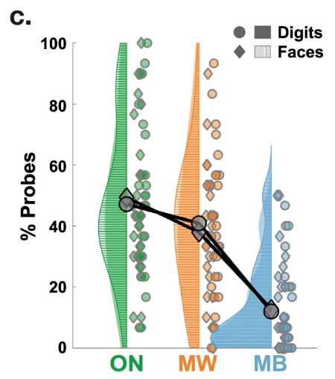
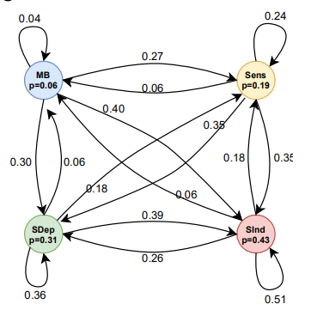
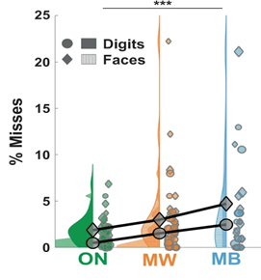
Behavioral Correlates of MB
Sparse and unlikely
Reduced perceptions
Equiprobable across time
Andrillon et al, Nat. Commun., 2021
Mortaheb et al, bioRxiv, 2022
Andrillon et al, Nat. Commun., 2021
Mortaheb et al, bioRxiv, 2022
BAPS 2022
4
Notes:
Nowadays, MB is examined as a potential default mental state, alongside daydreaming, mind wandering, ruminating and task engagement. Examining mind blanking along other mental states, we observe that MB is reported significantly more infrequently than MW or thoughts on sensory stimuli. It is aksi associated with increased missed stimulus perception. However, the rate of occurrence seems to remain constant across time. So its difficult to suggest that mind blanking occurrence is tied to attentional depletion across time or mental fatigue.
4

Slide 5
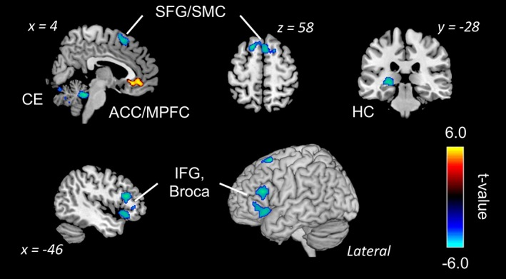
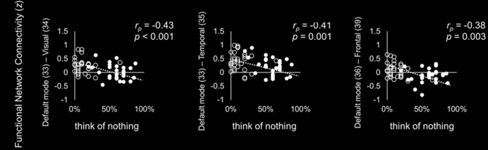
Cerebral correlates of MB
Decreased activation:
Broca's area → reduced “inner speech”
Hippocampus → less impressionable “content”
Increased activation:
ACC → stream of consciousness continuity is retained
Kawagoe et al, Hum. Brain Mapp.,2019
Decreased connectivity:
DMN - sensory cortices → less available content from sensory avenues to drive internally, self-oriented thought
Kawagoe et al , Eur. J. Neurosci.,2018
BAPS 2022
5
Notes:
So we think we have no thoughts. How does this come about on a neuronal level? Kawagoe has conducted two studies, where he asked people to think of nothing and empty their thoughts. In an activation analysis, examing a 4 second period preceding MB reports, they found decreased activity in the Broca’s area and the hippocampus. They interpret these results as reduced inner speech due to degraded content in our thought. Indeed, hippocampal lesions and reduced hippocampal activity have been associated with reduced reportable content in mind wandering. Supplementing this idea, their group also found that MB is preceeded by decreased connectivity between the default mode network and the sensory cortices, hinting also to the role of less available mental content from perceptual avenues.
5

Slide 6
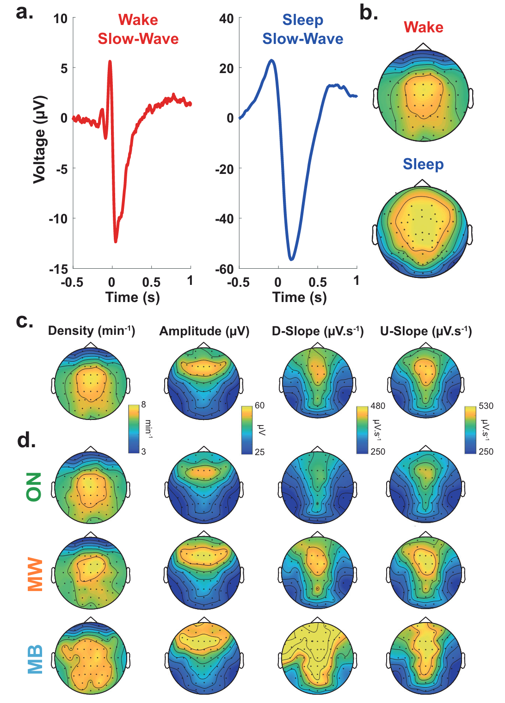
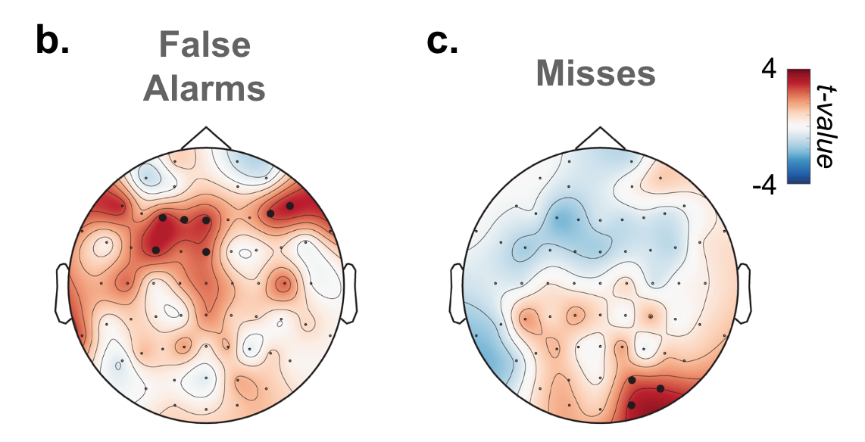
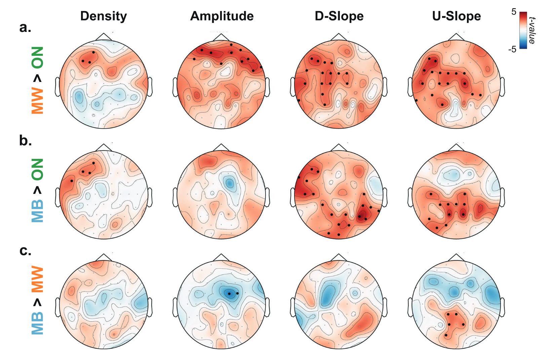
Slow waves precede MB
Impulsivity
Hasty responses and FA
Sluggishness
Slow reponses & misses
Unconstrained thoughts
Loss of awareness
BAPS 2022
Andrillon et al, Nat. Commun., 2021
6
Notes:
More recently, the group of andrillon found an interesting marker for MB, slow waves. Slow waves typically occur during non rem asleep and are associated with neuronal silencing, so less cortical communication. During wakefulness, these slow waves can occur across various cortical sites. What is important for us here, MB was precede by high amplitude slow waves in partietal regions, regions associated with conscious reports of percepts.
6

Slide 7

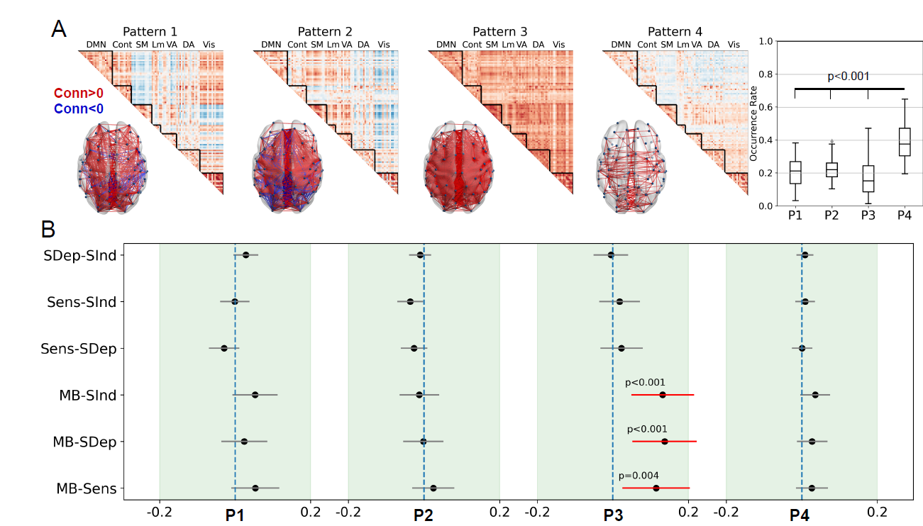
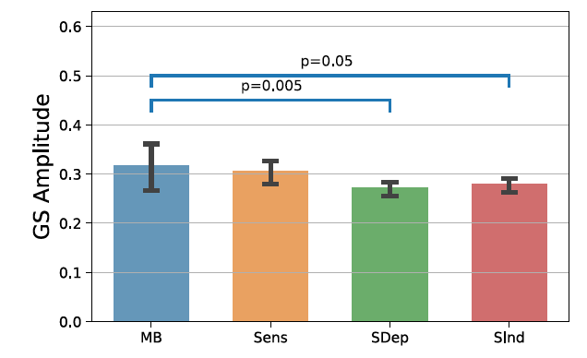
MB is predicted by an all-to-all cortical connectivity brain pattern
Friday 3 June 2022
Flash Talk
14.45 – 16.05
Mortaheb et al, bioRxiv, 2022
BAPS 2022
7
Notes:
Along these lines, at our lab, we examined which brain patters preceded different mental states. Our brain parcellation scheme showed that mind blanking was more associated with a cortical profile associated with overall cortical connectivity, such that every regions is connected to all the other. Usually, during healthy wakefulness, you have More simply, when everyone tries to speak, no one is able to be heard. However, the more all-to-all communication you have, the more inefficient brain communication is . Interestingly, this brain pattern is absent if we remove the global fmri signal. Now, the global fmri signal is just the average brain timeseries, yet was significantly predictive of MB. It is comprised from motion artifacts, scanner artifacts and physiological noise, such as heart and respiration oscillations. This lead us to consider that there might be a physiological component in MB.
7

Slide 8
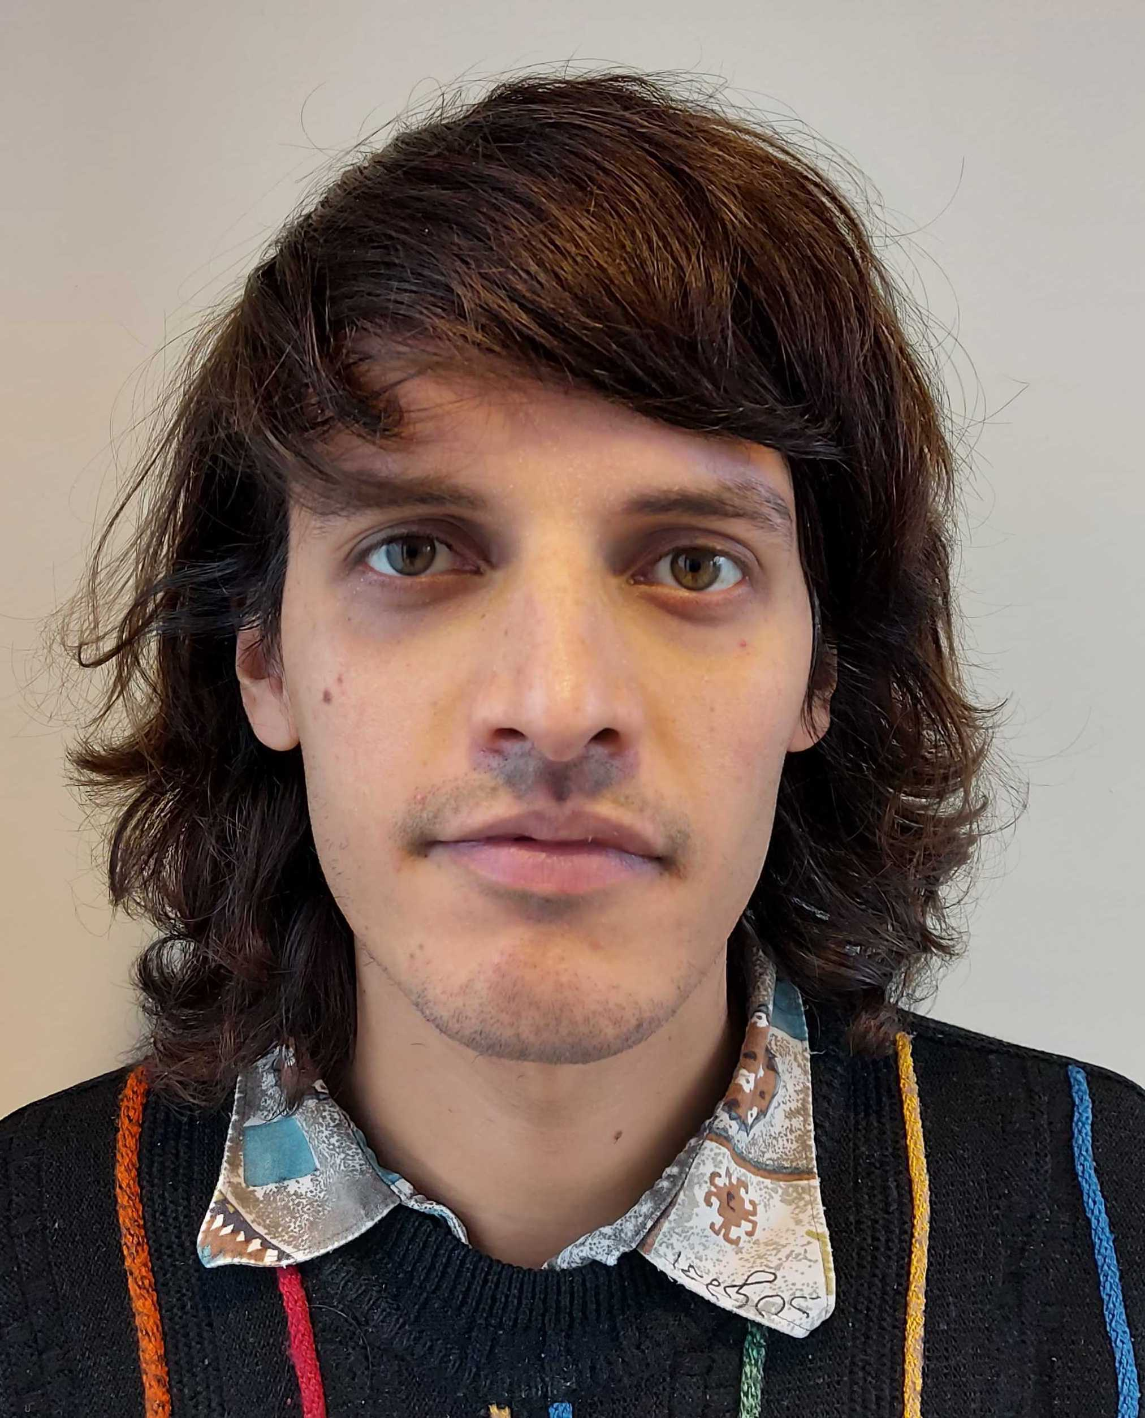
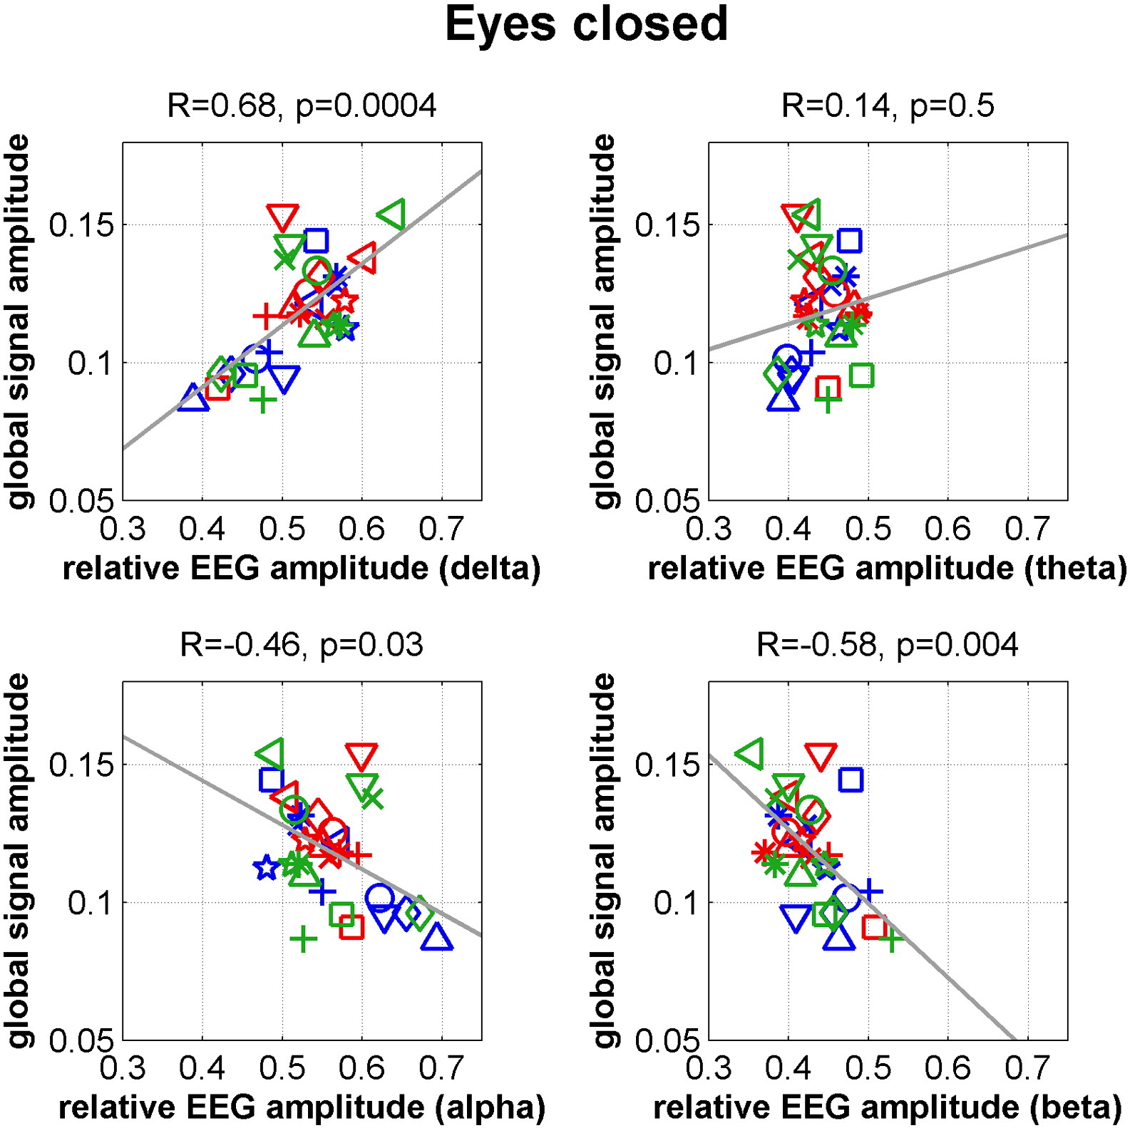
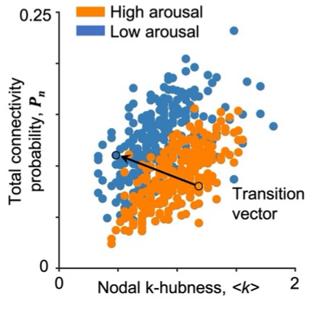
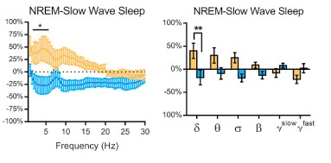
Arousal drives MB neuronal correlates
Friday 3 June 2022
Poster Session 2
10.30-11.40
Optogenetic stimulation of
cortical arousal sites (LC)
decreases slow wave occurrence
Swift et al, Curr Biol, 2018
GS follows vigilance indexes
Wong et al, Neuroimage,2013
Low arousal promotes
global connectivity and low integration
Lee et al, bioRxiv, 2021
BAPS 2022
8
Notes:
Well, the physiological component of the global signal led us to consider arousal. Indeed, we can see that arousal seems to mediate all the neuronal correlates of mind blanking. For example, as arousal decreases, the global signal inversely increases. Additionally, lower arousal levels promotes all-to-all cortical communication. Finally, stimulation of arousal promoting sites to decrease slow wave occurrence. Arousal decreases, the correlates of MB increase.
8

Slide 9
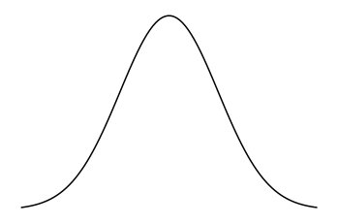
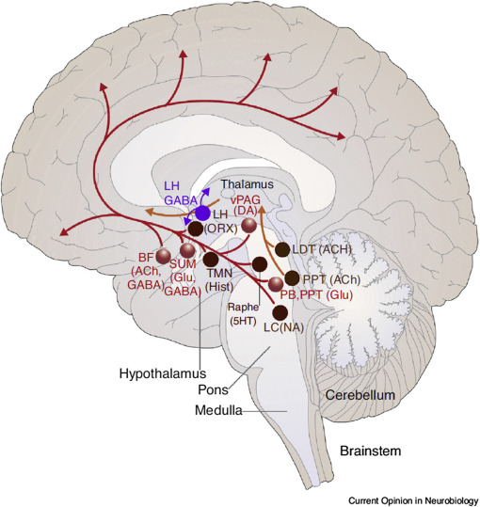
Mental state reportability ~ Arousal
Arousal
Behavioral Cortical Autonomic
Mind-Wandering
Task-Relate Thoughts
Content Reportability
Exploratory Thoughts
Exploratory Thoughts
Mind
Blanking
Mind
Blanking
Low
High
Arousal Level
Saper, Nature, 2005
BAPS 2022
Adapted from Mittner, Trends Cogn. Sci., 2018
9
Notes:
So is arousal a good mechanism ? Arousal overall is the state of wakefulness and responsiveness, associated with perceptual sampling, metacognition and confidence in our perceptions. Arousal has two main components of interest: by the ascending arousal system in the brain and the autonomic nervous system in the body. As arousal changes through the interplay of its subsystems, you have in turn shifts in cortical excitability that drive accesability to percepts. Optimal levels of arousal, traditionally modeled as the inverted U shaped curve support content monitoring. Inversesly, non optimal levels of arousal might hinder content monitoring, allowing for a stream of consciousness without any recollectable content.
9

Slide 10
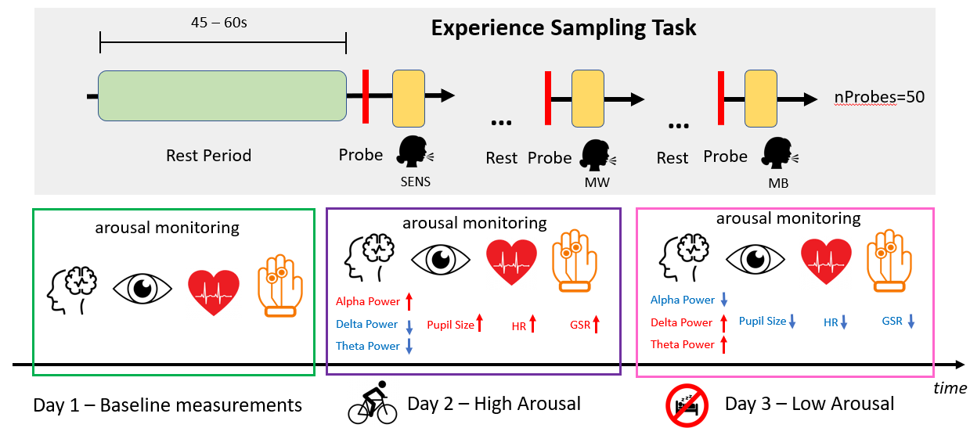
MB’s brain-body network determined by probing autonomic arousal

Slide 11
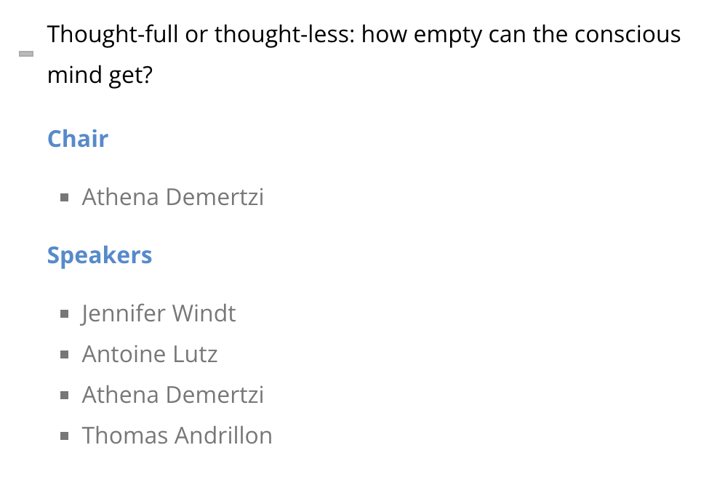

How we know that we don’t know
MB interrupts content monitoring
MB retains the stream of consciousness
MB’s neuronal profile mediated by arousal
Symposium
meta-cognition?
consciousness?
thought-full mind?
Friday 15 July 2022
09:00 – 11:00
BAPS 2022
11
Notes:
Is it possible to decode the experience of MB from brain body interaction? What would such a brain-body profile look like?
Is the experience of MB phenomenologically akin to other cases of inability to report our mental life, like blindsight? What can we draw from there?
11

Slide 12

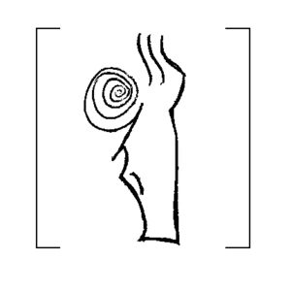




The team …
Demertzi Athena, PhD
Signorelli Camillo, PhD
Koroma Matthieu, PhD
Mortaheb Sepehr, MsC
Fort Larry, MsC
The project
BAPS 2022
12
Notes:
12

