Slide 1
Annual Congress of the RBSPRM
nervous excitability study
Maëlle Tyberghein
François Wang
Clinical neurophysiology department
CHU, Liège
Notes:
Goodmorning, thank you to the PMR belgian society for inviting me to talk to our annual congress
I’m Maelle Tyberghein, I’m doing a thesis in the clinical neurophysiology department of CHU Liege with Dr Wang and I’m going to talk to you about the study of peripheral axonal excitibility

Slide 2
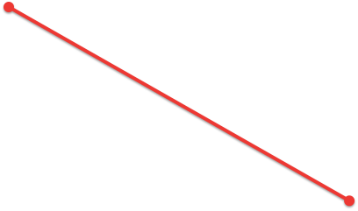
Why study axonal excitability?
Amp normal
CV decreased
Demyelinating
neuropathies
Amplitude
?
Amp decreased
CV normal
Axonal neuropathies
Conduction velocity
Excitability
Notes:
why are we studiing nervous excitibility?
For those of you who are doing electrodiagnosis studies, you know that we stimulate a nerve and we measure the amplitude of the response and its conduction velocity
And if the amplitudes are preserved and conduction velocity is decreased, it’s rather a demyelinating neuropathy as charcot Marie tooth disease, CIDP
And if the amplitudes are decreased and conduction velocity is preserved, it’s rather an axonal neuropathy as diabetic or alcoolic neuropathy
But when we are between these situations it’s sometimes difficult to make a diagnosis
By studying nervous excitability, we would like to study a third dimension of the axons
We think it could help to improve differential diagnosis of peripheral neuropahies and to have a better understanding of their physiopathology

Slide 3
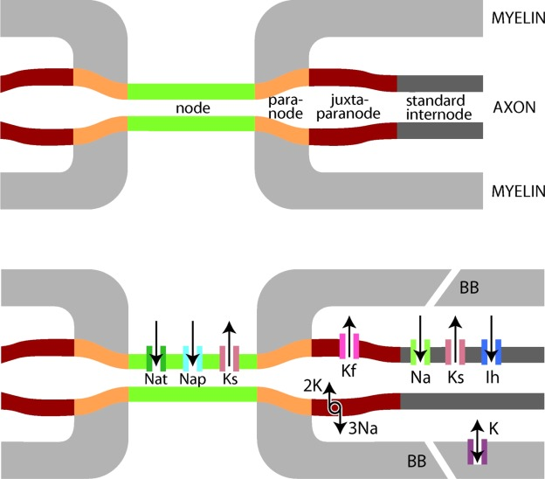
Basic principles
Excitability actors
0,1%
surface
Node
Myelin
Na_{t} Channels
=> action potential
K_{s} and K_{f} Channels
restrict axonal depolarisation
HCN Channels (Ih current) => restrict axonal
hyperpolarization
Nap Channels
Na-K Pump (ATPase)
Notes:
Who are the actors of this excitability?
The node which represente 0,1% of axon surface
The myelin sheet which cover the internode
Na transient channels which are open with deporalisation and are responsible of the action potential
Ks channels which are in the node and the internode and are open at resting membrane potential
Kf channels which are in the juxtaparanode and are open with depolarisation
Potassium channels restrict axonal depolarisation
HCN channels responsible of the Ih current (sodium and potassium input) which are in the internode and restrict axonal hyperpolarisation
Na persistent channel which represent 2% of the sodium current in the node and responsible af a leak current at resting membrane potential
And the well know NaK ATP ase pump which is responible of the output of 3 sodium and the input of two potassium and so of an hyperpolarization of the axons

Slide 4
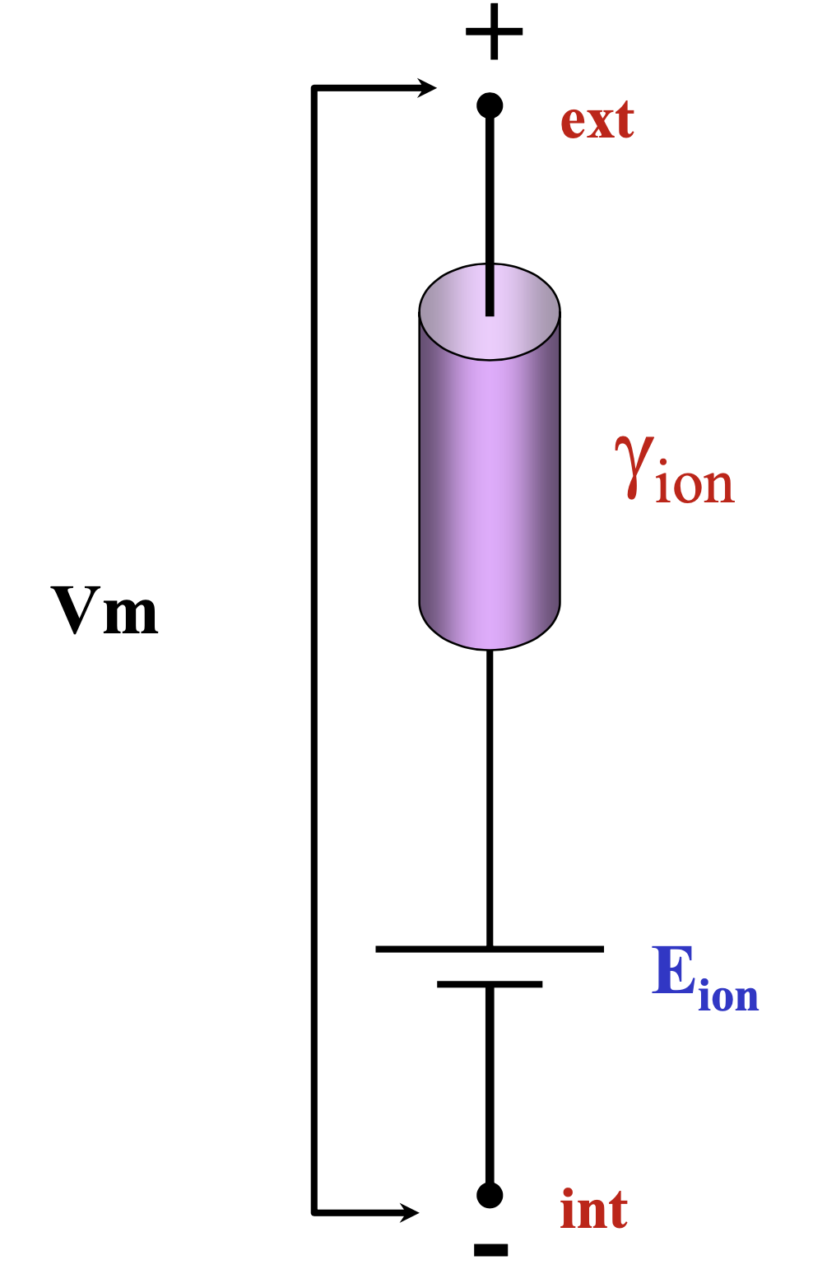
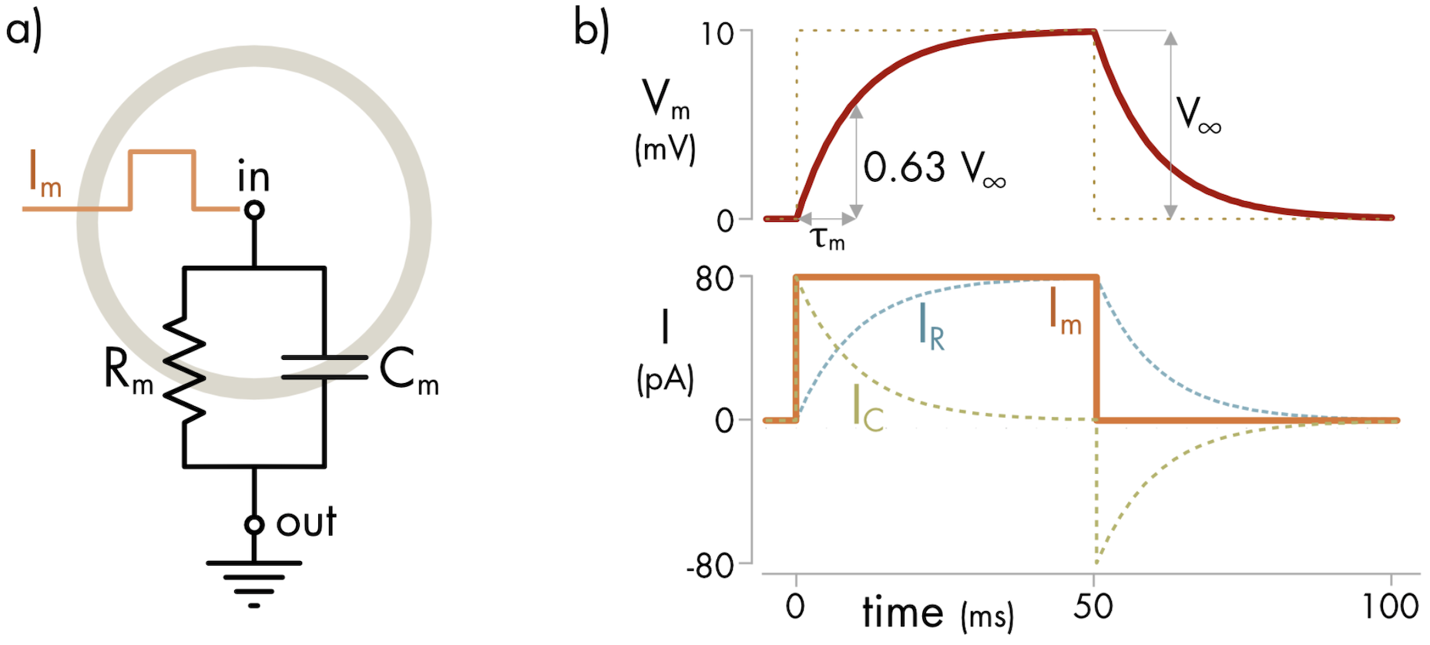
Basic principles
Neuron = parallel RC circuit
Membrane = capacity (C)
Capacitance = capacity to stock electric charges (depends on membrane surface) - node : low capacitance (quick charge) - internode : large capacitance (slow charge)
Ion channels = resistance (R)
Resistance variable : - open channels : low resistance - closed channels : high resistance
Nodal membrane potential increase and decrease depending on exponential kinetics characterized by time of constant = RC = 𝜏_{m} (time to change the potential of 63% of it’s final value)
≃ chronaxie

Slide 5

Basic principles
The action potential
Opening of Na nodal channels -> intrance of positives charges in the axone = incoming ionic current (Na⁺)
Longitudinal axonal ionic current (K⁺, Cl⁻, Na⁺)
Outgoing capacitative current in nodes where Na channels are closed -> node depolarization -> opening of nodal sodium channels

Slide 6
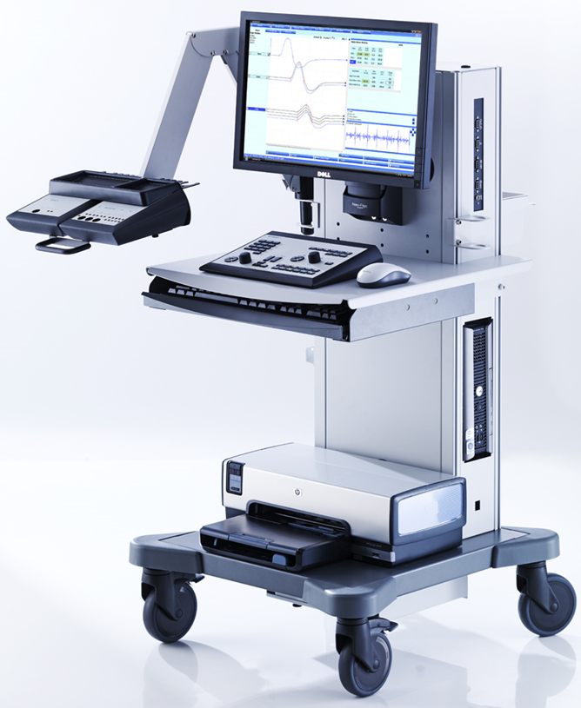
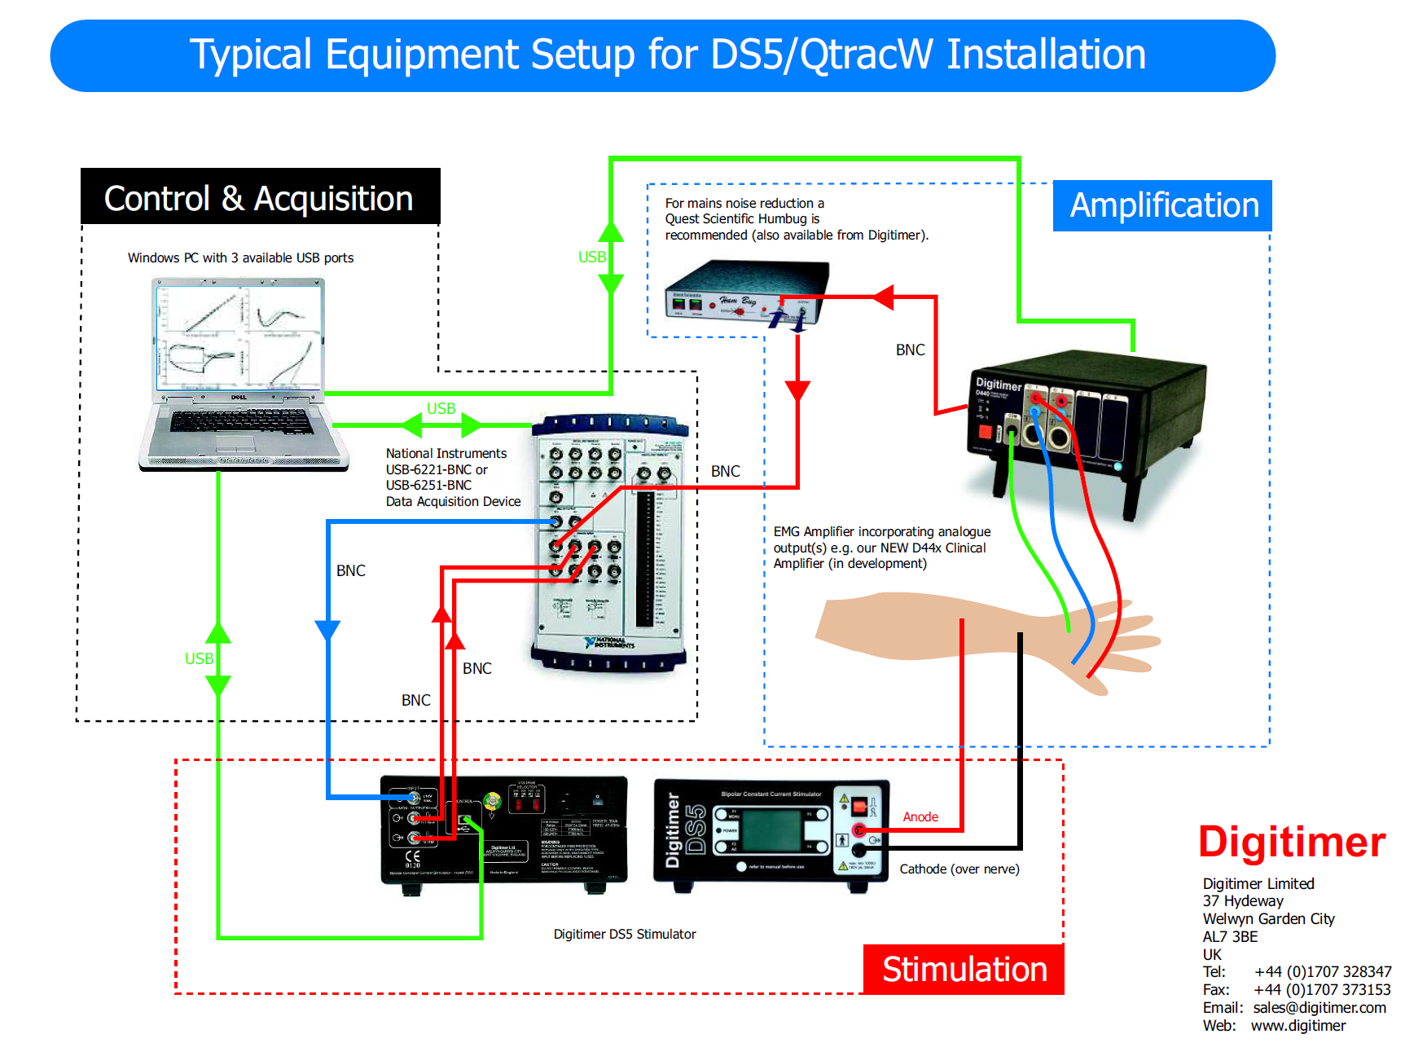
How to study axonal excitability?
1. Strentgh-duration curves
2. Axonal excitability recovery cycle
3. Stimulus-response curves
=> Node excitability
4. Threshold tracking
=> Internodal accomodation
Notes:
How can we study the axonal excitibility?
We can realise strentgh duration curves to study what happens just before the axonal potential
We can also study the axonal excitability recovery cycle to know what happens just after the action potential
We can realise stimululus response curves
These three techniques allow to study node excitability
Since 20/30 years a new technique called threshold tracking allow to study the internode

Slide 7
How to study axonal excitability?
1. Strentgh-duration curves
2. Axonal excitability recovery cycle
3. Stimulus-response curves
=> Node excitability
4. Threshold tracking
=> Internodal accomodation
Notes:
How can we study the axonal excitibility?
We can realise strentgh duration curves to study what happens just before the axonal potential
We can also study the axonal excitability recovery cycle to know what happens just after the action potential
We can realise stimululus response curves
These three techniques allow to study node excitability
Since 20/30 years a new technique called threshold tracking allow to study the internode

Slide 8
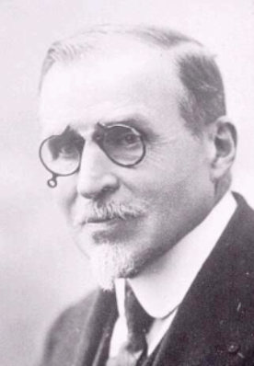
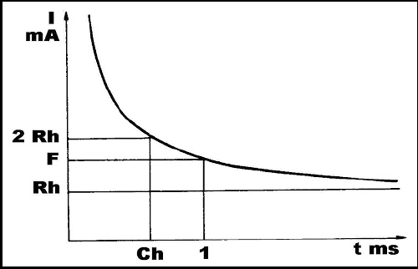
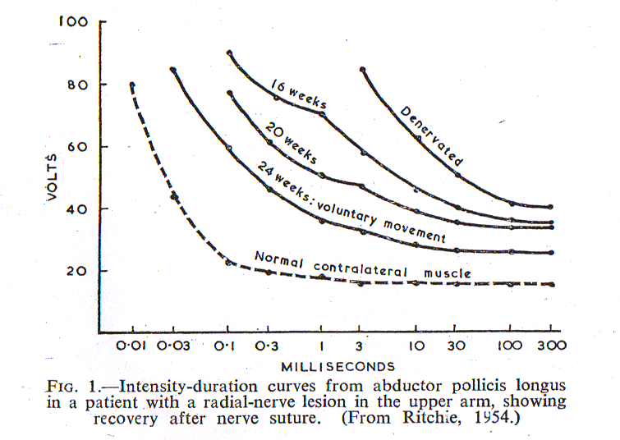
1. Strentgh-duration curves
In 1909, Lapicque defines:
Rheobase = estimated threshold current for a stimulus of infinitely long duration
Chronaxie = minimum stimulus duration for a current twice rheobase to stimulate a muscle.
Louis Lapicque
1866 – 1952
Sorbonne, Paris
Notes:
Strenght duration curves aren’t new, they come from the beginning of neurophysiology
These curves relate the intensity of the stimulation and the duration of the stimulation
In 1909, Lapicques defines
-the rheobase as the estimated threshold current for a stimulus of infinitely long duration so it’s the intensity needed to reach threshold when the duration is infinitively long
- The chronaxia as the stimulus duration needed to reach the threshold when the intensity of current is twice the rheobase

Slide 9
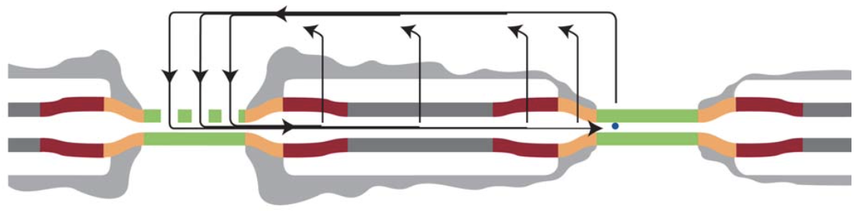
1. Strentgh-duration curves
Chronaxie (𝜏) = time of constant = time it takes for the change in potential to reach 63% of its final value
Passive composant : 50 μs
Node surface
Active composant : 300-400 μs
Leak Channels open at resting membrane potential Na_{p}
Rheobase :
Inversely proportional to nerve excitability
Due to passive property of the node (capacity)
Increased when there is damage in the myelin sheet
Depends also of extraneural parameters
Notes:
The chronaxia is a time of constant, it’s the time needed to load and unload the node of 63%
It depends of two composant : a passive composant which is the node surface and an active composant which are the Na persistant channel which are responsible af leak current at resting membrane potential
When the nerve is depolarised, the chronaxia is increased because persistant sodium channels are opened and when the nerve is hyperpolarised the chronaxia is decreased because sodium channel are closed
The rheobase is inverserly proportional to nerve excitability. It is due to passive property of the node. So it increases when there is damage in the myelin sheet.
We have to keep in mind that rheobase depends also of extraneural parameters as electrode or skin impedance

Slide 10
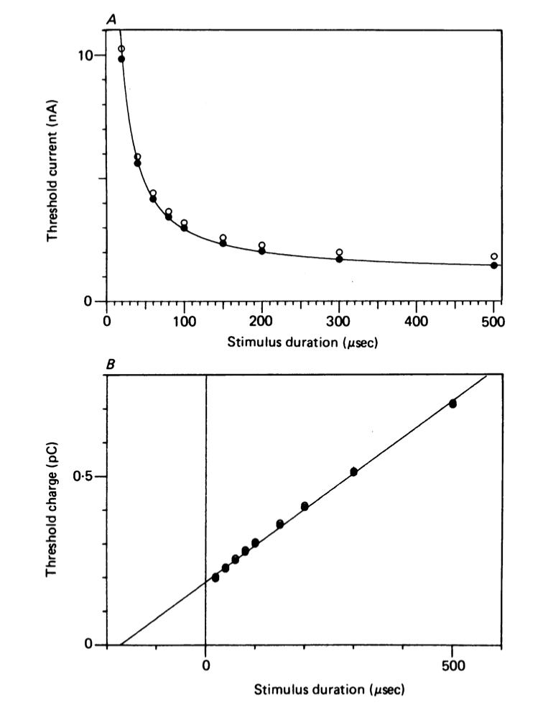
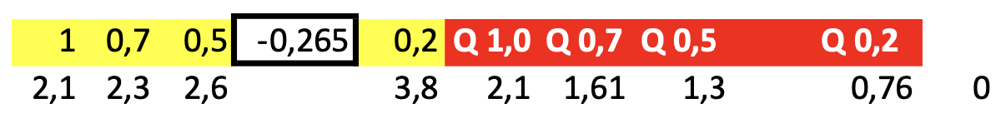
1. Strentgh-duration curves
I
Threshold = 2 mV
Strentgh (nA)
Define a threshold (ex. 2 mV)
What’s the intensity needed to reach the threshold with 4 different stimulus durations?
Excel
R
C
t
Stimulus duration (μs)
Q =I.t
Charge (pC)
a
Q = R.t + a
𝜏 = a/R
R
𝜏
Stimulus duration (μs)
t
Weiss Law : Q = R(t + 𝜏)
Notes:
How can we study rheobase and chronaxia in clinical practice?
We can define a threshold of response, for exemple 2mV and we mesure whats the intensity needed to reach the threshold with 4 different stimulus duration (for ex 0,2msec, 0,5msec, 0,7 msec and 1msec)
From this you can realise a graph which put in relation the stimulus duration in the X axis and the charge which is the stimulus duration multiplied by stimulus intensity
You obtain a curve with the 4 point and you can calculate the rheobase which is the slope of the curve and the chronaxia which is the point were the curve cross the X axis.
These comes from the Weiss Law. Details are over the scope of this presentation

Slide 11
1. Strentgh-duration curves
In peripheral neuropathies
Demyelinating neuropathies (CMT1A, CIDP, GBS), the rheobase is increased due to passive membrane property. (Kiernan et al., 2019)
There is a relationship between survival and chronaxie in ALS. (Kanai et al, 2012)
CIDP, one of direct action mechanism of intravenous immunoglobulin could depend of Nap Channel. (Boërio et al., 2010)
 | Chronaxia | Rheobase
ALS | increased | normal
CMT1a | normal | increased
GBS | normal | increased
CIDP | decreased | increased
Notes:
If the nerve is depolarised as during an ischemia, the chronaxia is increased because Na persistant channel are open and the rheobase is decrease because excitibility is increased
We can see the opposite when the nerve is hyperpolarised as in post ischemia
In ALS the chronaxia is increased while rheobase stay normal. In 2012, Kanai et al show a relationship between chronaxia and survival in ALS. Patients with a longer chronaxia had a shorter survival. They conclude that Na persistant channel could be responsible of the axon death.
In demyelinating neuropathies CMT1A, GBS and CIDP, the rheobase is increased due to passive membrane property.
The chronaxia is decreased in CIDP. In 2010, Boerio at al demonstrate a decrease of the chronaxia after treatment by intraveinous immunoglobulin

Slide 12
How to study axonal excitability?
1. Strentgh-duration curves
2. Axonal excitability recovery cycle
3. Stimulus-response curves
=> Node excitability
4. Threshold tracking
=> Internodal accomodation
Notes:
How can we study the axonal excitibility?
We can realise strentgh duration curves to study what happens just before the axonal potential
We can also study the axonal excitability recovery cycle to know what happens just after the action potential
We can realise stimululus response curves
These three techniques allow to study node excitability
Since 20/30 years a new technique called threshold tracking allow to study the internode

Slide 13
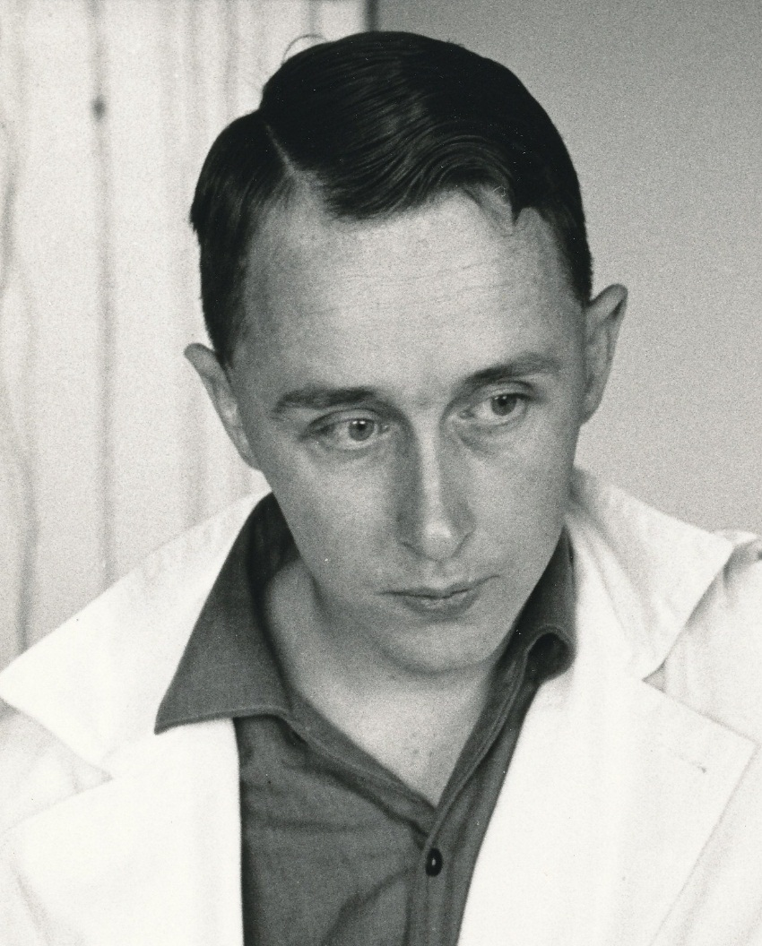
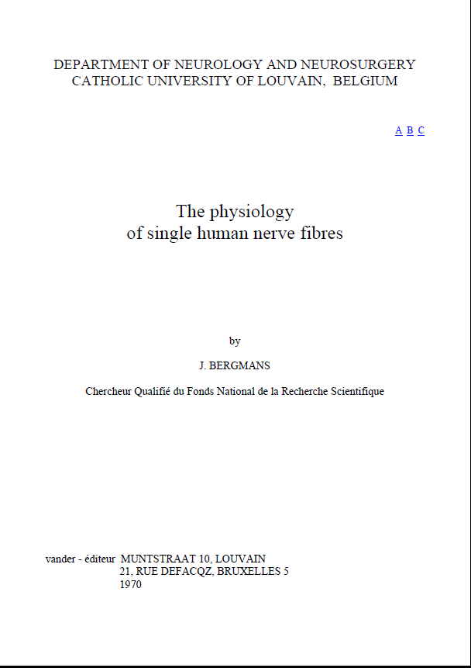
2. Axonal excitability recovery cycle
Hodgkin & Huxley -> ionic channels
Joseph Bergmans (ca. 1970)
Notes:
Another way to study excitability is to study axonal excitability recovery cycle.
It’s Joseph Bergman from UC Louvain who was the first to measure excitability changes in a single motor axon after the action potential.

Slide 14
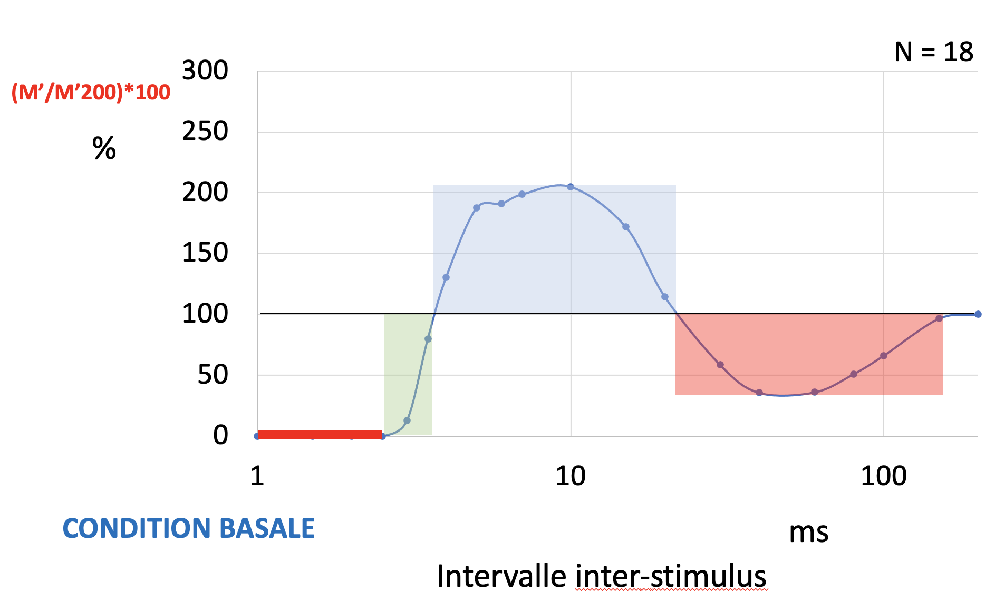
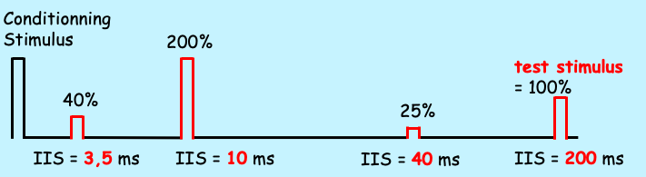
2. Axonal excitability recovery cycle
Absolute refractory period
Relative refractory period
Superexcitable period
Late subexcitable period
Double shock
2 successive stimuli with 2 different intensities - Conditioning stimulus (supramaximal) - Test stimulus (i40)
Variation of the interstimulus interval between 1-200 ms
Notes:
After the action potential we know that the axon will
first be non excitable : it’s the absolute refractory period
After hypoexcitable : it’s the relative refractory period
After superexcitable : it’s the superexcitable period
After subexcitable : it’s the late subexcitable period
We can study this cycle by appliing 2 successive stimuli : 1 first supramaximal and 1 test stimulus which correspond to the intensity needed to have 40% of the maximal response. We reduce progressively the interstimulus interval from 200msec to 1msec and we measure the CMAP variation in response to the second choc.
From these measurment we can do this graph which represent the response to the second stimulus normalized to the CMAP when the interval is 200msec

Slide 15
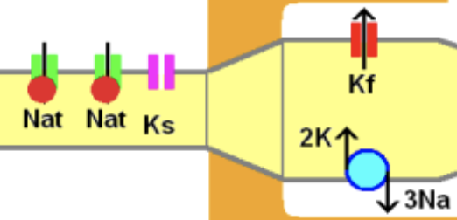
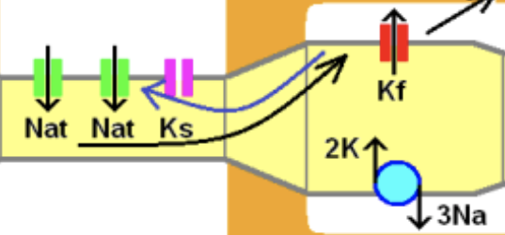
2. Axonal excitability recovery cycle
Absolute refractory period :
Nodal Na_{t} inactivation
Relative refractory period:
Nodal Na_{t} gradual reactivation
Superexcitable period:
During the action potential, there is a large influx of Na ions at the node which spread over nodal and internodal axolemma. After the action potential, there is a reflow of current coming from the large capacitance of the internode which depolarized the node.
Late subexcitable period :
Slow openning of nodal Ks => post potentiel hyperpolarization
Notes:
The absolute refractory period depends on Na transient channel inactivation and the relatively refractory period on the gradual reactivation of these channels
The superexcitable period comes after the refractory period and is maximal around 7msec
Where this superexcitibility come from?
During the action potential, there is a large influx of Na ions at the node which spread over nodal and internodal axolemma. After the action potential, there is a reflow of current coming from the large capacitance of the internode which depolarized the node.
This superexcitibility is reduce if the axon is depolarized because the sodium incoming current needed for the action potential is reduced and the potassium channels are open with depolarization
And it is the opposite when the membrane is hyperpolarized
The late subexcitability period which is maximale around 40msec is due to the opening of slow potassium channels which opens more slowly and are responsible of an hyperpolarisation of the membrane

Slide 16
2. Axonal excitability recovery cycle
In peripheral neuropathies
CMT1a and CIDP, refractory period and superexcitable period reduction is due to passive membrane property. (Kiernan et al., 2019)
AMAN, the refractory period is increased suggesting that nodal sodium channels are impaired by anti-ganglioside antibodies. (Pyun et al., 2017)
MMN, the supernormal period is increased below the conduction bloc reflecting membrane hyperpolarization (overactivation of NaKATPase pumps ?). (Kiernan et al, 2002)
 | Refractory period | Superexcitable period
ALS | reduce | increase
CMT1a | reduce | reduce
AMAN | increase | reduce
CIDP | reduce | reduce
Notes:
So as I just said, when the nerve is depolarized, the refractory period is increased and the superexcitable period is reduced and the opposite when the axon is hyperpolarized
In ALS, the axonal excitability is increased. This result in a decrease of the refractory period and an increase of the superexcitable period.
In CMT1a and CIDP, refractory period and superexcitable period reduction is due to passive membrane property
In AMAN, the refractory period is increased suggesting that nodal sodium channels are impaired by anti-ganglioside antibodies.
In MMN, the supernormal period is increased below the conduction bloc reflecting membrane hyperpolarization. This hyperpolarization could be due to overacivation of NaKATPase pumps.

Slide 17
2. Axonal excitability recovery cycle
CMT1a
Refractory period reduced
Superexcitability period reduced
Notes:
Here is an exemple of result in CMT1A
In grey, you can see Percentil 5 and 95 in normal control and in red the results in CMT1A with a reduction af the refractory period and the superexcitability period

Slide 18
2. Axonal excitability recovery cycle
GBS
basal
M11
D10
M1
Refractory period reduced
Superexcitabiity reduced
Improvement with time
Notes:
Here is the example of a guillain barre syndroma
As in CMT1A, the refractory period and the superexcitability period are reduced
And we can see that this excitibility parameters are improving with time with almost normal results eleven month after the beginning of symptoms
You can also see that the curve in ischemia is almost the same than in basal condition, it’s what we call a ischemia resistance

Slide 19
2. Axonal excitability recovery cycle
Lewis & Sumner
Membrane hyperpolarization
- Refractory period reduced
- Superexcitability increased (especially in ischemia)
basal
ischemia
Notes:
Here is an exemple of lewis sumner were in opposite the superexcitability is increase especially in ischemia. This could be due to overactivation of the NaKATPase pump
I will come back to this concept later.

Slide 20
How to study axonal excitability?
1. Strentgh-duration curves
2. Axonal excitability recovery cycle
3. Stimulus-response curves
=> Node excitability
4. Threshold tracking
=> Internodal accomodation
Notes:
How can we study the axonal excitibility?
We can realise strentgh duration curves to study what happens just before the axonal potential
We can also study the axonal excitability recovery cycle to know what happens just after the action potential
We can realise stimululus response curves
These three techniques allow to study node excitability
Since 20/30 years a new technique called threshold tracking allow to study the internode

Slide 21
3. Stimulus response curve
Less excitable axons
CMAP
mV
CMAP = 6,1 mV
0,2 ms
mA
Most excitable axons
Notes:
We can also study axonal excitability with the stimulus response curve
It relate the intensity of stimulation to the amplitude of the response
With low stimulations only most excitable axons reach the threshold to produce an action potential.
Less excitable axons are recruited near the intensity needed to produce a supramaximal response

Slide 22
3. Stimulus response curve
(Cappelen-Smith et al, 2001)
Notes:
The stimulus response curve depends on the stimulus duration
When the stimulus duration increase, the curve shift to the left and the slope is increased
Here you can see the result of a study of Cappelen and smith in CIDP. In black it’s healthy controls with stimulus duration of 0,2 msec and 1msec and in white it’s patients with Cidp.
You can see that you need greater intensity to stimulate the axons and that the difference between controls and CIDP is bigger near maximal CMAP.

Slide 23
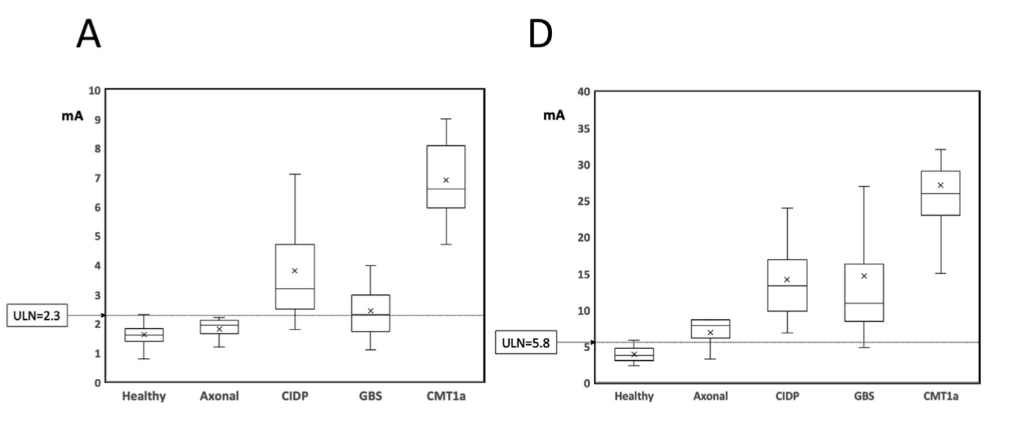
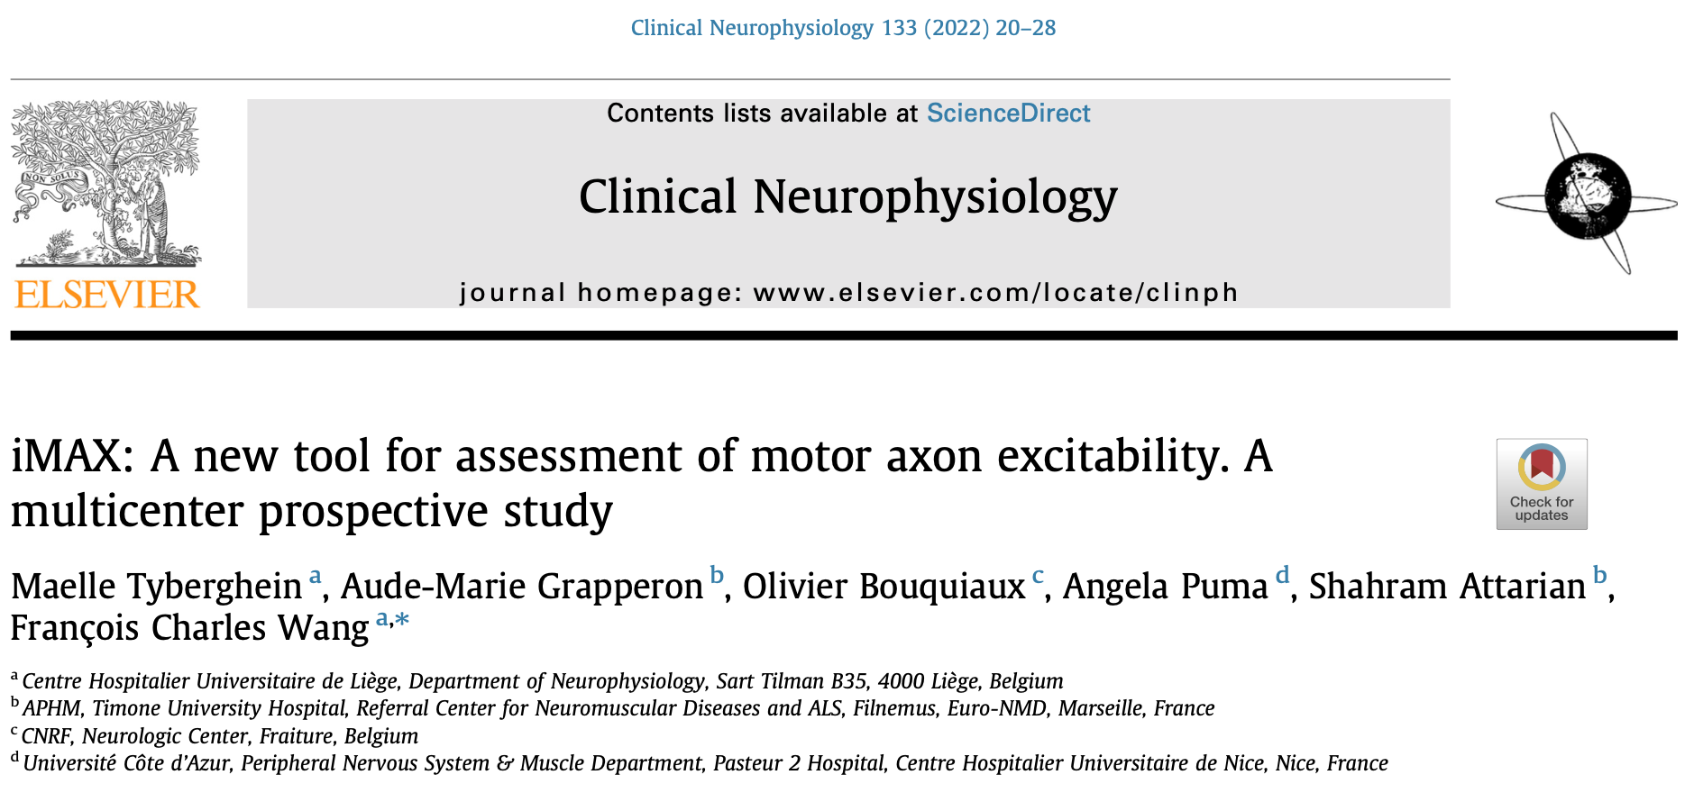
3. Stimulus response curve
iMAX the minimal intensity needed
to evoke a maximal response
Notes:
From this curve we develop a new tool to assess nerve excitability, the iMAX
iMAX is the minimal intensity needed to evoke a maximal response
It’s this point of the curve
When we are studiing iMAX we are also measuring threshold which is the minimal stimulation intensity needed to evoke a response of 0,1mV
In practice, we are first searching the threshold
When the threshold is define we increase the intensity with 1mA increment until we find the minimal intensity needed to evoke a maximal response with a 1mA precision its the iUP and after we decrease the intensity with 0,1 mA decrement until we reach the minimal intensity needed to evoke a maximal reponse with a 0,1mA precision, it’s the iMAX

Slide 24
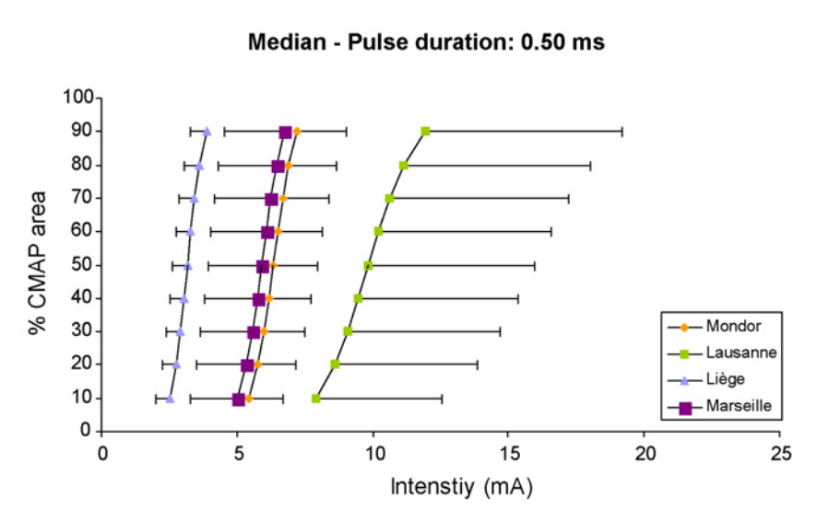
3. Stimulus response curve
 | Shift of the curve | Slope
CMT1a | Right +++ | ---
GBS | Right + | -
CIDP | Right ++ | --
Like the rheobase, the stimulus response curve depends on passive property of the membrane + impedance of electrodes + resistance of the extraneural tissue
Great variability of results (Boërio et al, 2008) We need to control the impedance
Notes:
When the nerve is depolarised, the intensity needed to trigger an action potential is decreased and so the curve shift to the left and the slope increase
It’s the opposite when the nerve is hyperpolarized
In demyelinating neuropathies the intensity needed to stimulate the nerve is increase so the curve shift to the right and the slope decrease mainly in charcot marie tooth disease
Like the rheobase, the stimulus response curve depends on passive property of the membrane but also of the impedance of electrode and of resistance of the extraneural tissue
So we can see a great variability in the results as you can see in the multicenter study in which we participated. Here are the mean stimulus response curve in healthy controls in 4 different centres.
=> We need to control the impedance

Slide 25
How to study axonal excitability?
1. Strentgh-duration curves
2. Axonal excitability recovery cycle
3. Stimulus-response curves
=> Node excitability
4. Threshold tracking
=> Internodal accomodation
Notes:
How can we study the axonal excitibility?
We can realise strentgh duration curves to study what happens just before the axonal potential
We can also study the axonal excitability recovery cycle to know what happens just after the action potential
We can realise stimululus response curves
These three techniques allow to study node excitability
Since 20/30 years a new technique called threshold tracking allow to study the internode

Slide 26
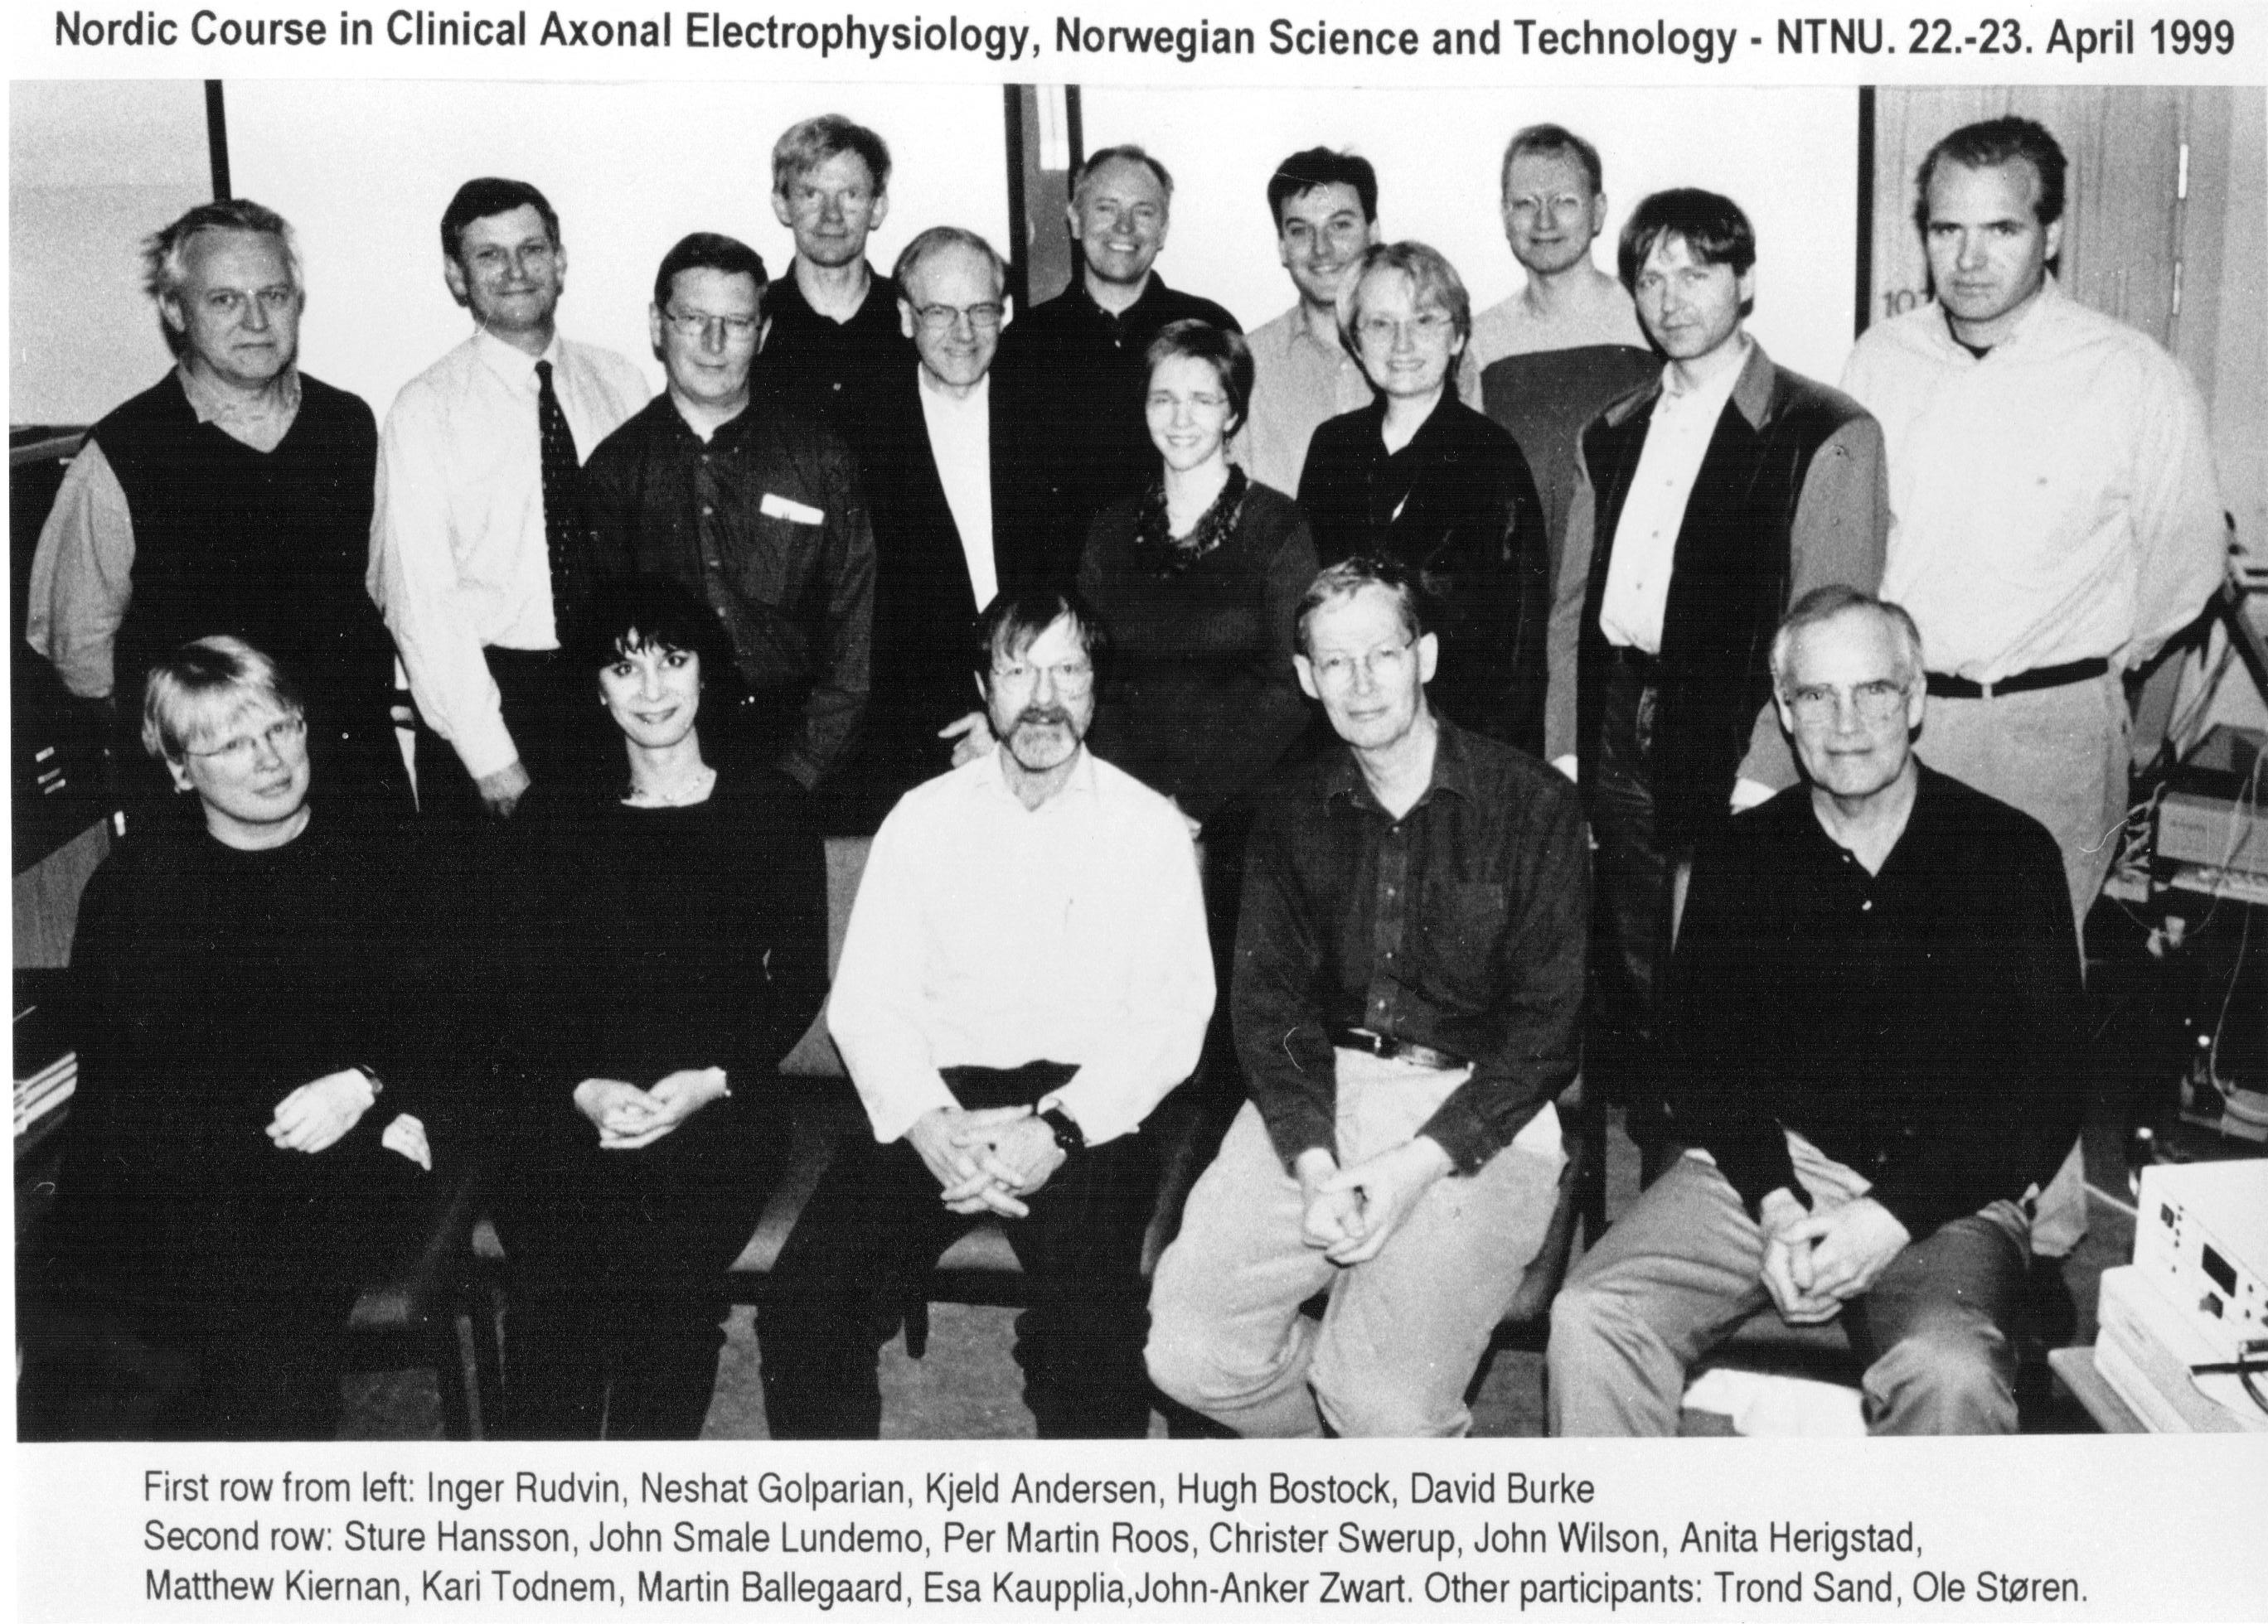
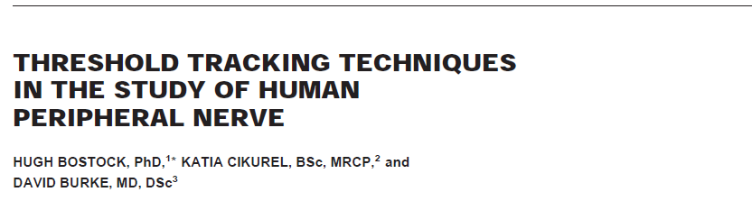
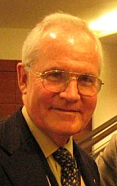
4. Threshold Tracking
1990- 2010
Study of the internode
The TROND protocol
David Burke
Matthew Kiernan
Notes:
In the ninetees, Huge Bostock and his team develop a new method allowing to study nerve excitibility. This method called threshold tracking require a specific equipment and software which allow to study the internodal membrane. The basic principle of threshold tracking is to keep a stable response with a retrocontrole of the stimulus intensity.
This is the equipment which allow a feedback of the stimulus intensity according to the amplitude of the response

Slide 27
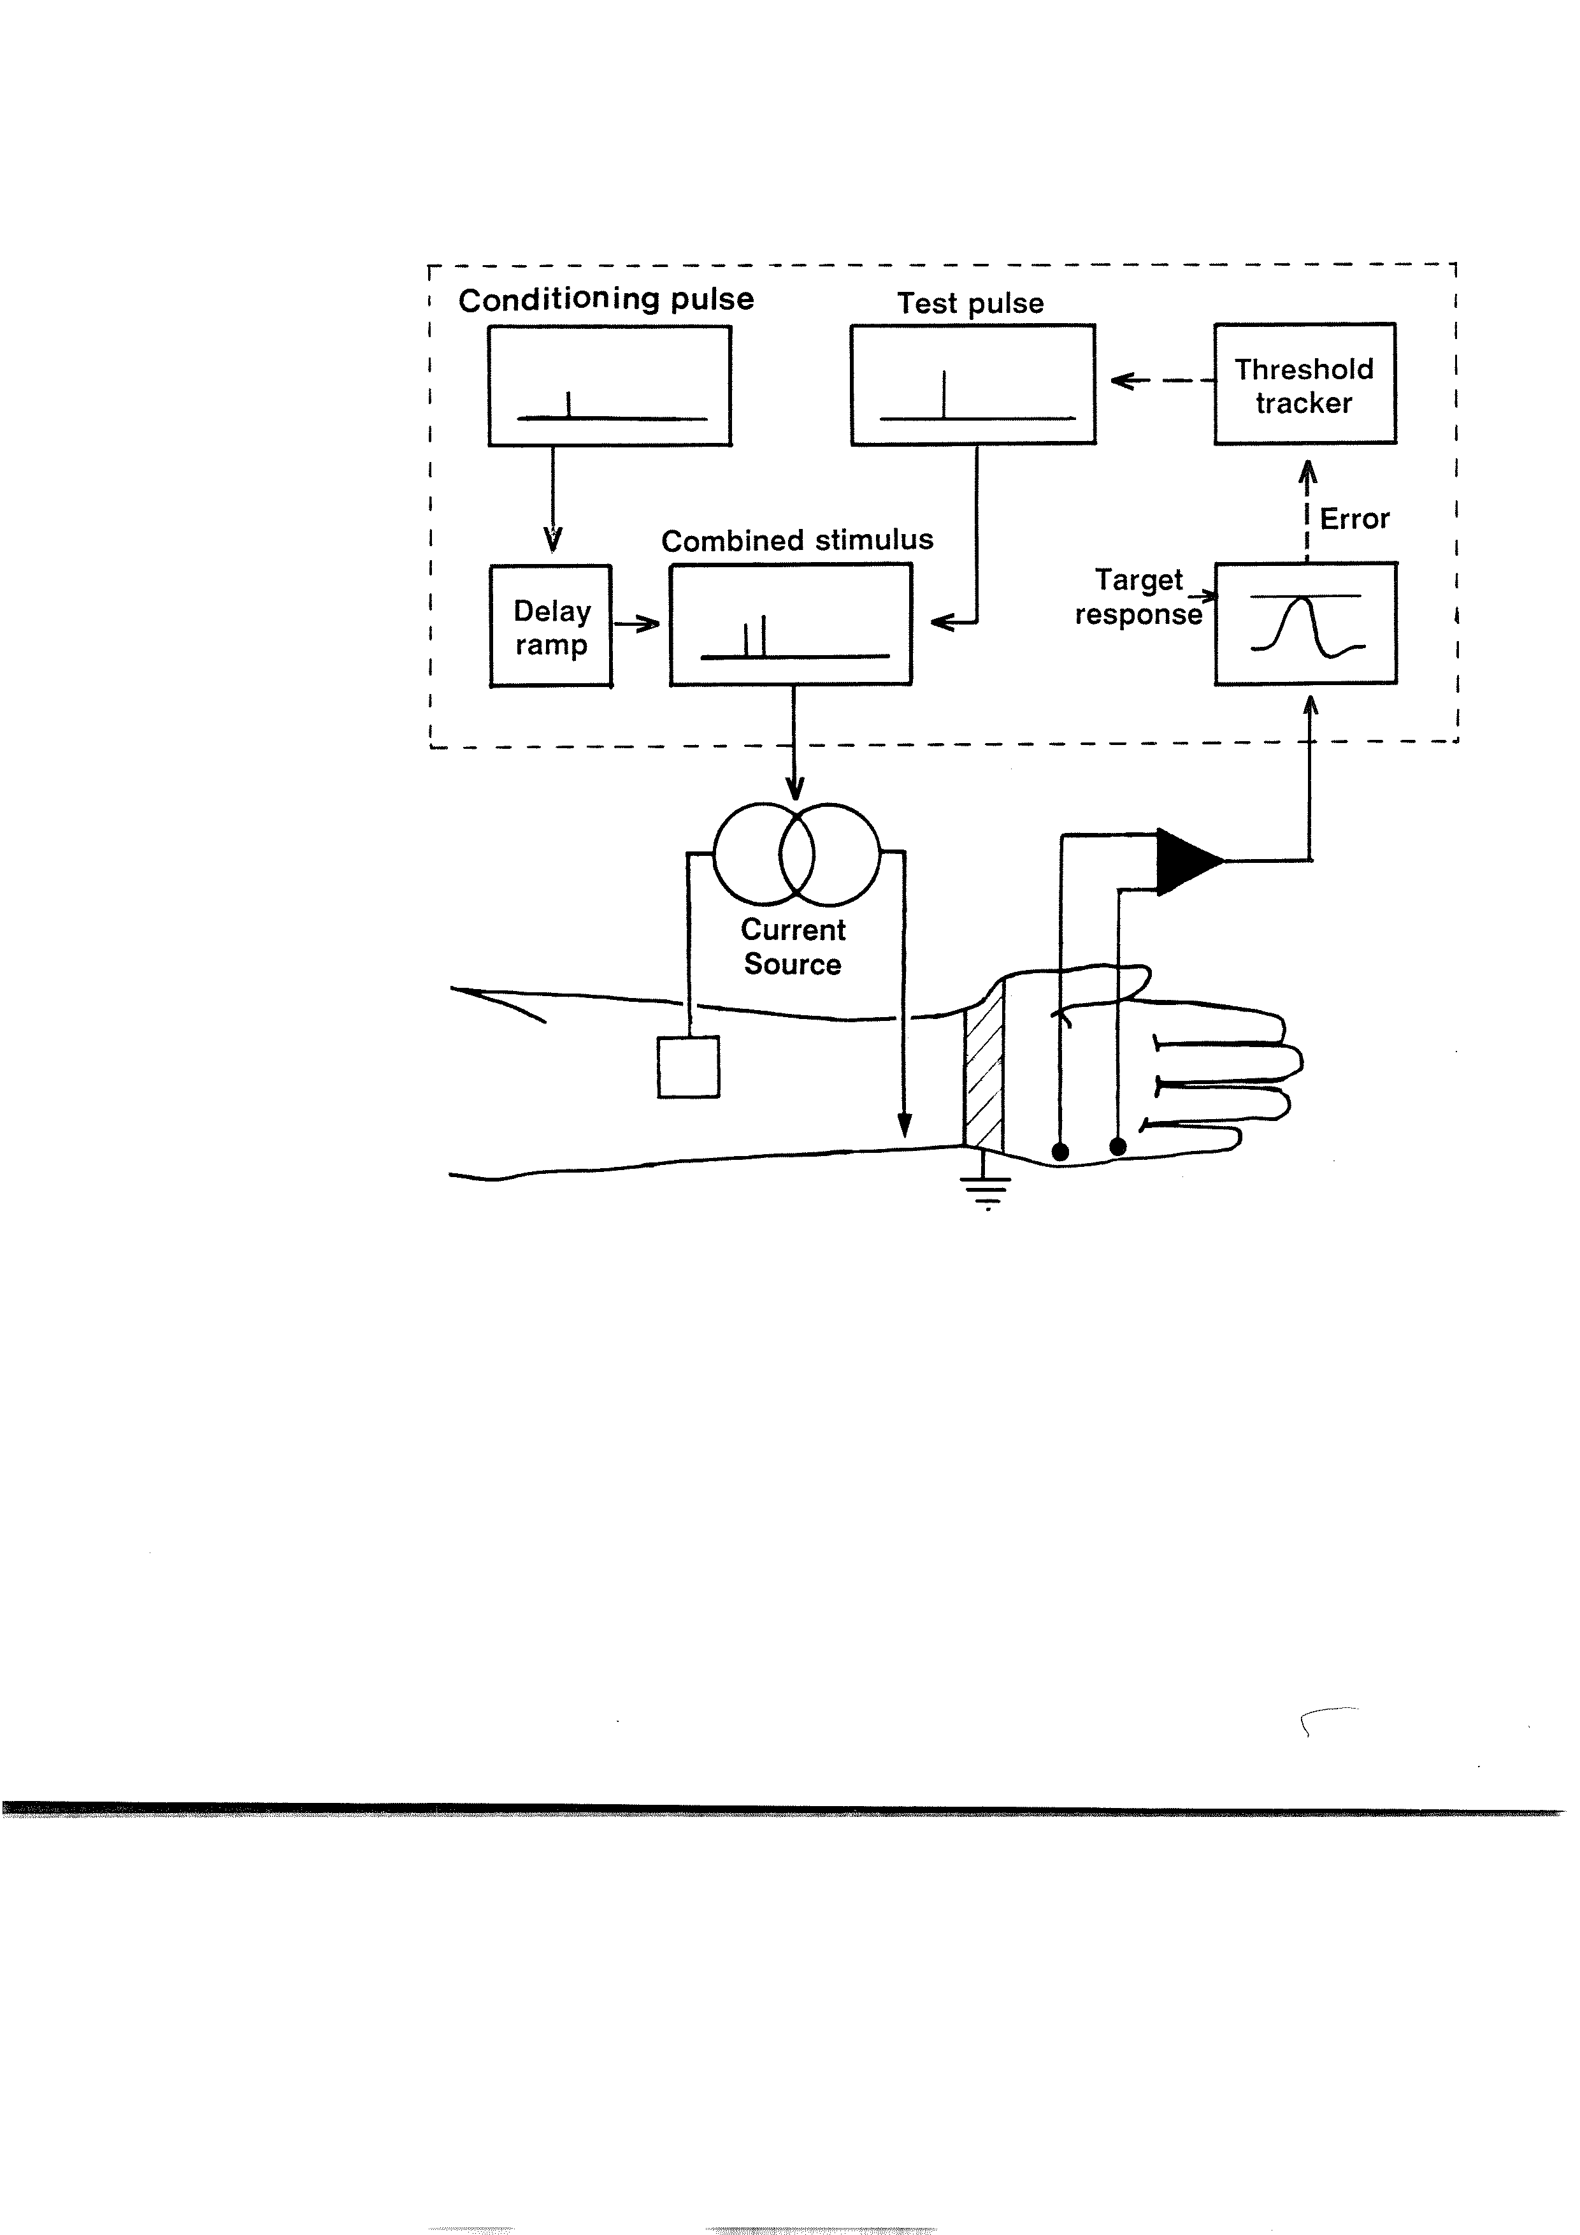
4. Threshold tracking
Target : CMAP = 40-50% maximale CMAP
Threshold : stimulation intensity needed to reach the target => depends on membrane potential
Conditionning stimuli of long duration - depolarizing de 100-200 ms - hyperpolarizing de 100-200 ms - intensity: 20% et 40% of the threshold
Threshold variations = membrane potential variation
Notes:
They called the threshold, the intensity of stimulation needed to reach 40 or 50% of the maximal response
And they study the variation of this threshold which depend on the membrane potential. If the membrane is depolarized, the intensity needed to reach the target will be decreased and so the threshold will be decreased.
By applying long duration hyperpolarizing or depolorising current of 100 or 200 msec, this method allow to study the accommodation of the internodal membrane

Slide 28
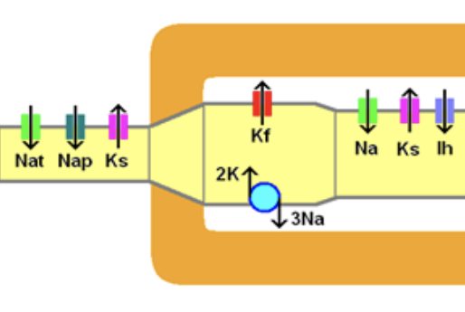
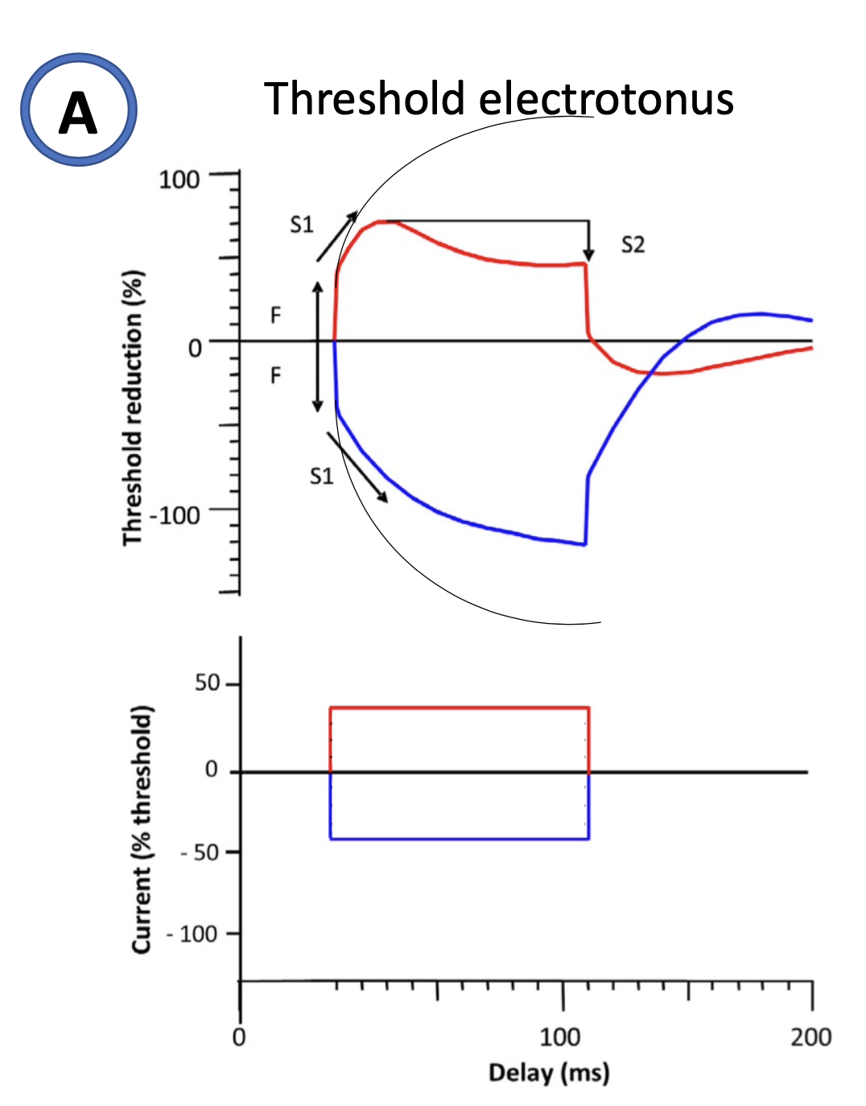
4. Threshold tracking
S1
S2
F
V
I
I depolarizing (40% of the threshold) - F : fast threshold reduction (nodal depolarization) - S1 : threshold reduce more slowly (depolarization in the internode, limited by K_{f}) - S2 : threshold increase (K_{S} nodal and internodal)
Notes:
Here are the result of threshold variation with long depolarizing or hyperpolarizing current
If we apply a long depolarizing current which is too weak to trigger an action potential, the threshold will be first reduce quickly due of nodal depolarization
and after this reduction of the threshold will be limited by the opening of fast potassium channels first and slow potassium channel lately
When the depolarizing current end, there is a increase in the threshold due to slow closing of the slow potassium channels

Slide 29
4. Threshold tracking
F
S1
V
I hyperpolarizing (40% of the threshold) - F : fast increase of the threshold (nodal hyperpolarization) - S1 : threshold increase more slowly (hyperpolarization diffusion in the internode, limited by Ih current)
I
Notes:
If we apply a long hyperpolarizing current, the threshold will be first increase quickly due of nodal hyperpolarization and after limited by the diffusion of the hyperpolarization in the internode and the opening of HCN channels wich are responsible of Ih current (input of sodium and potassium)

Slide 30
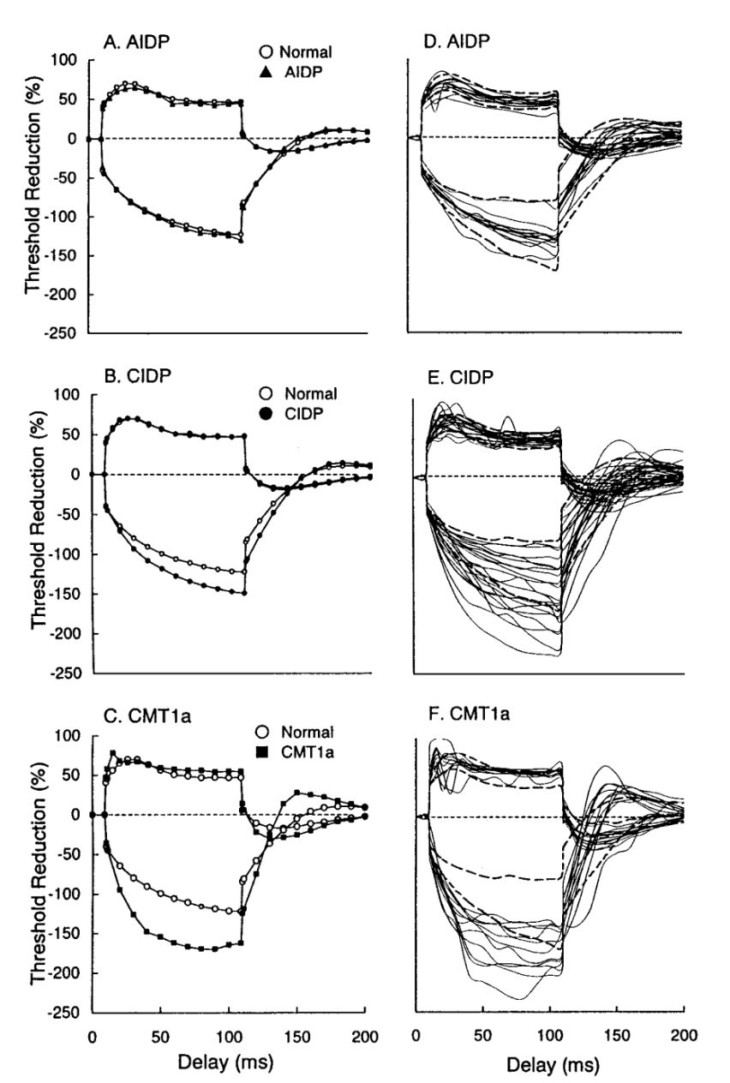
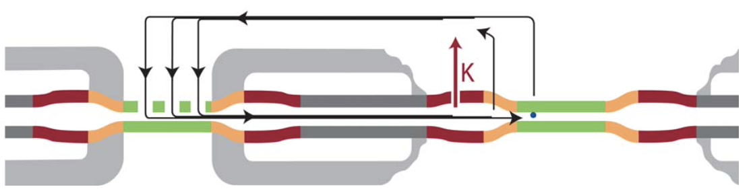
CMT1a
K_{f} juxta-paranodal -> node (juxta-paranodale demyelinization)
“fanning out”
Notes:
Here are the results in peripheral neuropathies
We can see a fanning out of the threshold electrotonus in CIDP and CMT1A
In CMT1A, the juxta paranodal demyelinisation is responsible of a diffusion of the ionic channels in the node and internode which create a rapid outward rectification with long depolarizing current

Slide 31
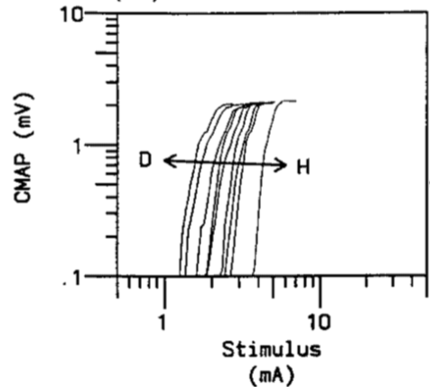
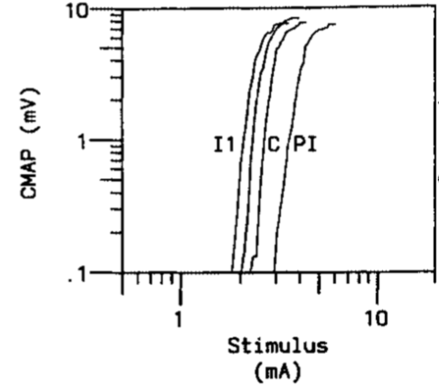
Study of membrane polarity
Depolarization/hyperpolarization
Ischemia = NaKATPase inactivation
=> depolarization
Post-ischemia = NaKATPase overactivation
=> hyperpolarization
Stimulus – Response curve
Notes:
By studying nervous excitability we can also predict if the nerve was previously depolarized or hyperpolarized
We can provoke depolarisation of the nerve making an ischemia by inflate a sphygmanometer during 5 minutes. The ischemia will provoke an inactivation of the NaKATPase pump and so a depolarisation of the nerve. In post ischemia we have the inverse effect with an overactivation of NaKATPase pump.
When the nerve is depolarised, the stimulus response curve shift to the left and refractory period is increase and supernormal period is decrease.
The effect is opposite with hyperpolarisation

Slide 32
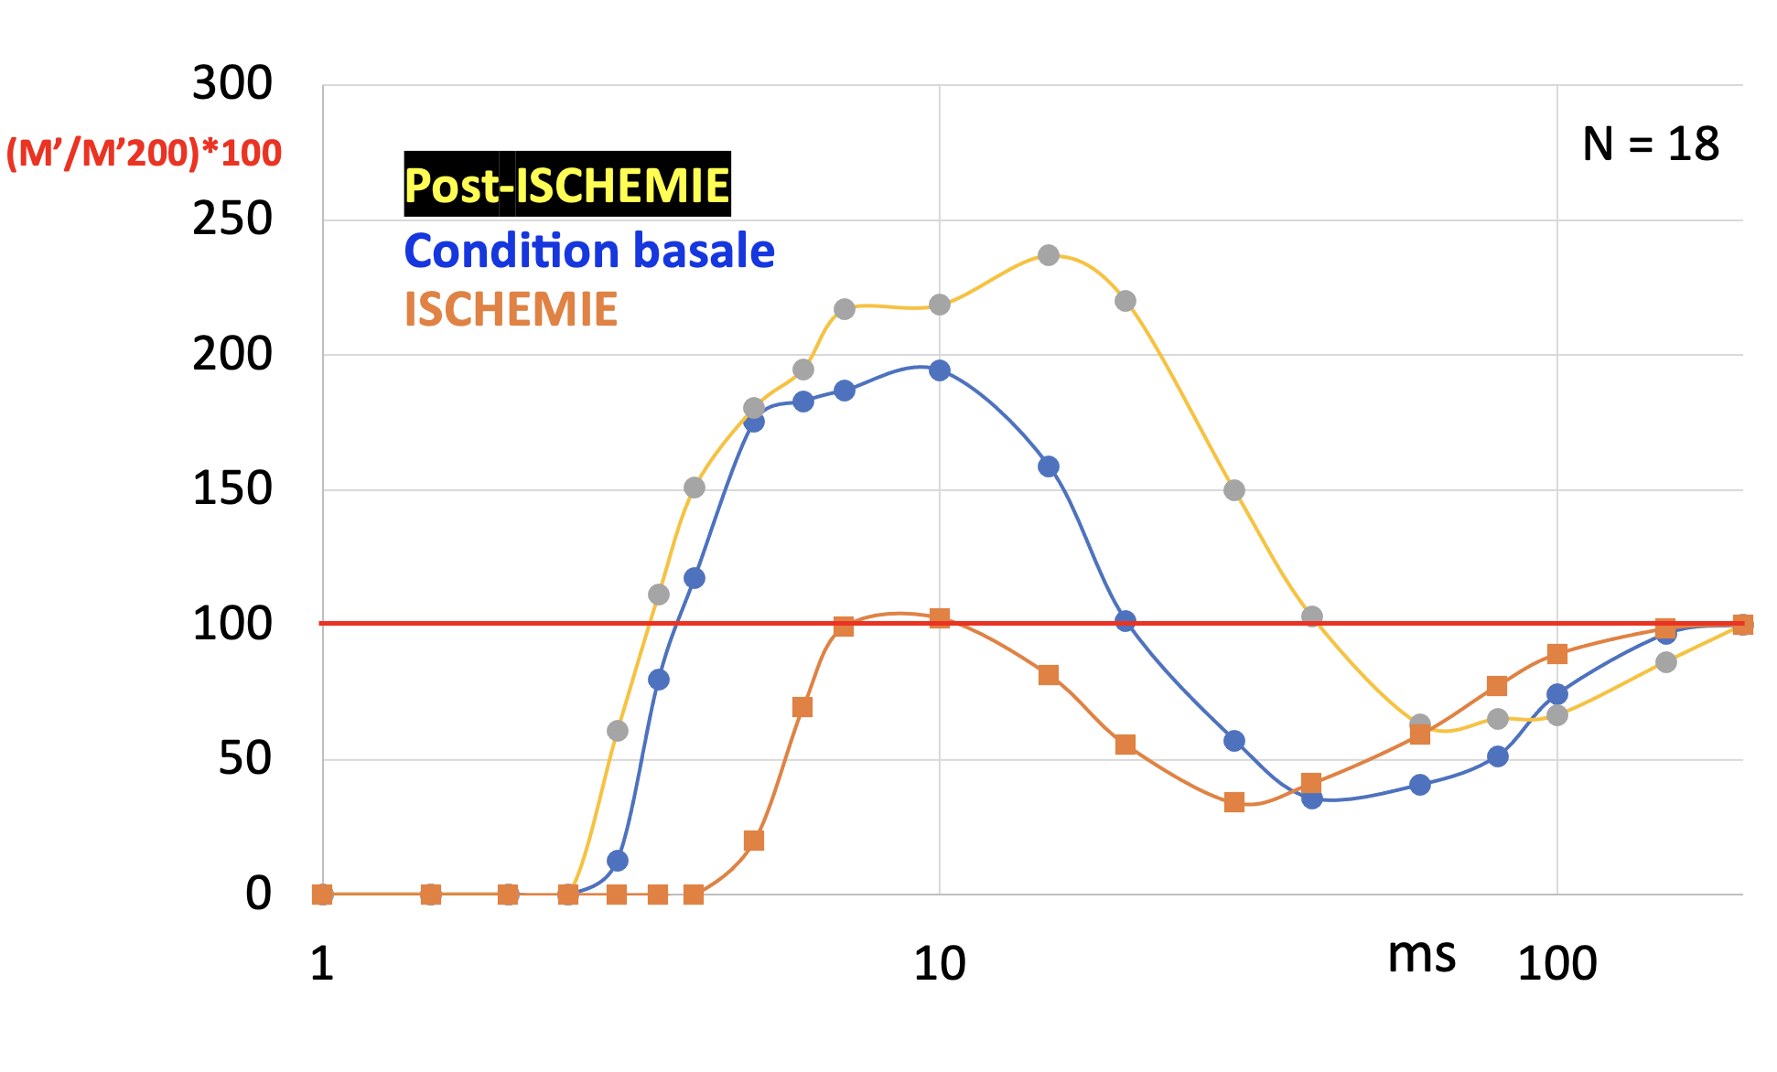
Study of membrane polarity Depolarization/hyperpolarization
Excitability recovery cycle
Ischemia
Basal condition
Post ischemia

Slide 33
Study of membrane polarity
Depolarization/hyperpolarization
Depolarization/
Ischemia“fanning in”
Hyperpolarization/post ischemia“fanning out”
Notes:
In threshold electrotonue,
If the nerve is previously depolarized, there is a fanning in of the response and the opposite when the nerve is hyperpolarised

Slide 34
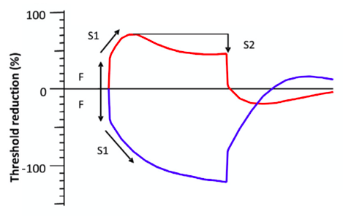
Conclusion
Amplitude
Why study axonal excitability?
Membrane polarity
Ion channels
Passive membrane properties
Conduction velocity
How can we study excitability?
Excitability

