Slide 1
Deep Learning
Introduction & Basics
Vincent Boudart
PhD student

Slide 2
Course 1 : Table of contents
1) What is deep learning ?
2) How it is used nowadays ?
3) Why it will become vital in the future
4) Objectives of this course
5) From linear regression to neural network
5.1) Definition of the problem
5.2) Adding complexity
5.3) Towards MLP
6) Analogy with the polynomial regression
1/33

Slide 3
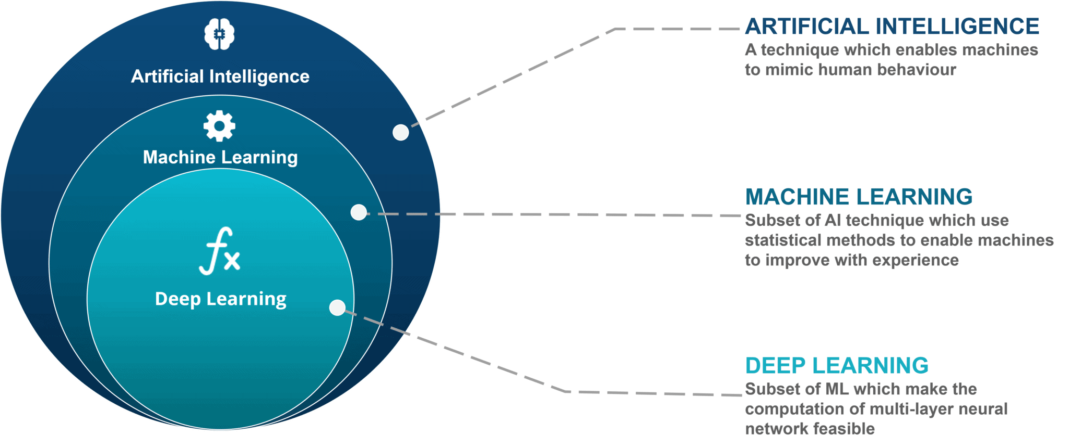
1) What is deep learning ?
Artificial Intelligence vs Machine Learning vs Deep Learning
(http://wiki.pathmind.com/ai-vs-machine-learning-vs-deep-learning)
- pile of if-then statements
- statistical model mapping raw sensory data to symbolic categories
- ...
- optimization algorithms
- decision tree, random forest, K-means
linear regression, support vector machine, ...
- neural networks
- performs exceptionally well on lots of tasks
2/33

Slide 4
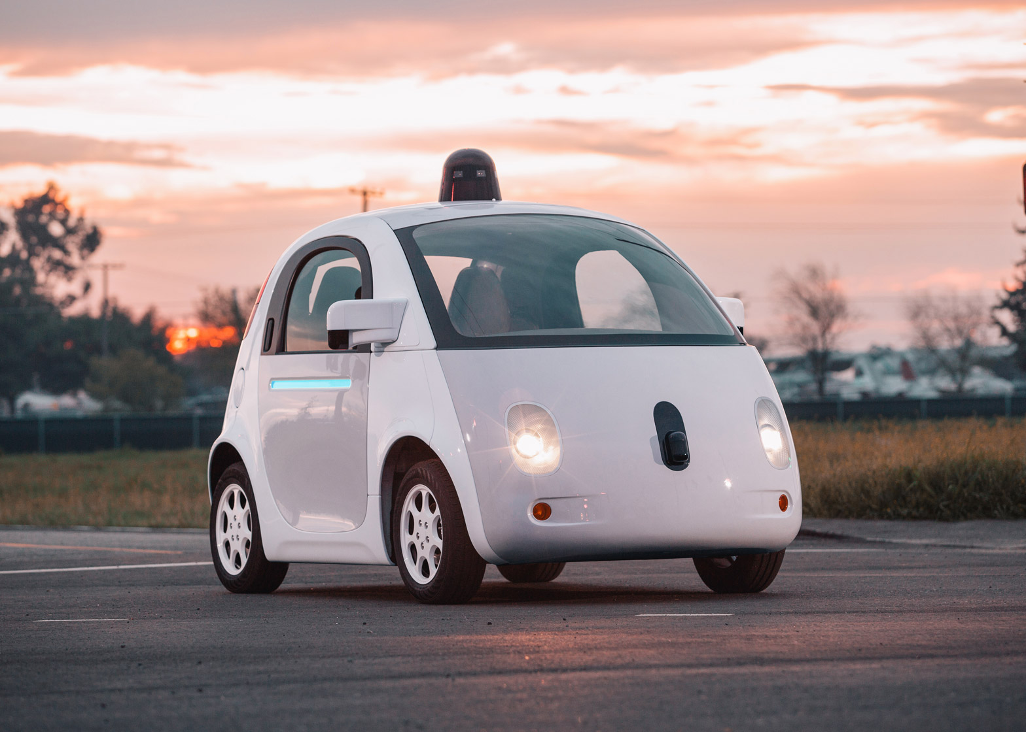
2) How it is used nowadays ?
Self-driving cars (Tesla, Google)
- Lots of data to process (camera, LiDAR, RADAR,
GPS, various sensors, …)
- Lots of action to take (breaking, turning, prediction of
human and vehicle behavior, …)
©Google self-driving car
Source : https://arxiv.org/pdf/1910.07738
3/33

Slide 5
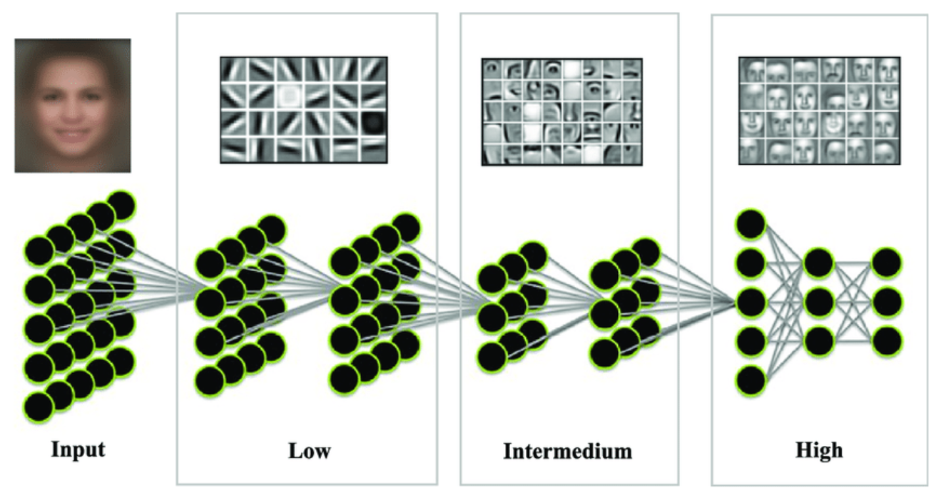
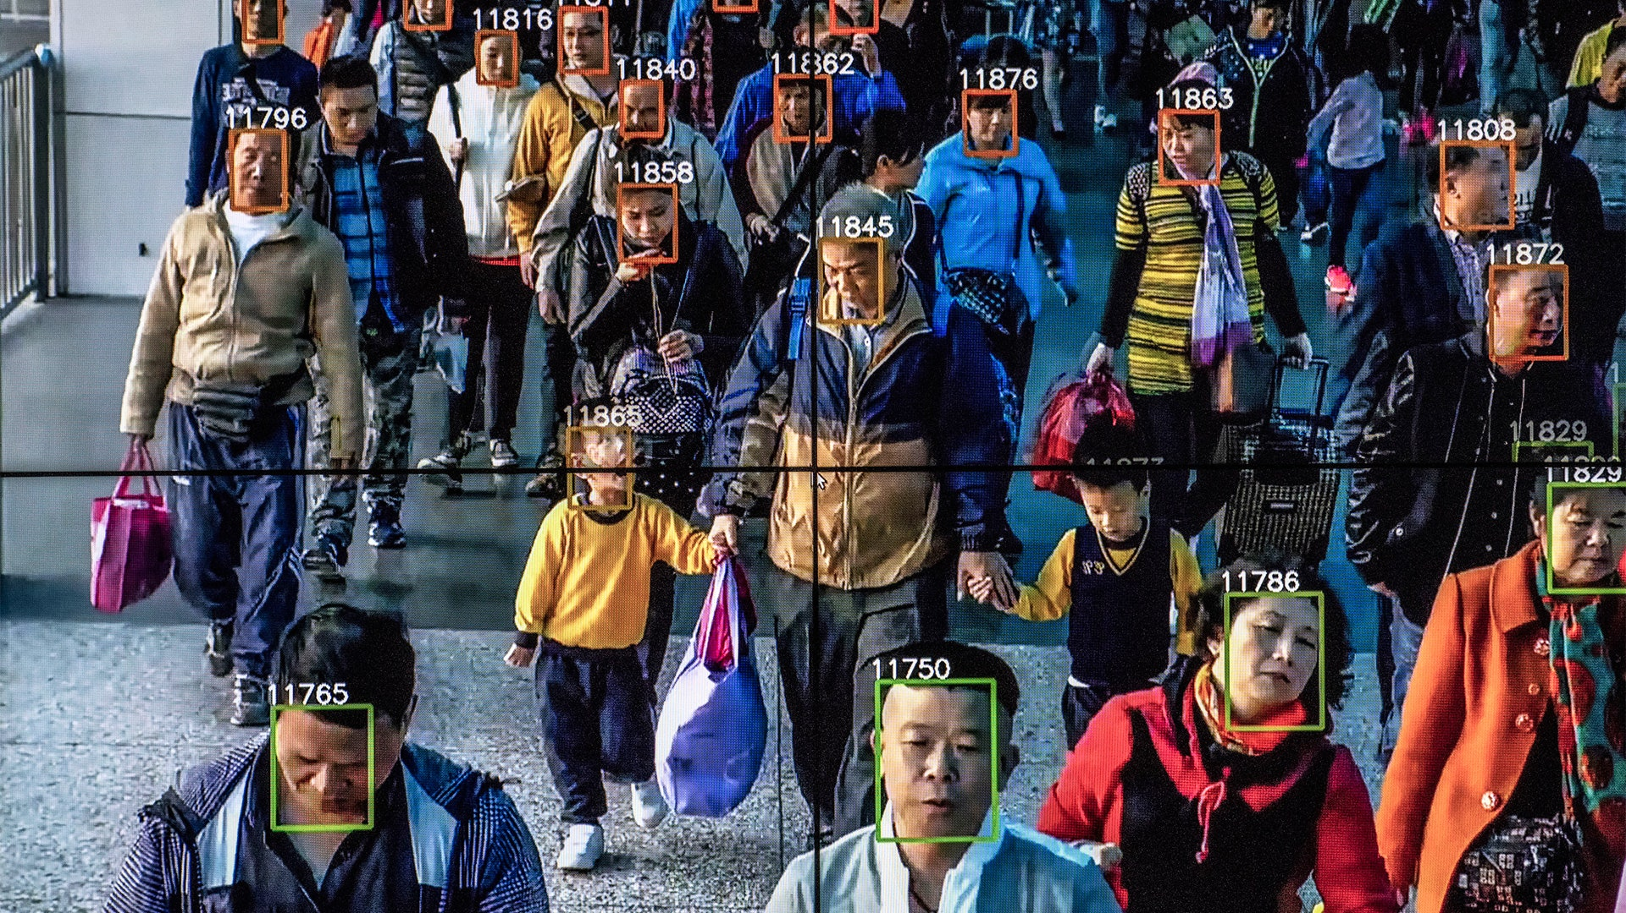
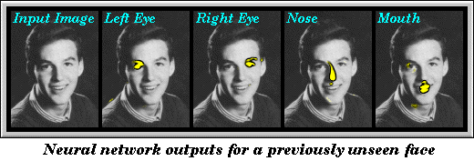
2) How it is used nowadays ?
Face recognition
Li, Xiang et al. Computer Methods in Applied Mechanics and Engineering. 347. 10.1016/j.cma.2019.01.005. (2019).
Paul Debevec. A Neural Network for Facial Feature Location. UC Berkeley CS283 Project Report, December 1992. http://www.debevec.org/FaceRecognition/
4/33

Slide 6
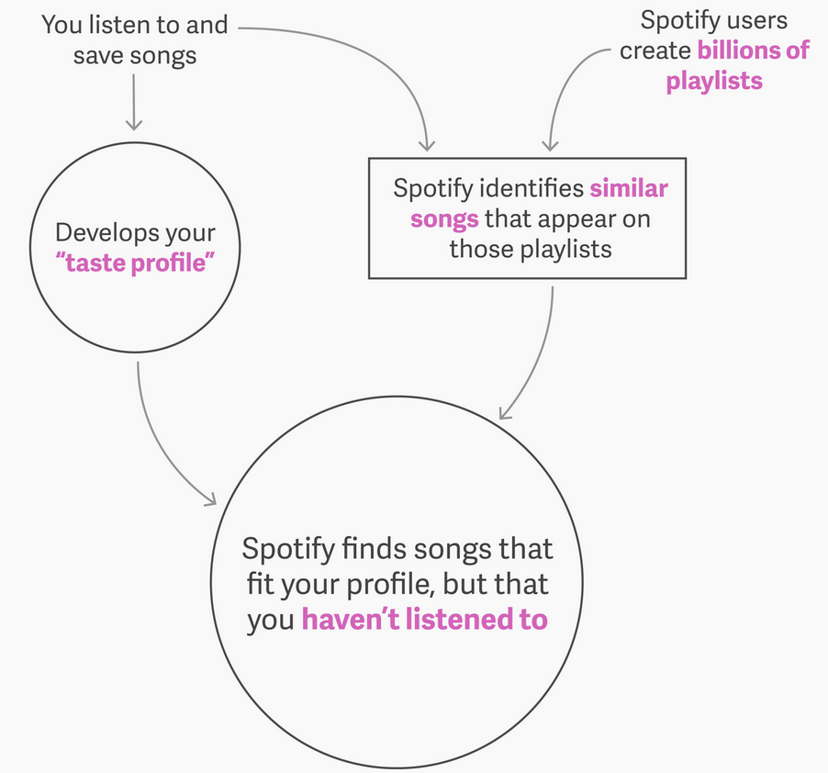
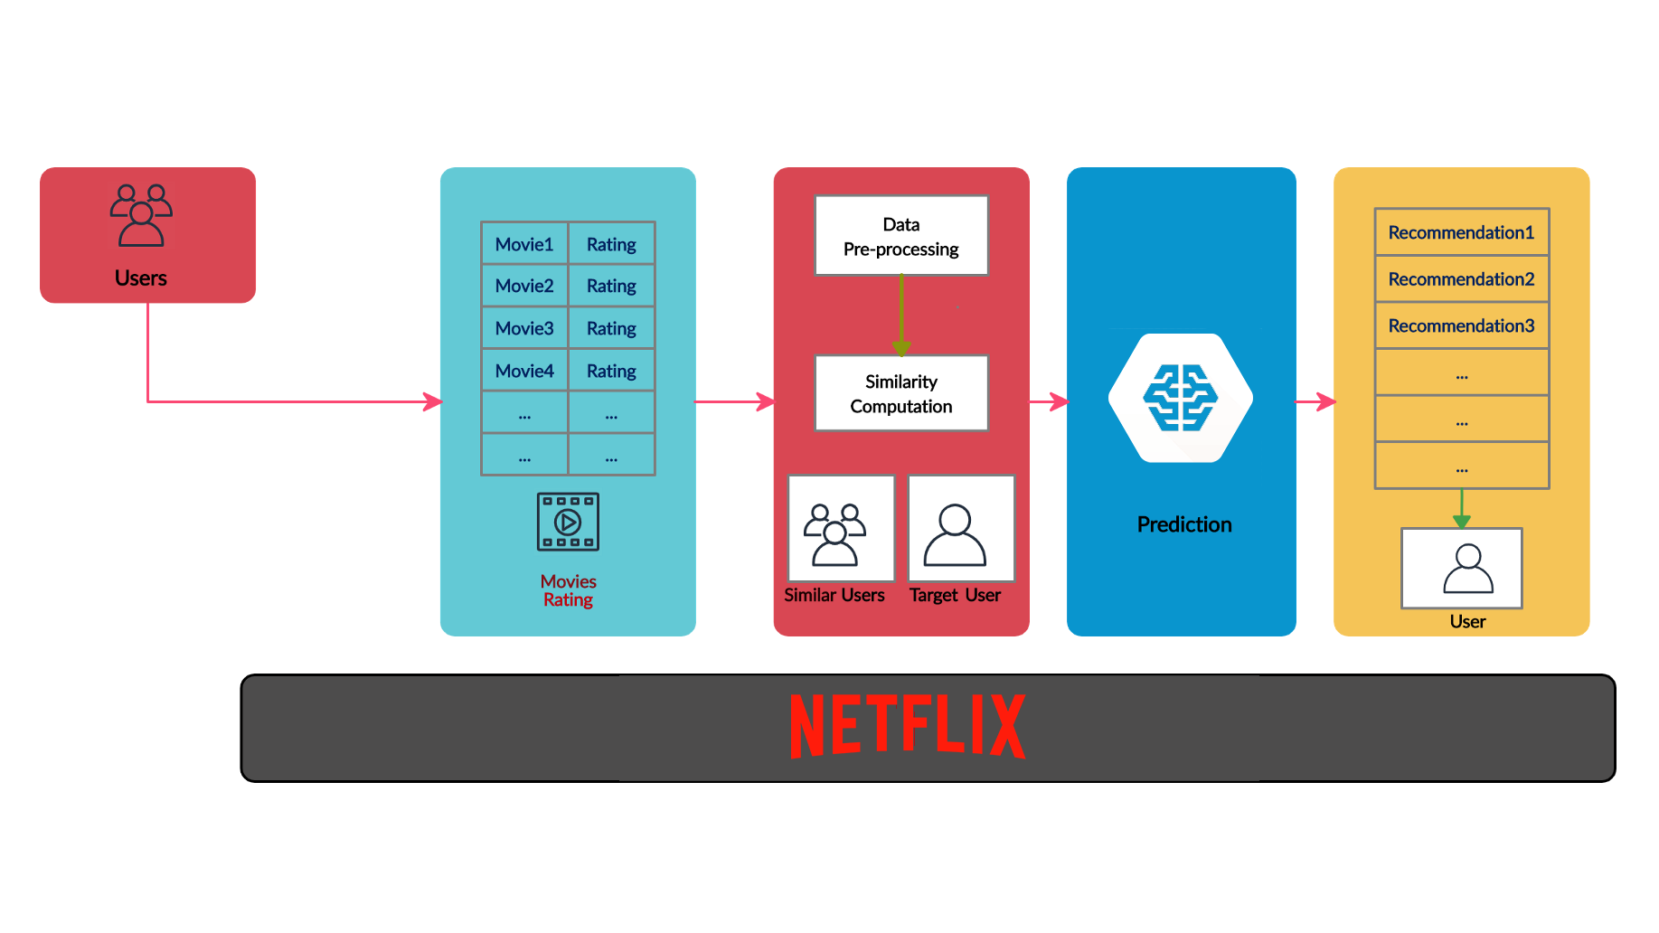
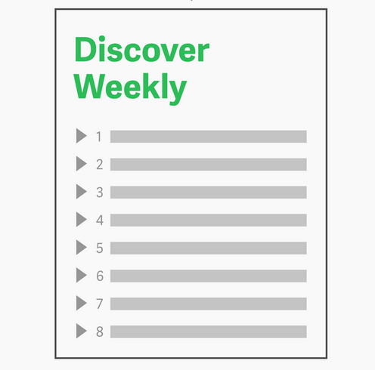
2) How it is used nowadays ?
Recommendation systems (Netflix, Amazon, Spotify, …)
"75% of what people are watching on Netflix comes from recommendations" McKinsey & Company
Source: https://qz.com/571007/the-magic-that-makes-spotifys-discover-weekly-playlists-so-damn-good/
5/33

Slide 7
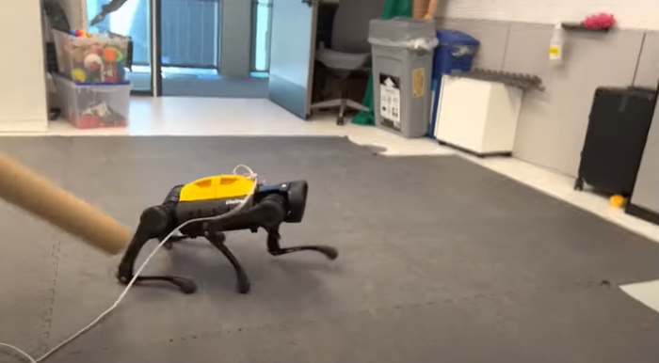
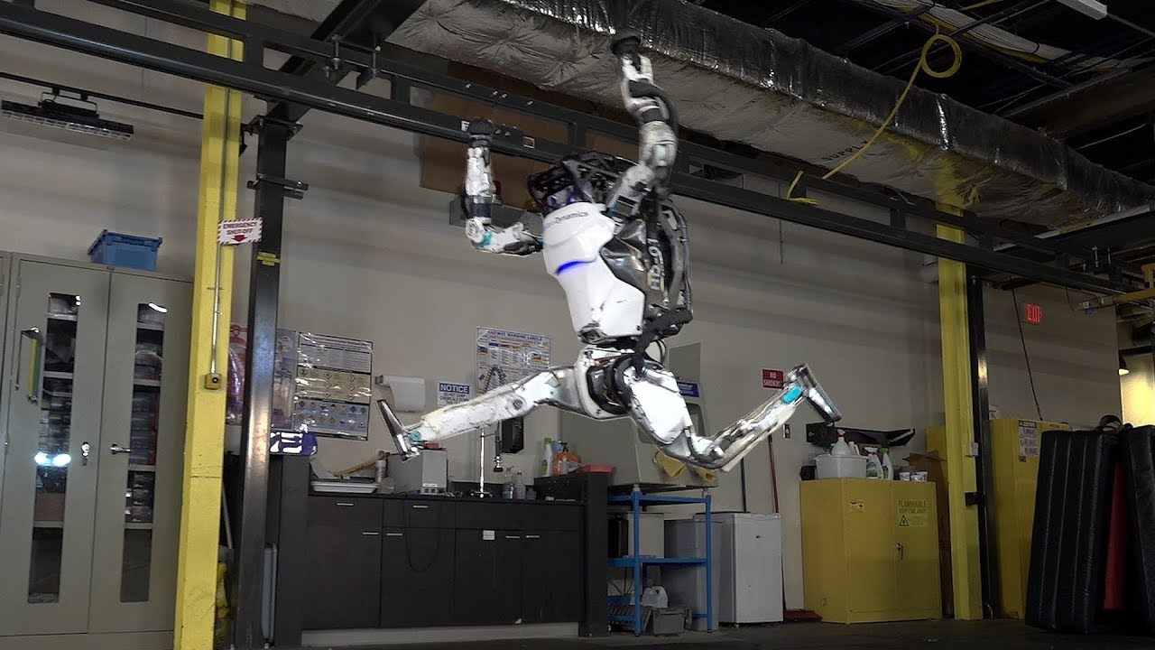
2) How it is used nowadays ?
Self-learning robots
This robot dog has an AI brain and taught itself to walk in just an hour, University of California, Berkeley
Atlas robot (Boston Dynamics) performing a sequence of dynamic maneuvers that form a gymnastic routine
6/33

Slide 8
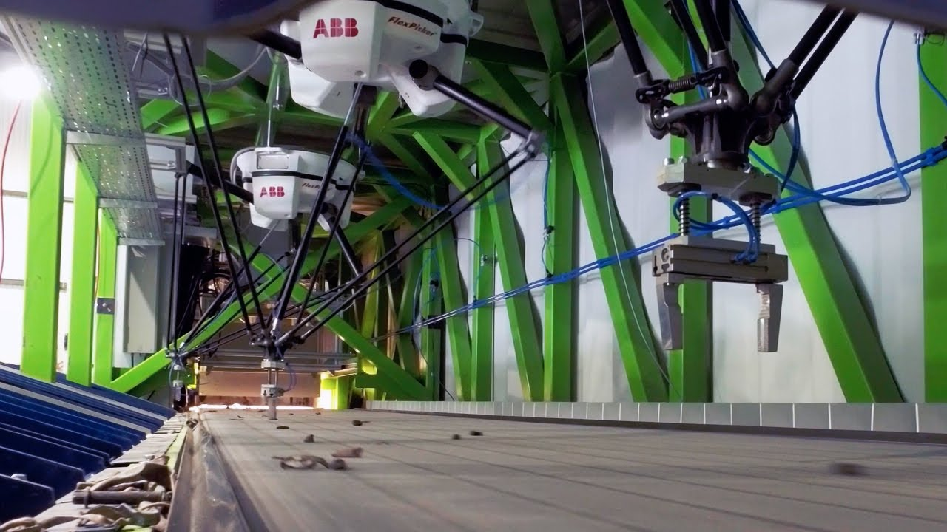
2) How it is used nowadays ?
Automatic detection of fruits/vegetables …... and metal waste !
AI camera recognizes more than 120 fruits and vegetables with a 97% precision (Robovision)
In …. Courtrai/Kortrijk, Belgium !!!
World first: metals sorted by robots. GeMMe laboratory (Faculty of Applied Sciences at ULIEGE) & Citius engineering & COMET Group
7/33

Slide 9
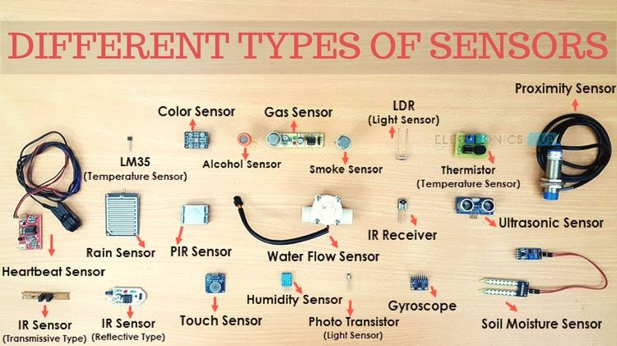
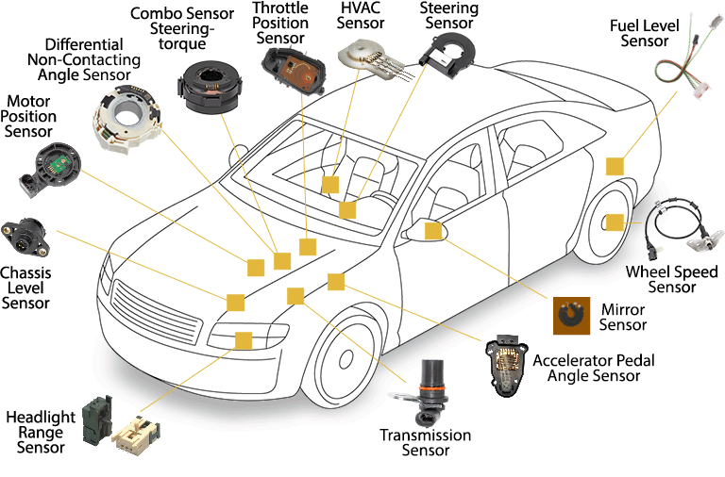
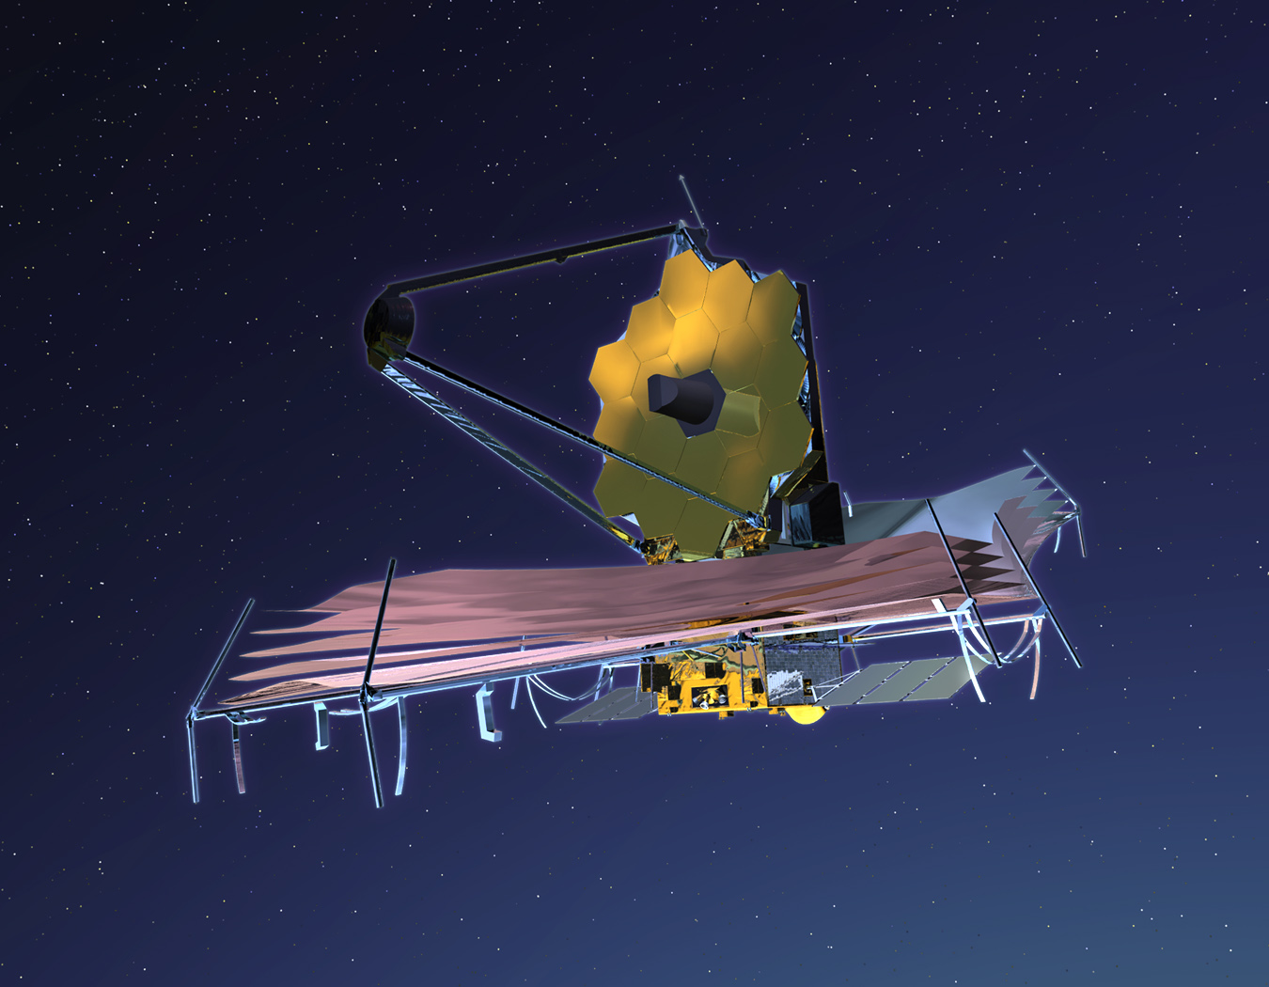
3) Why it will become vital in the future
Sensors are everywhere, data keep growing !
8/33

Slide 10
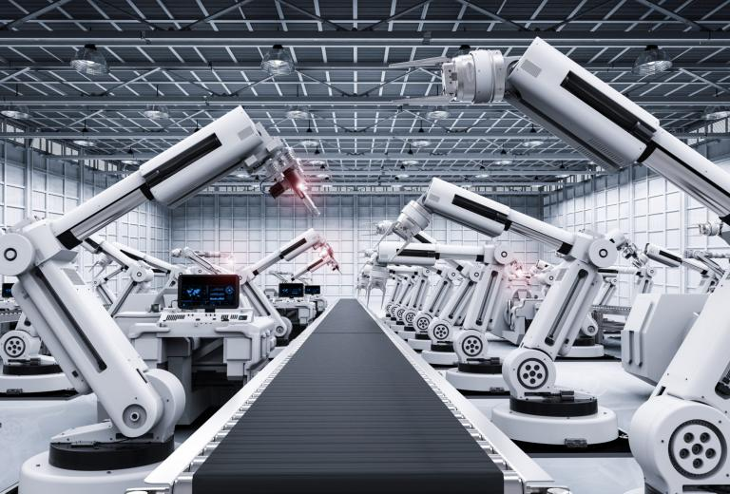
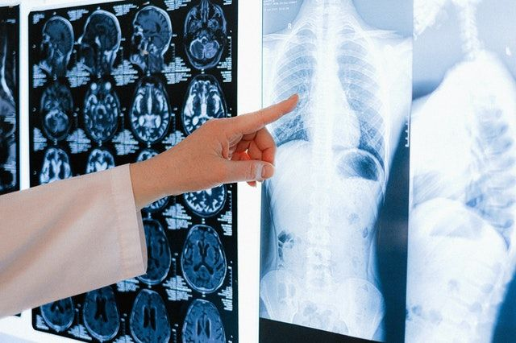
3) Why it will become vital in the future
Performance achieved by AI in many domains is now state-of-the-art
Drug discovery
Netflix
Manufacturing
Medical diagnosis
Security Camera
9/33

Slide 11
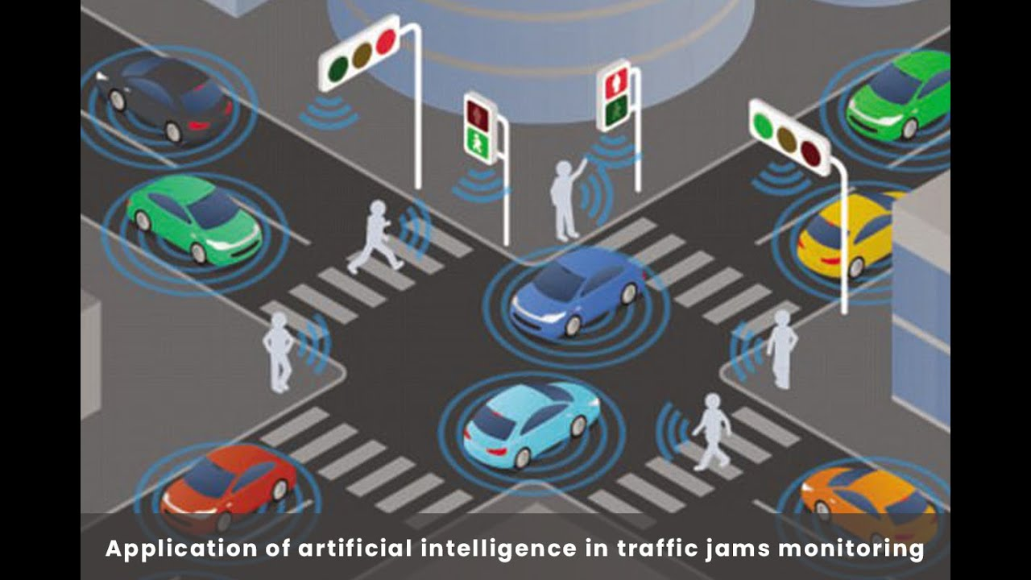
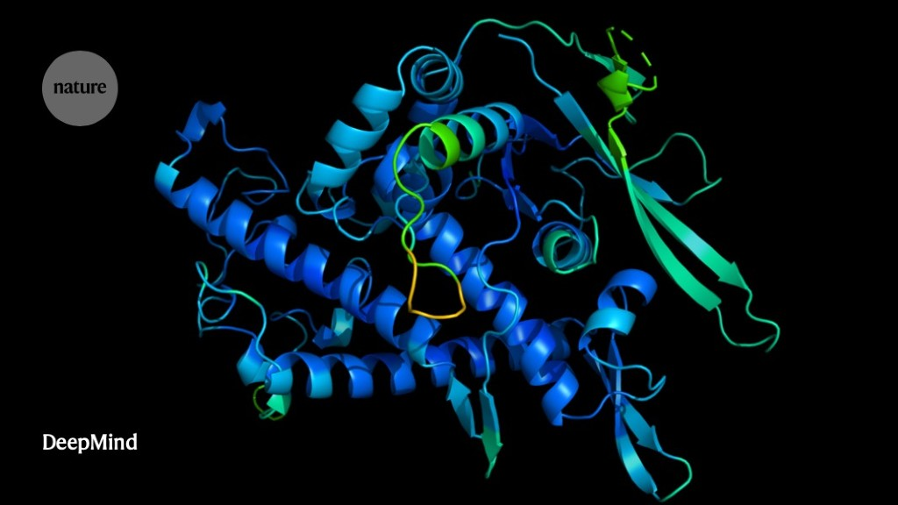
3) Why it will become vital in the future
Some problems have found a new solution
Rapid fraud detection
Automatic translation
Traffic management
Protein folding
Books digitalization
10/33

Slide 12
4) Objectives of this course
This course is only an introduction but you should be able to...
- understand most of the key words/jargon of ML and DL
- be able to criticize papers in your field where deep learning is used
- understand problems that can happen during NN training
- create and train basic networks (both on tabular data, time series and images)
11/33

Slide 13
4) Objectives of this course
GradCAM
The deep learning jargon...
Batch size
Overfitting >< underfitting
Convolution layers
Pooling
Vanishing gradients
Loss function
Activation function
Transfer learning
RNN
Learning rate
Normalization
Optimizer
Transposed convolution
Backpropagation
Gradient descent
Fully-connected
ReLU
YOLO
Initialization
12/33

Slide 14
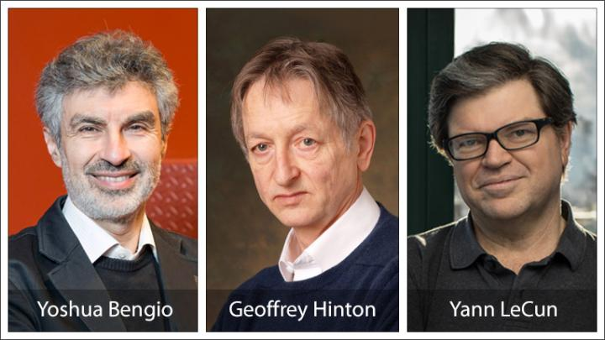
4) Objectives of this course
My pyramid of deep learning levels....
GOD
Experts
Advanced
Amateurs
Fanatics
General public
Create new architecture, rethink basic principles (Google, Microsoft, …)
Can manipulate neural networks and adapt them to their need
Understand basic concepts and can implement simple neural networks
Black box doing amazing things
Terminator, iRobot, self-driving cars, ...
13/33

Slide 15
4) Objectives of this course
My pyramid of deep learning levels....
GOD
Experts
Advanced
Amateurs
Fanatics
General public
Create new architecture, rethink basic principles (Google, Microsoft, …)
Can manipulate neural networks and adapt them to their need
Understand basic concepts and can implement simple neural networks
You can reach this level !
Black box doing amazing things
Terminator, iRobot, self-driving cars, ...
13/33

Slide 16
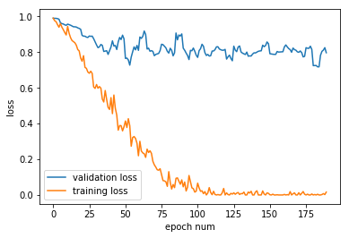
4) Objectives of this course
You will be able to do AND understand...
GoogLeNet (Google Brain team)
14/33

Slide 17
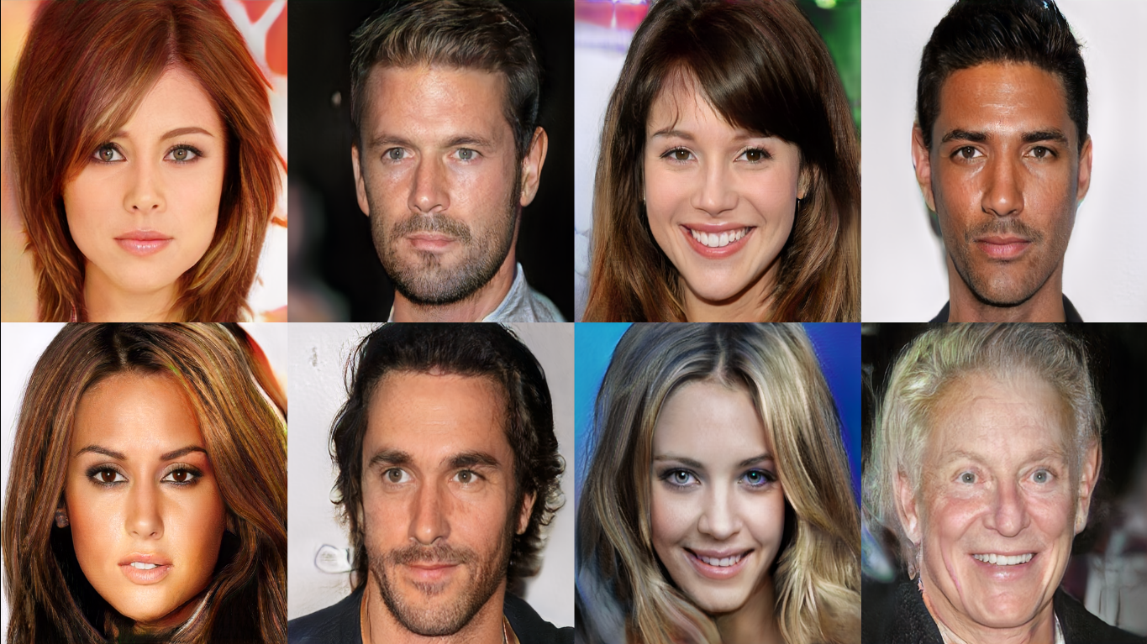
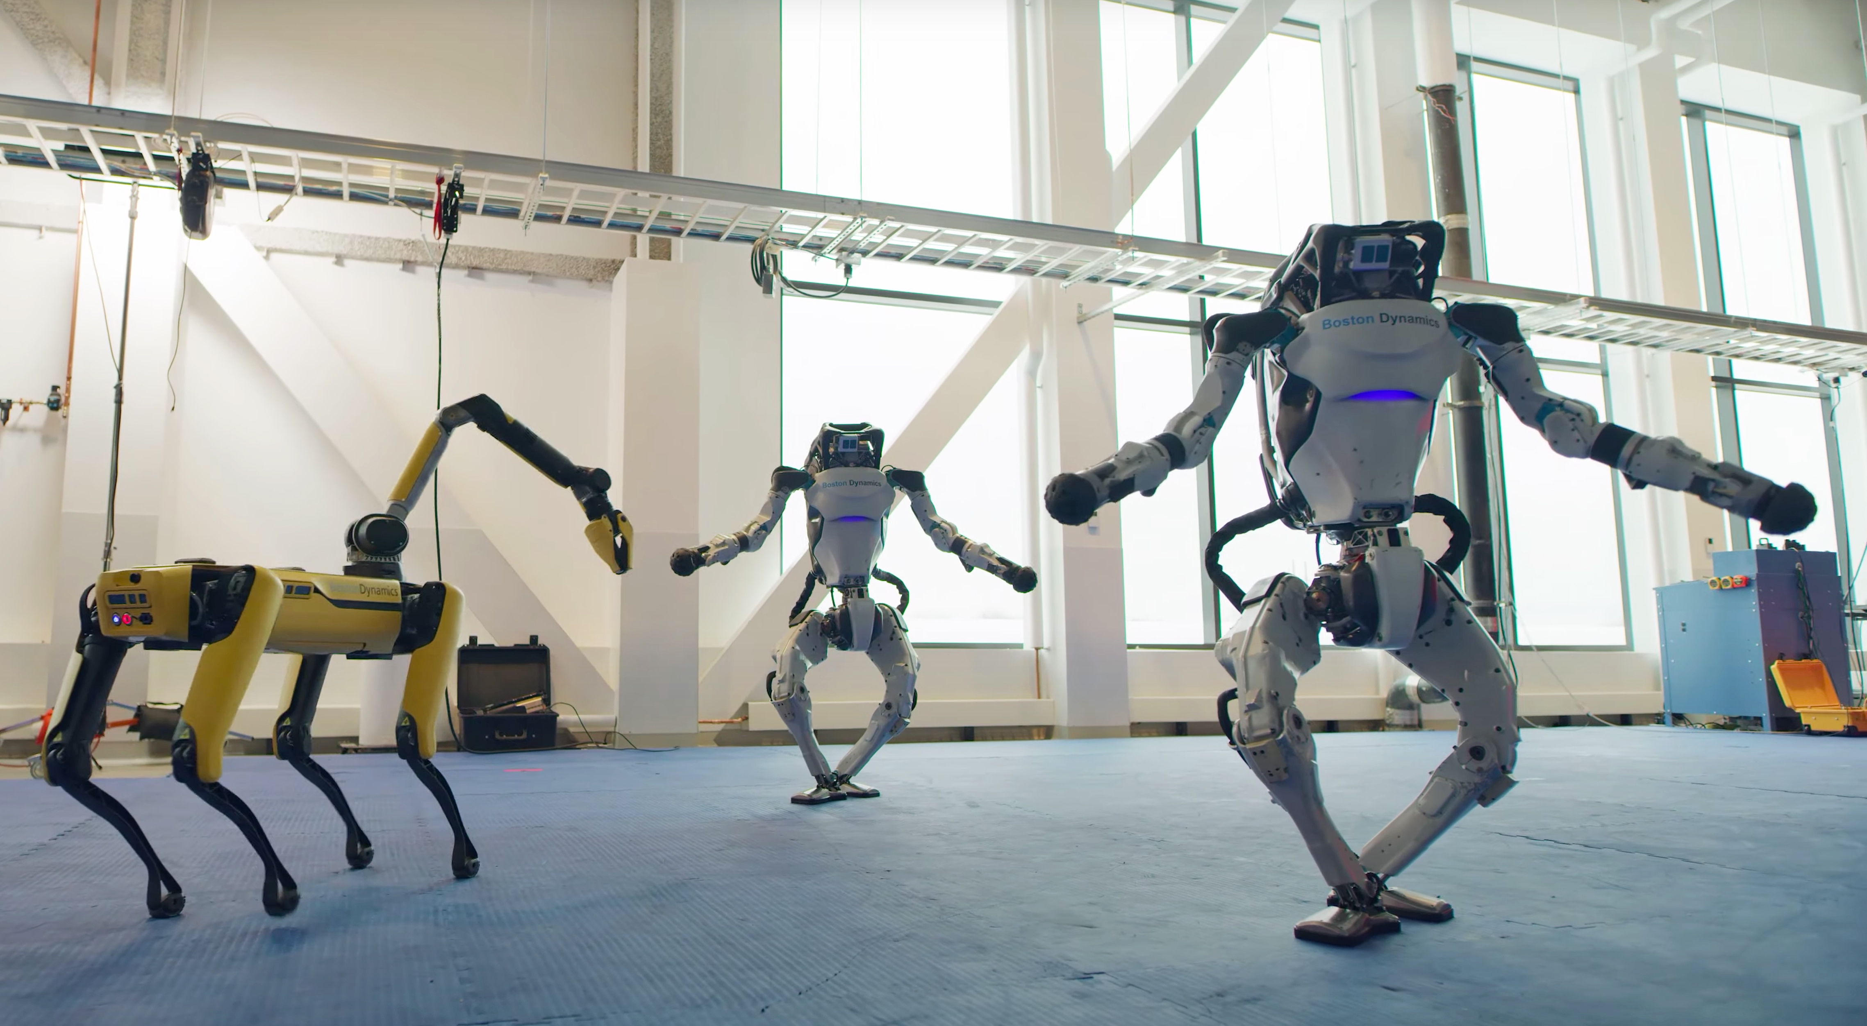
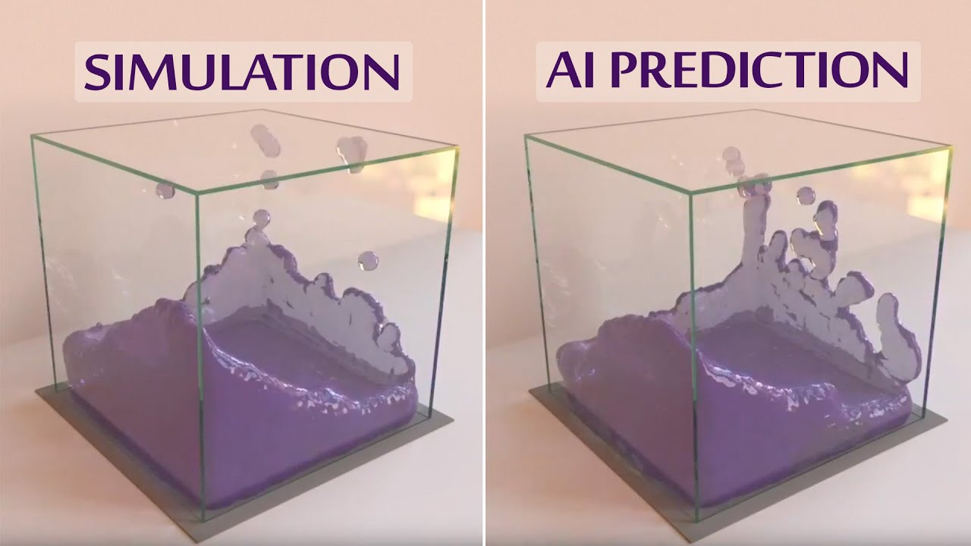
4) Objectives of this course
You will NOT be able to do this...
Robot dancing (Boston dynamics)
Faces created by using ProGAN.
These people do not exist.
Simulate and find laws of physics (Google DeepMind, 2min55)
15/33

Slide 18
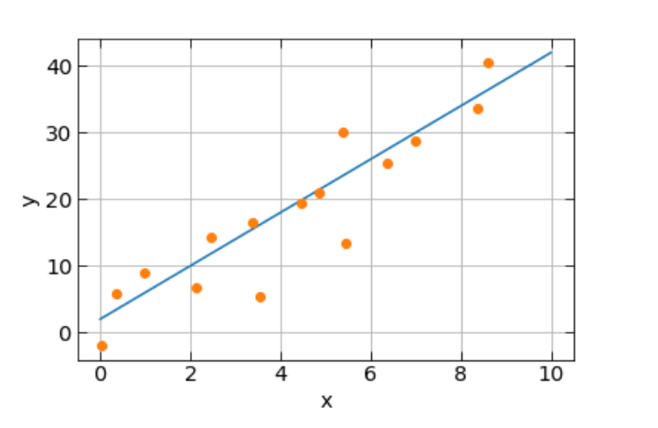
5) From linear regression to neural network
5.1) Definition of the problem
5.2) Adding complexity
5.3) Towards MLP
Let us settle a very simple problem: linear regression
- You have N data points with coordinates (x,y)
- You want to fit a line to these data
- AND predict new y for new x coordinates
Model : y = w*x + b
Parameters : w and b
To find the best w and b, we need a mathematical expression to assess how close is our model with respect to the existing data :
Graph taken from Grégory Baltus thesis
16/33

Slide 19
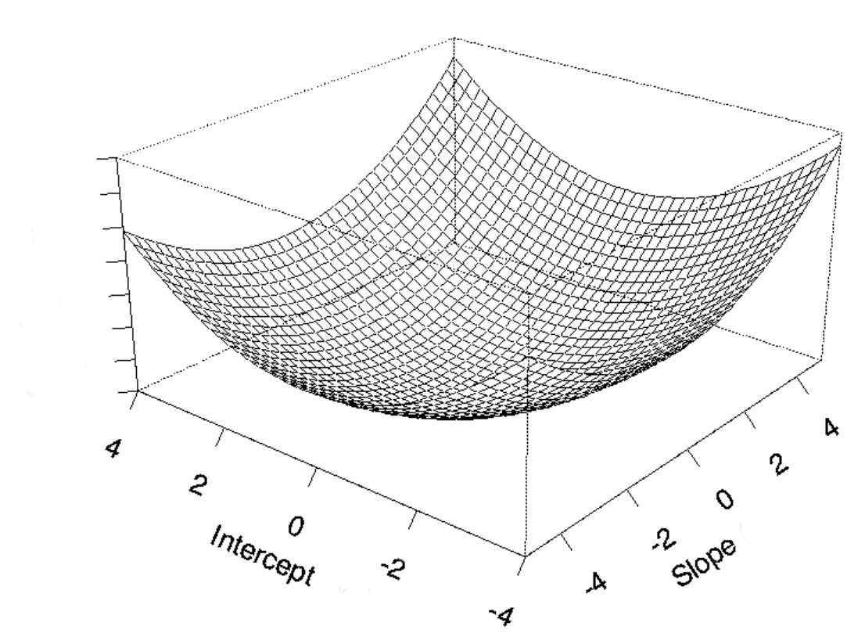
5) From linear regression to neural network
5.1) Definition of the problem
5.2) Adding complexity
5.3) Towards MLP
The problem becomes an optimization problem !
- find w and b such that is minimal.
We can solve this problem with a 3D graph
- Out of any possible combination of w and b, only 1
gives the minimum of the function.
- Local minimum = global minimum
- This is the ordinary least square regression for which
analytical solutions exist (for polynomial regression)
17/33

Slide 20
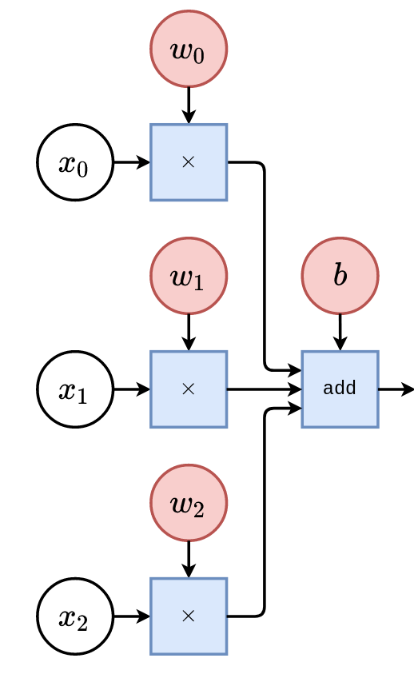
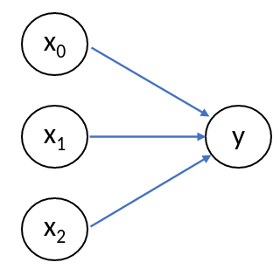
5) From linear regression to neural network
5.1) Definition of the problem
5.2) Adding complexity
5.3) Towards MLP
Let us rewrite our problem... with some adaptations
- You now have N data points with coordinates (x₀, x₁, x₂, y)
- You want to predict new y from new (x₀, x₁, x₂) couples
Let us write our model :
The graph can be summarized as :
y
Adapted from Louppe, G. Deep Learning
18/33

Slide 21
5) From linear regression to neural network
5.1) Definition of the problem
5.2) Adding complexity
5.3) Towards MLP
Let us rewrite our problem... with some adaptations
- You now have N data points with coordinates (x₀, x₁, x₂, y₀, y₁, y₂)
- You want to predict new (y₀, y₁, y₂) from new (x₀, x₁, x₂) couples
- Every y might need the input from all x (namely x₀, x₁ and x₂)
The model becomes :
- fully linear
- some inputs (x) might be useless for some outputs (y)
(e.g. y₂ depends only on x₀ and x₂)
How can we learn more complex relation between the data ?
x₀
y₀
x₁
y₁
x₂
y₂
19/33

Slide 22
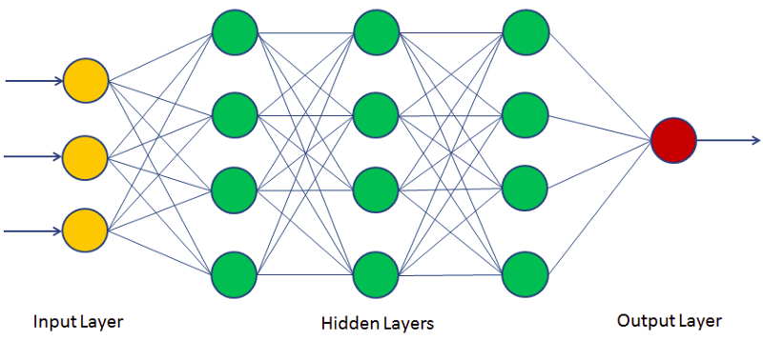
5) From linear regression to neural network
5.1) Definition of the problem
5.2) Adding complexity
5.3) Towards MLP
How can we learn more complex relation between the data ?
First guess : add more layers ?
composition of linear functions = linear function
20/33

Slide 23
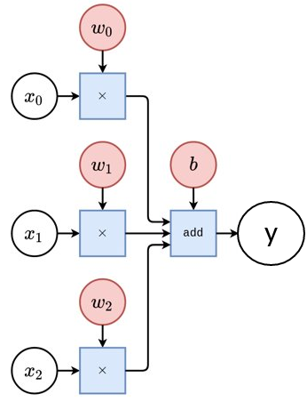
5) From linear regression to neural network
5.1) Definition of the problem
5.2) Adding complexity
5.3) Towards MLP
How can we learn more complex relation between the data ?
Second guess : use polynomial models
- Replace the simple linear regression with higher order models
Two problems :
- require some knowledge of the solution
- computationally more expensive
Adapted from Louppe, G. Deep Learning
21/33

Slide 24
5) From linear regression to neural network
5.1) Definition of the problem
5.2) Adding complexity
5.3) Towards MLP
How can we learn more complex relation between the data ?
Third guess : add some non-linearities
Where ?
Easy answer : at the output
- we keep a simple linear relation
- and add non-linearity at the end
This non-linear function is called an activation function
Adapted from Louppe, G. Deep Learning
22/33

Slide 25
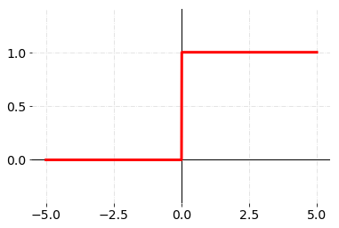
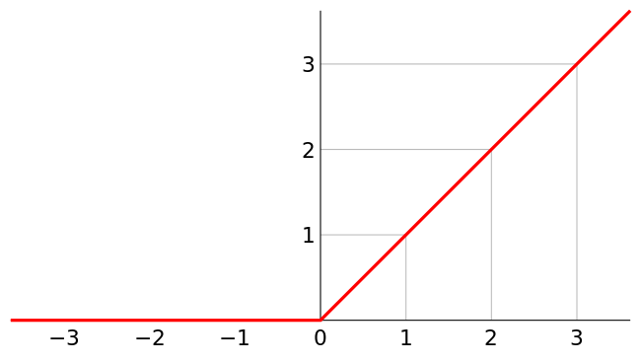
5) From linear regression to neural network
5.1) Definition of the problem
5.2) Adding complexity
5.3) Towards MLP
Simplest activation function
These simple functions, added to a linear model, can lead to impressive results !
Step function
Rectified Linear Unit (ReLU)
23/33

Slide 26
5) From linear regression to neural network
5.1) Definition of the problem
5.2) Adding complexity
5.3) Towards MLP
The unit we have built is the basic mathematical formulation of a neuron
The activation function allows to cancel the contribution from some neurons
Information is sometimes not relevant
24/33

Slide 27
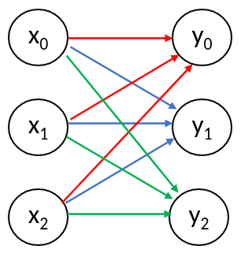
5) From linear regression to neural network
5.1) Definition of the problem
5.2) Adding complexity
5.3) Towards MLP
Even if our model is better than the multilinear model, it still cannot handle the underlying complexity of the relationship between inputs and output
- Let us consider the output of our model as intermediate features
- We can repeat this pattern and build new layers, with different weights (and activation ?)
25/33

Slide 28
5) From linear regression to neural network
5.1) Definition of the problem
5.2) Adding complexity
5.3) Towards MLP
We have built our first neural network, called the multi-layer perceptron (MLP)
It is made up of :
- simple model to tune
- non-linearities
- multiple layers (fully-connected or
linear layers)
Disclaimer 1 : all the neural networks do not fit the template described above
Disclaimer 2 : once defined, the model still need to be fitted (optimization)
26/33

Slide 29
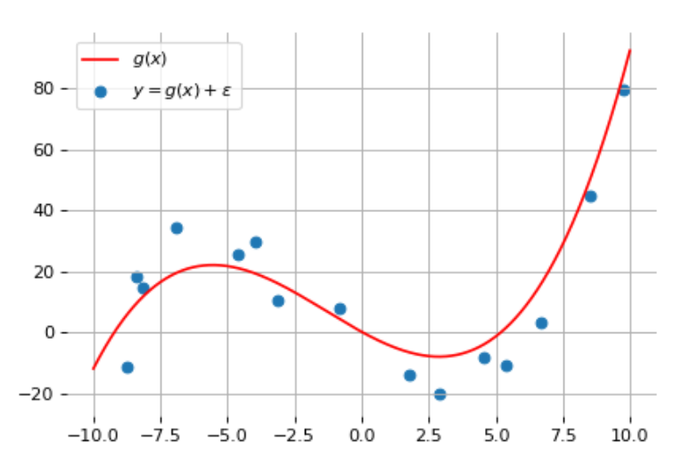
6) Analogy with the polynomial regression
Let us consider a set of points that you want to fit with a polynomial
- you don’t know the exact relation between the data
- you decide to go for "trial and error" and solve the least
square regression with a polynomial of degree d
- your final choice is based on the total error
Taken from Louppe, G. Deep Learning
27/33

Slide 30
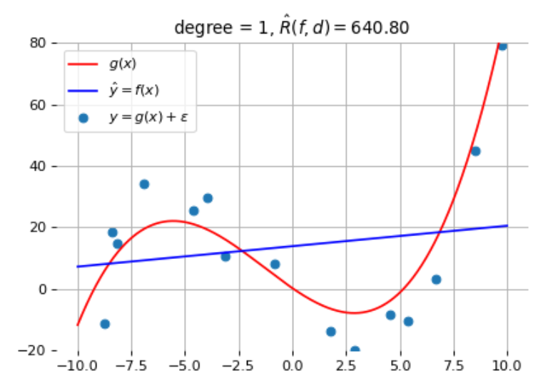
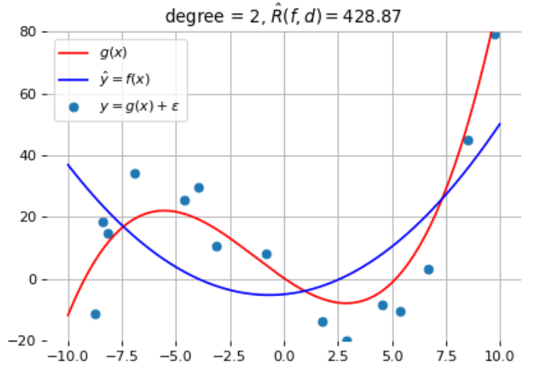
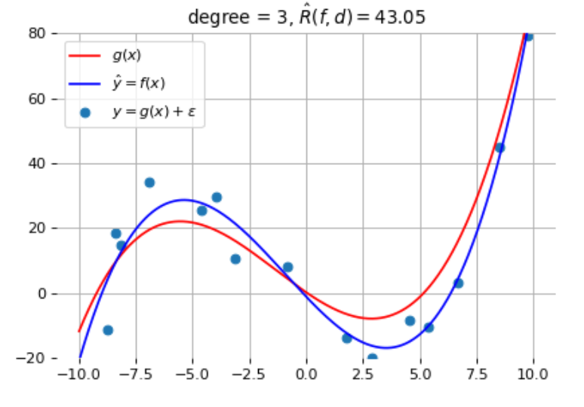
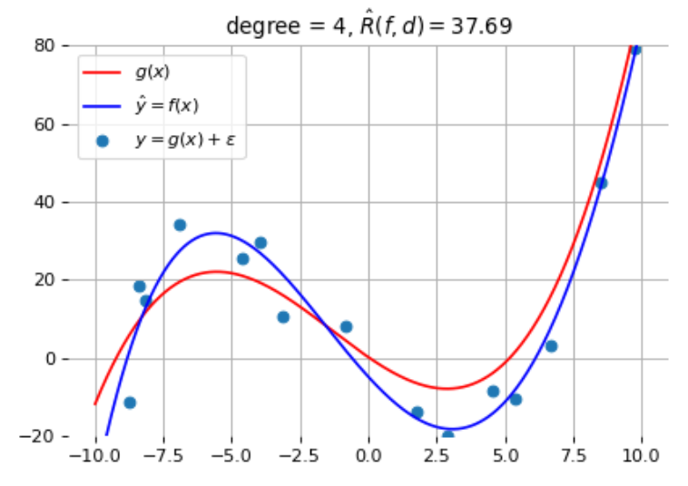
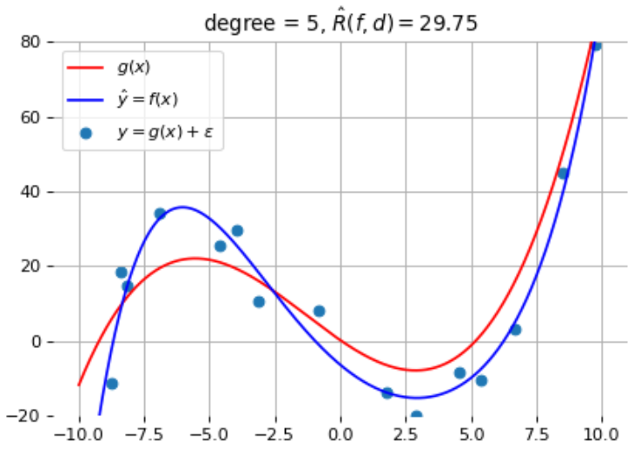
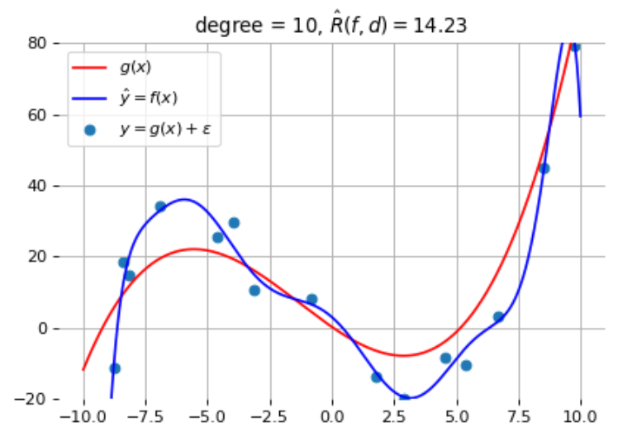
6) Analogy with the polynomial regression
Fit and total error for some polynomial degrees
Taken from Louppe, G. Deep Learning
28/33

Slide 31
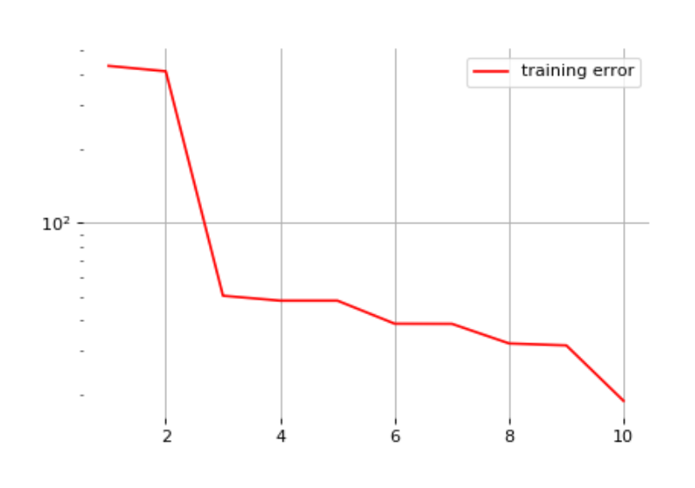
6) Analogy with the polynomial regression
The best solution seems achieved when d=10
Total error
Taken from Louppe, G. Deep Learning
Degree of the polynomial
29/33

Slide 32
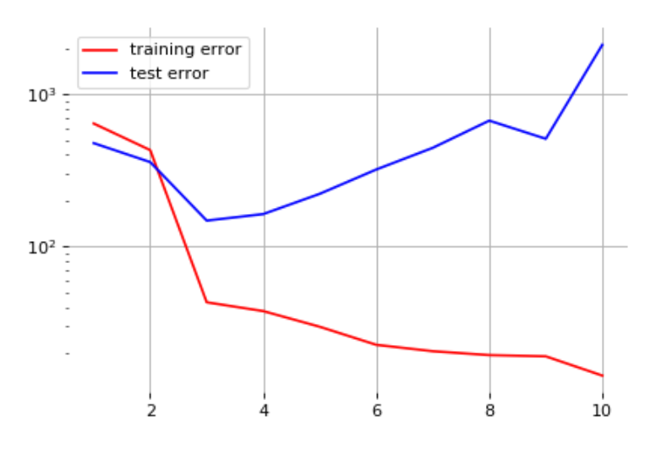
6) Analogy with the polynomial regression
But when you add data points that were left aside...
Total error
Taken from Louppe, G. Deep Learning
Degree of the polynomial
30/33

Slide 33
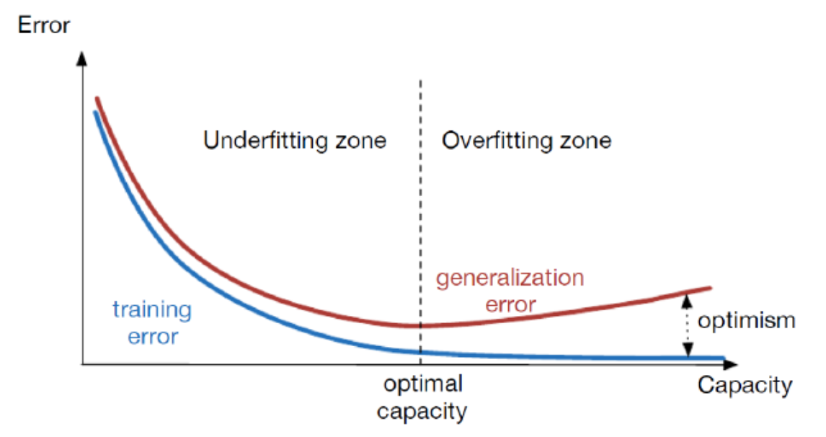
6) Analogy with the polynomial regression
Capacity is the ability to find a good model
- polynomial regression : degree d
- neural network : number of layers, number of training steps, regularization terms, ...
Underfitting >< overfitting
Separate training and testing data
31/33

Slide 34
6) Analogy with the polynomial regression
You always have to test your model ONCE the training is completed
- this will help you to understand
what your network is doing
- you will learn how to interpret both
training and testing curves
32/33

Slide 35
The deep learning jargon...
GradCAM
Batch size
Overfitting >< underfitting
Convolution layers
Pooling
Vanishing gradients
Loss function
Activation function
Transfer learning
RNN
Learning rate
Normalization
Optimizer
Transposed convolution
Backpropagation
Gradient descent
Fully-connected
ReLU
YOLO
Initialization
33/33

Slide 36
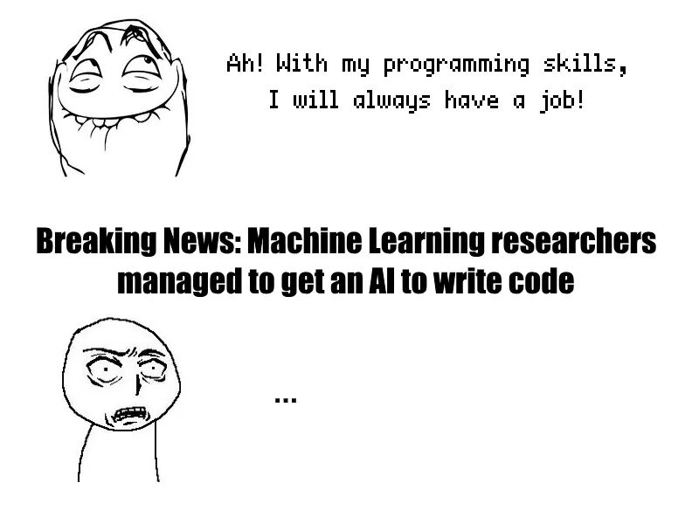
Course 1 : The end
Vincent Boudart, PhD student
vboudart@uliege.be

Slide 37
Deep Learning
Introduction & Basics
Vincent Boudart
PhD student

Slide 38
Course 2 : Table of contents
1) How neural networks learn ?
1.1) Gradient descent
1.2) Backpropagation
2) A word about activation functions
3) How to train neural networks ?
3.1) Optimizers
3.2) Initialization
3.3) Normalization
4) How to choose the loss function ?
4.1) Regression or classification ?
4.2) Interpretation of the loss
1/47

Slide 39
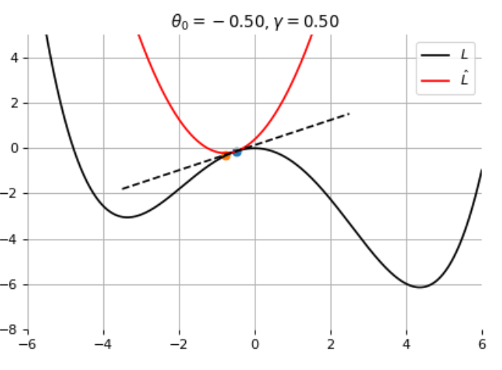
1) How neural networks learn ?
1.1) Gradient descent
1.2) Backpropagation
The learning phase of a neural network is an iterative process based on gradient descent
Let us consider a loss function defined over model parameters
- We will use the local information to iteratively find the minimum
- Let us define a starting point
- For a small perturbation of this starting point, the loss can
be written :
where is a constant that has been added
Taken from Louppe, G. Deep Learning
2/47

Slide 40
1) How neural networks learn ?
1.1) Gradient descent
1.2) Backpropagation
The learning phase of a neural network is an iterative process based on gradient descent
To minimize the loss approximation, one has to solve :
which happens when
By repeating this "small step" process, the update rule for the model parameters is thus :
3/47

Slide 41
1) How neural networks learn ?
1.1) Gradient descent
1.2) Backpropagation
The learning phase of a neural network is an iterative process based on gradient descent
We know how to update model parameters iteratively :
- are the initial parameters of the model
- is called the learning rate
Both parameters are critical for the convergence of
the update rule !
Taken from Louppe, G. Deep Learning
4/47

Slide 42
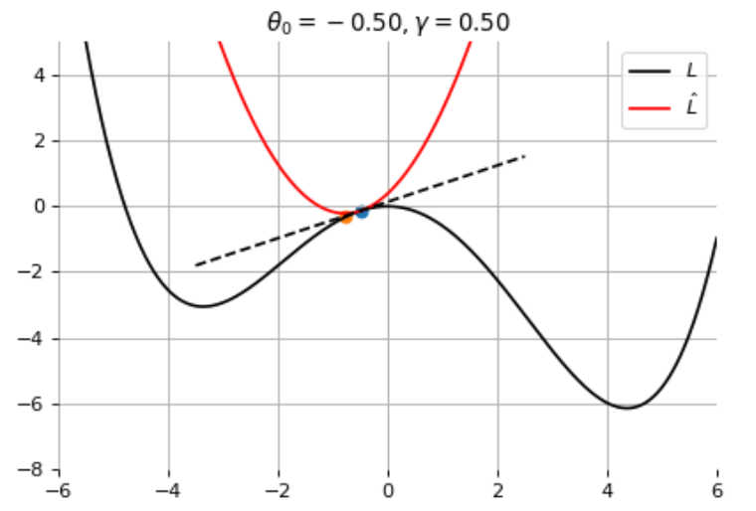
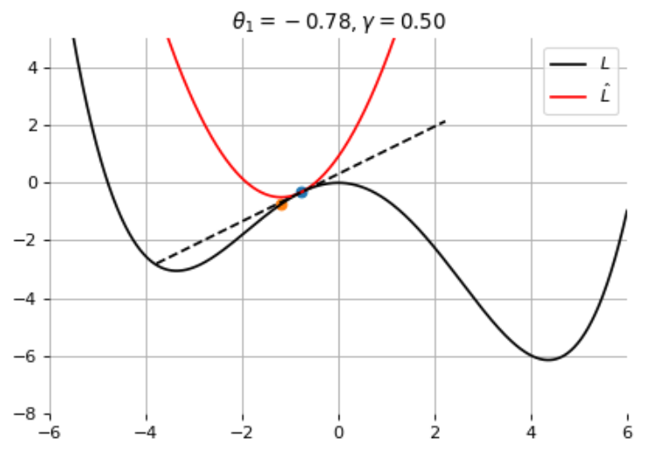
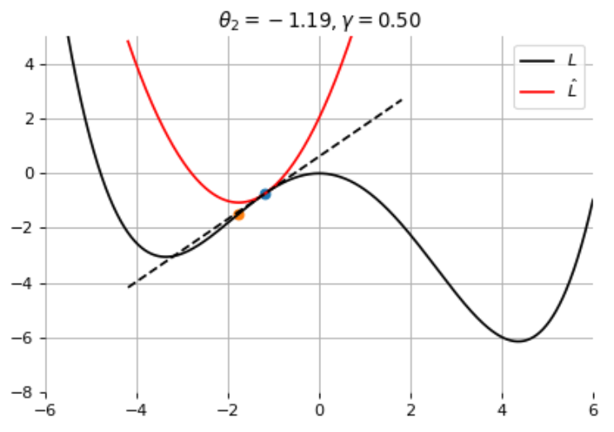
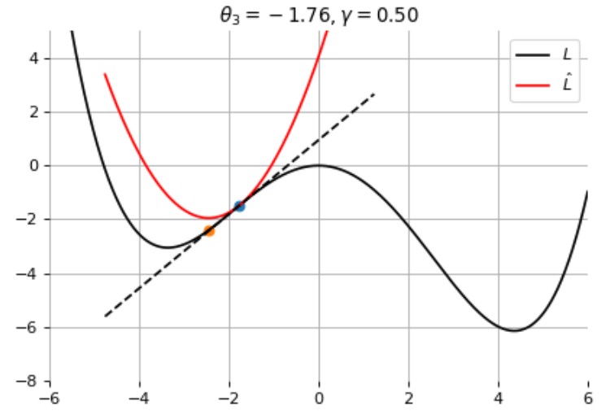
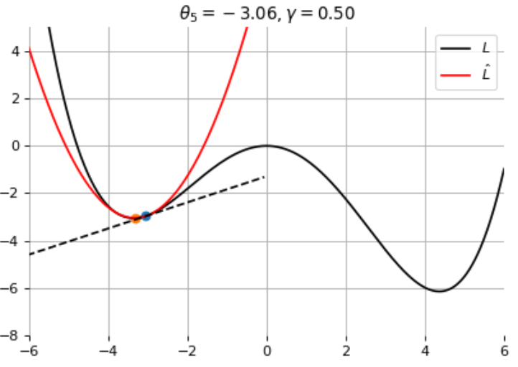
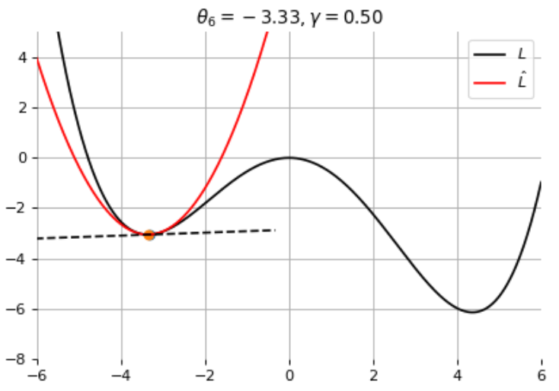
1) How neural networks learn ?
1.1) Gradient descent
1.2) Backpropagation
The learning phase of a neural network is an iterative process based on gradient descent
When the learning rate has the right value :
Taken from Louppe, G. Deep Learning
5/47

Slide 43
1) How neural networks learn ?
1.1) Gradient descent
1.2) Backpropagation
The learning phase of a neural network is an iterative process based on gradient descent
When the learning rate is too high :
Taken from Louppe, G. Deep Learning
6/47

Slide 44
1) How neural networks learn ?
1.1) Gradient descent
1.2) Backpropagation
The learning phase of a neural network is an iterative process based on gradient descent
How do we know if the feedback from the gradients is accurate ?
- training a NN means finding the minimum of your loss function over your data
Ideal solution : compute the loss over all the samples in the training set
In practice you have thousands/millions of samples, leading to memory overload !
- Solution 1 : evaluate the loss over every single sample : stochastic gradient descent
- Solution 2 : evaluate the loss over a small subset : mini-batch gradient descent
7/47

Slide 45
1) How neural networks learn ?
1.1) Gradient descent
1.2) Backpropagation
The learning phase of a neural network is an iterative process based on gradient descent
Comparison between stochastic and mini-batch gradient descent
Batch GD
- impracticable
Stochastic GD
- computationally cheap
- costly in time
Mini-batch GD
- computationally heavier
- faster
8/47

Slide 46
1) How neural networks learn ?
1.1) Gradient descent
1.2) Backpropagation
The learning phase of a neural network is an iterative process based on gradient descent
We will use mini-batch gradient descent as a good compromise
At this point, we know how to update the model parameters
How do we evaluate the gradients ?
- gradient for one parameter :
- gradient for multiple parameters :
9/47

Slide 47
1) How neural networks learn ?
1.1) Gradient descent
1.2) Backpropagation
The procedure to evaluate partial derivatives in a NN is called backpropagation
To introduce this concept, let us define a very simple NN with 2 hidden layers
Let us define the forward pass
- First layer :
- Second and third layer :
10/47

Slide 48
1) How neural networks learn ?
1.1) Gradient descent
1.2) Backpropagation
The procedure to evaluate partial derivatives in a NN is called backpropagation
The forward pass expressions and matrices :
Total : 16 parameters
11/47

Slide 49
1) How neural networks learn ?
1.1) Gradient descent
1.2) Backpropagation
The procedure to evaluate partial derivatives in a NN is called backpropagation
Let us try to evaluate the partial derivative of the loss with respect to one parameter
- The chain rule of partial derivatives
- A neural network is a composition of very simple functions !
12/47

Slide 50
1) How neural networks learn ?
1.1) Gradient descent
1.2) Backpropagation
The procedure to evaluate partial derivatives in a NN is called backpropagation
Let us try to evaluate
easy to compute
known
depends on the loss function
known
13/47

Slide 51
1) How neural networks learn ?
1.1) Gradient descent
1.2) Backpropagation
Gradient descent and backpropagation are the core of deep learning algorithms
What have we learned ?
- Backpropagation is cheap since we know some of the terms thanks to the forward pass !
- The other terms are easy to compute if we choose activation and loss functions adequately
- The weights cannot be initialized to zero
What is left ?
- How to choose the loss function ?
- How to initialize the weights ?
14/47

Slide 52
1) How neural networks learn ?
1.1) Gradient descent
1.2) Backpropagation
Let us have a look at the values of the different terms
- sigmoid as the activation function
- weights are initialized randomly from a Gaussian
Gradients shrink to zero as the number of layers grows !
vanishing gradient problem
-1 ≤ w ≤ 1
≤ 0.25
≤ 1
15/47

Slide 53
2) A word about activation functions
Activation function brings non-linearities to neural networks
- they help constraining the output of neurons
- they influence the network's capacity to learn and converge
To be a good activation function (AF), you need to :
- be efficient : an AF should reduce the computation time
- be differentiable (almost everywhere)
Consequence of backpropagation
This is ok ! In practice, the values never reach exactly zero !
16/47

Slide 54
2) A word about activation functions
Bounded activation functions are prone to vanishing gradient
- That is why the ReLU has been introduced !
- This is a useful property to induce sparsity
- Other activation functions have been proposed to solve sparsity
-1 ≤ w ≤ 1
= 1
= 1
17/47

Slide 55
3) How to train neural networks ?
3.1) Optimizers
3.2) Initialization
3.3) Normalization
Training a NN consists in applying a strategy to update the weights of your NN
Why do we need a strategy ?
Ideal surface
Surface valley
Real surface
18/47

Slide 56
3) How to train neural networks ?
3.1) Optimizers
3.2) Initialization
3.3) Normalization
The learning rate chosen in the beginning of the training might not be adequate later on !
One trick to solve this problem is called momentum
- Momentum adds inertia in the choice of the step direction
- The new variable is called the velocity
Properties :
- It can go through barrier walls
- It accelerates when the gradient does not change much
- It dampens oscillations in narrow valleys
19/47

Slide 57
3) How to train neural networks ?
3.1) Optimizers
3.2) Initialization
3.3) Normalization
Particular case of momentum : Nesterov momentum
- simulate a step in the direction of the velocity, then calculate the gradient and make a correction
20/47

Slide 58
3) How to train neural networks ?
3.1) Optimizers
3.2) Initialization
3.3) Normalization
Particular case of momentum : Nesterov momentum
21/47

Slide 59
3) How to train neural networks ?
3.1) Optimizers
3.2) Initialization
3.3) Normalization
The learning rate chosen in the beginning of the training might not be adequate later on !
Other algorithms implementing momentum-like methods :
Adam
RMSProp
- works well with
- one of the default optimizers in deep learning
- performs better in non-convex problems
- does not grow unboundedly
22/47

Slide 60
3) How to train neural networks ?
3.1) Optimizers
3.2) Initialization
3.3) Normalization
Training a NN consists in applying a strategy to update the weights of your NN
this means adapting the learning rate and implementing momentum
The algorithms that compute the gradients, implement the backpropagation, deal with the learning rate and the momentum are called optimizers
Other methods exist to tune the learning rate,
such as the scheduling :
- consists in reducing the learning rate over time
- can be combined with Adam, RMSProp, ...
23/47

Slide 61
3) How to train neural networks ?
3.1) Optimizers
3.2) Initialization
3.3) Normalization
So far, we have learned how to train a neural network
- gradient descent and backpropagation allows to update the weights
- batch size and learning rate are very important
- choosing the right activation and loss functions is critical
What about the initial values of the weights ?
- we know they cannot be zero
- are there some preferred initialization schemes ?
for convex problems, providing a good learning rate,
convergence is achieved regardless of the initial parameter values
weight's value
24/47

Slide 62
3) How to train neural networks ?
3.1) Optimizers
3.2) Initialization
3.3) Normalization
In practice, most of the problems are non-convex
initial values are important
First strategy : you want the information to flow in your
network without reducing or magnifying the amplitude of the signals
- deeper layers should receive the information
- a way of stating that consists in preserving the same variance across layers !
25/47

Slide 63
3) How to train neural networks ?
3.1) Optimizers
3.2) Initialization
3.3) Normalization
Mathematically, this can be expressed as :
where q_{l} is the width of layer l.
The only way to ensure the same variance across layers is :
This is enforced in LeCun's uniform initialization :
Taken from Louppe, G. Deep Learning
26/47

Slide 64
3) How to train neural networks ?
3.1) Optimizers
3.2) Initialization
3.3) Normalization
Second strategy : you want the gradients to flow in the backward pass without vanishing
- this can be enforced by maintaining the variance of the gradient fixed across layers
Mathematically,
Taken from Louppe, G. Deep Learning
27/47

Slide 65
3) How to train neural networks ?
3.1) Optimizers
3.2) Initialization
3.3) Normalization
The variance of the gradients with respect to the activations is preserved across layers if :
A compromise on the conditions for the forward and backward pass is found in Xavier's initialization, which initializes the weights with a variance :
The normalized Xavier's initialization :
28/47

Slide 66
3) How to train neural networks ?
3.1) Optimizers
3.2) Initialization
3.3) Normalization
How effective is the Xavier's initialization ?
Credits: Glorot and Bengio, Understanding the difficulty of training deep feedforward neural networks, 2010
29/47

Slide 67
3) How to train neural networks ?
3.1) Optimizers
3.2) Initialization
3.3) Normalization
He initialization (He et al., 2015) vs Xavier's initialization
Performs better than Xavier's initialization in some cases
×
30/47

Slide 68
3) How to train neural networks ?
3.1) Optimizers
3.2) Initialization
3.3) Normalization
Previous initialization strategies rely on preserving the variance across layers
- what about the first layer ?
For the first layer, we have assumed that the variances of the input features are the same, that is
31/47

Slide 69
3) How to train neural networks ?
3.1) Optimizers
3.2) Initialization
3.3) Normalization
This constraint is not satisfied in general but can be enforced by normalizing or standardizing the inputs through
with
Before normalization
After normalization
32/47

Slide 70
3) How to train neural networks ?
3.1) Optimizers
3.2) Initialization
3.3) Normalization
Another method to normalize your data is called batch normalization
- let us consider a mini-batch of data, where B is the number of data
- a mean and a variance are estimated across the batch
- These estimates will be used to normalize the output :
Credits: Ioffe and Szegedy, Batch Normalization: Accelerating Deep Network Training by Reducing Internal Covariate Shift, 2015.
33/47

Slide 71
3) How to train neural networks ?
3.1) Optimizers
3.2) Initialization
3.3) Normalization
Where are we so far ?
Mini-Batch
34/47

Slide 72
3) How to train neural networks ?
3.1) Optimizers
3.2) Initialization
3.3) Normalization
Where are we so far ?
Mini-Batch
35/47

Slide 73
4) How to choose the loss function ?
4.1) Regression or classification ?
4.2) Interpretation of the loss
The choice of the loss function is critical
- the best architecture + the best optimizer + the wrong loss = FAIL
- a simple architecture + a random optimizer + the good loss = SUCCESS
Most of the problems can be translated into regression OR classification
36/47

Slide 74
4) How to choose the loss function ?
4.1) Regression or classification ?
4.2) Interpretation of the loss
Regression : involves predicting a value that is continuous in nature (temperature, price, ..)
Mean Squared Error
Mean Absolute Error (L1 loss)
Advantages :
- no local minima
- penalizes large errors
Drawbacks :
- outliers are not handled properly
Advantages :
- outliers are handled better than MSE
Drawbacks :
- computationally expensive
- there may be local minima
Mean Squared Logarithmic Error
Huber loss
Advantages :
- relax the penalties on huge errors
Drawbacks :
- more expensive than MSE
- penalizes more underestimates than overestimates
Advantages :
- outliers handled properly
- no local minima
Drawbacks :
- parameter to tune
- complex
37/47

Slide 75
4) How to choose the loss function ?
4.1) Regression or classification ?
4.2) Interpretation of the loss
Classification : involves predicting a discrete class output
Binary Cross Entropy Loss
BCE with Logits Loss
Notes :
- requires the use of Sigmoid function as the output of your NN
Notes :
- Sigmoid included in the loss (more numerically stable than BCE)
Cross Entropy Loss
Notes :
- requires one-hot encoding of labels
- requires the use of Softmax function as the output of your NN
38/47

Slide 76
4) How to choose the loss function ?
4.1) Regression or classification ?
4.2) Interpretation of the loss
Training a NN is long, complex and sometimes confusing
- You don't want to use brute force and redo the training 20 times
- Need visualization tools meanwhile the NN is being trained !
Plot your loss curves !
Once your model is trained, check the loss curves before testing your network !!!
Workflow :
39/47

Slide 77
4) How to choose the loss function ?
4.1) Regression or classification ?
4.2) Interpretation of the loss
First problem : underfitting/overfitting (Jason Brownlee, 2019)
Problem : flat curve or noisy behavior of with high values
Problem : loss curves can go lower but halted prematurely
Loss
Loss
Epochs
Epochs
Solution(s) :
- add more data
- increase model capacity (more layers, etc..)
Solution(s) :
- add more training steps
- increase the learning rate if the training is too long
40/47

Slide 78
4) How to choose the loss function ?
4.1) Regression or classification ?
4.2) Interpretation of the loss
First problem : underfitting/overfitting (Jason Brownlee, 2019)
Problem : validation curve increases while training curve decreases
Problem : validation curve levels off while training curve decreases
Loss
Loss
Epochs
Epochs
Possible solution(s) :
- reduce model capacity (less layers, etc..)
- reduce the learning rate if NN learns too fast
Possible solution(s) :
- collect more data (in case of memorization)
- change NN architecture
41/47

Slide 79
4) How to choose the loss function ?
4.1) Regression or classification ?
4.2) Interpretation of the loss
Second problem : unrepresentative training/validation dataset (Jason Brownlee, 2019)
Problem : both losses show improvement but a large gap remains
Problem : training loss smoothly decreases while the validation loss oscillates "randomly"
Loss
Loss
Epochs
Epochs
Solution(s) :
- add more samples in the training set
Solution(s) :
- add more samples in the validation set
42/47

Slide 80
4) How to choose the loss function ?
4.1) Regression or classification ?
4.2) Interpretation of the loss
Third problem : too large momentum
Problem : Training loss is increasing after some iterations!
Momentum
Direction
Momentum
Direction
Loss
Gradient
Gradient
Iterations
Possible solution(s) :
- use scheduling to reduce the learning rate or change the optimizer
- use another loss function (if possible)
43/47

Slide 81
4) How to choose the loss function ?
4.1) Regression or classification ?
4.2) Interpretation of the loss
Comment : the (mini-)batch size is closely related to the learning rate
Identical learning rate, different batch sizes
Batch size : 64
Batch size : 256
Batch size : 1024
Naïve conclusion : increasing the batch size leads to worst results
44/47

Slide 82
4) How to choose the loss function ?
4.1) Regression or classification ?
4.2) Interpretation of the loss
Comment : the (mini-)batch size is closely related to the learning rate
Identical learning rate, different batch sizes
Different batch sizes AND learning rates
Batch size : 64
Batch size : 256
Batch size : 1024
Batch size : 64 | Learning rate : 0.01
Batch size : 1024 | Learning rate : 0.1
Batch size : 1024 | Learning rate : 0.01
Naïve conclusion : increasing the batch size leads to worst results
Correct conclusion : batch size and learning rate have to be adapted together !
45/47

Slide 83
4) How to choose the loss function ?
4.1) Regression or classification ?
4.2) Interpretation of the loss
Most of the problems can be solved by simply looking at the loss curves !
- the examples shown should serve as a general rule
- depending on your architecture, lots of other things can go wrong
You will not get it immediately
- understanding loss curves take time
- … and failures !
From "Amateurs" to "Advanced" :
- interpreting loss curves + adapting your NN training
- be comfortable with other architectures
GOD
Experts
Advanced
Amateurs
Fanatics
General public
46/47

Slide 84
The deep learning jargon...
GradCAM
Batch size
Overfitting >< underfitting
Convolution layers
Pooling
Vanishing gradients
Loss function
Activation function
Transfer learning
RNN
Learning rate
Normalization
Optimizer
Transposed convolution
Backpropagation
Gradient descent
Fully-connected
ReLU
YOLO
Initialization
47/47

Slide 85
Course 2 : The end
Vincent Boudart, PhD student
vboudart@uliege.be

Slide 86
Deep Learning
Introduction & Basics
Vincent Boudart
PhD student

Slide 87
Course 3 : Table of contents
1) Why convolutional neural networks ?
2) How to build a CNN ?
2.1) Parameters of a convolution
2.2) Ingredients of a CNN
2.3) How it really works
3) Going further with convolutions
3.1) Skip connections
3.2) Transposed convolutions
3.3) Upsampling
3.4) Dropout
4) Tips and tricks to train NN better
4.1) Data augmentation
4.2) Transfer learning
5) More advanced networks
5.1) Advanced convolutions
5.2) GANs and autoencoders
5.3) Transformers
5.4) Recurrent networks
1/47

Slide 88
1) Why convolutional neural networks ?
For the moment, we know how to process tabular data with the multi-layer perceptron
In lots of domains, data are much different than values in a table
Security Camera
Telescopes
Medical diagnosis
2/47

Slide 89
1) Why convolutional neural networks ?
Can you process images with the multi-layer perceptron ?
Let us consider Hubble images captured via the Advanced Camera for Surveys (ACS)
- High Resolution Channel : 1000 pixels square images
- Wide Field Channel : 4000 pixels square image
You can flatten the images to get 1 dimensional data
millions of pixels leads to billions of parameters to train
(Might be ok for small images)
3/47

Slide 90
1) Why convolutional neural networks ?
Why MLP is not a good idea to process images ?
Do we really need to connect all the pixels together ?
- No, resource consuming
How can you be sure your MLP detects what you want ?
- No visual information, even in the intermediate layers
4/47

Slide 91
1) Why convolutional neural networks ?
What conditions should we fulfill ?
- locality : only look in a small region around the pixel of interest
- invariance to translation : should recognize objects everywhere in the image
- feature hierarchy : should be composed of layers learning features at different scales
What can we use to satisfy these conditions ?
- In computer vision, lots of tools make use of kernels
- edge detection, blurring and sharpening operators, template matching, ...
Kernels are linear operators convolved with the input image
Convolution
5/47

Slide 92
1) Why convolutional neural networks ?
A convolution layer applies the same linear transformation locally everywhere
Convolutions generalize easily to N dimensions through multi-dimensions tensors
- for a 3D kernel u, it slides across the input image along its height h and width w
- the size h x w is the size of the receptive field
Taken from : Francois Fleuret, EE559 Deep Learning, EPFL
6/47

Slide 93
1) Why convolutional neural networks ?
Convolutions generalize easily to N dimensions through multi-dimensions tensors
- for a 3D kernel u, it slides across the input image along its height h and width w
- the size h x w is the size of the receptive field
Taken from : Francois Fleuret, EE559 Deep Learning, EPFL
7/47

Slide 94
1) Why convolutional neural networks ?
Convolutions are great BUT do gradient descent and backpropagation still work ?
- Example of a very simple convolution :
Let us write the convolution operation as a single matrix multiplication :
- For this, we can flatten the input :
- The kernel u can be expressed as :
8/47

Slide 95
1) Why convolutional neural networks ?
Convolutions are great BUT do gradient descent and backpropagation still work ?
- The matrix multiplication gives :
A convolution layer is just a special case of a fully connected layer :
9/47

Slide 96
2) How to build a CNN ?
2.1) Parameters of a convolution
2.2) Ingredients of a CNN
2.3) How it really works
Convolutions allow to process images with less parameters than fully-connected layers
Gradient descent and backpropagation still work
We can use convolutions in a neural network !
Can we adjust the convolution operation ?
What are the ingredients needed to build a CNN ?
How do the layers interact with each other ?
10/47

Slide 97
2) How to build a CNN ?
2.1) Parameters of a convolution
2.2) Ingredients of a CNN
2.3) How it really works
Can we adjust the convolution operation ?
- convolution is a linear combination of values from the input
- the kernel size is not the only parameter we can tune
The padding specifies the size of a zeroed frame added around the input
- Padding is useful to control the spatial
dimension of the output map, for example to
keep it constant across layers
Taken from : Dumoulin and Visin, 2016.
11/47

Slide 98
2) How to build a CNN ?
2.1) Parameters of a convolution
2.2) Ingredients of a CNN
2.3) How it really works
Can we adjust the convolution operation ?
- convolution is a linear combination of values from the input
- the kernel size is not the only parameter we can tune
The stride specifies a step size when moving the kernel across the signal
- Stride is useful to reduce the spatial dimension of
the feature map by a constant factor
Taken from : Dumoulin and Visin, 2016.
12/47

Slide 99
2) How to build a CNN ?
2.1) Parameters of a convolution
2.2) Ingredients of a CNN
2.3) How it really works
Can we adjust the convolution operation ?
- convolution is a linear combination of values from the input
- the kernel size is not the only parameter we can tune
The dilation modulates the expansion of the filter without adding weights
- The dilation modulates the expansion of the kernel support
by adding rows and columns of zeros between coefficients
- Having a dilation coefficient greater than one increases the
units receptive field size without increasing the number of
parameters
Taken from : Dumoulin and Visin, 2016.
13/47

Slide 100
2) How to build a CNN ?
2.1) Parameters of a convolution
2.2) Ingredients of a CNN
2.3) How it really works
Convolution are defined through 4 parameters : kernel size, padding, stride and dilation
The output of a convolution layer can be computed via :
- example : input image of size 200x200, kernel 3x3, stride 2x2, dilation 1x1, padding 0x0
- output : image of size 99x99
The stride is the main parameter to reduce the size of the data !
Can we reduce the size of the image in another way ?
14/47

Slide 101
2) How to build a CNN ?
2.1) Parameters of a convolution
2.2) Ingredients of a CNN
2.3) How it really works
Pooling layers
- When the input image is large, pooling layers can be very useful
- the goal of pooling is to reduce the dimensions of the image but retaining useful features
- pooling layers do not have trainable parameters
Most used pooling operations :
Maximum Pooling
Average Pooling
Taken from : Francois Fleuret, EE559 Deep Learning, EPFL
15/47

Slide 102
2) How to build a CNN ?
2.1) Parameters of a convolution
2.2) Ingredients of a CNN
2.3) How it really works
Let say we want to classify 200x200 pixels images into two categories : cats and dogs
Let us apply a first convolution with k = 3x3, s = 2x2, d = 1x1, p = 0x0
- output : 99x99
Applying again a convolution with the same parameters
- output : 49x49
What are the problems of this procedure ?
Cat !
16/47

Slide 103
2) How to build a CNN ?
2.1) Parameters of a convolution
2.2) Ingredients of a CNN
2.3) How it really works
1) Convolutions are linear operators
- stacking them do not lead to a more complex relationship
- need non-linearities : activation functions !
2) You cannot choose the output of a convolution layer
- need to tune the parameters accordingly (kernel size, stride, dilation, padding)
- large images require a lot of convolution layers to be reduced by a sufficient factor
- how do you go from 2D images to 1D outputs (the classes "dogs" and "cats") ?
17/47

Slide 104
2) How to build a CNN ?
2.1) Parameters of a convolution
2.2) Ingredients of a CNN
2.3) How it really works
What are the ingredients needed to build a CNN ?
- convolutions
- activation functions (ReLU, Leaky ReLU, …)
- fully-connected layers (FC)
(- pooling layers)
The most common CNN architectures follow the pattern :
- usually N ≤ 3 (for basic CNN), M ≥ 0 and K ≤ 3
- YOLO : N = 13, GoogLeNet : N = 22, ResNet50 : N = 48
18/47

Slide 105
2) How to build a CNN ?
2.1) Parameters of a convolution
2.2) Ingredients of a CNN
2.3) How it really works
A typical CNN architecture :
- convolution layers are used to learn some features in the input image
- fully-connected layers gather all these features to produce an output
NB : some CNN do not contain fully-connected layers, it is usually the case when the goal is not classification
19/47

Slide 106
2) How to build a CNN ?
2.1) Parameters of a convolution
2.2) Ingredients of a CNN
2.3) How it really works
What does the depth correspond to ?
20/47

Slide 107
2) How to build a CNN ?
2.1) Parameters of a convolution
2.2) Ingredients of a CNN
2.3) How it really works
What does the depth correspond to ?
The depth of a layer corresponds to the number of different kernels used in that layer
- the more kernel, the more features can be learned
- but the more kernel, the more parameters to train
20/47

Slide 108
2) How to build a CNN ?
2.1) Parameters of a convolution
2.2) Ingredients of a CNN
2.3) How it really works
To distinguish and classify objects, animals or scenes lots of aspects are useful
- shape, color, texture, orientation, companion object, ...
- these aspects are often complex and require to be learned in a couple of steps
That is why multiple kernels are useful !
Let us consider applying a convolution on a RGB image
- a 2D kernel slides over each channel (R, G and B)
- the resulting images are summed into a feature map
- this is repeated N times with N different kernels, giving
N feature maps for this layer (= depth of the layer)
21/47

Slide 109
2) How to build a CNN ?
2.1) Parameters of a convolution
2.2) Ingredients of a CNN
2.3) How it really works
A composition of multiple convolutions allows the network to learn a hierarchical composition of patterns
Example with the ImageNet feature maps
- first layers appear to encode direction and color
- the direction and color filters get combined into
grid and spot textures
- these textures gradually get combined into
increasingly complex patterns
Taken from Zeiler & Fergus, 2013
22/47

Slide 110
3) Going further with convolutions
3.1) Skip connections
3.2) Transposed convolutions
3.3) Upsampling
3.4) Dropout
So far, we have seen the basic ingredients that compose convolutional networks
- you can now build simple networks for classification tasks
- if you want to build large networks, some additional ingredients will be needed
Large networks, even with ReLU, suffer from vanishing gradients
With Sigmoid
With ReLU
23/47

Slide 111
3) Going further with convolutions
3.1) Skip connections
3.2) Transposed convolutions
3.3) Upsampling
3.4) Dropout
Training large neural networks is made possible thanks to skip connections
They allow the gradients to shortcut the layers and
pass through without vanishing
24/47

Slide 112
3) Going further with convolutions
3.1) Skip connections
3.2) Transposed convolutions
3.3) Upsampling
3.4) Dropout
For some applications, you do not want to reduce the size of the image, rather you want to have images as outputs
Convolutions are used to downscale the useful information
Can we reverse the convolution operation ?
Image segmentation
Super-resolution
25/47

Slide 113
3) Going further with convolutions
3.1) Skip connections
3.2) Transposed convolutions
3.3) Upsampling
3.4) Dropout
Transposed convolutions
- used to increase the size of the data
- different from deconvolution (that is the exact inverse convolution)
- generally used together with convolutions
26/47

Slide 114
3) Going further with convolutions
3.1) Skip connections
3.2) Transposed convolutions
3.3) Upsampling
3.4) Dropout
Transposed convolutions
- suffer from checkerboard effects (can be reduced by using a kernel size divisible by the stride)
- can prevent the network to converge (leading to funny images...)
- sometimes other upscaling strategies are preferred
Taken from Jinsol Kim, 2022
Taken from Odena, et al., 2016
27/47

Slide 115
3) Going further with convolutions
3.1) Skip connections
3.2) Transposed convolutions
3.3) Upsampling
3.4) Dropout
Transposed convolutions are not always the best solution to upscale the information
- suffer from checkerboard effects
- involve trainable parameters
Upsampling methods can be used to this purpose !
- only one parameter to tune : upsampling factor
- no trainable weights
Nearest Neighbors
Bilinear Interpolation
28/47

Slide 116
3) Going further with convolutions
3.1) Skip connections
3.2) Transposed convolutions
3.3) Upsampling
3.4) Dropout
Another upsampling method : unpooling
- exact inverse of pooling
- used together with pooling layers in two-sided network
29/47

Slide 117
3) Going further with convolutions
3.1) Skip connections
3.2) Transposed convolutions
3.3) Upsampling
3.4) Dropout
Increasing the depth of your CNN can lead to overfitting
- because you increase the capacity of your network
- for some tasks, it can learn the statistical noise in your data
- this improves the training curves but fails on the validation curves
Dropout has been introduced to solve this problem
- dropout consists in "dropping" out some nodes
- each node has a probability p to be dropped
- for a layer of 1000 nodes, if p=0.5, 500 nodes will be dropped
- dropout is activated only during the training phase
Loss
Epochs
Taken from : Srivastava, N. 2014
30/47

Slide 118
3) Going further with convolutions
3.1) Skip connections
3.2) Transposed convolutions
3.3) Upsampling
3.4) Dropout
Dropout is part of the regularization methods
- regularization consists in discouraging the learning of a more complex model to prevent overfitting
- bring sparsity in the network layers
- the nodes focus more on learning the generalized features
Without dropout
With dropout
Without dropout
With dropout
Taken from : Srivastava, N. 2014
31/47

Slide 119
4) Tips and tricks to train NN better
4.1) Data augmentation
4.2) Transfer learning
The lack of data is the biggest limit to the performance of deep learning models
- collecting more data is usually expensive and laborious
- synthesizing data is sometimes complicated and may not represent the true distribution
How can we create larger datasets in a simple and efficient way ?
- convolutions are translation invariant, they are translation equivariant
- but they are not equivariant to other transformations
Data augmentation consists in applying transformations
to your data to create an artificially larger dataset
Taken from Divyanshu M. 2020
32/47

Slide 120
4) Tips and tricks to train NN better
4.1) Data augmentation
4.2) Transfer learning
Some of the transformations used
- rotation, flipping and cropping are the most used
- noise can also be added to the weights, gradients or activations
Taken from DeepAugment, 2020.
33/47

Slide 121
4) Tips and tricks to train NN better
4.1) Data augmentation
4.2) Transfer learning
Training deep models from scratch on millions of images can take days or weeks
- sometimes you do not have the resources required to train large models for a long period
- or you lack experience to build deep networks
Why can't you take advantage of the resources of others ?
- many trained models are publicly available
- they can be used as features extractors for your own problem !
There exists two ways :
- transfer learning
- fine-tuning
34/47

Slide 122
4) Tips and tricks to train NN better
4.1) Data augmentation
4.2) Transfer learning
Transfer learning
- consists in taking a pre-trained network, remove the last layer(s) and take the rest of the network as a fixed feature extractor
- the only trainable weights are in your own layers at the end
- generally better than training from your own data only
- requires sometimes to adjust your data (resizing, resampling, …)
Taken from Mormont et al, 2018.
35/47

Slide 123
4) Tips and tricks to train NN better
4.1) Data augmentation
4.2) Transfer learning
Fine-tuning
- Nearly identical to transfer learning but the weights from the pre-trained network are also fine-tuned
- all or only some of the layers can be tuned
Taken from Dive Into Deep Learning, 2020.
Taken from Matthia Sabatelli et al, 2018.
36/47

Slide 124
5) More advanced networks
5.1) Advanced convolutions
5.2) GANs and autoencoders
5.3) Recurrent networks
5.4) Transformers
Let us consider a problem where you want to classify images
- we know how to do it if there is only one object in the image
- in the case of multiple objects, our approach does not work anymore
- the ideal goal would be to separate the objects in the image
To achieve that goal, we can use bounding boxes
- this implies finding the location AND the class of an object
- these two problems are not easy two solve together !
…. or segmentation !
- it consists in finding a label for every pixel in the image
- can transposed convolutions be useful ?
37/47

Slide 125
5) More advanced networks
5.1) Advanced convolutions
5.2) GANs and autoencoders
5.3) Recurrent networks
5.4) Transformers
Bounding boxes : YOLO (You Only Look Once – Redmon et al, 2015.)
- YOLO is one of the best object detection algorithm
- it considers object detection as a regression problem
- from a pre-identified set of bounding boxes and confidence values, it select the best ones
Many engineering choices :
- the network is pre-trained on the ImageNet dataset
- use Leaky ReLUs for all layers
- data augmentation with scaling and color transformation
- normalize the bounding box parameters in [0,1]
- dropout after the first convolutional layer
- reduce the weight of large bounding boxes by using the square roots of the size in the loss
38/47

Slide 126
5) More advanced networks
5.1) Advanced convolutions
5.2) GANs and autoencoders
5.3) Recurrent networks
5.4) Transformers
Bounding boxes : YOLO (You Only Look Once – Redmon et al, 2015)
- the input image is divided into a grid (S x S) and for each grid cell, the network predicts B bounding boxes, a confidence value for each box and C class probabilities
- the loss designed to train YOLO is quite complex and contains many terms achieving different purposes
Taken from : Francois Fleuret, EE559 Deep Learning, EPFL
39/47

Slide 127
5) More advanced networks
5.1) Advanced convolutions
5.2) GANs and autoencoders
5.3) Recurrent networks
5.4) Transformers
Segmentation : UNet (Ronneberger et al, 2015)
- built as a fully convolutional network
- consists in symmetric contraction and expansion paths, with connections from the contracted part to the expanding part
Taken from Ronneberger et al, 2015.
40/47

Slide 128
5) More advanced networks
5.1) Advanced convolutions
5.2) GANs and autoencoders
5.3) Recurrent networks
5.4) Transformers
To go further...
Object detection :
- Single Shot Multi-box Detector (SSD, Liu et al, 2015) : improves over YOLO by using a fully convolutional network
- Region-based CNN (R-CNN, Girshick et al, 2014) : instead of producing a large set of bounding boxes, region proposals are extracted from the image
Segmentation :
- Mask R-CNN (He et al, 2017) : extends the R-CNN model for segmentation
41/47

Slide 129
5) More advanced networks
5.1) Advanced convolutions
5.2) GANs and autoencoders
5.3) Recurrent networks
5.4) Transformers
How can you be sure your network detects what it is supposed to ?
- sometimes CNNs do not work as expected
- a deep network can overfit and learn the statistical noise in the data
- you can look at the feature maps to see how the layers are activated
...or let a neural network do it for you : Grad-CAM
- Grad-CAM is a neural network producing heatmaps
- check how the gradients flow through a network to
trace back the important regions in the input image
- you can trace back the gradients to any feature map
- easily adaptable to any CNN
Taken from Zeiler & Fergus, 2013
42/47

Slide 130
5) More advanced networks
5.1) Advanced convolutions
5.2) GANs and autoencoders
5.3) Recurrent networks
5.4) Transformers
Generative Adversarial Networks (GANs) and Autoencoders
- the goal of these networks is both to learn the underlying distribution in the data
AND to produce realistic data
- they mainly differ by the way they are trained
Autoencoders
- made of two networks : an encoder and a decoder
- the networks can either be MLPs or CNNs
- often used to denoise data
- do not really work as it is
Variational Autoencoders
Taken from Francois Fleuret, Deep Learning, UNIGE/EPFL
Taken from Deepak Birla, 2019.
43/47

Slide 131
5) More advanced networks
5.1) Advanced convolutions
5.2) GANs and autoencoders
5.3) Recurrent networks
5.4) Transformers
Generative Adversarial Networks
- the generator is responsible for the generation of new images from a random noise vector (latent space)
- the discriminator tries to discriminate the generated images from the real ones
- the training is a competition between these two networks
GANs are very powerful but very hard to train
Taken from Thalles Silva, 2018.
Taken from Karras et al, 2018.
44/47

Slide 132
5) More advanced networks
5.1) Advanced convolutions
5.2) GANs and autoencoders
5.3) Recurrent networks
5.4) Transformers
How to make sense of sequential data ?
- examples : activity recognition in videos, text translation, speech recognition, ...
- the analysis of some situations can change with time
Recurrent networks have been designed to address data sequentially
- they maintain a recurrent state, updated at each step
- predictions can be computed at each step
- implement gating, similar to skipped connections
- examples : LSTM and GRU
- might be hard to train for long sequences
LSTM block
45/47

Slide 133
5) More advanced networks
5.1) Advanced convolutions
5.2) GANs and autoencoders
5.3) Recurrent networks
5.4) Transformers
Transformers are very different from other neural networks
- composed of an encoder and a decoder
- they implement the attention mechanism, consisting in transporting information from parts of the input signals to parts of the output specified dynamically
- attention layers produce weights that are functions of the inputs
- require input embedding
Steps :
- The encoders start by processing the input sequence.
- The output of the encoder is then transformed into a set
of attention vectors K and V that will help the decoders focus
on appropriate places in the input sequence.
- Each step in the decoding phase produces an output token,
until a special symbol is reached indicating the transformer
decoder has completed its output.
46/47

Slide 134
The deep learning jargon...
GradCAM
Batch size
Overfitting >< underfitting
Convolution layers
Pooling
Vanishing gradients
Loss function
Activation function
Transfer learning
RNN
Learning rate
Normalization
Optimizer
Transposed convolution
Backpropagation
Gradient descent
Fully-connected
ReLU
YOLO
Initialization
47/47

Slide 135
Course 3 : The end
Vincent Boudart, PhD student
vboudart@uliege.be

