Slide 1
Pharmacognostic and pharmacological aspects of plants
genus Allium growing in Georgia
Giorgi Jgerenaia
Tbilisi State Medical University (Georgia)
Université de Liège (Belgique)

Slide 2
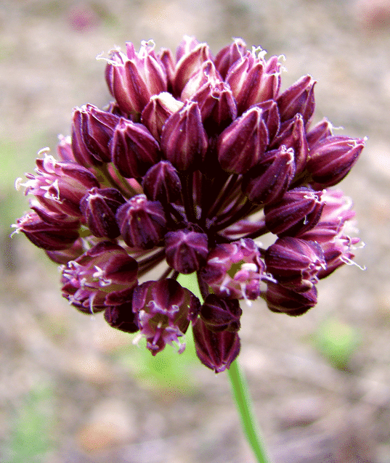
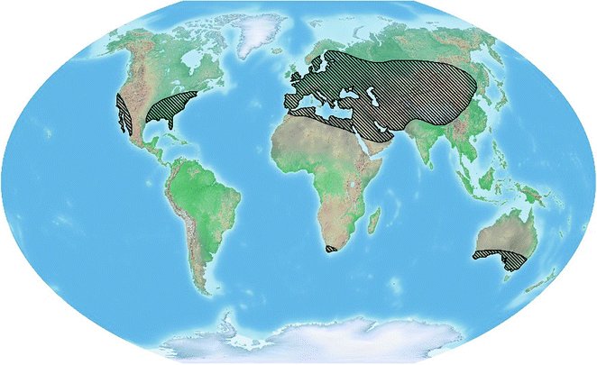
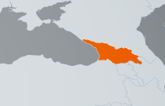
ALLIUM SPECIES AROUND THE WORLD
The genus Allium belongs to the family Alliaceae.
This genus involves up to 1233 species, growing mostly in the northern hemisphere
Allium ponticum
Allium saxatile

Slide 3
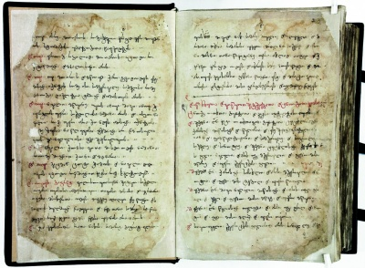
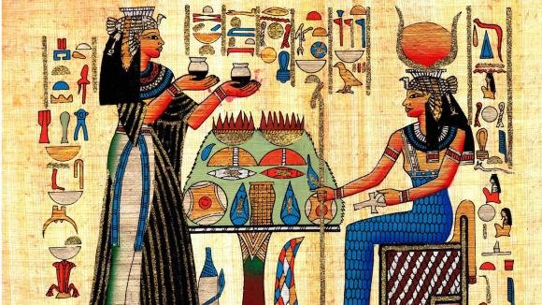
ETHNOPHARMACOLOGY
Allium plants have a long history of traditional use, as food and medicine, around the world, extending back to ancient times.
The story of Allium cultivation starts over 4000 years ago in ancient Egypt.
According to “Karabadini “ and “Iadigar-Daudi” Allium species were widely used in Georgian traditional medicine as an antifungal, antiseptic and antibacterial remedy.
“Iadigar-Daudi”_ the book of Georgian traditional medicine
Egyptian traditional medicine

Slide 4
CONSTITUENTS FOUND IN ALLIUM SP.
Saponins
Atroviolaceoside
Eruboside B
Flavonoids
Quercetin
Luteolin
Sulfuric compounds
Allicin
Dimethyl disulfide
Anthocyanins
Cyanidin 3-(6-malonylglucoside)
Phenolic compounds
Cyanidin-3-O-glucoside
Organic and fatty acids
Protocatechuic acid
Gallic acid
Amino acids
Oxalic acid
Succinic acid
Cystine
Tryptophan
Deltonine
Yayoisaponin C
Leucospiroside A
Leucofuranoside A
Tuberoside A-U
Aginoside
Quercetin 3-O-β-glucopyranoside
Astragalin
Kaempferol
Isorhamnetin
Methyl allyl sulfide
Methyl-propyldisulphide
Dipropyl disulfide
Dipropyl trisulfide
Malvidin-3′-glucoside
Ferulic acid
Malic acid
Tartaric acid
Citric acid
Sitosterol
Arginine
Glycine

Slide 5
PHARMACOLOGICAL ACTIVITIES OF ALLIUM-DERIVED COMPOUNDS
Pharmacological activities
Cytotoxic
Antioxidant
Anti-inflammatory
Analgesic
Antifungal
Antibacterial

Slide 6
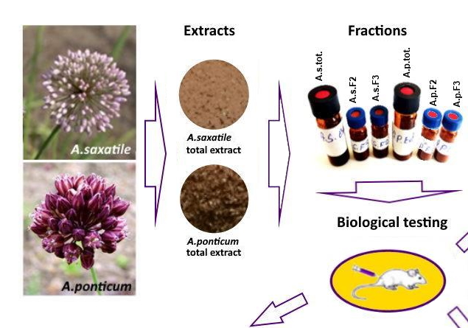
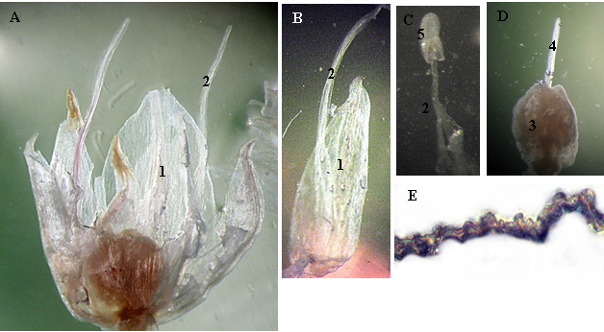
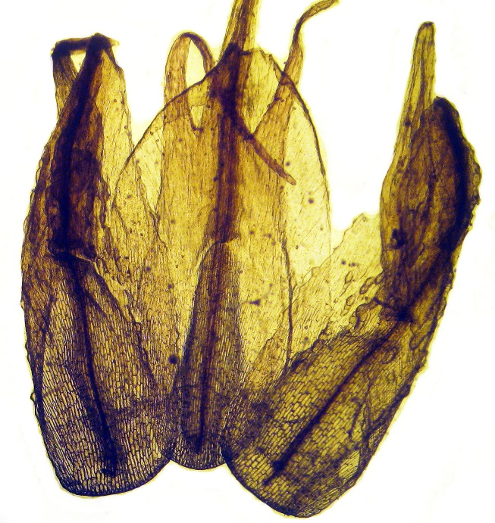
OBJECTIVES
Study of morphology and anatomy of the plants;
Obtaining crude extracts from both plants;
Separation of crude extracts, using column chromatography to obtain enriched fractions;
Determination of analgesic, anti-inflammatory and gastroprotective activities of fractions and total extract;
actions

Slide 7
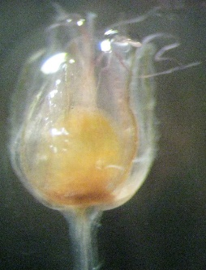
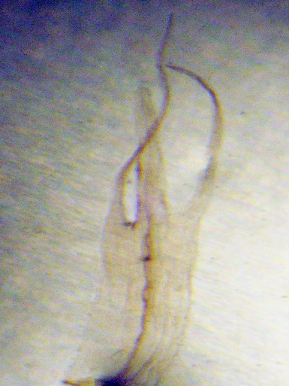
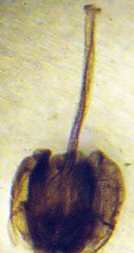
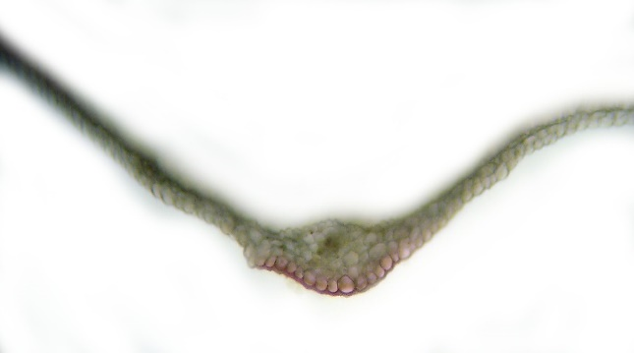
Microscopy of the flower of Allium ponticum
Microscopy of the flower of Allium saxatile
A
Flower;
Petal;
Filament;
Disposition of petals and filaments;
Petals;
Filament;
Stamen;
5. Anther;
Pistil;
3. Ovary;
4. Style;
Cross section of petal;
2
B
Flower
Disposition of petals and filaments;
Petals;
Filament;
Stamen;
Pistil;
Ovary;
Style;
Stigma;
Cross section of petal;
1
C
D
6
E
E
5
2
4

Slide 8
Allium Saxatille
Allium Ponticum
Dried and powdered plant 500 g
Dried and powdered plant 500 g
(Extraction with 80% EtOH)
(Extraction with 80% EtOH)
Ethanol extract 35,7 g
Ethanol extract 30,5 g
(15 g Chromatographed over Diaion HP-20)
(15 g Chromatographed over Diaion HP-20)
4 Fractions
4 Fractions
A.S. F1
(H₂O_100%)
8,2 g
A.S. F2
(MeOH_50%)
1,7 g
A.S. F3
(MeOH_100%)
3,5 g
A.S. F4
(EtOAc_100%)
0,02 g
A.P. F1
(H₂O_100%)
6,7 g
A.P. F2
(MeOH_50%)
3,9 g
A.P. F3
(MeOH_100%)
2,3 g
A.P. F4
(EtOAc_100%)
0,2 g

Slide 9
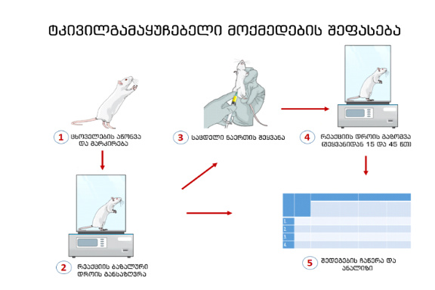
Hot plate assay
ANALGESIC ACTIVITY
Weighing and marking
the mouse
Injection
Hot plate latency
30 and 60 min after injection
30
60
Determine baseline latency
Note the results
Table 1. Analgesic effects of A. saxatile and A. ponticum total extracts and fractions
 | Baseline latency # | 30 min | 60 min
Control | 11.5±3.5 | 11.6±2.6 | 11.8±2.4
A.s. tot (50 mg/kg ip) |  | 17.9±5.6* | 20.1±7.3**
A.s. F2 (25 mg/kg ip) |  | 13.5±5.3 | 15.1±5.6
A.s. F2 (50 mg/kg ip) |  | 16.6±2.3* | 18.6±2.5**
A.s. F3 (25 mg/kg ip) |  | 17.4±5.4 | 19.5±7.2*
A.s. F3 (50 mg/kg ip) |  | 19.0±5.4* | 21.2±6.7***
A.p. tot (50 mg/kg ip) |  | 23.7±6.7** | 21.3±6.4*
A.p. F2 (25 mg/kg ip) |  | 14.6±2.9 | 13.2±2.6
A.p. F2 (50 mg/kg ip) |  | 18.0±4.5* | 16.2±4.4
A.p. F3 (25 mg/kg ip) |  | 14.3±3.5 | 12.9±3.1
A.p. F3 (50 mg/kg ip) |  | 18.3±2.5*** | 16.5±2.2*
Fig. 1. Analgesic effects of A. saxatile and A. ponticum total extracts and fractions

Slide 10
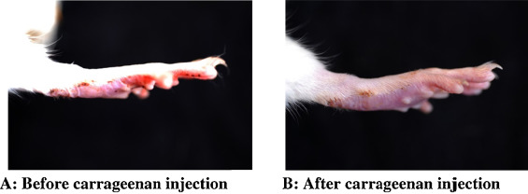
Anti-inflammatory activity
ANTI-INFLAMMATORY ACTIVITY
Fig. 1. General view
Fig. 2. Thickness of the paw, of control and experimental groups
Fig. 3. Efficacy of the extracts and fractions.

Slide 11
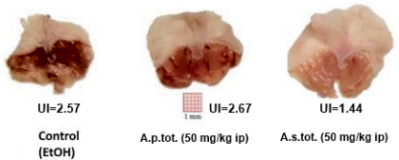
Gastroprotective activity
GASTROPROTECTIVE ACTIVITY: (ETHANOL INDUCED ULCER IN RODENTS)
Fig. 5. Efficacy of extracts (%I).
Fig. 4. Ulcer index (UI)

Slide 12
CONCLUSIONS
The microstructural study of Allium saxatile and Allium ponticum revealed that:
Allium ponticum: Stamen filaments are as long as the petals or slightly shorter. the stamen is divided into three, the lateral teeth of which exceed the middle one, on which the anther is placed. The leaves stomata are immersed in the cells of the epidermis. Stomatas are paracytic type.
Allium saxatile: Stamen filaments are longer than the petals. Stomata is placed on the level of the epidermal tissue. Stomatas are mostly anomocytic type.
Optimal conditions were elaborated to obtain crude extracts;
A.S.F3 fraction has higher analgesic and anti-inflammatory activity, than other fractions;
A. saxatile is characterized with marked dose dependent analgesic and anti-inflammatory activity presumably because of A.S.F3 content, that well correlates with the worsening of gastric mucosa condition, suggesting having mechanism of action similar to the one of NSAIDs
A. ponticum total extract revealed faster onset analgesic activity but shorter duration of action;

Slide 13
Thank you for your attention

