Slide 1
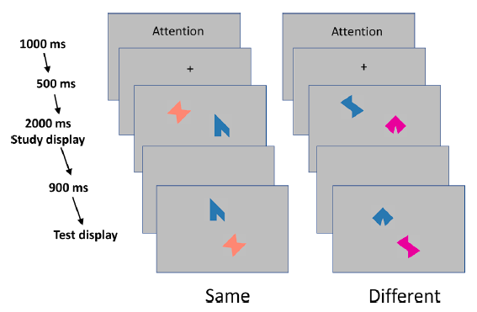
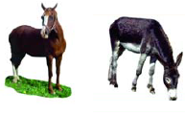
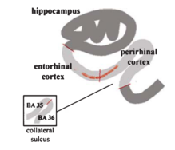
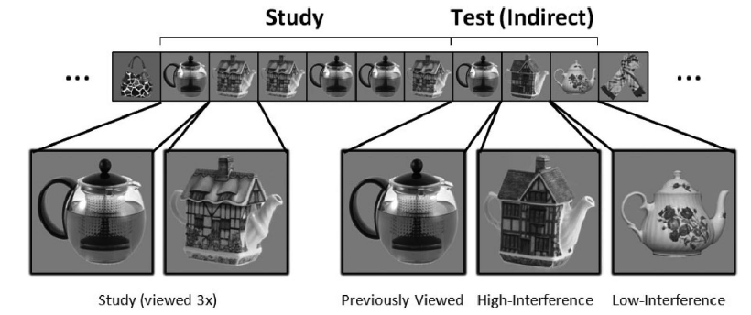
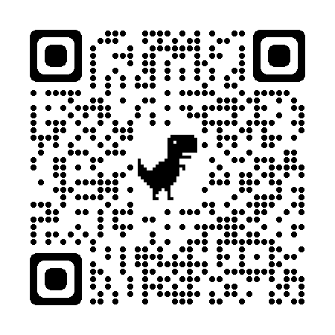
Targeting the function of the transentorhinal cortex to identify early cognitive markers of Alzheimer’s disease
Christine Bastin & Emma Delhaye
GIGA-CRC In Vivo Imaging, University of Liège, Belgium
Introduction
Neurofibrillary tangles and neurodegeneration are the best predictors of cognitive decline in Alzheimer’s disease (AD)^{1,2}. They follow a typical pattern of topographical progression, with initial cortical accumulation in the transenthorinal cortex³. As the presence of subtle cognitive decline in the preclinical and predementia stages is a robust predictor of future cognitive and functional outcomes⁴, the identification of the most sensitive and specific cognitive markers of AD is a key for early diagnosis. Here we consider that the earliest cognitive changes in AD should concern the cognitive functions depending on the transentorhinal cortex. We review potential functions associated with the transentorhinal cortex, which have been explored in the context of AD and its early stages. Then, we propose a unifying view pointing to entity-level representation as one specific function of the transentorhinal cortex that should be considered as the best candidate for a cognitive marker of Alzheimer’s disease.
Review
Conjunctive binding
Disambiguation of objects
Related to sub-hippocampal regions, but not to the hippocampus.
Impaired in AD, but not in other dementias.
Impaired in asymptomatic PSEN1 mutation carriers and in Subjective Cognitive Decline and MCI
Predicts the presence of amyloid burden
Naming of living things correlates with transentohinal cortical thickness in MCI and mild AD
False recognitions of similar objects correlate with transentorhinal volume and presence of tau in anterior MTL
Impaired visual discrimination of similar objects in MCI and familial AD.
Novelty detection
Familiarity
In MCI, viewing time indicates a failure to detect the novelty of high-interference objects
The extent of processing of conjunctive parts correlates with transentorhinal volume.
In MCI and mild AD, familiarity for objects (especially viewpoint-invariant recognition) correlates with transentorhinal volume.
Impaired familiarity predicts future progression to AD in MCI.
Reviewed references in the PsyArXiv preprint
Discussion
All these tasks share a common element that could be the key to identify the best cognitive marker of AD.
Even if the tasks pertain to various cognitive domains, it is always necessary to create, store and retrieve an entity-level representation. An entity is defined as an exemplar of a category which is distinguished from other similar exemplars by its unique configuration of perceptual-conceptual traits.
As the apex of a hierarchy of processing in the ventral visual stream, the transentorhinal cortex stores orthogonal representations of entities, allowing us to make fine-grained discrimination between very similar stimuli (e.g., living items, very similar objects), distinguishing them through the unique conjunctive integration of their features.
We suggest that the best cognitive marker of early AD needs to measure the ability to represent entities that relies specifically on the transentorhinal cortex. A tool mixing tasks from various domains, all probing representations of entities, would be an ideal candidate screening tool
(1) Terry et al. (1991). Annals of Neurology, 30(4), 572-580. (2) Timmers et al. (2019). Neurobiology of Aging, 79, 131-141. (3) Braak & Del Tredici (2018). Cerebral Cortex, 28(9), 3372-3384. (4) Elman et al. (2020). Biological Psychiatry, 87(9), 819-828.
Christine.Bastin@uliege.be Emma.Delhaye@uliege.be

