Slide 1
Parliamentary immunities, human rights, and the separation of powers
Andy JOUSTEN
PhD-Student at the University of Liège (Belgium)
Deputy Auditor at the Supreme Administrative Court (Belgium)

Slide 2
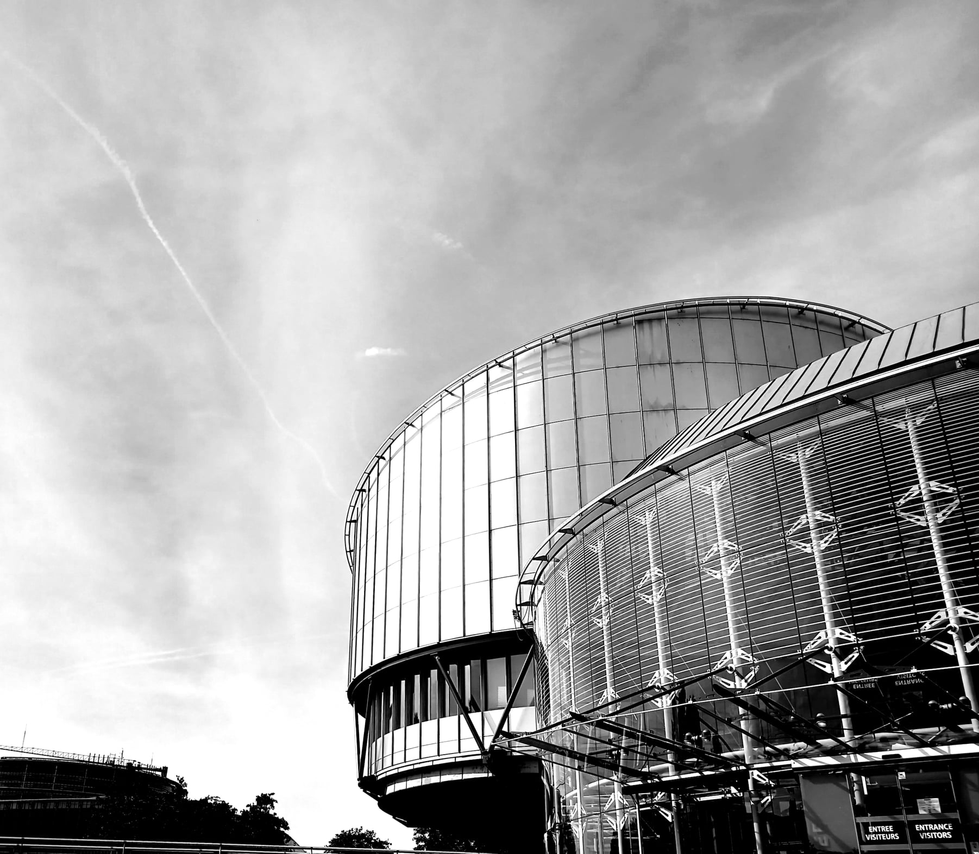
Introduction
Case law of the European Court of Human Rights (E.Ct.H.R.)
Interactions between human rights and parliamentary immunities
Courts’ vision on the relations between Parliament, MPs and the judiciary

Slide 3
Introduction
Thesis formulated for the purpose of the presentation:
“L’immunité parlementaire (au sens strict) est un mal nécessaire, mais peut parfois s’avérer insuffisante”
“Parliamentary immunity (in the strict sense) is a necessary evil, but can sometimes prove to be insufficient”

Slide 4
Introduction
Public opinion and the reshaping of public institutions (Parliament)
Parliamentary opposition in the relationship between the political power and the judiciary

Slide 5
I. Un « mal » - An “evil”
Parliamentary immunity and harmed third parties’ human rights
Challenged before the E.Ct.H.R.
Right to access to court (Art. 6.1 E.C.H.R.)
Compatible, but only under certain conditions relating to the scope of parliamentary immunities

Slide 6
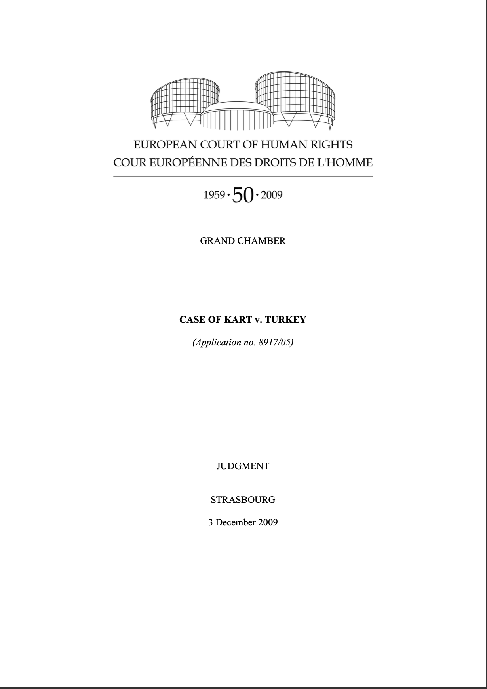
I. Un « mal » - An “evil”
Parliamentary immunity and the MPs’ interests (and rights)
Parliamentary immunity and the public opinion
Bad reputation of the parliamentary immunities in the public opinion
Risk of a “trial” by the “court of the public opinion”
The MPs’ interests (and rights)
No possibility for the MP to renounce to the immunity
Compatible with his right to access to court (E.Ct.H.R., Grand Chamber, Kart v. Turkey, 3 December 2009)
Political importance of the image

Slide 7
II. Un « mal nécessaire » - A “necessary evil”
The legitimate objective of parliamentary immunities
Protection of the parliamentary function and institution
Arbitrary and political prosecution
Parliamentary control of the political motivation / basis of the prosecution

Slide 8
III. Une protection insuffisante - An insufficient protection
The importance of the immunity for members of the opposition
The danger of majority decisions
E.Ct.H.R., Grand Chamber, Selahattin Demirtaş v. Turkey No. 2, 22 December 2020
Procedural guarantee
Based on article 3 of the Additional Protocol to the E.C.H.R.

Slide 9
III. Une protection insuffisante - An insufficient protection
E.Ct.H.R., Grand Chamber, Selahattin Demirtaş v. Turkey No. 2, 22 December 2020
“Nevertheless, in view of the importance in a democratic society of the right to liberty and security of a member of parliament, the domestic courts must show, while exercising their discretion, that in ordering a person’s initial and/or continued pre-trial detention, they have weighed up the relevant interests, in particular those of the person concerned as safeguarded by Article 3 of Protocol No. 1 against the public interest depriving that person of his or her liberty where required in the context of criminal proceedings. An important element in this balancing exercise is whether the charges have a political basis. The Court’s role is then to review the decisions of the national courts from the standpoint of the Convention, without taking the place of the relevant domestic authorities”.
N.B. Confirmed in E.Ct.H.R., Yüksekdağ Şenoğlu a.o. v. Turkey, 8 November 2022

Slide 10
III. Une protection insuffisante - An insufficient protection
Revue Trimestrielle des Droits de l'Homme, (11 January 2022): 29-62.

