Slide 1
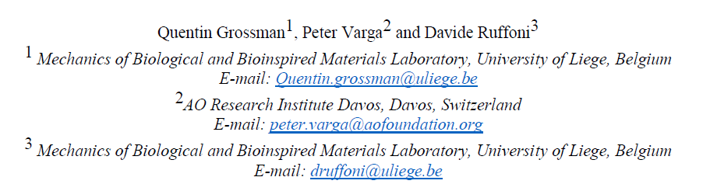



Architectured Interfaces in Bimaterial Attachements

Slide 2
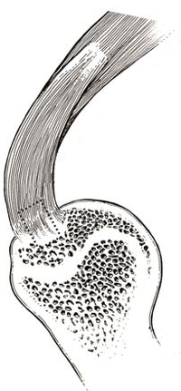
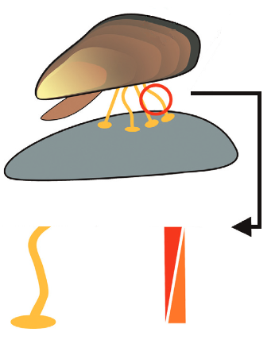
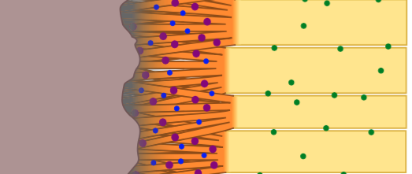

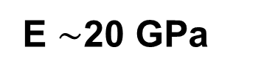
Bimaterial Attachments In Nature
Long gradient
Short gradient
Achilles tendon
OR
Side attached
to soft body
Locke et al., ACS Biomaterials 2016
Deformability
E ~ 0.2 MPa
500µm
cm
E ~ 25 GPa
E $\sim$20 GPa
E$\sim$0.5 GPa
Side attached to hard surface
Stiffness
Dunlop at al., Materials Today 2011
Rossetti et al, Nat Mat 2017

Slide 3
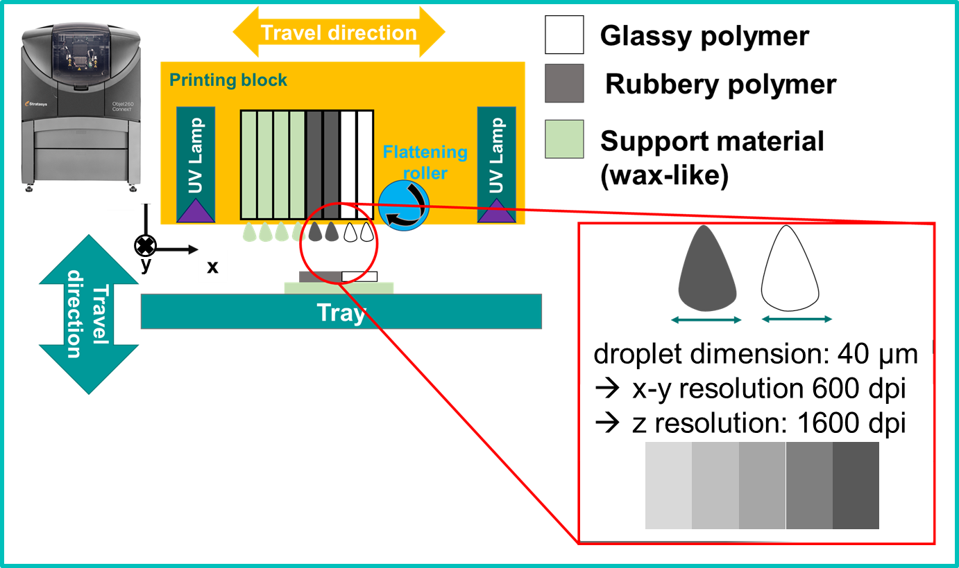
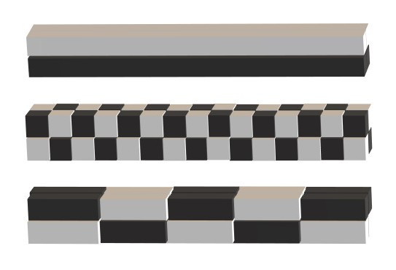
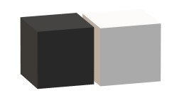
Bimaterial Interfaces with 3D Printing Technology
Stratasys Objet260 Connex2 :
Droplets dimension : 40 µm
Control on local microstructure and mechanical properties
High geometrical freedom
Allows Voxel 3D printing
Voxel 3D printing

Slide 4
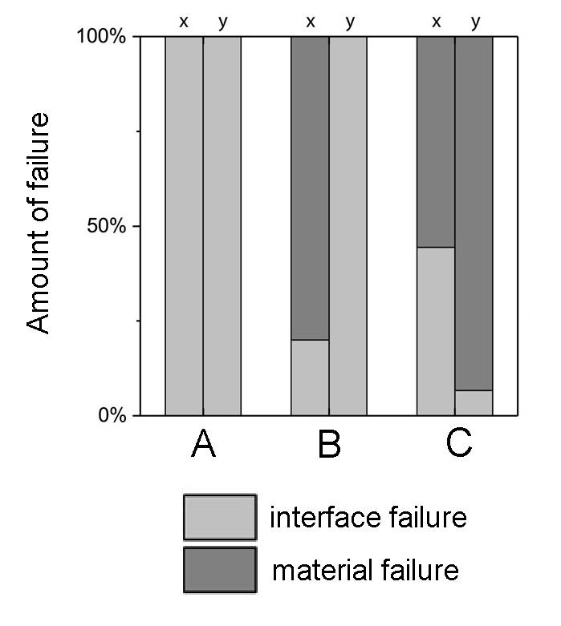
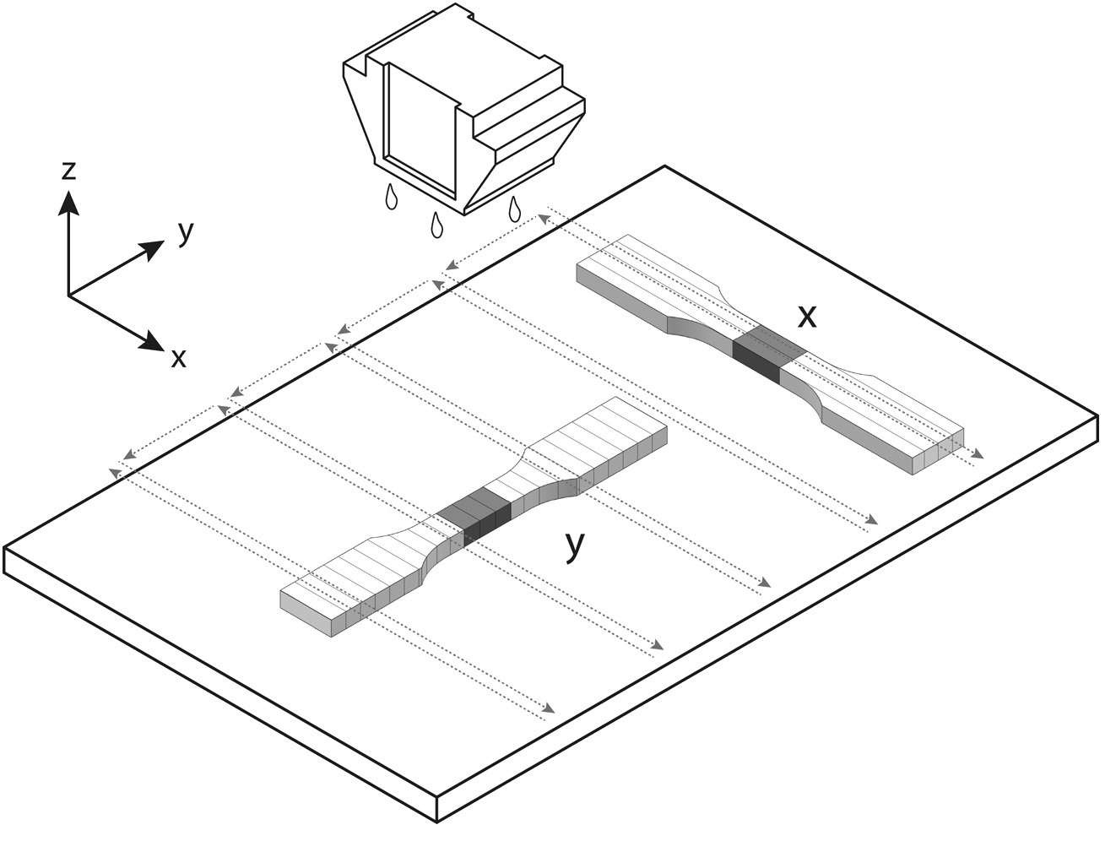
Interfaces in Polyjet Printing as Weak Regions
Results
Printing direction
Material properties
ERigid
Stiffness ratio =
ESoft
Adapted from Lumpe et al., Materials and Design 2019
Interface as weakness :
Printing direction (y)
Elastic contrast should not be too high

Slide 5
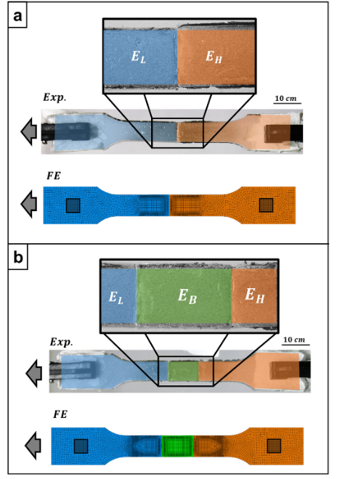
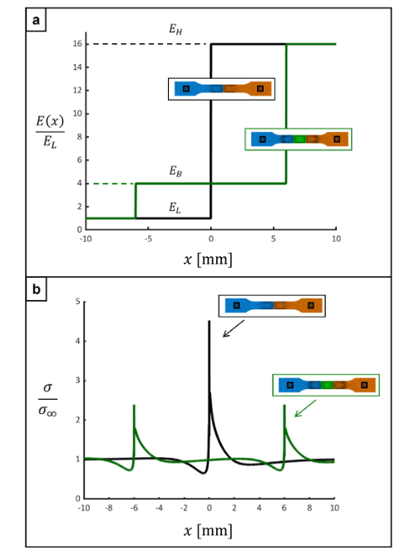
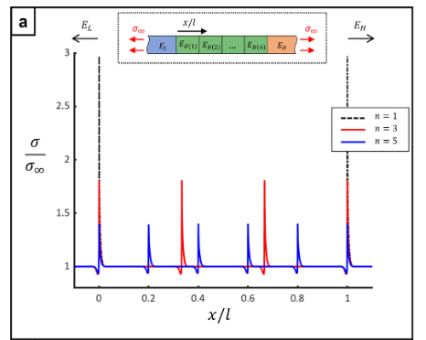

Interfaces in Polyjet Printing as Weak Regions
A.Y. Uzan, O. Milo, Y. Politi et al., Principles of elastic bridging in biological materials, Acta Biomaterialia
Interface as weakness :
Intermediate layer reduces stress mismatch
Optimised Young’s Modulus is

Slide 6
Aims
Prototype new bimaterial attachments based on minimal perturbation using voxel 3D printing
Aim 1 :
Understand impact of perturbations on stiffness, strength, failure behaviour
Aim 2 :
Aim 3 :
Understand local stress distribution at interfaces

Slide 7
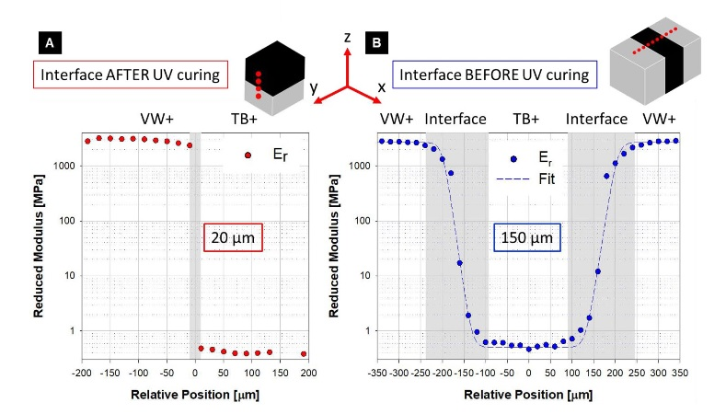
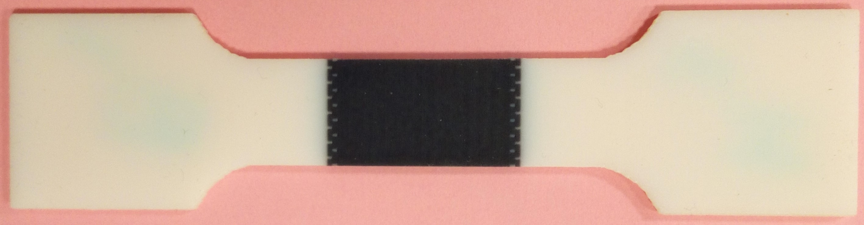
Methodology
Droplets mix
Voxel size chosen is 420x420 µm²
Types of bimaterial attachments :
Minimal perturbation : < 10% length
Flat interface (Reference case)
Ordered Interface patterning (6 configurations)
Methods :
Voxel based finite element simulations
Experimental testing on 3D printed bimaterial samples
Zorzetto et al., Scientific Reports 2020

Slide 8
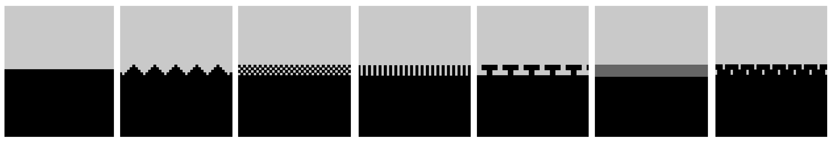
Methodology
Only 4 voxels perturbation
Ordered:
Rigid
(E = 2 GPa)
Soft
(E = 50 MPa)
Flat
Triangular
Chessboard
Rectangular
Interlocking
Soft interface
Staggered
Softer layer
(E = 2 MPa)

Slide 9
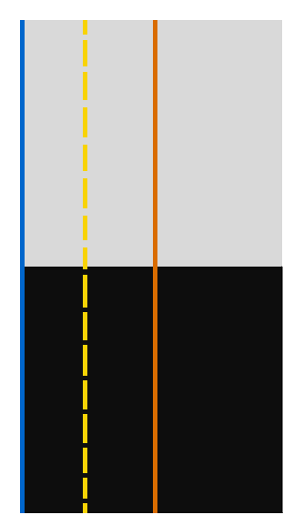
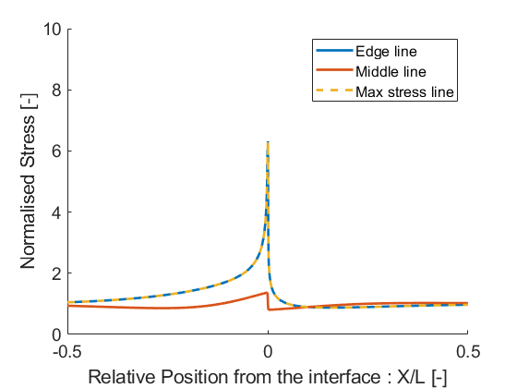
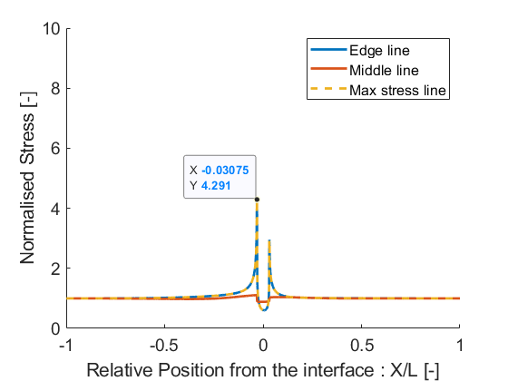
Results : Flat & Soft
Flat
Soft interface
Soft intermediate layer decreases the stress mismatch

Slide 10
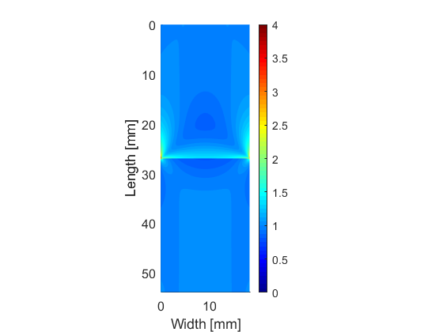
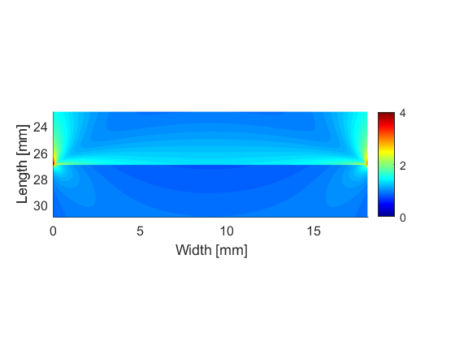
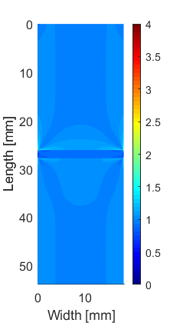
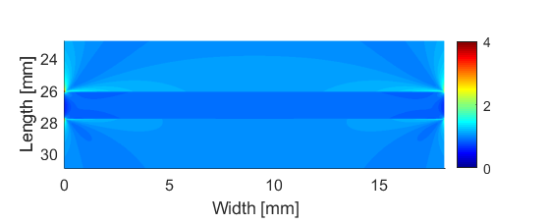
Results : Flat & Soft
Flat
Soft interface
Soft intermediate layer decrease the stress mismatch

Slide 11
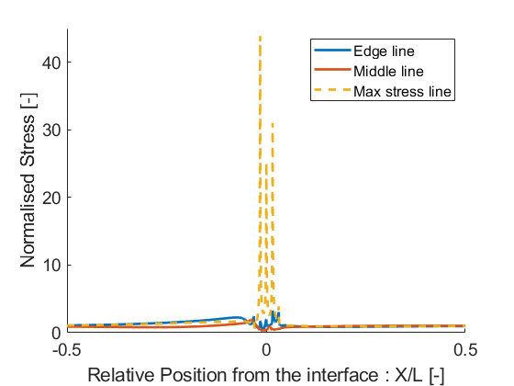
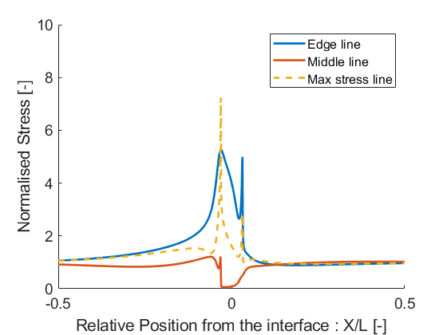
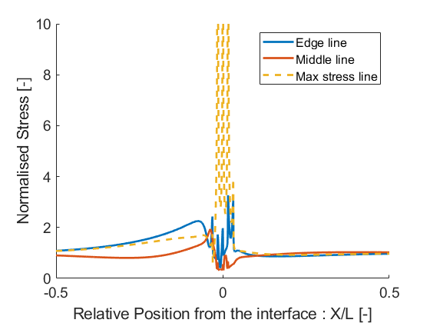
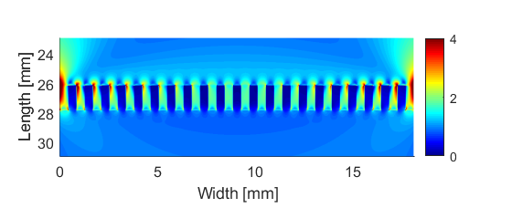
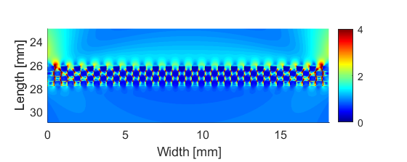
Results : Other geometries
Flat
Digitation
Chessboard

Slide 12
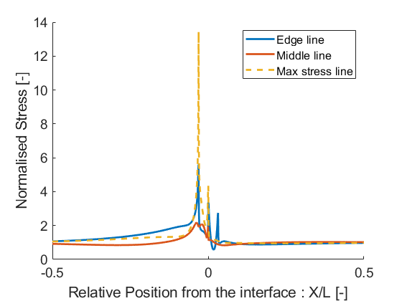
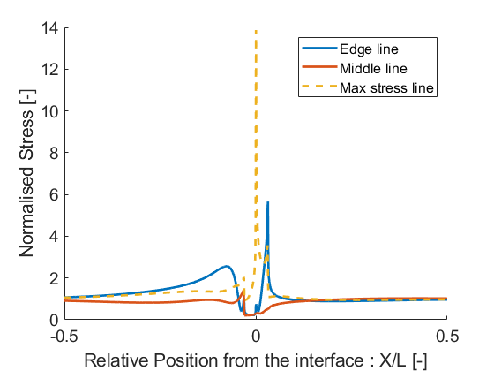
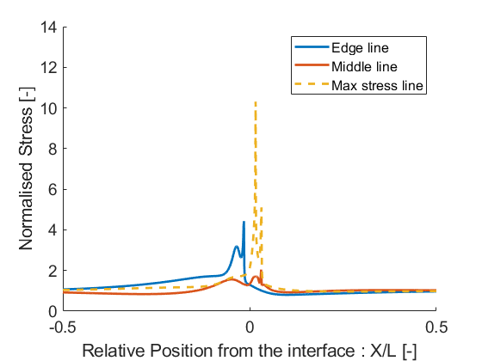
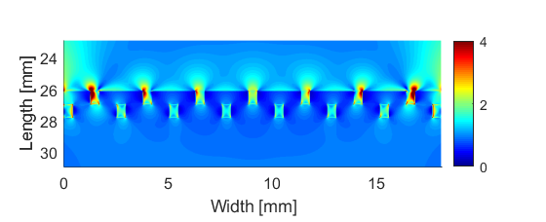
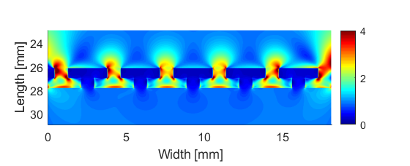
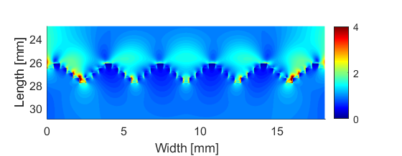
Results : Other geometries
Staggered
Interlocking
Triangular

Slide 13
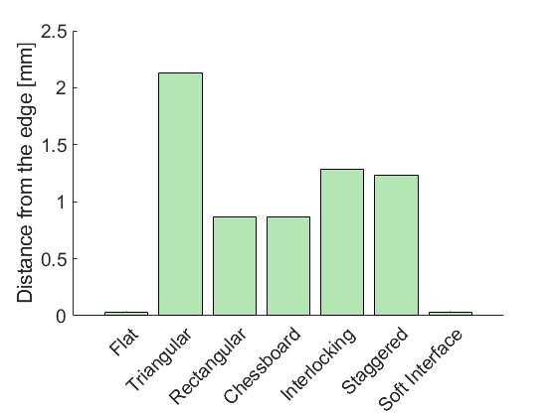
Results : Distance of the max Stress from free edge
D
Maximum of Stress is taken away from free edge
Does it delay breaking of samples ?
See experimental results

Slide 14
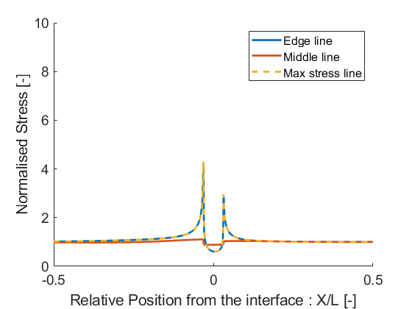
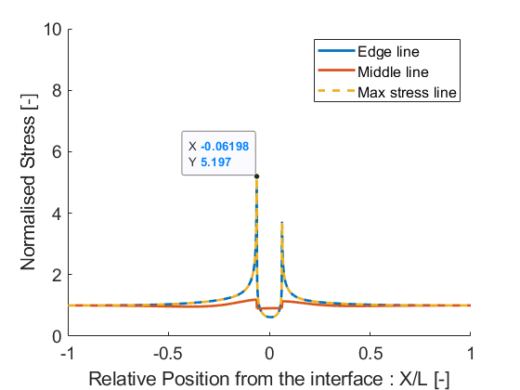
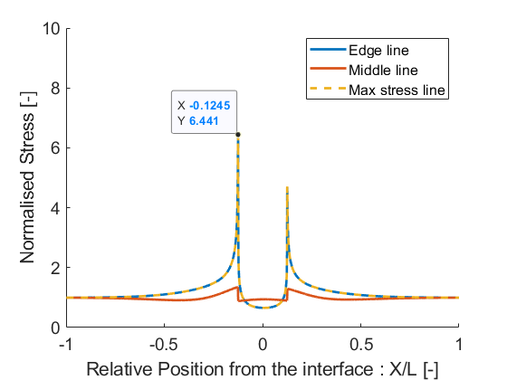
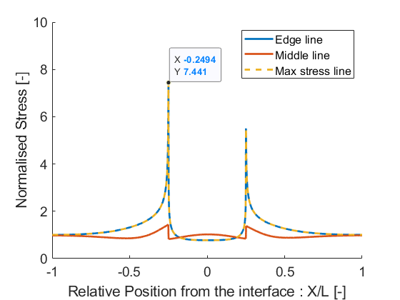
Results : Effect of width : Soft interface 2MPa
4 voxels
8 voxels
4 voxels = 1.68mm
8 voxels = 3.36mm
16 voxels = 6.72mm
32 voxels = 13.44mm
16 voxels
32 voxels

Slide 15
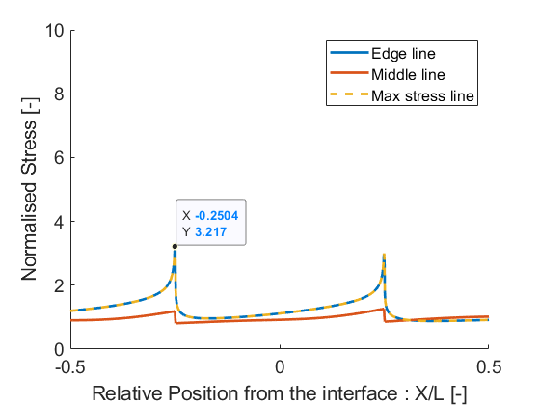
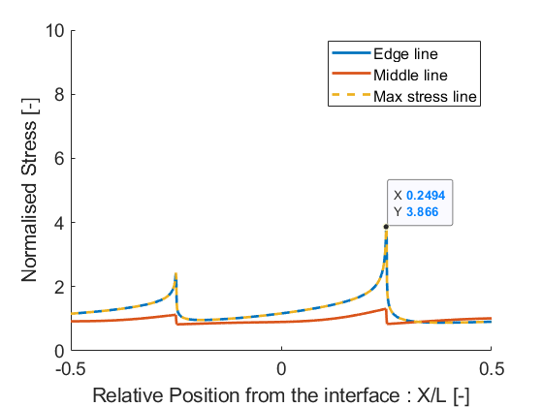
Results : Reduce mismatch with Soft interface
Soft Interface 2MPa
32 voxels wide
Soft Interface Optimised (316 MPa) 32 voxels wide
Soft Interface 500 MPa
32 voxels wide
Minimisation of mismatch criteria met ! Optimised Young’s Modulus is

Slide 16
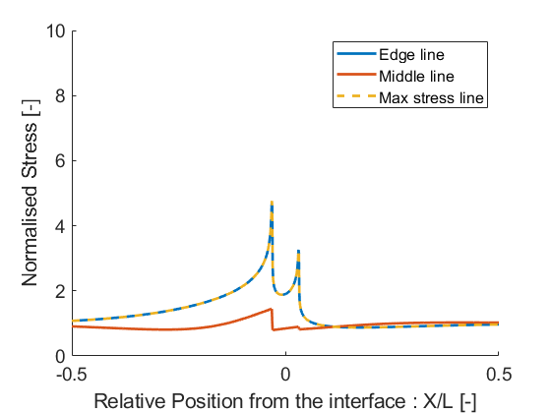
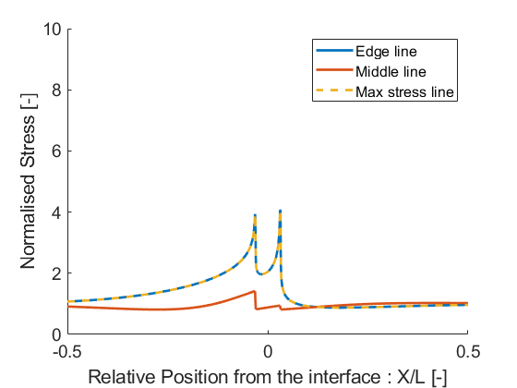
Results : Reduce mismatch with Soft interface
Soft Interface 2 MPa
Soft Interface Optimsed (316 Mpa)
Soft Interface 500 MPa
Minimisation of mismatch criteria is not met when the layer is too small

Slide 17
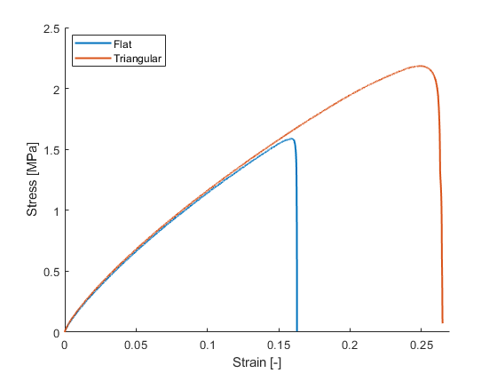
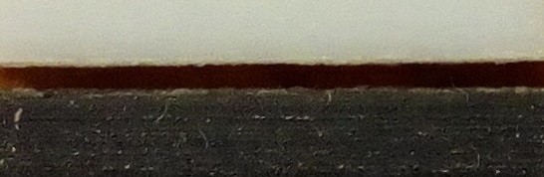
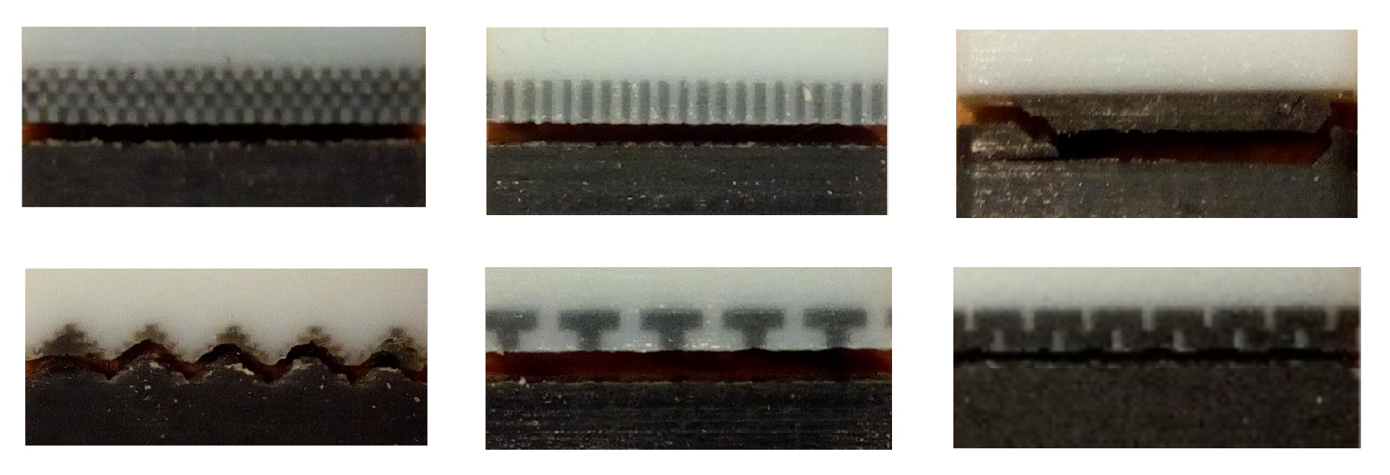
Results : Stress-strain
Fractured samples

Slide 18
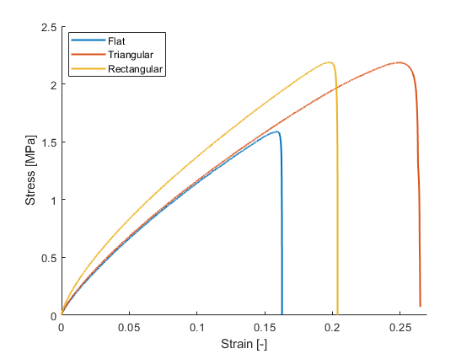
Results : Stress-strain
Fractured samples

Slide 19
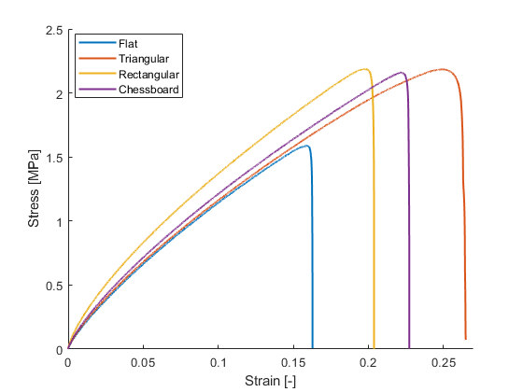
Results : Stress-strain
Fractured samples

Slide 20
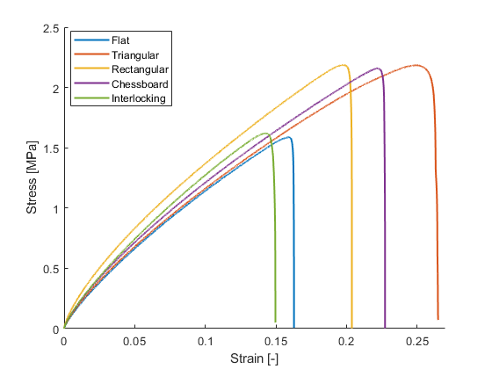
Results : Stress-strain
Fractured samples

Slide 21
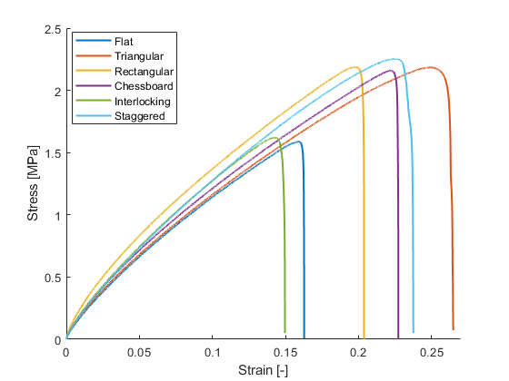
Results : Stress-strain
Fractured samples

Slide 22

Results : Stress-strain
Fractured samples

Slide 23



Results : Apparent Stiffness & Strength
Strength increases significantly while apparent stiffness stays approximately constant

Slide 24



Results : Work Pre/Post-Failure
Force
Pre-failure work
Post-failure work
Displacement
Ordered
Max increase : pre-failure work 3x
post-failure work 5x

Slide 25
Conclusions
Adding a small layer of soft materials decreases the stress mismatch between materials.
Towards increased fatigue performance ?
Minimal perturbations increase strength and failure resistance of bimaterial attachment.
Interface patterning induces a shift in the maximum stress inside the bulk of material.
Increased mechanical properties in uniaxial tension !

Slide 26
Architectured Interfaces in Bimaterial Attachements
Quentin Grossman
Mechanics of Biological and
Bioinspired Materials Laboratory
Belgium
Davide Ruffoni
Peter Varga

Slide 27





Results : Other geometries
Flat
Digitation
Chessboard
Staggered
Interlocking
Triangular

Slide 28










Von Mises Stress Distribution
Mean VM
Distribution
Flat
Triangular
[MPa]
Flat
Staggered
Triangular
75% VF
Std VM
Staggered
75% VF
Stress concentration is taken away from edges
Spread of Stress : Higher amount of voxels with high and low Stress

