Slide 2
LATE SPONTANEOUS AORTO-ENTERIC FISTULA
AFTER ENDOVASCULAR REPAIR
OF ABDOMINAL ANEURYSM
J. PUDZEIS¹, A. KERZMANN¹, A. MOSCATO², N. MAWAIT¹, E. BOESMANS¹, C. HOLEMANS¹, D. SZECEL¹ and J-O. DEFRAIGNE¹
1. Department of Cardiovascular and Thoracic Surgery, CHU, Liege, Belgium
2. Department of Surgery, Vivalia Saint Joseph Hospital, Arlon, Belgium
Notes:
I’m Justine Pudzeis and I am surgeon trainee at the University of Liege.
I'm going to present you a case report about spontaneous aorto-enteric fistula 6 years after an elective endovascular repair of abdominal aneurysm.

Slide 4
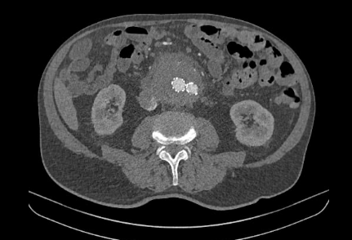
Case Report
82 years old caucasian man
Anemia
Hematemesis and melena
Computed tomography (CT) two months before
History
Endovascular repair of an infrarenal abdominal aortic aneurysm (EVAR) 6 years before
Pacemaker implantation after third-degree atrioventricular block
Treatment
Asaflow 80mg
Bisoprolol 5mg
L-thyroxine 12.5mcg
Notes:
A 82 years old caucasian man was admitted to the emergency room because of anemia and gastrointestinal bleeding mixed.
Six years previously, he had undergone an uneventful endovascular repair of a infrarenal abdominal aortic aneurysm.
A CT scan performed at approximately two month before showed the stent was in the right position, without evidence of infection. However, we noted a progressive enlargement of the aneurysm sac with no clear evidence of endoleak.

Slide 5
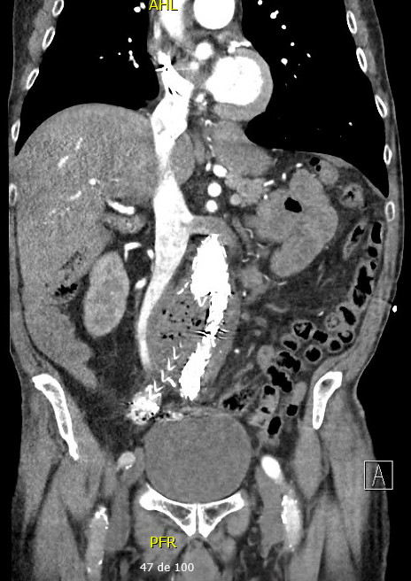
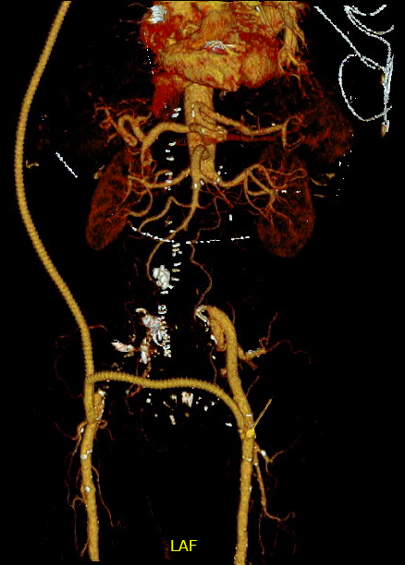
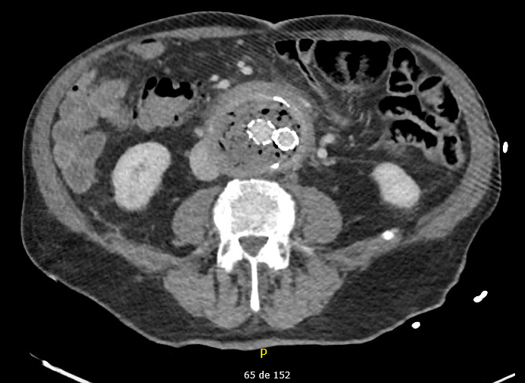
CT in the emergency room & treatment
Suspicion of an aorto-enteric fistula
Extra-anatomic axillo-bifemoral bypass
Notes:
In the emergency room, a repeat CT scan showed presence of massive amount of periprosthetic air bubbles within the aneurysm sac, which raised suspicion for an aorto-enteric fistula.
An extra-anatomic axillobifemoral bypass, endograft explantation, aneurysm sac debridement, and enteric repair were done urgently.

Slide 6
Discussion
Secondary aorto-enteric fistula (AEF) after EVAR
Extremely rare but life-threatening illness
Any time postoperatively
CT confirms diagnosis in only 80% of cases
Mechanisms
Aortic wall erosion or perforation
Peri-aortic inflammation
Compression
Management
Surgical treatment associated with antibiotic therapy
Notes:
Aorto-enteric fistula formation after endovascular abdominal aortic aneurysm repair without prior abdominal surgery is exceedingly rare. It is associated with a serious prognosis. It can occur at any time postoperatively.
CT scan confirms diagnosis in only 80% of cases. Often, diagnosis is established during surgical exploration.
The most frequently reported mechanism is :
1) Aortic wall erosion or perforation by the stent graft body with or without migration, kinking or fracture, by the hook, a guidewire, and/or a coil.
2) Peri-aortic inflammation which includes pre-EVAR infected or inflammatory aneurysm, local infection, stent graft infection, intervention for endoleak.
3) Compression caused by the pre-existing aneurysm sac, persistent endotension, and re-expansion of the aneurysm sac.
Surgical treatment must be associated with antibiotic therapy, but no guideline exist on the exact duration of treatment. Traditionally, surgical treatment consists of aortic replacement by cryopreserved allograft or by axillo-bifemoral bypass in conjunction with enteric reconstruction or repair.

Slide 7
Conclusion
AEF can occur even after initially successful EVAR, so long term surveillance is essential
No time limit for the fistula to occur
Etablishing the diagnosis is more difficult due to the multiple mechanisms leading to formation of AEF
Diagnosis can be suspected on CT and confirmed by surgery
Notes:
In conclusion,
Aorto-enteric fistula can occur even after initially successful EVAR, so long term surveillance is essential
Because there is no time limit for the fistula to occur
Etablishing the diagnosis is more difficult due to the multiple mechanisms leading to formation of aorto-enteric fistula
But the Diagnosis can be suspected on CT and confirmed by surgery

Slide 8
References
Chenu C, and al. Aorto-enteric fistula after endovascular abdominal aortic aneurysm repair : case report and review. Eur J Vasc Endovasc Surg. 2009;37(4),401‑6.
Zaki M, and al. Secondary aortoduodenal fistula following endovascular repair of inflammatory abdominal aortic aneurysm due to Streptococcus anginosus infection : A case report and literature review. Int J Surg Case Rep. 2014;5(10),710‑3.
Koda Y, and al. Secondary Aorto-enteric Fistula and Type II Endoleak Five Years after Endovascular Abdominal Aortic Aneurysm Repair. EJVES Short Rep. 2019;43,12‑17.
Kahlberg A, and al. Results from the Multicenter Study on Aortoenteric Fistulization after Stent Grafting of the Abdominal Aorta (MAEFISTO). J Vasc Surg. 2016;64(2):313-20.
Lane JS, and al. Aortoduodenal fistula after endovascular aneurysm repair presenting with aneurysm sac abscess. J Vasc Surg. 2009;50(4):919-20.

