Slide 2
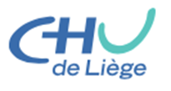
Atherectomy with drug-eluting balloon for common femoral artery occlusive disease: short term experience
A. Kerzmann, E. Boesmans, C. Holemans, D. Szecel, V. Demesmaker, J. Pudzeis, V. Alexandrescu, J.O. Defraigne
Department of Cardiovascular and Thoracic Surgery, CHU Liège, Belgium

Slide 3
DISCLOSURES
Arnaud Kerzmann, MD
Consultant: BD, Boston Scientific
Grant/research support: BD, Boston Scientific, Medicor

Slide 4
INTRODUCTION
Gold standard treatment for occlusive lesions of the common femoral artery used to be endarterectomy.
In recent years, interest for endovascular treatment of the common femoral artery has been increasing¹.
Stenting of the common femoral artery is possible^{1,2} but we believe it is better to avoid it. Calcified arterial lesions are not well treated with drug coated balloons alone³.
¹ Deloose K, Martins I, Neves C, Callaert J. Endovascular treatment for the common femoral artery: is there a challenger to open surgery? J Cardiovasc Surg. 2019;60:8-13.
² Gouëffic Y, Della Schiava N, Thaveau F, Rosset E, Favre JP, Salomon du Mont L, Alsac JM, Hassen-Khodja R, Reix T, Allaire E, Ducasse E, Soler R, Guyomarc'h B, Nasr B. Stenting or Surgery for De Novo Common Femoral Artery Stenosis. JACC Cardiovasc Interv. 2017;10:1344-1354.
³ Fanelli F, Cannavale A, Gazzetti M, Lucatelli P, Wlderk A, Cirelli C, d'Adamo A, Salvatori FM. Calcium burden assessment and impact on drug-eluting balloons in peripheral arterial disease. Cardiovasc Intervent Radiol. 2014;37:898-907.

Slide 5
INTRODUCTION
Vessel preparation with rotational atherectomy, followed by drug-eluting balloon usage, could be a good option.
Our aim is to evaluate it for common femoral artery calcified occlusive disease.
We report our early experience.

Slide 6
METHODS
Prospective registry
In one Belgian center: University Hospital of Liège.
Start in June 2021
Inclusion of all atherosclerotic common femoral artery stenosis and chronic total occlusions.
Percutaneous treatment: rotational atherectomy followed by drug coated balloon angioplasty.
Exclusion: embolic occlusive disease, hybrid procedure (endovascular and open surgery), critical acute ischemia.
Primary end point: primary patency rate.

Slide 7
RESULTS
procedures | 26
men | 15
women | 7
mean age | 75
arterial hypertension | 86% (19/22)
smoking or stopped < 3 y. | 55% (12/22)
diabetes (all types) | 32% (7/22)
dyslipidemia (all types) | 86% (19/22)
chronic kidney disease | 32% (7/22)
Rutherford | 3 stage 2, 18 stage 3, 3 stage 4, 2 stage 5
mean ankle-brachial index | 0,69
chronic total occlusion | 3
heavy calcifications | 100 %
mean lesion length | 4,2 cm (2 to 8)
Between June 2021 and March 2022, 22 patients including 4 with bilateral lesions were treated.

Slide 8
RESULTS
All procedures were performed under local anesthesia.
19 were anterograde with controlateral femoral puncture and 7 were retrograde with ipsilateral superficial femoral puncture.
No filter was used.
Technical success rate was 100%.
One asymptomatic embolization in deep femoral artery side branch.

Slide 9
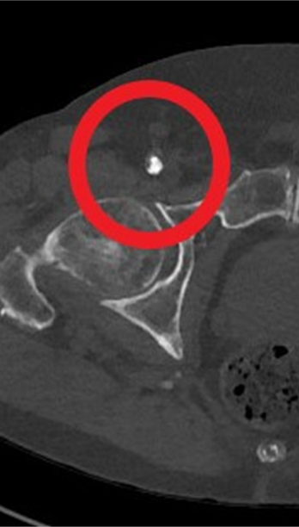
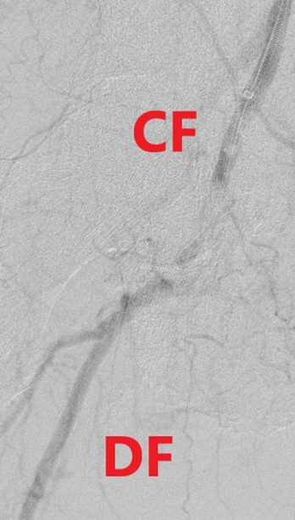
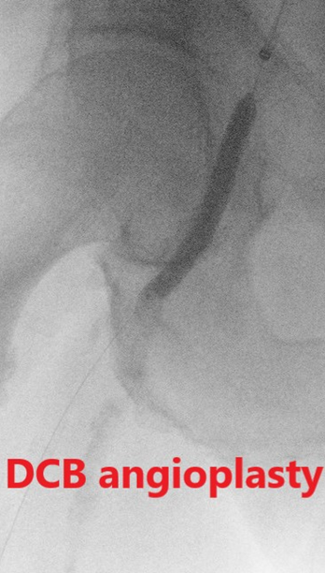
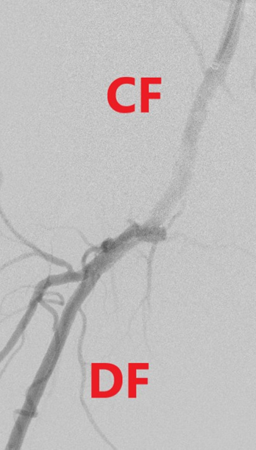
RESULTS

Slide 10
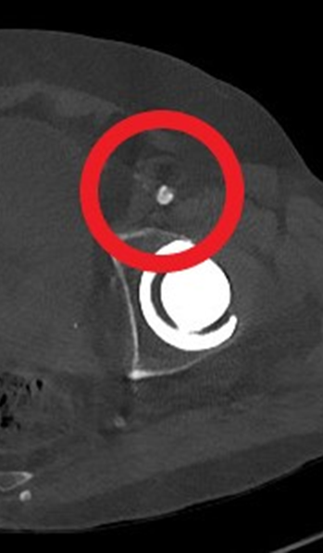
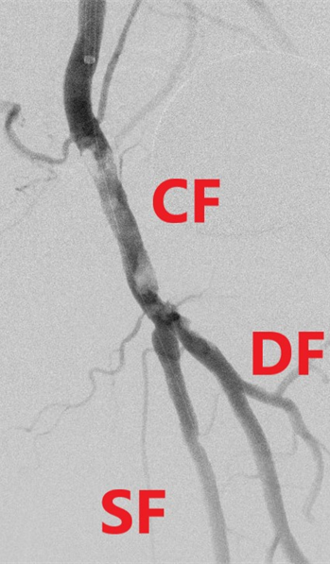
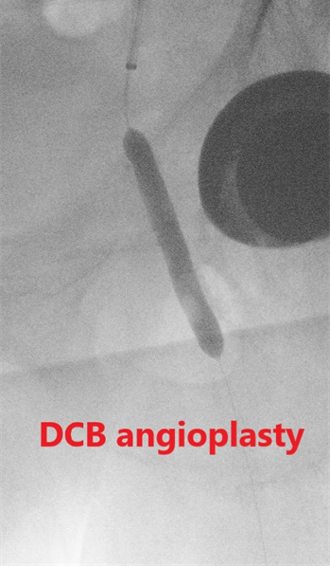
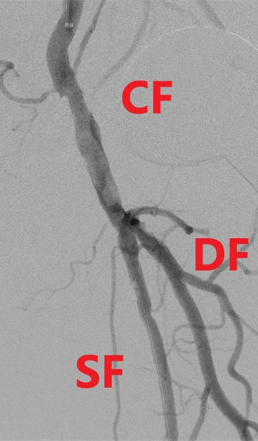
RESULTS

Slide 11
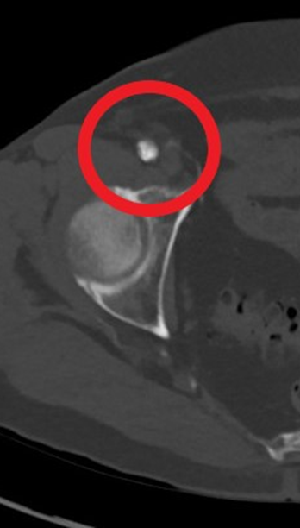
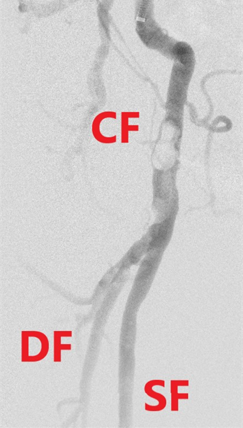
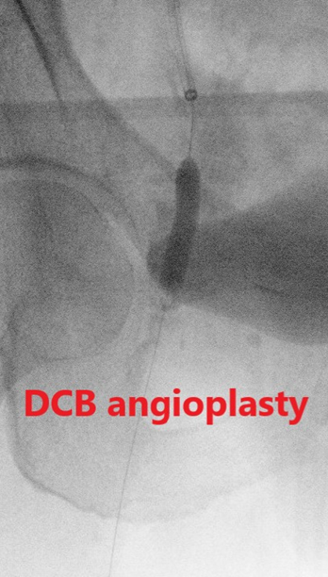
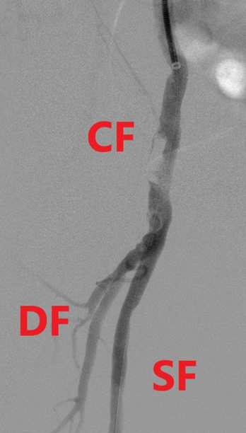
RESULTS

Slide 12
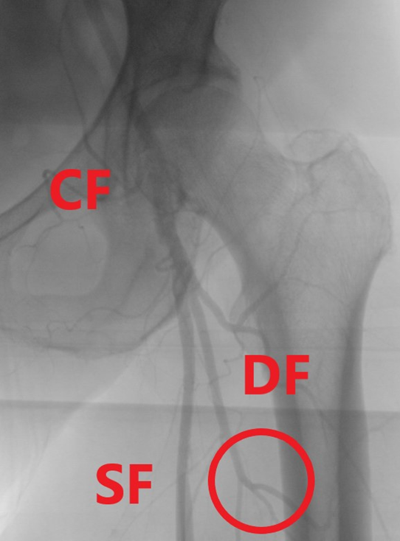
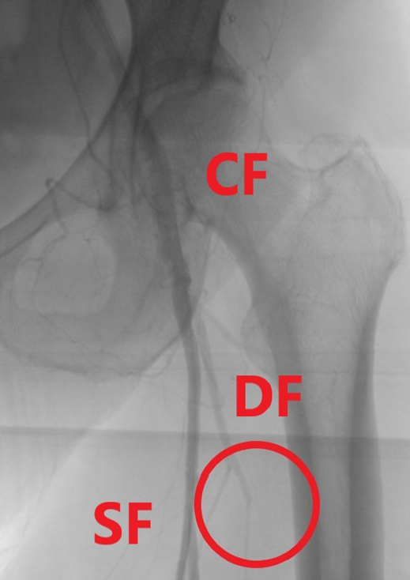
RESULTS
Deep femoral artery side branch embolization

Slide 13
RESULTS
Mean follow-up was 4 months.
Primary patency rate was 100 %.
1 death after one month following cardiac decompensation.
1 toe amputation.
2 patients with none-ST-elevation myocardial infarction, 1 on the 1st and 1 on
the 30th postoperative day.
2 patients with false aneurysm at the puncture site, one treated surgically and one with thrombin injection.
All patients with decreased Rutherford stage peripheral arterial disease

Slide 14
CONCLUSIONS
Rotational atherectomy followed by drug coated balloon angioplasty for common femoral artery calcified occlusive disease is feasible and safe.
The advantages are
- to avoid the potential complications of the surgical treatment
- to leave nothing behind
Long term results will be required.
Enrollment and follow-up are on-going.

