Slide 1
The Vienna self-assessment questionnaire,
a tool towards more health-literate hospitals ?
Three explorative case studies in Belgium
EPH/EUPHA 2022 Berlin
Abstract W202200123
Dr. Gilles Henrard
Prof. Jany Rademakers
Notes:
12 min
Assume ton frenchglish, parle calmement.
Good morning to all of you,
I’m happy to open the dance
My name is Gilles Henrard and I am mostly a field clinician, working as a GP in a primary care team, beside this i’m also a « part time » teacher, running a Phd, at Liege university, french speaking part of belgium, as you can hear it from my accent.

Slide 2
Background
Tackling « unnecessary complexity » in health institutions
Role of self-assesment tools (questionnaires)
Vienna HLO tool for hospitals Pelikan et Dietscher 2016
Notes:
What motivates my work is the clear observation that health systems are very often far too complex for the people and the conviction that this “unnecessary complexity” is one of the faces of social exclusion.
What can be tried to tackle that complexity ? According to the literature…One way to develop more health literacy responsive institutions would be the use of self-assessment tools to raise awareness, mobilize stakeholders and help prioritize action.
At the time we began our study, we choosed to work with the V tool, It had been developed and tested in Austria by… At that time it was just available in german. Since then, the tool has been developed within networks and it has been translated into English and by the way a specific working group of M-POHL works now on a version adapted to primary care (you will hear about it from Dr De Gani in presentation n° 4).
((This is already maybe one of the key messages of today's session : tools, and the way they are used/applied, must be settings and goals specific (ateliers 2, Gugllberger)))

Slide 3
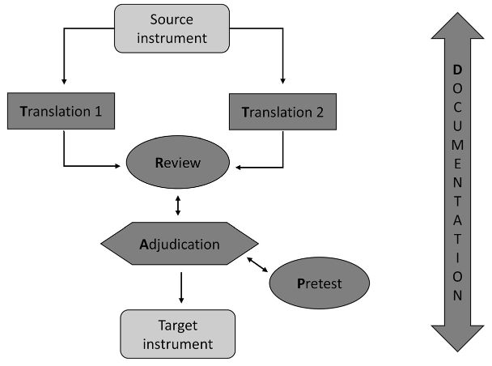
Methods (1/2)
TRAPD cross-cultural translation method
Henrard et al. BMC 2019
Cognitive interviews (« think aloud »)
with local experts
« Reconciliation » team meeting
Notes:
The original questionnaire was in German… Our first task was to translate and adapt it for the French-speaking Belgian context.
And thinking back , It was perhaps the most instructive part of the work, we used an interesting methodology, in wich you do not perform a traditional forward-backward translation, but two forward translations in parallel with a “reconciliation” meeting afterward, so it gives a lot of space to discussion and collegiality. To pretest our translated questionnaire we used “cognitive interviews”, local quality experts were asked to read the questionnaires and to “think aloud”, allowing us to dig into their minds…

Slide 4
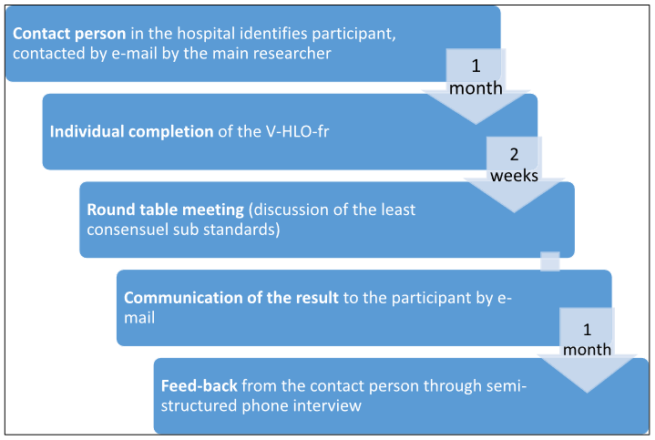
Methods (2/2)
Exploratory case studies in 3 hospitals
A two steps approach
with multidisciplinary panels
Round table meetings
2 hours
chaired and structured with a roadmap
Henrard et al. BMC 2021
Notes:
We applied the translated questionnaire by performing 3 explorative case studies in the main hospitals of Liège.
Our mode of application of the V-HLO-fr was a two step approach inspired by the way it had been applied in Austria : first, individual members of an internal multidisciplinary managers panel (build thanks to a person of contact…) filled out the questionnaire and then the results were discussed collectively in each hospital during a ‘round table’ meeting, whose process has been formalized :…
For the multidisciplinary panel, we invited quality and/
or care managers in the broadest sense (medical directors,
heads of department, quality managers, logistics
managers, human resources managers, hospital mediator
(ombudsman) and patients’ representatives) to participate.
by taking inspiration from the RAND method (The influence of this method took the form of individual quotations of the participants without the necessity for consensus, the presence of a chairman responsible for preparing and facilitating the round tables or the targeting of those discussions that seemed most necessary)
The feasibility of the process was assessed by direct observation of the round tables and with semi-structured phone interviews…

Slide 5
Main results
Insight about :
barriers regarding OHL in our local context
some strengths and weaknesses in terms of OHL in local hospitals
Overall positive signal about the feasibility of the V-HLO-fr
Notes:
Cognitive interviews with quality expert during the pretesting of the traduction allowed us to improve the translation, off course but also to identify possible barriers to the adoption of the tool (such as for example fear of overwhelming staff with too high standar of care, lack of attention for integration of hospital services with primary care inside the questionnaire) and contributed to the future development of the tool.
Strengths (e.g. the facilitation of patient navigation to the hospital) and weaknesses (e.g. the lack of provision of easy to read, understand and act on health information materials) in terms of health literacy responsiveness have been highlighted.
The tool was fully applied in the three targeted hospitals and the process seems to be at least acceptable, practicable and integrable.
3) Feedback to further refine its mode of application
Its mode of application, could be further improved, e.g. by paying more attention to recruiting and supporting participants.

Slide 6
Discussion
(Sometimes) lack of discrimination for priorization
Mainly useful as a « group facilitation » tool?
Evaluation of the impact of pragmatic intervention?
Notes:
Last slide.
Two main discussion points.
In one of the three hospitals, the ratings were not discriminating enough to identify strengths and/or weaknesses.
If particular attention should be paid to this aspect in future applications of the questionnaire, for example by recalling this particular objective of prioritization during the instructions or by allowing sufficient time to react during the discussions to allow participants to highlight the priority nature of certain items, it is also an opportunity to recall that the interest of the questionnaire lies in our view above all as a facilitator of a dynamic of group.
So Maybe we could change something on the dynamic of the round table meeting or proceed to a nominal group in a second step …?
But after all, we wonder if the real value of the tool would mostly be his “group facilitation” effect
The goal of my studies were analytical, but what about the évaluation of the impact of intervention buildt to change things on the ground ? (both positive or négative !). I don’t know if those questionnaires have the “psychometric properties / consistency” to measure change (I don’t think they have been validated that way). This remains an open question for me...
Ok, I’ve finished, tank you for your attention, for your tolerance to my sometimes chaotic English, the floor is yours.
Analytical vs pragmatic aim
In our study, the approach was just analytical : studying and refining a tool and its the processes of application or at most obtaining an organisational diagnosis. When it will be used to launch and accompany organisational change, the optimal way of implementing the tool (individual and/or collective, spread over several meetings or not) and very important “the right” stakeholders to target will have to be chosen according to the specifics of the context and the overall change strategy chosen. (Do not raise disproportionate expectations…)
Divers : pas co-créé, top down…
The V-HLO tool is neither the
result of a large participatory research, nor intrinsically
intended to be implemented in a participatory
manner. It is addressed to a narrow user target, in
their language, and the goal of our study was not to
fundamentally reshape it. This aspect could be considered
as an opportunity by remembering that the
purpose of self-assessment tools, apart from organisational
diagnosis, is to raise awareness and gain su
of the management level inside hospital,
indispensable in order to allow structural adoption of
innovation in such large organisation

Slide 7
Thanks for your attention
gilles.henrard@uliege.be

