Slide 1
Auroral Main Structure & Dynamics Overview
Bertrand Bonfond
Notes:
PAGE D'INTRODUCTION 1 / page permettant l'insertion du titre de la présentation ainsi que d'autres infos (date, lieu, orateur, sous-titre,…)
Si vous souhaitez modifier la photo de fond :
Allez dans le menu « Affichage » > « Masques » > « Masque des diapositives »
Supprimez l’image du drapeau déjà présente
Allez dans « Insertion » > « Photo » et chargez votre image (en veillant à la bonne qualité de celle-ci)
Placez celle-ci en « Arrière-plan » via le menu « Réorganiser »

Slide 2
What did we know before Juno?

Slide 3
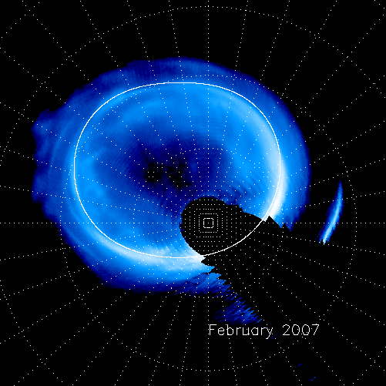
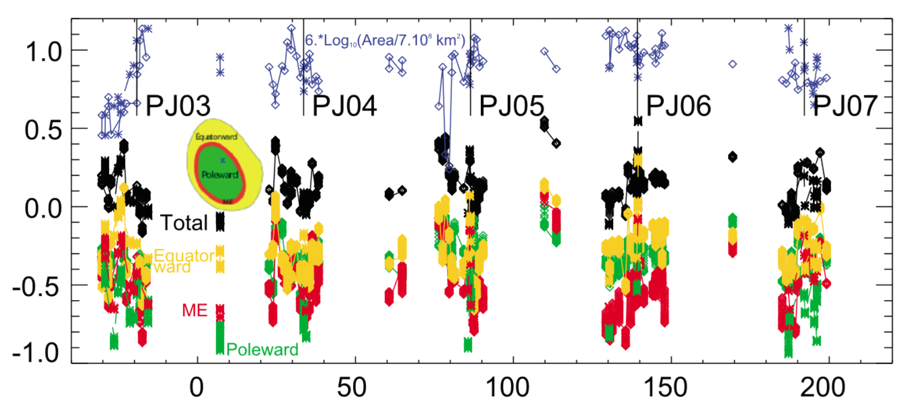
The 3 parts of the Jovian aurora
Equatorward (or outer) emissions
Main emissions
  on the main oval
  can be irregular
  typically maps 30-60 R_{J}
Polar emissions
Each typically account for 1/3 of the total H₂ UV power.
Bonfond et al. 2012
Grodent et al. 2017

Slide 4
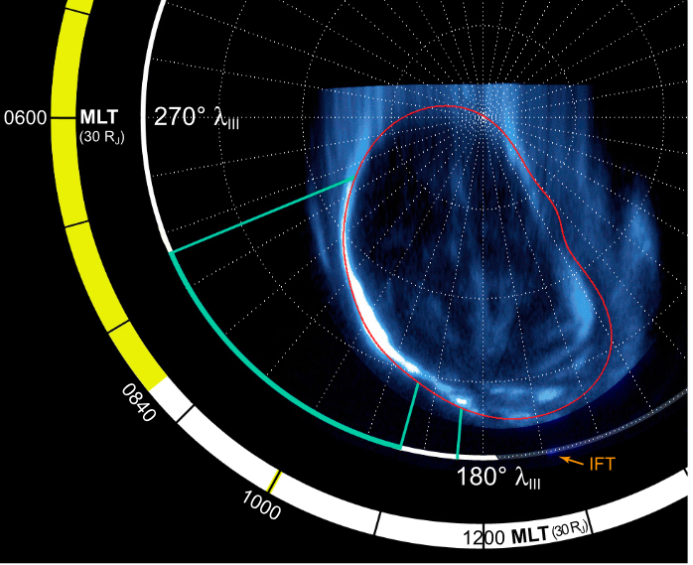
Dawn storms
Intense brightening of the dawn arc
Transient
High CR
Gustin et al. 2006

Slide 5
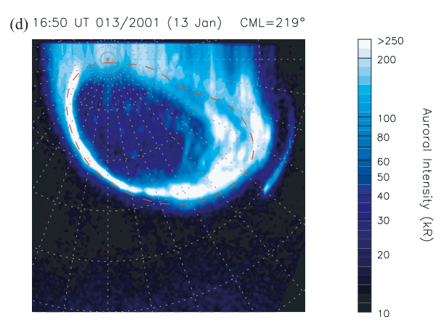
Response to solar wind shocks
In all studies (Nichols et al. 2007, Nichols et al. 2009, etc.), the whole main (+polar) emissions brighten
The dusk side becomes nore complex, forming parallel arcs inside the main oval
Nichols et al. 2007

Slide 6
What are the main emissions?
The typical definitions usually contain 3 different approches
  Forms a (quasi-)continuous contour
  Maps to 30-60 RJ
  Caused by corotation enforcement currents
Personal takes:
  Not so easy to identify (what to do with multiple arcs?)
  not always mutually compatible
  Is it a boundary (for flares and injections)?

Slide 7
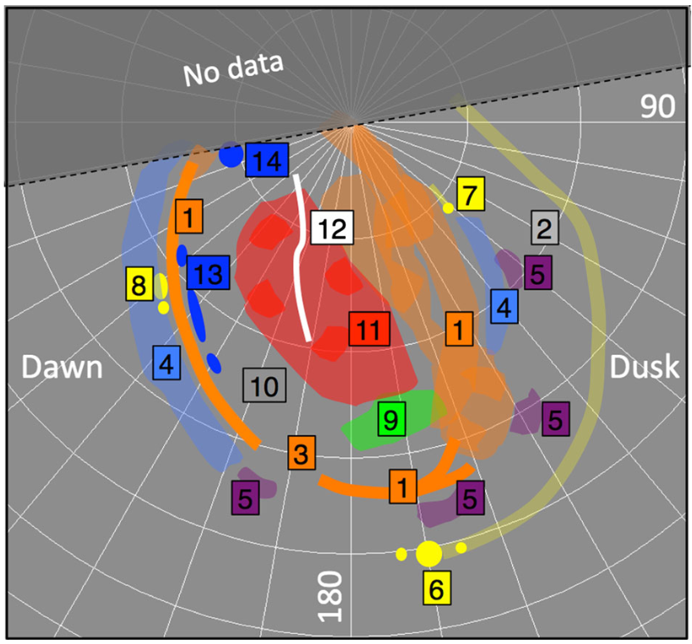
The main emission has substructures
Dusk arcs
Discontinuity in the pre-noon sector
Transient small scale features around noon
Pulsating arcs
Grodent 2015

Slide 8
What did we learn in the Juno era?

Slide 9
Overall behaviour of the main emissions

Slide 10
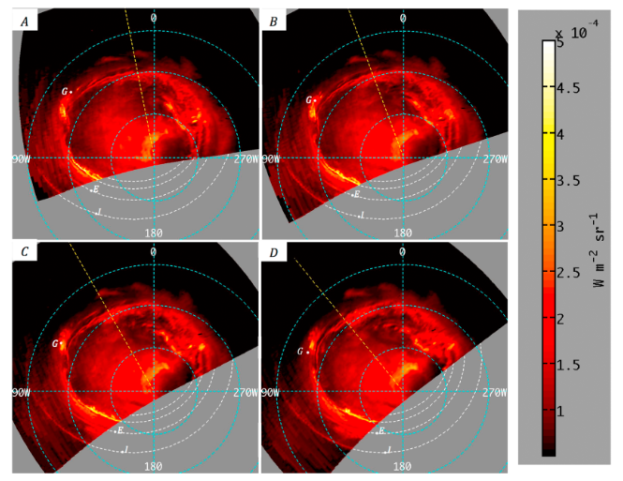
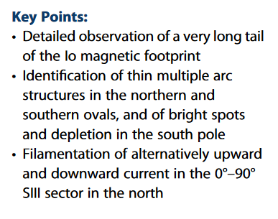
First high-definition images of the aurora: infrared
Identification of thin (~200 km) multiple arcs in both hemispheres
Complex morphology, especially on the dusk side
Mura et al. 2017

Slide 11
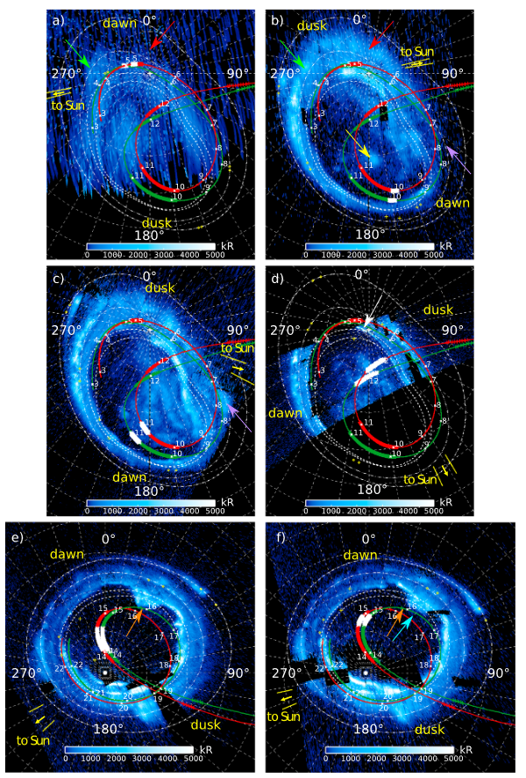
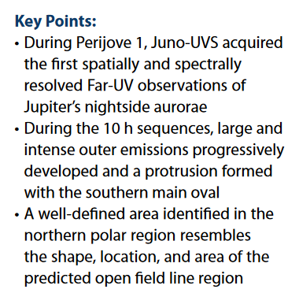
First high-definition images of the aurora: ultraviolet
Complexity/non-uniformity of the ME
Narrow auroral arcs (down to ~100km)
New auroral forms in the night sector (similar to the terrestrial omega aurora)
Bonfond et al. 2017

Slide 12
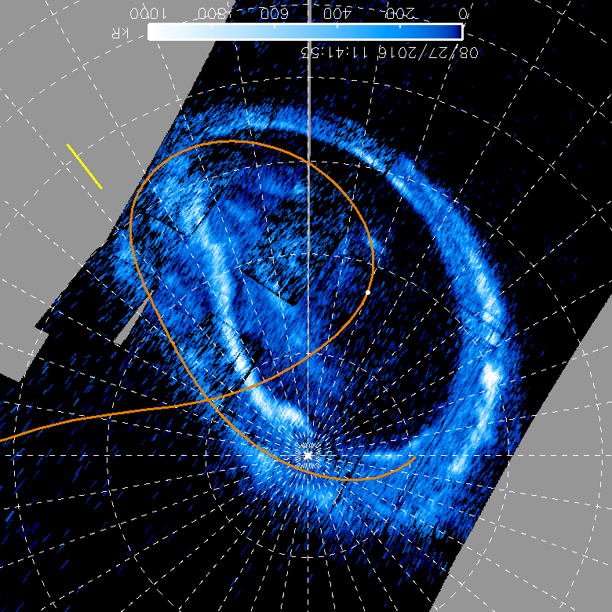
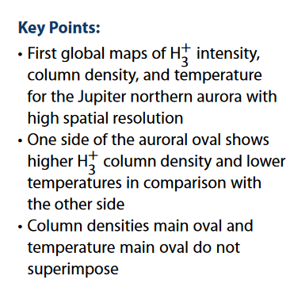
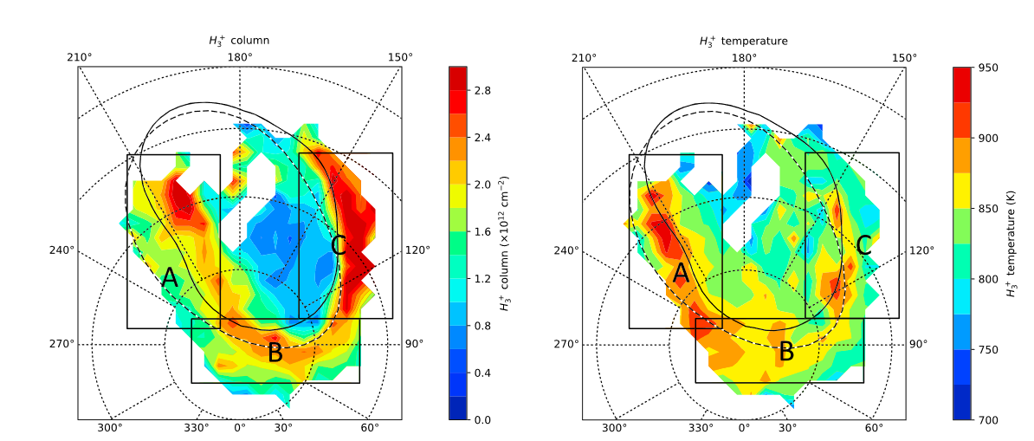
Maps of the H₃⁺ column and temperature
Column densities and temperatures do not particularly match each other, neither for the main emissions nor for the outer emissions
Dinelli et al. 2017

Slide 13
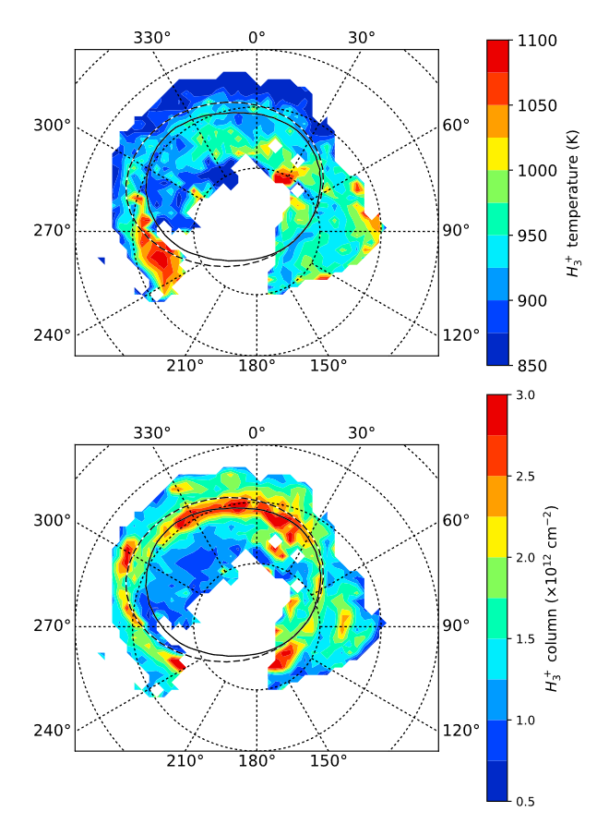
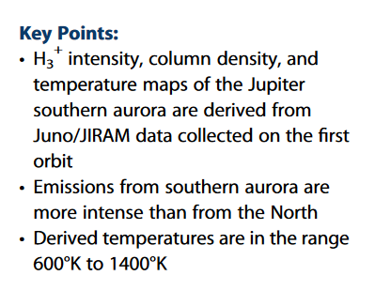
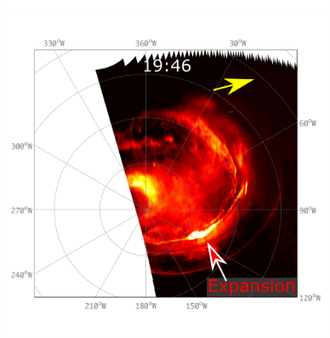
High H₃⁺ temperatures in the dawn storm region
H₃⁺ column and temperature are not corelated
More intense emissions then in the north
High temperature at the dawn storm
Adriani et al. 2017

Slide 14
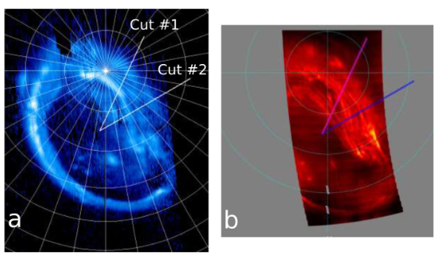
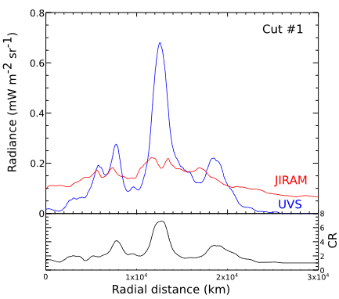
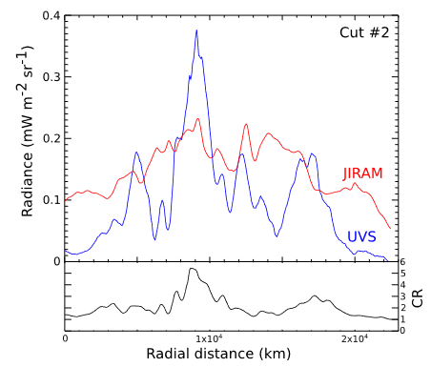
Comparaison IR/UV
Lower constrasts in the IR compared to UV
Complex relation between the electron energy input, their characteristic energy and the H₃⁺ emission.
Low values of the H₃⁺ intensity relative to the H₂ brightness are observed in regions of high FUV color ratio
The rapid loss of H+ 3 ions reacting with methane near and below the homopause
Gérard et al. 2018

Slide 15
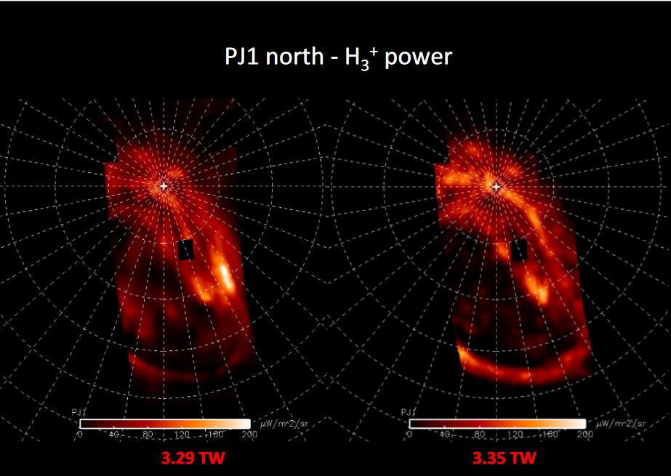
Comparison of the H₃⁺ heating, inferred from UVS measurements and H₃⁺ cooling, from JIRAM
The H₃⁺ cooling in the aurora is ~0.5 time less than the particle collisional heating.
The comparison of the H₃⁺ modeled radiance map with the JIRAM observations shows general good agreement with some local differences.
Gérard et al. 2022

Slide 16
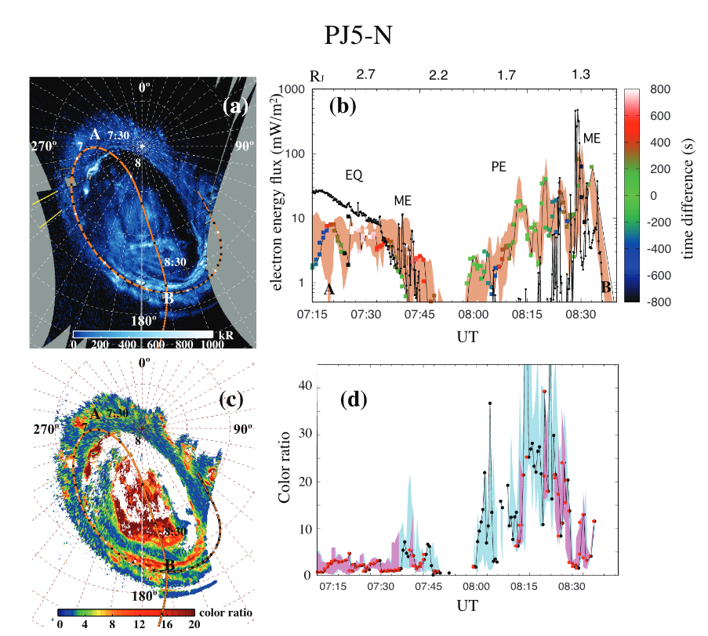
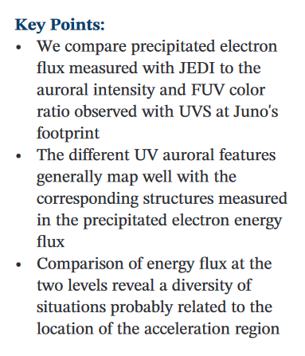
High latitude in-situ/UV comparison
The comparison between the precipitating energy flux and the JRM09 brightness profile leads to ambiguous conclusions for the ME
Gérard et al. 2019

Slide 17
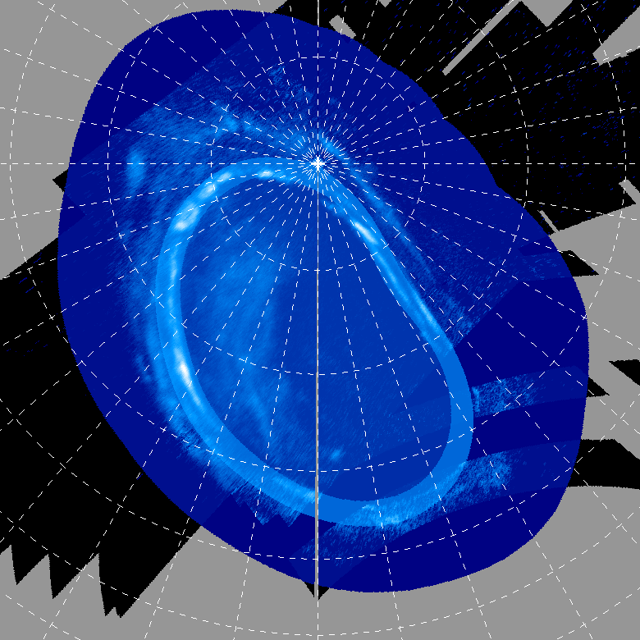
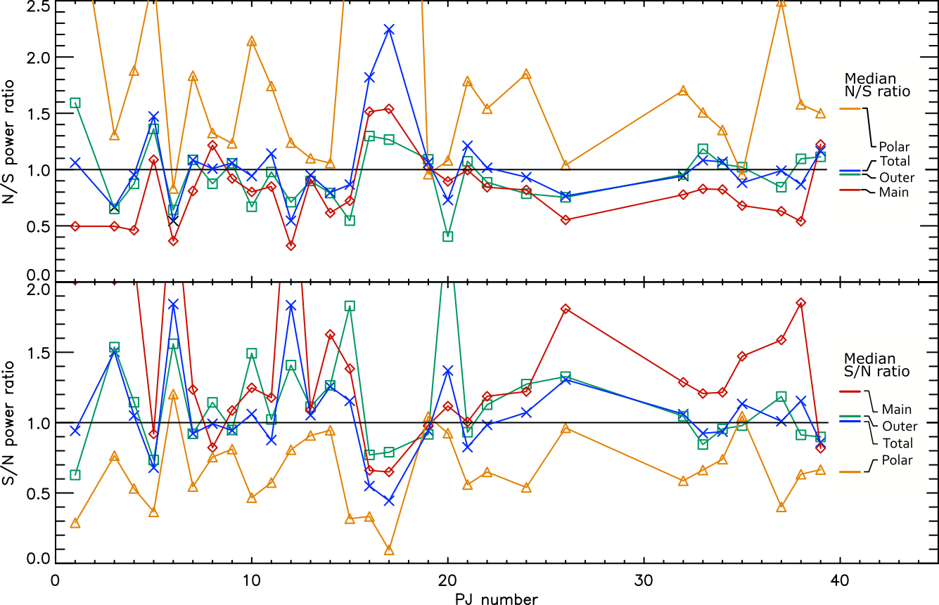
North-South asymmetry
Comparisons using UVS observation from both hemispheres shows that southern ME emitted power > northern ME e.p.
Consistent with measurements of the larger electric currents in the South (e.g. Kotsiaros et al. 2028, Al-Saati et al. 2022)
Bonfond et al., in preparation

Slide 18
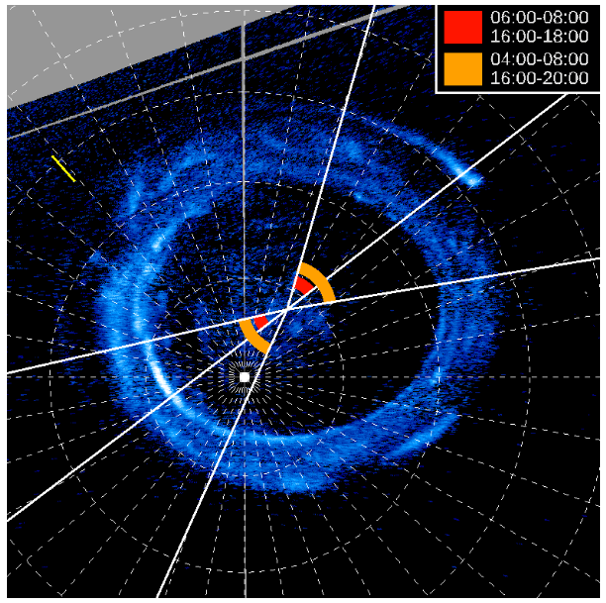
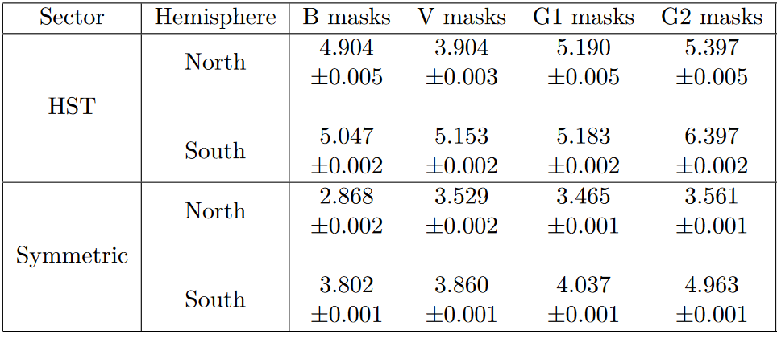
Dawn/dusk asymmetry of the ME UV power
Different methods to define the ME all lead to the same results
Dusk emissions are generally brighter than the dawn emissions
Groulard et al., in preparation

Slide 19
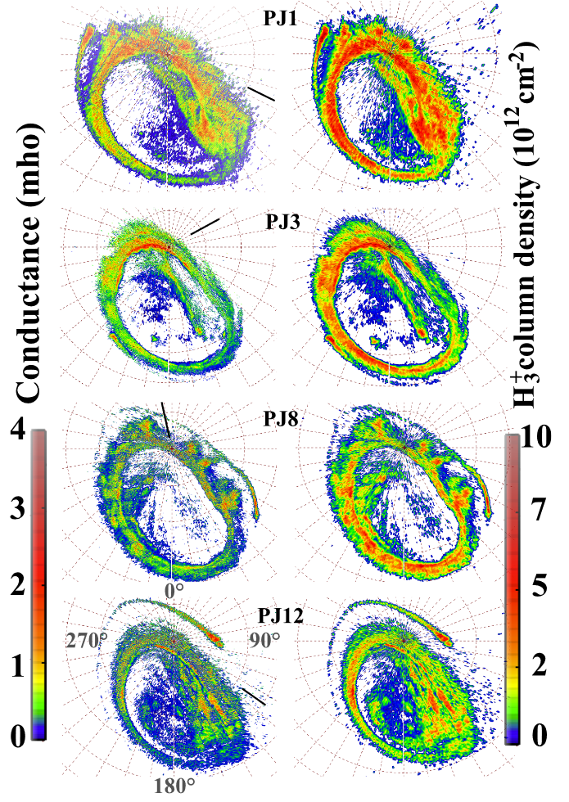
The auroral emissions are the main cause of the ionospheric conductance
UV multispectral observervations used to derive maps of the Perdersen conductance
Auroral precipitations increase the conductance from 0.1 to several mohs
Gérard et al. 2020

Slide 20
Interactions with the solar wind

Slide 21
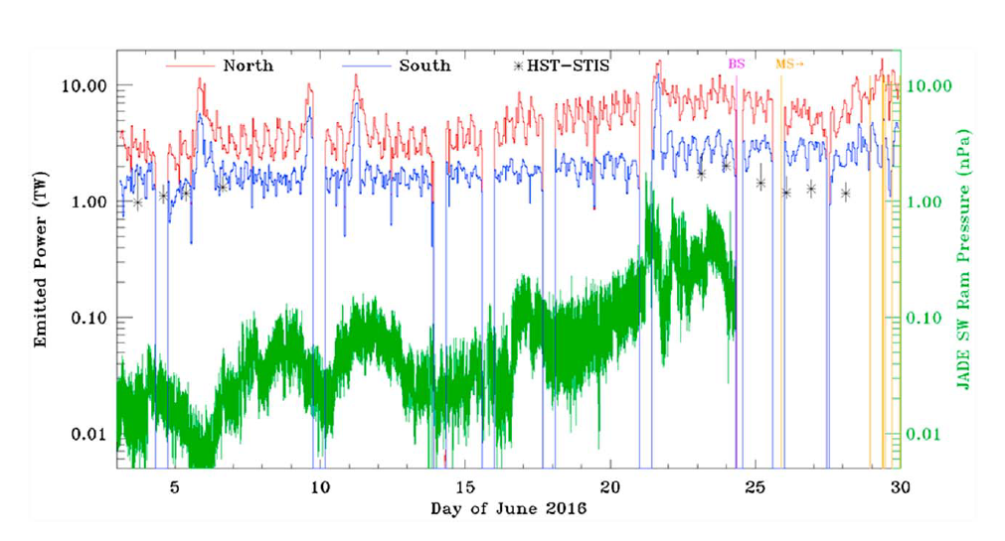
Monitoring of the aurora
Several brightenings independent of the SW
1 associated with a CIR arrival
Gladstone et al. 2017

Slide 22
Auroral response to the solar wind
During compressions, the main emissions and the dusk poleward region brightened
The equatorward emissions brightened independently, following a sodium nebula enhancement
Nichols et al. 2017

Slide 23
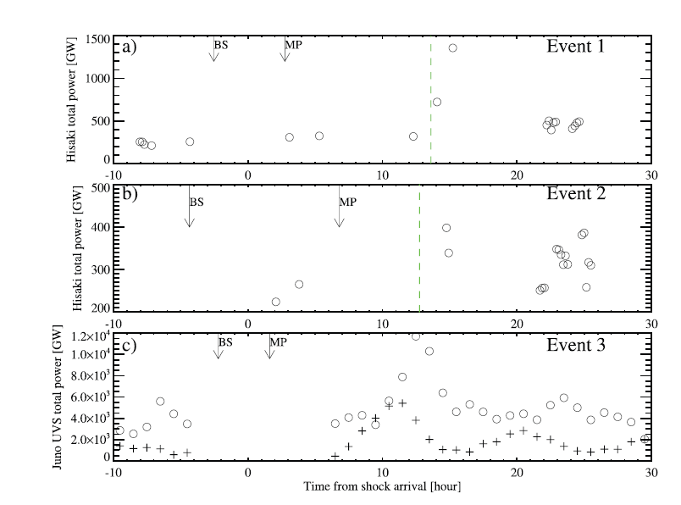
Lag between shock arrival and UV brightening
Hisaki observations of the whole aurora when Juno in SW
Transient brightening with a 10 hrs lag time.
Kita et al. 2019

Slide 24
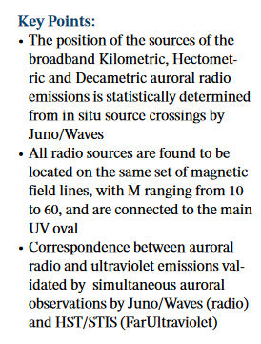
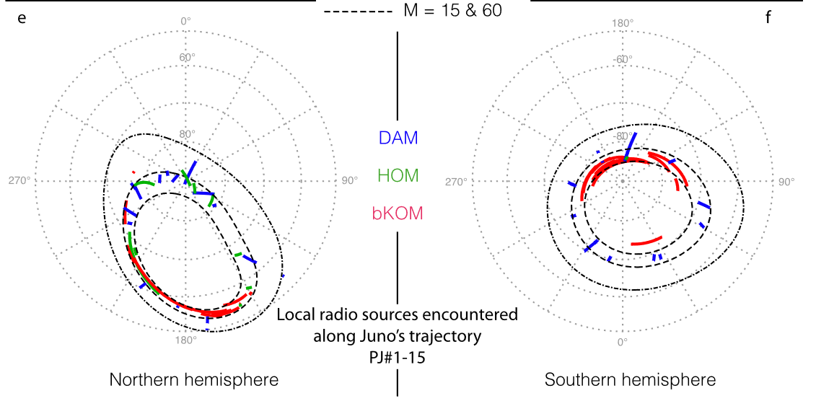
Radio and UV auroral emissions
Observations of radio source emissions
  mapping on the planet
Good correspondance between radio sources footprints and UV aurora
Louis et al. 2019

Slide 25
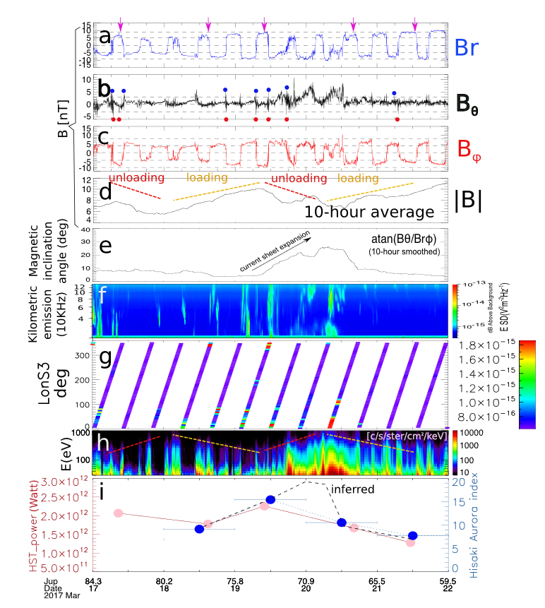
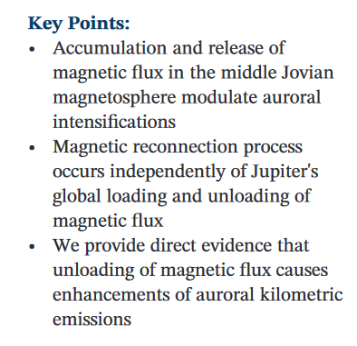
Magnetic loading/unloading under SW compressions
During SW compression, accumulation/release of magnetic flux
Unloading corresponds to enhanced KOM and UV emitted power
Yao et al. 2019

Slide 26
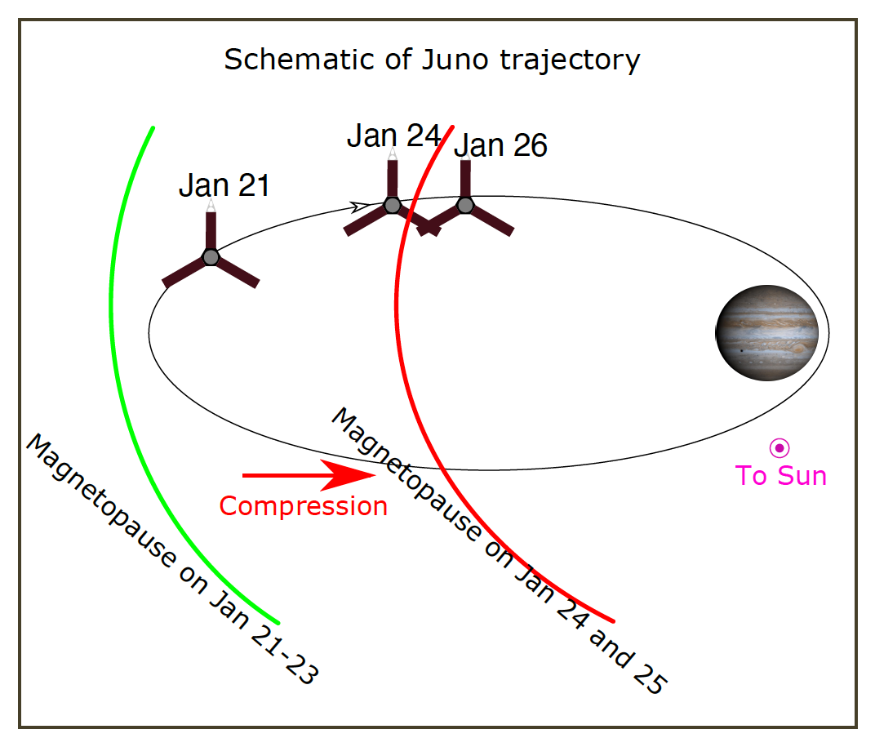
Main Aurora Brightening vs. Dawn Storm
MAB a all local times (including noon)
MAB during compressions
No MAB during expansion
DS possible at any time
Yao et al. 2022

Slide 27
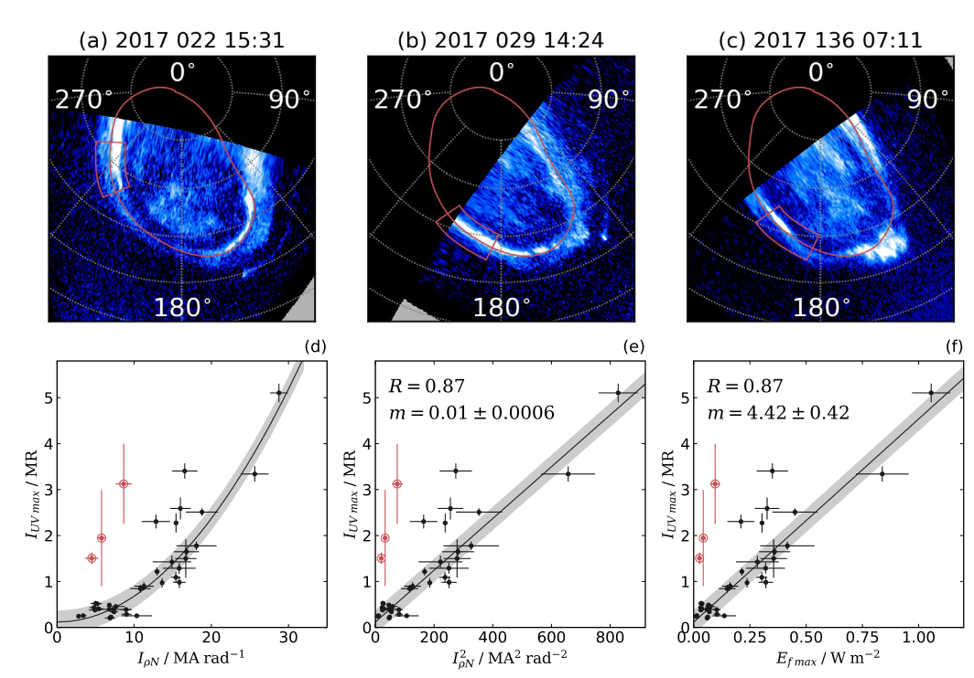
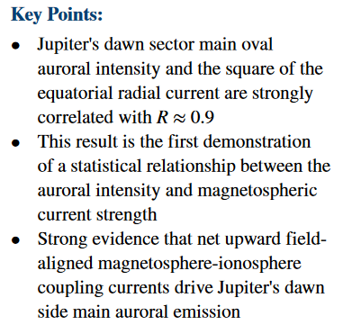
Dawn-side ME and equatorial radial currents
Strong correlation between the auroral intensity of the dawn arc and the square of the equatorial radial currents
Nichols and Cowley, 2022

Slide 28
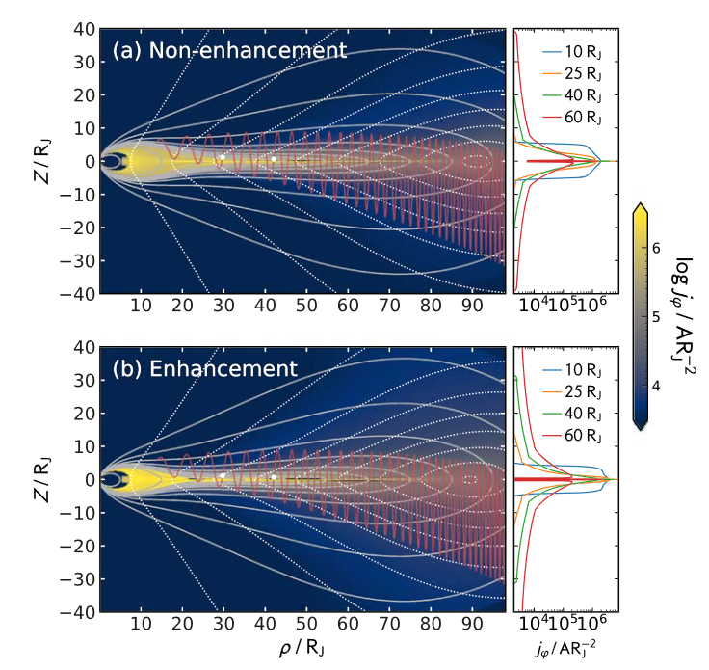
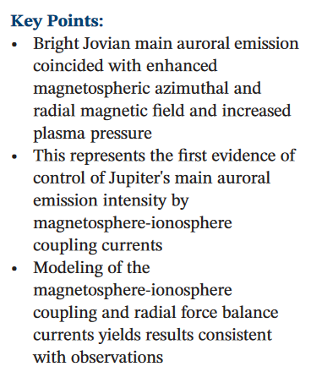
Brightening of the ME
Bright Jovian main auroral emission coincided with enhanced magnetospheric azimuthal and radial magnetic field and increased plasma pressure
Modeling of the magnetosphere‐ionosphere coupling and radial force balance currents yields results consistent with observations
Nichols et al., 2022

Slide 29
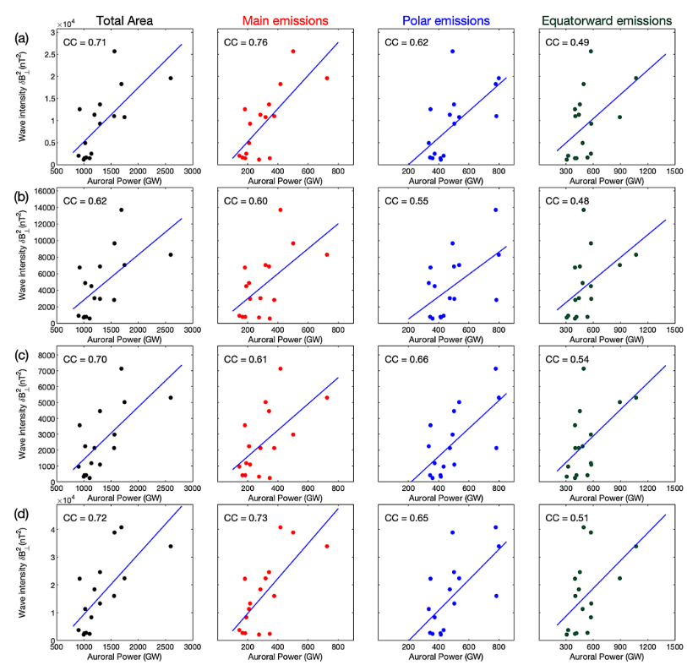
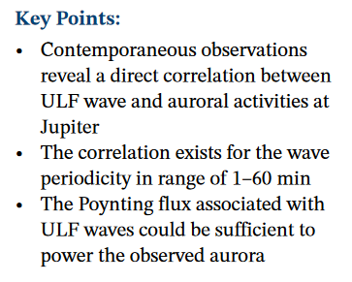
ULF waves and aurora
Correlation between ULF waves and the ME auroral power
Poynting flux associated with these waves could be sufficient to power the aurora
Pan et al. 2021

Slide 30
Dawn storms

Slide 31
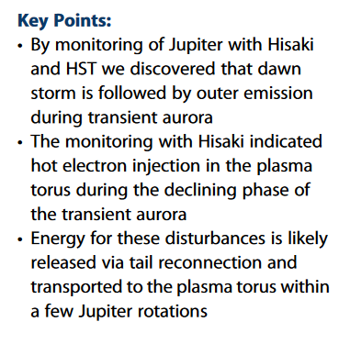
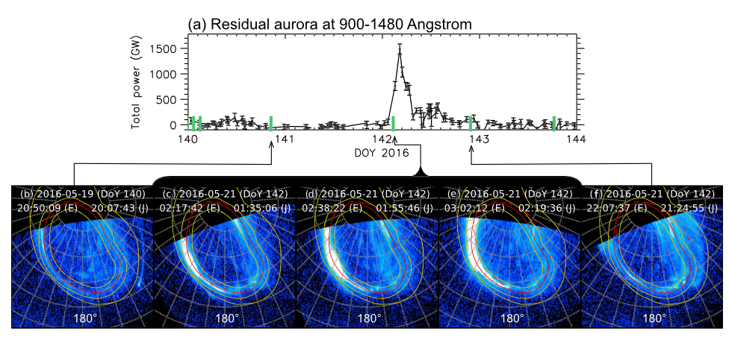
Extreme dawn storm
Extreme dawn storm recorded by both HST and Hisaki, followed by injection signatures
Hot electron injection heated the plasma torus during the declining phase
Likely associated with tail reconnection
SW as a trigger?
Kimura et al. 2017

Slide 32
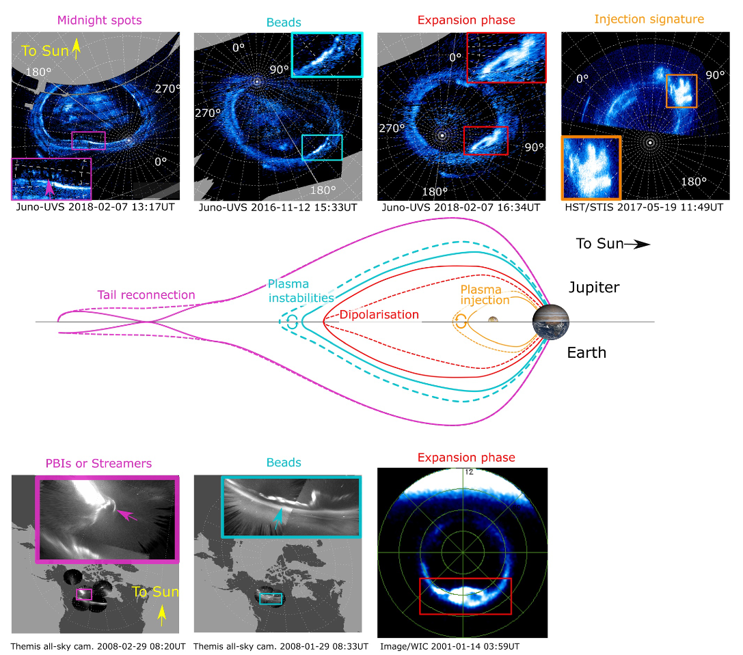
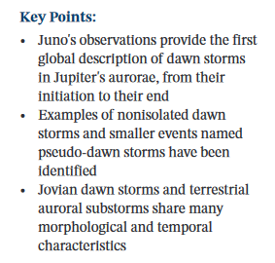
Overview of the full dawn storm sequence
Full development of DS, from the initiation on the night to their end as injection signatures
Non-isolated DS and pseudo-DS
Jovian DS and terrestrial substorms share many morphological and temporal characreristics
Bonfond et al. 2021

Slide 33
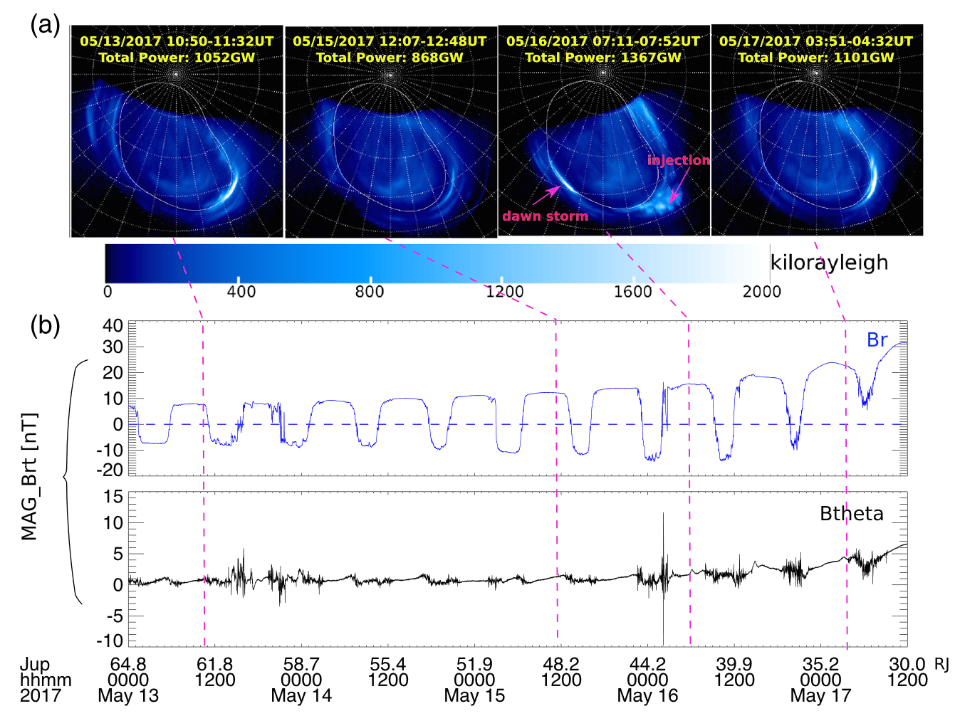
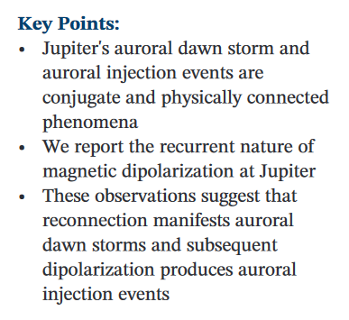
Reconnection and dipolarisation connected to dawn storms
Magnetic reconnection signatures and dipolarisation signatures are observed on field lines mapping towards a dawn storm and the subsequent injection signatures
Yao et al. 2020

Slide 34
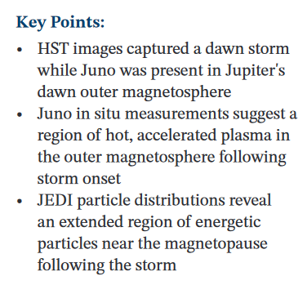
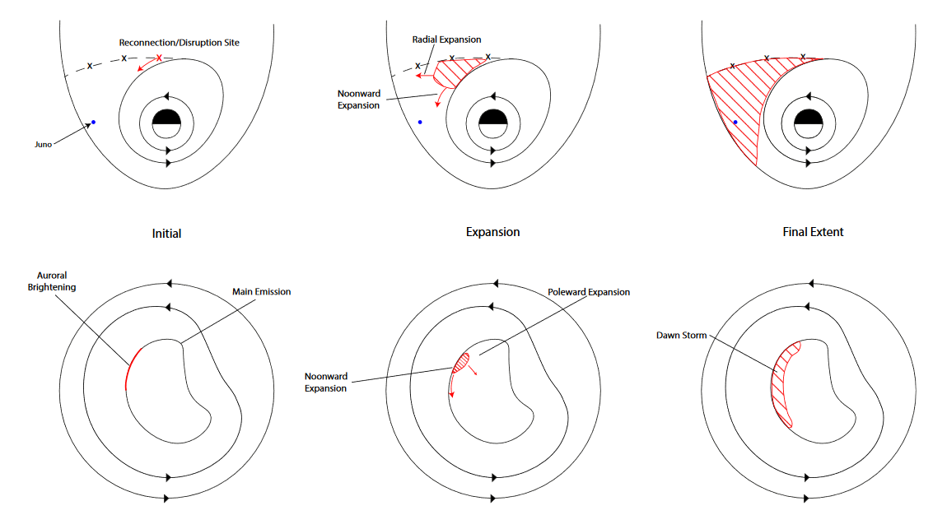
Dawn storm signature in the outer magnetosphere
Juno in situ measurement suggest a region of hot, accelerated plasma in the outer magnetosphere following the dawn strom onset
Swithenbank-Harris et al. 2021

Slide 35
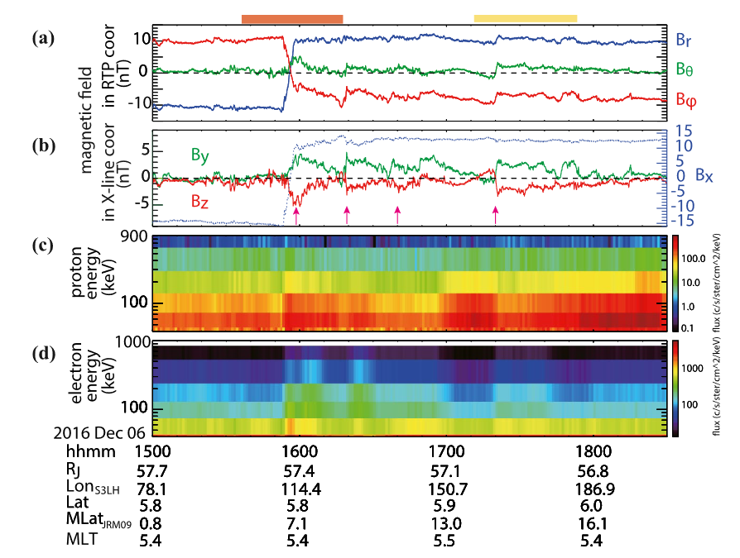
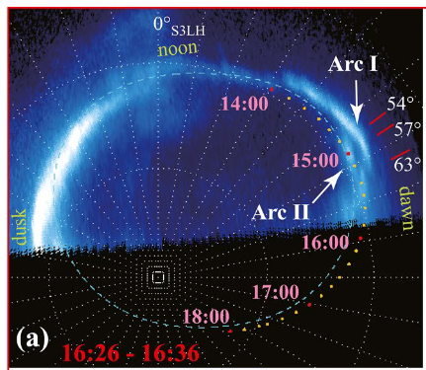
Dawn-side double arc and reconnection
Transient polar-most arc and equatorward motion
Multiple reconnection fronts observed by Juno => drizzle reconnection?
Guo et al. 2021

Slide 36
Conclusions
Small scale substructures
Asymmetries
Response to the SW
  Systematic brightnening at all LT
  ~10 hrs delay
  Short timescale pulsations
  Correlations on the dawn side
Dawn storms
  Usually unrelated to SW shock
  Start at midnight and unfolds similarly to Earth substorms
  Large scale reconnection/ dipolarisation/injections
  Pseudo-dawn storms
  Double arcs and drizzle reconnection

Slide 37
Thanks

Slide 38
Additional ressources from the Juno era (but not based on Juno data)

Slide 39
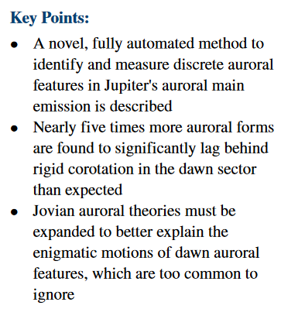

Illuminating the Motions of Jupiter's Auroral Dawn Storms
Rutala et al. 2022

Slide 40

VariaPeriodic Emission Within Jupiter's Main Auroral Ovalbility of the ME
Nichols et al. 2017

Slide 41


Jupiter's Aurora Observed With HST During Juno Orbits 3 to 7
Grodent et al. 2017

Slide 42


Variability of Jupiter's Main Auroral Emission and Satellite Footprints Observed With HST During the Galileo Era
Vogt et al. 2022

Slide 43


Nichols et al. 2019

Slide 44


Six Pieces of Evidence Against the Corotation Enforcement Theory to Explain the Main Aurora at Jupiter
Bonfond et al. 2020

