Slide 1
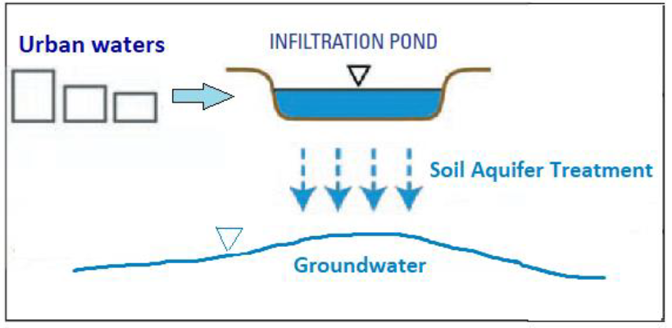

Risk assessment of groundwater contamination during managed aquifer recharge with urban waters in the Geer basin (Liège, Belgium)
MARISS programme
Monday, August 29th, 2022
Presenter: Robin Glaude

Slide 2
Table of contents
Personal background
Expectations about MARISS
Description of the research work + Work plan
Open questions
Discussion
Notes:
Simple contenu de la présentation

Slide 3
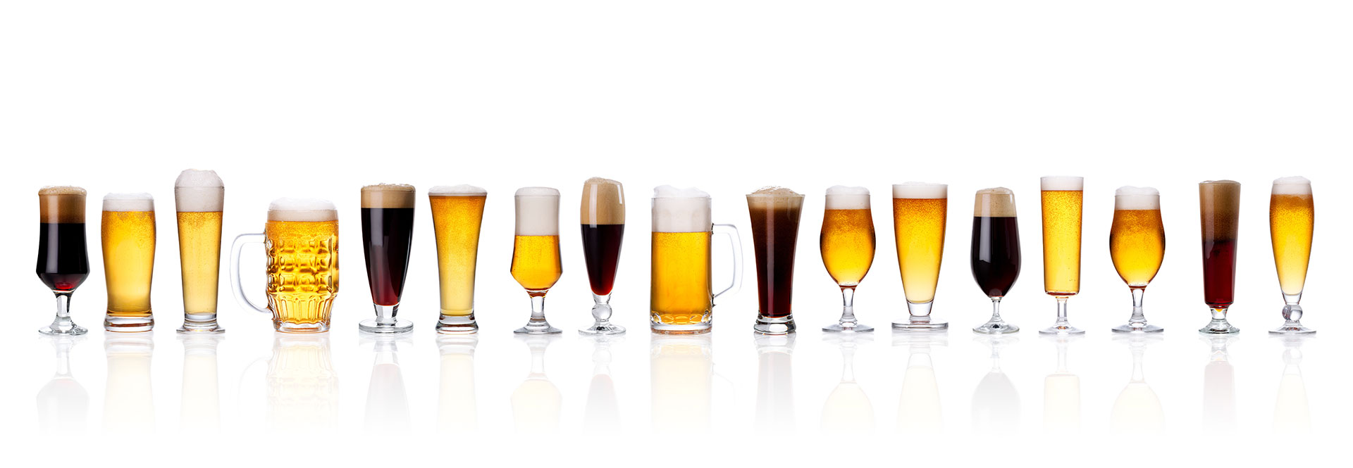

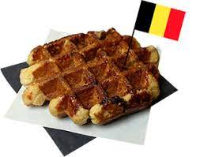
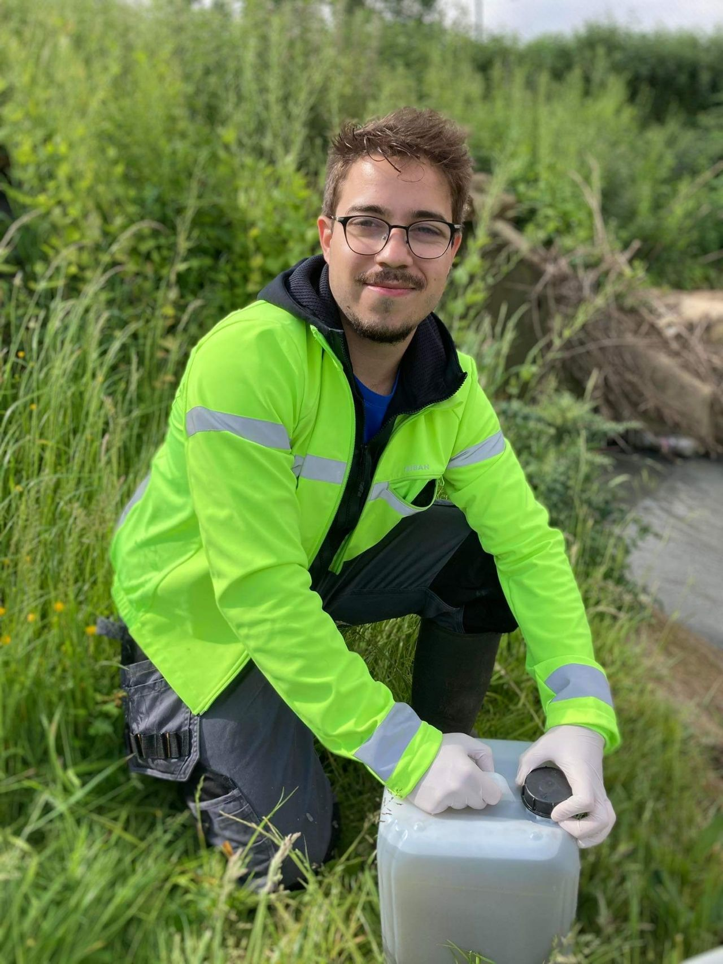
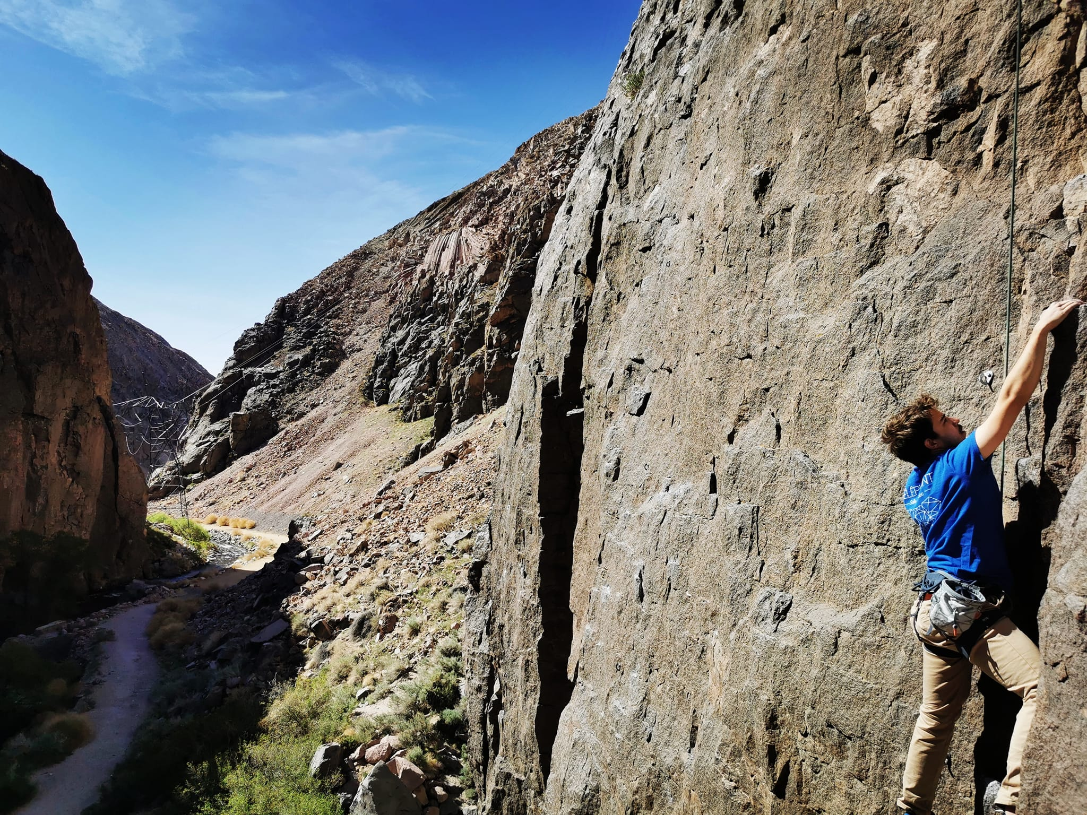
Personal background
Name: Robin Glaude
Country: Belgium
Institution: University of Liège, HGE Department (Hydrogéologie et Géologie de l’environnement)
Hobbies: Climbing, playing the guitar, learning languages, traveling, etc…
Most importantly,
I am an hydrogeologist
Notes:
Simple contenu de la présentation

Slide 4
Professional background
2015- 2018: Bachelor degree in Sciences of Engineering at the University of Liège (Belgium)
2018-2020: Double Master degree in Geological engineering at the University of Liège (Belgium) and Environmental Engineering at the University of Bologna (Italy)
2020-2021: Research Assistant in the Hydrogeology Department of the University of Liège. Development of regional groundwater numerical models in Wallonia in order to predict the impact of rainfall shortages on groundwater.
2021-2025 (Hopefully): PhD fellow in the Hydrogeology Department of the University of Liège.
Notes:
Simple contenu de la présentation

Slide 5




Expectations about MARISS
Getting useful knowledge about MAR aspects related to my thesis (more details in open questions)
Learn more about INOWAS platform
Connect with people working in complementary fields of work
4. Have fun !
Notes:
Simple contenu de la présentation

Slide 6
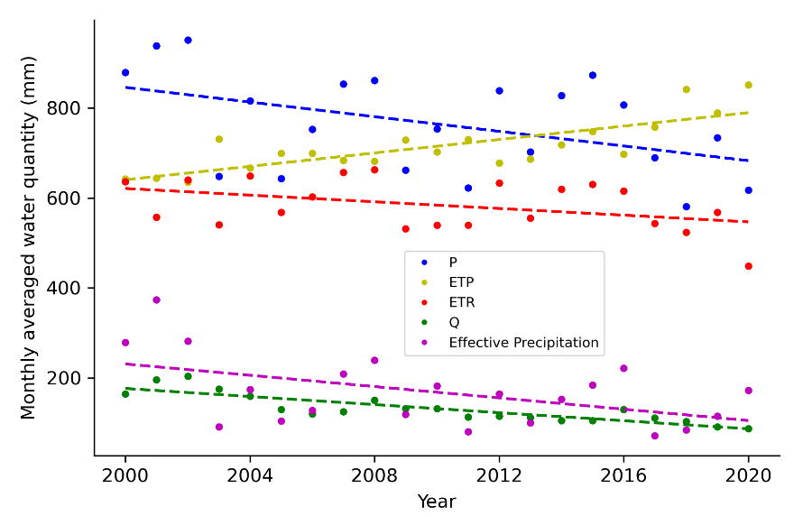

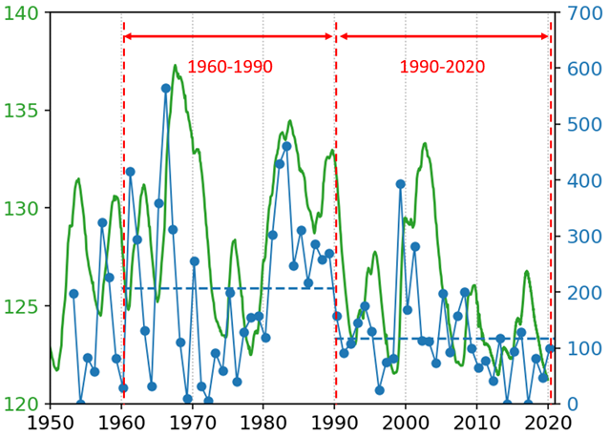




Research work: background [1]
Annual hydrological balance in the Geer basin
Climate change
Increase in global mean temperature
Increase evapotranspiration rates
Affect subsurface water storage
Recharge evolution in the Geer basin
Increase’s occurrence of hydrological extremes
Floods (e.g. summer 2021)
Droughts
Notes:
Le changement des températures affecte le cycle hydrologique. Si les taux d’évapotranspiration changent, il en est de même pour les taux d’infiltration des aquifères d’où l’observation d’une tendance à la baisse des niveaux piézométriques dans de nombreux aquifères.
Exemple avec le bassin du Geer où l’on voit le changement des facteurs climatiques ces dernières années + la diminution de la recharge.

Slide 7
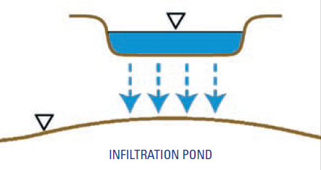
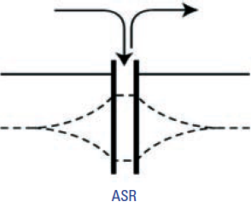
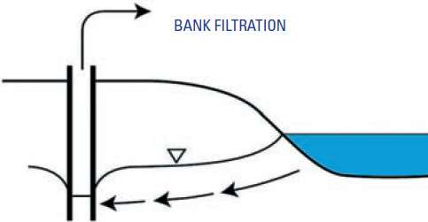
Research work: background [2]
MAR techniques
« Avoid the unmanageable, manage the unavoidable »
Managed aquifer recharge (MAR) increasingly seen as
a solution to store water in aquifers for subsequent recovery
or environmental benefits.
Other beneficial aspects such as improving recharge water quality
through Soil Aquifer Treatment (SAT) or as a flood remediation measure
Water sources in urban areas
Stormwater, treated wastewater, etc…
Notes:
Plus uniquement dans pays méditerranéens mais également en climat tempéré.
En environnement urbain, pas le choix de traiter avec des eaux urbaines (pas uniquement eaux de surface)

Slide 8

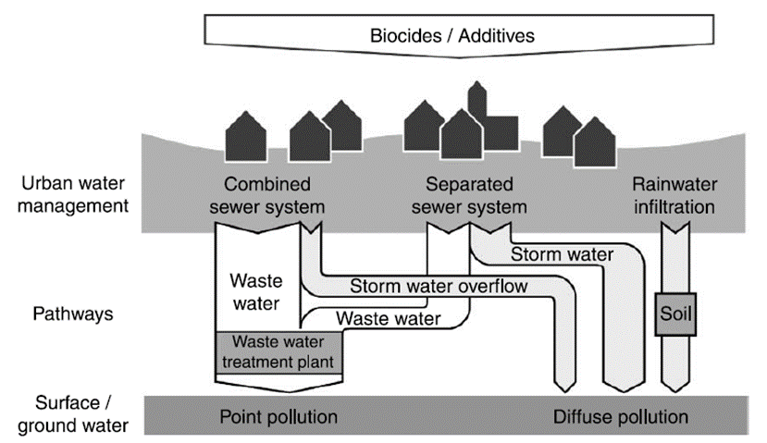
Research work: background [3]
Unfortunately, wide range of pollutants in urban waters
e.g. urban stormwater: total suspended solid (TSS), heavy metals,
polycyclic hydrocarbons and nutrient
Also series of contaminants called of « emerging concerns »
such as pharmaceuticals, polyfluoroalkyl substances (PFAs),
personal care products, etc…
Need to ensure that no risk of groundwater deterioration during MAR operations with urban waters
Burkhardt et al., 2007
Subject of my PhD
Notes:
On trafficked surface, accumulation of particulate matter (dust, tire wears, breaks,).

Slide 9
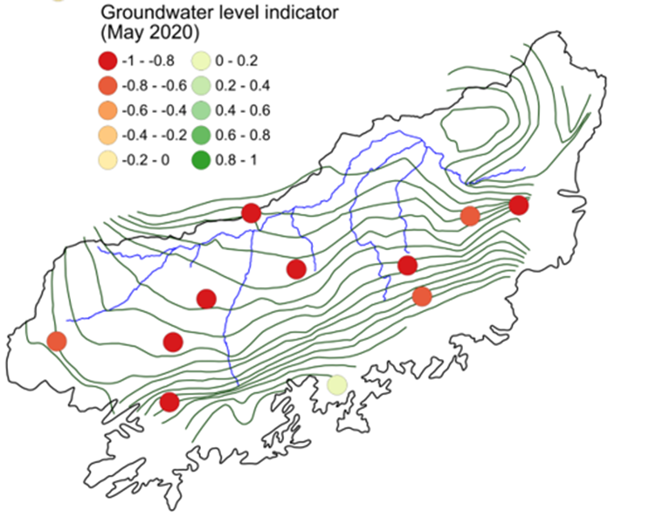
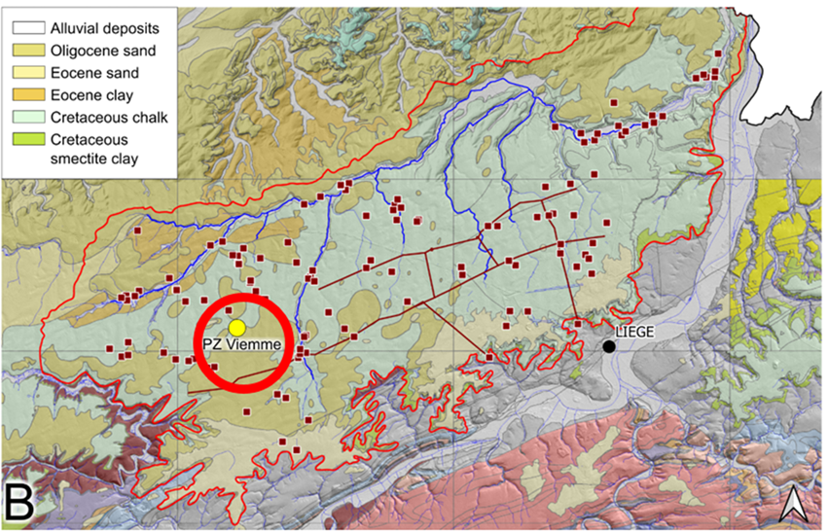
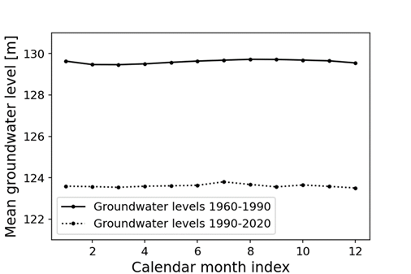
Research work [1]
Hesbaye’s aquifer considered as a representative case study to support and illustrate research development for several reasons:
Clear decreasing trend in groundwater levels (relevant for MAR operation)
Major source of drinking water for the city of Liège
Huge volume of storage due to its dual chalk porosity
Plenty of existing studies related to this aquifer as well as future ones related to MAR
Goderniaux et al., 2020

Slide 10
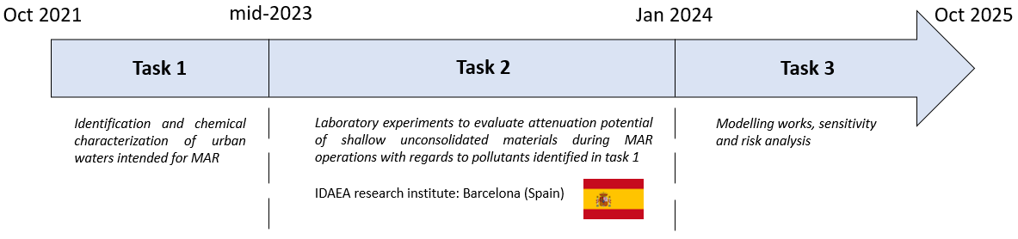
Research work [2]
The research will be divided into 3 main tasks:
Identification and chemical characterization of urban waters intended for MAR
Study the fate of selected contaminants during infiltration for MAR purposes
Modelling works, sensitivity and risk analysis
Current work

Slide 11



Research work [3]
The first Task (and current work) focuses on the chemical characterization of urban waters intended for MAR
Different types of urban waters can be considered
It has been decided to study runoff water from stormwater basins connected to highways
And Liège’s airport area
Water samples collected in May 2022 and other sampling campaign planned in December 2022
Pollutants identified and quantified with advanced mass spectrometry analytical methods
Notes:
Pas le temps de présenter les résultats de recherche maintenant

Slide 12
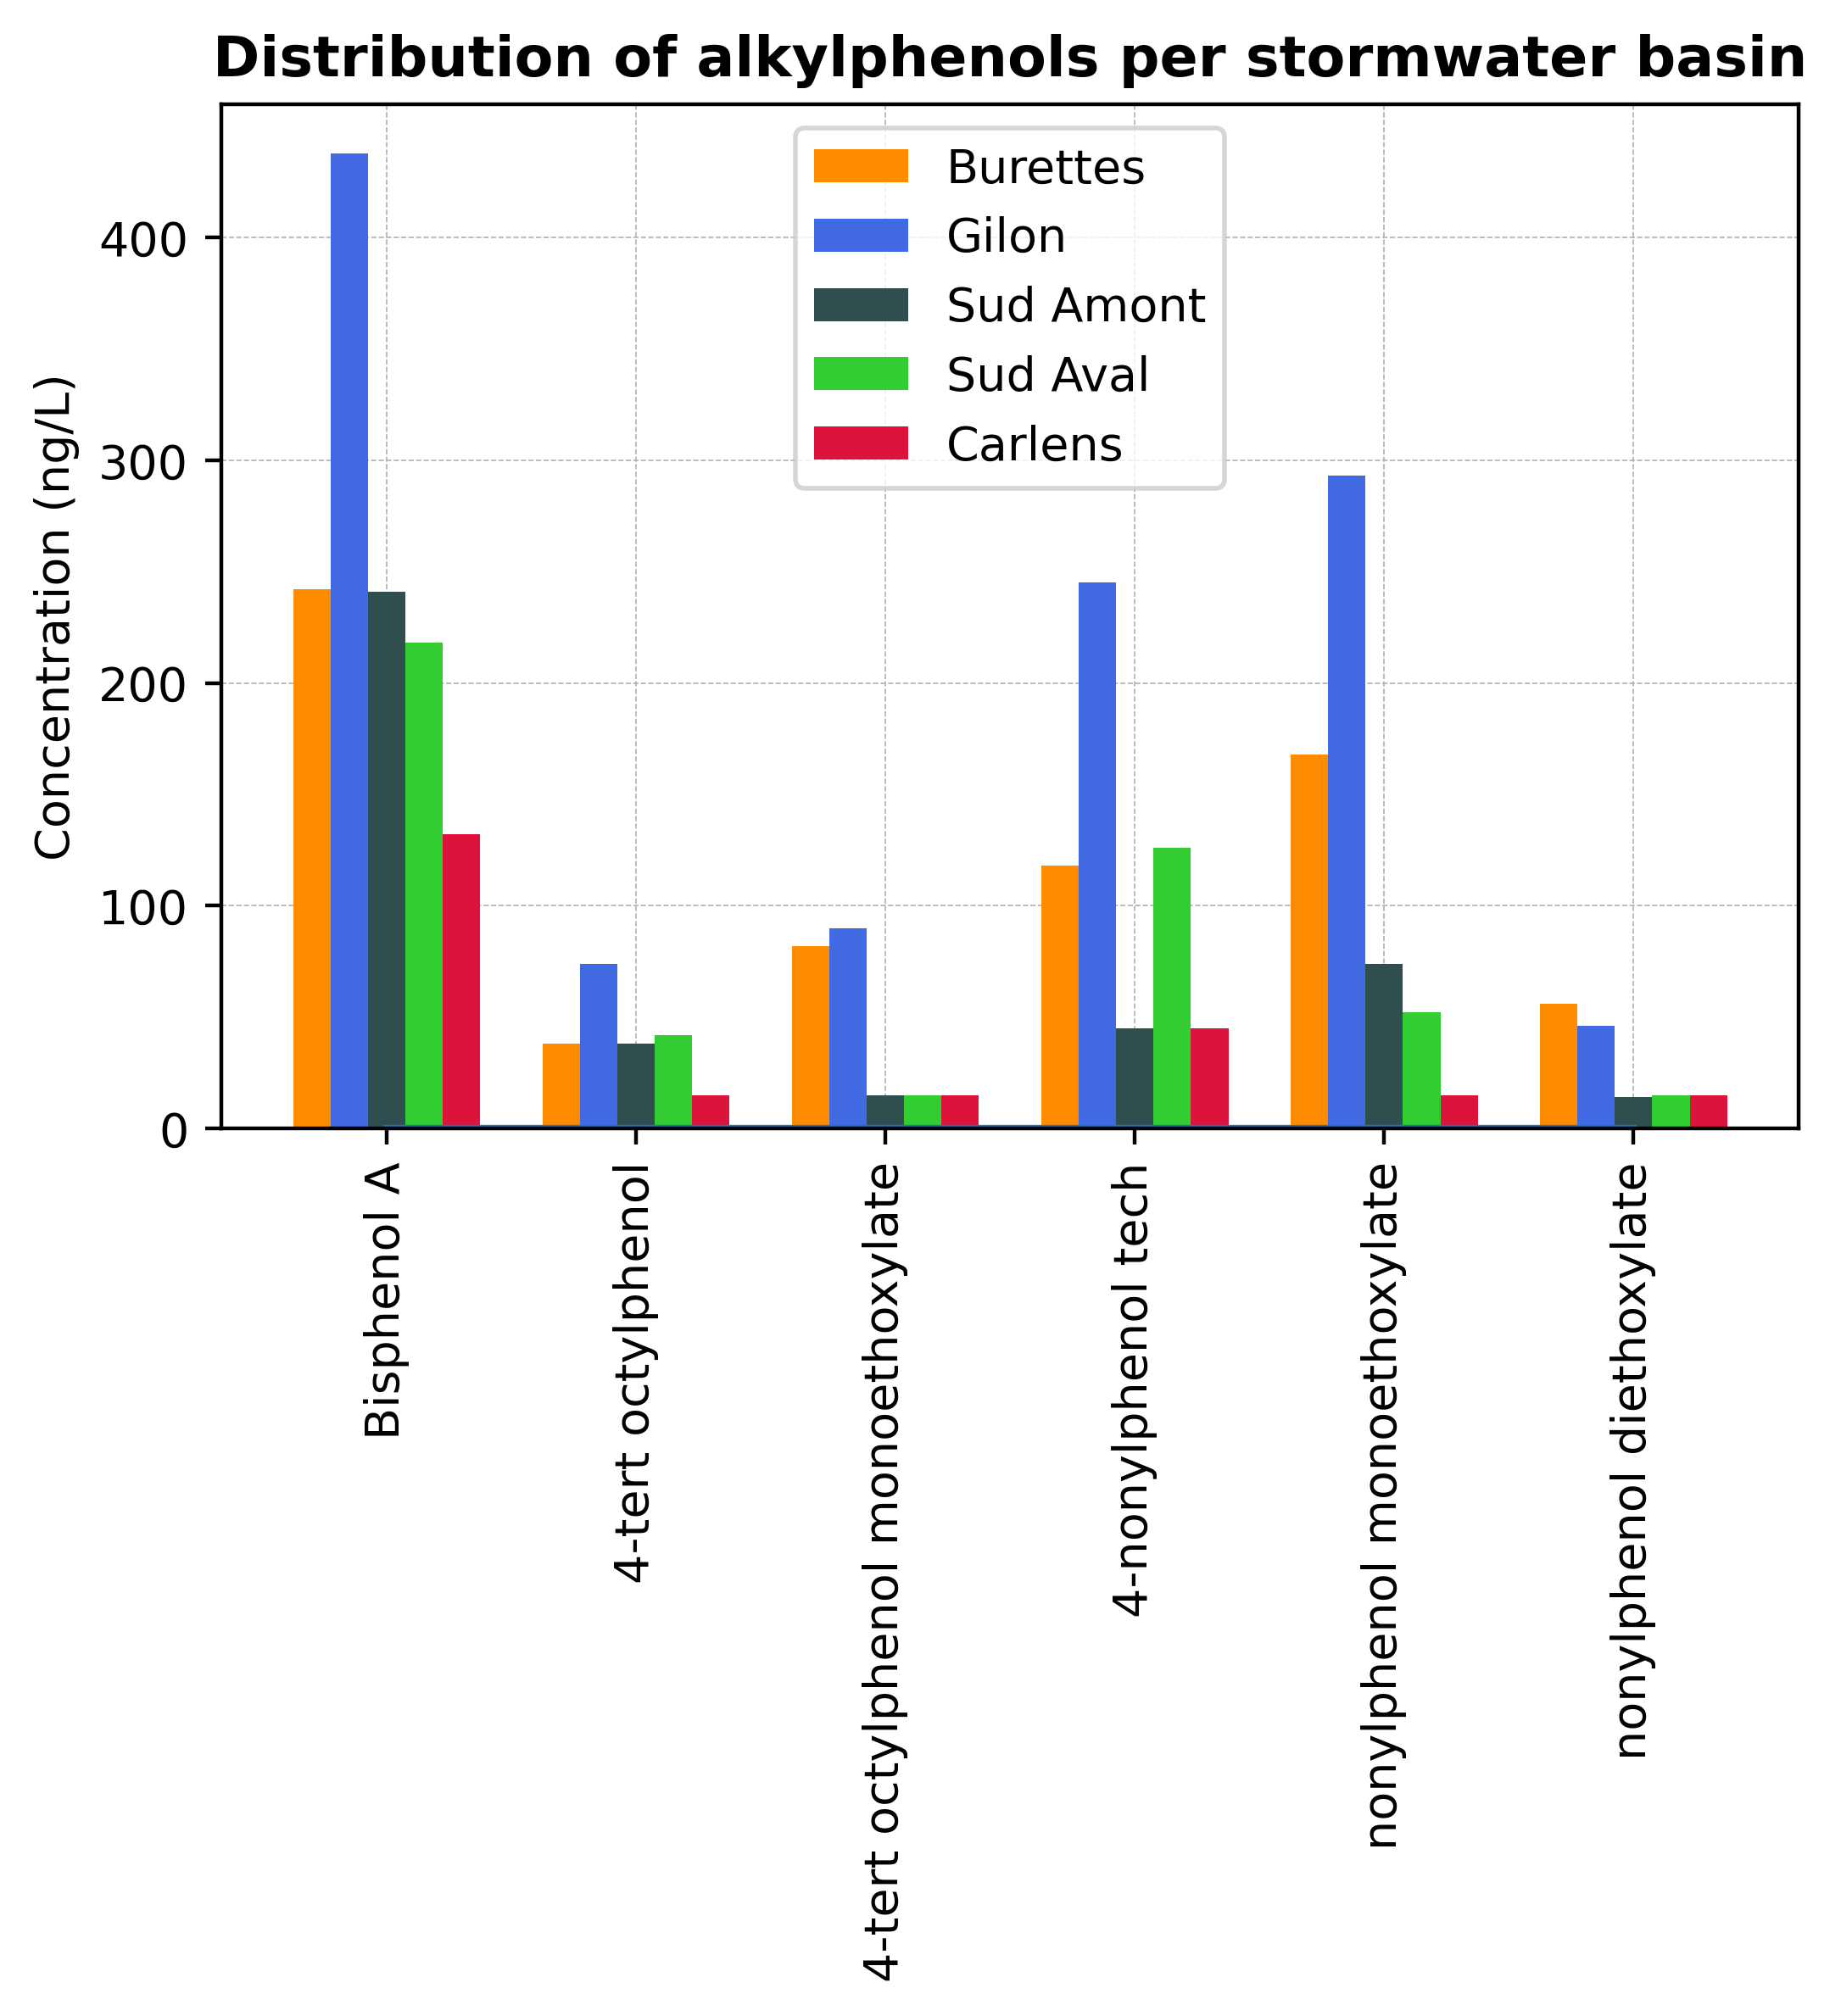
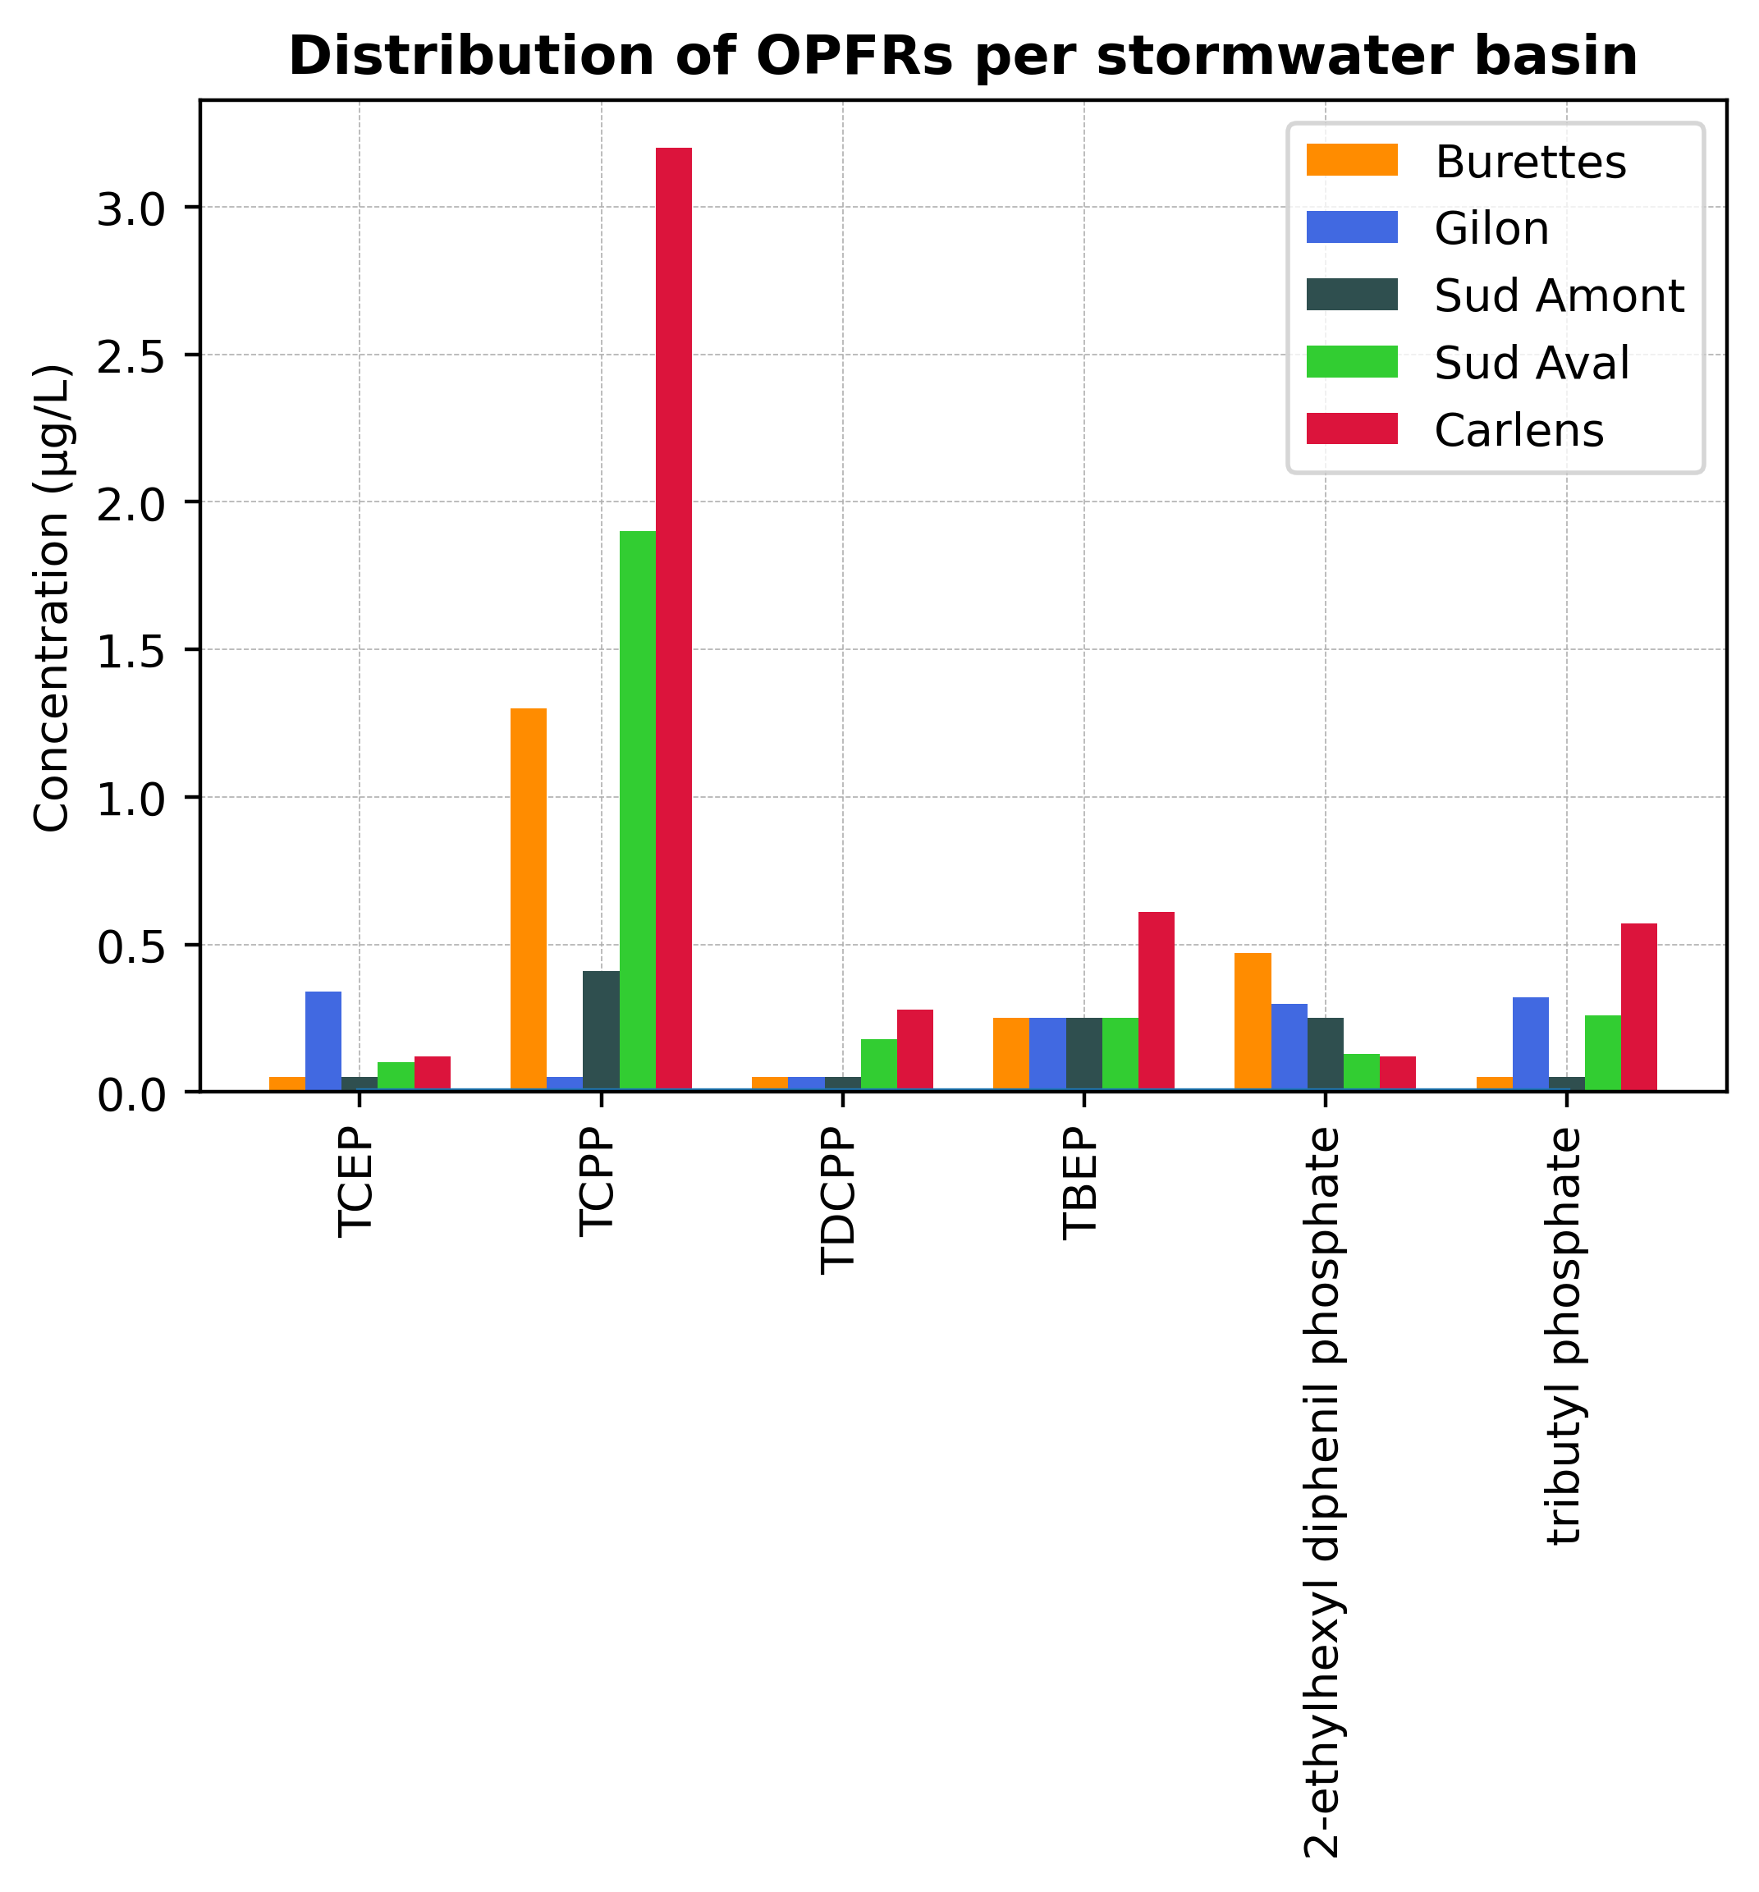
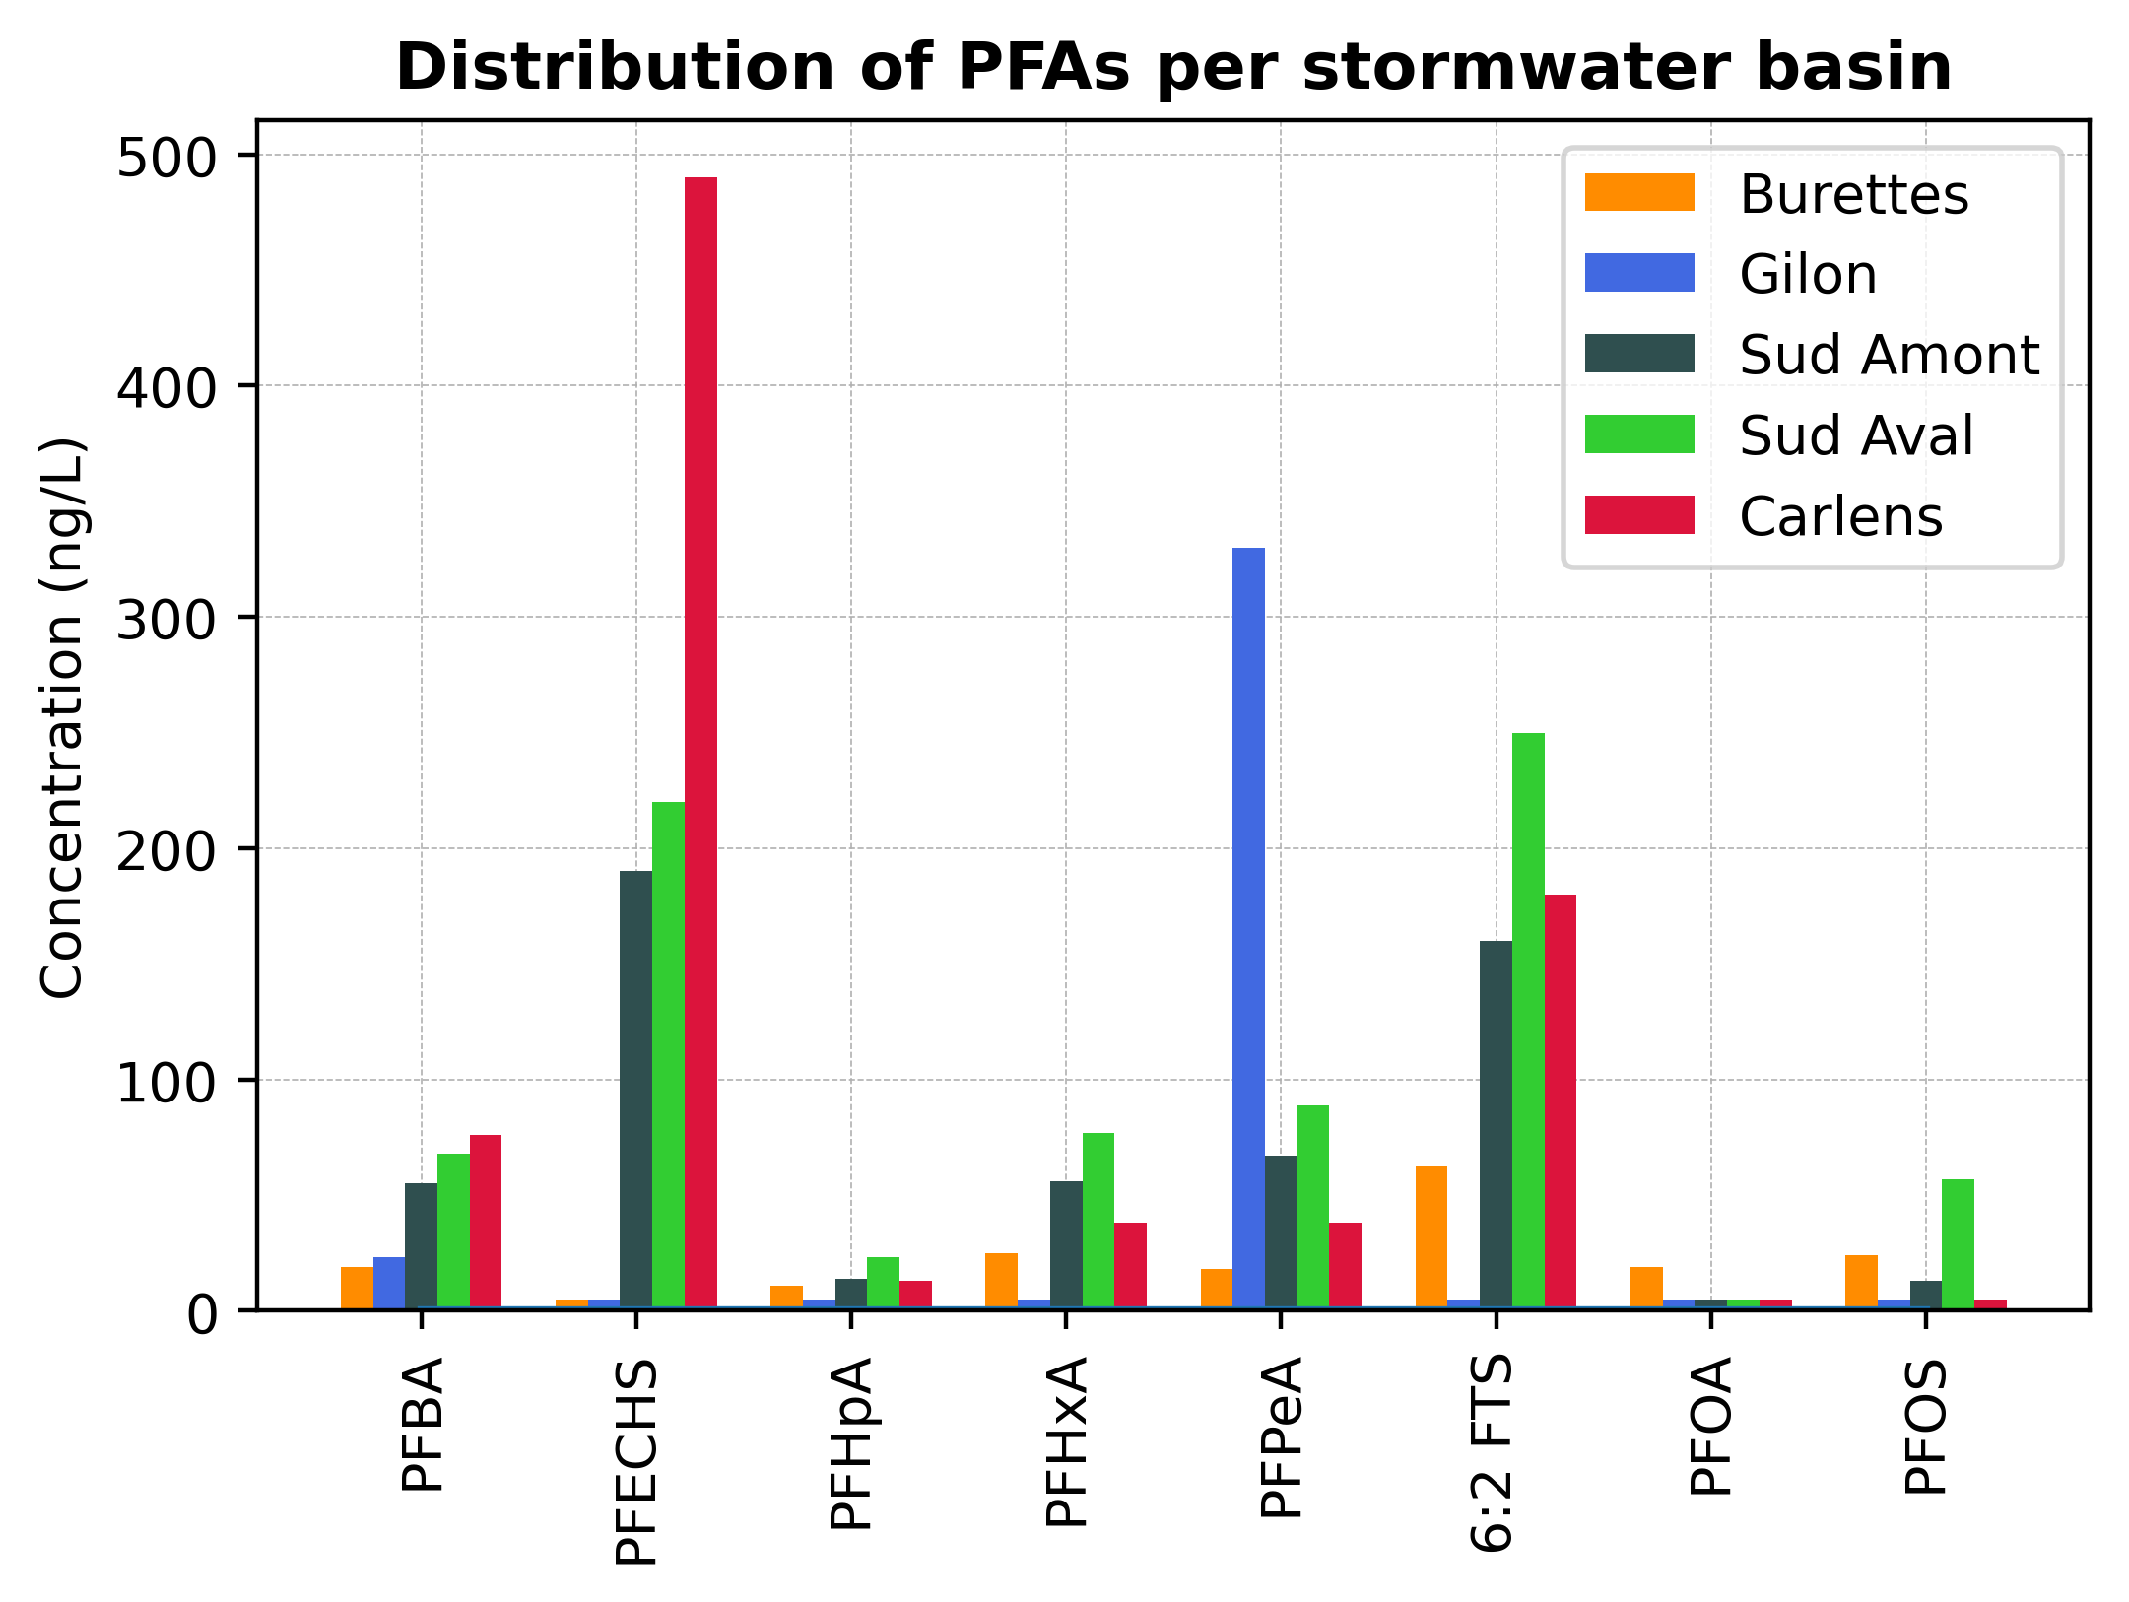
Research work [4]
Preliminary analysis results:
+ other pollutants: heavy metals, PAHs, cyanides
Notes:
Pas le temps de présenter les résultats de recherche maintenant

Slide 13
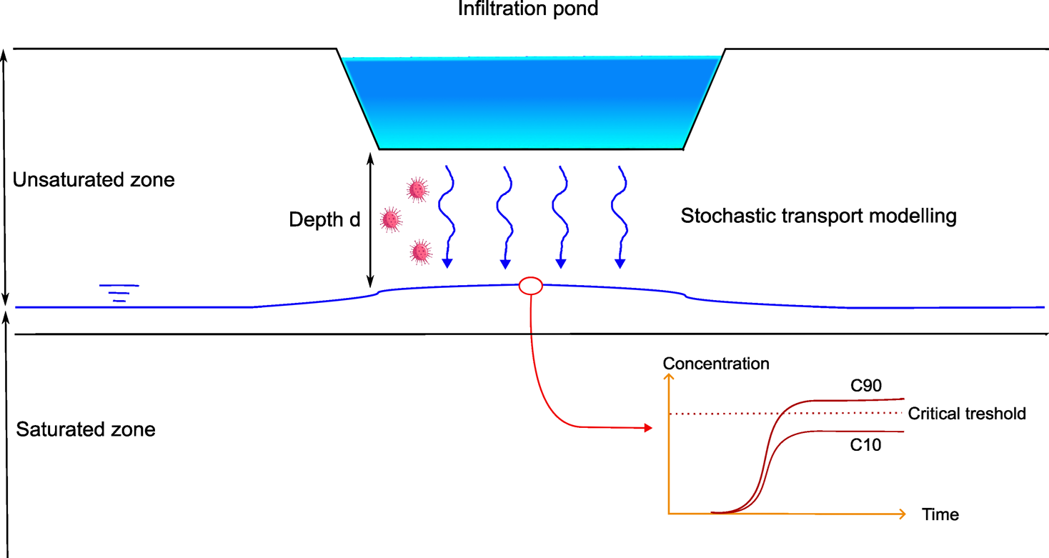
Future perspective [1]
Notes:
Pas le temps de présenter les résultats de recherche maintenant

Slide 14
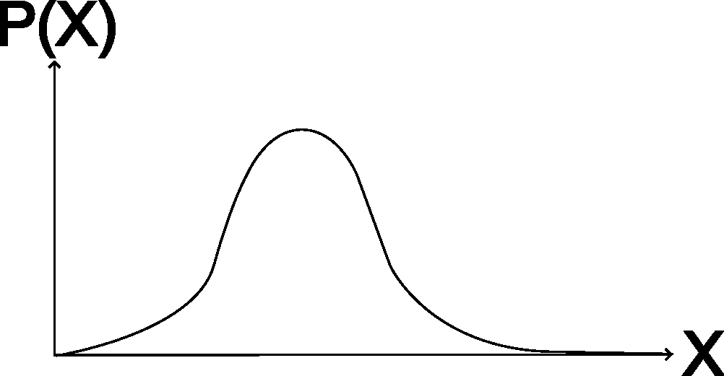
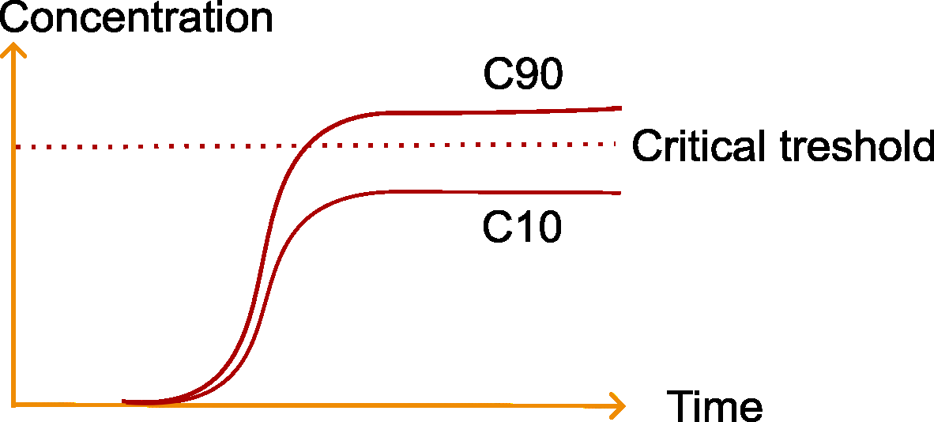

Future perspective [2]
AquaPriori tool
+
QSAR
Predictors:
T1/2, Koc, Kd, etc
Pdf of each predictor
n Monte Carlo simulations
Simple 1D transport modeling
software
e.g. Stanmod, MT3DMS, etc…
Risk $= \frac{Number of simulations above the limit}{Total number of simulations}$
Notes:
Pas le temps de présenter les résultats de recherche maintenant

Slide 15
Open questions
1) Is urban stormwater really the most adapted for MAR purposes?
Non-continuous input, quantity aspects hard to assess, water not clean, etc…
2) How to ensure not to miss one pollutant family in the recharge water?
3) How to quantify uncertainty related to the transport parameters ?
4) If we rely on natural soil filtration to clean the water, doesn’t it mean we pollute the soil?

Slide 16

Discussion time !

