Slide 1
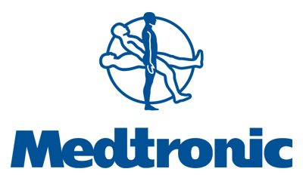
Percutaneous angioplasty with drug eluting balloon for infra-inguinal venous bypass stenosis: case report
IN.PACTTM DCB Belgium on the map forum Dr Arnaud Kerzmann CHU Liège

Slide 2
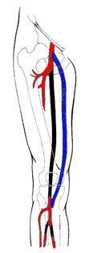
Introduction (1)
Infra-inguinal bypasses have better results
with saphenous vein graft. There are 3 types of venous bypass failure:
thrombosis, intimal hyperplasia and
atherosclerosis. Most of the time intimal
hyperplasia occurs between the third and the
eighteenth month after the bypass operation.

Slide 3
Introduction (2)
Open surgical repair is still the best way to treat infra-inguinal venous bypass stenosis. Conventional percutaneous angioplasty doesn’t show high primary patency rates at short-term.
The recent studies about paclitaxel coated balloons in peripheral arterial disease (PAD) reveal the benefits of such balloons compared to not coated balloons. Here is one case report about use of drug eluting balloon to treat infra-inguinal venous bypass stenosis.

Slide 4
Case report
man, 60 years old
past history: smoker
arterial hypertension
dyslipidemia
type 2 diabetes
ischemic heart disease
CABG 16 y ago
right profundoplasty 2 m ago

Slide 5
Case report
below the knee femoro-popliteal venous
bypass 50 m ago
left calf pain by walking, category 3
Rutherford PAD
ABI = 0,75
monophasic spectrum at Doppler
ultrasound
angio-MRI

Slide 6
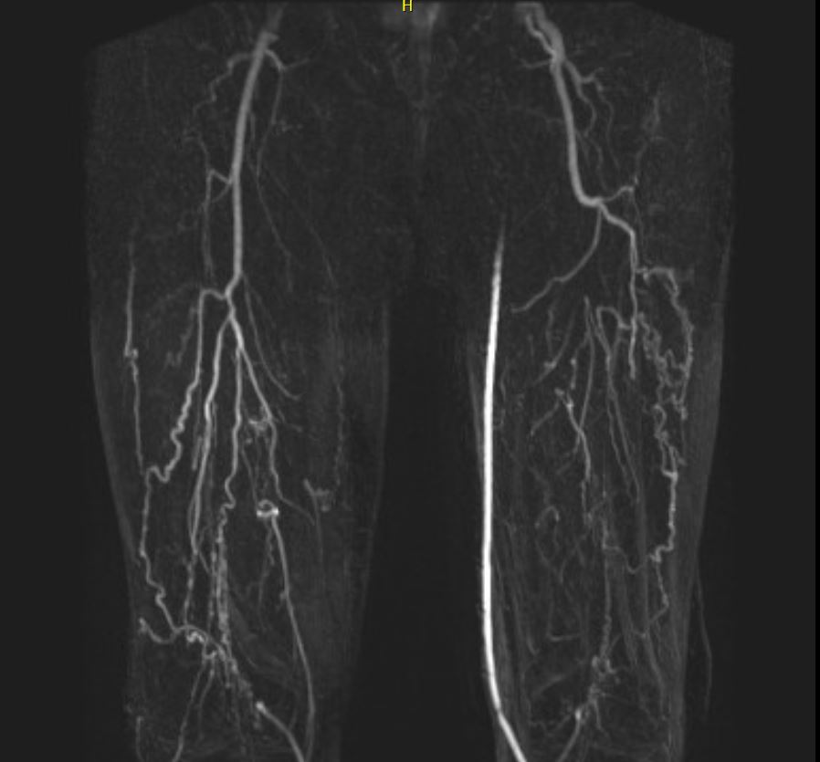
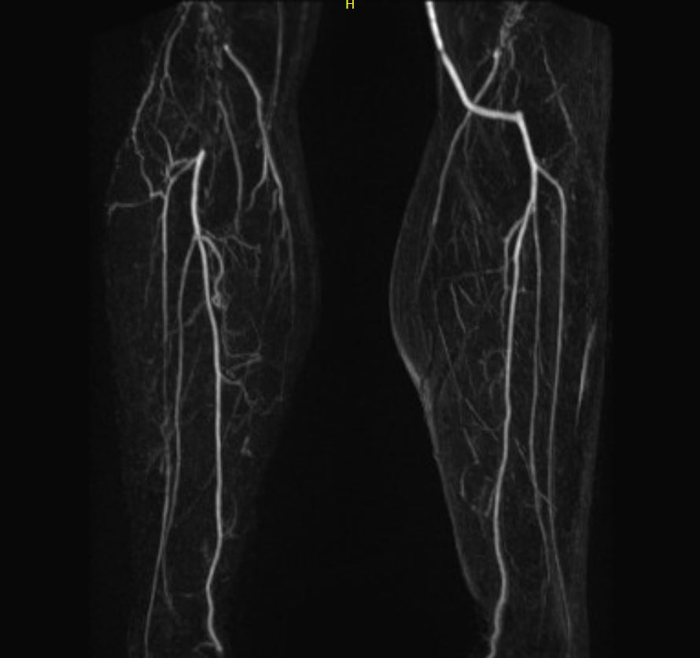
Case report

Slide 7
Case report
Operation
general anaesthesia
puncture of the right common femoral artery
2500 IU heparin
6 French (F) introducer sheath
0,035 guide wire
cross over with pigtail catheter
0,014 guide wire

Slide 8
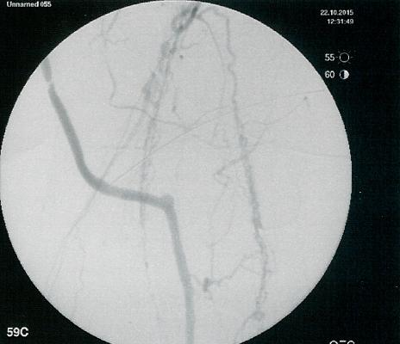
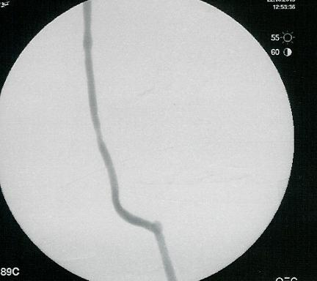
predilatation with balloon 2mm-4cm
dilatation with drug eluting balloon Medtronic
Inpact AdmiralⓇ 4mm-8cm
compression

Slide 9
Case report
Follow-up
category 0 Rutherford PAD after 5 m
ABI = 0,94
biphasic spectrum at Doppler ultrasound

Slide 10
Conclusions
The use of drug eluting balloon to treat infra-inguinal venous bypass stenosis is minimal invasive and safe.
Randomized studies are mandatory to compare paclitaxel coated balloon with conventional balloon angioplasty and with open surgical repair for the treatment of infra-inguinal venous bypass stenosis.

