Slide 1


Slide 2


What proves better: surgery or percutaneous atherectomy in extended femoro-popliteal lesions?
^{A. Kerzmann, MD}
Department of Cardiovascular and Thoracic Surgery (Pr Defraigne)
CHU Liège, Belgium

Slide 3
DISCLOSURES
Arnaud Kerzmann, MD
Consultant: BD, Boston Scientific
Grant/research support: BD, Boston Scientific, Medicor

Slide 4
INTRODUCTION
Extended or long femoro-popliteal lesions belong to complex lesions, like chronic total occlusions (CTO), in-stent restenosis and heavy calcified diseases.
Complex femoro-popliteal lesions are common in clinical routine.
Endovascular treatment of complex lesions is associated with poorer outcomes.
Endovascular treatment of femoropopliteal arterial occlusive disease. Kerzmann A, Boesmans E, Holemans C, Quaniers J, Alexandrescu V, Defraigne JO. Rev Med Liege. 2020 Nov;75(11):717-723.

Slide 5
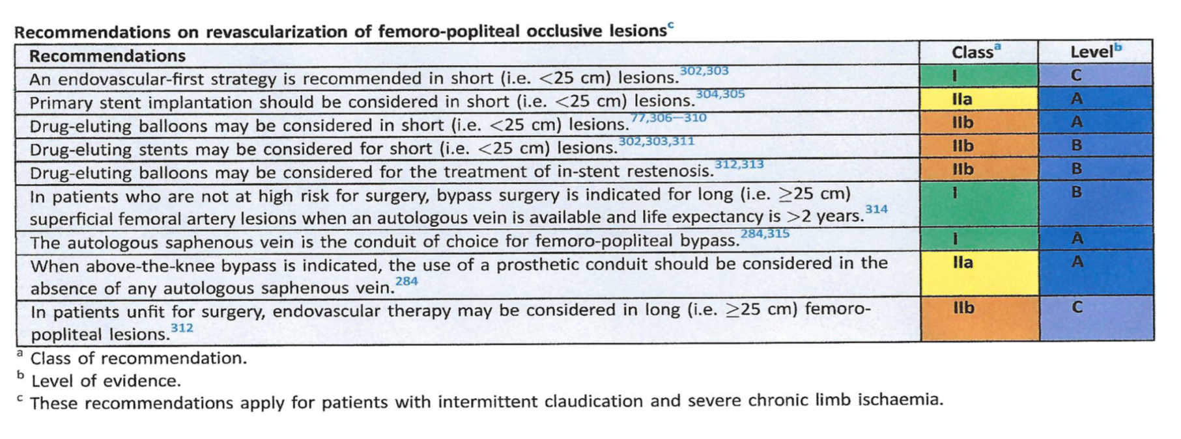
GUIDELINES
ESVS guidelines for extended femoro-popliteal lesions

Slide 6

GUIDELINES
Surgery is only recommended in lesions longer than 25 cm in patients not at high operative risk
Treatment algorithm :
Bosiers M. Treatment algorithm for long segment femoropopliteal disease. J Cardiovasc Surg. 2019;60(5):543-545.

Slide 7
VESSEL PREP
Vessel preparation is essential to treat percutaneously femoro-popliteal lesions.
low-trauma balloons
cutting and scoring balloons
atherectomy or debulking
lithotripsy
Bosiers M. Is vessel prep necessary before treating the superficial femoral artery? J Cardiovasc Surg. 2019 Oct;60(5):557-566.

Slide 8
VESSEL PREP
BEST-SFA - Best Endovascular STrategy for complex lesions of the Superficial Femoral Artery comparing a stent-avoiding versus stent-preferred approach
Exploratory pilot study comparing strategies rather than single devices
Randomized controlled pilot study comparing stent-avoiding (DCB) vs stent-preferred (DES) strategies encouraging vessel preparation
1 year follow-up ongoing (target Q3/2022)
Steiner S. LINC. June 2022.

Slide 9
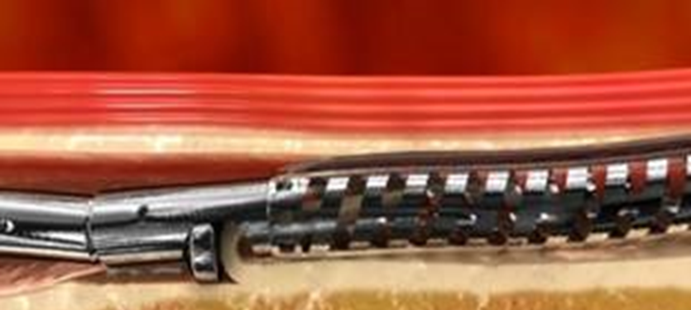
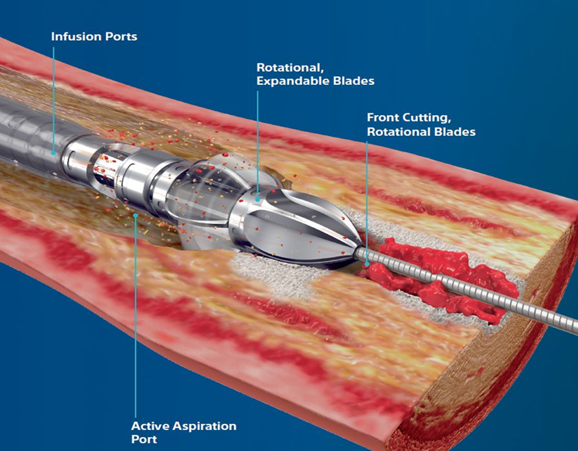
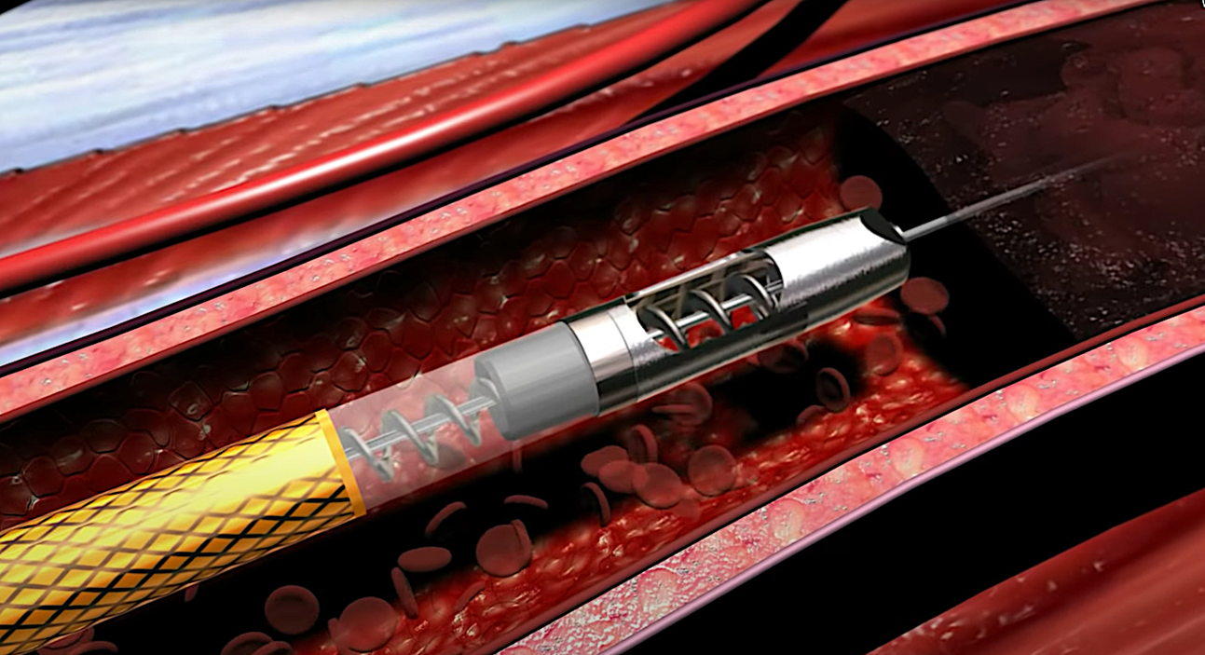
ATHERECTOMY
Goals : - lumen gain
- vessel compliance
- drug delivery
- dissection and bailout stenting prevention
Wire has to cross the lesion intraluminal !
Types : - directional
- hybrid
- rotational
- laser
- orbital
Bosiers M. Is vessel prep necessary before treating the superficial femoral artery? J Cardiovasc Surg. 2019 Oct;60(5):557-566.

Slide 10
PROOFS
Dissections post atherectomy are grossly under-appreciated (4 to 6 times) on angiogram when compared to IVUS^{Ɨ}.
The severity of the induced dissections is associated with lower primary patency and higher target lesion revascularization (TLR) rates^{ƗƗ}.
^{Ɨ}Shammas NW, Torey JT, Shammas WJ, Jones-Miller S, Shammas GA. Intravascular Ultrasound Assessment and Correlation With Angiographic Findings Demonstrating Femoropopliteal Arterial Dissections Post Atherectomy: Results From the iDissection Study. J Invasive Cardiol. 2018 Jul;30(7):240-244.
^{ƗƗ}Fujihara M, Takahara M, Sasaki S, et al. Angiographic dissection patterns and patency outcomes after balloon angioplasty for superficial femoral artery disease. J Endovasc Ther 2017;24:367-75.

Slide 11
PROOFS
DCB angioplasty of femoropopliteal artery disease reduces reintervention rates through 5 years compared to percutaneous transluminal angioplasty (PTA).
Real-world data from the IN.PACT Global study confirmed the 5-year safety and effectiveness of the IN.PACT™ Admiral™ DCB in complex lesions (in-stent restenosis, chronic total occlusions, long lesions).
However, the use of DCBs alone in long, calcified lesions may be associated with vessel recoil or dissection requiring provisional stenting.
The use of atherectomy to debulk calcified lesions prior to DCB treatment may facilitate drug diffusion into the vessel wall and provide better outcomes in complex atherosclerotic lesions.
Tepe G. VIVA. October 5-6, 2021.

Slide 12
PROOFS
Combination of Percutaneous Rotational Thrombectomy and Drug-Coated Balloon for Treatment of Femoropopliteal Artery Nonembolic Occlusion: 12-Month Follow-up
Qi Wang, Ren-Ming Zhu, Hua-Liang Ren, Rui Leng, Wang-De Zhang, Chun-Min Li.
J Vasc Interv Radiol. 2020 Oct;31(10):1661-1667.
Jetstream Atherectomy System treatment of femoropopliteal arteries: Results of the post-market JET Registry
William A Gray , Lawrence A Garcia, Ali Amin, Nicolas W Shammas, JET Registry Investigators.
Cardiovasc Revasc Med. 2018 Jul;19(5 Pt A):506-511.
SAFETY

Slide 13
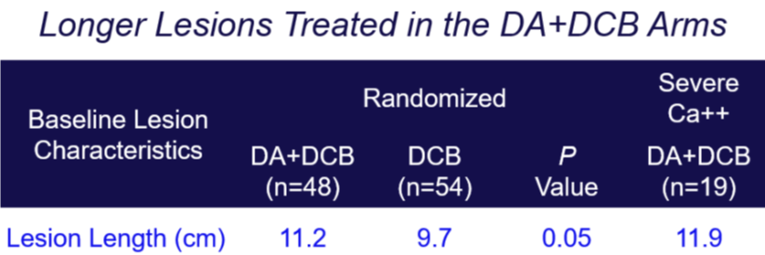
PROOFS
Directional Atherectomy Followed by a Paclitaxel-Coated Balloon to Inhibit Restenosis and Maintain Vessel Patency: Twelve-Month Results of the DEFINITIVE AR Study.
Zeller T, Langhoff R, Rocha-Singh KJ, Jaff MR, Blessing E, Amann-Vesti B, Krzanowski M, Peeters P, Scheinert D, Torsello G, Sixt S, Tepe G; DEFINITIVE AR Investigators.
Circ Cardiovasc Interv. 2017 Sep;10(9):e004848.
Multicentre RCT
10 centres, 121 patients

Slide 14
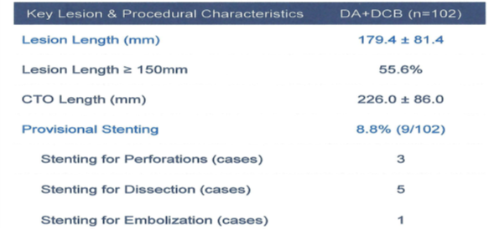
PROOFS
The REALITY study
Zeller T
LINC 2022
Evaluation of HawkoneTM followed by DCB
Prospective, non-randomized, single-arm study
13 centers, 102 patients
Primary endpoints:
Effectiveness: Primary Patency at 12 months
Safety: Freedom from Major Adverse Events (MAE) through30 days
Results from a single-center prospective registry (V. Puttaswamy, LINC, 6th June 2022) support the longer-term sustainability of these results, with a 71.4% primary patency rate and 63.8% freedom from CD-TLR through 3 years

Slide 15
PROOFS
A prospective randomized trial on endovascular recanalization with stenting versus remote endarterectomy for the superficial femoral artery total occlusive lesions.
Saaya S, Osipova O, Gostev A, Rabtsun A, Starodubtsev V, Cheban A, Ignatenko P, Karpenko A.
J Vasc Surg. 2022;76(1):158-64.
Single-center prospective RCT
119 recanalization with stenting versus 119 remote endarterectomy
Mean lesions lenght ≥ 250 mm in both groups
All CTOs
Cumulative primary patency rates 83% versus 82% at 1 year and 28% versus 46% at 4 years (p-value 0,04)
Endovascular reintervention possible after remote endarterectomy

Slide 16
PROOFS
1-Year Results of a Multicenter Randomized Controlled Trial Comparing Heparin-Bonded Endoluminal to Femoropopliteal Bypass.
Reijnen MMPJ, van Walraven LA, Fritschy WM, Lensvelt MMA, Zeebregts CJ, Lemson MS, Wikkeling ORM, Smeets L, Holewijn S.
JACC Cardiovasc Interv. 2017 Nov 27;10(22):2320-2331.
Mulicenter prospective RCT
62 prosthetic surgical bypass versus 63 heparin-bonded endografts
Mean lesions lenght 23 mm in both groups
CTO 80% versus 75%
Same patency rate
Less morbidity and quicker improvements in quality of life

Slide 17
PROOFS
Nitinol Stent Versus Bypass in Long Femoropopliteal Lesions: 2-Year Results of a Randomized Controlled Trial.
Enzmann FK, Nierlich P, Aspalter M, Hitzl W, Dabernig W, Hölzenbein T, Ugurluoglu A, Seitelberger R, Linni K.
JACC Cardiovasc Interv. 2019 Dec 23;12(24):2541-2549.
Single-center prospective RCT
55 surgical bypass versus 55 self expandable stents
Mean lesions length 27 cm
49% of chronic limb-threatening ischemia
Same primary patency, limb salvage, survival and complications rates
Clinical improvement was significantly better in the bypass group

Slide 18
PROOFS
ZILVERPASS Study: ZILVER PTX Stent vs Bypass Surgery in Femoropopliteal Lesions.
Bosiers M, Setacci C, De Donato G, Torsello G, Silveira PG, Deloose K, Scheinert D, Veroux P, Hendriks J, Maene L, Keirse K, Navarro T, Callaert J, Eckstein HH, Teβarek J, Giaquinta A, Wauters J.
J Endovasc Ther. 2020 Apr;27(2):287-295.
Multicenter prospective RCT
220 DES versus 113 surgical bypass
Results at 12 months
Primary patency rate 74,5% versus 72,5%
Lower complications rate and
shorter hospital stays for DES group

Slide 19
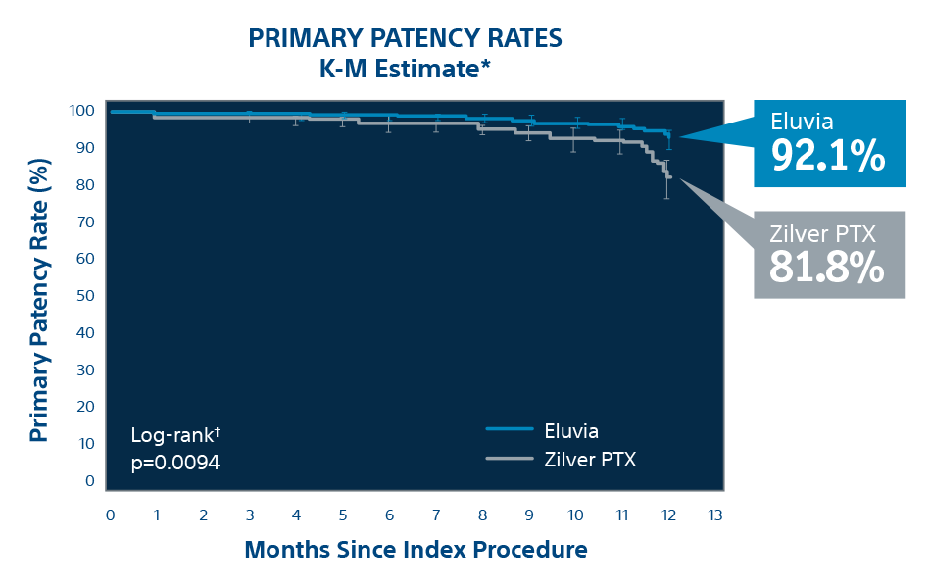
PROOFS
A polymer-coated, paclitaxel-eluting stent (Eluvia) versus a polymer-free, paclitaxel-coated stent (Zilver PTX) for endovascular femoropopliteal intervention (IMPERIAL): a randomised, non-inferiority trial.
Gray WA, Keirse K, Soga Y, Benko A, Babaev A, Yokoi Y, Schroeder H, Prem JT, Holden A, Popma J, Jaff MR, Diaz-Cartelle J, Müller-Hülsbeck S; IMPERIAL investigators.
Lancet. 2018 Oct 27;392(10157):1541-1551.
Multicentre prospective randomized single-blind study
309 Eluvia versus 156 ZilverPTX
Primary patency rate 86,8 versus 81,5 % (p < 0,0001)
Same MAE and TLR rates

Slide 20
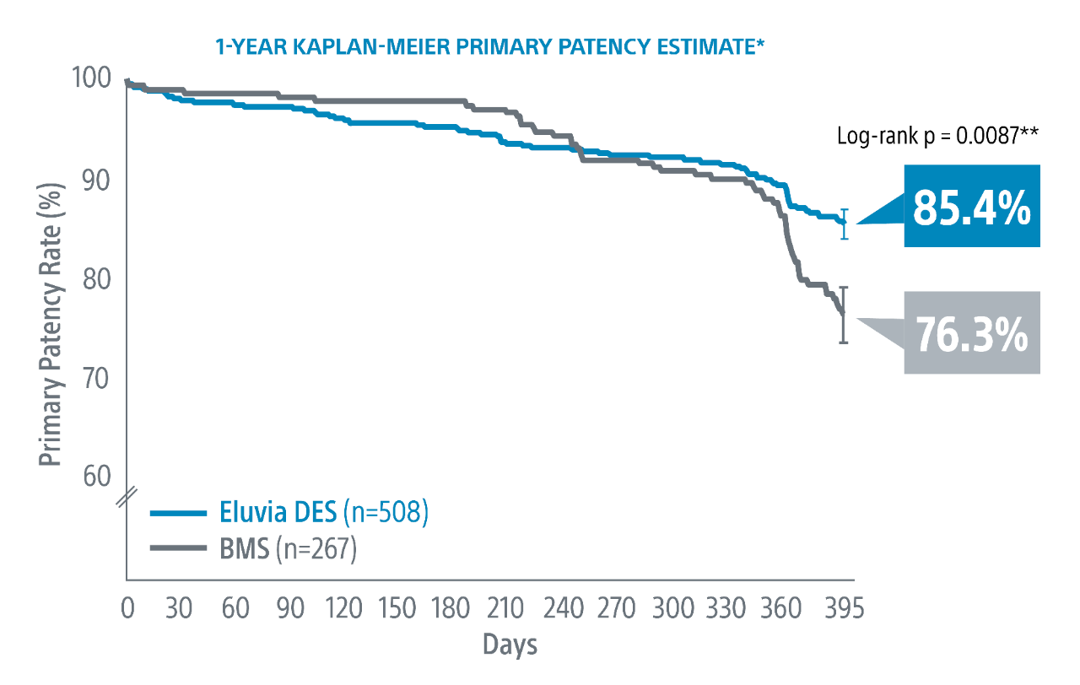
PROOFS
Eminent study
Goueffic Y
VIVA 2021
Multicentre randomized controlled trial
267 bare metal stents versus 508 Eluvia
at 1 year

Slide 21
PROOFS
Drug-eluting stents for the treatment of complex femoro-popliteal disease: a systematic review and meta-analysis.
Katsogridakis E, Ballance L, Cawley O, Antoniou GA.
J Cardiovasc Surg. 2022 Jun;63(3):299-307.
10 articles, 1539 patients
TASC C and D
All Zilver PTX
Primary patency rate 70,5% at 1 year
Secondary patency rate 89,8% at 1 year

Slide 22
CONCLUSIONS
Endovascular therapies work as well as open surgery to treat extended femoro-popliteal lesions.
Drug eluting therapies seem to be the best treatment for femoro-popliteal lesions.
Vessel preparation is essential.
Atherectomy for femoro-popliteal lesions is safe if the wire stays intraluminal.
Atherectomy could enhance primary patency and TLR rates for complex femoro-popliteal lesions.
Bypass surgery indicated for CLTI patient with low operative risk and good saphenous vein, especially with multistaged disease.

