Slide 1



PhD DEFENSE
Nora Vandeleene
Characterizing multiple sclerosis lesioned brain tissues using quantitative MRI
December 2022
Jury members:
President: Prof. Pierre Geurts, ULiège
Prof. Muhamed Barakovic, University of Basel, Switzerland
Prof. Jeroen Van Schependom, VUB, Belgium
Prof.Emilie Lommers, ULiège
Prof. Pierre Sacré, ULiège
Dr. Laurent Lamalle, ULiège
Supervisor: Prof. Christophe Phillips, ULiège

Slide 2
Presentation plan
Introduction
Purpose of the study
Segmentation
Applications
Conclusion
Unified Segmentation (US) on healthy brains
Limitations
Quantitative MRI
Comparison between MPM and NODDI
Multiple sclerosis (MS)
US-with-Lesions
on MS brains
Perspectives
Magnetic Resonance Imaging (MRI)
Discussion
MS
Longitudinal study

Slide 3

Introduction

Slide 4
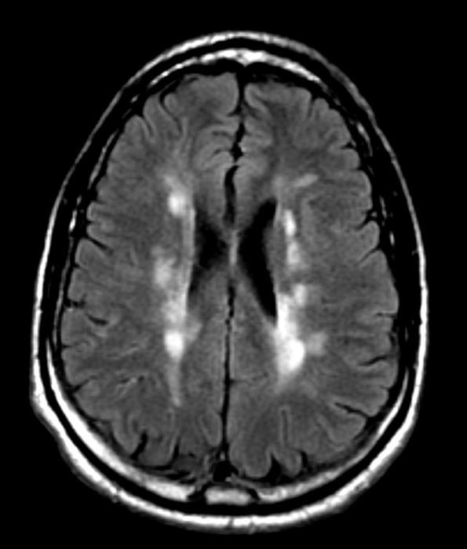
Multiple sclerosis
Introduction
Purpose of the study
Segmentation
Applications
Conclusion
Over two million people affected worldwide
Incurable
Chronic, inflammatory, autoimmune, neurological disease
Lesions in the CNS, inducing cognitive and mobility impairments
Conventional FLAIR images depict demyelinated lesions
Notes:
causes and pathogenesis largely unknown.
desctruction of the myelin sheaths around axons, and thus impairments of the signal transmission between neurons.

Slide 5
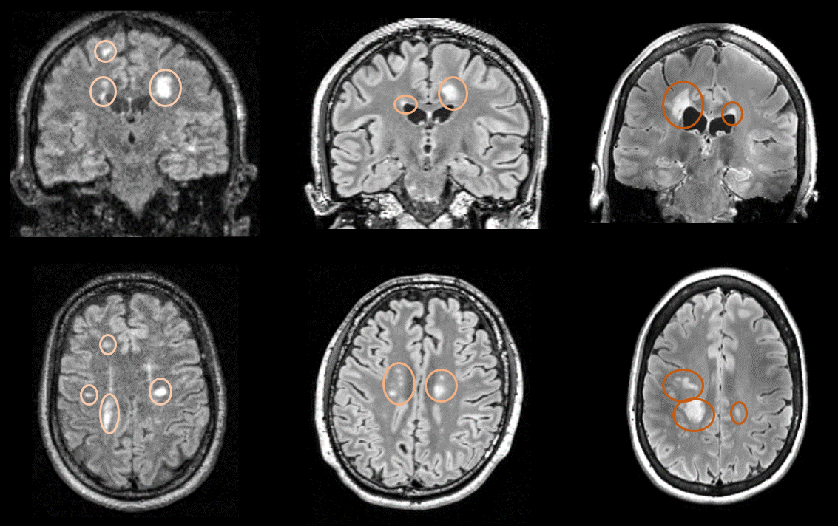
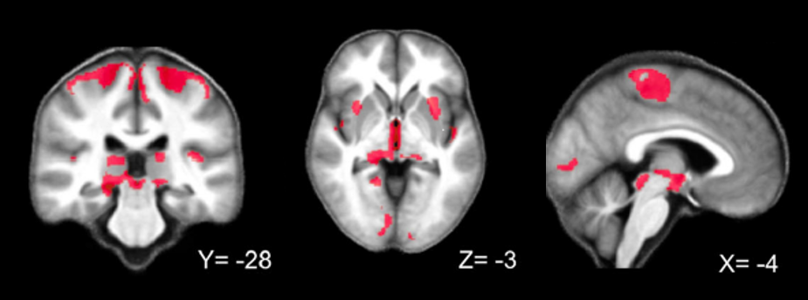
Multiple sclerosis
Introduction
Purpose of the study
Segmentation
Applications
Conclusion
Inflammation + demyelination
Focal lesions
Within white and gray matter
Different types of lesions reflecting different activity
Visible on conventional MRI
Diffuse neurodegeneration
Within normal appearing tissues
Not visible on conventional scans
Better correlated to disability scores
Lommers et al., Hum. Brain Map. 2021
Notes:
two important phenomena : inflammation and demyelination.
vary in size, location, and might reflect different levels of activity.
global diffuse neurodegeneration = irreversible neuronal tissue destruction.

Slide 6
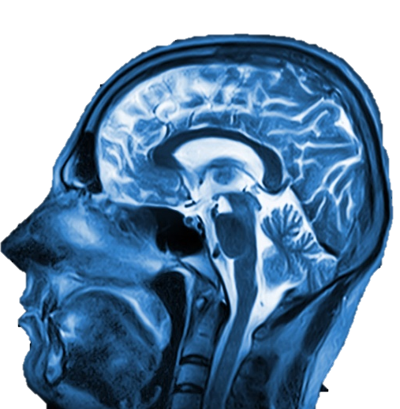
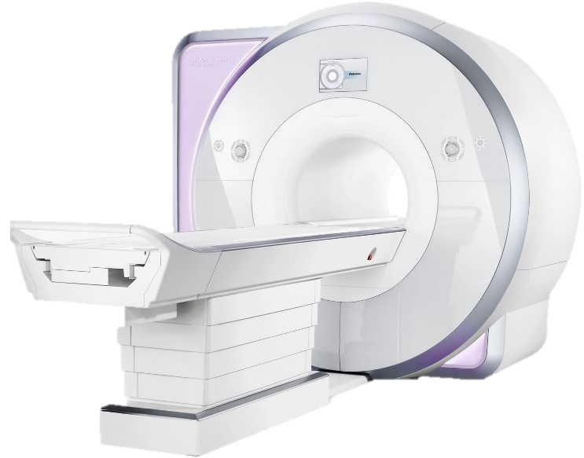
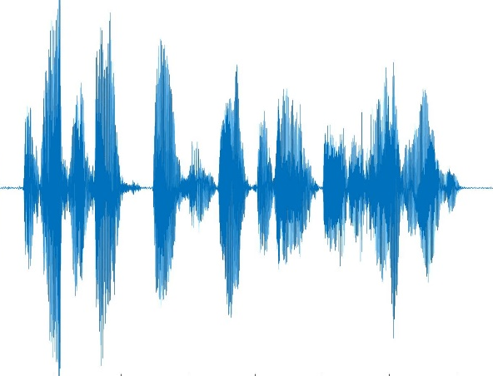
Magnetic Resonance Imaging (MRI)
Introduction
Purpose of the study
Segmentation
Applications
Conclusion
Powerful tool for in-vivo
visualisation of brain tissues
Notes:
born in the seventies, around 30 years after the discovery of the nuclear magnetic resonance, or NMR, phenomenon.

Slide 7
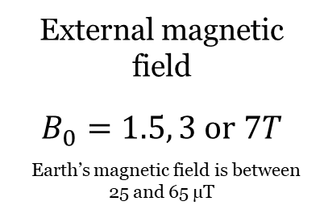

Magnetic Resonance Imaging (MRI)
Introduction
Purpose of the study
Segmentation
Applications
Conclusion
Ingredients for MRI
External magnetic field
$$B_{0}=1.5, 3 or 7T$$
Earth’s magnetic field is between 25 and 65 µT
Electromagnetic field $B_{1}$
(Radio-frequency or RF)
Magnetic properties of the NUCLEI
(protons)
Nuclear magnetic resonance (NMR) phenomenon
Notes:
The NMR phenomenon appears after this perturbation, when the particles enter in relaxation.
The shimming and imaging gradients are used to encode the location in the constructed image.

Slide 8
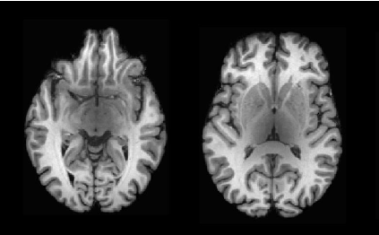
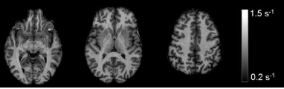
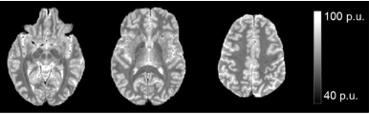
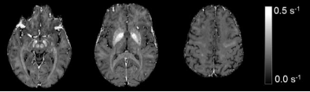
Magnetic Resonance Imaging (MRI)
Introduction
Purpose of the study
Segmentation
Applications
Conclusion
The acquired signal is a composite of different physical MR parameters, such as:
T1w
Longitudinal relaxation rate
Transverse relaxation rate
R1
R2
Proton density
PD
Notes:
inverse time constant describing the relaxation in the longitudinal plane.
Signal WEIGHTED in T1 but acutally a mixture of other physical parameters

Slide 9
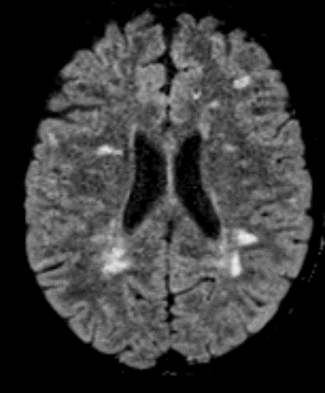
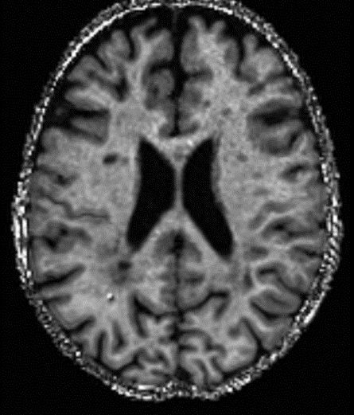
Quantitative MRI
Introduction
Purpose of the study
Segmentation
Applications
Conclusion
Conventional MRI
Quantitative MRI
Qualitative representation of tissues
Value of voxel is meaningless
Different contrasts depending on the sequence
Quantitative representation of tissues
Value of voxel reflects physical properties
Maps of individual parameters

Slide 10

Quantitative MRI
Introduction
Purpose of the study
Segmentation
Applications
Conclusion
High specificity and sensitivity to microstructural brain tissues properties
Axon, Myelin, Water concentration, Iron….
Physical/chemical variables measured in physical units and compared between tissue regions (voxels)
Allows comparison across sites, time points and participants

Slide 11
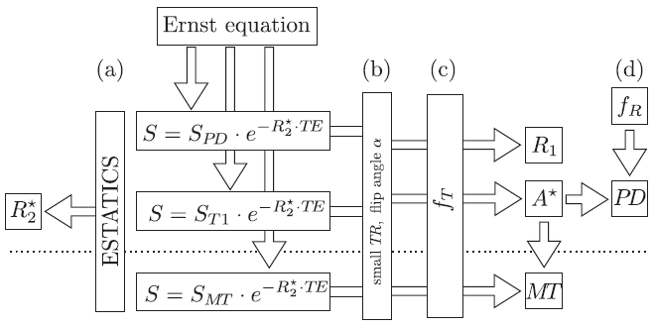
Quantitative MRI
Introduction
Purpose of the study
Segmentation
Applications
Conclusion
Multi-parameter mapping (MPM) sequence
Three series of images taken at different echo times: MTw, PDw, T1w
Signals are modelled with the Ernst equation
R2* map derived from ESTATICS model (a)
MT, R1 and A* maps estimated with approximations
of small TR and flip angle (b)
Transmit bias field used to correct for inhomogeneties
in MT, R1 and A* maps (c)
PD map derived from A* and corrected for instrumental
biases using the receive bias field (d)
Tabelow et al., NeuroImage. 2019
Notes:
The three signals corresponding of the three series of images are modeled with the Ernst equation
with an exponential decay based on the echo time TE.
ESTASTICS model, which gathers the multi-echo data from all three contrasts into a single model.
Transmit bias field influences the flip angle which affects all maps, but the receive bias field influences only the PD map.
Here, those bias fields were estimated during the acquisition, but it is still possible to correct for them even when they are not measured.

Slide 12
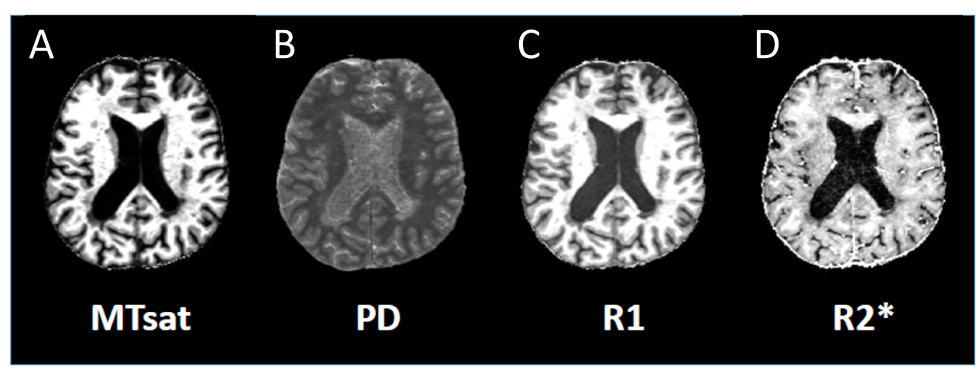
Quantitative MRI
Introduction
Purpose of the study
Segmentation
Applications
Conclusion
Multi-parameter mapping (MPM) sequence
Arises from cross-relaxation between protons in « bound » and « free » water compartments.
Proportional to
myelin and axonal contents
Corresponds to 1/T2*, which characterizes the effective transverse relaxation.
Proportional to iron and myelin contents
Relates to the number of protons participating to the MRI signal.
Proportional to water content
Corresponds to 1/T1, which characterizes the longitudinal relaxation.
Proportional to water, iron, myelin contents, as well as gliosis and axonal dysfunction

Slide 13
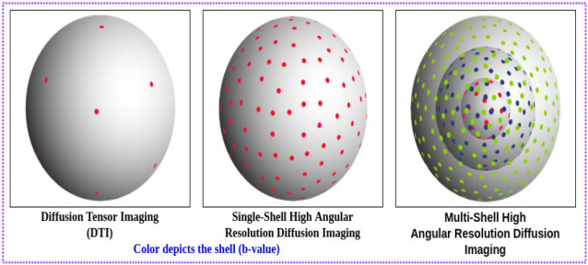
Quantitative MRI
Introduction
Purpose of the study
Segmentation
Applications
Conclusion
Diffusion MRI
Measures random Brownian motion of water molecules
Obstacles in the diffusion information on the tissue microstructure
Different gradient directions
Multi-shell diffusion imaging = several b-values
DTI
Single-shell HARDI
Multi-shell HARDI
Notes:
We can measure physical MR parameters such as R1, R2, but also properties of the water molecules diffusion motion-> diffusion MRI
B value = measures the degree of diffusion weighting applied (depends on amplitude, time of application and duration between gradients)
b = 0 -> no diffusion attenuation
Gradients = b-vectors in different direction in the space
First bubble = basic diffusion tensor imaging This is the simplest and well-established sampling technique, where only a few points are needed for the reconstruction of fiber streamlines. But represents only one fiber orientation per voxel (tensor)
Second : single shell high angular resolution diffusion imaging (HARDI)
Third : Multi-shell HARDI
Figure : https://reader.elsevier.com/reader/sd/pii/S0730725X22000431?token=F9591E79F8DF2AC9A2E1B1F2CCD52A6A4D5A5CC839130B06F8D58B38CF8FBC504858428094BC20AD0B9F882F080E9F90&originRegion=eu-west-1&originCreation=20221213154119

Slide 14
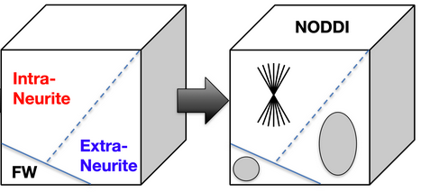
Quantitative MRI
Introduction
Purpose of the study
Segmentation
Applications
Conclusion
Neurite orientation dispersion and density imaging (NODDI)
Diffusion-weighted EPI images with a two-shell HARDI protocol
Then, NODDI images derived from a three compartment tissue model (free water, intra-cellular material and extra-cellular material)
Zhang et al., NeuroImage. 2012
Full normalized signal : $A=\left(1−υ_{iso}\right)\left(υ_{ic}A_{ic}+\left(1−υ_{ic}\right)A_{ec}\right)+υ_{iso}A_{iso}$
Collection of sticks with zero radius
Gaussian anisotropic diffusion
Gaussian isotropic diffusion
Notes:
displacement of water molecules
set of sticks = highly bouded diffusion inside the neurits.
Gaussian anisotropic displacement = displacement around glial cells present in the extra-cellular environment, but the displacement is not restricted to them.
In free water = considered in all directions, so it is modeled with an isotropic Gaussian diffusion.

Slide 15
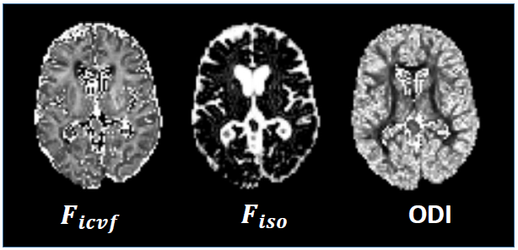
Quantitative MRI
Introduction
Purpose of the study
Segmentation
Applications
Conclusion
Neurite orientation dispersion and density imaging (NODDI)
Intra-cellular volume fraction.
It describes the density of axons and dendrites.
Orientation dispersion index.
It describes the degree of bending and fanning of axons and dendrites.
Isotropic volume fraction.
It describes the free water diffusion.

Slide 16
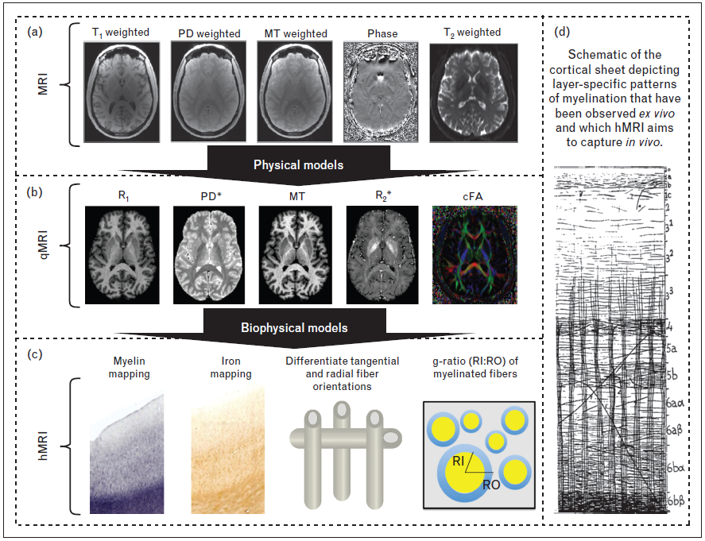
Quantitative MRI
Introduction
Purpose of the study
Segmentation
Applications
Conclusion
Biophysical modelling combined with qMRI measures allows to compute advanced microstructural tissues characteristics
Weiskopf et al., CO Neurology, 2015
Notes:
hMRI = goal with quantitative MRI, but we do not have it yet. Here we test the interpretability of qMRI
Withi the biophysical modelling we can go to macro to micro

Slide 17
Purpose of the study

Slide 18
qMRI and Multiple sclerosis
Introduction
Purpose of the study
Segmentation
Applications
Conclusion
With qMRI,
Physical measurements can probably detect more damage than what is seen with the naked eye
With FLAIR,
Lesions are easily visually detectable due to their hyperintensity
Need histological validation !
Notes:
Segmentation works « fine » with FLAIR images, but quantitative nature of data might show more damage than what can be seen with naked eye on FLAIR images.
BUT must be validated with histology

Slide 19
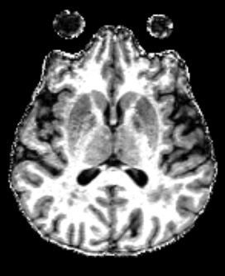
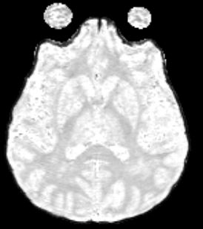
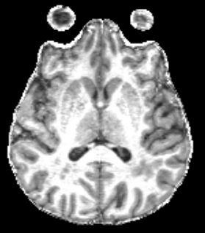
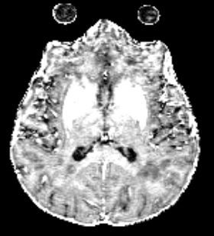


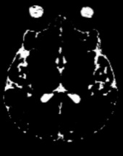
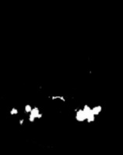
General objectives
Introduction
Purpose of the study
Segmentation
Applications
Conclusion
Improve the characterization of tissues microstructural properties in MS brains
Develop tools to segment WM lesions by taking advantage of quantitative nature of qMRI data
Being able to track microstructural alterations over time
Improve biophysical modelling and better define link between histological and in vivo measurements
MTsat
PD
R1
R2*
Gray matter
White matter
Cerebrospinal fluid
Lesion

Slide 20
Objectives of this thesis
Introduction
Purpose of the study
Segmentation
Applications
Conclusion
Optimize a segmentation tool for WM lesions and normal appearing tissues based on MPM data
Optimize common US algorithm with MPM data of healthy subjects, and determine optimal set of parameters (N = 25, med. age = 50 y)
Use the same setting for USwL on MS patients (N = 36, med. age = 46 y)

Slide 21
Objectives of this thesis
Introduction
Purpose of the study
Segmentation
Applications
Conclusion
Optimize a segmentation tool for WM lesions and normal appearing tissues based on MPM data
Evaluate the evolution of MPM parameters over time in MS brains tissues
MS patients (N = 17, med. age = 36 y) with two scanning sessions separated by at least one year
In normal appearing tissues and WM lesions

Slide 22
Objectives of this thesis
Introduction
Purpose of the study
Segmentation
Applications
Conclusion
Optimize a segmentation tool for WM lesions and normal appearing tissues based on MPM data
Evaluate the evolution of MPM parameters over time in MS brains tissues
Compare MPM and NODDI parameters
Both healthy subjects (N = 15, med. age = 50 y) and MS patients (N = 17, med. age = 48 y)

Slide 23
Segmentation

Slide 24
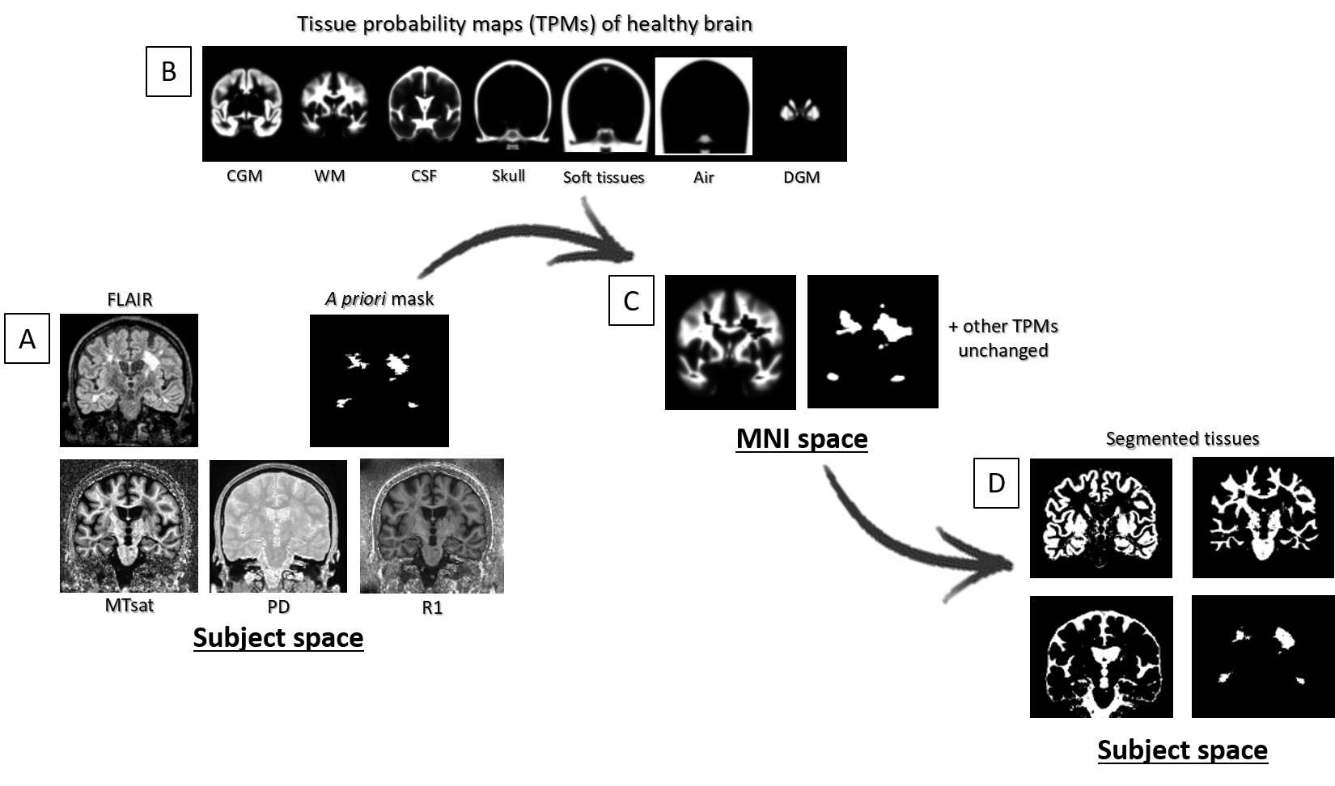
US on healthy brain tissues
Introduction
Purpose of the study
Segmentation
Applications
Conclusion
Unified segmentation (US):
Segmentation and registration of brain tissues, based on mixture of Gaussian models of the intensity distribution of each tissue, and a priori tissue probability maps (TPMs), in a common space
Notes:
TPMs, are included as priors for the spatial localization.
Modified set of TPMs with the gray matter class divided into cortical gray matter, and deep gray matter because they have different intensities in qMRI maps (mostly due to iron deposition).

Slide 25
US on healthy brain tissues
Introduction
Purpose of the study
Segmentation
Applications
Conclusion
Goal: Find parameters for optimal multi-channel segmentation with MPM data of healthy subjects
Number of Gaussians used to model each tissue class (CGM, DGM, WM and CSF)
Combination of the four quantitative maps (MTsat, PD, R1, R2*)

Slide 26
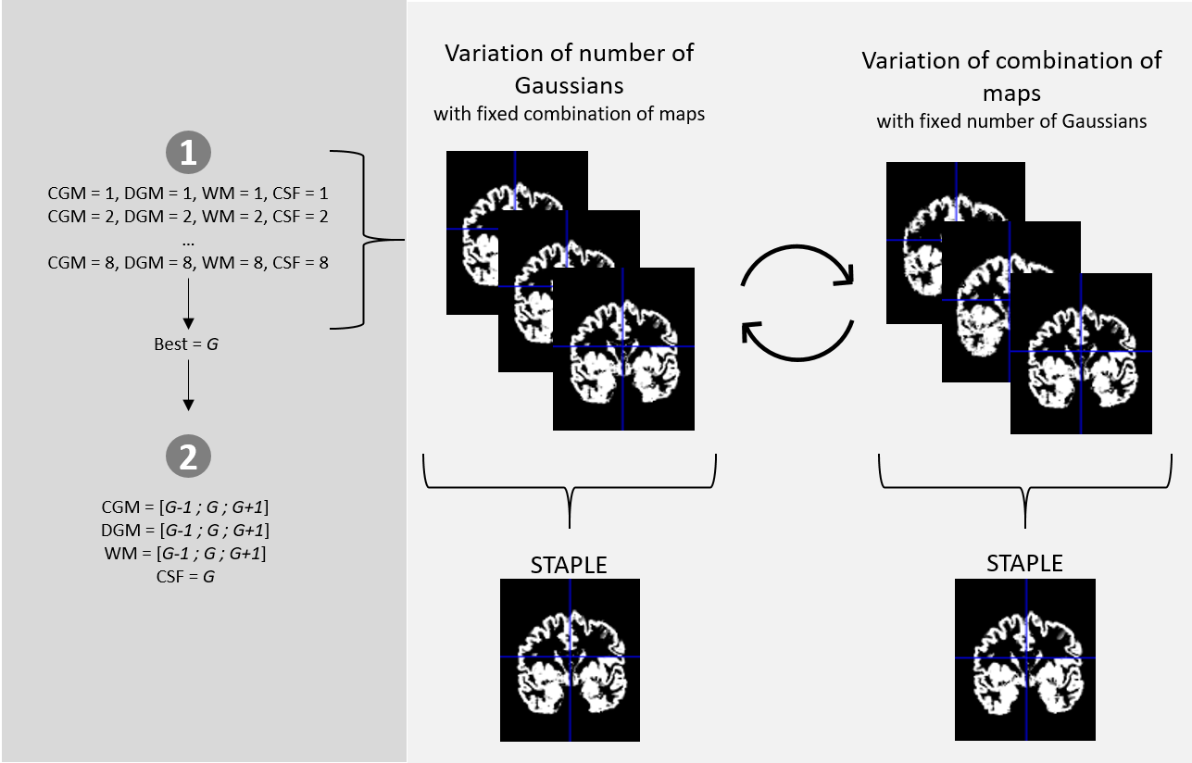
US on healthy brain tissues
Introduction
Purpose of the study
Segmentation
Applications
Conclusion
Starting point:
Test of the optimal number of Gaussians with a segmentation using only MTsat map
Weiskopf et al., CO Frontiers in Neurosciences, 2013
Notes:
Mtsat map = because used in previous studies, lead to rather good segmentation.
We want to see if we do better with other combinations.

Slide 27
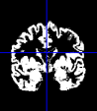
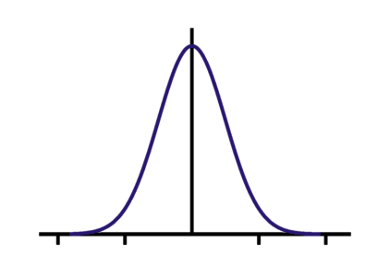
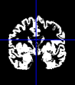


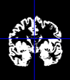
US on healthy brain tissues
Introduction
Purpose of the study
Segmentation
Applications
Conclusion
First problem: There is no ground truth available to test accuracy of segmentation
Use of STAPLE algorithm
« Simultaneous Truth and Performance Level Estimation »
Dice score
Jaccard score
Matthew correlation coefficient
Collection of segmentations
Probalistic estimate of true segmentation
Performance level for each segmentation
Notes:
Dice, Jaccard, MCC = score of accuracy, widely used to evaluate binary segmentations

Slide 28
US on healthy brain tissues
Introduction
Purpose of the study
Segmentation
Applications
Conclusion
Compute set of scores between each segmentation and the « reference » STAPLE

Slide 29
US on healthy brain tissues
Introduction
Purpose of the study
Segmentation
Applications
Conclusion
Second problem: The number of segmentation tests is too high
Start with equal number of Gaussians for each tissue class
Ranging from 1 to 8
Test only a range around this optimal number
For WM, CGM and DGM
CSF is set to the optimal number
Notes:
The segmentation procedure is quite intensive and if we want to test all the combinations it would require too much time (more than 200 days)

Slide 30
US on healthy brain tissues
Introduction
Purpose of the study
Segmentation
Applications
Conclusion

Slide 31
US on healthy brain tissues
Introduction
Purpose of the study
Segmentation
Applications
Conclusion
Goal: Find parameters for optimal segmentation with MPM data of healthy subjects
Number of Gaussians used to model each tissue class (CGM, DGM, WM and CSF) = 5 – 5 – 6 – 5
Combination of the four quantitative maps (MT, PD, R1, R2*)
= MTsat + PD + R1

Slide 32
USwL for MS lesioned brain tissues
Introduction
Purpose of the study
Segmentation
Applications
Conclusion
Unified segmentation with lesion (USwL):
Unified segmentation approach extended to account for lesion tissue.
Relies on a prior approximated mask of the lesion(s)
Extends the set of TPMs with an extra tissue class (and update the others)
Runs as US with new set of TPMs
Generates accurate warping to common space for inter-subject comparisons
Provides more precise delineation of lesion(s)
Notes:
We used the parameters found in this analysis for the segmentation of lesions using US with Lesion
For brains with focal lesions, the US algorithm cannot account for the abonormal tissue type
prior approximate mask = manually drawn or constructed with an automatic method.

Slide 33
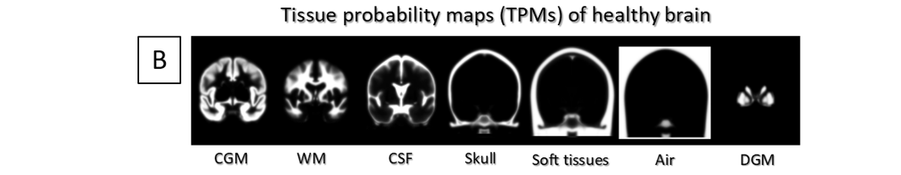
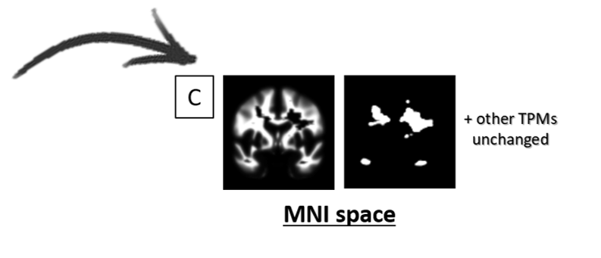
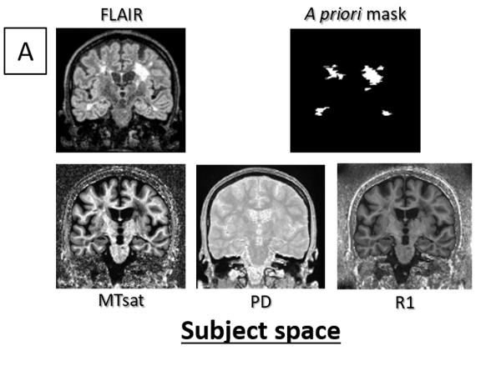
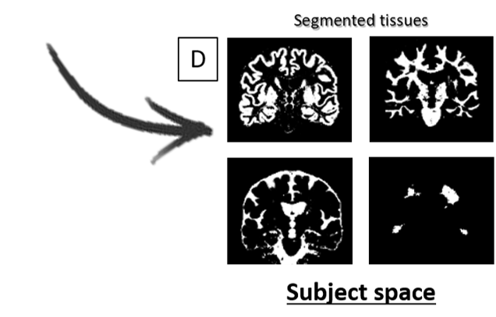
USwL for MS lesioned brain tissues
Introduction
Purpose of the study
Segmentation
Applications
Conclusion

Slide 34
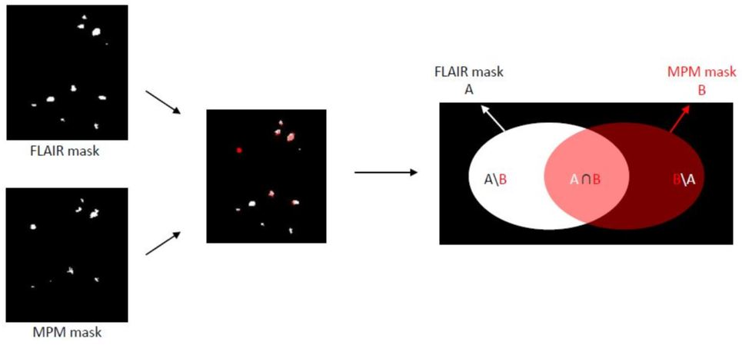
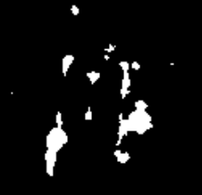
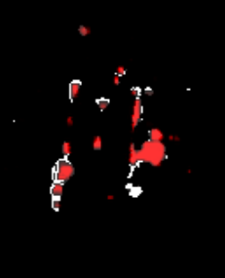
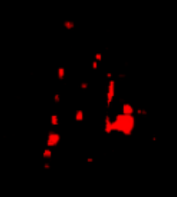
USwL for MS lesioned brain tissues
Introduction
Purpose of the study
Segmentation
Applications
Conclusion
Is the segmentation better using MPM maps than FLAIR ?
Specific to lesion
Notes:
Intersection = Most likely to cover actual lesion (FLAIR hyperintensities + MPM alterations)
Probably very specific to lesion, but not sensitive. Ok because we look at voxels values (and not segmentation contours)

Slide 35
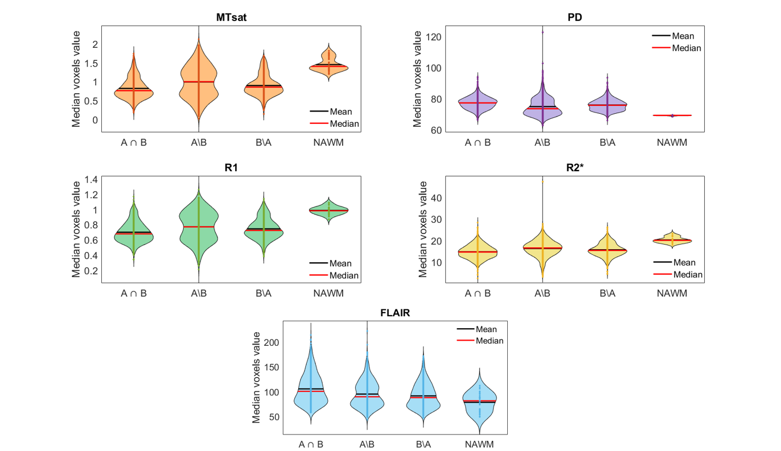
USwL for MS lesioned brain tissues
Introduction
Purpose of the study
Segmentation
Applications
Conclusion
Is the segmentation better using MPM maps than FLAIR ?
Notes:
Each violin = distribution of the voxels intensities in each region

Slide 36
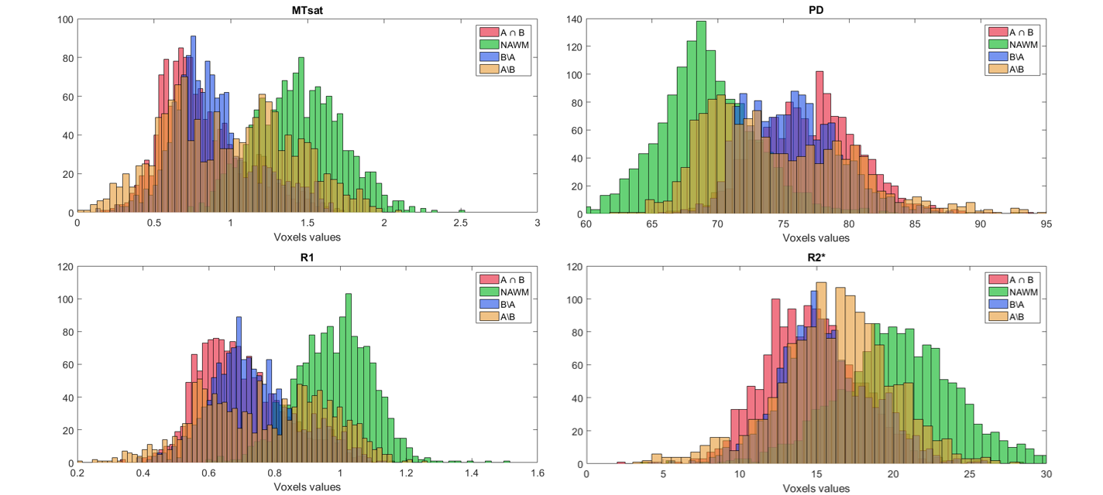
USwL for MS lesioned brain tissues
Introduction
Purpose of the study
Segmentation
Applications
Conclusion
Is the segmentation better using MPM maps than FLAIR ?
Two peaks
= possible set of voxels misclassified as lesion
Notes:
Explain colors !

Slide 37
USwL for MS lesioned brain tissues
Introduction
Purpose of the study
Segmentation
Applications
Conclusion
Unified segmentation with lesion (USwL):
With MPM maps (MTsat + PD + R1)
Voxels classified as lesion with MPM-derived segmentation only are more similar to « true » lesion
Voxels classified as lesion with FLAIR-derived segmentation only are more similar to NAWM
True reference segmentation would have to come from histology analysis

Slide 38
Applications

Slide 39
Longitudinal study
Introduction
Purpose of the study
Segmentation
Applications
Conclusion
Paper:
« Using quantitative magnetic resonance imaging to track cerebral alterations in multiple sclerosis: a longitudinal study »
Brain volume change
Analysis of normal appearing tissues
Analysis of lesions and peripheral tissues

Slide 40
Longitudinal study
Introduction
Purpose of the study
Segmentation
Applications
Conclusion
Population and data acquisition
17 MS patients (age: 25-65) from two studies
Scanned 2 or 3 times on the same MRI machine (3T PRISMA)
Scans separated by a median time period of 30 months
MPM and FLAIR acquisitions
Parameters extracted in NA tissues and lesions

Slide 41
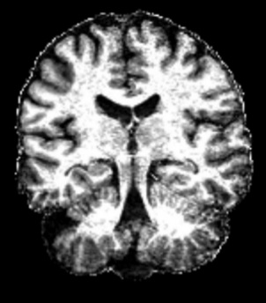
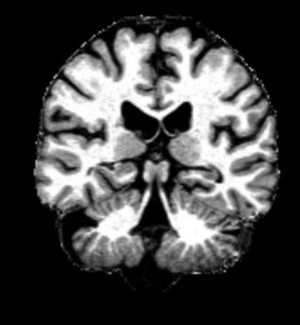
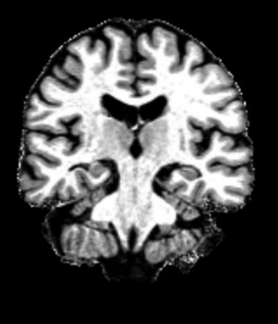
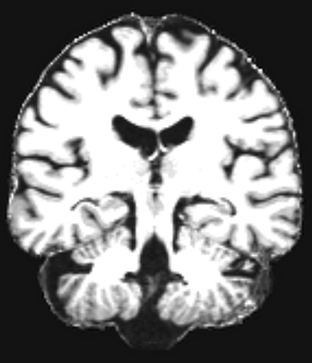
Longitudinal study
Introduction
Purpose of the study
Segmentation
Applications
Conclusion
Longitudinal registration with SPM
Mid-point average
T0
T1
T2
Deformation field
Notes:
longitudinal registration between serial images, because of the dependence of repeated measurements within-subject.

Slide 42
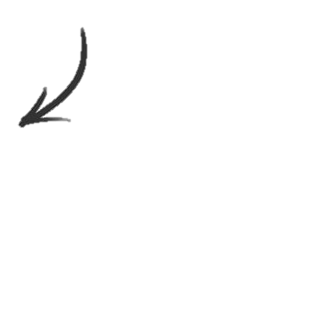

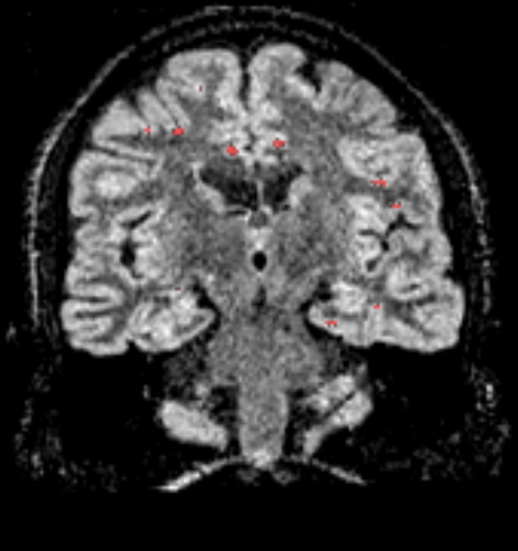
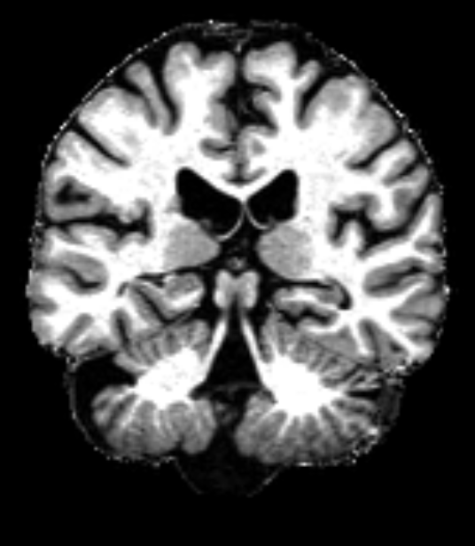
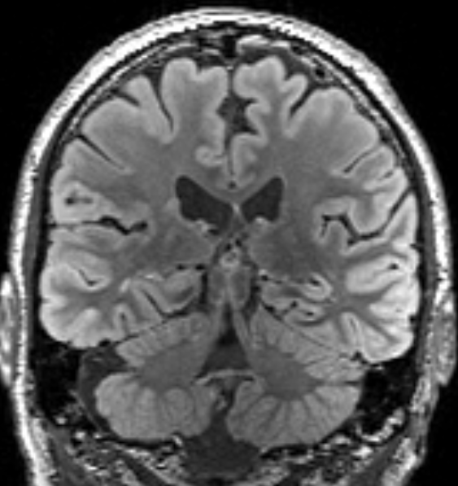


Longitudinal study
Introduction
Purpose of the study
Segmentation
Applications
Conclusion
USwL on each session
Before segmentation…
T0
T1
Images are brought to T0 space
Thanks to deformation field

Slide 43








Longitudinal study
Introduction
Purpose of the study
Segmentation
Applications
Conclusion
USwL on each session
T1 (in T0 space)
T1
Back to initial space
USwL
+
+
After segmentation…

Slide 44

Longitudinal study
Introduction
Purpose of the study
Segmentation
Applications
Conclusion
1. Brain volume change
Evolution of volumetric measurements (measured in %) between both scanning sessions:
Brain parenchymal fraction (BPF) = $\frac{volume(WM+GM+Lesion)}{volume(WM+GM+Lesion+CSF)}$
Gray matter fraction (GMF) = $\frac{volume(GM)}{volume(WM+GM+Lesion+CSF)}$
Lesion fraction (LF) = $\frac{volume(Lesion)}{volume(WM+GM+Lesion+CSF)}$

Slide 45

Longitudinal study
Introduction
Purpose of the study
Segmentation
Applications
Conclusion
1. Brain volume change
Evolution of volumetric measurements (measured in %) between both scanning sessions:
Brain parenchymal fraction (BPF): -0,67 ± 1,12%
-> Significantly different from 0, t-test: $t\left(16\right)=2.57;p= .0204$
Gray matter fraction (GMF): -0,30 ± 1,44%
Lesion fraction (LF): 22,88 ± 26,13%
-> Significantly different from 0, t-test: $t\left(16\right)= −3.70;p= .0019$

Slide 46


Longitudinal study
Introduction
Purpose of the study
Segmentation
Applications
Conclusion
2. Analysis of normal appearing tissues
Evolution of median MPM values in NA tissues:
Where
$Y$= Annual Rate of Change (ARoC) for one tissue and one parameter
$β$ = Regression parameters
$ε$ = Residuals
$X_{status}$ = Disease status score, based on clinical evolution between scanning sessions (EDSS, relapses, new lesions)
1 = clinically stable or improving, 0 otherwise
$$Y=β_{0}+β_{1}X_{status}+ ε$$
Notes:
global median values over the entire tissue

Slide 47

Longitudinal study
Introduction
Purpose of the study
Segmentation
Applications
Conclusion
2. Analysis of normal appearing tissues
Permutations tests (n = 5000) on the observed R-squared ($R_{obs}$) value for one test:
$$p= \frac{\#(R_{π}>R_{obs}) }{n+1}$$
Which estimates the probability of obtaining $R_{obs}$ under the null hypothesis that Y is not correlated to $X_{status}$.
Null hypothesis is rejected if $p< .05$ FDR-corrected for multiple comparison
Notes:
permutation tests for inferences

Slide 48


Longitudinal study
Introduction
Purpose of the study
Segmentation
Applications
Conclusion
2. Analysis of normal appearing tissues
MTsat
R2*
PD
R1

Slide 49

Longitudinal study
Introduction
Purpose of the study
Segmentation
Applications
Conclusion
2. Analysis of normal appearing tissues
Changes in MPM parameters varied across subjects
Annual rate of change positively regressed with disease status (MTsat in NAWM and NACGM, R2* in NAWM)
No significant correlation between volumetric measures and disease status
Notes:
In our case, there were no significant correlation between volumetric measures and disease status.
This suggests that MPM are more sensitive to possible repair mechanisms in patients who are doing well, than volumetric measures.

Slide 50

Longitudinal study
Introduction
Purpose of the study
Segmentation
Applications
Conclusion
3. Analysis of lesions and peripheral tissues
Evolution of median MPM values in four regions:
The focal FLAIR lesions, as clinically defined (hyperintensity of T0 FLAIR)
The initial peripheral lesion detected on qMRI maps at T0
The later peripheral lesion detected on qMRI maps at follow-up (T1)
The NAWM

Slide 51

Longitudinal study
Introduction
Purpose of the study
Segmentation
Applications
Conclusion
3. Analysis of lesions and peripheral tissues

Slide 52
Longitudinal study
Introduction
Purpose of the study
Segmentation
Applications
Conclusion
Longitudinal study: conclusion
Brain atrophy is in accordance with literature but not linked to disease status
qMRI results on normal appearing tissues suggest repair mechanisms in terms of increased myelin content and/or axonal density in patients with positive disease status
In WM lesions, the surrounding NAWM showed microstructural modifications, months to years before they are visible on conventional MRI
Once again, the relevance of qMRI to study MS disease is highlighted
Need for larger replication studies

Slide 53
Comparison between MPM and NODDI
Introduction
Purpose of the study
Segmentation
Applications
Conclusion
Paper:
« Exploring the link between MPM and NODDI measurements in healthy and multiple sclerosis brain tissues »
Analysis with global tissues measures
Multimodal voxel-based quantification (VBQ) analysis

Slide 54


Comparison between MPM and NODDI
Introduction
Purpose of the study
Segmentation
Applications
Conclusion
17 MS patients
15 healthy controls
Creation of NODDI maps: ODI, $F_{icvf}$, $F_{iso}$
Coregistered to corresponding hMRI maps

Slide 55

Comparison between MPM and NODDI
Introduction
Purpose of the study
Segmentation
Applications
Conclusion
1. Analysis with global tissues measures
MS
HC
r = 0.5587
p = .0009
r = 0.7363
p = .0008
r = 0.8658
p < .0001
r = 0.6828
p < .0001
r = -0.4603
p = .0012
Notes:
/!\ relire discussion MPM NODDI
some of the significant correlations
Ficvf (= density of neurites) correlated to all MPM parameters (highly sensitive to the MPM measures, but its specificity is quite poor)
it seems that Ficvf indirectly indicates myelin content, a factor that picked up by MTsat, R1 and R2*. Its negative correlation with PD could be explained by the presence of edema where axonal content is missing.
ODI is an index of the degree of dispersion of the fibers.
ODI correlated only in WM for MTsat and PD (good candidates for complementary biomarkers of tissue microstructure beyond MPM maps)
The correlation between Mtsat and ODI is probably due to the fact that a loss of axonal content induces a dispersion of the axons, thus an increase of ODI. The correlation with PD might also be due to the loss of fibers replaced by extra cellular water.

Slide 56



Comparison between MPM and NODDI
Introduction
Purpose of the study
Segmentation
Applications
Conclusion
2. Multimodal voxel-based quantification (VBQ) analysis
All images (MPM and NODDI) transformed to MNI space
Images smoothed with a FWHM = 3
GM tissue isolated (examples = MTsat, $F_{icvf}$)
Test voxel-wise difference among both groups
(MS patients vs healthy controls)
MSPM tool allows multimodal analyses

Slide 57
Comparison between MPM and NODDI
Introduction
Purpose of the study
Segmentation
Applications
Conclusion
2. Multimodal voxel-based quantification (VBQ) analysis
Two-sample t-test
Significant regional differences between MS patients and healthy controls
1.
Including all MPM parameters
2.
Including all MPM and NODDI parameters
Notes:
Controlled for age, gender and total intra cranial volume

Slide 58


Comparison between MPM and NODDI
Introduction
Purpose of the study
Segmentation
Applications
Conclusion
2. Multimodal voxel-based quantification (VBQ) analysis
All MPM parameters:
MTsat, PD, R1 and R2*
All MPM and NODDI parameters:
MTsat, PD, R1, R2*
+ ODI, $F_{icvf}$, $F_{iso}$
Notes:
This is the Mtsap map averaged among all subjects
We conudcted cluster-level inferences at a p value under .05 after familiy wise error rate correction for multiple comparison across the entire gray matter
Red : clusters of significant differences between the two groups with the model including only MPM parameters

Slide 59

Comparison between MPM and NODDI
Introduction
Purpose of the study
Segmentation
Applications
Conclusion
Comparison NODDI-MPM: conclusion
$F_{icvf}$ seems to be related to all MPM measures, at least considering myelin and water contents
ODI is correlated to MTsat and PD, might go beyond MPM measures
At the voxel level, NODDI maps do not seem to bring additional information to what is captured with MPM parameters
NODDI protocol might be more useful to study global measurements or with tractogtaphy
Notes:
MPM and NODDI protocols have proven their efficiency to investigate MS-related microstructural alterations but have not been compared to each other

Slide 60
Conclusion

Slide 61
Discussion
Introduction
Purpose of the study
Segmentation
Applications
Conclusion
Relevance of using qMRI to study MS-related microstructural properties
Optimization of existing algorithm for segmentation based on MPM
MPM-based lesions segmentation seems to incorporate more actually lesioned tissue than conventional FLAIR imaging
Detection of possible microstructural repair mechanisms treatments ?
Evidence of alterations months before visible on cMRI prediction with qMRI ?
MPM and NODDI seem to provide complementary biomarkers of tissue microsctructure
Thesis connects with a collection of studies on neurological conditions using qMRI, bringing closer its implementation in clinical routines
Notes:
Multiple sclerosis pathology lacks of imaging tools for in vivo monitoring, as conventional MRI techniques only depict the « tip of the iceberg » and biopsies are not always possible
MPM and NODDI protocols are currently widely used in research

Slide 62
Limitations
Introduction
Purpose of the study
Segmentation
Applications
Conclusion
Small sample size
Absence of histological validation
Acquisition instabilities
But
Difficult and possible only in a few labs
Done on other qMRI sequences
Heterogeneity
Absence of longitudinal control group
But
Possible corrections with recent techniques
But
Difficulties of acquisition when clinical population to be scanned on research machines
But
Results from other studies can be used

Slide 63


Perspectives
Introduction
Purpose of the study
Segmentation
Applications
Conclusion
Technology & acquisition
Data sharing and processing
Moving to clinical routine
3T
Sharing qMRI data across centers
7T
More robust algorithms
+ improved B0 and B1 corrections
+ reduce artefacts and intensity inhomogeneities
+ shorter sequences
Better disease monitoring
Benefits surpassing drawbacks must be validated for implementation in clinical routines (to replace some sequences or evaluate treatments)

Slide 64



Conclusion
Introduction
Purpose of the study
Segmentation
Applications
Conclusion
Lack of standard tool to process data/diagnosis
qMRI is interesting for that purpose
Neurologists/engineers integration for eased processing and analyses
New links between brain and symptoms
Still gaps to fill but promising for the future
Notes:
encouraged

Slide 65
Thank you for your attention !

Slide 66
Back up slides

Slide 67

Previous results
Introduction
Purpose of the study
Segmentation
Applications
Conclusion
Lommers et al., NI: Clinical, 2019
Notes:
In the past, several studies combining quantitative MRI and MS have been conducted, and in accordance with histological results.
For example, in a study conducted by Dr Lommers here, the difference in MPM parameters between MS patients and healthy controls was assessed within their normal appearing tissues, in white matter, as well as in cortical and deep gray matter.
It mostly arises in white matter and cortical gray matter, where Mtsat, R1 and R2* are significantly reduced in MS patients compared to healty subjects.

Slide 68

Previous results
Introduction
Purpose of the study
Segmentation
Applications
Conclusion
Lommers et al., Hum. Brain Map., 2021
Notes:
In her second study, Dr Lommers has also detected a number of loco-regional differences between MS patients and healthy controls, picked up by the four MPM parameters.
The green spots correspond to the average lesion probability.
In red we can observe the average brain atrophy estimated by the loss of gray matter.
Here in blue we see the reduced Mtsat, in yellow the reduced R1 and in purple the reduced R2*.
In primary cortices, both atrophy and MPM alterations are observed, although in the deep gray matter nuclei we only observe atrophy, while in hippocampus and paralimbi cortices we see a reduction of Mtsat and R1 with no atrophy.

Slide 69


R2*, atrophy and iron accumularion
Introduction
Purpose of the study
Segmentation
Applications
Conclusion
When interpreting R2* changes (especially in DGM), one must make the difference between iron concentration and iron accumulation.
Mean R2* value does not take atrophy into account
Notes:
In her second study, Dr Lommers has also detected a number of loco-regional differences between MS patients and healthy controls, picked up by the four MPM parameters.
The green spots correspond to the average lesion probability.
In red we can observe the average brain atrophy estimated by the loss of gray matter.
Here in blue we see the reduced Mtsat, in yellow the reduced R1 and in purple the reduced R2*.
In primary cortices, both atrophy and MPM alterations are observed, although in the deep gray matter nuclei we only observe atrophy, while in hippocampus and paralimbi cortices we see a reduction of Mtsat and R1 with no atrophy.

Slide 70

US and USwL
Introduction
Purpose of the study
Segmentation
Applications
Conclusion
Standard vs updated TPMs
CGM
GM
DGM
Notes:
New TPMs from quantitative maps (Mtsat and R2*), including more gray matter in subcortical regions
In addition, separation between CGM and DGM because quantitative parameters inside them differ, mainly due to their different iron contents

Slide 71
US and USwL
Introduction
Purpose of the study
Segmentation
Applications
Conclusion
Lesion mask from subject to MNI space
CFM + US on healthy tissues
Approximative alignment to MNI space
Smoothing
Lesion TPM computed based on classe(s) affected and load ratio
Notes:
The lesion mask goes from subject space to MNI space thanks to an algorithm called « cost function masking ».
With this process, the lesion area is masked out of the image, and the rest of healthy tissue is segmented with the traditionnal US algorithm. This provides a first warping between subject and MNI space, which can be applied to the lesion mask to approximately align it to the TPMs
The initial mask can be dilated of 1 or 2 voxels to ensure complete coverage
Then, this mask is smoothed with a 4 mm kernel.
The the lesion TPM is computed based on the tissue classes affected and a load ratio.

Slide 72

US and USwL
Introduction
Purpose of the study
Segmentation
Applications
Conclusion
USwL schematic process
Notes:
The lesion mask goes from subject space to MNI space thanks to an algorithm called « cost function masking ».
With this process, the lesion area is masked out of the image, and the rest of healthy tissue is segmented with the traditionnal US algorithm. This provides a first warping

Slide 73

US and USwL
Introduction
Purpose of the study
Segmentation
Applications
Conclusion
Group mean value differences between each lesion region

Slide 74


US and USwL
Introduction
Purpose of the study
Segmentation
Applications
Conclusion
Histograms metrics

Slide 75

Disease status score
Introduction
Purpose of the study
Segmentation
Applications
Conclusion

Slide 76

Longitudinal study
Introduction
Purpose of the study
Segmentation
Applications
Conclusion
2. Analysis of normal appearing tissues
Notes:
This is why we tested its link to the disease status X_status with the regression model I presented just before.
With the permutation tests, we found that the annual rate of change positively regressed with the disease status, in normal appearing white matter for Mtsat and R2*, and also in normal appearing cortical gray matter for Mtsat.
In these three cases we see the differences in the violins here, significantly different with t-test.
However, we did not find a significant correlation between the two volumetric measures, brain parenchymal fraction and lesion fraction with the disease status, showing that the MPM parameters are more sensitive to microstructural changes in normal appearing brain tissues over time than global morphological measurements.
Since Mtsat and R2* both correlate with myelin content, these results suggest the presence of repair mechanisms within normal appearing brain tissues in patients who are improving, or at least not getting worse.

Slide 77


Comparison between MPM and NODDI
Introduction
Purpose of the study
Segmentation
Applications
Conclusion
1. Replication of literature findings
Notes:
For the replication of literature findings, we found significant results for the intra-cellular volume fraction between healthy subjects and MS patients in NAWM; and in the intra-cellular and isotropic volume fractions between normal-appearing white matter and lesions in patients only.
Those results agree with literature.
Regarding ODI, we found no significant results, but we found an increasing tendency in normal appearing white matter compared either to the white matter of controls or the lesions in patients, which agrees with previous studies.
In addition, this tendency is verified with a significant difference comparing ODI in lesions and their normal appearing white matter contralateral region, in restricted sample, proving that ODI increases in normal appearing white matter.

Slide 78

Comparison between MPM and NODDI
Introduction
Purpose of the study
Segmentation
Applications
Conclusion
1. Analysis with global tissues measures
Notes:
For the replication of literature findings, we found significant results for the intra-cellular volume fraction between healthy subjects and MS patients in NAWM; and in the intra-cellular and isotropic volume fractions between normal-appearing white matter and lesions in patients only.
Those results agree with literature.
Regarding ODI, we found no significant results, but we found an increasing tendency in normal appearing white matter compared either to the white matter of controls or the lesions in patients, which agrees with previous studies.
In addition, this tendency is verified with a significant difference comparing ODI in lesions and their normal appearing white matter contralateral region, in restricted sample, proving that ODI increases in normal appearing white matter.

Slide 79
OUT

Slide 80

Multiple sclerosis
Introduction
Purpose of the study
Segmentation
Applications
Conclusion
Confavreux and Vukusic, 2014
Notes:
Multiple sclerosis is characterized by different phenotypes, reflecting different courses of the disease.
Those courses depend on the expression of two distinct phenomena : first the relapses, which corresponds to periods of acute neurological symptoms followed by partial or complete recovery, and second the progression, where a refers to the steady and irreversible worsening of the clinical status.
Four categories can be dinstincted : a relapsing remitting form, corresponding to the first phenomenon, which can in time be associated to a progression, the secondary progressive form.
Some patients directly start with a progressive form, called primary progressive, or progressive relapsing when he or she also experiences episodes of relapses.

Slide 81
Multiple sclerosis
Introduction
Purpose of the study
Segmentation
Applications
Conclusion
Space dissemination criterion: at least two lesions in the CNS
Diagnosis
Time dissemination criterion: at least two episodes of the disease
Inflammation criterion: inflammation detected in a CSF analysis

Slide 82


Magnetic Resonance Imaging (MRI)
Introduction
Purpose of the study
Segmentation
Applications
Conclusion
Y coil
Z coil
Patient
Radio-frequency transmitter and receiver
X coil
Patient table
Gradient coils
Magnet
Radio-frequency transmitter and receiver
Patient
Notes:
superconductive magnet
distorts the main magnetic field in a slight but predictable pattern, which allows the spatial encoding of the constructed image.

Slide 83
Previous results
Introduction
Purpose of the study
Segmentation
Applications
Conclusion
A number of studies combined qMRI estimates and multiple sclerosis
MT (MTR and MTsat) imaging has been largely employed to quantify the extent of damage in focal WM lesions as well as in normal appearing tissues, especially regarding myelin destruction.
MTR and R1 measurements show a similar behavior, decreasing in normal appearing tissues (indicating a progressive loss of myelin outside of lesions) comparing MS patients and HC, and globally decreasing in focal lesions.
R2* values are decreased in normal appearing WM and CGM in MS patients compared to controls (indicating the presence of subtle microedema), while increased in normal appearing DGM.
Notes:
In agreement with histo studies

Slide 84




Longitudinal study
Introduction
Purpose of the study
Segmentation
Applications
Conclusion
USwL on each session
+
+
T2: MPM + FLAIR + mask from USwL
+
USwL
T0: MPM + FLAIR with mask
USwL
+
+
T1: MPM + FLAIR + mask from USwL
Notes:
Then, we used the US-with-Lesion method to segment the white matter lesions and normal appearing tissues.
In T0, we used the FLAIR-based mask, computed with LST, as the approximate mask, like I showed in the previous section.
Then the mask constructed with US-with-Lesion at T0 was used as the prior lesion mask in the T1 dataset.
We ran US-with-Lesion a second time with the prior mask from the previous dataset, and obtained a new lesion mask for the T1 dataset.
In the case where a third dataset was available, we did the same thing, we used the mask constructed at T1 as prior in T2.

Slide 85





Longitudinal study
Introduction
Purpose of the study
Segmentation
Applications
Conclusion
USwL on each session
T0, T1, T2...
Median value for each parameter (MTsat, PD, R1 and R2*) in each tissue class, for each session
R2*
R1
PD
MTsat
Notes:
At the end, for each session, we extract the MPM voxels values inside each tissue of interest, cortical gray matter, deep gray matter, white matter, and the lesions.

Slide 86

Longitudinal study
Introduction
Purpose of the study
Segmentation
Applications
Conclusion
Notes:
This is the entire process, for the FLAIR images we started by constructing the lesion mask with LST, then all images, FLAIR and MPM at following sessions, were brought to the T0 space.
Then the tissues were segmented with the three MPM maps Mtsat, PD and R1, and FLAIR.
Then the images are brought back to their initial T0 space.
Then we used the maps and the segmented tissues to run the three analyses focusins on volume changes, normal appearing tissues and lesions.

Slide 87
Limitations
Introduction
Purpose of the study
Segmentation
Applications
Conclusion
Absence of histological validation
Small sample size
Low SNR in NODDI maps
Acquisition instabilities
Different spatial resolutions
(MPM and NODDI)
Heterogeneity
Absence of public datasets to test algorithms
Absence of longitudinal control group
Notes:
The analyses presented a number of limitations.
First regarding the dataset we know that its size, its heterogeneity regarding the age, sex, MS phenotypes etc of the patients constitute a great
Instabilities = different scanners and/or sequences used
Heterogeneity = age, sex, phenotype etc of patients + time period between scans in longitudinal study

Slide 88
Discussion
Introduction
Purpose of the study
Segmentation
Applications
Conclusion
Multiple sclerosis pathology lacks of imaging tools for in vivo monitoring, as conventional MRI techniques only depict the « tip of the iceberg » and biopsies are not always possible
The MPM protocol gathers 4 interesting quantitative maps gathered in one (relatively short) acquisition
MPM and NODDI protocols are currently widely used in research
This thesis connects with a collection of studies on neurological conditions using qMRI, bringing closer its implementation in clinical routines
Notes:
Multiple sclerosis pathology lacks of imaging tools for in vivo monitoring, as conventional MRI techniques only depict the « tip of the iceberg » and biopsies are not always possible

Slide 89
Limitations
Introduction
Purpose of the study
Segmentation
Applications
Conclusion
BUT…
Large datasets are difficult to acquire with advanced techniques in research dedicated machines, especially in longitudinal settings
The clinical situation of participants must also be taken into account
qMRI still allows multicenter and/or longitudinal studies when identical protocols are used
Control group might not be necessary due to quantitative nature of data
Technical improvements are constantly under study
The current methodology might help further larger studies

Slide 90

Comparison between MPM and NODDI
Introduction
Purpose of the study
Segmentation
Applications
Conclusion
Conclusion
MPM and NODDI protocols have proven their efficiency to investigate MS-related microstructural alterations but have not been compared to each other
NODDI maps alone showed similar results as in the literature, at least with similar samples
$F_{icvf}$ seems to be related to all MPM measures, at least considering myelin and water contents
ODI is correlated to MTsat and PD, might go beyond MPM measures
At the voxel level, NODDI maps do not bring additional information to what is captured with MPM parameters
Notes:
To conluce, a lot of studies with MPM and NODDI have already proven their efficiency to study multiple sclerosis but they have not been compared to one another yet.
There are a lot of studies combining NODDI and multiple sclerosis, sometimes with opposite results, in our case we found similar results as the ones with similar datasets as ours.
The intracellular volume fraction is correlated to all MPM measures, so it seems to be related to the same microstructural characteristics as the MPM maps
On the contrary, the ODI is correlated to Mtsat and PD, and this might be because it goes beyond what is captured with MPM.
At the voxel level, the inclusion of NODDI maps did not allow to highlight specific regions compared to MPM.

Slide 91
Comparison between MPM and NODDI
Introduction
Purpose of the study
Segmentation
Applications
Conclusion
Paper:
« Exploring the link between MPM and NODDI measurements in healthy and multiple sclerosis brain tissues »
Replication of literature findings
Analysis with global tissues measures
Multimodal voxel-based quantification (VBQ) analysis
Notes:
The second application using the segmented tissues obtained with US-with-Lesion consisted of a study comparing the two families of quantitative MRI parameters : MPM and NODDI.
The study is divided into three points :
First, we tried to replicate the findings combining NODDI and multiple sclerosis present in the literature.
Then, we compared MPM and NODDI parameters at the global tissue levels, by taking the median value inside each segmented tissue.
And finally, we ran a voxel-based quantification analysis in a multi-modal way to detect voxel-wise regions where a difference could appear between patients and controls, considering NODDI and MPM parameters together.

Slide 92

Comparison between MPM and NODDI
Introduction
Purpose of the study
Segmentation
Applications
Conclusion
ODI = Orientation Dispersion Index
Describes the degree of the bending and fanning of axons and dendrites that are widespread troughout the WM and GM
The more structured the tissue, the smaller ODI value
$F_{icvf}$ = Intra-cellular volume fraction
Describes the density of the axons and dendrites
$F_{iso}$ = Isotropic volume fraction
Describes the free water diffusion (indirect value of the CSF volume fraction)
Notes:
We focused on three NODDI parameters that are very present in the literature
First the orientation dispersion index, which is an index of the bending and fanning of axons and dendrites within white matter and gray matter. If ODI is equal to 0, it means that the fibers are perfectly aligned, and when it is equal to 1, it means that the fibers are completely isotropic.
The second one is the intra-cellular volume fraction, describing the density of axons and dendrites.
And finally, the isotropic volume fraction, which is an indirect measure of the CSF volume fraction since it describes the diffusion of free water.
We used those three parameters first to replicate literature findings, then along with MPM parameters in global and voxel-wise analyses.

Slide 93

Magnetic Resonance Imaging (MRI)
Introduction
Purpose of the study
Segmentation
Applications
Conclusion
Some particles possess a « spin angular momentum » characterized by a precession with specific frequency
In MRI, the targeted particles are the protons (mostly in water and fat)
The spins align to the fixed magnetic field ($B_{0}$)
Particles are stimulated with an electromagnetic wave at the same frequency of their precession
The MRI signal arises from the « nuclear magnetic resonance » phenomenon following the perturbation

Slide 94


Magnetic Resonance Imaging (MRI)
Introduction
Purpose of the study
Segmentation
Applications
Conclusion
Some particles possess a « spin angular momentum » characterized by a precession with specific frequency
In MRI, the targeted particles are the protons (mostly in water and fat)
The spins align to the fixed magnetic field ($B_{0}$) with two distinct levels of energy
A greater number of spins align with a lower level of energy (E1), in the « spin up » status
A longitudinal magnetization in the direction of $B_{0}$ arises
The MRI signal arises from the « nuclear magnetic resonance » phenomenon when the particles are stimulated with an electromagnetic wave at the same frequency of their precession

Slide 95


Magnetic Resonance Imaging (MRI)
Introduction
Purpose of the study
Segmentation
Applications
Conclusion
Resonance phenomenom
The interaction with $B_{1}$ is by means of an RF pulse which disturbs the spin properties:
  In the z plane: There is a transition from $E_{1}$ to $E_{2}$ for a lot of spins
  $M_{z}$ decreases
  In the xy plane: There is a rephasing of the spins (phase coherence)
  $M_{xy}$ increases
Resonance condition : The RF frequency $ω_{RF}$ must be equal to the Larmor frequency $ω_{0}$

Slide 96




Magnetic Resonance Imaging (MRI)
Introduction
Purpose of the study
Segmentation
Applications
Conclusion
1.
The external magnetic field $B_{0}$
Equilibrium state
2.
The electromagnetic field (RF) $B_{1}$
Disturbance
3.
Relaxation
Back to equilibrium state

Slide 97

Magnetic Resonance Imaging (MRI)
Introduction
Purpose of the study
Segmentation
Applications
Conclusion
Relaxation – Back to equilibrium state
  In the z plane: There is a transition from $E_{2}$ to $E_{1}$
  $M_{z}$ increases
  T1 relaxation
  In the xy plane: There is a dephasing of the spins
  $M_{xy}$ decreases
  T2 (T2*) relaxation

Slide 98
Quantitative MRI
Introduction
Purpose of the study
Segmentation
Applications
Conclusion
Neurite orientation dispersion and density imaging (NODDI)
Orientation-dispersed cylinder model associated with a two-shell HARDI protocol
Diffusion-weighted EPI images, which further need correction for
off-resonance fields from head susceptibility and eddy currents
Then, NODDI images derived from a three compartment tissue
model (free water, intra-cellular and extra-cellular material)
Intra-cellular: collection of sticks to capture bounded diffusion
Extra-cellular: Gaussian anisotropic displacement
Free water: isotropic Gaussian diffusion
Notes:
Another quantitative MRI protocol used in this study in the neurite orientation dispersion and density imaging protocol, or NODDI.
This is from the family of diffusion imaging.
The NODDI protocol consists of an orientation-dispersed cylinder model associated with a two-shell HARDI protocol.
The acquisition consists of a series of diffusion-weighted EPI images which are corrected for inhomogeneities due to head susceptibility and eddy currents.
Then the NODDI maps are estimated with a three compartment model, which divides the tissues into compartments representing the intra-cellular material, the extra-cellular material and the free water.
The compartments are modelled in different ways to better represents the displacement of water molecules in each case:
It corresponds to a set of sticks for the intra-cellular compartment, to represent the highly bouded diffusion inside the neurits.
The extra-cellular material is characterized by a Gaussian anisotropic displacement to descibe the displacement of water molecules around glial cells present in the extra-cellular environment, but the displacement is not restricted to them.
In free water, basically in the CSF, the displacement of water molecules is considered in all directions, so it is modeled with an isotropic Gaussian diffusion.

Slide 99



Longitudinal study
Introduction
Purpose of the study
Segmentation
Applications
Conclusion
Longitudinal registration with SPM
Mid-point average
Jacobian
Divergence of velocity field
T0
T1
T2
Deformation field

