Slide 1
The Un/Deserving Child : Philanthropic philosophies and practices in Combating child poverty
Tissa Conference, Ghent

Slide 2
Setting the Scene

Slide 3
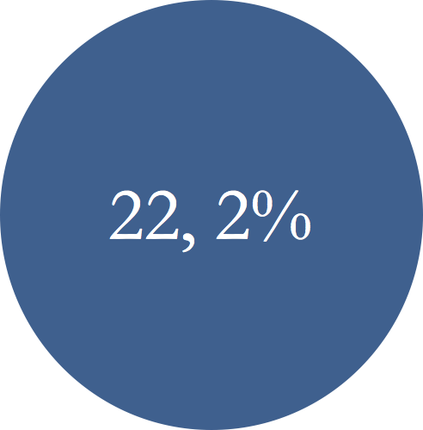
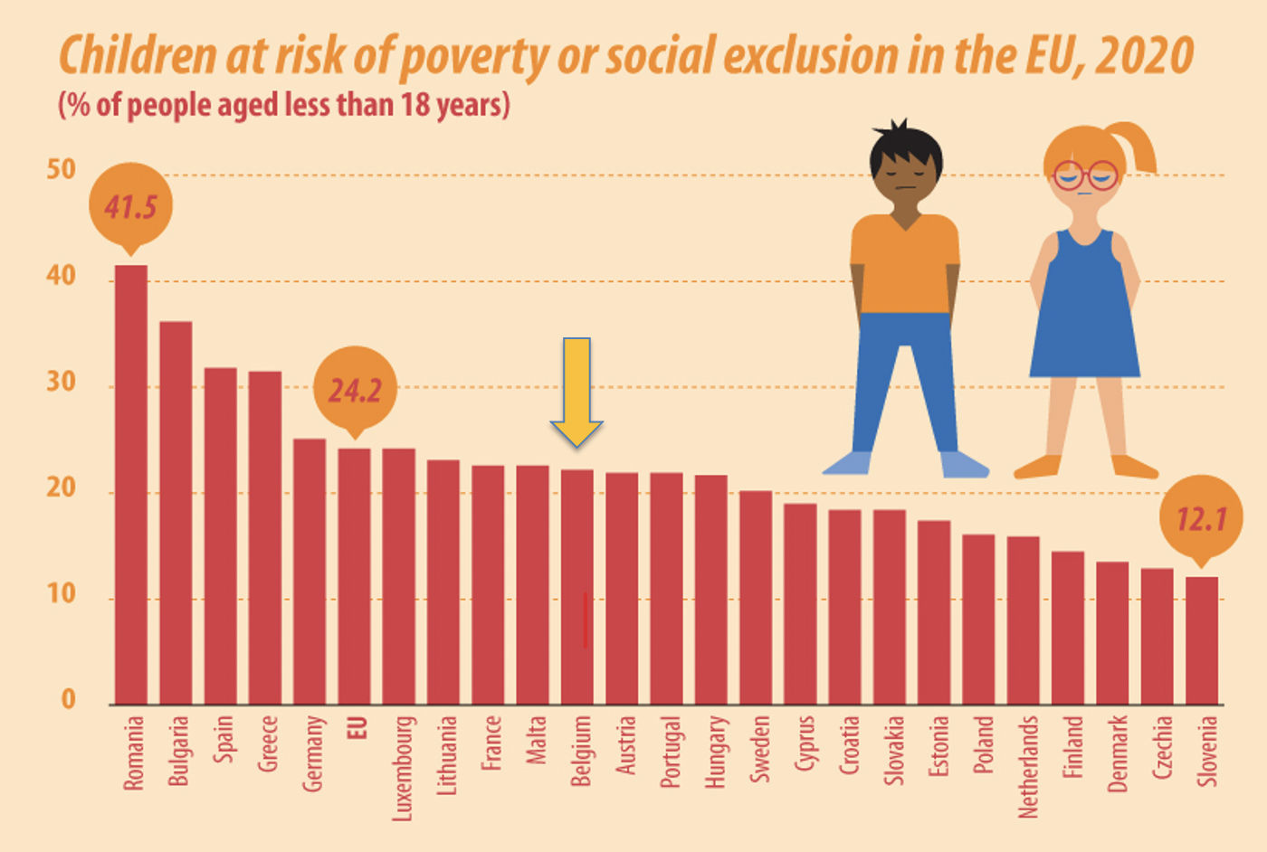
Children at risk of poverty or social exclusion
2020

Slide 4
Child poverty is always a normative construct
grasp the implicit conceptions of social question
social state, civil society and the market it supports
Social workers collaborating with private actors?
Child poverty reduction strategies in practice?

Slide 5
Methodology

Slide 6
Qualitative research with semistructured interviews
Flanders and Walllonia (Belgium)
A “new” Foundation
Social commissions (Fondation’s administrators, n=7)
Social partners (social workers, n=20)
Huge diversity of organisations
4 dimensions to analyse poverty reduction practices
Governance model
Selective vs universal, Un/conditionality, Instrumental vs lifeworld oriented (Maeseele 2012)
Notes:
Type of organisation : 8 schools + 4 PCSW + 2 Orthopedagogical Centre + 2 Foster Care Institution + 1 Medical Pedagogical Institute + 1 Foodbank

Slide 7
Governance model

Slide 8
Foundation goals and singularities
support children living in extreme poverty (residual)
long-term basis (from 1st demand until 18st of 25st birthday of the child)
every domains
break poverty reproduction (welfare dependency)
Via its social partners (front-line social practitioners)
partnership in almost every communities
wide range of structures (including PCSW)
partners receive the money and spread it to children

Slide 9
3 different strategies of fundraising
short-term and ad hoc gifts
testaments and legacies
long-term social commitment from companies
Avoiding welfare state ways of redistribution

Slide 10
Partners are glad to get the support
fast, simple, flexible and long-run
in contrast with bureaucracy and short-term support (PCSW)
New-charity model
transformation of the welfare state (on its back)
redistribute financial resources to children living in poverty
charity and business development case
redistribution of financial resources from civil society commitment that plays into market dynamics

Slide 11
Selective vs universal

Slide 12
Foundation approach is selective
social partners select the children
criteria : extreme poverty
what does it mean? How frontline practitioners mesure it?
Varies from of partner to another
more selective than Foundation Philosophy (un/deserving)
parents habits / parents stigmatization
competition between children across communities
poverty diagnoses can be problematic
intrusive strategy can be stigmatizing (home visit)

Slide 13
Un/conditional

Slide 14
Foundation is almost unconditional with children
1250€/year between 0 and 12 years old
2000€/year between 12 and 18 or 25 years old
schools' bills, medical bills, shoes, clothes, summer camps, glasses etc.
Support stops when parents' economical situation improves
Foundation is almost unconditional with social partners
freedom to manage the budget
unusual for partners that are used to bureaucracy

Slide 15
Social partners with children
parents’ expected behavior (merit, motivation, habits)
parents don’t know the exact amount of money that is available
wide variety of practices from one partner to another
Social partners workload is problematic
Foundation support as a threat to parents
Notes:
In doing so, we note a wide variety of practices from one partner to another, with some not willing to make the support provided more conditional, while others adding additional admission criteria:
The diversity of practices across the various social partners also extends to concrete payment systems adopted, bringing along different degrees of control performed by the practitioner. Some of the social partners go shopping with the children or families, others ask the bills afterwards or work with coupons:
The diversity of practices across the various social partners also extends to concrete payment systems adopted, bringing along different degrees of control performed by the practitioner. Some of the social partners go shopping with the children or families, others ask the bills afterwards or work with coupons:
The workload involved in follow-up can also lead to further conditionalisation and ultimately directly affect the child/youngster support. Although the collaboration with Pelicano is smooth and fast, the fact that partners have to deal with one or more Pelicano cases can be time-consuming and difficult to integrate into their daily practice. The role that the social partner has to take on can be more difficult to manage for some of them, especially when the missions of the partner organisation differ from those required in the collaboration with the Foundation:
The size of the team in the partner organisation that deals with Pelicano cases can also have an impact on the follow-up of the child and youngster, but also on the introduction of new applications within the structure. This can lead to more conditionality. This is illustrated in the following extract:
The extra workload for the partner, when it impinges on the partner's daily tasks, can lead to a loss of investment by the partner in the follow-up of the case:
In addition to the above, one social partner explained that it had already made the continuation of the Foundation's financial intervention conditional for a reason inherent to its organization. This is a school that threatened the parents of a child supported by Pelicano to stop the follow-up if they did not put their child in school:

Slide 16
Instrumental/life-world

Slide 17
Foundation approche is life-world oriented
except for parents
long terms as innovative (//child benefit)
diplomas and jobs to escape poverty
Social partners are in the here and now
Partners un-able to follow up children's trajectories

Slide 18
Discussion

Slide 19
New charity model
back to charity and wilingness to « redistribute »
avoiding welfare state mechanisms
UFO in social policies field
children trajectories (long-term support)
Foundation limits
market based approached => new charity business case
political actor in constructing and definying what is chlid poverty
parents are left aside (undeserving)
great disparity in practices between the social partners
competitition between children, between territories
foundation victim of its success (Flanders)

