Slide 1
“Counting Back”: What kind of bibliodiversity does the Impact Factor brand reflect?
A case study of IF journals included in the 2021 Journal Citations Report
Marjorie Bardiau & Christophe Dony – LIS Bibliometrics 2022

Slide 2
1.
Background & context

Slide 3
What do we mean by “counting back” and bibliodiversity?
Critique of the IF mainly focuses on how the metric is flawed
- how the IF favors citation-dense fields
- how it presents skewed citation distribution in using average data
- how it does not correlate with quality of research, nor its reliability
- …
Assessing the type of bibliodiversity that the IF brand reflects matters too in a research assessment perspective focusing on DEI
For the purpose of this study, bibliodiversity = measuring the number of journals per:
Publisher
Publishing model
Country/world region where journals are produced
Language(s) of publication
Subject (macro-discipline)
APC price (if any)
‘Counting Back’ approach: applied to IF journals included in the 2021 Journal Citations Report (JCR)
> 12391 journals > SSCI = 3593 journals; SCIE 7541 journals (701 journals included in both indexes)

Slide 4
Methodological notes (1)
Grouping Publishers
- The Web of Science (WoS) uses imprints, brands, and client organizations for its publisher data. We standardized these by grouping them with their parent/distribution company. For example, Elsevier includes Academic Press, Cell Press, Pergamon Press, etc.
World regions
- WoS data for country (based on WoS publishers's adress) was used to map World Regions data. - The Unicef Regional Classification scheme was used for this mapping.
Languages
- WoS data was used for languages (except for 88 journals for which this info was missing; it was collected manually on journals' websites).
- WoS structures data regarding multilingualism in two fashions, either enumerating languages or using the tag "Multi-Language" (n=715). We considered every journal tagged with this “Multi-Language” label as joournals using English in addition to at least another language.
Models
- Information gathered from publishers' lists and W. Crawford's GOA6 data (i.e. DOAJ). Manual data collection was used for journals that did not get an ISSN match in these lists.
- Journals labelling themselves as "transformative" were tagged as "Hybrid". Journals participating in a Subscribe to Open Model were tagged as "OA-no fees" journals (n=28). Delayed OA journals were tagged as "Subscription".

Slide 5
Methodological notes (2)
APCs
- APC prices were colleced is $US for US authors without taxes, membership, or society discounts for what comes closest to “traditional” research articles in terms of output type. Possible extra fees were not taken into account.
- When APC price varied according to licences, we collected prices for a CC-BY license. When APC varied according to length, the limit of 10 pages was used.
- Currency conversion was applied when necessary, using the date when data was collected on the journals' websites (usually with a date-stamped wayback machine link to ensure replicability).
Subjects
- WoS uses over 250 subject categories to classify the journals that it indexes. To facilitate the analysis for the present study, we used Milojević’s reclassification scheme of WoS content (Milojević 2020) to recategorize the WoS categories from our preliminary dataset into broad subject categories.
- Most journals with more than one WoS category fall into the same broad area after reclassification. But this was not true in some cases. As a result, we made the arbitrary decision to assign a broad area based on the reclassification of the first WoS category appearing in the WoS data that we used.
- The WoS category scheme contains the “Multidisciplinary Sciences” label that has no equivalent in Milojević’s reclassification scheme. We kept this category since we are working at the journal level, not at the article level (as Milojević does).

Slide 6
2.
Results

Slide 7
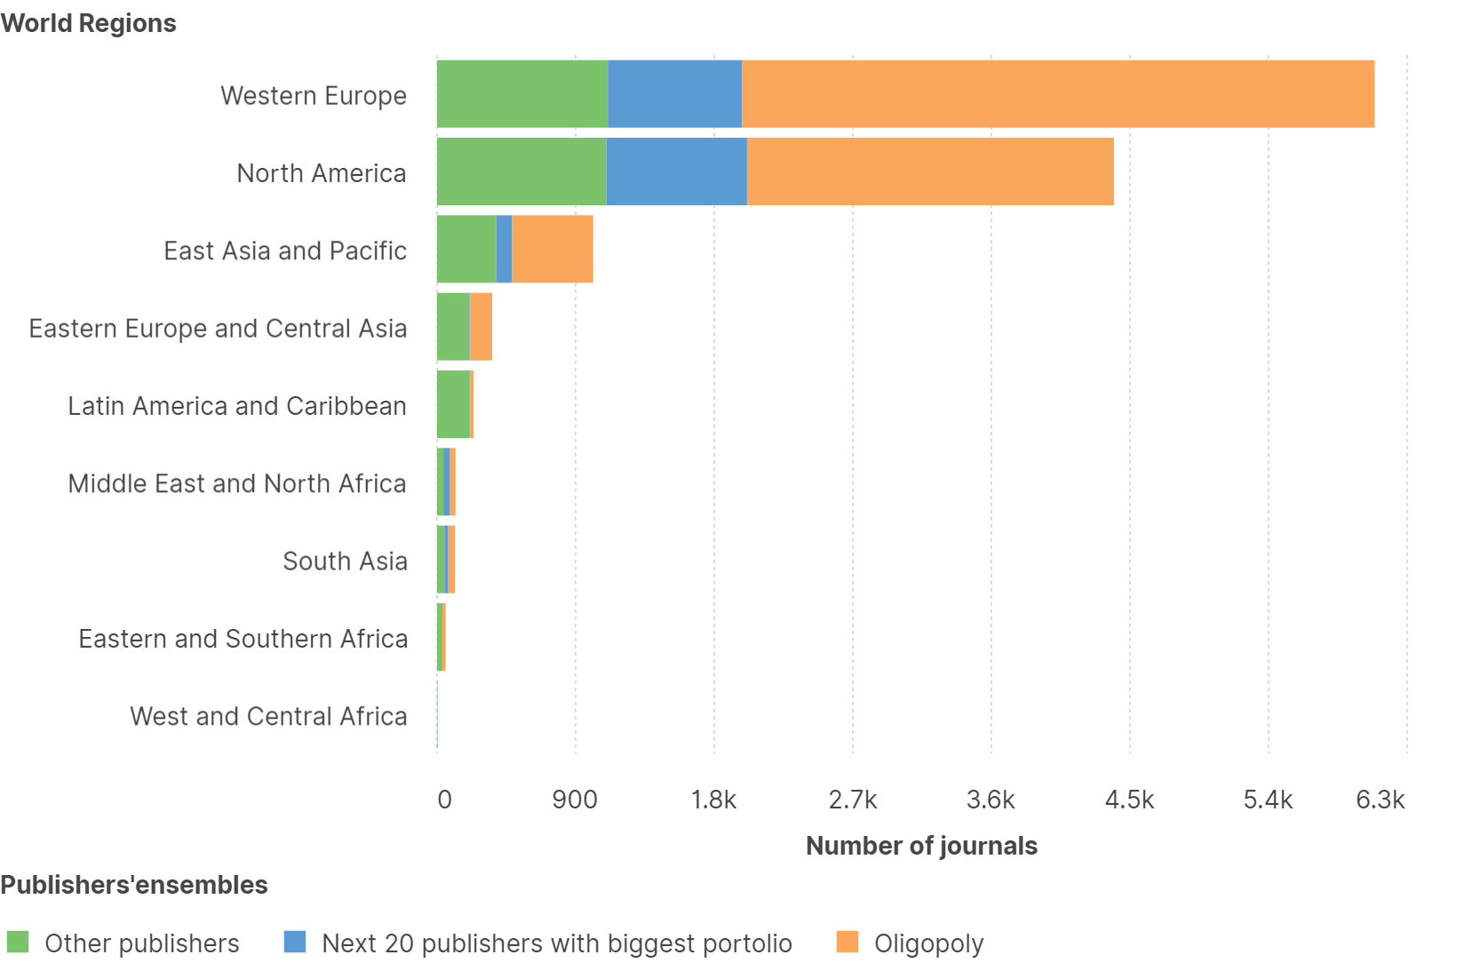
Geographic distribution of journals per publishers’ensembles
25 publishers publish 75% of all IF journals
59% by the Oligopoly
(five publishers: Springer Nature, Elsevier, Wiley, T&F, Sage)
85% of IF journals are produced in Western Europe and North America
More diversity in terms of publishing structures outside Western Europe, North America, and East Asia and Pacific
* ACS, Annual Reviews, APA, Bentham, BMJ, CUP, De Gruyter, Emerald, Karger, Frontiers, IEEE, IOP Publishing, Mary Ann Liebert, MDPI, OUP, Thieme, Uni. Of Chicago Press, Wolters Kluwer, World Scientific Pub.
*

Slide 8
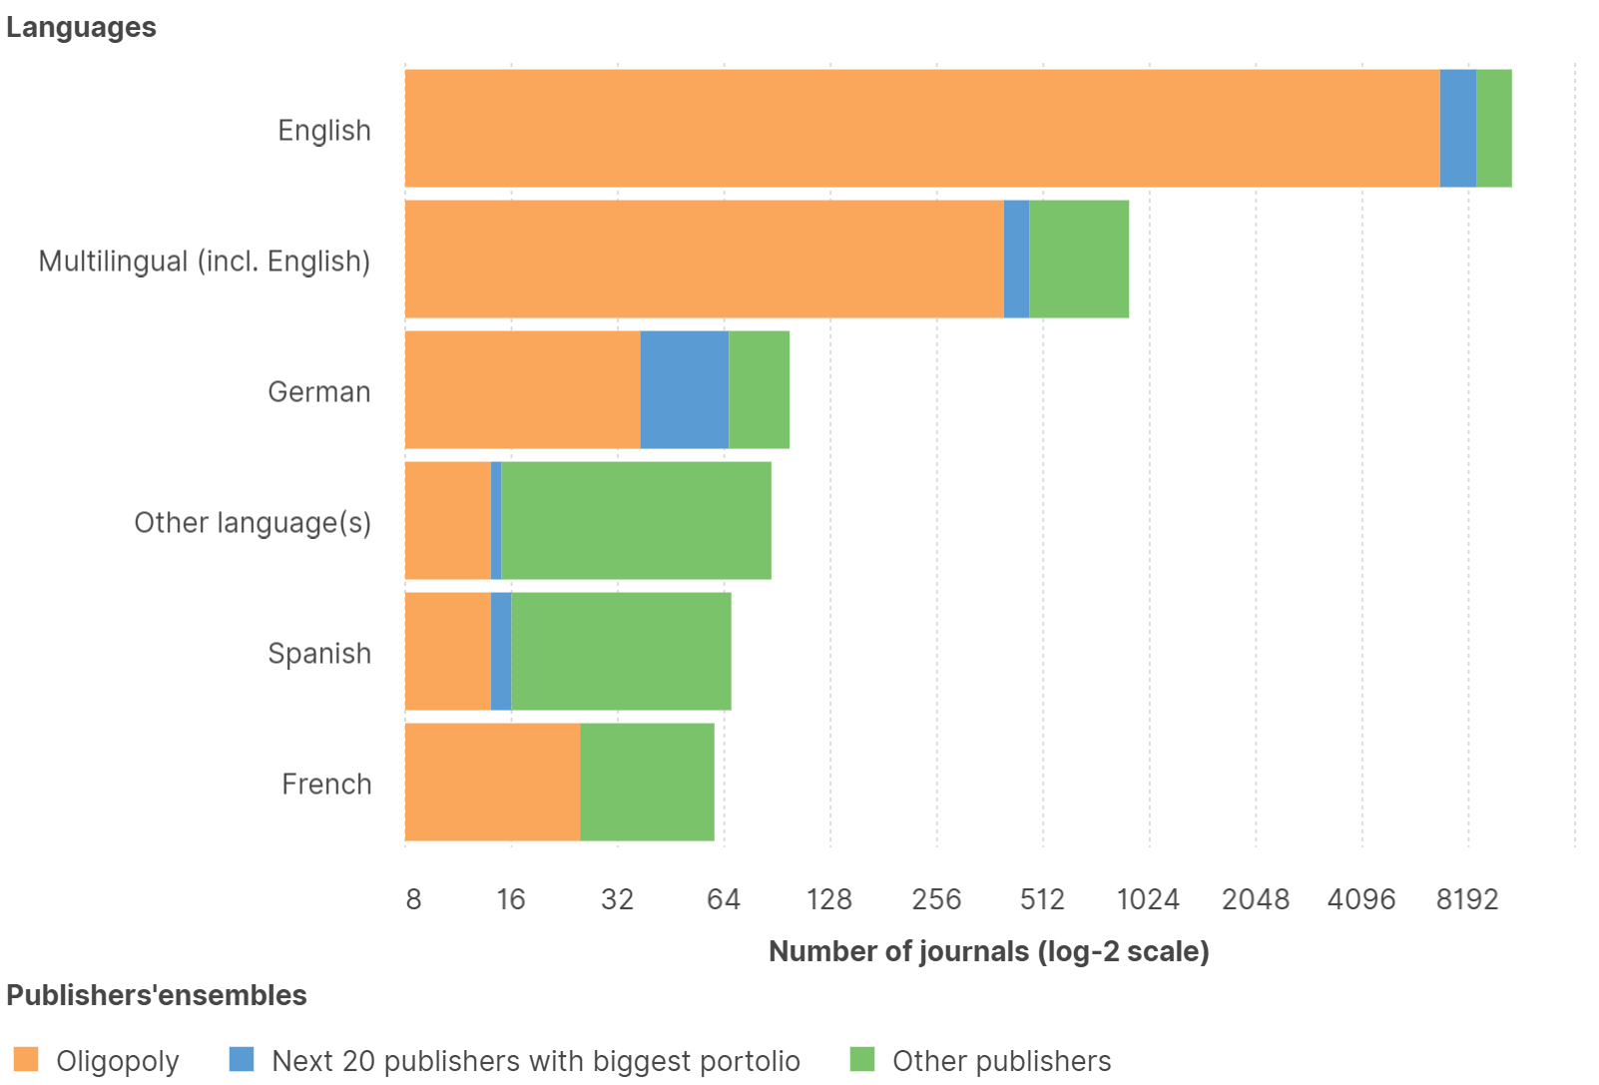
Distribution of journals per language(s) and publisher’s ensembles
Journals published only in English represent 84% of all journals
More than 90% of IF journals accept papers in English
More diversity in terms of publishing structures for journals published in languages other than English
* ACS, Annual Reviews, APA, Bentham, BMJ, CUP, De Gruyter, Emerald, Karger, Frontiers, IEEE, IOP Publishing, Mary Ann Liebert, MDPI, OUP, Thieme, Uni. Of Chicago Press, Wolters Kluwer, World Scientific Pub.
*

Slide 9
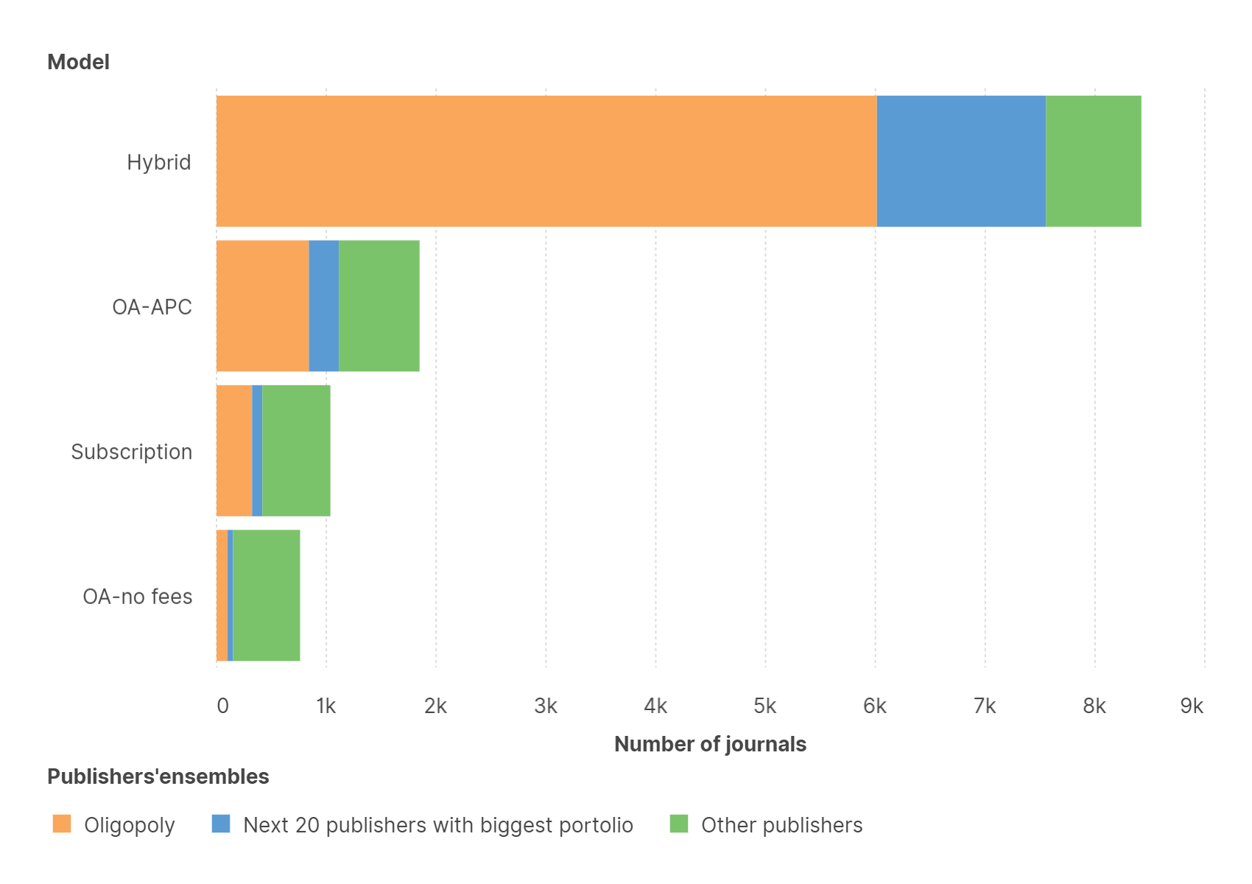
Distribution of journals per model and publishers’ ensembles
*
*
68% of IF journals in the 2021 JCR use a hybrid model
90% of these hybrid journals are published by the 25 publishers with the biggest IF portfolio
These 25 publishers also publish 60% of IF journals requiring APC to publish OA
In contrast, “other” publishers publish 80% of OA journals without fees (APC)
The proportion of OA journals here (n=2610) with or without fees is the opposite of the proportion observed in DOAJ data (n=18338; Oct.6 2022)
OA journals with IF: OA-APC (71%), OA-no fees (29%)
OA journals in DOAJ: OA-APC (31%), OA-no fees (69%)
**
* ‘Models’ not included in the graph: unidentified (n=19); - OA possible presence of fees undetermined (n=303)
** ACS, Annual Reviews, APA, Bentham, BMJ, CUP, De Gruyter, Emerald, Karger, Frontiers, IEEE, IOP Publishing, Mary Ann Liebert, MDPI, OUP, Thieme, Uni. Of Chicago Press, Wolters Kluwer, World Scientific Pub.

Slide 10
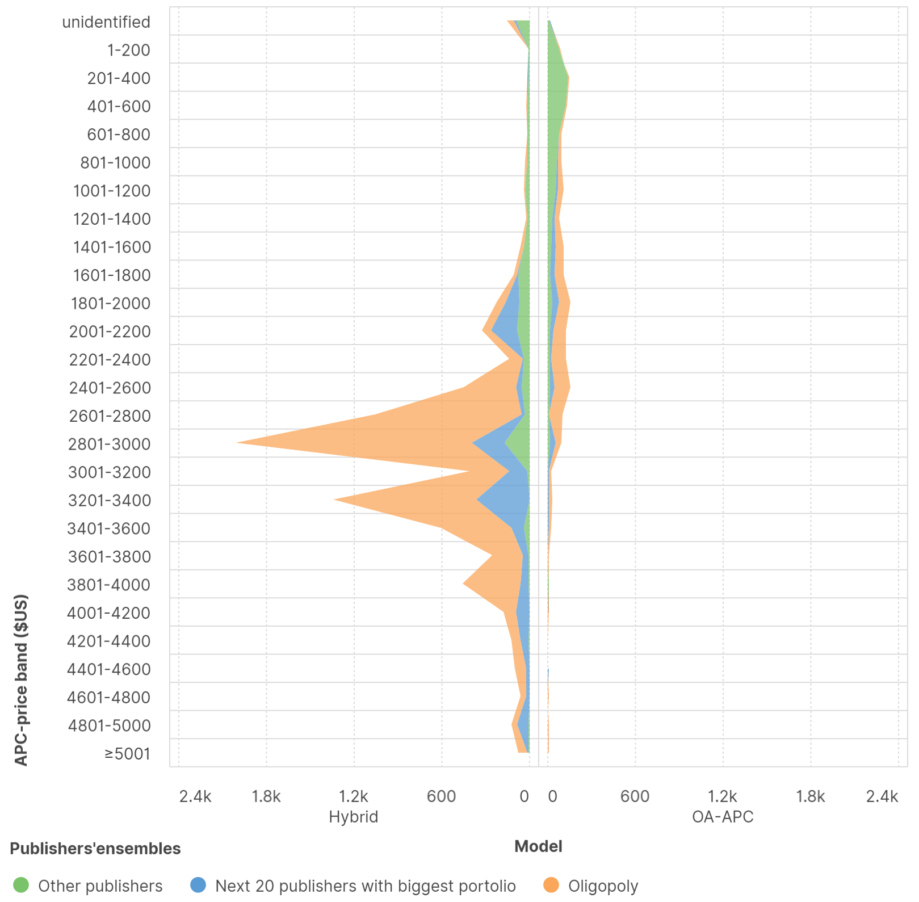
Distribution of journals per APC price-band and publishers’ ensembles
Oligopoly publishers have more journals with higher publication fees
Hybrid: 85% between $2201 and $4000
OA-APC: 74% between $1401 and 3000$
"Other publishers":
Hybrid: 42%between $2201 and $4000
OA-APC:
19% between $1401 and 3000$
77% between 1$ and $1400

Slide 11
3.
Conclusions and recommendations

Slide 12
Concluding remarks, recommendations and perspectives
SUPPORTING THE IF BRAND:
Perpetuates publishing concentration
(25 publishers produce 75% of IF journals; oligopoly = 59%)
Maintains a domination of the Global North and its artificial image of quality/mega producer of scholarly content
(West EU and NA produce 85% of journals)
Does not promote linguistic diversity (84% of journals in English only)
Entrenches an unfair model that discriminates against particular authors and institutions (hybrid = 68% of journals)
De-incentivizes fair and equitable open access publishing in journals ( OA journals without fees = 6%)
Encourages APC inflation by maintaining OA publishing options with high APCs
RECOMMENDATIONS & PERSPECTIVES
Inform stakeholders involved in research assessment (reforms) of bibliodiversity issues of the IF-brand (and raise awareness)
Encourage stakeholders involved in research assessment (reforms) to question the sustainability and ethical dimensions underlying the bibliodiversity issues of the IF-brand or similar journal-based lists
Counter homogenizing and provide expression for unheard voices
Replicate this "counting-back" method as applied to IF journals for every newly released IF list to monitor the development of bibliodiversity results
Possible conversion rate for Hybrid journals?
See if correlations exist between IF score and APC
Apply this "counting-back" strategy to other journal-based lists used in research evaluation and compare with IF-brand results

Slide 13
4.
Other graphs we probably won't have the time to show you and discuss😅

Slide 14
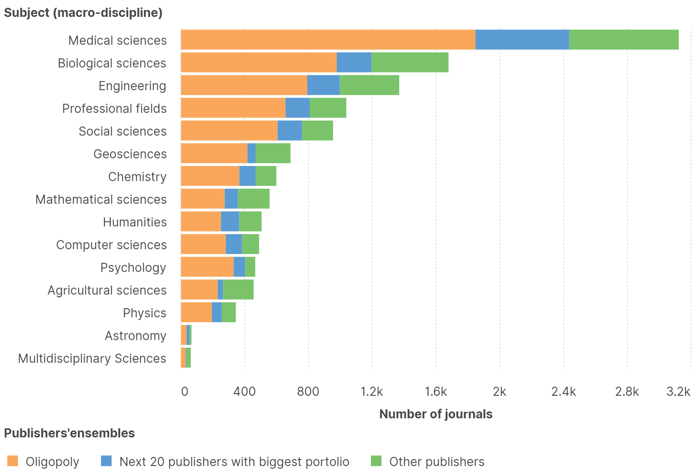
Distribution of journals per subject and publisher’s ensembles
SCIE journals represent 77% of all IF journals
SSCI journals represent 29% of all IF journals
701 journals are included in both indexes !
More publisher diversity for Agricultural Sciences and Multidisciplinary Sciences categories (<60% published in top 25)
Less diversity in terms of publishing structures for Psychology, Social sciences, Astronomy (>80% published in top 25)
*
*
* ACS, Annual Reviews, APA, Bentham, BMJ, CUP, De Gruyter, Emerald, Karger, Frontiers, IEEE, IOP Publishing, Mary Ann Liebert, MDPI, OUP, Thieme, Uni. Of Chicago Press, Wolters Kluwer, World Scientific Pub.

Slide 15
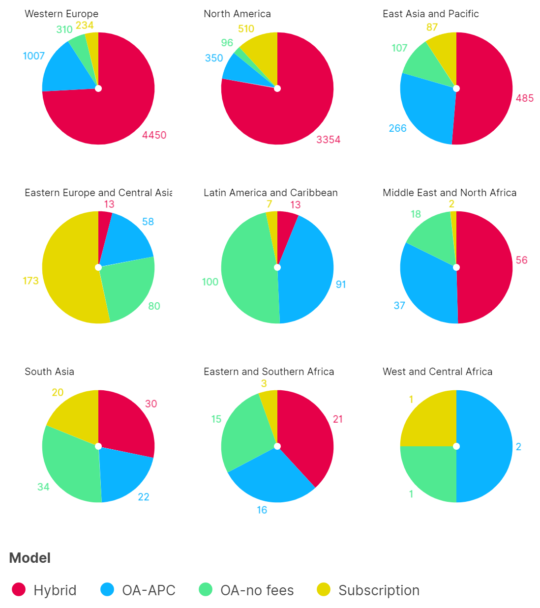
Distribution of journals per model and world region
Publishing models vary widely according to world regions
Hybrid journals are dominant in
Western EU (74%)
North America (78%)
East Asia and Pacific (51%)
A big share of OA-APC journals are produced in Western EU (54% of all OA-APC journals)
Proportionally, more OA journals without fees are published in other regions than Western Europe, North America, and East Asia and Pacific (esp. In Latin America and Caribbean)
All in all, more publishing models diversity in the least represented regions
* ‘Models’ not included in the graph:
- unidentified (n=19)
- OA possible presence of fees undetermined (n=303)
*

Slide 16
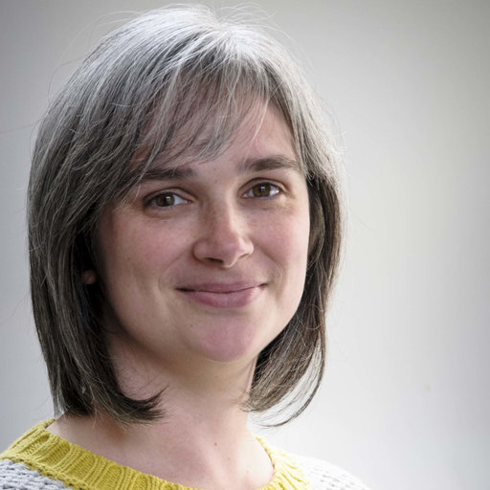
Thanks for your attention!
Marjorie Bardiau
Librarian, University of Liège (Belgium)
mbardiau@uliege.be
Christophe Dony
Librarian, University of Liège (Belgium)
cdony@uliege.be

