Slide 1


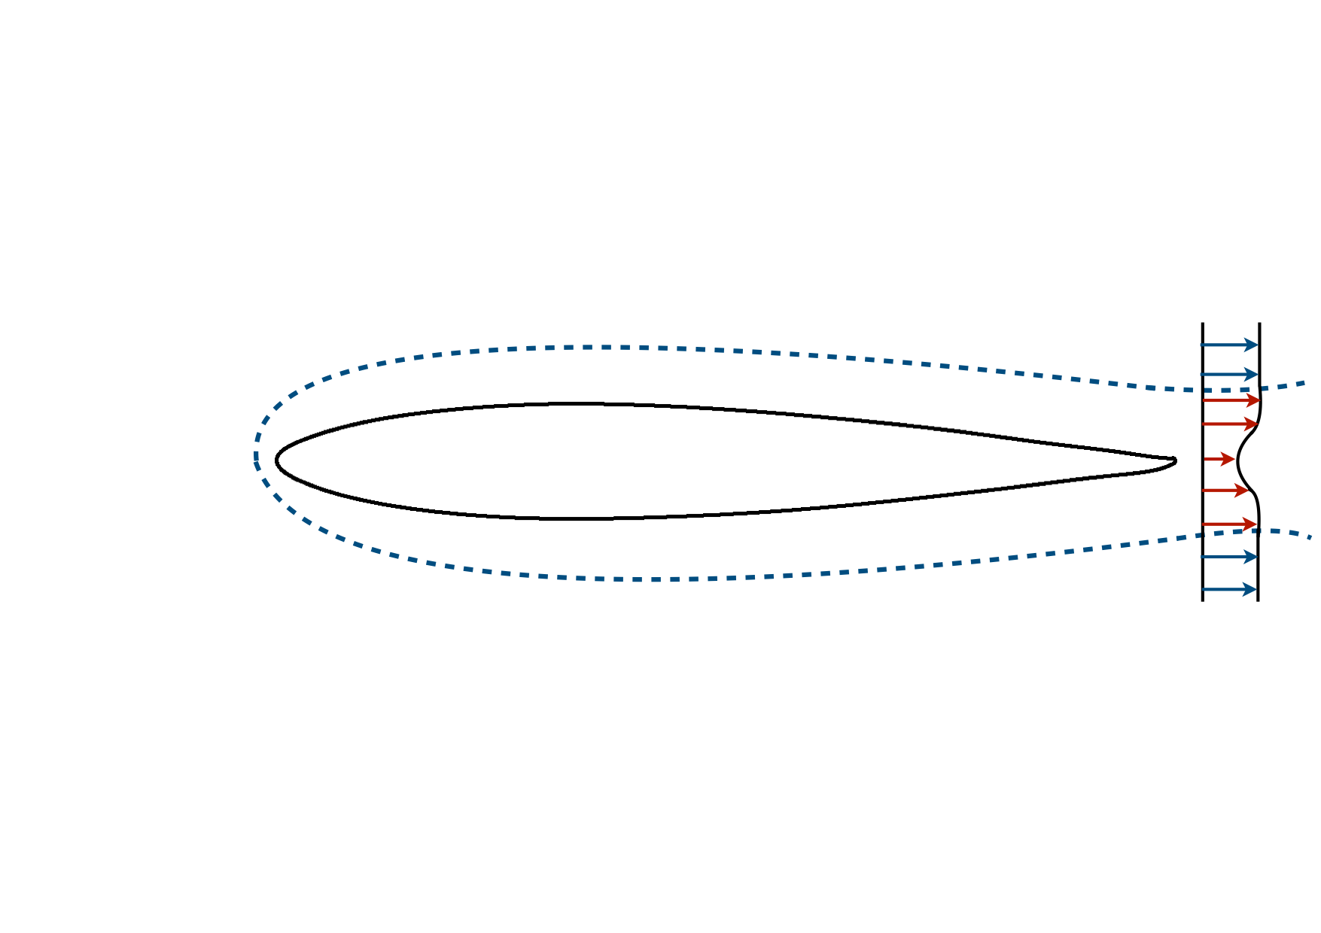
Interactive boundary layer methodology
P. Dechamps
A. Bilocq
A. Crovato
G. Dimitriadis
V.E. Terrapon

Slide 2
Motivations
Levels of fidelity
Direct Numerical Simulation
Large Eddy Simulation
Reynolds-Average Navier-Stokes
Viscous Inviscid Interaction
Inviscid methods
(Full potential, panel method…)
Months/Years (if it can be done)
Weeks/Days
Days/Hours
Minutes
Seconds

Slide 3
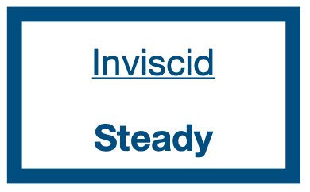



2D Viscous - Inviscid interaction
Viscous correction applied on an inviscid flow
Relevant near the body surface (Boundary layer)
Our case
Inviscid full potential flow
Boundary layer model
Edge parameters ($u_{e}$, $M_{e}$, $ρ_{e}$)
Displacement from the surface ($δ^{∗}$)

Slide 4
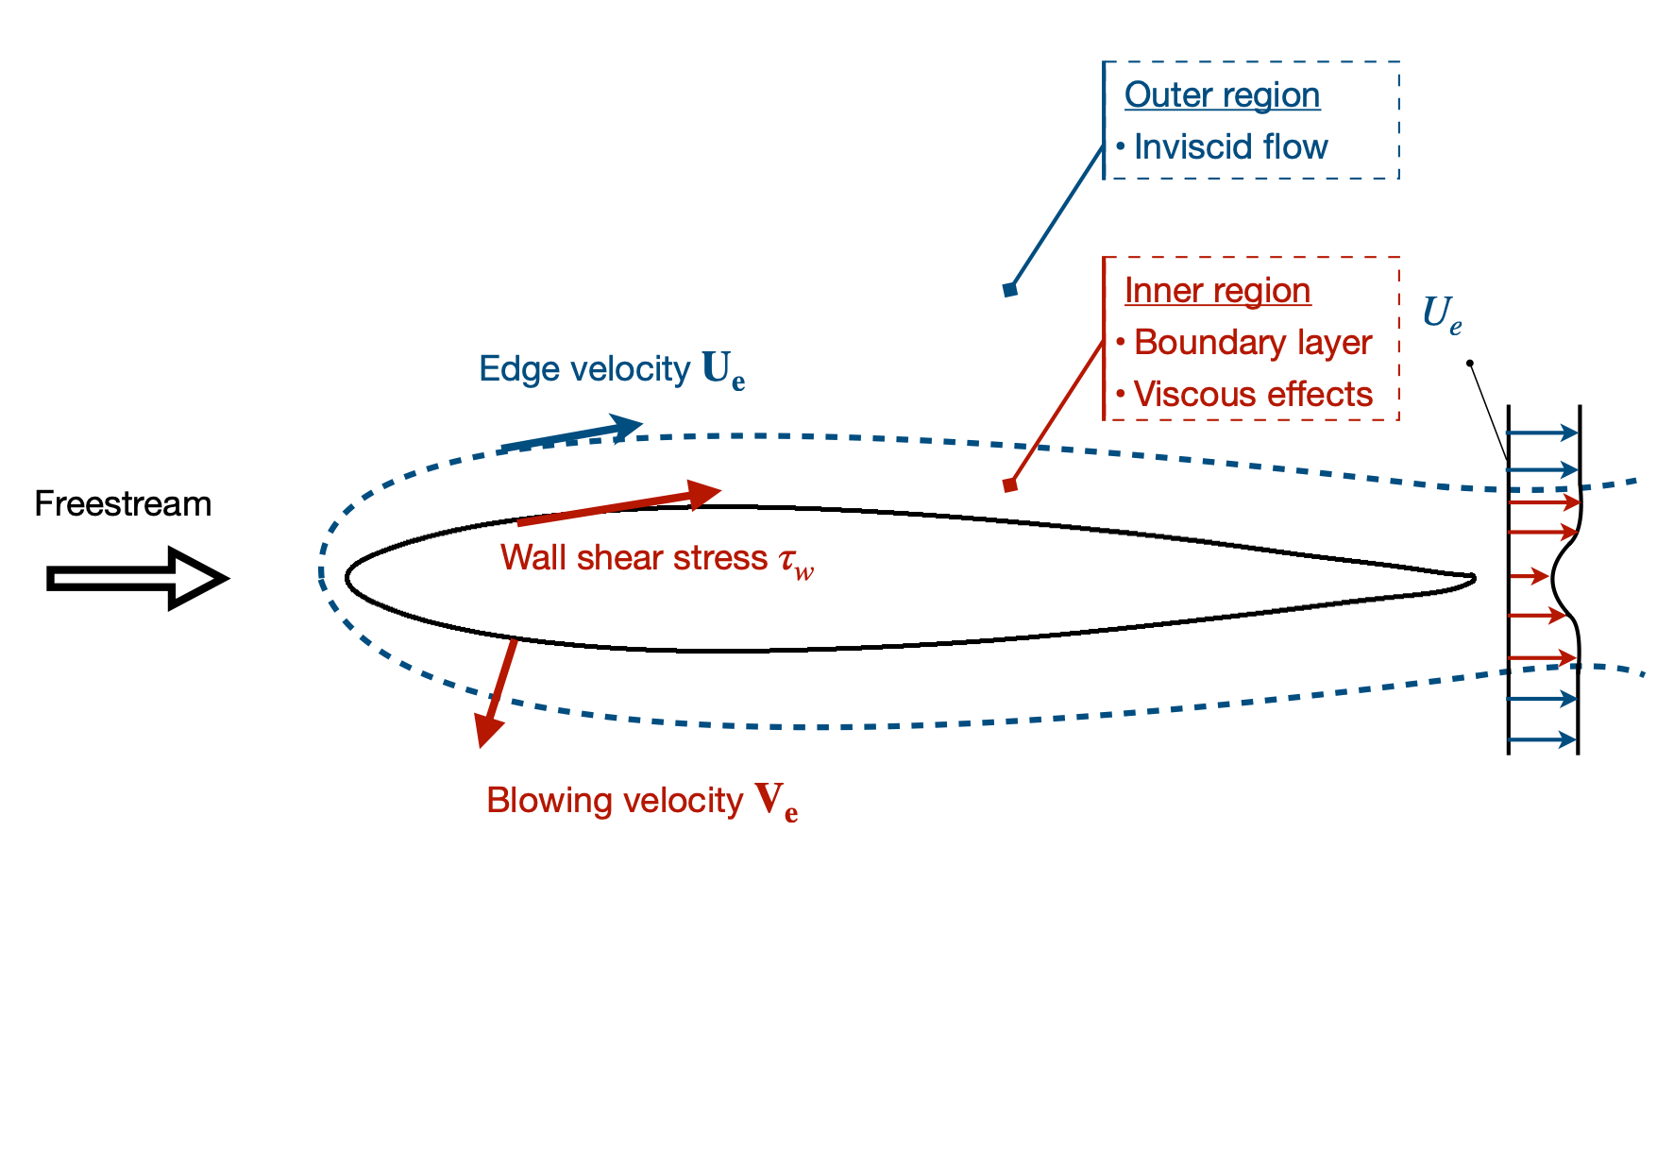
VII - Methodology
Flow studied separately in each region
Edge velocity (inviscid) used to solve the boundary layer equations
Blowing velocity (normal to surface) used to account for the presence of the boundary layer

Slide 5
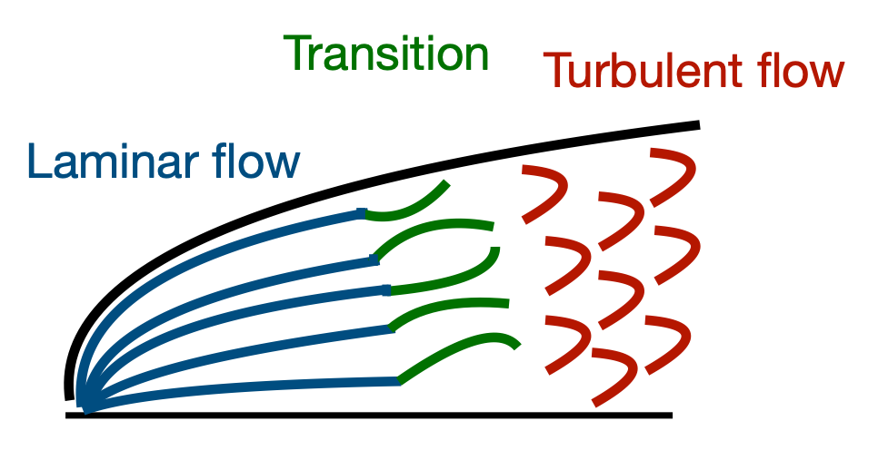
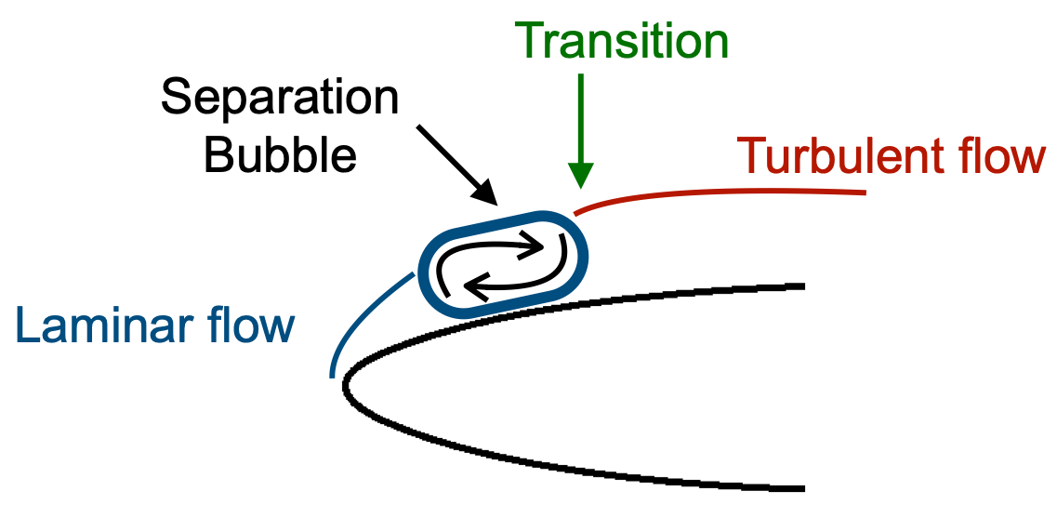
VII - Model
The proposed model is able to deal with
Compressible transonic flows,
Laminar and turbulent flows,
Laminar to turbulent transition,
Mildly separated flows
Small separation bubble

Slide 6
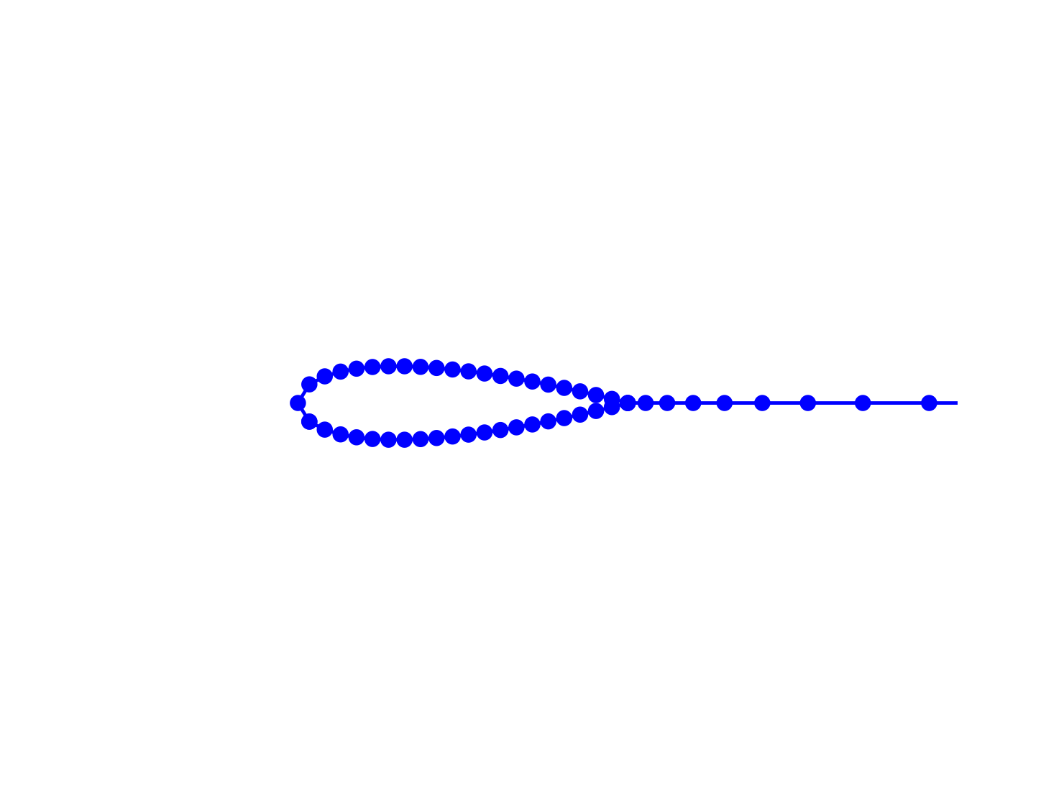
VII - Algorithm
1
3
2
Boundary condition (stagnation)
Space marching method
Start from the boundary condition imposed at the stagnation point
Each point treated individually
Upper and lower sides treated successively

Slide 7
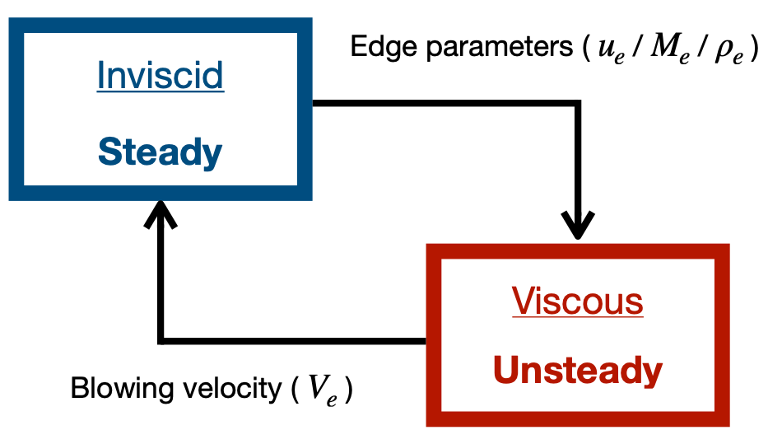
VII - Stability of the method
Stabilisation is usually the main issue of this type of models
Reasons why the algorithm is stable here
Unsteady nature of the viscous model
Special treatment at the interface to ensure that the models can coexist

Slide 8
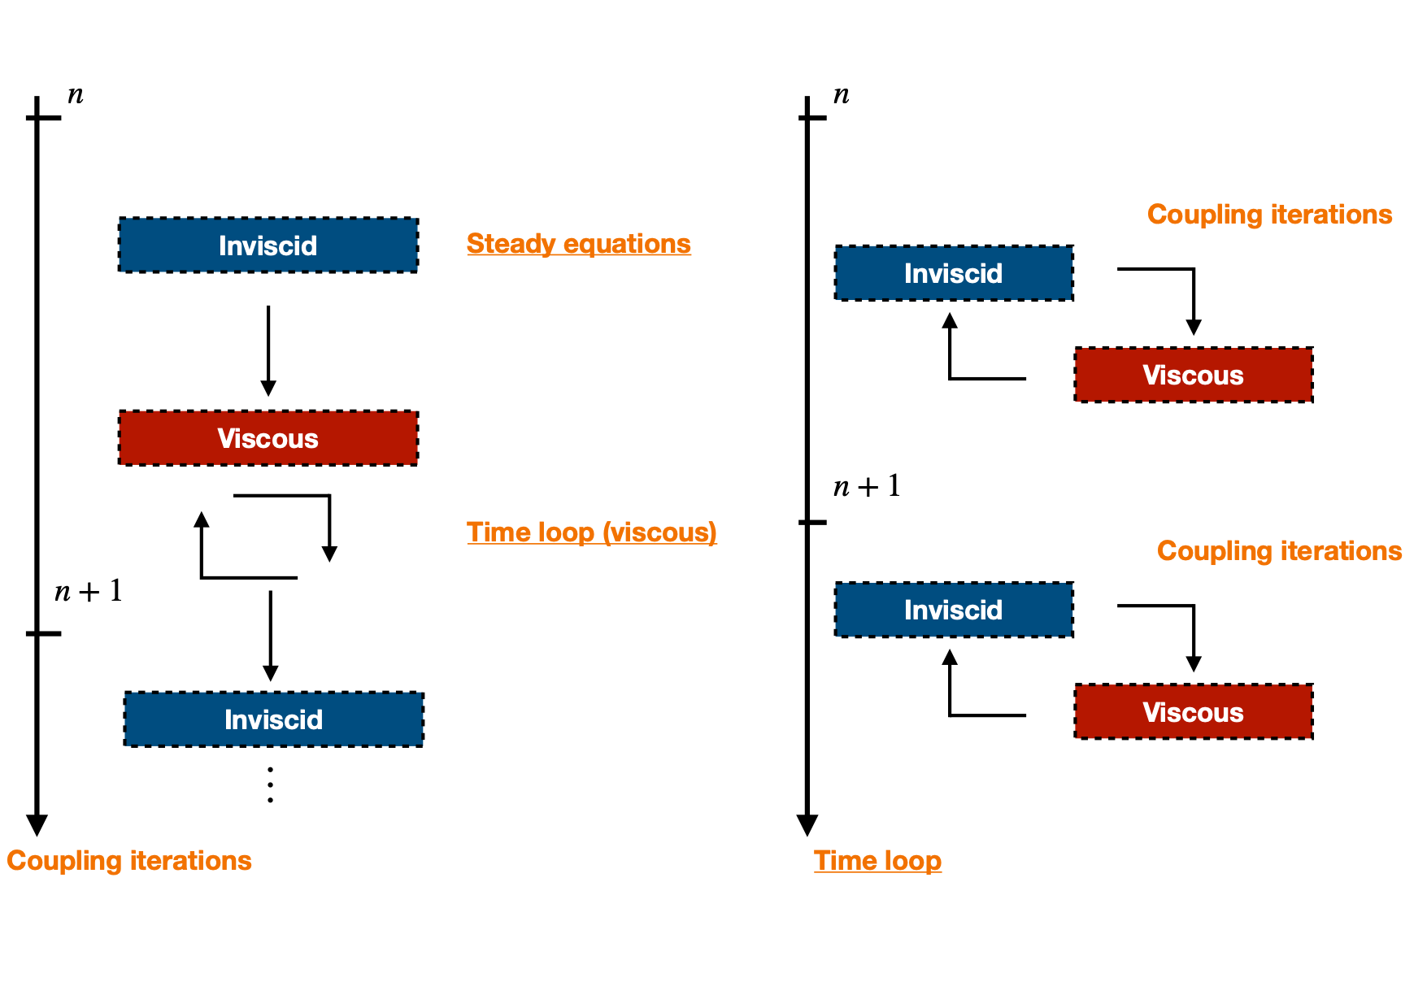
VII - Stability of the method
Our case
Literature

Slide 9
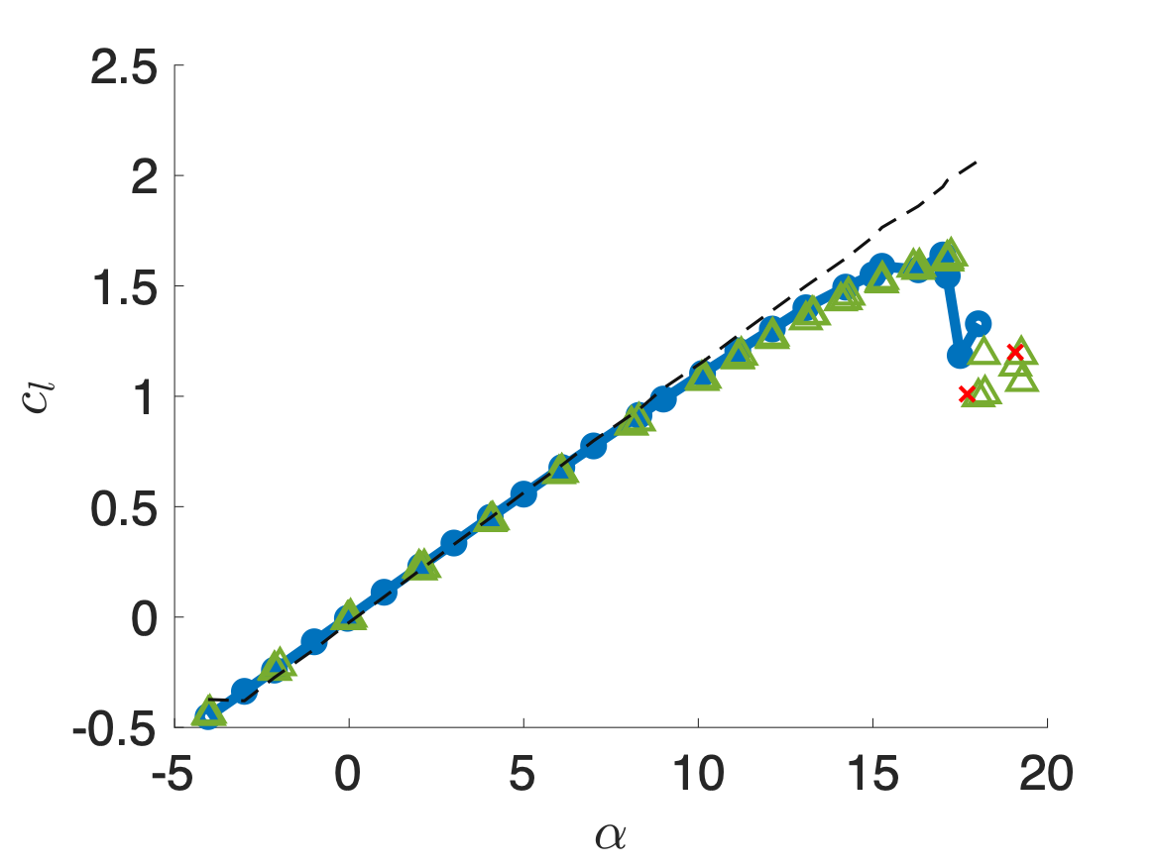
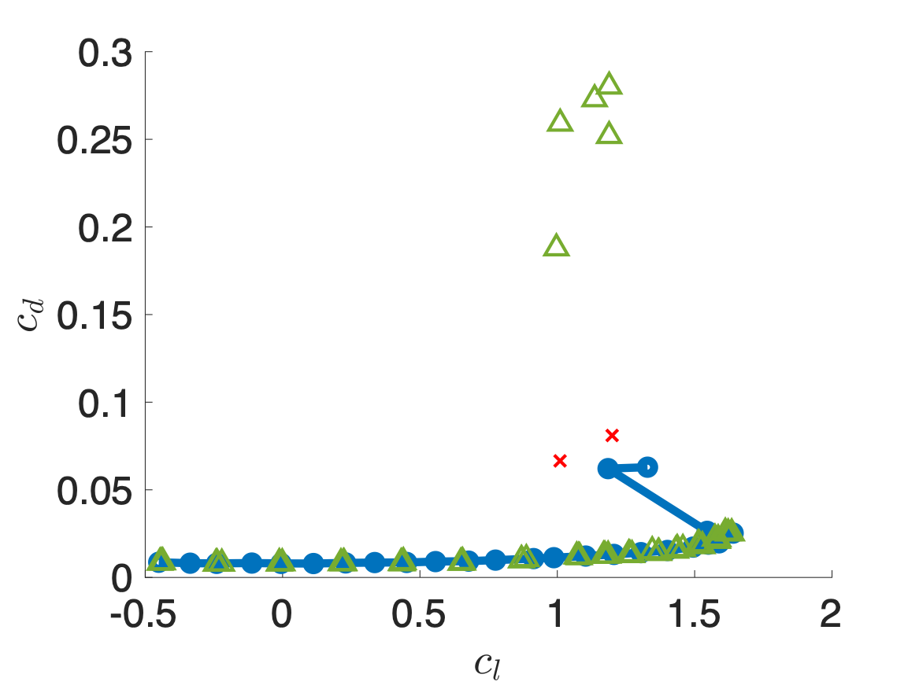

2D Model - Viscous correction
NACA-0012, $M_{∞}=0.15$, Re = 6 million
Lift coefficient
Drag coefficient
Inviscid solution
DART
Experimental (NASA)
DART
Experimental (NASA)

Slide 10
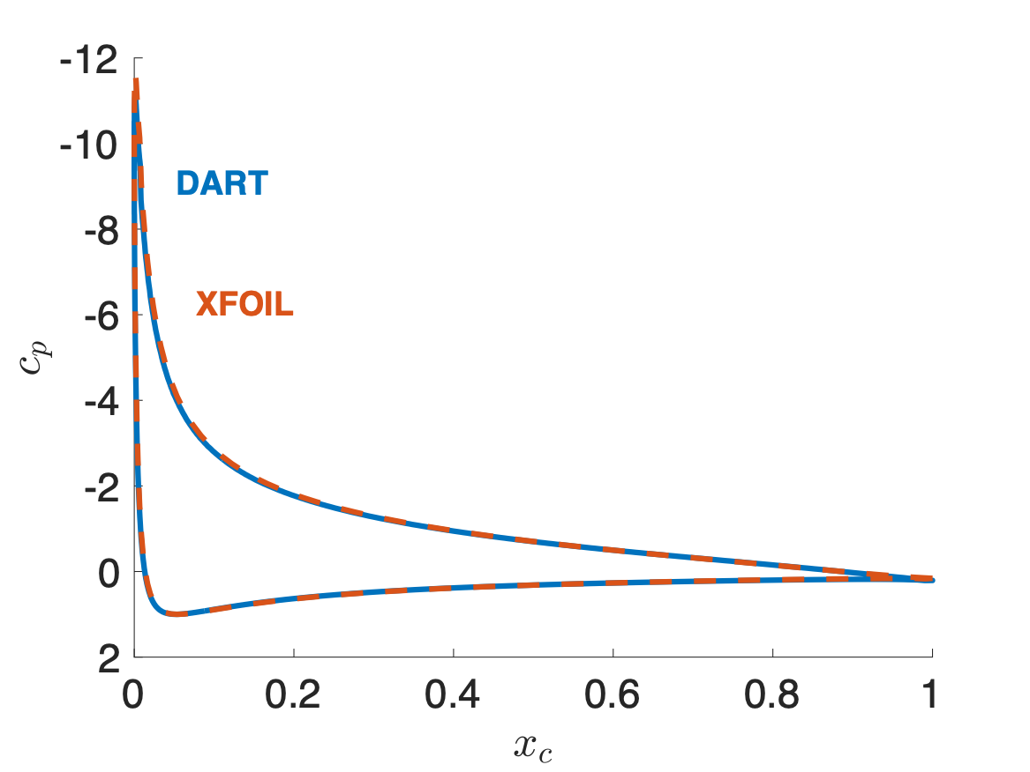
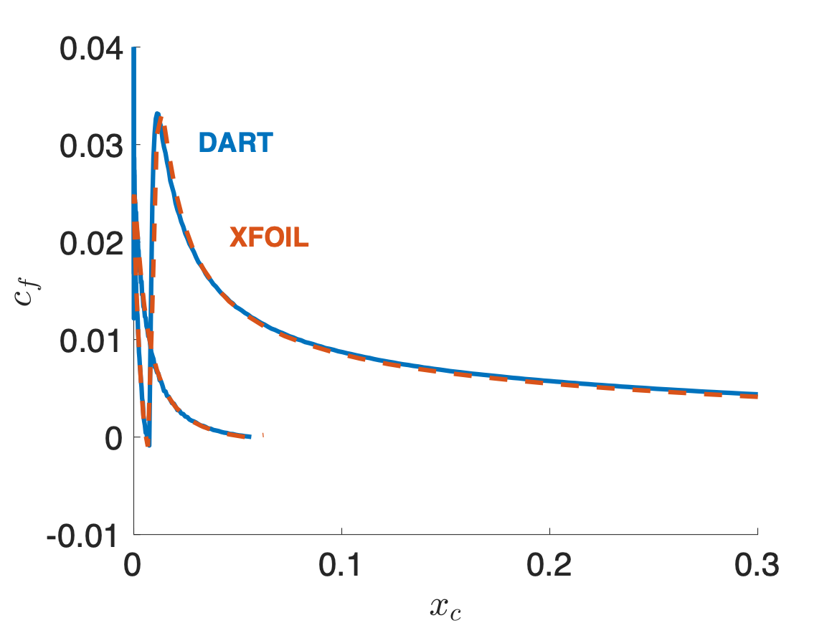

2D Model - Separation
NACA-0012, $α=15$°, $M_{∞}=0$, Re = 10 million
Pressure coefficient
Friction coefficient

Slide 11
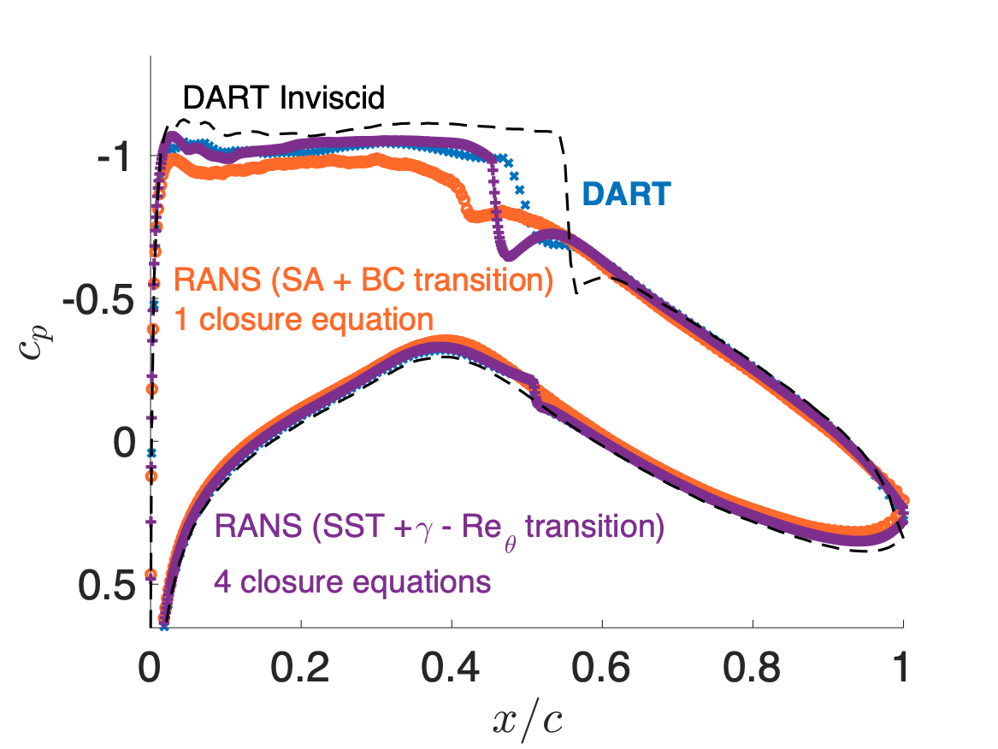
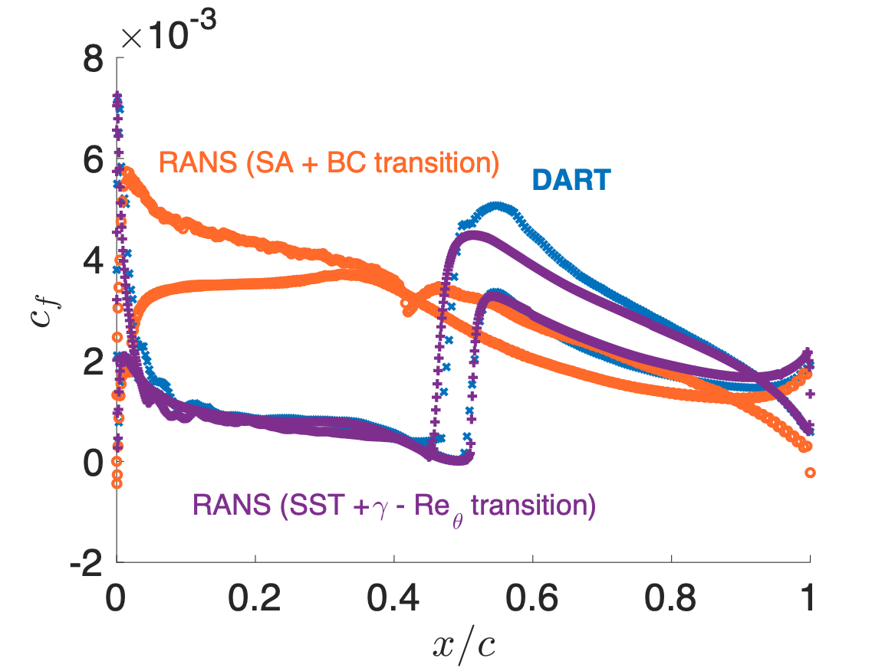
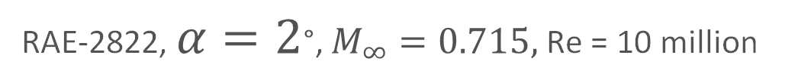
Transonic + Transition
RAE-2822, $α=2$°, $M_{∞}=0.715,$Re = 10 million
Pressure coefficient
Friction coefficient

Slide 12
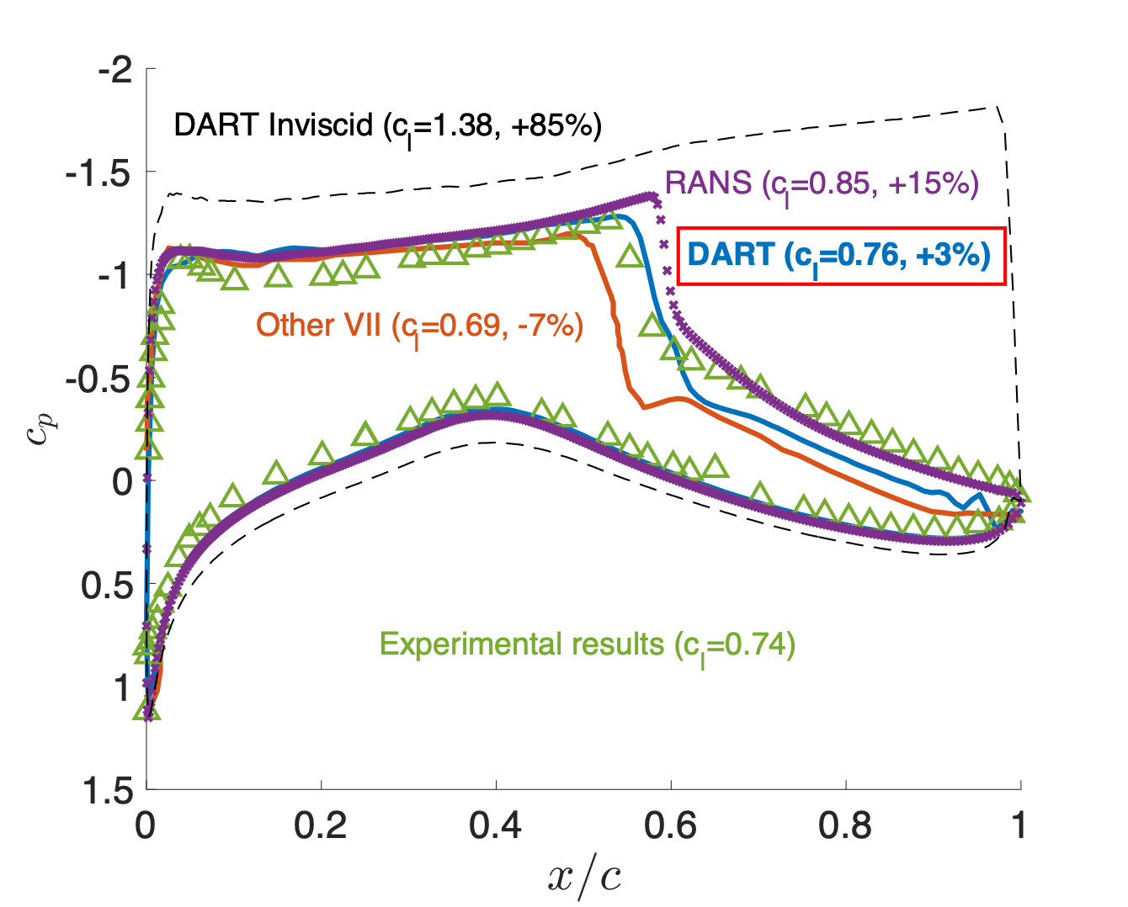
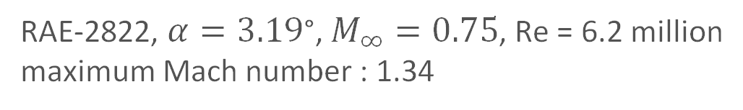
Transonic flow
RAE-2822, $α=3.19$°, $M_{∞}=0.75$, Re = 6.2 million
maximum Mach number : 1.34
Computational times (single core)
DART ~ 1 min 30 sec
RANS ~ 3 hours
Other VII unknown
DART inviscid ~ 7sec
Other VII : Kinney et. al. (1997)

Slide 13
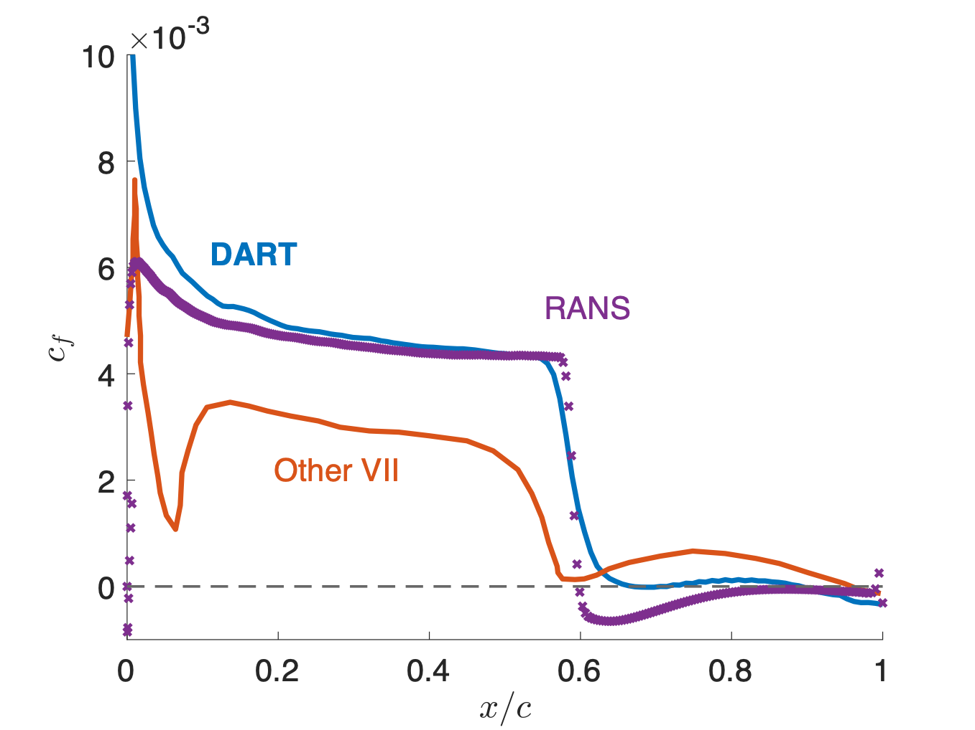

Transonic flow
RAE-2822, $α=3.19$°, $M_{∞}=0.75$, Re = 6.2 million
maximum Mach number : 1.34
Shock
Separation induced by the shock
Attached boundary layer
Trailing edge separation
$$c_{d}$$
Solver
DART
RANS
0.023
0.036

Slide 14
Conclusions
2D interactive boundary layer model
Novelties
  Unsteady boundary layer equations
  Special coupling strategy and numerical method
Transonic
Separated
Transitional

Slide 15
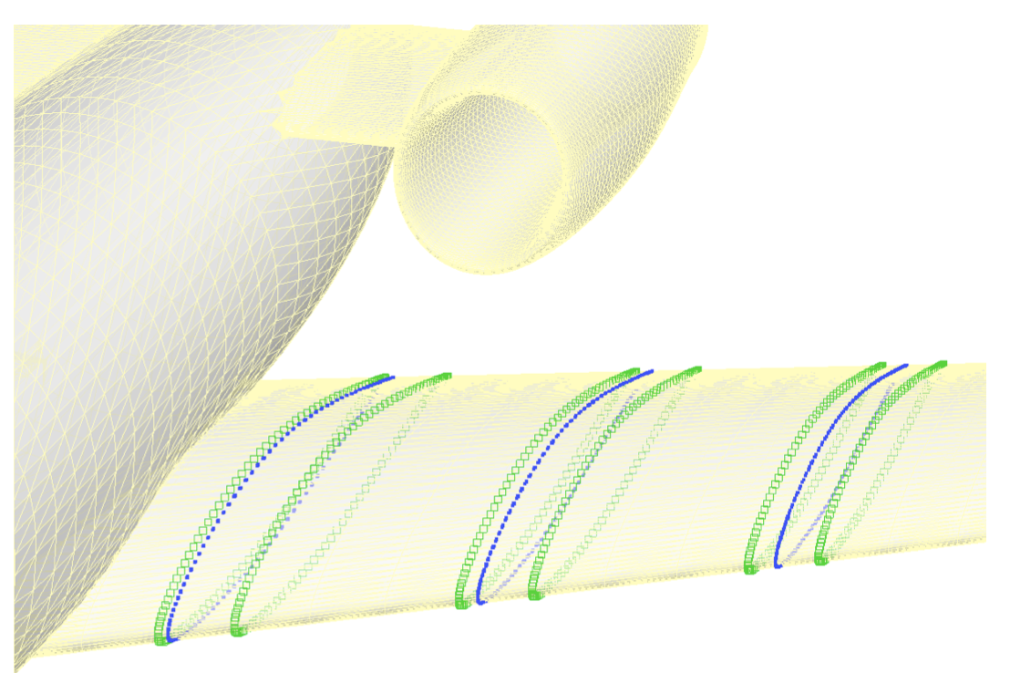
Futur work : 3D model
2D BL model solved at spanwise stations
Inviscid solution computed on 3D mesh
Viscous solution computed at each station
Boundary condition is interpolated between stations
…

Slide 16
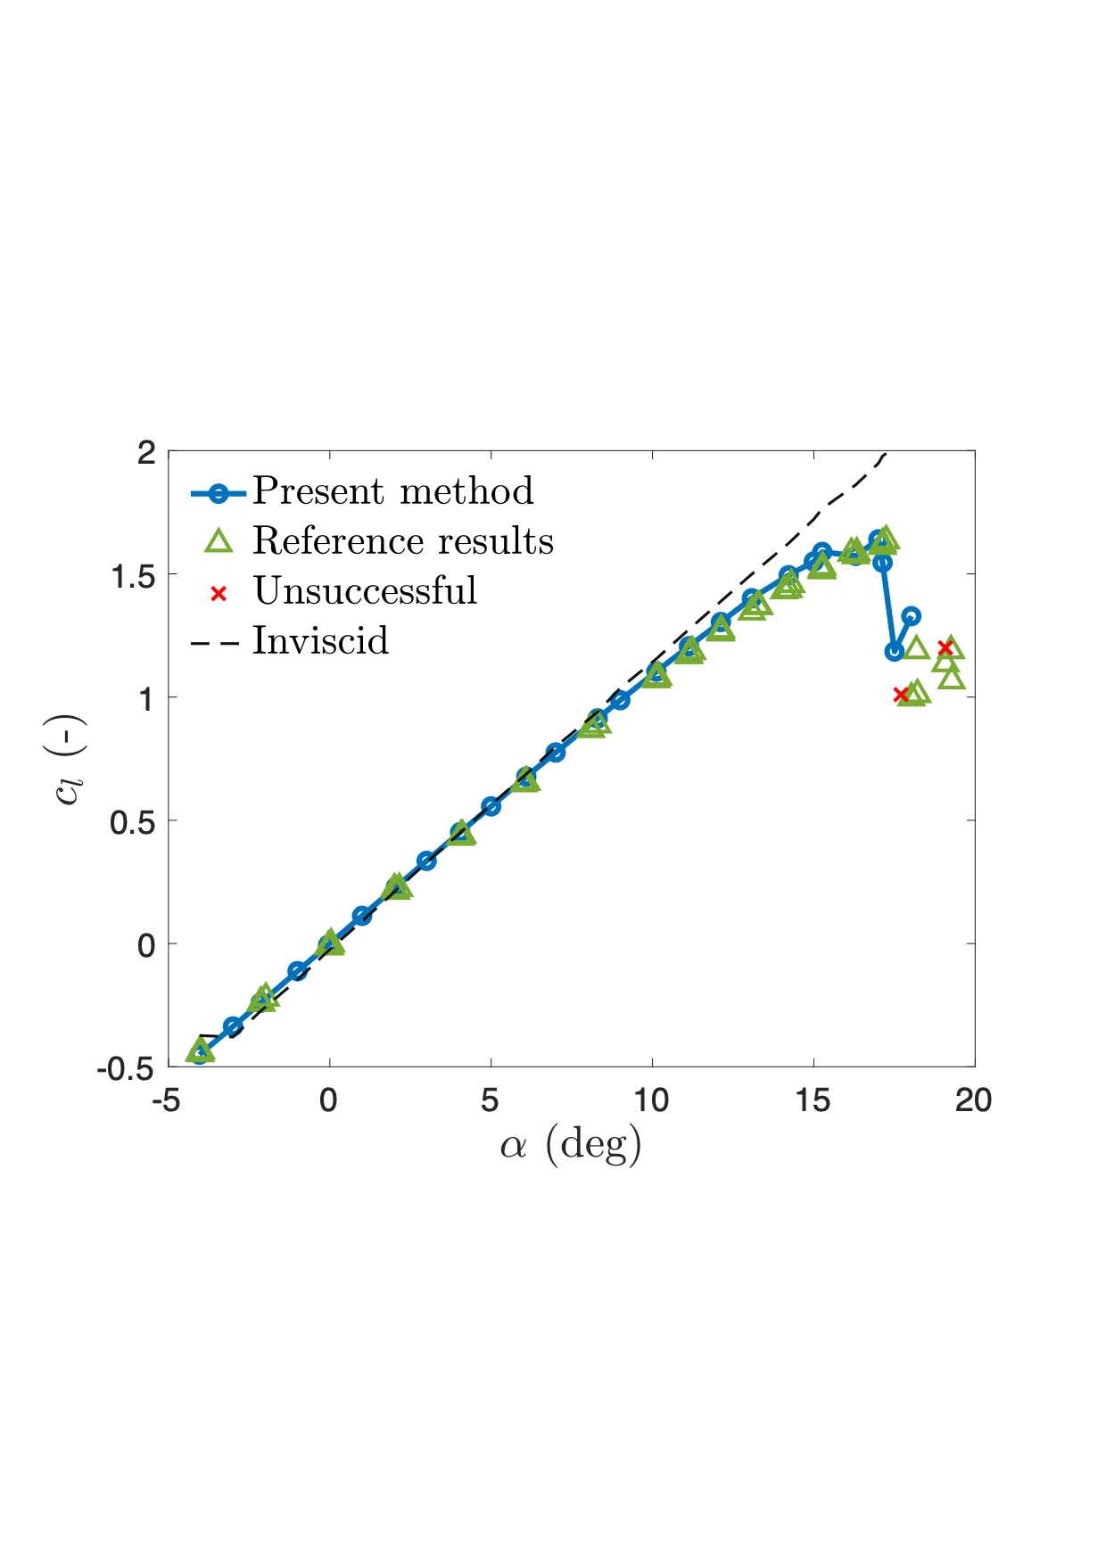
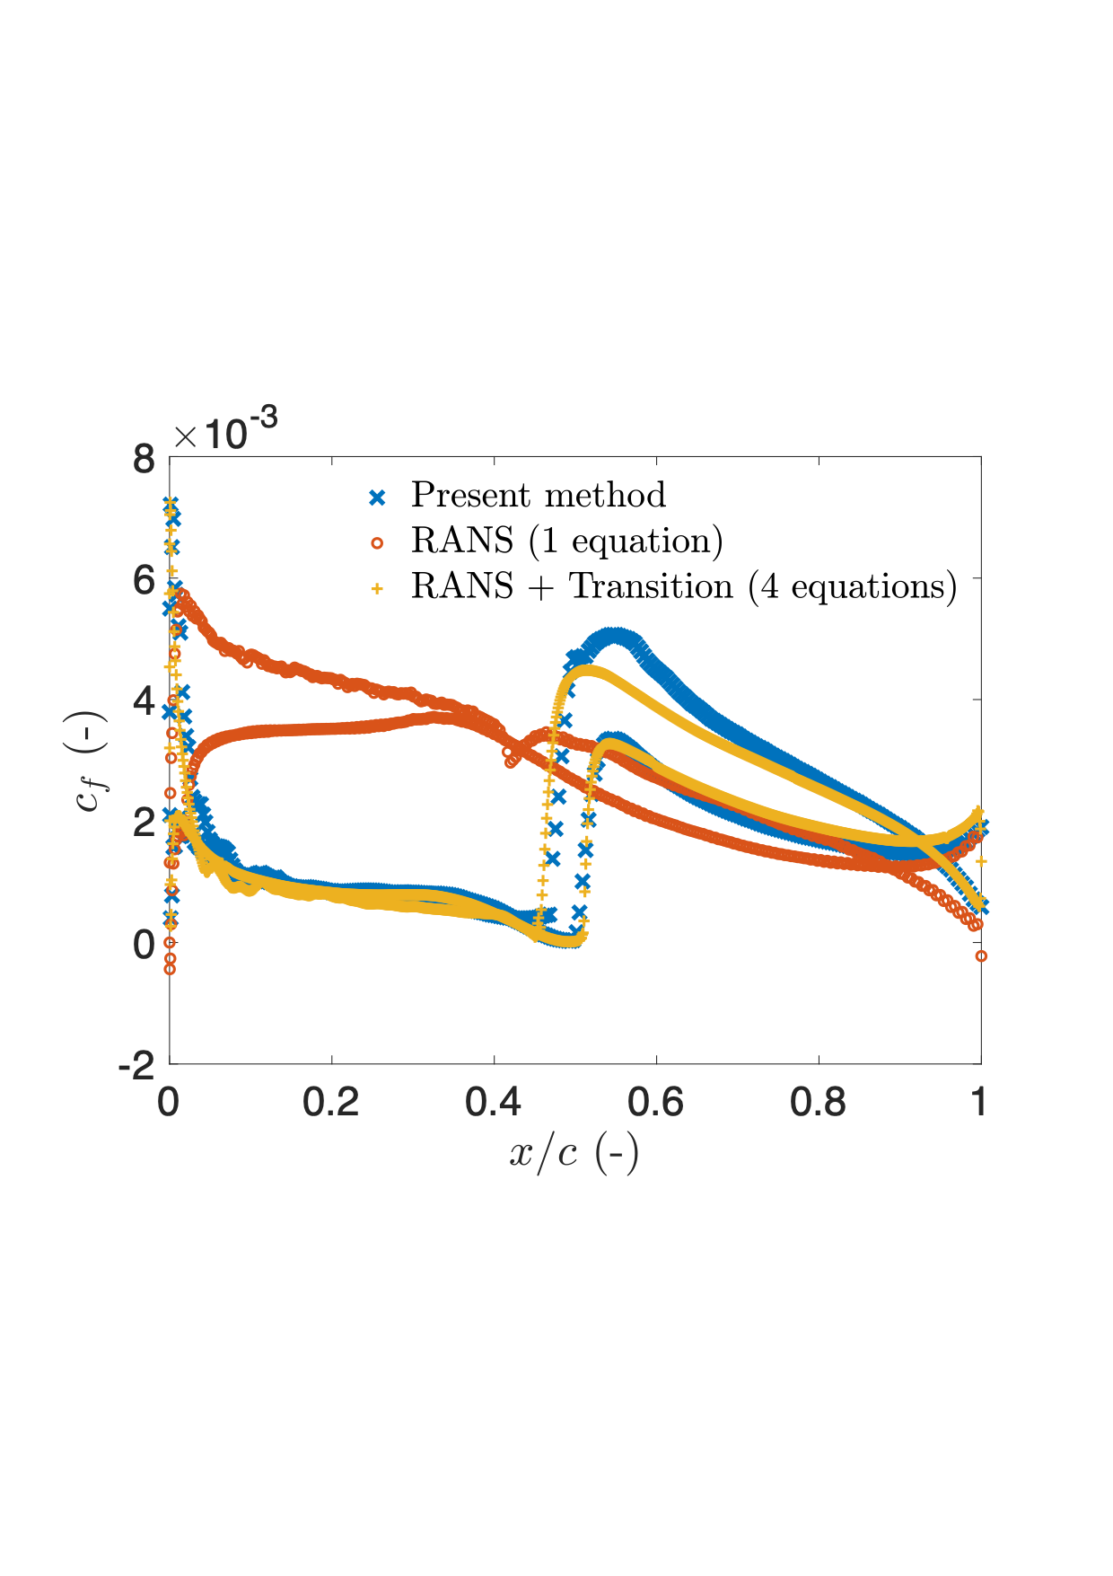
Thank you for your attention

