Slide 1
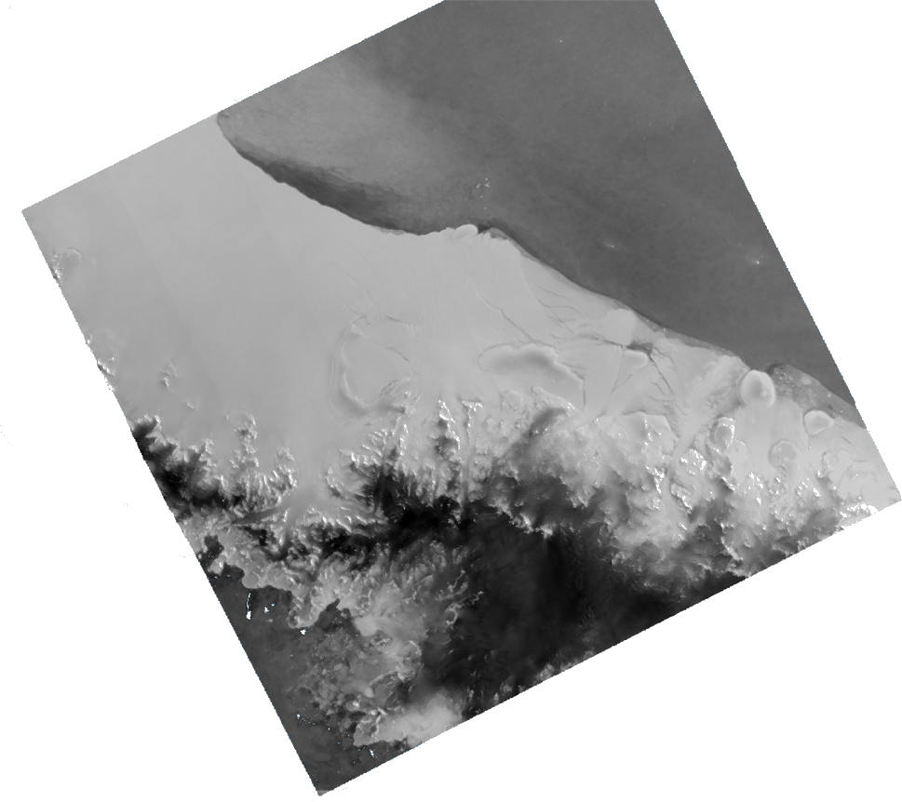
Comparison between Surface Melt Extent Estimated by Sentinel-1 and the Regional Climate Model MAR
Thomas DETHINNE
Master thesis in Geomatics
Academic year 2020-2021

Slide 2
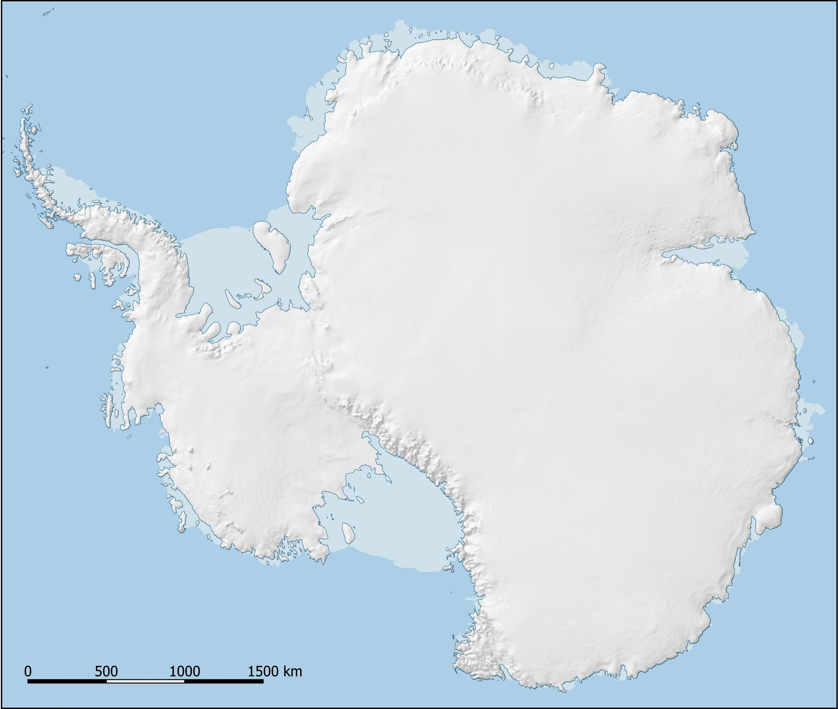
Introduction
Antarctica
Introduction
Sensitive to Climate Change
56m of sea-level rise
Difficult to study
Strong Belgian Expertise
Data
Comparison
Discussion

Slide 3
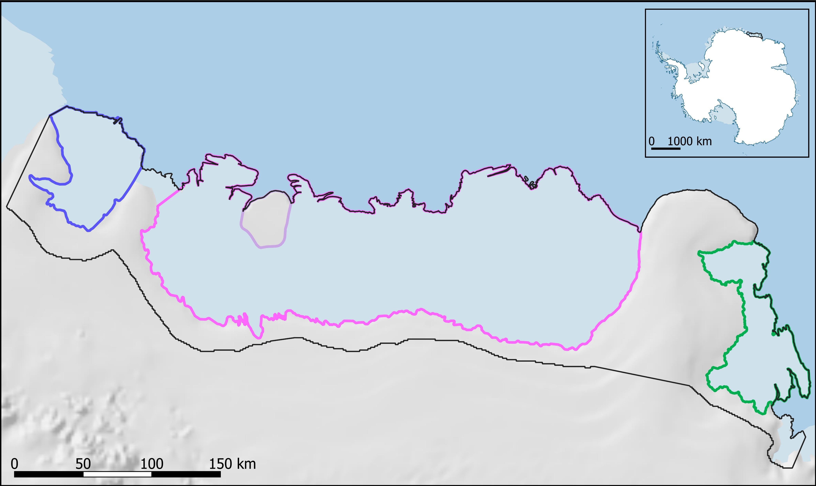
Introduction
Roi Baudouin and Surrounding Ice Shelves
Introduction
Borchgrevink
Derwael Ice Rise
Data
Roi Baudouin
Comparison
± 66.000 km² ≃ 2 Belgium
Discussion
Prince Harald

Slide 4
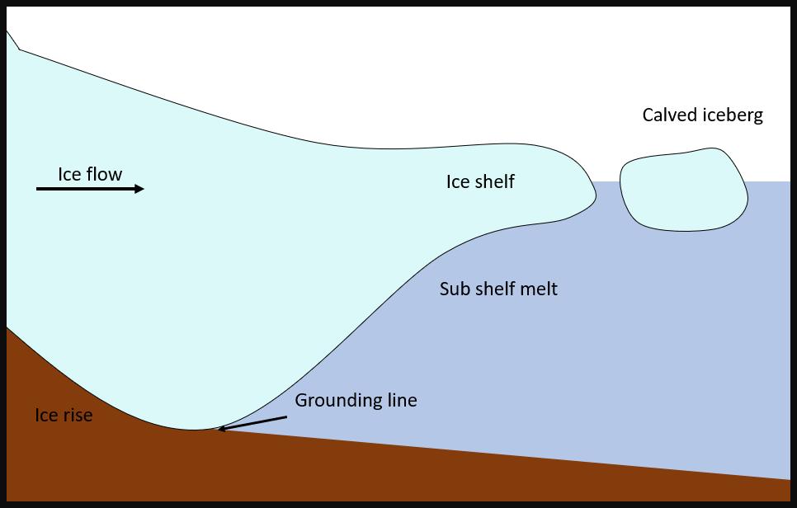
Introduction
Ice Shelf and their Role
Introduction
Floating Extension of the Ice Sheet
Buttressing effect
Ice Flow Regulator
Data
Comparison
Discussion

Slide 5
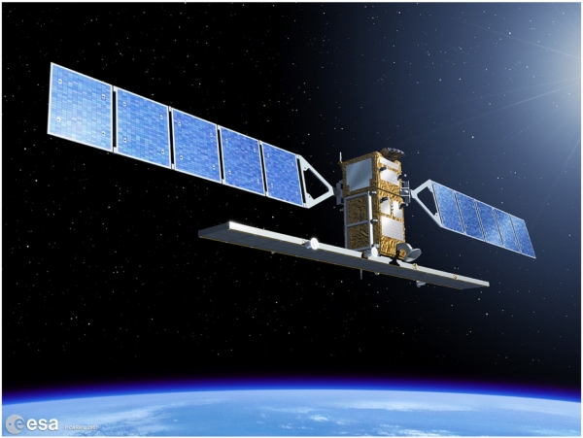
Objective
==
?
Introduction
Data Complementarity
Comparison of Data
Potential Combination
Temporal
Data
Quantitative
Comparison
Spatial
Discussion

Slide 6
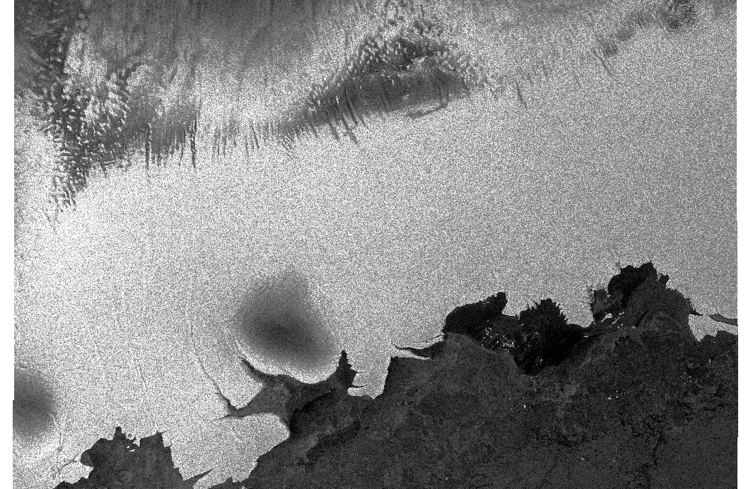
Data Presentation
SAR Data
Introduction
Active Satellite Data → Sentinel-1
10x10m or 40x40m
6 days revisit time
Data
Free and Open access data
1582 Acquisitions
Comparison
Discussion

Slide 7
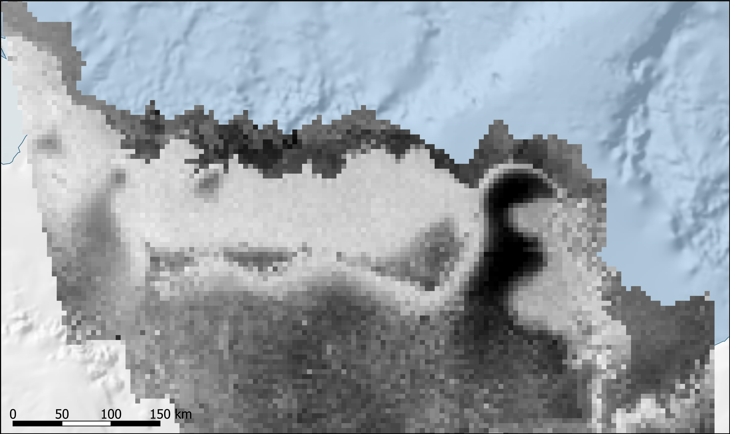
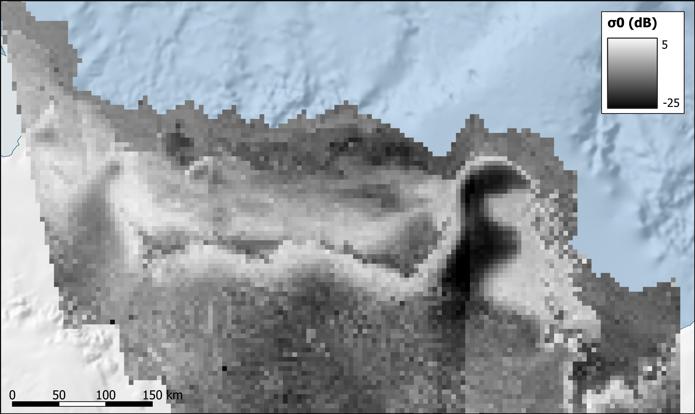
Data Presentation
SAR Data
Introduction
Sensitive to the presence of liquid water : [water] = $σ_{0}$
Data
Comparison
Discussion
22-12-2018
09-01-2019

Slide 8
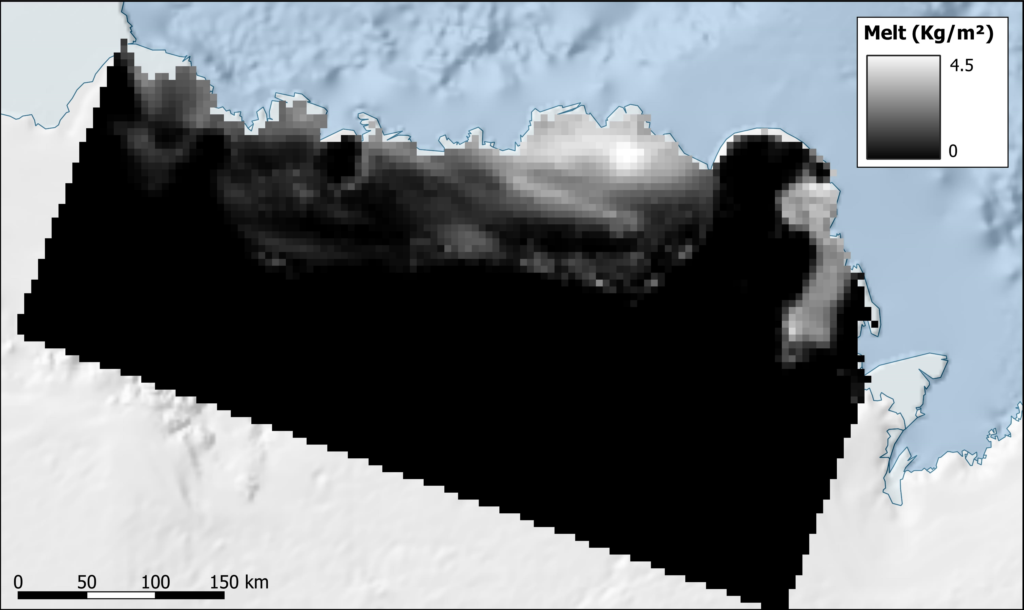
Data Presentation
MAR Data
Introduction
Climate Model Data → Modèle Atmosphérique Régional
5x5km
Data
Daily data
Multiple variables (Melt, Liquid Water Content, Runoff, …)
Comparison
Discussion
24-12-2018

Slide 9
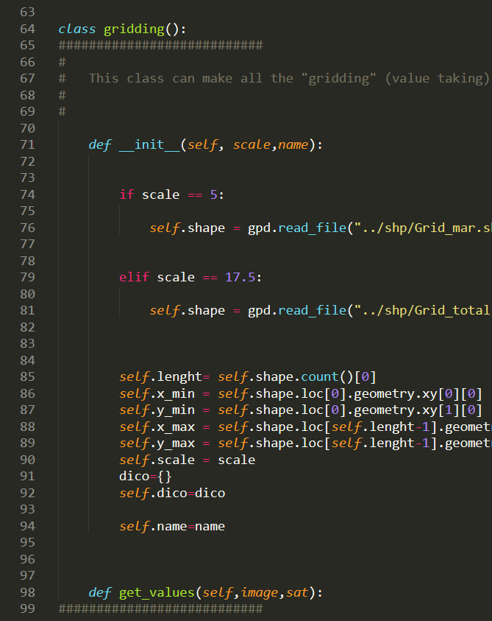
Data Processing
SAR:
Calibration
Resampling
Mosaicking
Classification
MAR:
Extraction
Projection
Classification
Introduction
Data
Comparison
Discussion

Slide 10
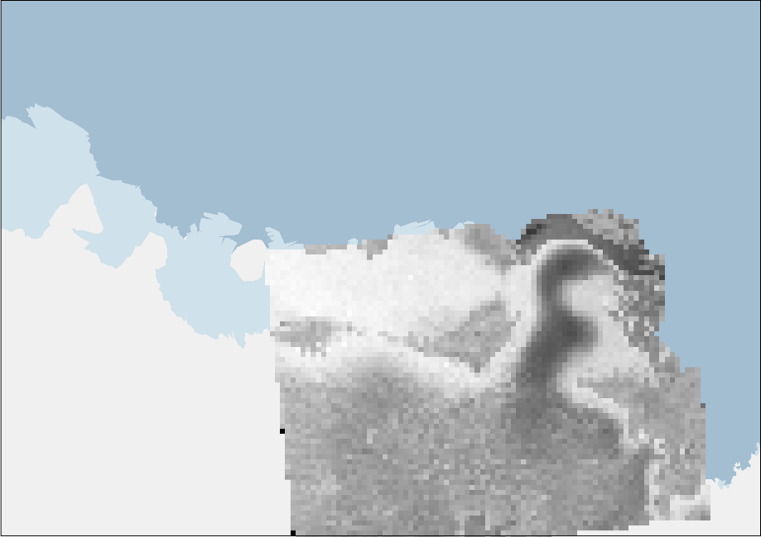
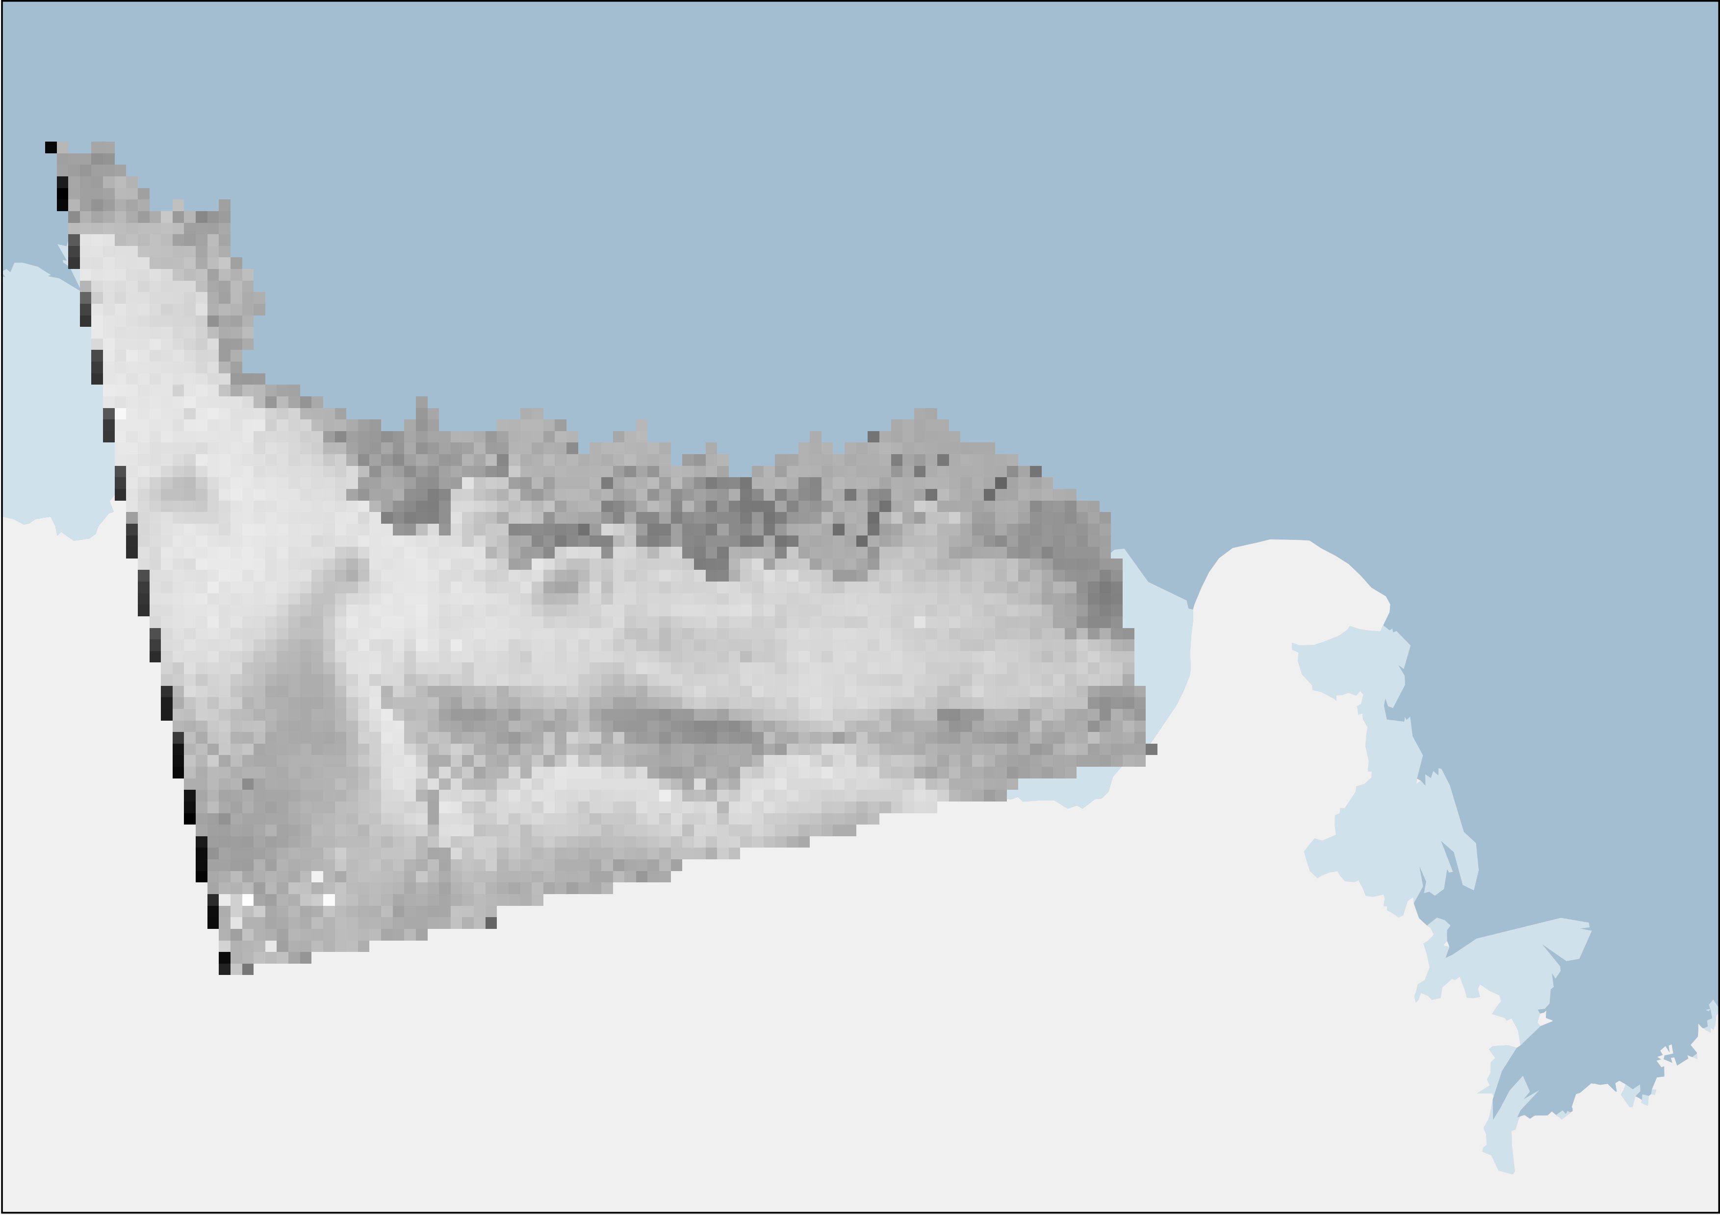
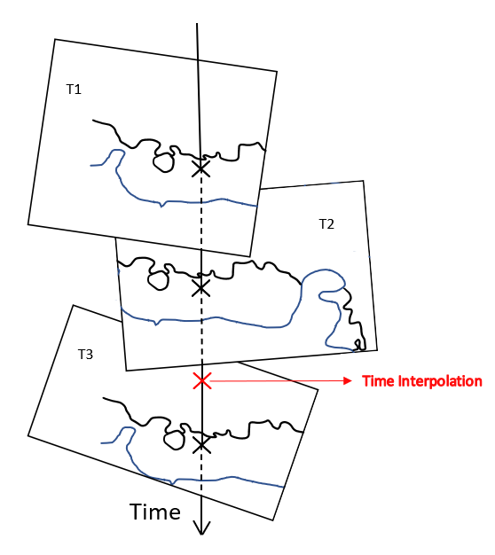
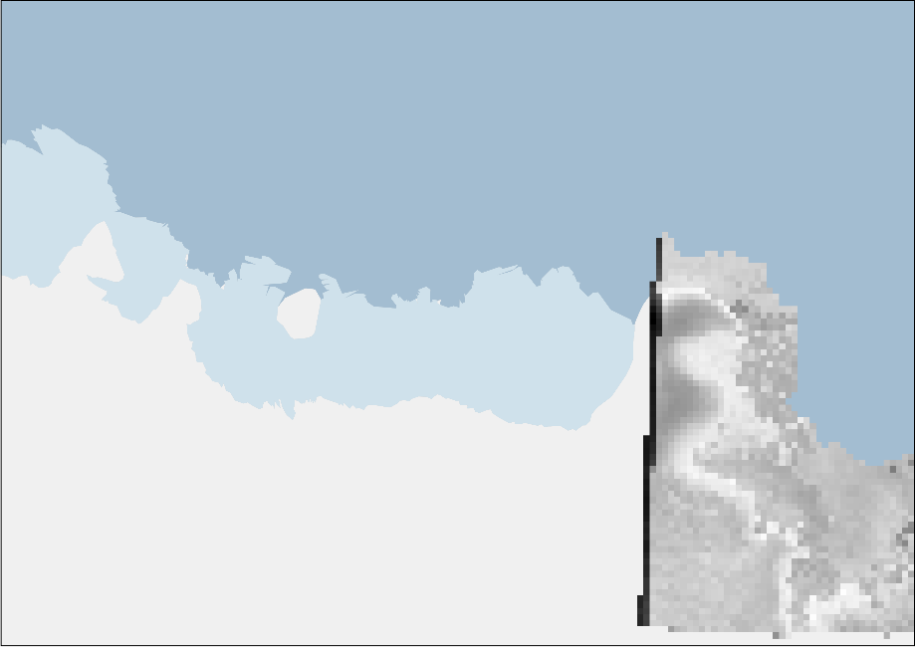
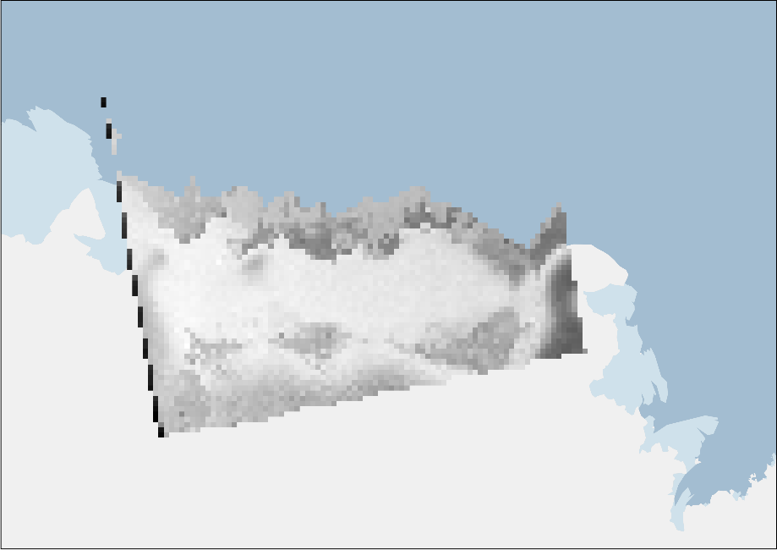
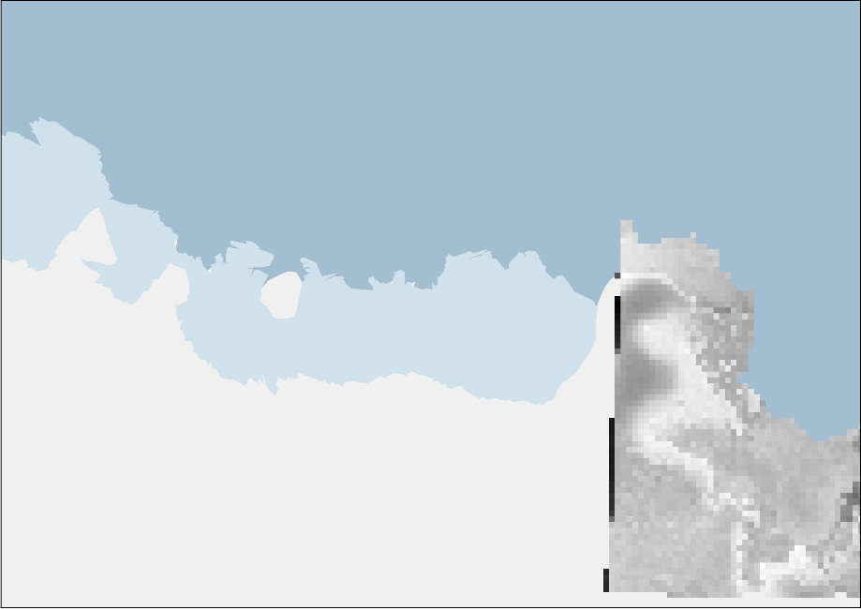
Data Processing
Mosaicking
Introduction
Data
22-12-2018
Comparison
Discussion

Slide 11
Data Processing
Binary Classification to Melt Mask
Introduction
MAR:
SAR:
> 0,1 or > 0 (Depending on the variable)
Or
0,1*(0,1*RO1[k = 1 : 10@ave]*WA1[k = 1 : 10@ave]) > 0,1%
$σ_{0HH}$ < -2,6 dB (from literature)
Or
$σ_{0HV}$ < -5 dB
Data
Comparison
Discussion

Slide 12
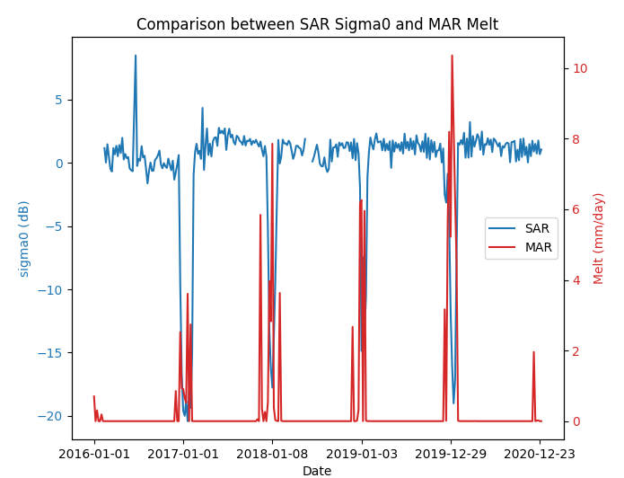
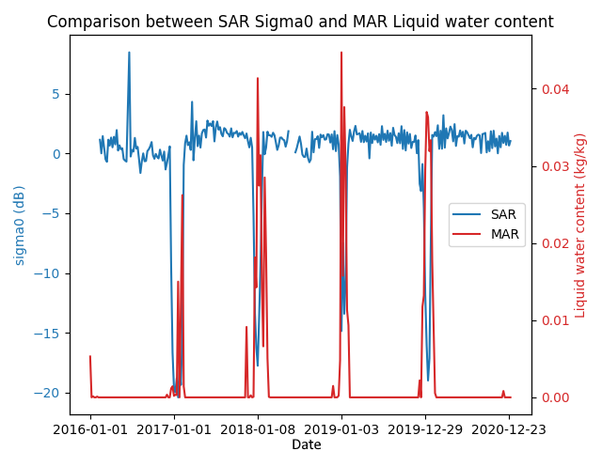
Temporal Comp.
Melt vs $σ_{0}$
Liquid Water Content vs $σ_{0}$
Introduction
Data
Comparison
Discussion
→ The evolutions are strongly correlated

Slide 13
Temporal Comp.
Melt vs $σ_{0}$
Liquid Water Content vs $σ_{0}$
Introduction
?
?
?
?
?
?
?
?
?
?
Data
Comparison
Discussion
→ Discrepancy between the observations and the model

Slide 14
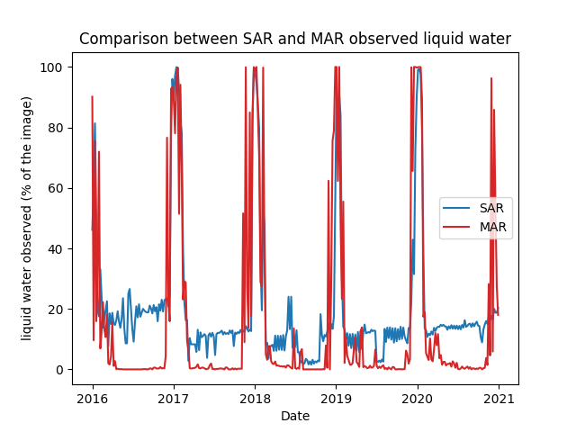
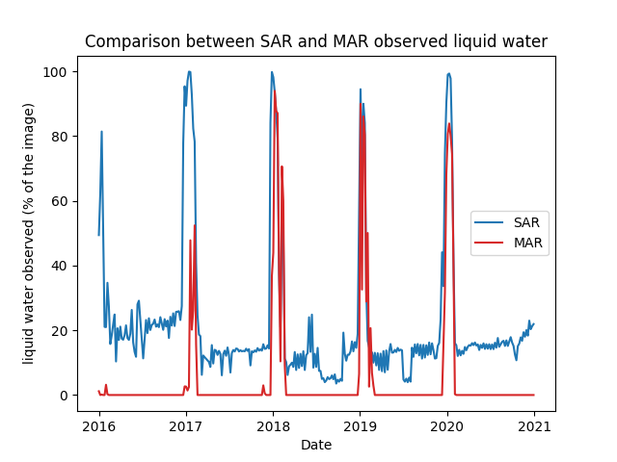
Quant. Comp.
Melt vs Sentinel-1 melt extent
Water Ratio vs Sentinel-1 melt extent
Introduction
Data
Comparison
Discussion
→ Continuous noise in Sentinel-1 observations

Slide 15
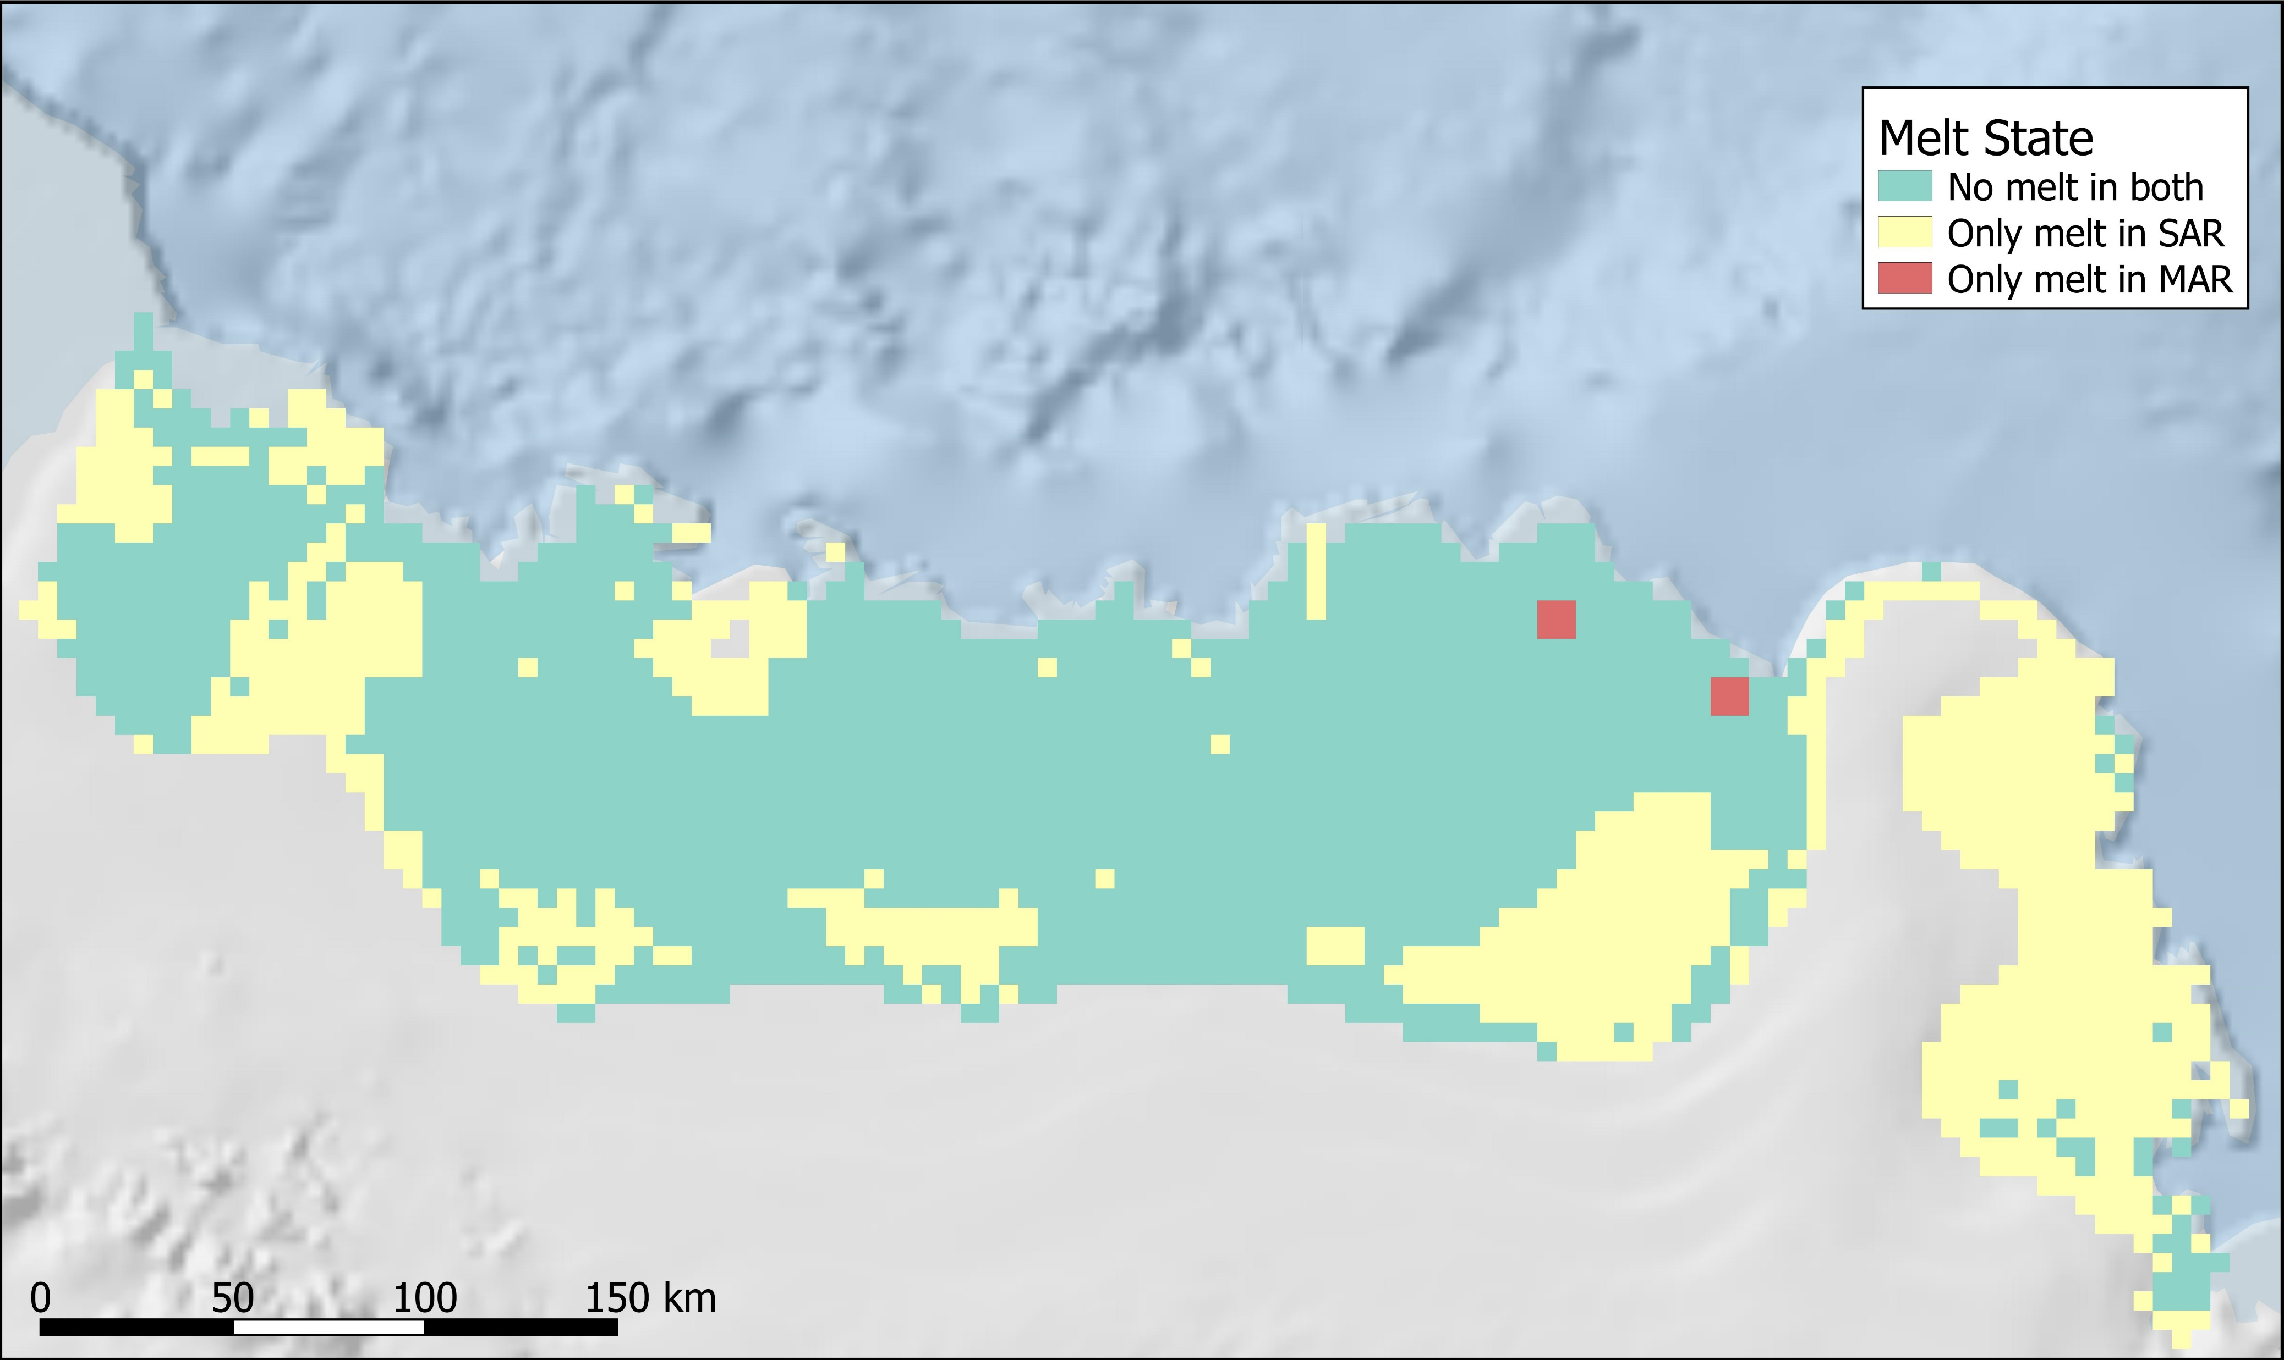
Quant. Comp.
Identified Factors
Introduction
Slopes
Prince Harald Ice Shelf
Data
Comparison
Blue ice / lakes
Discussion
10-09-2016

Slide 16
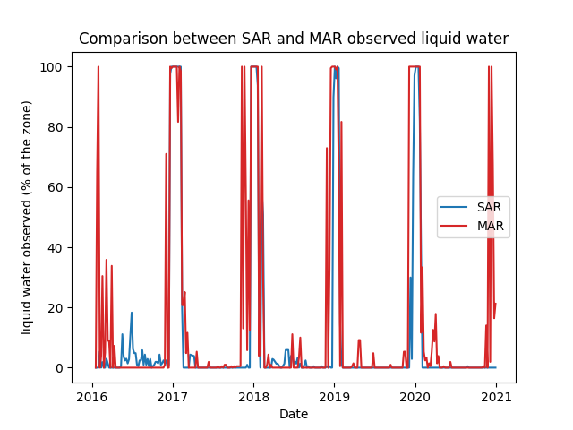
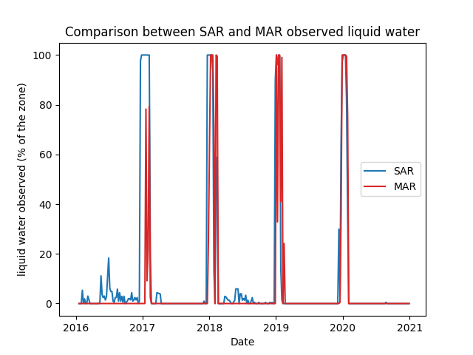
Quant. Comp.
Melt vs Sentinel-1 melt extent
Water Ratio vs Sentinel-1 melt extent
Introduction
Data
Comparison
Discussion
→ Temporal discrepancies influence the quantitative comparison

Slide 17
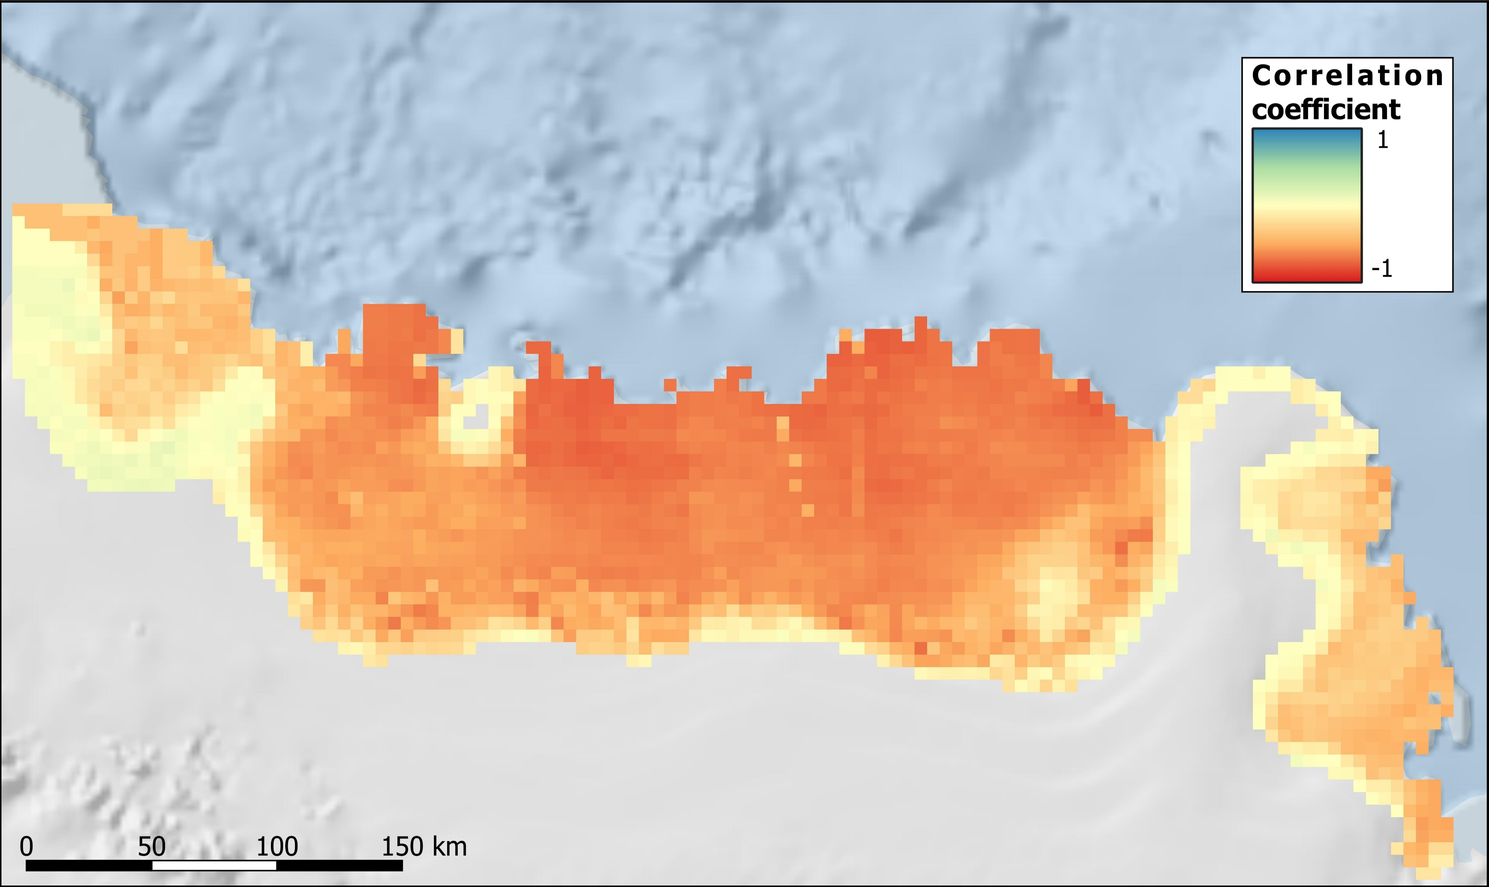
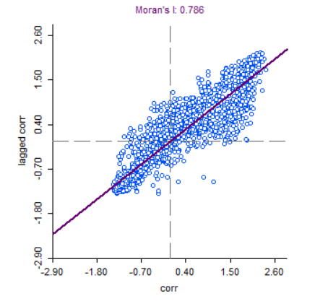
Spatial Comp.
Correlation of MAR and Sentinel-1 σ0 Between 01-01-2016 and 29-12-2020
Melt vs $σ_{0}$
Introduction
Data
Moran’s I : 0,786
→ Spatially correlated
Comparison
Discussion

Slide 18
Spatial Comp.
Differences are related to the previously identified geophysical elements
Introduction
Slopes
Data
Prince Harald Ice Shelf
Comparison
Blue ice / lakes
Discussion

Slide 19
Perspective
Introduction
Problematic zone have been masked→ Normalization of SAR images
Possibility to extent the region of interest
Data are consistent with each other → can be used together
Data
Comparison
Discussion

Slide 20
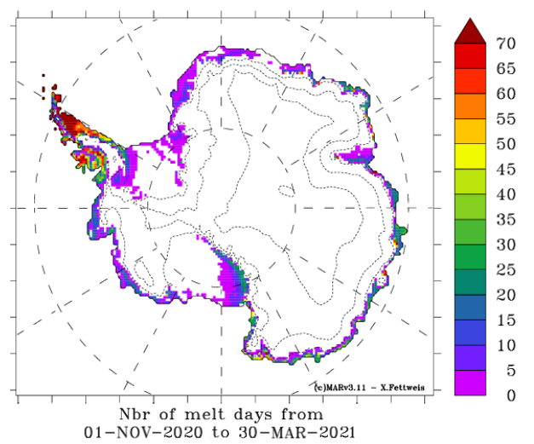
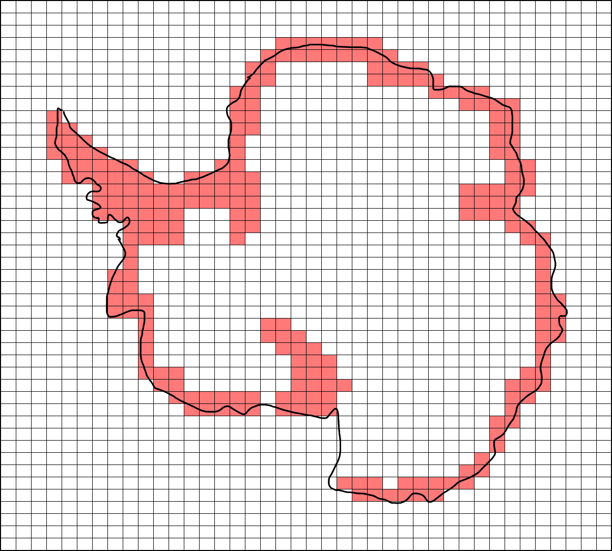
Perspective
Global Circulation Model
Introduction
Better quantification of surface melt
+
Study of snowpack evolution
Data
Data Assimilation
Comparison
Discussion

