Slide 1




Hieroglyphic Sign-lists, the Thot Sign List (TSL) and towards a Unicode Hieroglyphic expansion.
Jorke Grotenhuis (UC Berkeley)
Peter Dils (SAWL), Stéphane Polis (F.R.S.-FNRS; ULiège), Daniel Werning (BBAW)
Notes:
Many thanks to the organizer and to all of you for coming.
In this talk I will introduce the Thot Sign List (TSL in short), a digital repertoire of hieroglyphic signs
The TSL is joint project and I am here presenting the results on behalf of large team of scholars who collaborated for many years.
1

Slide 2
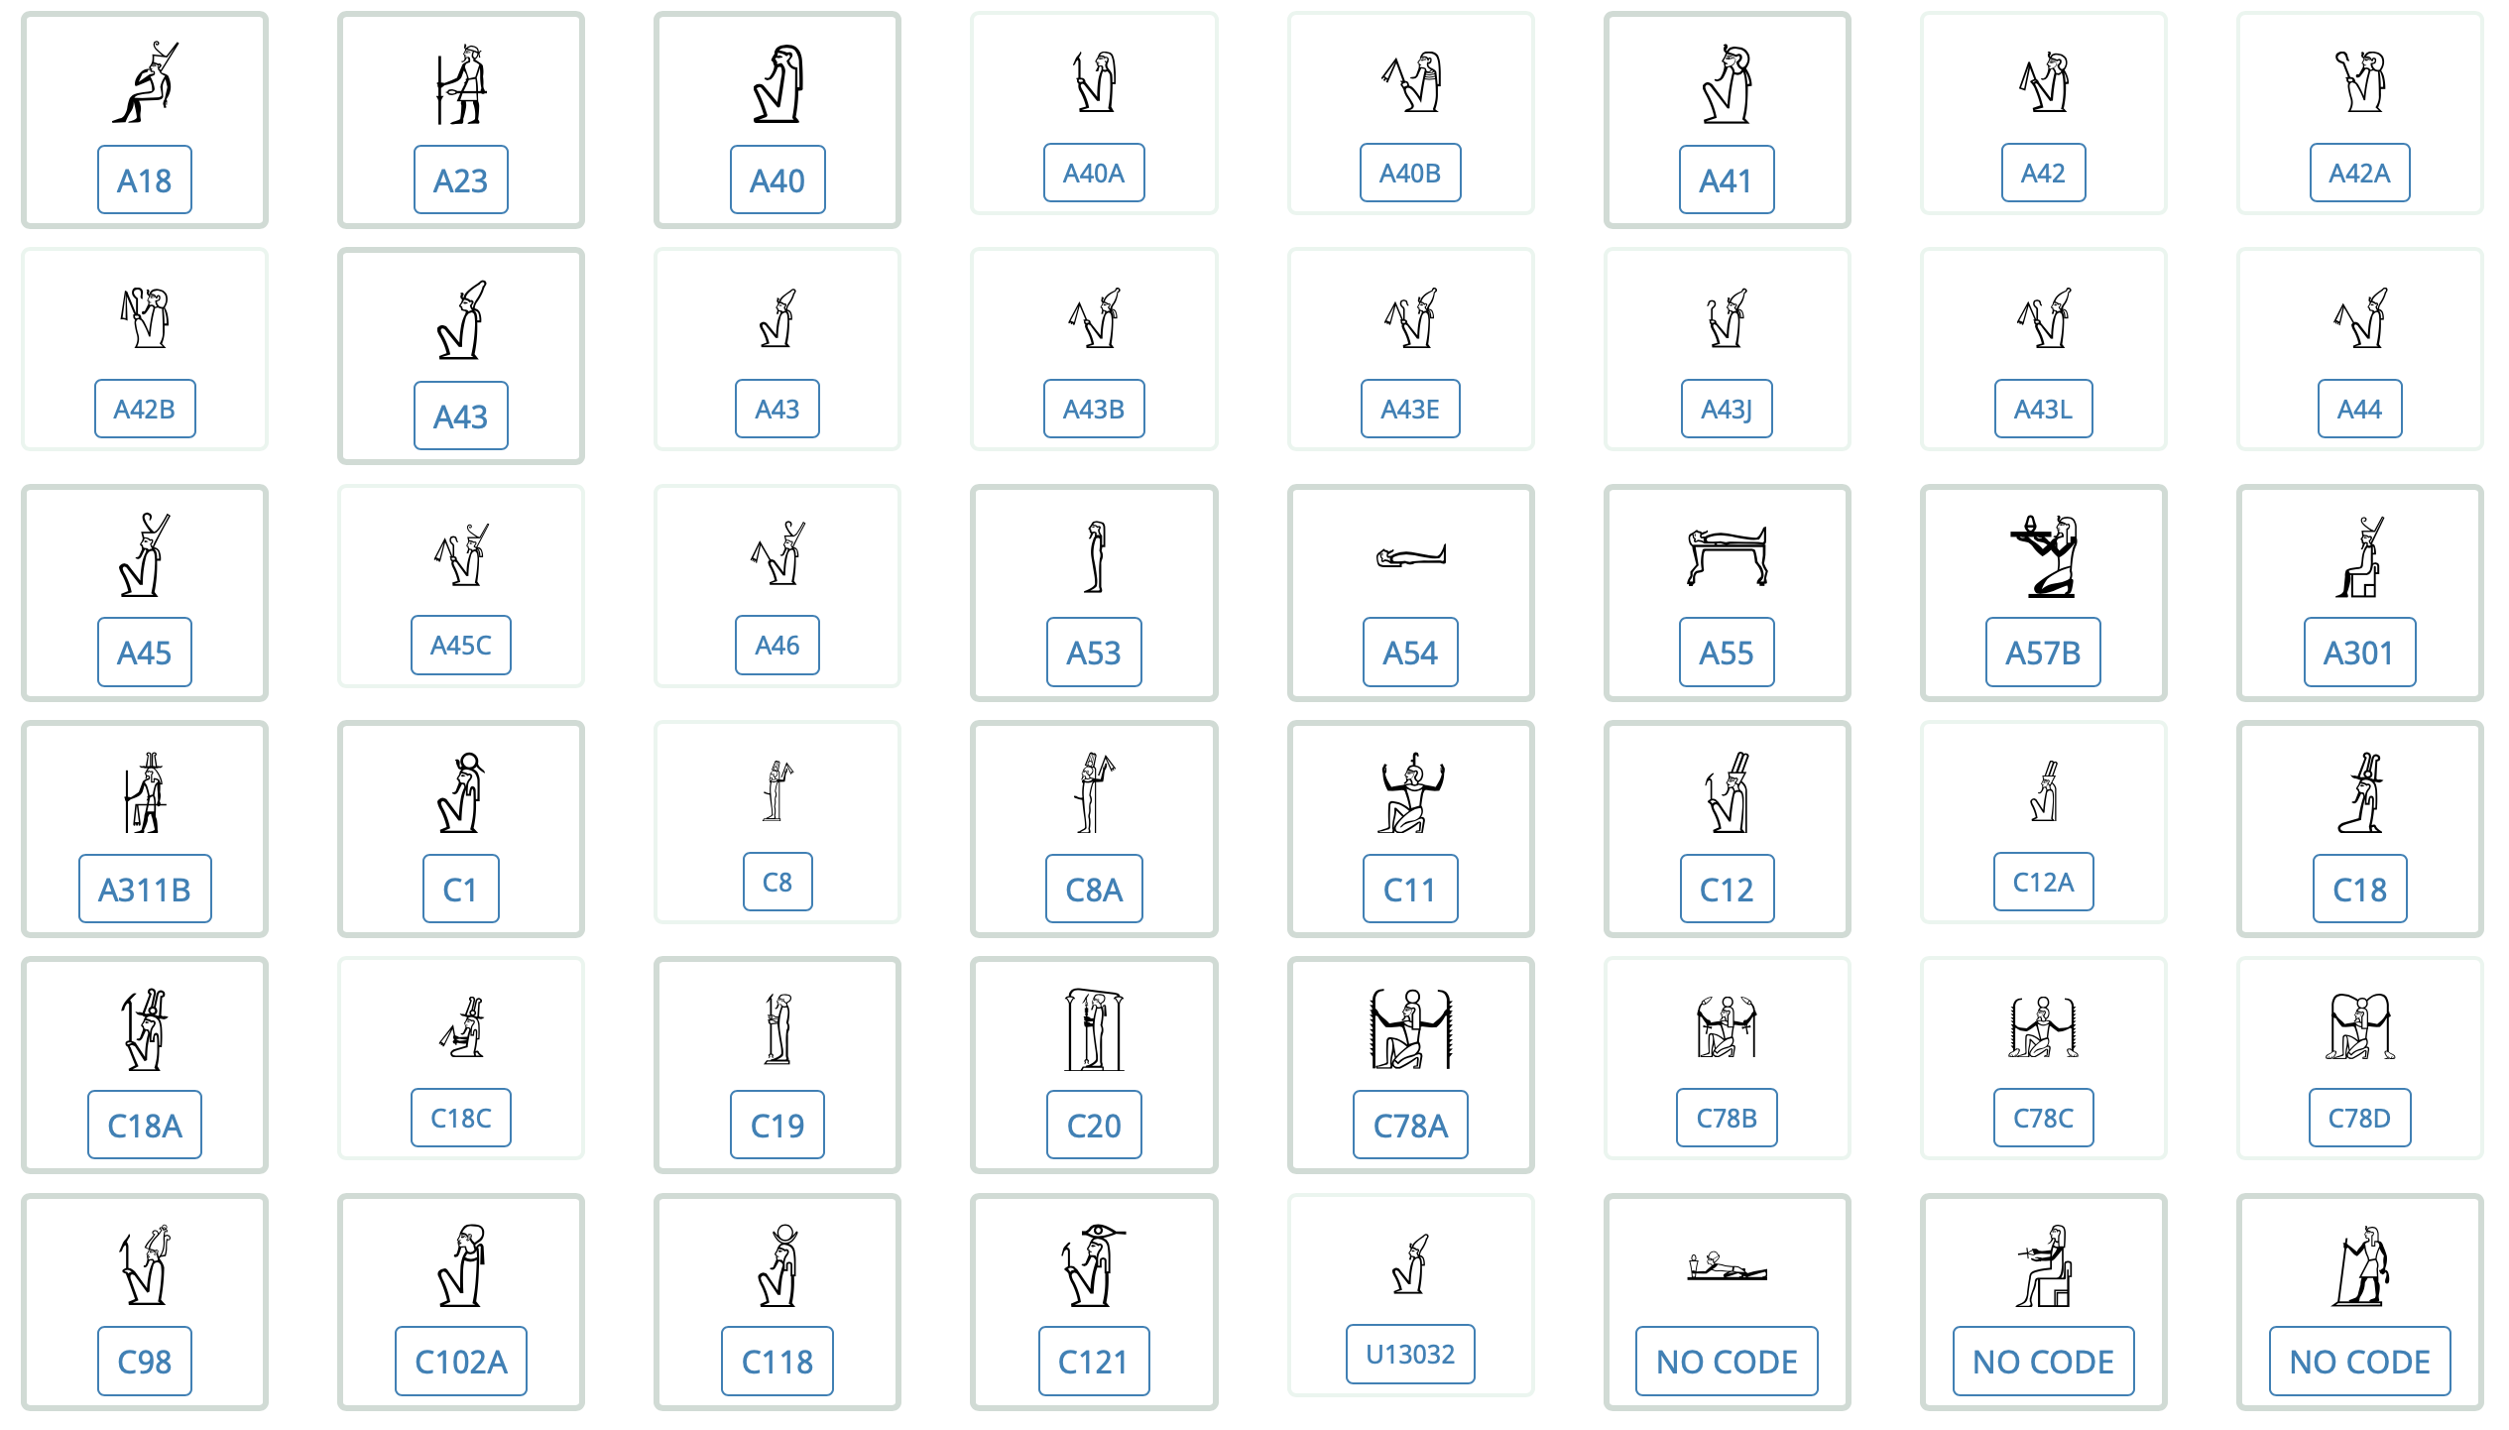
Outline of the talk
History of Sign-lists
Notes:
2

Slide 3
Outline of the talk
History of Sign-lists
Research into Hieroglyphic signs
Notes:
3

Slide 4
Outline of the talk
History of Sign-lists
Research into Hieroglyphic signs
History of the TSL project
Notes:
4

Slide 5
Outline of the talk
History of Sign-lists
Research into Hieroglyphic signs
History of the TSL project
Goal and data model
Notes:
5

Slide 6
Outline of the talk
History of Sign-lists
Research into Hieroglyphic signs
History of the TSL project
Goal and data model
Recent developments
Notes:
6

Slide 7
Outline of the talk
History of Sign-lists
Research into Hieroglyphic signs
History of the TSL project
Goal and data model
Recent developments
Unicode Hieroglyphic expansion
Notes:
7

Slide 8
Outline of the talk
History Sign-lists
Research into Hieroglyphic signs
History of the TSL project
Goal and data model
Recent developments
Unicode Hieroglyphic expansion
Unicode Hieroglyphic font
Notes:
8

Slide 9
History of Sign-lists
1836–2019

Slide 10
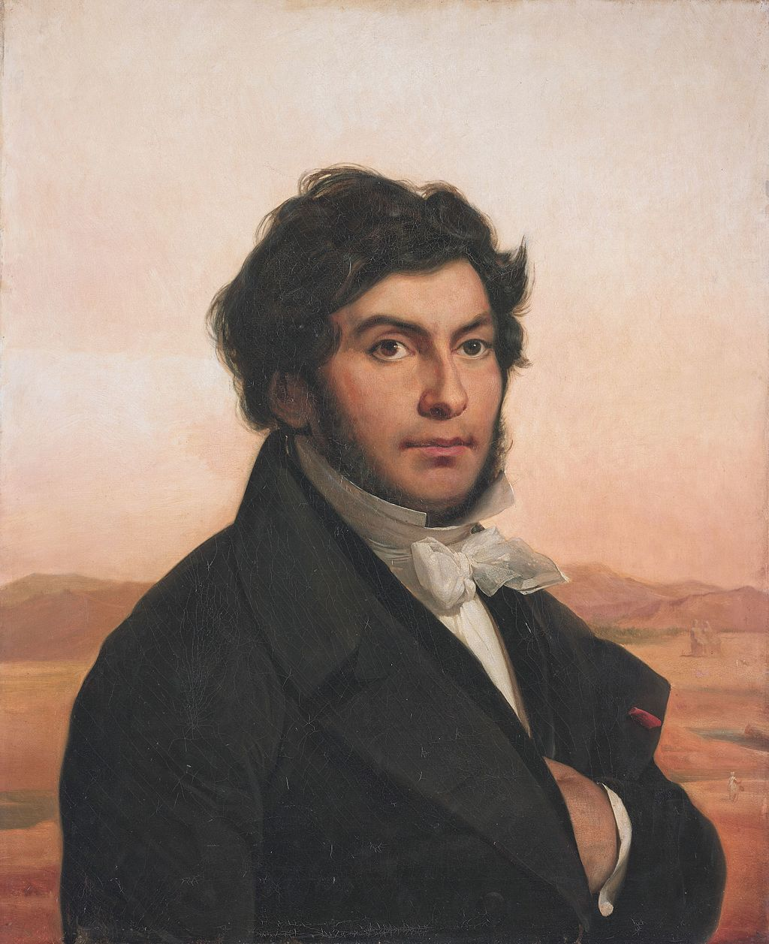
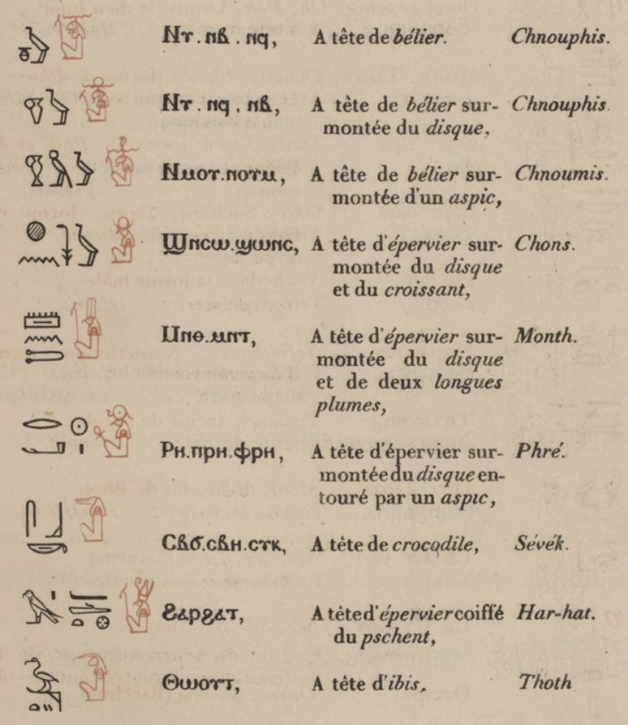
History of Sign-lists
Jean-François Champollion (1836)
1790-1832
Notes:
As with most stories about the history of Egyptology, we have to go back to Champollion. He created the first modern sign-list in Egyptology, which included a limited description of the phonetic function of the signs, and also made a classification of the signs into thematic groups, although the amounts of groups varied between 7 and 18. Moreover, he created the first assumptions of the different functions of the signs.
10

Slide 11
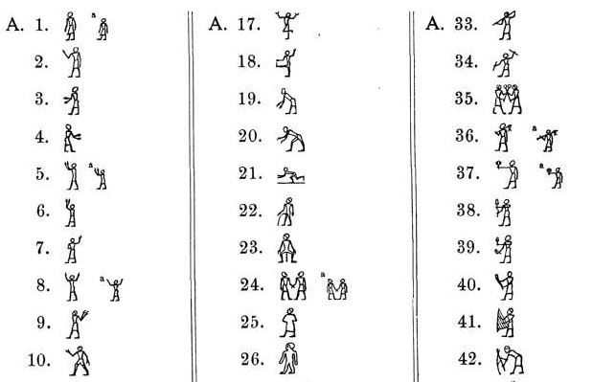
History of Sign-lists
Jean-François Champollion
Theinhardt font
Notes:
In the second halve of the 19th century, more or less at the same time, two fonts were developed for publication purposes. One of them, known as the Theinhardt font was developed under the supervision of Lepsius. A notable inclusion in this sign-list was the division into categories, which included man, female, god, ect. These might seem quite familiar to everyone, based on the best known sign list:
11

Slide 12
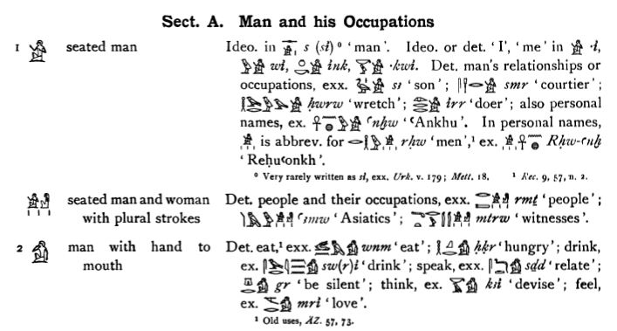
History of Sign-lists
Jean-François Champollion
Theinhardt font
Gardiner
Notes:
The Gardiner Sign list. This sign list was developed by Gardiner from the structure of the Theinhard font, which included a description, the linguistic aspect and the basic reading of the sign in question. As the sign list was intended as an supportive tool for his grammar, the signs used were standardized to the signs used in the 18th dynasty, and then limited to include only the generally occurring signs.
12

Slide 13
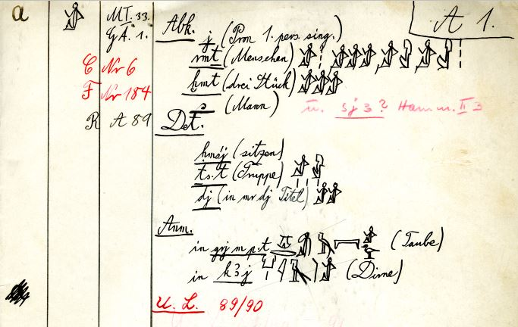
History of Sign-lists
Jean-François Champollion
Theinhardt font
Gardiner
Berliner Zeichenliste
https://aaew.bbaw.de/archive/berliner-zeichenliste-1935-39
Notes:
At roughly the same time Gardiner developed his sign list, Erman and Grapow developed their own sign list as compendium to their dictionary. It shares many similarities with the sign-list of Gardiner, which is hardly surprising considering the fact that Gardiner worked together with Erman in the first decade of the 20th century. Sadly this sign list, known as the Berliner Zeichenliste, was never published after the second world war, but is currently available online.
13

Slide 14
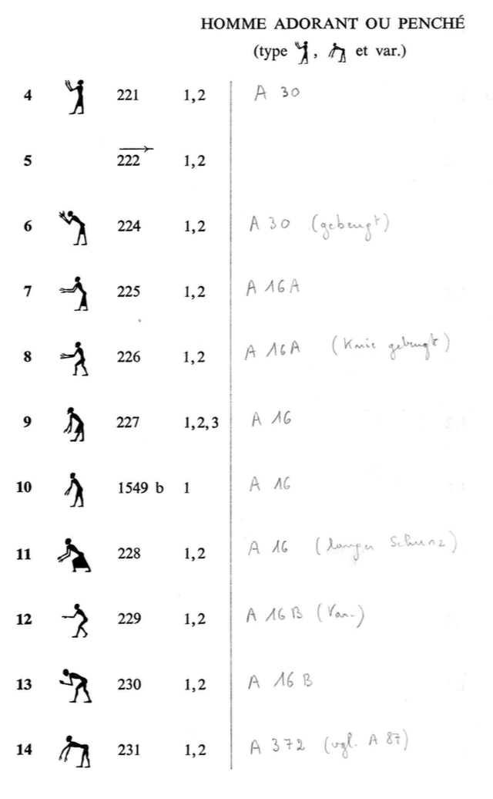
History of Sign-lists
Jean-François Champollion
Theinhardt font
Gardiner
Berliner Zeichenliste
IFAO font
Notes:
During the late 19th century and the early 20th century, a font was developed by the IFAO for their publications, especially for the publication of Graeco-Roman temples, which was extensive, with over 7000 signs. Originally only created for the typesetter, it held no information about the signs themselves, but in the second edition, under Sauneron, it was reorganized around the principles of Gardiner, and included information about the functions of the signs, in order to enhance the usefulness of the list to egyptologist.
14

Slide 15
History of Sign-lists
Many other sign-lists since then
Part of Grammars: Allen, Borghouts, Malaise & Winand, Schenkel, Kurth, Leitz
Part of Dictionaries: Hannig, van der Molen
Paleographical works: Paléographie Hiéroglyphique I-VIII, Hibis temple project, etc.
Addendum to series: Daumas, Cauville (Dendera), Sauneron (Esna I-II, VIII)
Cryptographic Hieroglyphs: Fairman, Drioton, Darnell, Roberson
Unpublished: Hornung & Schenkel
Hieratic Sign lists: Möller, AKU project Mainz (http://aku-pal.uni-mainz.de/)
Notes:
15

Slide 16
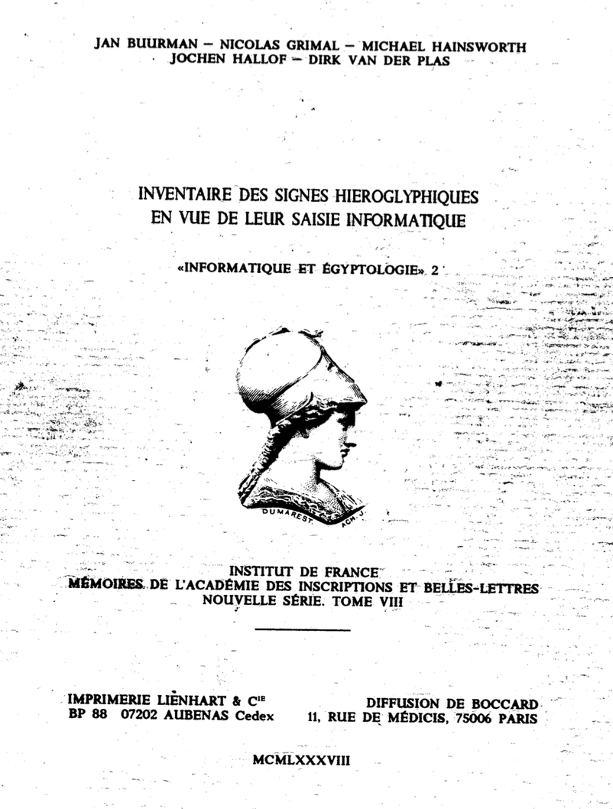
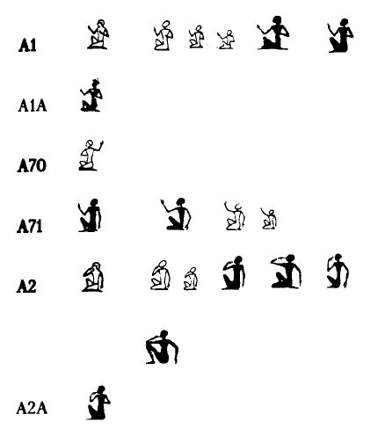
History of Sign-lists
Sign-lists for digital encoding: Manuel de Codage (1988)
Notes:
The first major push towards an digital sign list occurred with the publication of the “Inventaire des signes hiéroglyphiques en vues de leur saisie informatique: Manuel de codage des textes hiéroglyphiques en vue de leur saisie sur ordinateur”, known as the manuel de codage. This inventory collected the signs used by most earlier sign lists, and grouping them together under a common number.
16

Slide 17
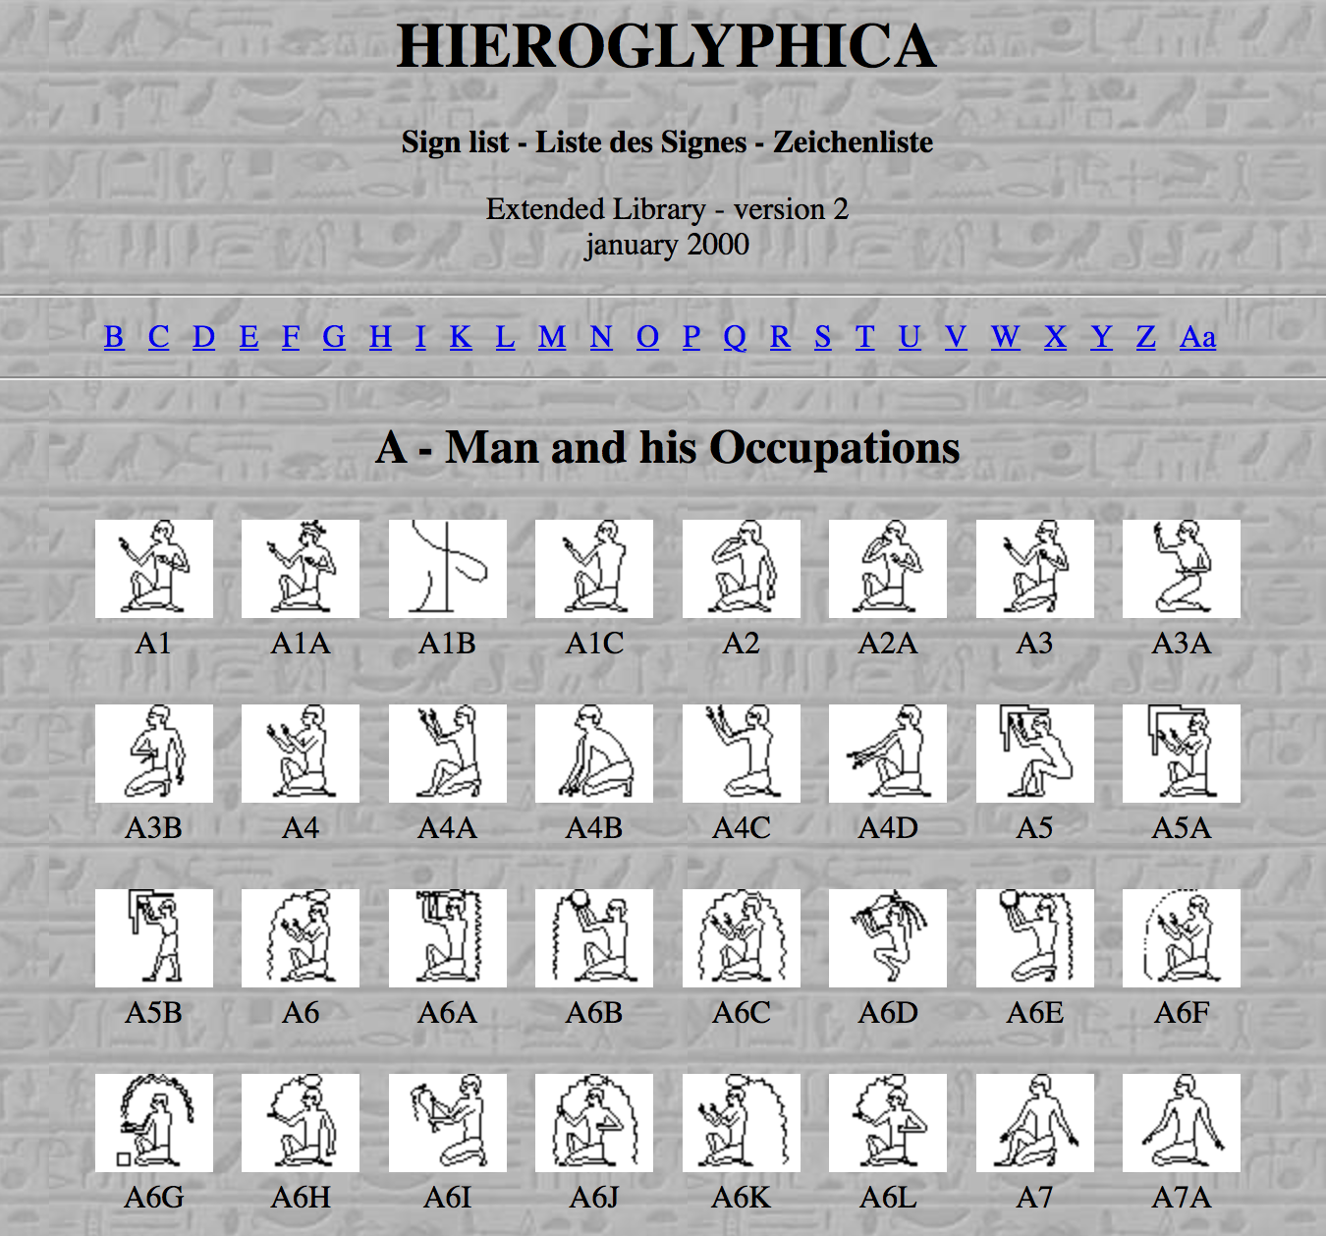
History of Sign-lists
Sign-lists for digital encoding: Extended Library
Notes:
In 2000, a revised and updated version of the Manual de Codage was released, which included an extended library of signs, but which was mostly undocumented, represented in the font of winglyph: Hieroglyphica.
17

Slide 18
History of Sign-lists
Sign-lists for digital encoding:
Glyph
Macscribe
Winglyph
Jsesh
Perfectglyph
Visualglyph
Etc.
Notes:
This common number allowed programs, initially Glyph, and later MacScribe and Winglyph to encode text by using these numbers
18

Slide 19
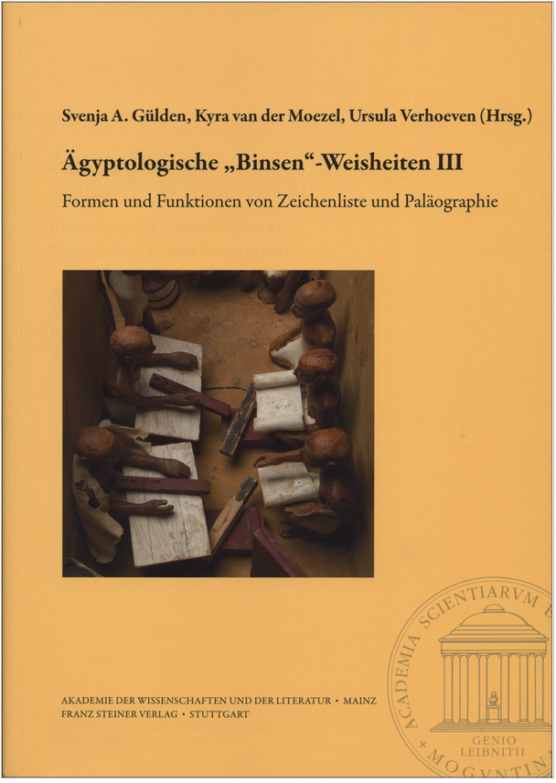
History of Sign-lists
Ingelore Hafemann (2018)
Die beschreibende und kommentierte hieroglypische Zeichenliste als offenes System
Notes:
For a more in depth discussion about the history of sign Lists, I would like to refer you to the following article by Ingelore Hafemann, or guide d’écriture, edited by Stéphane Polis, english version should arrive soon.
19

Slide 20
History of Sign-lists
Sign-lists:
Font (publications)
Commented (tool)
Referenced or not
Descriptive
Paleographical information
Notes:
At this point, I wish to quickly discuss the common uses of sign lists, and the effects of these uses on the sign lists in general. One has to take this diffusion between the sign lists into regard, as the commented sign list is meant as a tool for egyptologists, and the other is “merely” a tool for publication. This division has only become more prevalent since the advent of digital fonts. In this era, one could consider the newest published sign lists actually 2, as they are published with an digital font, they include the commented and the fond together. Secondly, most sign list are created as an compendium to another publication, be it a grammar or dictionary. Thus, the sign list is a support to the goal of the publication in question, and bound by its limitations. Lastly, a sign list can be made for Paleographical purposes, which focuses more on the shape of the signs, then the actual function.
20

Slide 21
Research into Hieroglyphic signs
Notes:
In the following section, I would like to discuss some of the problems one comes across when trying to do research into hieroglyphic signs. Note that in quite a few cases I will show here, I am just highlighting the problem, as often I cannot give a clear solution to a problem that will satisfy everyone. Thus, as stated before, the issue becomes more about what the purpose is of the work being done which informs how one will deal with the issues. As any hieroglyph will still reflect handwriting to some extend, variation is rather likely to occur, which will be of high value on the paleographic level, but presents an rather potent problem if one wishes to encode texts, and is less interested in the exact position of the arm, if there is no functional difference because of the position of the arm.

Slide 22
Research into Hieroglyphic signs
Existing referenced sign-lists: Gardiner, Borghouts, Valeurs phonétiques (Daumas), Kurth, Cauville, Hornung & Schenkel, Berliner Zeichenliste, Esna VIII (Sauneron)
Notes:
Now, I don’t intent to bore you all with the tiniest menutia of the general research (which I can), but I want to at least give a general idea how one finds the data. The general method starts with using existing sign lists. However, this brings their own problems, as often you will see that the lists start referring to each other, and/or refer to the same source.
Additionally, depending on the function of the list, the reference might be less benificial for shape recognision than one would expect. For example, there are multilple cases where Valeurs refers to Alliot, from which one can find the actual sign in the publications of Edfu from Chassinat. As Valeurs is more focussed on the function, the reference to Alliot makes sense, as it discusses the function of the sign. However, it can be rather frustrating to have to locate the sign itself, to where it occurs in Edfu, beside the issues that the transcription is not stable between Alliot and Edfu (before one looks at the images).
As another example, for some of the functions of signs, Daumas refers to his own publication about Mammisies for a function, which then refers to the actual publication, which was done by, well, Daumas.
22

Slide 23
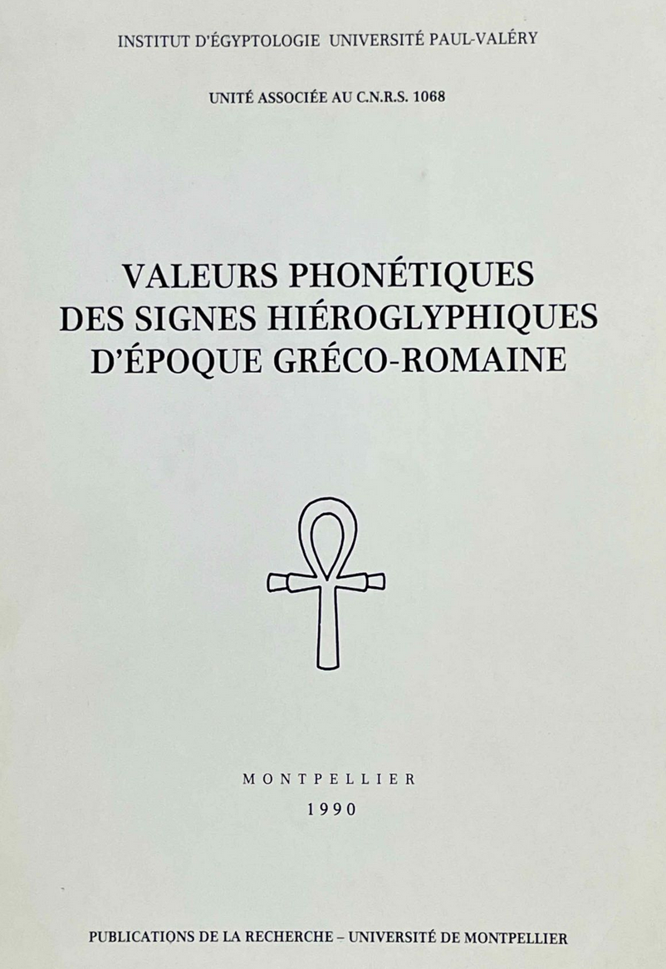
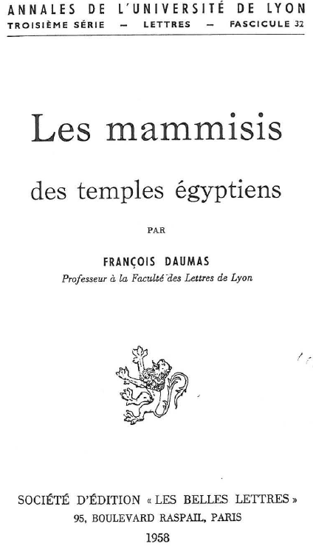
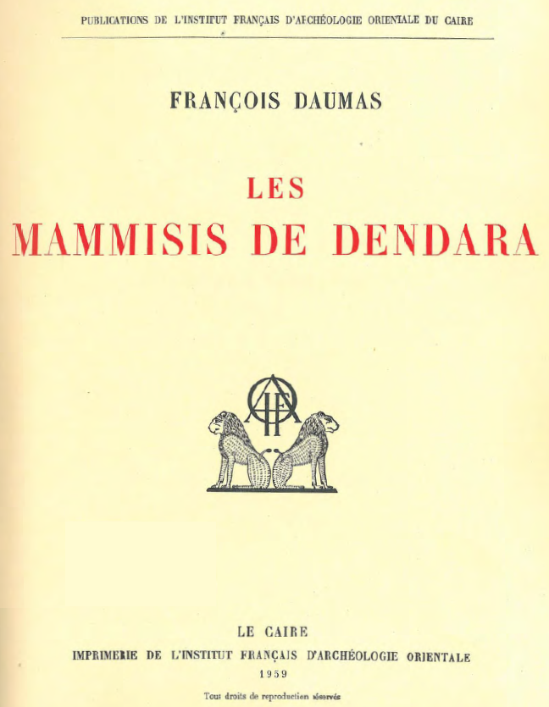
Research into Hieroglyphic signs
Existing referenced sign-lists: Gardiner, Borghouts, Valeurs phonétiques (Daumas), Kurth, Cauville, Hornung & Schenkel, Berliner Zeichenliste
> >
Notes:
Now, I don’t intent to bore you all with the tiniest menutia of the general research (which I can), but I want to at least give a general idea how one finds the data. The general method starts with using existing sign lists. However, this brings their own problems, as often you will see that the lists start referring to each other, and/or refer to the same source.
Additionally, depending on the function of the list, the reference might be less benificial for shape recognision than one would expect. For example, there are multilple cases where Valeurs refers to Alliot, from which one can find the actual sign in the publications of Edfu from Chassinat. As Valeurs is more focussed on the function, the reference to Alliot makes sense, as it discusses the function of the sign. However, it can be rather frustrating to have to locate the sign itself.
As another example, for some of the functions of signs, Daumas refers to his own publication about Mammisies for a function, which then refers to the actual publication, which was done by, well, Daumas.
23

Slide 24
Research into Hieroglyphic signs
Existing referenced sign-lists: Gardiner, Borghouts, Valeurs phonétiques (Daumas), Kurth, Cauville, Hornung & Schenkel, Berliner Zeichenliste
Databases: TLA, Ramses online, Projet Karnak
Notes:
Since more and more is starting to be put online, another great source of data comes from databases that encode texts. (making a digital representation of a texts, which is based on the underlying codes of characters on a computer, in order to create a stable digital representation). However, these are bound by issues as well, as the available signs might not be sufficient for encoding (making digital transcriptions), so a shortcut is used, or the encoding is based on a transcription, in which case any errors or simplifications made in the transcription might be exported to the database.
24

Slide 25
Research into Hieroglyphic signs
Existing referenced sign-lists: Gardiner, Borghouts, Valeurs phonétiques (Daumas), Kurth, Cauville, Hornung & Schenkel, Berliner Zeichenliste
Databases: TLA, Ramses online, Projet Karnak
Publications: Hallof (Dendera, Esna VII), Eicke, Labrique (Kom Ombo), Leitz, Teotino (Athribis)
Notes:
Or, more recent publications, which often have the encodings digitally, which can be used to locate the signs you are looking for. The reason that I mention these specifically, is that these were the primary sources used for the work on the TSL and the Unicode expansion. Obviously there are many, many more sources, but one needs to start somewhere, as it would be impossible to actually locate all the signs by oneself.
25

Slide 26
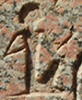
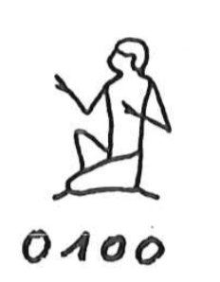
Research into Hieroglyphic signs
Tokens, classes and graphemes
Token: a single attestation of a hieroglyph (ancient or modern)
http://www.cfeetk.cnrs.fr/archives/?n=62828
Photograph from the Karnak Project: CNRS, USR 3172 - CFEETK / UMR 5140 - ASM supported by the CNRS and the LabEx Archimede ANR-11-LABX-0032-01, Programme Investissement d'Avenir. All photographs © CNRS-CFEETK
Notes:
Now, it might be worthwhile to go into more detail here about what the terminology which I use here is discussed. If we refer to a hieroglyphic sign as an attestation of a Hieroglyph, it will be impossible to ever create a functional list, as we will be dealing with millions of signs, of which a large section will look rather similar. This is not practical. Even though with handwriting a letter a can vary drastically, everyone who reads it will still extract the phonetic value from the general shape, so it is not needed for our alphabet to contain many different forms for the letter a. This is true of hieroglyphs as well. So, some standardisation is warrented.
Thus, we use the term token here instead.
26

Slide 27
Research into Hieroglyphic signs
Tokens, classes and graphemes
Token: a single attestation of a hieroglyph (ancient or modern)
Class: a group of tokens which share iconic features and functions
𓎼 𓎽
Notes:
27

Slide 28
Research into Hieroglyphic signs
Tokens, classes and graphemes
Token: a single attestation of a hieroglyph (ancient or modern)
Class: a group of tokens which share iconic features and functions
Grapheme (sign): a cluster of classes which share the same functions (and similar iconic features).
Notes:
And finally, the grapheme, what could be referred to as well as sign, as an oversimplification. In regard to the grapheme, this is in the TSL represented by one of the classes, which can be argued to be the prototypical representation of a cluster of classes. Thus, for Gardiner W11 and W12, although graphically different, they are functionally similar, with the same base-line iconic features, that it is both a ring-stand for jars.
Why is it rather important to make these distinctions, well, that is where multiple issues come in, and what I will be talking about next, as where one would place the border between classes
28

Slide 29
Research into Hieroglyphic signs
Tokens, classes and graphemes
Token: a single attestation of a hieroglyph (ancient or modern)
Class: a group of tokens which share iconic features and functions
Grapheme (sign): a cluster of classes which share the same functions (and similar iconic features)
𓅭 𓆇 𓎃 𓐠
Notes:
So, for example, the followin hieroglyphs all have the same function, i.e., phonemogram sA, but do not share any iconic features, so they cannot be considered classes of each other.
29

Slide 30

Research into Hieroglyphic signs
Gardiner, MdC, JSesh and Hieroglyphica codes not always the same grapheme
Gardiner/JSesh code R15:
Hieroglyphica code R15:
Notes:
So, how does this become a problem. Well, at the first level, in the current codes used by Egyptologists, it is not always known that certain codes do not always create the same image, even though the variation is relatively small, and you are usually still in the same ball-park.
So, here the case of R15. Now, where it becomes rather interesting. At some point, whoever drew the sign for Hieroglyphica diverged from the Gardiner font. Should we then say that Hieroglyphica is wrong, well, not really.
30

Slide 31

Research into Hieroglyphic signs
Gardiner, MdC, JSesh and Hieroglyphica codes not always the same exact image
Gardiner/JSesh code R15:
Hieroglyphica code R15:
Notes:
So, how does this become a problem. Well, at the first level, in the current codes used by Egyptologists, it is not always known that certain codes do not always create the same image, even though the variation is relatively small, and you are usually still in the same ball-park.
So, here the case of R15. Now, where it becomes rather interesting. At some point, whoever drew the sign for Hieroglyphica diverged from the Gardiner font. Should we then say that Hieroglyphica is wrong, well, not really. As shown here, actually both forms do exist. So, we are dealing with classes here then. However, now I would like to ask you, imagine you have to encode a text, and your purpose is to provide a transcription for a translation, and you are not required to provide a perfect paleographical transcription. Would you like to look through a list of 2000 signs to locate the correct paleographical form, or would you prefer a more standardized form, for the ease of use. This is without discussing the work one would have to do if studying the word iAb.t, and you want to see with a search of a text, where the lemma occurs, not really caring what it exactly looks like. This is part of the discussion one constantly has during research into signs.
Additionally, when dealing with databases, one using Hieroglyphica and one Jsesh, subtle changes might happen which are not always known to the user. The variation here is minor, but this can easily spiral out of control.
It is not my intention here to deny the importance of the two variants on a paleographical level, as it can represent diachronic variation, which would be important.
31

Slide 32
Research into Hieroglyphic signs
The beard issue*
Short and straight (nobles) 𓀻
Long and straight (king) 𓀯
Long and curved (god) 𓀭
Bushy (foreigner) 𓀺
* Daniel Werning, (2021), Suggestions for corrections/clarification of beards and headdress in Unicode and different other lists
Notes:
The next example of a problematic feature was brought up by Daniel Werning, which we have start to call the beard issue.
With a bit of standardisation, one could argue there are four types of beards in Ancient Egypt, namely short and straight, long and straight, long and curved, and bushy.
As one can rather instantly see here, these details can be rather hard to make out in any font. So, one could argue that there is no reason to make a clear distinction between the beards.
32

Slide 33
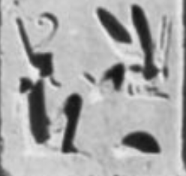
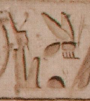
Research into Hieroglyphic signs
The beard issue
http://www.cfeetk.cnrs.fr/archives/?n=62828
Photograph from the Karnak Project: CNRS, USR 3172 - CFEETK / UMR 5140 - ASM supported by the CNRS and the LabEx Archimede ANR-11-LABX-0032-01, Programme Investissement d'Avenir. All photographs © CNRS-CFEETK
Goelet; Iskander (2015), The temple of Ramesses II in Abydos. Volume 1: Wall scenes, p. 161, pl. 3.1.10
Notes:
The problem is that this distinction can actually have an intentional semantic variation, but not one can easily make out based on the function, and this is often most clearly visible when dealing with the king. In the usual form, the king should have the long straight beard, but in the left hand example, there is a clear curved beard, so although the function is bi.ty (King of LE), there is a divine aspect to it, as it is part of an offering scene, so the king in this case refers to a god, and this semantic difference is reflected in the token.
But when dealing with the king itself, one will have the straight beard, as there is no additional semanic value, even though it is used with bi.ty as well. Thus, there is some value to the beard, that should probably be represented in a sign list, even though at the base line, it is the same function.
33

Slide 34

Research into Hieroglyphic signs
The beard issue
Seated woman in the Hieroglyphic fonts
Gardiner/JSesh:
Hieroglyphica:
Notes:
In the same vein as the earlier example, there is another feature that entered due to how the fonts were designed, in this case the seated woman.
I hope that the diference between the two signs is relatively clear, as the following topic might start to sound a bit scandalous, but the difference is the addition of breasts in Hieroglyphica, likely to make clear that this is a woman, not a man, as an seated woman and seated god can look remarkably similar if the beard is not that clear.
34

Slide 35
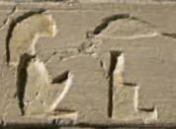
Research into Hieroglyphic signs
The beard issue
Seated woman in the Hieroglyphic fonts
Gardiner/JSesh:
Hieroglyphica:
BM EA 1628, top line.
https://www.britishmuseum.org/collection/object/Y_EA1628
© British museum, CC BY-NC-SA 4.0
Notes:
In the same vein as the earlier example, there is another feature that entered due to how the fonts were designed, in this case the seated woman.
I hope that the diference between the two signs is relatively clear, as the following topic might start to sound a bit scandalous, but the difference is the addition of breasts in Hieroglyphica, likely to make clear that this is a woman, not a man, as an seated woman and seated god can look remarkably similar if the beard is not that clear.
Based on the preliminary research done, it seems that for the pharaonic period, the Gardiner/Jsesh form is indeed the best candidate to represent the tokens.
35

Slide 36
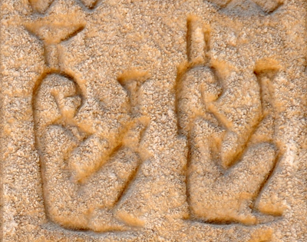
Research into Hieroglyphic signs
The beard issue
Seated woman in the Hieroglyphic fonts
Gardiner/JSesh:
Hieroglyphica:
Cauville, Dendera X, p. 287,11
©Heidelberger Akademie der Wissenschaften; image: A2971
Notes:
In the same vein as the earlier example, there is another feature that entered due to how the fonts were designed, in this case the seated woman.
I hope that the diference between the two signs is relatively clear, as the following topic might start to sound a bit scandalous, but the difference is the addition of breasts in Hieroglyphica, likely to make clear that this is a woman, not a man, as an seated woman and seated god can look remarkably similar if the beard is not that clear.
Based on the preliminary research done, it seems that for the pharaonic period, the Gardiner/Jsesh form is indeed the best candidate to represent the tokens.
However, to make things complicated again, the Hieroglyphica form is not completely incorrect, as some seated female figures with breasts have been attested as well.
Thus, there are two main argument to consider here, that either the Gardiner form is followed, which will be paleographically correct in most cases, or, in order to aid egyptologists, students, encoders to more easily distinguish between signs, it might be worthwhile to follow the Hieroglyhpica model instead, even though it is paleographically more doubious. As ever, this is based on preference, and what the signlist is supposed to do.
36

Slide 37
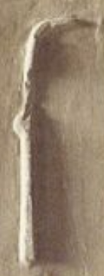
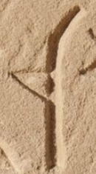
Research into Hieroglyphic signs
The beard issue
Seated woman in the Hieroglyphic fonts
Chronological variants
M4 M4B
http://www.cfeetk.cnrs.fr/archives/?n=69184
Photograph from the Karnak Project: CNRS, USR 3172 - CFEETK / UMR 5140 - ASM supported by the CNRS and the LabEx Archimede ANR-11-LABX-0032-01, Programme Investissement d'Avenir. All photographs © CNRS-CFEETK
http://www.cfeetk.cnrs.fr/archives/?n=69184
Photograph from the Karnak Project: CNRS, USR 3172 - CFEETK / UMR 5140 - ASM supported by the CNRS and the LabEx Archimede ANR-11-LABX-0032-01, Programme Investissement d'Avenir. All photographs © CNRS-CFEETK
Notes:
Now, to show another issue, based on hieroglyphic variants that are based on a chronological distinction.
One of the best examples here is M4 and M4B, the notched reed-leaf, which occurs (among others) as a round notch and a sharp triangular notch, as seen in these examples.
At first glance, this would not be a meaningful variant, a class, but hardly of any importance. However, if one considers that nearly all attestations of this sign in the Graeco-roman period is M4B, it suddenly becomes rather important, as it could be used as a dating feature. So, is it important, or not to make the distinction? Note of course that even Gardiner has already multiple cases of signs that are OK forms of his 18th dynasty font, so it is not remotely new.
37

Slide 38
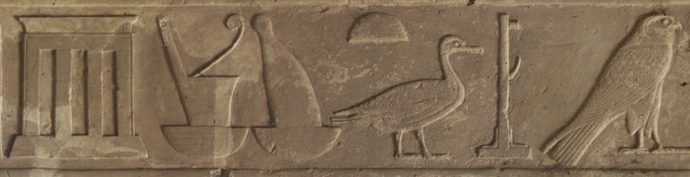
Research into Hieroglyphic signs
The beard issue
Seated woman in the Hieroglyphic fonts
Chronological variants
Unique variants and too many variants
White chapel
http://www.cfeetk.cnrs.fr/archives/?n=73096
Photograph from the Karnak Project: CNRS, USR 3172 - CFEETK / UMR 5140 - ASM supported by the CNRS and the LabEx Archimede ANR-11-LABX-0032-01, Programme Investissement d'Avenir. All photographs © CNRS-CFEETK
Notes:
Finally, I wanted to quickly go over the problem with unique variants and when a sign is so varied, that you start to wonder if it is actually worthwhile to include all classes of signs into standardized lists used for digital representation of signs. First, a quick case of a unique variant that I rather love, as it shows the Ancient Egyptain tendency to be playful with how signs are depicted.
On the white chapel, the name of the chapel itself is classified with a unique variant of the O21 shrine sign, made to resemble the white shrine itself. But the question is now, for general encoding purposes, is it worthwhile to add this variant, or would the O21 suffice?
38

Slide 39




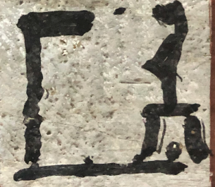
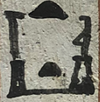
Research into Hieroglyphic signs
The beard issue
Seated woman in the Hieroglyphic fonts
Chronological variants
Unique variants and too many variants
Xr.t-nTr (R10)
© Rijksmuseum van Oudheden, CC BY 3.0 NL
Turin S. 6175
© Stéphane Polis
Notes:
Or, what to do with a sign that is so varied, that nearly every variant is a unique variant?
I hope that these examples, at least to some extend, show that research into signs might can become more of a headache than one might expect, but depending if any of you worked for the epigraphic survey, some of these issues might sound more familiar.
39

Slide 40
History of the project
2013–2021

Slide 41
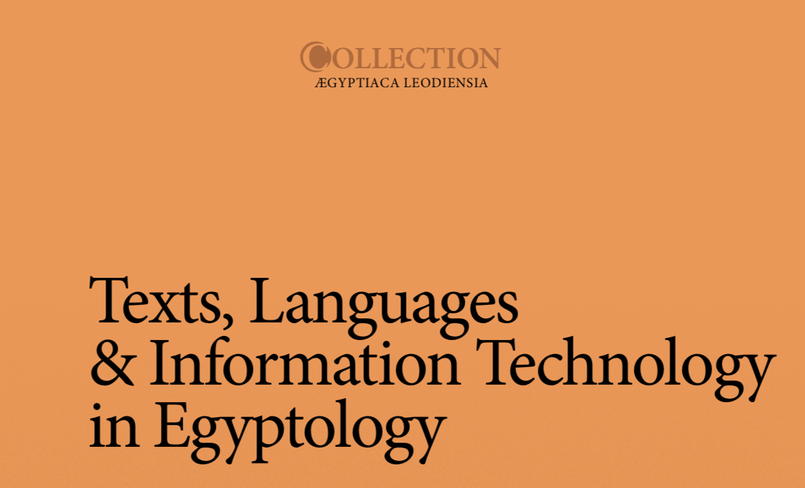
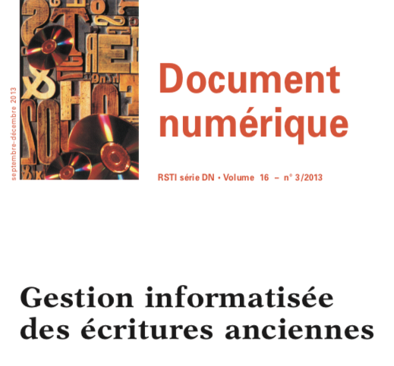
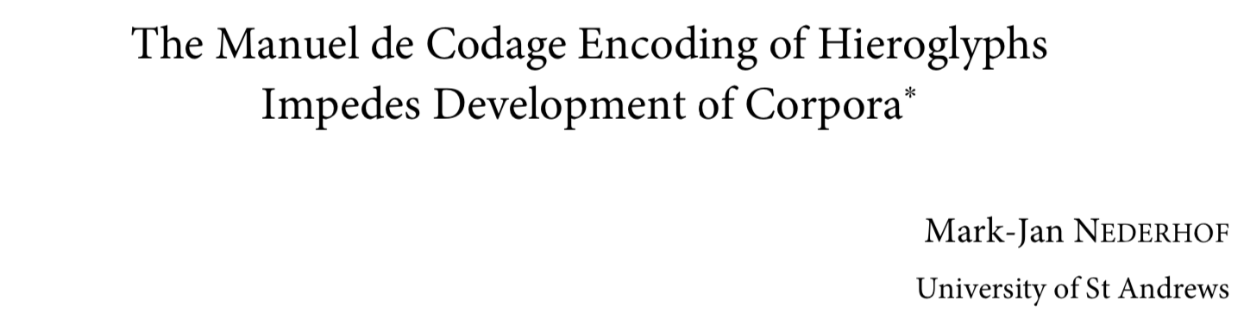
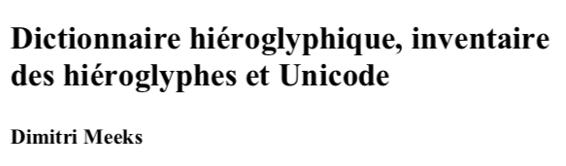
History of the project
2013
Notes:
The intellectual birth of the TSL goes back 9 years from now, when ...
41

Slide 42
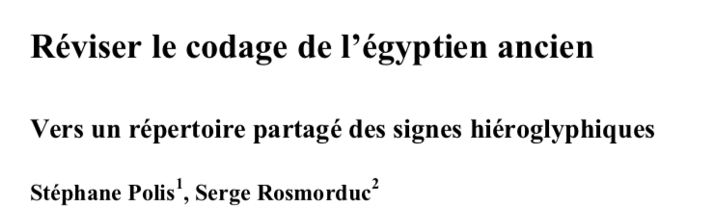
History of the project
2013
Notes:
Based on an analysis of thousands of spellings found in the Ramses corpus showed that the encoding scheme that is used for hieroglyphic texts, known as the Manuel de Codage – a standard that developed chaotically based on practical needs for text editions implemented in new software solutions is problematic for the development of text corpora.
And we suggested that a shared, structured repertoire of hieroglyphic signs would be needed to overcome the issue.
42

Slide 43

History of the project
2013
2015
St. Polis & S. Rosmorduc
A shared repository of hieroglyphic signs: The Thot Sign List (TSL)
Notes:
When Stéphane Polis and Serge Rosmorduc presented the TSL on the international congress in 2015, it was just a concept.
43

Slide 44
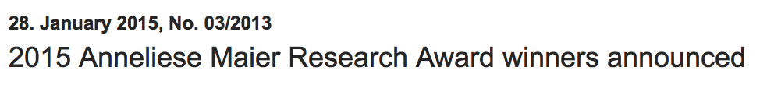
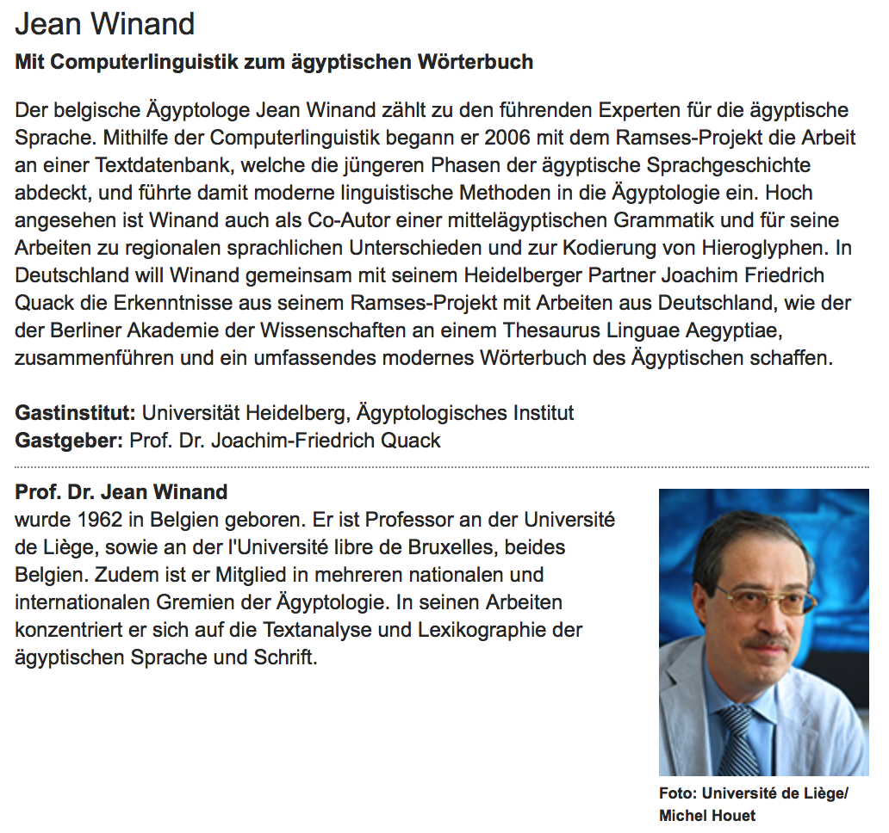
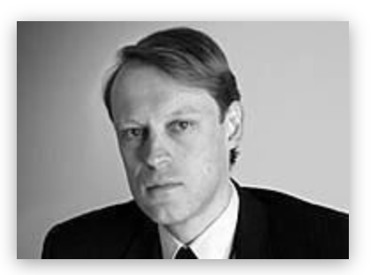
History of the project
2013
2015
Notes:
Just after ICE 2015, not linked with TSL. Two directors of dict. projects: collaboration! Materialized thanks to the Anneliese Mayer research grant introduced by Joachim Fr. Quack (at that time director of the Berlin Egyptian Wörterbuch Project with the TLA, its electronic corpus) and awarded to Jean Winand (University of Liège)
44

Slide 45
History of the project
2013
2015
Notes:
Ever since, the thot sign-list has been conceived as a joint endeavor between the University of Liège and the Berlin-Brandenburg Academy of Sciences and Humanities
45

Slide 46
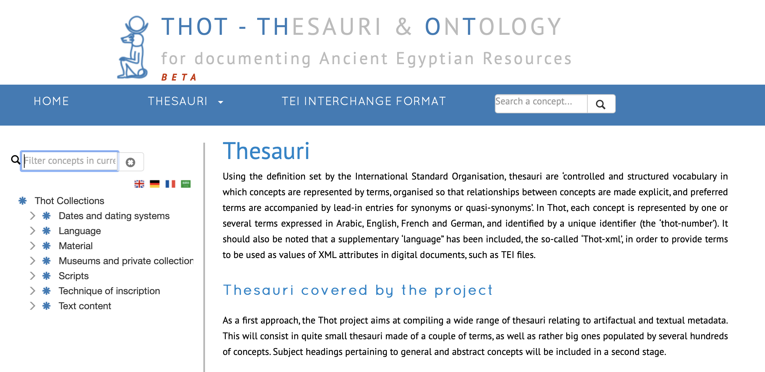
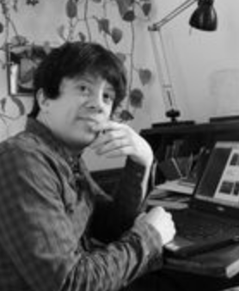
History of the project
2013
2015–2016
Notes:
Razanajao 2015 at Liège and finished THOT Thesauri which serves as foundation of TSL. Common point of Ramses and Berlin: Sign DB. Thesauri are necessary, in order to describe the data in coherent fashion.
46

Slide 47
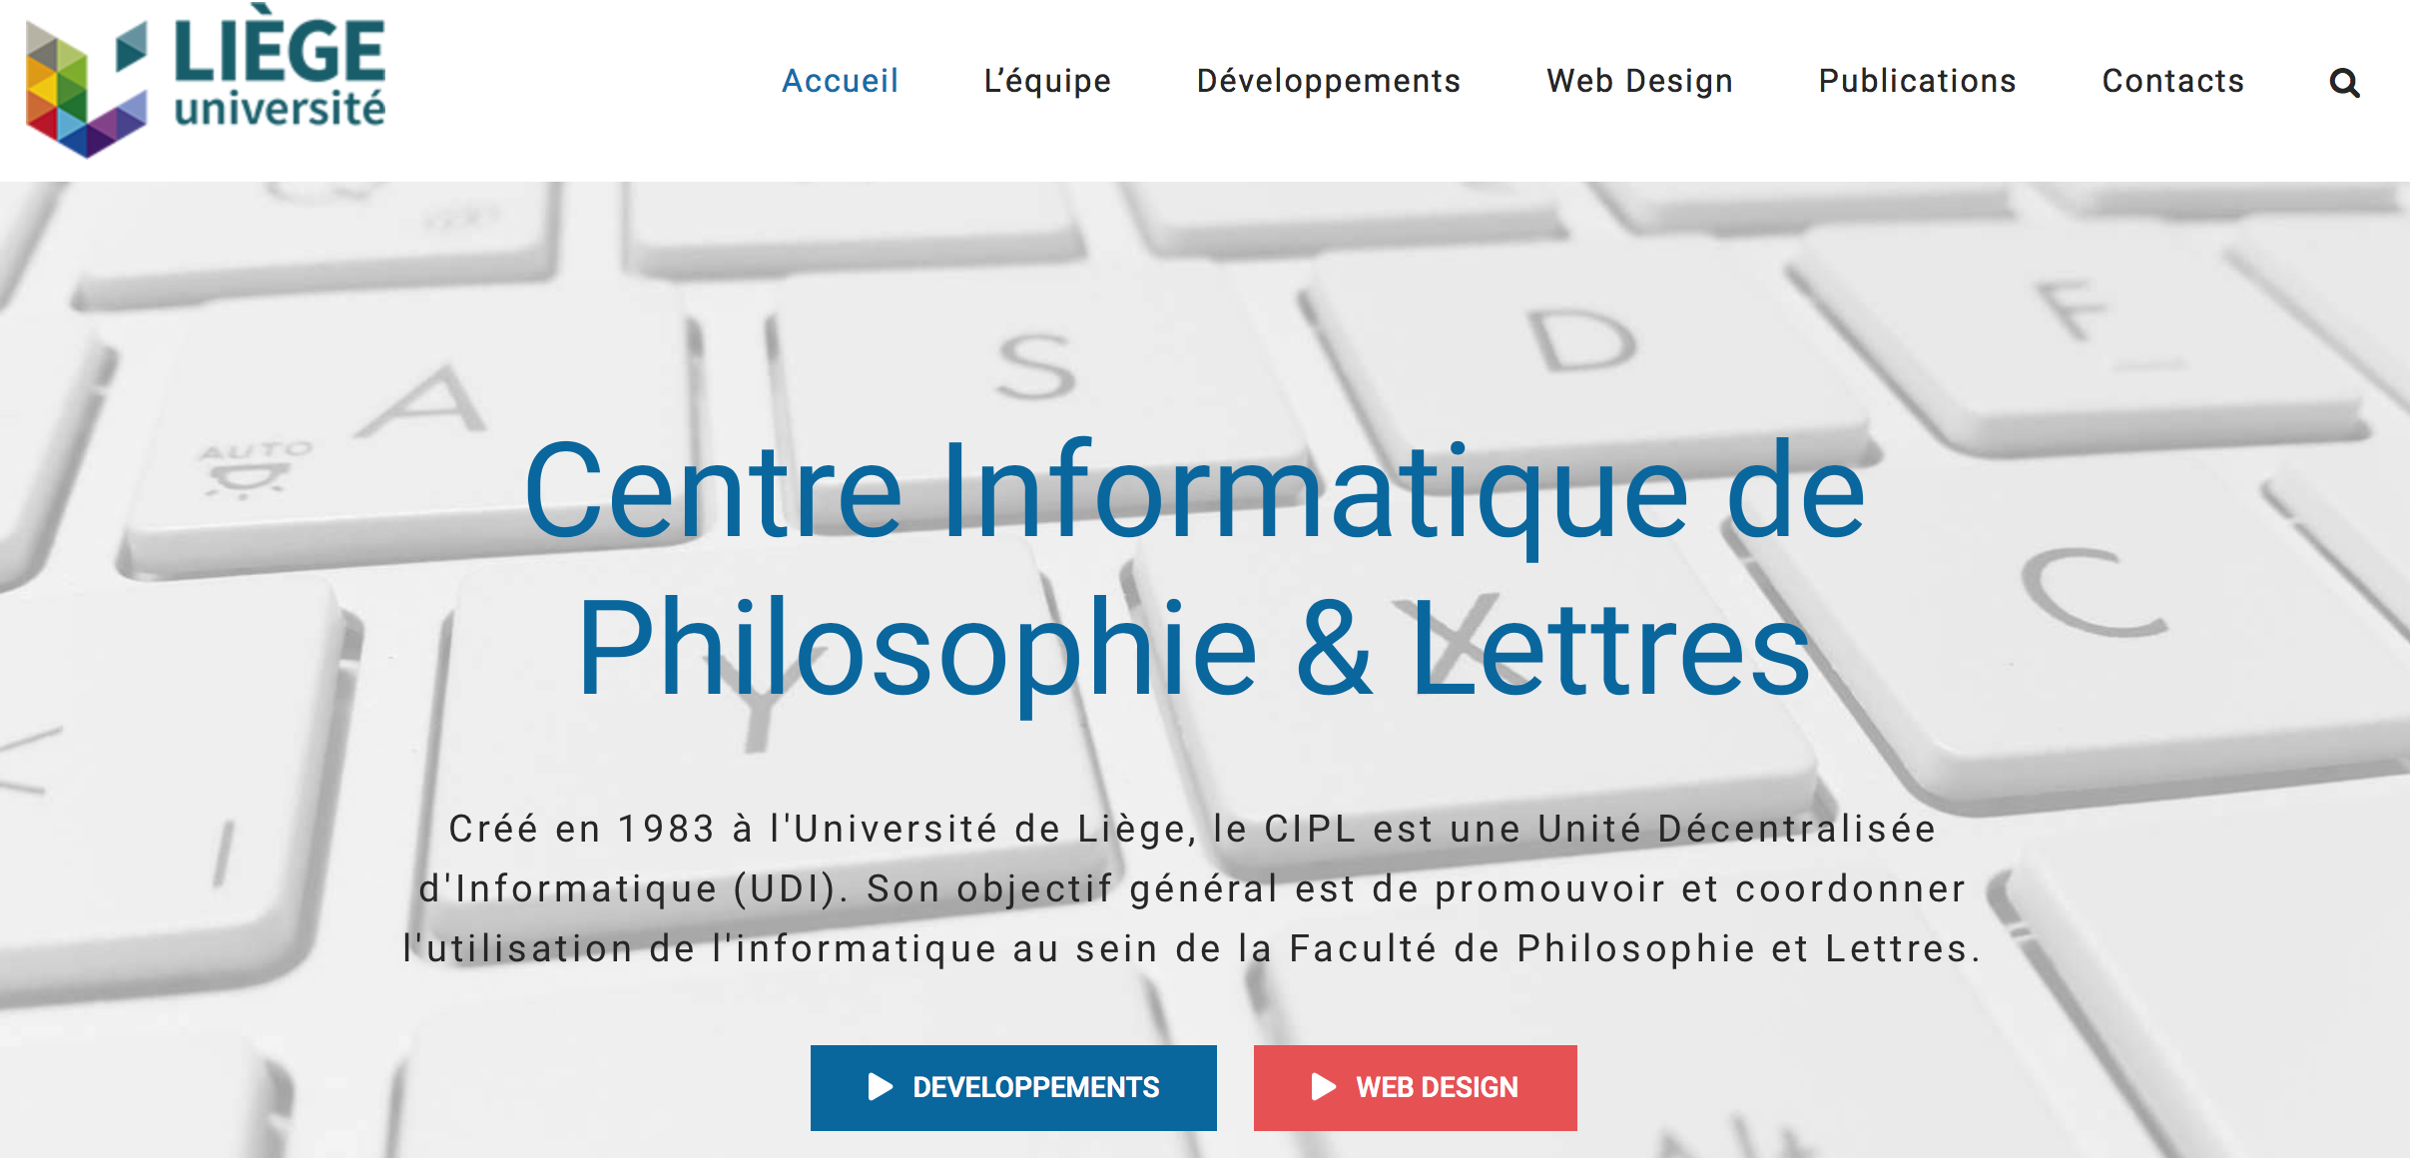
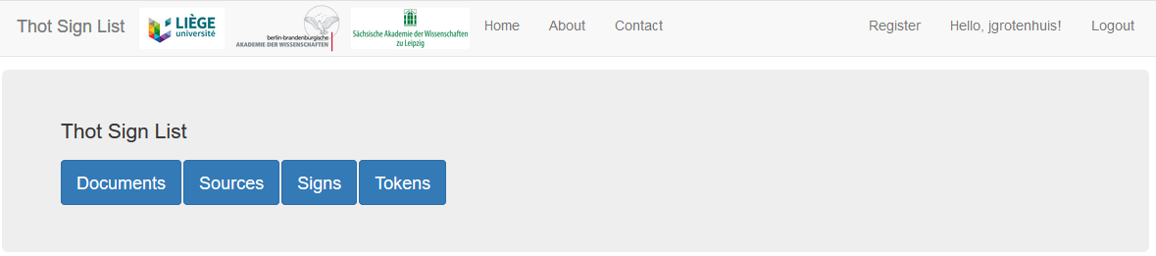
History of the project
2013
2015–2016
Luc Desert
Notes:
2015-6 creation of digital structure.
47

Slide 48
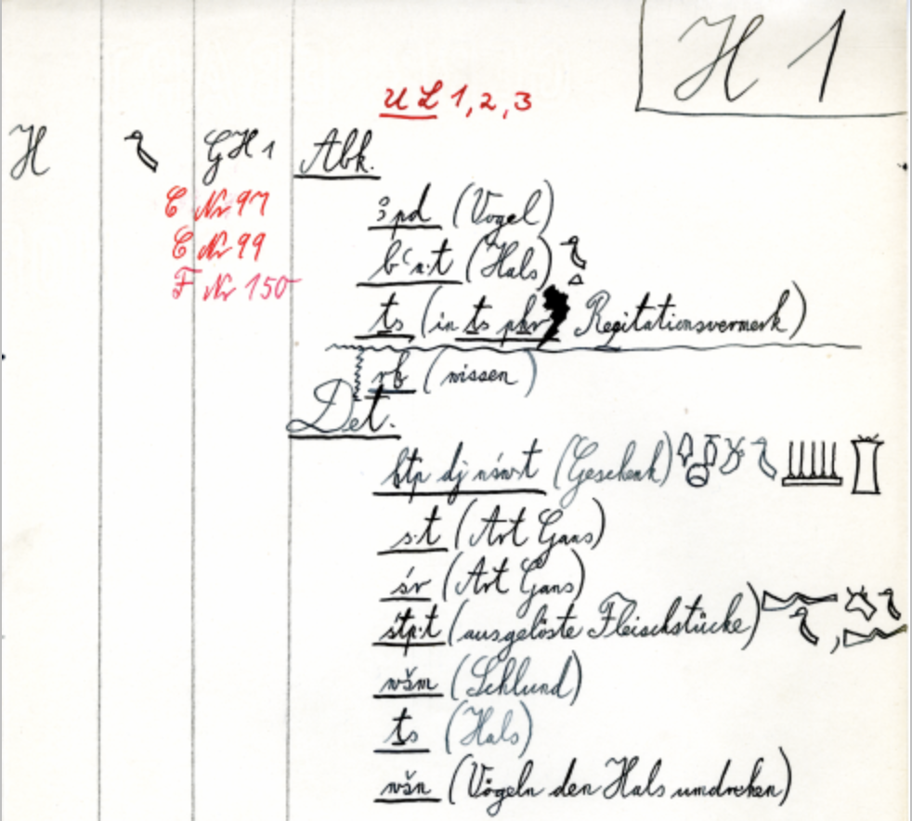
History of the project
2013
2015–2016
2016–2017
Notes:
Berliner Zeichen list imported; digital version of Berliner Zeichenliste
48

Slide 49
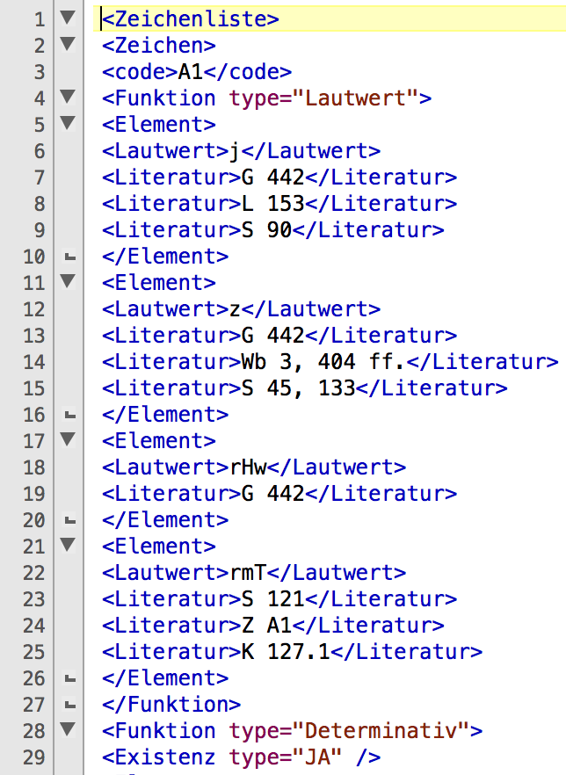
History of the project
2013
2015–2016
2016–2017
Notes:
Berliner Zeichenliste + lexikographical information and references to signs lists .xml
49

Slide 50
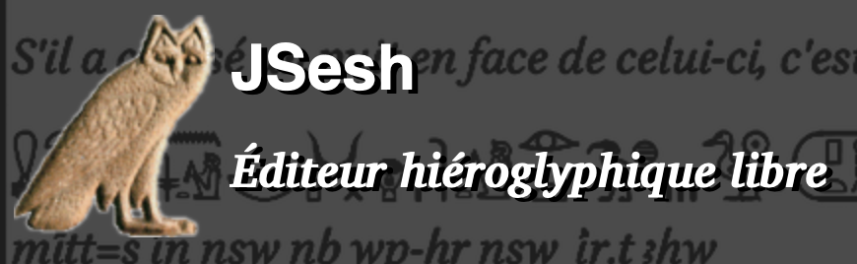
History of the project
2013
2015–2016
2016–2017
Notes:
all JSESH hieros inserted into TSL
50

Slide 51
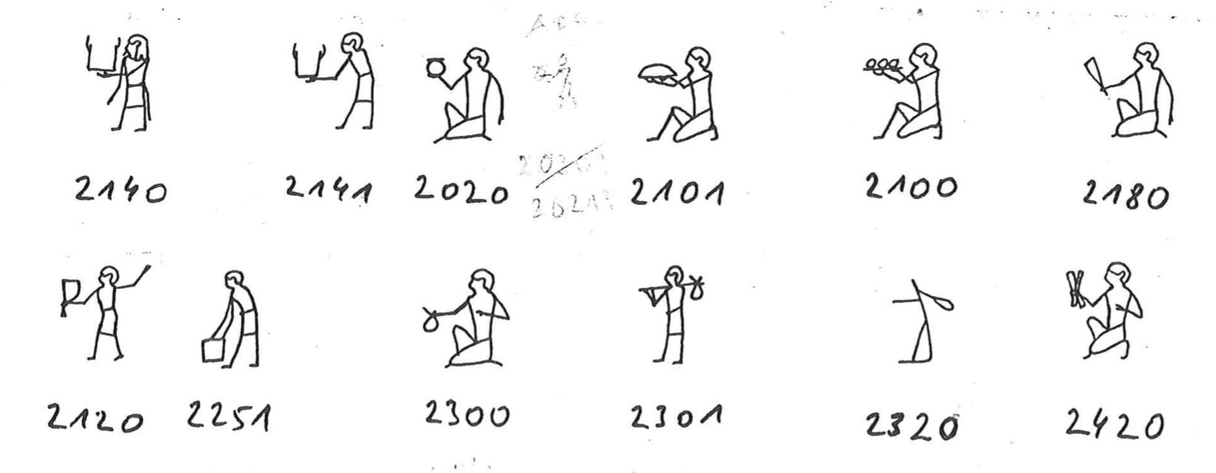
History of the project
2013
2015–2016
2016–2017
Notes:
Hornung – Schenkel list inserted.
51

Slide 52
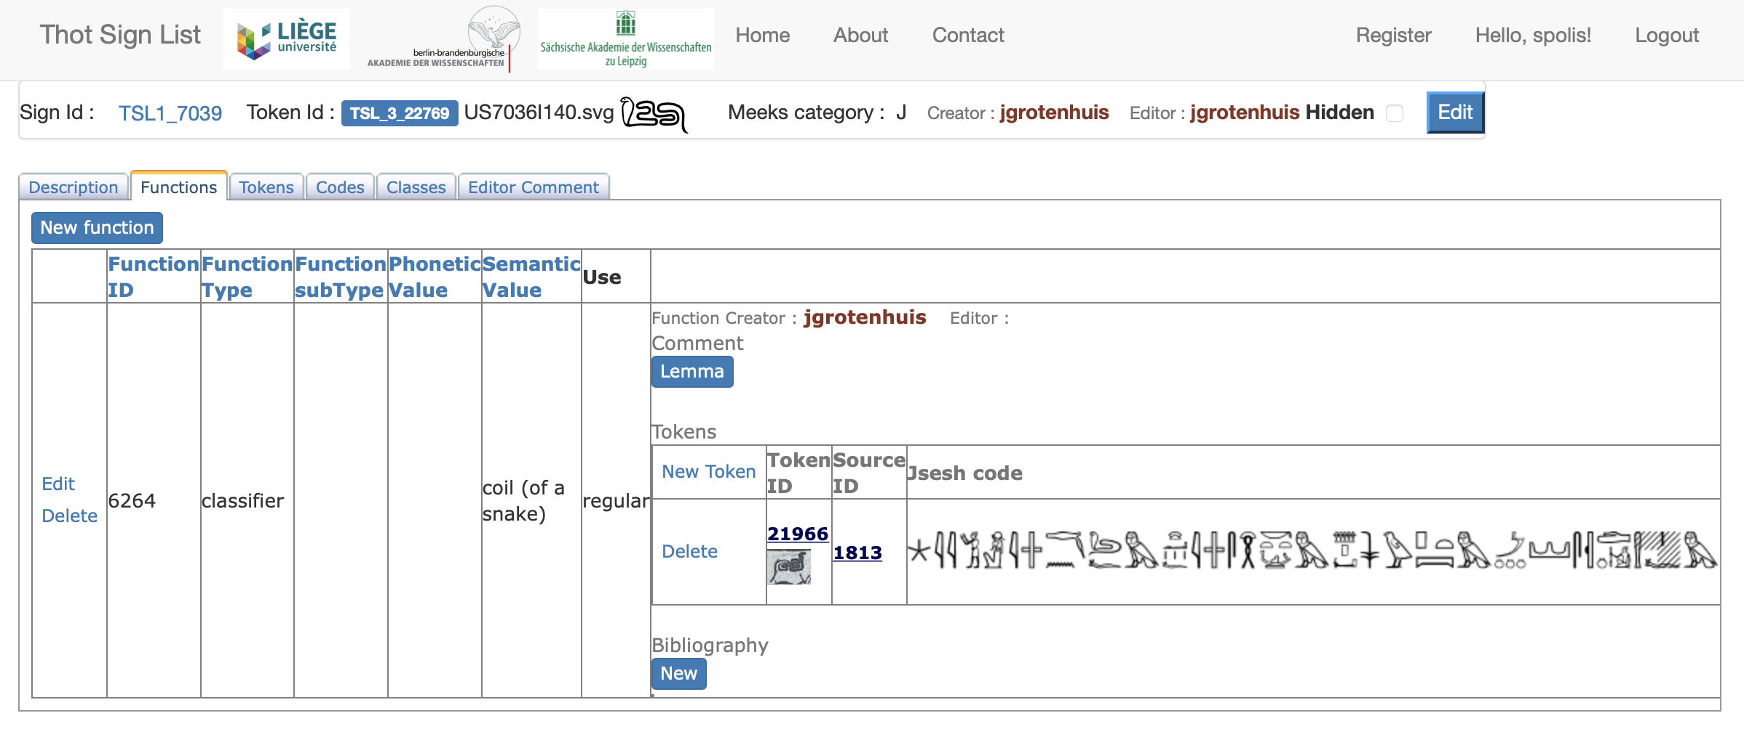

History of the project
2013
2015–2016
2016–2017
2016–2019
Notes:
Since 2016 Jorke works half time on TSL. He checks and encodes Gardiner list.
52

Slide 53

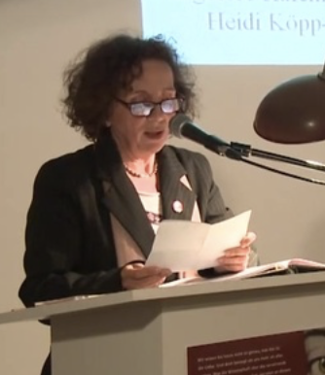
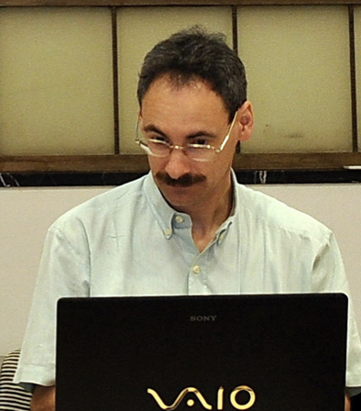

History of the project
2013
2015–2016
2016–2017
2016–2019
Notes:
Different people working on sign list and reworking the structure of the TSL, in order to get the present data model
53

Slide 54
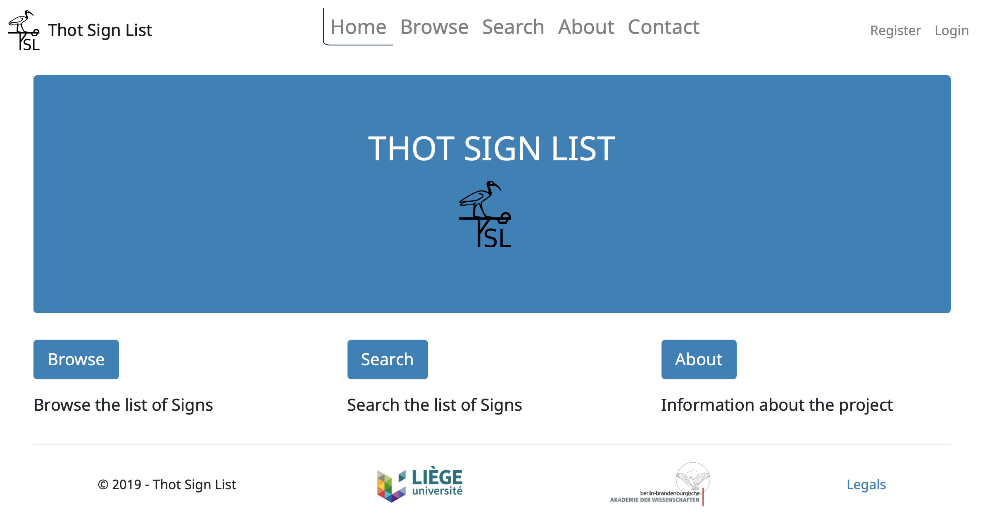
History of the project
2013
2015–2016
2016–2017
2016–2019
2019–today
Notes:
In 2019 the TSL was Gardiner ready and went online.
54

Slide 55
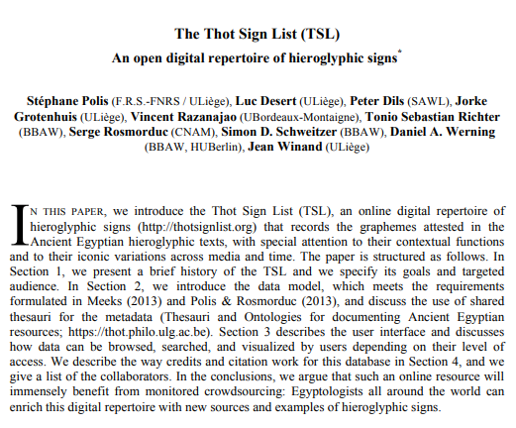
ENiM 14, 2021, 55–74
Notes:
The project history is concisely described in the ENiM article

Slide 56
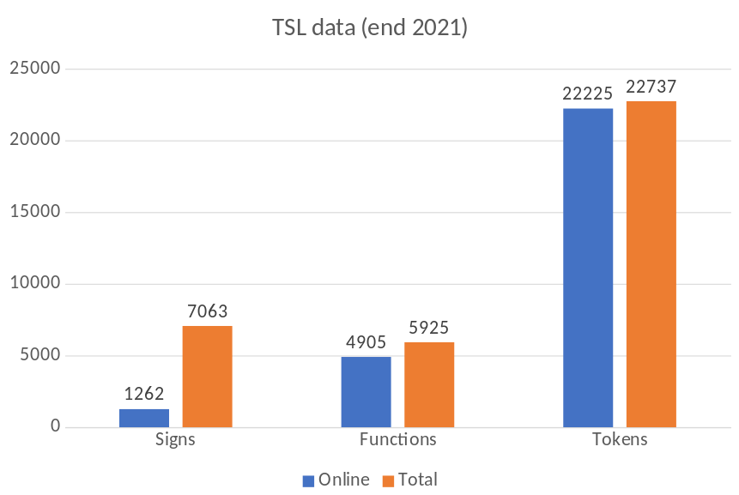
TSL – encoded data
Notes:
As for the data which are encoded and available at the moment
56

Slide 57
TSL – encoded data
Notes:
only a little more than one sixth of the imported signs available
57

Slide 58
TSL – encoded data
Notes:
BUT: most of the functions. This is due to the fact that many sign lists do not offer any information on the sources used and it takes a huge amount of time to find them.
58

Slide 59
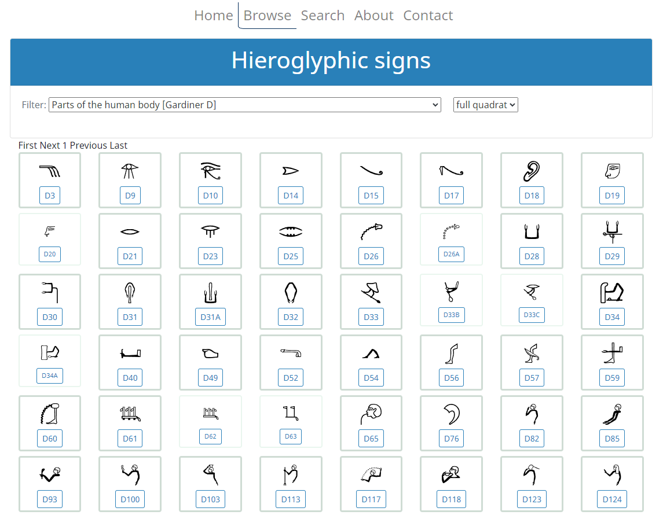
Notes:
User Interface structured according to the Gardiner Categories we all are used to
59

Slide 60
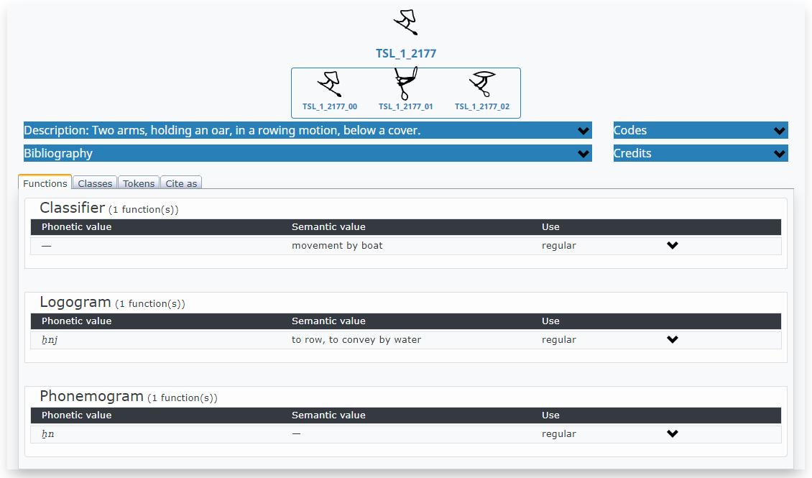
Notes:
You click on one sign and a menu appears showing the sign functions
60

Slide 61
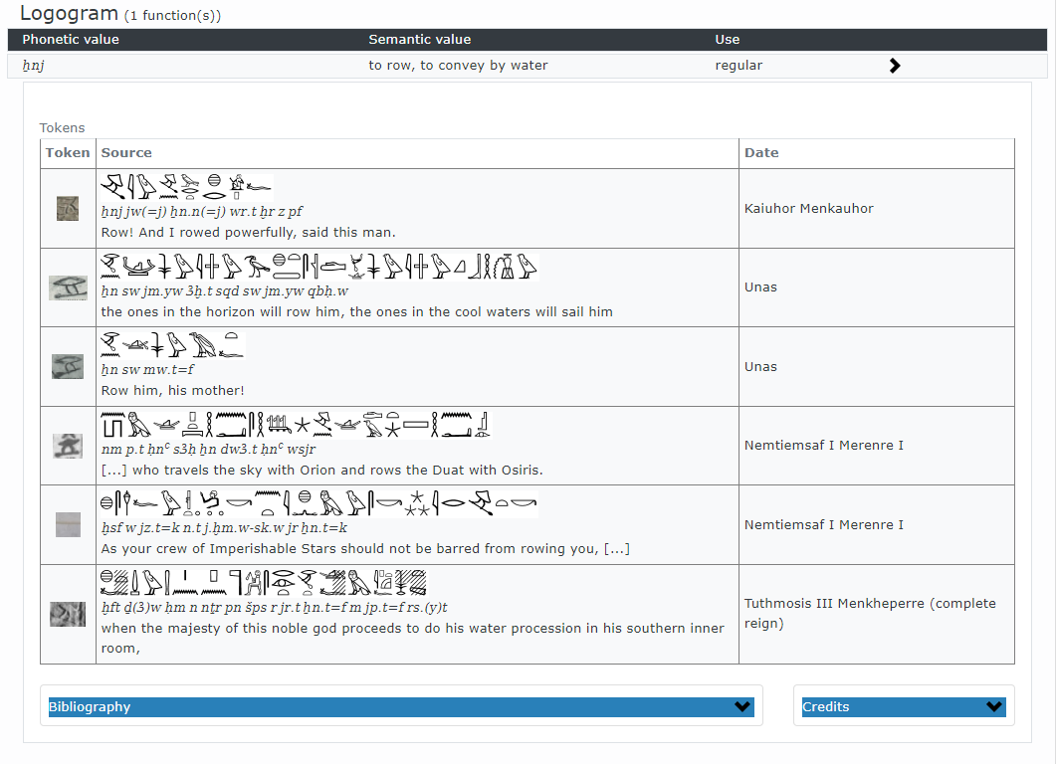
Notes:
For each sign function you will find attestations from a more or less large range of time; all provided with an image of the source and its context in standardised typeset, transcription and translation
61

Slide 62

Notes:
Going further to the classes, description with possible components etc.
62

Slide 63

Notes:
and the tokens are sorted according to the classes to which we attributed them
63

Slide 64

Notes:
Additionally, there is a search function, where different criteria can be combined; e.g. you have a text with one sign which is largely lost, but you know that you search for a logogramm which should mean „to see“, you will get the following options
64

Slide 65
Goal and data model

Slide 66
Goal and data model
TSL is born out of the practical necessity of creating electronic corpora of hieroglyphic texts in a principled way and its first aim is to document the functions attested for individual signs
Notes:
- in order to indicate which standardized character may be used in which context.
- Other potential users: students and Unicode developpers
66

Slide 67
Goal and data model
TSL is born out of the practical necessity of creating electronic corpora of hieroglyphic texts in a principled way and its first aim is to document the functions attested for individual signs
References to ancient sources
Description of the iconic features
Structured repertoire
Notes:
Requirement presented in Florence in 2015
67

Slide 68

Token
Notes:
starting from a concrete token in a text. Two arms, holding an oar, in a rowing motion, below a cover.
68

Slide 69

KIU 1730
Source
Token
1
n
Notes:
is part of a source
69

Slide 70

KIU 1730
Document
Source
Token
1
n
1
n
Notes:
which is part of a monument, in this case one of the reerected red granite obeliscs from Hatshepsut at Karnak
70

Slide 71
KIU 1730
Document
Source
Token
1
n
1
n
Notes:
Both, source and document can be described by metadata which contextualize the token in time, space, social context, etc.
71

Slide 72
KIU 1730
Phonogram ẖn
(in ẖn.t ‘statue’)
Document
Source
Token
Function
1
n
1
n
n
1
Notes:
Coming back to the token. In most context is has a specific function in this specific context; in this case as phonogram Xn in Xn.t « statue »
72

Slide 73
KIU 1730
Phonogram ẖn
(in ẖn.t ‘statue’)
Document
Source
Token
Function
1
n
1
n
n
1
n
1
Class
Notes:
As for the shape of the tokens, it can be grouped with similar tokens to form a « class »
73

Slide 74
KIU 1730
Phonogram ẖn
(in ẖn.t ‘statue’)
Document
Source
Token
Function
1
n
1
n
n
1
n
1
Class
Notes:
and by using this inductive method you will come to the conclusion that there are at least three different classes which actually cover the same functions
74

Slide 75
KIU 1730
Phonogram ẖn
(in ẖn.t ‘statue’)
Document
Source
Token
Function
1
n
1
n
n
1
n
n
1
1
Class
Sign
n
1
Notes:
This justifies the creation of the sign, which is per se an abstract construct and corresponds to the grapheme in linguistic discourses
75

Slide 76
KIU 1730
Phonogram ẖn
(in ẖn.t ‘statue’)
Document
Source
Token
Function
1
n
1
n
n
1
n
n
n
1
1
1
Class
Sign
n
1
Notes:
Practically spoken, the deductive method largely facilitates the encoding proces.
76

Slide 77

Notes:
To sum up: There is the abstract sign which can comprise several classes and all the classes comprise many tokens
77

Slide 78
Recent developments
Notes:
The recent developments within the project aim at expanding the TSL xxx

Slide 79

Well known but not recorded hieroglyphs and local hieroglyphs
Philipp Seyr (Uliège/Austrian Academy of Sciences)
Documentation of signs not yet recorded in sign-lists
QV 52 (Tyti)
© Philipp Seyr
Notes:
79

Slide 80

Well known but not recorded hieroglyphs and local hieroglyphs
Philipp Seyr (Uliège/Austrian Academy of Sciences)
Documentation of signs not yet recorded in sign-lists
Local variants
Class of S20 (𓋩) in Moalla and Gebelein
Tomb of Ankhtifi
© Philipp Seyr
Notes:
80

Slide 81
Well known but not recorded hieroglyphs and local hieroglyphs
Philipp Seyr (Uliège/Austrian Academy of Sciences)
Documentation of signs not yet recorded in sign-lists
Local variants
Focus on FIP and SIP
Hieroglyphic sign shapes influenced by corresponding hieratic graphemes
Notes:
81

Slide 82
Well known but not recorded hieroglyphs and local hieroglyphs
Philipp Seyr (Uliège/Austrian Academy of Sciences)
Documentation of signs not yet recorded in sign-lists
Local variants
Update of the sign bibliography
Notes:
82

Slide 83
Unicode Hieroglyphic expansion
Notes:
The recent developments within the project aim at expanding the TSL xxx

Slide 84
Hieroglyphs in Unicode
First proposal
Everson, Michael (1997). N1636 Encoding Egyptian Hieroglyphs in ISO/IEC 10646-2 (http://www.unicode.org/L2/L1997/97266-n1636.pdf)
Notes:
The initial proposal for Hieroglyphs in the Unicode standard was written in 1997 by Michael Everson, as a start, after which the proposel went to a long period of revision
84

Slide 85
Hieroglyphs in Unicode
First proposal
List accepted in 2009 (Unicode 5.2)
1071 signs from primarily Gardiner (1928, 1929, 1931, 1953, 1957) and other sources
Only linearly depiction: 𓇋𓅱𓀀𓇍𓎡𓅱𓀀𓅓𓊵𓏏𓊪 vs 𓇋𓅱𓀀𓇍𓎡𓐰𓐷𓅱𓐱𓀀𓐸𓅓𓊵𓐰𓐷𓏏𓐱𓊪𓐸
Notes:
It took a while until a set of signs was made, primarily based on the list of Gardiner, and additional supplements of Gardiner.
85

Slide 86
Hieroglyphs in Unicode
First proposal
List accepted in 2009 (Unicode 5.2)
Proposal for expansion of the Hieroglyphic repertoire
Suignard, Michael. (2015) Preliminary draft of the Ptolemaic repertoire (A: Man and his occupations) (http://www.unicode.org/L2/L2015/15240-ptolemaic-hieroglyphs.pdf)
Notes:
Finally, in 2015, the start of the current work began, with the proposal to extent the existing repetoire.
86

Slide 87
Hieroglyphs in Unicode
Deborah Anderson (UC Berkeley)
Peter Dils (SAWL)
Andrew Glass (Microsoft)
Jorke Grotenhuis (UC Berkeley)
Svenja Gülden (TU Darmstadt; JGU Mainz)
Jan Kučera (Charles University, Prague)
Mark-Jan Nederhof (University of St Andrews)
Stéphane Polis (F.R.S.-FNRS; ULiège)
Robert Richmond
Serge Rosmorduc (CNAM)
Michel Suignard
Daniel Werning (BBAW)
Notes:
As the current work has already been in the works for quite some time, I would like to mention the current group of people working on the hieroglyphic extention.
87

Slide 88
Hieroglyphs in Unicode
2019 (Unicode 12.0) Introduction of 9 control characters
Glass, Andrew, et al. A method for encoding Egyptian quadrats in Unicode (https://www.unicode.org/L2/L2017/17112r-quadrat-encoding.pdf)
Notes:
So, as the process started 7 years ago, what has happened so far (taking in mind the first batch took quite a while as well).
So first, in 2019, 9 control characters were accepted in Unicode to deal with the issue of the two dimentional nature of the Hieroglyphic script.
88

Slide 89
Hieroglyphs in Unicode
2019 (Unicode 12.0) Introduction of 9 control characters
Vertical joiner 𓀀𓐰𓏥
Horizontal joiner 𓏌𓐱𓏤
Notes:
So, as the process started 7 years ago, what has happened so far (taking in mind the first batch took quite a while as well).
So first, in 2019, 9 control characters were accepted in Unicode to deal with the issue of the two dimentional nature of the Hieroglyphic script.
89

Slide 90




Hieroglyphs in Unicode
2019 (Unicode 12.0) Introduction of 9 control characters
Insert top start 𓄂𓐲𓏏 𓄂 𓏏
Insert bottom start 𓆓𓐳𓏏 𓆓 𓏏
Insert top end 𓅭𓐴𓏏 𓅭 𓏏
Insert bottom end 𓅜𓐵𓏏 𓅜 𓏏
Notes:
So, as the process started 7 years ago, what has happened so far (taking in mind the first batch took quite a while as well).
So first, in 2019, 9 control characters were accepted in Unicode to deal with the issue of the two dimentional nature of the Hieroglyphic script.
90

Slide 91





Hieroglyphs in Unicode
2019 (Unicode 12.0) Introduction of 9 control characters
Stack middle (overlay) 𓅓𓐶𓂝 𓅓 𓂝
Segment start and segment end 𓏶𓐝𓐰𓐷𓁷𓐱𓐷𓂋𓐰𓏏𓐸𓐸 𓐝 𓁷 𓂋 𓏏
Notes:
So, as the process started 7 years ago, what has happened so far (taking in mind the first batch took quite a while as well).
So first, in 2019, 9 control characters were accepted in Unicode to deal with the issue of the two dimentional nature of the Hieroglyphic script.
91

Slide 92
Hieroglyphs in Unicode
2019 (Unicode 12.0) Introduction of 9 control characters
2022 (Unicode 15.0) Addition of 29 additional control characters
Glass, Andrew et al. Additional control characters for Ancient Egyptian hieroglyphic texts (https://www.unicode.org/L2/L2021/21248-egyptian-controls.pdf)
Notes:
So, as the process started 7 years ago, what has happened so far (taking in mind the first batch took quite a while as well).
So first, in 2019, 9 control characters were accepted in Unicode to deal with the issue of the two dimentional nature of the Hieroglyphic script.
92

Slide 93
Hieroglyphs in Unicode
2019 (Unicode 12.0) Introduction of 9 control characters
2022 (Unicode 15.0) Addition of 29 additional control characters
Middle insertion
Top insertion
Bottom insertion
Begin and end enclosure
Notes:
93

Slide 94
Hieroglyphs in Unicode
2019 (Unicode 12.0) Introduction of 9 control characters
2022 (Unicode 15.0) Addition of 29 additional control characters
Mirror control
Blanks (full and half)
Lost sign
Damage modifiers
Notes:
94

Slide 95
Hieroglyphs in Unicode
2019 (Unicode 12.0) Introduction of 9 control characters
2022 (Unicode 15.0) Addition of 29 additional control characters
2022 Addition of rotation variation selectors
Werning, Daniel A. Rotations of Egyptian Hieroglyphs to be Registered in Unicode (revised) (https://www.unicode.org/L2/L2022/22012r-hieroglyph-rotations.pdf)
Notes:
95

Slide 96
Hieroglyphic repertoire expansion in Unicode
Primarily an expansion based on Graeco-Roman signs.
Unicode project funded through a Google Research grant awarded to Dr. Deborah Anderson at UC Berkeley (Performed by Jorke Grotenhuis)
Notes:
96

Slide 97
Hieroglyphic repertoire expansion in Unicode
Primarily an expansion based on Graeco-Roman signs.
Creation of a candidate list
Two candidate lists
Unicode candidate list:
Inclusion based on data from modern and ancient sources: TLA, Ramses, TSL, Karnak database, Cauville, Kurth, Valeurs phonétiques (Daumas), Hannig, Dendera (Hallof), Esna (Hallof) Athribis , Kom Ombo.
Notes:
97

Slide 98
Hieroglyphic repertoire expansion in Unicode
Primarily an expansion based on Graeco-Roman signs.
Creation of a candidate list
Two candidate lists
Unicode candidate list
Unicode core list
A curated list, where every sign is verified with an image (photo or facsimile of an Ancient source) and accompanied by a description and function.
Notes:
98

Slide 99
Hieroglyphic repertoire expansion in Unicode
Primarily an expansion based on Graeco-Roman signs.
Creation of a candidate list
Two candidate lists
Unicode candidate list: +/- 4000-4500 signs (including the 1072 existing signs)
Unicode core list: +/- 3000-3500 signs (including most of the 1072 existing signs).
Notes:
99

Slide 100
Unicode Hieroglyphic font
Notes:
The recent developments within the project aim at expanding the TSL xxx

Slide 101
Unicode Hieroglyphic font
Created by Andrew Glass (Microsoft)
Egyptian outlines based on work by James Allen; Updates and additions to the Hieroglyphic character set by Sue Lightfoot, Ian Patterson and Andrew Glass; OpenType by Andrew Glass. Latin outlines: STIX Two Text Italic by Ross Mills, John Hudson & Paul Hanslow, Tiro Typeworks Ltd; with portions MicroPress Inc., with additions and corrections provided by Coen Hoffman, Elsevier (retired).
Notes:
101

Slide 102
Unicode Hieroglyphic font
Created by Andrew Glass (Microsoft)
Based on current Unicode set (1071 signs)
Notes:
102

Slide 103
Unicode Hieroglyphic font
Created by Andrew Glass (Microsoft)
Based on current Unicode Hieroglyphic set (1071 signs)
Unicode 12.0 control characters are functional
(i.e, vertical joiner, horizontal joiner, corner insertions, stack middle and sequence open and close)
Notes:
So, even though the current set of hieroglyphs is limited, thanks to the control characters, it will be possible to create more signs through the overlay control.
103

Slide 104
Unicode Hieroglyphic font
Created by Andrew Glass (Microsoft)
Based on current Unicode set (1071 signs)
Unicode 12.0 control characters are functional
Unicode 15.0 control characters to be implemented in the future (early 2024)
Notes:
104

Slide 105
Unicode Hieroglyphic font
Created by Andrew Glass (Microsoft)
Based on current Unicode set (1071 signs)
Unicode 12.0 control characters are functional
Unicode 15.0 control characters to be implemented in the future (early 2024)
Currently Unicode 12.0 version of the font is in Beta
Notes:
105

Slide 106
Unicode Hieroglyphic font
Created by Andrew Glass (Microsoft)
Based on current Unicode set (1071 signs)
Unicode 12.0 control characters are functional
Unicode 15.0 control characters to be implemented in the future (early 2024)
Currently Unicode 12.0 version of the font is in Beta
No timeline yet on the extended library (2025 or later)
Notes:
And finally, it I cannot give an clear idea when the extended library will be implemented in the font, as this depends on a lot of work, as all the additional signs need to be drawn, which will take quite a bit of time. I apologise that I cannot give more exact dates, as we are dependent on multiple factors, but the Unicode 12.0 font should (hopefully) come out somewhere next year, ideally part of a windows update. As Unicode 15.0 will be implemented over the next year, and Andrew glass already has performed a lot of work on the 15.0 control characters, this capability will be available relatively soon after the 12.0 version (but is likely 2-3 years of, depending on implementation). But please, be asured that this is a case of when, not a case of if!
For those who do not use microsoft software, it might take a little bit longer, but based on my own tests, the font is functional on online browsers, so it can already be used.
106

Slide 107
Unicode Hieroglyphic font example
Notes:
107

