Slide 1
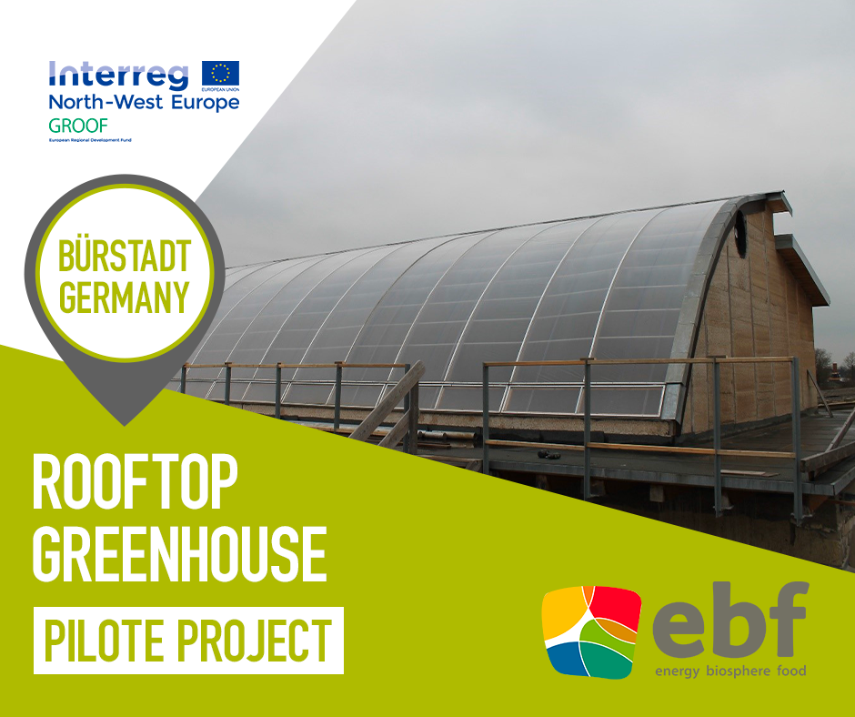
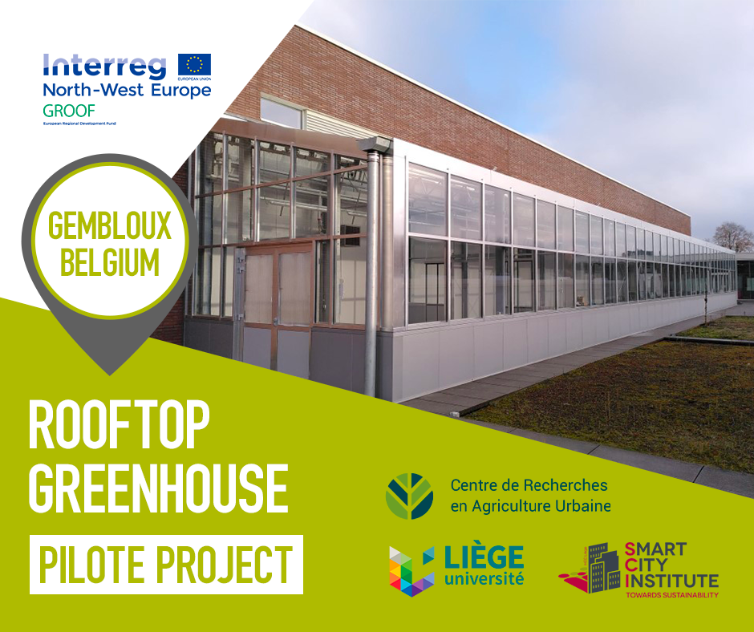
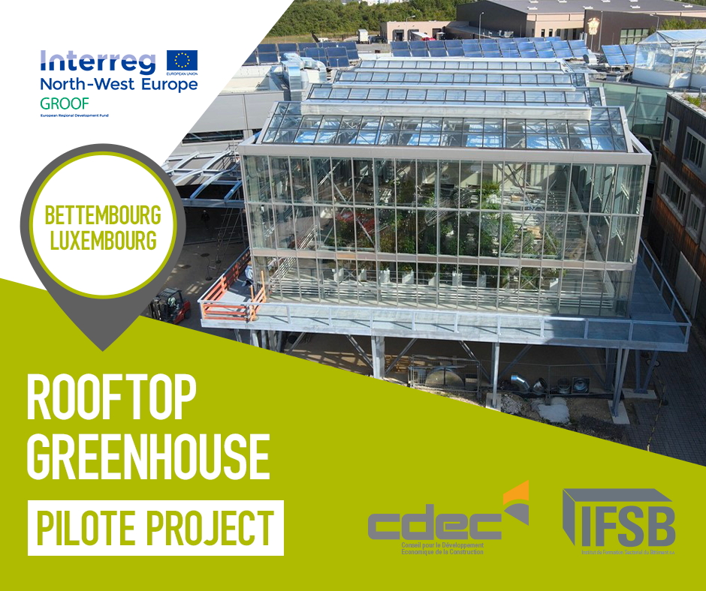
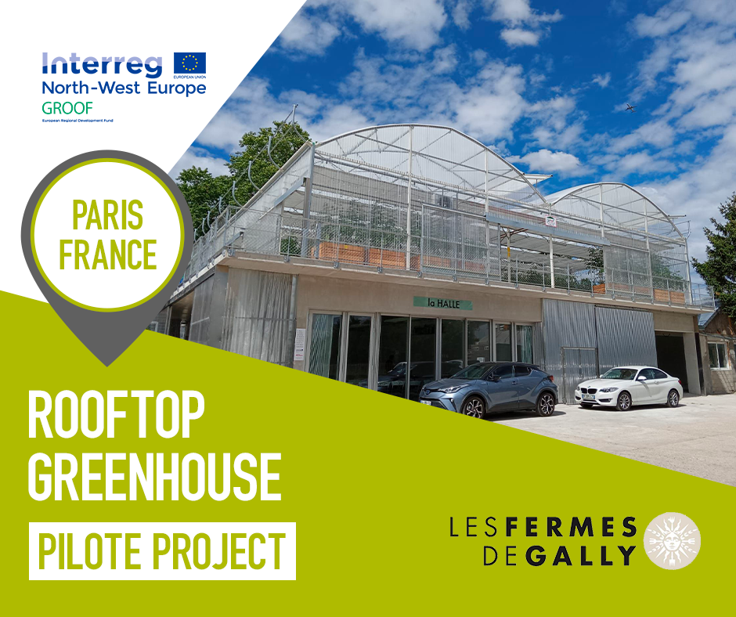
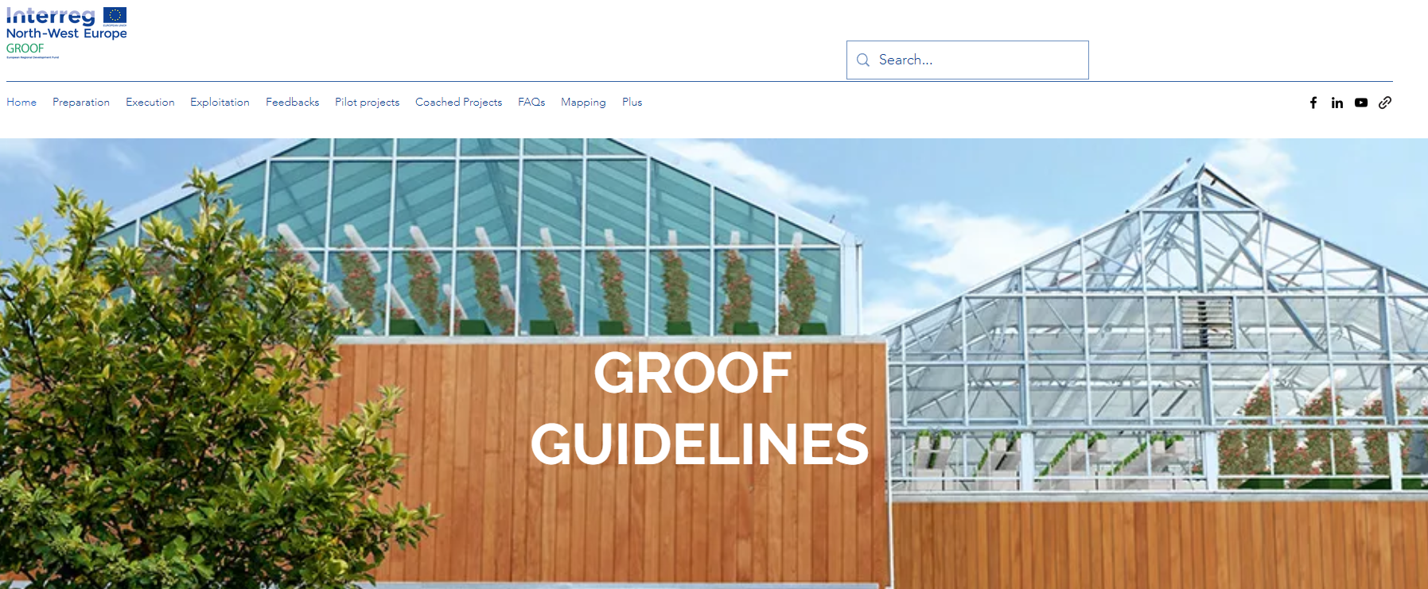
GROOF – Reduce CO2 thanks to energy optimised greenhouse
Picture of the presenting author to help find you in the Congress!
Nicolas ANCION¹, Pierre RAULIER¹, Maeva SABRE², Franz SCHREIER³, David VOLK³, Verónica ARCAS⁴, Xavier Gabarrell⁴, Gara Villalba⁴, Nicolas BRULARD⁵, Christophe MELON⁶, Marcel DERAVET⁶, Karsten WILHELM⁷, Guillaume MOREL-CHEVILLET⁸, Marie Angélique SCHOTT⁸, Nicolas ZITA⁹, Caroline BINI¹⁰, Céline DOHOGNE¹¹, Roxane HUART¹, N. Crutzen¹², M. Haïssam JIJAKLI¹
Contact: Nicolas.ancion@uliege.be
¹Laboratory of Integrated and Urban Phytopathology, University of Liège, Gembloux Agro-Bio Tech (Belgium), ²CSTB (France) Centre Scientifique et Technique du Bâtiment, ³EBF GmbH (Germany) Energy Biosphere Food ; ⁴UAB (Spain) Universitat Autònoma de Barcelona; ⁵GALLY (France) Les Jardins de Gally ; ⁶IFSB (Luxembourg) Institut de Formation Sectoriel du Bâtiment, ⁸ASTREDHOR (France) Institute Technique de l’Horticulture ; ⁹CDED (Luxembourg) Conseil de Développement Economique pour la Construction ; ⁷HS Trier/IfaS (Germany) Hochschule Trier Institut für angewandtes Stoffstrommanagement ; ¹⁰Groupe One (Belgium) Groupe One ; ¹¹CEC (Belgium) Cluster Eco Construction ;. ¹²Smart City Institute, ULg (Belgium) University of Liège, Gembloux Agro-Bio Tech & HEC Liège
Introduction, context and objectives
The GROOF project is an innovative cross-sectorial approach to reduce CO2 emissions in the building and agricultural sectors by combining energy use for heating and cooling with local food production in one building. This CO2 emissions reduction is possible thanks to 1) the recirculation of the heat generated by the building to a rooftop greenhouse (RTG) actively (through the ventilation system) and passively to promote plant production, (2) the collect of CO2 produced by human activity and building activities to stimulate plants growth and improve yield, (3) the reduction of transport-generated CO2 emissions by producing fresh food locally.
The pilots:
Four pilots of rooftop greenhouses were created and build within the project partners as technologies for CO2 reduction.
GERMANY
Building renovation
Commercial purposes
Chili production
100 m²
Soil-based hydroponics
BELGIUM
Recent building
Research purposes
Lettice & hemp production
200 m²
Hydroponics (Goponic)
Material & Methods
For each of these aspects, GROOF
(i) identified barriers to market access,
(ii) created a state of the art and a guideline based on literature and experience of existing roof greenhouse. GROOF will also
(iii) experiment, validate and demonstrate the effectiveness of rooftop greenhouses thanks to the study of 4 pilots.
Results
LUXEMBOURG
New building
Commercial purposes
Tomatoes production
380 m²
Hydroponics
FRANCE
New building
Commercial purposes
Tomatoes & herbs production
360 m²
Hydroponic drip system kit
(I & ii) GROOF Guidelines:
Barriers to market access were identified and a guideline was developed and are accessible at https://www.urbanfarming-greenhouse.eu/
Conclusions and perspective
The further study of the 4 pilots during the following years will complete scientific knowledge’s of such concept and will provide tools to overcome the barrier and facilitate new projects. It will also strengthen an additional ongoing mission of GROOF: coaching 20 stakeholders to build their own RTGs also based on CO2 emissions reduction.

