Slide 1
Development of a genomic tool for breed assignment
Hélène Wilmot

Slide 2
Introduction
Importance of inclusion of animals with unknown pedigree to Herdbook of endangered breeds
Development of genomic tools for breed
assignment
Article 19 of the EU Regulation 2016/1012 on Animal breeding
1

Slide 3
3 steps
Selection of markers
Classification methods
Validation on external animals

Slide 4
However…
No consensus in the literature for the methodology to use
Often a confusion between the selection of SNPs and classification methods
Often no validation on external animals

Slide 5
However…
No consensus in the literature for the methodology to use
Often a confusion between the selection of SNPs and classification methods
Often no validation on external animals
Still a need to organize and compare the different methodologies

Slide 6
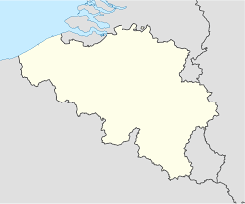
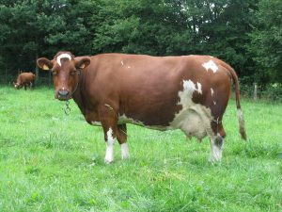
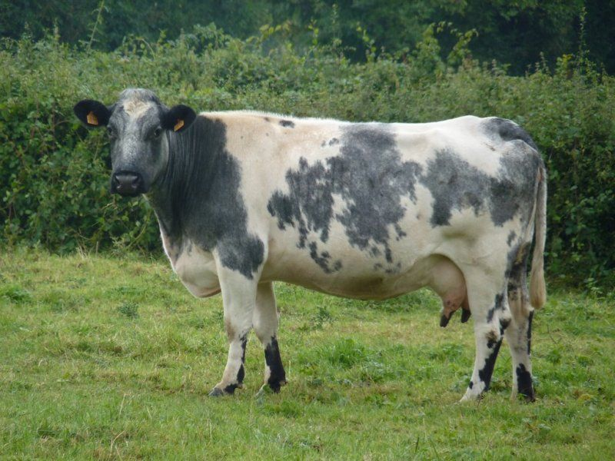
East Belgian Red and White (EBRW)
Dual-Purpose Belgian Blue (DPBB)
Red-Pied of Ösling (RPO)

Slide 7
Dataset
12 reference breeds of which the three breeds of interest
562 animals
17,667 SNPs

Slide 8
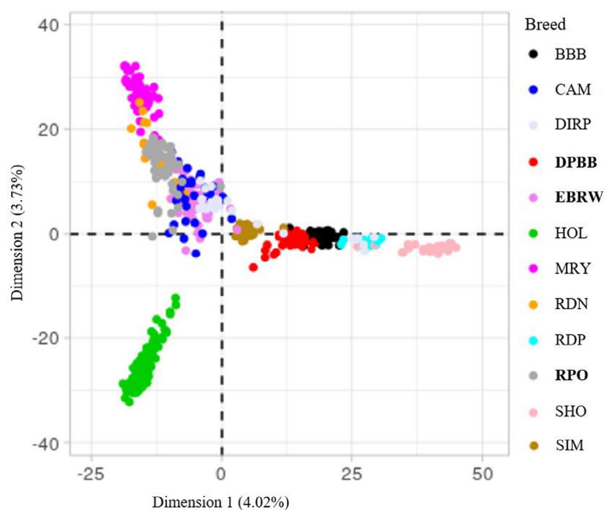
PCA of individuals
Figure 2 from Wilmot, H., Bormann, J., Soyeurt, H., Hubin, X., Glorieux, G., Mayeres, P., Bertozzi, C., & Gengler, N. (2022). Development of a genomic tool for breed assignment by comparison of different classification models: Application to three local cattle breeds. Journal of Animal Breeding and Genetics, 139, 40– 61. https://doi.org/10.1111/jbg.12643

Slide 9
Step 1: Selection of SNPs
16 different SNP panels
Methods of selection:
Two-step methods: F_{st} and PCA combined with a random forest
One-step method: PLS-DA
No selection
3 different thresholds for each of the method

Slide 10
Step 2: Methods of classification
4 different methods of classification:
PLS-DA
Random forest
Nearest shrunken centroids
Linear support vector machine
If more than 90% of accuracy in 10-fold CV, step 3

Slide 11
Step 3: External validation
40 Dual-Purpose Belgian Blue
40 East Belgian Red and White
40 Red Pied of Ösling
40 Holstein
40 Beef Belgian Blue

Slide 12
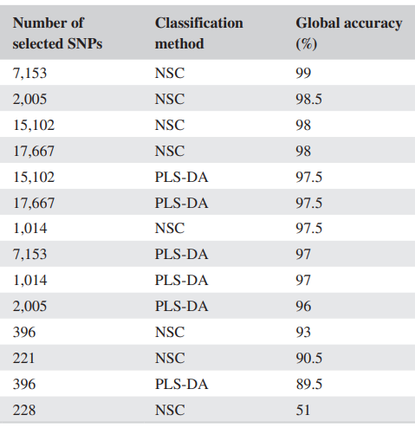
Adapted from Table 6 from Wilmot, H., Bormann, J., Soyeurt, H., Hubin, X., Glorieux, G., Mayeres, P., Bertozzi, C., & Gengler, N. (2022). Development of a genomic tool for breed assignment by comparison of different classification models: Application to three local cattle breeds. Journal of Animal Breeding and Genetics, 139, 40– 61. https://doi.org/10.1111/jbg.12643

Slide 13
Results of external validation
Highly variable in terms of:
Number of SNPs: from 221 to 17,667
Global accuracy: from 51 to 99%
The 3 best panels of SNPs were obtained with the PLS-DA
Only NSC and PLS-DA classification methods allowed high global accuracies

Slide 14
Choice for a routine model
The number of SNPs is also important
Balance between the number of SNPs used and the global accuracy
Second best model chosen

Slide 15
Adapted from Table 6 from Wilmot, H., Bormann, J., Soyeurt, H., Hubin, X., Glorieux, G., Mayeres, P., Bertozzi, C., & Gengler, N. (2022). Development of a genomic tool for breed assignment by comparison of different classification models: Application to three local cattle breeds. Journal of Animal Breeding and Genetics, 139, 40– 61. https://doi.org/10.1111/jbg.12643

Slide 16
Take-home message
3 main steps
Selection of SNPs
Choice of a classification method
External validation
The combination of methods of the first two steps is important
PLS-DA for Step 1
NSC for Step 2

Slide 17
More details…
https://doi.org/10.1111/jbg.12643

Slide 18
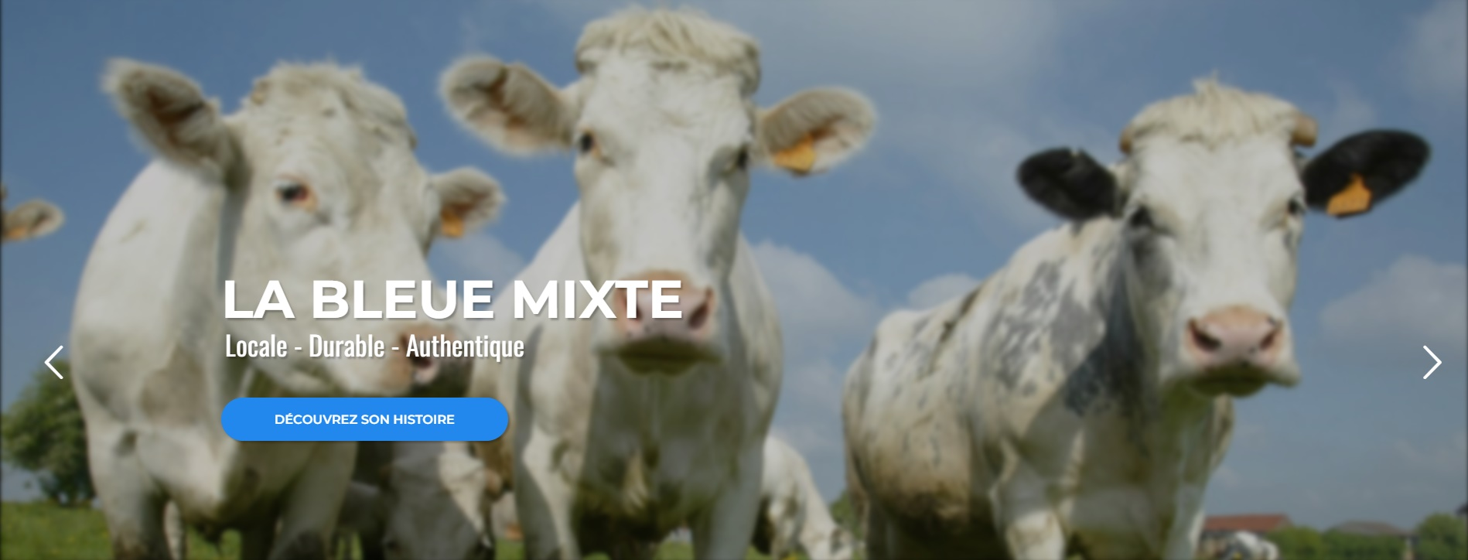
Other implications
Routine use in the certification process of labelled breed-derived products
https://www.projet-bluester.eu/

Slide 19
Thank you for your attention!
Questions?
Contact
Helene.Wilmot@uliege.be

