Slide 1
Gembloux Agro-Bio Tech
Laboratory of Chemistry of Natural Molecules
ML Fauconnier
Gembloux 16/09/2022
Notes:
First of all I would like to thank my colleague Giorgia Purcaro for inviting me to this workshop

Slide 2
SPME: a powerful tool to answer scientific questions in the field of agronomy Prof. Marie-Laure Fauconnier Laboratory of Chemistry of Natural Molecules Gembloux Agro-Bio Tech, ULg,Belgium
Notes:
When Giorgia asked me to give a talk in this workshop I had no idea what I was going to talk about. But when I saw that Professor Pawlliszyn, the father of SPME, was present, I decided to devote my talk to the applications of SPME to answer scientific questions in the field of agronomy. Of course SPME is not the only sampling method we use but it is clearly a vey important one.

Slide 3
1) Fruit aromas, « terroir effect » and genetics 2) Plants and insects 3) Plants speak to plants 4) Mycotoxins 5) Boar taint
Notes:
I decided to select various contexts in which we used SPME to answer scientific questions in the field of agronmy and not to focuss on one specific application. You will thus see a « collection of applications »

Slide 4
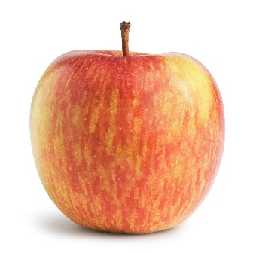
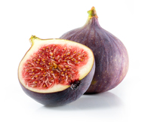
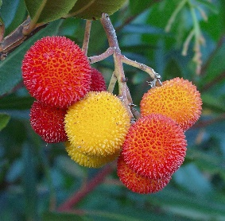
1. Fruit aromas, « terroir effect », genetics
Xinye Wu
Hafida Hanine
SPME-GC-MS was used for aroma profiling
➔ Especially for « low-odour fruits » like apples, strawberry trees (Arbutus unedo L.) or figs
Kahina Zidi
Link between VOCs profile and
➔ varieties, terroir effect (climate, soil, …), genetic traits
« Classical use » of SPME-GC-MS
10.1080/15538362.2022.2037038
10.3389/fpls.2021.667809
10.1021/acsfoodscitech.1c00010
10.3390/foods11050690
10.3390/foods11111631
Notes:
SPME was used very frequently for aroma profiling. In the case of low-odour fruits it was the sampling techniques that gave the best results. It is typically the case for apple, strawberry tree fruits and figs. Fig was perhaps the worst sample we have worked on because when you eat it it is sweet but in fact when you just smell it it smell almost nothing. Those studies wer used to link aroma profile with genetics traits but also to study terroir effect which is the influence of climate, soil and agronomical practises

Slide 5
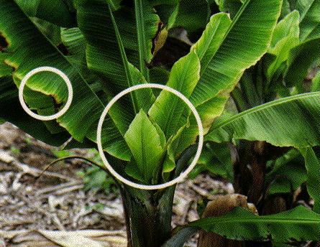
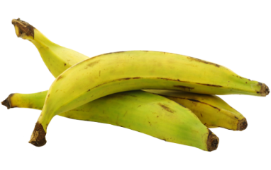
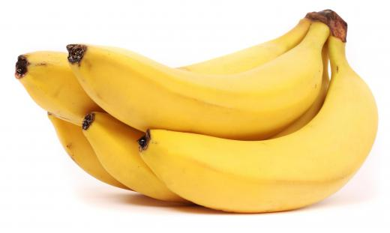
2. Plants and insects
Ignace Murhububa Safari
Banana plants: plantain and dessert
Bunchy top virus (BTV) can cause severe disease on banana plants and aphids can be the vector of viral infection
Aphids are more attracted by infected plants than healthy plants
VOCs from plantain banana plants are different and more abundant than VOCs from dessert banana plants
VOCs emitted by plant infected by BTV are much more abundant than uninfected ones
Entomologists are trying to understand why …
By modifying VOC emission by the plant, the virus may produce conditions that favor its propagation?
Have you ever smelled a banana plant?
Journal of Chemical Ecology (2021) 47:755–767
Notes:
Another completelly different application was the use of SMPE to study bunchy top virus in banana plants. Next time you see a banana plant try to smell it … I know that human nose is not dog nose and that we are so good to detect low amount of odoeur but banana plant is really a low VOC plant.

Slide 6
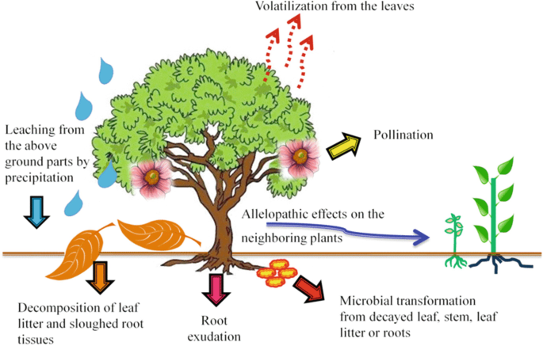
3. Plants speak to plants
Allelopathy
Allelochemicals from a plant will impact negativelly germination or growth of another plant
➔ costly from an energetic point of view
Aziz et al. 2021
Notes:
Walnut tree

Slide 7
3. Plants speak to plants
Florian Martini
Aurélie Gfeller
Newly discovered: allelopathy can be induced by the presence of a plant from another species but … how plants can detect the presence of another plant in the neighbourhood?
3. Amanranthus
retroflexus alone
4. Amanranthus retroflexus and rye
1. Rye alone
2. Rye with rye
Root VOCs profiling
Notes:
PAGE DE SOUS-SECTION / Page avec possibilité d'insertion d'un titre de sous-chapitre et d'un petit texte

Slide 8
3. Plants speak to plants
Results:
Allelochemicals produced by rye increase when co-cultured with A. retroflexus (induced allelopathy)
Both root plants emits VOCs (some common, some different)
Rye cultivated with rye results in new VOCs emited by roots
Rye cultivated with A. retroflexus results in a strong VOCs pattern modification (new VOCs)
Questions:
Which plant is producing these new VOCs ???
Do VOCs emitted by A. retroflexus be the ”signal molecules” for non-kin recognition
The signal is perhaps due to non volatile molecules?
How rye perceive the signal molecules?
Waseem Mushtaq
Laura Lheureux
Notes:
PAGE DE SOUS-SECTION / Page avec possibilité d'insertion d'un titre de sous-chapitre et d'un petit texte

Slide 9
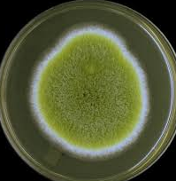
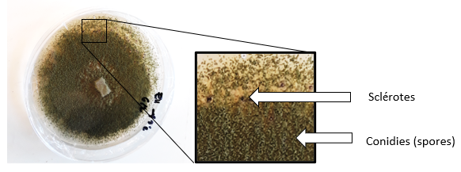
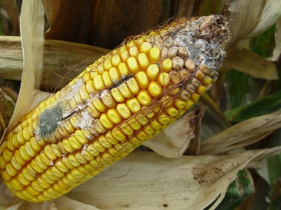
4. Mycotoxins
Laurie
Josselin
Aspergillus flavus
Two categories (type S and L)
Aspergillus sp.
Aflatoxin B1, B2, G1 and G2
Toxigenic
Toxigenic
Non-toxigenic
High aflatoxin
Variable aflatoxin
No aflatoxin
➔ Specific sensor to detect A. flavus contamination very early in silo
Notes:
PAGE DE SOUS-SECTION / Page avec possibilité d'insertion d'un titre de sous-chapitre et d'un petit texte

Slide 10
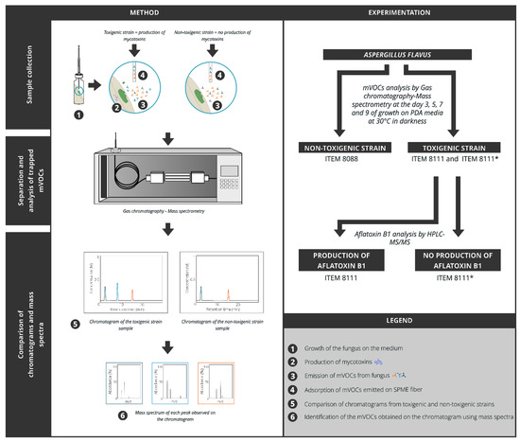
4. Mycotoxins
Josselin, L.; De Clerck, C.; De Boevre, M.; Moretti, A.; Jijakli, M.H.; Soyeurt, H.; Fauconnier, M.-L. Volatile Organic Compounds Emitted by Aspergillus flavus Strains Producing or Not Aflatoxin B1. Toxins 2021, 13, 705.
Notes:
PAGE DE SOUS-SECTION / Page avec possibilité d'insertion d'un titre de sous-chapitre et d'un petit texte

Slide 11
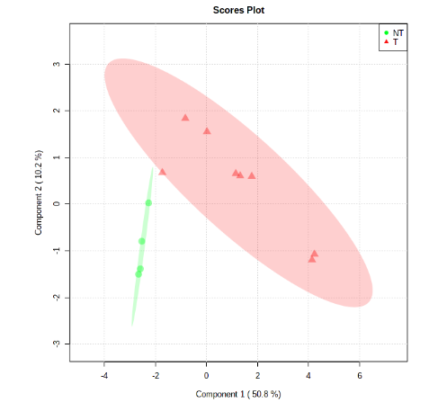
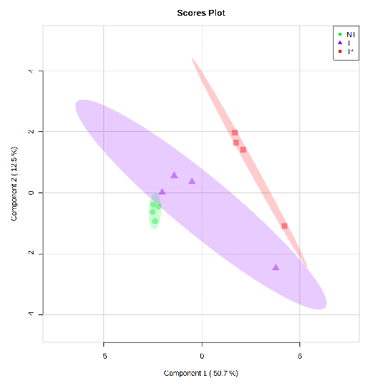
4. Mycotoxins
Toxigenic /Non-toxigenic
AFB1 producer / Non AFB1 producer
(a)
(b)
Notes:
serendipity

Slide 12
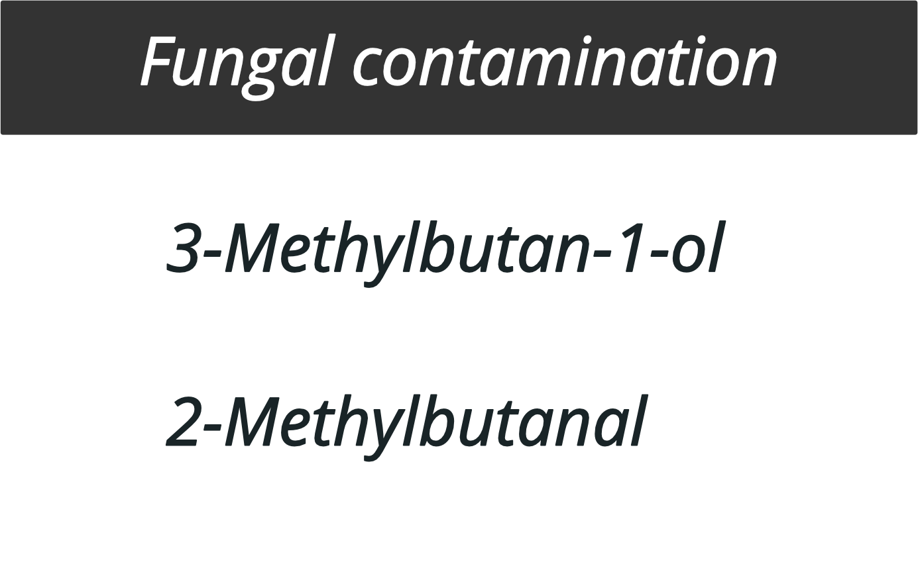
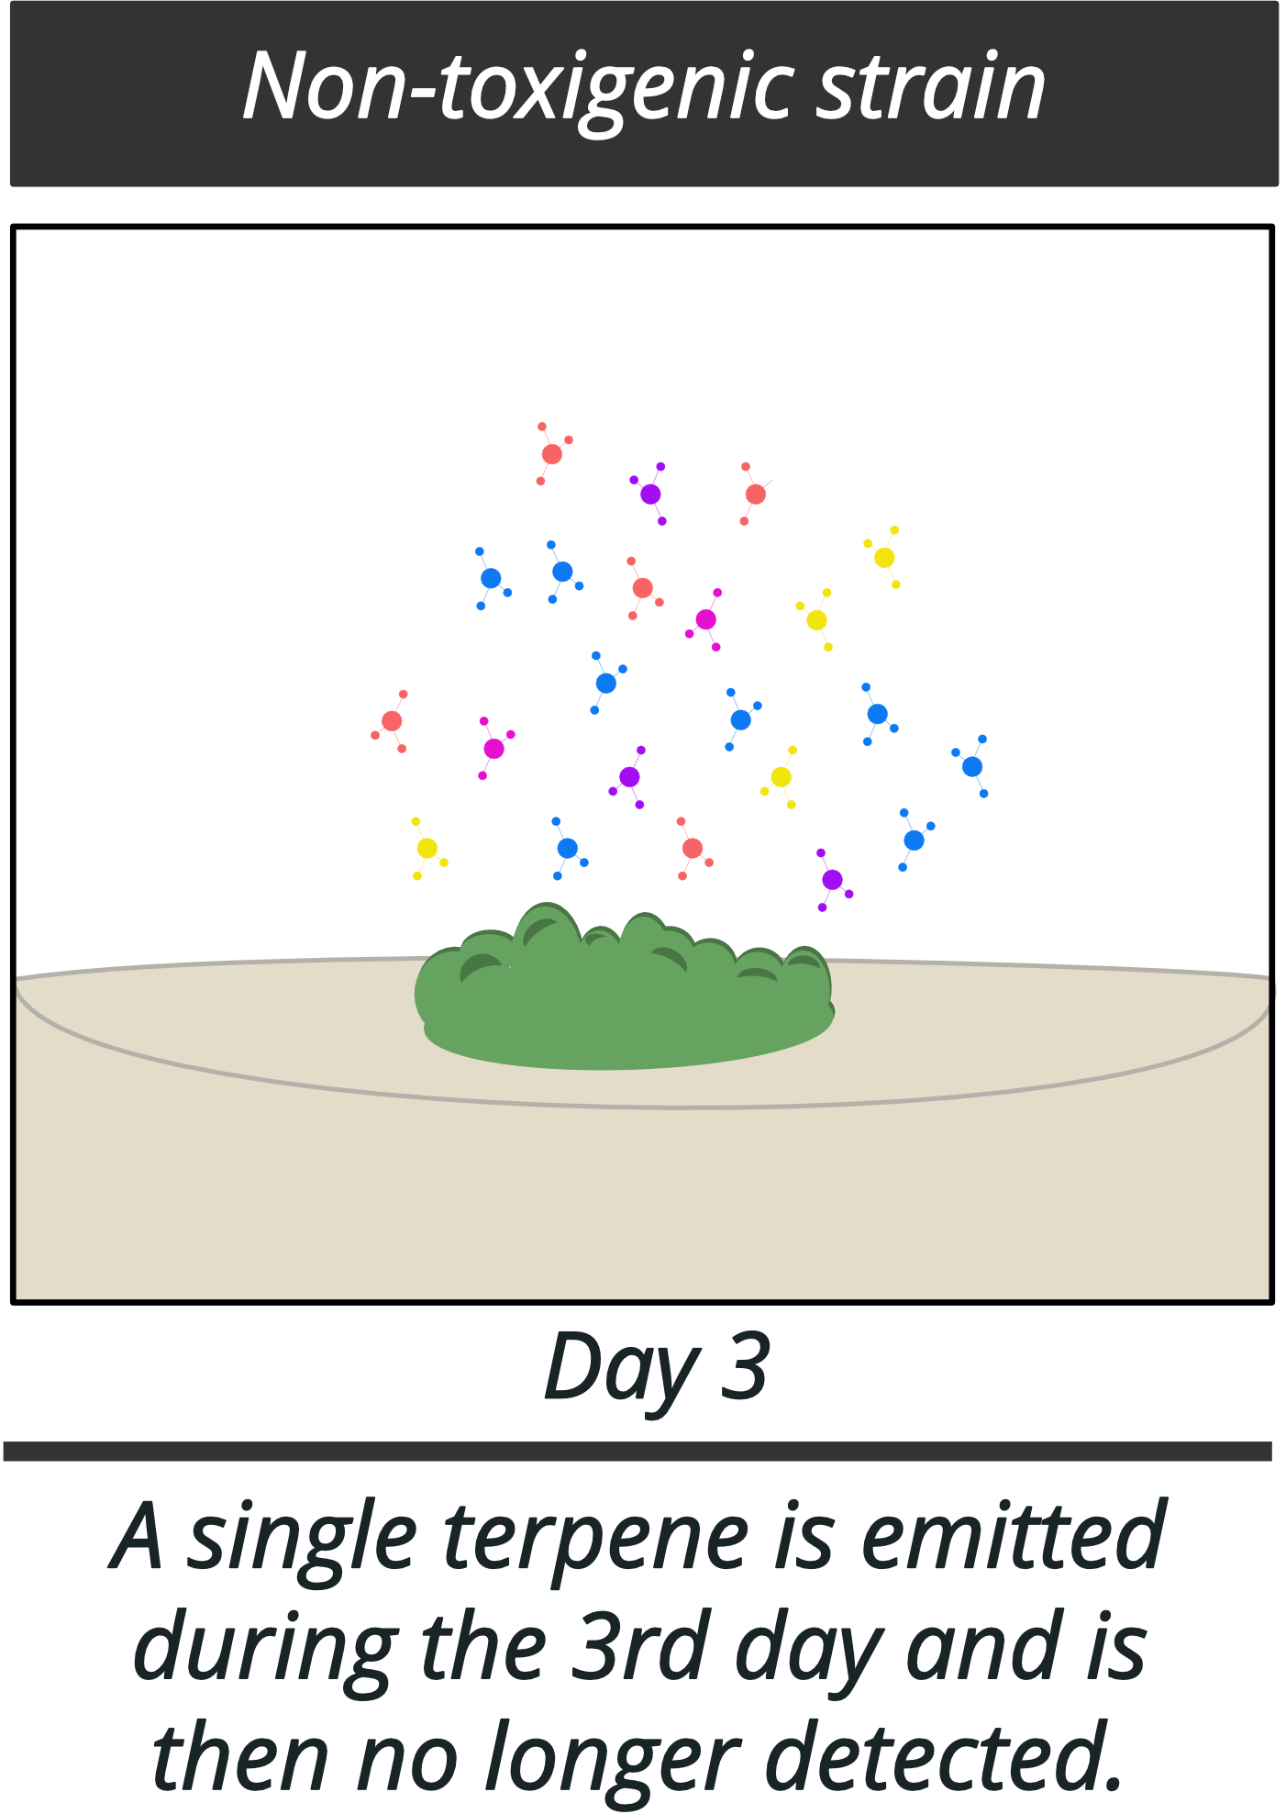
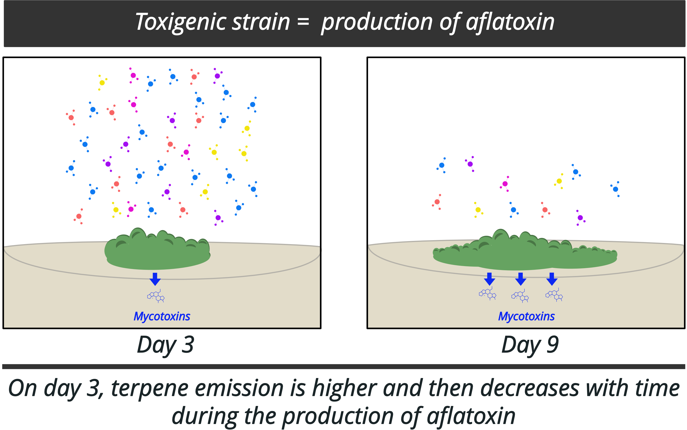
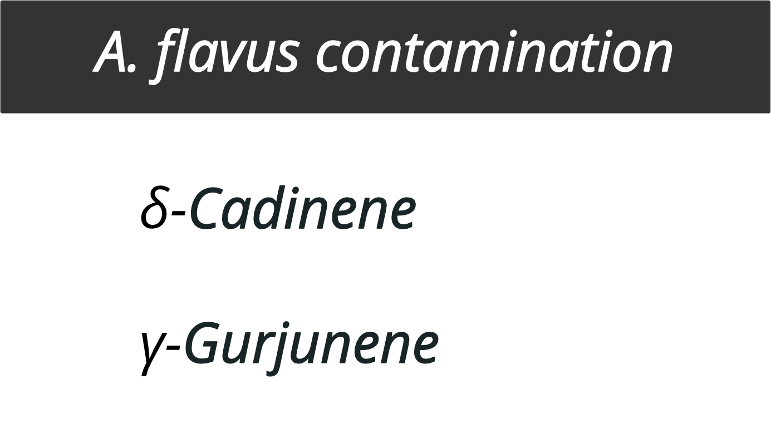
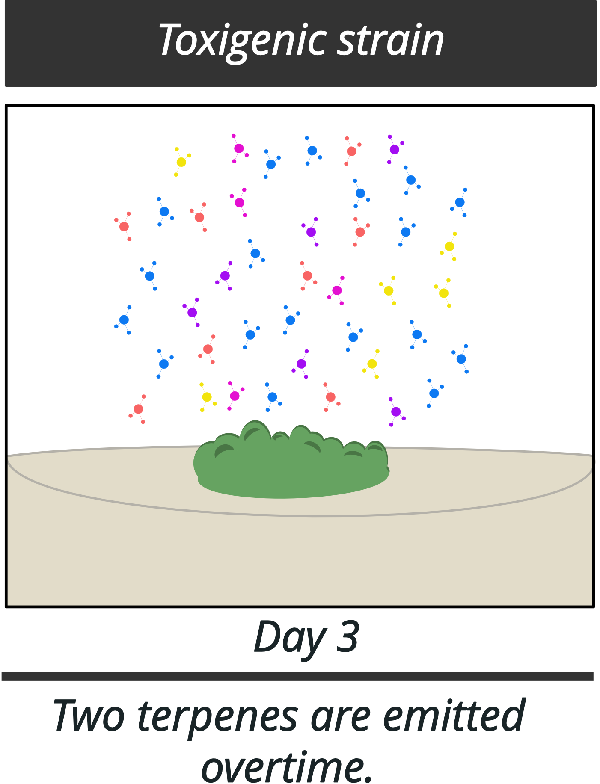
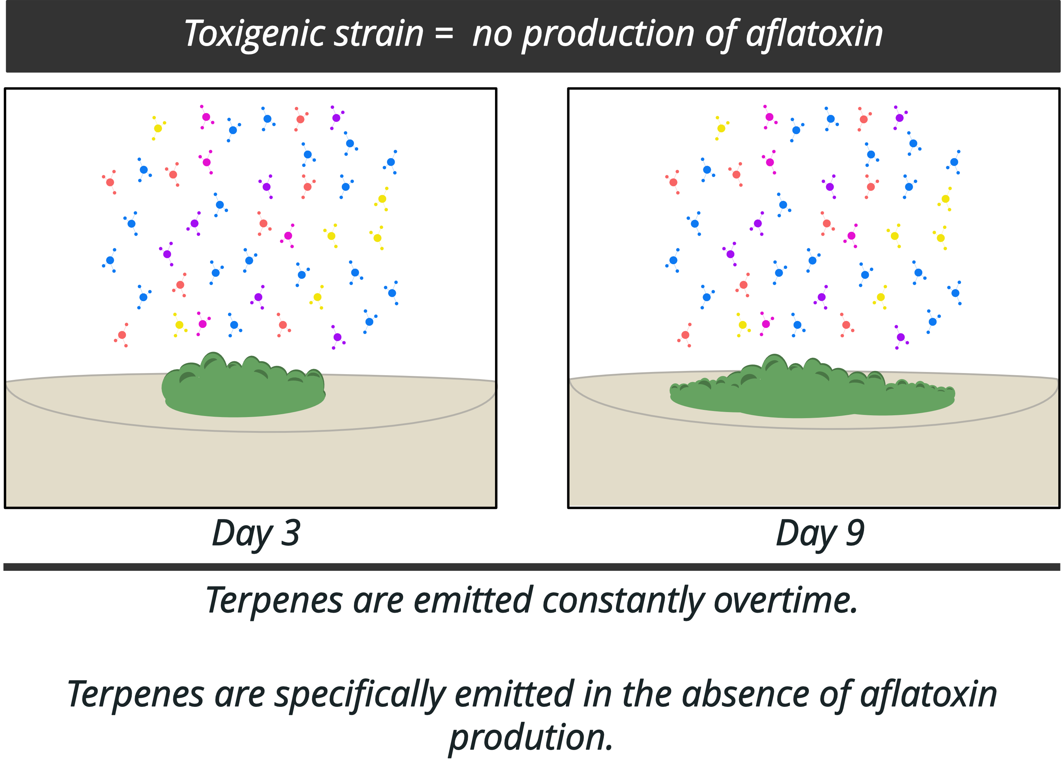
4. Mycotoxins
Terpenes not specific enough for MIPS and too low concentrations ➔ VOCs as biological control agents
Notes:
Serendipity

Slide 13
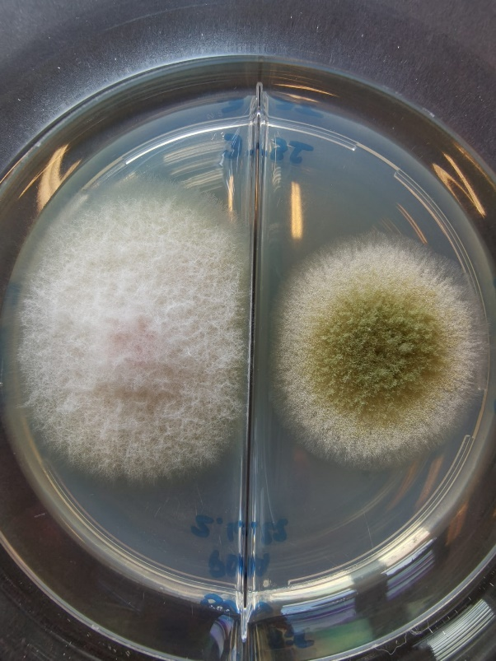
4. Mycotoxins
New research on the use of specific VOCs to decrease mycotoxin production
Specific VOCs can reduce growth of other fungal strains and … mycotoxin production
Fusarium verticiloides (fumonisin) VOCs versus Aspergillus flavius (aflatoxin)
Notes:
PAGE DE SOUS-SECTION / Page avec possibilité d'insertion d'un titre de sous-chapitre et d'un petit texte

Slide 14
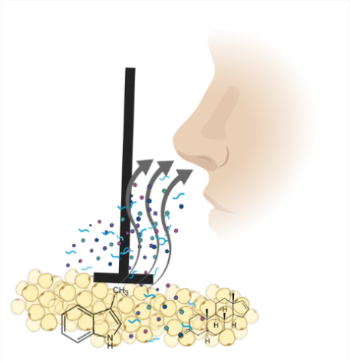
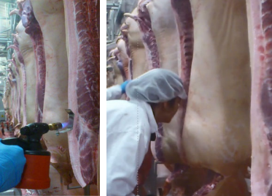
5. Boar taint
Clément Burgeon
Sensory evaluation
Skatole and androstenone
Burgeon, C., Debliquy, M., Lahem, D., Rodriguez, J., Ly, A., & Fauconnier, M. L. (2021). Past, present, and future trends in boar taint detection. Trends in Food Science and Technology, 112 (April), 283– 297.
Notes:
Animal welfare is a major concern in many countries. Castration of piglets without anesthesia is no longer accepted. However, the rearing of uncastrated pigs or the use of immunocastration leads to the presence of tainted pigs in slaughterhouses. In order to sort the carcasses at present an operator uses a soldering iron to heat the fat and detects with his nose the presence or absence of boar smell. This operation is very unpleasant and not always very accurate with false positives and false negatives

Slide 15
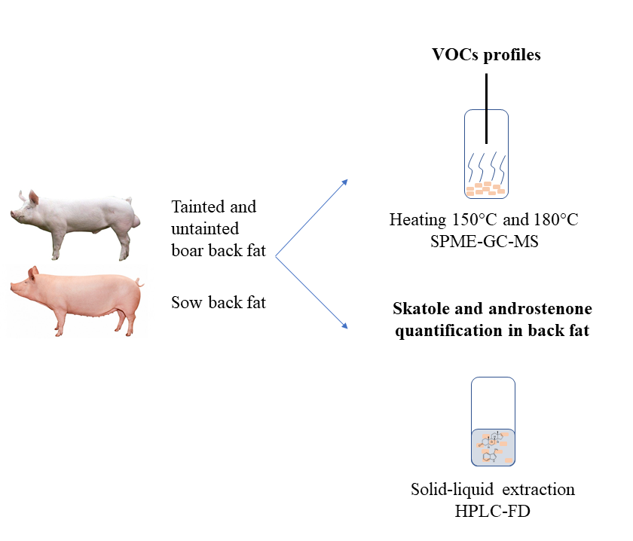
5. Boar taint
Fatty acid profile
Sensory evaluation
Notes:
PAGE DE SOUS-SECTION / Page avec possibilité d'insertion d'un titre de sous-chapitre et d'un petit texte

Slide 16
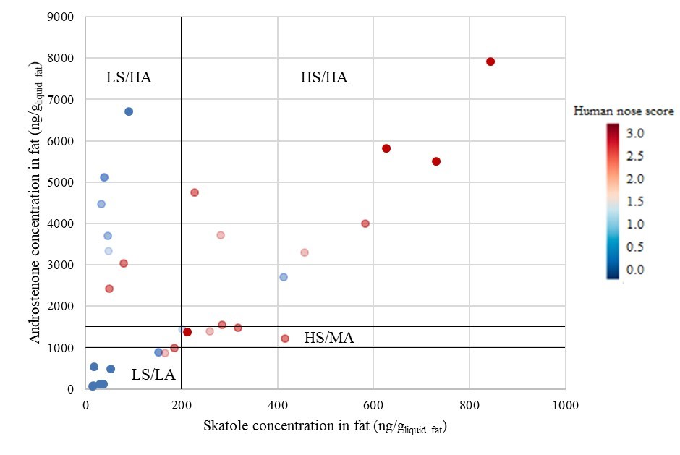
5. Boar taint
Sensory evaluation versus chemical analysis
Chemical analysis
LS/LA: low skatole, low androstenone
LS/HA: Low skatole, high androstenone
HS/MA: High skatole, medium androstenone
HS/HA: high skatole, high androstenone
Some discrepancies
Origin of discrepancies?
Notes:
PAGE DE SOUS-SECTION / Page avec possibilité d'insertion d'un titre de sous-chapitre et d'un petit texte

Slide 17
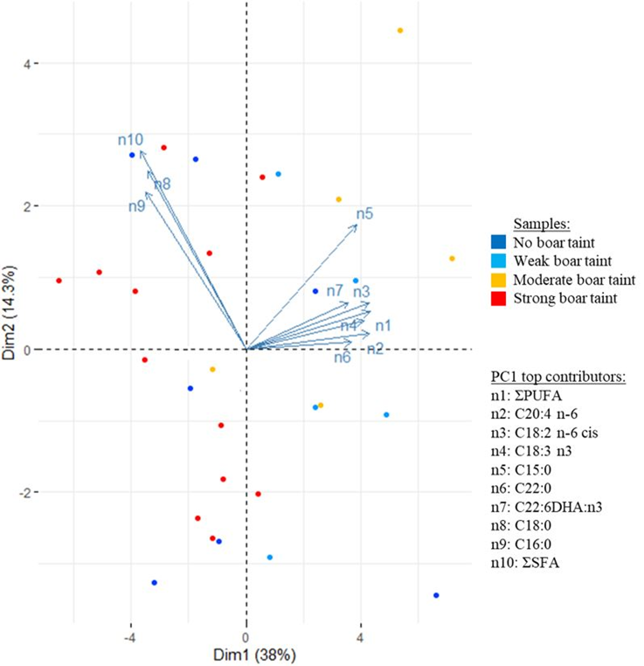
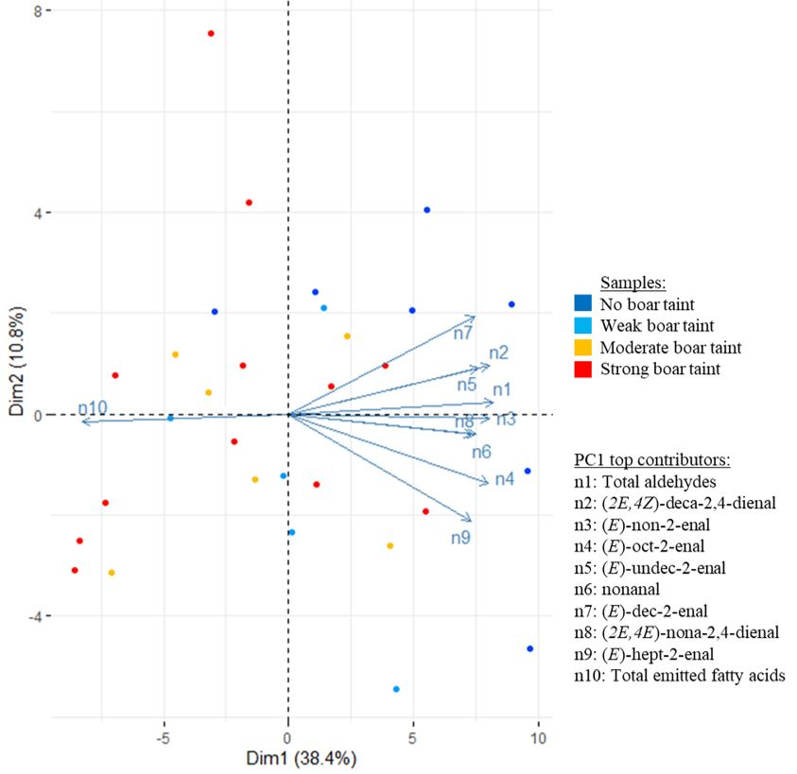
Fatty acids composition as a source of discrepancy? ➔ NO
5. Boar taint
Origin of discrepancies?
VOCs as a source of discrepancy?
➔ YES (oxidation products at 150°C)
Can sensory boar taint levels be explained by fatty acid composition and emitted volatile organic compounds in addition to androstenone and skatole content? Meat science in press
Notes:
PAGE DE SOUS-SECTION / Page avec possibilité d'insertion d'un titre de sous-chapitre et d'un petit texte

Slide 18
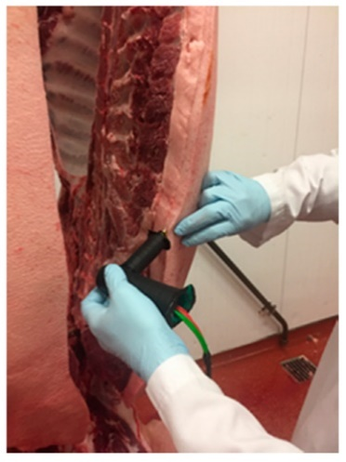
5. Boar taint
Discrepancies
between sensory evaluation and chemical analysis
due to VOCS
Optimization of VOCs sampling for sensor
New specific sensor
Agrosensor project
Notes:
PAGE DE SOUS-SECTION / Page avec possibilité d'insertion d'un titre de sous-chapitre et d'un petit texte

Slide 19
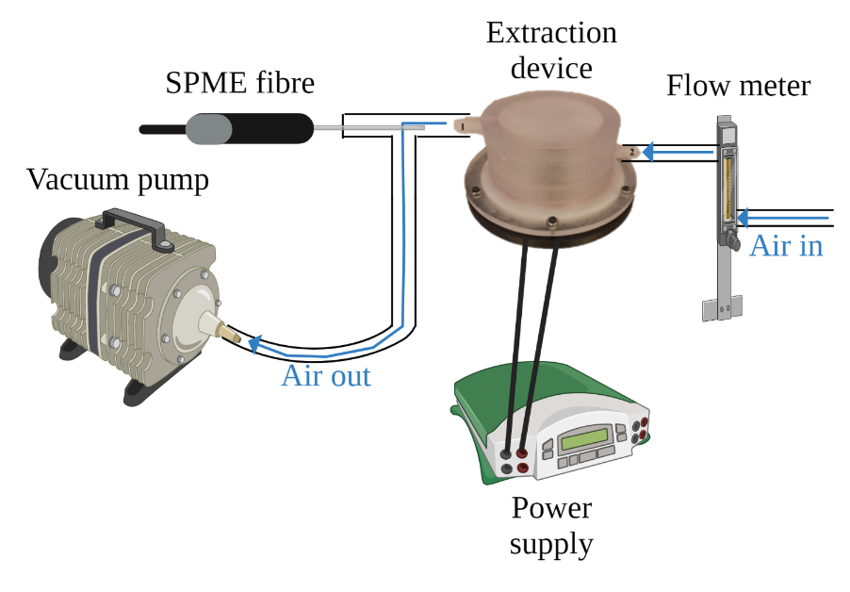
5. Boar taint
T° = 150, 300, 450°C
ATM = air, nitrogen, reduced pressure
Increase androstenone and skatole content in head space to increase sensitivity of sensor
Reduce oxidation products to avoid sensor fouling and lack of specificity
Patent for a new sensor to detect rapidly and efficiently boar taint in slaughterhouse
Notes:
PAGE DE SOUS-SECTION / Page avec possibilité d'insertion d'un titre de sous-chapitre et d'un petit texte

Slide 20
Conclusion
SPME is a powerful tool to answer scientific questions in the field of agronomy
Simple
Not expensive
Adaptable (lab ➔ field)
But not always obvious for quantification
To be compared to other sampling techniques …

Slide 21
Thanks for your attention

