Slide 1


Mechanical properties of the component “column web in compression” in steel beam-to-column joints
J-P. Jaspart, A. Corman & J-F. Demonceau
UEE department, University of Liège (ULiège), Liège, Belgium
jean-pierre.jaspart@uliege.be
Notes:
Good afternoon everyone
My name is Adrien and I am a PhD student from the University of Liège in Belgium
The article I am going to present today deals with the characterization of the component “column web in compression” in steel beam-to-column joints

Slide 2
Outline
Introduction
Literature review: EN 1993-1-8 model
New analytical model
Conclusions & perspectives
1/20
Notes:
Here is the outline of the presentation which will be divided into four main parts:
Firstly a short introduction where I am gonna descried the context and the motivation of the research
Then a literature review of the already existing predictive model provided in part 1-8 of Eurocode 3
Afterwards, a description of the new analytical model which was developed in the present study
And finally some conclusions and perspectives

Slide 3
Outline
Introduction
Literature review: EN 1993-1-8 model
New analytical model
Conclusions & perspectives
1/20
Notes:
So let’s start with the introduction

Slide 4

Context: behaviour of steel joints
1. Identification
Initial stiffness $K_{ini}^{CWC}$
Plastic resistance $F_{y,Rd}^{CWC}$
Post-plastic stiffness $K_{pp}^{CWC}$
Ultimate resistance $F_{u,Rd}^{CWC}$
➔ 4 key parameters:
2/20
Notes:
This article deals with the behaviour of steel joints such the single-sided joint presented on this slide
Such joint exhibits a bi-linear rotational response under gravity loads

Slide 5
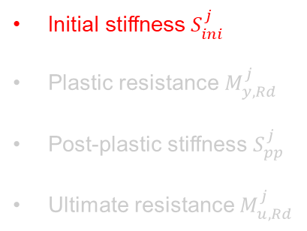
Context: behaviour of steel joints
1. Identification
Initial stiffness $S_{ini}^{j}$
Plastic resistance $M_{y,Rd}^{j}$
Post-plastic stiffness $S_{pp}^{j}$
Ultimate resistance $M_{u,Rd}^{j}$
➔ 4 key parameters:
2/20
Notes:
Therefore, it can be characterized by four key parameters:
The initial stiffness

Slide 6
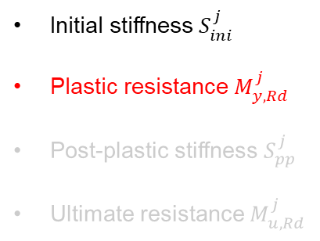
Context: behaviour of steel joints
1. Identification
Initial stiffness $S_{ini}^{j}$
Plastic resistance $M_{y,Rd}^{j}$
Post-plastic stiffness $S_{pp}^{j}$
Ultimate resistance $M_{u,Rd}^{j}$
➔ 4 key parameters:
2/20
Notes:
The plastic resistance

Slide 7
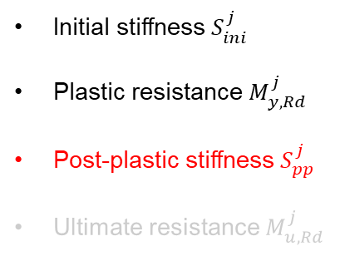
Context: behaviour of steel joints
1. Identification
Initial stiffness $S_{ini}^{j}$
Plastic resistance $M_{y,Rd}^{j}$
Post-plastic stiffness $S_{pp}^{j}$
Ultimate resistance $M_{u,Rd}^{j}$
➔ 4 key parameters:
2/20
Notes:
The post-plastic stiffness

Slide 8
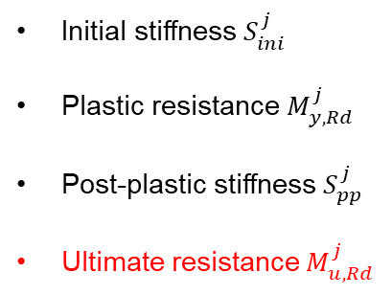
Context: behaviour of steel joints
1. Identification
Initial stiffness $S_{ini}^{j}$
Plastic resistance $M_{y,Rd}^{j}$
Post-plastic stiffness $S_{pp}^{j}$
Ultimate resistance $M_{u,Rd}^{j}$
➔ 4 key parameters:
2/20
Notes:
And the ultimate resistance

Slide 9
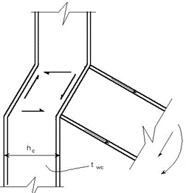
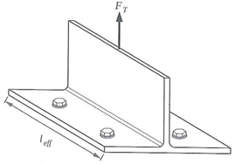
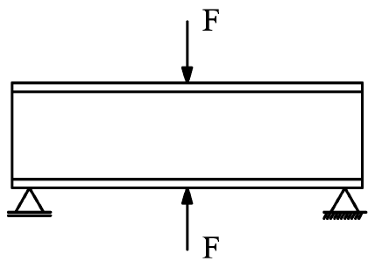
Context: component method
1. Identification
A. Component in shear
2. Characterization
B. Components in tension
3. Assembly
C. Component in compression
3/20
Notes:
Today it is refer to the well-known component method to characterize/when it comes to the characterization the joint behaviour and predict some of these key parameters
This method follows a 3-step procedure/is dividing into three main steps:
The first step consists in dividing the joint into a series of individual components

Slide 10
Context: component method
1. Identification
A. Component in shear
2. Characterization
B. Components in tension
3. Assembly
C. Component in compression
3/20
Notes:
The second step consists in characterizing those components, which means deriving the resisting curve of each individual component

Slide 11
Context: component method
1. Identification
A. Component in shear
2. Characterization
B. Components in tension
3. Assembly
C. Component in compression
3/20

Slide 12
Context: component method
1. Identification
A. Component in shear
2. Characterization
B. Components in tension
3. Assembly
C. Component in compression
3/20
Notes:
The third step consists in assemblying those components in order to derive/predict the rotational response of the joint

Slide 13
Context: component method
1. Identification
A. Component in shear
2. Characterization
B. Components in tension
3. Assembly
C. Component in compression
3/20

Slide 14
Context: component method
1. Identification
A. Component in shear
2. Characterization
EN 1993-1-8
B. Components in tension
3. Assembly
EN 1993-1-8
EN 1993-1-8
C. Component in compression
EN 1993-1-8
4/20
Notes:
Up to now, the component method as it is presented in the part 1-8 of Eurocode 3 allows predicting the moment rotation curve of the joint up to the plastic bending moment resistance only
This method has proven to work well under gravity loads

Slide 15
Problem: ductility assessment
1. Identification
A. Component in shear
2. Characterization
EN 1993-1-8
Def. capacity?
B. Components in tension
3. Assembly
EN 1993-1-8
Def. capacity?
EN 1993-1-8
C. Component in compression
EN 1993-1-8
Ductility?
Def. capacity?
4/20
Notes:
However, when it comes to exceptional loading such as an explosion, which could cause significant damage to the structure, it is required to know/predict the ductility/rotation capacity of the joint in order to mitigate the risk of progressive collapse.
And the Eurocode 3 in its current state does not allow to do so

Slide 16
Problem: ductility assessment
1. Identification
A. Component in shear
2. Characterization
Objectives of the project
Extension of the component method
➔ Towards the large deformation field
➔ Under complex loading conditions
EN 1993-1-8
Def. capacity?
B. Components in tension
3. Assembly
EN 1993-1-8
Def. capacity?
EN 1993-1-8
C. Component in compression
EN 1993-1-8
Ductility?
Def. capacity?
4/20
Notes:
So the objective of the research project which is currently being conducted at the university of Liège is to extend the component method towards the large deformation field and under complex loading conditions
To do so, it is required to characterize the behaviour of the different components up to failure

Slide 17
Problem: ductility assessment
1. Identification
A. Component in shear
2. Characterization
Objectives of the project
Extension of the component method
➔ Towards the large deformation field
➔ Under complex loading conditions
EN 1993-1-8
Def. capacity?
B. Components in tension
3. Assembly
EN 1993-1-8
This paper
Def. capacity?
EN 1993-1-8
C. Component in compression
EN 1993-1-8
Ductility?
Def. capacity?
4/20
Notes:
In this context, the present paper focusses on the column web in compression component

Slide 18
Behaviour of the CWC component
A. Thick CWC
B. Slender CWC
5/20
Notes:
To study the behaviour of the CWC, it can be isolated from the whole joint.
It is characterized by a force displacement F-delta curve
Depending on the slenderness of the column web, this curve exhibit a well marked bilinear behaviour or a less marked bilinear behaviour
Similarly to the joint, the CWC behaviour can be characterized by four main key parameters

Slide 19
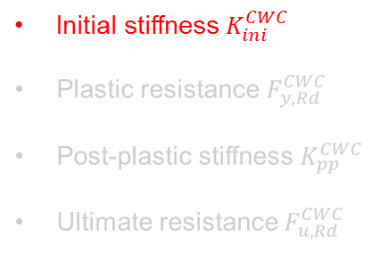
Behaviour of the CWC component
A. Thick CWC
➔ 4 key parameters:
B. Slender CWC
Initial stiffness $K_{ini}^{CWC}$
Plastic resistance $F_{y,Rd}^{CWC}$
Post-plastic stiffness $K_{pp}^{CWC}$
Ultimate resistance $F_{u,Rd}^{CWC}$
5/20
Notes:
The initial stiffness

Slide 20
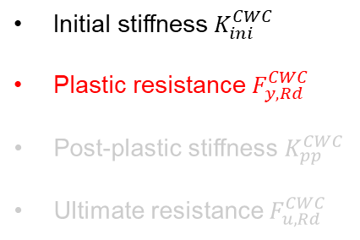
Behaviour of the CWC component
A. Thick CWC
➔ 4 key parameters:
B. Slender CWC
Initial stiffness $K_{ini}^{CWC}$
Plastic resistance $F_{y,Rd}^{CWC}$
Post-plastic stiffness $K_{pp}^{CWC}$
Ultimate resistance $F_{u,Rd}^{CWC}$
5/20
Notes:
The plastic resistance

Slide 21
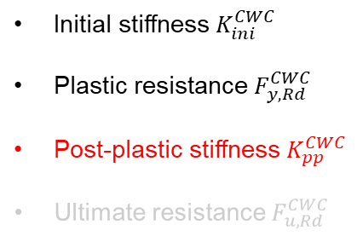
Behaviour of the CWC component
A. Thick CWC
➔ 4 key parameters:
B. Slender CWC
Initial stiffness $K_{ini}^{CWC}$
Plastic resistance $F_{y,Rd}^{CWC}$
Post-plastic stiffness $K_{pp}^{CWC}$
Ultimate resistance $F_{u,Rd}^{CWC}$
5/20
Notes:
The post-plastic stiffness

Slide 22
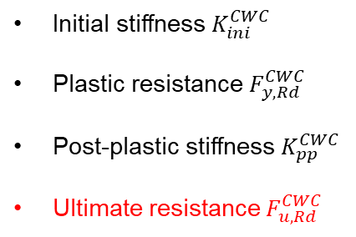
Behaviour of the CWC component
A. Thick CWC
➔ 4 key parameters:
B. Slender CWC
Initial stiffness $K_{ini}^{CWC}$
Plastic resistance $F_{y,Rd}^{CWC}$
Post-plastic stiffness $K_{pp}^{CWC}$
Ultimate resistance $F_{u,Rd}^{CWC}$
5/20
Notes:
The ultimate resistance

Slide 23
Outline
Introduction
Literature review: EN 1993-1-8 model
New analytical model
Conclusions & perspectives
6/20
Notes:
Today, Eurocode 3 provides analytical formulae for the prediction of some of these parameters

Slide 24

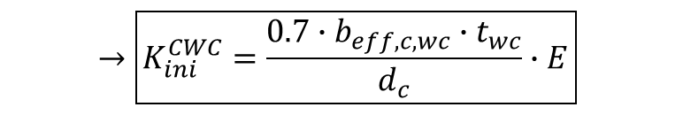
Initial stiffness $K_{ini}^{CWC}$
$$→\boxed{K_{ini}^{CWC}=\frac{0.7∙b_{eff,c,wc}∙t_{wc}}{d_{c}}∙E}$$
7/20
Notes:
For (the prediction of) the initial stiffness, the following expression is available, where beff is the effective width of the column web in compression

Slide 25
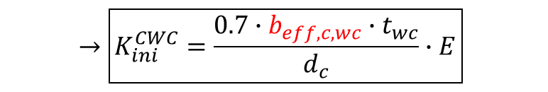
Initial stiffness $K_{ini}^{CWC}$
$$→\boxed{K_{ini}^{CWC}=\frac{0.7∙b_{eff,c,wc}∙t_{wc}}{d_{c}}∙E}$$
7/20

Slide 26



Plastic resistance $F_{y,Rd}^{CWC}$
Thick CWC
Slender CWC
$$→\boxed{F_{y,Rd}^{CWC}=\min\left(\frac{ω∙k_{wc}∙b_{eff,c,wc}∙f_{y,wc}}{γ_{M0}};ρ∙\frac{ω∙k_{wc}∙b_{eff,c,wc}∙f_{y,wc}}{γ_{M1}}\right)}$$
$ω∙k_{wc}$: stress interaction factor
$ρ$: reduction factor accounting for the risk of web buckling
${\overline{λ}}_{p}=0.932∙\sqrt{\frac{ω∙k_{wc}∙b_{eff,c,wc}∙d_{c}∙f_{y,wc}}{E∙t_{wc}^{2}}} → ρ=\left\{\begin{matrix}1.0 & if {\overline{λ}}_{p}≤0.67 \\ \frac{{\overline{λ}}_{p}−0.22}{{\overline{λ}}_{p}^{2}} & if {\overline{λ}}_{p}>0.67\end{matrix}\right.$
8/20
Notes:
For the prediction of the plastic resistance, the following expression is available

Slide 27
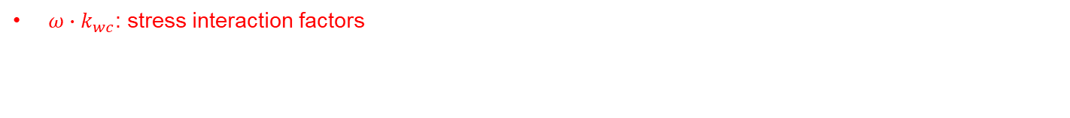
Plastic resistance $F_{y,Rd}^{CWC}$
Thick CWC
Slender CWC
$$→\boxed{F_{y,Rd}^{CWC}=\min\left(\frac{ω∙k_{wc}∙b_{eff,c,wc}∙f_{y,wc}}{γ_{M0}};ρ∙\frac{ω∙k_{wc}∙b_{eff,c,wc}∙f_{y,wc}}{γ_{M1}}\right)}$$
$ω∙k_{wc}$: stress interaction factors
$ρ$: reduction factor accounting for the risk of web buckling
${\overline{λ}}_{p}=0.932∙\sqrt{\frac{ω∙k_{wc}∙b_{eff,c,wc}∙d_{c}∙f_{y,wc}}{E∙t_{wc}^{2}}} → ρ=\left\{\begin{matrix}1.0 & if {\overline{λ}}_{p}≤0.67 \\ \frac{{\overline{λ}}_{p}−0.22}{{\overline{λ}}_{p}^{2}} & if {\overline{λ}}_{p}>0.67\end{matrix}\right.$
8/20
Notes:
In this formula, omega and k are stress interaction factors

Slide 28
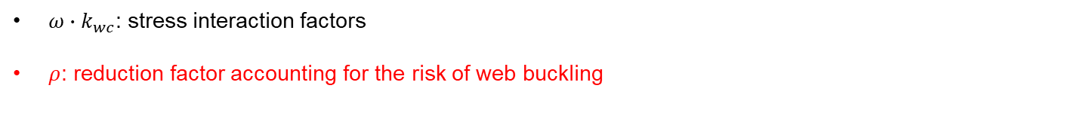
Plastic resistance $F_{y,Rd}^{CWC}$
Thick CWC
Slender CWC
$$→\boxed{F_{y,Rd}^{CWC}=\min\left(\frac{ω∙k_{wc}∙b_{eff,c,wc}∙f_{y,wc}}{γ_{M0}};ρ∙\frac{ω∙k_{wc}∙b_{eff,c,wc}∙f_{y,wc}}{γ_{M1}}\right)}$$
$ω∙k_{wc}$: stress interaction factors
$ρ$: reduction factor accounting for the risk of web buckling
${\overline{λ}}_{p}=0.932∙\sqrt{\frac{ω∙k_{wc}∙b_{eff,c,wc}∙d_{c}∙f_{y,wc}}{E∙t_{wc}^{2}}} → ρ=\left\{\begin{matrix}1.0 & if {\overline{λ}}_{p}≤0.67 \\ \frac{{\overline{λ}}_{p}−0.22}{{\overline{λ}}_{p}^{2}} & if {\overline{λ}}_{p}>0.67\end{matrix}\right.$
8/20
Notes:
And rho is a redction factor accounting for the risk of web buckling

Slide 29

Plastic resistance $F_{y,Rd}^{CWC}$
$$k_{cr}=\frac{4}{π}$$
Thick CWC
Slender CWC
$$→\boxed{F_{y,Rd}^{CWC}=\min\left(\frac{ω∙k_{wc}∙b_{eff,c,wc}∙f_{y,wc}}{γ_{M0}};ρ∙\frac{ω∙k_{wc}∙b_{eff,c,wc}∙f_{y,wc}}{γ_{M1}}\right)}$$
$ω∙k_{wc}$: stress interaction factors
$ρ$: reduction factor accounting for the risk of web buckling
${\overline{λ}}_{p}=0.932∙\sqrt{\frac{ω∙k_{wc}∙b_{eff,c,wc}∙d_{c}∙f_{y,wc}}{E∙t_{wc}^{2}}} → ρ=\left\{\begin{matrix}1.0 & if {\overline{λ}}_{p}≤0.67 \\ \frac{{\overline{λ}}_{p}−0.22}{{\overline{λ}}_{p}^{2}} & if {\overline{λ}}_{p}>0.67\end{matrix}\right.$
8/20
Notes:
For the derivation of this coeeficient, Eurocode 3 assumes perfectly pinned boundary conditions for the plate
This allows the derivation of the buckling coefficient

Slide 30
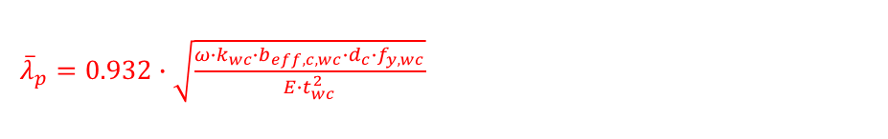
Plastic resistance $F_{y,Rd}^{CWC}$
$$k_{cr}=\frac{4}{π}$$
Thick CWC
Slender CWC
$$→\boxed{F_{y,Rd}^{CWC}=\min\left(\frac{ω∙k_{wc}∙b_{eff,c,wc}∙f_{y,wc}}{γ_{M0}};ρ∙\frac{ω∙k_{wc}∙b_{eff,c,wc}∙f_{y,wc}}{γ_{M1}}\right)}$$
$ω∙k_{wc}$: stress interaction factors
$ρ$: reduction factor accounting for the risk of web buckling
${\overline{λ}}_{p}=0.932∙\sqrt{\frac{ω∙k_{wc}∙b_{eff,c,wc}∙d_{c}∙f_{y,wc}}{E∙t_{wc}^{2}}} → ρ=\left\{\begin{matrix}1.0 & if {\overline{λ}}_{p}≤0.67 \\ \frac{{\overline{λ}}_{p}−0.22}{{\overline{λ}}_{p}^{2}} & if {\overline{λ}}_{p}>0.67\end{matrix}\right.$
8/20
Notes:
With this assumption, the slenderness factor can be computed and eventually the reduction factor rho

Slide 31
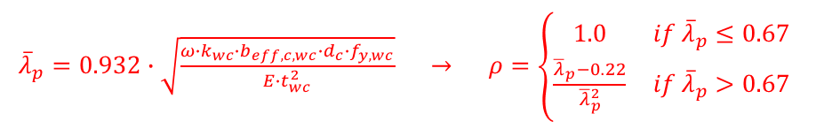
Plastic resistance $F_{y,Rd}^{CWC}$
$$k_{cr}=\frac{4}{π}$$
Thick CWC
Slender CWC
$$→\boxed{F_{y,Rd}^{CWC}=\min\left(\frac{ω∙k_{wc}∙b_{eff,c,wc}∙f_{y,wc}}{γ_{M0}};ρ∙\frac{ω∙k_{wc}∙b_{eff,c,wc}∙f_{y,wc}}{γ_{M1}}\right)}$$
$ω∙k_{wc}$: stress interaction factors
$ρ$: reduction factor accounting for the risk of web buckling
${\overline{λ}}_{p}=0.932∙\sqrt{\frac{ω∙k_{wc}∙b_{eff,c,wc}∙d_{c}∙f_{y,wc}}{E∙t_{wc}^{2}}} → ρ=\left\{\begin{matrix}1.0 & if {\overline{λ}}_{p}≤0.67 \\ \frac{{\overline{λ}}_{p}−0.22}{{\overline{λ}}_{p}^{2}} & if {\overline{λ}}_{p}>0.67\end{matrix}\right.$
8/20

Slide 32
Comparisons with experimental results
9/20
Reference: F. Kühnemund, Verification of the Rotation Capacity of Joints in Steel Structures (in German) (Ph.D. thesis), University of Stuttgart, Stuttgart (Germany, 2003).
Notes:
Comparisons with experimental results show good results in terms of prediction of the elastic stiffness and plastic resistance

Slide 33
Comparisons with experimental results
?
?
9/20
Reference: F. Kühnemund, Verification of the Rotation Capacity of Joints in Steel Structures (in German) (Ph.D. thesis), University of Stuttgart, Stuttgart (Germany, 2003).
Notes:
However, this model is limited to the elastic field
New formulae are required for the prediction of the post-plastic behaviour of the CWC

Slide 34
Outline
Introduction
Literature review: EN 1993-1-8 model
New analytical model
Conclusions & perspectives
10/20
Notes:
This is precisely the aim of the new analytical model that is developed/presented in the paper

Slide 35

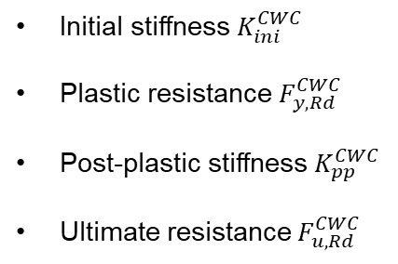
Philosophy
Initial stiffness $K_{ini}^{CWC}$
Plastic resistance $F_{y,Rd}^{CWC}$
Post-plastic stiffness $K_{pp}^{CWC}$
Ultimate resistance $F_{u,Rd}^{CWC}$
➔ 4 key parameters:
$$∆_{u}^{CWC}$$
11/20
Notes:
The idea is to obtain an estimation of the deformation capacity based on the estimation of the post-plastic stiffness and the ultimate resistance

Slide 36

Philosophy
Initial stiffness $K_{ini}^{CWC}$
Plastic resistance $F_{y,Rd}^{CWC}$
Post-plastic stiffness $K_{pp}^{CWC}$
Ultimate resistance $F_{u,Rd}^{CWC}$
adjustment
➔ 4 key parameters:
$$∆_{u}^{CWC}$$
11/20
Notes:
A small adjustment of the formula for the prediction of the plastic resistance is also suggested

Slide 37
Plastic resistance $F_{y,Rd}^{CWC}$
$$→\boxed{F_{y,Rd}^{CWC}=\min\left(\frac{ω∙k_{wc}∙b_{eff,c,wc}∙f_{y,wc}}{γ_{M0}};ρ_{restr}∙\frac{ω∙k_{wc}∙b_{eff,c,wc}∙f_{y,wc}}{γ_{M1}}\right)}$$
Thick CWC
Slender CWC
13/20
Notes:
This little adjustment concerns the reduction factor “rho” which accounts for the risk of plate buckling

Slide 38
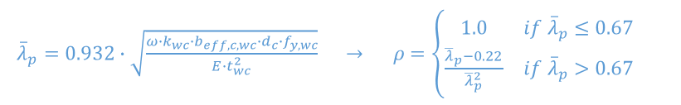

Plastic resistance $F_{y,Rd}^{CWC}$
$$→\boxed{F_{y,Rd}^{CWC}=\min\left(\frac{ω∙k_{wc}∙b_{eff,c,wc}∙f_{y,wc}}{γ_{M0}};ρ_{restr}∙\frac{ω∙k_{wc}∙b_{eff,c,wc}∙f_{y,wc}}{γ_{M1}}\right)}$$
EN 1993-1-8
Thick CWC
Slender CWC
${\overline{λ}}_{p}=0.932∙\sqrt{\frac{ω∙k_{wc}∙b_{eff,c,wc}∙d_{c}∙f_{y,wc}}{E∙t_{wc}^{2}}} → ρ=\left\{\begin{matrix}1.0 & if {\overline{λ}}_{p}≤0.67 \\ \frac{{\overline{λ}}_{p}−0.22}{{\overline{λ}}_{p}^{2}} & if {\overline{λ}}_{p}>0.67\end{matrix}\right.$
$$k_{cr}=\frac{4}{π}$$
13/20
Notes:
In the current version of Eurocode 3, the assumption of simple supports is made to derive this reduction coefficient
This assumption is quite conservative as local buckling is known to occur in the elastic field before significant yielding of the web
As a consequence, the web can be assumed to be fully restrained by the flanges

Slide 39
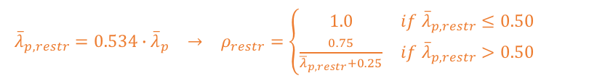

Plastic resistance $F_{y,Rd}^{CWC}$
$$→\boxed{F_{y,Rd}^{CWC}=\min\left(\frac{ω∙k_{wc}∙b_{eff,c,wc}∙f_{y,wc}}{γ_{M0}};ρ_{restr}∙\frac{ω∙k_{wc}∙b_{eff,c,wc}∙f_{y,wc}}{γ_{M1}}\right)}$$
EN 1993-1-8
Thick CWC
Slender CWC
${\overline{λ}}_{p}=0.932∙\sqrt{\frac{ω∙k_{wc}∙b_{eff,c,wc}∙d_{c}∙f_{y,wc}}{E∙t_{wc}^{2}}} → ρ=\left\{\begin{matrix}1.0 & if {\overline{λ}}_{p}≤0.67 \\ \frac{{\overline{λ}}_{p}−0.22}{{\overline{λ}}_{p}^{2}} & if {\overline{λ}}_{p}>0.67\end{matrix}\right.$
$$k_{cr}=\frac{4}{π}$$
New proposal
$\begin{matrix}{\overline{λ}}_{p,restr}=0.534∙{\overline{λ}}_{p} & → & ρ_{restr}=\left\{\begin{matrix}1.0 & if {\overline{λ}}_{p,restr}≤0.50 \\ \frac{0.75}{{\overline{λ}}_{p,restr}+0.25} & if {\overline{λ}}_{p,restr}>0.50\end{matrix}\right.\end{matrix}$
$$k_{cr}=\frac{14}{π}$$
13/20
Notes:
This is the assumption that is made in the present paper
This leads to a new value for the buckling coefficient and a new estimation of the reduced slenderness factor
In addition, the authors propose a new formula for the derivation of the reduction factor, which is a compromise between the current formula provided in the part 1-8 of Eurocode 3 ad the formula provided in the part 1-5 of Eurocode 3 dedicated to the design of plated structural elements

Slide 40
Plastic resistance $F_{y,Rd}^{CWC}$
$$→\boxed{F_{y,Rd}^{CWC}=\min\left(\frac{ω∙k_{wc}∙b_{eff,c,wc}∙f_{y,wc}}{γ_{M0}};ρ_{restr}∙\frac{ω∙k_{wc}∙b_{eff,c,wc}∙f_{y,wc}}{γ_{M1}}\right)}$$
EN 1993-1-8
Thick CWC
Slender CWC
${\overline{λ}}_{p}=0.932∙\sqrt{\frac{ω∙k_{wc}∙b_{eff,c,wc}∙d_{c}∙f_{y,wc}}{E∙t_{wc}^{2}}} → ρ=\left\{\begin{matrix}1.0 & if {\overline{λ}}_{p}≤0.67 \\ \frac{{\overline{λ}}_{p}−0.22}{{\overline{λ}}_{p}^{2}} & if {\overline{λ}}_{p}>0.67\end{matrix}\right.$
$$k_{cr}=\frac{4}{π}$$
New proposal
$\begin{matrix}{\overline{λ}}_{p,restr}=0.534∙{\overline{λ}}_{p} & → & ρ_{restr}=\left\{\begin{matrix}1.0 & if {\overline{λ}}_{p,restr}≤0.50 \\ \frac{0.75}{{\overline{λ}}_{p,restr}+0.25} & if {\overline{λ}}_{p,restr}>0.50\end{matrix}\right.\end{matrix}$
$$k_{cr}=\frac{14}{π}$$
13/20
Notes:
A comparison between the current formula in blue and the new proposed formula in orange shows that the proposal is a bit less conservative due to the improved boundary conditions

Slide 41

Post-plastic stiffness $K_{pp}^{CWC}$
$$→\boxed{\begin{matrix}K_{pp}^{CWC}=\frac{2∙E_{pp}∙t_{wc}∙\left(μ−1\right)∙\cot{α}}{μ∙\ln{μ}} & with μ=\frac{b_{eff,c,wc}+d_{c}∙\cot{α}}{b_{eff,c,wc}}\end{matrix}}$$
14/20
Notes:
For the derivation of the post-plastic stiffness, the following expression is proposed
Assumption diffusion angle alpha
Elastic contribution to the total deformation
Plastic contribution to the total deformation

Slide 42
Post-plastic stiffness $K_{pp}^{CWC}$
$$→\boxed{\begin{matrix}K_{pp}^{CWC}=\frac{2∙E_{pp}∙t_{wc}∙\left(μ−1\right)∙\cot{α}}{μ∙\ln{μ}} & with μ=\frac{b_{eff,c,wc}+d_{c}∙\cot{α}}{b_{eff,c,wc}}\end{matrix}}$$
14/20
Notes:
In order to develop this formula, one half of the column web has been studied as a beam element under compression
The compression force Fx is higher than the plastic resistance of the CWC

Slide 43
Post-plastic stiffness $K_{pp}^{CWC}$
$$→\boxed{\begin{matrix}K_{pp}^{CWC}=\frac{2∙E_{pp}∙t_{wc}∙\left(μ−1\right)∙\cot{α}}{μ∙\ln{μ}} & with μ=\frac{b_{eff,c,wc}+d_{c}∙\cot{α}}{b_{eff,c,wc}}\end{matrix}}$$
14/20
Notes:
The diffusion of the load-introduction force within the column web is assumed to be linear
And the diffusion angle was taken equal to 40°
This value was selected based on comparisons with experimental results

Slide 44
Post-plastic stiffness $K_{pp}^{CWC}$
$$→\boxed{\begin{matrix}K_{pp}^{CWC}=\frac{2∙E_{pp}∙t_{wc}∙\left(μ−1\right)∙\cot{α}}{μ∙\ln{μ}} & with μ=\frac{b_{eff,c,wc}+d_{c}∙\cot{α}}{b_{eff,c,wc}}\end{matrix}}$$
14/20
Notes:
Under this force Fx:
The column web is assumed to be in the post-plastic zone over the depth x
While it behaves elastically over the depth dc/2-x

Slide 45
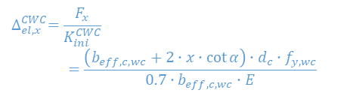
Post-plastic stiffness $K_{pp}^{CWC}$
$$→\boxed{\begin{matrix}K_{pp}^{CWC}=\frac{2∙E_{pp}∙t_{wc}∙\left(μ−1\right)∙\cot{α}}{μ∙\ln{μ}} & with μ=\frac{b_{eff,c,wc}+d_{c}∙\cot{α}}{b_{eff,c,wc}}\end{matrix}}$$
Elastic deformation
$$∆_{el,x}^{CWC}=\frac{F_{x}}{K_{ini}^{CWC}}$$
  $$=\frac{\left(b_{eff,c,wc}+2∙x∙\cot{α}\right)∙d_{c}∙f_{y,wc}}{0.7∙b_{eff,c,wc}∙E}$$
14/20
Notes:
Th elastic shortening of the web under the force Fx can be computed as follows
The evolution of this contribution for an increasing value of Fx is depicted on the picture

Slide 46
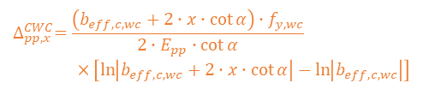
Post-plastic stiffness $K_{pp}^{CWC}$
$$→\boxed{\begin{matrix}K_{pp}^{CWC}=\frac{2∙E_{pp}∙t_{wc}∙\left(μ−1\right)∙\cot{α}}{μ∙\ln{μ}} & with μ=\frac{b_{eff,c,wc}+d_{c}∙\cot{α}}{b_{eff,c,wc}}\end{matrix}}$$
Elastic deformation
$$∆_{el,x}^{CWC}=\frac{F_{x}}{K_{ini}^{CWC}}$$
  $$=\frac{\left(b_{eff,c,wc}+2∙x∙\cot{α}\right)∙d_{c}∙f_{y,wc}}{0.7∙b_{eff,c,wc}∙E}$$
Plastic deformation
$$∆_{pp,x}^{CWC}=\frac{\left(b_{eff,c,wc}+2∙x∙\cot{α}\right)∙f_{y,wc}}{2∙E_{pp}∙\cot{α}}$$
  $$×\left[\ln\left|b_{eff,c,wc}+2∙x∙\cot{α}\right|−\ln\left|b_{eff,c,wc}\right|\right]$$
14/20
Notes:
Similarly, the post-plastic shortening of the web under Fx is given by the following formula
(it is obtained form the integration of an incremental displacement over the depth x)
And the evolution of this contribution for an increasing value of Fx is depicted on the picture in orange

Slide 47

Post-plastic stiffness $K_{pp}^{CWC}$
$$→\boxed{\begin{matrix}K_{pp}^{CWC}=\frac{2∙E_{pp}∙t_{wc}∙\left(μ−1\right)∙\cot{α}}{μ∙\ln{μ}} & with μ=\frac{b_{eff,c,wc}+d_{c}∙\cot{α}}{b_{eff,c,wc}}\end{matrix}}$$
Elastic deformation
$$∆_{el,x}^{CWC}=\frac{F_{x}}{K_{ini}^{CWC}}$$
  $$=\frac{\left(b_{eff,c,wc}+2∙x∙\cot{α}\right)∙d_{c}∙f_{y,wc}}{0.7∙b_{eff,c,wc}∙E}$$
Plastic deformation
$$∆_{pp,x}^{CWC}=\frac{\left(b_{eff,c,wc}+2∙x∙\cot{α}\right)∙f_{y,wc}}{2∙E_{pp}∙\cot{α}}$$
  $$×\left[\ln\left|b_{eff,c,wc}+2∙x∙\cot{α}\right|−\ln\left|b_{eff,c,wc}\right|\right]$$
Full deformation
14/20
$$∆_{tot,x}^{CWC}=∆_{el,x}+∆_{pp,x}$$
Notes:
The total shortening of the web can eventually be computed as the sum of the elastic and post-plastic contributions

Slide 48

Post-plastic stiffness $K_{pp}^{CWC}$
$$→\boxed{\begin{matrix}K_{pp}^{CWC}=\frac{2∙E_{pp}∙t_{wc}∙\left(μ−1\right)∙\cot{α}}{μ∙\ln{μ}} & with μ=\frac{b_{eff,c,wc}+d_{c}∙\cot{α}}{b_{eff,c,wc}}\end{matrix}}$$
Elastic deformation
$$∆_{el,x}^{CWC}=\frac{F_{x}}{K_{ini}^{CWC}}$$
  $$=\frac{\left(b_{eff,c,wc}+2∙x∙\cot{α}\right)∙d_{c}∙f_{y,wc}}{0.7∙b_{eff,c,wc}∙E}$$
$$α=40°$$
Plastic deformation
$$∆_{pp,x}^{CWC}=\frac{\left(b_{eff,c,wc}+2∙x∙\cot{α}\right)∙f_{y,wc}}{2∙E_{pp}∙\cot{α}}$$
  $$×\left[\ln\left|b_{eff,c,wc}+2∙x∙\cot{α}\right|−\ln\left|b_{eff,c,wc}\right|\right]$$
Full deformation
14/20
$$∆_{tot,x}^{CWC}=∆_{el,x}+∆_{pp,x}$$
Notes:
The final expression of the post-plastic stiffness is obtained from the linearization of this total deformation

Slide 49

Ultimate resistance $F_{u,Rd}^{CWC}$
$$→\boxed{F_{u,Rd}^{CWC}=\max\left(F_{u,pp,Rd}^{CWC};F_{u,ep,Rd}^{CWC}\right)}$$
Thick CWC
Slender CWC
15/20
Notes:
For the derivation of the ultimate resistance, it can be obtained as the maximum of two expressions

Slide 50
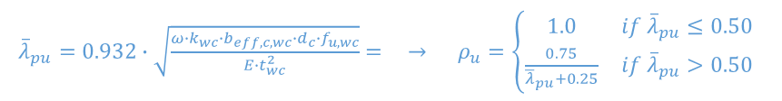


Ultimate resistance $F_{u,Rd}^{CWC}$
$$→\boxed{F_{u,Rd}^{CWC}=\max\left(F_{u,pp,Rd}^{CWC};F_{u,ep,Rd}^{CWC}\right)}$$
Thick CWC
Slender CWC
Thick CWC
${\overline{λ}}_{pu}=0.932∙\sqrt{\frac{ω∙k_{wc}∙b_{eff,c,wc}∙d_{c}∙f_{u,wc}}{E∙t_{wc}^{2}}}= → ρ_{u}=\left\{\begin{matrix}1.0 & if {\overline{λ}}_{pu}≤0.50 \\ \frac{0.75}{{\overline{λ}}_{pu}+0.25} & if {\overline{λ}}_{pu}>0.50\end{matrix}\right.$
$$k_{cr}=\frac{4}{π}$$
$F_{Ru,pp,Rd}^{CWC}$= $\min\left(\frac{ω∙k_{wc}∙b_{eff,c,wc}∙f_{u,wc}}{γ_{M0}};ρ_{u}∙\frac{ω∙k_{wc}∙b_{eff,c,wc}∙f_{u,wc}}{γ_{M1}}\right)$
15/20
Notes:
In this formula, the first contribution refers to the resistance of a thick column web
For such column web significant plasticity can develop in the web at the border with the flanges before the ultimate resistance is reached due to buckling or due to the attainment of the material ultimate strength
Therefore it can be assumed pinned boundary conditions, leading to the following values of the reduction coefficient and subsequently of the ultimate resistance

Slide 51
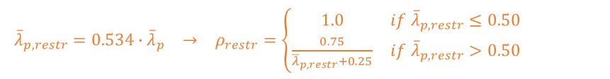
Ultimate resistance $F_{u,Rd}^{CWC}$
$$→\boxed{F_{u,Rd}^{CWC}=\max\left(F_{u,pp,Rd}^{CWC};F_{u,ep,Rd}^{CWC}\right)}$$
Thick CWC
Slender CWC
Thick CWC
${\overline{λ}}_{pu}=0.932∙\sqrt{\frac{ω∙k_{wc}∙b_{eff,c,wc}∙d_{c}∙f_{u,wc}}{E∙t_{wc}^{2}}}= → ρ_{u}=\left\{\begin{matrix}1.0 & if {\overline{λ}}_{pu}≤0.50 \\ \frac{0.75}{{\overline{λ}}_{pu}+0.25} & if {\overline{λ}}_{pu}>0.50\end{matrix}\right.$
$$k_{cr}=\frac{4}{π}$$
$F_{Ru,pp,Rd}^{CWC}$= $\min\left(\frac{ω∙k_{wc}∙b_{eff,c,wc}∙f_{u,wc}}{γ_{M0}};ρ_{u}∙\frac{ω∙k_{wc}∙b_{eff,c,wc}∙f_{u,wc}}{γ_{M1}}\right)$
Slender CWC
$\begin{matrix}{\overline{λ}}_{p,restr}=0.534∙{\overline{λ}}_{p} & → & ρ_{restr}=\left\{\begin{matrix}1.0 & if {\overline{λ}}_{p,restr}≤0.50 \\ \frac{0.75}{{\overline{λ}}_{p,restr}+0.25} & if {\overline{λ}}_{p,restr}>0.50\end{matrix}\right.\end{matrix}$
$$k_{cr}=\frac{14}{π}$$
$F_{Ru,ep,Rd}^{CWC}$= $F_{y,Rd}^{CWC}$
15/20
Notes:
The second term of the equation refers to the resistance of a slender column web
In this case, buckling is known to occur in the elastic field and fixed boundary conditions can be assumed
And the formula for the plastic resistance also applies for the ultimate resistance

Slide 52

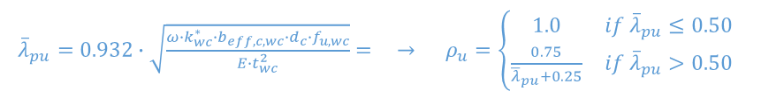
Ultimate resistance $F_{u,Rd}^{CWC}$
$$→\boxed{F_{u,Rd}^{CWC}=\max\left(F_{u,pp,Rd}^{CWC};F_{u,ep,Rd}^{CWC}\right)}$$
Thick CWC
Slender CWC
Thick CWC
${\overline{λ}}_{pu}=0.932∙\sqrt{\frac{ω∙k_{wc}^{∗}∙b_{eff,c,wc}∙d_{c}∙f_{u,wc}}{E∙t_{wc}^{2}}}= → ρ_{u}=\left\{\begin{matrix}1.0 & if {\overline{λ}}_{pu}≤0.50 \\ \frac{0.75}{{\overline{λ}}_{pu}+0.25} & if {\overline{λ}}_{pu}>0.50\end{matrix}\right.$
$$k_{cr}=\frac{4}{π}$$
$F_{Ru,pp,Rd}^{CWC}$= $\min\left(\frac{ω∙k_{wc}^{∗}∙b_{eff,c,wc}∙f_{u,wc}}{γ_{M0}};ρ_{u}∙\frac{ω∙k_{wc}^{∗}∙b_{eff,c,wc}∙f_{u,wc}}{γ_{M1}}\right)$
Slender CWC
$\begin{matrix}{\overline{λ}}_{p,restr}=0.534∙{\overline{λ}}_{p} & → & ρ_{restr}=\left\{\begin{matrix}1.0 & if {\overline{λ}}_{p,restr}≤0.50 \\ \frac{0.75}{{\overline{λ}}_{p,restr}+0.25} & if {\overline{λ}}_{p,restr}>0.50\end{matrix}\right.\end{matrix}$
$$k_{cr}=\frac{14}{π}$$
$F_{Ru,ep,Rd}^{CWC}$= $F_{y,Rd}^{CWC}$
15/20
Notes:
This formula is depicted in orange in the present figure for a specific value of fu equal to 1.2 times fy

Slide 53
Ultimate resistance $F_{u,Rd}^{CWC}$
$$→\boxed{F_{u,Rd}^{CWC}=\max\left(F_{u,pp,Rd}^{CWC};F_{u,ep,Rd}^{CWC}\right)}$$
Thick CWC
Slender CWC
Thick CWC
${\overline{λ}}_{pu}=0.932∙\sqrt{\frac{ω∙k_{wc}^{∗}∙b_{eff,c,wc}∙d_{c}∙f_{u,wc}}{E∙t_{wc}^{2}}}= → ρ_{u}=\left\{\begin{matrix}1.0 & if {\overline{λ}}_{pu}≤0.50 \\ \frac{0.75}{{\overline{λ}}_{pu}+0.25} & if {\overline{λ}}_{pu}>0.50\end{matrix}\right.$
$$k_{cr}=\frac{4}{π}$$
$F_{Ru,pp,Rd}^{CWC}$= $\min\left(\frac{ω∙k_{wc}^{∗}∙b_{eff,c,wc}∙f_{u,wc}}{γ_{M0}};ρ_{u}∙\frac{ω∙k_{wc}^{∗}∙b_{eff,c,wc}∙f_{u,wc}}{γ_{M1}}\right)$
Slender CWC
$\begin{matrix}{\overline{λ}}_{p,restr}=0.534∙{\overline{λ}}_{p} & → & ρ_{restr}=\left\{\begin{matrix}1.0 & if {\overline{λ}}_{p,restr}≤0.50 \\ \frac{0.75}{{\overline{λ}}_{p,restr}+0.25} & if {\overline{λ}}_{p,restr}>0.50\end{matrix}\right.\end{matrix}$
$$k_{cr}=\frac{14}{π}$$
$F_{Ru,ep,Rd}^{CWC}$= $F_{y,Rd}^{CWC}$
15/20
Notes:
And the final ultimate resistance of the column web is eventually obtained as the maximum of the two expressions

Slide 54


Ultimate deformation capacity $∆_{u}^{CWC}$
$$→\boxed{∆_{u}^{CWC}=\max\left(\frac{F_{u,Rd}^{CWC}−F_{y,Rd}^{CWC}}{K_{pp}^{CWC}};\frac{F_{u,Rd}^{CWC}}{K_{ini}^{CWC}}\right)}$$
Initial stiffness $K_{ini}^{CWC}$
Plastic resistance $F_{y,Rd}^{CWC}$
Post-plastic stiffness $K_{pp}^{CWC}$
Ultimate resistance $F_{u,Rd}^{CWC}$
➔ 4 key parameters:
$$∆_{u}^{CWC}$$
16/20
Notes:
Knowing the post-plastic stiffness and the ultimate resistance, the deformation capacity of the CWC easily obtained by construction, using the following formula

Slide 55
Validation against experimental results
17/20
Reference: F. Kühnemund, Verification of the Rotation Capacity of Joints in Steel Structures (in German) (Ph.D. thesis), University of Stuttgart, Stuttgart (Germany, 2003).
Notes:
This new analytical model has been validated against the tests A6 and B6 similarly to the Eurocode 3 model
Comparisons show that the new model depicted in red in the figures provides a very good estimation of the CWC behaviour up to the local buckling of the latter
It clearly outperforms the current EN 1993-1-8 model which is depicted in blue in the figure

Slide 56
Outline
Introduction
Literature review: EN 1993-1-8 model
New analytical model
Conclusions & perspectives
18/20
Notes:
Let’s move to the conclusions and perspectives

Slide 57
Context of the research
1. Identification
A. Component in shear
2. Characterization
EN 1993-1-8
Def. capacity?
B. Components in tension
3. Assembly
EN 1993-1-8
This paper
Def. capacity?
EN 1993-1-8
C. Component in compression
New proposal
EN 1993-1-8
Ductility?
Def. capacity
19/20
Notes:
In the present article, a new model has been developed for the prediction of the complete deformation curve of the CWC component

Slide 58
Context of the research
1. Identification
Other available results
A. Component in shear
2. Characterization
New proposal
EN 1993-1-8
Def. capacity
B. Components in tension
3. Assembly
EN 1993-1-8
Def. capacity?
EN 1993-1-8
C. Component in compression
New proposal
EN 1993-1-8
Ductility?
Def. capacity
19/20
Notes:
A similar work has already been achieved for the column web panel in shear component

Slide 59
Context of the research
1. Identification
A. Component in shear
2. Characterization
New proposal
EN 1993-1-8
Under investigation
Def. capacity
B. Components in tension
3. Assembly
EN 1993-1-8
Def. capacity?
EN 1993-1-8
C. Component in compression
New proposal
EN 1993-1-8
Ductility?
Def. capacity
19/20
Notes:
While the components in tension are currently being investigated within the research team

Slide 60
Context of the research
1. Identification
A. Component in shear
2. Characterization
New proposal
EN 1993-1-8
Def. capacity
B. Components in tension
New assembly model
3. Assembly
EN 1993-1-8
New proposal
Def. capacity?
EN 1993-1-8
C. Component in compression
New proposal
EN 1993-1-8
Ductility
Def. capacity
19/20
Notes:
Finally, a new generalised mechanical model has also been developed within the research team which tackles the shortcomings of the model currently used in the Eurocode 3

Slide 61
List of publications
Column web in compression
  Jaspart, J.-P., Corman, A., Demonceau, J.-F. (2022) « Characterization of column webs in transverse compression in steel beam-to-column joints ». Thin-Walled Structures, Vol. 180, no. 109848. https://doi.org/10.1016/j.tws.2022.109848
Column web panel in shear
  Corman, A., Demonceau, J.-F., Jaspart, J.-P. (2022) « Analytical model for the panel zone resistance in welded steel beam-to-column joints ». Journal of Constructional Steel Research, Vol. 189, no. 107099. https://doi.org/10.1016/j.jcsr.2021.107099
  Corman, A., Demonceau, J.-F., Jaspart, J.-P. (2021) « Analytical model for the prediction of the plastic shear resistance of the panel zone in welded joints ». CE/papers, Vol. 4, no. 2–4, pp. 995-1005. https://doi.org/10.1002/cepa.1389
  Corman, A., Jaspart, J.-P., Demonceau, J.-F. (2019) « Resistance of the beam-to-column component “column web panel in shear” ». Steel Construction, Vol. 12, no. 3, pp. 322–230. https://doi.org/10.1002/stco.201900020
Assembly procedure
  Golea, T., Corman, A., Mathieu, J., Jaspart, J.-P., Demonceau, J.-F. (2022) « A generalised innovative mechanical model for structural joints ». Engineering structures (under submission).
20/20
Notes:
More information about this research projet may be found in the already published articles that are listed on this slide

Slide 62
Thank you for listening !
Adrien Corman
PhD candidate
University of Liège (ULiège)
Adrien.Corman@uliege.be

Slide 64
List of publications
Column web in compression
  Jaspart, J.-P., Corman, A., Demonceau, J.-F. (2022) « Characterization of column webs in transverse compression in steel beam-to-column joints ». Thin-Walled Structures, Vol. 180, no. 109848. https://doi.org/10.1016/j.tws.2022.109848
Column web panel in shear
  Corman, A., Demonceau, J.-F., Jaspart, J.-P. (2022) « Analytical model for the panel zone resistance in welded steel beam-to-column joints ». Journal of Constructional Steel Research, Vol. 189, no. 107099. https://doi.org/10.1016/j.jcsr.2021.107099
  Corman, A., Demonceau, J.-F., Jaspart, J.-P. (2021) « Analytical model for the prediction of the plastic shear resistance of the panel zone in welded joints ». CE/papers, Vol. 4, no. 2–4, pp. 995-1005. https://doi.org/10.1002/cepa.1389
  Corman, A., Jaspart, J.-P., Demonceau, J.-F. (2019) « Resistance of the beam-to-column component “column web panel in shear” ». Steel Construction, Vol. 12, no. 3, pp. 322–230. https://doi.org/10.1002/stco.201900020
Assembly procedure
  Golea, T., Corman, A., Mathieu, J., Jaspart, J.-P., Demonceau, J.-F. (2022) « A generalised innovative mechanical model for structural joints ». Engineering structures (under submission).
20/20

