Slide 1


Contribution from sleep & circadian research to the understanding of cognition and brain ageing
Christina Schmidt
GIGA-CRC in Vivo Imaging
University of Liège, Belgium
Session: Diverse Approaches to Understanding Clocks and Sleep in Disease
Monday July 26th 2022, Zürich, Switzerland
Notes:
First, I would like to thank the conference organizers for the opportunity to give a talk in the context of this session. In the upcoming I would like to discuss some findings from my group about sleep and circadian rhythms, cognition and brain ageing.

Slide 2
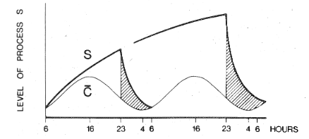
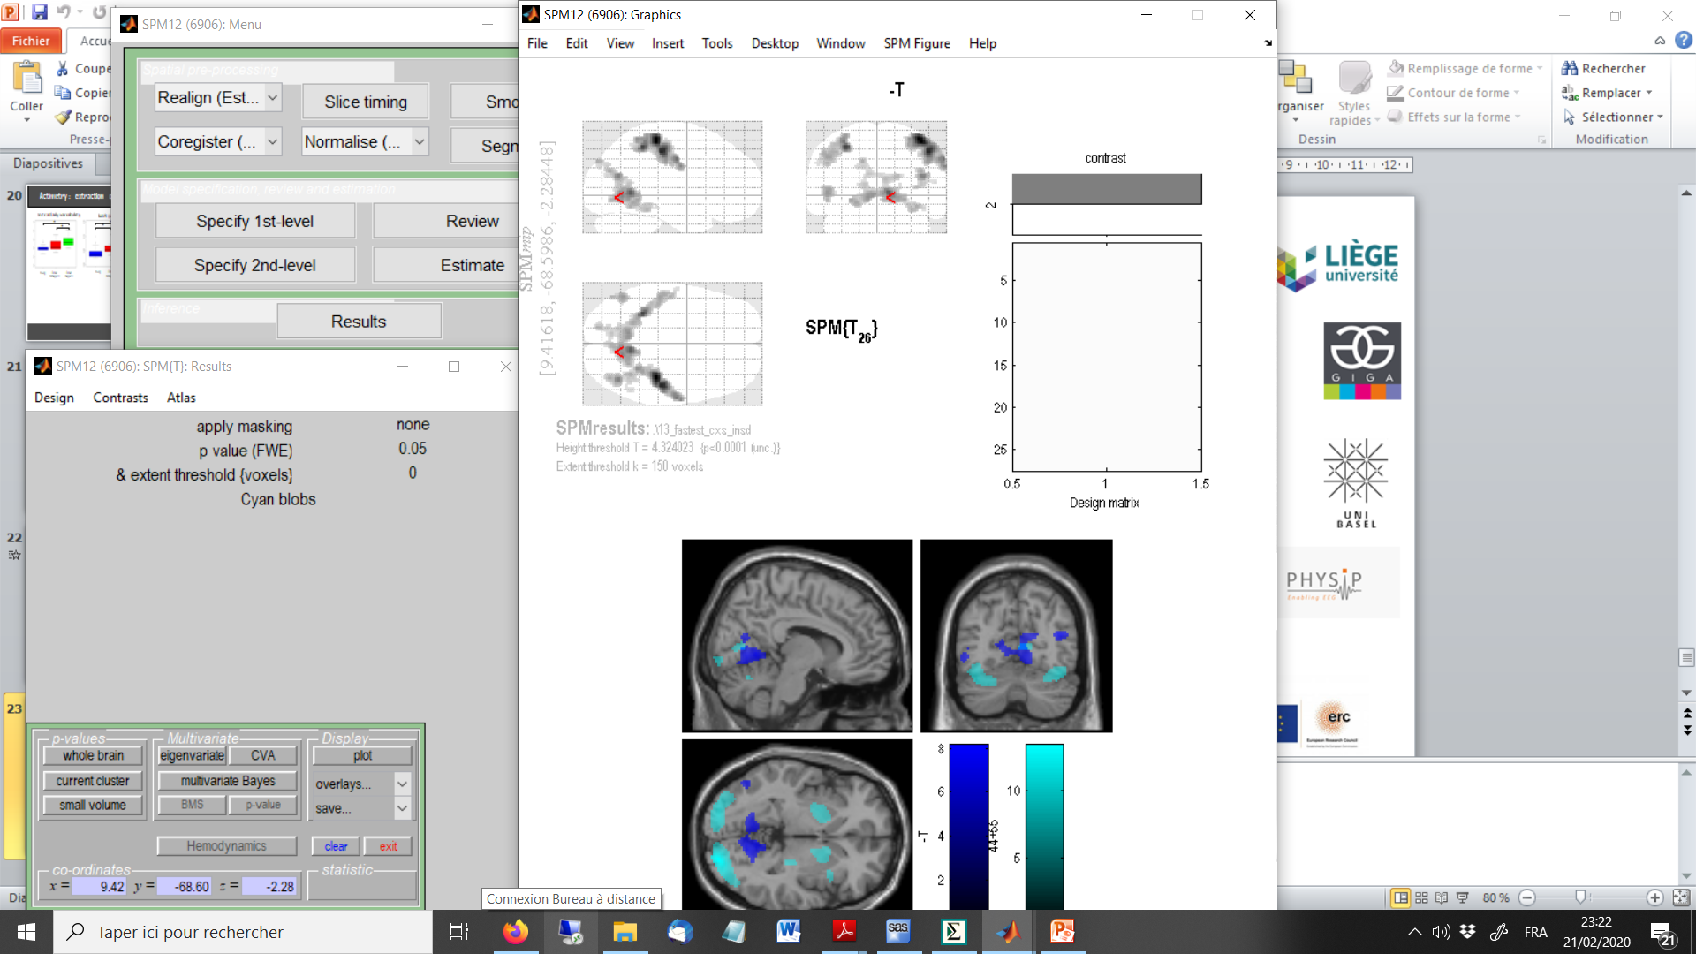
Sleep-Wake Regulation & Neurobehavioral Function
20
0
-20
Subjective Alertness (mm)
-40
-60
3.0
2.8
Borbély, 1982, Daan & Borbély 1984
2.6
2.4
Sustained attention
2.2
2.0
1.8
1.6
8
16
24
8
16
24
5.0
Time of day (h)
Modified from Dijk et al., 1992; Muto et al., 2016
BOLD signal (a.u.)
2.5
Muto et al., 2016
Maire et al., 2018
0.0
8
16
24
8
16
24
Time of day (h)
Muto et al., 2016
e.g. Dijk et al. 1992, Cajochen et al., 1999, Reichert et al., 2014, Maire et al., 2014, Muto et al., 2016
Notes:
The two-process model of SW regulation posits that the circadian timing system modulates the sleep-wake cycle by generating an oscillatory signal that acts in opposition to wake-dependent homeostatic sleep propensity; promoting wake during the biological day and promoting sleep during the night.
Importantly, this model not only simulates successfully the timing and intensity of sleep but has also been shown to explain temporal modulations in alertness, vigilance or neurobehavioral performance. The phase relation between the circadian pacemaker and the sleep-wake cycle is uniquely timed to maintain stable alertness and performance levels throughout a typical waking day. Obviously, extending wakefulness into the biological night is associated with steep decreases in alertness. However when wakefulness is further extended into daytime, alertness and performance partially recovers, most likely due to the reactivation of a circadian alerting signal.
Interestingly, we observed that BOLD activation underlying vigilance performance underwent a very similar pattern. This is highlighted here by the conjunction of two independent studies (depicted in dark and light blue) and both assessing BOLD activation underlying vigilance performance over a 40 hours sleep deprivation protocol. You can see that a remarkably similar profile to the one observed for alertness or vigilance was observed.
Furthermore, one of these studies revealed that cerebral responses over nearly the entire cortical mantle showed significant circadian rhythmicity, the phase of which varied across brain regions, thereby underlining a regional modulation of the cerebral correlates underlying vigilance by sleep dept and circadian phase.
Together, these findings posit …

Slide 3
Sleep homeostasis and circadian rhythmicity
=
Powerful modulators of human brain function
Cognitive & Brain Aging?
Notes:
Having said that, a next question that arises is the role and the importance of these regulating systems on the individual’s cognitive and brain aging trajectory.

Slide 4
Age-related changes in sleep-wake regulation
Earlier bed & wake-up times
Reduced night-time sleep duration
Reduced slow wave sleep/slow wave activity/increased sleep fragmentation
Decreased daytime sleepiness/sleep propensity
Altered activity-dependent built-up of homeostatic sleep pressure during wake
Concomitant reduction of circadian wake propensity rhythm amplitude
5
Notes:
Classically, healthy older people sleep go to bed and wake up earlier, sleep less and show reduced SWS/SWA and increased sleep fragmentation. Interestingly, during healthy aging, these changes appear not to be necessarly associated with increased daytime sleepiness, but rather decreased levels of daytime sleepiness have been reported.
Reported age-related changes in sleep may be best explained by an overall age-related reduction in sleep need and a concomitant amplitude reduction of circadian wake propensity rhythm.

Slide 5
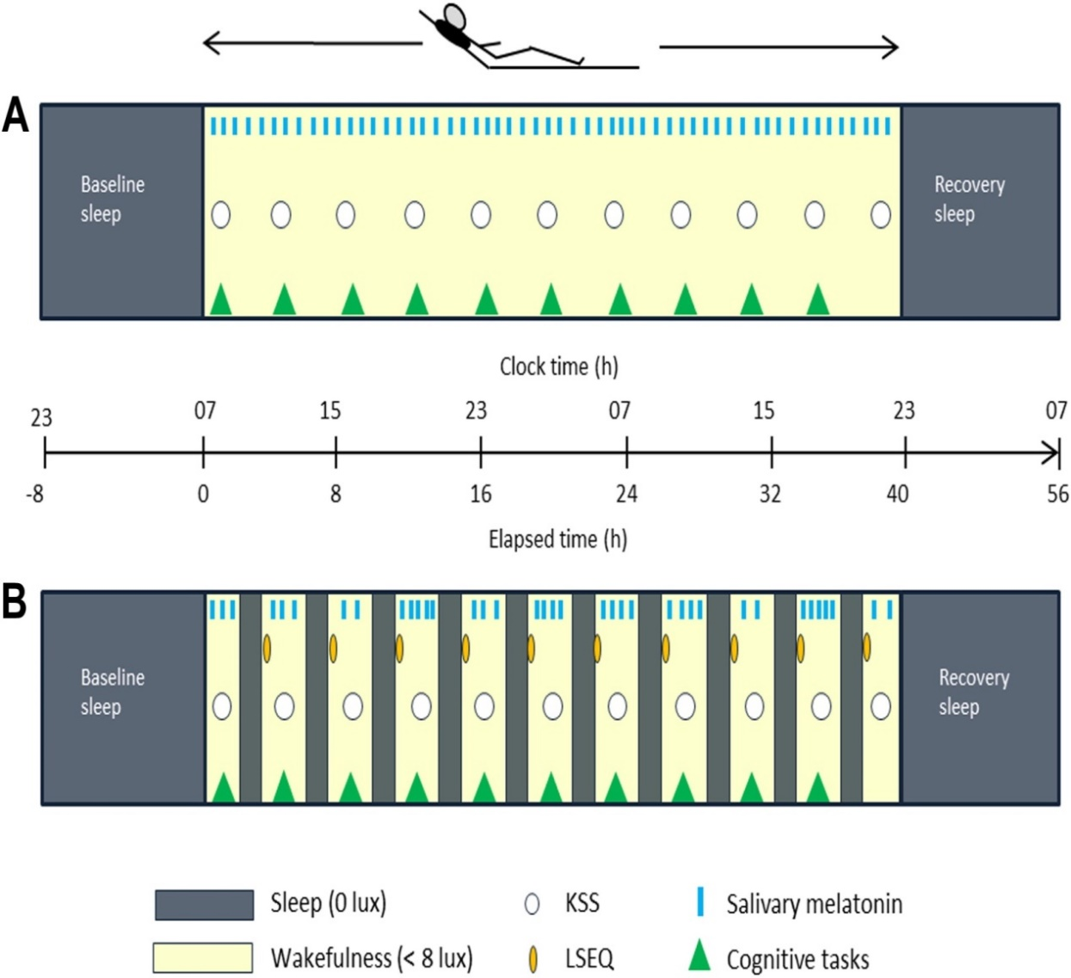
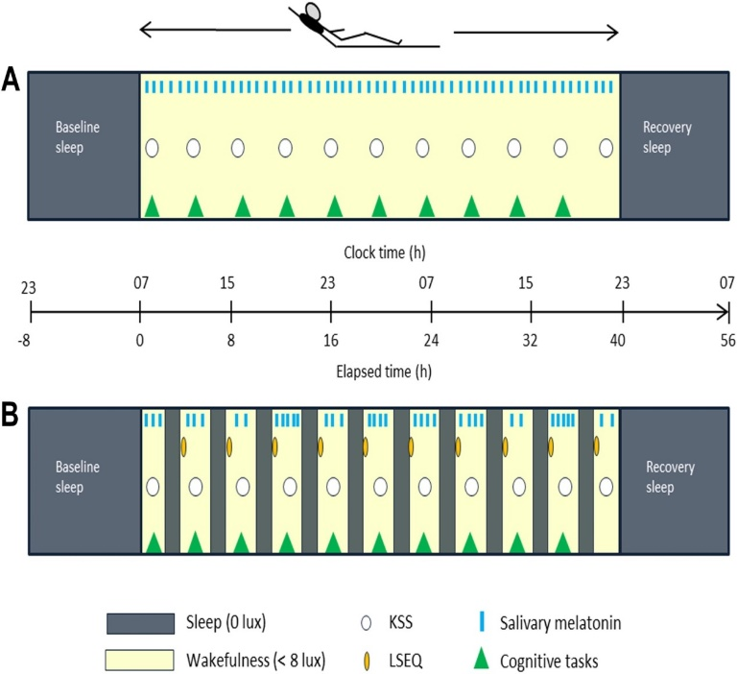
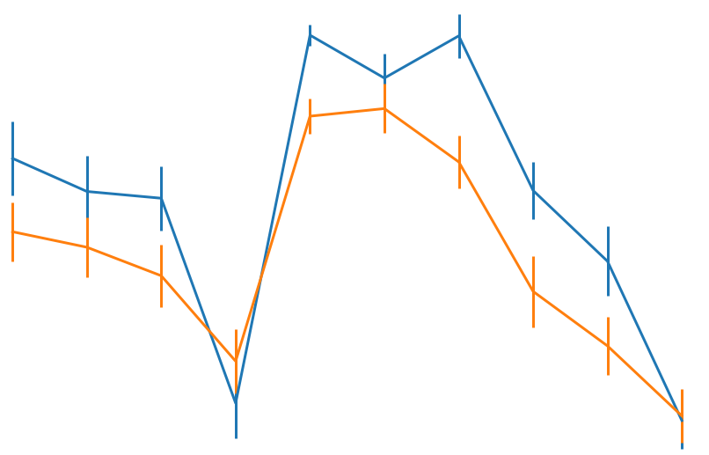
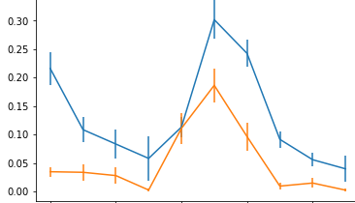
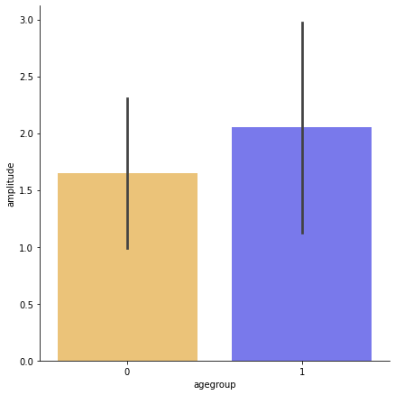
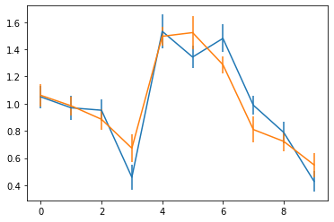
Age-related changes in sleep-wake regulation: Circadian amplitude
Older (n=30)
Young (n=30)
Age: F(1,53)=6.1, p<0.05
Age*Session: F(9,477) = 1.8, p = 0.059
Age: F(1,53)=29.6, p<0.05
Age*Session: F(9,477) = 3.27, p < 0.05
Night
90
Age: p<0.05
80
70
Sleep efficiency (%)
REM sleep (proportion TST)
60
50
Circadian amplitude
40
30
20
2
10
18
26
34
2
10
18
26
34
Age group
Time into protocol (hrs)
(0=wake-up from baseline night)
Time into protocol (hrs)
(0=wake-up from baseline night)
Deantoni et al., in prep
Notes:
One option to assess circadian amplitude in sleep-wake propensity drives is to apply mutliple nap protocol allowing to assess sleep ability over the circadian cycle. Participants enter in the laboratory for a baseline sleep and than undergo a multiple nap protocol encompassing for example 10 80-minutes nap opportunities over a 40-hours protocol.
By using such a protocol, age-related changes can indeed be detected. Plotted here is the sleep efficiency during the nap opportunities over the protocol in young adults in blue and in older adults in orange. A clear circadian modulation can be detected in both groups, with reduced sleep efficienies over daytime compared to night-time, but an overall reduced sleep propensity in the aged
as well as a reduced circadian amplitude compared to younger individuals (if we compute the differences in sleep efficiency between daytime and night-time sleep opportunities).
.

Slide 6
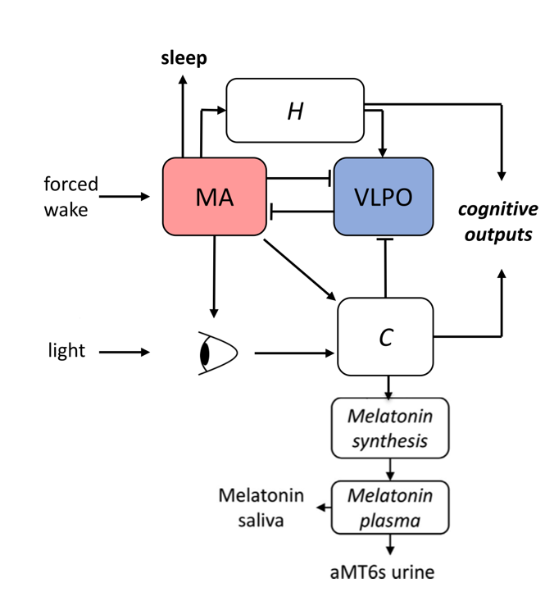
Age-related changes in sleep-wake regulation
Model of arousal state dynamics (S.Postnova, USydney)
90
80
Model simulation with default values (young)
70
60
Sleep efficiency
Model tuned to the aged
50
40
30
20
10
18
26
34
2
10
18
26
Time into protocol (hrs)
Agreement between prediction and data* is increased by reducing the parameter for circadian amplitude & input to the monoaminergic drive below the defaults of the young population
DeHaan et al., in prep
Confirmation of role of circadian wake promoting drive for reported age-related changes in sleep
Notes:
In collaboration with S.Postnova from the University of Sydney, we than applied a physiological mathematical model of of arousal state dynamics to our data data. On this graph, black dots highlight the SE over the multiple nap protocol while the blue line reflects the model simulation with the default values for a population tuned to healthy young individuals.
Scanning of the model parameters revealed that for the best prediction (oragne line) could only be achieved by drasticly reducing the parameter for circadian amplitude (nuVC), but also the input of the monoaminergic drive and this, whatever the changes performed in the other parameters.
These results thereby confirm the important role of circadian amplitude of the sleep-wake propensity drive to understand age-related changes in sleep.
Now, I’m already at the half of my talk and not yet spoke a lot about the functional relevance of circadian sleep regulation in the aged.

Slide 7
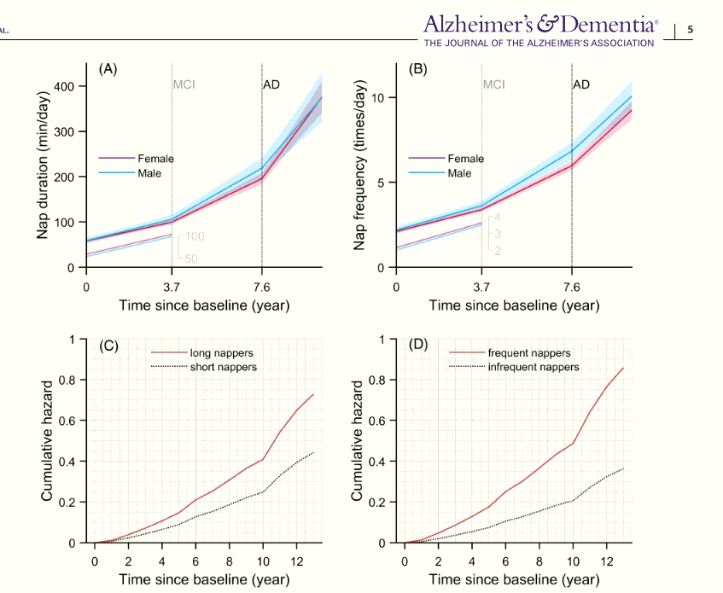
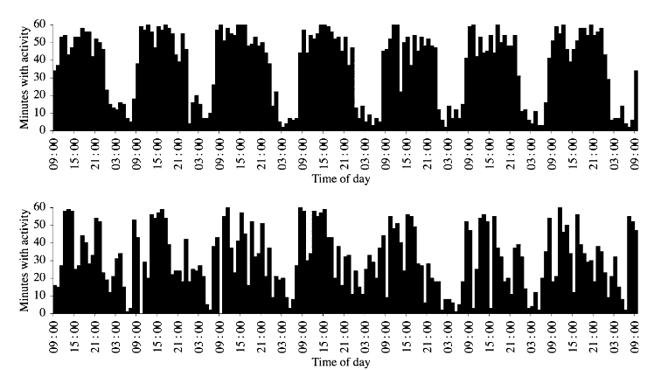
Circadian amplitude - Temporal organisation of 24-h rest-activity
From Oosterman et al., 2009
Day = activity/wake
Night = rest/sleep
Li et al., 2022
Daytime napping
66.7
52.0
Chronic napping as a reflection of altered circadian sleep regulation?
% Nappers
38.3
23.5
19.8
12.6
13.9
20-30 y.
41-50 y.
61-70 y.
81-90 y.
Chronic napping: a “health indicator” of the aging brain?
31-40 y.
51-60 y.
71-80 y.
Wirz-Justice, Cannes, 1991
Notes:
In everyday life, a visible manifestation of altered circadian sleep-wake propensity is putatively altered temporal organisation of 24-h rest-activity profiles. More precisely, the circadian clock is timed to promote wakefulness during the day and sleep during the night. Circadian clock alteration would thereby lead to a less distinct allocation of rest or sleep to night-time and of activity or wakefulness to daytime.
The consequences are fragmented 24-h rest-activity profiles as depicted by actimetry recordings here.
Within this context, it might be assumed that chronic napping in the aged reflects altered circadian sleep regulation.
Chronic napping habits increase with advancing age such that more than half of adults aged 70 and above nap at least twice a week.
Important here is that a series of epidemiological studies link chronic napping habits to cognitive decline and also increased beta amyloid burden, especially if naps are frequent, long (>1h) and unplanned.
A very recent study for example show quite strong support for a bi-directional link between chronici nappin and the development and progression of AD.. The upper plot here shows cumulative hazard functions for nap duration (C) or nap frequency (D) for two representative individuals. Individuals who napped ≥1hour/day(longnappers) had1.4-fold increased risk compared to those who napped <1hour/day (short nappers). Participants who napped once or more than once a day (frequent nappers) had 40% increased risk of developing Alzheimer’s dementia compared to those who napped less than once a day (infrequent nappers
Chronic napping in the aged indeed starts to be used as a health risk factor during aging.

Slide 8
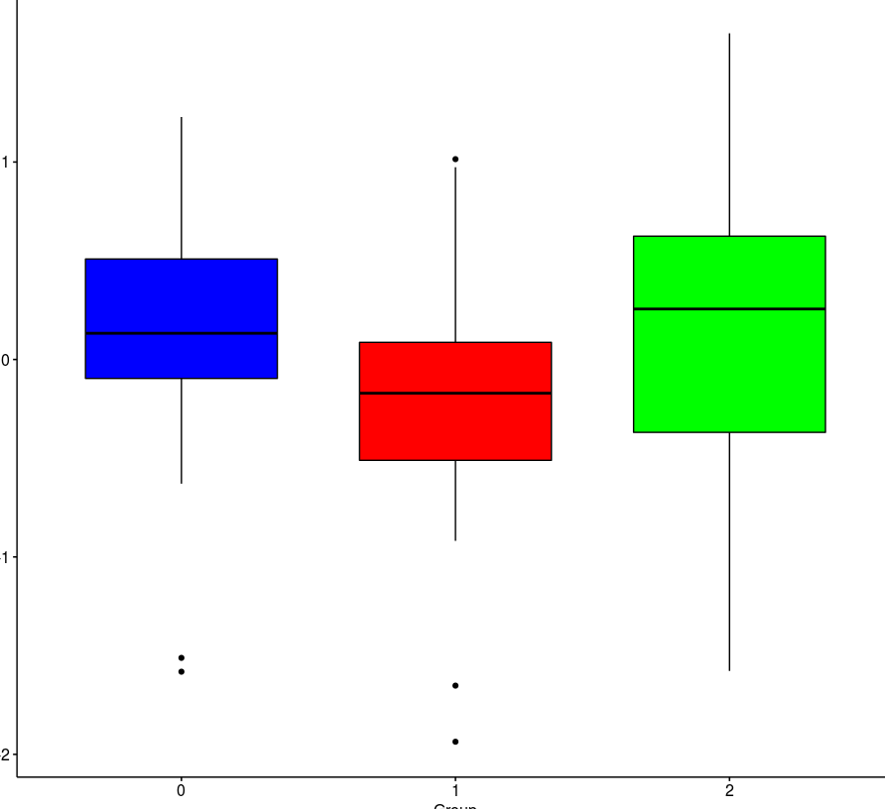
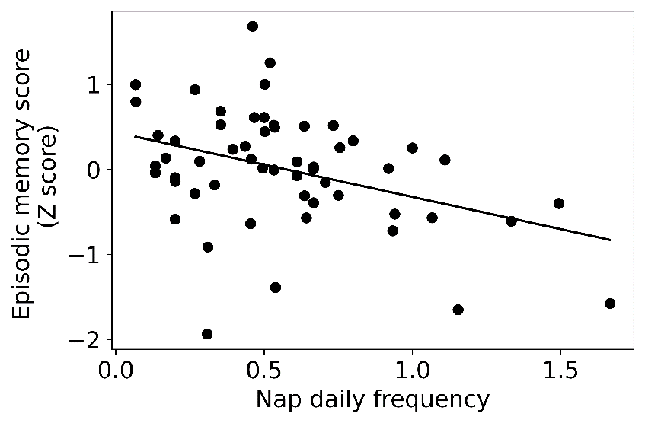
Daytime napping & cognition in aging
Episodic memory
(30 nappers, 30 no-nappers, matched for age, sexe and educational level, season of assessment)
t = -2.26, p < 0.05,
Non-nappers
Nappers
Reyt et al., under review
Napping: Impact on cognition
Health indicator in the context of age-related cognitive decline?
Notes:
Considering that, we prospectively recruited healthy older individuals with respect to their napping habits and tested first whether we can confirm previous observations of an assocation between daytime napping and cognition in the aged.
To do so, different cognitive domains, including attention performance, episodic memory and executive functions were probed.
We observed that for episodic memory, nappers (depicted here in red) performed significantly worse than no-nappers.
Similarly, when extracting nap frequency as a continuous variable derived from actimetry, we observed that, daytime rest nap frequency was significantly negatively associated with episodic memory performance which is also congruent with previous littérature reports.
Overall, these results confirm an impact of napping on cognition. However, thereby promoting napping as al health risk might be too premature at the current stage, not only since it highly depends on the combination of different nap characteristics, but also not yet know a lot about the regulation processes underlying napping in the aged.

Slide 9
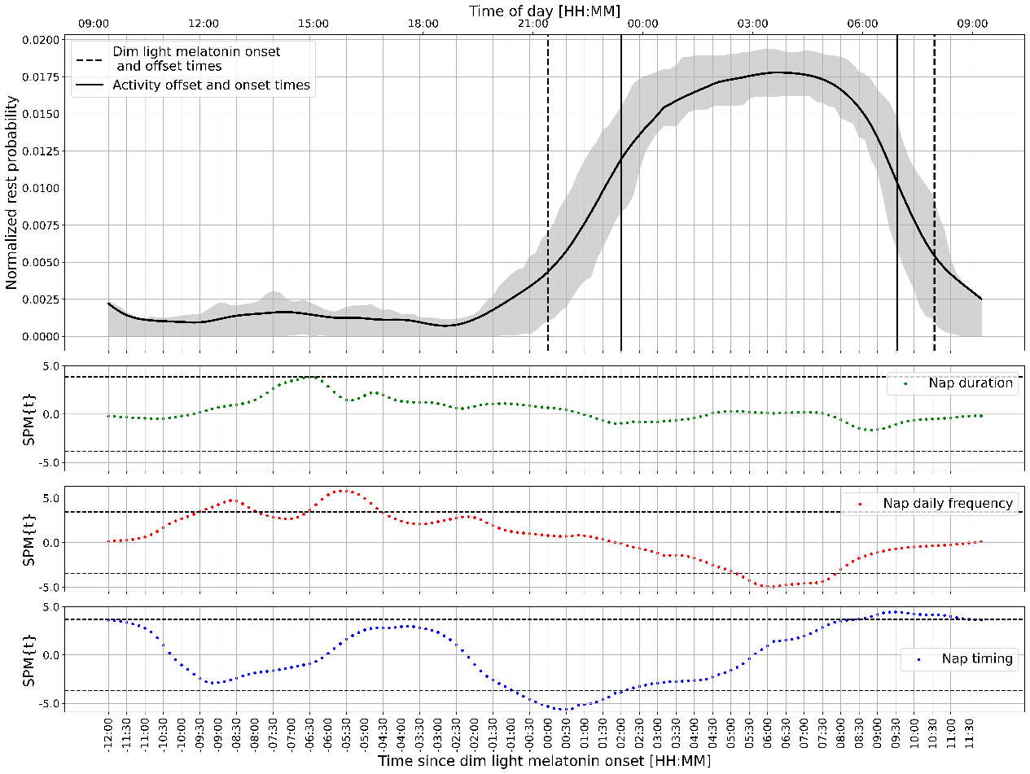
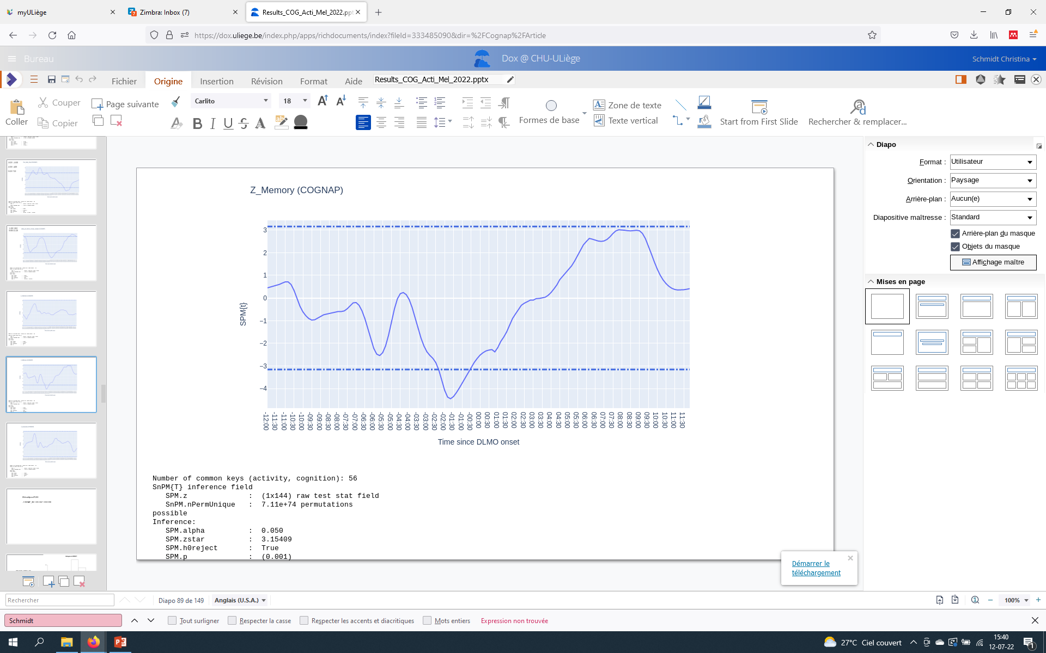
Nap frequency: Association with 24-rest/activity organisation
Episodic memory: Association with 24-rest/activity organisation
Notes:
Nap frequency appears thus to have a functional significance in the context of cognitive ageing. We further explored the impact of daytime rest bout frequency and the concomitant 24-h organization of the rest-activity cycle . Plotted here is the normalised 24-h rest probability profile of a group of healther older nappers and no-nappers. The dotted line represents the group averaged dim light melatonin onset and offset times and the straight line here the average actitivy onset and offset times. We tested whether the number of detected daytime rest bouts affects rest probabilities over the 24-h cycle. The statistical map is depicted here by this line, where it can be observed that higher DTR frequency is obvioulsy associated with increased rest probabilities during the classical napping window in the afternoon: here between 12-16, but increased DTR rest is also negatively associated with rest probabilities in the second half of the night, such that higher frequency goes along with reduced rest during that part of the 24-h cycles. This finding is a hint towards fragemented night-time rest.
In a next step, we similaraly assessed whether the 24-h organisation of RA can be predicted by the cognitive status of the individual and observed that increased rest probabilites in the early evening hours, close to the WMZ is associated with reduced episodic memory performance in healthy older individuals. This finding is interesting in the sense that it suggests that resting at speficic times of the day might be more or less indicative of cognitive health during ageing. A trend for a positive effect for high rest prob at the end of the night wa similarly observed

Slide 10
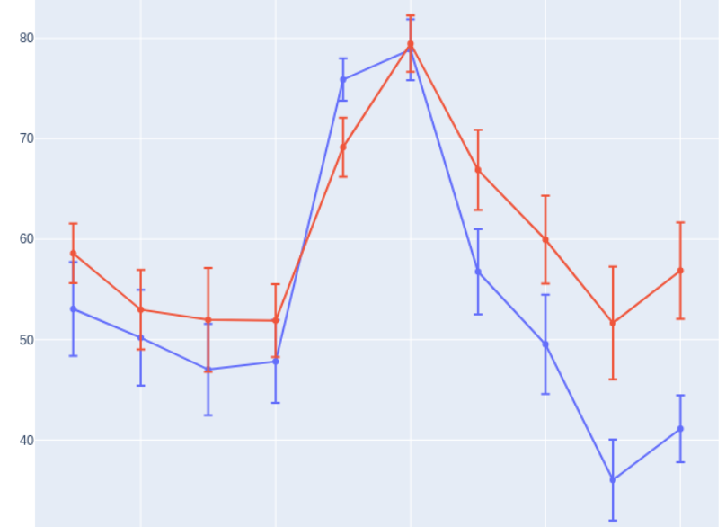
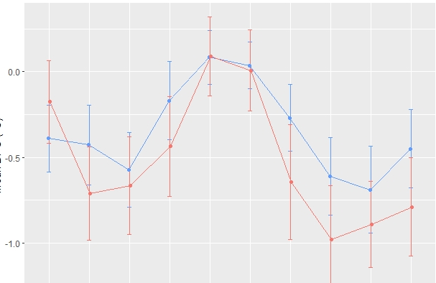
Chronic napping: a reflection of altered circadian sleep regulation?
40-hours multiple nap protocol
Night
Interaction session*group
p < 0.05
Non-nappers
80
Nappers
70
60
Sleep efficiency (%)
50
Impact on circadian regulation (amplitude,misalignment):
Wake fragmentation?
Temperature (DPG)
6
14
22
30
38
Time into protocol (hrs)
(0=wake-up from baseline night)
11
Notes:
In a next step, we thus aimed at investigating the impact of napping on circadian sleep regulation.. Again, invited them to undergo the aforementionned multiple nap porotocol. In this graph, nappers are depicted in red and no-nappers in blue The plot shows the time course of sleep efficiency over the 40-hours protocol. The results indeed suggest an altered circadian sleep modulation in nappers, who seem to show a reduced circadian amplitude, reflected by a higher ability to initate or maintain sleep over daytime, which seems to be counter-regulated in the temperature profile which appears to show a slightly increased amplitude in nappers compared to no nappers.
Overall, these data indicate altered circadian regulation in nappers, putatively leading to an increased wake-state instability.

Slide 11
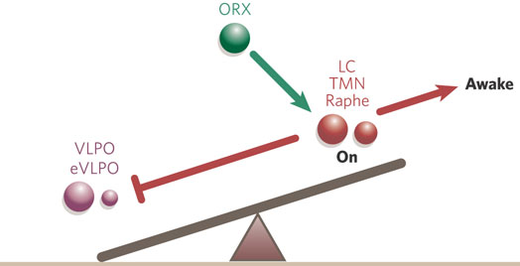
Association between daytime rest & hypothalamic integrity
PyActigraphy (Hammad et al., 2021)
Magnetization transfer imaging
Saper et al., 2005
p<0.05
Baillet et al., submitted
Wake fragmentation (intrusion of rest during daytime) is related to reduced in vivo microstructural integrity within the lateral part of the posterior hypothalamus in healthy older individuals.
Notes:
To further assess this concept, wake fragmentatio in our participants was estimated as the fraction of rest over daytime that we extracted from actigraphy data.
We than assessed whether whether the fraction of rest during daytime as indicator of wake instability is related to in vivo microstructural integrity of the hypothalamus.
To do so, we parcellated the hypothalamus and extracted the macromolecular content in the hypothalamic grey matter subfields.
And observed that higher daytime rest is related to reduced in vivo microstructural integrity within the postero-lateral hypothalamus.
The latter contains orexinergic neurons, responsible for the stabilization of the switch between sleep and wake active neuronal populations.
How and whether this can also be simulated by an altered input of orexinergic tone to physiology-based models of (circadian) sleep regulation remains to be established, but
These data provide exciting evidence for an association between wake-state instability and reduced vivo microstructural integrity within the postero-lateral hypothalamus in healthy older individuals.

Slide 12
Conclusion
Circadian sleep regulation, cognitive performance and their underlying neural correlates
Sleep, cognitive performance and their underlying neural correlates
Circadian sleep regulation: protective role in the context of cognitive and brain ageing
Importance of sleep timing (vs. dose)
Daytime rest/napping: a health indicator in the context of aging? Cognition – circadian misalignment - Hypothalamic integrity (mono-aminergic input?)
Notes:
To conclude and before to come up with some research perspectives,
I would have retrospectively opted for the title « circadian sleep regulation ».
Besides that, I think that our current findings can be summarized in three principal take home messages:
First, our data emphazise on the importance of circadian regulation in age-related changes in sleep and suggest a protective role for both cognitive and brain ageing.
They thereby put a focus on sleep timing, besides sleep quantity and and quality, which are increasingly advertised as correlates of age-related brain in the context of both healthy and pathological ageing.
Within this context, chronic daytime napping as assessed in our studies indicated altered cognition, circadian misalignment and putatively also an altered neuronal functioning in the wake-stabilizing postero-lateral hypothalamus.

Slide 13









Sleep & Chronobiology Research Unit
Gilles Vandewalle & his team
Pierre Maquet & his team (Neurology Department)
Marion Baillet – post-doc
Michele Deantoni – PhD student
Stella De Haan – PhD student
Marine Dourte – PhD student
Gregory Hammad – senior post-doc
Vincenzo Muto – alumni
Alexia Lesoinne – study coordinator
Mathilde Reyt – PhD student
At the GIGA-CRC
Fabienne Collette, Christine Bastin: Aging & Memory
Christophe Philipps & Nikita Beliy: Methodological developments
Eric Salmon: Medical Director – Alzheimer’s Disease – PET imaging
Christian Cajochen & Carolin Reichert (Basel)
Derk Jan Dijk (Surrey)
Svetlana Postnova (Sydney)
Manuel Spitschan (Münich)
Notes:
I would conclude with thanking a number of researches who significantly contributed to the presented work.
Pierre Maquet and Gilles Vandewalle who currently initiated the sleep lab in Liège.
My team (Vincenzo, Gregory, Marion, Michele, Mathilde, Stella and Marine) , performed all the acquisitions which we could finalize in autumn of this year; despite the COVID pandemics. They also performed the analyses that I presented today.
Last but not least, Prof. Dijk from the Surrey University and Cajochen from Basel contributed to the work, mainly by providing precious conceptual support and I’m very delighted to work together with Prof. Postnova for the biomathematical modelling of sleep regulating processes.
Thank you for your attention!

Slide 14
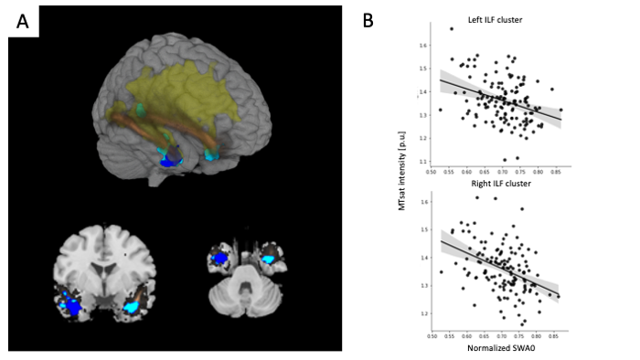
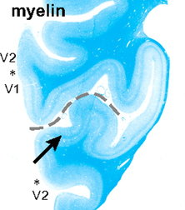
Perspectives
Homeostatic sleep regulation
Probe regional microstructural integrity (e.g. myelin content)
Association between SWA predominance and regional myelin content during early adulthood (N=236)
Deantoni et al., in prep.
Causality? Intervention, longitudinal designs
Notes:
In the upcoming, we aim at further probe regional micro-structural integrity in association with sleep regulation.
More recent developments of quantitative MRI protocols will allow us to extract good estimates of myelin content.
Also, we want to assess the modulatory potential of homeostatic sleep regulation which has also affected by the ageing process and which may be quantified by slow wave activity dynamics
Within this context, we recently observed that during early adulthood, SWA predominance, but not it’s modulation through sleep deprivation for example, was associated with regional myelin content in the temporal portion of the inferior longitudinal fascilus. Wehter thus region-specific association are also observed at older age, remains to be assessed.
Last, but not least, we aim at prompting causality through an ongoing interventional approach to assess whether an intervnetion on napping can stabilize circadian amplitude and thereby act on cognition and brain integrity. In the same vain, we aim at combining the role of sleep regulation with other protective or reserve factors favouring functional brain compensation in order to keep stable cognitive performance despite age-related brain atrophy or altered structural brain integrity for example.

Slide 16
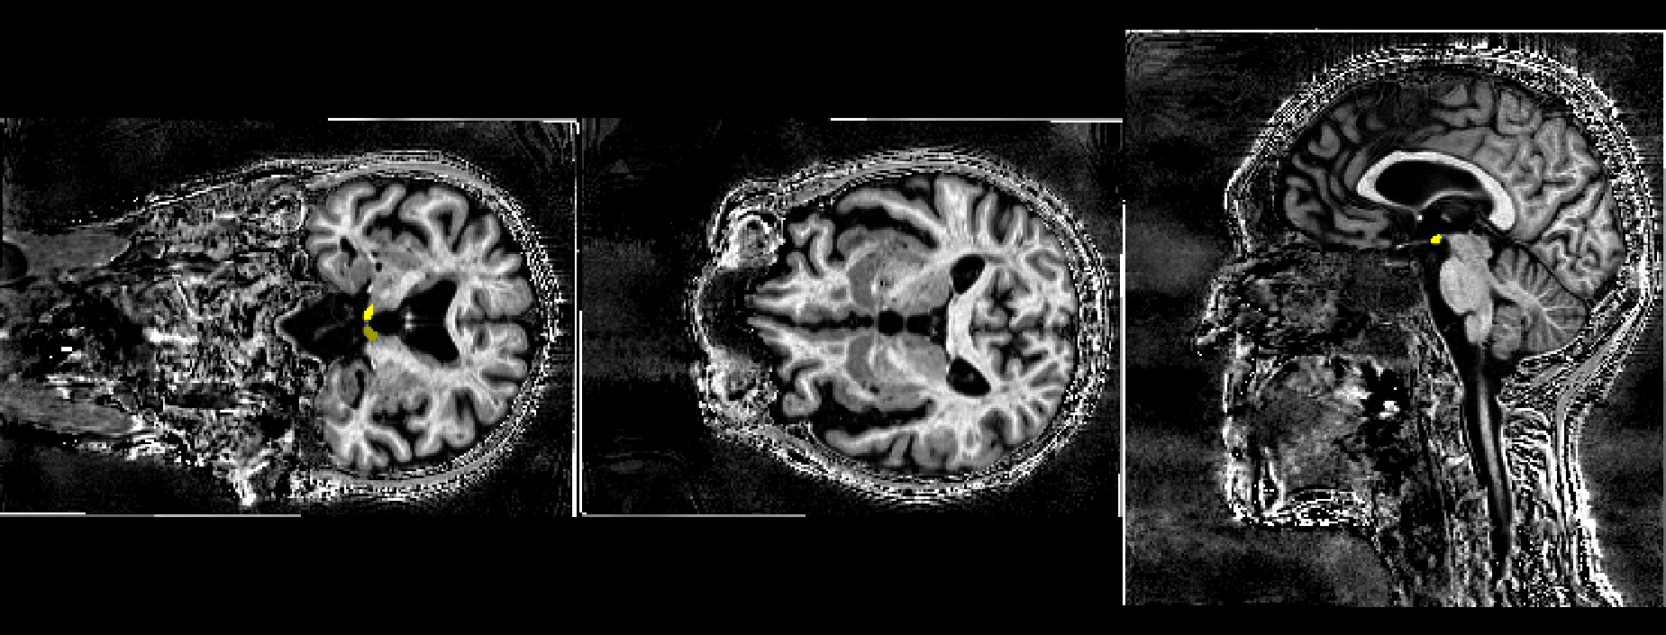
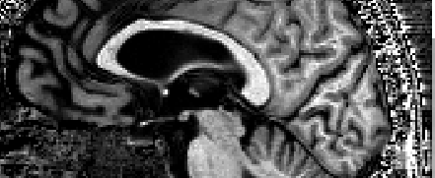

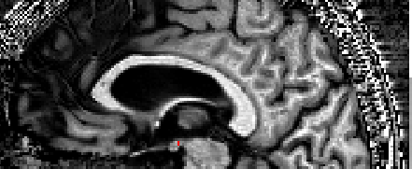

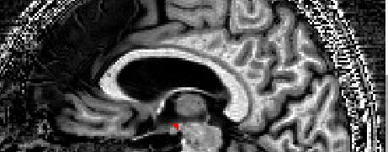

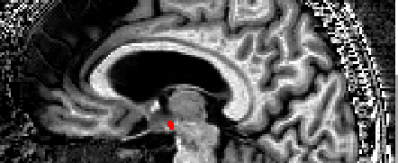
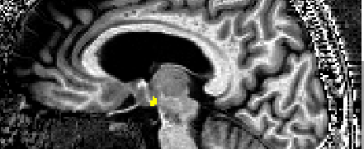
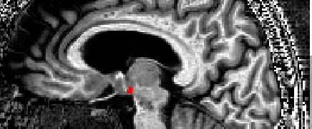
Posterior mask with manual removing of most mammillary bodies voxels
Posterior masks
R
L
MTsat map
Coronal plane
Sagittal plane
Sagittal plane

Slide 17
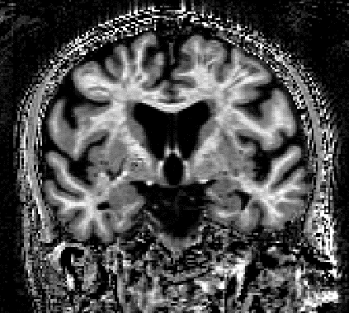
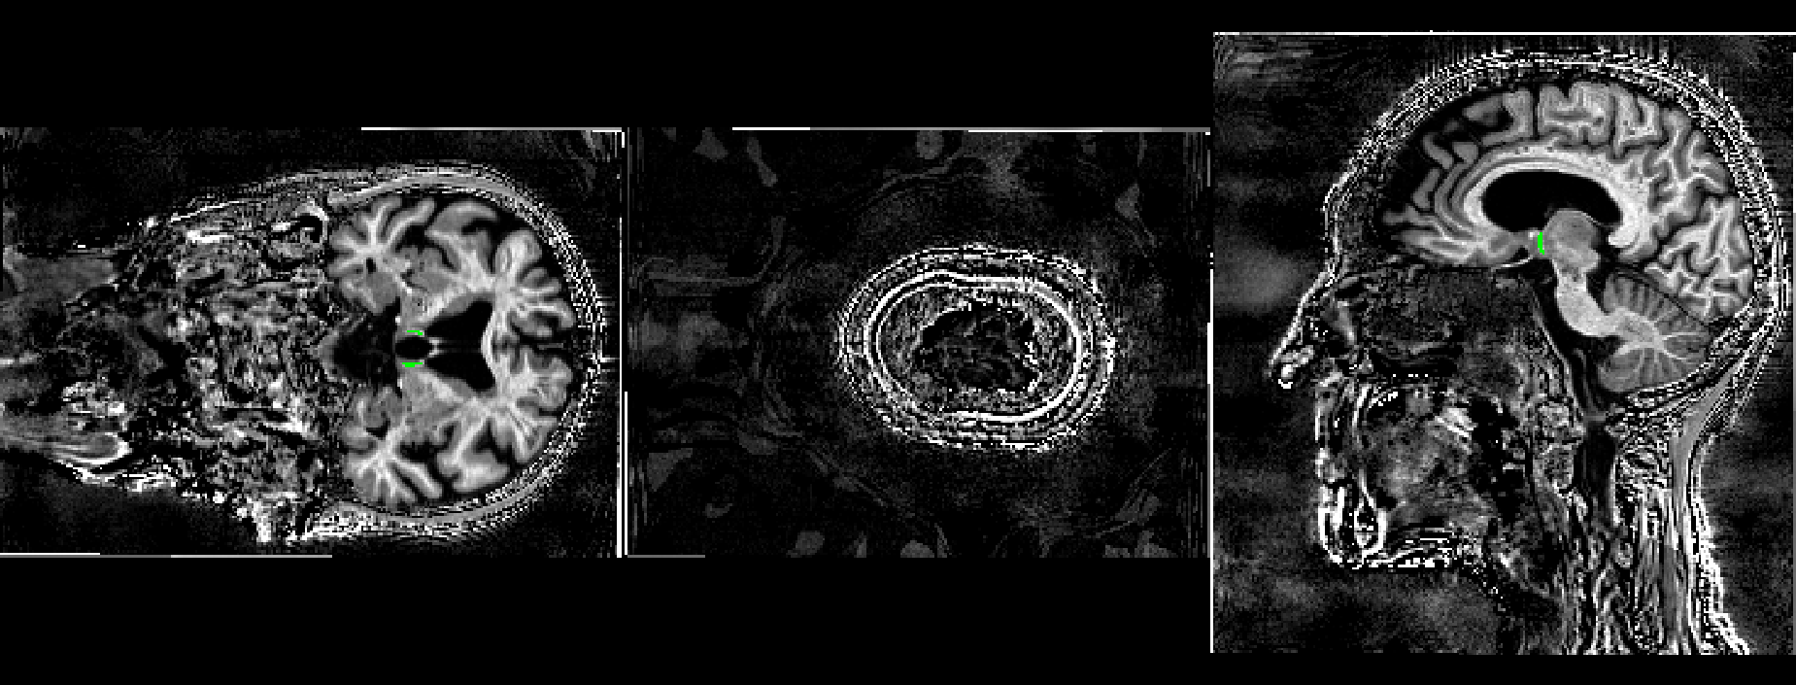

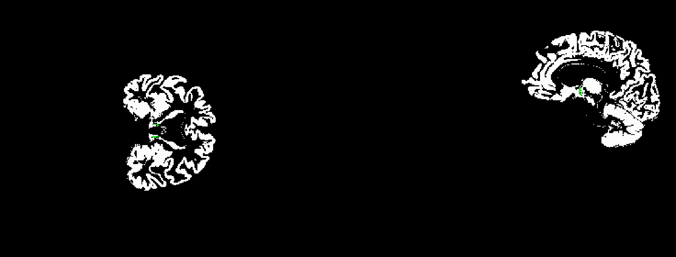
To limit the influence of the fornix, MTsat values were extracted within a grey matter map thresholded at 0.2 and for which the intensity is greater than the one of the white matter
The fornix is located close to the hypothalamus
Coronal plane
R
L
R
L
A
P
R
L
Fornix
MTsat map
Coronal plane
A
P
Sagittal plane
Grey matter thresholded map (MTsat segmentation)

Slide 18
Homeostatic regulation of slow wave activity (SWA) and brain microstructural integrity
363 healthy young participants (University of Liège – University of Surrey)
HAB
BAS
EXT (12h)
BEF (8h)
constant routine (CR)
(40 hr of sleep depriv.)
REC (12h)
NAP
Quantitative sMRI:
Notes:
Took advantage of available quite large data set in the lab were participants stayed in the lab for about 1 week in order to assess sleep dynamics across different contexts. More specifically,
360 participants

Slide 19
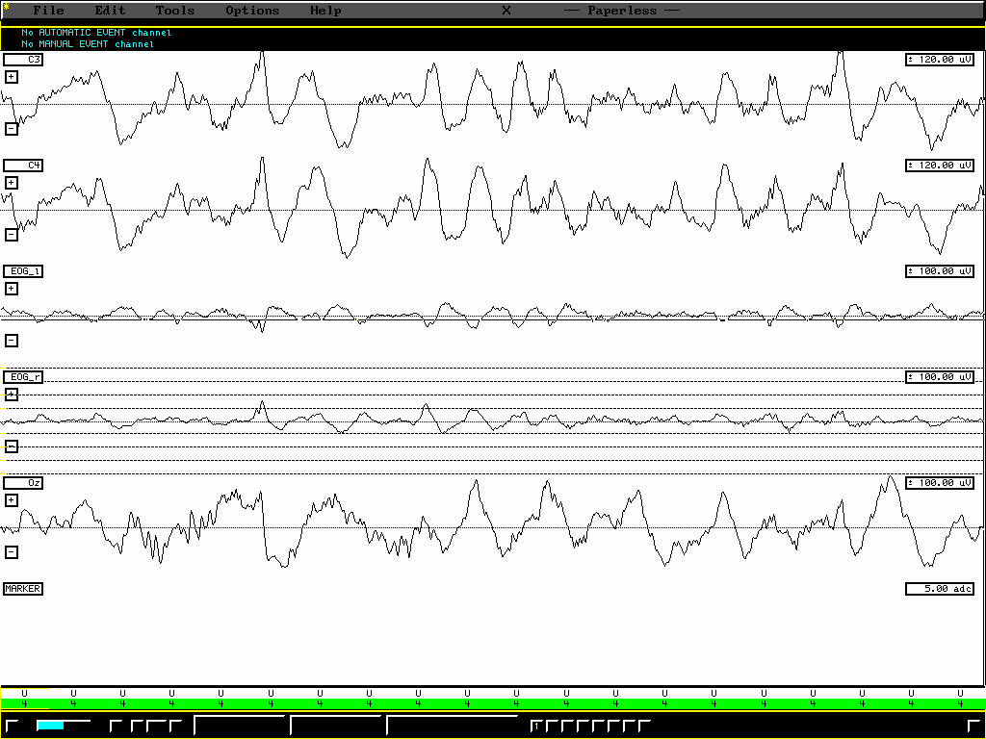
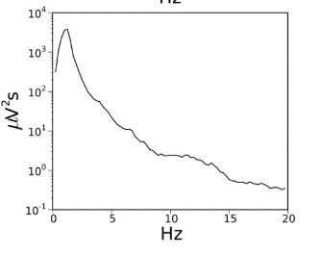
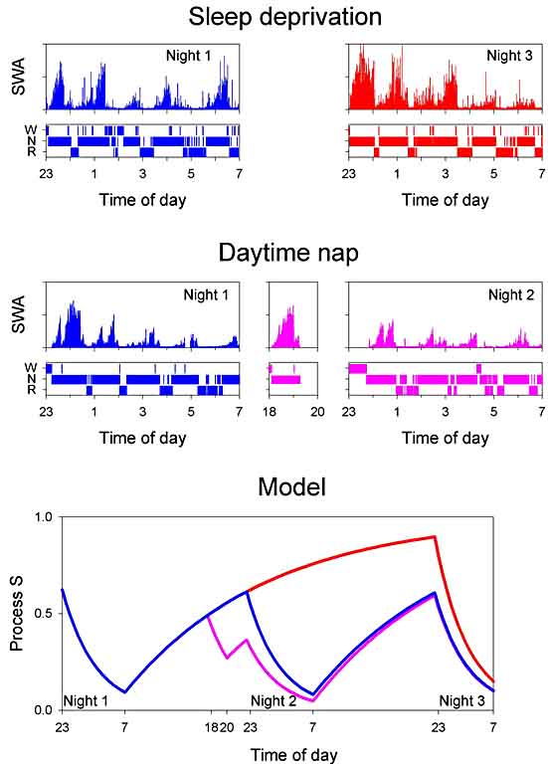
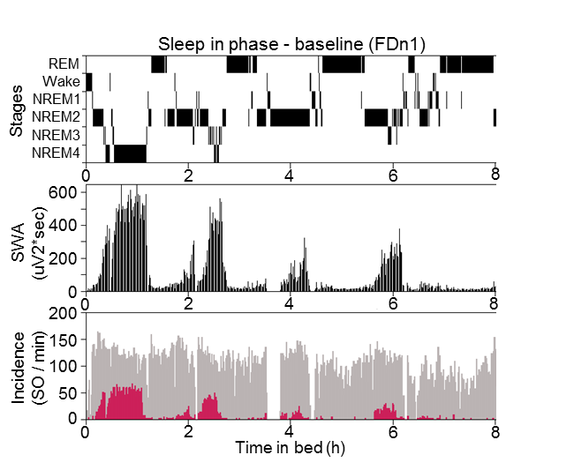
Homeostatic sleep regulation
Lazar et al., 2015
Notes:
Slow waves, high-amplitude, low frequency oscillation occuring during NREM sleep and thus highly prevalent first part, dissipative process, exponential deca Reactive to sleep homeostatic condition (SD vs NAP)

Slide 20
Association between SWA and local myelin content in the human brain
Frontal lobe myelination as last step of brain development (= brain maturation).
Deantoni et al., in preparation
Notes:
Within the time window of development explored in the present study, progressive changes such as increases in myelination and white matter occur (De Bellis et al., 2001; Giedd, 2004; cf. Nagel et al., 2006) and regressive changes, such as decreases in gray matter volume or synaptic density, have also been reported in certain brain regions
Post-hoc analyses revealed that higher SWA0 under well rested conditions was associated with lower myelin content in the temporal portion of the inferior longitudinal fasciculus. Notably, the homeostatic response of SWA to sleep deprivation and sleep satiation, were not predictive for local myelin content across individuals, neither was its intra-night exponential dynamics . SWA at sleep onset has been shown under genetic control and to reflect the wake-dependent build-up of sleep need. Beyond, this marker undergoes developmental concomitant to ongoing myelinogenesis in the temporal lobe. Our findings point towardsa region-specific association between myelin integrity and sleep slow wave generation in the human brain.
Rem sleep however (not declining in this age range): check for association MT_WM and REM duration (%) during BASN.
Post-hoc analyses revealed that higher SWA0 under well rested conditions was associated with lower myelin content in the temporal portion of the inferior longitudinal fasciculus. Notably, the homeostatic response of SWA to sleep deprivation and sleep satiation, were not predictive for local myelin content across individuals, neither was its intra-night exponential dynamics . SWA at sleep onset has been shown under genetic control and to reflect the wake-dependent build-up of sleep need. Beyond, this marker undergoes developmental concomitant to ongoing myelinogenesis in the temporal lobe. Our findings point towardsa region-specific association between myelin integrity and sleep slow wave generation in the human brain.
Rem sleep however (not declining in this age range): check for association MT_WM and REM duration (%) during BASN.
The brain undergoes profound changes across lifespan that includes both progressive and regressive cytoarchitectural events . Brain maturation undergoes region-specific trajectories, such that. Cortical grey matter volume for example peaks in sensory-motor cortices first, before reaching plateau levels in the frontal and temporal lobes during adolescence onlya [1]. Thereafter, lineardecreases in grey matter volume are observed that start in early adulthood majorly due to the elimination of cortical synapses [2]. Concomitantly to grey matter decreases,
white matter volume starts to increase during young adulthood, with peak levels only occurring later in life (e.g. around the age of 40 in the frontal lobe and even later in the the temporal lobe [1]). Add ref ?
Myelination temporally matches with increase in EEG coherence and overall connectivity (REF??)
Brain development
Progressive & regressive cytoarchitectural events
→ grey matter - white matter changes
→ region-specific trajectories

Slide 21
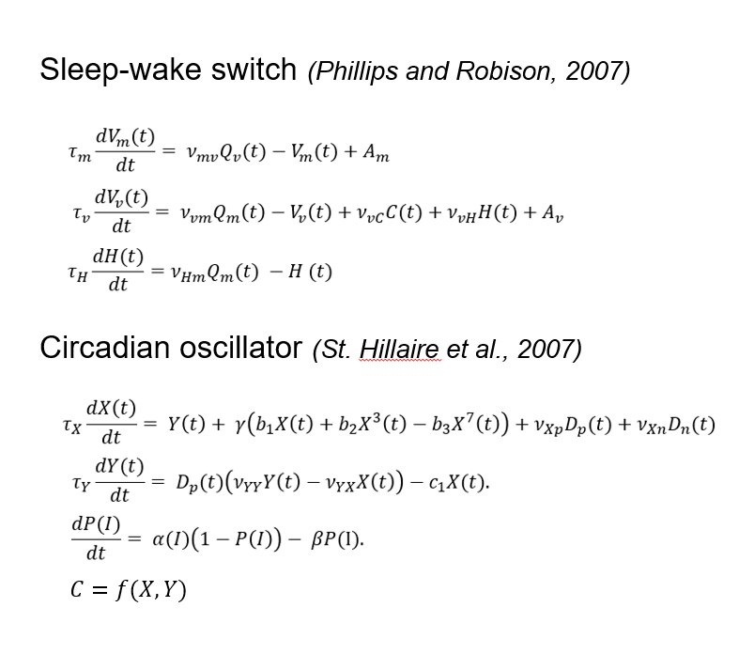
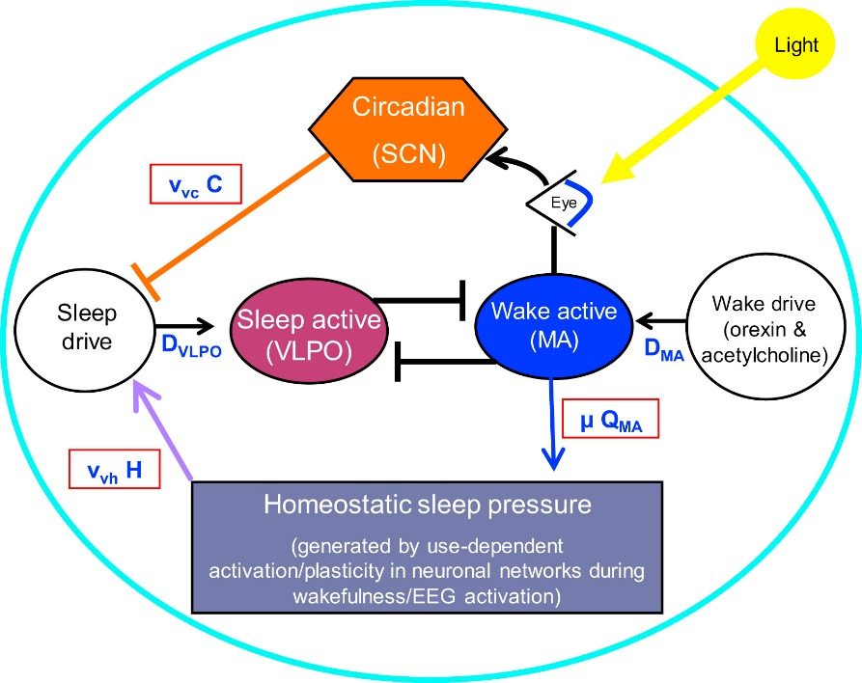
Model of Arousal Dynamics
key equations

Slide 22
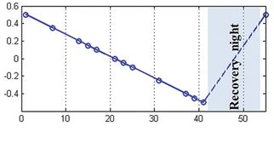
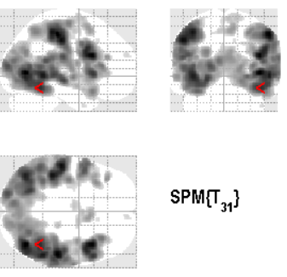
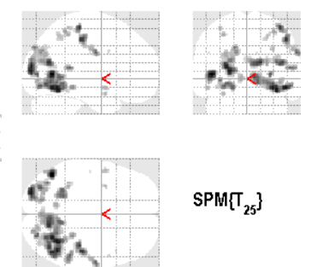

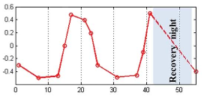
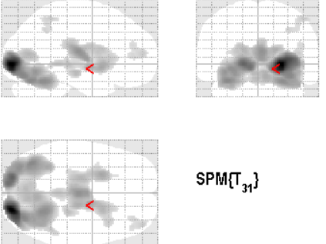
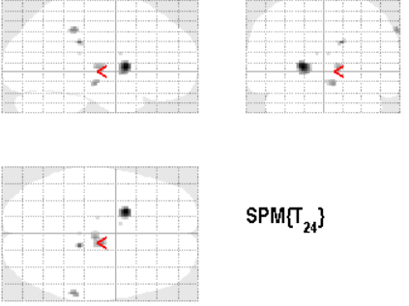
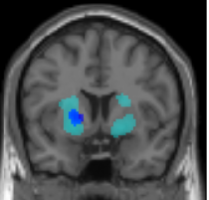
Circadian and Sleep-Wake dependent Modulation in task-related BOLD responses (vigilance)
Modified from Muto et al., 2016, Maire et al., 2018
P<0.05 (FWE-corrected over entire brain volume)
Notes:
What about the cerebral correlates
Linear
Access to two data sets, recalculated same contrasts, difference between studies
Glass brain, statistical map, darkest = higest t-values, strongest effects.
Linear slope (as a reflection of linear increase of homeostatic sleep pressure): large set of cortical, particulalr occipital-motor regions (local use, visual task)
Melatonin (as a reflection of circadian process: thalamus-putamen: increased activation during night time

Slide 23
Local modulation of human brain responses by circadian rhythmicity and sleep debt
Muto et al., 2016

Slide 24
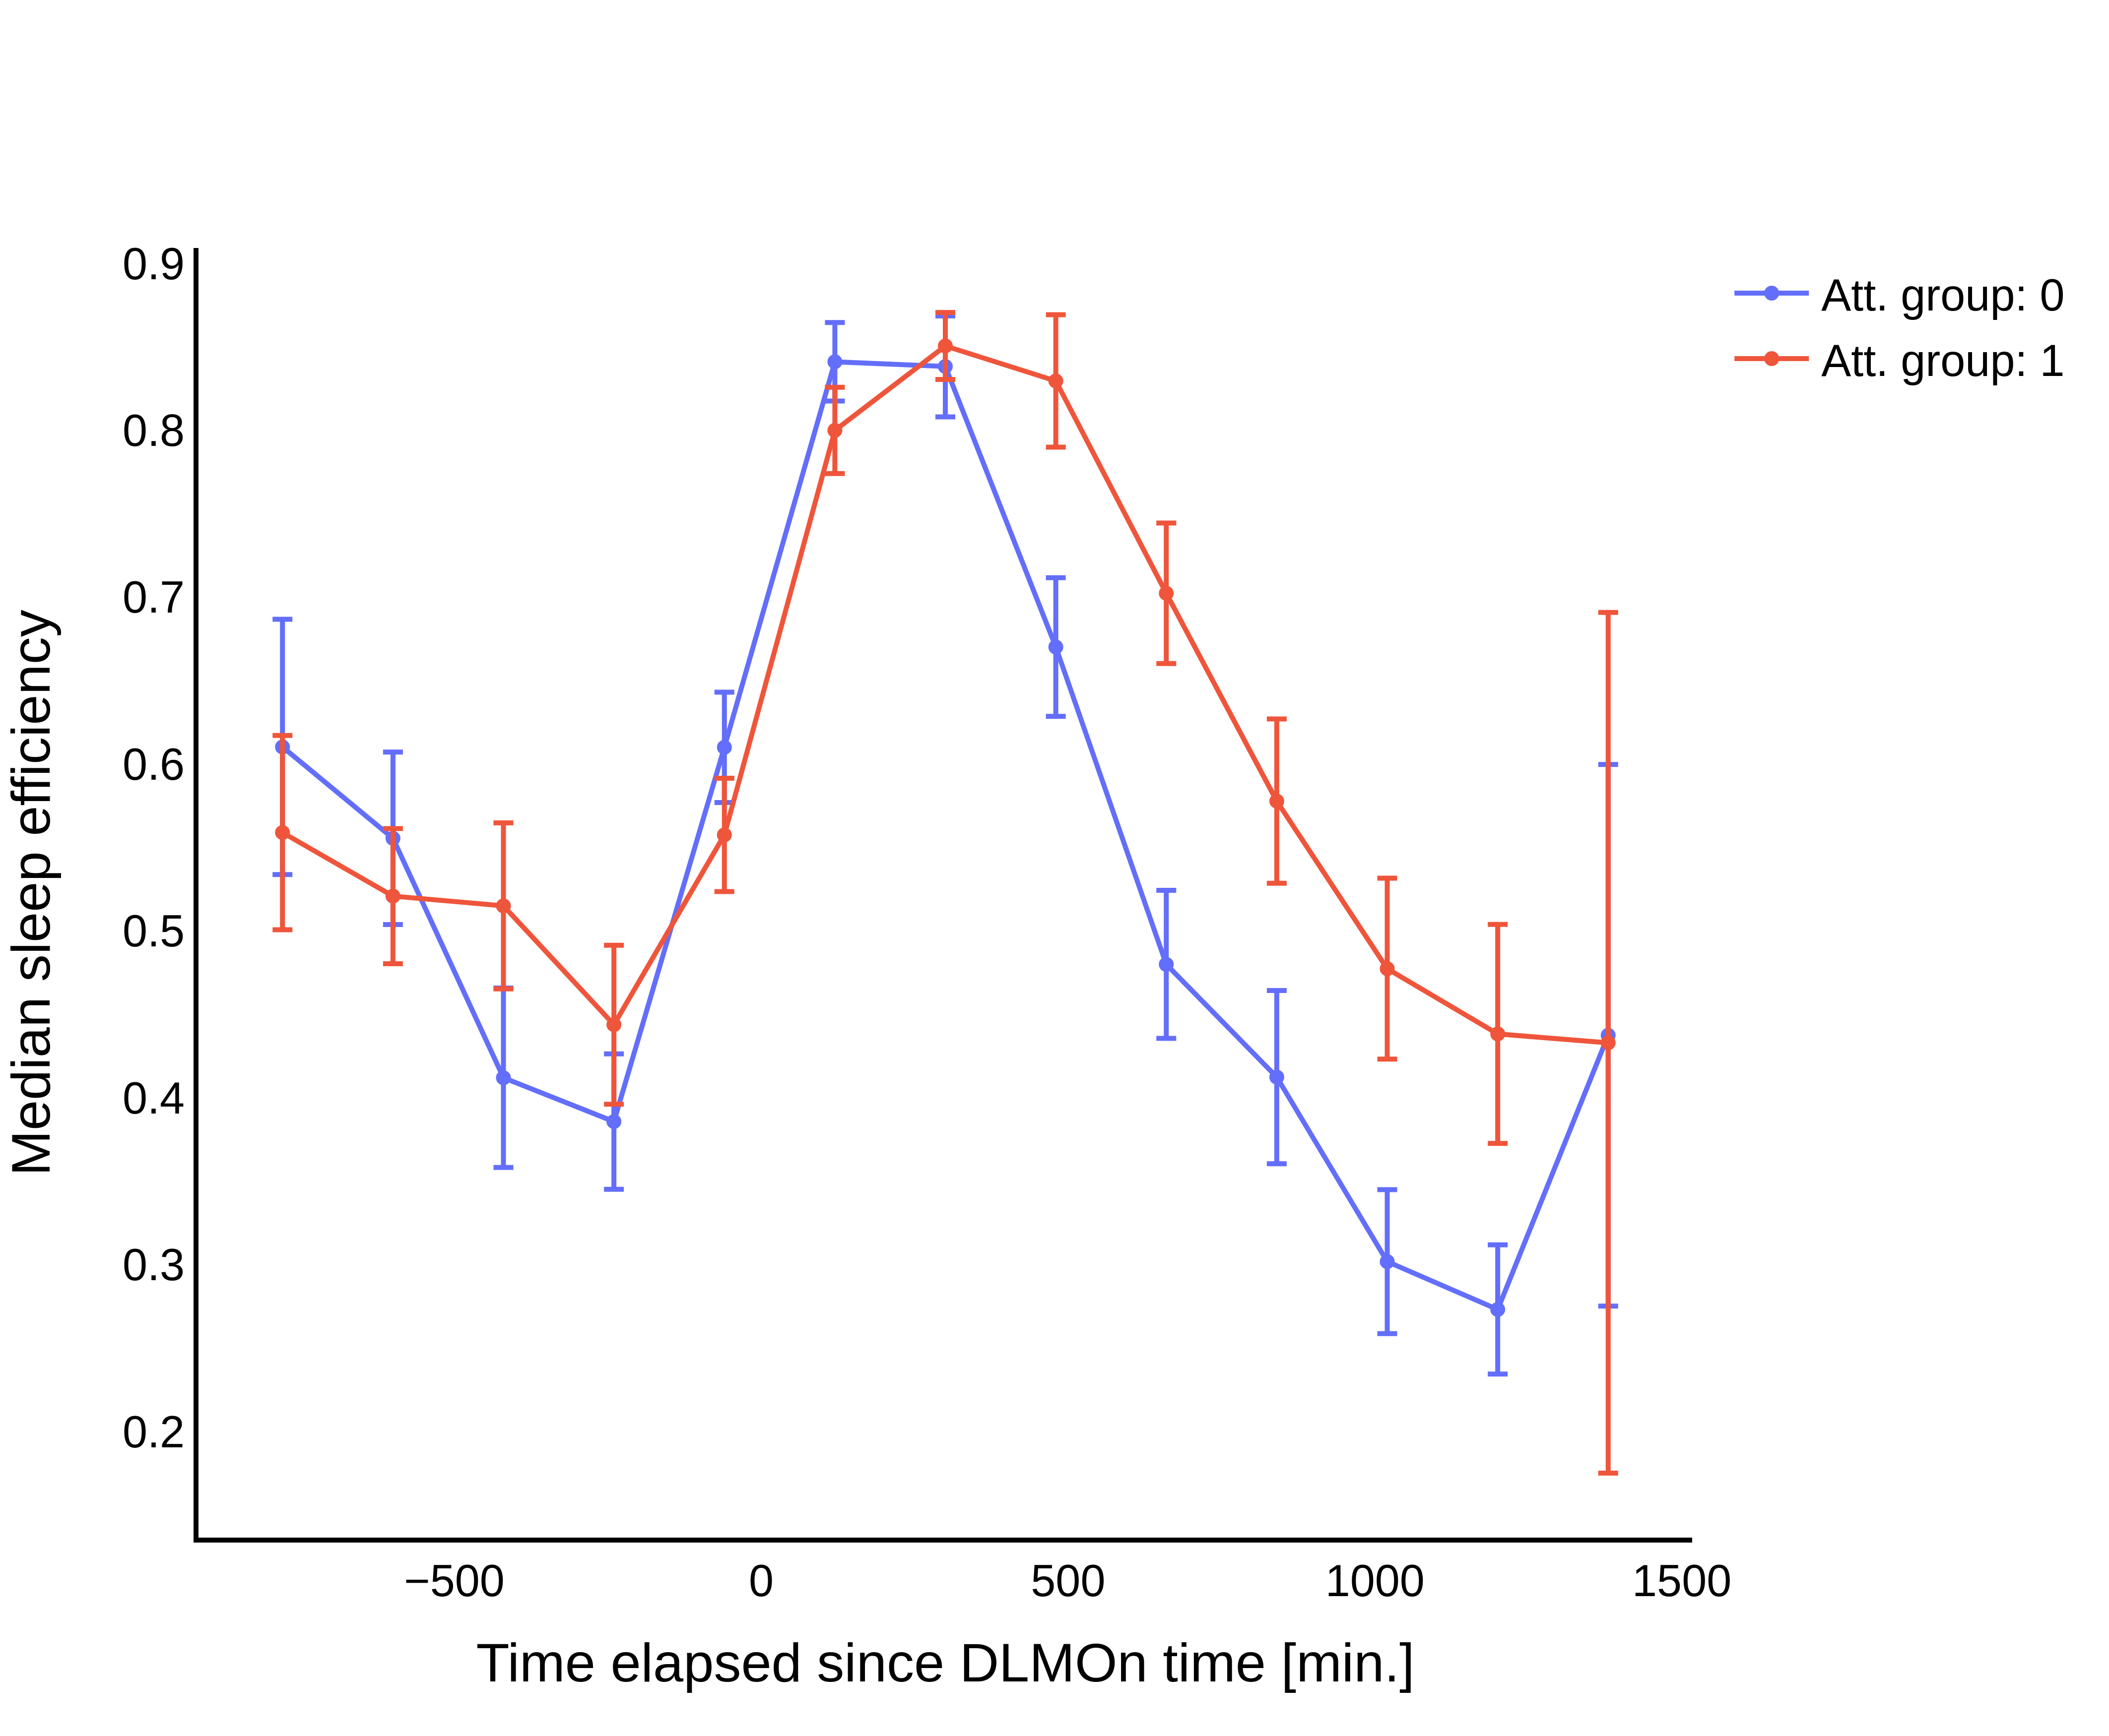

Slide 25
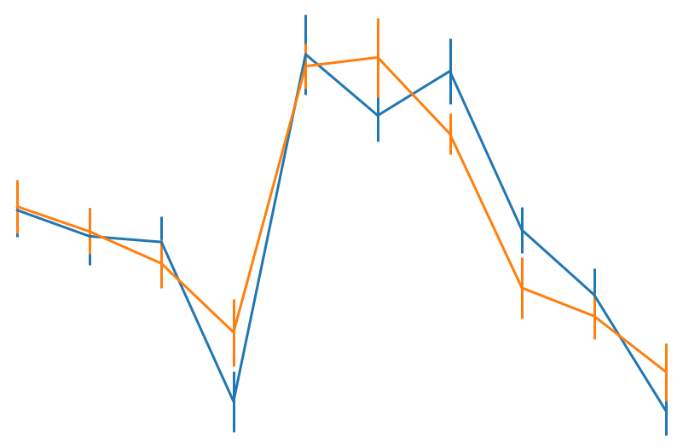
Age-related changes in sleep-wake regulation: Circadian amplitude
Older (n=30)
Young (n=30)
90
1.8
80
1.6
Night
70
1.4
Sleep efficiency (%)
Normalized sleep efficiency
60
1.2
50
1.0
40
0.8
30
0.6
20
0.4
2
10
18
26
34
2
10
18
26
34
Time into protocol (hrs)
(0=wake-up from baseline night)
Time into protocol (hrs)
(0=wake-up from baseline night)
Deantoni et al., in prep
Notes:
Now, assessing circadian amplitude in humans in not a so easy task.
One option is to apply mutliple nap protocol allowing to assess sleep ability over the circadian cycle. Participants enter in the laboratory for a baseline sleep and than undergo a multiple nap protocol with encompassing for example 10 80-minutes nap opportunities over a 40-hours protocol.
By using such a protocol, age-related changes can indeed be detected. Plotted here is the sleep efficiency during the nap opportunities over the protocol in young adults in blue and in older adults in orange. On t A clear circadian modulation can be detected in both groups, with reduced sleep efficienies over daytime compared to night-time, but an overall reduced sleep propensity can also be observed in the aged compared to younger individuals.
Furthermore, when normalizing the values by dividing by the overal sleep efficiency, our data at least partially corroborate previous observations of an increased ability to sleep in the late evening hours, when circadian wake propensity is high, thereby indicating reduced circadian wake propensity. Likewise, the normalized values also point to reduced circadian sleep propensity, expressed by lower abilities to sleep in the early morning hours during high circadian as well as a trend for a reduce circadian sleep drive at circadian strategic time windows, here and here.

Slide 26
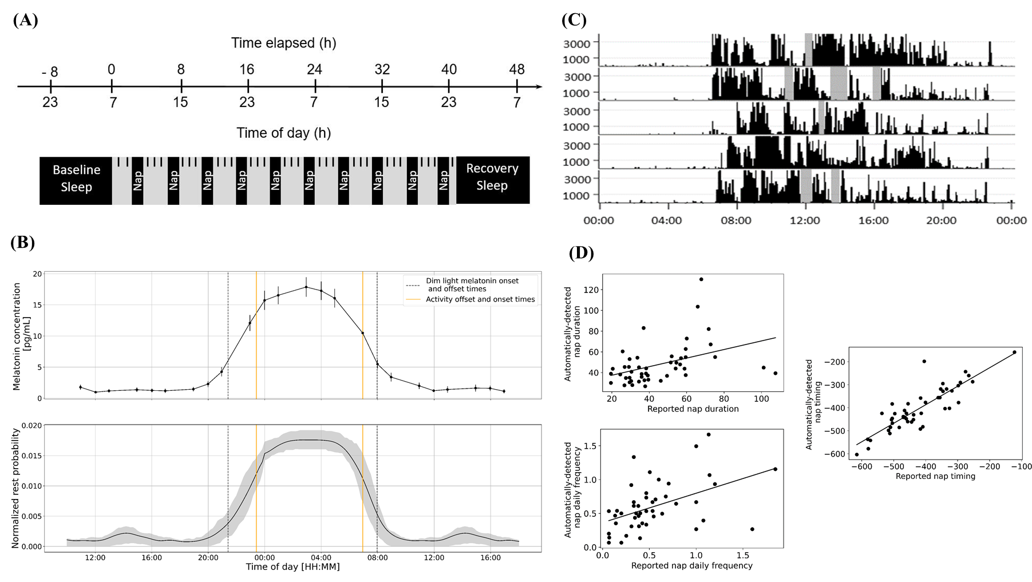
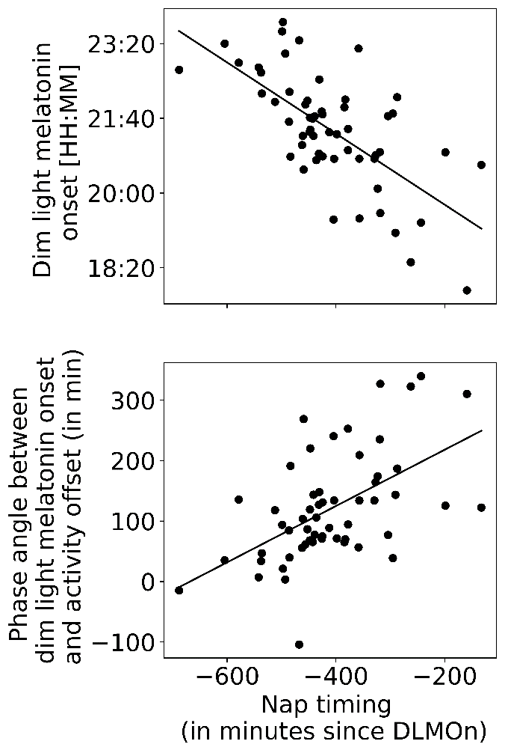
Circadian correlates of daytime rest in the aged
PyActigraphy (Hammad et al., 2021)
Duration
Frequency
Timing
Nap timing
Association with circadian phase
Nap frequency
Association with 24-rest/activity organisation
Reyt et al., under review
Notes:
Note that the latter significantly correlated with subjectively reported nap characteristics, thereby allowing to extrapolate our reasoning to a certain degree from ‘daytime rest’ to ‘daytime napping’.
We tested then tested first whether nap characteristics are associated with overall changes in 24-h rest profiles and circadian timing
Here is plotted th average 24-h rest profile over the entire sample of healthy young nappers. By applying statistical parametric mapping to this time series, we observed that
nap frequency was not only positively associated with rest probabilities during the day (obviously, depicted by green bars here),
but also with lower rest probabilities during the night (depicted by red bar) and suggesting more fragmented night-time sleep with increasing nap frequency.
Moreover, late nap timing was associated with an advanced circadian phase as well as with an altered phase angle of entrainment between the rest-activity cycle and circadian phase.

Slide 27
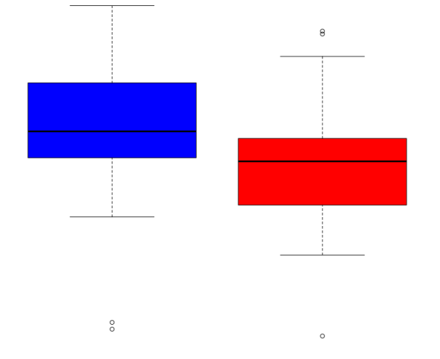
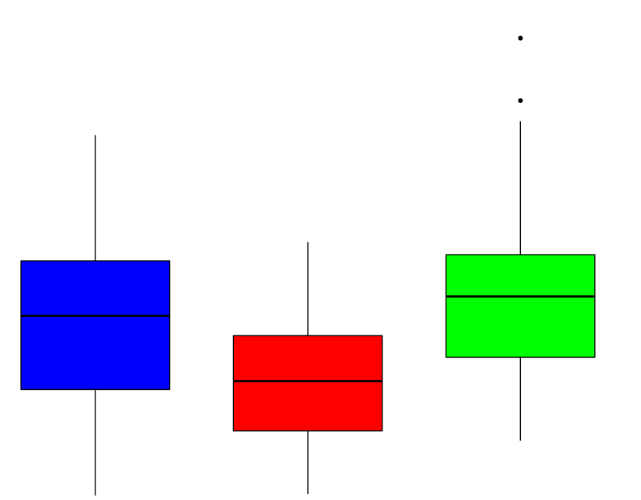
Daytime napping & cognition in aging
Daily rest frequency
Subjectively reported nappers
Episodic Memory (z-score)
Executive functions (z-score)
1.0
No-nappers
2
0.5
Long & frequent nappers
1
0.0
-0.5
Short & frequent nappers
-0
-1.0
-1.5
-1
Cross-talk between the circadian timing system, nap characteristics and associated cognitive fitness in older adults.
→ Wake-state instability?
Notes:
Finally higher nap frequency was also associated with lower episodic memory performance.
XXXX
In the same vain, subjectively reported frequent nappers performed worse on episodic memory tasks, compared to subjectively reported no-nappers.
Our data thus point towards a cross-talk between the circadian timing system, nap characteristics and associated cognitive fitness in older adults, thereby highlighting a potential functional relevance of napping at older age. Indeed, a frequent intrusion of longer rest bouts during the day may be a correlate of wake state instability.

Slide 28
No COI to disclose.
Employed at University of Liège by the National Funds of Research
(FNRS-Belgium).
The FNRS and European Research Council funded the research and the travel here.
Notes:
I have no conflict of interest to disclose

