Slide 1
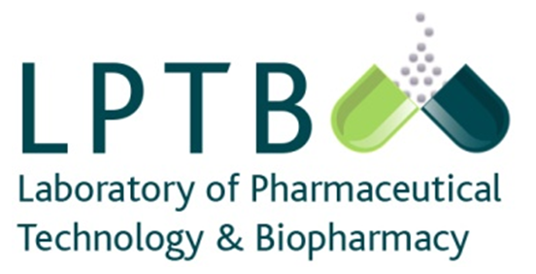
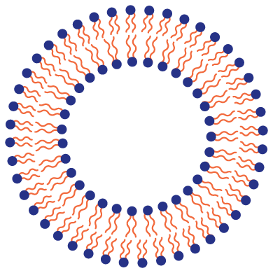

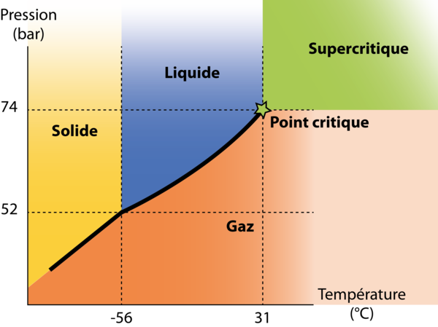
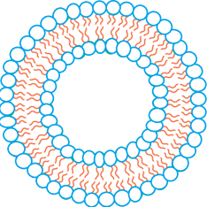
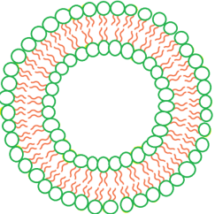

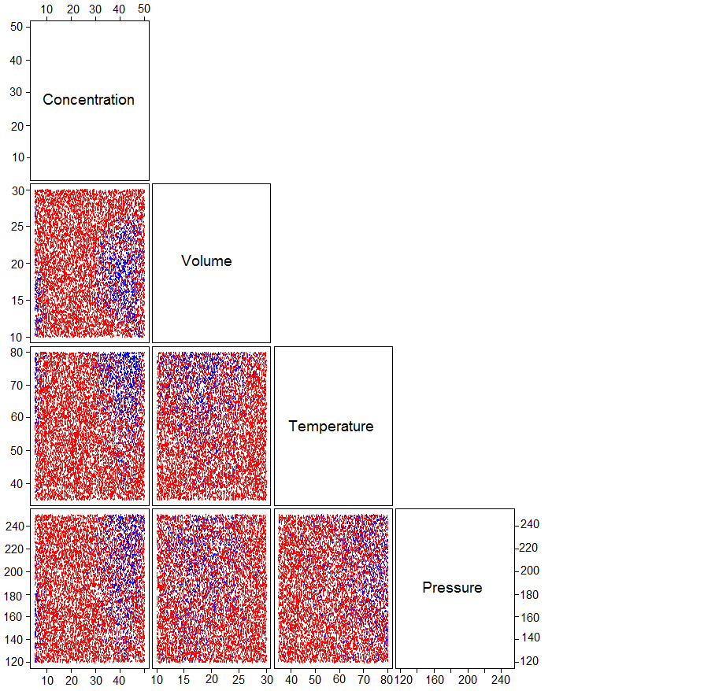

The quality by design strategy to prepare different liposomes formulations by a new supercritical fluid method
Penoy N., Koch N., Grignard B., Evrard B., Piel G.
Laboratory of Pharmaceutical Technology and Biopharmacy, CIRM, University of Liège, 4000 Liège (Belgium)
INTRODUCTION
Liposomes are interesting tool for drug delivery and are widely used in new pharmaceutical formulations with an increasing of the liposomal drug preparations used in clinical trials. ^{[1]} However, the usual methods of production often involve the use of organic solvents and are generally difficult to transfer to the industrial scale under GMP conditions.^{[2]} Supercritical fluid-based liposome preparation processes are more advantageous because they can allow one-step liposome preparation with a significant decrease or complete suppression of the use of organic solvent and a better control of the physicochemical properties. ^{[3]}
The aim of this study is to find optimal conditions of production by a quality by design strategy (QbD), allowing the production of different formulations of liposomes with a size around 200 nm and a low dispersity.
OBJECTIVES
One-step
No organic solvent
Green method
Industrial scale
GMP conditions
± 200 nm
Low dispersity
Different lipid composition
Supercritical CO₂
MATERIALS AND METHODS
Size and PdI: minimum probability: 0.56
3.1 Liposomes formulations
Soybean phosphatidylcholine (SPC), cholesterol (CHOL) : 70/30 % (m/m) used for the QbD strategy
SPC, CHOL, DSPE PEG 2000 : 65/30/5 % (m/m)
Egg PC (EPC), DC-CHOL, CHOL, DSPE PEG 2000 : 50,05/29,4/0,6/19,95 % (m/m)
DOPE, cholesterol hemisuccinate (CHEMS), CHOL, DSPE PEG 750 : 43/21/30/6 % (m/m)
DOTAP, CHOL, DOPE : 44,45/33,33/22,22 % (m/m)
3.2 Quality by design strategy :
The parameters influencing the characteristics of the liposomes are the lipids concentration, the dispersion volume, the temperature and the pressure. This strategy highlighted two production zones where the
liposomes produced have acceptable physicochemical characteristics (blue areas on the design space (Figure 1)).
3.3 Supercritical process
CO₂ was chosen as a supercritical fluid
A phospholipid dispersion in aqueous buffer (HEPES 10 mM pH 7,4) was prepared before the process at 65°C and 1200 rpm
Condition 1 and 2 of production (Figure 1)
Non influential fixed parameters : agitation rate of 500 rpm, reaction time of 30 min
Samples were then proceed regarding the condition (n=3)
Condition 1 :
45 mM, 14 mL, 80°C, 240 bars
Condition 2 :
5 mM, 10 mL, 80°C, 156 bars
3.4 Physico-chemical properties
Size was characterized before and after supercritical process using Dynamic Light Scattering (DLS) (n=3
RESULTS AND DISCUSSION
(A) Size (nm) expressed in Z-average size and principal peak of the diffractogram of liposomes produced under condition 1 and 2, (B) PdI of liposomes produced under condition 1 and 2.
Figure 1. Design space of the analysis of the influence of the different parameters in the experimental design.
SPC/CHOL/DSPE PEG 2000
(65/30/5% m/m)
EPC/DC-CHOL/CHOL/DSPE PEG 2000
(50,05/29,4/0,6/19,95 % m/m)
DOTAP/CHOL/DOPE
(44,45/33,33/22,22 % m/m)
DOPE/CHEMS/CHOL/DSPE PEG 750
(43/21/30/6 % m/m)
(A)
(B)
CONCLUSION AND PERSPECTIVES
The QbD approach allowed to determine two operative conditions for the production of liposomes by the PGSS process. A condition involving a low lipid concentration (COND2) which allows to produce liposomes of various compositions with physicochemical characteristics compatible with most of drug administrations. An interesting condition from the industrial point of view (COND1) allows to produce liposomes of simple composition with satisfactory physicochemical characteristics and without any homogenization step. For applications which require a lower dispersity, an optimization of the production parameters remains possible.
6. REFERENCES
[1] A. Wagner et al., GMP Production of Liposomes — A New Industrial Approach, Journal of Liposome Research, 2006
[2] C. Tikshdeep et al., Liposome Drug Delivery: A review, International Journal of Pharmaceutical and Chemical Sciences, 2012
[3] Bigazzi W. et al., Supercritical fluid methods: An alternative to conventional methods to prepare liposomes, Chemical Engineering Journal, 2020
Penoy et al., A supercritical fluid technology for liposome production and comparison with the film hydration method, International Journal of Pharmaceutics, 2021
7. ACKNOWLEDMENTS
Authors thank the European Regional Development
Fund (FEDER) for the financial support
www.cirm.uliege.be www.ltpb.ulg.be npenoy@uliege.be

