Slide 1
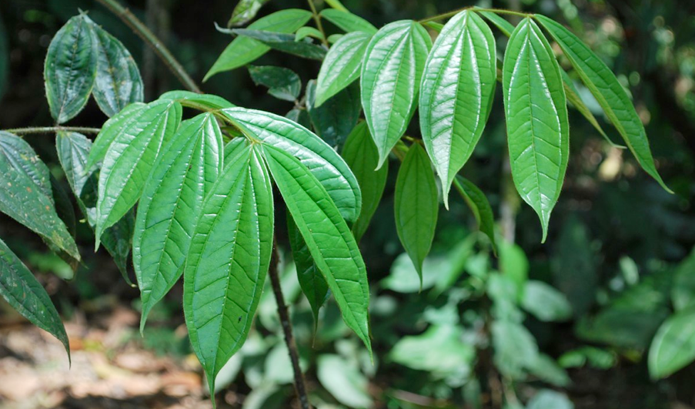
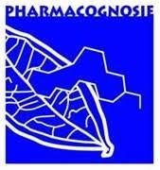

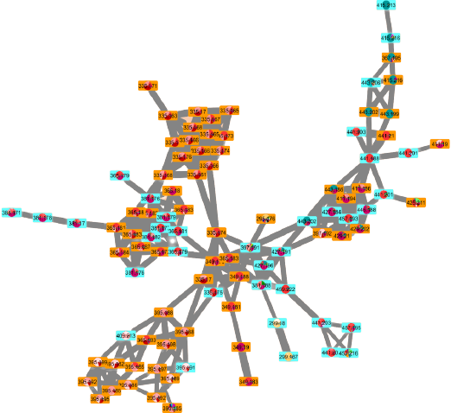
In-depth exploration of Strychnos alkaloids by molecular networking: Discovery of strychnine in new species
Olivier Bonnet
Short Lecture (SL-F06)
70th International Congress and Annual Meeting of the GA
August 28-31, 2022

Slide 2



Strychnos alkaloids, a famous phytochemical class through the arts
Strychnine
Curare

Slide 3

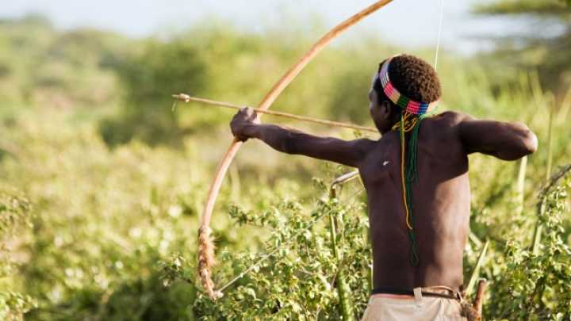
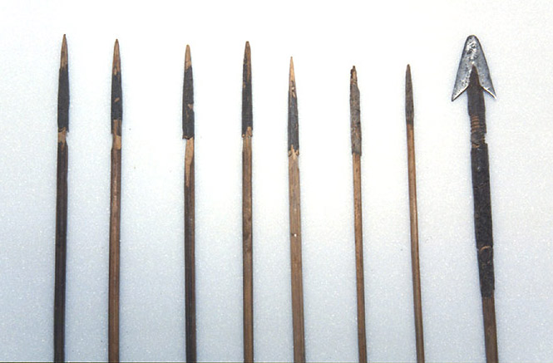
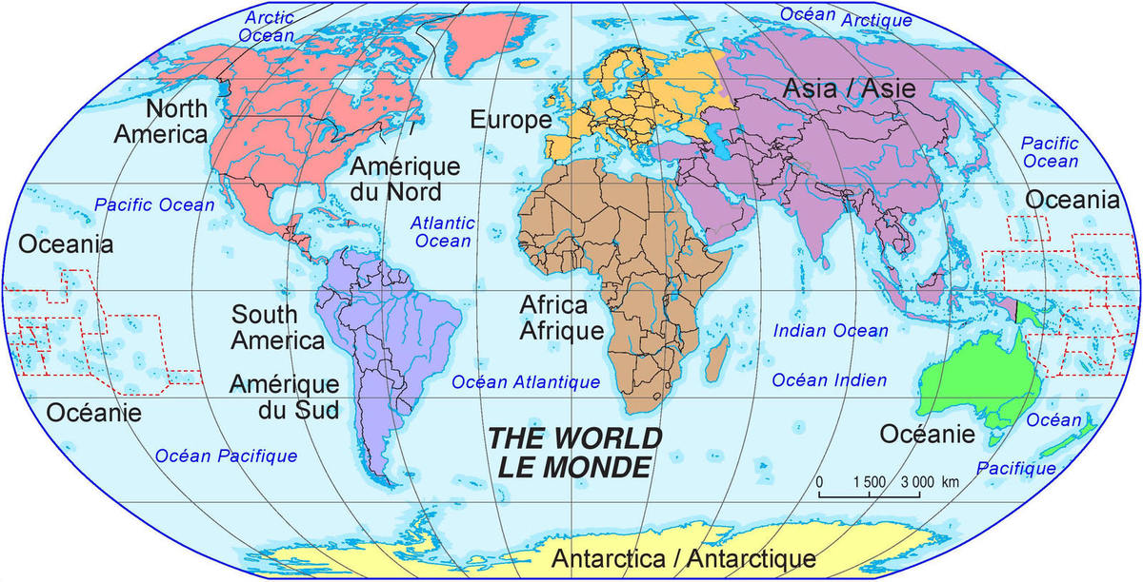
The Strychnos genus
Studied more than two centuries;
Curarizing and tetanizing properties;
Traditionally used as hunting poison because of their curarizing properties;
Promising antiplasmodial activities;
Traditionally used to treat fevers;
About 200 species;
Originally from Asia, Oceania, Africa and South America;

Slide 4
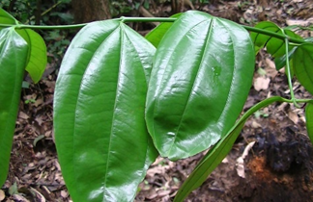
Botanical aspects of Strychnos
Lianas, shrubs and small trees
Characteristic nervation: lateral nervation of leaves
Lateral nervation
Lateral nervation
Leaves of Strychnos icaja

Slide 5
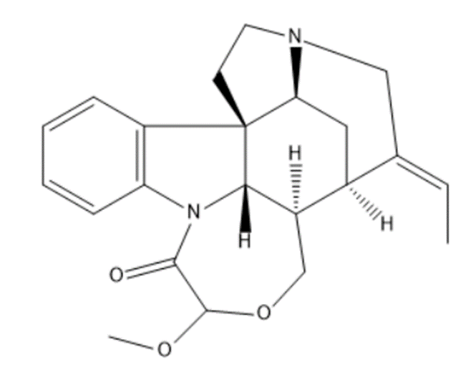
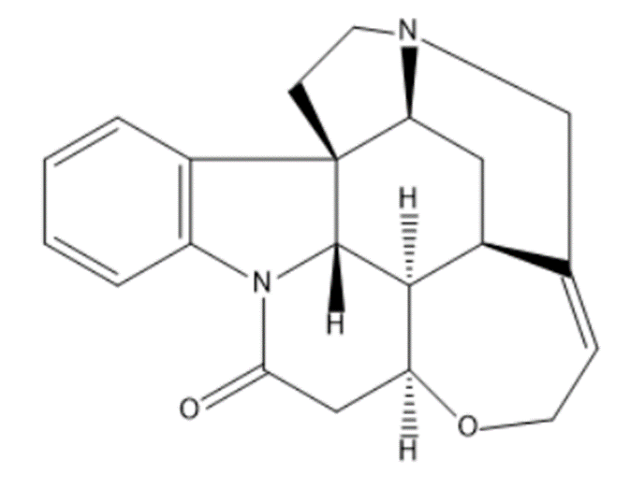
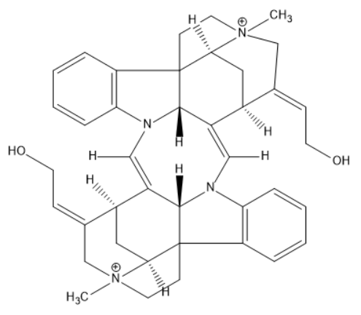
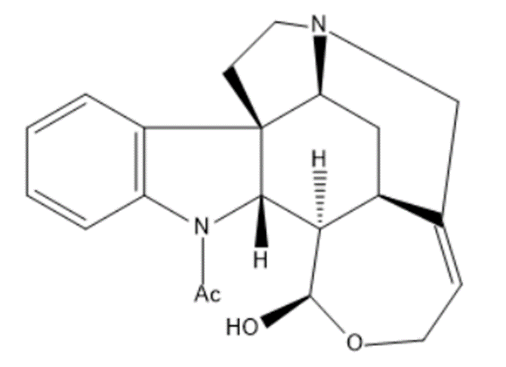

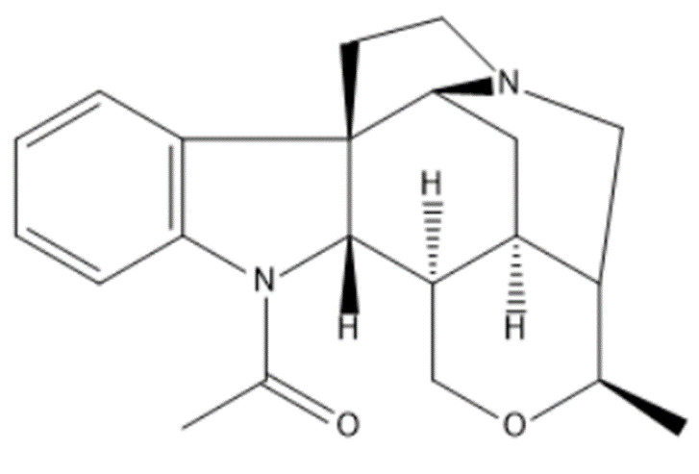
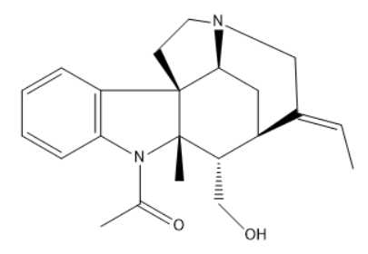
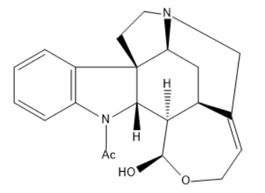



Alkaloids of Strychnos
Indoline alkaloids
Specific to Strychnos
    Strychnine type
    Spermostrychnine type
    Retuline type
    Tsilanine type
    Diaboline type
    Toxiferine type

Slide 6
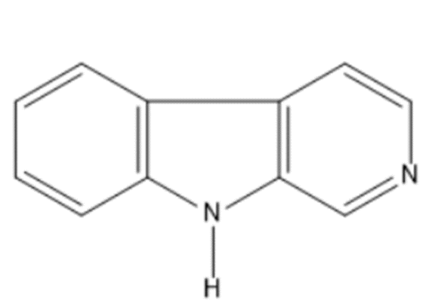
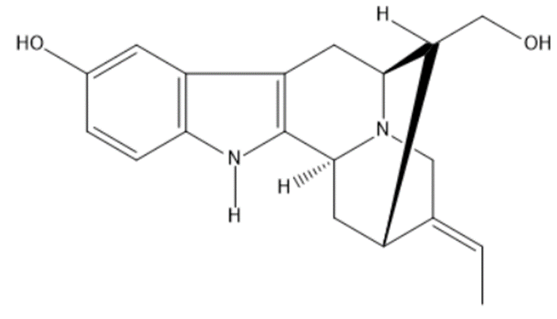
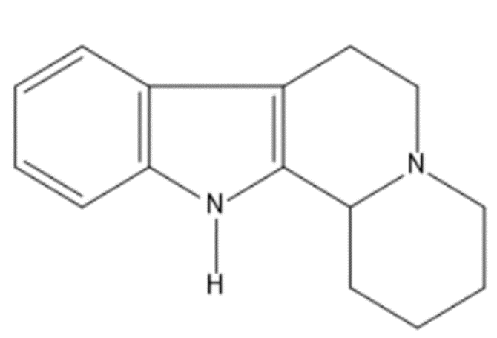
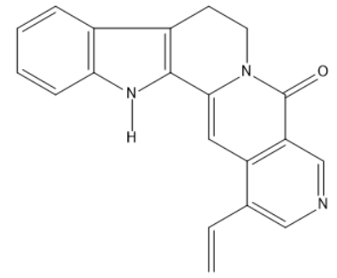
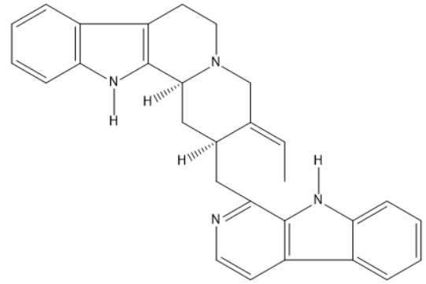
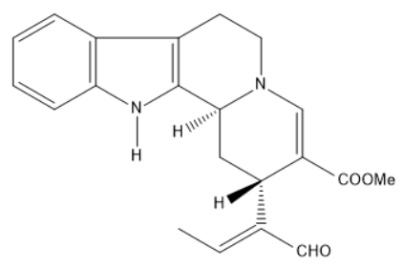


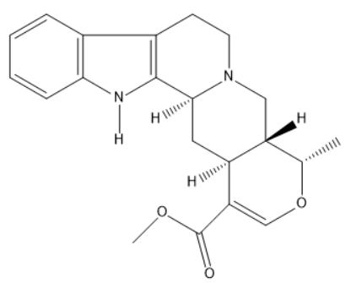




Alkaloids of Strychnos
Indole alkaloids
Not specific to Strychnos
    Beta-carboline group
    Indoloquinolizine group
    Ajmalicine group
    Sarpagine group
    Vallesiachotamine group
    Angustine group
    Usambarensine group

Slide 7
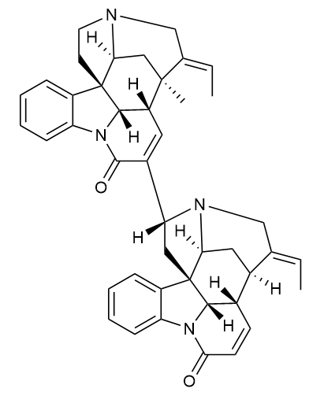

Alkaloids isolated from the Strychnos genus and identified in the University of Liège (CIRM)
Since more than three decades of research in the Pharmacognosy department in the University of Liège.
Usambarensine
Strychnobiline
Sungucine
Strychnogucine B

Slide 8
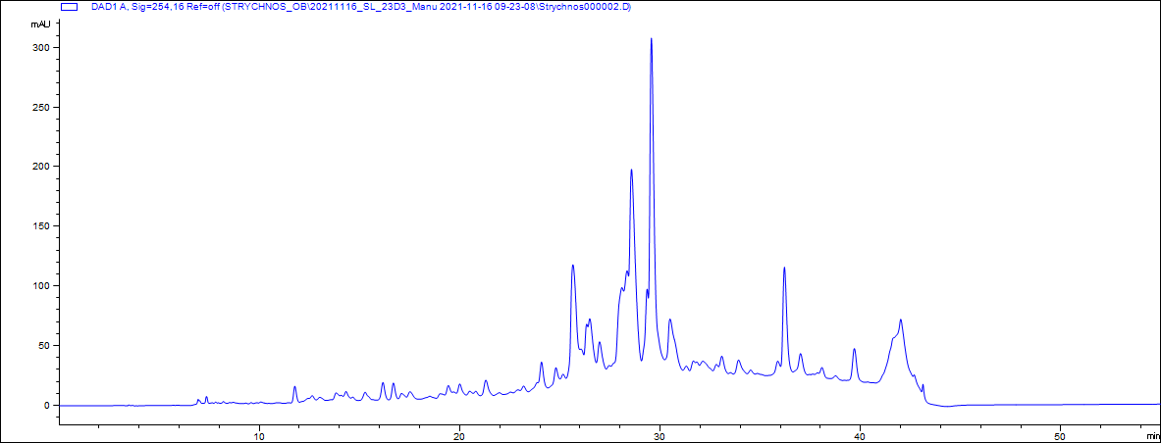
The project’s objectives
Objective 1:
Exploration of the chemodiversity of alkaloids by molecular networking
Starting point:
Large collection of various Strychnos species (44 crude extracts from 28 Strychnos species) and implementation of dereplication tools in the field of natural products research
Objective 3:
Identification of new alkaloids potentially active against malaria
Objective 2:
Quick discrimination of known and unknown metabolites using shared spectral databases
Areas of metabolites difficult to identify with conventional analysis techniques (HPLC, TLC, ...) but more easily accessible through the implementation of dereplication tools such as molecular networking

Slide 9

Molecular networking workflow
Global Natural Products Social Molecular Networking
MS and MS/MS analyses of crude extracts
Processed data (MS Convert and MZmine 2)
Interpretation of the molecular network
Annotated molecular network
Molecular network

Slide 10
Molecular network of Strychnos: Proposed identifications (only alkaloids)
19,20-Dihydrousambarensine
S. usambarensis (RB+STB)
Usambarine
S. usambarensis (L)
Strychnofoline
S. usambarensis (L)
6,7-Dihydroflavopeirerine
S. usambarensis (RB+STB)
S. variabilis (RB)
Usambarensine
S. nux-vomica (RB)
S. elaeocarpa (TB)
S. johnsonii (L)
S. usambarensis (RB)
Retuline
S. variabilis (RB)
Isoretuline
S. variabilis (RB)
C-mavacurine
S. usambarensis (STB)
S. henningsii (L)
S. henningsii (L)
S. angolensis (RB)
S. longicaudata (TB)
S. icaja (TB)
S. nux-vomica (RB)
S. densiflora (TB)
S. tchibangensis (TB)
Strychnine
S. tricalysioides (TB)
S. icaja (R+CB)
S. nux-vomica (TB+RB+S)
S. ignatii (Fr)
S. camptoneura (TB)
S. congolana (TB)
S. boonei (TB)
S. densiflora (TB)
S. tchibangensis (TB)
Wieland-Gumlich aldehyde
S. icaja (TB)
S. boonei (TB)
S. staudtii (TB)
S. tchibangensis (TB)
S. usambarensis (L)
Legend:
CB= Collar barks; Fr= Fruits; L= Leaves; R= Roots; RB= Root barks; S= Seeds; STB= Stem and twig barks; TB= Trunk barks.

Slide 11

Akagerine
S. usambarensis (Fr+RB+STB)
S. elaeocarpa (TB)
S. usambarensis (RB)
Isomalindine
S. usambarensis (L+Fr+RB+STB)
S. mellodora (TB)
S. elaeocarpa (TB)
Nb-methylusambarensine
Sungucine
S. icaja (R+CB)
S. densiflora (TB)
Isodolichantoside
S. usambarensis (Fr+RB)
S. variabilis (TB)
S. gossweileri (RB)
S. mellodora (R+TB+L)
S. angolensis (L)
S. tricalysioides (TB)
S. elaeocarpa (TB)
S. johnsonii (L)
α-Colubrine
2,7-Dihydroxyapogeissoschizine
S. icaja (CB)
S. icaja (TB)
C-fluorocurarine
Holstiline
S. henningsii (L)
S. gossweileri (RB)
S. nux-vomica (TB+RB+S)
S. ignatii (Fr)
S. malacoclados (RB)
Protostrychnine
S. icaja (R+CB)
S. nux-vomica (RB)
S. densiflora (TB)
Brucine
S. mattogrossensis (L)
S. nux-vomica (TB+RB+S)
S. ignatii (Fr)
Strychnine N-oxide
S. nux-vomica (TB+RB+S)
S. ignatii (Fr)
Antirhine
N⁴-methylantirhine
S. usambarensis (Fr+RB)
S. gossweileri (RB)
S. gossweileri (RB)
S. mellodora (R+TB+L)
S. tricalysioides (TB)
S. mellodora (R)
S. icaja (CB)
S. nux-vomica (TB+RB)
S. johnsonii (L)
Panarine
S. tricalysioides (TB)
S. longicaudata (TB)
S. icaja (TB)
S. nux-vomica (TB)
S. potatorum (TB)
S. malacoclados (RB)
S. camptoneura (TB)
S. congolana (TB)
S. boonei (TB)
S. staudtii (TB)
S. elaeocarpa (TB)
S. tchibangensis (TB)

Slide 12
Molecular network of Strychnos: Proposed identifications (only alkaloids)
19,20-Dihydrousambarensine
S. usambarensis (RB+STB)
Usambarine
S. usambarensis (L)
Strychnofoline
S. usambarensis (L)
6,7-Dihydroflavopeirerine
S. usambarensis (RB+STB)
S. variabilis (RB)
Usambarensine
S. nux-vomica (RB)
S. elaeocarpa (TB)
S. johnsonii (L)
S. usambarensis (RB)
Retuline
S. variabilis (RB)
Isoretuline
S. variabilis (RB)
C-mavacurine
S. usambarensis (STB)
S. henningsii (L)
S. henningsii (L)
S. angolensis (RB)
S. longicaudata (TB)
S. icaja (TB)
S. nux-vomica (RB)
S. densiflora (TB)
S. tchibangensis (TB)
Strychnine
S. tricalysioides (TB)
S. icaja (R+CB)
S. nux-vomica (TB+RB+S)
S. ignatii (Fr)
S. camptoneura (TB)
S. congolana (TB)
S. boonei (TB)
S. densiflora (TB)
S. tchibangensis (TB)
Wieland-Gumlich aldehyde
S. icaja (TB)
S. boonei (TB)
S. staudtii (TB)
S. tchibangensis (TB)
S. usambarensis (L)
Legend:
CB= Collar barks; Fr= Fruits; L= Leaves; R= Roots; RB= Root barks; S= Seeds; STB= Stem and twig barks; TB= Trunk barks.

Slide 13
Occurrence of strychnine in the molecular network
Roots and root barks of:
S. icaja
S. nux-vomica
Collar barks of:
S. icaja
Trunk barks of:
S. nux-vomica
Seeds of:
S. nux-vomica
Fruits of:
S. ignatii
Trunk barks of:
S. tricalysioides
S. camptoneura
S. congolana
S. boonei
S. densiflora
S. tchibangensis
Leaves of:
S. usambarensis
Already described in the literature
Not described in the literature

Slide 14
Additional analyses to confirm the presence of strychnine
TLC
NMR
HPLC
UPLC-MS/MS
Comparison of MS/MS spectra

Slide 15
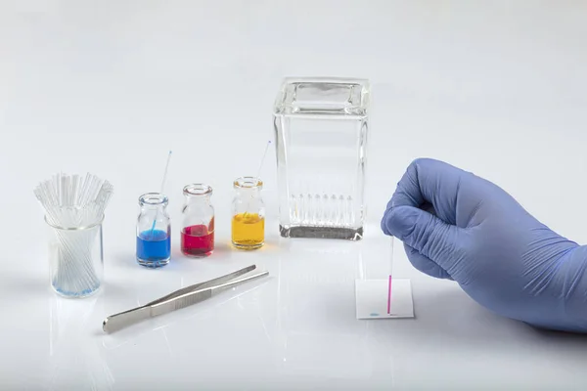
Additional analyses to confirm the presence of strychnine
TLC

Slide 16
TLC analyses
Mobile phase (A):
Toluene/ethyl acetate/diethylamine
(7:2:1 V/V/V)
Mobile phase (B):
Ethyl acetate/2-propanol/ammonia 25% (60:25:15 V/V/V)
Pulverization solvent:
Iodoplatinate reagent
1
2
1
2
1: Methanolic crude extract of S. densiflora trunk barks
2: Strychnine reference

Slide 17
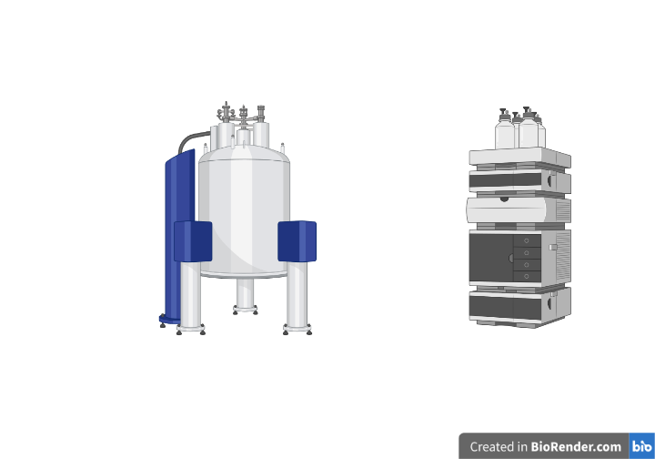
Additional analyses to confirm the presence of strychnine
TLC
NMR
NMR 500

Slide 18
NMR analyses
A
H-12 of strychnine
A. Proton spectrum of strychnine reference.
B. Proton spectrum of the methanolic crude extract of Strychnos densiflora trunk barks.
C. Proton spectrum of the same sample as B with strychnine added.
B
C

Slide 19
Additional analyses to confirm the presence of strychnine
TLC
NMR
HPLC
Column: XBridge® C₁₈
(150 x 4.6 mm, 3.5 µm)
Mobile phase: triethylamine, acetonitrile HPLC, methanol HPLC and tris buffer (pH=9) with different proportions

Slide 20
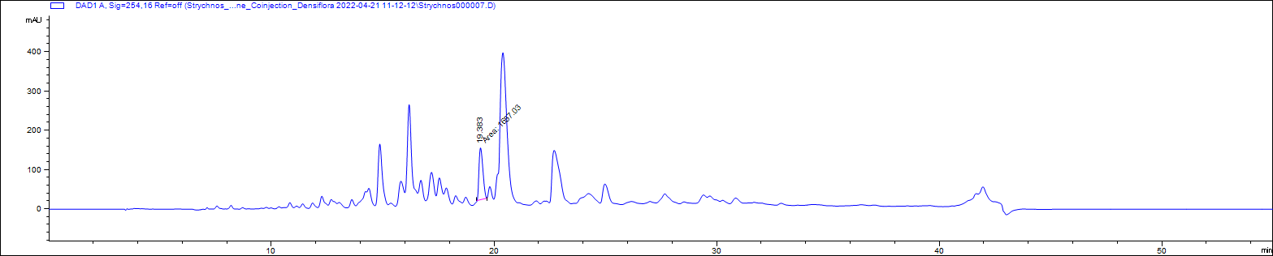
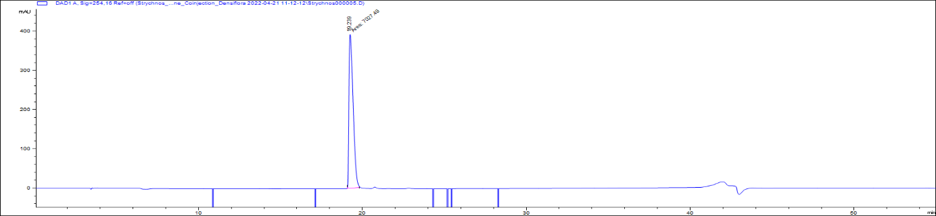
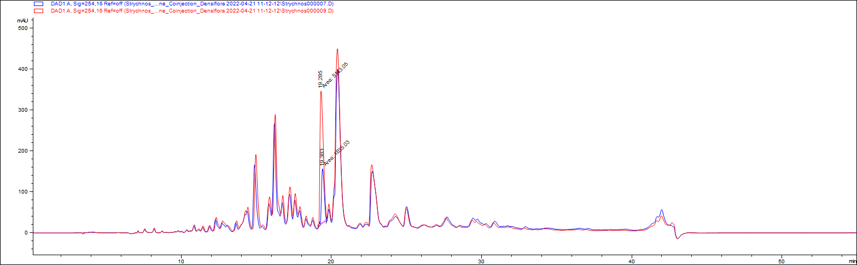
HPLC analyses
A
Retention time: 19.38 min
A. Chromatogram of methanolic extract of S. densiflora trunk barks (λ=254 nm).
B. Chromatogram of strychnine reference (λ=254 nm).
C: Comparison of chromatogram A (in blue) with the chromatogram of methanolic extract of S. densiflora trunk barks co-eluted with strychnine reference (in red) (λ=254 nm).
Strychnine
B
Retention time: 19.24 min
Strychnine
C
Retention time: 19.38 min and 19.29 min
Strychnine

Slide 21
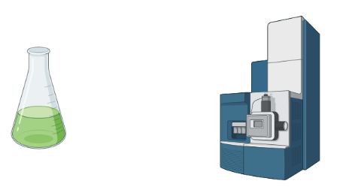
Additional analyses to confirm the presence of strychnine
TLC
NMR
HPLC
UPLC-MS/MS
Column: Acquity BEH® C₁₈
(100 x 2.1 mm, 1.7 µm)
Mobile phase: Water + 0.1% formic acid and acetonitrile

Slide 22
UPLC-MS/MS analyses
S. tricalysioides (trunk barks)
S. icaja (roots)
S. icaja (collar barks)
S. nux-vomica (trunk barks)
S. nux-vomica (root barks)
S. nux-vomica (seeds)
S. ignatii (fruits)
S. camptoneura (trunk barks)
S. congolana (trunk barks)
S. boonei (trunk barks)
S. densiflora (trunk barks)
S. tchibangensis (trunk barks)
S. usambarensis (leaves)
Strychnine

Slide 23
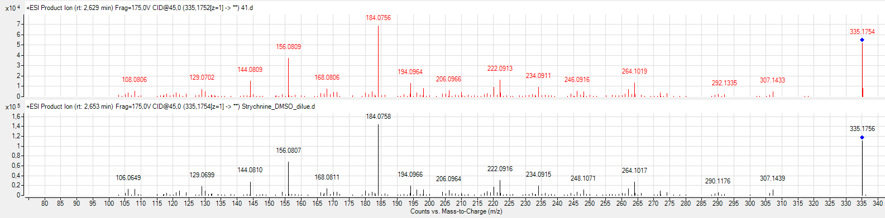
Additional analyses to confirm the presence of strychnine
TLC
NMR
HPLC
UPLC-MS/MS
Comparison of MS/MS spectra
Methanolic crude extract of S. densiflora trunk barks
Strychnine reference

Slide 24

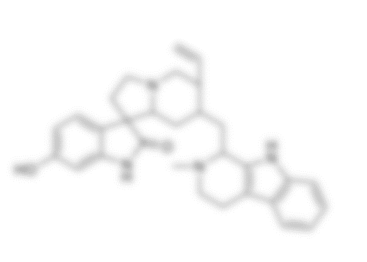

Conclusions
Unveiling of strychnine in seven species of Strychnos genus
Presence of strychnine at very low concentration (trace) for 6 species
Molecular networking: powerful tool to quickly identify metabolites at high and low concentrations
Significant contribution to the chemotaxonomic study of Strychnos

Slide 25
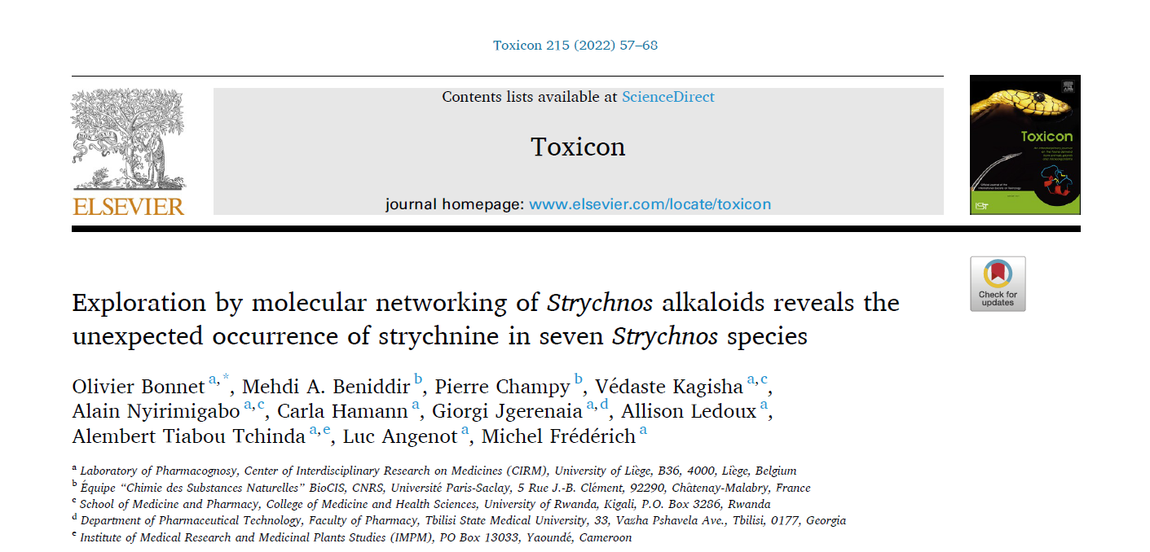

Slide 26
