Slide 1


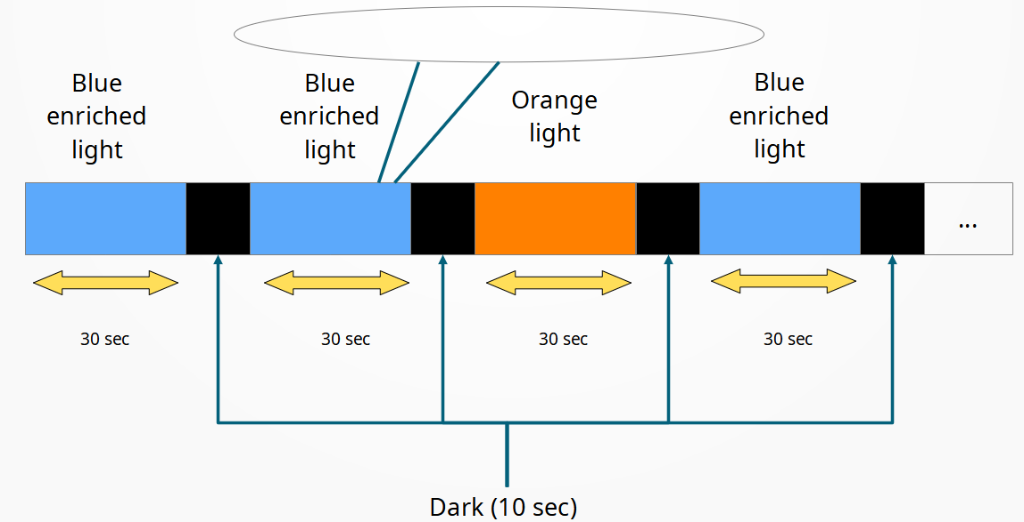
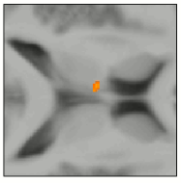
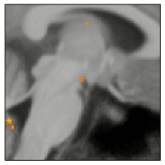
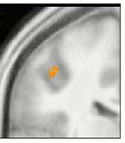



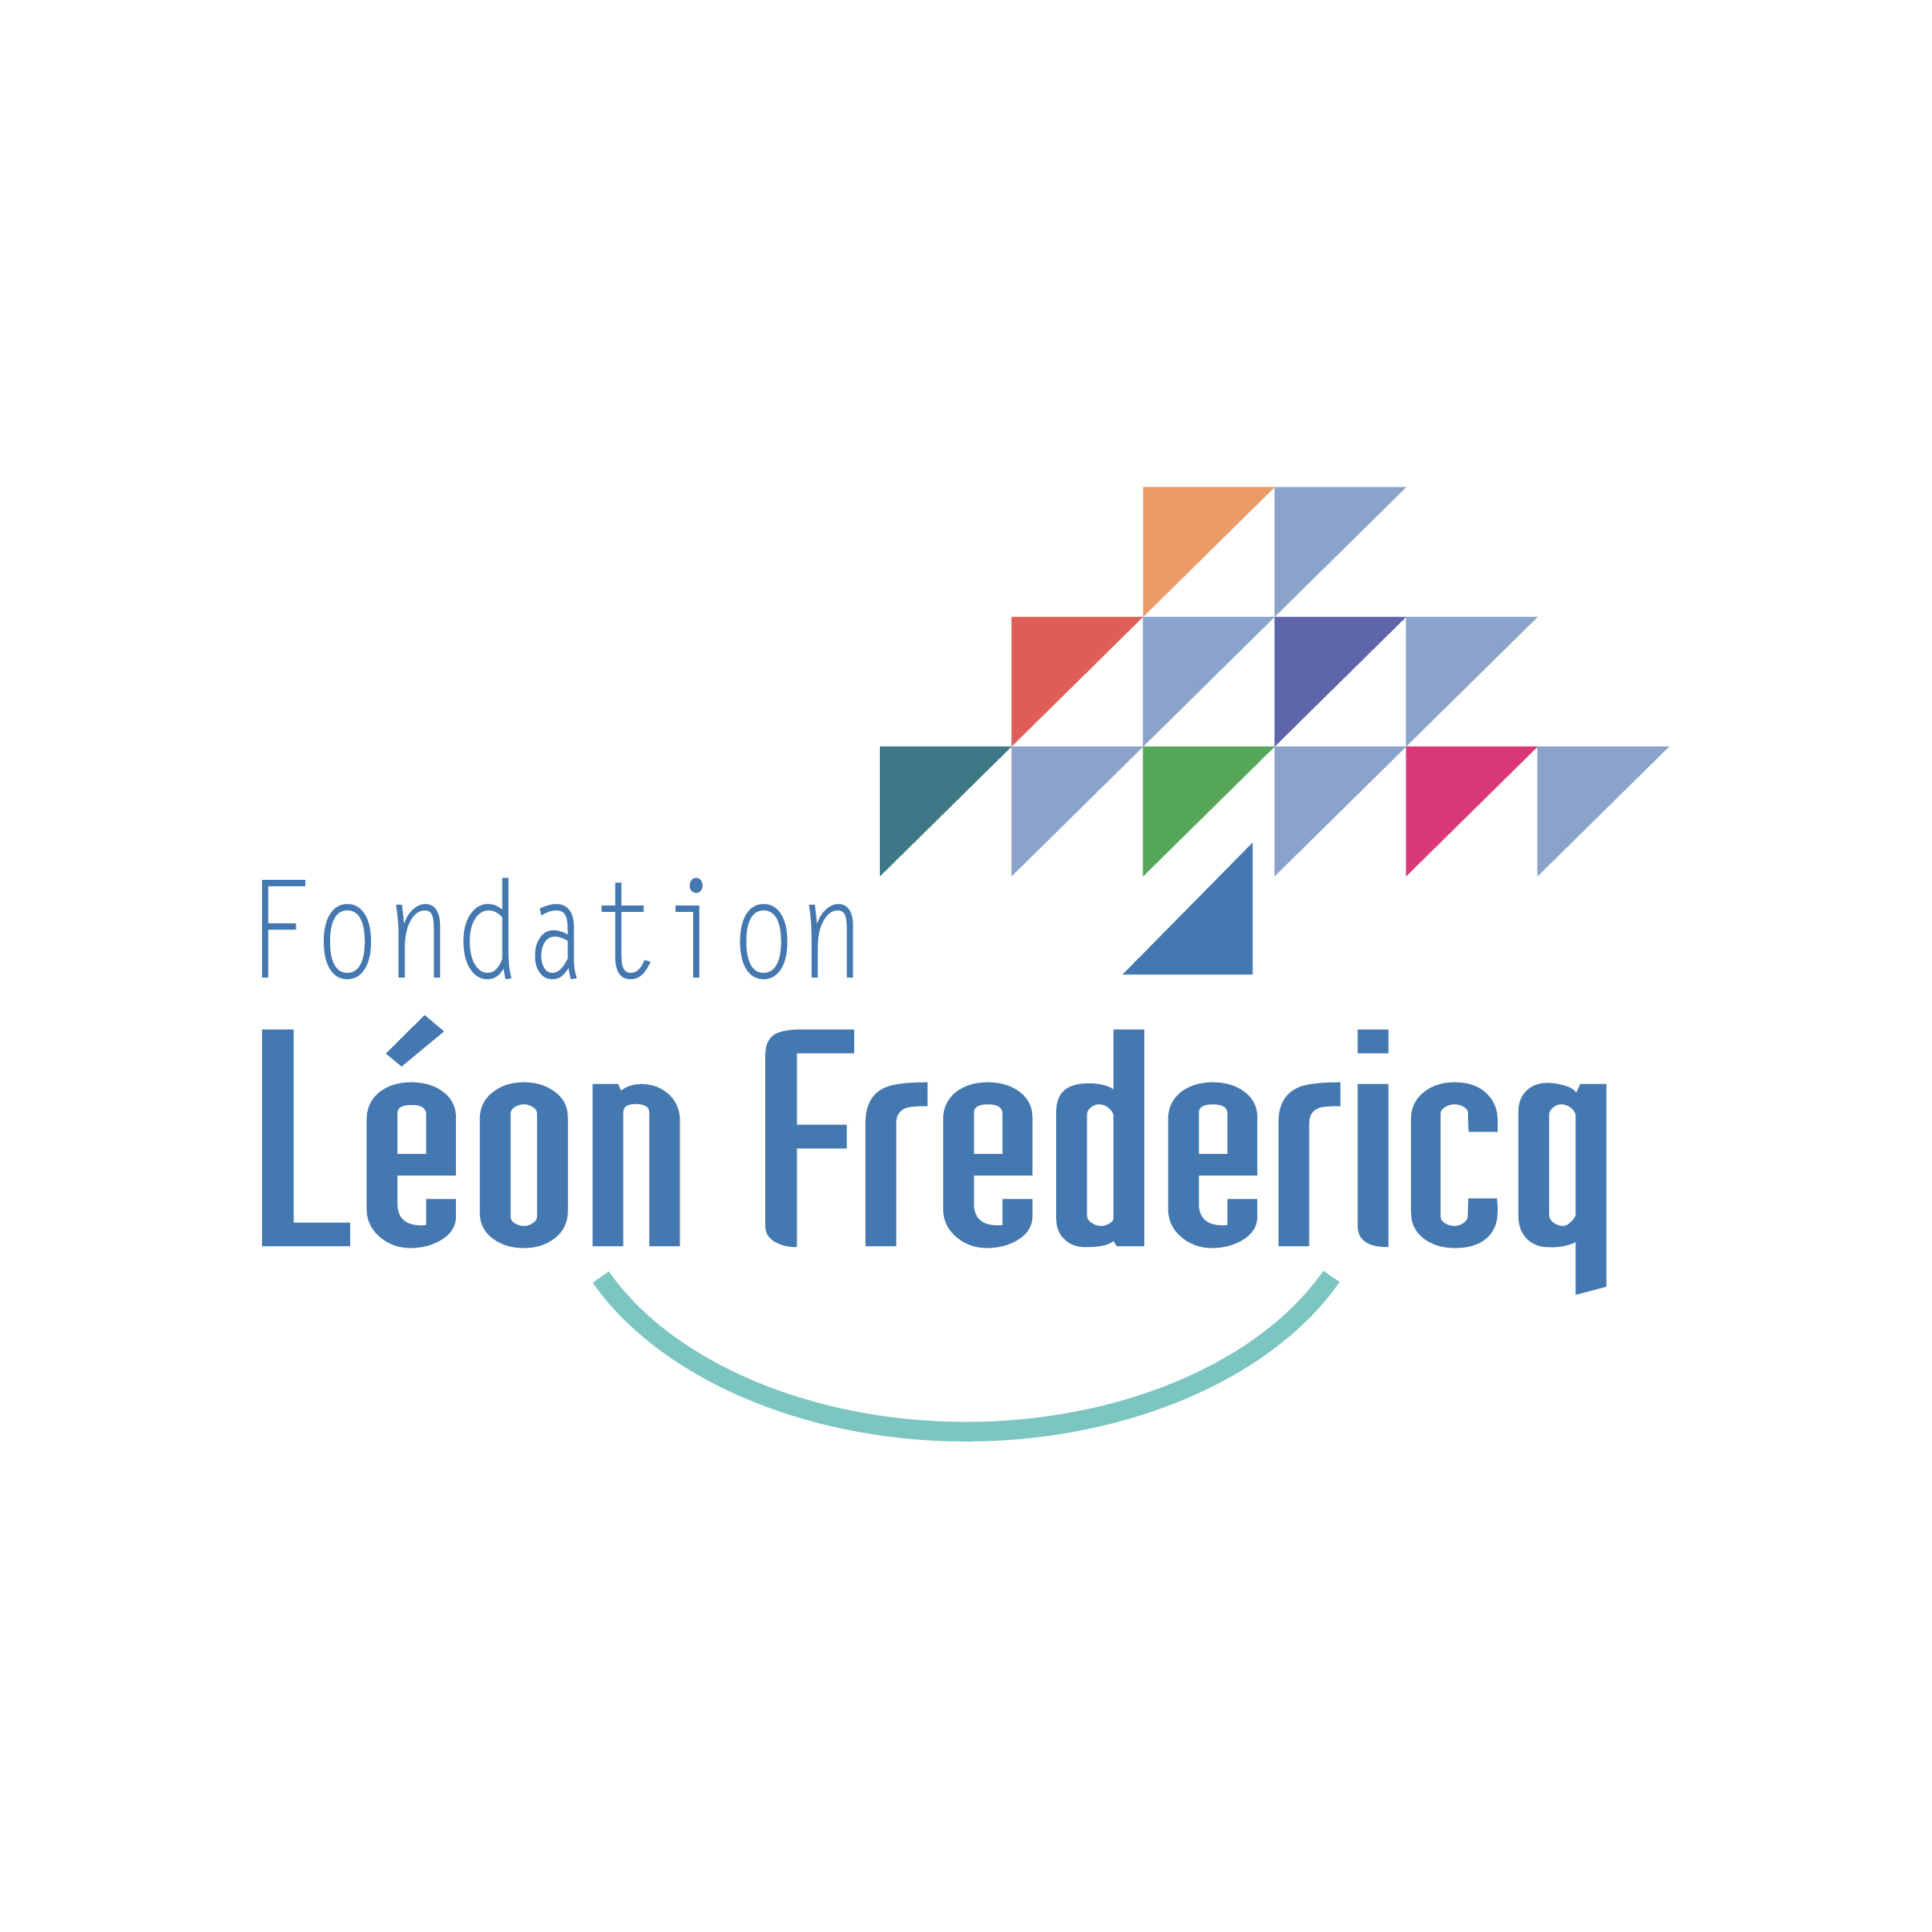
ULTRA HIGH-FIELD MRI INDICATIONS THAT EXPOSURE TO BLUE ENRICHED LIGHT INCREASES ATTENTION BRAIN RESPONSES DURING AN ODDBALL TASK
Jose Fermin Balda Aizpurua¹, Ilenia Paparella¹, Islay Campbell¹, Roya Sharifpour¹, Alexander Berger^{1,3,4}, Ekaterina Koshmanova¹, Elise Beckers^{1,2}, Nasrin Mortazavi¹, Laurent Lamalle¹, Christophe Phillips¹, Pierre Maquet¹, Siya Sherif¹, Gilles Vandewalle¹.
¹Cyclotron Research Centre, University of Liège, 8 Allée du 6 Août, Bâtiment B30, B-4000 Liège, Belgium.
²Alzheimer Centre Limburg, School for Mental Health and Neuroscience, Faculty of Health, Medicine
and Life Sciences, Maastricht University, Maastricht, The Netherlands.
³Institute of Neuroscience (IoNS), Université Catholique de Louvain (UCLouvain), Brussels, Belgium.
⁴Synergia Medical SA, Mont-Saint-Guibert, Belgium.
Introduction
Light has multiple Non-Image Forming (NIF) functions including stimulation of cognition and alertness.
NIF functions are driven by blue-light-sensitive intrinsecally photosensitivesensitive retinal ganglion cells (ipRCGs) expressing melanopsin photopigment.
Most light studies are based on 3T MRI scans, which provide poor resolution for analysis of light activated subcortical region.
We used a 7T MRI to assess NIF impact of light on cortical and subcortical regions during an ongoing attentional task (Fig.1).
Methods
PARTICIPANTS
TASK
STATISTICS
Table 1: Summary of subject included in the analysis
SSDSDSSSDSD…
General Linear Model (GLM) sought impact of light on activity evoked by target tones
Nº subj | Age | Male/ Female | BMI
22 | 24.2y ± 2.7 | 7 / 15 | 21.7 kg/m² ± 2.5
Fig. 1: Schematic representation of fMRI acqisition: Participants performed an auditory oddball task while exposed to pseudo random alterning blocks of 30s of polychromatic blueish light (190 melanopic EDI lux) and monochromatic orange light (.16 melanopic EDI lux) separated by 10s of darkness
See poster 330 and 333 for pupil response during fMRI
See poster 025 and 011 for other fMRI results
Results
Increased response to target sound in a attentional oddball task under blueish vs. orange light exposure over the thalamus, hypothalamus, and IPS.
Figure 2: Increase in the brain responses to the deviant tones under blueish vs. orange light conditions (N=22; 7 men and 15 women) Results are displayed over the mean structural image of all subjects (p<0.001 - uncorrected). Regions of interest are hilighted by red circle.
Activation of the left thalamus (alertness, attention, cognition).
Activation of the posterior hypothalamus (sleep-wake regulation)
Activation of the Intra Parietal Sulcus (attention)
A
B
C
Conclusion
Preliminary demonstration of an impact of light on NIF attentional brain responses in the thalamus, hypothalamus and IPS using 7T MRI
This hold promise for the investigation of the subcortical circuitry mediating the NIF impact of light on alertness and cognition
Results will be confirmed / detailled in a larger sample
fbalda@uliege.be

