Slide 1
Is it possible to differentiate meat products of a local breed from those of its sister breed based on genotypes?
H. Wilmot^{1,2}, G.Glorieux³, X. Hubin³ and N. Gengler²
¹National Fund for Scientific Research (F.R.S.-FNRS), Rue d'Egmont, 5, 1000 Brussels, Belgium
² TERRA Research and Teaching Centre, Gembloux Agro-Bio Tech, University of Liège, Passage des Déportés, 2, 5030 Gembloux, Belgium
³ Walloon Association of Breeders, Rue des Champs Elysées, 4, 5590 Ciney, Belgium

Slide 2
WCGALP 2022
Introduction
Specialized breeds were often preferred to dual-purpose breeds
Decline of dual-purpose cattle during the second half of the last century
1

Slide 3
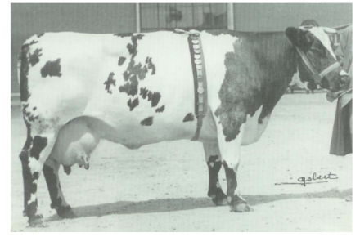
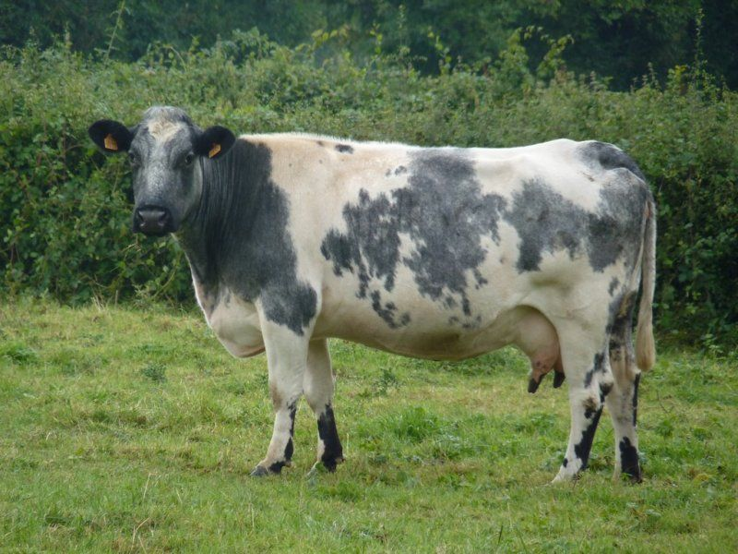
WCGALP 2022
Dual-Purpose Blue (DPB)
1900
1973
2018
Shorthorn cattle to improve local cattle in Belgium
Mid and Upper Belgium Breed
Beef Belgian Blue (BBB)
Separation of both branches
BlueSter project
2

Slide 4
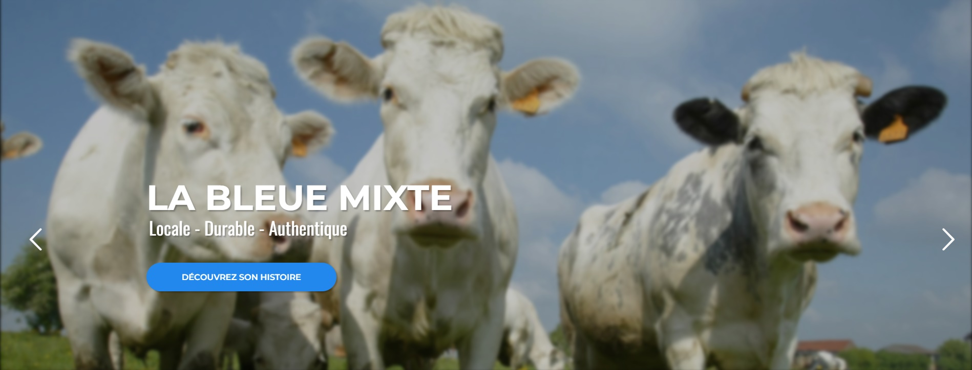
WCGALP 2022
Introduction
The BlueSter project
Specificity and importance of local breeds
Sustainability through local products
https://www.projet-bluester.eu/
3
3

Slide 5
WCGALP 2022
Introduction
Development of breed-derived labelled products
Need for a certification process
Differentiation between DPB and BBB meat
4

Slide 6
WCGALP 2022
Objective
To determine the possibility to differentiate meat of DPB and BBB by the use of a genomic breed assignment tool previously developed
5

Slide 7
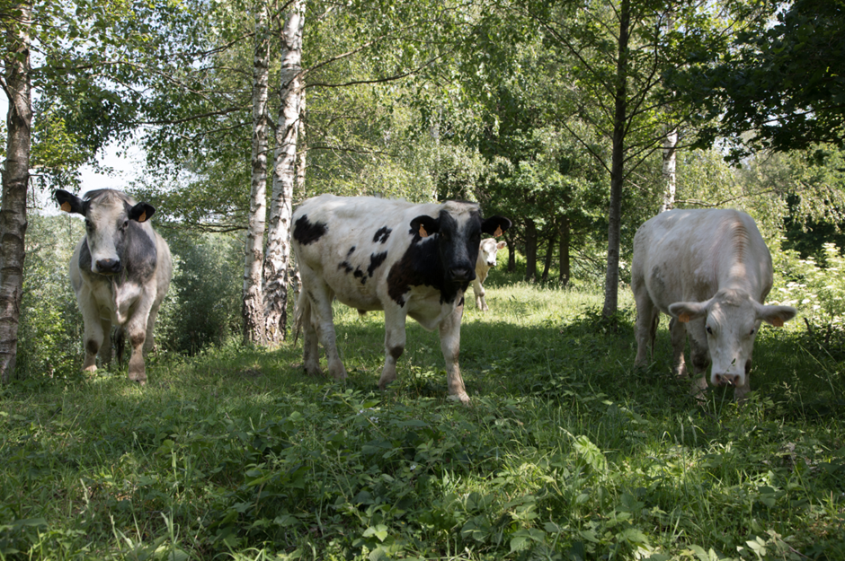
WCGALP 2022
Challenges
DPB and BBB diverged only 50 years ago
Three same color patterns: black-pied, blue-pied and white
6
Mélanie Rivet-CRRG, 2020

Slide 8
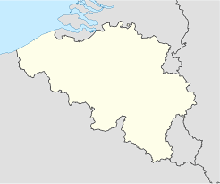
WCGALP 2022
Challenges
The DPB breed is transboundary
Three different genotypes for muscular types:
+/+
mh/+
mh/mh (shared with BBB)
Belgium
France
7

Slide 9
WCGALP 2022
Principal component analysis
60 DPB
52 Belgian DPB
8 French DPB
60 BBB
8

Slide 10
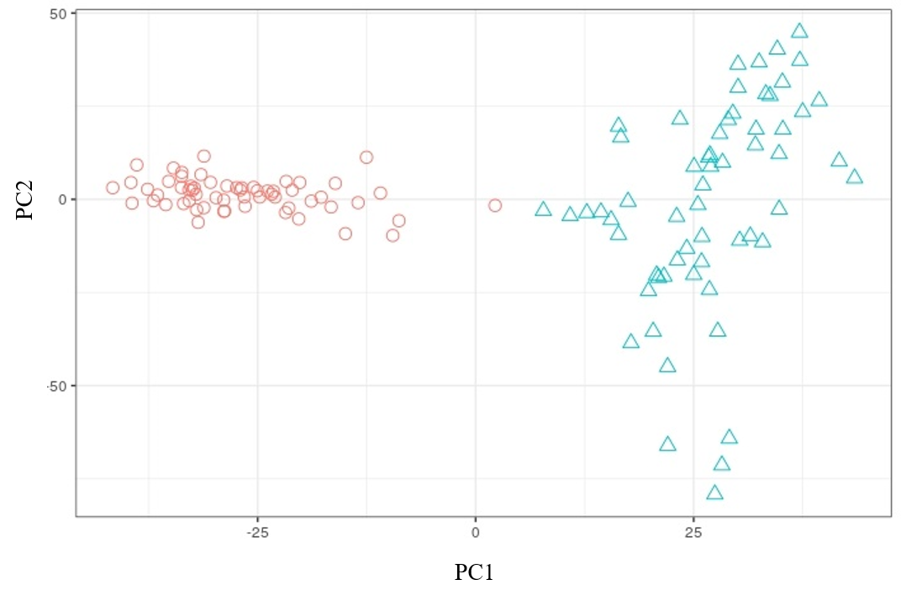
WCGALP 2022
Principal component analysis
Beef Belgian Blue Dual-Purpose Blue
9

Slide 11
WCGALP 2022
Meat sampling
16 DPB
8 Belgian DPB (mh/mh)
8 French DPB (mh/+ and +/+)
8 BBB
8 Holstein animals
10

Slide 12
WCGALP 2022
Breed assignment model
Can differentiate 12 breeds
2,005 SNPs
Classification based on Nearest Shrunken Centroids
https://doi.org/10.1111/jbg.12643
11

Slide 13
WCGALP 2022
Breed assignment model
167 SNPs to differentiate DPB
173 SNPs to differentiate BBB
Overlap of 7 SNPs
12

Slide 14
WCGALP 2022
Confusion matrix
Predicted breed | Breed of origin
 | Beef Belgian Blue | Dual-Purpose Blue | Holstein
Beef Belgian Blue | 8 | 0 | 0
Dual-Purpose Blue | 0 | 16 | 0
Holstein | 0 | 0 | 8
13

Slide 15
WCGALP 2022
Implications
It is possible to differentiate meat of DPB from BBB with a high accuracy
Even for mh/mh animals!
Use in routine in a certification process for labelled products
Accumulation of phenotypic and genotypic differences since divergence Different breeding goals
14

Slide 16
WCGALP 2022
https://doi.org/10.1016/j.livsci.2022.104996
15

Slide 17
Thank you for your attention! Questions?
Hélène Wilmot
PhD Candidate
Helene.Wilmot@uliege.be

