Slide 1
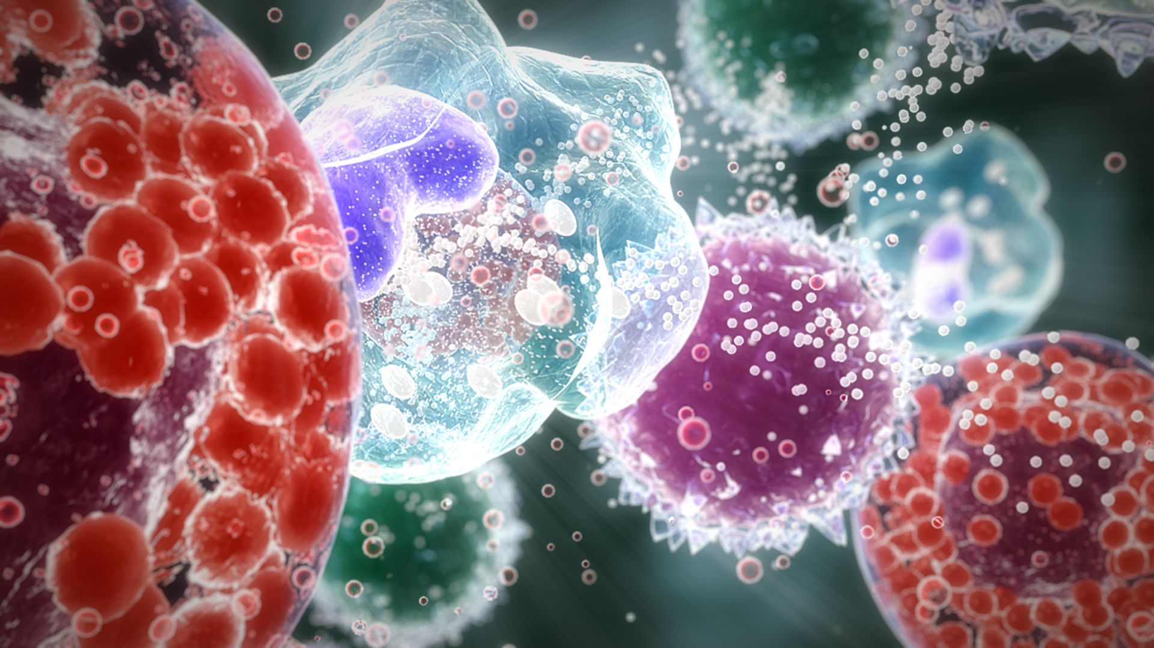
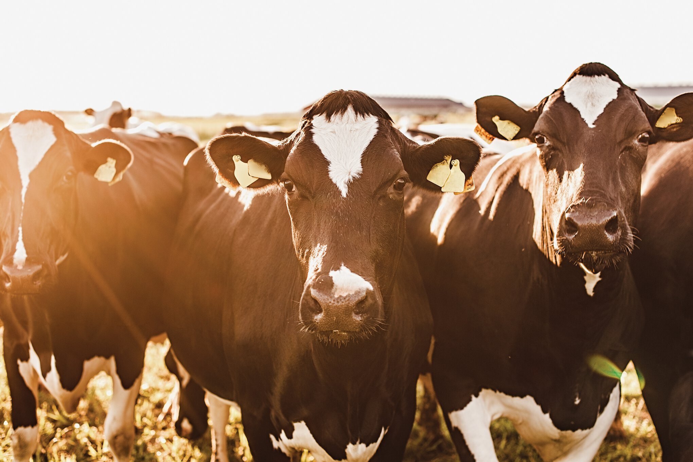
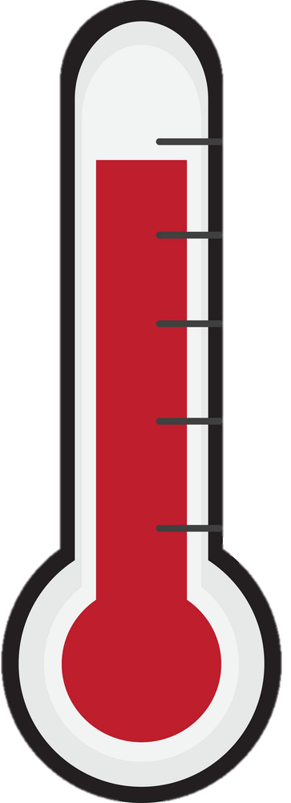
Innovative phenotyping strategies exploiting immune response to heat stress conditions
P. Lemal, M. Schroyen, N. Gengler
pauline.lemal@uliege.be

