Slide 1
Political ethics and its potential interference with the right to privacy
Mathilde Franssen & Léna Geron
University of Liège (Belgium)
ICON•S 2022 | Global problems and prospects in public law
DAY 2 – 5 july
Panel #81 Constitutional Theory I

Slide 2
Overview
A global context : the decay of political trust
What’s political ethics ?
The right to privacy of politicians in the ECHR
Political ethics and the right to privacy
Conclusion and questions to explore

Slide 3
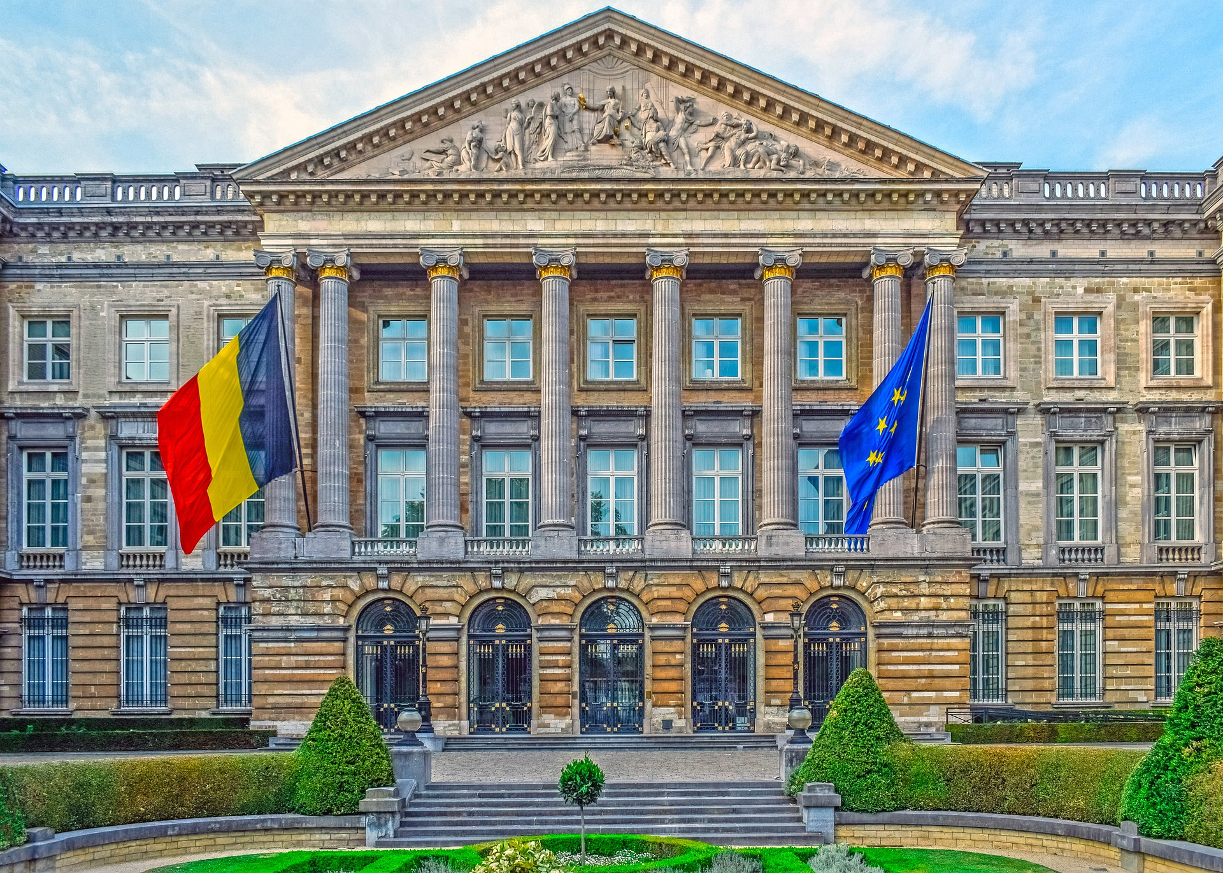
A global context :
the decay of political trust

Slide 4
What’s political ethics ?
Notes:
Déontologie politique au sens large à la fois la législation (hard law) et les normes éthiques qui visent à moraliser les gouvernants

Slide 5
The right to privacy of the politicians in the ECHR
Art. 8 ECHR – right to private and family life
1. Everyone has the right to respect for his private and family
life, his home and his correspondence.
2. There shall be no interference by a public authority with the
exercise of this right except such as is in accordance with the
law and is necessary in a democratic society in the interests of
national security, public safety or the economic well-being of the
country, for the prevention of disorder or crime, for the protection
of health or morals, or for the protection of the rights and freedoms
of others.

Slide 6
The right to privacy of the politicians in the ECHR
Art. 10 ECHR – Freedom of expression
1. Everyone has the right to freedom of expression. This right
shall include freedom to hold opinions and to receive and impart
information and ideas without interference by public authority
and regardless of frontiers. This Article shall not prevent States
from requiring the licensing of broadcasting, television or cinema
enterprises.

Slide 7
The right to privacy of politicians in the ECHR
Art. 3 First Protocol to the ECHR – Right to free elections
The High Contracting Parties undertake to hold free elections at reasonable intervals by secret ballot, under conditions which will ensure the free expression of the opinion of the people in the choice of the legislature.
Notes:
Idée = il faut suffisamment d’informations pour que le peuple puisse se prononcer en connaissance (« garantir la libre expression de l’opinion du peuple ») de cause sur un candidat. Reste à fixer ce qui est nécessaire pour se prononcer…

Slide 8
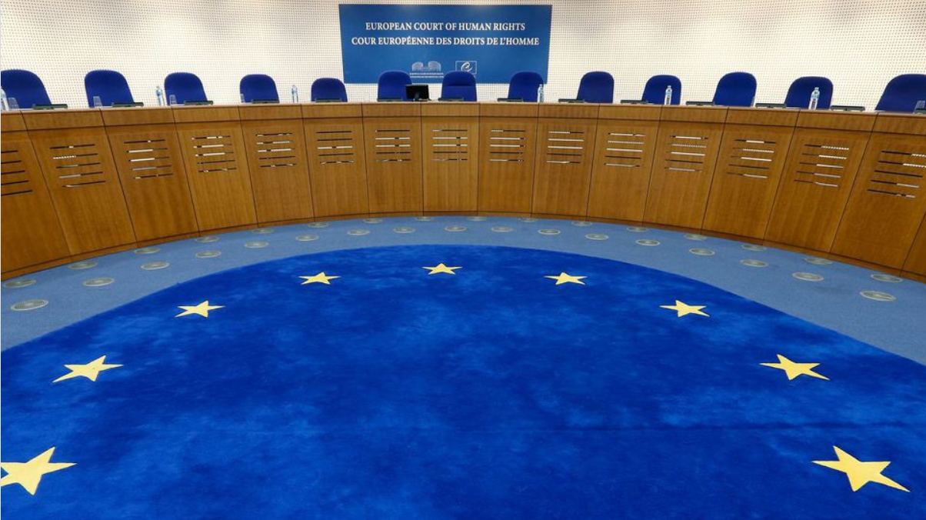
Political ethics and right to privacy
Tammer v. Estonia
Satakunnan markkinapörssi oy et satamedia oy c. Finland
1986
2012
2022
2017
?
2001
Lingens v. Austria
Patrício Monteiro Telo de Abreu c. Portugal
Von Hannover v. Germany II

Slide 9
Political ethics and right to privacy
ECtHR, Satakunnan markkinapörssi oy et satamedia oy c. Finland, 27 june 2017
§180. “[…] the information published by the applicant companies did not pertain specifically to any particular category of persons such as politicians, public officials, public figures or others who belonged to the public sphere by dint of their activities or high earnings […]. As the Court has previously stated, such persons inevitably and knowingly lay themselves open to close scrutiny by both journalists and the public at large”.

Slide 10
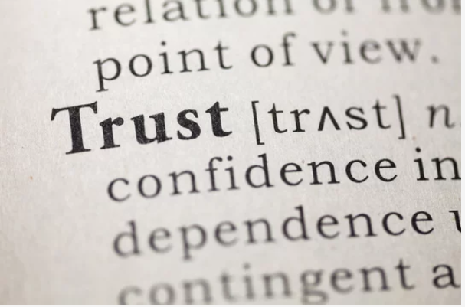
Conclusion and questions to explore

Slide 11
Thank you for your attention
mathilde.franssen@uliege.be
lena.geron@uliege.be

