Slide 1
Between Utopia and Pragmatism:
Relational vs Algorithmic Management
A critical assessment of an atypical platform
Academy Of Management
Working for an Algorithm: Gig Work Symposium
Seattle – August 08, 2022
Brassart Chloé, Ph.D student
Pichault François
University of Liège

Slide 2
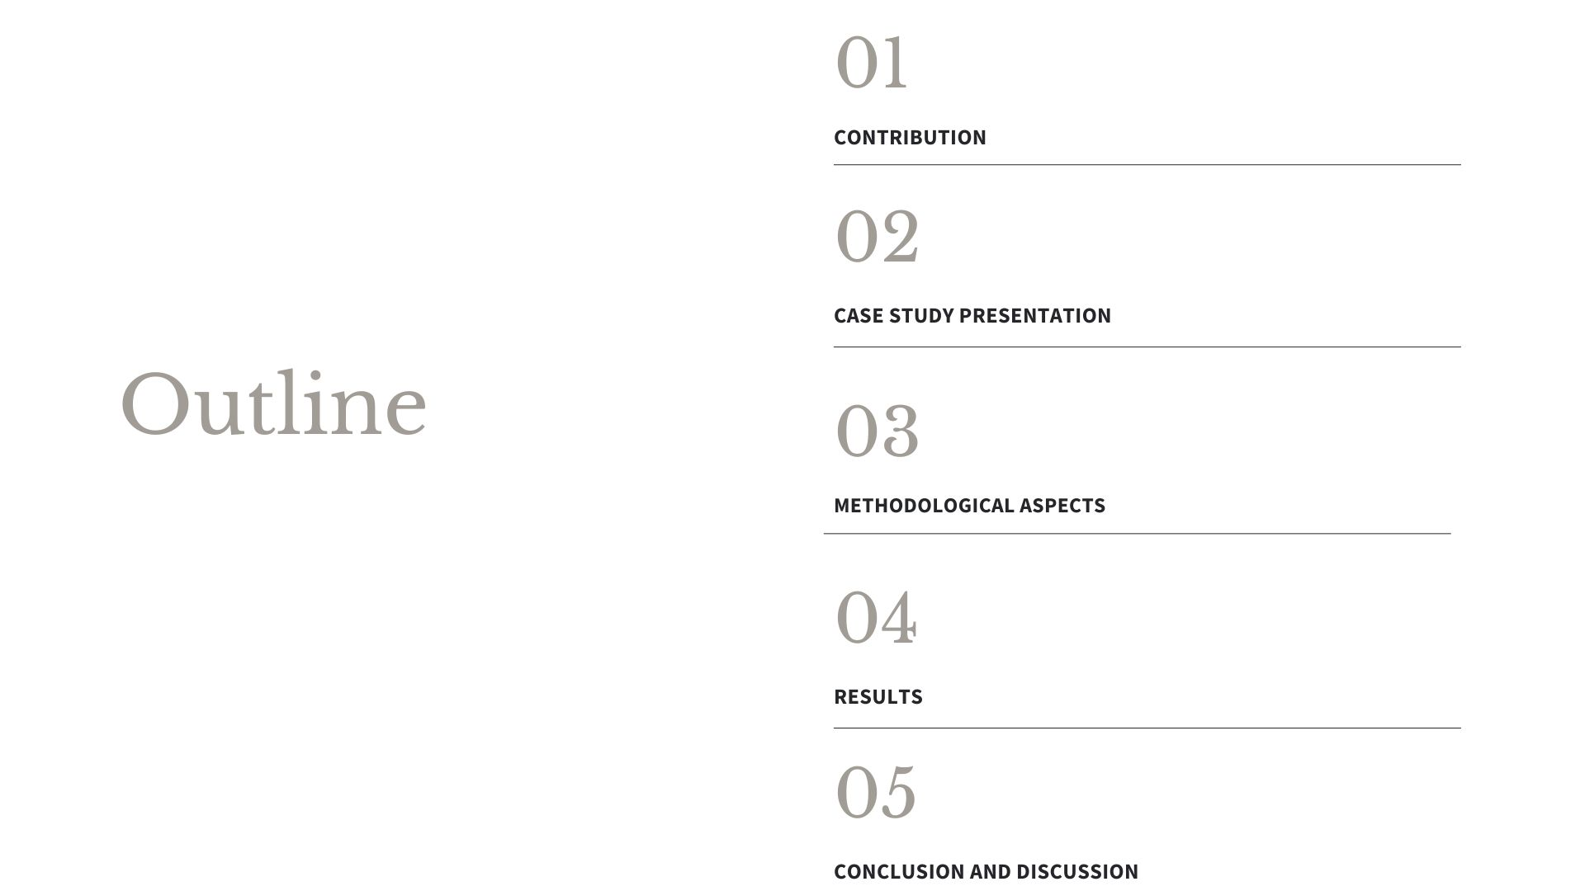

Slide 3
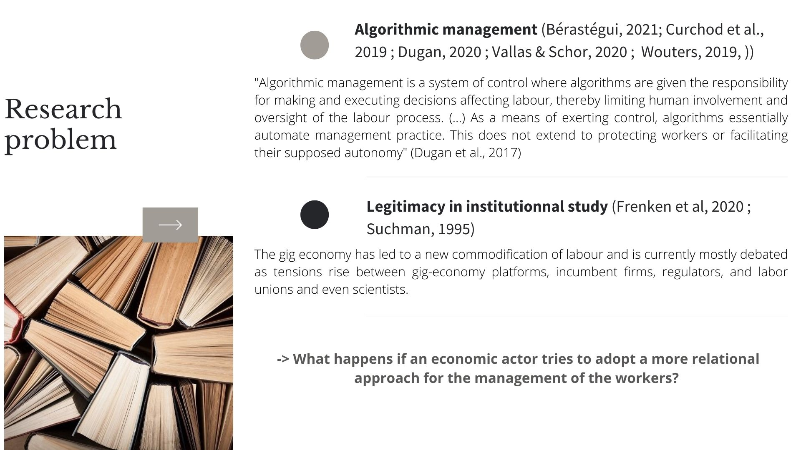

Slide 4
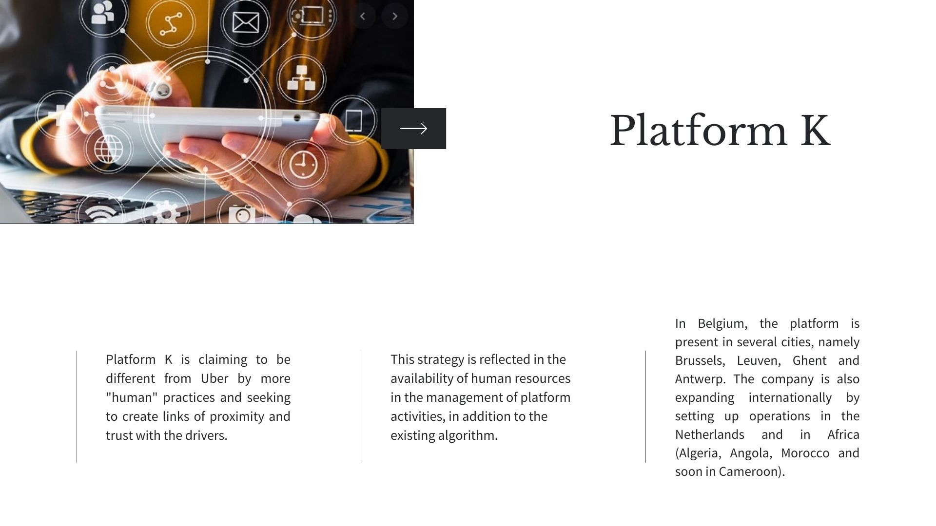

Slide 5
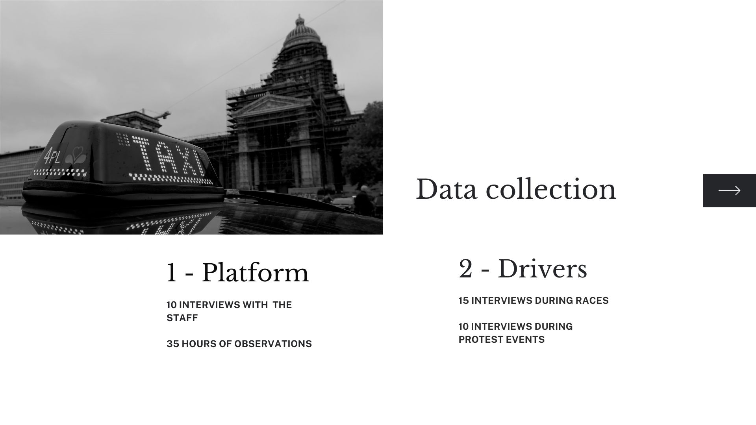
Notes:
Multi platforms ici
Empirical case study on this platform indepth

Slide 6
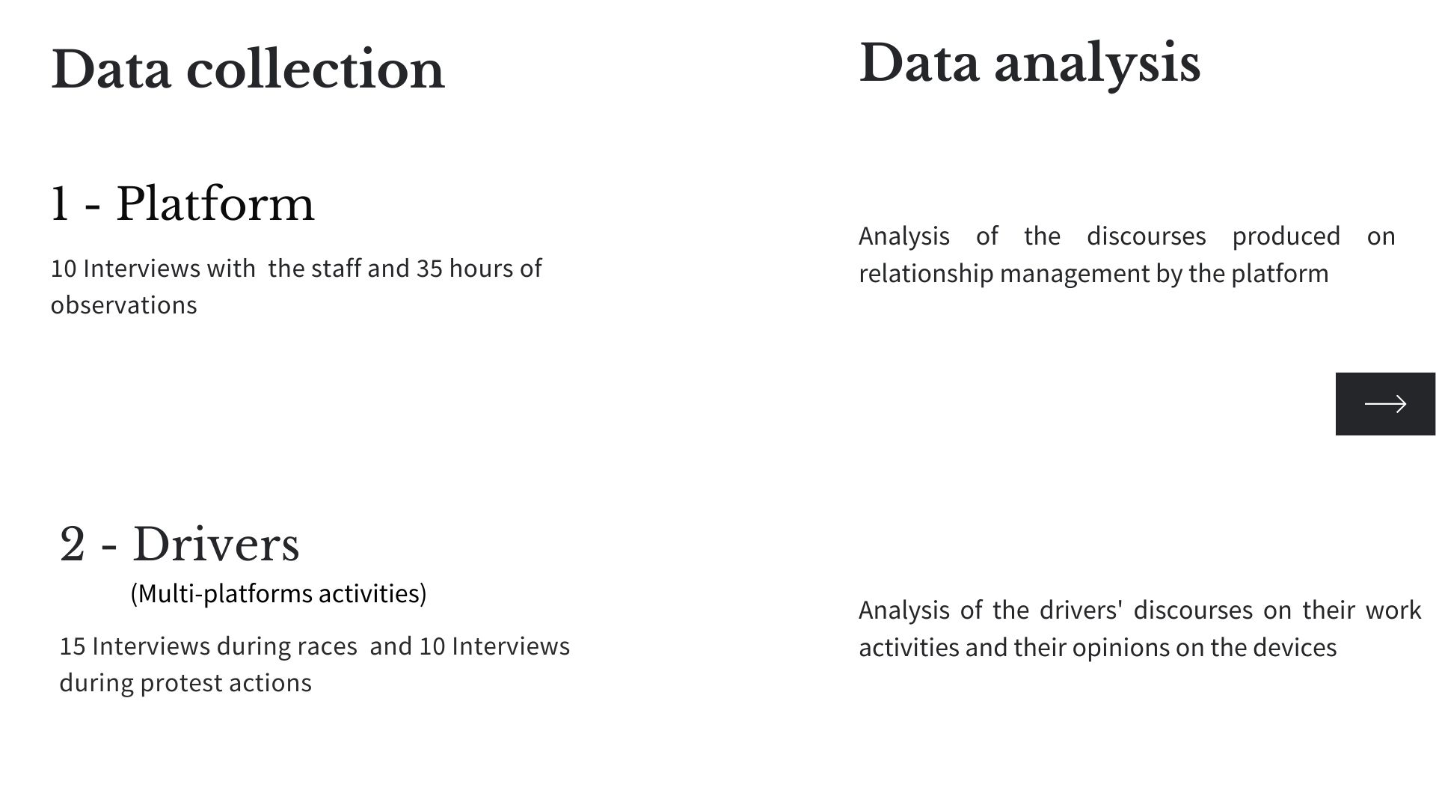

Slide 7
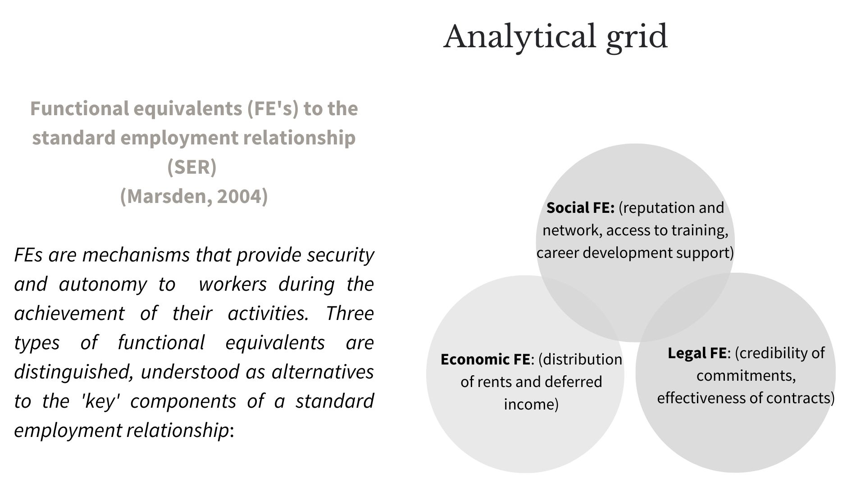

Slide 8
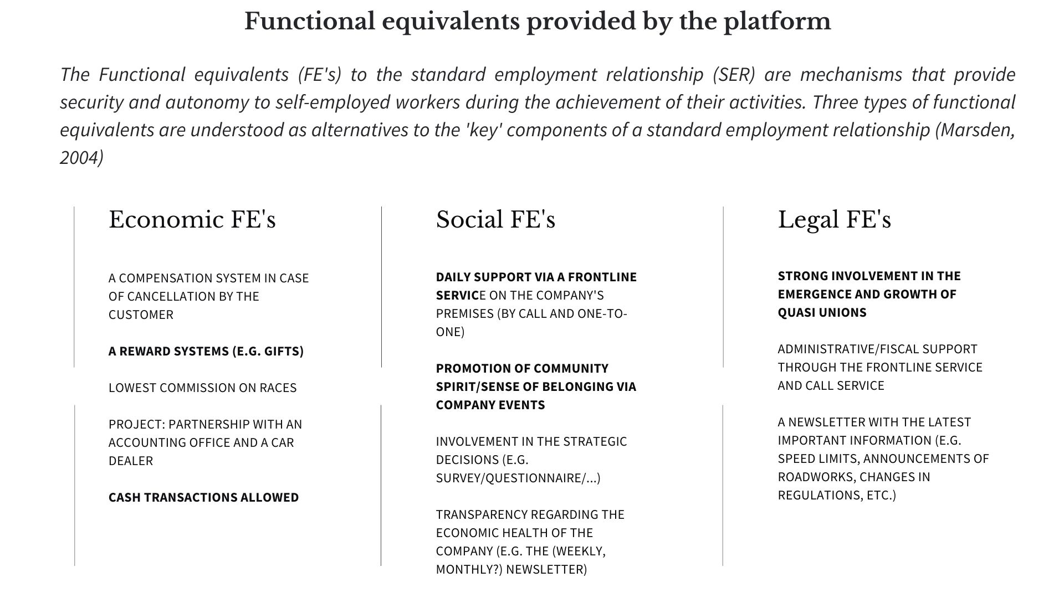

Slide 9
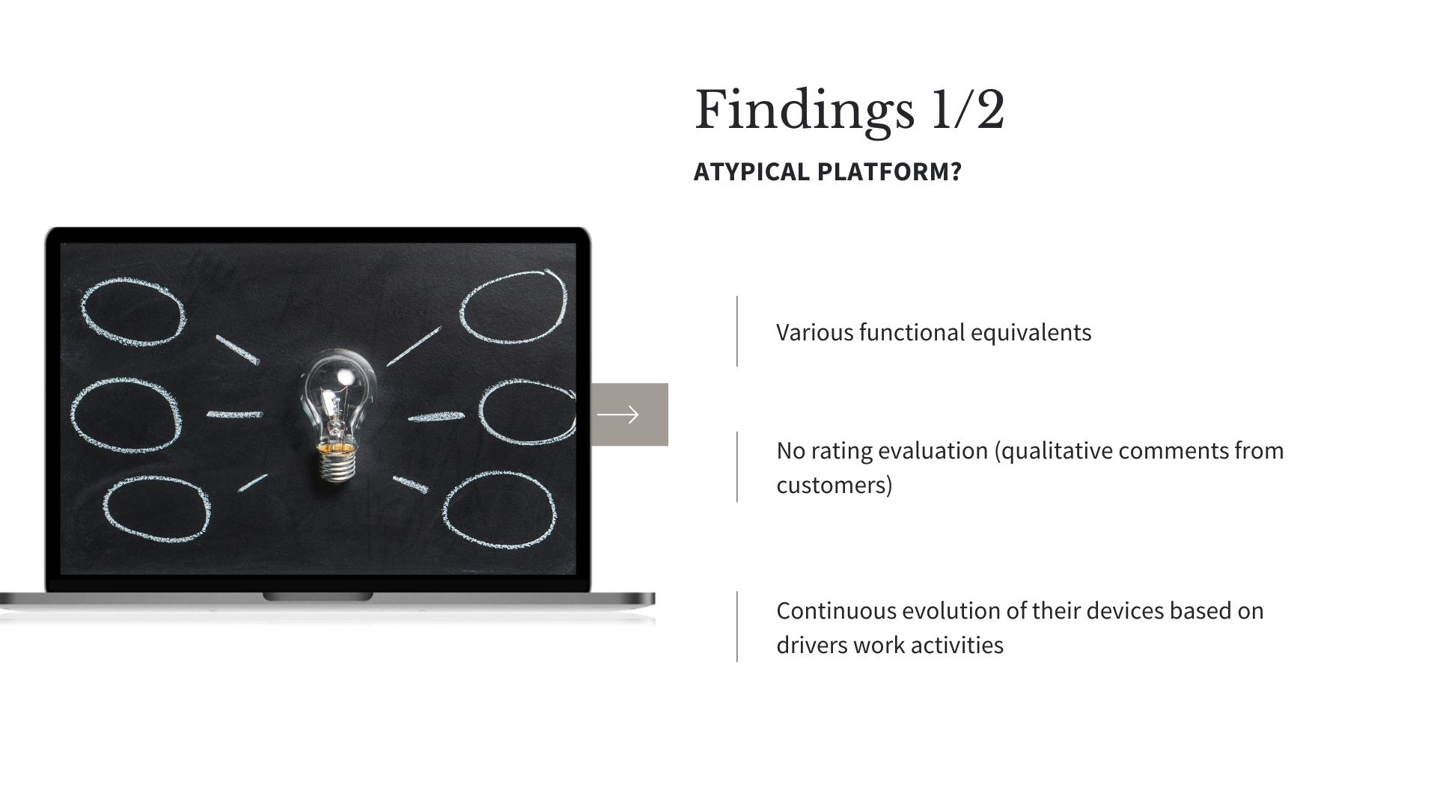

Slide 10
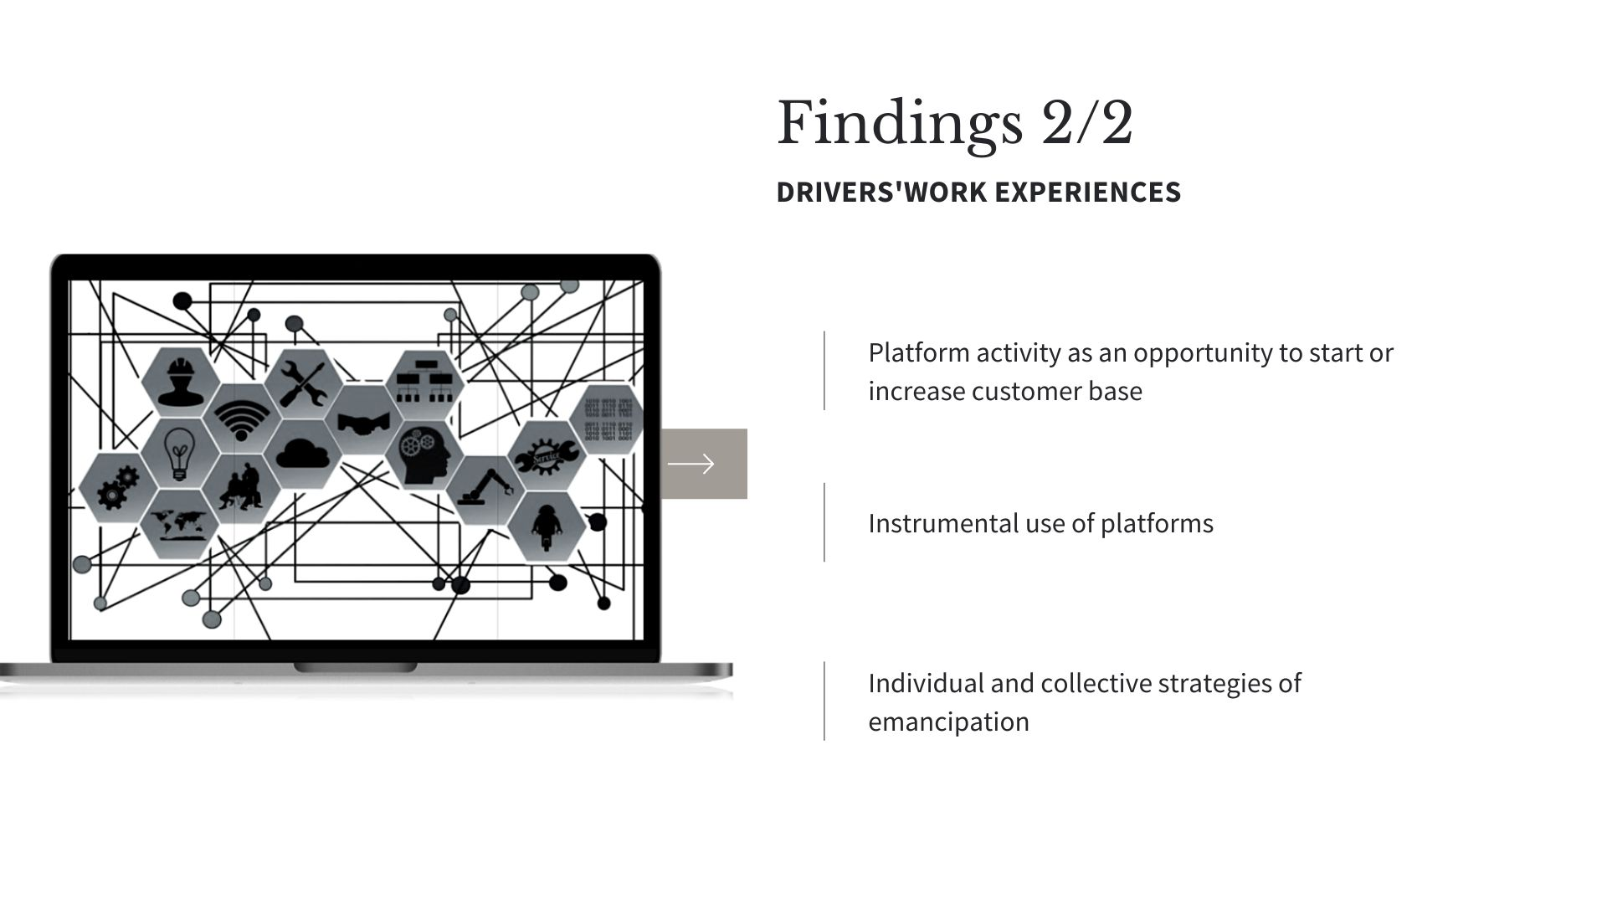

Slide 11
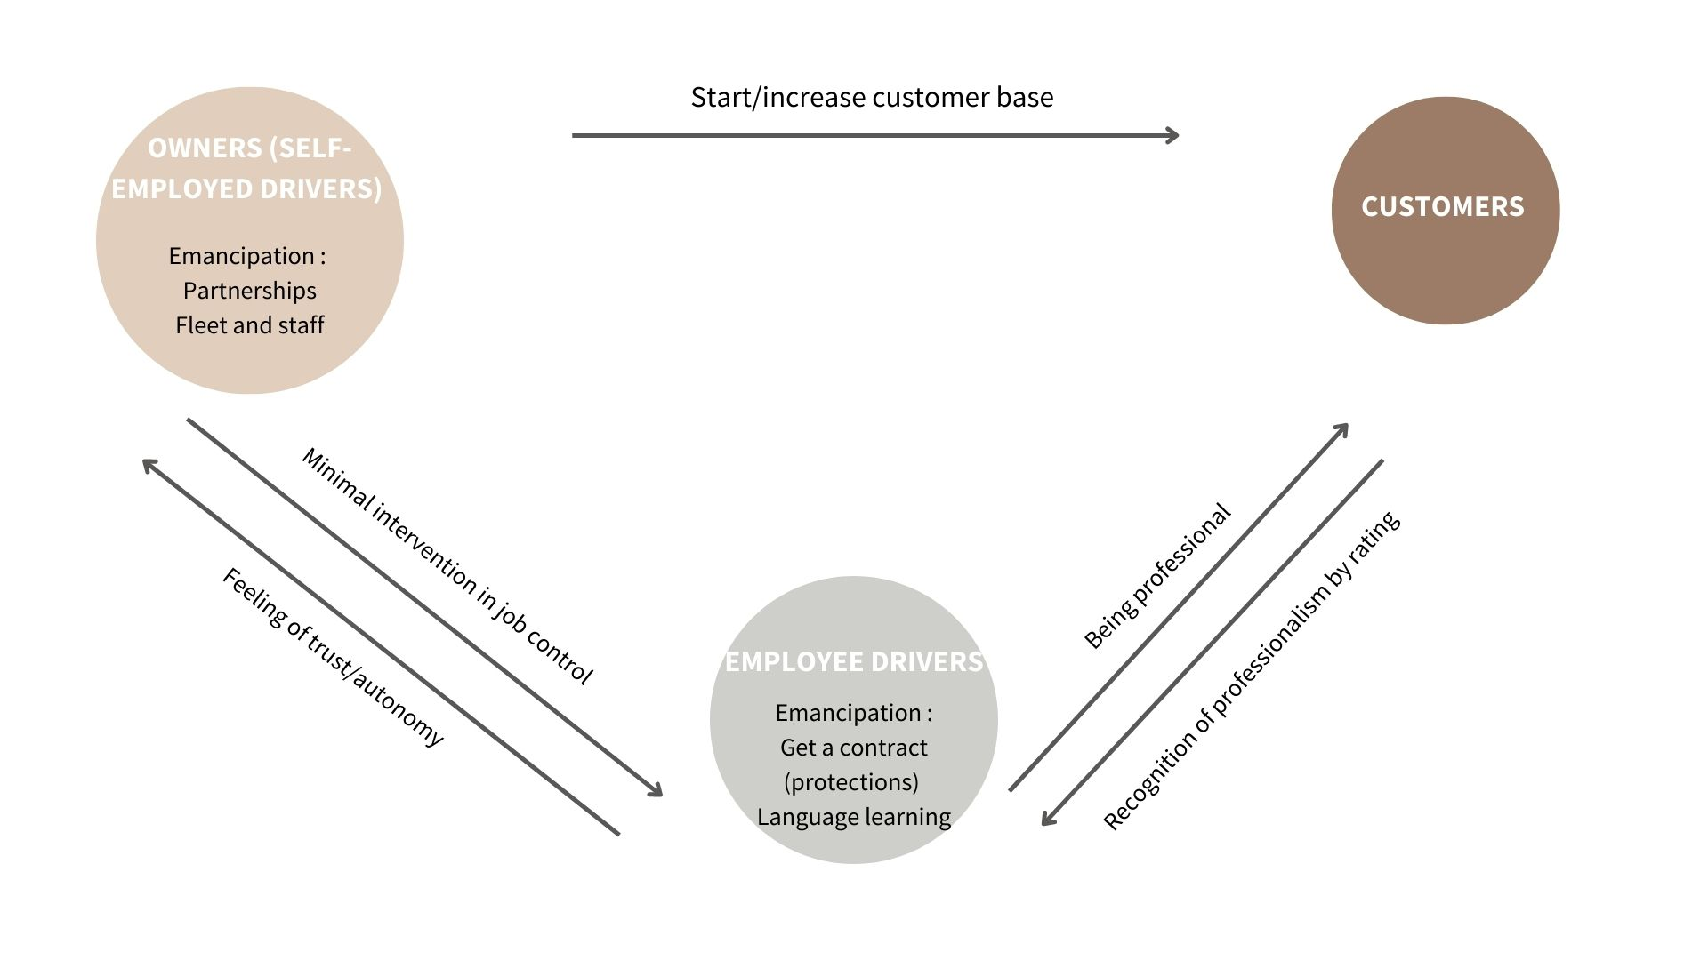


Slide 12
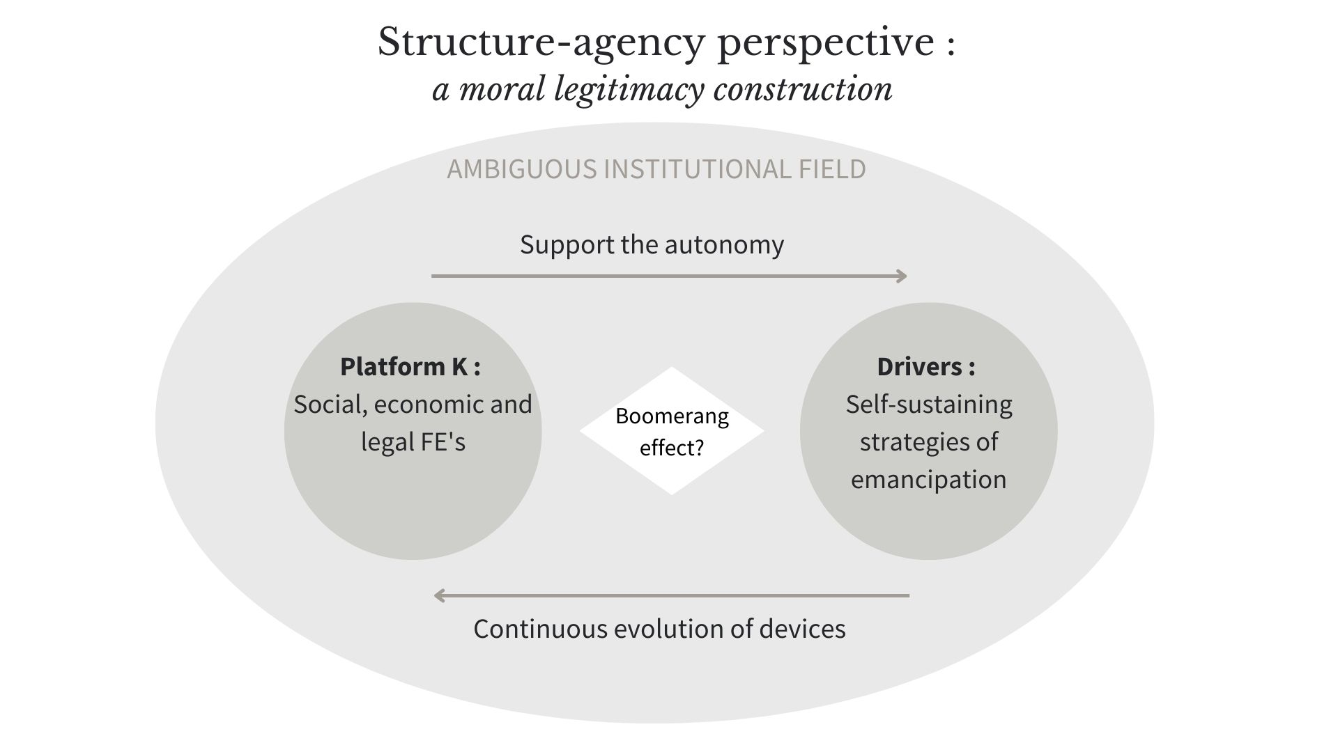

Slide 13
Discussion
When an economic actor tries to adopt a more relational management of the workers (FE’s), while remaining embedded in the current institutionnal field, the findings show that :
The drivers create their own mechanisms of sustainability and emancipation with an instrumental use of the platforms
The evolution process of the platform goes towards higher technology, more professional devices and less informal contacts

Slide 14
-> Increased moral legitimacy (positive perception of the drivers, no claim from the drivers, no legal action, no criticism in media ) …
… but simultaneously less relational management towards more algorithmic management - > Isomorphism effect
Platform K cannot change the rules of the game as long as it has no pragmatic legitimacy
However, drivers do not feel alienated by algorithmic management and use platforms as levers of emancipation
=> debates on algorithmic management should pay more attention to drivers' experiences rather than remaining focused on platform devices
-

Slide 15


Your questions are welcome!
Chloe.brassart@uliege.be
Chloe Brassart
Chloe Brassart, Ph.D student
Supervisor : François Pichault

