Slide 1
METAL TOXICITY AND HEALTH PROBLEMS LINKED TO THE CONSUMPTION OF ARK SHELLS (ARCA NOAE L.) FROM A TUNISIAN COASTAL LAGOON
Feriel GHRIBI ¹ , Safa BEJAOUI ¹ , Michel Marengo ², RICHIR Jonathan ², Imene Chetoui ¹, M’hamed EL CAFSI ¹, Sylvie GOBERT ²
¹Unité de physiologie et environnement aquatique, Université Tunis El Manar, 2092, Tunis, Tunisie
²Laboratoire d’océanologie, centre MARE, Université de Liège, 4000 Liège, Belgique

Slide 2
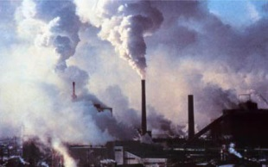
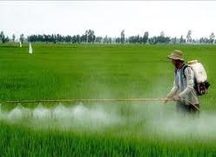
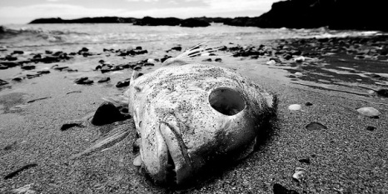
Estuaries and coastal lagoons known as highly productive areas are considered to be of extreme ecological and economic value.
Industrial
Urban
Agricultural
Agricultural, urban and industrial discharges resulting from human activities can lead to high levels of pollution in these coastal habitats.
Contaminants
Affect living organisms
Change their communities and the global ecological functioning of ecosystems

Slide 3
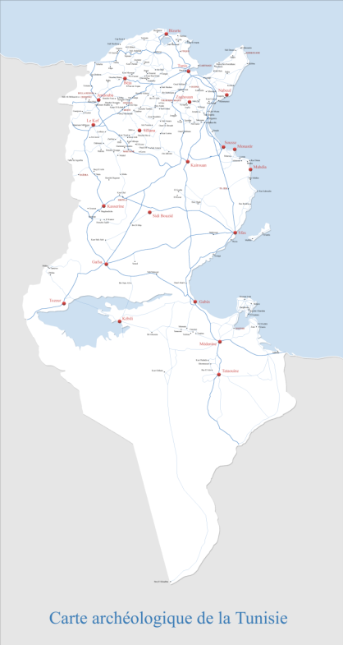
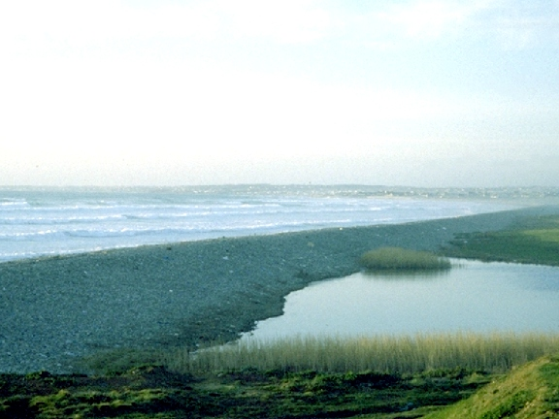
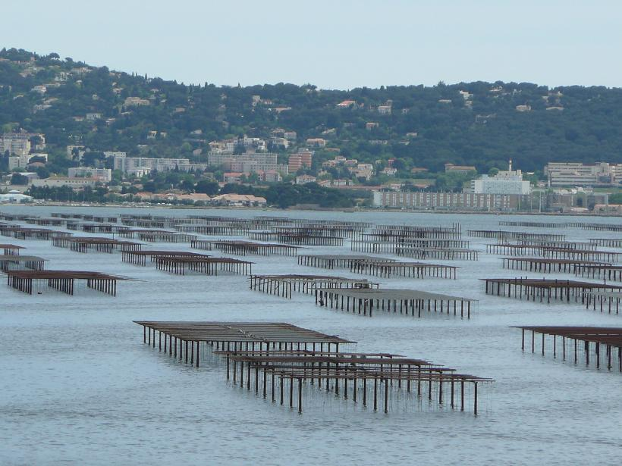
Among coastal lagoons, we quote the Bizerte lagoon (northern Tunisia), one of the first local ecosystems for fishing and mussels and other bivalve species production in Tunisia.
Bivalves
Food
Bio-monitoring
Conchyliculture

Slide 4
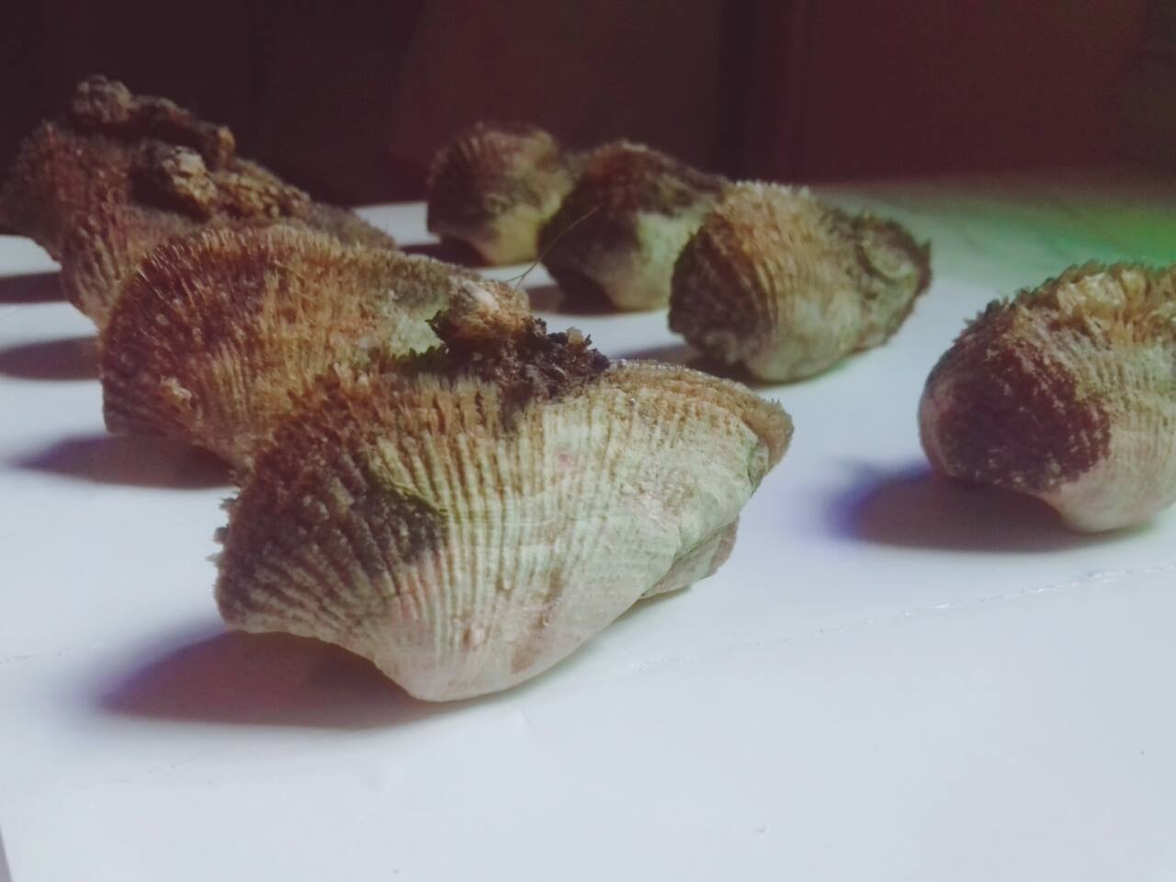
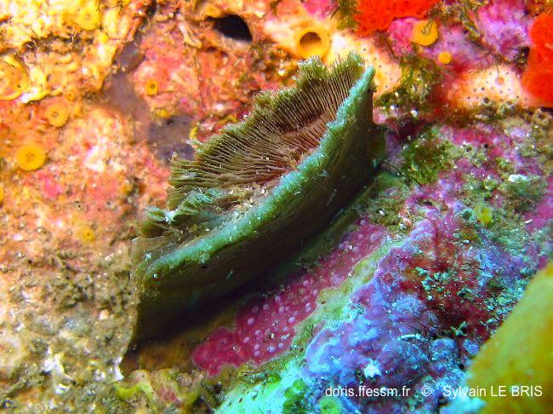
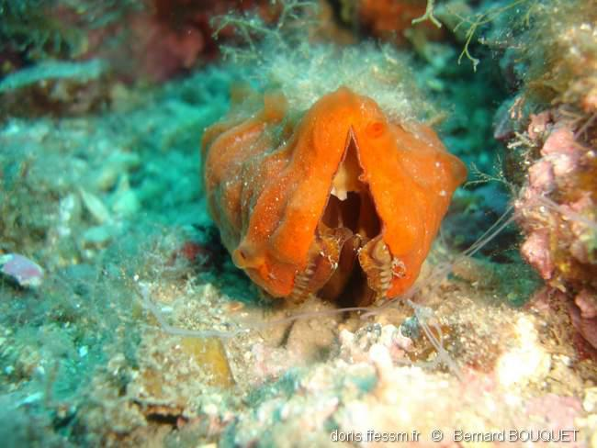
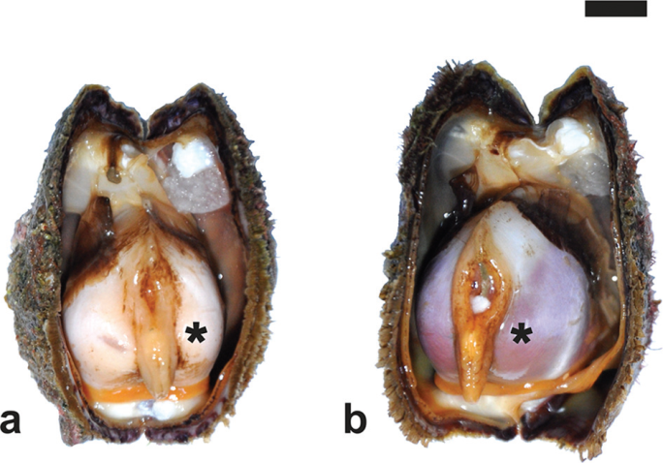
The Bizerte lagoon inhabits a wide diversity of marine invertebrates, among them the valuable shellfish Arca noae.
The Ark shell: Noah’s Ark Arca noae (Linnaeus, 1756)
Arca noae
A. noae byssus
A. noae covered by the sponge Crambe crambe
Epifaunal / fixed on rocky grounds
It lives attached to the substrate using its strong greenish byssus, it can reach a length of 120 mm and lives up to 25 years
Mediterranean sea / Black sea / Atlantic ocean
Important commercial value in Croatia and Italy

Slide 5
Objectives
What would be the concentrations of the trace elements (TE) in the soft tissue of A. noae harvested from the Bizerte lagoon?
1
What is the state of health of A. noae in the Bizerte lagoon and possible consumption of this marine product do poses risks to human health?
2

Slide 6
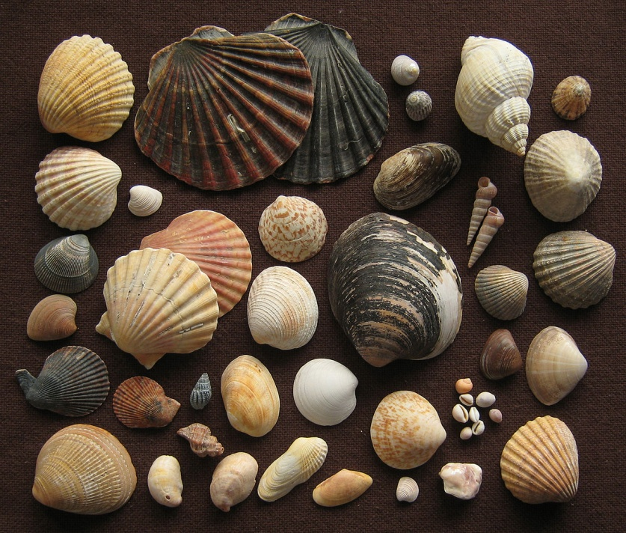
Materials & Methods

Slide 7
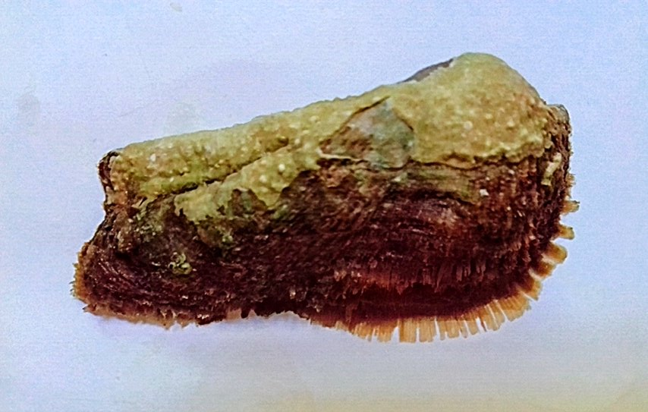
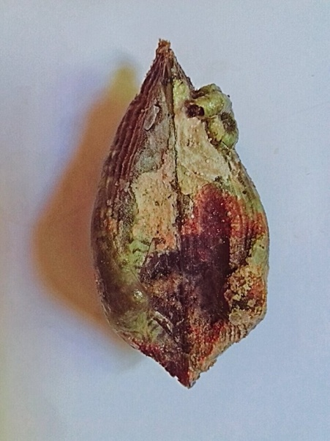
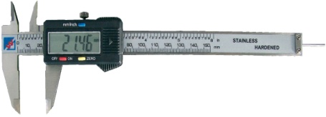
Bizerte lagoon
37°08'36.0"N 9°52'20.4"E
(October 2013-September 2014)
H
L
W
TUNISIA

Slide 8
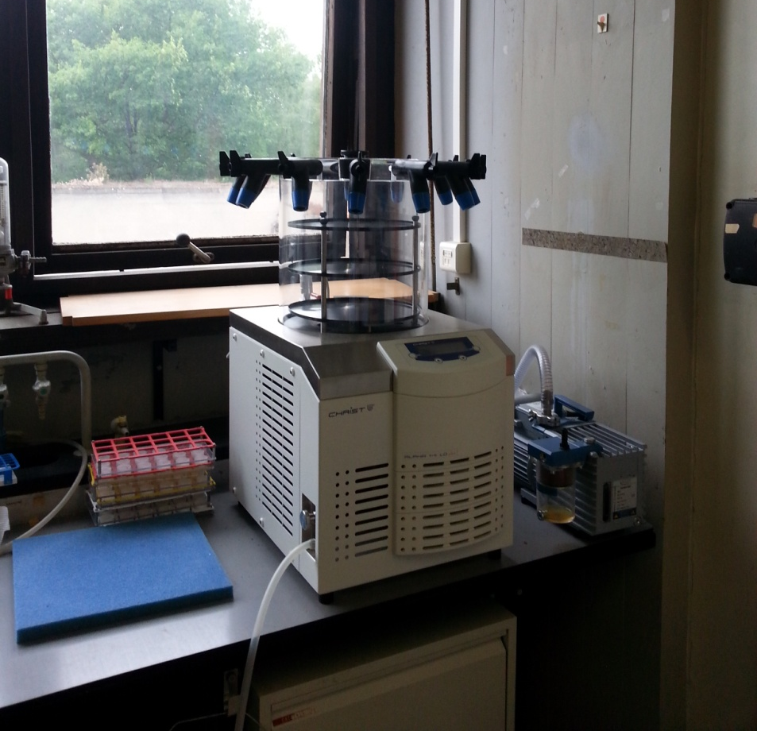
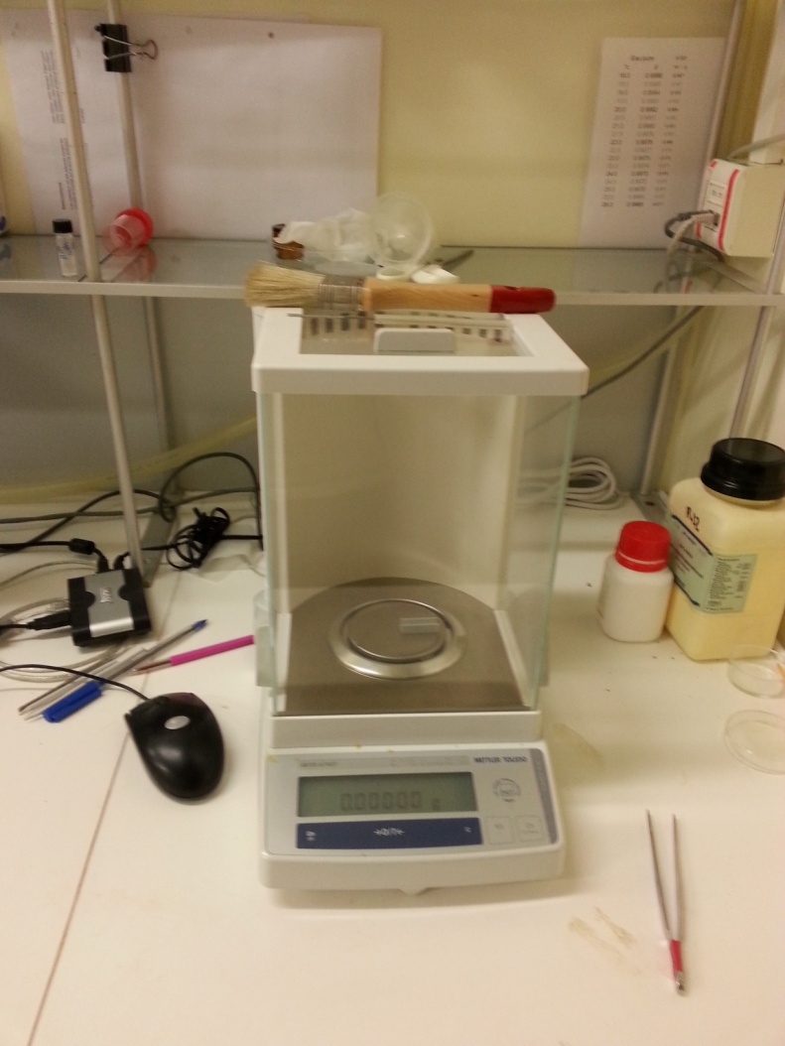
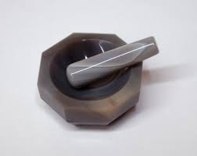
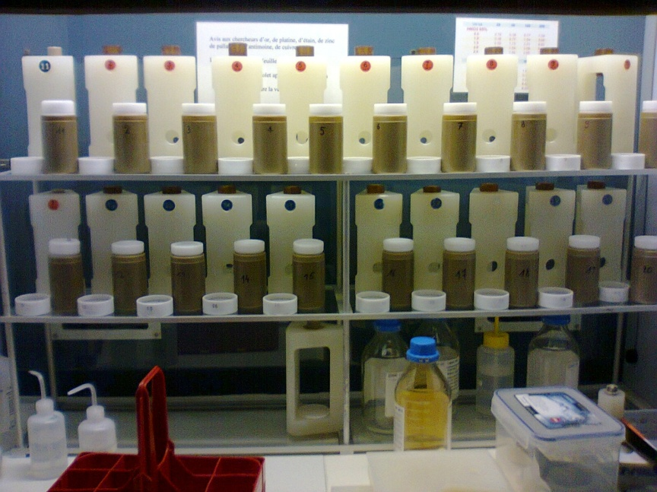
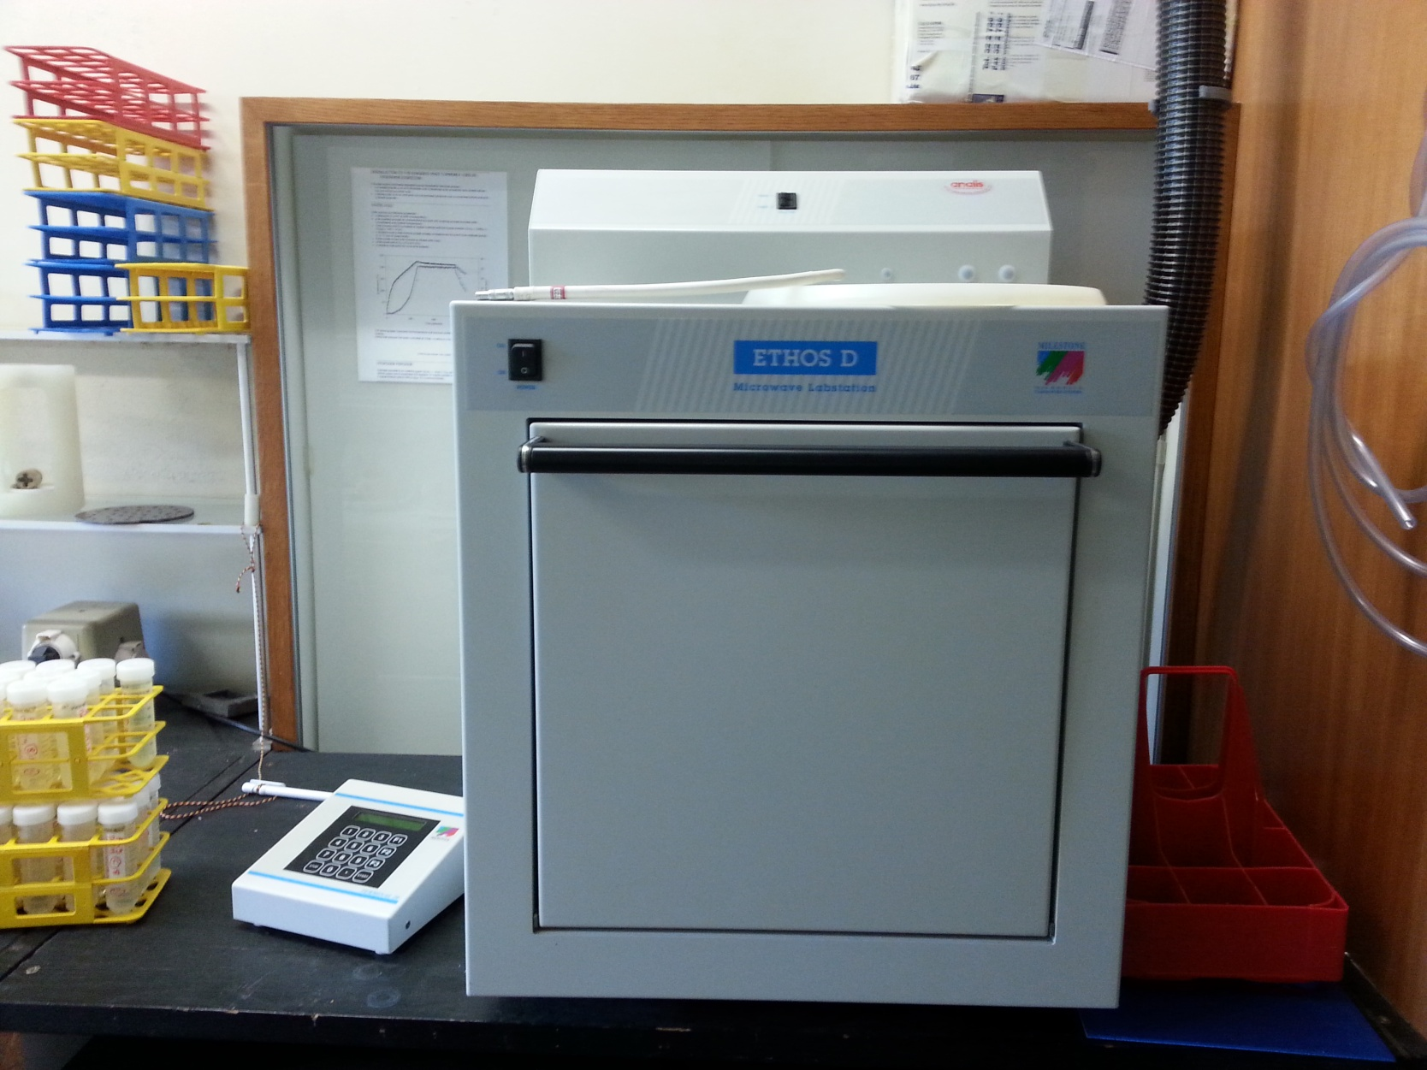
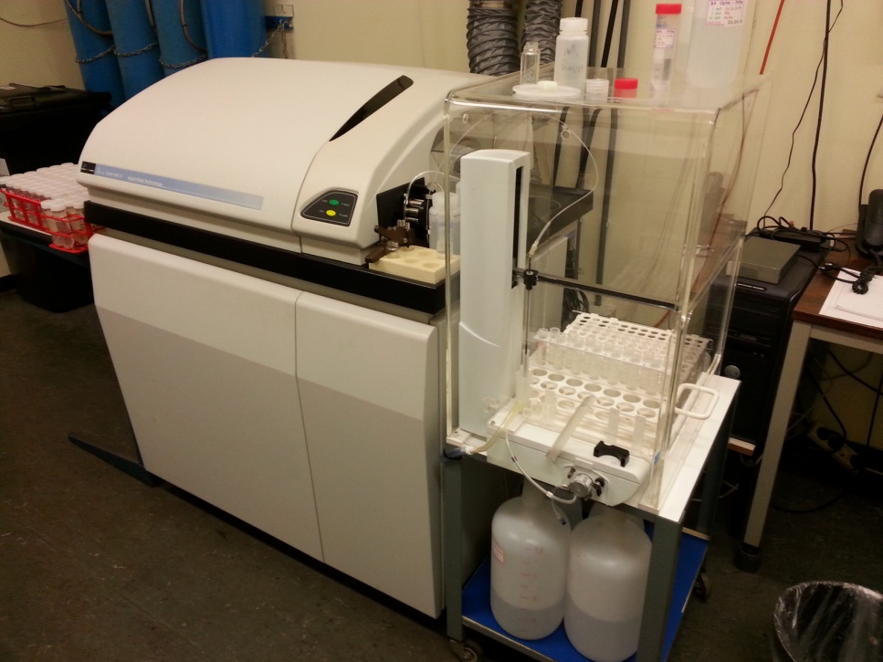
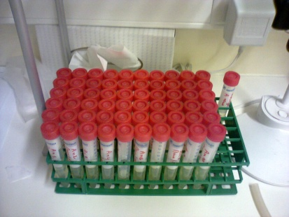
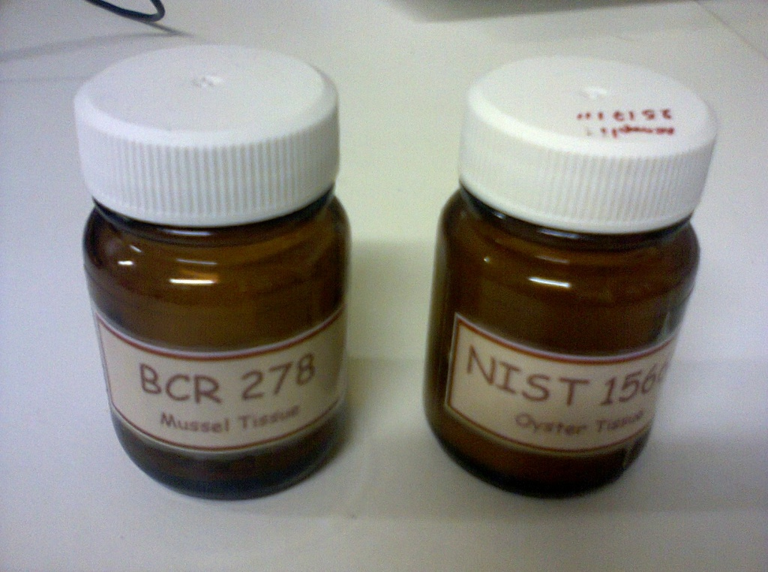
Inductively Coupled Plasma Mass Spectrometry (ICP-MS)
Lyophilisation
Mineralization
Cd
Ni
Trace elements
Cr
Pb

Slide 9
The daily intake of TE depends on both their concentrations in food and the daily food consumption. In addition, the consumer body weight can influence the tolerance of contaminants.
In the current work, the impact of each TE on consumer health was considered through several parameters:
1- Estimated weekely intake (EWI)
2- Target hazard quotient (THQ)
3- Target cancer risk (TR)

Slide 10
1- Estimated weekly intake (EWI)
In this work, risk of TE intake was estimated by calculating the respective levels measured in A. noae, for a person weighting 60 kg and with a consumption rate of 154 g per week (a medium level mussel consumer). The estimated weekly intake of each TE was determined using the following equation (1):
Estimated weekly intake: EWI = (C_{m} x IR_{w}) / BW (1)
where Cm is the TE concentration in A. noae soft tissue (mg/kg _{WW}), IR_{w} the weekly ingestion rate (kg) and BW the body weight (kg).
To assess public health risks, weekly Ark shell intakes were compared with the Provisional Tolerable Weekly Intake (PTWI) recommended by the joint FAO/WHO Expert Committee on Food Additives (FAO/WHO, 2011).

Slide 11
2- Target hazard quotient (THQ)
The THQ of a contaminant, defined as the ratio between the exposure and the reference dose (RfD) for that contaminant, expresses the risk of non-carcinogenic effects.
If the ratio is less than 1, there will be no obvious risk. Conversely, an exposed population will experience health risks if the exposure dose is equal to or greater than the RfD, so the ratio above 1.
Since the exposure to two or more contaminants may result in additive or interactive effects, we evaluated the total THQ (TTHQ) by summing THQ value of individual TE. The models for estimating THQ and TTHQ follow equations (2) and (3):
THQ = (EF x ED x IR_{d} x C) / (RfD x BW x AT) (2)
TTHQ = THQ (TE1) + THQ (TE 2) … + THQ (TE n) (3)
where EF is the exposure frequency (365 days/year), ED is the exposure duration (70 years, average lifetime), IR_{d} is the food ingestion rate (0.0022 kg per day per person; Jovic and Stankovic 2014), RfD is the oral reference dose (Marengo et al. 2018; Nadal et al. 2008), BW is the average adult body weight (60 kg) and AT is the average exposure time for non-carcinogens (365 days per year x ED, assuming 70 years).

Slide 12
3- Target cancer risk (TR)
Target cancer risk (TR) indicates an incremental probability of an individual of developing cancer over a life time due to exposure to a potential carcinogen.
TR, derived from the intake of Pb, was calculated since this element may promote both non-carcinogenic and carcinogenic effects depending on the exposure dose.
Cancer risk over a lifetime exposure to Pb was obtained using cancer slope factor (CPSo) provided by the USEPA (USEPA 2010). The model for estimating cancer risk follows equation (4):
TR = (EF x ED x IR_{d} x C x CPSo) / (BW x AT) (4)
where CPSo is the oral carcinogenic slope factor of 0.0085 (mg/kg/day)⁻¹ for Pb from the Integrated Risk Information System (USEPA 2010) database. Acceptable life time cancer risk levels range from 10⁻⁴ (indicating a probability of 1 in 10000 chance of developing cancer) to 10⁻⁶ (indicating a probability of 1 in 1000000 chance of developing cancer). The four TR categories are: TR ≤ 10⁻⁶ = low, 10⁻⁴ to 10⁻³ = moderate, 10⁻³ to 10⁻¹ = high and ≥ 10⁻¹ = very high (Marengo et al. 2018).

Slide 13
Results

Slide 14
Table 2. Seasonal variation of trace element concentrations (mean ± SD; in mg/kg DW; n=30) in soft tissue of Arca noae sampled from Bizerte Lagoon.
Pb | Cd | Cr | Ni
1-6 | 2 | - | - | FAO
1.5 | 1 | - | - | EC
1.7 | 4 | 13 | 80 | USFDA
From a nutritional point of view, TE concentrations in A. noae from the lagoon of Bizerte were well below international food safety standards and the maximum allowable level in bivalve flesh set by the international organizations Food and Agriculture Organization of the United Nations (FAO 2003), European Community (EC 2006) and US Food and Drug Administration (USFDA 2001).

Slide 15
Table 2. Human risk assessment associated with the consumption of Arca noae harvested from the lagoon of Bizerte: trace element (TE), oral reference dose (RfD), provisional Tolerable Weekly Intake (PTWI), estimated weekly intake (EWI), target hazard quotient (THQ) and target cancer risk (TR).
EWI values for A. noae at the four different seasons were far below the PTWI values. Therefore, the consumption of this bivalve does not pose sanitary problems.
THQ values were less than 1 for A. noae analyzed in this study, indicating no potential carcinogenic risk from ingestion of a single TE through their consumption. Consumption of A. noae involved exposure to a mixture of TE. Values of cumulative health risks (TTHQ, the sum of health risks of the 3 TE) were however also less than 1, again indicating no potential significant health risk from TE ingestion.
The risk of cancer due to exposure to Pb was not of concern since the values of TR were lower than the acceptable risk limit of 10⁻⁴ (USEPA 2010).

Slide 16
Conclusions
From all these observations, it can be said that continued consumption over long periods of this shellfish may not represent a potential risk to the health of consumers regarding Pb, Cd, Ni and Cr.
This work is the first step towards the valorization of this unexploited shellfish species in Tunisia, this bivalve being already commercialized and consumed in other areas from the Mediterranean (Adriatic Sea).
Notes:
A

