Slide 1
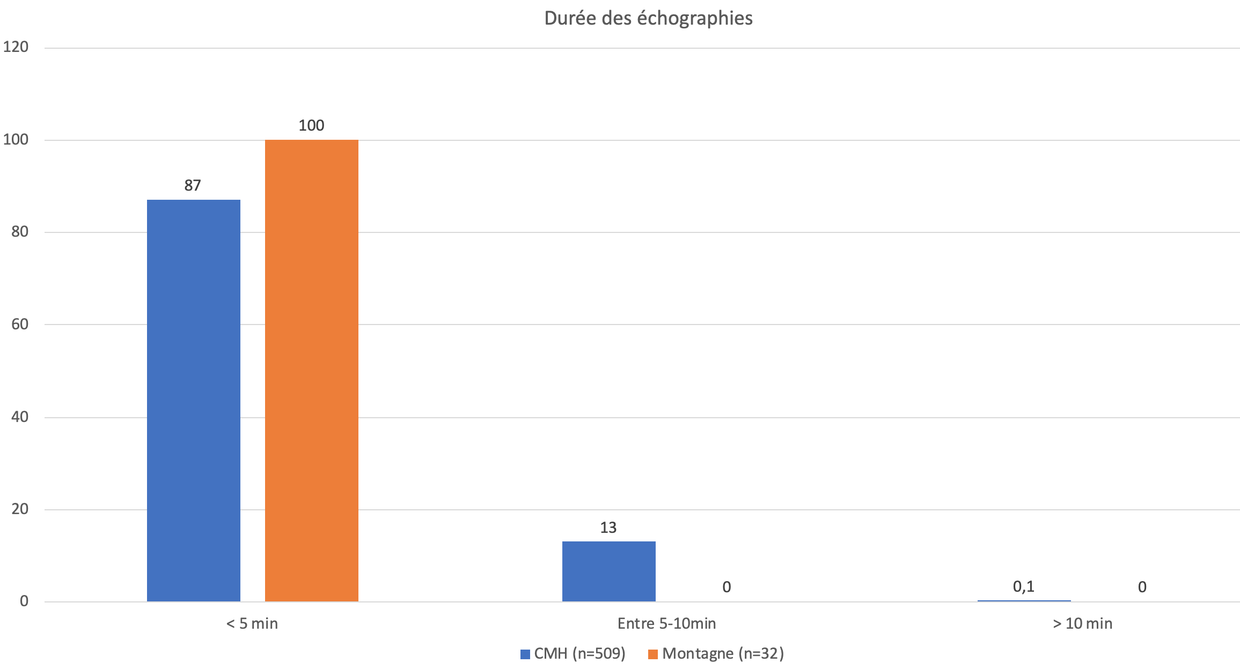
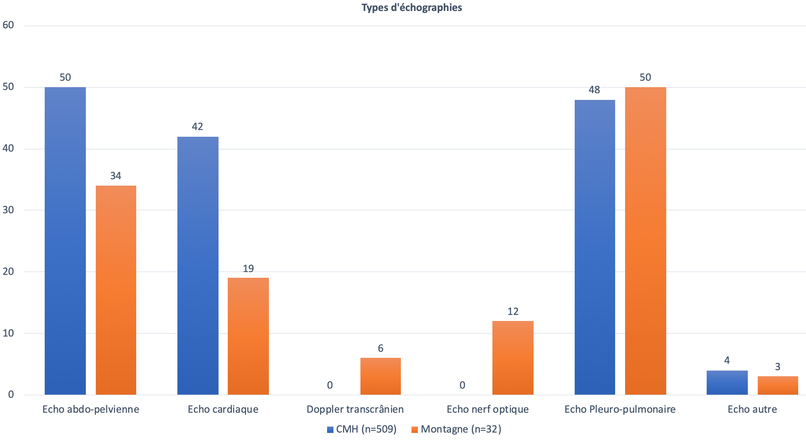
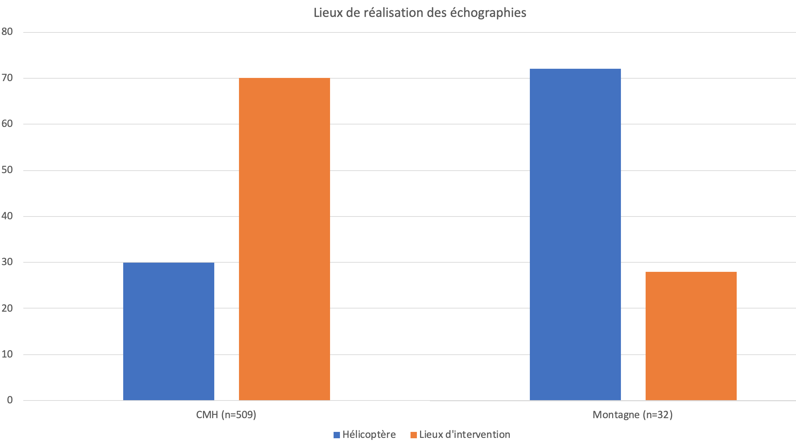
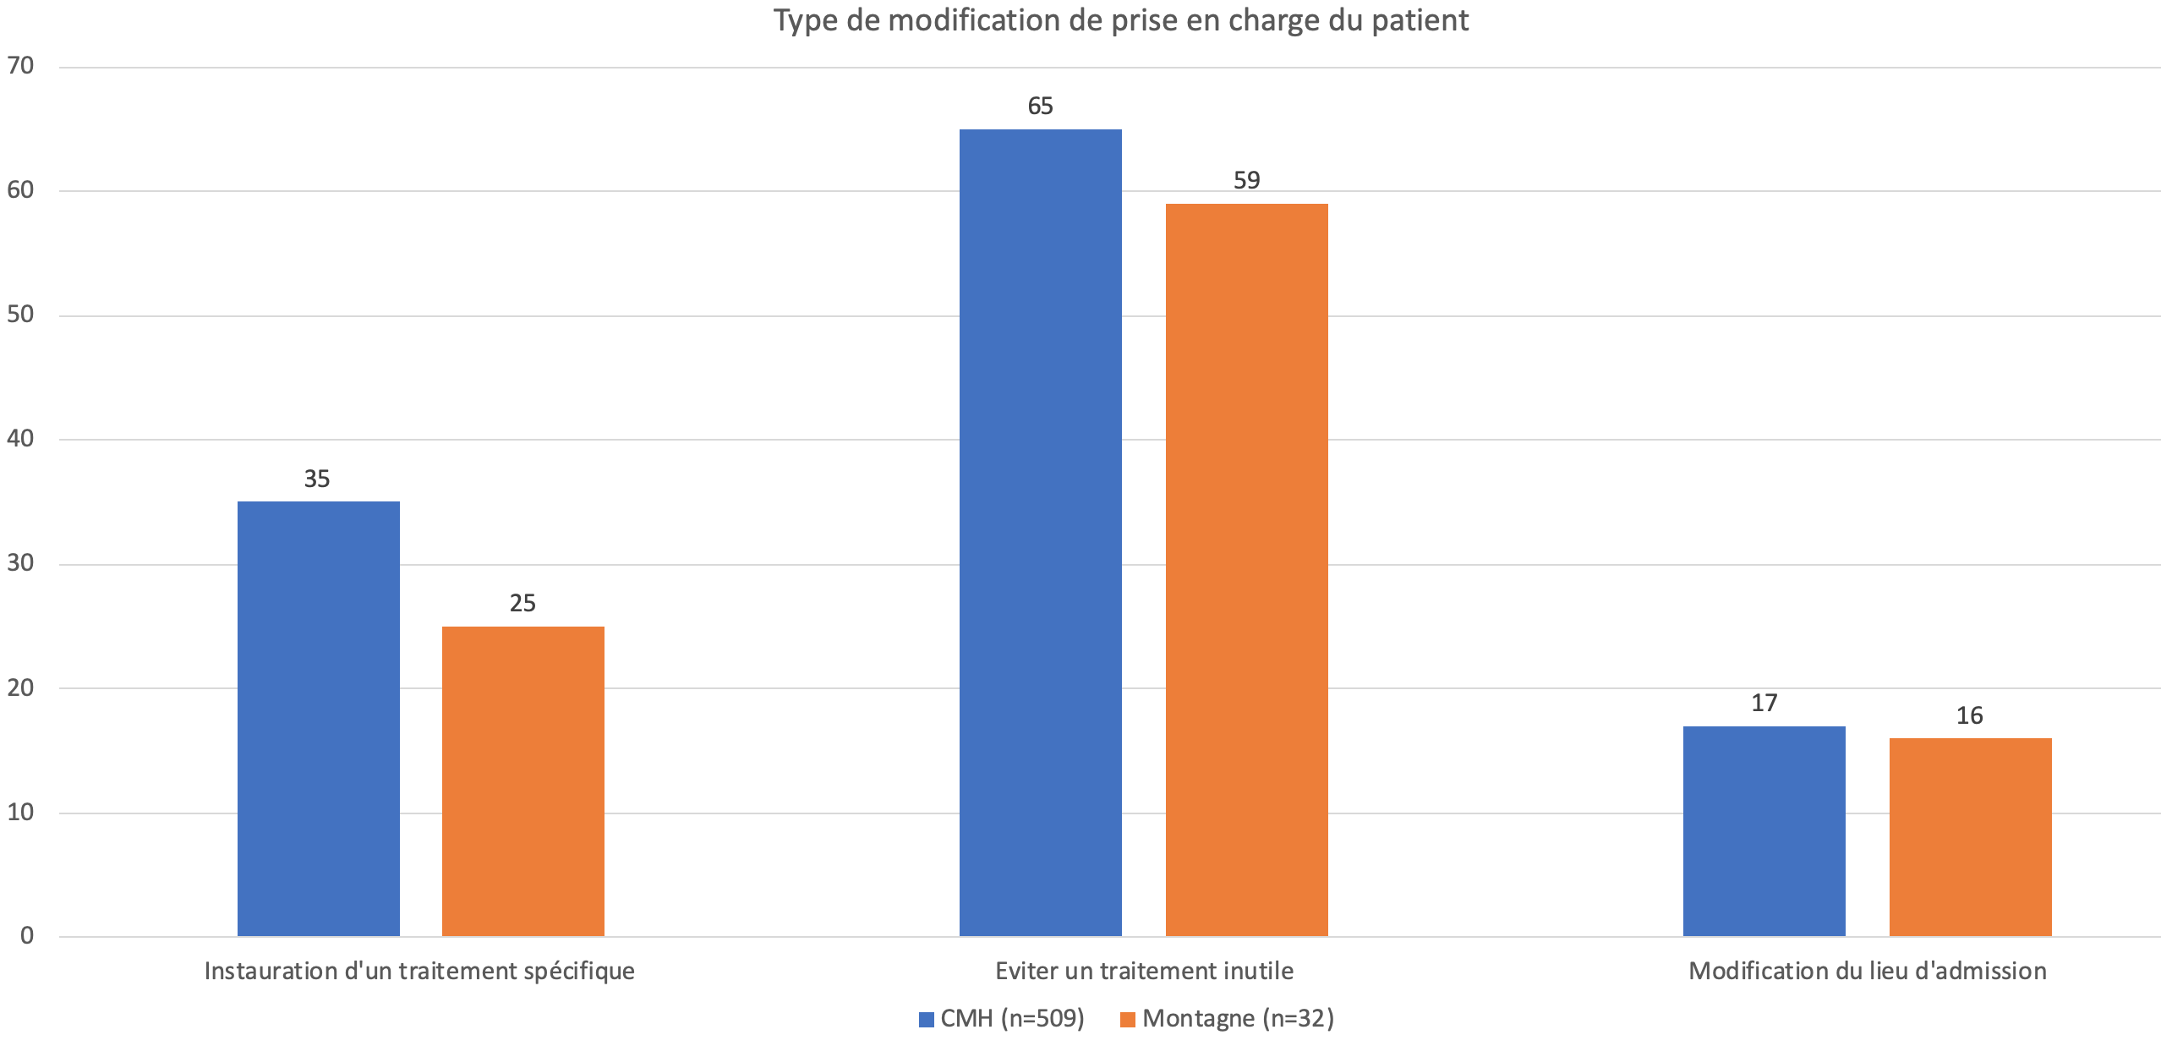
A comparison of pre-hospital "Point of care" ultrasound use between rural/urban and mountain rescues
Romain HUBERT¹, MD – Didier MOENS, MD^{1,2} - Justine PIAZZA, MD^{1,2} – Benjamin JAVILLIER, MD¹
1) University of Liège, Liège (Belgium) – 2) Heliport Medical Center of Bra-sur-Lienne, Bra-sur-Lienne (Belgium)
Introduction:
A large number of publications have demonstrated the benefits of using POCUS in emergency departments, intensive care units and pre-hospital medicine. The purpose of this analysis is to compare the use of Point-Of-Care ultrasound between a hostile environment such as a mountain rescue and a mixed urban/rural environment.
Materials and methods:
We compare a prospective analysis of the use of ultrasound by the French mountain rescue teams and the Hems’Doctors of Bra sur Lienne (CMH) (Belgium) during a one year period. A questionnaire was created and available online for all French mountain rescue doctors, members of the national association for medical mountain rescue (ANMSM). The CMH’s data were collected and extracted from their database. We compared the type of ultrasound scan performed, the places where it was performed, the duration of the exams and the changes in patient care according to the environment in which the ultrasound scan was performed.
Results:
The highly qualified and experienced medical teams from both the CMH (Belgium) and mountain rescue carry out the examination in less than 5 minutes, respectively 87% vs. 100%. P = 0.081 (Graph 1). It appears that 87% of them are carried out on the intervention site in urban/rural areas for only 13% during helicopter transport, while the ratio is reversed in mountain medicine. P < 0.0001 (Graph 2). In both situations, most of them are performed for trauma patients. Therefore, for the majority of CMH patients, Thoraco-abdominal (efast) (50%) and cardio-pulmonary (48%) ultrasounds are performed. The mountain rescuers follow the same trend, but with a lower proportion of thoraco-abdominal ultrasound (34%) (less complete but more trauma site focused) . Limited cardiac ultrasound alone comes in third place in both types of rescue (42%) for CMH vs. 19% for mountain rescues). P < 0.0001 (Graph 3). In 17% of the cases in CMH, the patient's triage is influenced by the result of the ultrasound scan compared to 16% in mountain rescues. Treatment plan is modified in 58% for CMH, 87,5% in mountain recue. Ultrasound avoids unnecessary treatment in 65% of cases at CMH compared to 59% in mountain rescues, and allows for specific treatment in 35% of cases at CMH compared to 25% in mountain rescues. P = 0.875 (Graph 4).
Conclusion:
Ultrasound scans performed in a hostile or mixed environment are similar both in terms of time consumption, type of ultrasound performed and the impact on medical management. Ultrasound scans in hostile environments are mostly trauma targeted and performed during helicopter transport, probably as a consequence of the risk of exposure to the cold and the difficulty to access the patient when rescuing in the mountains.
Graph 1.
Graph 3.
Graph 2.
Graph 4.

