Slide 1

Thermal effect on in-situ THM behaviour
of COx claystone
23 June 2022 • EUROTUN, Bochum (Germany)
Hangbiao Song¹, Frédéric Collin¹
¹ Geomechanics and Engineering Geology, University of Liège

Slide 2
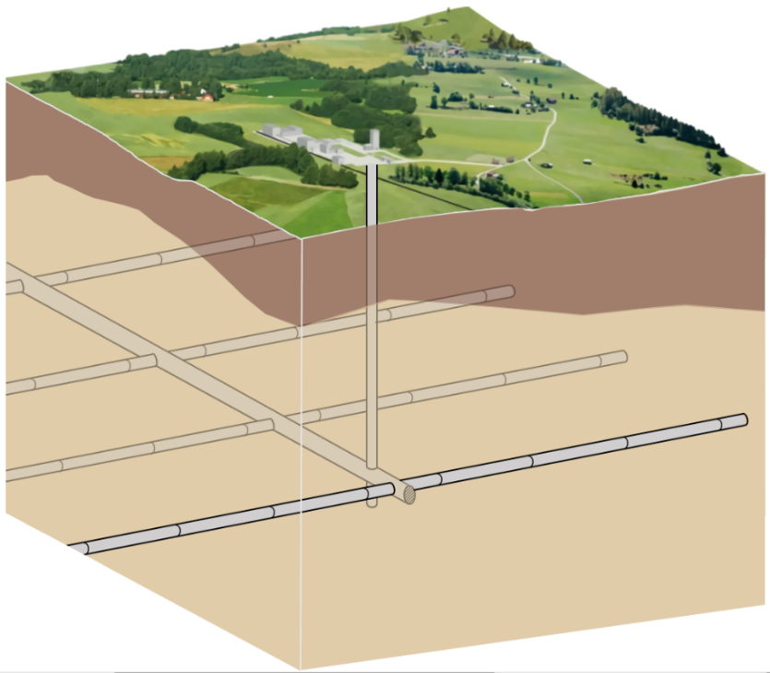
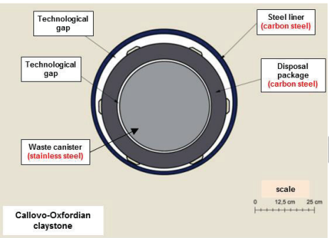
Context
Geological disposal of radioactive wastes
Multi-barrier confinement
Long-term management
THMC coupling process
Excavation, open drift, waste emplacement, backfilling, self-sealing, repository closure
Technological gap
Steel liner
(Carbon steel)
Technological gap
Disposal
package
(Carbon steel)
Host rock
Main gallery
Waste canister
(stainless steel)
Storage alveole
Scale
Callovo-Oxfordian claystone
0 12.5 25cm
Conceptual scheme of a deep geological disposal, modified from ENSI (2013)
Schematic view of repository concepts/disposal cells, modified from ANDRA (2005)
02/13

Slide 3
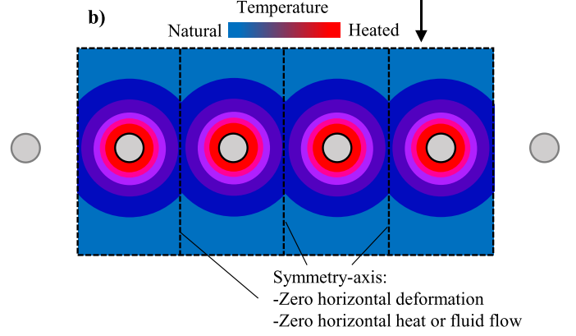
Context
Near field:
Excess pore pressure
Fracture re-opening/propagation
Alter permeability
Far field:
Tensile failure
Shear failure
Reactivate old fractures/faults
Temperature
Rock layers
Natural
Heated
Thermal conduction
Thermal pressurization
T
P_{w}
Canister
α_{w} > α_{s}
Symmetric axes: No horizontal deformation
No horizontal heat/water flow, modified from Braun P., (2019)
Objective:
Reproduce the damage processes and the in-situ observations around EDZ induced by thermal effects.
03/13

Slide 4
Table of content
Context
Description of the numerical model
Applications
Conclusions
04/13

Slide 5
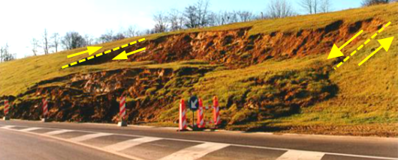
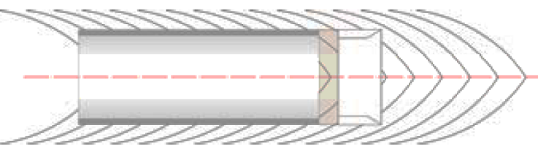
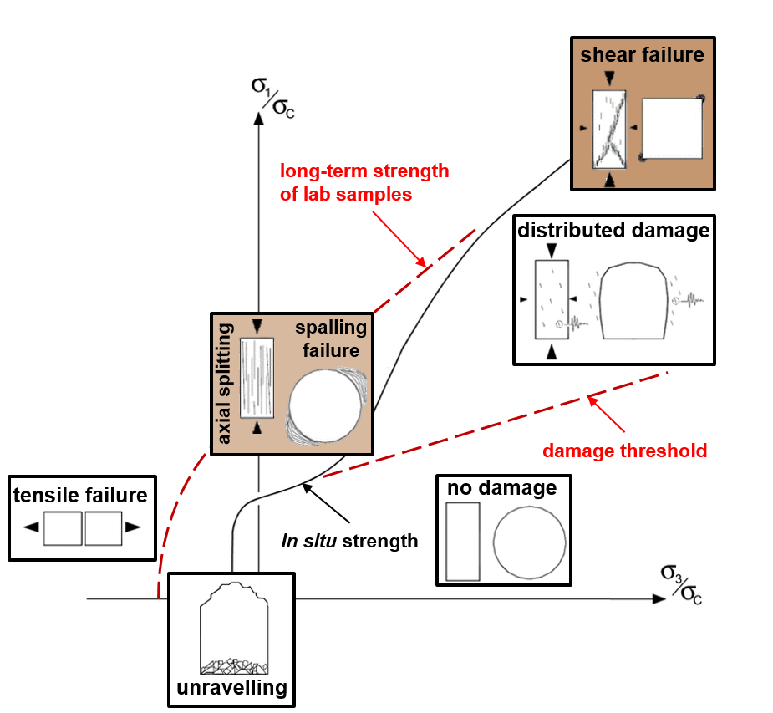
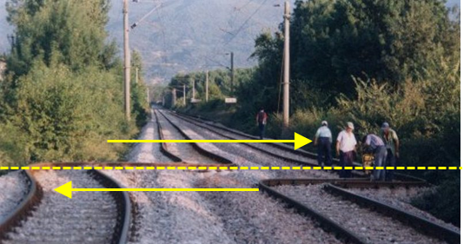
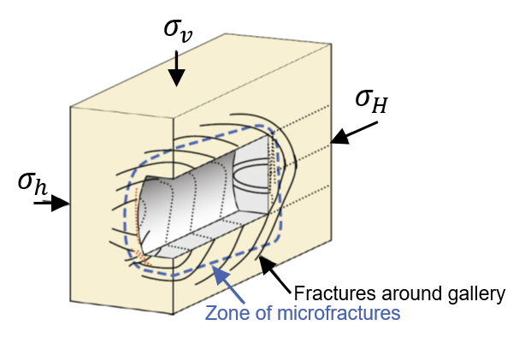
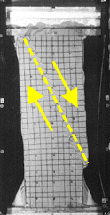
Shear strain localisation evidence
Representation of damage
From geomaterials failure…
…to the drilling of underground galleries…
…in host rock formations.
Boom Clay
Human-made slope failure (Belgium,1998)
COx claystone
Railway tracks after an earthquake (Turkey, 1999)
Biaxial compression test on sand,
Desrues et al. (1999)
Mechanisms of rock mass failure around gallery, adapted from Diederichs (2003)
Fracturation pattern around storage galleries, Bastiaens et al. (2003) and Bernier et al. (2007)
05/13

Slide 6
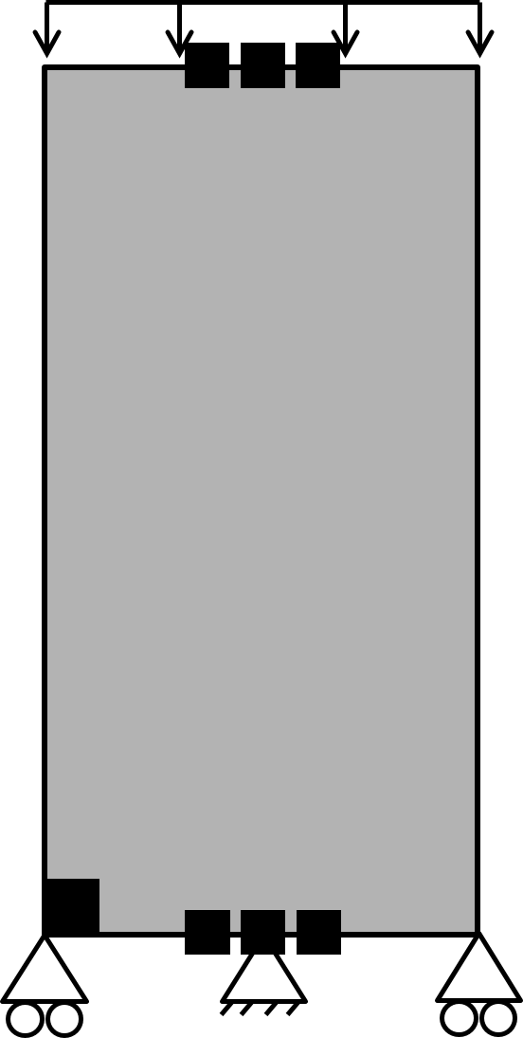
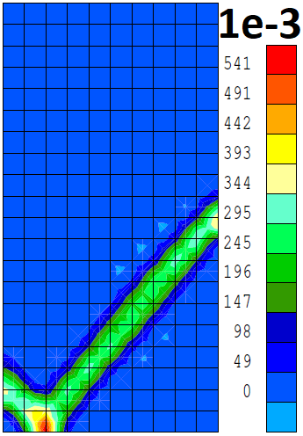
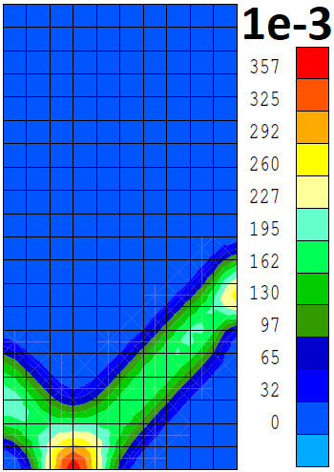
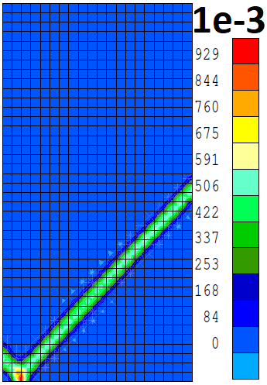
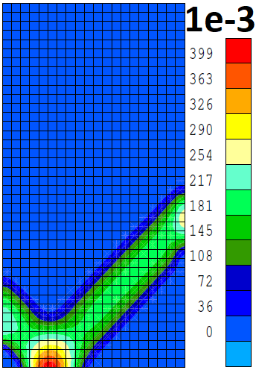
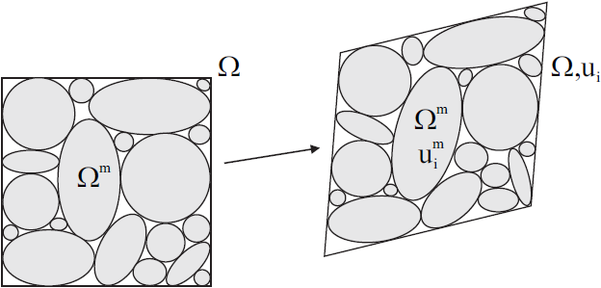
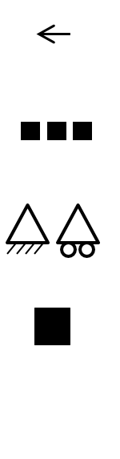






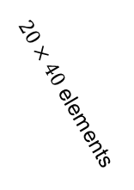




Numerical considerations
Representation of damage
Classical FE methods:
Mesh size dependency
Regularisation technique:
Shear band width control
Local 2nd gradient model:
Regularisation technique Chambon et al. (1998)
Collin et al. (2006)
Deviatoric strain
increment
Deviatoric strain increment
Enrichment of the kinematics with microstructure effects
$10×20$ elements
Macro-volume $Ω$  Micro-volumes $Ω^{m}$
e₁
e₁
e₁
Displacement
$$u_{i}$$
$$u_{i}^{m}$$
$$F_{ij}=\frac{∂u_{i}}{∂x_{j}}$$
$$ν_{ij}=\frac{∂u_{i}^{m}}{∂x_{j}}$$
$20×40$ elements
Deformation
e₁$≠$ e₂
e₁$=$e₂
Deviatoric strain
increment
Deviatoric strain
increment
Imposed displacement
Impervious boundary
Constraint displacement
e₂
e₂
Material imperfection
$$Ω$$
$$Ω,u_{i}$$
Mesh size: variable
Kinematics of microstructure continuum
06/13

Slide 7
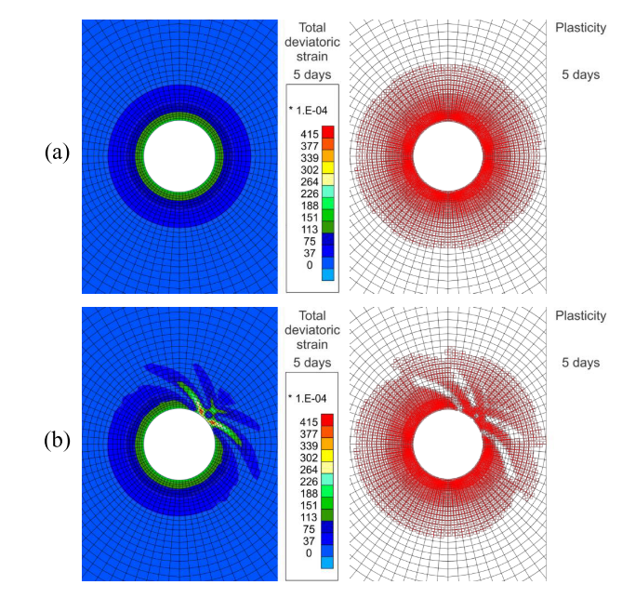
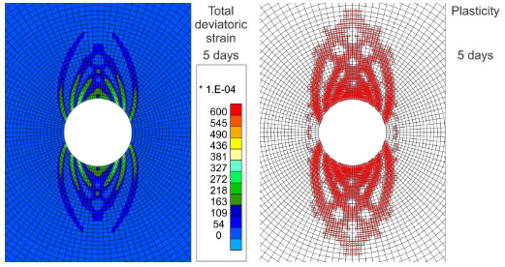
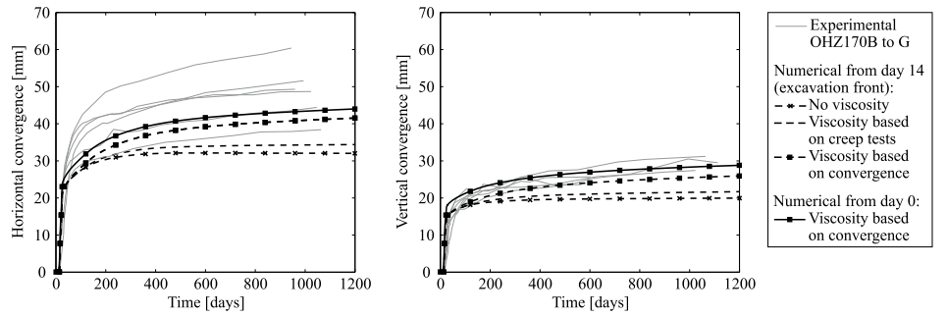
HM coupled processes - COx Claystone – Strain localisation during Excavation Pardoen (2015)
Representation of damage
From isotropic stress state and isotropic material…
To anisotropic stress state…
Without imperfection σx = σy = σz = 15.6 MPa
Without imperfection σx = 15.6 MPa, σy = σz = 12 Mpa
Total deviatoric strain
5 days
Plasticity
5 days
Total deviatoric strain
5 days
Plasticity
5 days
With imperfection σx = σy = σz = 15.6 MPa
lower cohesion for weaker elements
Validation of numerical model
Total deviatoric strain
5 days
Plasticity
5 days
Evolution of the convergence of a gallery for different sets of viscoplastic parameters
07/13

Slide 8
Table of content
Context
Description of of the numerical model
Applications
Conclusions
04/13

Slide 9

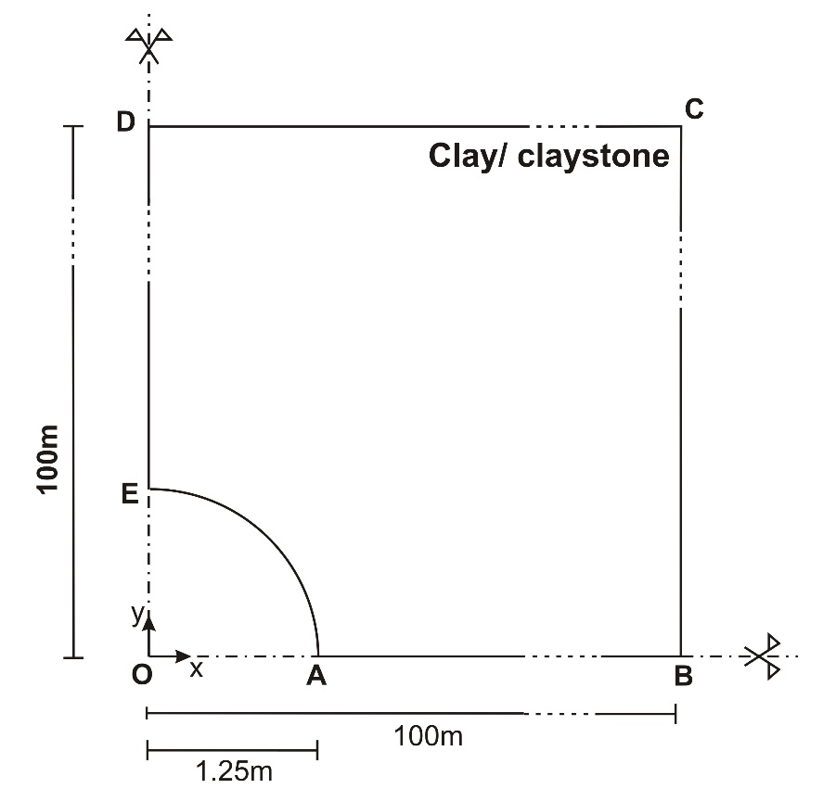
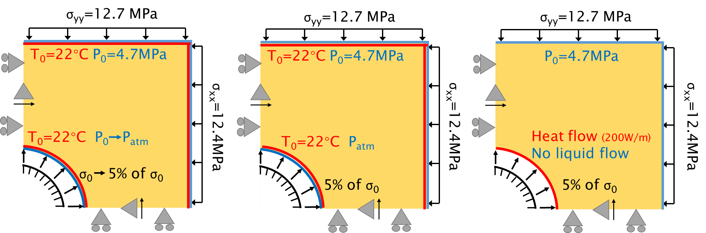
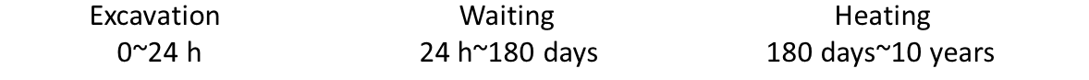
THM coupled processes - COx Claystone - Strain localisation during Heating ?
Applications
EURAD-HITEC Subtask 2.3 – THM modelling of effect of temperature in near field: selection of benchmark exercises
2D plane strain generic model
Steel liner
Gap=4.63 mm
Lagamine: finite element code developed in ULiege
08/13

Slide 10
THM coupled processes - COx Claystone – Cross anisotropic Elastic response
Applications
Elastic parameters
ρ_{s} (kg/m³) | 2639
n (-) | 0.18
E∥ (MPa) | 8000
E⊥ (MPa) | 5000
ν∥∥ (-) | 0.21
ν∥⊥ (-) | 0.35
G⊥ (MPa) | 2500
b∥ (-) | 0.83
b⊥ (-) | 0.87
Temperature
Pore pressure
Convergence
09/13

Slide 11


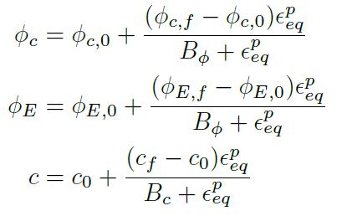
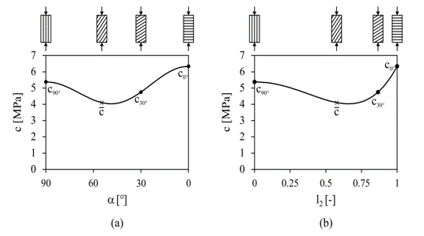
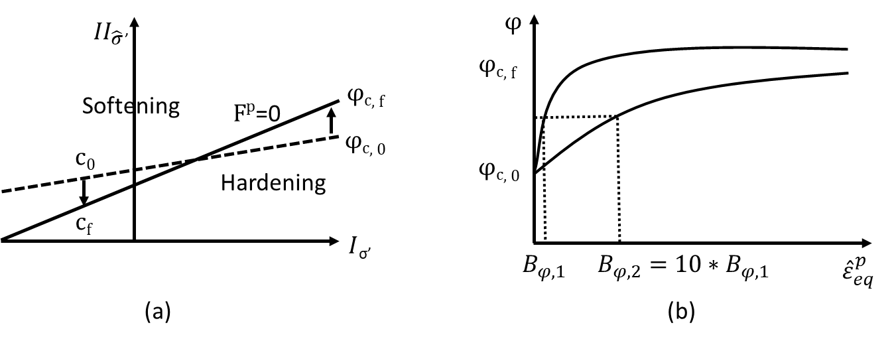
THM coupled processes - COx Claystone - Constitutive modelling
Applications
First gradient law: Van Eekelen criterion
Second gradient law:
Van Eekelen (1980)
Mindlin, 1965
Internal length scale: control of bands’ width
Variation of cohesion for cross-anisotropic rock (fabric tensor):
Niandou et al., (1997); Valès et al., (2004)
Van Eekelen yield surface with hardening/softening
hyperbolic relation for two values of coefficient Bϕ
(a) as a function of the angle between the normal to the bedding planes and the direction of loading and (b) as a function of the loading vector.
10/13

Slide 12
THM coupled processes - COx Claystone – Strain localisation (THM)
Applications
Plasticity
Deviatoric strain increment
Total deviatoric strain
Plasticity
Deviatoric strain increment
Total deviatoric strain
Excavation
T0+24 h
1e-3
1e-5
1e-5
T0+2 years
1e-3
1e-4
1e-5
Waiting
T0+180 days
1e-3
1e-5
1e-5
T0+4 years
1e-3
1e-4
1e-5
Heating
T0+198 days
1e-3
1e-4
1e-5
T0+8 years
1e-3
1e-5
1e-5
T0+270 days
1e-3
1e-4
1e-5
T0+10 years
1e-3
1e-5
1e-5
11/13

Slide 13
THM coupled processes - COx Claystone – stress path
Applications
End of excavation
End of waiting
Horizontal axis
Vertical axis
12/13

Slide 14
Table of content
Context
Description of of the numerical model
Applications
Conclusions
04/13

Slide 15
Conclusions
We developed a 2nd gradient THM coupled element able to
  Model damage around EDZ with strain localisation in shear band mode.
  Reproduce thermal effects on the in-situ THM behaviour of COx claystone.
We showed that
  The obtained fracturing pattern is in good agreement with the in-situ observations.
  During the heating, the shear strain localisation is highly pronounced.
We plan to
  A tensile failure criterion will be taken into account to better represent the extensional stress pathways.
13/13

Slide 16
Thank you for your attention
23 June 2022 • EUROTUN, Bochum (Germany)
Hangbiao Song¹, Frédéric Collin¹
¹ Geomechanics and Engineering Geology, University of Liège

Slide 17
References
Ensi (2013), Geologische Tiefenlager, Radioaktive abfälle sicher entsorgen Rapport.
Andra (2005), Dossier 2005: Argile Synthesis. Evaluation of the Feasibility of a Geological Repository in an argillaceous Formation Meuse/Haute-Marne Site. National Agency for Radioactive Waste Management, Paris.
P. Braun(2019), Thermo-hydro-mechanical behavior of the Callovo-Oxfordian. PhD thesis. Université Paris-Est.
J. Desrues and M. Mokni (1999), Strain localisation measurements in undrained plane-strain biaxial test on Hostun RF sand, Mech Cohes-Frict Mat, 4(4):419–441.
M. S. Diederichs (2003), Rock Fracture and Collapse Under Low Confinement Conditions, Rock Mech Rock Eng, 36(5):339–381.
W. Bastiaens, F. Bernier, M. Buyens, M. Demarche, X. L. Li, J.-M. Linotte, J. Verstricht (December 2003), The extension of the HADES underground research facility at Mol, Belgium, The construction of the connecting gallery, EURIDICE report 03-294.
F. Bernier, Y. Wileveau (2008), Similarities in the hydromechanical response of Callovo-Oxfordian clay and Boom Clay during gallery excavation, Physics and Chemistry of the Earth 33 S343–S349.
F. Collin, R. Chambon, and R. Charlier (2006), A finite element method for poro-mechanical modelling of geotechnical problems using local second gradient models, International Journal for Numerical Methods in Engineering, 65(11):1749-1772.
R. Chambon, D. Caillerie, and N. El Hassan (1998), One-dimensional localisation studied with a second grade model. European Journal of Mechanics, A/Solids, 17(4):637-656.
B. Pardoen (2015), Hydro-mechanical analysis of the fracturing induced by the excavation of nuclear waste repository galleries using shear banding, PhD Thesis, University of Liège, Faculty of Applied Sciences.
EURAD WP HITEC - Milestone report 49 – Selection of benchmark exercises for task 2.3.
Van Eekelen, H. A. M. (1980). Isotropic yield surfaces in three dimensions for use in soil me- chanics. Int J Numer Anal Meth Geomech, 4(1):98–101.
R. D. Mindlin (1965) , Second gradient of strain and surface-tension in linear elasticity. Int J Solids Struct, 1:417–438.
H. Niandou, J. F. Shao, J. P. Henry, and D. Fourmaintraux (1997), Laboratory investigation of the mechanical behaviour of tournemire shale. Int J Rock Mech Min Sci, 34(1):3–16.
F. Valès, D. N. Minh, H. Gharbi, and A. Rejeb (2004), Experimental study of the influence of the degree of saturation on physical and mechanical properties in tournemire shale (france). Appl Clay Sci, 26(1-4):197–207.

Slide 18
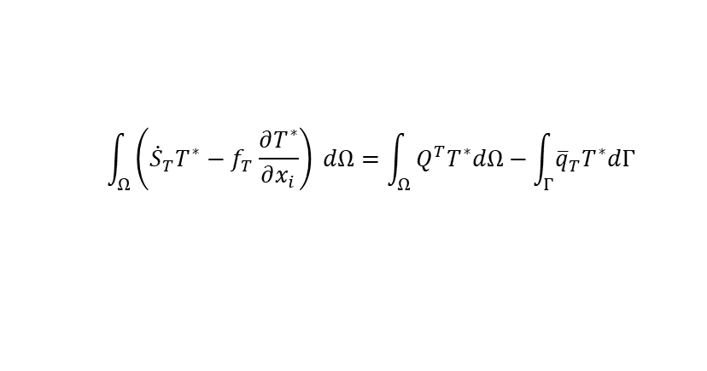
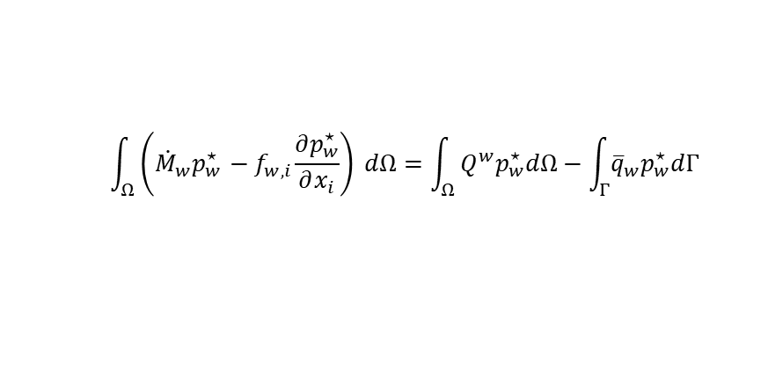

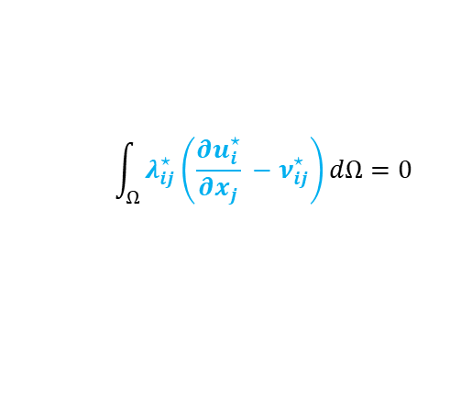
Balance equations
(Biphasic porous media with full saturation)
Momentum balance of mixture
Microstructure effects
$$\int_{Ω}{\left(σ_{ij}\frac{∂u_{i}^{⋆}}{∂x_{j}}+Σ_{ijk}\frac{∂ν_{ij}^{⋆}}{∂x_{k}}\right) dΩ−\int_{Ω}{λ_{ij}\left(\frac{∂u_{i}^{⋆}}{∂x_{j}} −ν_{ij}^{⋆}\right)dΩ}=\int_{Ω}{ρ^{mix}g_{i}u_{i}^{⋆}dΩ+\int_{Γ}{\left(\overline{t_{i}}u_{i}^{⋆}+{\overline{T}}_{i}Du_{i}^{⋆}\right)dΓ }}}$$
Field of Lagrange multipliers
$$\int_{Ω}{λ_{ij}^{⋆}\left(\frac{∂u_{i}^{⋆}}{∂x_{j}} −ν_{ij}^{⋆}\right)dΩ}=0$$
Kinematic restriction
Water mass balance
$$\int_{Ω}{\left({\dot{M}}_{w}p_{w}^{⋆}{ − f}_{w,i}\frac{∂p_{w}^{⋆}}{∂x_{i}}\right) dΩ=\int_{Ω}{Q^{w}p_{w}^{⋆}dΩ−\int_{Γ}{{\overline{q}}_{w}p_{w}^{⋆}dΓ }}}$$
$$f_{w,i}=−ρ_{w}\frac{k_{w}}{μ_{w}}\left(\frac{∂p_{w}}{∂x_{j}}+ρ_{w}g_{j}\right)$$
Energy balance of mixture
$$\int_{Ω}{\left({\dot{S}}_{T}T^{∗}−f_{T}\frac{∂T^{∗}}{∂x_{i}}\right) dΩ=\int_{Ω}{Q^{T}T^{∗}dΩ−\int_{Γ}{{\overline{q}}_{T}T^{∗}dΓ }}}$$
𝑓$T$_{,𝑖} = $−Γ∇T+c_{p,w}ρ^{w}f_{w,i}(T−T0)$
$ST$ $=ρ^{mix}C_{p}\left(T−T_{0}\right)$
13

Slide 19
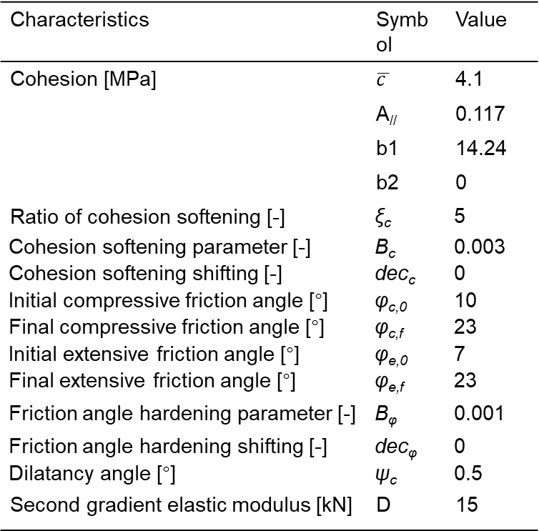
THM coupled processes - COx Claystone – Elastoplastic results
Applications
Anisotropic parameters
Characteristics | Symbol | Value
Cohesion [MPa] | $$\overline{c }$$ | 4.1
 | A// | 0.117
 | b1 | 14.24
 | b2 | 0
Ratio of cohesion softening [-] | ξ_{c} | 5
Cohesion softening parameter [-] | B_{c} | 0.003
Cohesion softening shifting [-] | dec_{c} | 0
Initial compressive friction angle [°] | φ_{c,0} | 10
Final compressive friction angle [°] | φ_{c,f} | 23
Initial extensive friction angle [°] | φ_{e,0} | 7
Final extensive friction angle [°] | φ_{e,f} | 23
Friction angle hardening parameter [-] | B_{φ} | 0.001
Friction angle hardening shifting [-] | dec_{φ} | 0
Dilatancy angle [°] | ψ_{c} | 0.5
Second gradient elastic modulus [kN] | D | 15
Pore pressure
Convergence
10/16

Slide 20
THM coupled processes - COx Claystone – Elastoplastic results
Applications
(a)
(b)
(c)
Fig. : Contact situation at: (a) End of excavation, (b) End of waiting, (c) 18th day of heating.
(a)
(b)
(c)
Fig. : Cohesion variation at: (a) Horizontal, (b) Vertical, (c) 45 degree directions.
10/16

Slide 21


Discussion
Applications
Since Mohr-Coloumb overestimates the tensile strength of rock material, the objective is to limit the plasticity caused by tensile stress, to implement the law with ranking tensile criterion.
${II}_{\hat{σ}}$’
Mohr-Coloumn
Ranking tensile criterion
hyperbolic model
$I$_{σ’}
21
10/16

