Slide 1
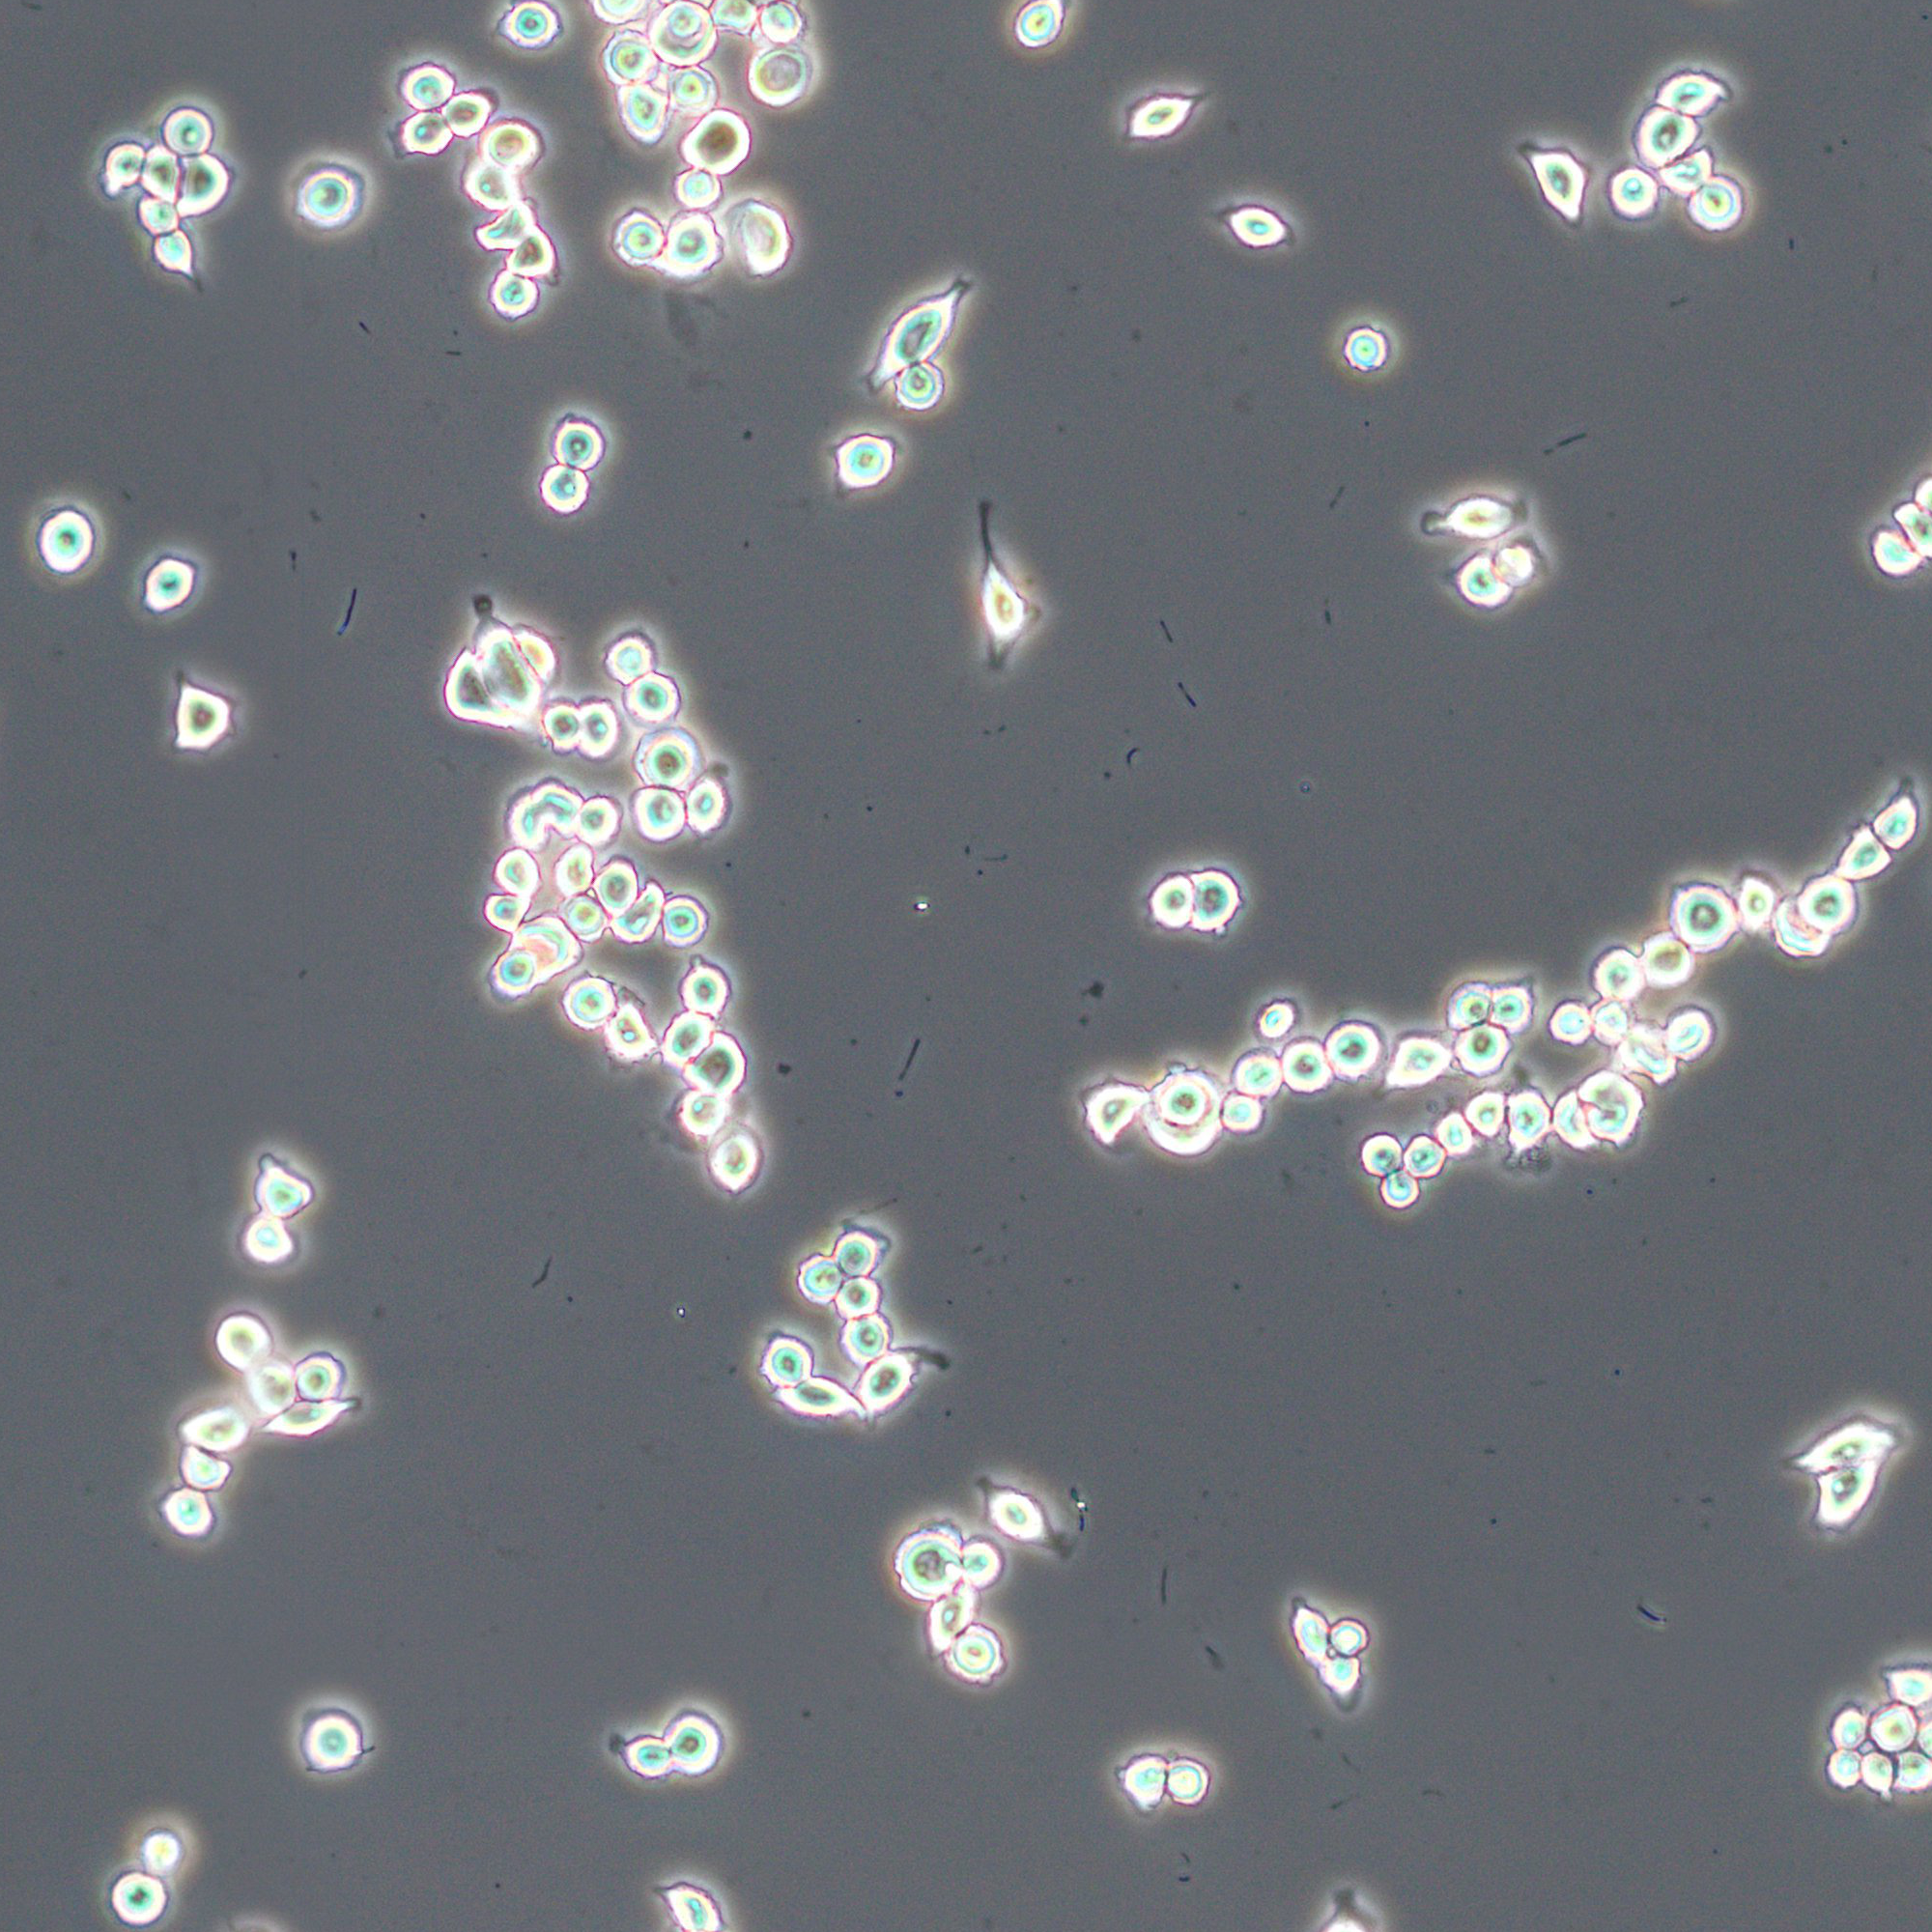
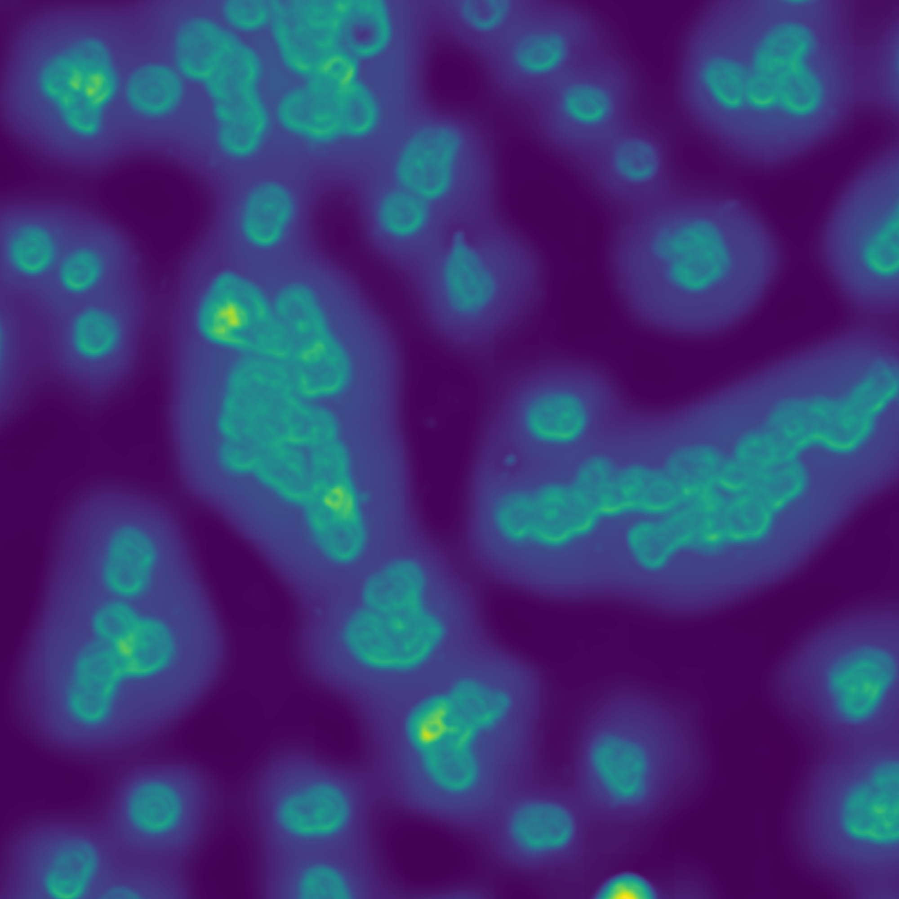
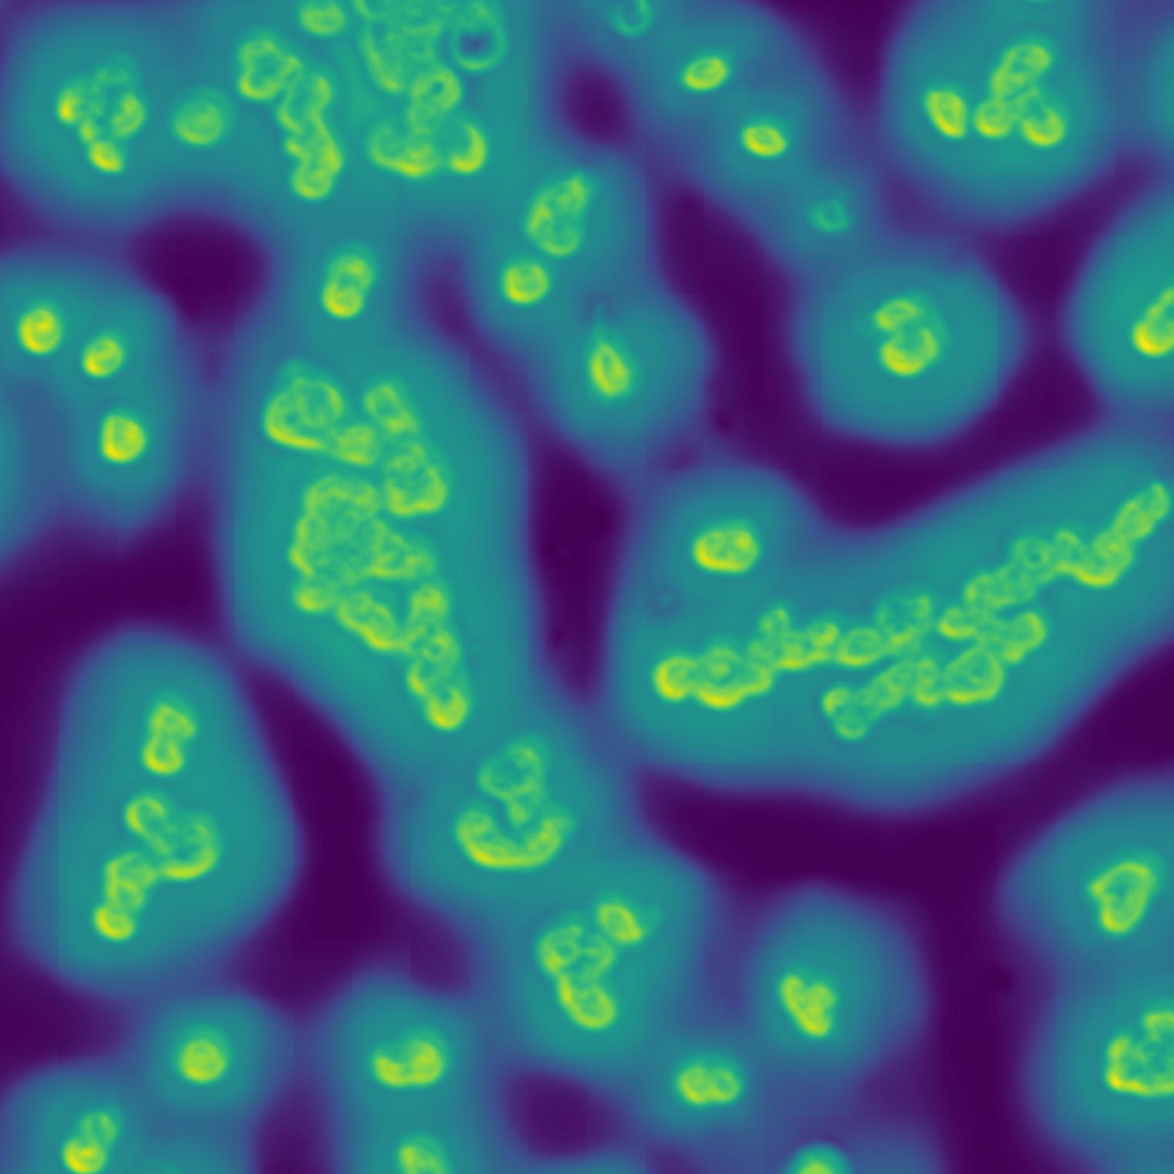
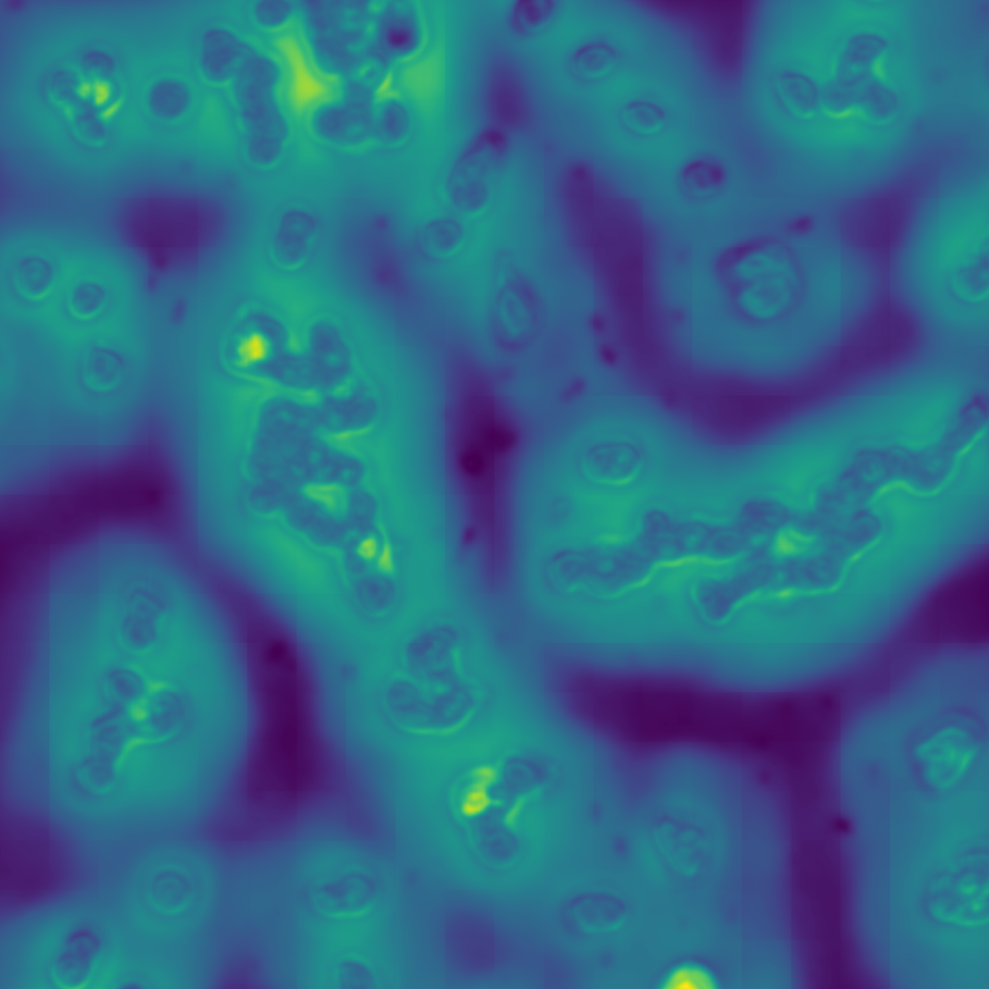
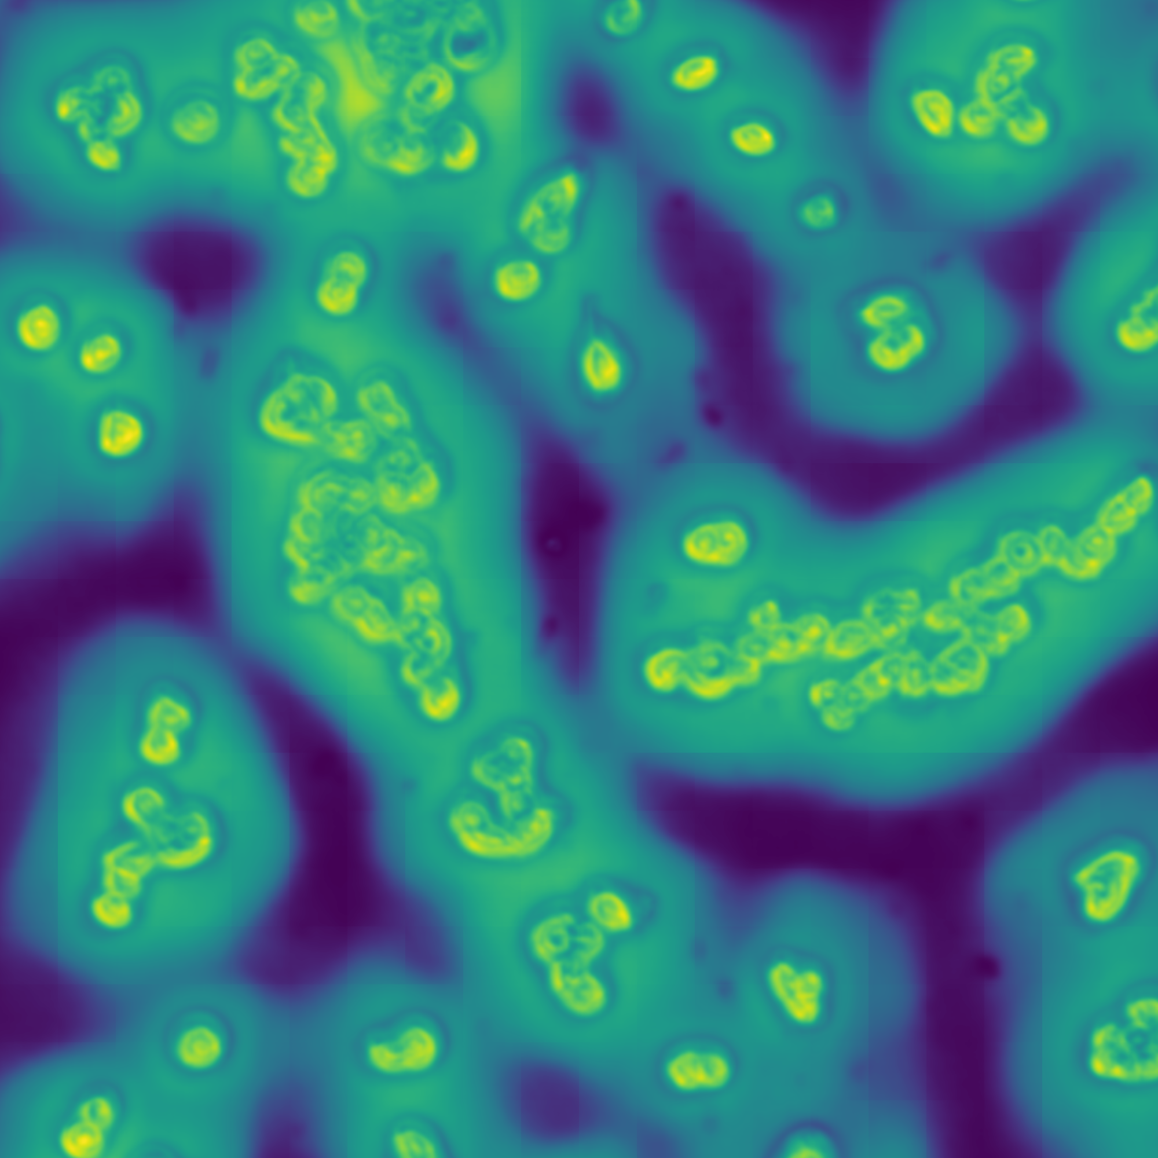
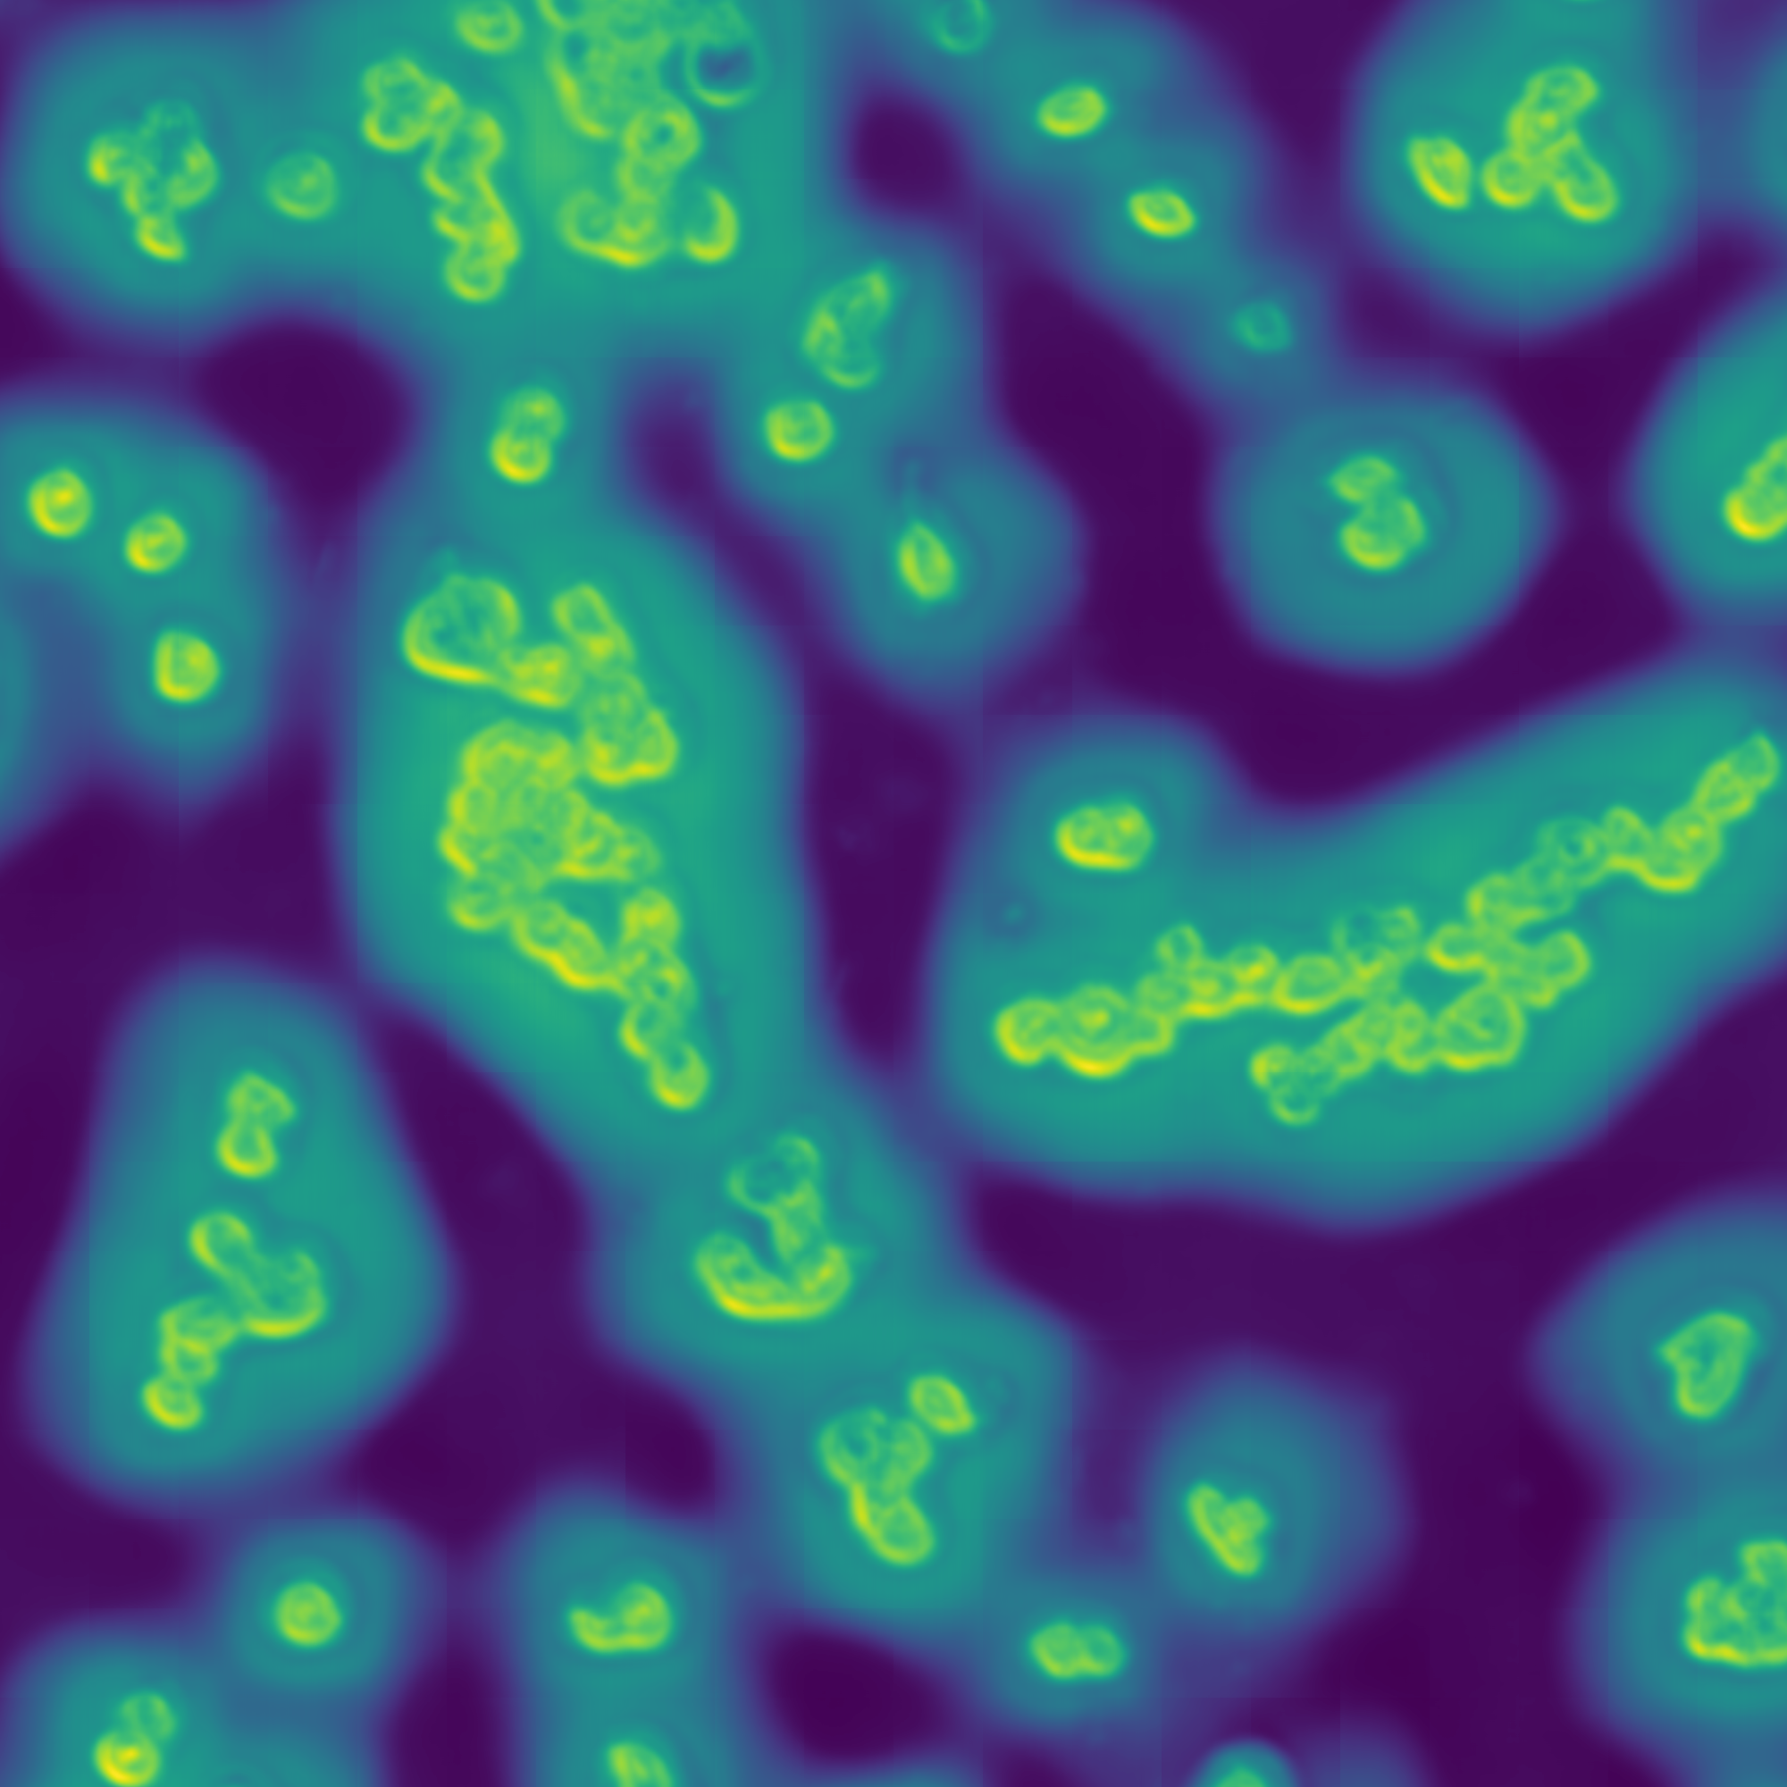
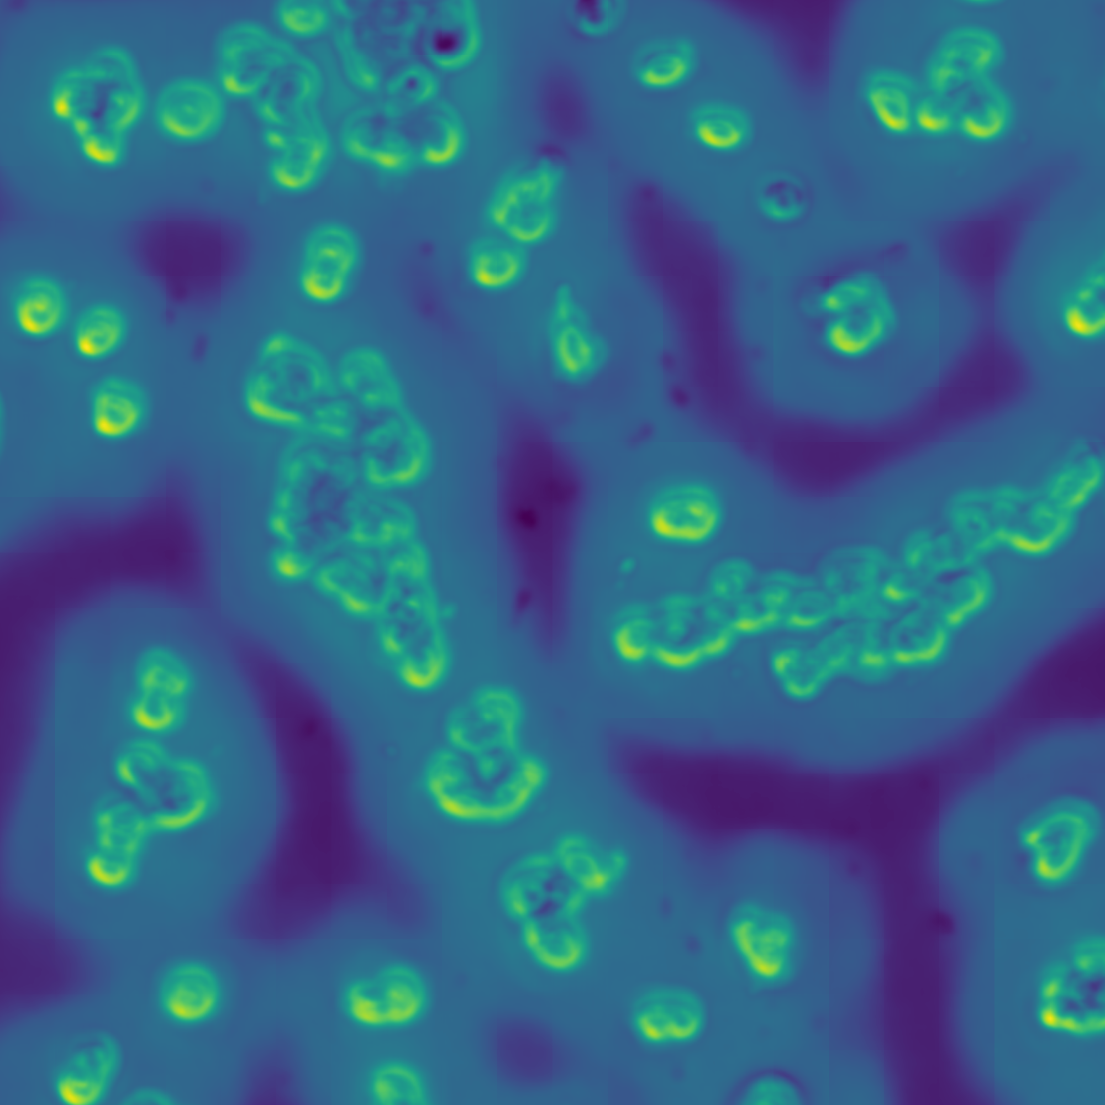
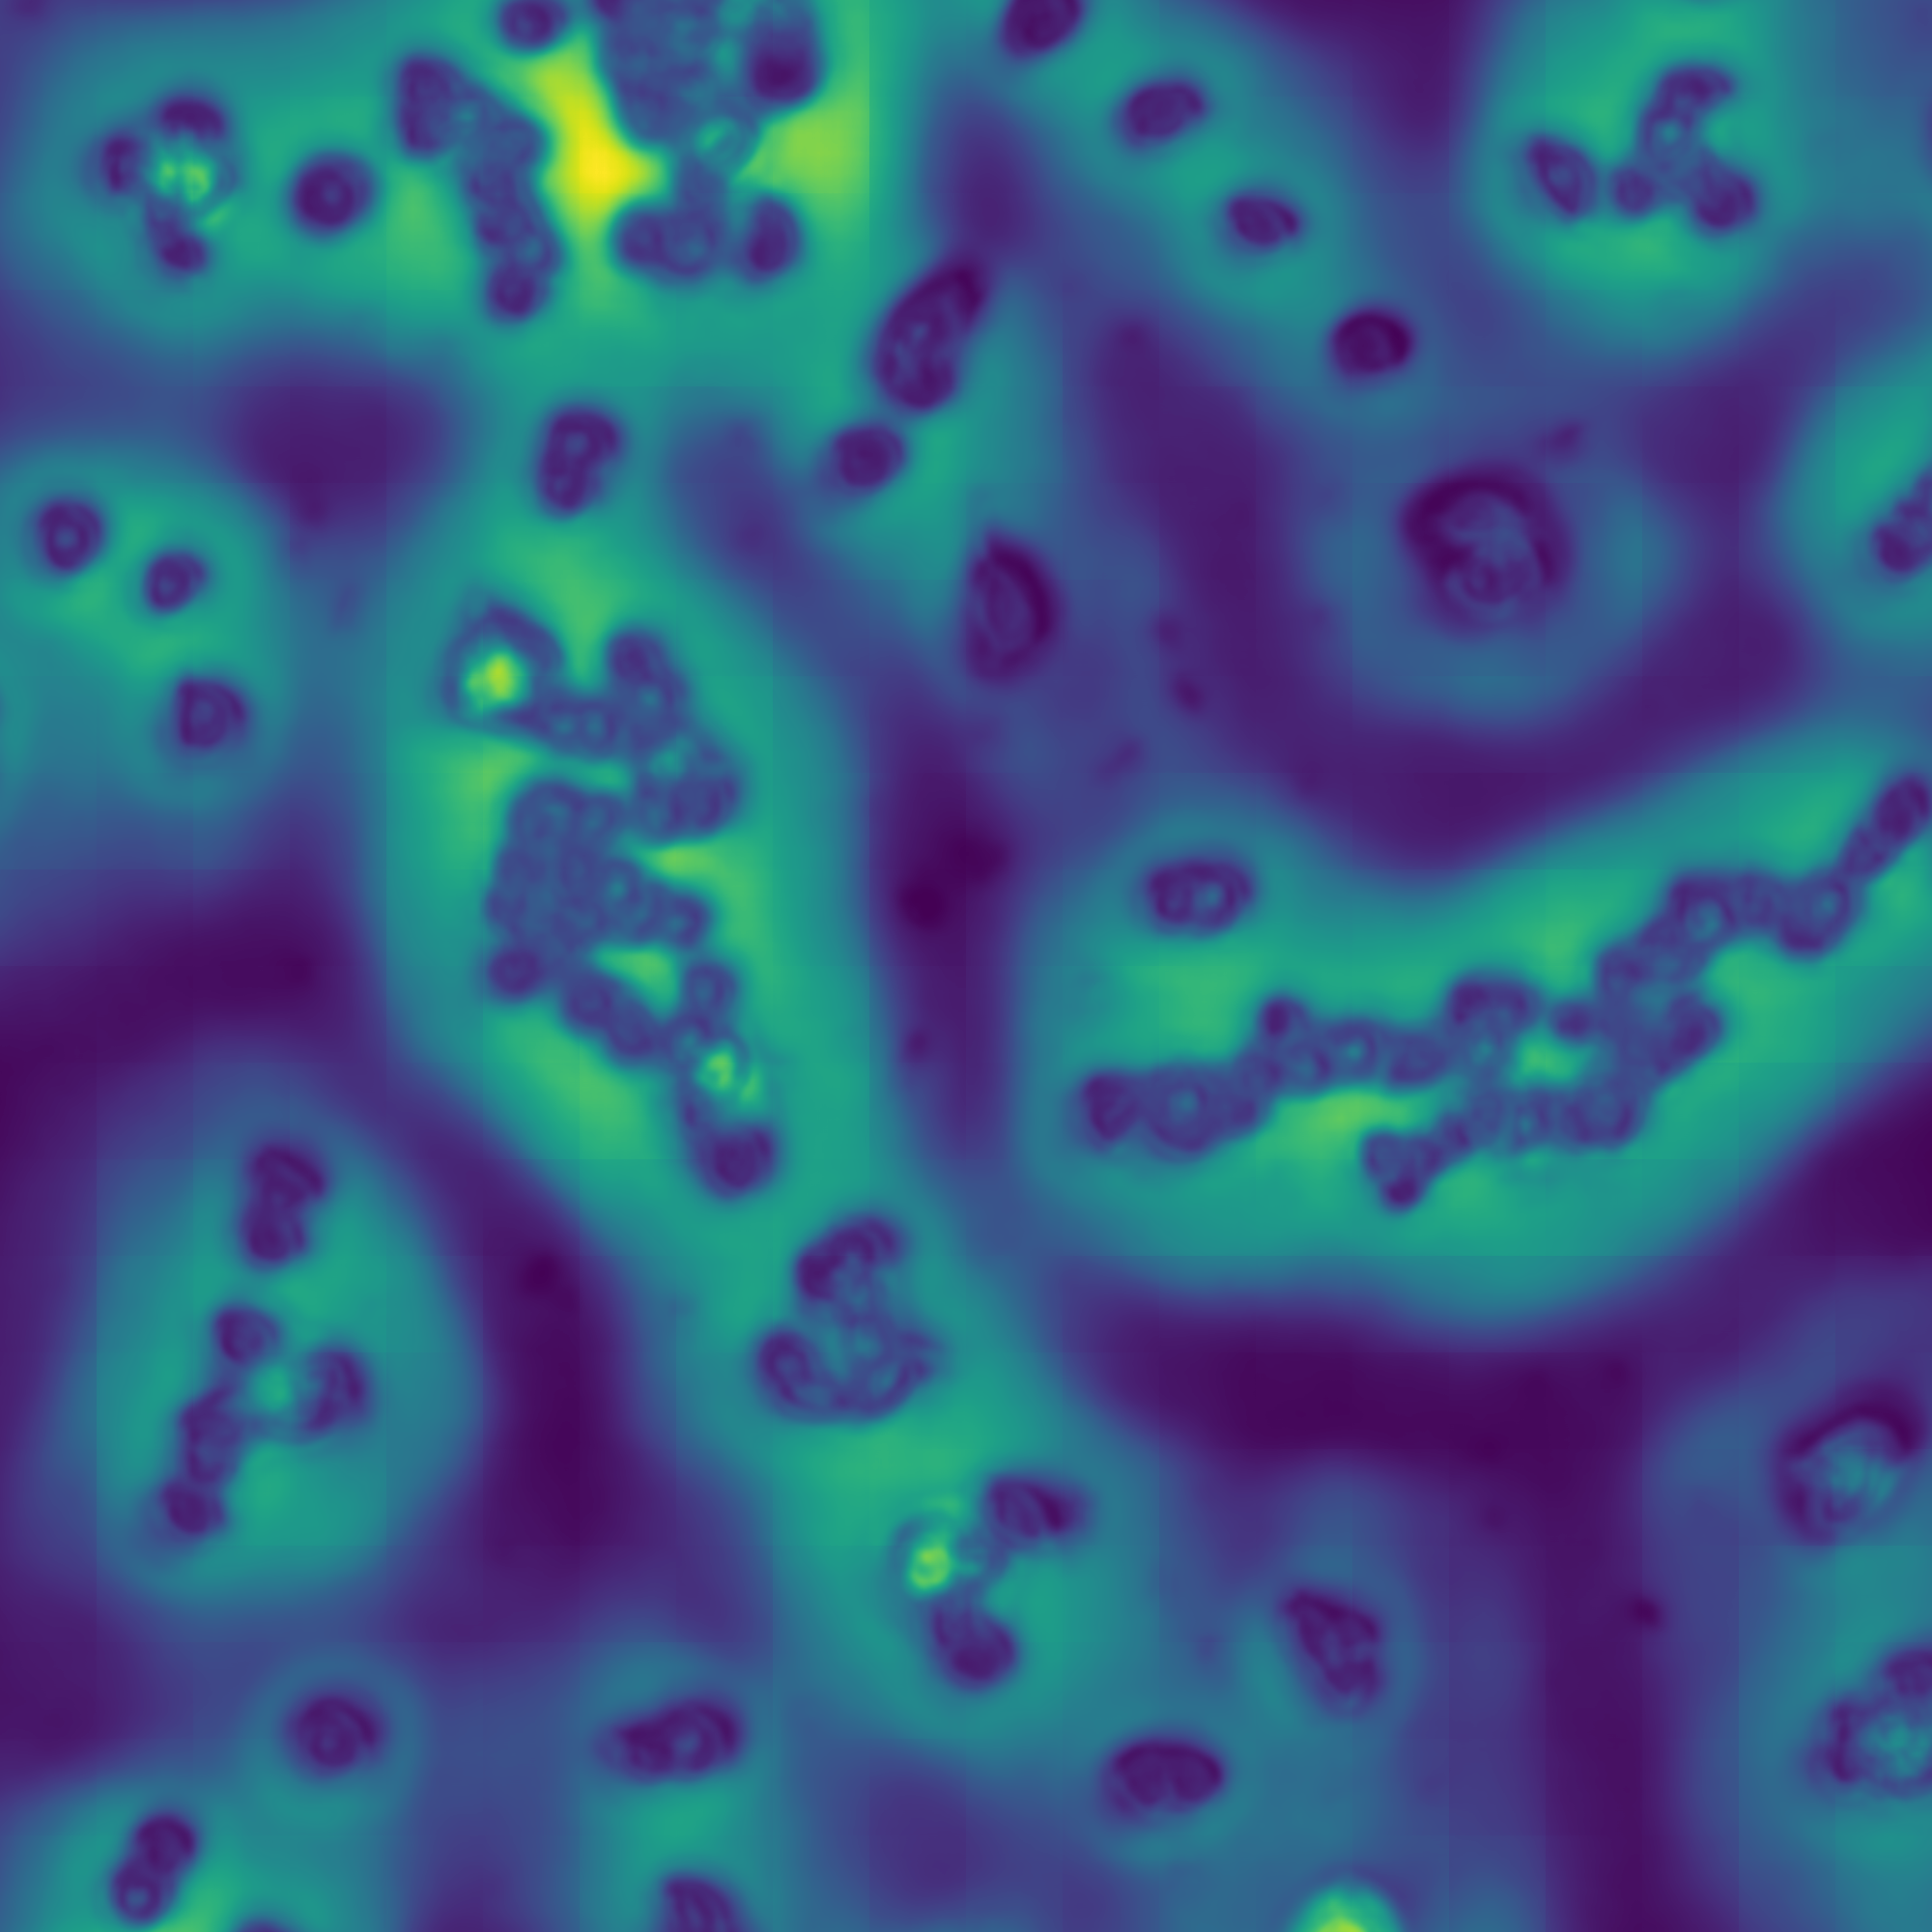
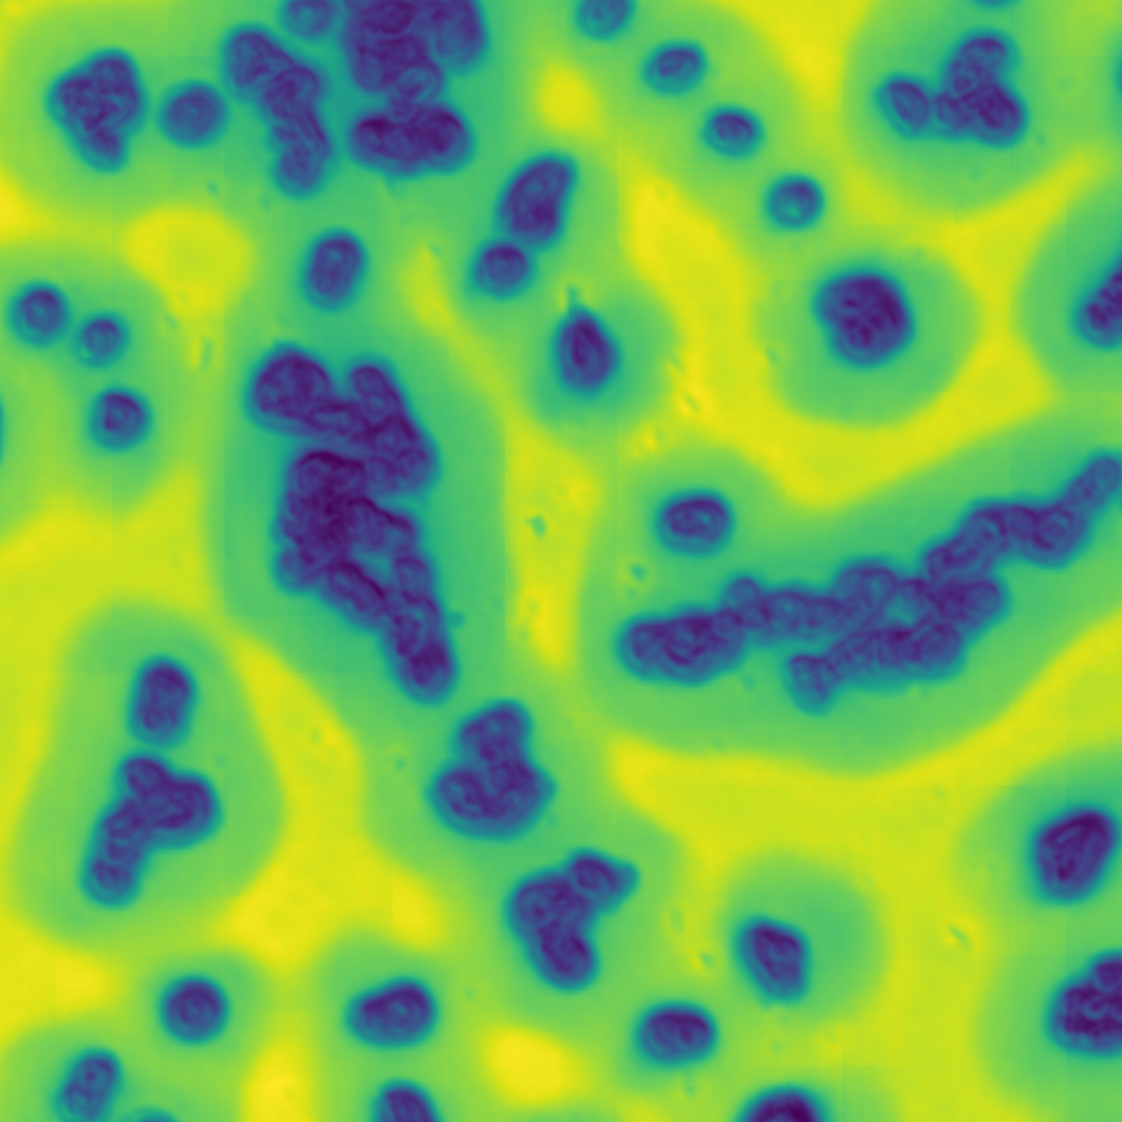
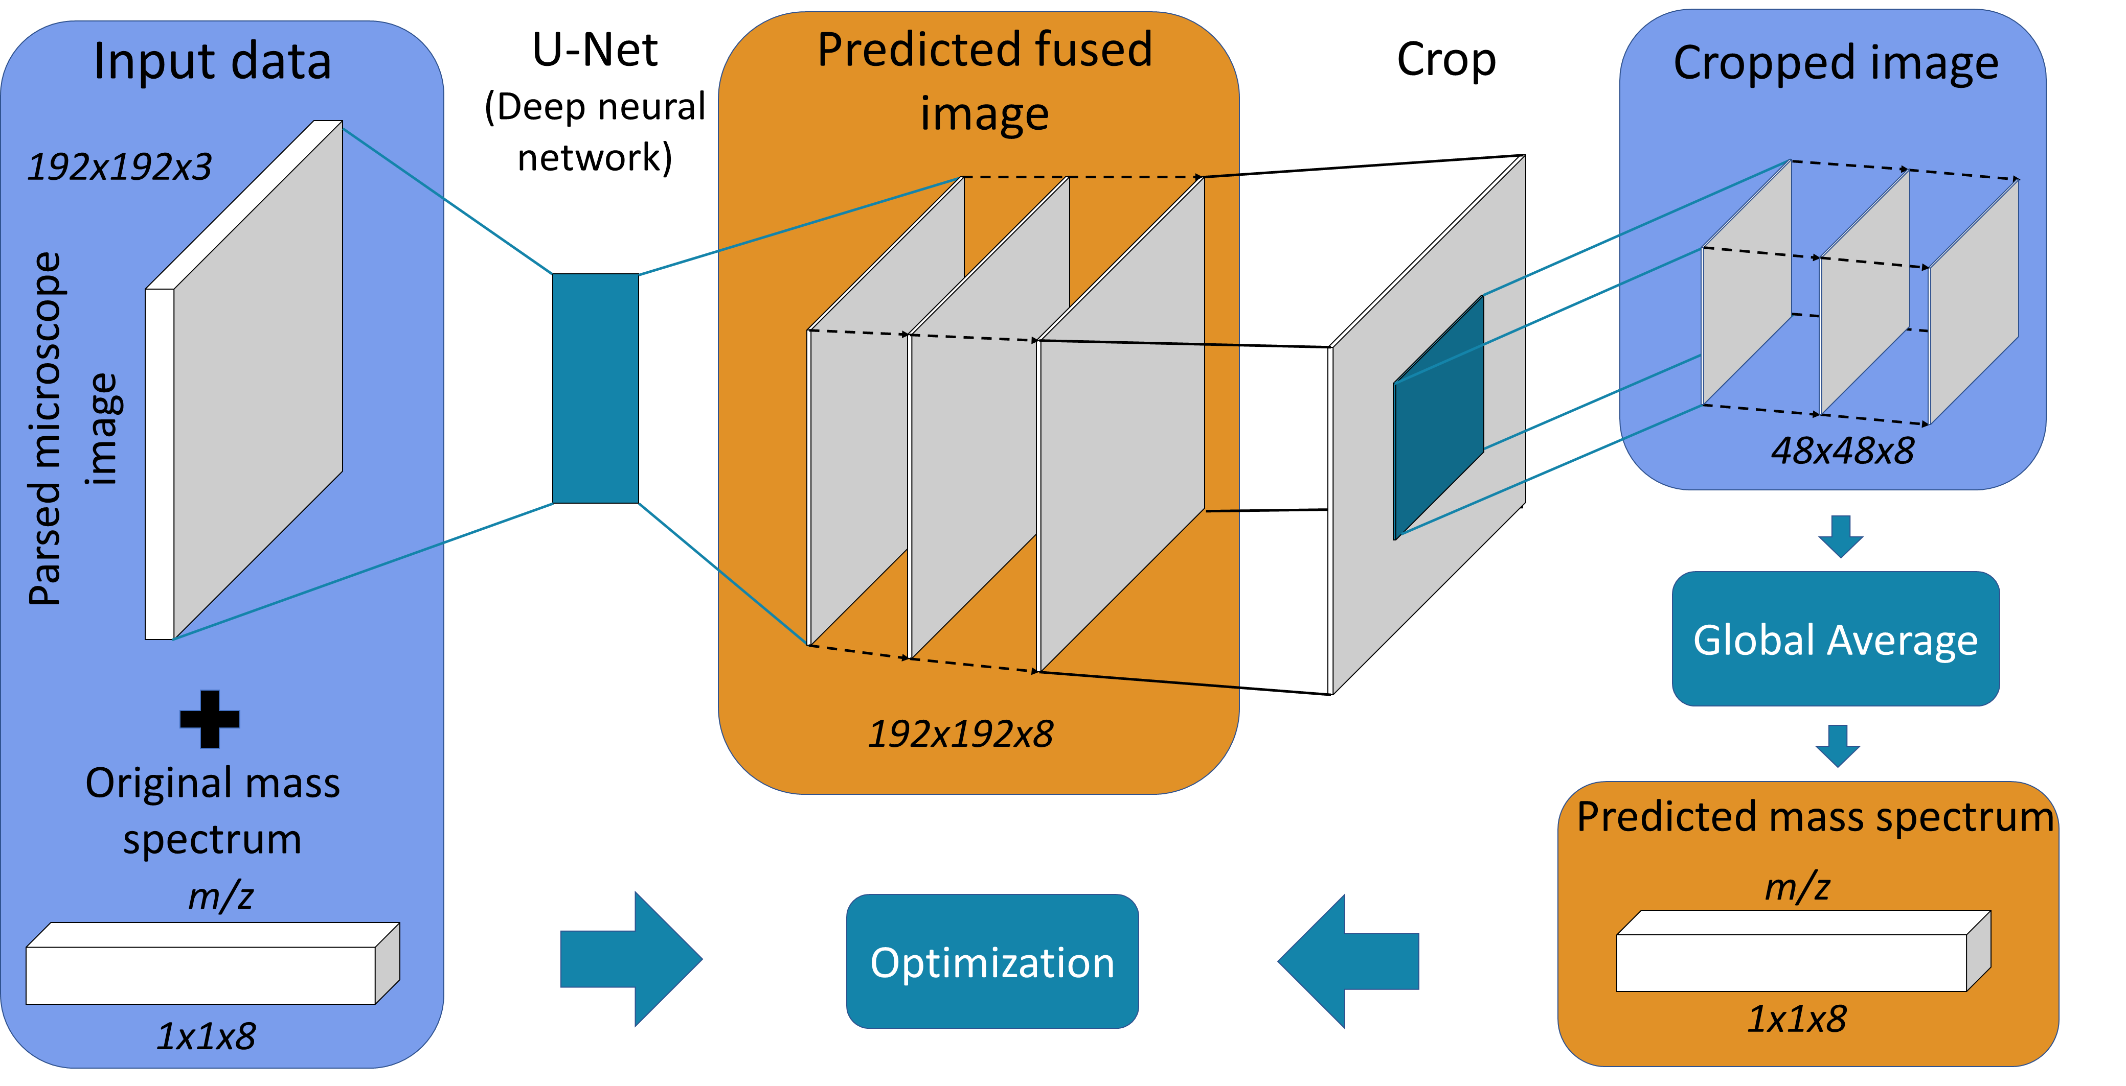
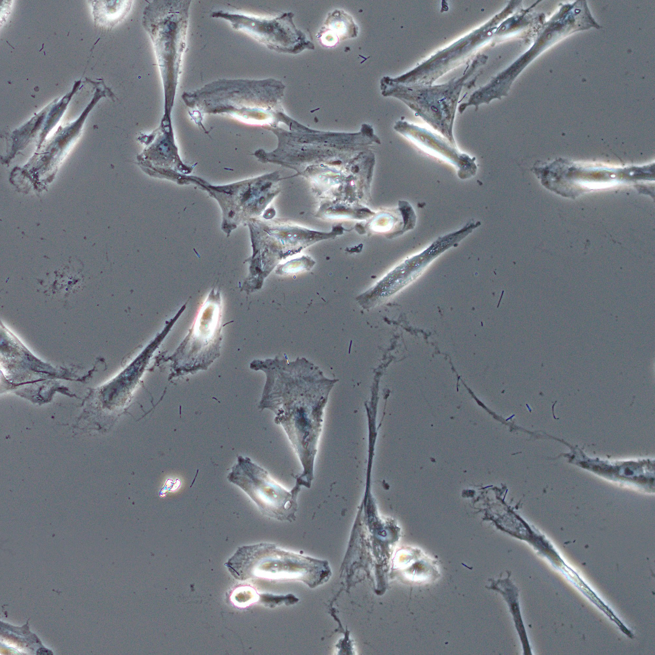
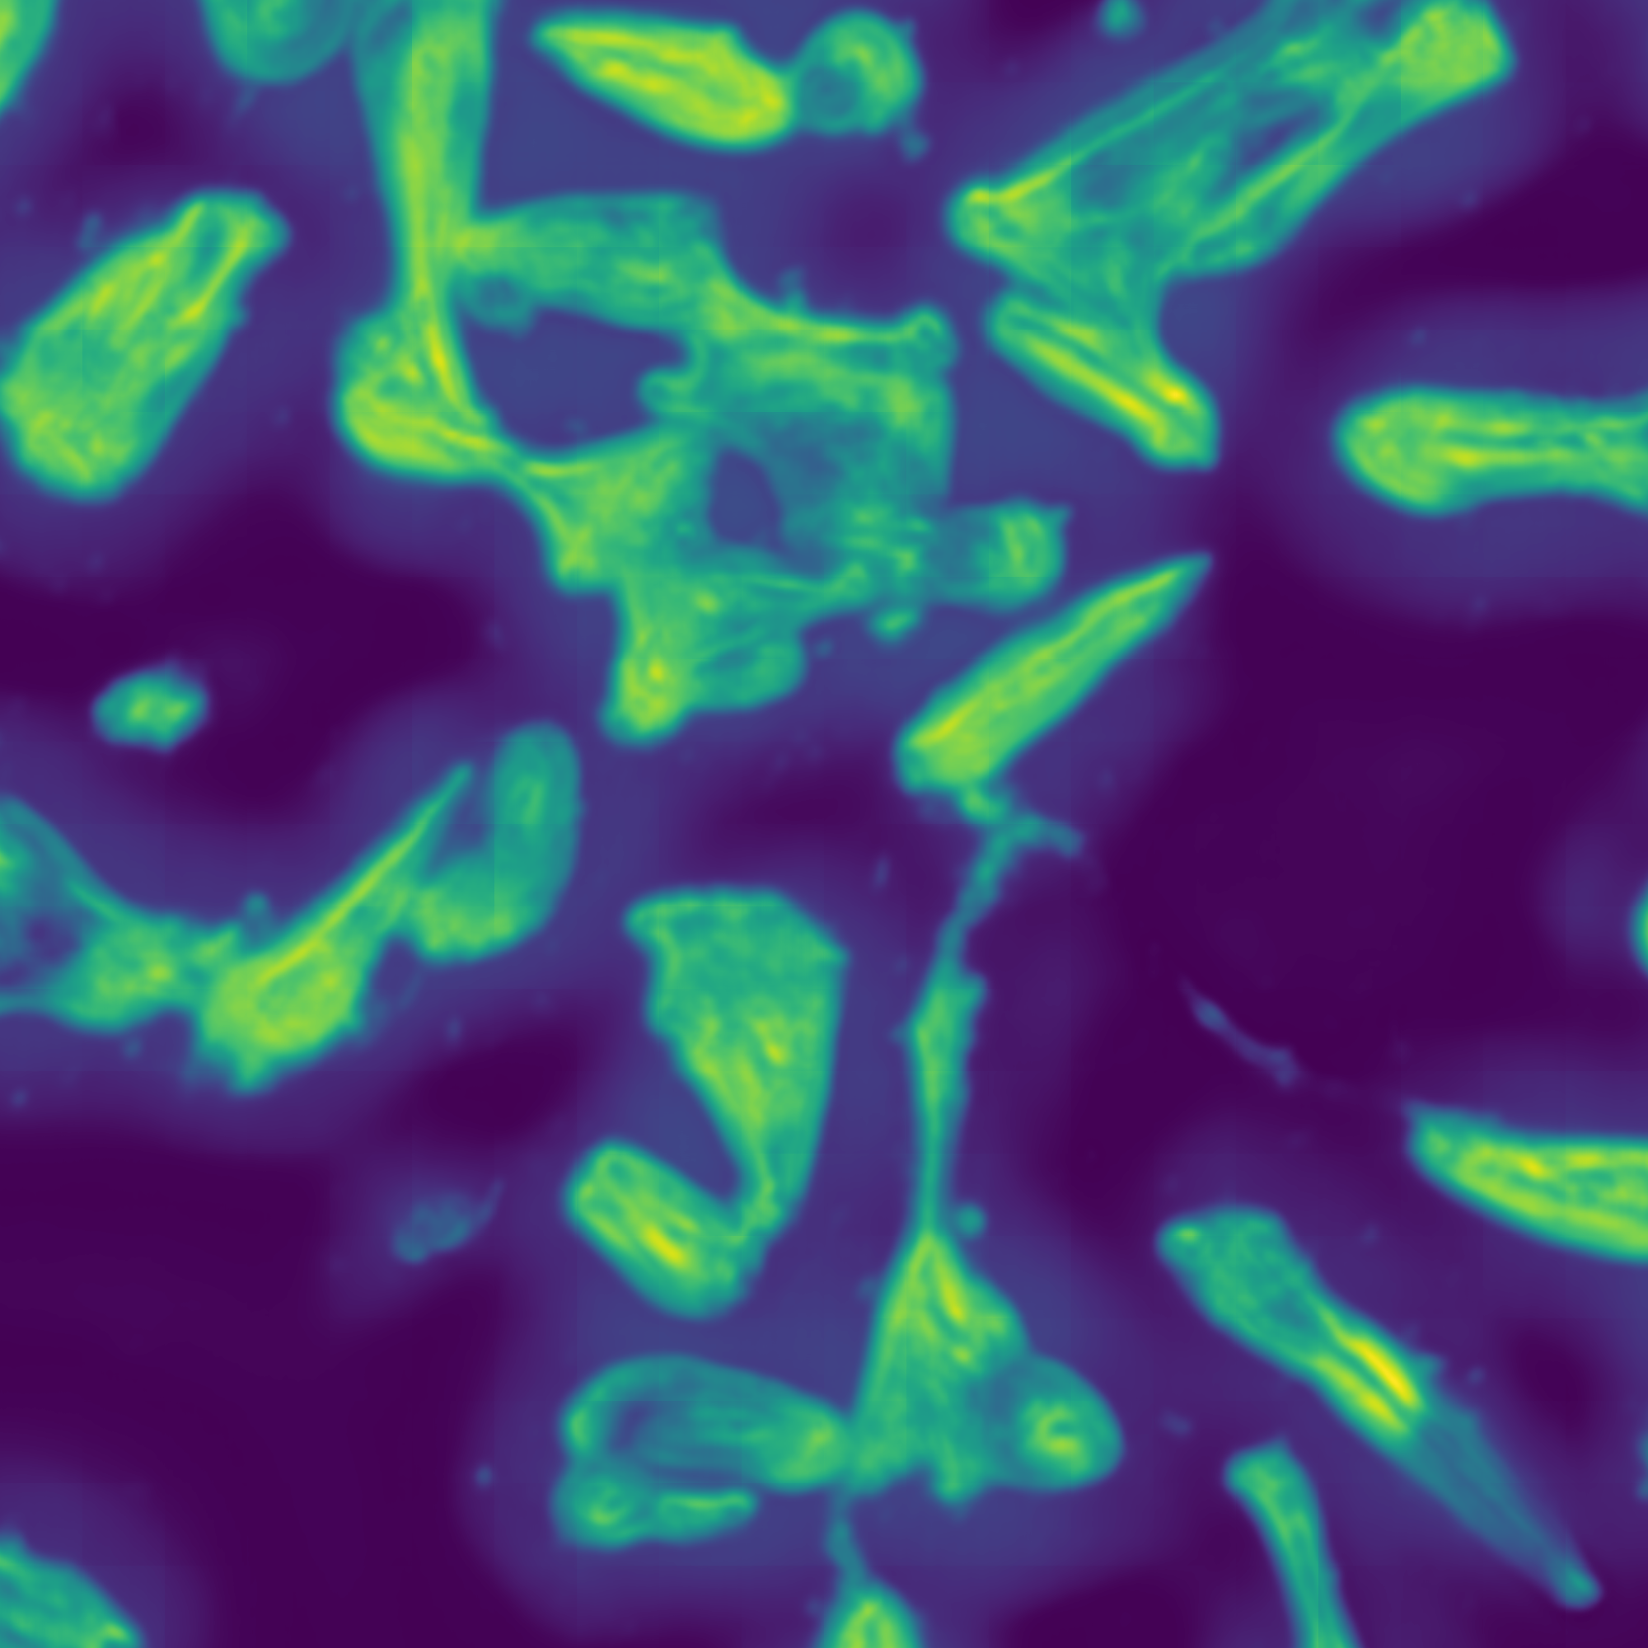
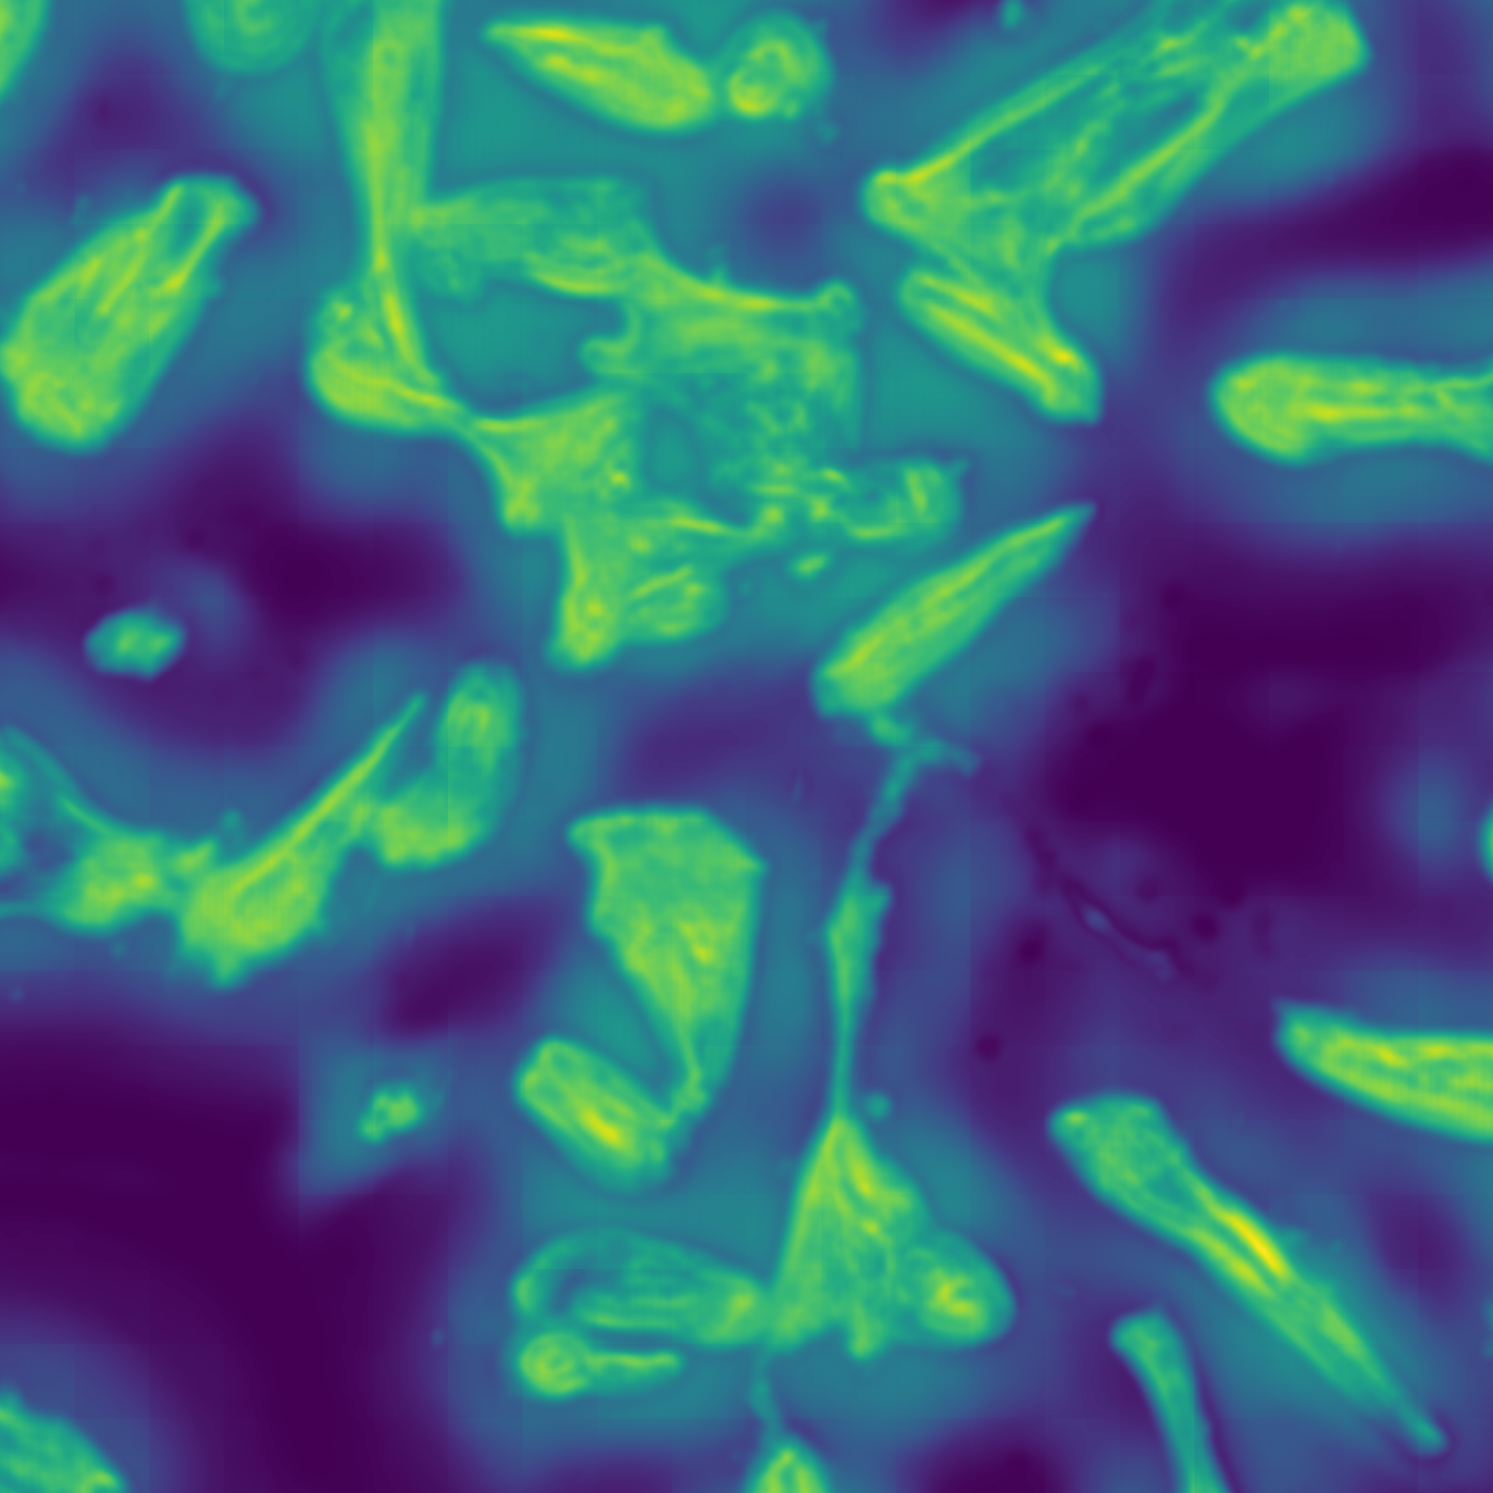
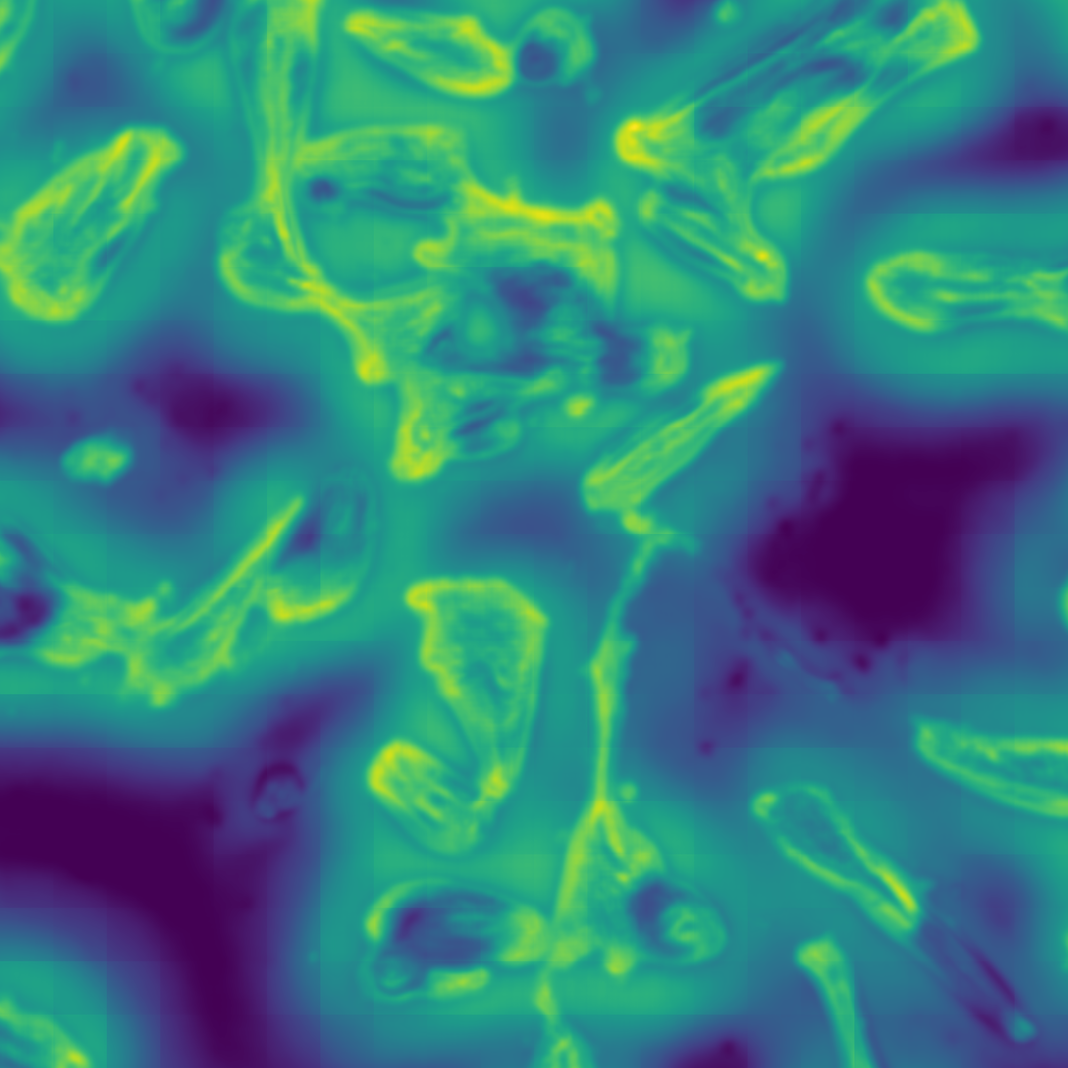
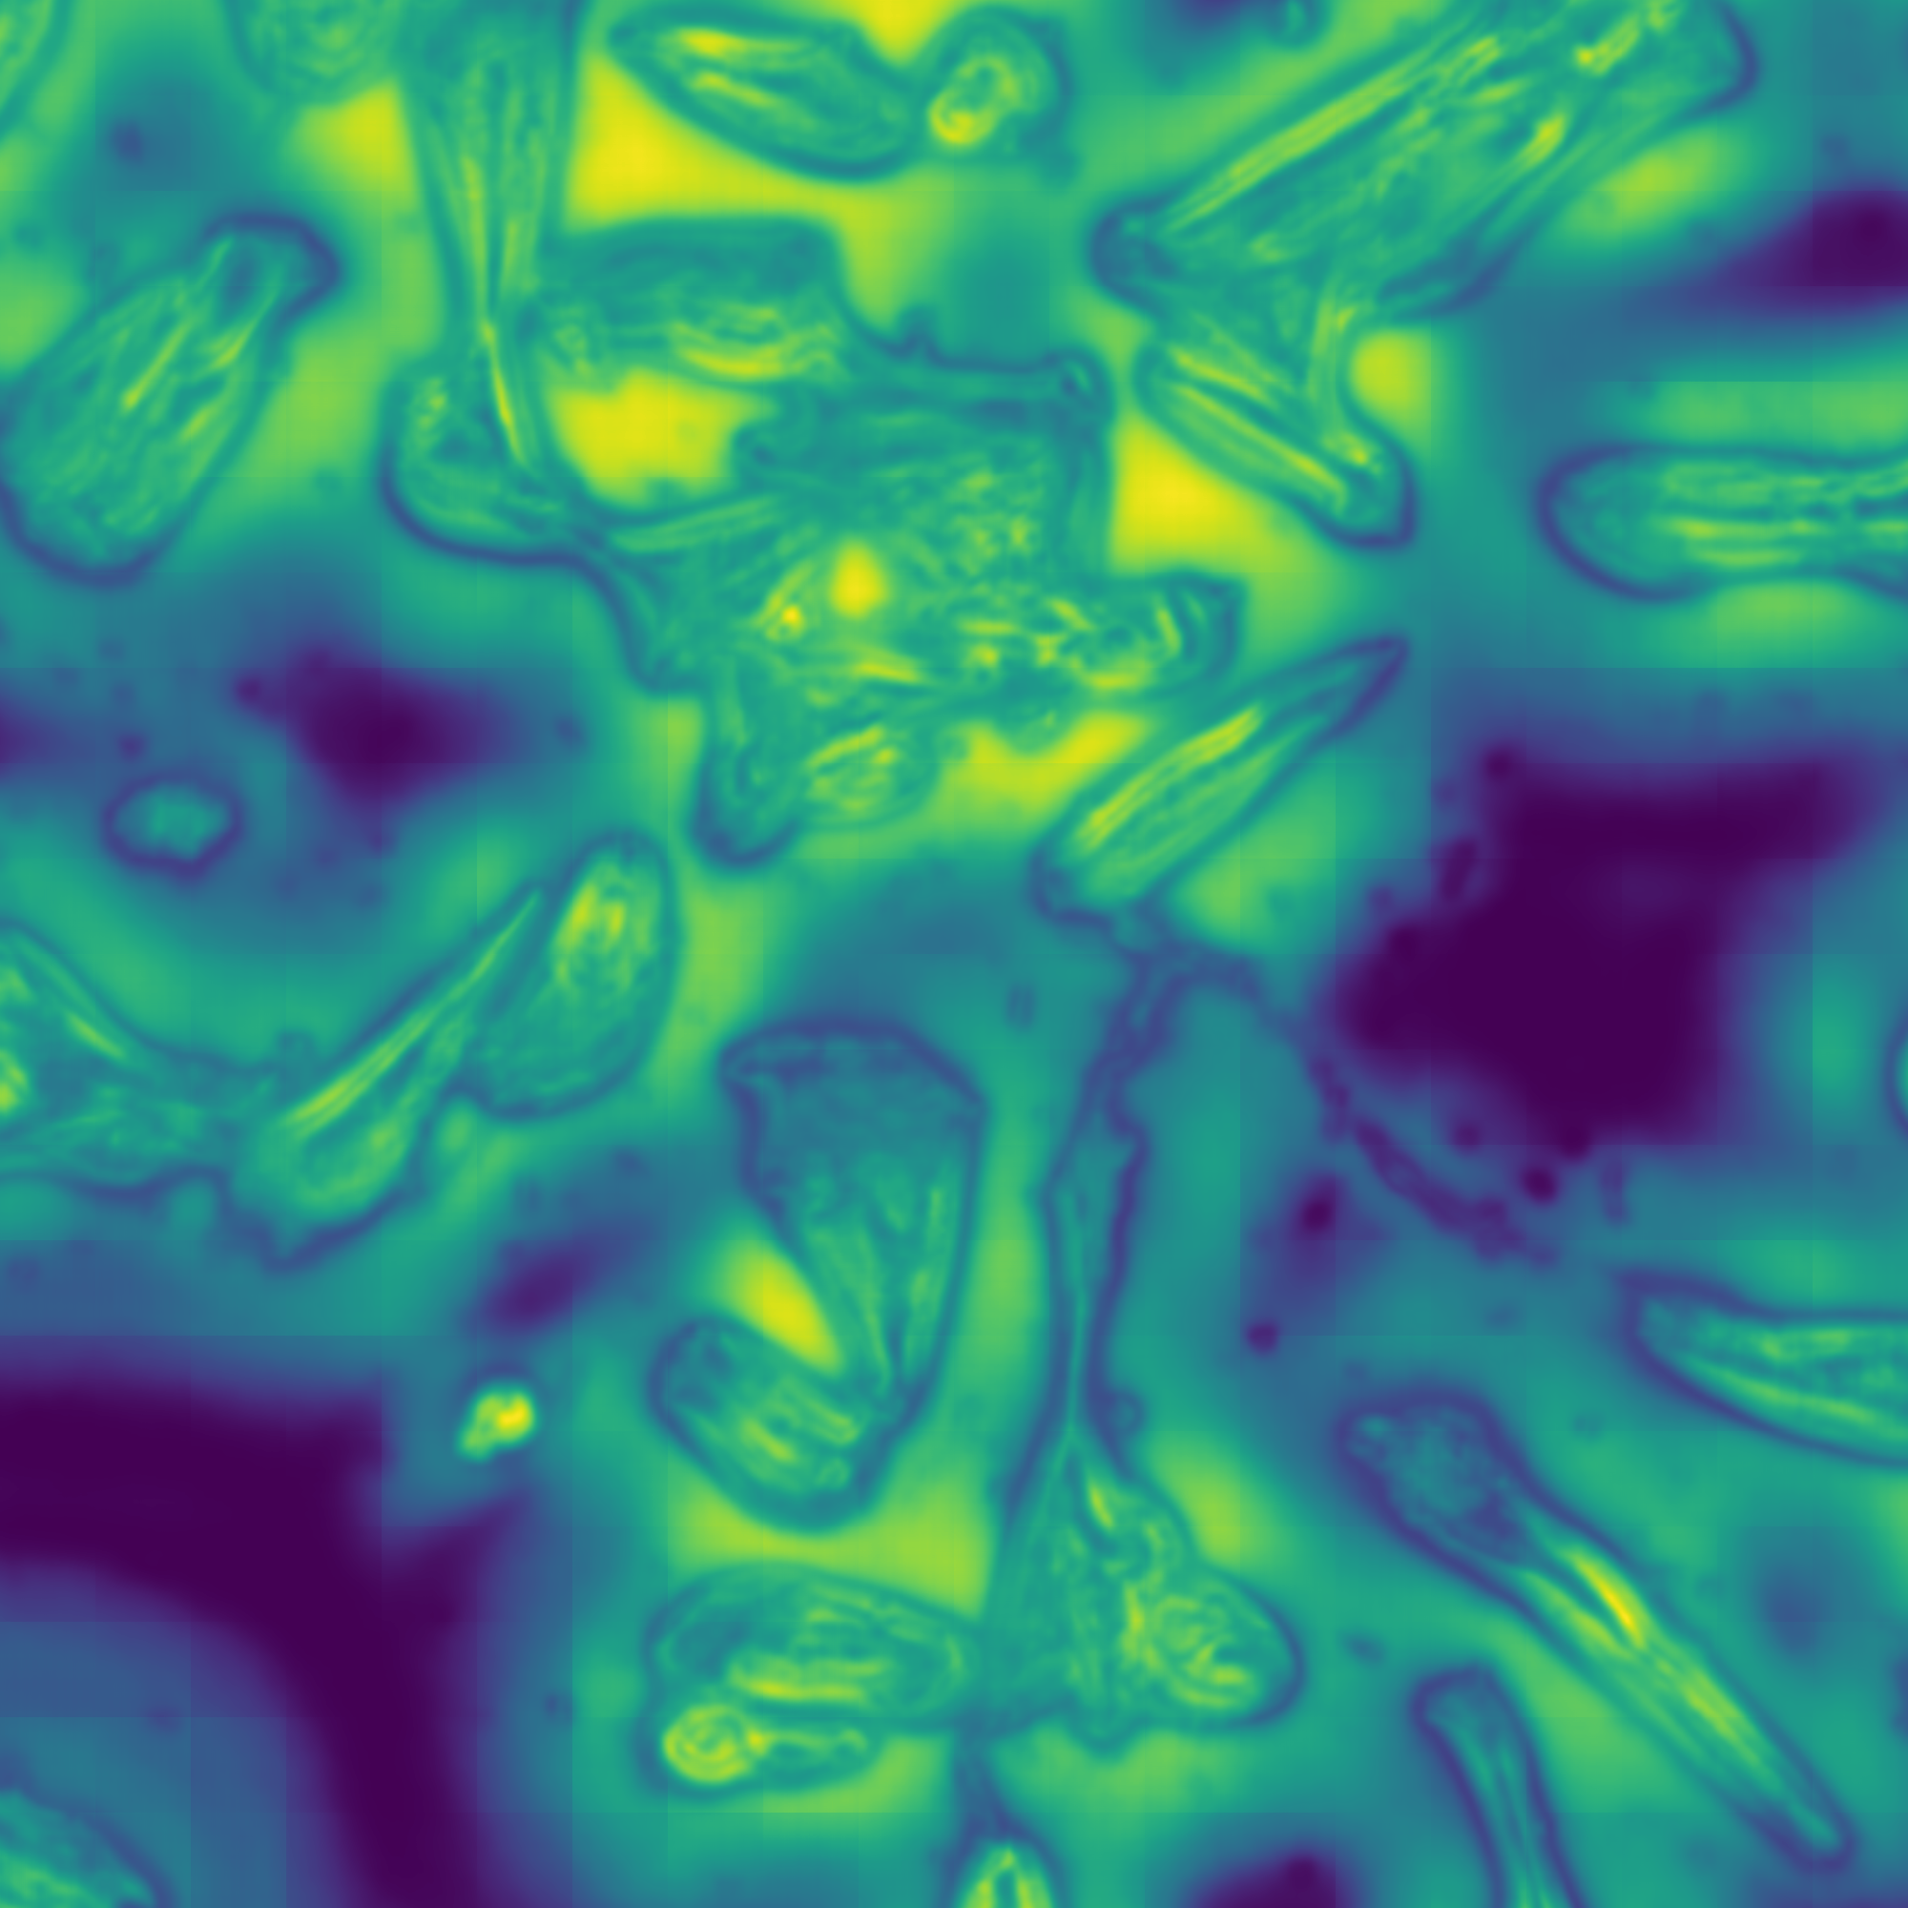
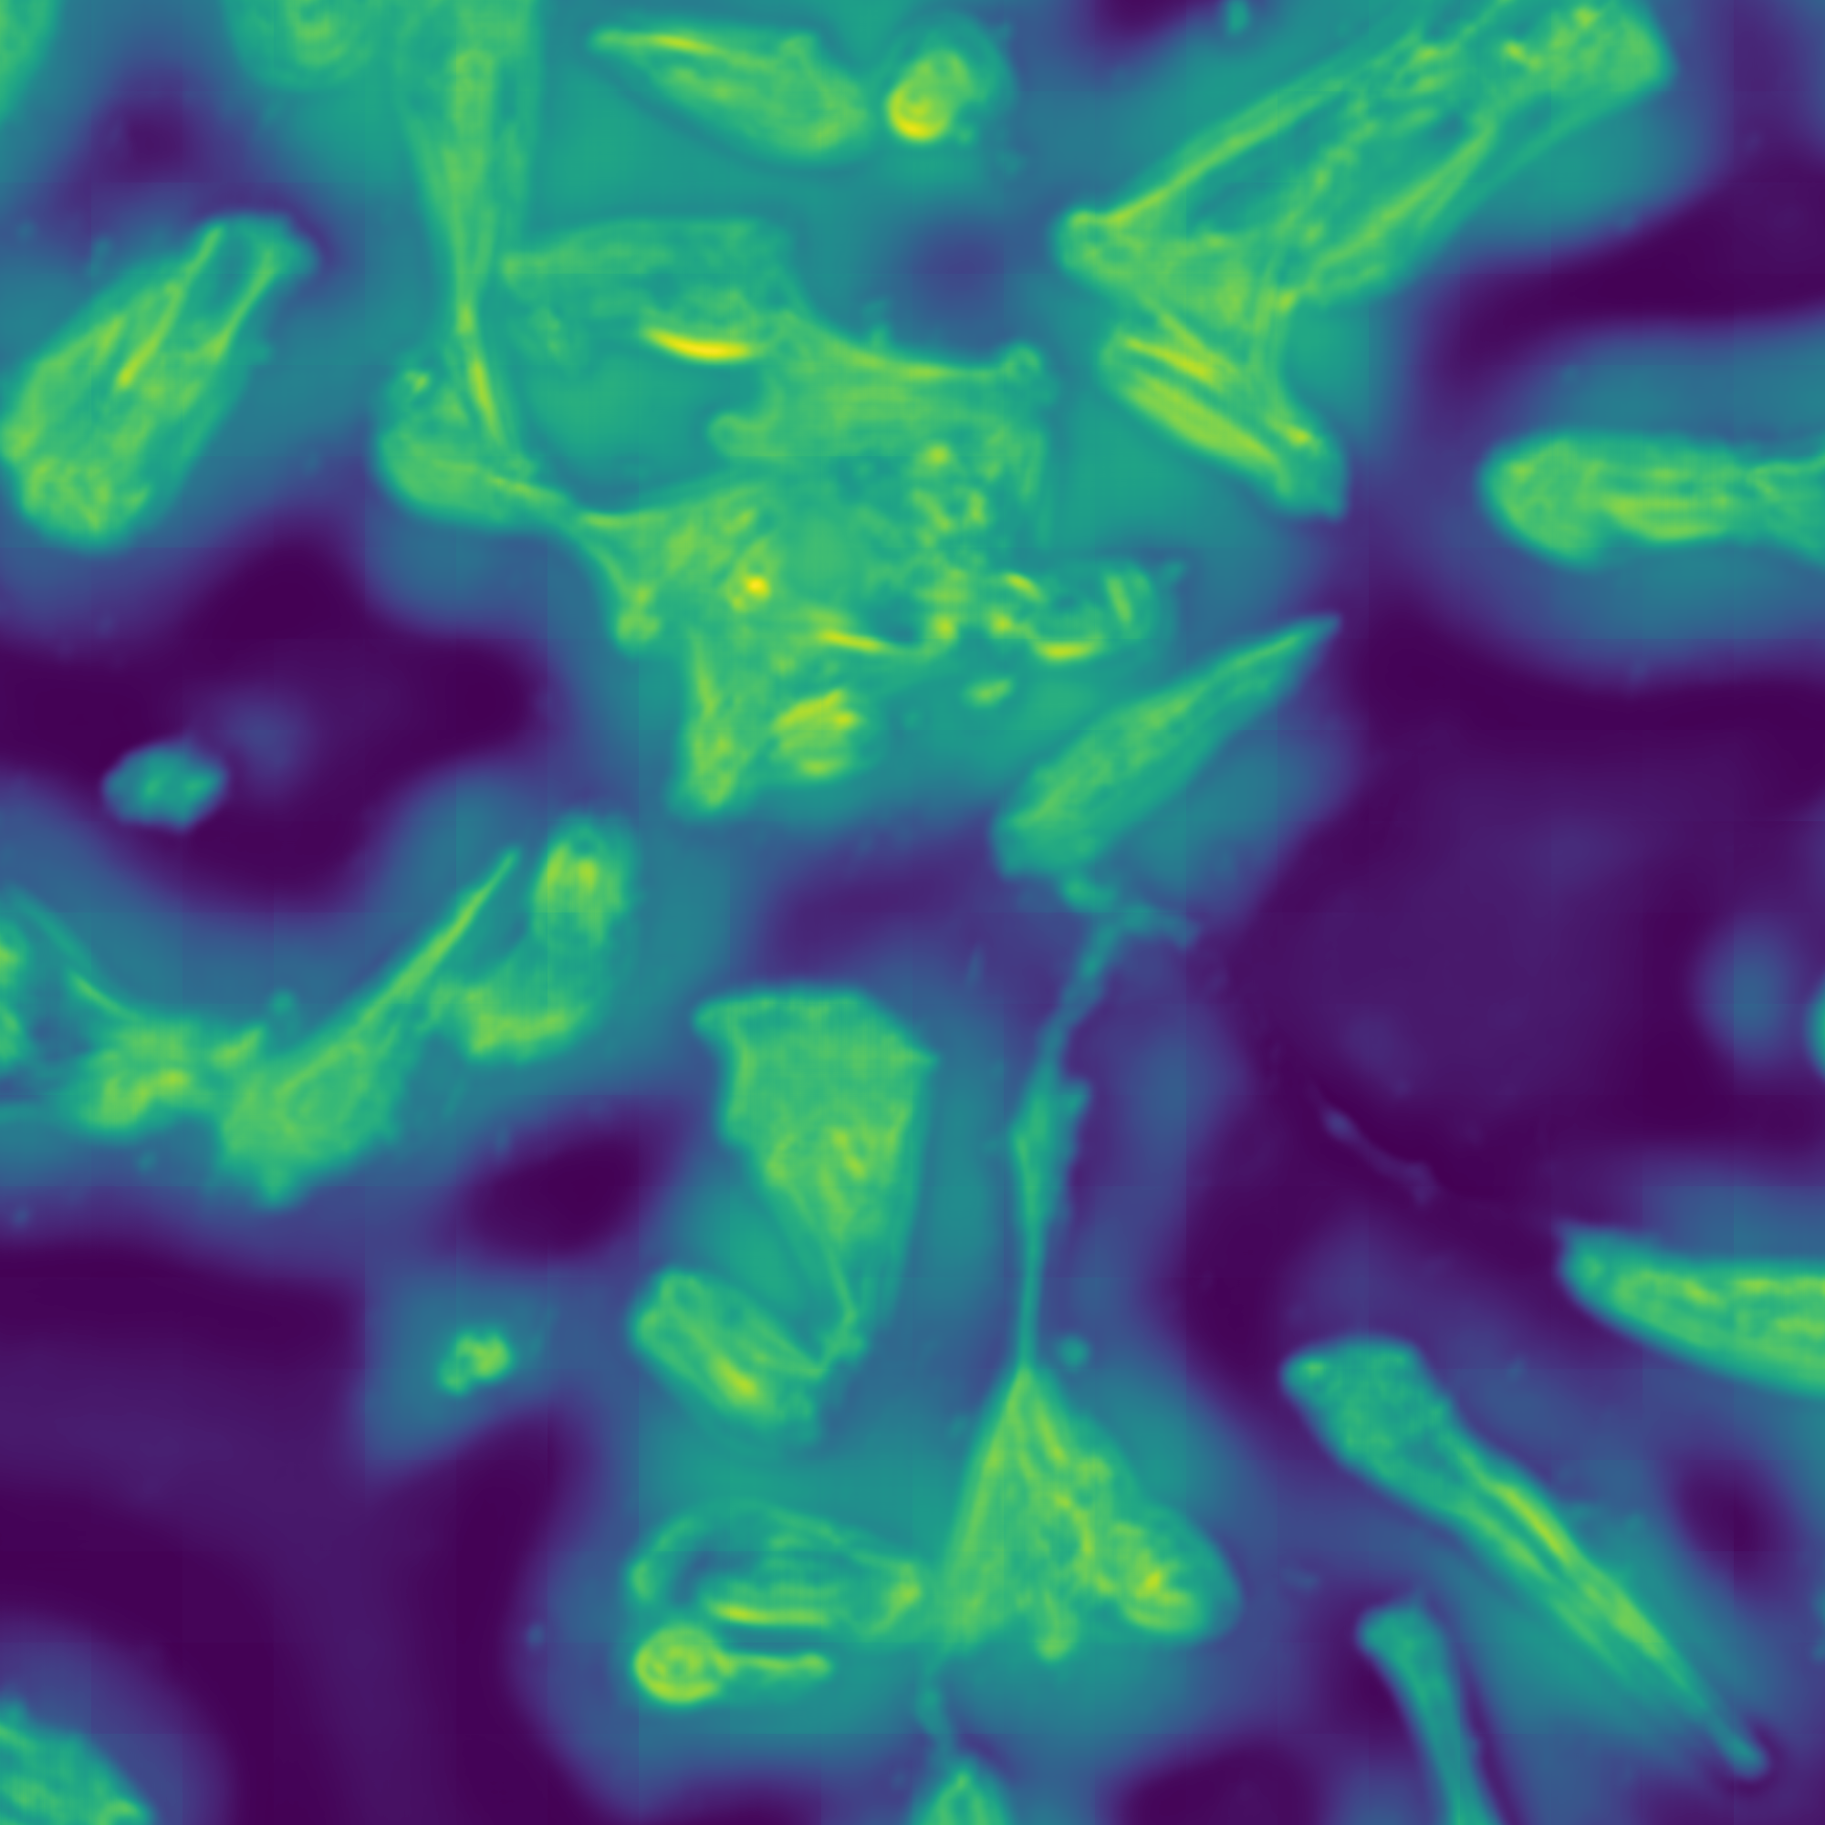
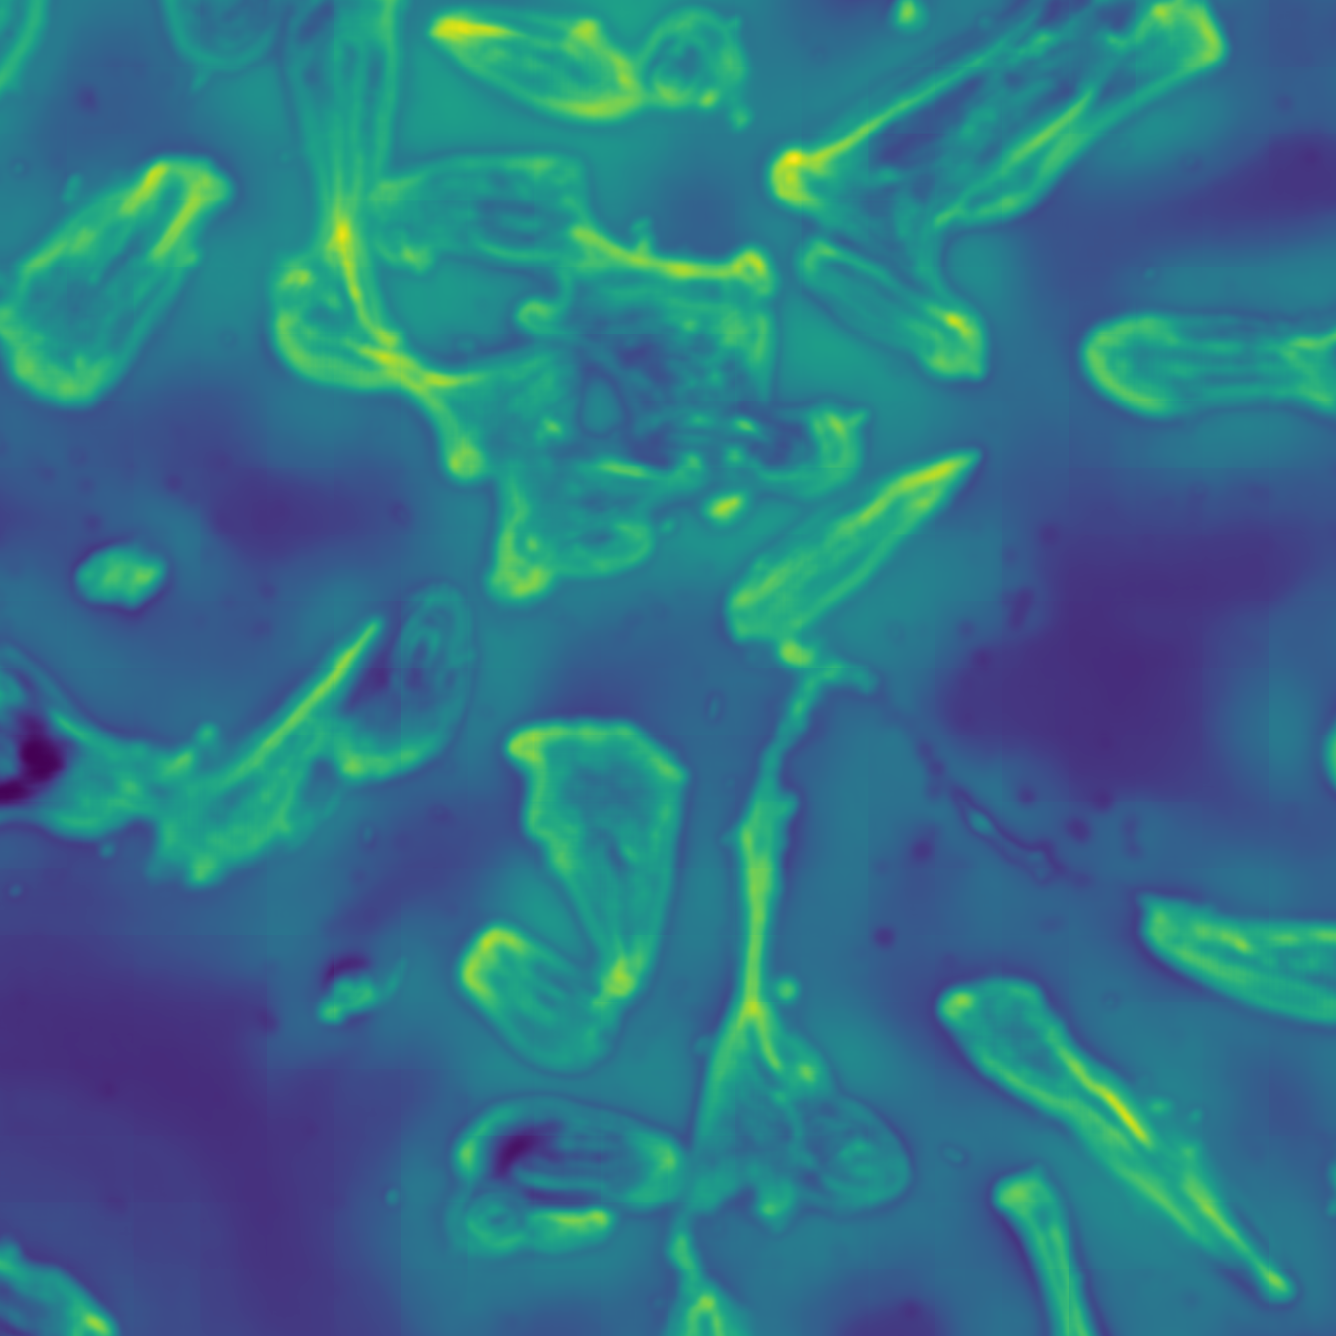
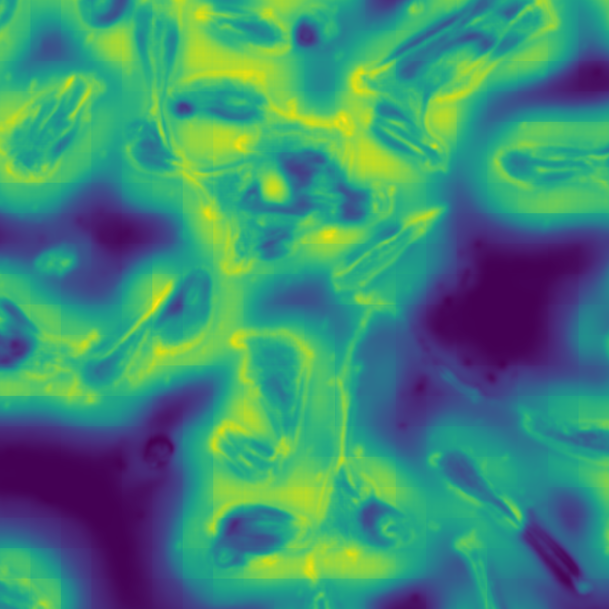
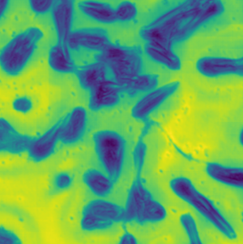
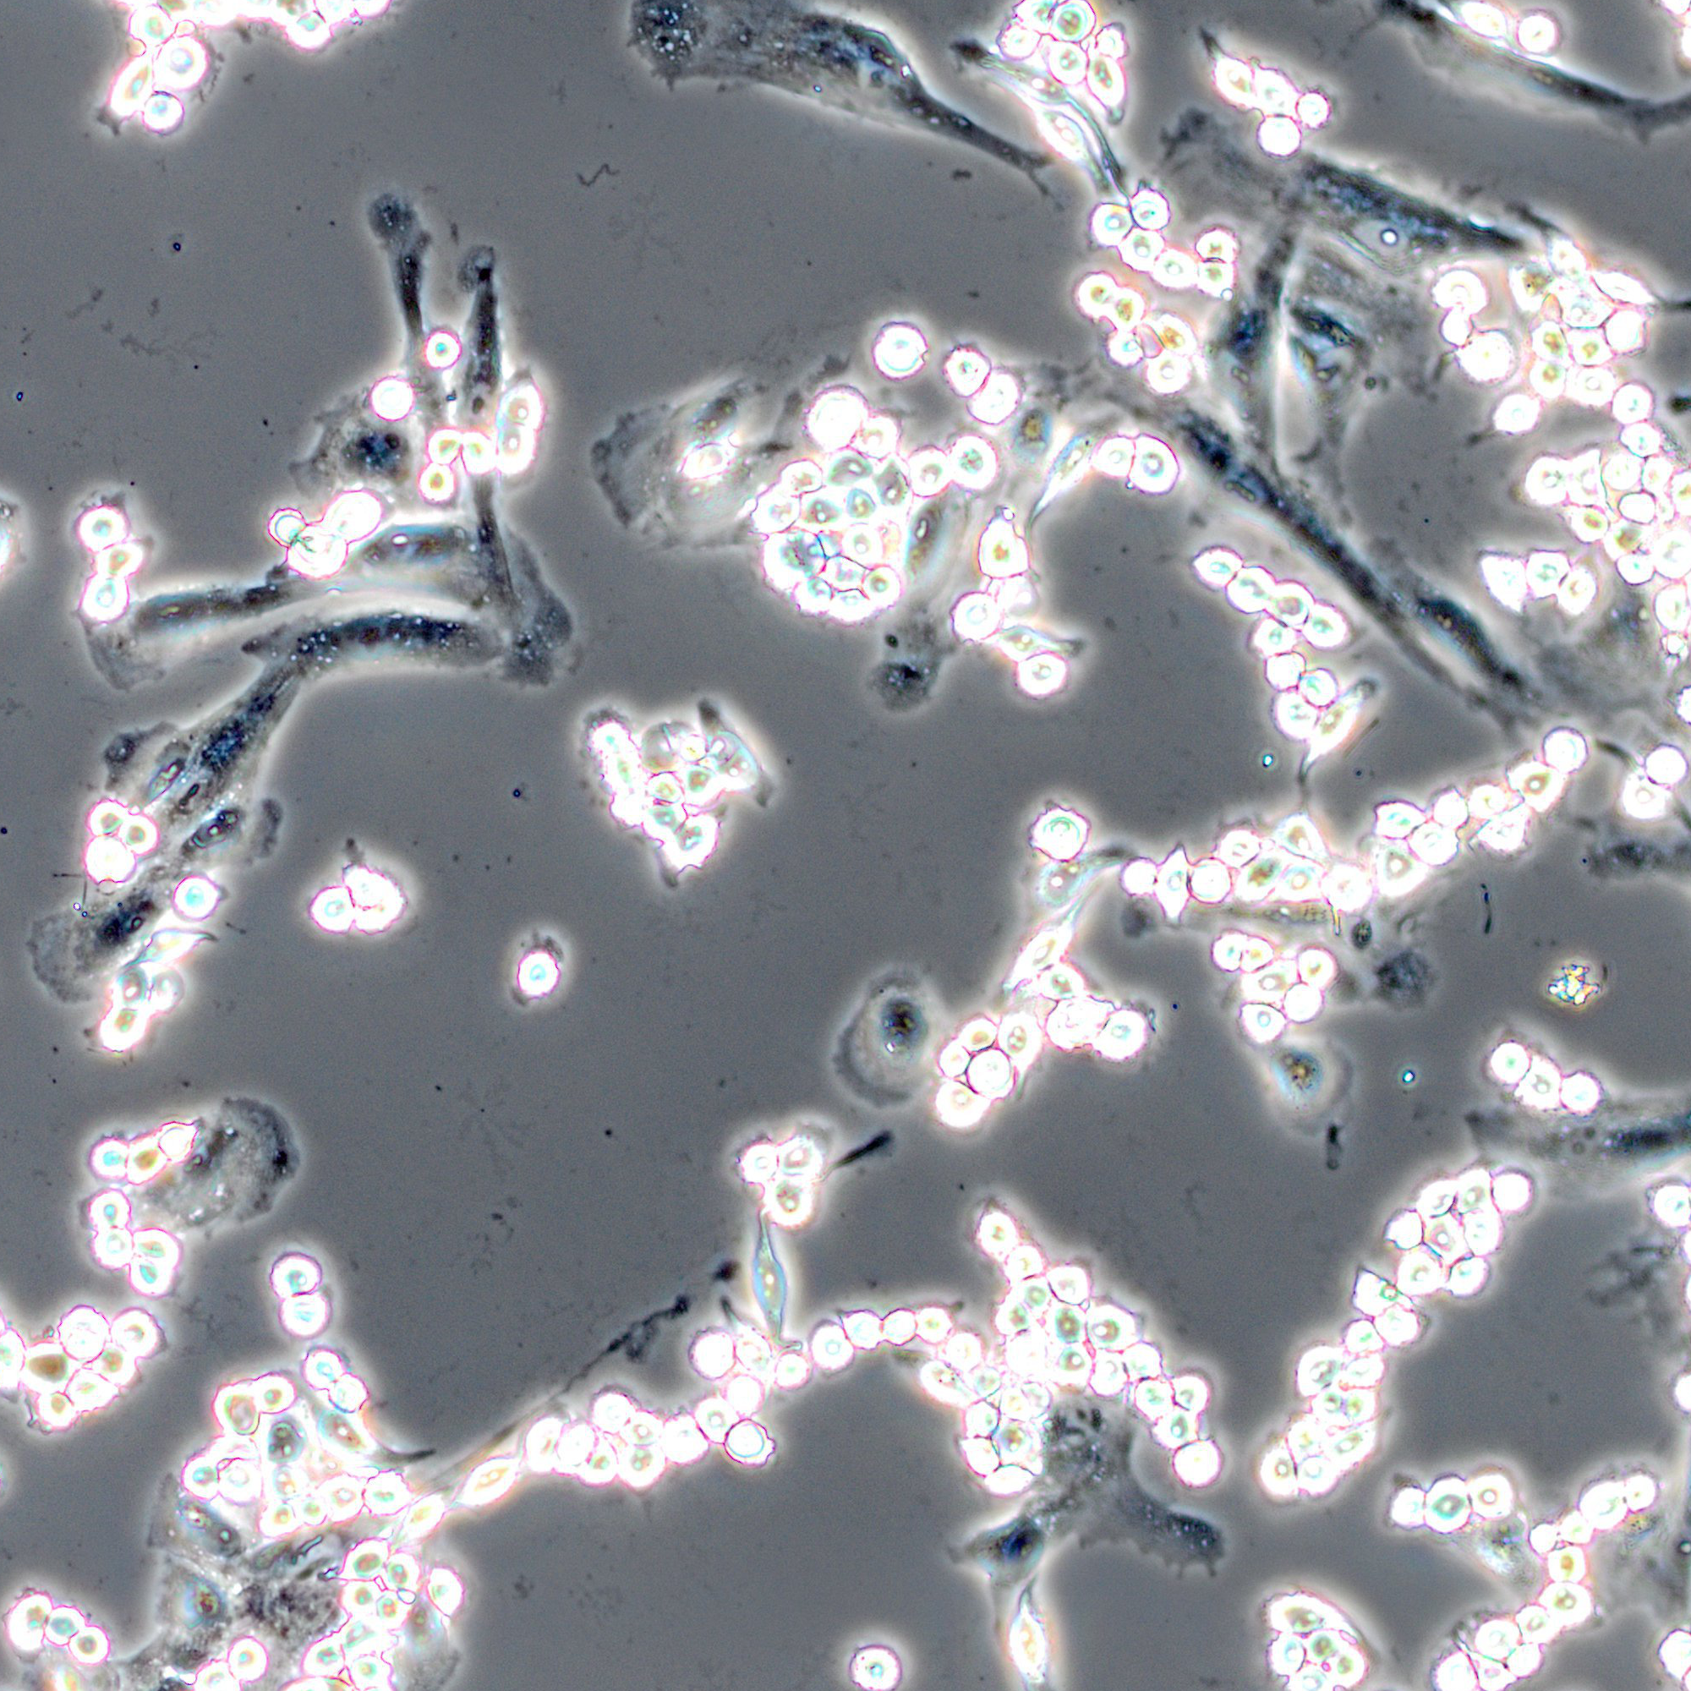
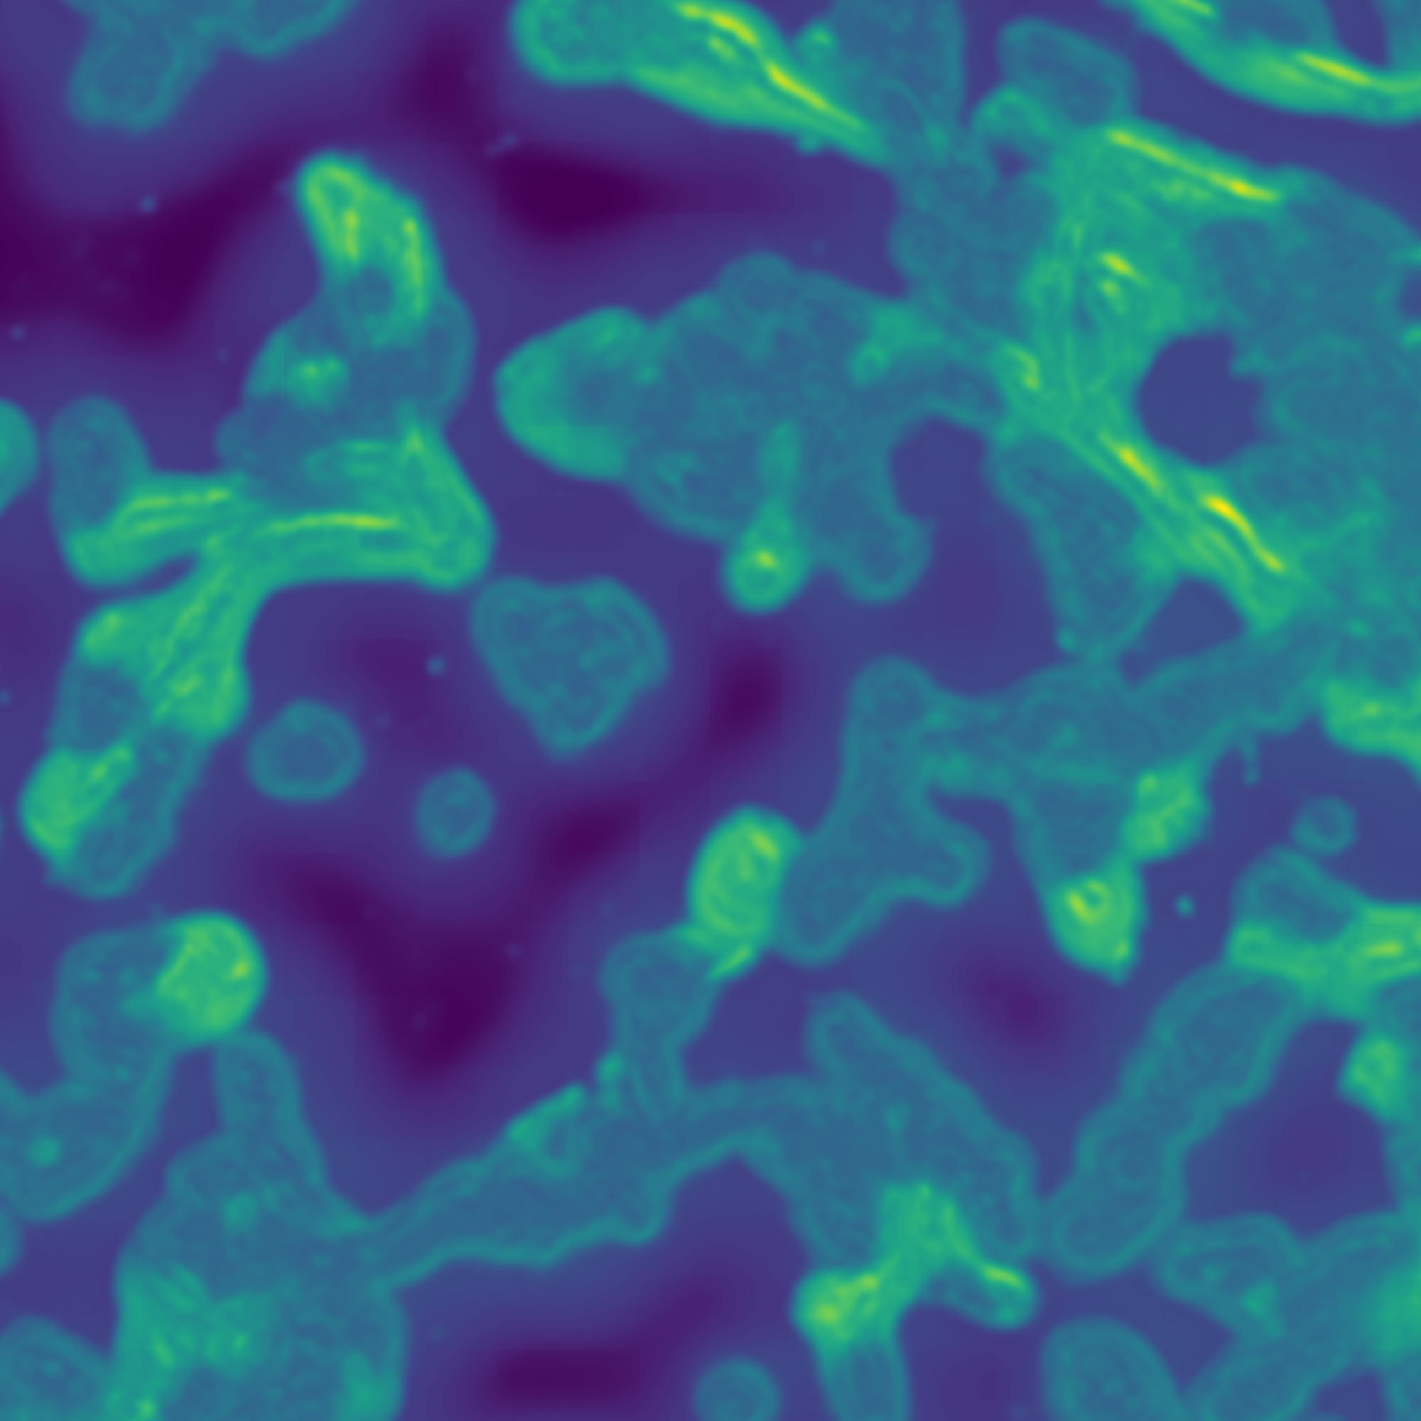
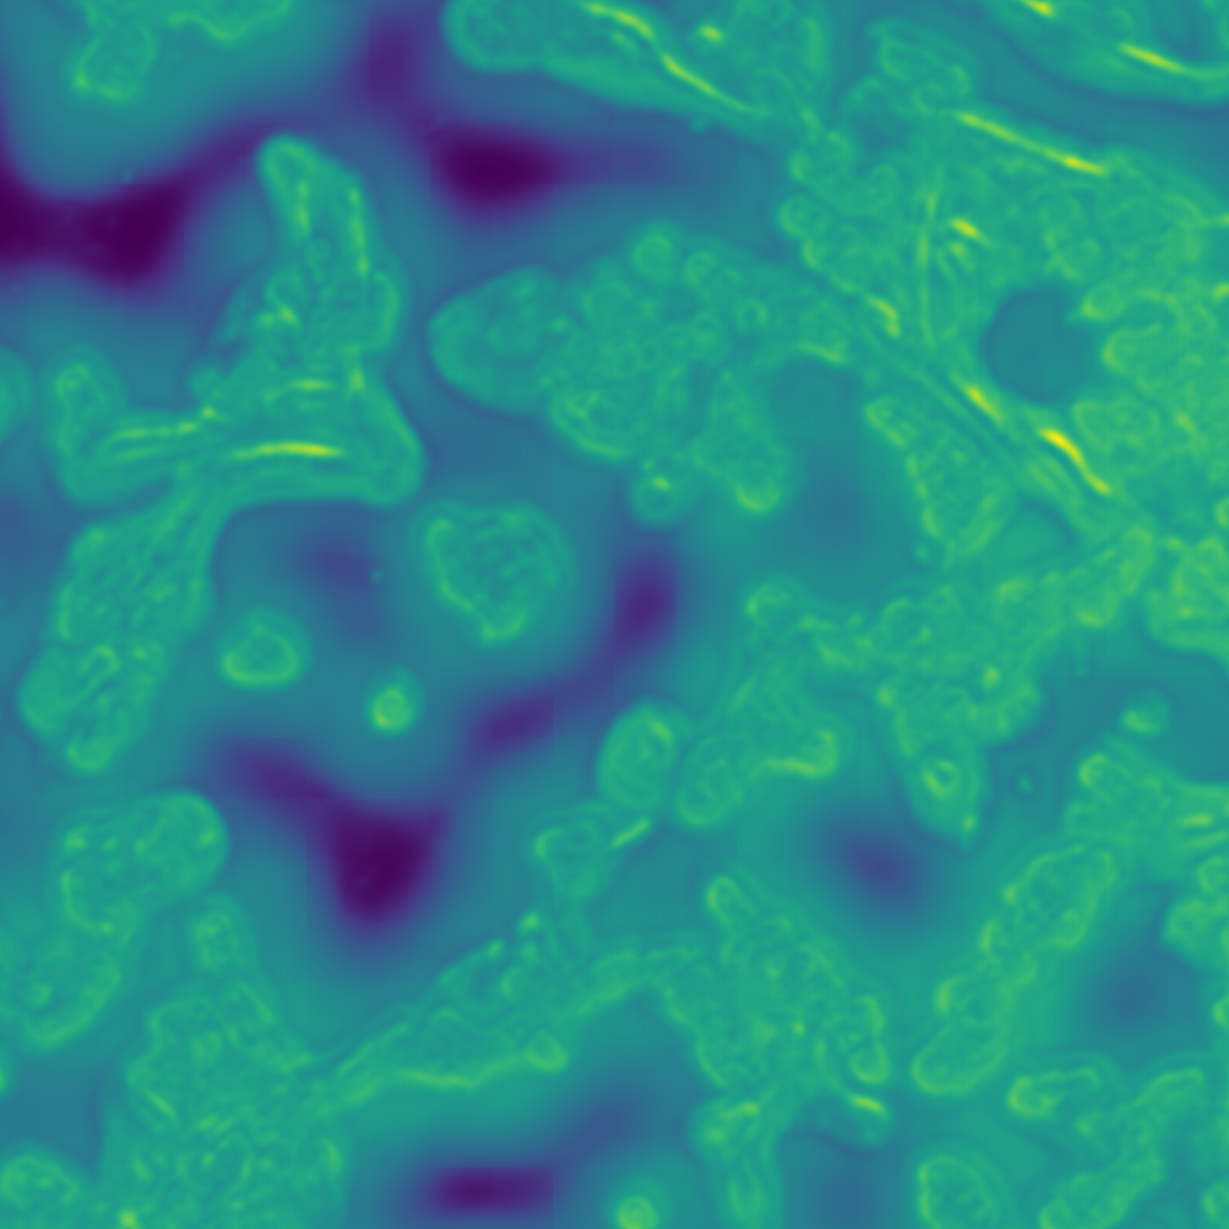
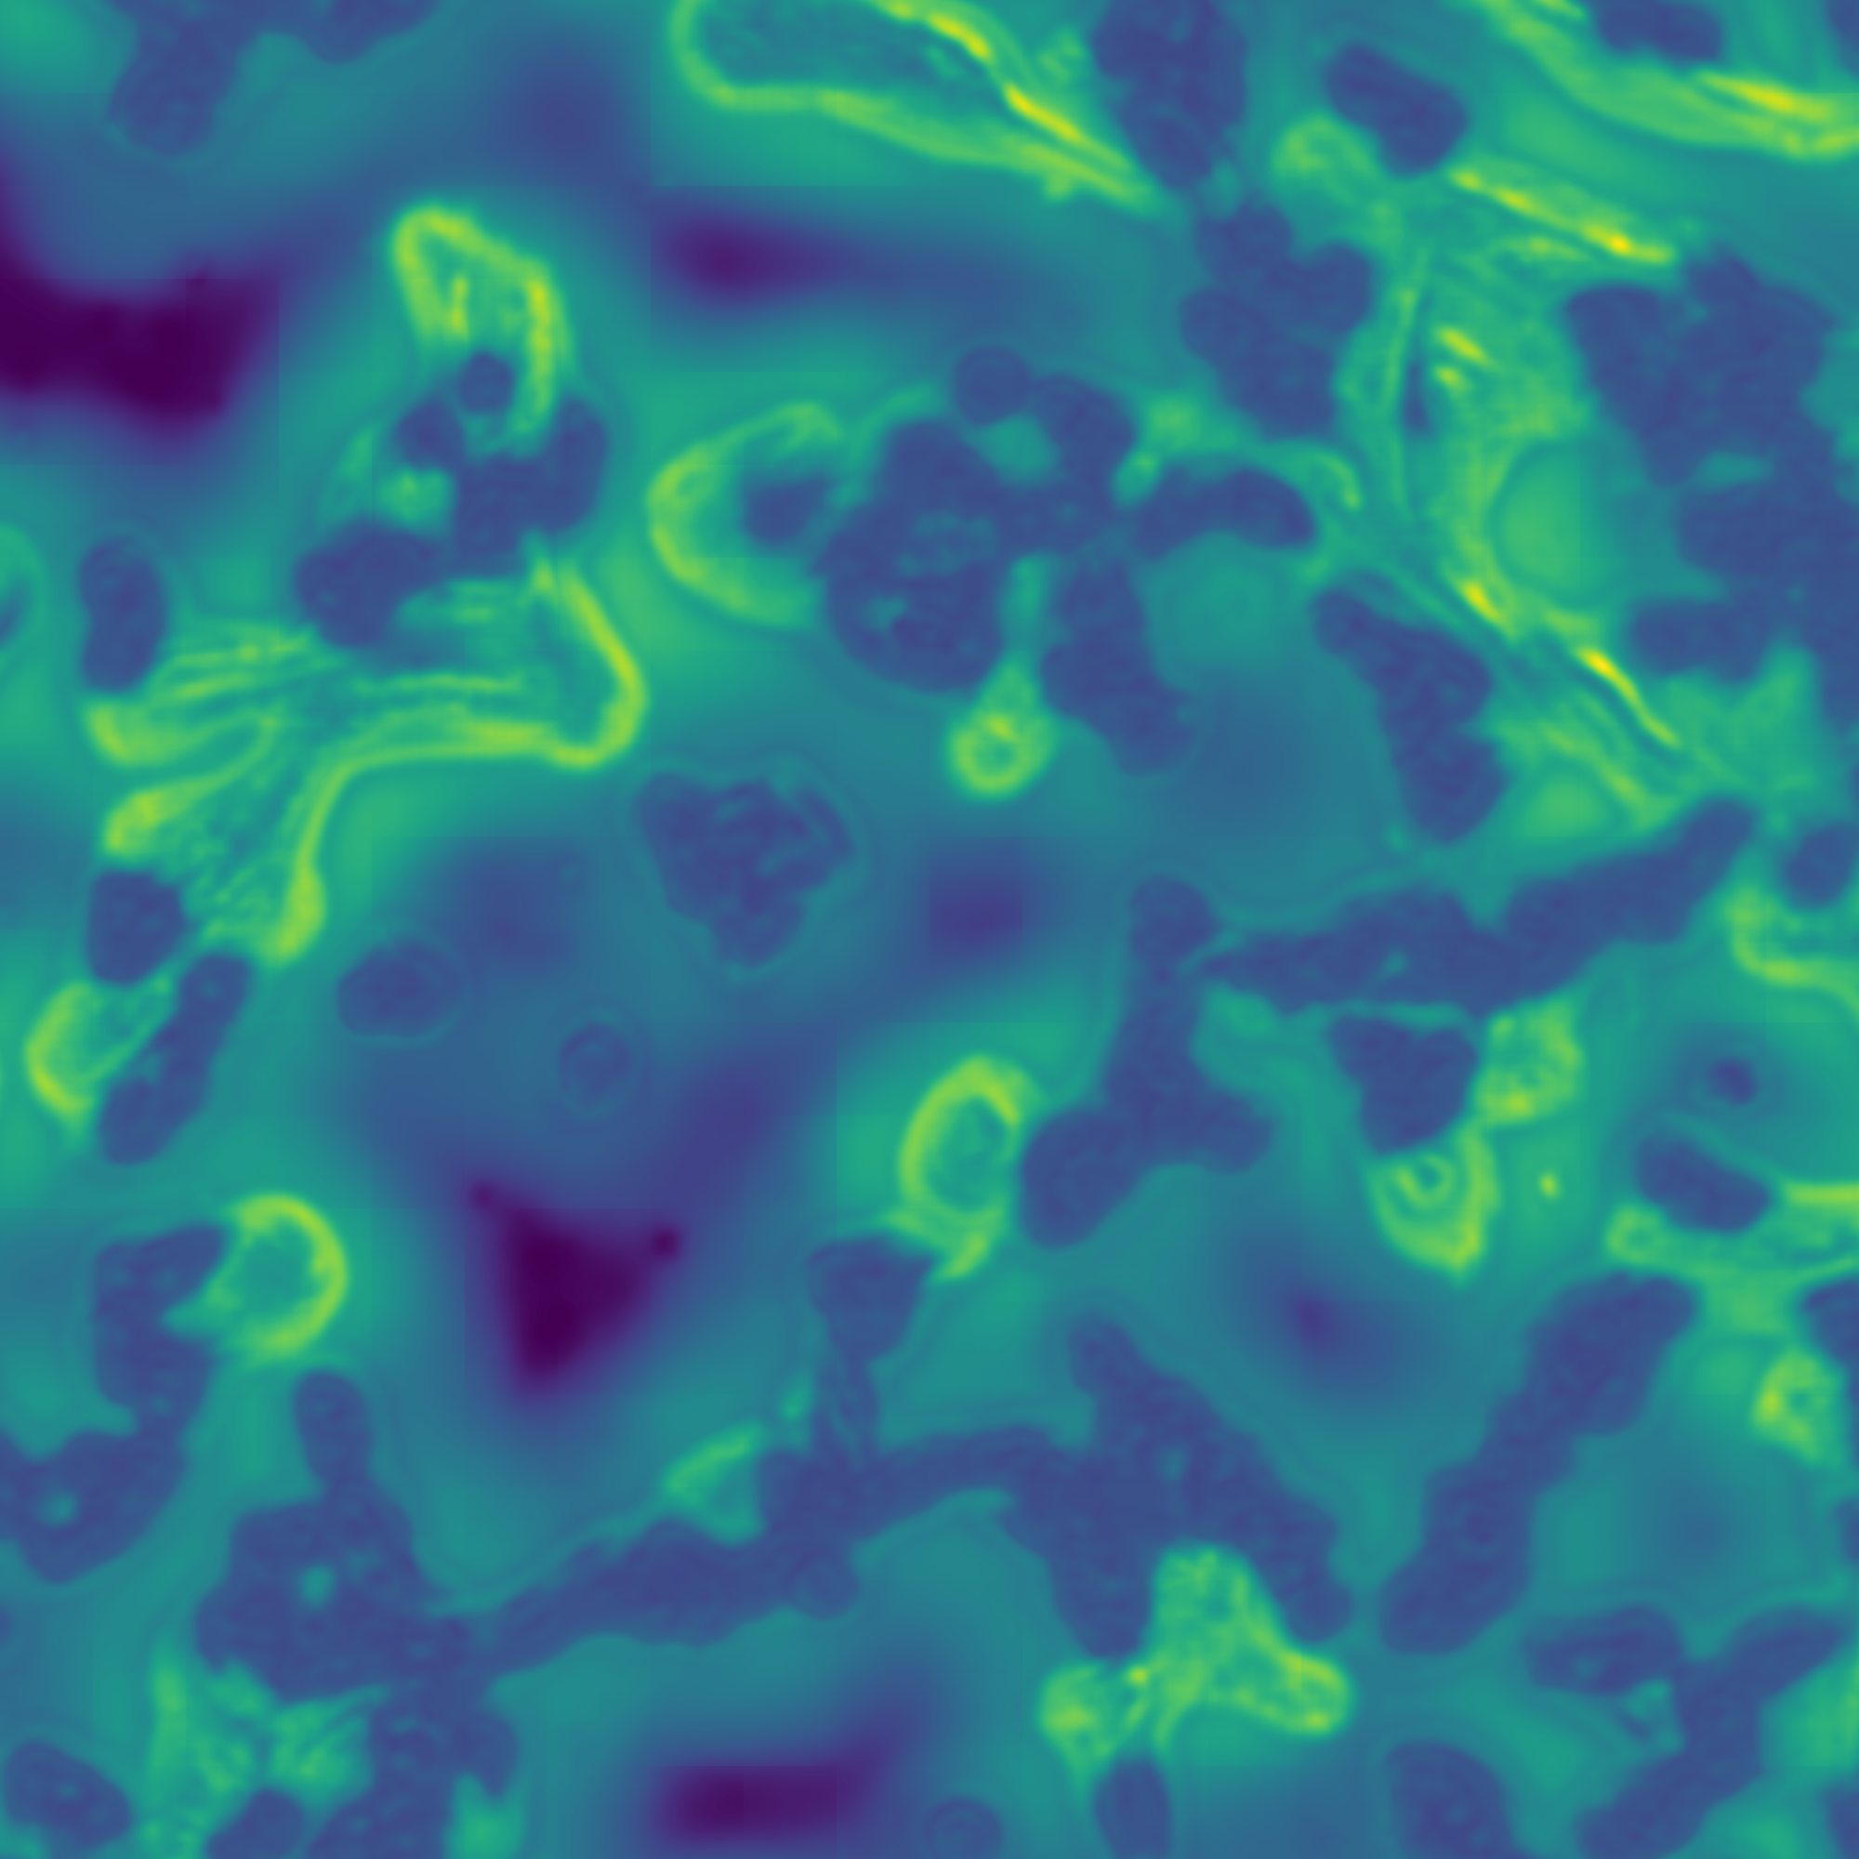
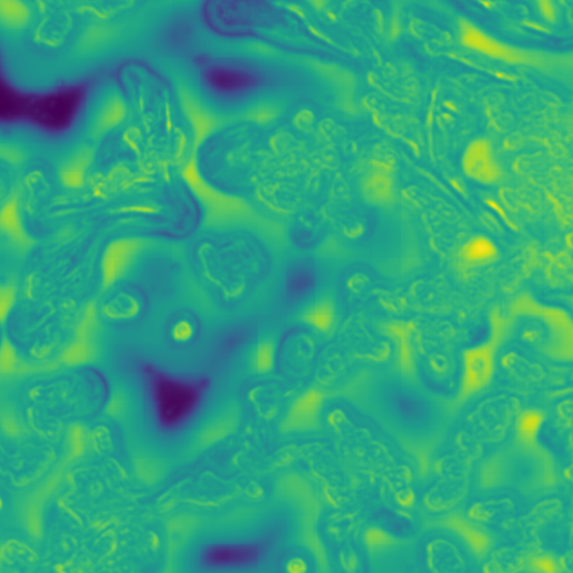
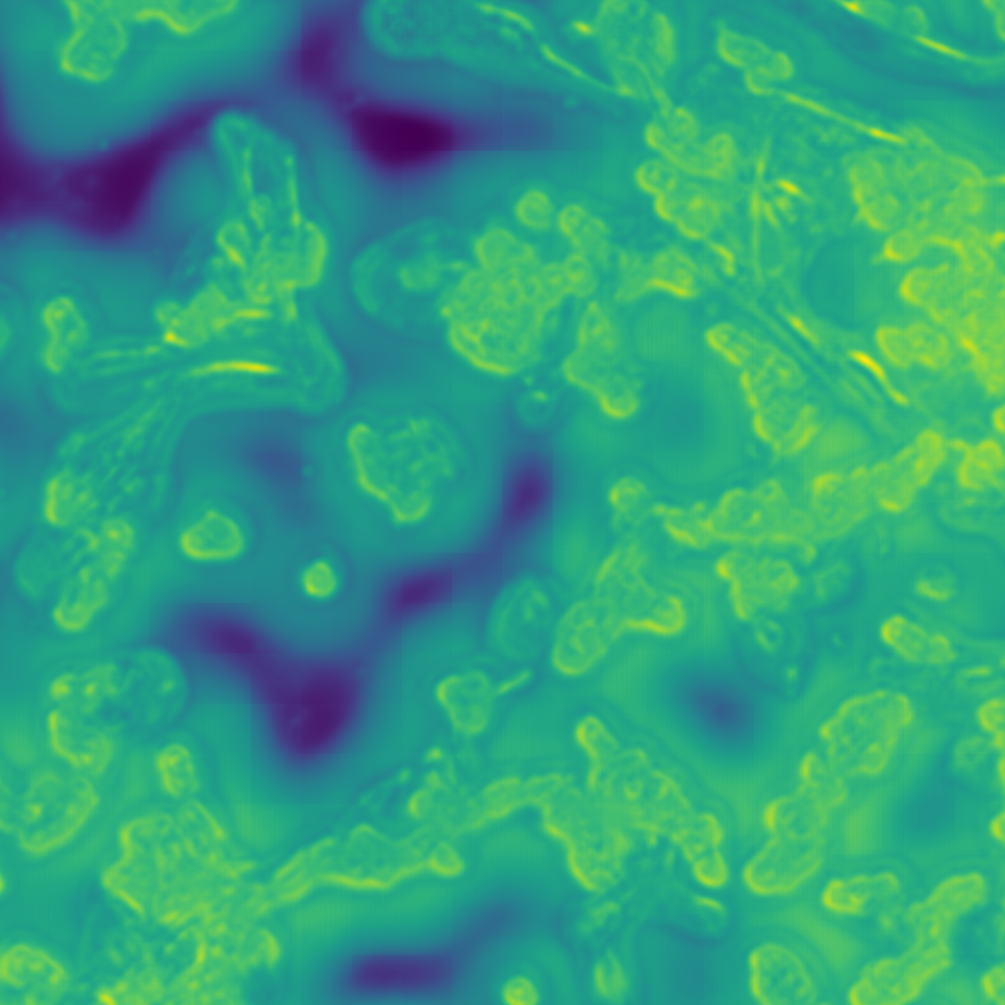
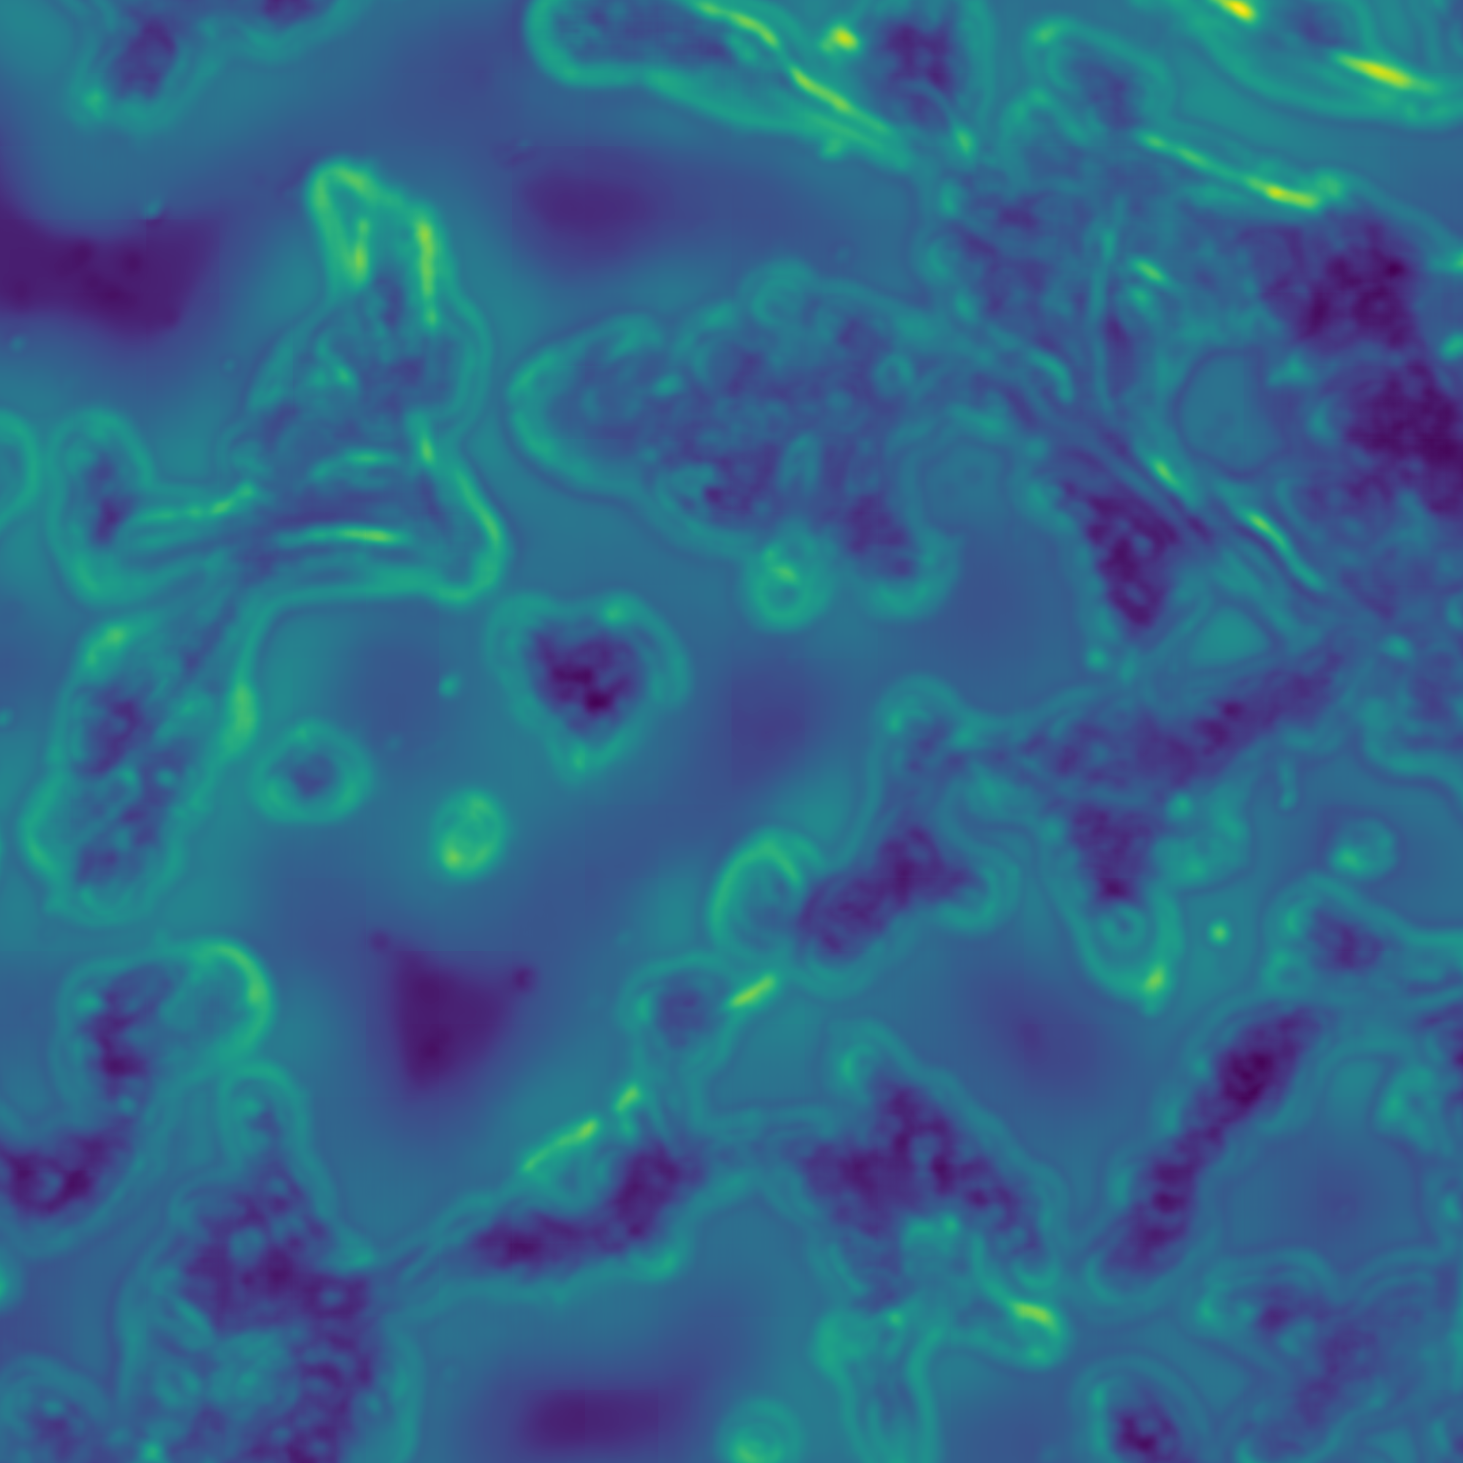
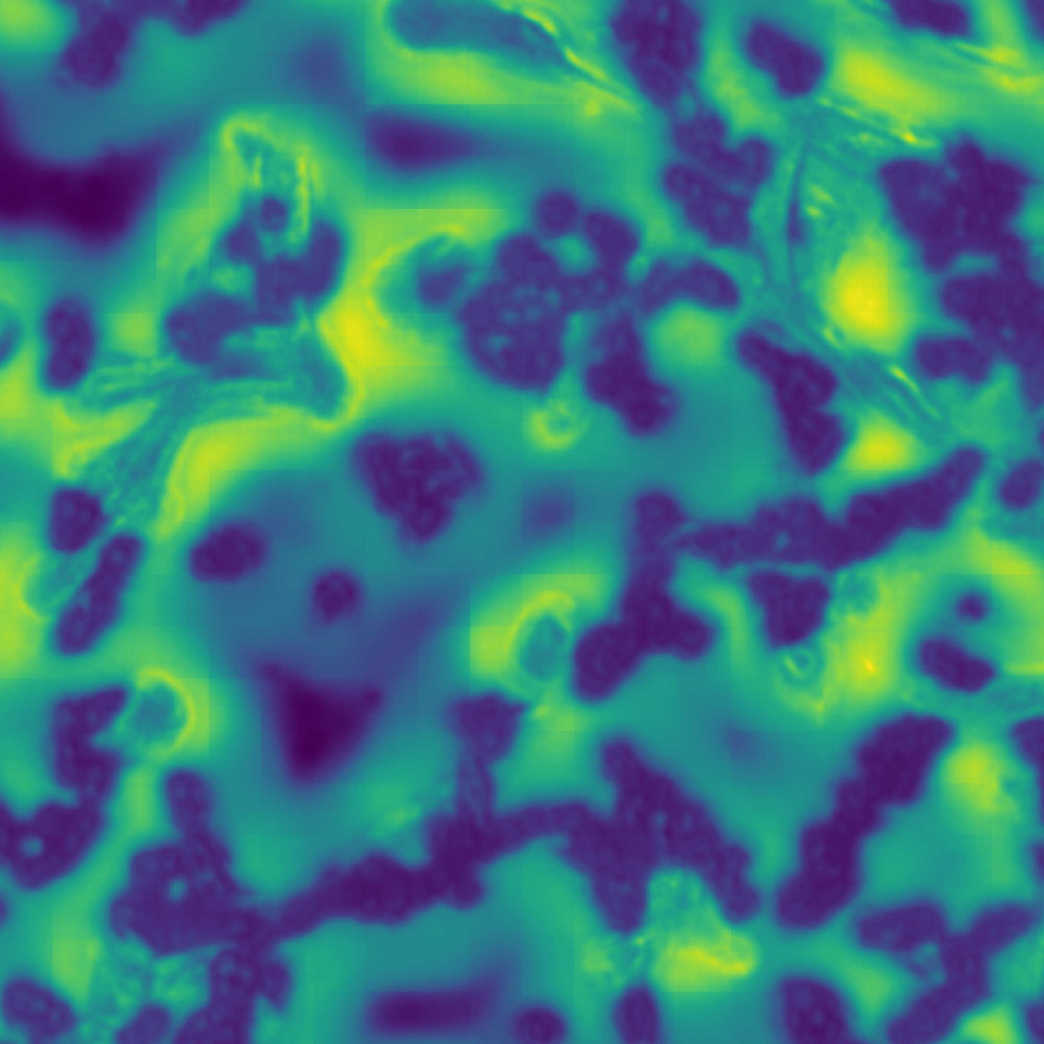
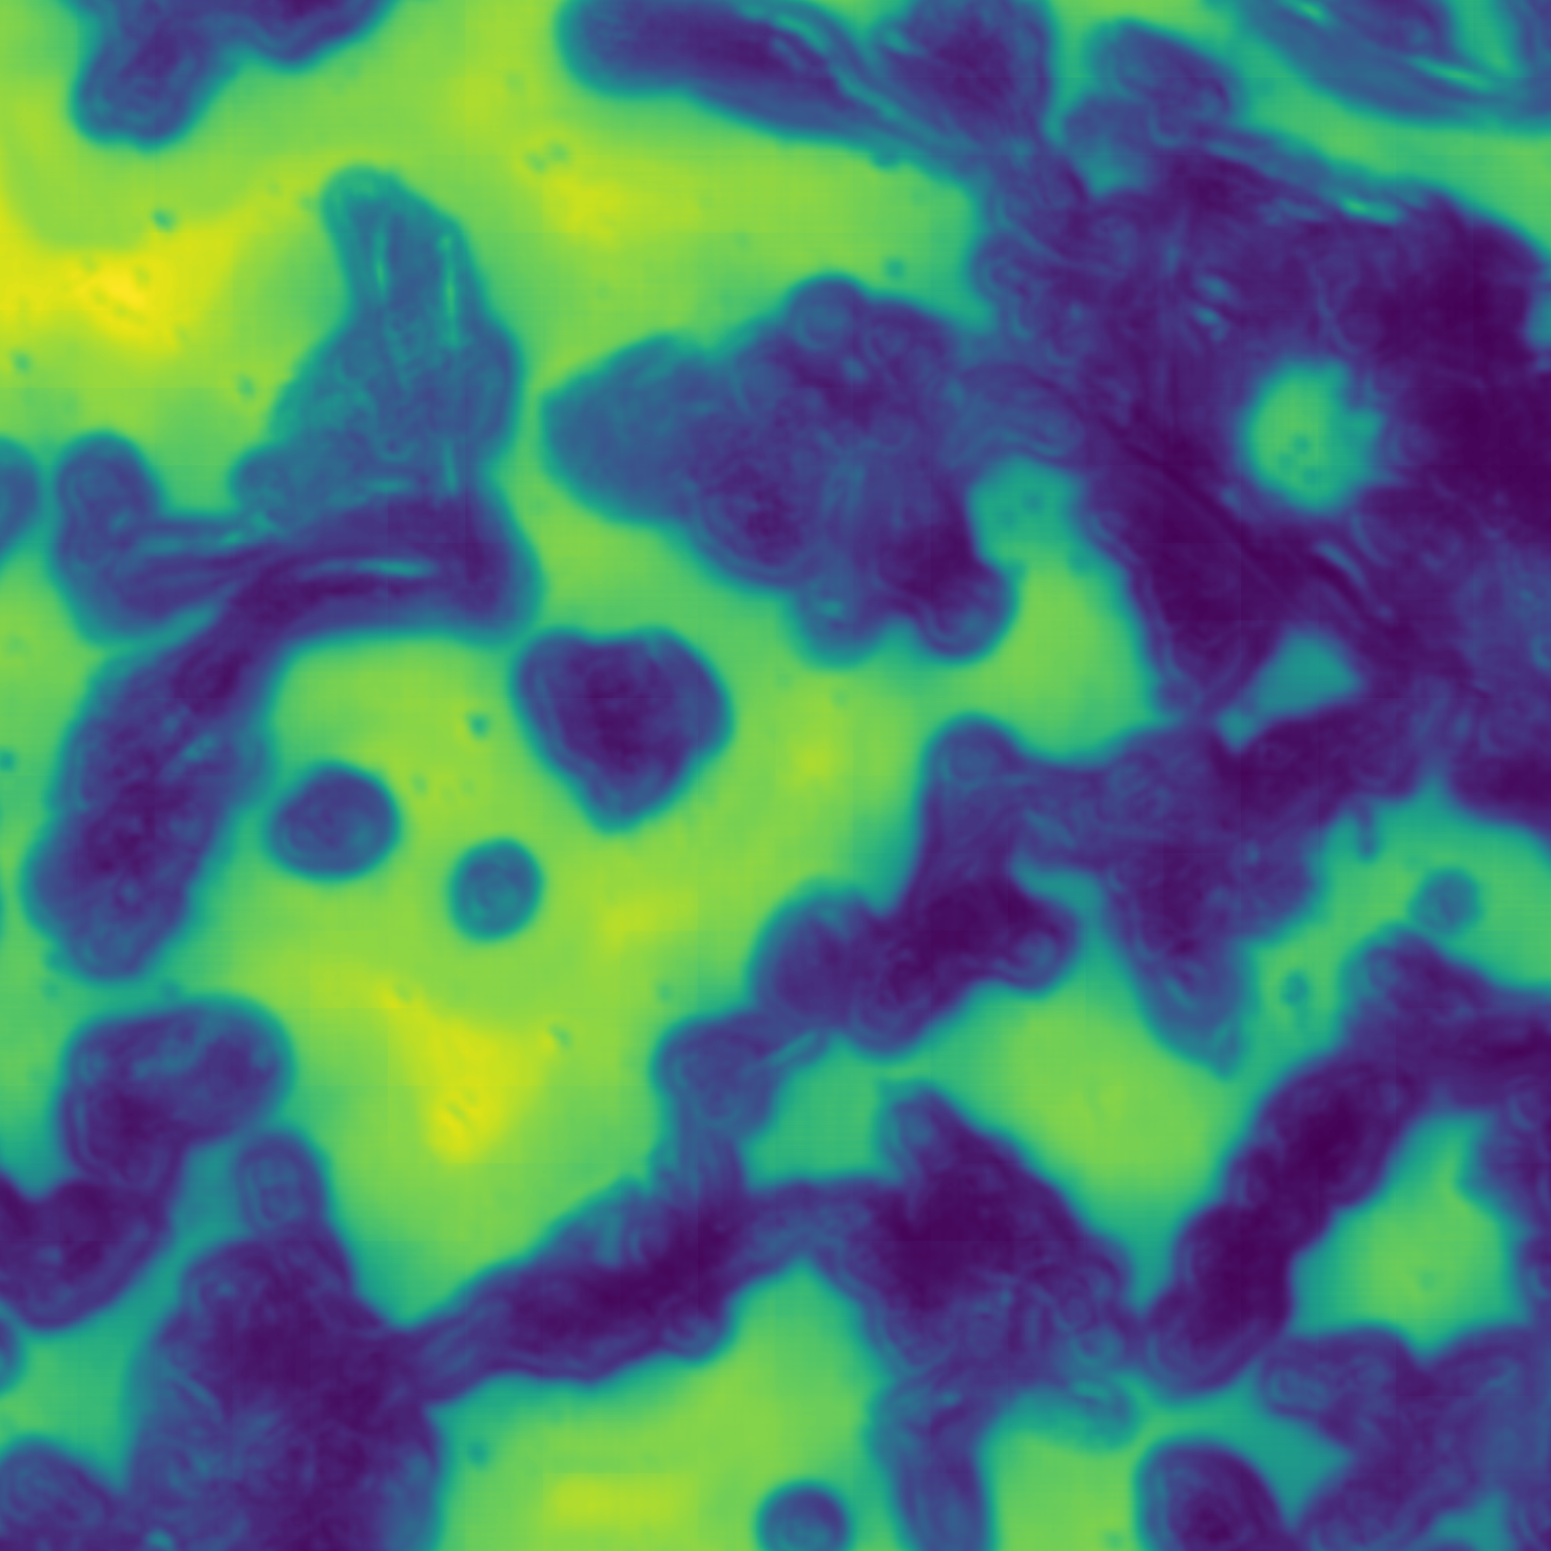
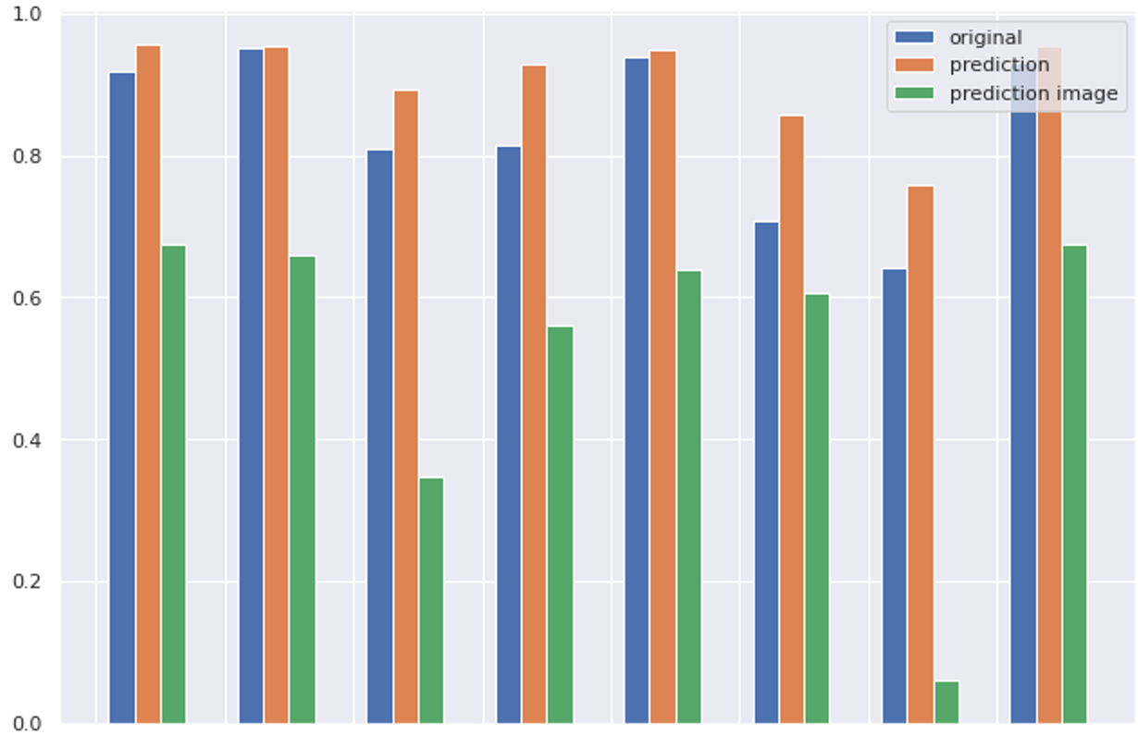
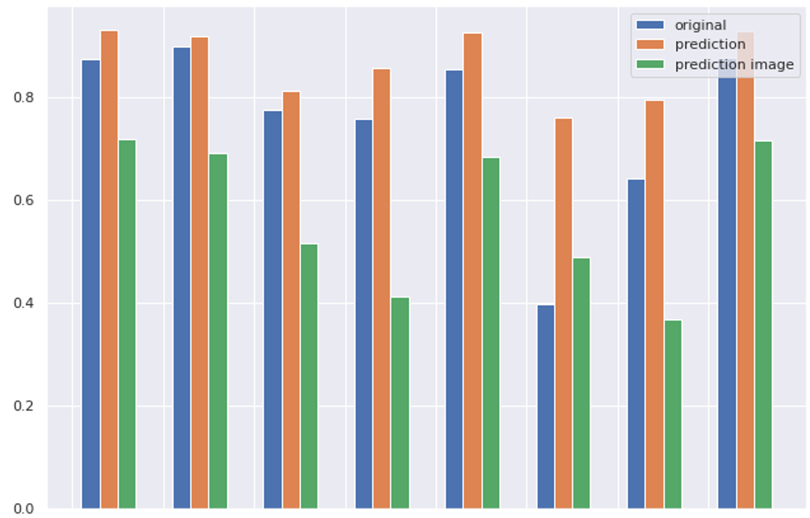
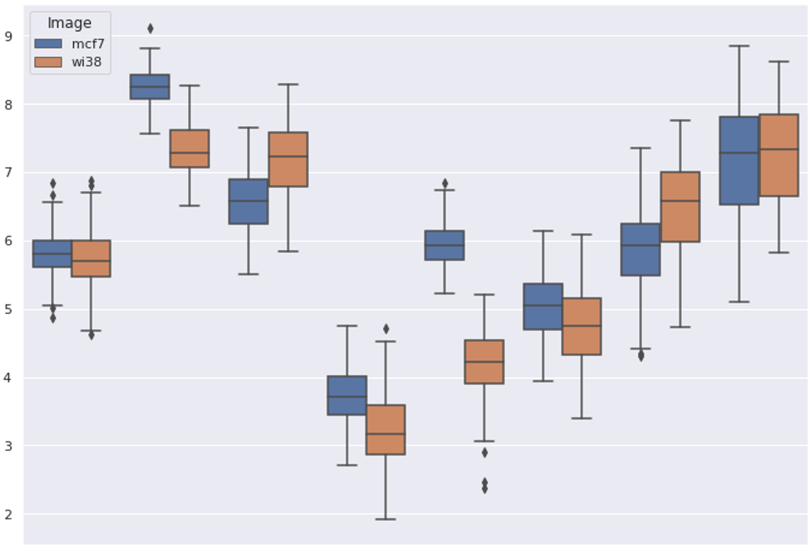
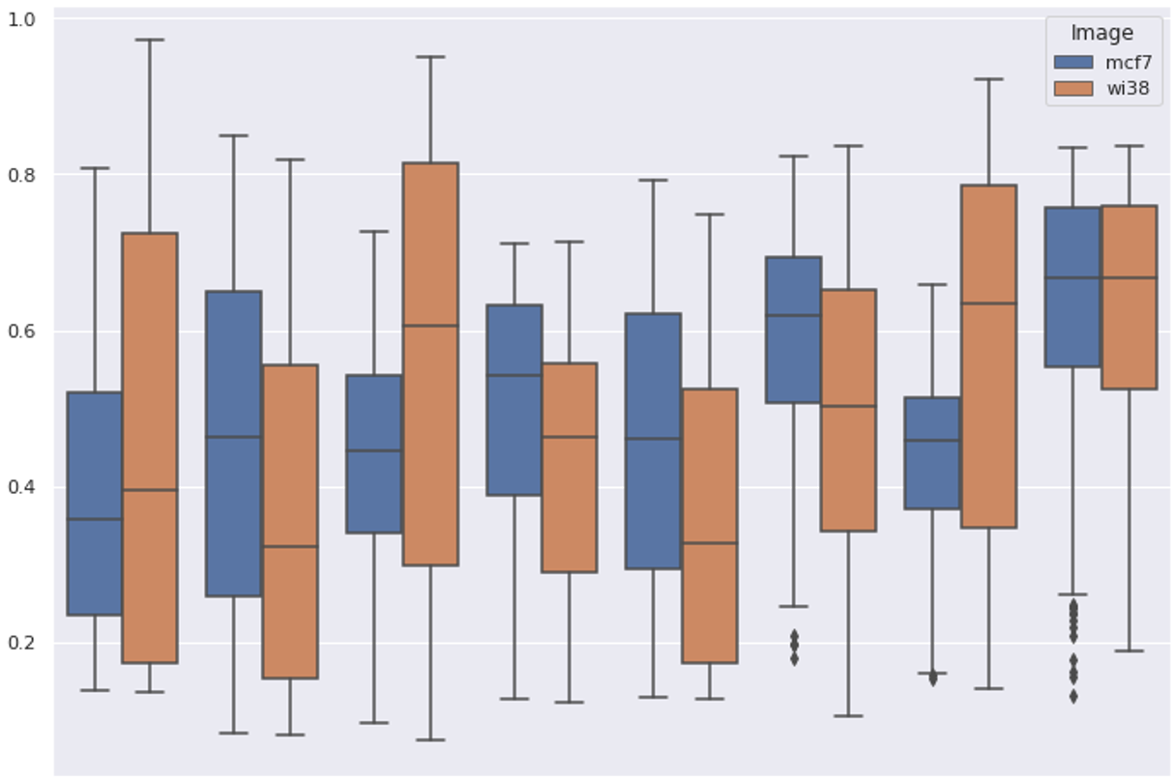
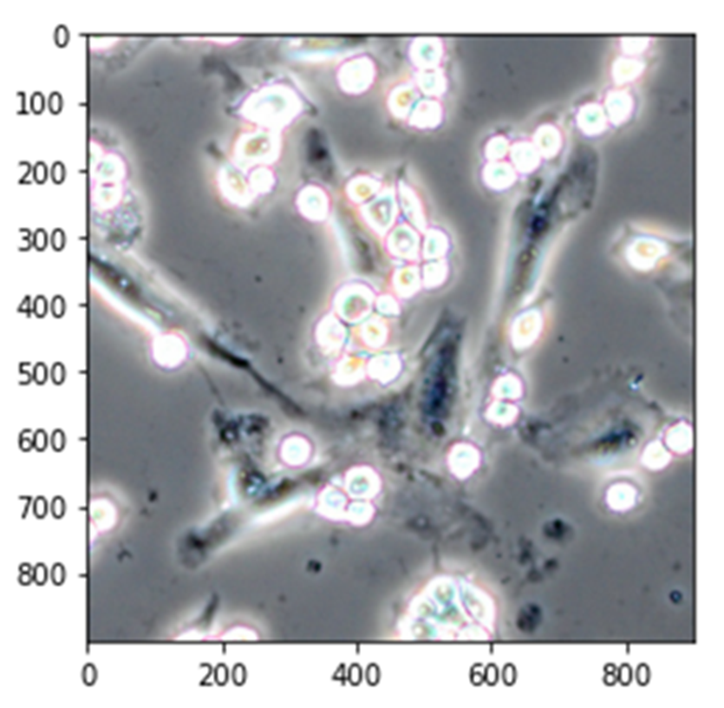
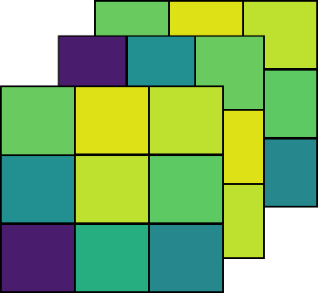
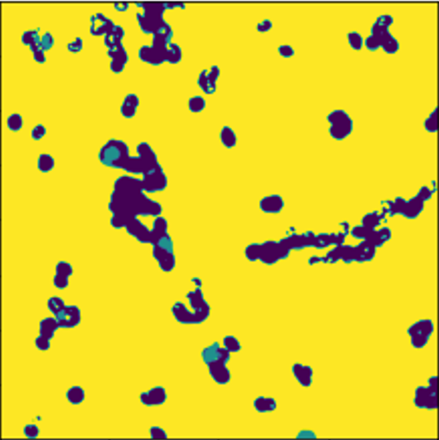
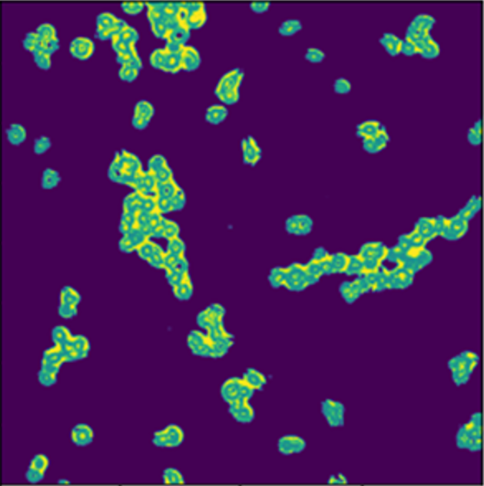
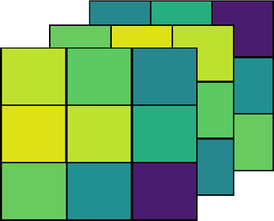
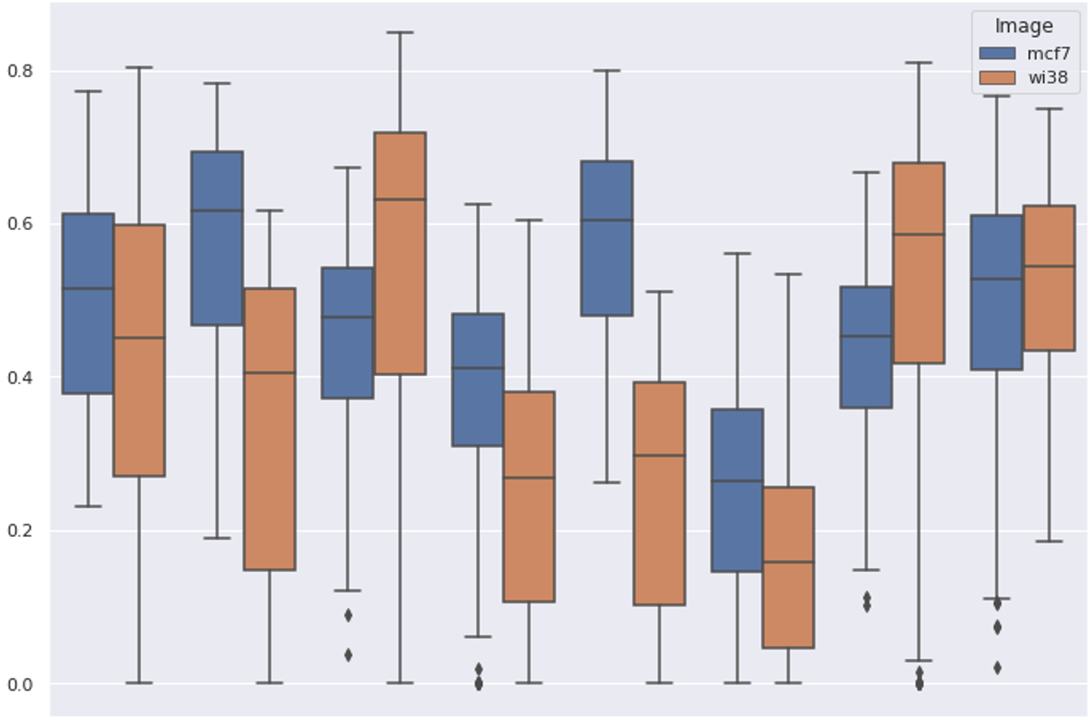
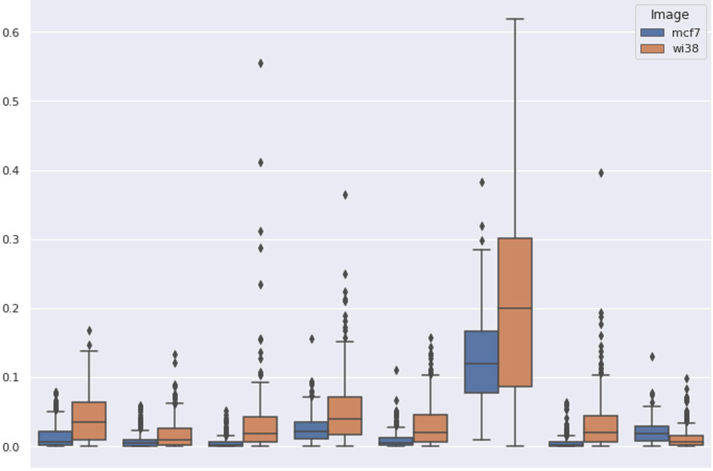
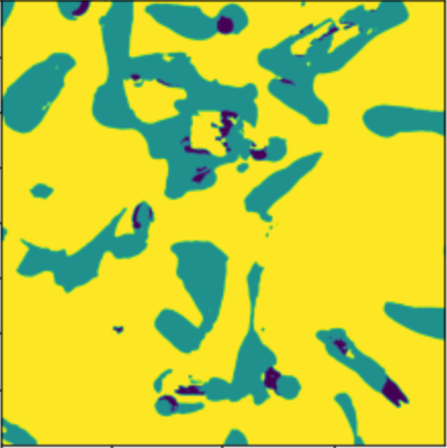
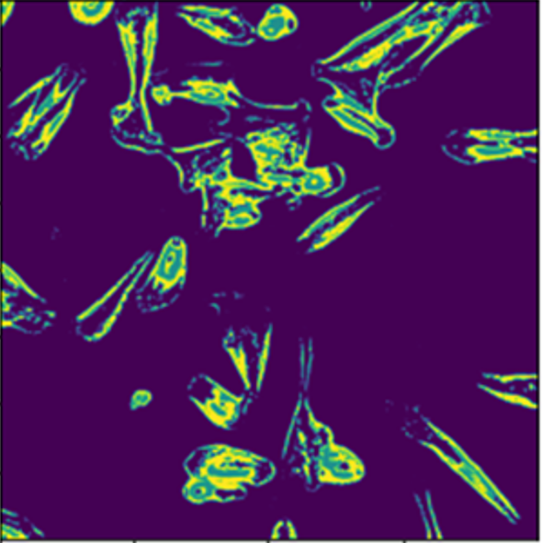
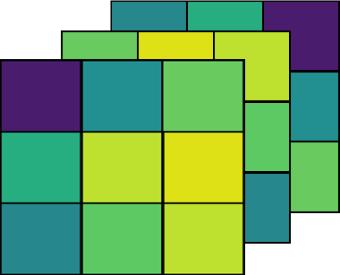
Application of deep learning for linking microscope image features to ionic signal distribution
Raphaël La Rocca¹; Virginie Bertrand¹; Eppe Gauthier¹; Edwin De Pauw¹; Loïc Quinton¹
¹Mass Spectrometry Laboratory, MolSys Research Unit, Department of Chemistry, University of Liège, Liège, Belgium
Contact: raphael.larocca@uliege.be
1) Motivation
4) Fusion Method
6) Predicted Fused Image
Goal
The full microscope image is parsed in small images of 300 µm represented by 192x192 pixels with 3 color channels.
The mass spectrum associated to the parsed microscope image by registration is composed of 8 ions to simplify data interpretation.
PC
[C46H84NO8P + H]⁺ 810.6016 m/z
PC
[C44H80NO8P + H]⁺ 782.5698 m/z
SM
[C41H77N2O6P + H]⁺ 725.5600 m/z
PE
[C29H50NO8P + H]⁺ 572.3343 m/z
PA
[C43H73O8P + H]⁺ 749.5124 m/z
PS
[C37H66NO9P + H]⁺
700.4548 m/z
CerP
[C38H68NO6P + H]⁺ 666.4858 m/z
HCCA
2HCCA H2Na+
High spatial resolution of mass spectrometry imaging is difficult to obtain as it is time consuming and the reduction of ionized matter reduces the sensitivity.
Image fusion can increase artificially the spatial resolution of mass spectrometry images when combined with image modalities of a higher spatial resolution.
Fusion method with predictive capabilities are rare and also dependent on multiple image preprocessing.
Deep learning methods have shown to be more robust for image analysis by avoiding any image preprocessing.
MCF-7
WI-38
2) Goal
Input
Prediction
MCF-7 & WI-38
Correlation of cell monoculture annotations with detected signal
MCF-7
WI-38
m/z
Microscope image
Mass spectrometry image
with a high spatial resolution
5) Predicted signal comparison
Original signal
Absolute correlation
Absolute correlation
Predicted signal
Original mass signal
Predicted mass signal
Predicted image
3) Challenge
a) Log of raw signal
c) Standardized signal
Training on a mixed cell deposit of WI-38 and MCF-7 cells.
Signal
Signal
PC(1)
PC(2)
SM
PE
PA
PS
CerP
HCCA
PC(1)
PC(2)
SM
PE
PA
PS
CerP
HCCA
300 µm
7) Unsupervised Cells segmentation
8) Conclusion
300 µm
MODEL
Microscope
image
Fused image Segmentation
Microscope image
Segmentation
K-means segmentation with 3 clusters.
Clustering applied on monocultures.
Target classes: background, WI-38 cells and MCF-7 cells
Balanced accuracy:
Microscopic image: 0.56
Predicted fused image: 0.76
U-net architecture is modified to fused microscopy and mass spectrometry images.
Estimate the lipid composition of cells by increasing the spatial resolution from 100 µm to 1.5 µm.
The cause of mass signal has to visible in the microscopic image.
Detect/annotate cell types directly from a microscope image with a trained model.
m/z
PE
PA
PS
MCF-7
PC(1)
PC(2)
SM
PE
PA
PS
CerP
HCCA
PC(1)
PC(2)
SM
CerP
HCCA
WI-38
Testing on monocultures of WI-38 and MCF-7 cells separately.
b) Standardized signal
d) Mean square error between b) and c)
MCF-7
MCF-7
MODEL
Signal
MSE
WI-38
MODEL
WI-38
Acknowledgments
PC(1)
PC(2)
SM
PE
PA
PS
CerP
HCCA
PE(1)
PC
SM
PE(2)
PA
PS
CerP
HCCA
We thank the F.R.S. FRNS, EOS project Rhizoclip (grant number 30650620), the Interreg – Euregio MeuseRhin EurLipids project, and the EU_FT-ICR_MS H2020 project for financial support.
PC(1)
PC(2)
SM
PE
PA
PS
CerP
HCCA

