Slide 1
A Cartesian discontinuous Galerkin solver
with immersed boundaries
Nayan Levaux, A. Bilocq, P. Schrooyen, V. Terrapon, K. Hillewaert

Slide 2
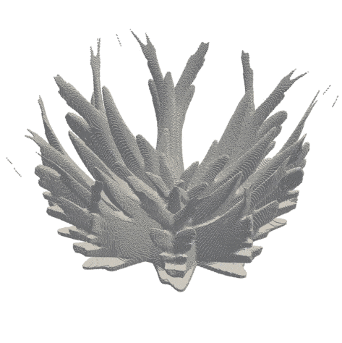
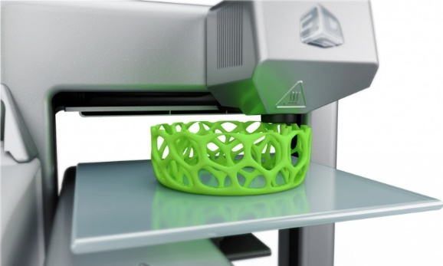
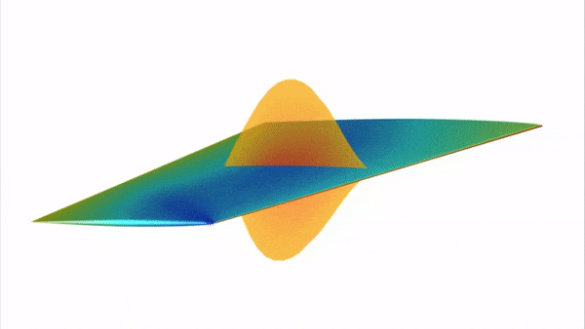
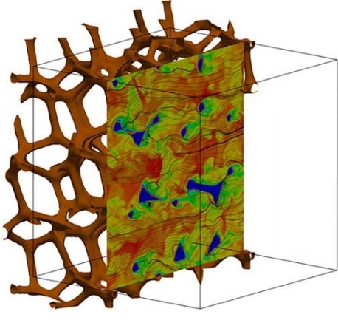
Motivation
Additive manufacturing
Topology optimization
Complex / evolving
geometry
[Alexandersen, 2016]
Fluid-solid interactions
Conjugate heat transfer
Multiphysics
[Thomas, 2019]
[Das, 2018]
High resolution
[Frère, 2015]

Slide 3
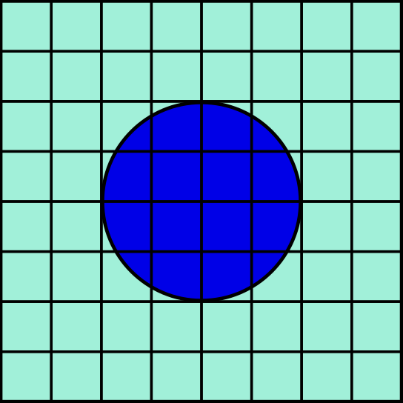
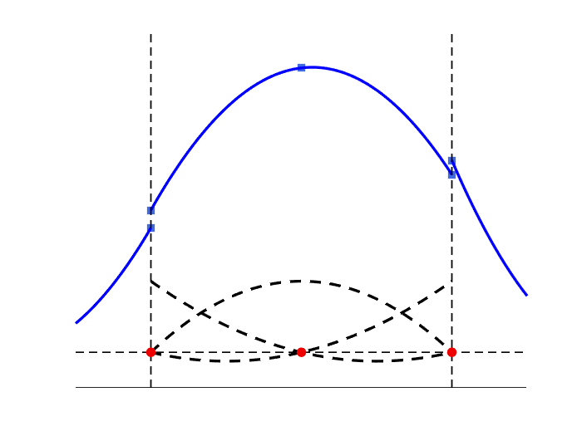
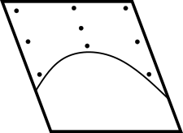
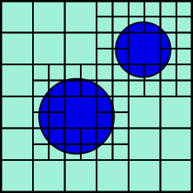
Towards high accuracy immersed
How to tackle lack of accuracy?
Cut-cell
Solid
Solid
Fluid
High-order DG
on cartesian grid
High-order
cut-cells
Immersed approach
Simple mesh generation
Numerical errors at interface
Lack of resolution near interfaces
Adaptive mesh refinement
Adaptive mesh refinement

Slide 4
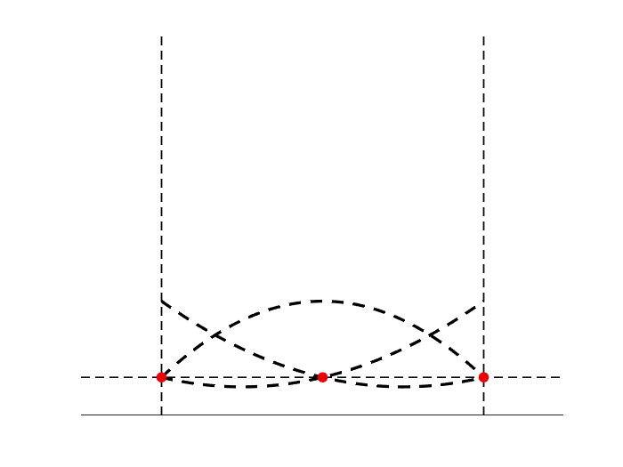
What is discontinuous Galerkin?
$$e$$
$$v_{1}^{e}$$
$$v_{2}^{e}$$
$$v_{3}^{e}$$
1
0
$$u^{e}\left(x\right)=\sum_{i=0}^{p}{u_{i}^{e}v_{i}^{e}(x)}$$

Slide 5
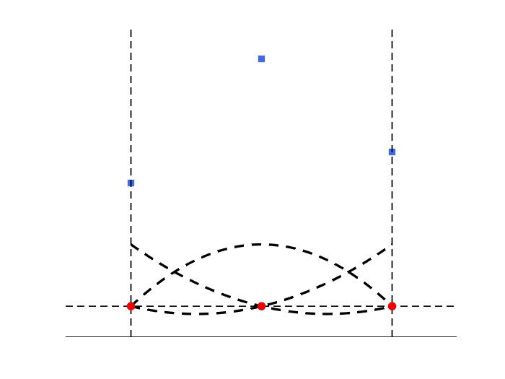
What is discontinuous Galerkin?
$$e$$
$$u_{2}^{e}$$
$$u_{3}^{e}$$
$$u_{1}^{e}$$
$$v_{1}^{e}$$
$$v_{2}^{e}$$
$$v_{3}^{e}$$
1
0
$$u^{e}\left(x\right)=\sum_{i=0}^{p}{u_{i}^{e}v_{i}^{e}(x)}$$

Slide 6
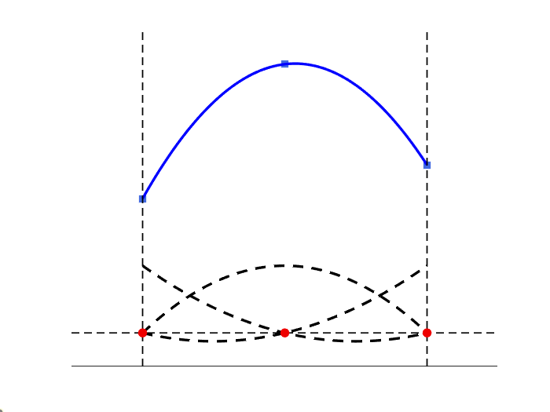
What is discontinuous Galerkin?
$$e$$
$$v_{1}^{e}$$
$$v_{2}^{e}$$
$$v_{3}^{e}$$
1
0
$$u^{e}\left(x\right)=\sum_{i=0}^{p}{u_{i}^{e}v_{i}^{e}(x)}$$
Continuous within volume

Slide 7
What is discontinuous Galerkin?
$$e$$
Discontinuities
$$v_{1}^{e}$$
$$v_{2}^{e}$$
$$v_{3}^{e}$$
1
0
$$u^{e}\left(x\right)=\sum_{i=0}^{p}{u_{i}^{e}v_{i}^{e}(x)}$$
Continuous within volume
Doubling of DOF at interface
Locality
$≠$ classical FEM

Slide 8
What is discontinuous Galerkin?
$$e$$
$$\sum_{e}{\left(\int_{e}{v_{i}^{e}\frac{∂u^{e}}{∂t}dV}−\int_{e}{∇v_{i}^{e}∙{\vec{g}}^{e}dV+}\sum_{f∈∂e}{\int_{f}{γ^{e}dS}}\right)}=0, ∀ v_{i}^{e}$$
Discontinuities
$$v_{1}^{e}$$
$$v_{2}^{e}$$
$$v_{3}^{e}$$
1
Classical FEM
0
$$u^{e}\left(x\right)=\sum_{i=0}^{p}{u_{i}^{e}v_{i}^{e}(x)}$$
Continuous within volume
Doubling of DOF at interface
Locality

Slide 9
What is discontinuous Galerkin?
$$e$$
$$\sum_{e}{\left(\int_{e}{v_{i}^{e}\frac{∂u^{e}}{∂t}dV}−\int_{e}{∇v_{i}^{e}∙{\vec{g}}^{e}dV+}\sum_{f∈∂e}{\int_{f}{γ^{e}dS}}\right)}=0, ∀ v_{i}^{e}$$
Discontinuities
$$v_{1}^{e}$$
$$v_{2}^{e}$$
$$v_{3}^{e}$$
1
Appropriate numerical flux
0
$$γ=γ^{conv}+γ^{diff}$$
Connect elements
Weakly impose BCs
$$u^{e}\left(x\right)=\sum_{i=0}^{p}{u_{i}^{e}v_{i}^{e}(x)}$$
Continuous within volume
Doubling of DOF at interface
Locality

Slide 10
What is discontinuous Galerkin?
$$e$$
$$\sum_{e}{\left(\int_{e}{v_{i}^{e}\frac{∂u^{e}}{∂t}dV}−\int_{e}{∇v_{i}^{e}∙{\vec{g}}^{e}dV+}\sum_{f∈∂e}{\int_{f}{γ^{e}dS}}\right)}=0, ∀ v_{i}^{e}$$
Discontinuities
$$v_{2}^{e}$$
Quadrature rule
Solution expansion
$$v_{1}^{e}$$
$$v_{3}^{e}$$
1
0
Semi-discretized eqn.
$$u^{e}\left(x\right)=\sum_{i=0}^{p}{u_{i}^{e}v_{i}^{e}(x)}$$
$$\frac{∂u_{i}^{e}}{∂t}=M^{−1}R$$
Continuous within volume
Doubling of DOF at interface
Locality

Slide 11
Residual computation
$$\int_{e}{∇v∙\vec{g}dV}≈\sum_{q=0}^{n}{w_{q}∇v(x_{q})∙\vec{g}(u_{q},{∇u}_{q},x_{q})}\left|𝒥\right|$$
Collocation
Flux computations
Redistribution/Integration
Inverse mass matrix
Advance in time

Slide 12
Residual computation
$$\int_{e}{∇v∙\vec{g}dV}≈\sum_{q=0}^{n}{w_{q}∇v(x_{q})∙\vec{g}(u_{q},{∇u}_{q},x_{q})}\left|𝒥\right|$$
Redistribution/Integration
Collocation
Flux computations
Redistribution/Integration
Inverse mass matrix
Advance in time

Slide 13
Residual computation
Collocation
Flux computations
Redistribution/Integration
Inverse mass matrix
Advance in time
$$\int_{e}{∇v∙\vec{g}dV}≈\sum_{q=0}^{n}{w_{q}∇v (x_{q})∙\vec{g}(u_{q},{∇u}_{q},x_{q})\left|𝒥\right|}$$
Redistribution/Integration

Slide 14
Residual computation
Collocation
Flux computations
Redistribution/Integration
Inverse mass matrix
Advance in time
$$\int_{e}{∇v∙\vec{g}dV}≈\sum_{q=0}^{n}{w_{q}∇v (x_{q})∙\vec{g} (u_{q},{∇u}_{q},x_{q})}\left|𝒥\right|$$
Redistribution/Integration

Slide 15
Residual computation
Collocation
Flux computations
Redistribution/Integration
Inverse mass matrix
Advance in time
Semi-discretized eqn.
For volume and interfaces
$$\frac{∂u_{i}^{e}}{∂t}=M^{−1}R$$

Slide 16
Residual computation
Collocation
Flux computations
Redistribution/Integration
Inverse mass matrix
Advance in time
Semi-discretized eqn.
$$\frac{∂u_{i}^{e}}{∂t}=M^{−1}R$$
Redistribution/Integration
Same element mass matrix for all domain

Slide 17
Residual computation
Collocation
Flux computations
Redistribution/Integration
Inverse mass matrix
Advance in time
Semi-discretized eqn.
$$\frac{∂u_{i}^{e}}{∂t}=M^{−1}R$$
Redistribution/Integration
High-order explicit/implicit time scheme

Slide 18
Implementation optimization
Data-structures
Grouping elements sharing same operations
Matrix-matrix multiplications
Efficient implementation
Collocation
$$u^{e}\left(x_{q}\right)=\sum_{i=0}^{p}{u_{i}^{e}v_{i}^{e}(x_{q})}$$
$$i$$
$$u^{e}(x_{q})$$
$$q$$
=
$$q$$
$$v_{i}^{e}(x_{q})$$
$$∙$$
$$i$$
$$u_{i}^{e}$$

Slide 19
Implementation optimization
Data-structures
Grouping elements sharing same operations
Matrix-matrix multiplications
Efficient implementation
Collocation
$$u^{e}\left(x_{q}\right)=\sum_{i=0}^{p}{u_{i}^{e}v_{i}^{e}(x_{q})}$$
$$e$$
$$i$$
$$e$$
=
$$∙$$
$$q$$
$$u^{e}(x_{q})$$
=
$$q$$
$$v_{i}^{e}(x_{q})$$
$$∙$$
$$i$$
$$u_{i}^{e}$$
$$i$$
Cartesian grid
Elements differ only by order
Sort by order and collocate all at once

Slide 20
Towards high accuracy immersed
How to tackle lack of accuracy?
Cut-cell
Solid
Solid
Fluid
High-order DG
on cartesian grid
High-order
cut-cells
Immersed approach
Simple mesh generation
Numerical errors at interface
Lack of resolution near interfaces
Adaptive mesh refinement
Adaptive mesh refinement

Slide 21
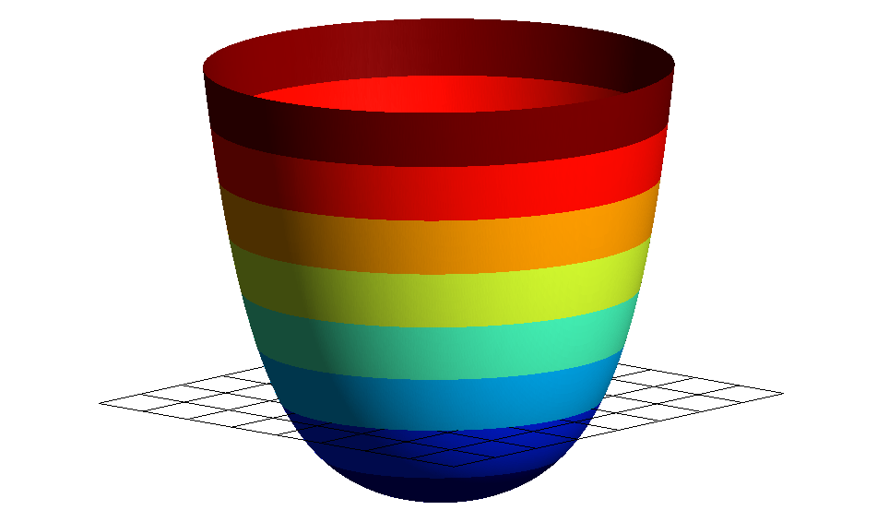
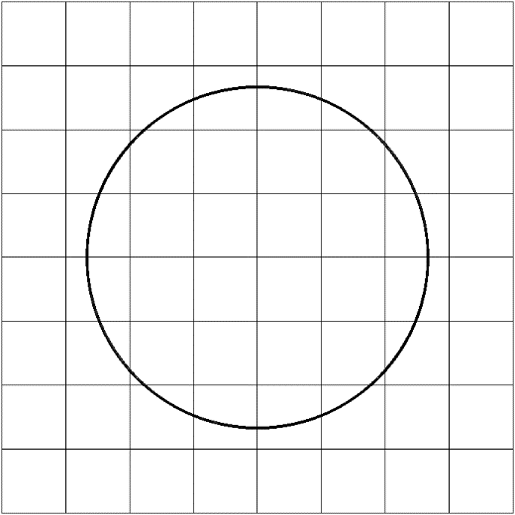
Geometry in Cartesian grid
Level-set
Where are we with respect to geometry limit?
$$φ<0$$
$$φ>0$$
0
Analytical level-set
Signed distance field
…
Project level-set onto Bernstein functional basis

Slide 22
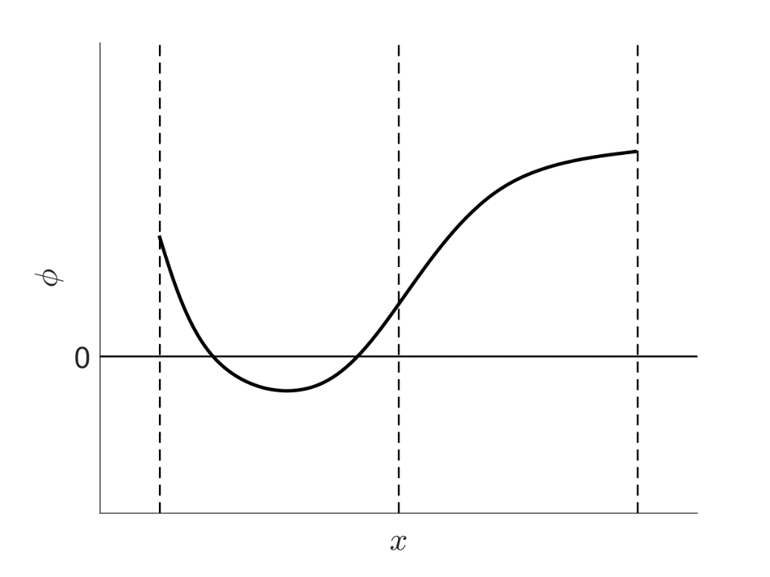
Cut-cell identification
Detect change of sign of $φ$
$$e$$
$$e+1$$
[Johnen, 2012]

Slide 23
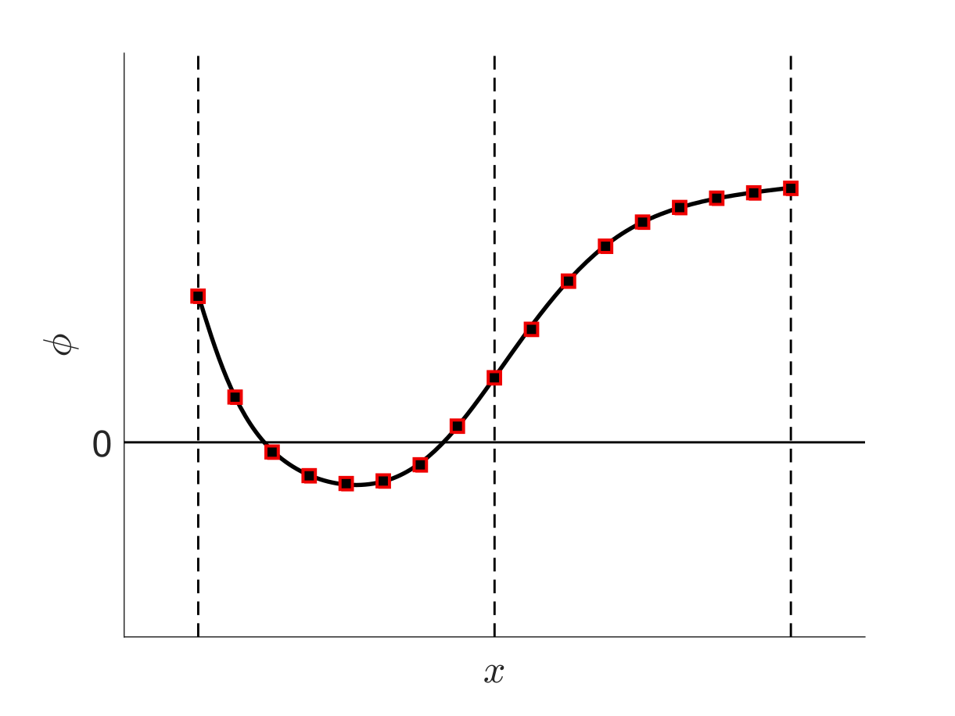
Cut-cell identification
Sampling of $φ$
Detect change of sign of $φ$
$$e$$
$$e+1$$
[Johnen, 2012]

Slide 24
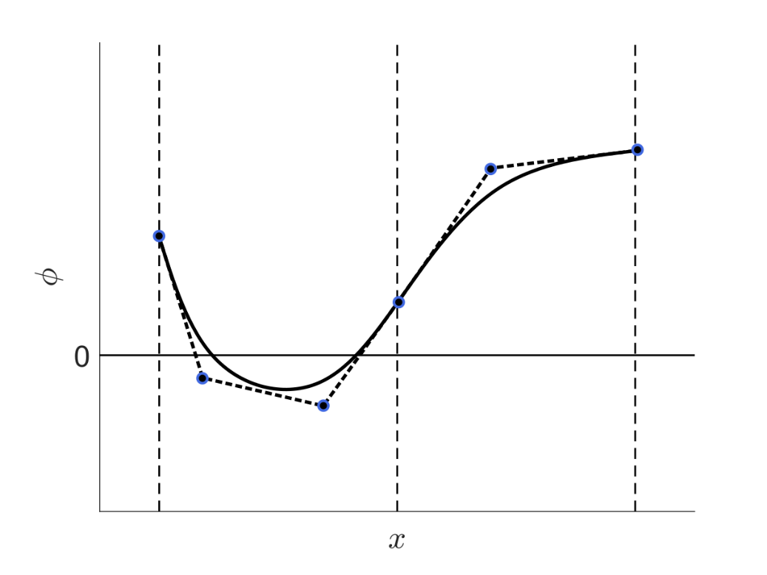
Cut-cell identification
Sampling of $φ$
Taking advantage of Bernstein polynomials properties
Detect change of sign of $φ$
$$e$$
$$e+1$$
$φ^{e}(x)<0$ if at least one $φ_{i}^{e}<0$
[Johnen, 2012]

Slide 25
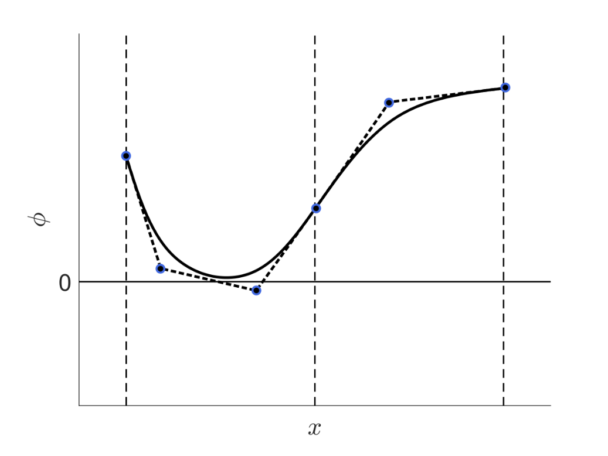
Cut-cell identification
Sampling of $φ$
Taking advantage of Bernstein polynomials properties
Detect change of sign of $φ$
$$e$$
$$e+1$$
$φ^{e}(x)<0$ if at least one $φ_{i}^{e}<0$
[Johnen, 2012]
False-positive

Slide 26
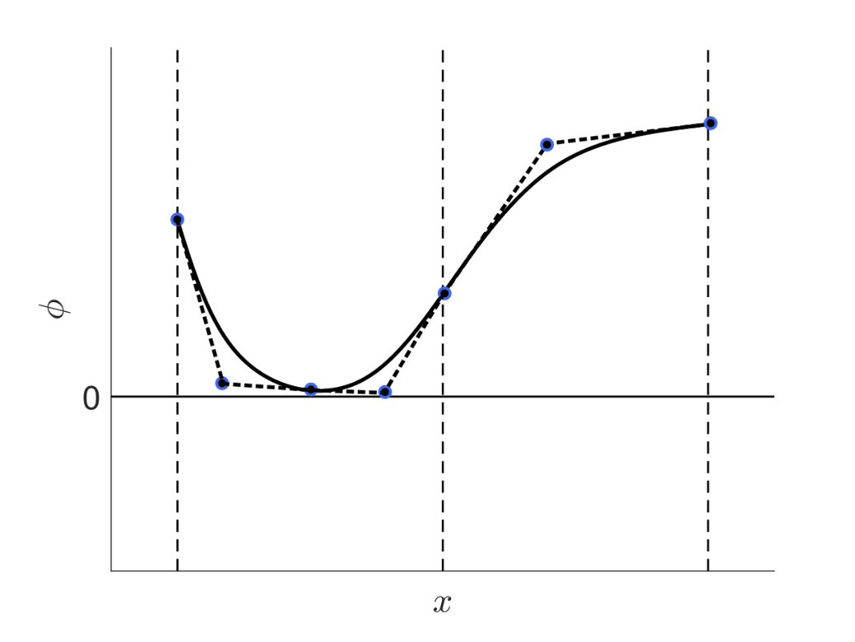
Cut-cell identification
Sampling of $φ$
Taking advantage of Bernstein polynomials properties
Detect change of sign of $φ$
$$e$$
$$e+1$$
$φ^{e}(x)<0$ if at least one $φ_{i}^{e}<0$
[Johnen, 2012]
False-positive: Refinement (but only on reduced set of elements)

Slide 27
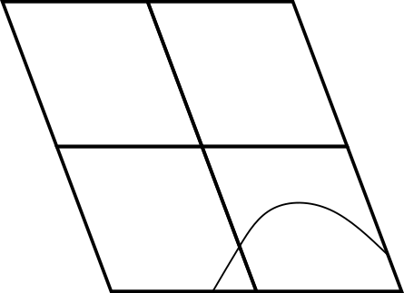
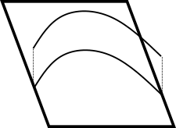
Quadrature rule for cut-cells
Integrate fluxes on implicitly cut-cells
$$φ<0$$
and
$$φ=0$$
$$φ>0$$
[Schrooyen, 2015]
Linear
reconstruction
High order
reconstruction
Moment
fitting
Height
function
Regularized

Slide 28
Quadrature rule for cut-cells
Integrate fluxes on implicitly cut-cells
$$φ<0$$
and
$$φ=0$$
$$φ>0$$
[Schrooyen, 2015]
Linear
reconstruction
High order
reconstruction
Moment
fitting
Height
function
Regularized
Low-order

Slide 29
Quadrature rule for cut-cells
Integrate fluxes on implicitly cut-cells
$$φ<0$$
and
$$φ=0$$
$$φ>0$$
[Schrooyen, 2015]
Linear
reconstruction
High order
reconstruction
Moment
fitting
Height
function
Regularized
[Müller, 2013]

Slide 30
Quadrature rule for cut-cells
Integrate fluxes on implicitly cut-cells
$$φ<0$$
and
$$φ=0$$
$$φ>0$$
[Schrooyen, 2015]
Linear
reconstruction
High order
reconstruction
Moment
fitting
Height
function
Regularized
[Saye, 2015]

Slide 31
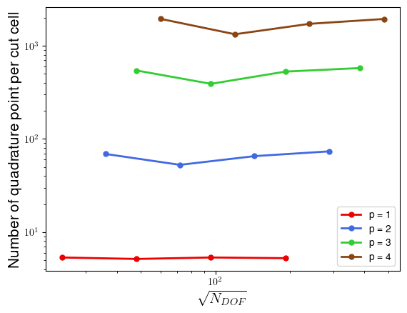
Height function
Positive weights
$p+1$ order convergence
No extension of integrand
Different quadrature points
Leads to large number of points
Number of points depends on error estimates on $φ$
Error predicted is too large
Better define error estimation for projected $φ$
[Saye, 2015]

Slide 32
Residual correction for cut-cells
A posteriori correction for cut-cells
Trivial/Optimized : from 5 to 200 speed-up
Collocation
Flux computations
Redistribution/Integration
Inverse mass matrix
Advance in time

Slide 33
Residual correction for cut-cells
A posteriori correction for cut-cells
For each cut-cells one by one, stored contiguously
Cut-cells may differ by number of quadrature points
Redistribution/Integration
Collocation
Flux computations
Redistribution/Integration
Inverse mass matrix
Advance in time
$u^{e}(x_{q})$ without sorting
Problematic for efficiency of fluxes evaluation
Notes:
Invert:
First, say collocation one by one
Then, say they may differ by number of QP
We sort solution at QP by number of QP

Slide 34
Residual correction for cut-cells
A posteriori correction for cut-cells
For each cut-cells one by one, stored contiguously
Cut-cells may differ by number of quadrature points
Redistribution/Integration
Collocation
Flux computations
Redistribution/Integration
Inverse mass matrix
Advance in time
$u^{e}(x_{q})$ with temporary sorting

Slide 35
Residual correction for cut-cells
A posteriori correction for cut-cells
$$u^{e}(x_{q})$$
Collocation
Flux computations
Redistribution/Integration
Inverse mass matrix
Advance in time
Redistribution/Integration
$${∇u}^{e}(x_{q})$$
Fluxes are computed for this block
Notes:
Efficiency of this operation is unchanged

Slide 36
Residual correction for cut-cells
A posteriori correction for cut-cells
$$u^{e}(x_{q})$$
Collocation
Flux computations
Redistribution/Integration
Inverse mass matrix
Advance in time
Redistribution/Integration
$${∇u}^{e}(x_{q})$$
and then fluxes for this block
Notes:
Add efficiency is bit lost for collocation é redistribution but not on fluxes

Slide 37
Residual correction for cut-cells
A posteriori correction for cut-cells
Collocation
Flux computations
Redistribution/Integration
Inverse mass matrix
Advance in time
For each cut-cells one by one
Return back to original element sorting
Redistribution/Integration

Slide 38
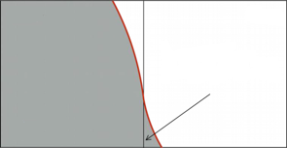
Agglomeration of small cells
A posteriori correction for cut-cells
[Müller, 2017]
Collocation
Flux computations
Redistribution/Integration
Inverse mass matrix
Advance in time
Ill-conditioned small cut-cell
tgt
src
-1
1
1.1
$$v^{merged}= v^{tgt}+v^{extended}$$
$$v^{src}Q$$
Extension without loss of accuracy since they share the same functional basis
Notes:
Extension is exact since 2 elements have same functional basis

Slide 39
Cell-agglomeration for stability
A posteriori correction for cut-cells
[Müller, 2017]
Collocation
Flux computations
Redistribution/Integration
Cell-agglomeration
Inverse mass matrix
Advance in time
Source update
Ill-conditioned small cut-cell
tar
src
-1
1
1.1
$$r^{agg}←r^{tgt}+{Q^{T}r}^{src}$$
$$M^{agg}=M^{tgt}+{Q^{T}M}^{src}Q$$
$$u^{src}←{Qu}^{agg}$$

Slide 40
Preliminary results
Pure convection of gaussian function around an immersed circle
Quadratic level-set projected on Bernstein basis
Discontinuous Galerkin with Lax-Friedrichs numerical flux
Cell-agglomeration with threshold of 5%
Explicit Runge-Kutta of order 4 ($CFL=0.01)$
Very low numerical diffusion and dispersion

Slide 41
Preliminary results
Pure convection of gaussian function around an immersed circle
Overview of backstage
Quadratic level-set projected on Bernstein basis
Discontinuous Galerkin with Lax-Friedrichs numerical flux
Cell-agglomeration with threshold of 5%
Explicit Runge-Kutta of order 4 ($CFL=0.01)$
Very low numerical diffusion and dispersion

Slide 42
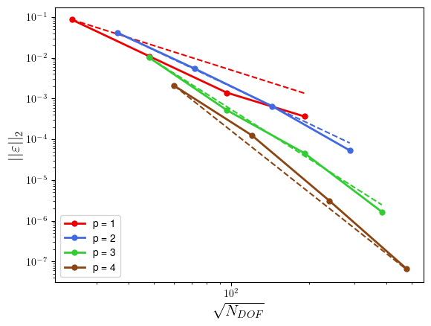
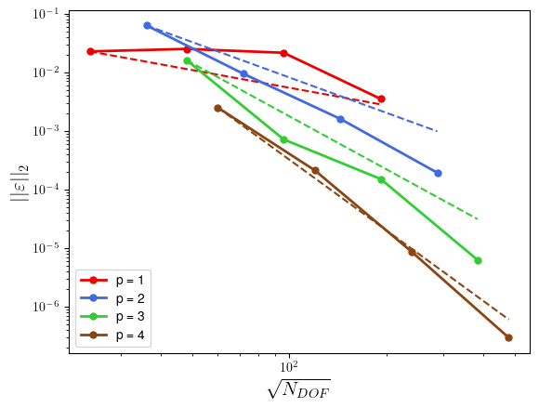
Preliminary results
Error in $L_{2}$-norm of initial solution
On domain
On boundary
Order of convergence $p+1$
Order of convergence $p$
Notes:
Change omega

Slide 43
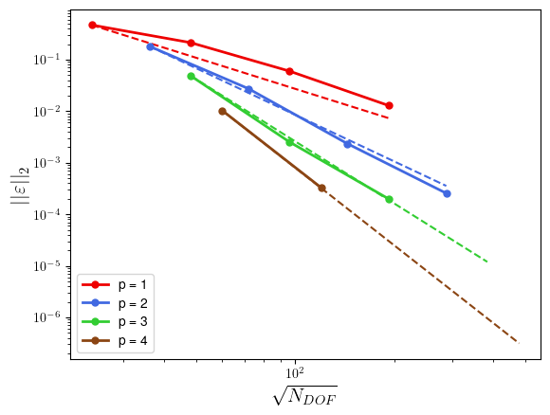
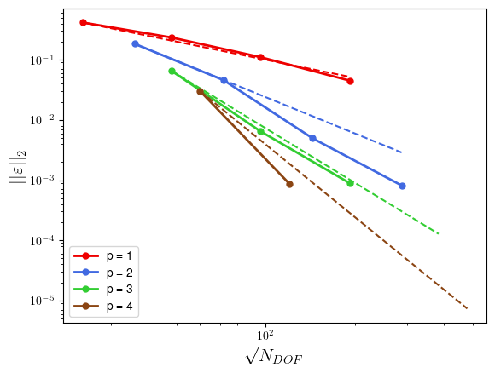
Preliminary results
Error in $L_{2}$-norm of solution after a quarter period
On domain
On boundary
Order of convergence $p+1$
Order of convergence $p$

Slide 44
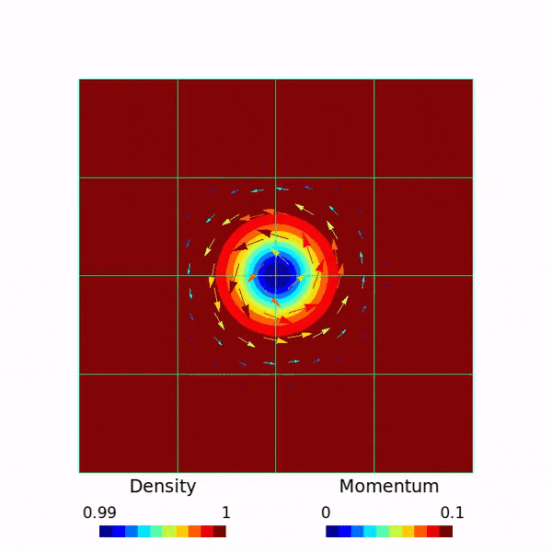
Current status
DG solver on a cartesian mesh with immersed boundary
C++, object-oriented programming
Collaborative (software forge spirit)
Development of shock-capturing methods (see A. Bilocq on 8th June)
ForDGe
Convection
Convection-Diffusion
Boundary conditions
Notes:
Video of Amaury?

Slide 45
Perspectives
Number of quadrature points for cut-cells
Diffusive term and implicit formulation
Data structures for cut-cells
Symmetric interface conditions for DG
Adaptive mesh-order refinement
ForDGe
Convection
Convection-Diffusion
Boundary conditions
Notes:
Should I put an image of CHT?

Slide 46
A Cartesian discontinuous Galerkin solver
with immersed boundaries
Nayan Levaux, A. Bilocq, P. Schrooyen, V. Terrapon, K. Hillewaert

Slide 47
References
[Alexandersen, 2016] Alexandersen, J., Sigmund, O., & Aage, N. (2016). Large scale three-dimensional topology optimisation of heat sinks cooled by natural convection. Int. J. Heat Mass Tran., 100, 876-891.
[Thomas, 2019] Thomas, D., Cerquaglia, M. L., Boman, R., Economon, T. D., Alonso, J. J., Dimitriadis, G., & Terrapon, V. E. (2019). CUPyDO-An integrated Python environment for coupled fluid-structure simulations. Adv. Eng. Softw., 128, 69-85.
[Frère, 2015] Frere, A., Hillewaert, K., Chivaee, H. S., Mikkelsen, R. F., & Chatelain, P. (2015). Cross-validation of numerical and experimental studies of transitional airfoil performance. In 33rd Wind Energy Symposium (p. 0499).
[Das, 2018] Das, S., Panda, A., Deen, N. G., & Kuipers, J. A. M. (2018). A sharp-interface immersed boundary method to simulate convective and conjugate heat transfer through highly complex periodic porous structures. Chem. Eng. Sci., 191, 1-18.
[Johnen, 2012] Johnen, A., Remacle, J. F., & Geuzaine, C. (2014). Geometrical validity of high-order triangular finite elements. Eng. Comput., 30, 375-382.
[Schrooyen, 2015] Schrooyen, P. (2015). Numerical simulation of aerothermal flows through ablative thermal protection systems (Doctoral dissertation, PhD thesis, UCL).
[Müller, 2013] Müller, B., Kummer, F., & Oberlack, M. (2013). Highly accurate surface and volume integration on implicit domains by means of moment‐fitting. Int. J. Numer. Methods Eng., 96, 512-528.
Notes:
Should I put an image of CHT?

Slide 48
References
[Saye, 2015] Saye, R. I. (2015). High-Order Quadrature Methods for Implicitly Defined Surfaces and Volumes
in Hyperrectangles. SIAM J. Sci. Comput. 37, A993-A1019
[Müller, 2017] Müller, B., Krämer-Eis, S., Kummer, F., & Oberlack, M. (2017). A high-order discontinuous Galerkin method for compressible flows with immersed boundaries, Int. J. Numer. Meth. Engng, 110,3-30.
Notes:
Should I put an image of CHT?

