Slide 1

High Open-Circuit Voltage Lead-Free Cs₂AgBiBr₆ Double Perovskite Solar Cells from Spray-Coating Deposition
Nathan Daem
Nathan.Daem@uliege.be
24th May 2022
València, HOPV 22

Slide 2
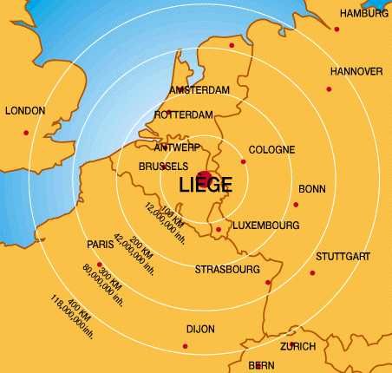
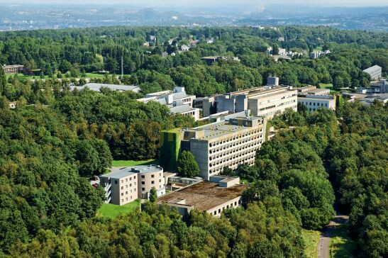
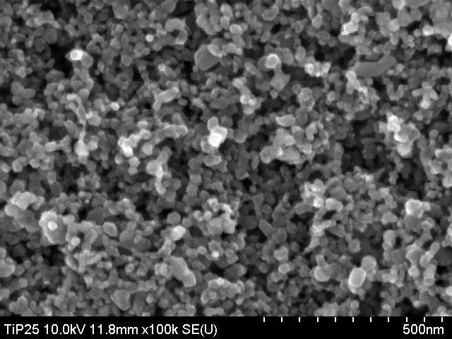
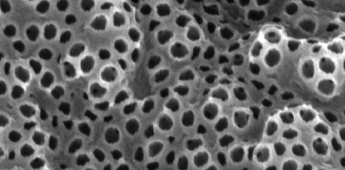
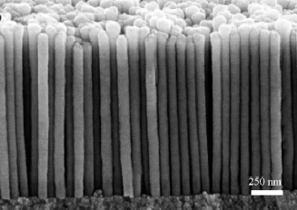
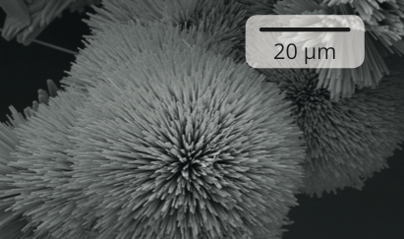
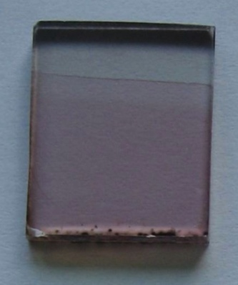
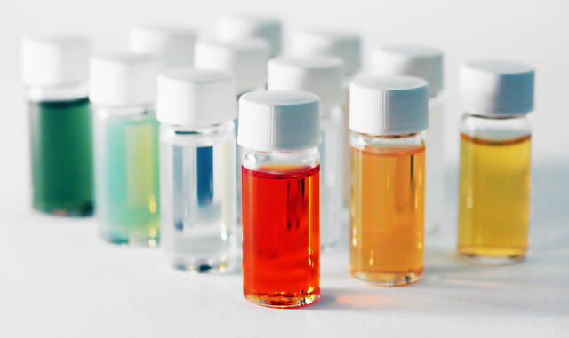
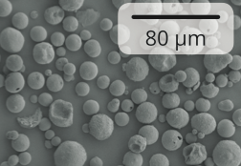
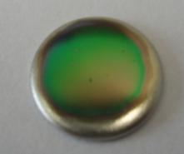
ULiège- GREEnMat
^{Hybrid and Inorganic} ^{Materials}
with Controlled Micro- and Nanostructure
POWDERS
SUSPENSIONS
COATINGS
Applications for energy (batteries, smart windows, solar cells…), environment (recycling, air/water treatment, catalysis)
and health (additive manufacturing, biomaterials…)
Notes:
For powders and coatings --> Pas from

Slide 3



Alternative: lead free materials
Low toxicity
Stability
Photo
conversion efficiency
Cell processability
Notes:
ATTENTION is one promising alternative
Eviter low efficiencies: are lower than the theoretical maximum efficiency

Slide 4
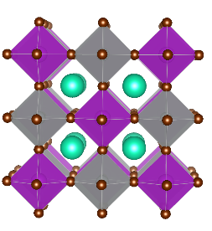


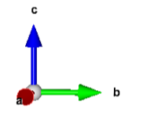


Alternative: lead free materials
Low toxicity
Stability
Photo
conversion efficiency
Cell processability
Cs₂AgBiBr₆
A = monovalent cation
M^{I} = monovalent metal ion
M^{III} = trivalent metal ion
A₂M^{I}M^{III}X₆
X= Br, Cl
Notes:
ATTENTION is one promising alternative
Eviter low efficiencies: are lower than the theoretical maximum efficiency

Slide 5
Alternative: lead free materials
Low toxicity
Stability
Photo
conversion efficiency
Cell processability
Cs₂AgBiBr₆
A = monovalent cation
M^{I} = monovalent metal ion
M^{III} = trivalent metal ion
A₂M^{I}M^{III}X₆
X= Br, Cl
Notes:
ATTENTION is one promising alternative
Eviter low efficiencies: are lower than the theoretical maximum efficiency

Slide 6
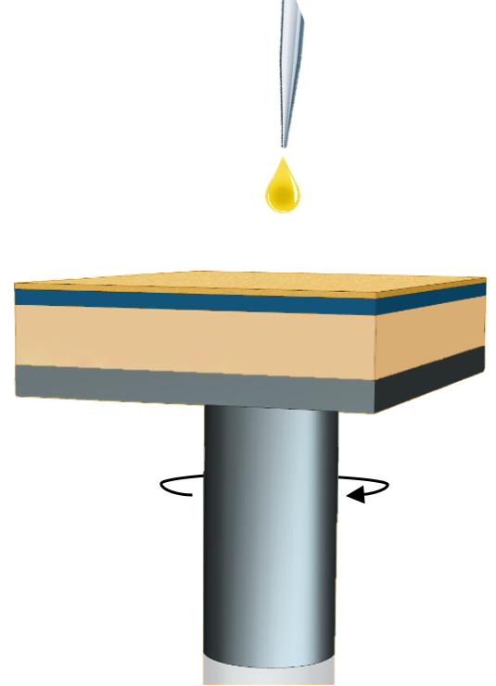
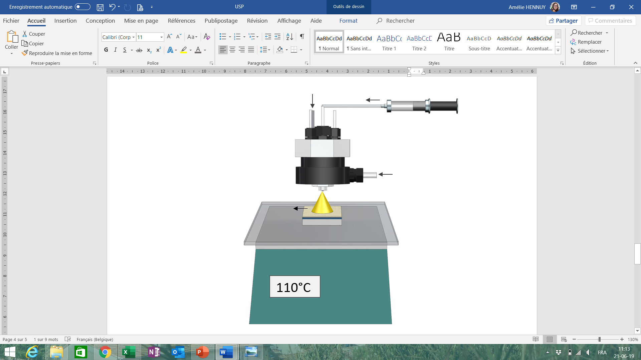
Strategy
Deposition of double perovskite (Cs₂AgBiBr₆) layers by spin-coating and ultrasonic spray pyrolysis (USP)
Solution of precursors
Ultrasonic generator
Solution of precursors
TiO₂
Carrier gas
vs.
TiO₂
Lab scale
(Spin coating)
Scalable process
(USP)
Notes:
Aspect fondamental: comparaison des 2 méthodes (morphologie, paramètres etc.) pas juste upscaling
Parler de l’ExactaCoat (permet de déposer jusqu’à 40X40cm)
ATTENTION ne pas citer tous les paramètres de dépôts USP
Méchanismes de dépôts différents donc comparaison fondamentale des deux techniques (spin: référence et USP et peut être développé pour des plus grandes surfaces).

Slide 7
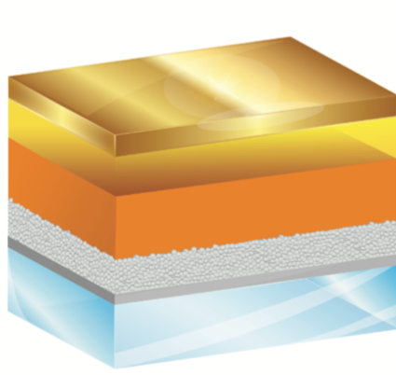
Cs₂AgBiBr₆ solar cell architecture
Substrate
FTO conducting glass
Notes:
The most appropriate architecture (n-i-p)
Pas préciser les épaisseurs

Slide 8
Cs₂AgBiBr₆ solar cell architecture
Dense TiO₂
Substrate
Avoids short-cuts
FTO conducting glass
Notes:
The most appropriate architecture (n-i-p)
Pas préciser les épaisseurs

Slide 9
Cs₂AgBiBr₆ solar cell architecture
Dense TiO₂
Substrate
Avoids short-cuts
Mesoporous TiO₂
Filled with Cs₂AgBiBr₆
Collects electrons
FTO conducting glass
Notes:
The most appropriate architecture (n-i-p)
Pas préciser les épaisseurs

Slide 10
Cs₂AgBiBr₆ solar cell architecture
Double perovskite
Cs₂AgBiBr₆
Absorbs light, creates electron-hole pairs
Dense TiO₂
Substrate
Avoids short-cuts
Mesoporous TiO₂
Filled with Cs₂AgBiBr₆
Collects electrons
FTO conducting glass
Notes:
The most appropriate architecture (n-i-p)
Pas préciser les épaisseurs

Slide 11
Cs₂AgBiBr₆ solar cell architecture
Hole transporting material
Spiro-OMeTAD
Double perovskite
Cs₂AgBiBr₆
Absorbs light, creates electron-hole pairs
Dense TiO₂
Substrate
Avoids short-cuts
Mesoporous TiO₂
Filled with Cs₂AgBiBr₆
Collects electrons
FTO conducting glass
Notes:
The most appropriate architecture (n-i-p)
Pas préciser les épaisseurs

Slide 12
Cs₂AgBiBr₆ solar cell architecture
Counter-electrode
Gold
Hole transporting material
Spiro-OMeTAD
Double perovskite
Cs₂AgBiBr₆
Absorbs light, creates electron-hole pairs
Dense TiO₂
Substrate
Avoids short-cuts
Mesoporous TiO₂
Filled with Cs₂AgBiBr₆
Collects electrons
FTO conducting glass
Notes:
The most appropriate architecture (n-i-p)
Pas préciser les épaisseurs

Slide 13
Cs₂AgBiBr₆ solar cell architecture
Counter-electrode
Gold
Hole transporting material
Spiro-OMeTAD
Double perovskite
Cs₂AgBiBr₆
Absorbs light, creates electron-hole pairs
Spin VS USP
Dense TiO₂
Substrate
Avoids short-cuts
Mesoporous TiO₂
Filled with Cs₂AgBiBr₆
Collects electrons
FTO conducting glass
Notes:
The most appropriate architecture (n-i-p)
Pas préciser les épaisseurs

Slide 14
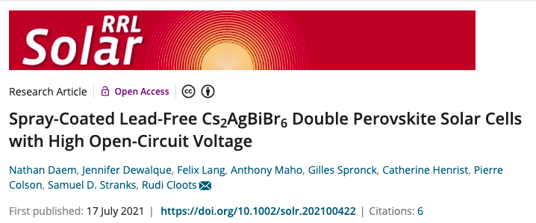

Publication

Slide 15
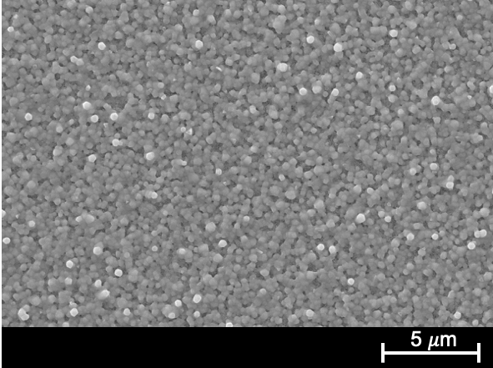
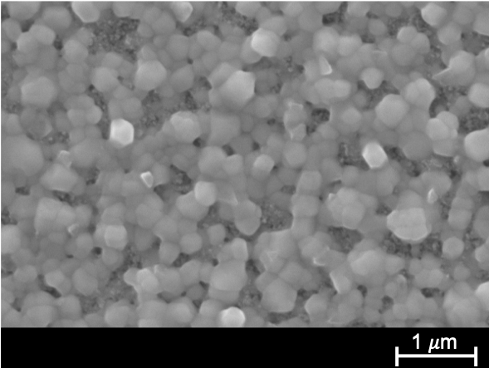
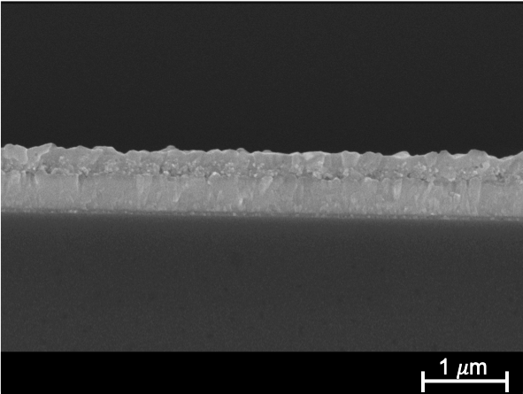
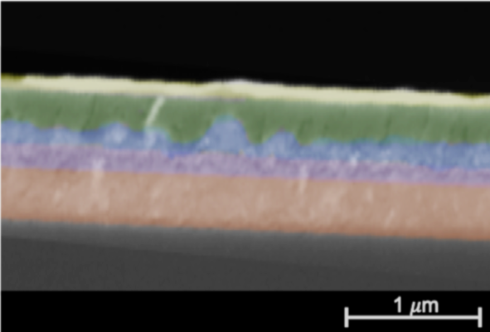
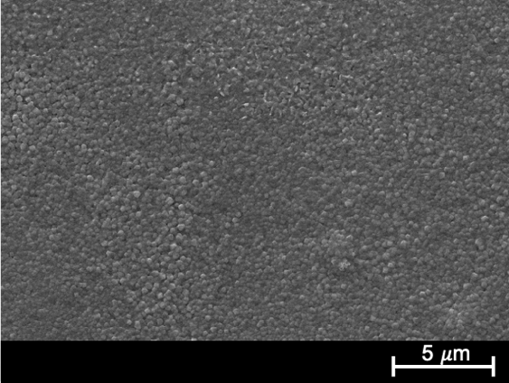
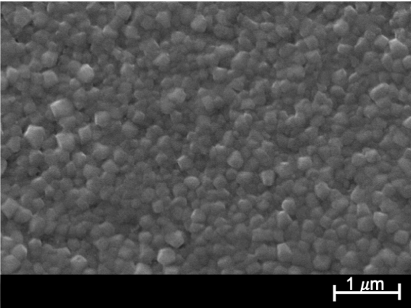
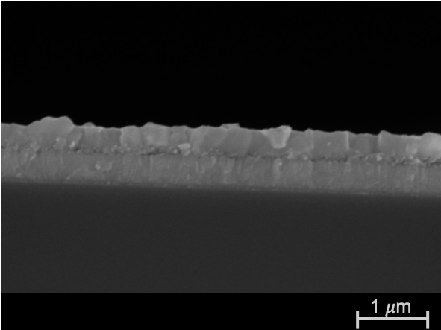
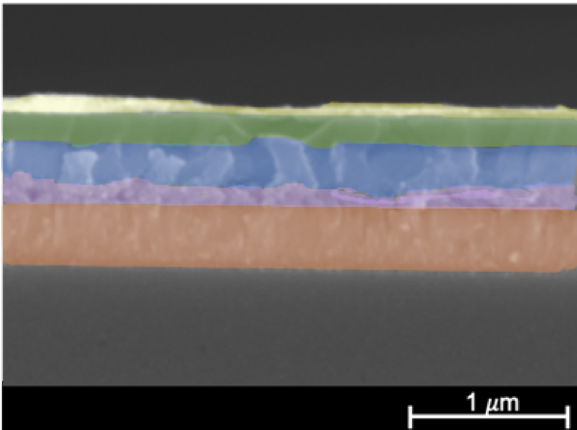
Morphology-SEM
Spin-coated double perovskite film
Top view
Cross section
(film + solar cell)
Spray-coated double perovskite film
Top view
Cross section
(film + solar cell)

Slide 16
Morphology-SEM
Spin-coated double perovskite film
Top view
Cross section
(film + solar cell)
Spray-coated double perovskite film
Top view
Cross section
(film + solar cell)
Spray: higher coverage and smaller grains (150 nm VS 350 nm)
Spin/Spray: overlayer = 150-200 nm

Slide 17
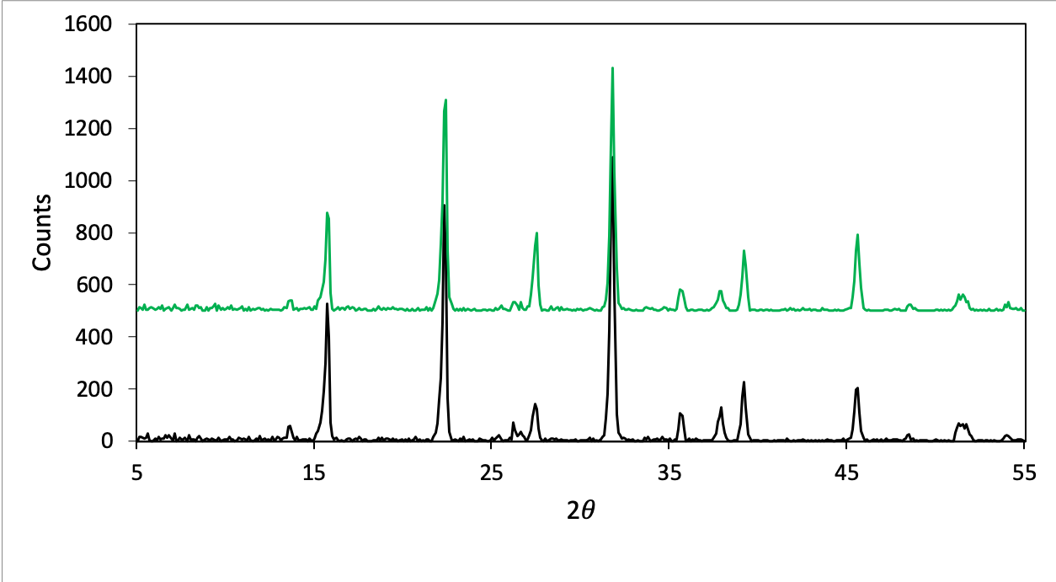
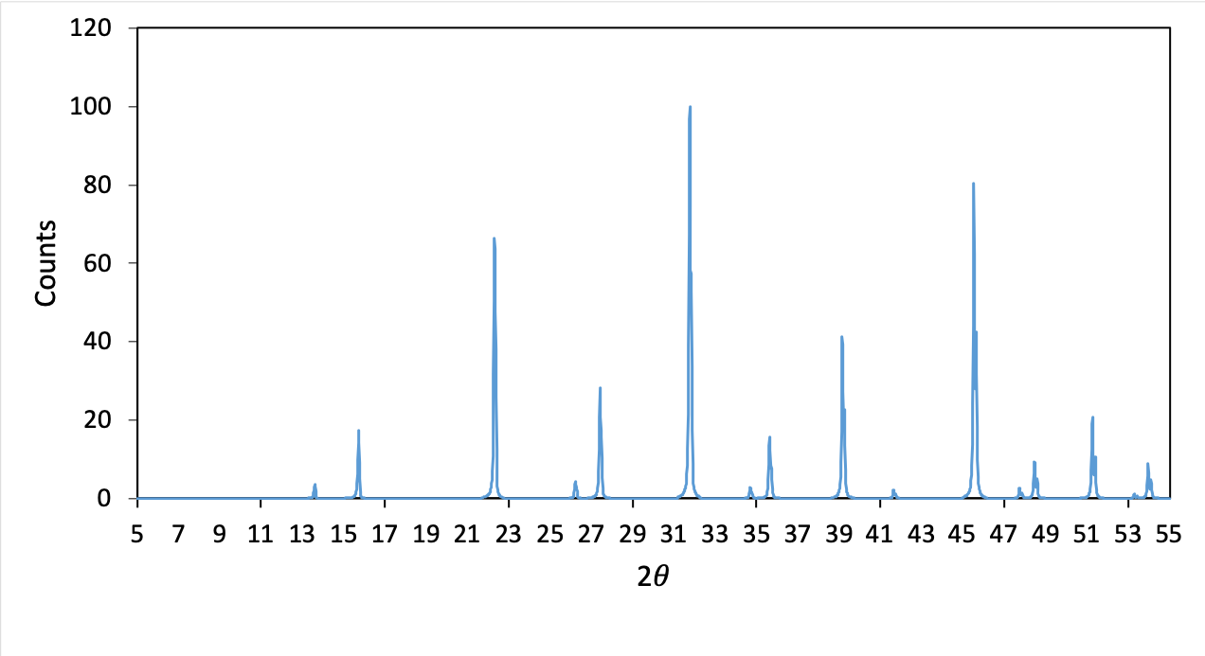
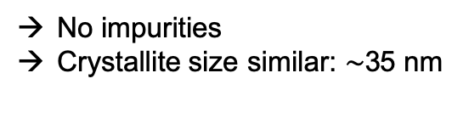
Structure-XRD
Spray-coated film
Spin-coated film
No impurities
Crystallite size similar: $\sim$35 nm
: Cs₂AgBiBr₆
Reference
(VESTA simulated)

Slide 18
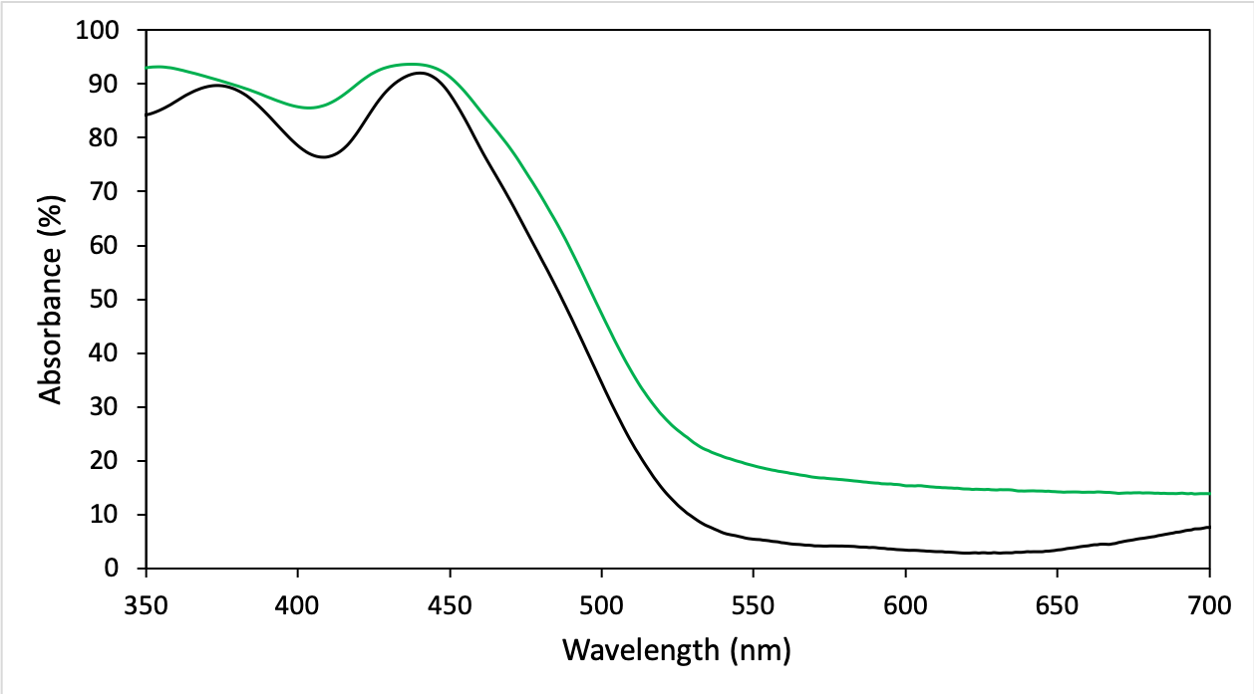
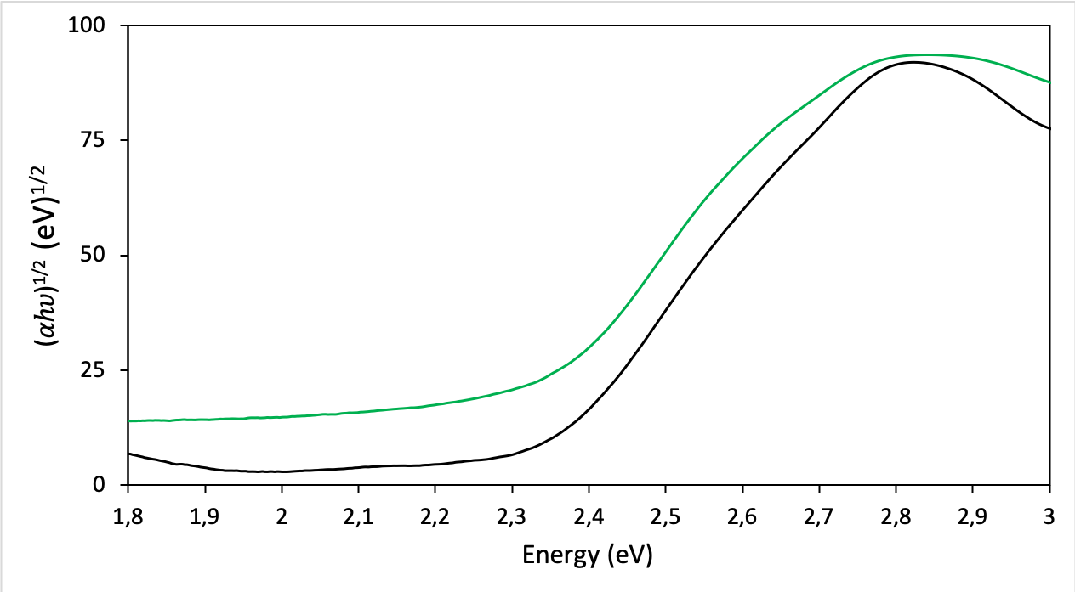
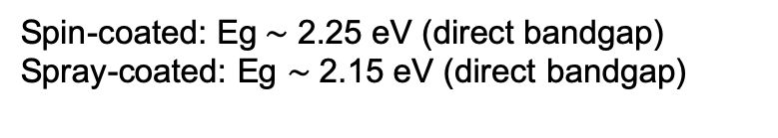
Optical properties-UV-VIS
2
1
.
5
1
0
.
5
Spray-coated film
Spin-coated film
Spin-coated: Eg$\sim$ 2.25 eV (direct bandgap)
Spray-coated: Eg $\sim$ 2.15 eV (direct bandgap)

Slide 19
Optical properties-UV-VIS
2
1
.
5
1
0
.
5
Spray-coated film
Spin-coated film
Spin-coated: Eg$\sim$ 2.25 eV (direct bandgap)
Spray-coated: Eg $\sim$ 2.15 eV (direct bandgap)
Higher absorbance for spray-coated film compared with spin-coated:
Different values of Eg for Cs₂AgBiBr₆ films due to different preparation methods

Slide 20
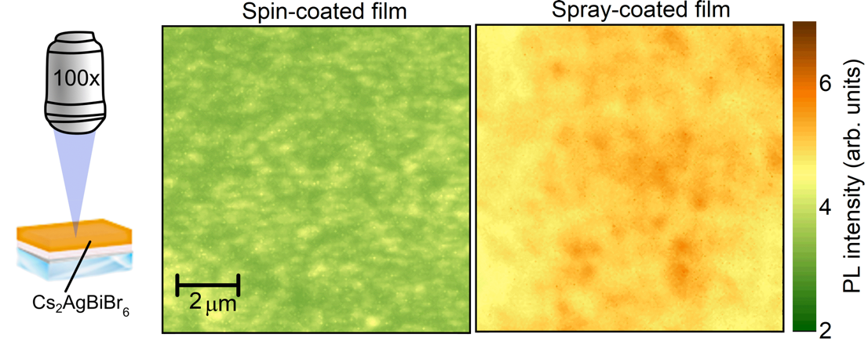
Optoelectronic properties-Photoluminescence
Prof. Samuel D. Stranks
Notes:
identify collab. U Cambridge (photo Sam) + parameters of PL measurements ; also PL mapping explanation (quite unique)
The higher the peak is, the better the photovoltaic compound is (longer electron lifetime).

Slide 21
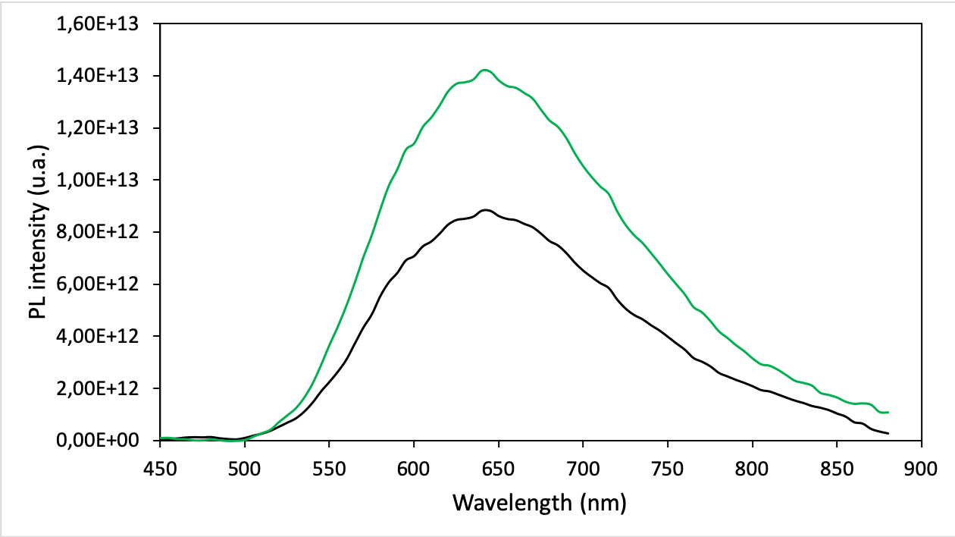
Optoelectronic properties-Photoluminescence
Prof. Samuel D. Stranks
Spray-coated film
Spin-coated film
Maximum of the curves at the same wavelength (640 nm ≈ 1.9 eV) → indirect bandgap
Higher PL intensity for spray VS spin (higher absorption and less recombination)
➔ Spray: very promising in terms of optoelectronic properties
Notes:
identify collab. U Cambridge (photo Sam) + parameters of PL measurements ; also PL mapping explanation (quite unique)
Faire animations: trop chargé
The higher the peak is, the better the photovoltaic compound is (longer electron lifetime).

Slide 22
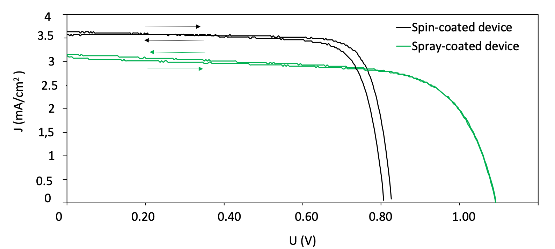
Photovoltaic properties-I-V curves
Spin-coated film
Spray-coated film
 |  | Voc (V) | Jsc (mA/cm²) | FF | PCE (%)
Spin-coated device | Direct | 0.827 | 3.6 | 81 | 2.3
 | Reverse | 0.811 | 3.7 | 78 | 2.3
Spray-coated device | Direct | 1.091 | 3.1 | 70 | 2.3
 | Reverse | 1.093 | 3.2 | 68 | 2.3
Notes:
Despite the higher absorbance and the better connectivity the spray-coated device shows reduced current density (Jsc) compared with the spin-coated benchmark and this trend is corroborated by the external quantum efficiency (EQE) measurements.
To further analyze the charge transfer properties of spin- coated and spray-coated Cs2AgBiBr6-based solar cells electrochemical impedance spectroscopy (EIS) is conducted.
Dire que c’est ma cellule championne
Uniformiser tableau

Slide 23
Photovoltaic properties-I-V curves
Spin-coated film
Spray-coated film
 |  | Voc (V) | Jsc (mA/cm²) | FF | PCE (%)
Spin-coated device | Direct | 0.827 | 3.6 | 81 | 2.3
 | Reverse | 0.811 | 3.7 | 78 | 2.3
Spray-coated device | Direct | 1.091 | 3.1 | 70 | 2.3
 | Reverse | 1.093 | 3.2 | 68 | 2.3
Among the highest efficiencies reached to date (2.3% vs. 2.5%)
Spray: no hysteresis and higher Voc (cf PL)
BUT lower Jsc → Why?
Notes:
Despite the higher absorbance and the better connectivity the spray-coated device shows reduced current density (Jsc) compared with the spin-coated benchmark and this trend is corroborated by the external quantum efficiency (EQE) measurements.
To further analyze the charge transfer properties of spin- coated and spray-coated Cs2AgBiBr6-based solar cells electrochemical impedance spectroscopy (EIS) is conducted.
Dire que c’est ma cellule championne
Uniformiser tableau

Slide 24
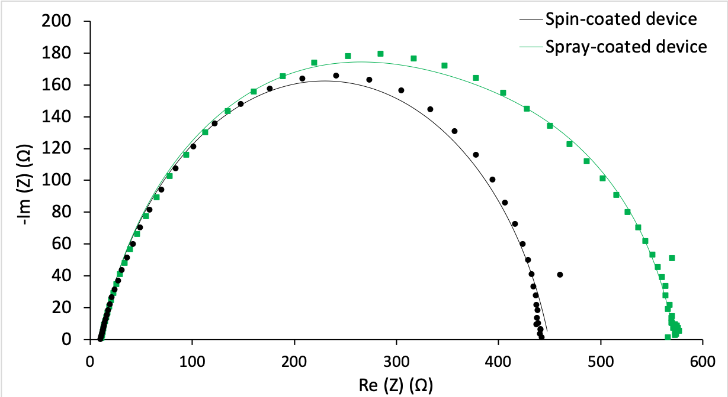
Photovoltaic properties- EIS
 | R₁ [Ω] | Q₂ [10⁻⁶ F. s^{a−1}] | a | R₂ [Ω] | Q₃ [10⁻⁶ F.s^{b−1}] | b | R₃ [Ω]
Spin-coated device | 10 | 0.381 | 0.979 | 178 | 0.615 | 0.808 | 254
Spray-coated device | 11 | 0.235 | 0.850 | 191 | 0.831 | 0.806 | 367
Recombination at the Cs₂AgBiBr₆/Spiro interface: R₃ ↑ = recombination ↓
→ Spray: lower recombination rate (V_{OC} ↑)
Notes:
Data were fitted with the equivalent circuit model.The equivalent electrical circuit consists of: an R1 resistance associated with wires and contacts; an R2//Q2 element characteristic of the selective contacts, including c-TiO2 and mp-TiO2 for electron-selective contacts and the Spiro-OMeTAD for hole-selective contacts, respectively and an R3//Q3 element for interfacial recombination between electrons and holes
Focus on two parameters: R3 and R2
EIS data corroborate PL and J–V results

Slide 25
Photovoltaic properties- EIS
 | R₁ [Ω] | Q₂ [10⁻⁶ F. s^{a−1}] | a | R₂ [Ω] | Q₃ [10⁻⁶ F.s^{b−1}] | b | R₃ [Ω]
Spin-coated device | 10 | 0.381 | 0.979 | 178 | 0.615 | 0.808 | 254
Spray-coated device | 11 | 0.235 | 0.850 | 191 | 0.831 | 0.806 | 367
Selective contact resistance:
Spray: R₂ ↑ = less efficient charge transfer
With Spin: larger grains and better infilitration
Notes:
Data were fitted with the equivalent circuit model.The equivalent electrical circuit consists of: an R1 resistance associated with wires and contacts; an R2//Q2 element characteristic of the selective contacts, including c-TiO2 and mp-TiO2 for electron-selective contacts and the Spiro-OMeTAD for hole-selective contacts, respectively and an R3//Q3 element for interfacial recombination between electrons and holes
Focus on two parameters: R3 and R2
EIS data corroborate PL and J–V results

Slide 26
Conclusion
Cs₂AgBiBr₆
Easy processability
High stability
Nontoxicity
A = monovalent cation
M^{I} = monovalent metal ion
M^{III} = trivalent metal ion
A₂M^{I}M^{III}X₆
X= Br, Cl
Notes:
Perspectives : facilitate infiltration, substitution, improve hole conduction => PEN/TET
To conclude about Cs2AgBiBr6 as an alternative lead-free perovskite

Slide 27
Conclusion
Cs₂AgBiBr₆
Easy processability
High stability
Nontoxicity
A = monovalent cation
M^{I} = monovalent metal ion
M^{III} = trivalent metal ion
A₂M^{I}M^{III}X₆
X= Br, Cl
Spray-coating
Smooth and uniform film
Smaller and better
connected grains
PCE: 2.3 % (Voc )
Notes:
Perspectives : facilitate infiltration, substitution, improve hole conduction => PEN/TET
To conclude about Cs2AgBiBr6 as an alternative lead-free perovskite

Slide 28
Conclusion
Cs₂AgBiBr₆
Easy processability
High stability
Nontoxicity
A = monovalent cation
M^{I} = monovalent metal ion
M^{III} = trivalent metal ion
A₂M^{I}M^{III}X₆
X= Br, Cl
Spray-coating
Next steps
Smooth and uniform film
Smaller and better
connected grains
PCE: 2.3 % (Voc )
Efficiencies improvement by
Substitution of elements
Improvement of Cs₂AgBiBr₆/Spiro interface
Notes:
Perspectives : facilitate infiltration, substitution, improve hole conduction => PEN/TET
To conclude about Cs2AgBiBr6 as an alternative lead-free perovskite

Slide 29


Acknowledgements
Funding: University of Liège and FNRS
University of Liège – GREEnMat
Prof. Rudi Cloots
Dr. Pierre Colson
Dr. Anthony Maho
Dr. Jennifer Dewalque
Gilles Spronck
ULiège-GREENMAT co-workers & collaborators
University of Cambridge
Prof. Samuel D. Stranks
Dr. Felix Lang
Stranks’ Lab co-workers & collaborators

Slide 30
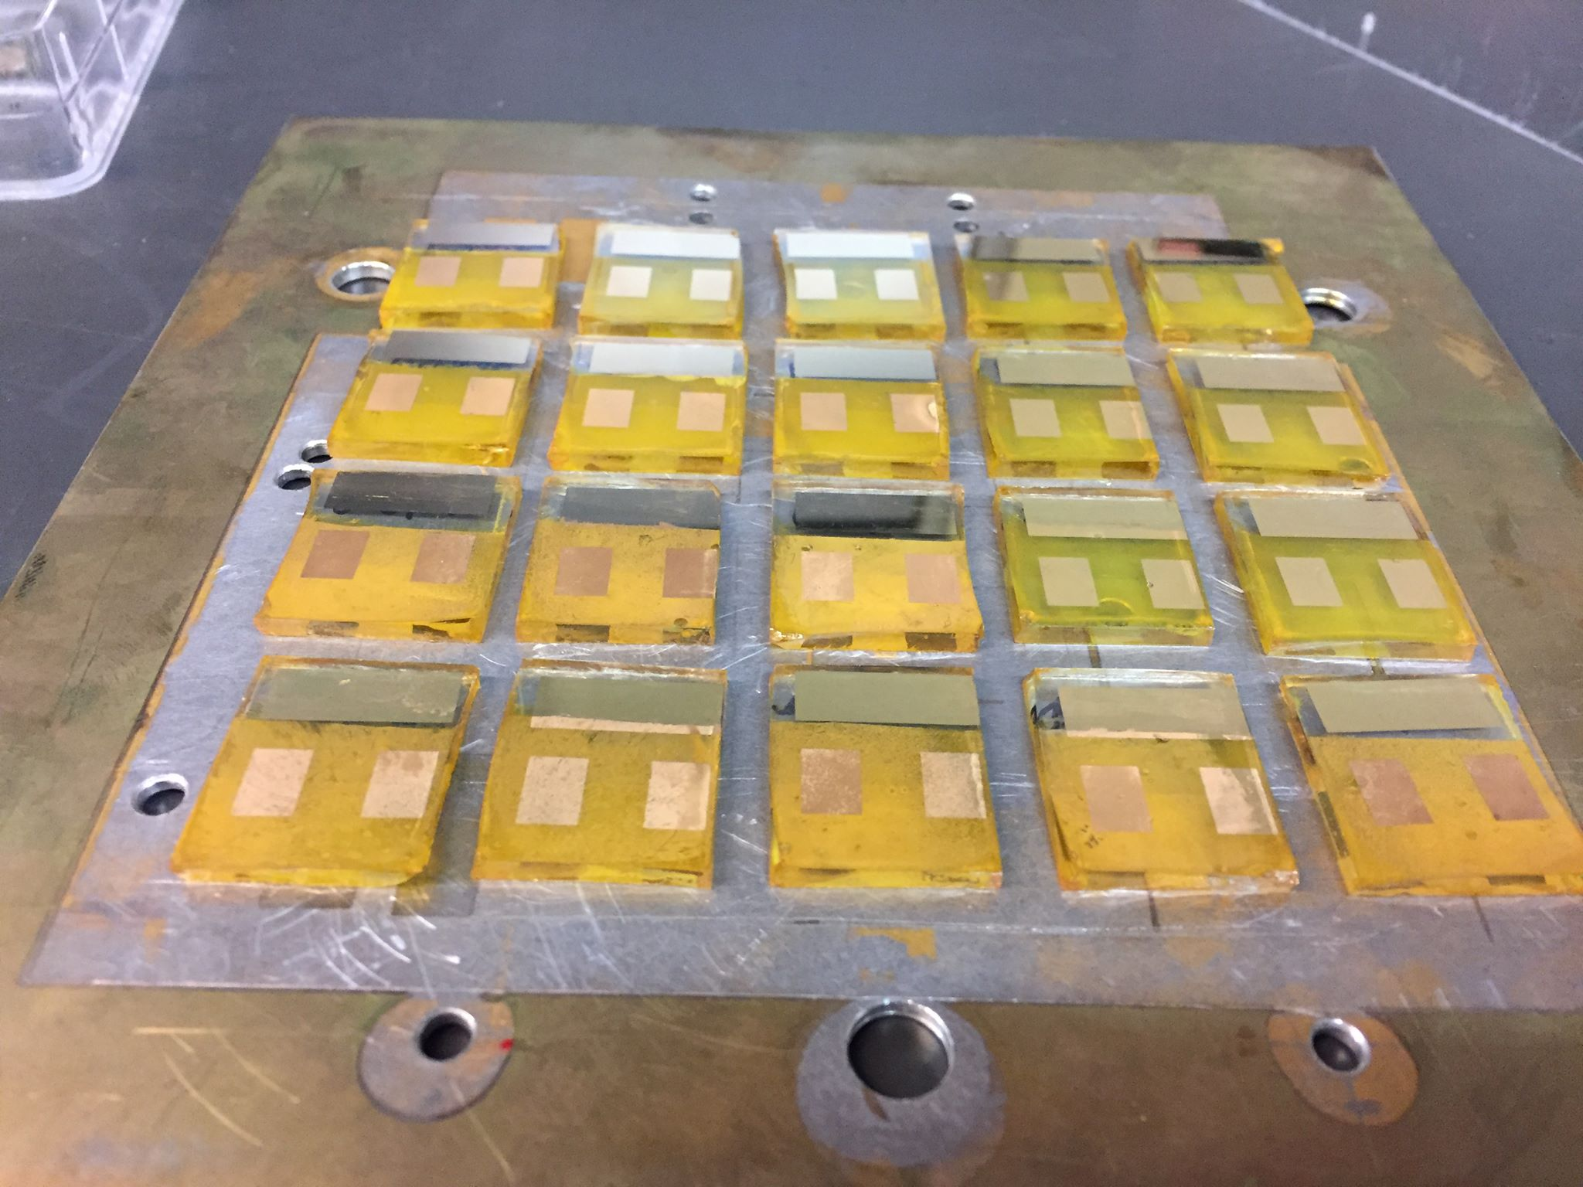


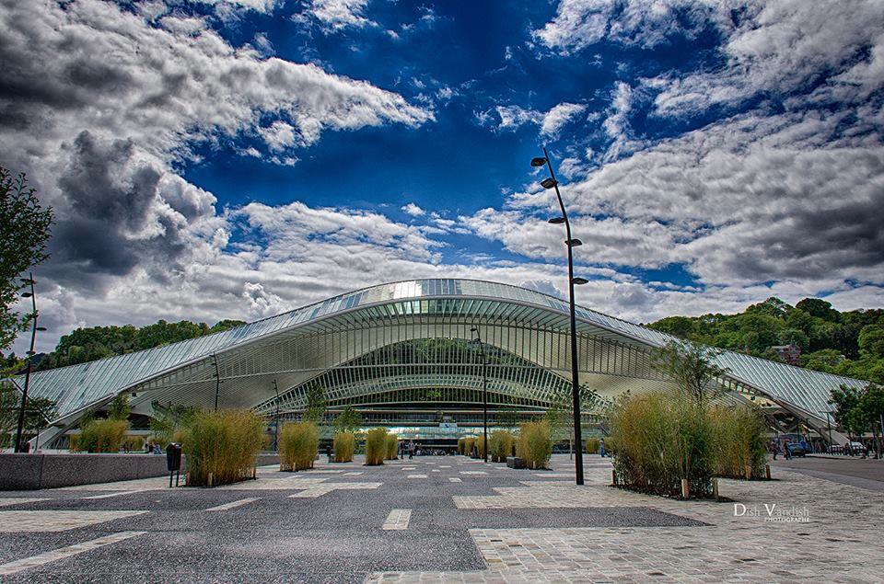


Thank you for
your attention
Website : http://www.greenmat.uliege.be
E-mail: nathan.daem@uliege.be
15

Slide 31
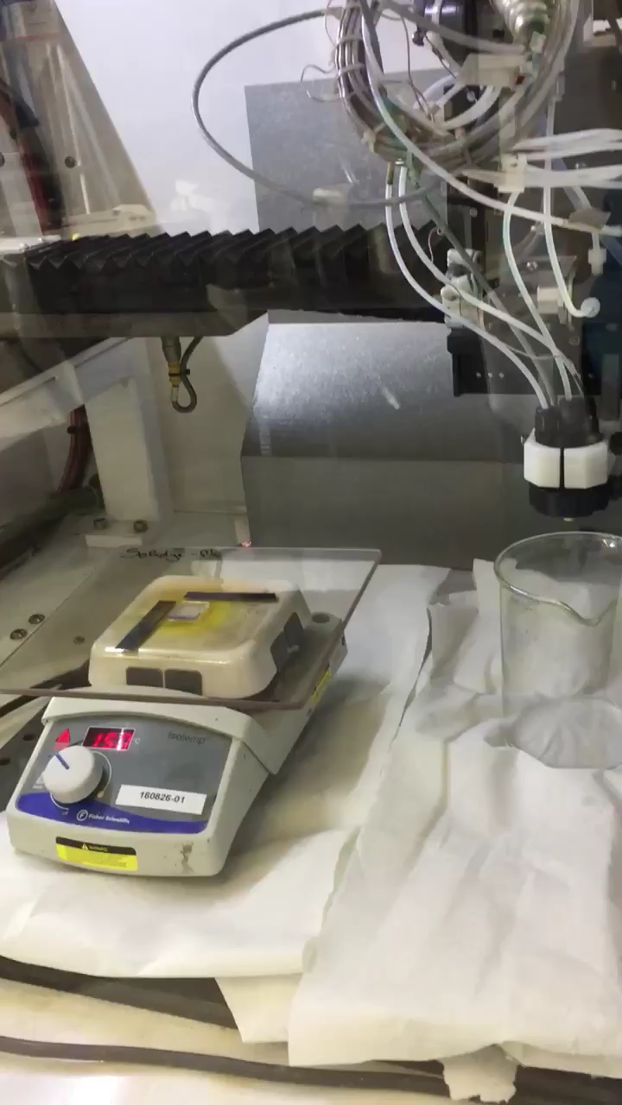
Ultrasonic spray pyrolysis
Notes:
Atomization with US => micron-sized droplets sprayed onto glass surface

Slide 32
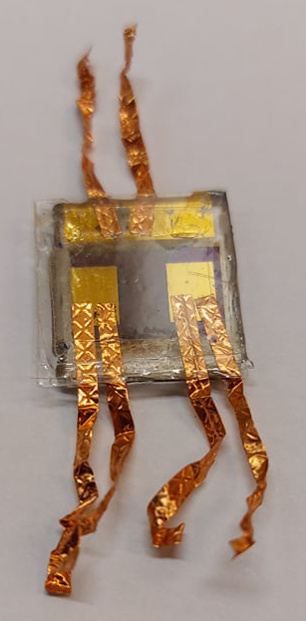
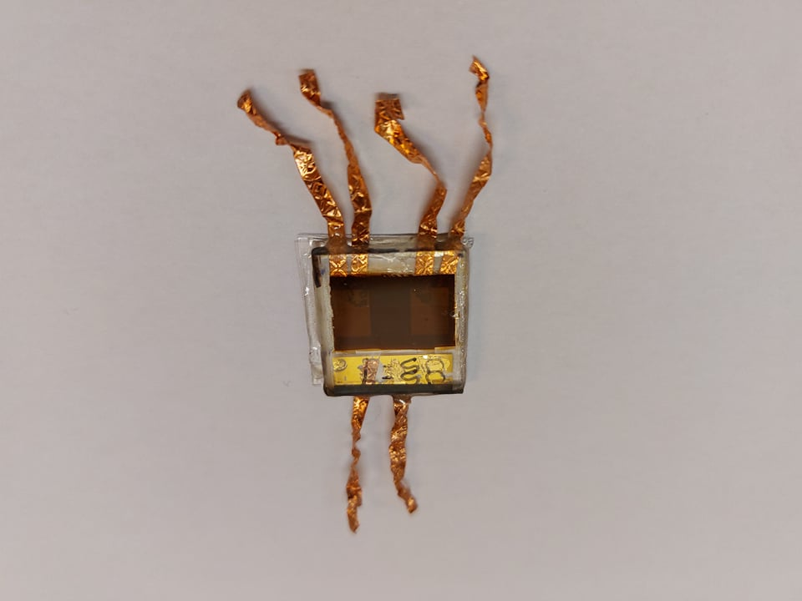
Perspectives- Stability tests
Tests recommandés (Normes ISOS-1)
Storage in humidity | Temperature= RT/65 °C
 | RH= dessiccator (20%)/ no controlled
Prolonged illumination test | Temperature= RT
 | RH= room humidity
Test of cycle illumination-humidity-thermal treatment | Temperature= RT RH: no controlled
1st tests: essential encapsulation for the rest of study: cover glass, thermoplastic, epoxy resin
M. V. Khenkin et al., “Consensus statement for stability assessment and reporting for perovskite photovoltaics based on ISOS procedures,” Nat. Energy, vol. 5, no. 1, pp. 35–49, 2020

Slide 33
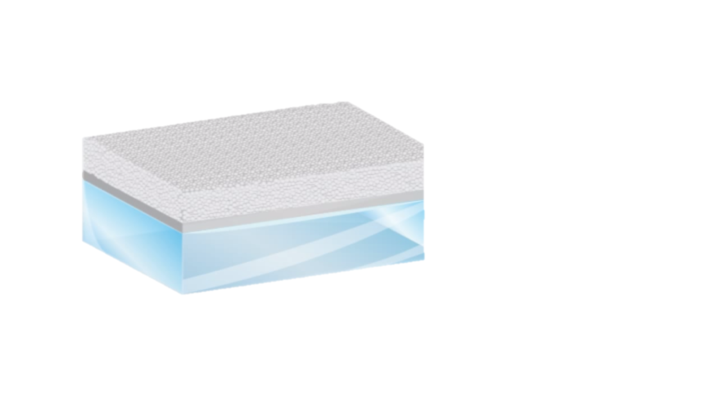
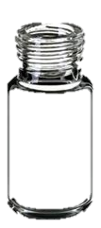
Strategy- double perovskite focus
CsBr, AgBr, BiBr₃ in DMSO
+
Spin-coating
@ 70°C
@ 70°C
Ultrasonic spray pyrolisis
CsBr, AgBr, BiBr₃ in DMF:DMSO
@ 150°C
18

