Slide 1
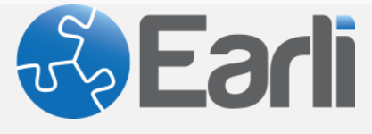
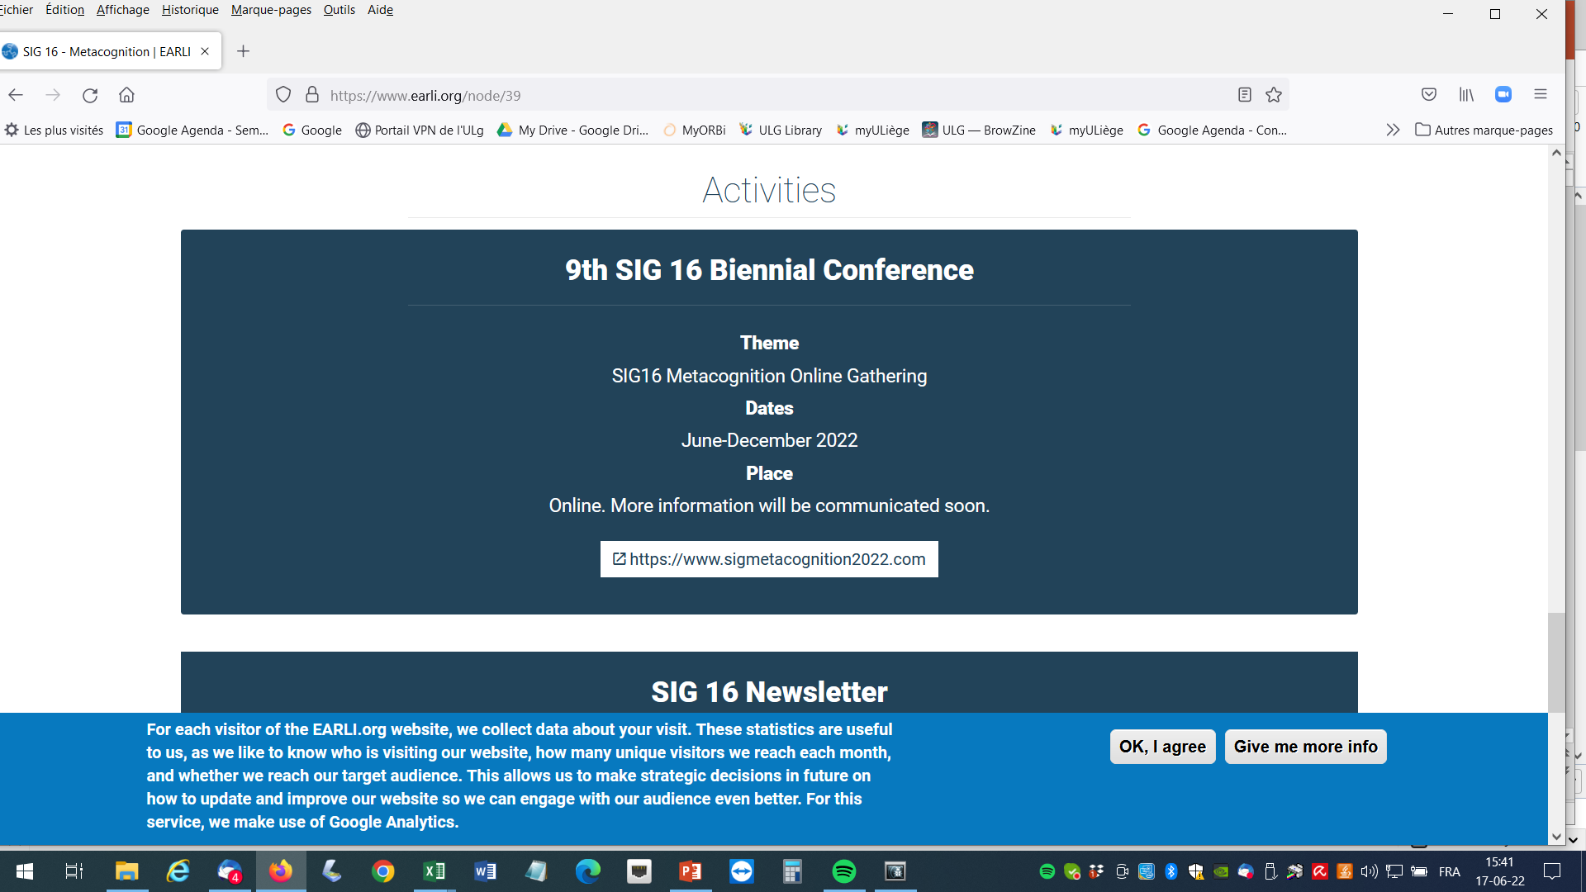

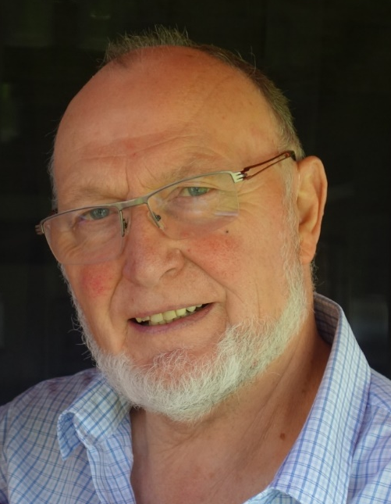

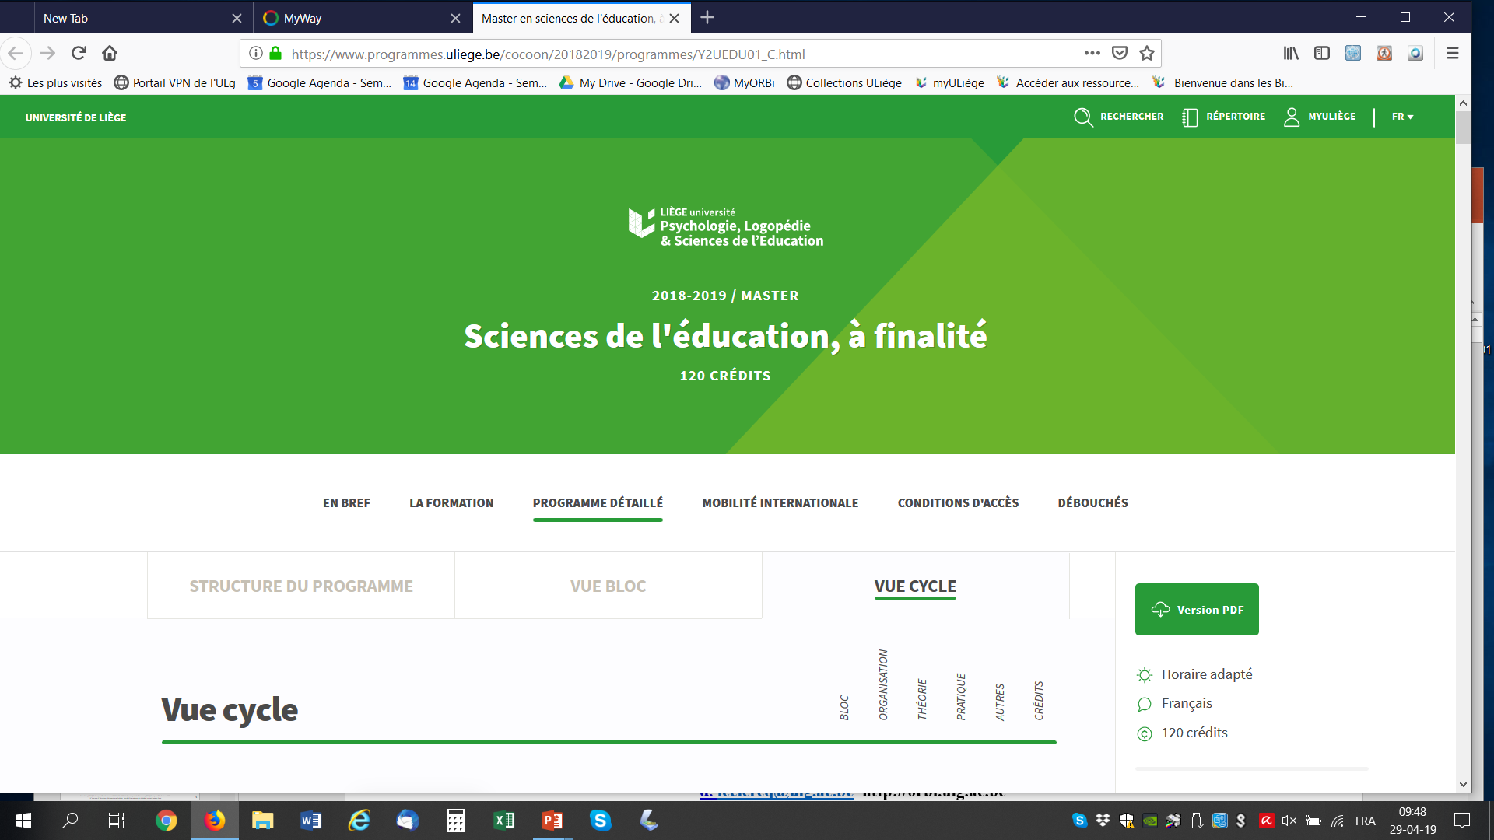


The precision or granularity of confidence degrees
measured by the method of repetition
June 24, 2022
Dieudonné LECLERCQ
Emeritus professor
in Education
Invited professor
EA3412
d.leclercq@uliege.be
https://orbi.uliege.be

Slide 2
The research question :
What is the optimal number of confidence degrees
in the percentages scale ranging from 0% to 100% ?
It has implications for several other measures:
-calibration indices
-measures of gains
-measures of revisions of probabilities
-personal thresholds for decision making
-institutional thresholds for decision making

Slide 3
Vickers (2001, p. 148, cited by Koriat, )
“confidence has been overlooked as an interesting variable in its own.”.
Many studies exist on Calibration,
but what about
precision
resolving power,
sensitivity,
definition,
granularity,
acuity,
the just noticeable difference (jnd)
Veenman (2007) calls for
“reliability measures
for the self-report data”
Fechner & S. S. Stevens “On the psychophysical law” (1957)
“In the domain of loudness, is 50 db perceived different from 60 db ?”.
In the domain of confidence, is 50% perceived different from 60% ?

Slide 4
A taxonomy of Instructions on Precision of Confidence scale
Instructions
suppressive
Confidence not permitted
studied by the
method of repetition
evasive
Confident or not ? (ex: Z for Zekerheid)
Compressive
-After a delay (hours, days, weeks) :
-here are the pretest questions
-here are your pretest answers
-give your confidence again (retest)
-on the same scale
expressive
Optimal
Excessive
illusory
Without any limit in precision (ex: Continuous confidence marking
Ex : « I am 34.15% confident »

Slide 5
To realize such a study, the researcher must
answer a prequisite question:
opt for a methodological option
fulfill 3 experimental conditions

Slide 6
the researcher must
-answer a prequisite question: Numbers or Words ?
My answer :
Numbers (% or percents) instead of Words (weakly sure, sure, very sure, etc.)
Words do not permit to compute classical calibration indices
Great inter-individual differences in translation of words in %
« I am as sure as ou are, but not with the same percents ».

Slide 7
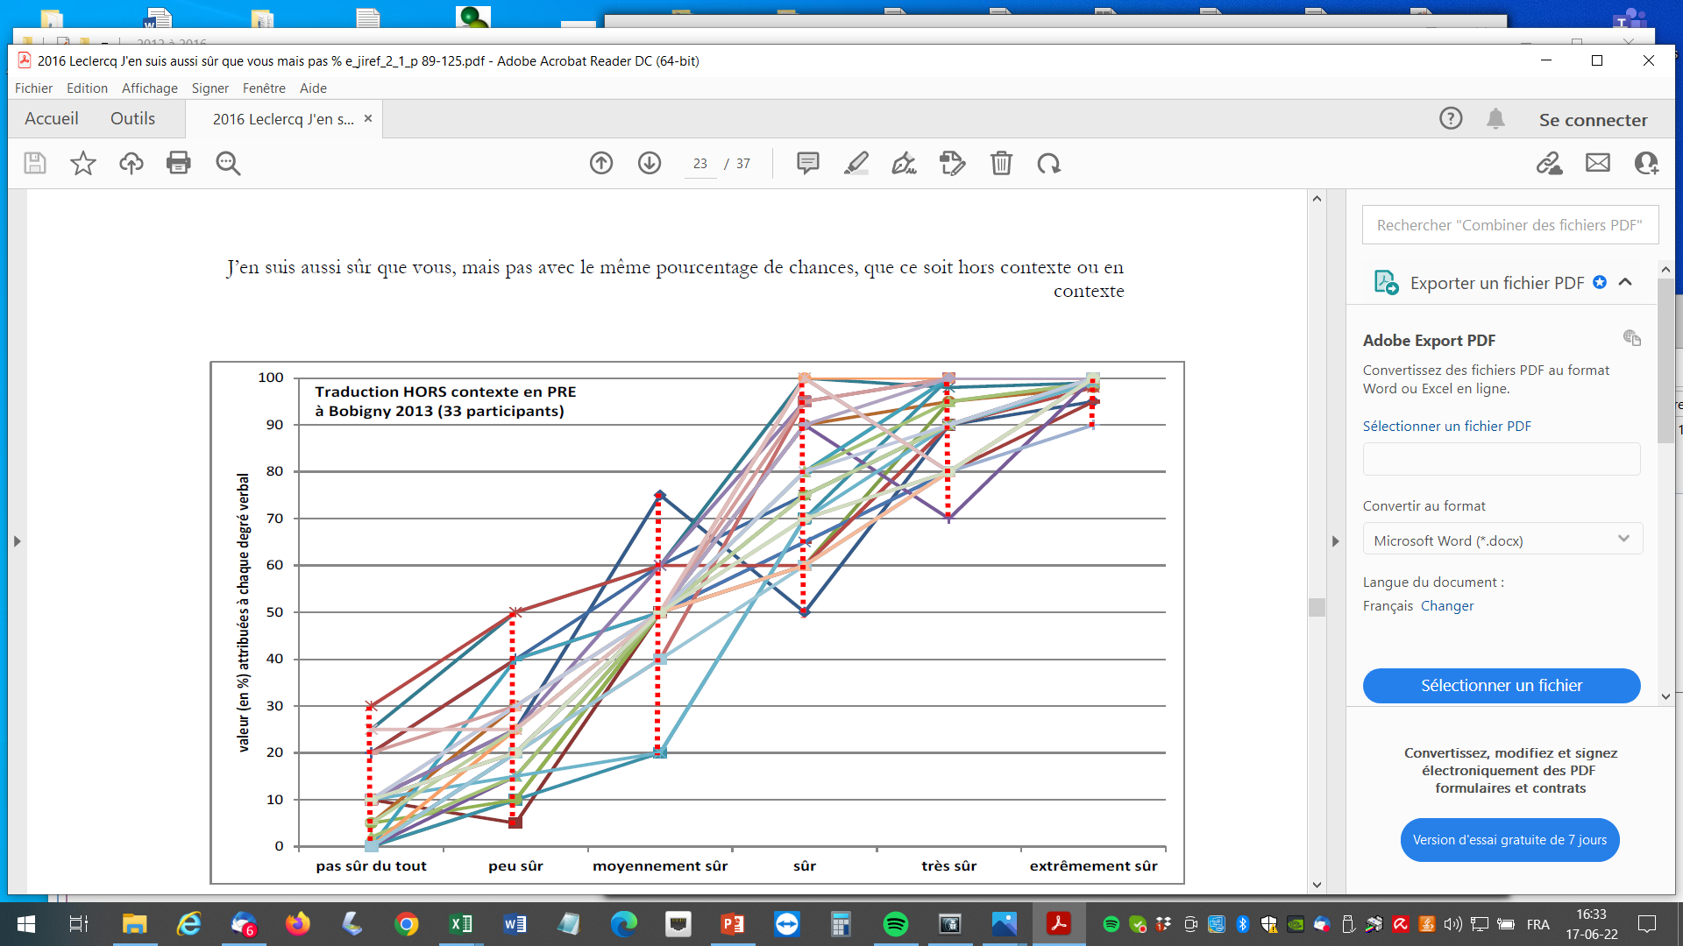
Words translated into Numbers (%)
2 Experiments (Leclercq 2016 & 2017)
Context free
33 subjects
%
Words
Not sure
at all
Weakly
sure
Moderately
sure
sure
Very
sure
Extremely
sure

Slide 8
the researcher must
opt for a method :
test-retest stability”
My option : repetition or
Koriat (2011) and Preston & Colman (2000)
i.e. providing a 2nd time the confidence degree to the same Question
with the same Response
after various delays (hours, days, weeks)

Slide 9
the researcher must
fulfill 3 methodological conditions :
Questions on a domain that permits
      -automatic generation of questions
      -automatic correction & feedback
      -large number of potential questions
My solution :
Letter Guessing Games
LGG
(2) A domain on which it can
neither be learned nor forgotten
during the interval between pre and post

Slide 10
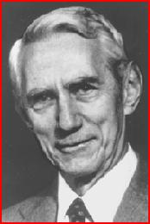
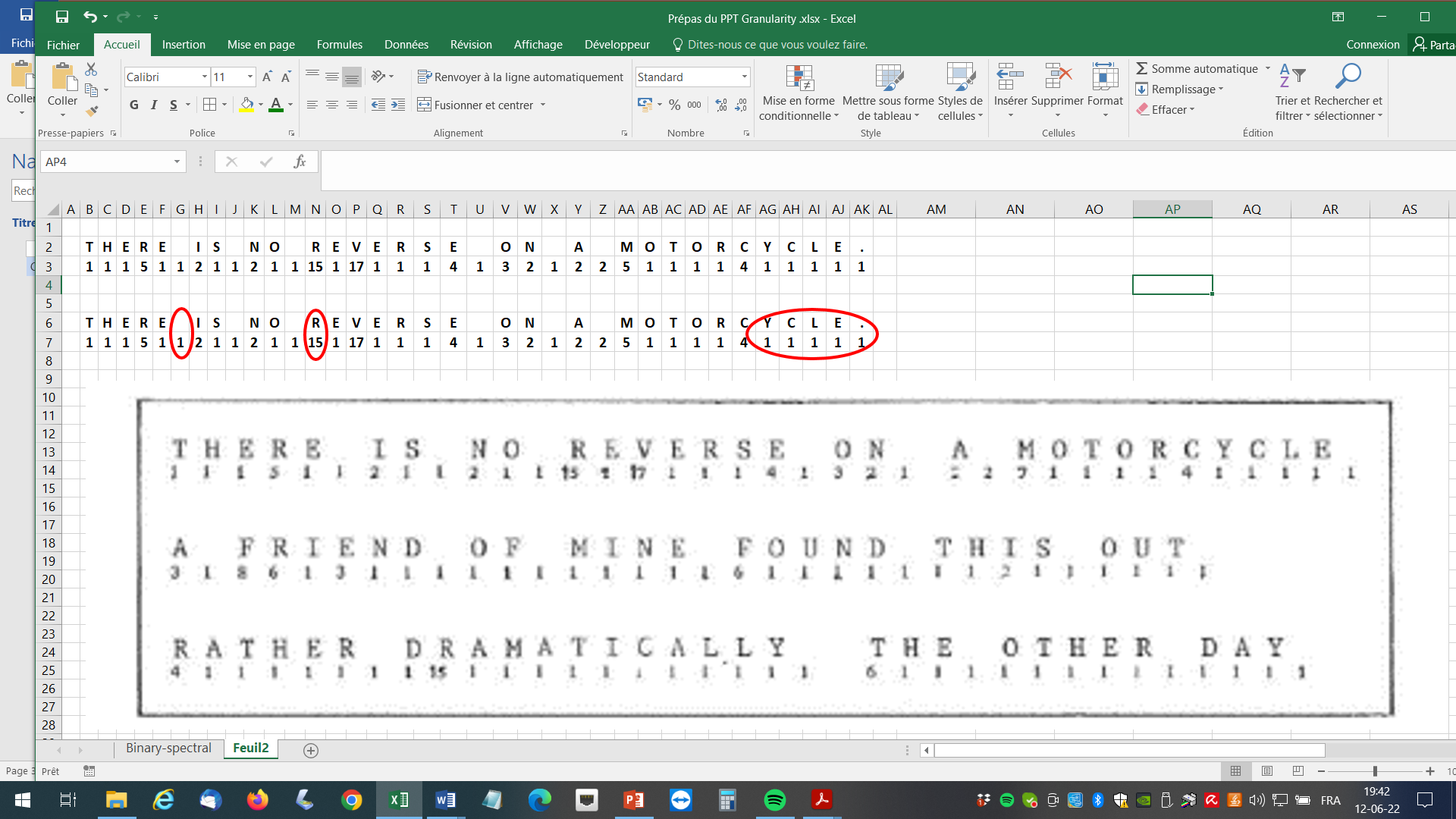
In 1971, I discovered the
Shannon Letter Guessing Game or SLGGame :
number of guesses per letter
Claude Shannon
Leclercq Letter Guessing Game
LLGGame 1 1 « confidenced » Letter
T
H
E
R
E
-
I
S
-
N
O

Slide 11
Some letters are difficult to guess
Space is a letter to be guessed
Some letters are easy to guess

Slide 12
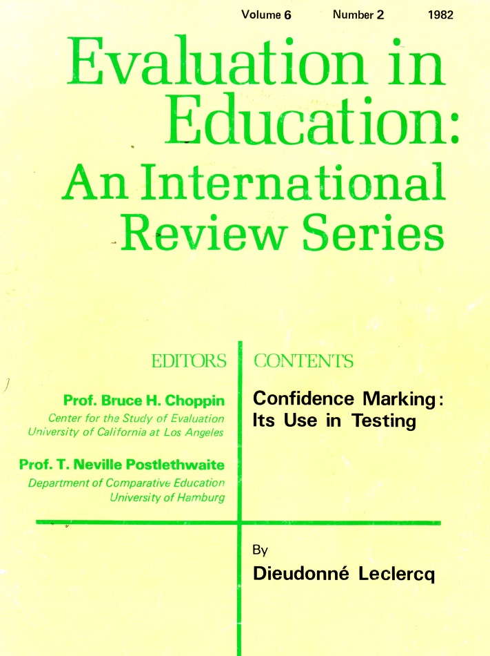
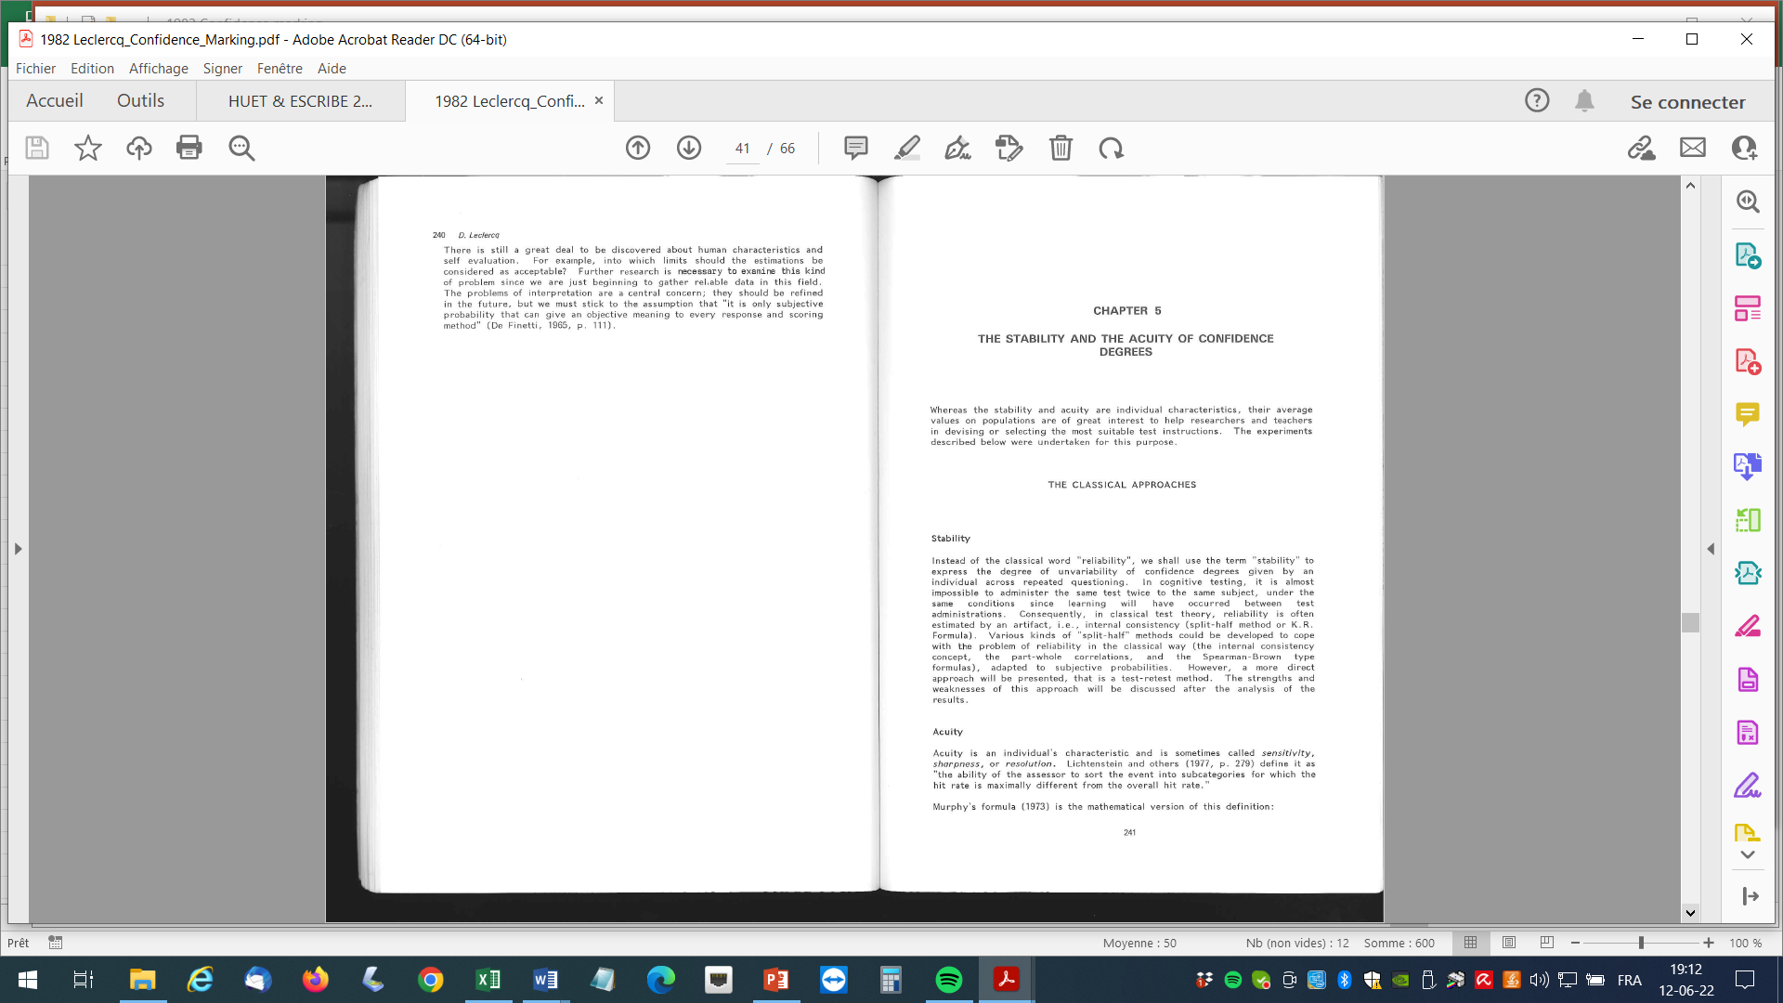
G1. The pioneer: Shannon’s Letters Guessing Game or SLGG
This game (Attneave, 1959, Leclercq, 1982, 243) is based on the selection, by the researcher, of a text from a book, or a newspaper or else, written in a language known by the subjects (French or English, or Spanish, etc.), but that has never been read by the player. It consists in asking to the player to guess the first letter of the text. After a response, the player is informed whether her guess is correct (then the player guesses the second letter, knowing the first one) or not (in this latter case, the subject proposes another letter). The number of guesses is counted for each letter to get the correct one. Shannon used this game to demonstrate how much redundant are natural languages like English or French: many letters are correctly guessed by providing only 1 response (in the first guess).
1982

Slide 13
LLGG 1 cannot be used for repetition ------→
Leclercq LGGame 2 truncated §

Slide 14
LLGG 2 : Truncated paragraphs (§)

Slide 15
Leclercq Letter Guessing Game LLGGame 2 : truncated §
3 confidence scales

Slide 16
3 scales with different Inter Confidences Intervals (ICI) ::
4 degrees
ICI = 25%
10 degrees
ICI = 10%
40 degrees
ICI = 2,5%

Slide 17
Results
Repetition curves with the
40
degrees scale

Slide 18
NB: The following values merge 2 sources of variation: items and subjects.
LLGG2 (truncated §) Chosen CDs with the 40 degrees scale by 74 adults on 100 items (Leclercq, 1982, p. 252)
Distribution of the 7400 Confidence degrees given with scale 40 degrees
Result : 11 prefered values : the multiples of 10
So let us concentrate on the 4 and 10 degrees scales

Slide 19
There are 2 criteria of a satisfying Repetition distribution
for instance for a Confidence Degree 60%
in a scale where the Inter-Confidence Interval or ICI is 10%
-criteria 1: The Mode (Most frequent value) of CD on retest is 60%
-criteria 2: The other Confidence Degrees are close to 60%,
i.e. the Repetition Error Range is narrow, i.e.
RER ≤ ICI
In science, the pretention of precision may not exceed the precision of the instrument.

Slide 20
A ficticious example for 10 Confidence Degrees (ICI = 10%) on pretest,
with the following Repetition distribution:
Mode OK
The repetition
Mode is 60%----→ OK
RER
= OK?
(2) The distribution Range
(or Repetition Error Range)
is narrow, but is it OK ?

Slide 21
How to compute
the Repetition Error Range or RER ?
Since many Repetition distributions are not normal (not gaussian),
- criterion 1 will be the Mode (and not Mean).
-the Repetition Error Range (RER) will be computed by
the Semi-Interquartile Range,
i.e. (Quart3 – Quart1) / 2
of the distribution of the confidences provided on re-test.

Slide 22
Example: if, for 10 uses of Confidence 60% and ICI = 10% on test,
the retest distribution is
then
Mode is OK
since it is 60% as expected
Quart1 = 50%
Number of uses in retest
Quart3 = 70%
RER = 20% / 2
= 10%
Here,
RER (10%) = ICI (10%)
OK

Slide 23
Results
Observed data from 40 Subjects answering 100 questions
on LLGG2 (truncated §)
Repetition curves with the
4
degrees scale

Slide 28
All OK
but
Compressive ?

Slide 29
Repetition curves with the
10
degrees scale

Slide 40
OK
3 Modes out of 10 do not match
All the Repetition Error Ranges
exceed the Inter-Confidence Interval
NO
OK
Granularity or Precision
is less than 10 degrees
OK
OK
OK
OK
0 10 20 30 40 50 60 70 80 90 100
0 1 2 3 4 5 6 7 8 9

Slide 41
methodological challenges :
Questions on which domain?
    Hopefully
      -automatic generation of questions
      -automatic correction & feedback
      -large number of potential questions
Leclercq Letter
Guessing Game
LLGG 2
(2) A domain on which it can
neither be learned nor forgotten
in the interval between pre and post
(3) With the same mindset in the 2 occasions (pretest and retest)

Slide 42
Example of answers to a question on the LLGG 3 (process noted)
Modified De Finetti (1965)’s 5 stars system : * * * * * i.e. 5 20 40 60 80 95
ICI = 20
Up to 4 responses
or
The sum of confidences may be inferior to 100
(here 85%)

Slide 43
Example of answers to 2 questions on the LLGG 3 (Leclercq Letter Guessing Game 3) process noted
There may be several hypotheses
for an answer
There may be less than 4 answers

Slide 44
Repetition curves with a
6
degrees scale
on LLGG 3
(truncated § and process noted)

Slide 52
Discussion & Conclusion
This level of granularity (6 degrees) and these ICIntervals (20) are also
convenient for 3 reasons
1. It fits learners preferences in terms of number of confidence degrees
2. For Research purposes
3. For Educational (school & training) purposes
I suggest this optimal number 6

Slide 53
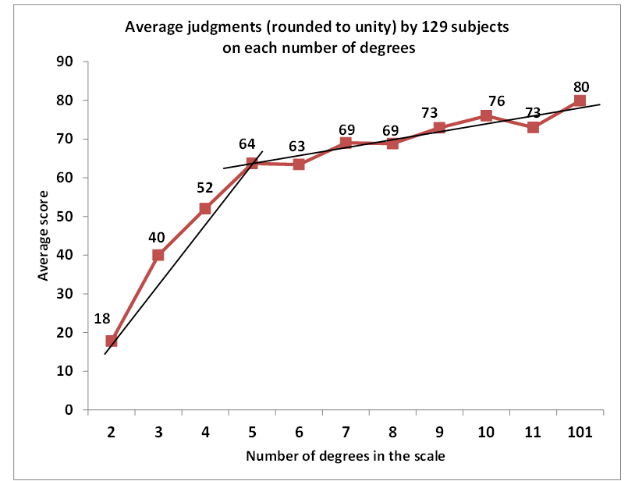
The optimal number
fits subjects preferences
Results from he study by
Preston & Colman, 2000
The question was :
« What is the adequacy of a
confidence scale with …….degrees ? »

Slide 54
Discussion & Conclusion
(2) This optimal number 6 is convenient for Research
-I used this 6 degrees scale to study,
on large populations (from 2000 to 4000 entering university students )
-their calibration characteristics
  -the issue of « local » or « global » characteristics (Schraw, 2003)
-the precision or granularity of confidence in binary questions (True / False)
-the reasons of miscalibration, especially in therapeutic patient edcuation.
But these are other stories

Slide 55
(3) This Optimal number 6 is convenient for educational purposes
The scale of qualities of confidenced responses (= spectrum of knowledge)
can be partitioned into zones such as
It can also be expressed in multiples of 20%,
even with the fingers.
These instructions have been used
in many training sessions
in various domains, in various conutries... and measures have been published
0 20 40 60 80 100

Slide 56
References on request
Thank you for your attention
d.leclercq@uliege.be

