Slide 1
Annual Congress of the Belgian Society of Internal Medicine 13 - 14 December 2019
CLINICAL CASE
CHRONIC GRANULOMATOUS DISEASE
Marine Mina
ULiège
Department of Infectious Diseases and Internal Medicine
Pr. Moutschen

Slide 2
CLINICAL CASE
In May 2018, a 28 year-old patient with chronic granulomatous disease (CGD) comes to our service
He is suffering from asthenia, chest pain and dry cough since 2 months. He has lost 3 kg over the last 6 months
Medical history:
- Anal granuloma
- Anal fistula treated by surgery
- Appendicectomy
Shoulder fracture
Lifestyle :
- He has always lived in Luxembourg.
- He has no allergies, he does not smoke and does not drink alcohol
- No recent travelling
Family history:
- 3 brothers with CGD
Medical treatment :
- Prophylaxis since birth with Cotrimoxazole (TMP-SMX) 1/d and Itraconazole 100mgx2/d
- Poor observance to microbial prophylaxis since 2017.

Slide 3
WHAT DO YOU KNOW ABOUT CHRONIC GRANULOMATOUS DISEASE (CGD) ?
A - It is a rare disease
B - It is a type of common variable immunodeficiency (CVID)
C - It is a genetic disorder
D - It is a X-linked genetic disorder
E – It is an autoimmune disease

Slide 4
WHAT DO YOU KNOW ABOUT CHRONIC GRANULOMATOUS DISEASE (CGD) ?
A - It is a rare disease
B- It is a type of common variable immunodeficiency (CVID)
C - It is a genetic disorder
D - It is a X-linked genetic disorder
E- It is an autoimmune disease
Dysfunction of the NADPH oxidase complex of phagocytes => increasing susceptibility to severe fungal and bacterial infections and granuloma formation, early in childhood.

Slide 5
GOING BACK TO OUR CLINAL CASE
A « CGD » patient with a low prophylaxis observance
Asthenia, chest pain, dry cough, moderate weight loss since March 2018
Clinical examination : swollen axillary left node (2,5 cm)
Blood test :
Hb : 12, 5 mg/L Bilirubine t : 0.60 mg/dl (<1.2)
GB : 4 360 /mm3 Bilirubine c : 0.29 mg/dl (<0.39)
CRP : 20 mg/L PAL : 143 U/L (40-130)
GFR : > 60 GGT : 26 U/L (<60)
TGO : 23 U/L (<37)
TGP : 21 U/L (<41)

Slide 6
WHAT WOULD YOU SUGGEST TO DO?
A - Quantiferon-TB Gold test
B - Chest CT
C - PET CT
D - Hospitalisation of the patient
E - ANA, ANCA
F - Main serologies : HIV, EBV, CMV, Toxoplasmosis, Bartonella, Nocardia
G - Lymphocyte subsets phenotyping
H - (1-3) beta D glucan
I - Lymph node biopsy
1 : all the answers
2 : all the answers except D
3 : answer I only
4 : all the answers except D and I
Another serology ? Which one ?

Slide 7
WHAT WOULD YOU SUGGEST TO DO?
A - Quantiferon-TB Gold test : negative test
B - Chest CT : cf next slide
C - PET CT : cf next slide
D - Hospitalisation of the patient
E - ANA, ANCA : negative
D - Main serologies : HIV, EBC, CMV, Toxoplasmosis, Bartonella, Nocardia , Histoplasmose: negative
E - Lymphocyte subsets phenotyping : negative
F - (1-3) beta D glucan : negative
H - Lymph node biopsy : ongoing
1 : all the answers
2 : all the answers except D
3 : answer I only
4 : all the answers except D and I
Another serology : Aspergillus antigen

Slide 8
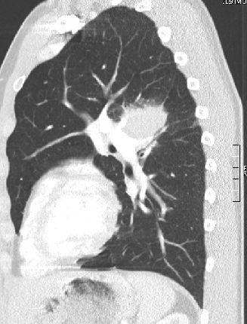
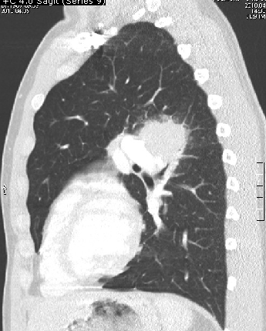
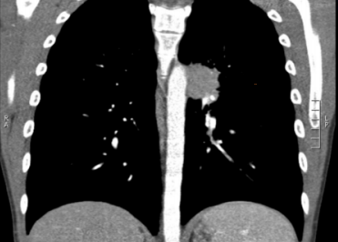
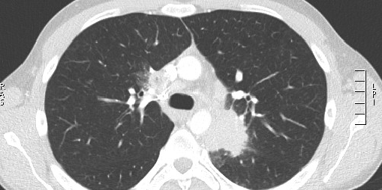
CT CHEST 05/18
Suprahilar right mass, posterior hilar left mass, hilar and mediastinal lymph nodes, axillary nodes
Axial section C+
Sagittal section C +

Slide 9
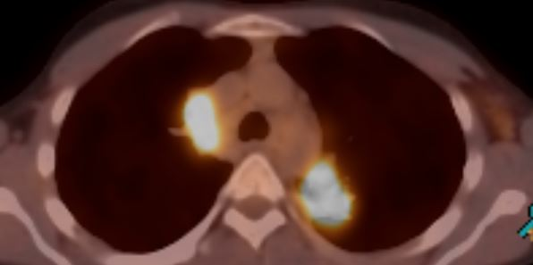
PET-CT 04/18
Axial section
Hypermetabolic activity on all chest CT anomalies described previously

Slide 10
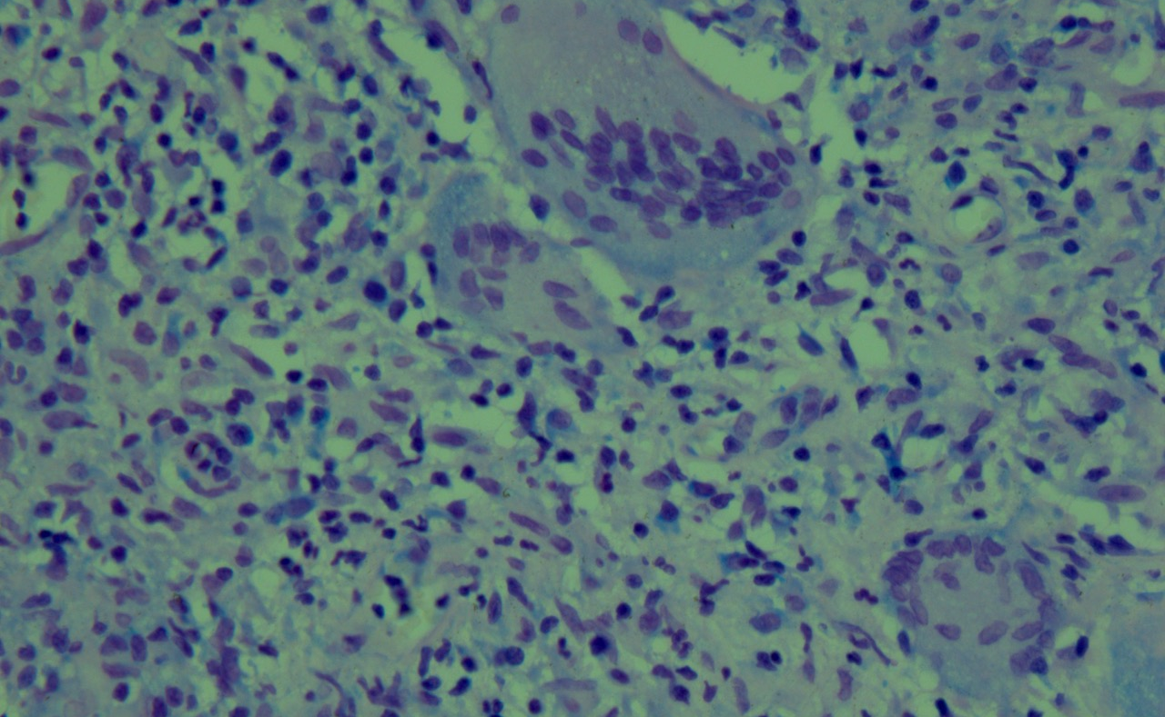
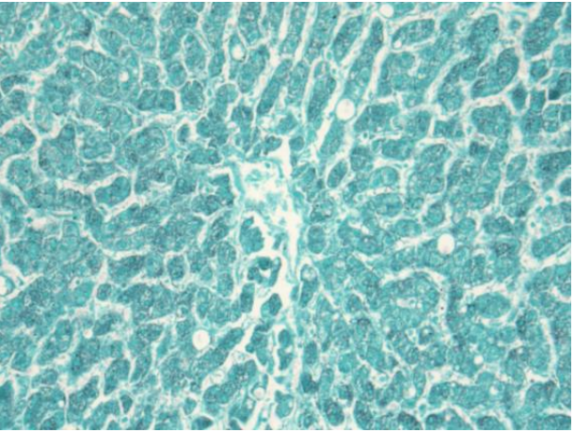
LYMPH NODE BIOPSY PATHOLOGY RESULT
Ziehl : negative
ZIEHL
= > non necrotizing granuloma
Epithelioid granuloma (GE)
Giant cells (CG)
Grocott : negative (not septate hyphae)
GROCCOTT

Slide 11
LYMPH NODE BIOPSY : MICROBIOLOGY RESULT
Mycobacterium of the tuberculosis group
Antibiogram : ongoing

Slide 12
WHAT IS YOUR DIAGNOSIS? WHICH TREATMENT WOULD YOU START?

Slide 13
WHAT IS YOUR DIAGNOSIS? WHICH TREATMENT WOULD YOU START?
Lymphadenitis and pulmonary tuberculosis
Quadritherapy is prescribed (05/18)
(Rifampicine, Isoniazide, Pyrazinamide, Ethambutol) + pyroxidine

Slide 14
ANTIBIOGRAM RESULTS 07/06/18
WHAT IS THE MOST LIKELY REASON FOR THIS RESISTANCE ?
= > Natural resistance ?
= > Acquired drug resistance ?
WHAT IS YOUR DEFINITIVE MICROBIOLOGICAL DIAGNOSIS ?
= > Mycobacterium bovis

Slide 15
WHAT IS THE MOST LIKELY RISK FACTOR FOR MYCOBACTERIUM BOVIS INFECTION ?
A - Travelling to exotic places
B - Farm work
C - Iatrogenic (which one ?)
D - Dairy consumption

Slide 16
WHAT IS THE LIKELIEST RISK FACTOR FOR MYCOBACTERIUM BOVIS INFECTION ?
A - Travelling to exotic places
B - Farm work
C - Iatrogenic : BCG vaccination in childhood ⬄ BCG DISEASE
D - Dairy consumption

Slide 17
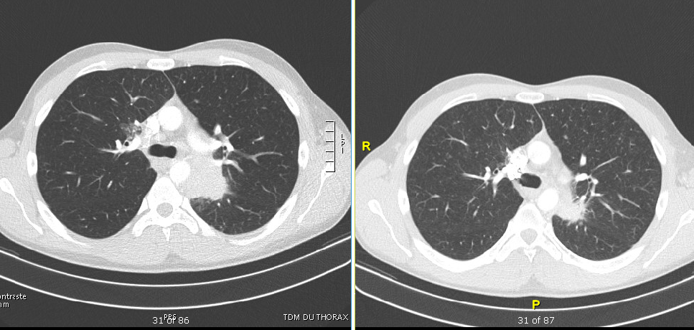
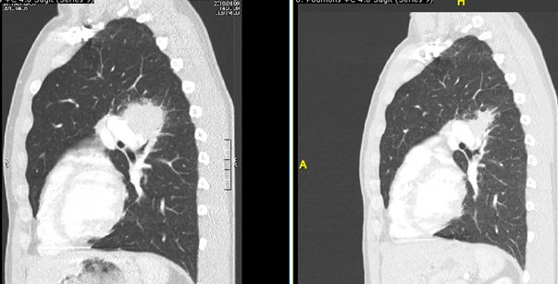
FROM 06/18 TO 02/19
Tritherapy (Rifampicine, Isoniazide, Ethambutol) during 2 months, then bitherapy only (Rifampicine, Isoniazide).
The patient is feeling better, blood tests improve, lung masses and lymph nodes in CT decrease.
1 in 1.2 million individuals
04/18 => 10/18 :
Hb : 13, 1 => 15, 6 mg/L Bilirubine t : 0.62 => 0.7 mg/dl (<1.2) GGT : 26 => 25 U/L (<60)
GB : 7290 = > 6800 /mm3 Bilirubine c : 0.2 = > 0.28 mg/dl (<0.39) TGO : 23 = >19 U/L (<37)
CRP : 19,8 => 4, 3 mg/L PAL : 143 = > 127 U/L (40-130) TGP : 21 = > 18 U/L (<41) GFR : > 60 = > 60
Axial section C+
Sagittal section C +
04/18
10/18
04/18
10/18

Slide 18
MARCH 19
The patient is not feeling well again: asthenia, coughing, chest pain…
Blood test :
Hb 15,1 g/dl
GB 10 470 /mm3
CRP 46,3 mg/L (vs 4,3)
GFR > 60
Bilirubine t : 0,9 mg/dl (<1,2)
Bilirubine c : 0,19 mg/dl (<0,30)
TGO : 31 U/L (<37)
TGO : 34 U/L ( <41)
GGT : 52 U/L ( <60) ;
PAL : 132 U/L ( < 129);

Slide 19
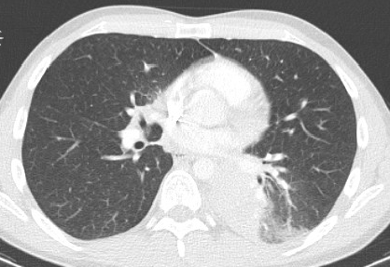
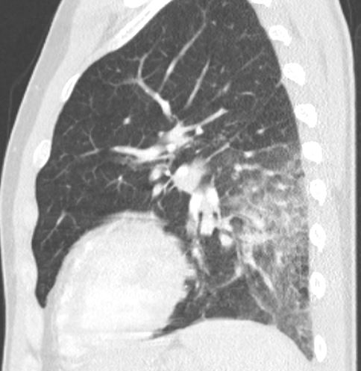
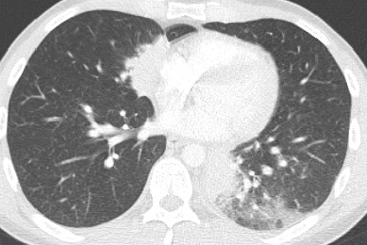
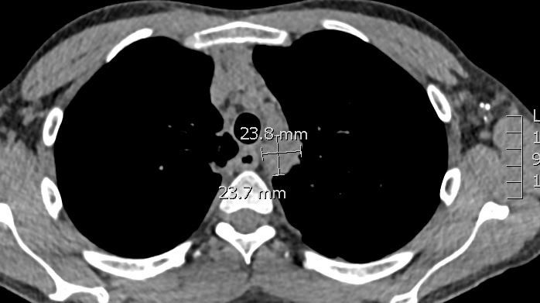
CT CHEST 03/19
Significant increase of the left lung mass, ground glass opacity
Axial section C+
Significant increase of the middle lobe mass
Sagittal section C +
Mediastinal lymph nodes
Axial section C+

Slide 20
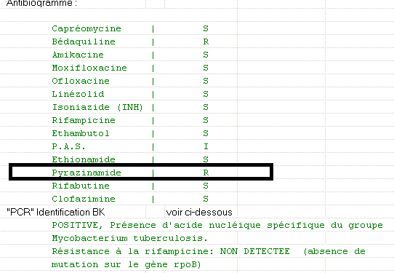
WHAT DO YOU SUGGEST TO DO?
A - Stop bitherapy
B - Restart quadritherapy
C - Restart tritherapy and add Moxifloxacine
D - Surgical excision of pulmonary lesion(s)
E - PET CT

Slide 21
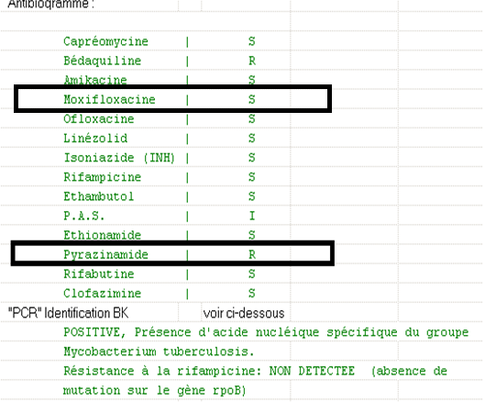
WHAT DO YOU SUGGEST TO DO?
A - Stop bitherapy
B - Restart quadritherapy
C - Restart tritherapy and add Moxifloxacine
D - Surgical ecxision of pulmonary lesion
E - PET CT

Slide 22
MARCH AND APRIL 19
Tritherapy is restarted, and Moxifloxacin is added
No clinical and no biological improvement after several weeks
Hb 10,46 vs 15,1 g/dl
GB 10 460 vs 10 470 /mm3
CRP 126 (vs 46 mg/L in 03/19)
GFR > 60
Bilirubine t : 0,43 mg/dl (<1,2)
Bilirubine c : 0,27 mg/dl (<0,30)
TGO : 32 U/L (<37)
TGO : 32 U/L ( <41°
GGT : 75 vs 52 U/L ( <60) ;
PAL : 130 vs 132 U/L ( < 129)
We decide to hospitalise the patient, who chooses to go to Wiltz in Luxembourg

Slide 23
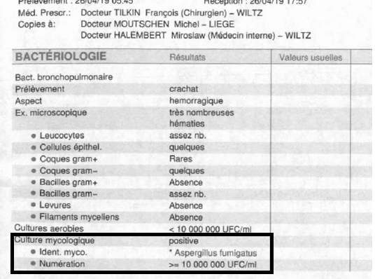
HOSPITALISATION IN LUXEMBOURG IN APRIL 19
CT chest and PET CT : confirm the aggravation
Expectorations :
- Aspergillus Fumigatus
- Negative
BAL :
- Normal macroscopy
- Microbiology : negative

Slide 24
WHICH TREATMENT WOULD YOU RECOMMEND?
Reminder of the patient‘s treatment :
Levofloxacine 400 mg/d;
Ethambutol 400mgx3/d;
Isoniazide 300mg/d,
Rifampicine 300mgx3/d ,
Pyroxidine 40mg/d
A - Cotrimoxazole
B - Voriconazole
C- Clarithromycine
D - Amphotericine B
E - Itraconazole
F - Posaconasole
G - Caspofungine

Slide 25
WHICH TREATMENT WOULD YOU RECOMMEND?
A - Cotrimoxazole
B - Voriconazole
C - Clarithromycine
D - Amphotericine B
E - Itraconazole
F - Posaconasole
G - Caspofungine
Reminder of Mr T’s medical treatment :
Levofloxacine 400 mg/d;
Ethambutol 400mgx3/d;
Isoniazide 300mg/d,
Rifampicine 300mgx3/d ,
Pyroxidine 40mg/d

Slide 26
RECOMMENDATIONS FROM IDSA GUIDELINES
(INFECTIOUS DISEASES SOCIETY OF AMERICA)
For primary treatment of invasive pulmonary aspergillosis :
- oral Voriconazole (200 mg/12h) is recommended for most patients, while IV (6mg/kg/12h day 1 followed by 4 mg/kg/12h) is recommended for seriously ill patients
- Amphotericine B (3-5mg/kg/d) may be considered as an alternative primary therapy
For salvage therapy, agents include : posaconazole, itraconazole, caspofungine or micafungine
6 to 12 weeks minimum
Treatment of Aspergillosis: Clinical Practice Guidelines of the Infectious Diseases Society of America
Thomas J. Walsh,1,a Elias J. Anaissie,2 David W. Denning,13 Raoul Herbrecht,14 Dimitrios P. Kontoyiannis,3 Kieren A. Marr,5 Vicki A. Morrison,6,7 Brahm H Segal,8 William J. Steinbach,9 David A. Stevens,10,11 Jo-Anne van Burik,7 John R. Wingard,12 and Thomas F. Patterson4,a

Slide 27
In our case, there was only one positive expectoration to Aspergillus : colonization ?
Because of the patient’s immunodepression, invasive pulmonary aspergillosis is probable(reference to EORTC criteria)
He is treated with Amphotericine B IV for 2 weeks, followed, as prophylaxis, by aerosolized Amphotericin B
After 2 weeks of Amphotericin, clinico-biologic-and radiologic evolution is reported as satisfactory

Slide 28
IN MAY AND JUNE 19 (DURING AEROSOLIZED AMPHOTERICINE THERAPY)
The patient reports fever and sweating
Blood test results :

Slide 29
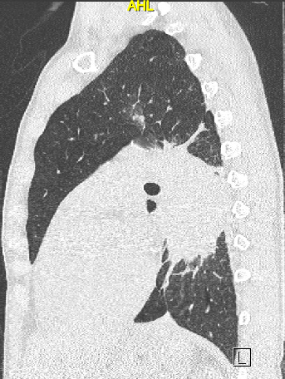
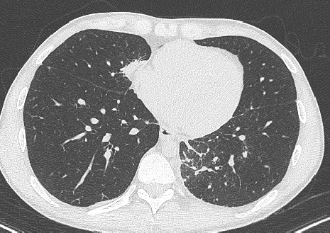
CT CHEST 06/19
Axial section C+
Sagittal section C+
Large left lung mass and middle lobe mass

Slide 30
This time, higher probability of invasive pulmonary aspergillosis is considered
We try Voriconazole, but the target level is never achieved, including with high dose (200mg x3/d)
We decide to stop Rifampicine
- Short combination of Ambisome and Voriconazole
- Then oral Voriconazole therapy only

Slide 31
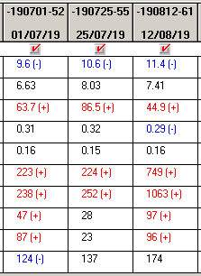
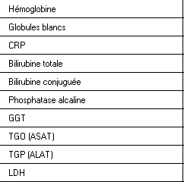
JULY 19 (DURING VORICONAZOLE THERAPY)
The patient suffers from right hip pain, he reports pain and swelling on his left ankle, and low back pain. No respiratory complaint
Blood test shows persitance of CRP and severe liver enzyme alteration
We decide to hospitalise the patient in August

Slide 32
WHAT WOULD YOU SUGGEST TO DO?
A - Stop Voriconazole and restart Amphotericine B
B - Continue Voriconazole (12 entire weeks)
C - Hip MRI, Ankle MRI, and Lumbar MRI
D - PET CT
E - Brain MRI
F - Abdominal US

Slide 33
WHAT WOULD YOU SUGGEST TO DO?
A - Stop Voriconazole and restart Amphotericine B
B - Continue Voriconazole (12 entire weeks)
C - Hip MRI, Ankle MRI, and Lumbar MRI
D - PET CT
E - Brain MRI
F - Abdominal US

Slide 34
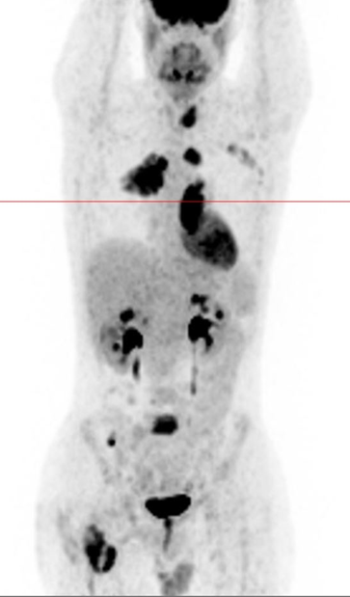
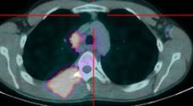
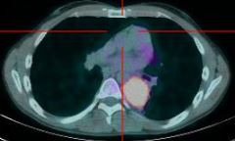
PET CT 08/19
Hypermetabolic activity on :
- middle lobe,
- left superior and inferior lobe,
- right parietal posterior chest wall,
- left lobe thyroid,
- L5,
- right hip,
- behind left pectoral,
- cecal,
- and many superior and inferior
diaphragmatic and left axillary lymph nodes.

Slide 35
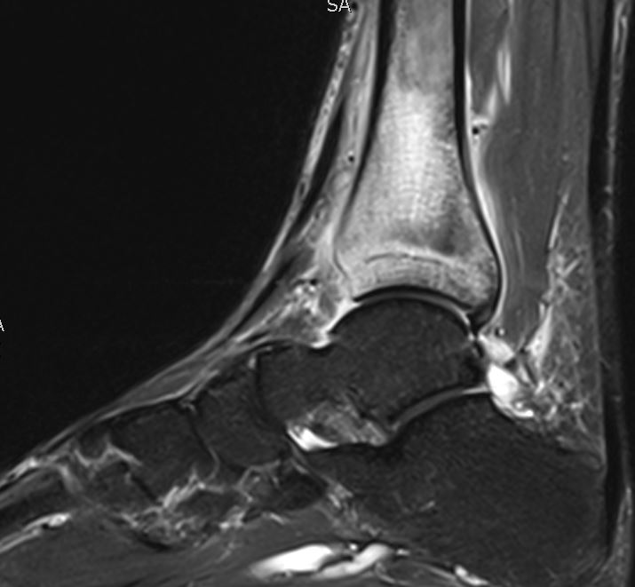
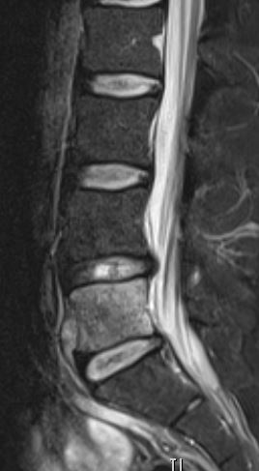
MRI : WHAT DIAGNOSIS CAN BE MADE?

Slide 36
MRI : WHAT DIAGNOSIS CAN BE MADE ?
Sagittale T2 FAT SAT
Axiale T2 FAT SAT
Sagittale T2 FAT SAT
diaphyseal tibial abscess and osteomyelitis
abscess at back of the femoral head with osteomyelitis and myositis
L5 spondylitis without discitis

Slide 37
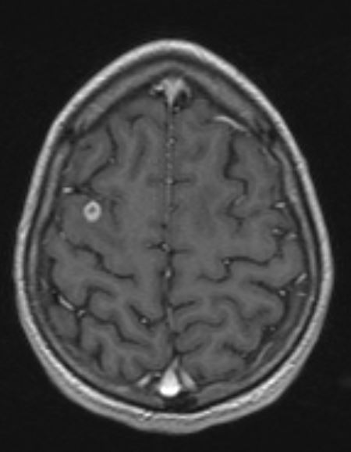
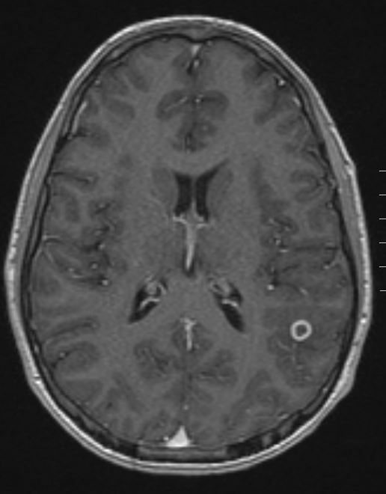
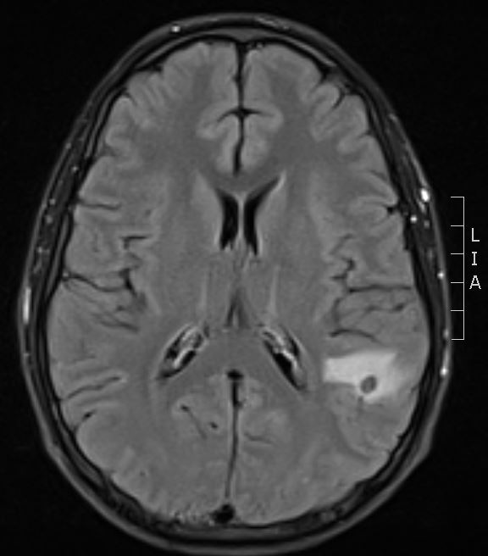
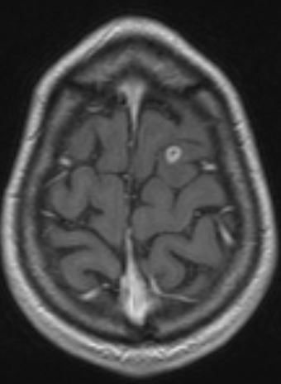
Axial T1 flash 3D C +
Axial T1 flash 3D C +
Axial T2 SWI
Axial T2 FLAIR
WHAT DIAGNOSIS CAN BE MADE ?
(in this clinical case and as differential diagnosis)
Axial T1 flash 3D C +

Slide 38
Axial T1 flash 3D C +
Axial T1 flash 3D C +
Axial T2 SWI
Axial T2 FLAIR
WHAT DIAGNOSIS CAN BE MADE?
Differential diagnosis :
- Bacterial abscess
- Tumor
- Toxoplasmosis
- Miliary Tuberculosis
-Invasive Aspergillosis
Axial T1 flash 3D C +

Slide 39
WHAT ARE THE TWO TYPES OF ORGANISMS IN SPONDYLITIS WITHOUT DISCITIS ?
Mycobacteria and fungal pathogens
SAGITTAL T2 STIR

Slide 40
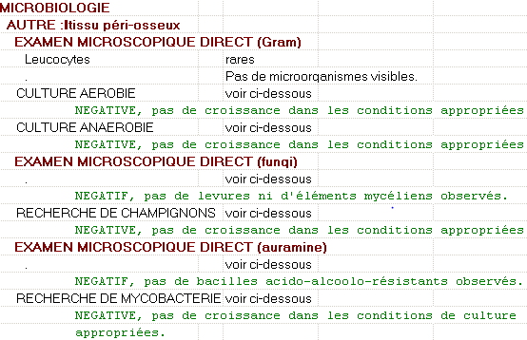
LEFT ANKLE SURGICAL DRAINAGE 08/19
Anatomical pathology :
Ziehl : negative
Grocott : negative (not septate hyphae)
May Grunwald Giemsa : non-necrotizing lymphocytic granuloma
Microbiology results: negative

Slide 41
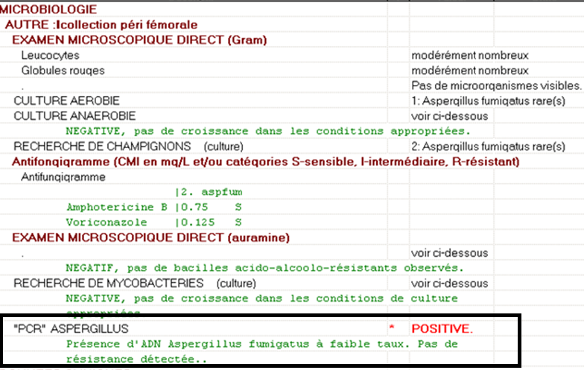
RIGHT HIP SURGICAL DRAINAGE 08/19

Slide 42
We finally conclude to an invasive aspergillosis disease
Ambisome and Imukine (INF gamma therapy, immunomodulatory treatment used in management of CDG) are started

Slide 43
WHAT IS THE TYPICAL SIDE EFFECT OF AMBISOME?
Hypokalemia
hypomognesemia, hyponatremia,
hyperglycemia,
creatinine increase,
flushing, tachycardia, low dose pressure,
nausea, vomiting, diarrhea, stomach pain,
headaches,
Hepatotoxicity.

Slide 44
HOSPITALISATION
Hypokalemia occurs :
We maintain Ambisome and add KCL
Because the patient refuses to stay in hospital, we shift to Posaconazole (250mg/d) :
Clinical improvement
Biological improvement (and no hepatotoxity as with Voriconazole)

Slide 45
Conclusions
Patients with CGD have to receive lifelong antifungal prophylaxis (Itraconazole) and antibacteria prohylaxis (TMP-SMX)
In CGD patients, BCG vaccination is contraindicated Keep in mind the intrinsic resistance of Pyrazinamide to Mycobacterium bovis
In CGD patients: early diagnosis of infection and aggressive management of infectious complications
Let’s not forget invasive aspergillosis in immunodeficent patients, especially CGD patients Invasive pulmonary aspergillosis is the most common life threatening form of invasive aspergillosis, but other forms must be researched
For primary treatment of invasive pulmonary aspergillosis:
Oral Voriconazole is recommended fort most patients, while IV is recommended for seriously ill patients Using a dose of 6mg/kg/12h (Day 1) followed by 4 mg/kg/12h, oral dosage is 200 mg/12h
Amphotericin B may be considered as an alternative primary therapy for some patients: 3-5mg/kg/d

Slide 46
THANK YOU

