Slide 1
A second gradient H²M model to investigate gas migrations in clay materials
13 June 2022 • Clay Conference, Nancy (France)
Gilles Corman¹, Frédéric Collin¹, Séverine Levasseur², Jean Talandier³
¹ University of Liège, ²ONDRAF/NIRAS, ³Andra

Slide 2
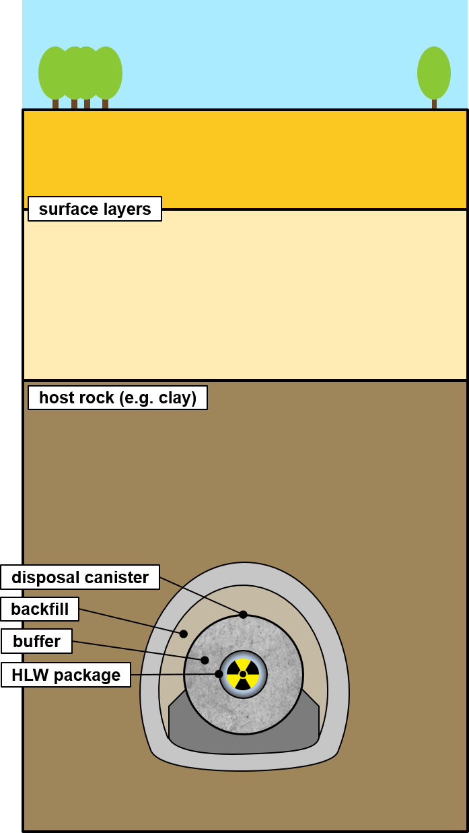
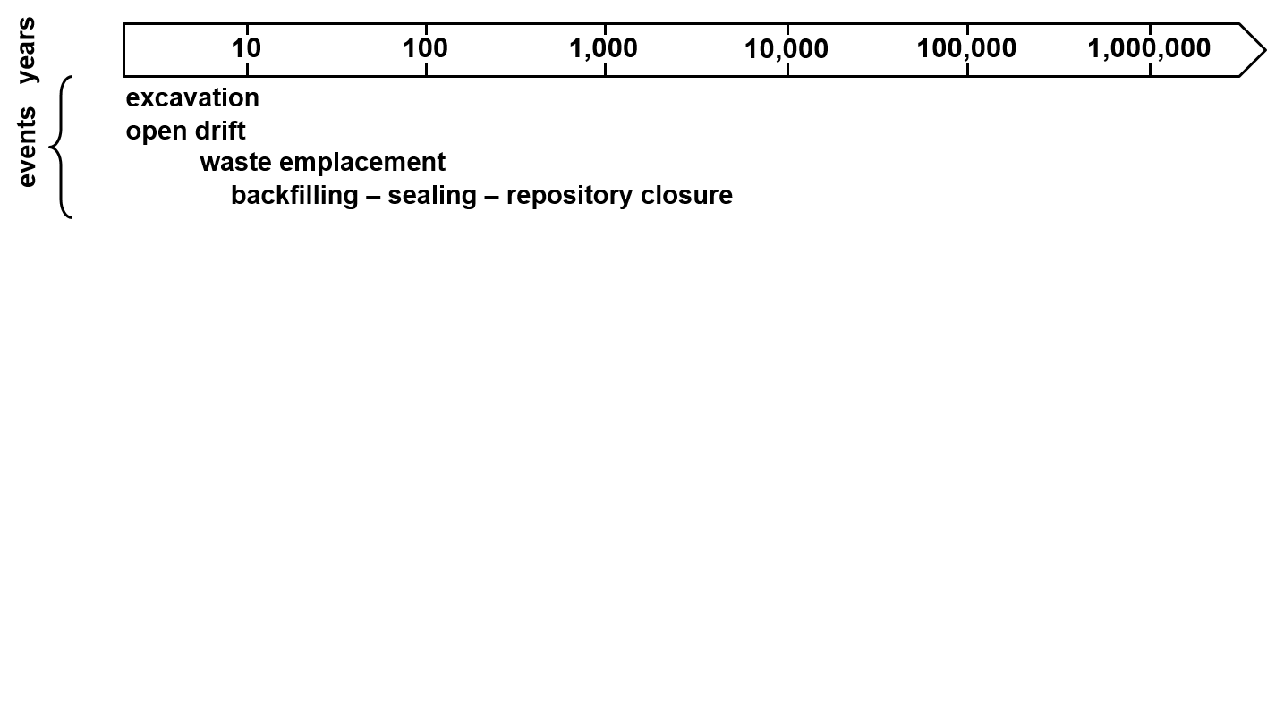
Context
Geological disposal of radioactive wastes
Conceptual scheme of a deep geological disposal, adapted from Grunwald. et al. (2021)
02/16

Slide 3
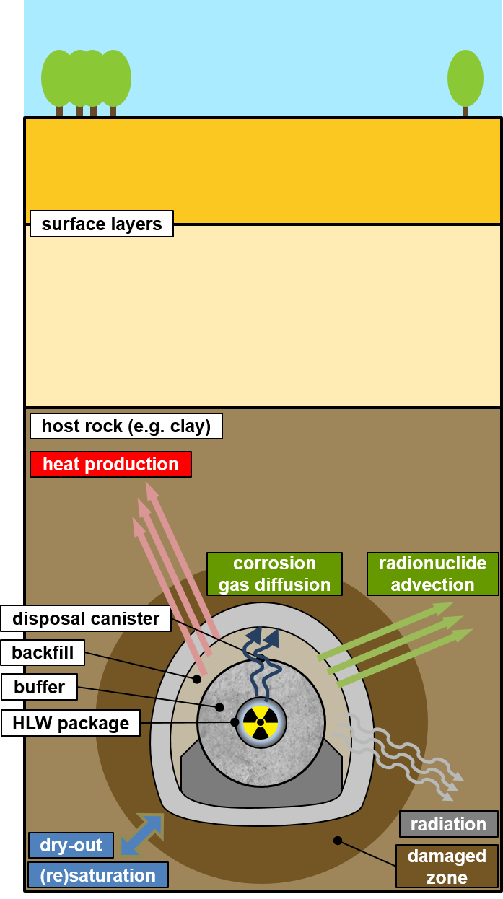
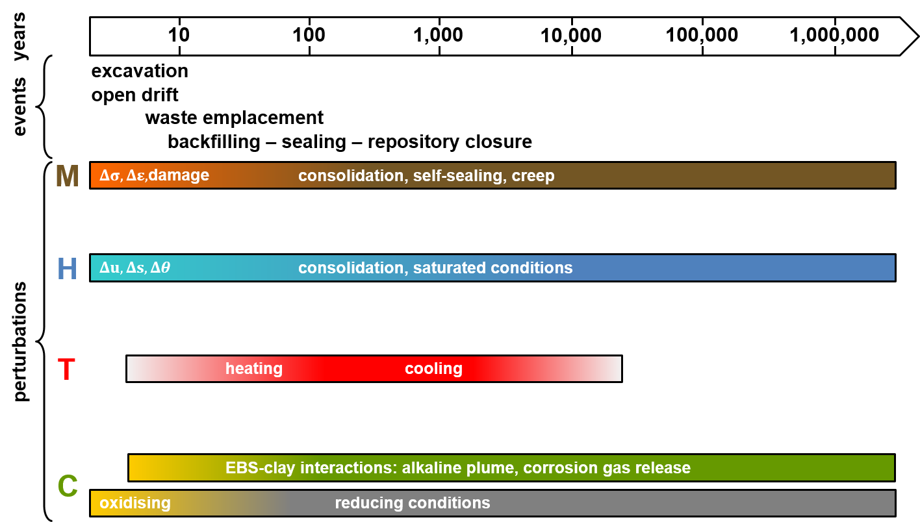
Context
Geological disposal of radioactive wastes
Complex multi-physical (THMC) processes
Conceptual scheme of a deep geological disposal, adapted from Grunwald. et al. (2021)
Major perturbations of the host rock over the lifetime of a geological repository, adapted from Sillen (2012)
02/16

Slide 4
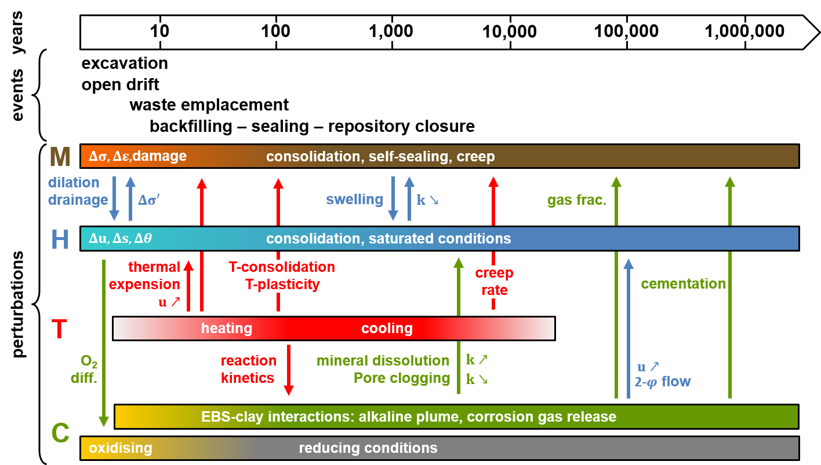
Context
Geological disposal of radioactive wastes
Complex multi-physical (THMC) processes
Interactions between processes
Conceptual scheme of a deep geological disposal, adapted from Grunwald. et al. (2021)
Major perturbations of the host rock over the lifetime of a geological repository, adapted from Sillen (2012)
02/16

Slide 5
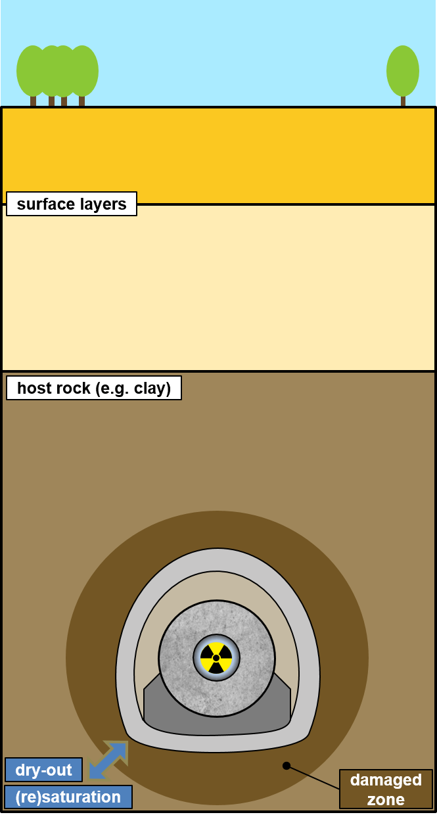
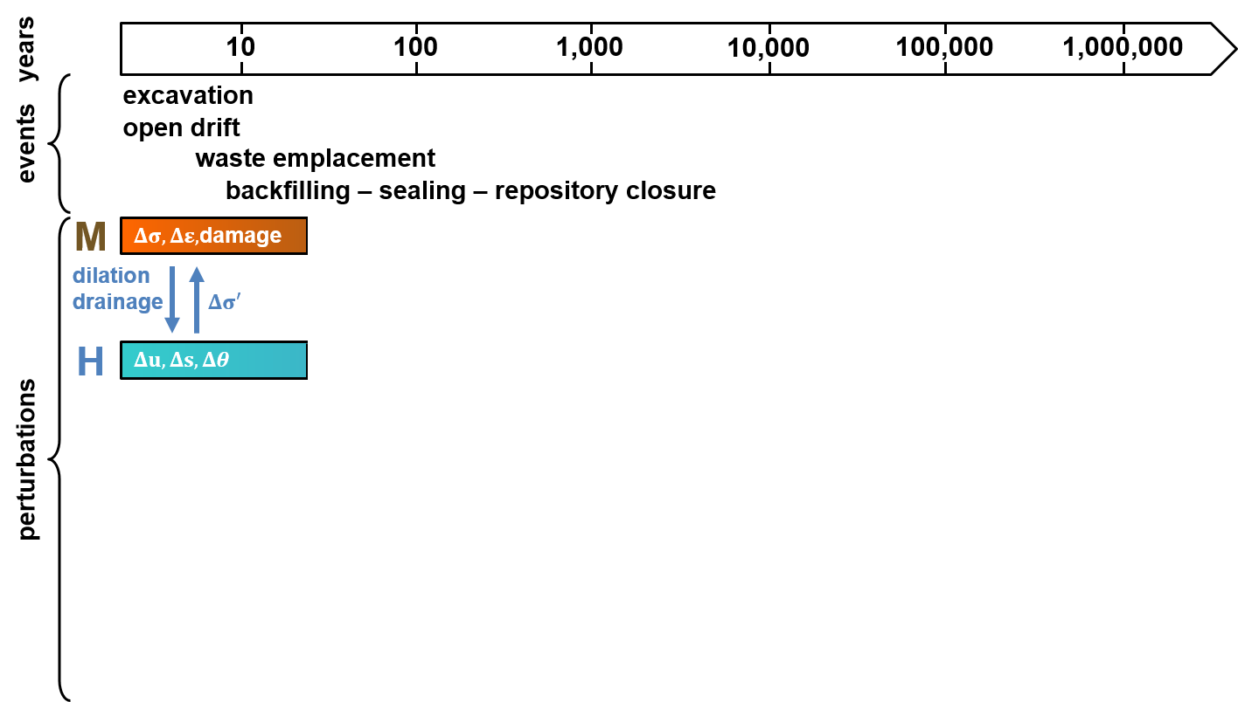
Context
Geological disposal of radioactive wastes
Complex multi-physical (THMC) processes
Interactions between processes
1st aspect:
short-term
Conceptual scheme of a deep geological disposal, adapted from Grunwald. et al. (2021)
Major perturbations of the host rock over the lifetime of a geological repository, adapted from Sillen (2012)
02/16

Slide 6
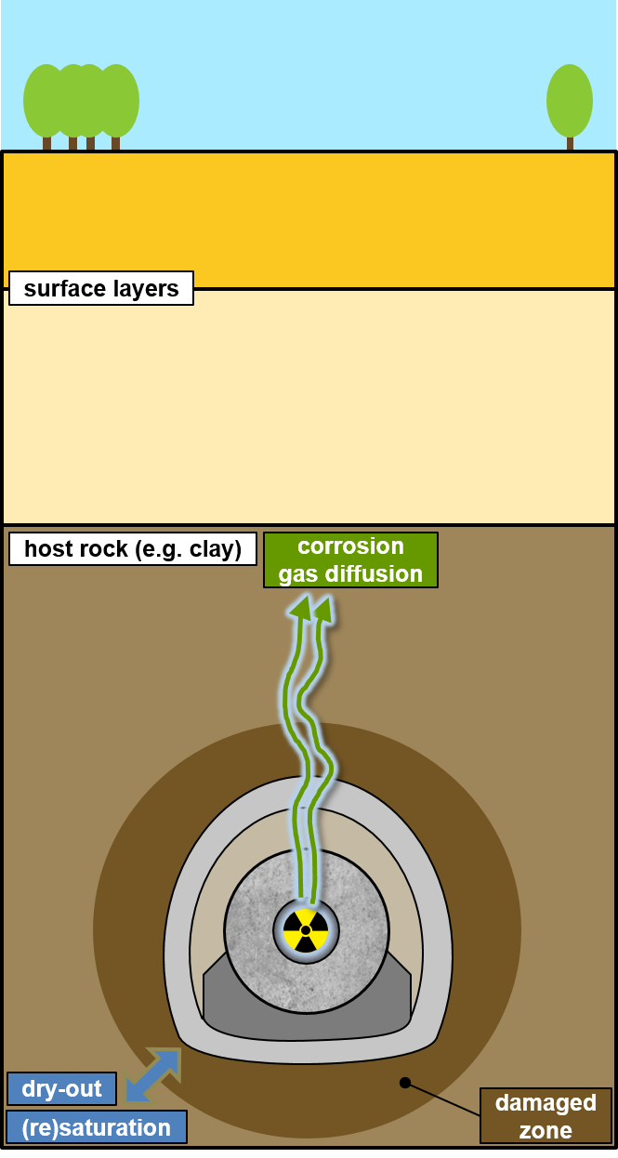
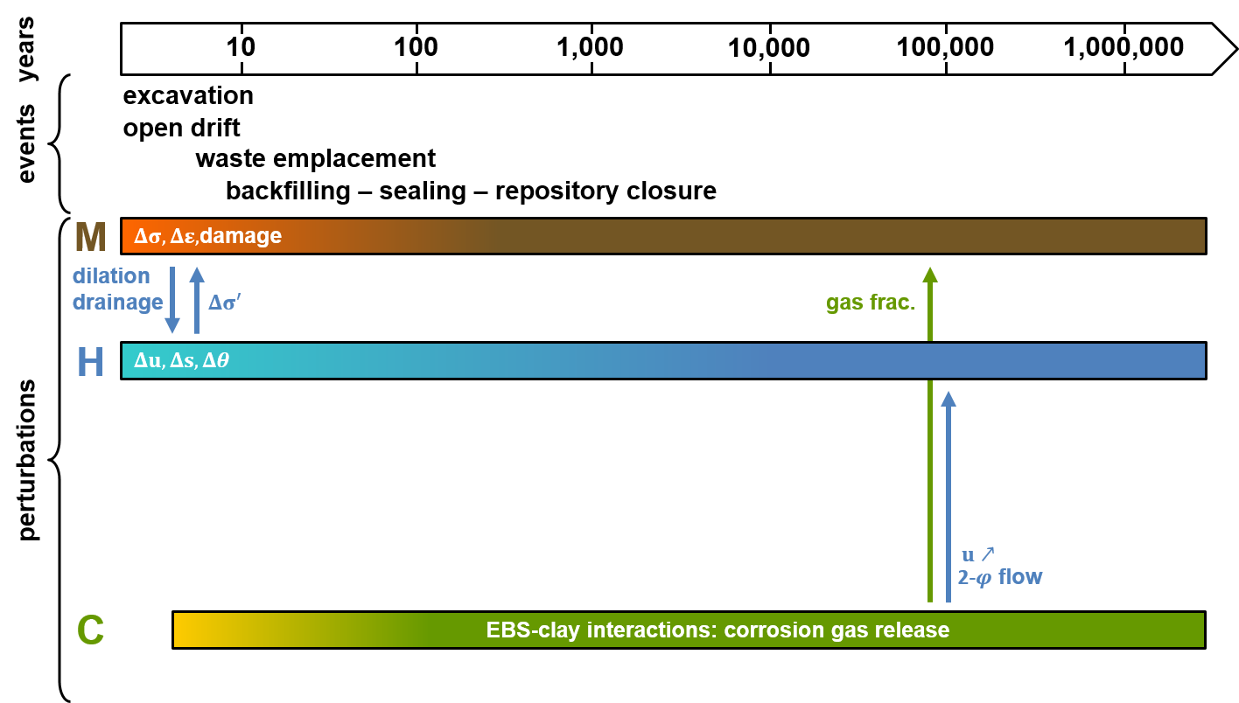
Context
Geological disposal of radioactive wastes
Complex multi-physical (THMC) processes
Interactions between processes
1st aspect:
short-term
2nd aspect:
long-term
Predictions: numerical modelling
Conceptual scheme of a deep geological disposal, adapted from Grunwald. et al. (2021)
Major perturbations of the host rock over the lifetime of a geological repository, adapted from Sillen (2012)
02/16

Slide 7
Table of content
Context
Ingredients of the model
Description of the numerical model
Applications
Conclusions
03/16

Slide 8
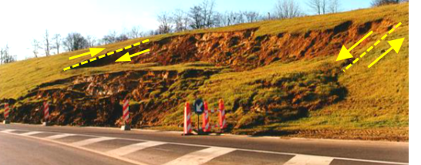
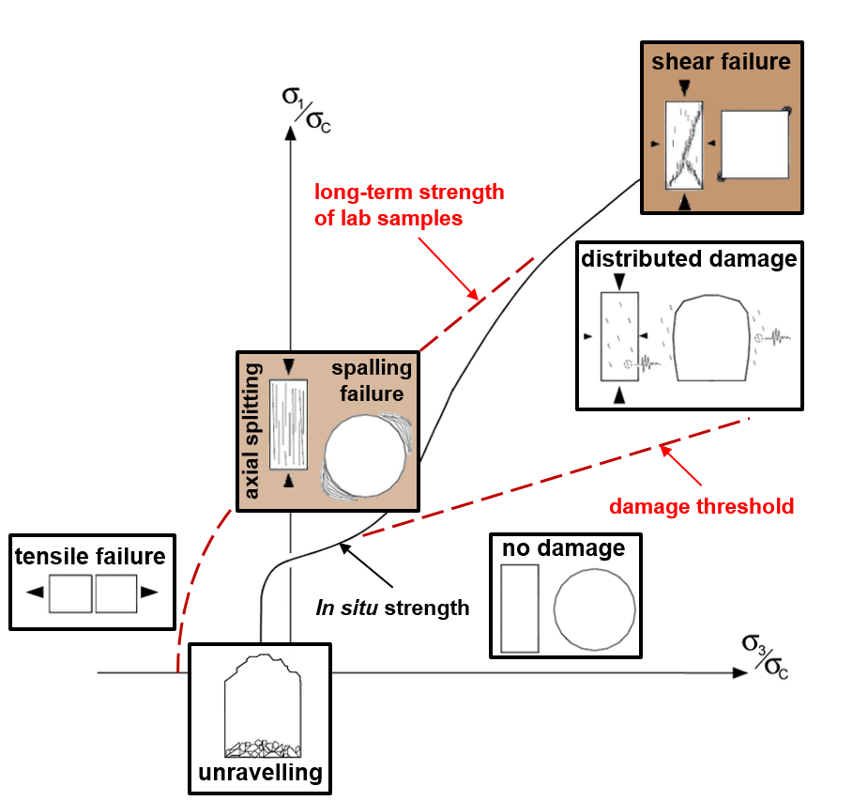
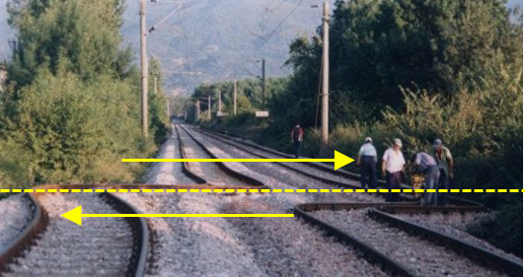
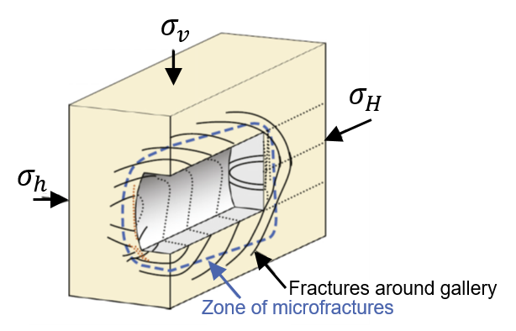
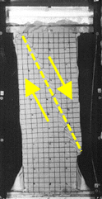
Shear strain localisation evidence
Representation of damage
From geomaterials failure…
…to the drilling of underground galleries…
…in host rock formations.
Boom Clay
Human-made slope failure (Belgium,1998)
COx claystone
Railway tracks after an earthquake (Turkey, 1999)
Biaxial compression test on sand,
Desrues et al. (1999)
Mechanisms of rock mass failure around gallery, adapted from Diederichs (2003)
Fracturation pattern around storage galleries, Bastiaens et al. (2003) and Bernier et al. (2007)
04/16

Slide 9
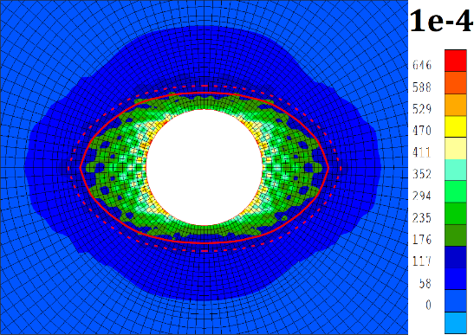
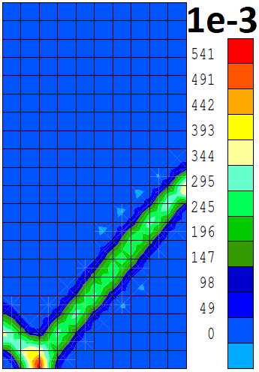
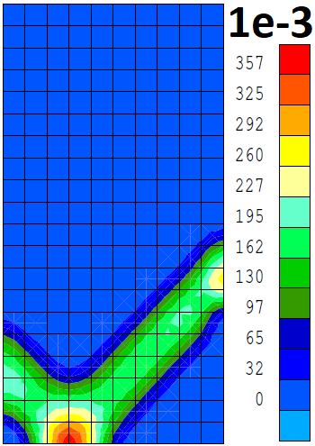
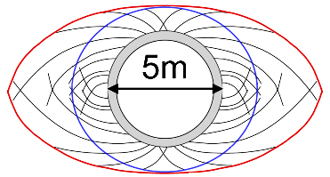
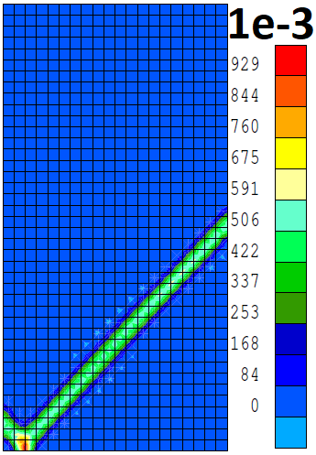
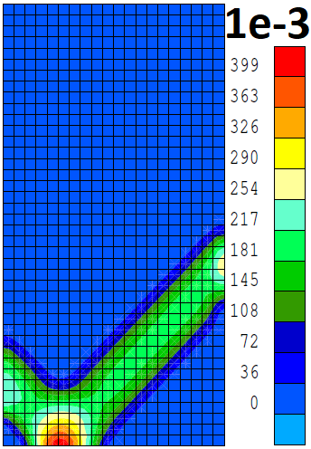
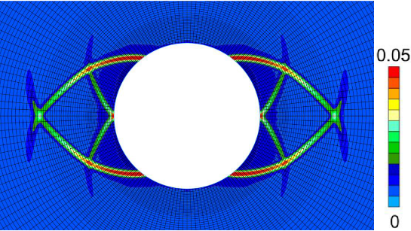
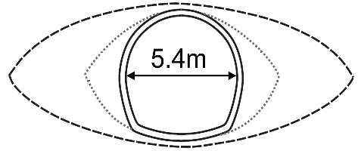
Numerical considerations
Representation of damage
Classical FE methods:
Mesh size dependency
Regularisation technique:
Shear band width control
Numerical vs conceptual extension of the damaged zone:
Boom Clay
Collin et al. (2006)
Deviatoric strain
increment
Deviatoric strain increment
$10×20$ elements
e₁
e₁
e₁
From Salehnia (2015)
$20×40$ elements
e₁$=$e₂
e₁$≠$ e₂
Deviatoric strain
increment
Deviatoric strain
increment
Callovo-Oxfordian claystone
Imposed displacement
Impervious boundary
Constraint displacement
e₂
e₂
Material imperfection
Mesh size: variable
From Pardoen (2015)
05/16

Slide 10
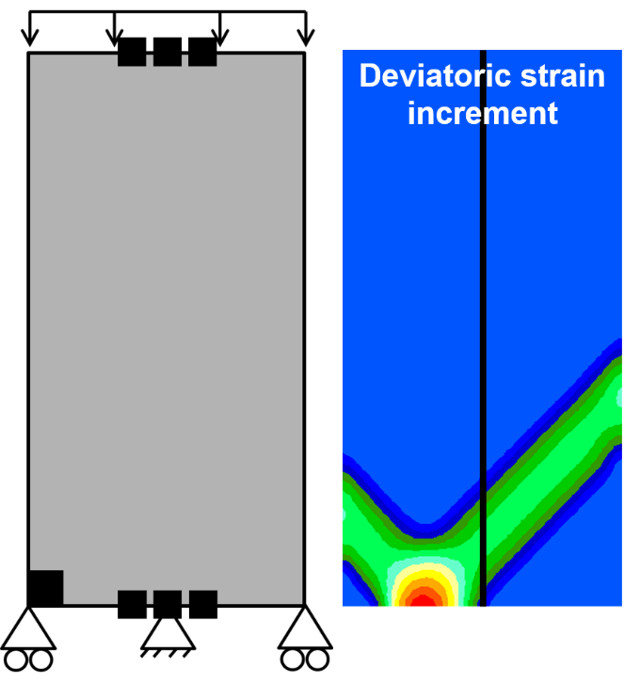
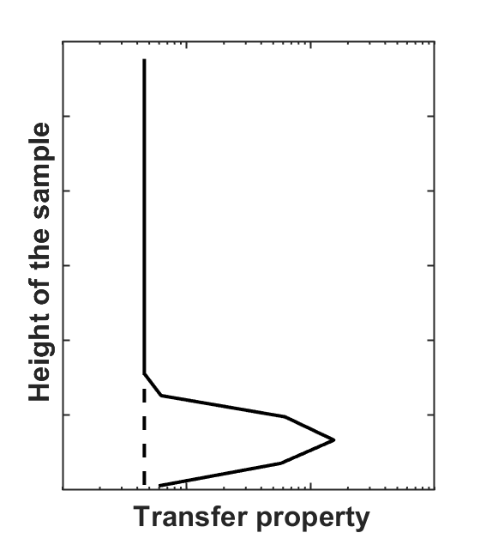
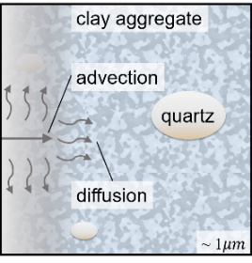
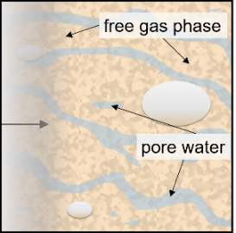
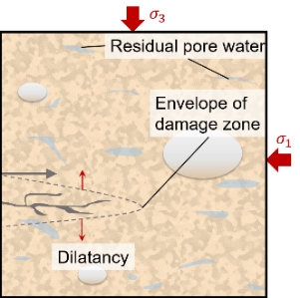
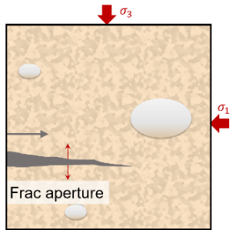
Effects of gas migrations
Concepts of gas transport
Transfer properties evolution with strain
Phenomenological description
Advection and diffusion of dissolved gas
Two-phase flow
Dilatancy-controlled gas flow
Gas transport in fractures
Transport mechanisms
single phase (liquid)
visco-capillary two phase flow
single phase (gas)
Geomechanical regime
poro-elastic deformation
dilatancy
distribted shear failure
localised tensile failure
Description of the four main processes of gas transport in clay materials, adapted from Marschall et al. (2005)
06/16

Slide 11
Table of content
Context
Ingredients of the model
Description of the numerical model
Applications
Conclusions
03/16

Slide 12
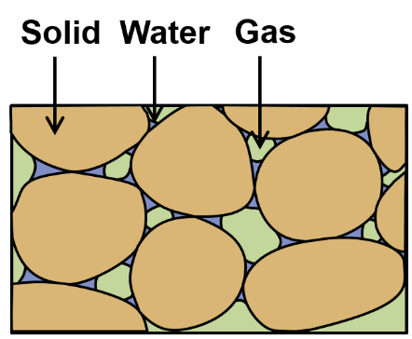
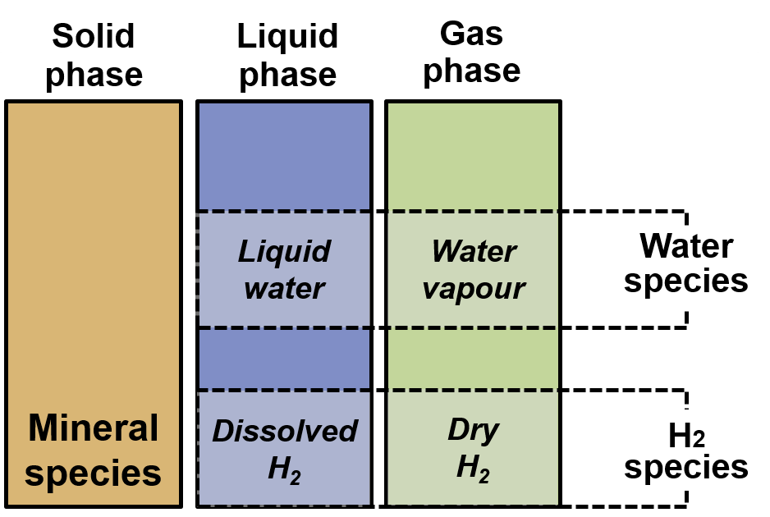
Description of the model
The rock environment surrounding the deep geological disposal can be modelled as:
A multiphasic porous medium
Triphasic porous medium
Phases and species
07/16

Slide 13
Description of the model
The rock environment surrounding the deep geological disposal can be modelled as:
A multiphasic porous medium
With strain localisation in the EDZ
Regularisation technique of 2nd gradient type
Chambon et al. (1998)
Enrichment of the kinematics with microstructure effects
Macro-volume $Ω$  Micro-volumes $Ω^{m}$
Triphasic porous medium
Displacement
$$u_{i}$$
$$u_{i}^{m}$$
$$F_{ij}=\frac{∂u_{i}}{∂x_{j}}$$
$$ν_{ij}=\frac{∂u_{i}^{m}}{∂x_{j}}$$
Deformation
$$Ω$$
$$Ω,u_{i}$$
Phases and species
Kinematics of microstructure continuum
07/16

Slide 14
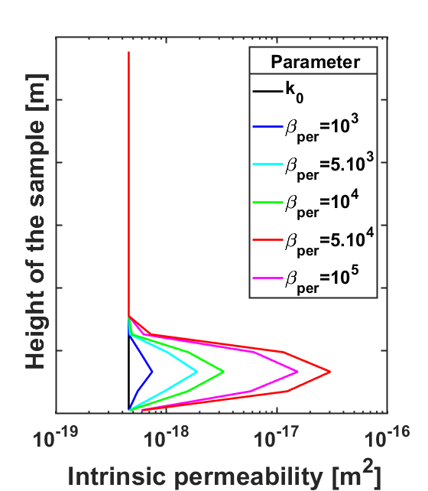
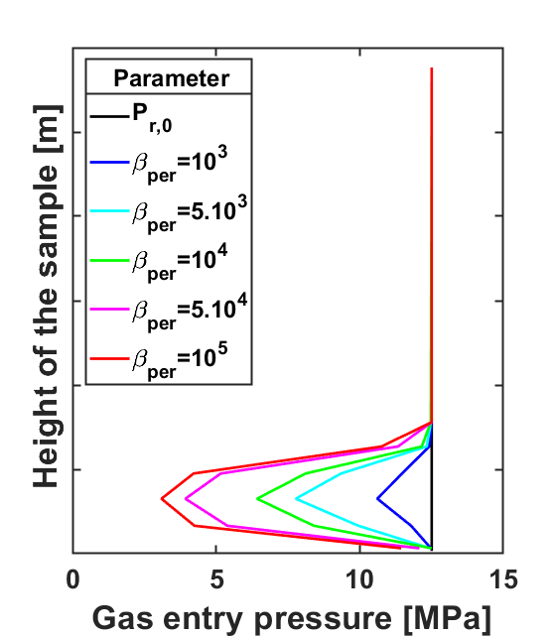
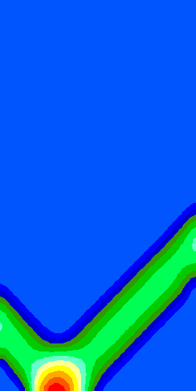
Description of the model
The rock environment surrounding the deep geological disposal can be modelled as:
A multiphasic porous medium
With strain localisation in the EDZ
Including transfer properties evolution with strain
The rock environment surrounding the deep geological disposal can be modelled as:
A multiphasic porous medium
With strain localisation in the EDZ
Including transfer properties evolution with strain
Second gradient H²M model
Intrinsic permeability Pardoen et al. (2014)
Retention behaviour Olivella et al. (2008)
$$k_{w,ij}=k_{w,ij,0}\left(1+β_{per}\left(YI−YI^{thr}\right) {\hat{ε}}_{eq}^{3}\right)$$
$$P_{r}=P_{r,0}\frac{\sqrt[3]{k_{0}}}{\sqrt[3]{k}}$$
Deviatoric strain
increment
08/16

Slide 15
Table of content
Context
Ingredients of the model
Description of the numerical model
Applications
Conclusions
03/16

Slide 16
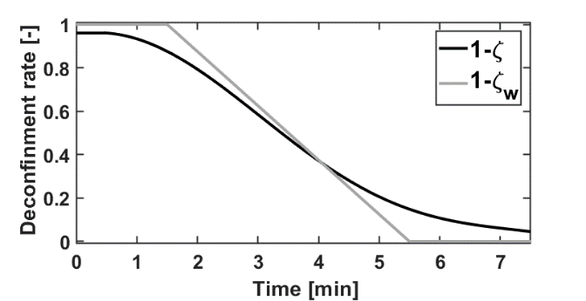
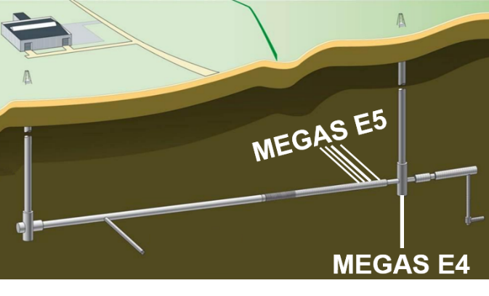
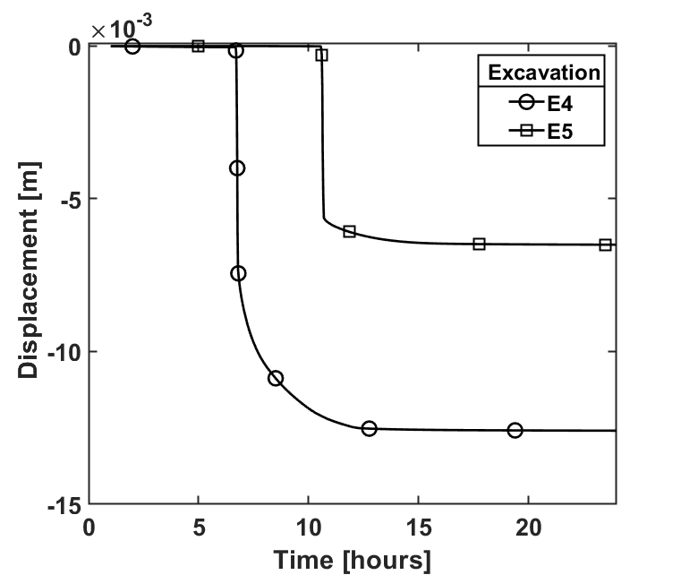
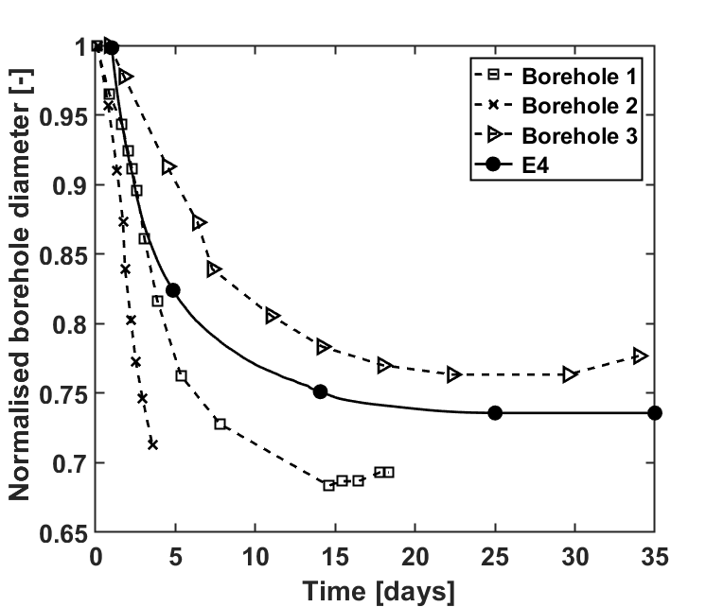
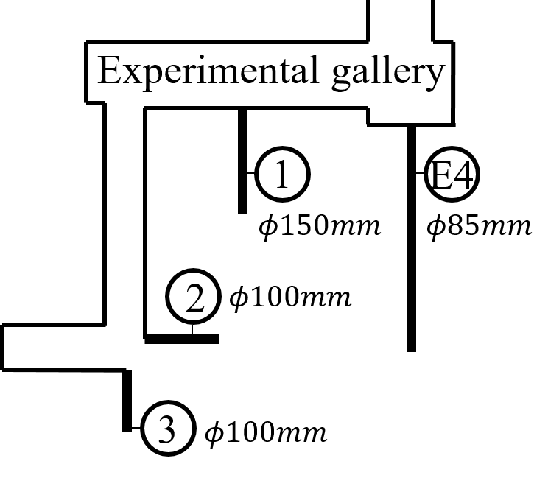
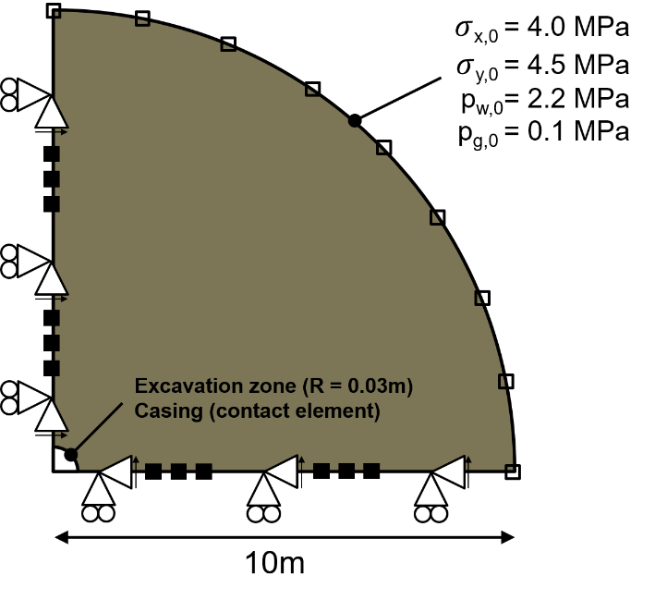
H²M coupled processes – small scale – Boom Clay
Application 1
E4 and E5 (MEGAS) piezometers in the Belgian host rock
Three-step simulations
Excavation
Stabilisation of Pw
Gas migrations
Relevant results
Convergence of the rock mass
Volckaert et al. (1995)
[mm]
09/16

Slide 17
H²M coupled processes – small scale – Boom Clay
Application 1
E4 and E5 (MEGAS) piezometers in the Belgian host rock
Three-step simulations
Excavation
Stabilisation of Pw
Gas migrations
Relevant results
Development of plasticity in the near field
E4 vertical piezometer
Volckaert et al. (1995)
E5 horizontal piezometer
10/16

Slide 18
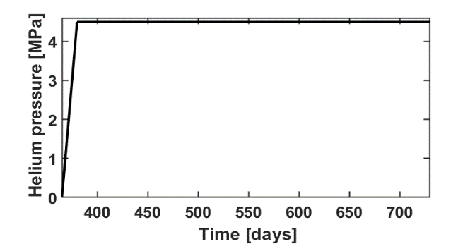
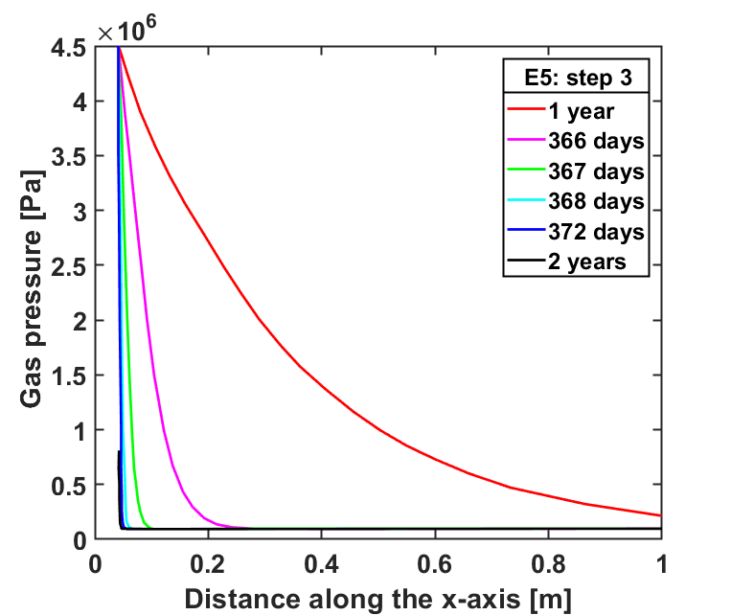
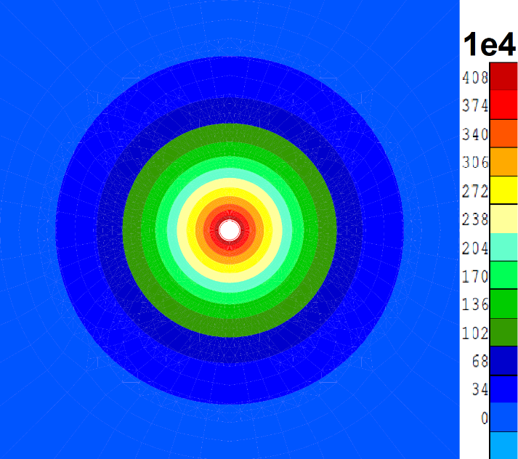
H²M coupled processes – small scale – Boom Clay
Application 1
E4 and E5 (MEGAS) piezometers in the Belgian host rock
Three-step simulations
Excavation
Stabilisation of Pw
Gas migrations
Relevant results
Evolution of gas pressures in the near field
Map of gas pressure evolution
Volckaert et al. (1995)
1m
11/16

Slide 19
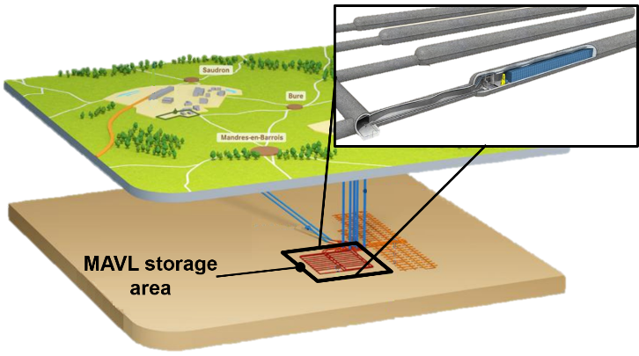
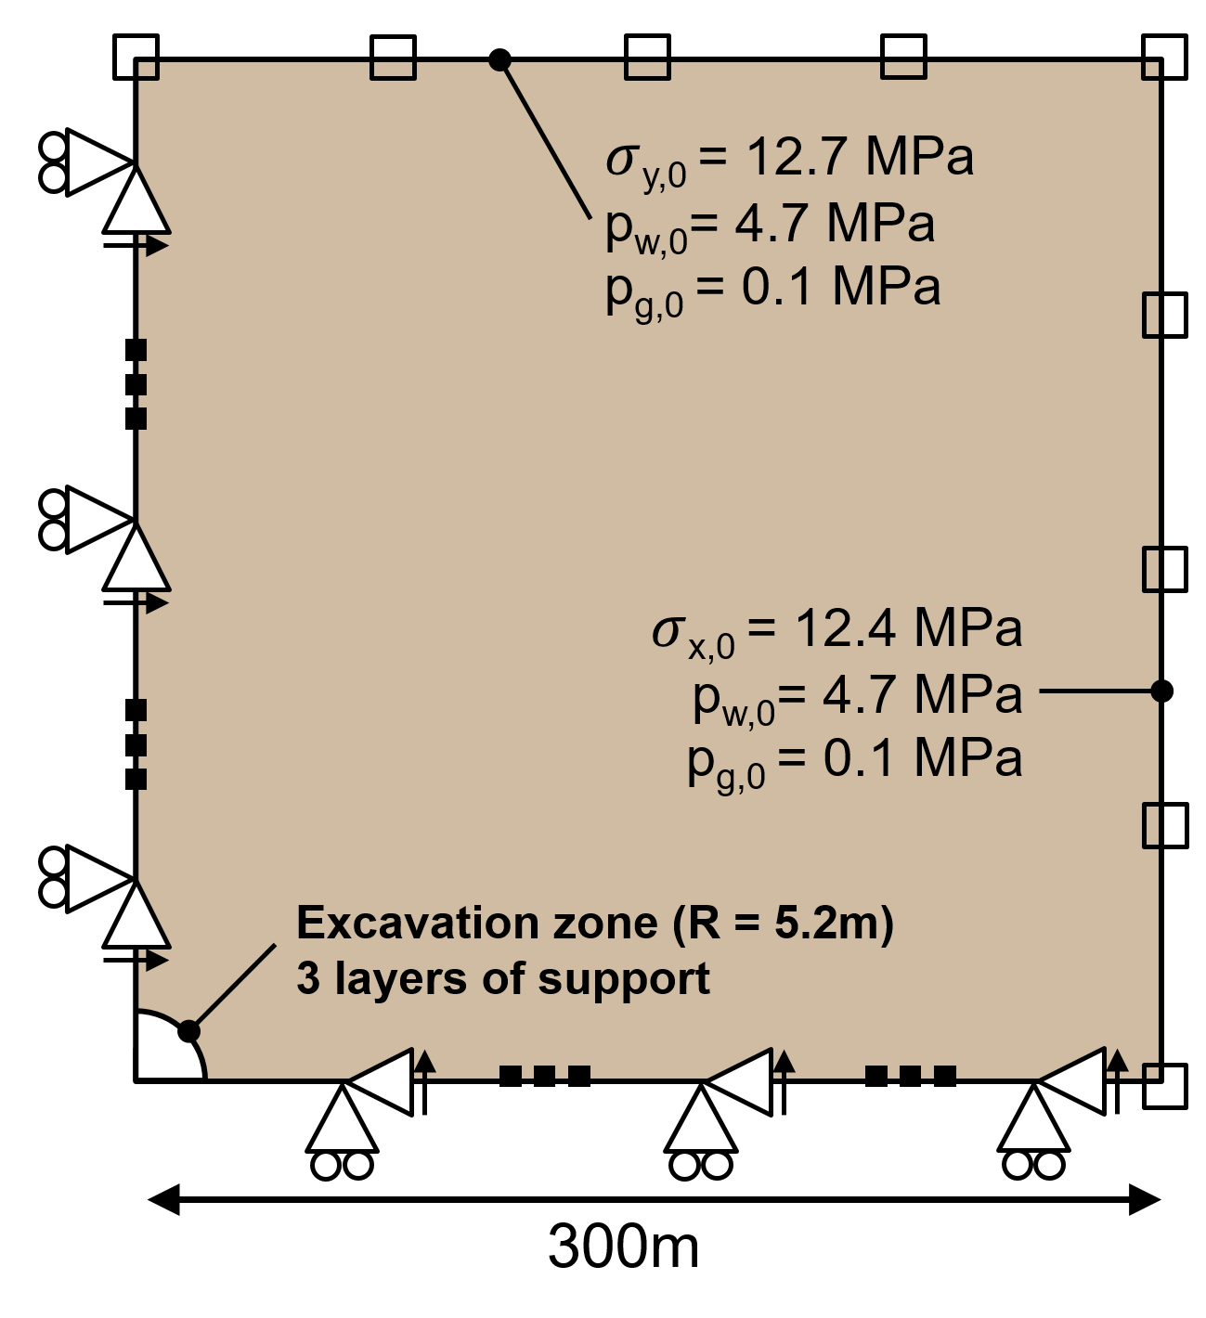
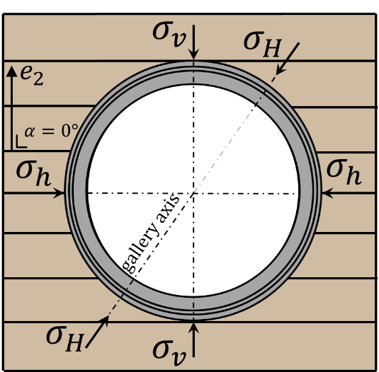
Advanced H²M couplings – large scale – Callovo-Oxfordian claystone
Application 2
HLW storage gallery according to the French concept
2D plane-strain simulations
Andra (2019)
Callovo-Oxfordian Claystone:
Elasto-viscoplastic rock
Horizontal bedding planes
r = 4.35m
3 layers of support:
Concrete arch segments
Compressible stuffing
Classical stuffing
12/16

Slide 20
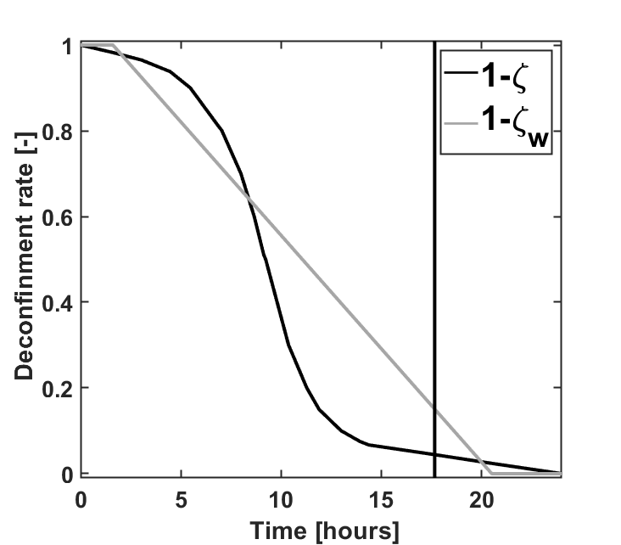
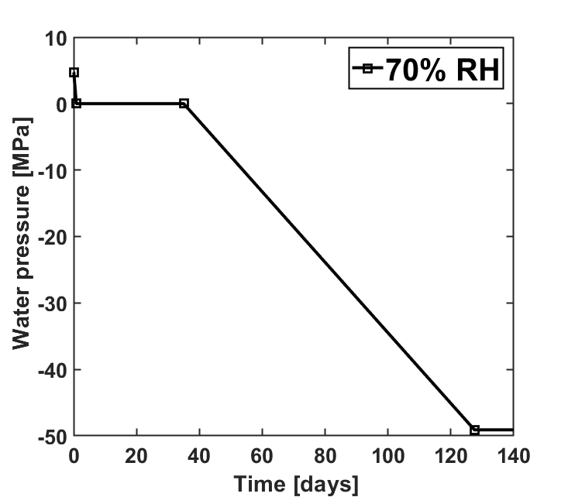
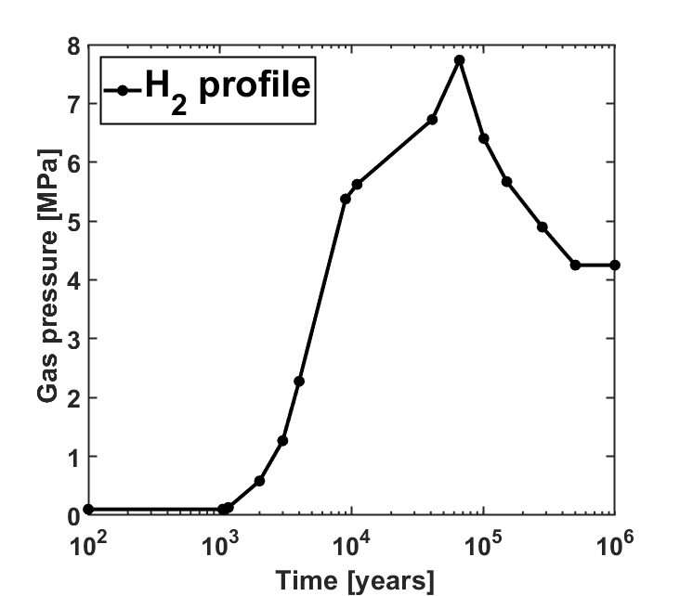
Advanced H²M couplings – large scale – Callovo-Oxfordian claystone
Application 2
Three-step simulations
Excavation phase
Deconfinement of the rock mass
Set-up of the support layers
Duration: 1 day
Operation phase
Ventilation
Filling of the storage drift
Duration: 100 years
Gas migration phase
Water pressure stabilisation
Gas release
Duration: 1.000.000 years
13/16

Slide 21
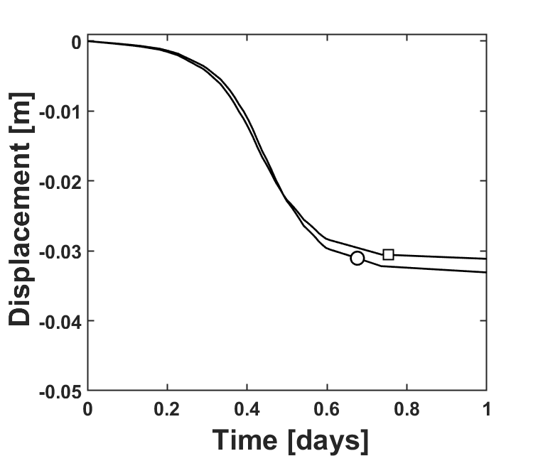
Advanced H²M couplings – large scale – Callovo-Oxfordian claystone
Application 2
Evolution of convergence
Development of damage in the near field
80% deconfinement
90% deconfinement
100% deconfinement
Reference case with transfer properties evolution
14/16

Slide 22
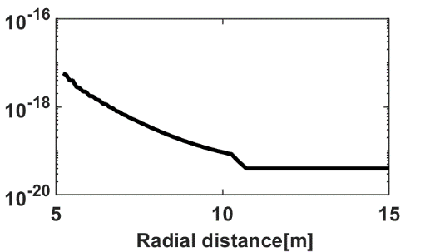
Advanced H²M couplings – large scale – Callovo-Oxfordian claystone
Application 2
Evolution of convergence
Evolution of the transfer properties
80% deconfinement
90% deconfinement
100% deconfinement
Reference case with transfer properties evolution
Permeability
[m²]
Gas entry pressure
[MPa]
14/16

Slide 23
Advanced H²M couplings – large scale – Callovo-Oxfordian claystone
Application 2
Maps of gas (H²) pressure evolution in the vicinity of the drift
No evolution of the transfer properties
10.000 years
50.000 years
100.000 years
15/16

Slide 24
Advanced H²M couplings – large scale – Callovo-Oxfordian claystone
Application 2
Maps of gas (H²) pressure evolution in the vicinity of the drift
No evolution of the transfer properties
10.000 years
50.000 years
100.000 years
Evolution of permeability with strain
15/16

Slide 25
Advanced H²M couplings – large scale – Callovo-Oxfordian claystone
Application 2
Maps of gas (H²) pressure evolution in the vicinity of the drift
No evolution of the transfer properties
10.000 years
50.000 years
100.000 years
Evolution of permeability & retention behaviour with strain
15/16

Slide 26
Table of content
Context
Ingredients of the model
Description of the numerical model
Application
Conclusions
03/16

Slide 27
Conclusions
We developed a 2nd gradient two-phase flow (H2M) coupled element able to
Model damage around underground structures with strain localisation in shear band mode
Reproduce mechanisms inherent to gas migrations
Take into account hydro-mechanical couplings (evolution of the transport properties with the deformations)
Investigate different host rock formations at different scales
We showed that
The obtained fracturing pattern is in good agreement with the experimental observations
The flow properties and transfer kinetics are affected in the damaged zone
This leads to a faster propagation of gas in the damaged zone which is in line with in situ observations
16/16

Slide 28
Thank you for your attention
13 June 2022 • Clay Conference, Nancy (France)
Gilles Corman¹, Frédéric Collin¹, Séverine Levasseur², Jean Talandier³

Slide 29
References
N. Grunwald. et al. (2021): Non-isothermal two-phase flow in deformable porous media: Systematic open-source implementation and verification procedure, Geomechanics and Geophysics for Geo-energy and Geo-Resources (submitted)
X. Sillen (2012), Keynote on repository-induced perturbations of the host rock, in the context of the safety case for the geological disposal of VHLW and SF in clay formations, Proceedings of the European Commission TIMODAZ-THERESA, International Conference, European Commission, Brussels, Belgium, pp. 159-171.
J. Desrues and M. Mokni (1999), Strain localisation measurements in undrained plane-strain biaxial test on Hostun RF sand, Mech Cohes-Frict Mat, 4(4):419–441.
M. S. Diederichs (2003), Rock Fracture and Collapse Under Low Confinement Conditions, Rock Mech Rock Eng, 36(5):339–381.
W. Bastiaens, F. Bernier, M. Buyens, M. Demarche, X. L. Li, J.-M. Linotte, J. Verstricht (December 2003), The extension of the HADES underground research facility at Mol, Belgium, The construction of the connecting gallery, EURIDICE report 03-294.
F. Bernier, Y. Wileveau (2008), Similarities in the hydromechanical response of Callovo-Oxfordian clay and Boom Clay during gallery excavation, Physics and Chemistry of the Earth 33 S343–S349.
F. Collin, R. Chambon, and R. Charlier (2006), A finite element method for poro-mechanical modelling of geotechnical problems using local second gradient models, International Journal for Numerical Methods in Engineering, 65(11):1749-1772.
B. Pardoen (2015), Hydro-mechanical analysis of the fracturing induced by the excavation of nuclear waste repository galleries using shear banding, PhD Thesis, University of Liège, Faculty of Applied Sciences.
F. Salehnia (2015), From some obscurity to clarity in Boom Clay behaviour: analysis of its coupled hydro-mechanical response in the presence of strain localization, PhD Thesis, University of Liège, Faculty of Applied Sciences.
P. Marschall, S. Horseman, T. Gimmi (2005), Characterisation of Gas Transport Properties of the Opalinus Clay, a Potential Host Rock Formation for Radioactive Waste Disposal, Oil & Gas Science and Technology - Revue de l IFP. 60. 121-139. 10.2516/ogst:2005008.
R. Chambon, D. Caillerie, and N. El Hassan (1998), One-dimensional localisation studied with a second grade model. European Journal of Mechanics, A/Solids, 17(4):637-656.
B. Pardoen, S. Levasseur, and F. Collin (2014), Excavation damaged zone modelling including hydraulic permeability evolution in unsaturated argilaceous rock, In: Khalili N, Russell AR,Khoshghalb A,eds. Unsaturated soils: research and applications. London: CRC Press, 387–1393.
S. Olivella and E. E. Alonso (2008). Gas flow through clay barriers. Geotechnique, 58(3):157{176.
G. Volckaert, L. Ortiz, P. De Canniere, M. Put, S. T. Horseman, J. F. Harrington, V. Fioravante, and M. Impey (1995), MEGAS: modelling and experiments on GAS migration in repository host rocks. Final report phase 1. Technical report, Eur. Comm., [Rep.] EUR 16235 EN.
Andra (2019), Concevoir des centres de stockage. Retrieved November 11, 2019 from https://www.andra.fr/nos-expertises/concevoir-des-centres-de-stockage.

Slide 30
The second gradient model
Regularisation method based on the enrichment of the continuum kinematics with the microstructure effects
Macro-volume $Ω$ + Micro-volumes $Ω^{m}$
Displacement
$$u_{i}$$
$$u_{i}^{m}$$
Deformation
$$F_{ij}=\frac{∂u_{i}}{∂x_{j}}$$
$$ν_{ij}=\frac{∂u_{i}^{m}}{∂x_{j}}$$
$$Ω$$
$$Ω,u_{i}$$
Principle of virtual work: the internal virtual work (Germain,1973) = the external virtual work (simplified)
The kinematical constraint $ν_{ij}=F_{ij}$ implying $ν_{ij}=\frac{∂u_{i}}{∂x_{j}}$ is added (Chambon et al.,1998; Matsushima et al.,2002)
Finite element formulation: introduction of Lagrange multiplier fields $λ_{ij}$
The Clay Conference – June 2022

Slide 31
The second gradient finite element
The second gradient mechanical law
Isotropic linear relationship (Mindlin,1965)
Only one constitutive parameter $D$

Slide 32
Description of the model
The rock environment surrounding the deep geological disposal can be modelled as:
A multiphasic porous medium
With strain localisation in the EDZ
Including transfer properties evolution with strain
Second gradient H²M model
3 balance equations
Balance of momentum (mixture)
Water mass balance
Gas mass balance
$$\frac{∂σ_{ij}}{∂x_{j}}−\frac{∂^{2}Σ_{ijk}}{∂x_{j}∂x_{k}}+ρ^{mix}g=0$$
$$\frac{∂f_{w,i}}{∂x_{i}}+\frac{∂(ρ^{w}φS_{r}^{w})}{∂t} +\frac{∂f_{v,i}}{∂x_{i}}+\frac{∂\left(ρ^{v}φ\left(1−S_{r}^{w}\right)\right)}{∂t}=Q^{w}$$
$$\frac{∂f_{H_{2},i}}{∂x_{i}}+\frac{∂\left(ρ^{H_{2}}φ\left(1−S_{r}^{w}\right)\right)}{∂t} +\frac{∂f_{H_{2}^{d},i}}{∂x_{i}}+\frac{∂\left(ρ^{H_{2}^{d}}φS_{r}^{w}\right)}{∂t}=Q^{H_{2}}$$
Microstructure effects
Liquid water
Water vapour
Dry Hydrogen
Dissolved Hydrogen
2 phases flow model
2 transport processes
Water
Advective component (Darcy’s law)
Gas (Hydrogen)
Diffusive component (Fick’s law)
$\dot{M}$: Stored fluid quantity
$f_{i}$ : mass flow of fluid
$Q$ : fluid source term
Advection
Diffusion

Slide 33
Parameters
Application 1

Slide 34
Advanced H²M couplings – large scale – Callovo-Oxfordian claystone
Application 2 (No support)
Evolution of convergence
Development of damage in the near field
80% deconfinement
90% deconfinement
100% deconfinement
Reference case with transfer properties evolution
No support

Slide 35
Advanced H²M couplings – large scale – Callovo-Oxfordian claystone
Application 2 (Effect of D parameter)
Evolution of convergence
Development of damage in the near field
80% deconfinement
90% deconfinement
100% deconfinement
Reference case with transfer properties evolution
Higher value of $D$

Slide 36
Mechanical parameters
Application 2

Slide 37
Flow parameters
Application 2

