Slide 1
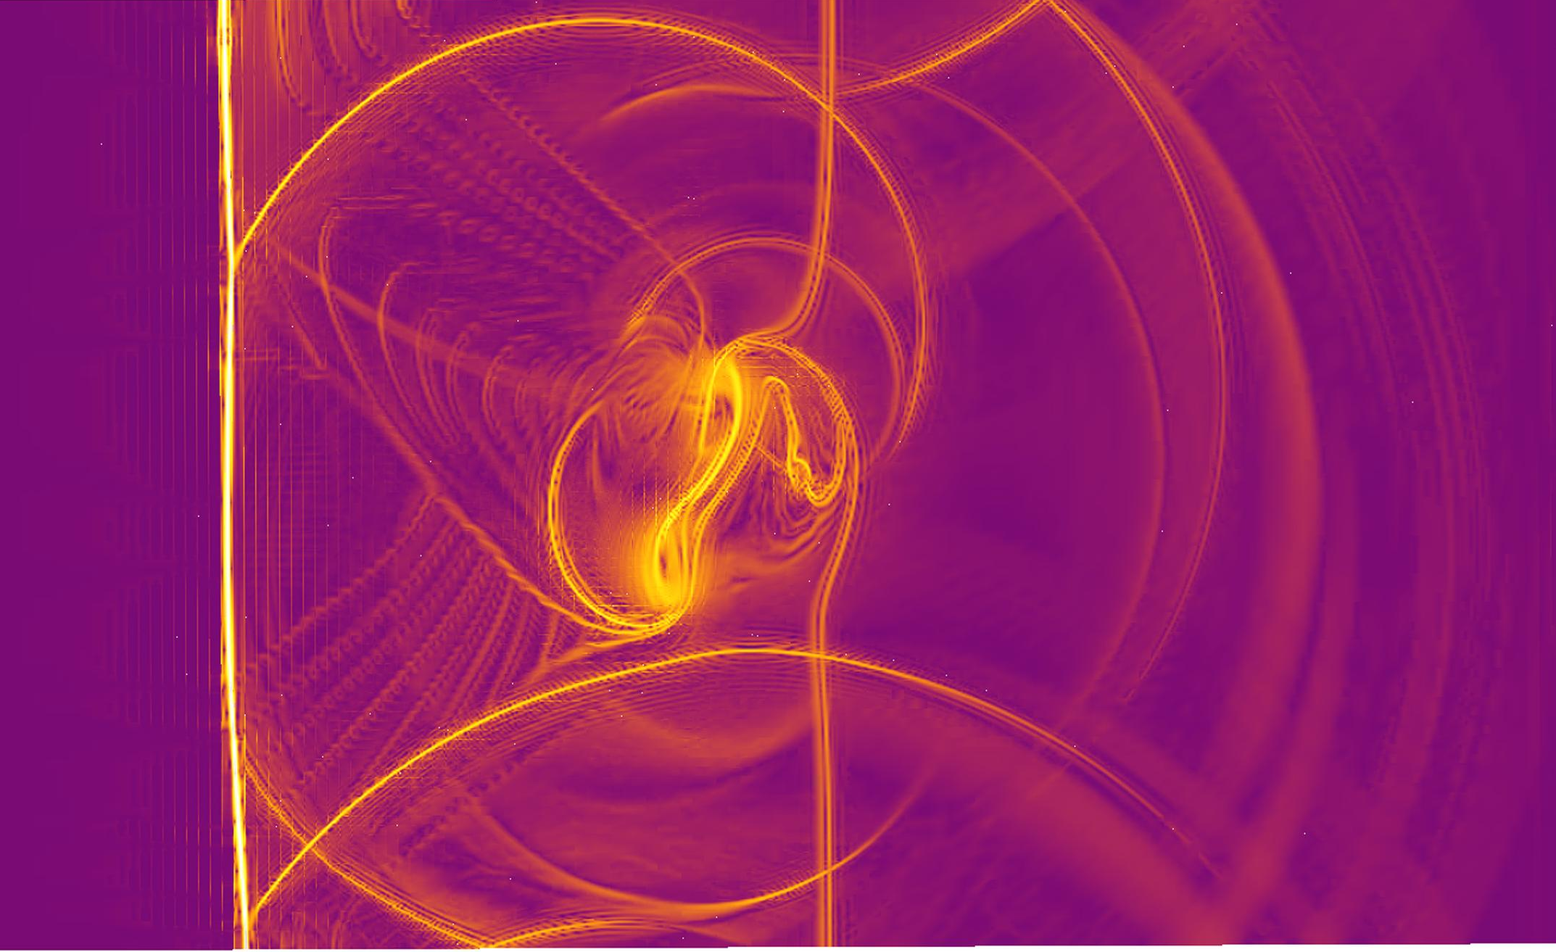


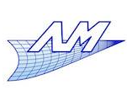
Hybridization of Discontinuous Galerkin methods for shock capturing in scale resolving simulations
Amaury Bilocq
N. Levaux
V.E. Terrapon
K. Hillewaert
ECCOMAS 2022

Slide 2
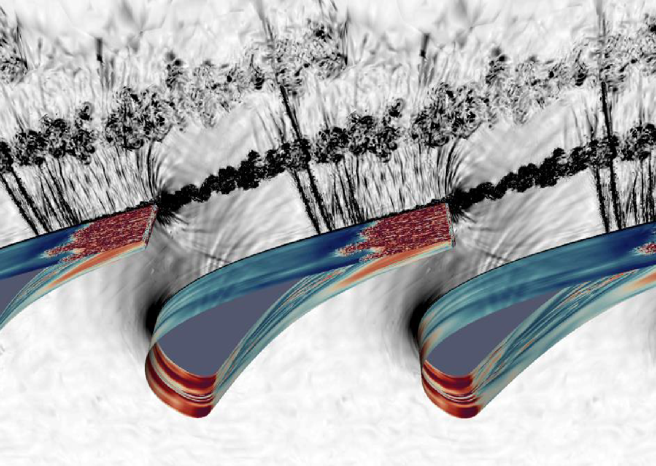
Transonic turbulent flows
Transonic and transitional blade
Thermal stresses
Structural stresses
impacted by turbulence

Slide 3

Transonic turbulent flows
Transonic and transitional blade
Thermal stresses
Structural stresses
impacted by turbulence
$→$ Detect transition accuratly
$→$ Represent correctly the turbulence

Slide 4
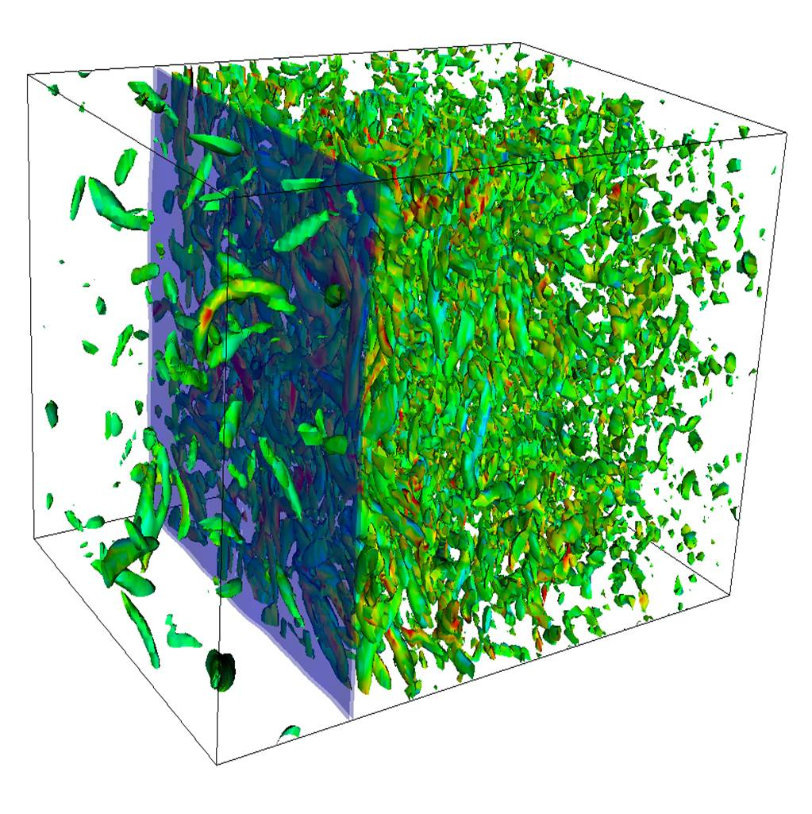
Transonic turbulent flows
$→$ Detect transition accuratly
$→$ Represent correctly the turbulence
Larsson(2006)
Turbulence amplification
!Shock and under-resolved turbulence induce numerical instabilities!

Slide 5
Transonic turbulent flows
Need stabilization
Persson(2006)
Gassner(2016)
Artificial viscosity
Entropy stability
Robustness
Cost
Dissipation
(weak shock)
Combine both methods:
Accurate
Fast enough for blade computations

Slide 6
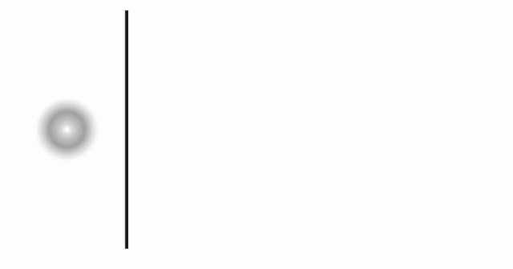
Strong vortex-shock interaction

Slide 7
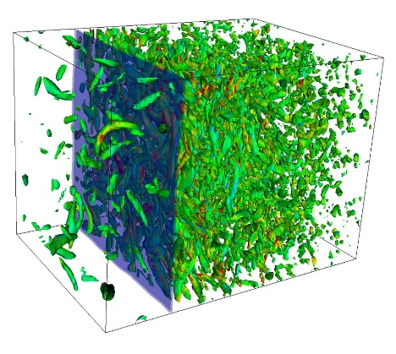
Artificial viscosity method
Shock waves/under-resolved turbulence induce oscillations
Sensor detects troubled cells
Numerical dissipation is added
The physics is modified hence turbulence is damped
Velocity
Turbulent dissipation
Reference
Shock capturing
No shock capturing
position
Adapted from Hillewaert(2016)
time
Notes:
Turbulent dissipation: dissipation work / acoustic work

Slide 8
Artificial viscosity: impact of the sensor
Persson(2006)
Regularity criteria
Distinction between low and high frequencies?
Energy stores in high frequencies

Slide 9
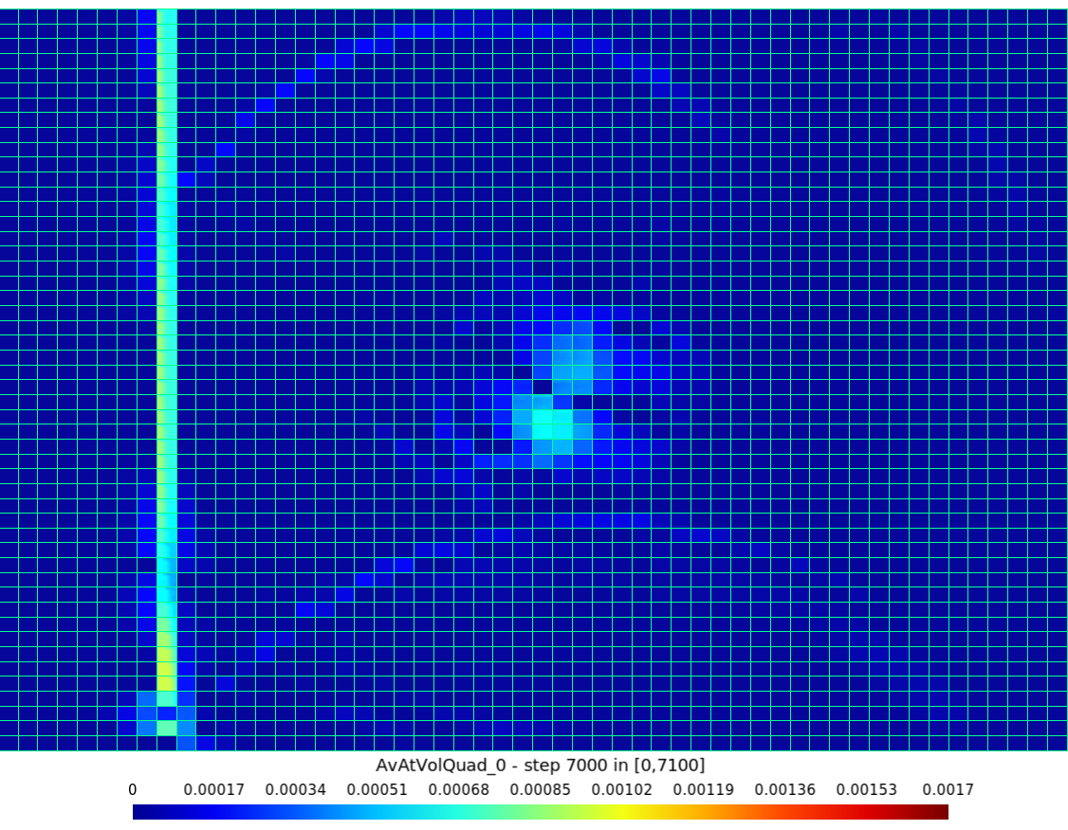
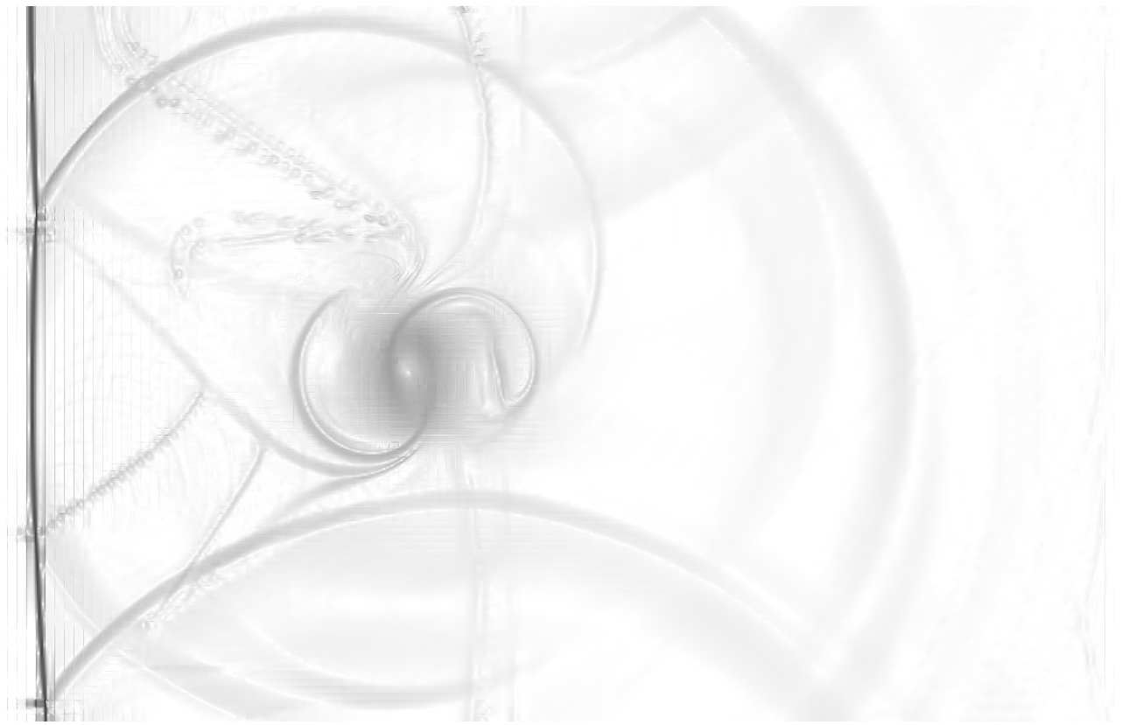
Artificial viscosity: impact of the sensor
Modal projection
unwanted dissipation
Artificial viscosity
h = 1/100

Slide 10
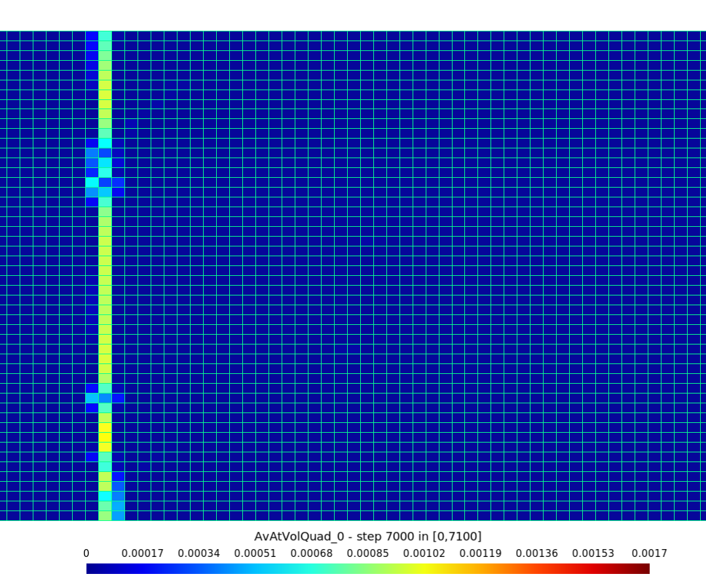
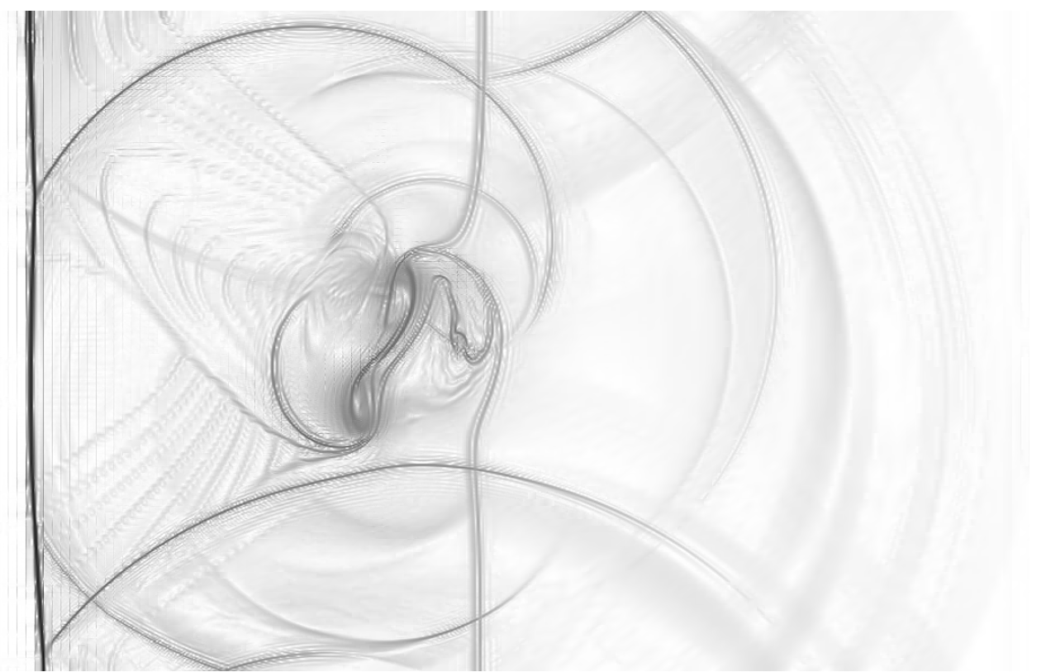
Artificial viscosity: impact of the sensor
Lagrange projection
Artificial viscosity
h = 1/100

Slide 11
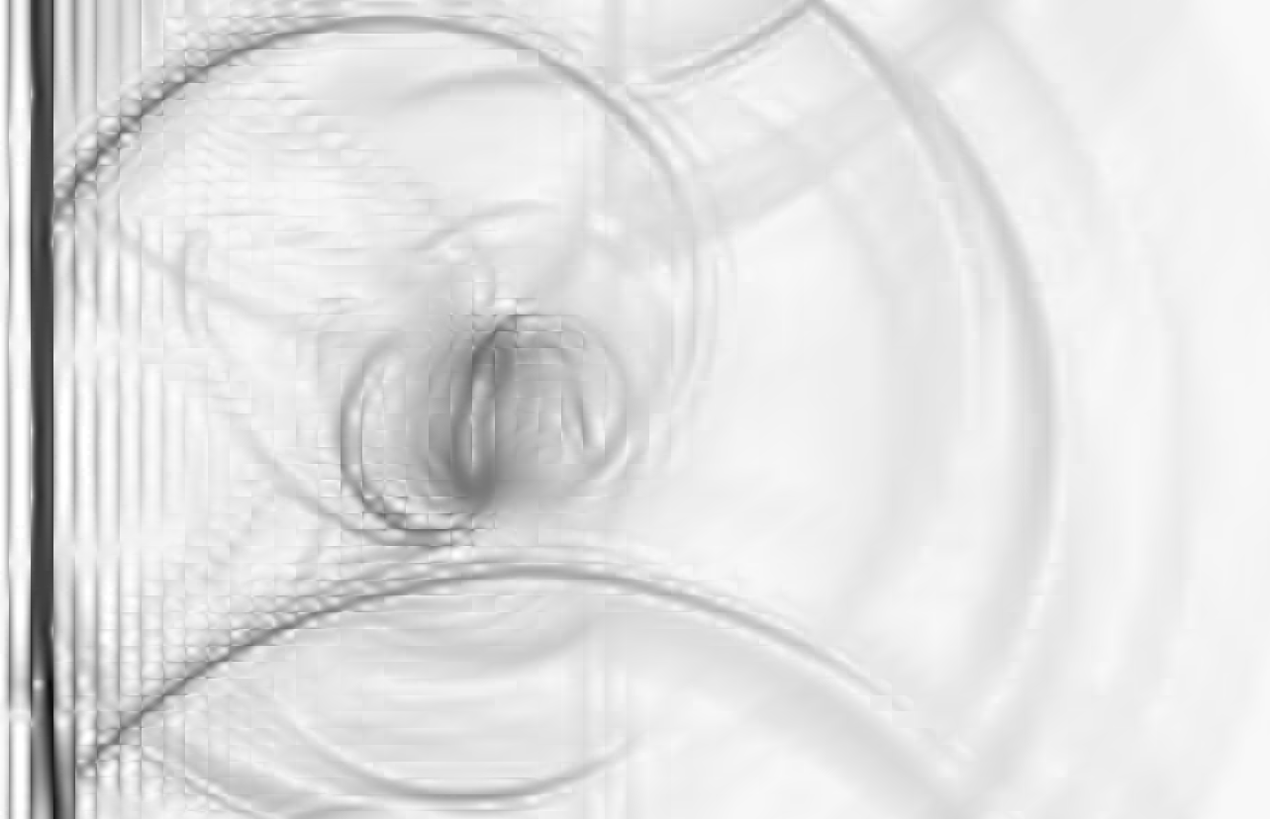
Artificial viscosity: impact on under-resolved grid
Lagrange projection
Vortex is impacted by the artificial viscosity
Similitude with DNS/LES on under-resolved grid
h = 1/50

Slide 12
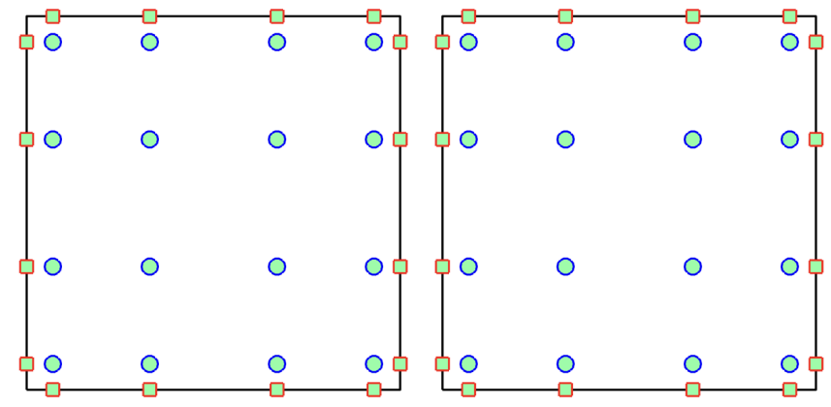
Non linear instabilities
1. Polynomial aliasing
Shock waves/under-resolved turbulence induce oscillations
Velocity
Volume quadrature rule
Surface quadrature rule
position
Can be avoided with accurate enough quadrature rules
Notes:
Turbulent dissipation: dissipation work / acoustic work

Slide 13
Non linear instabilities
2. Discrete energy instability
Shock waves/under-resolved turbulence induce oscillations
Velocity
position
Notes:
Turbulent dissipation: dissipation work / acoustic work

Slide 14

Non linear instabilities
2. Discrete energy instability
Shock waves/under-resolved turbulence induce oscillations
Velocity
Need to bound energy $→$ entropy stable scheme
position
Notes:
Turbulent dissipation: dissipation work / acoustic work

Slide 15
Non linear instabilities
2. Discrete energy instability
Shock waves/under-resolved turbulence induce oscillations
Velocity
Need to bound energy $→$ entropy stable scheme
Entropy function and fluxes
position
Notes:
Turbulent dissipation: dissipation work / acoustic work

Slide 16

Non linear instabilities
2. Discrete energy instability
Shock waves/under-resolved turbulence induce oscillations
Velocity
Need to bound energy $→$ entropy stable scheme
Entropy function and fluxes
Two-point numerical flux $→$ entropy consistent
position
Notes:
Turbulent dissipation: dissipation work / acoustic work

Slide 17
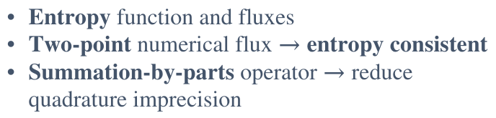
Non linear instabilities
2. Discrete energy instability
Shock waves/under-resolved turbulence induce oscillations
Velocity
Need to bound energy $→$ entropy stable scheme
Entropy function and fluxes
Two-point numerical flux $→$ entropy consistent
Summation-by-parts operator $→$ reduce quadrature imprecision
position
Notes:
Turbulent dissipation: dissipation work / acoustic work

Slide 18
Non linear instabilities
2. Discrete energy instability
Shock waves/under-resolved turbulence induce oscillations
Velocity
Need to bound energy $→$ entropy stable scheme
Entropy function and fluxes
Two-point numerical flux $→$ entropy consistent
Summation-by-parts operator $→$ reduce quadrature imprecision
position
Notes:
Turbulent dissipation: dissipation work / acoustic work

Slide 19
Entropy stable method
Entropy stable method is activated
Scheme limits energy in oscillations
The physics is NOT modified
Velocity
Turbulent dissipation
Reference
Entropy stability
position
time
Adapted from Hillewaert(2016)
Notes:
Turbulent dissipation: dissipation work / acoustic work

Slide 20
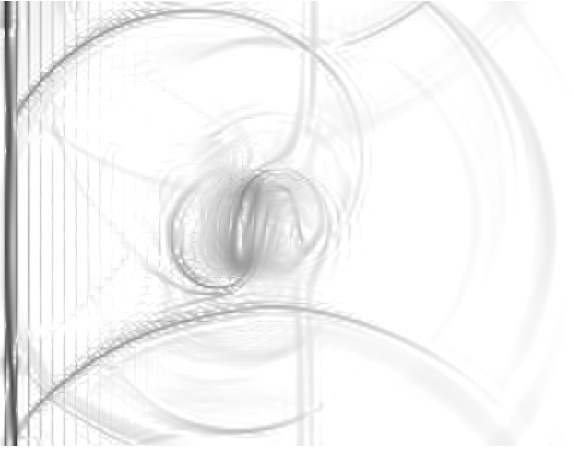
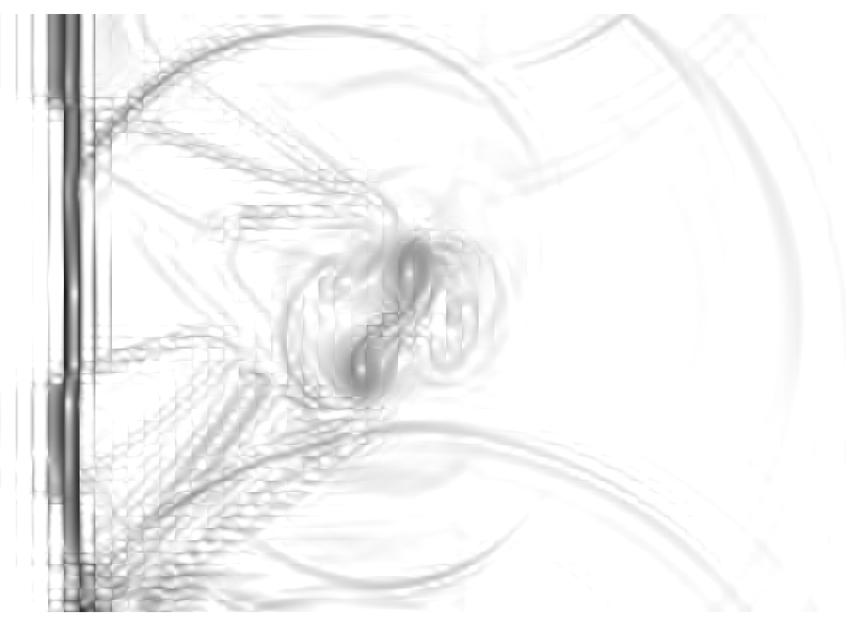
Comparison on under-resolved grid
Artificial viscosity
Entropy stable
t ~15min
t ~150min

Slide 21
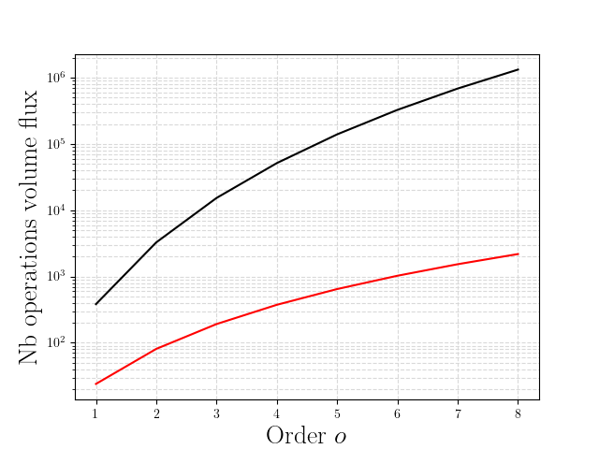
Floating point operations (without fluxes)
3d
ES Full quadrature
Full quadrature
Vanilla DG
Cost two point numerical fluxes > usual volume fluxes

Slide 22
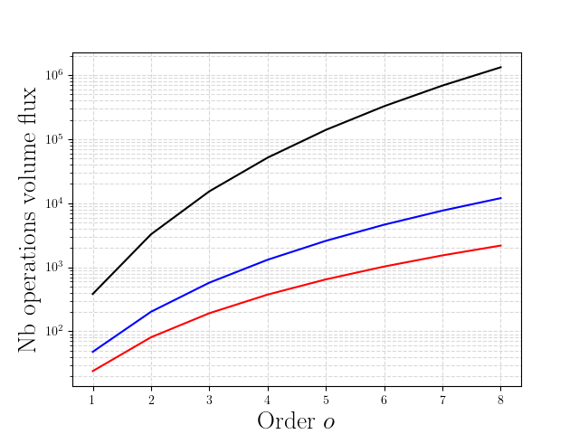
Floating point operations (without fluxes)
3d
ES Full quadrature
Full quadrature
ES Tensor product
Vanilla DG
Tensor product quadrature
! Increase polynomial aliasing!

Slide 23
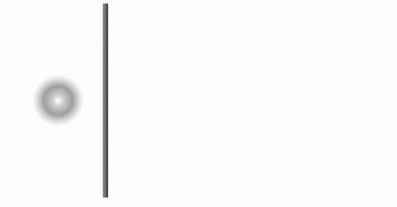
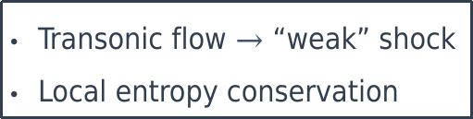
Sensor based entropy stable method
Transonic flow $→$ “weak” shock
Local entropy conservation
Need stabilisation here

Slide 24
Sensor based entropy stable method
Shock waves/under-resolved turbulence induce oscillations
Sensor detects troubled cells
Entropy stability is activated
The physics is NOT modified
Velocity
Turbulent dissipation
Reference
Shock capturing
No shock capturing
position
time
Adapted from Hillewaert(2016)
Notes:
Turbulent dissipation: dissipation work / acoustic work

Slide 25
Sensor based entropy stable method: impact of the sensor
Modal projection
Lagrange projection

Slide 26
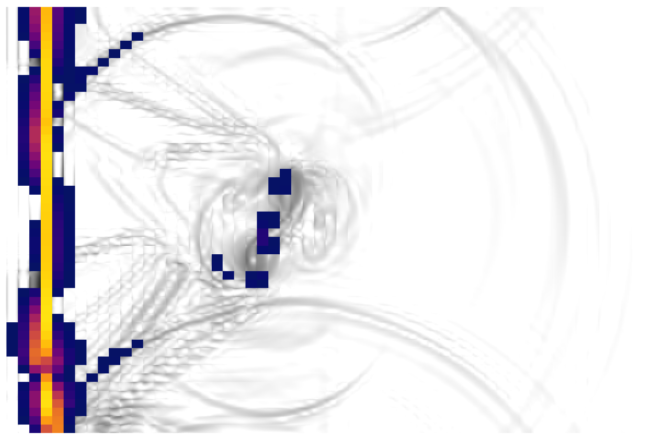
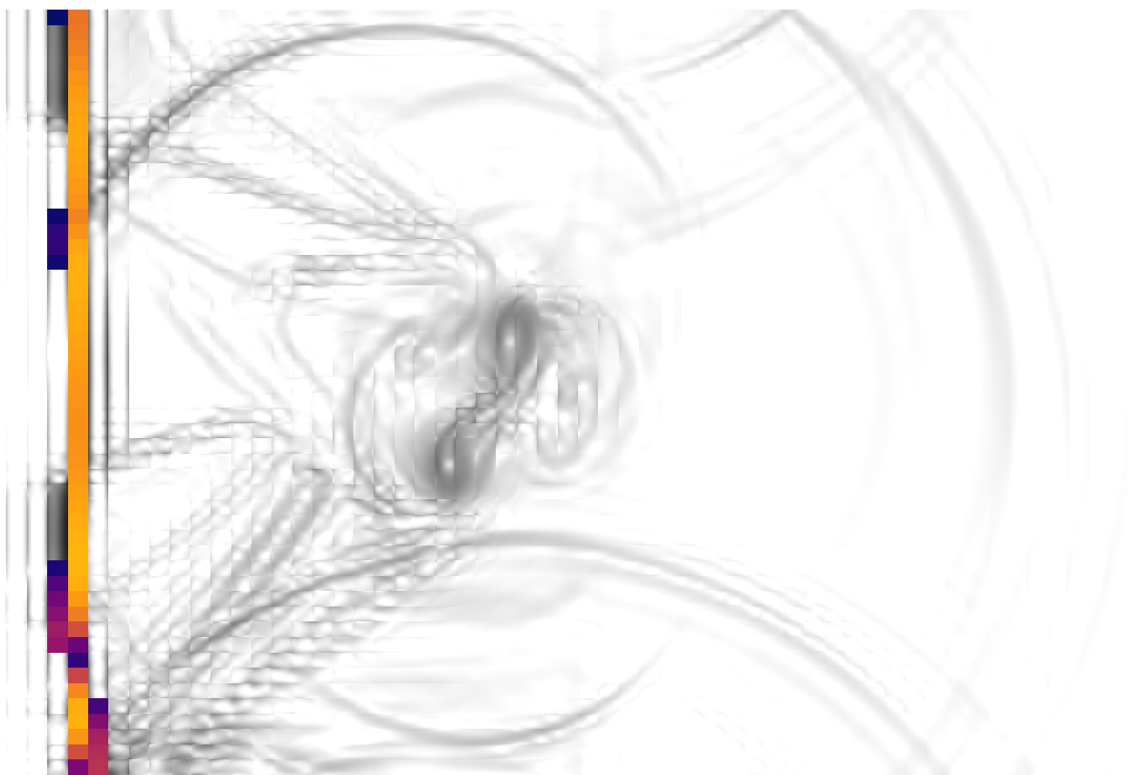
Sensor based entropy stable method: impact of the sensor
Modal projection
Lagrange projection
t ~90min
t ~60min

Slide 27
Comparison with entropy stable method
Fully entropy stable
Sensor based entropy stable
t ~150min
t ~60min

Slide 28

Comparison with entropy stable method
Fully entropy stable
Sensor based entropy stable
t ~150min
t ~60min
$$\frac{troubled cells }{cells}=\frac{100}{3750}$$

Slide 29
Floating point operations (without fluxes)
ES Full quadrature
ES Full quadrature
ES Tensor product
Sensor based ES
Vanilla DG
Sensor based ES
Vanilla DG

Slide 30
Conclusions
Hybridization between shock capturing and stable method
Stability without artificial dissipation
Tend to the computational cost of artificial viscosity method
Stability if strong shock
Reduce impact of the shock detection on the solution
Future Work
Tensor product / Gauss-Lobatto-Legendre quadrature
  Reduce computational cost
  Increase polynomial aliasing

Slide 31
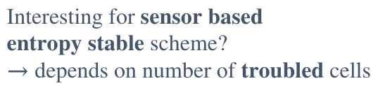
Conclusions
Hybridization between shock capturing and stable method
Stability without artificial dissipation
Tend to the computational cost of artificial viscosity method
Stability if strong shock
Reduce impact of the shock detection on the solution
Future Work
Tensor product / Gauss-Lobatto-Legendre quadrature
  Reduce computational cost
  Increase polynomial aliasing
Interesting for sensor based
entropy stable scheme?
$→$ depends on number of troubled cells
Add stability dissipative flux
Implicit formulation
Shock-turbulence interaction

Slide 32
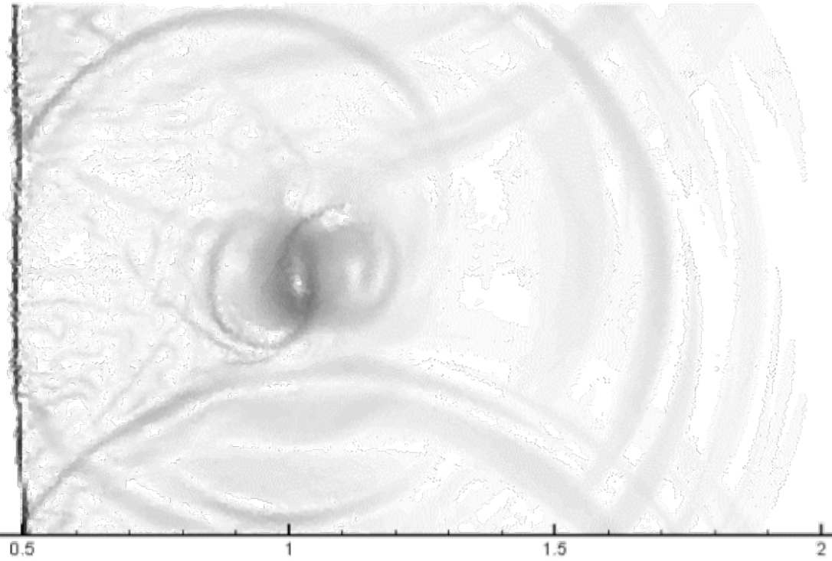
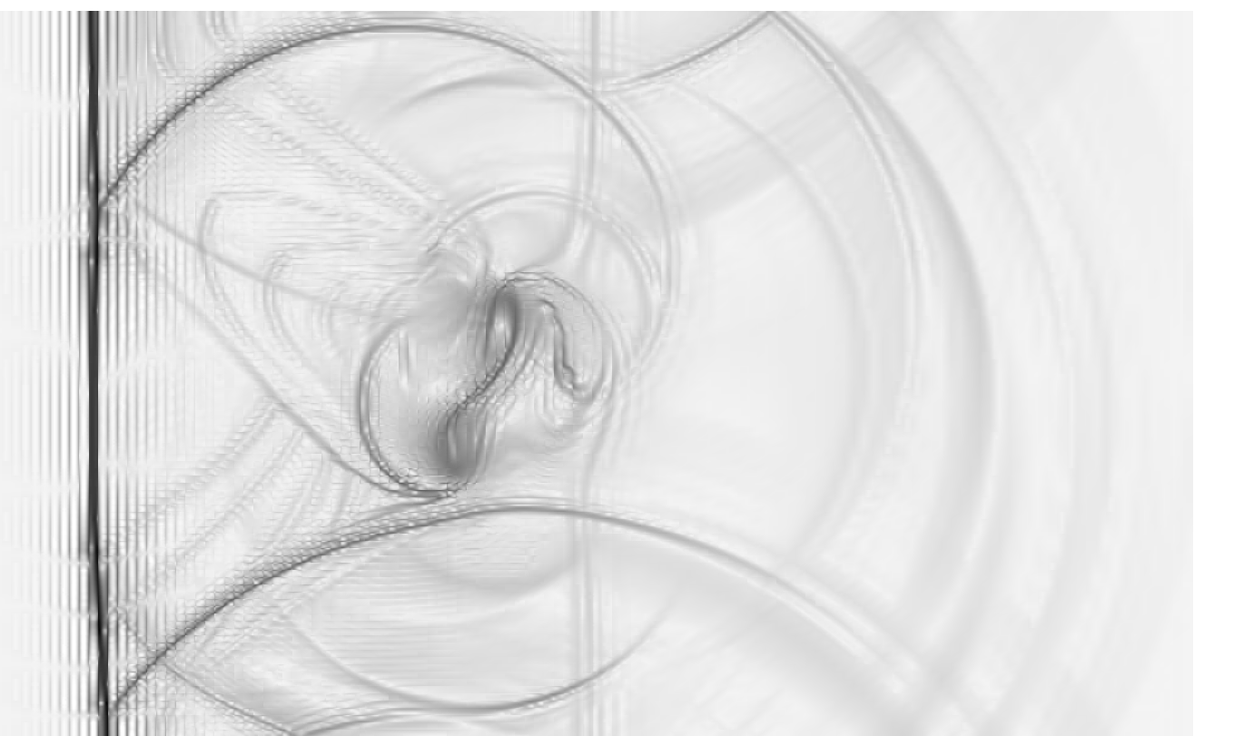
Schlieren at t = 0.7s
320k DOF (Seoul)
240k DOF, Lagrange projection

