Slide 1
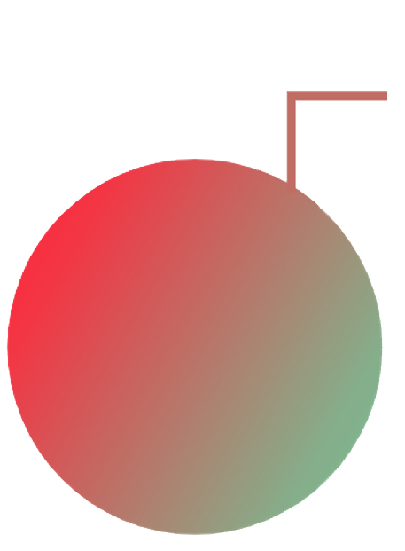
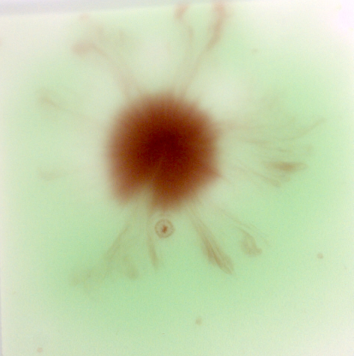
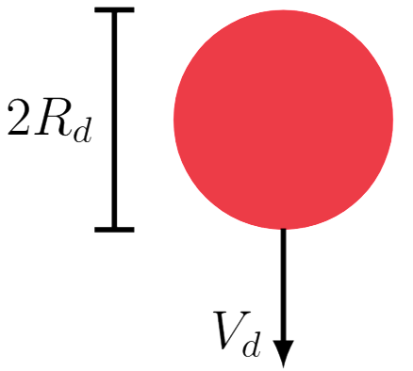
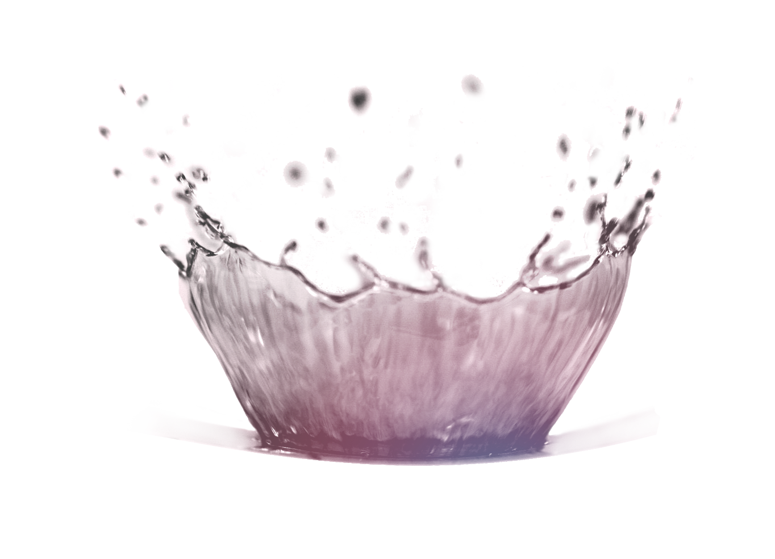
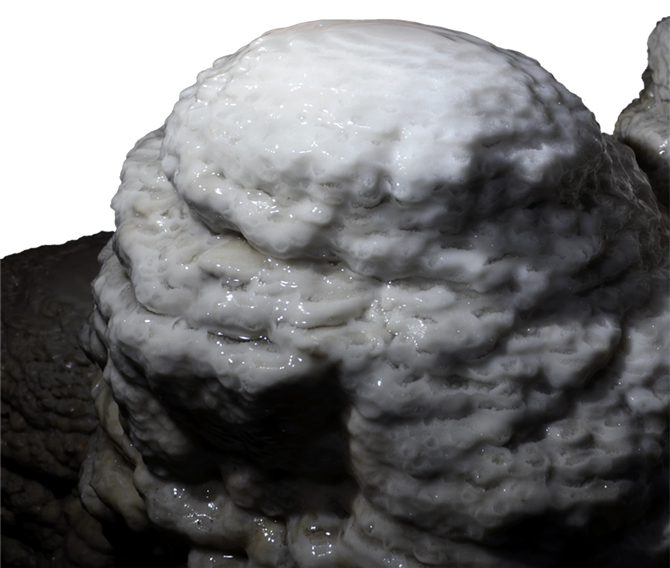
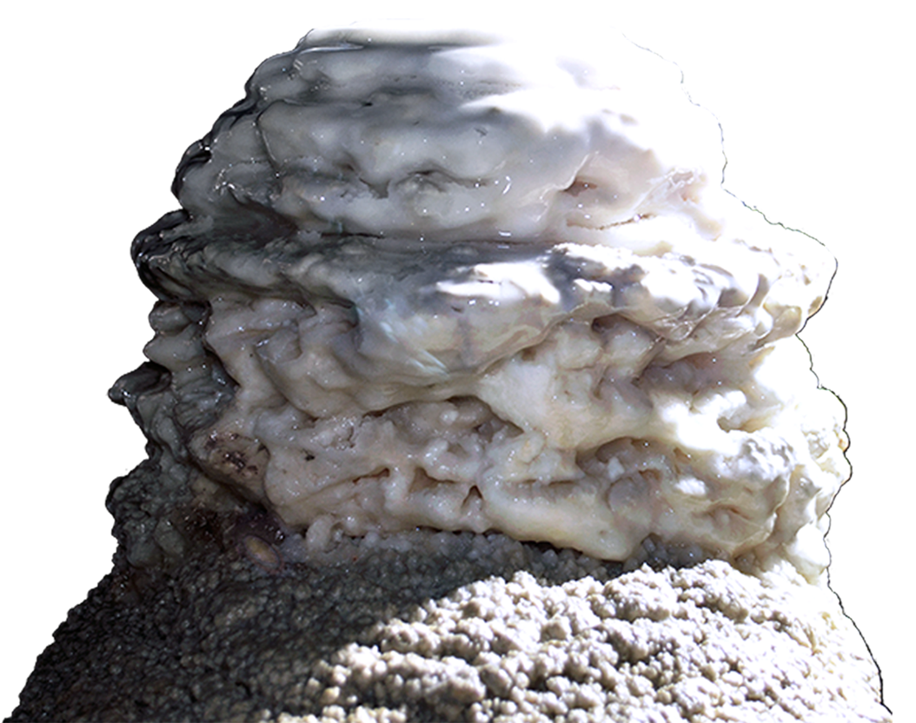
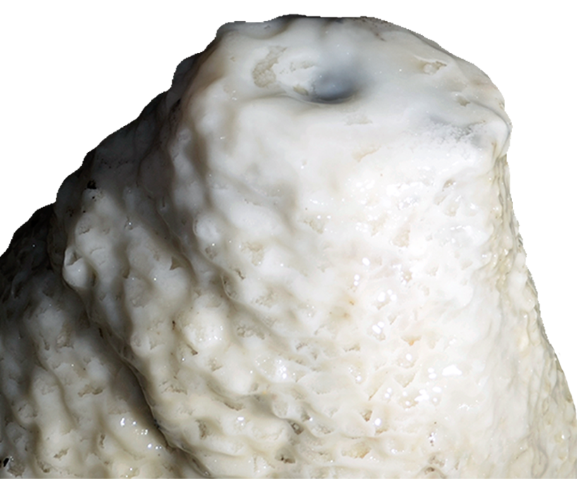
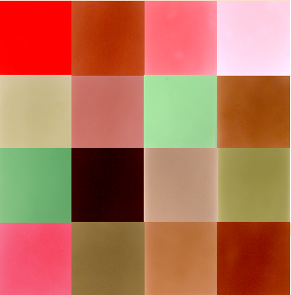
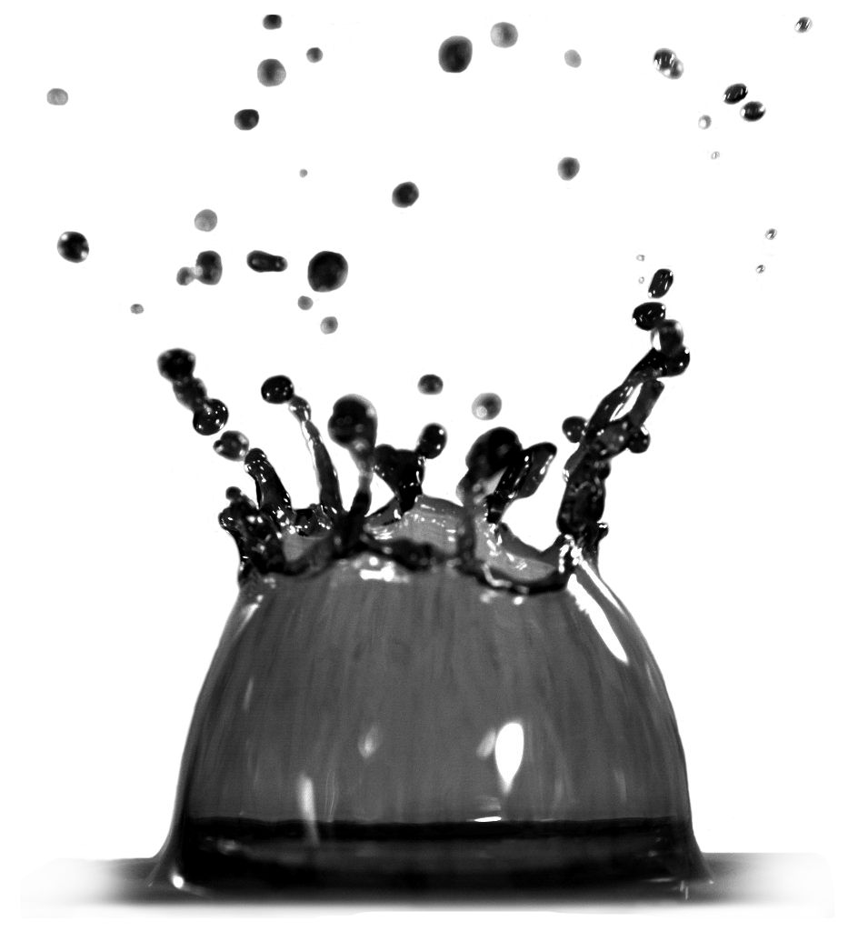
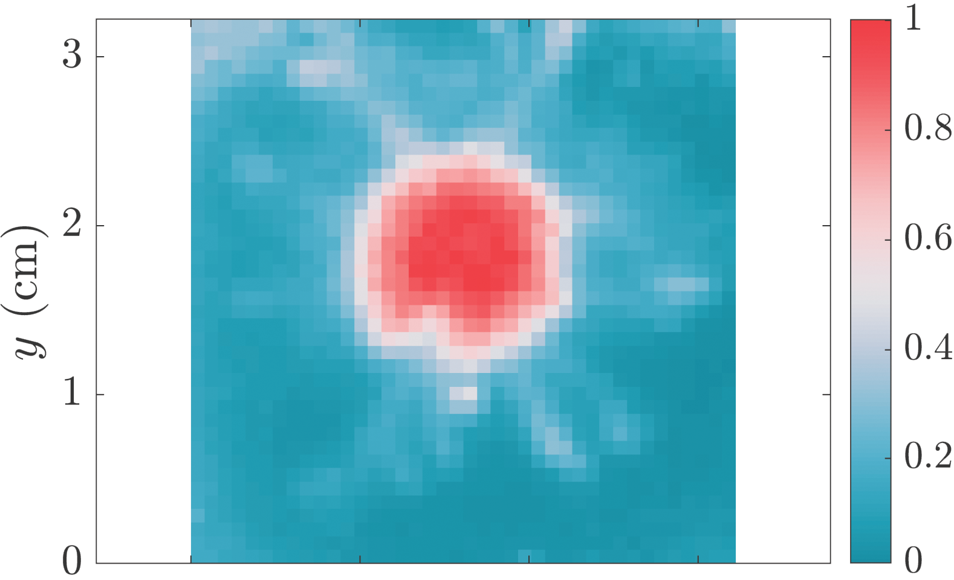
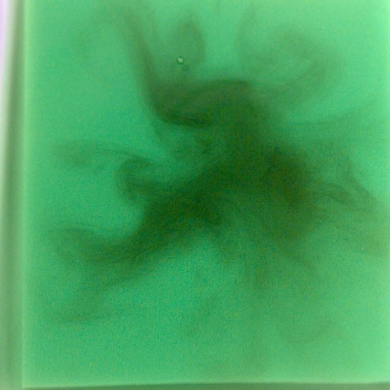
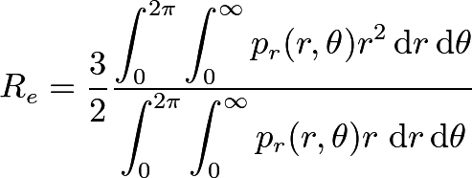
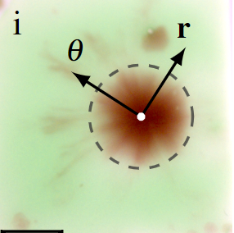
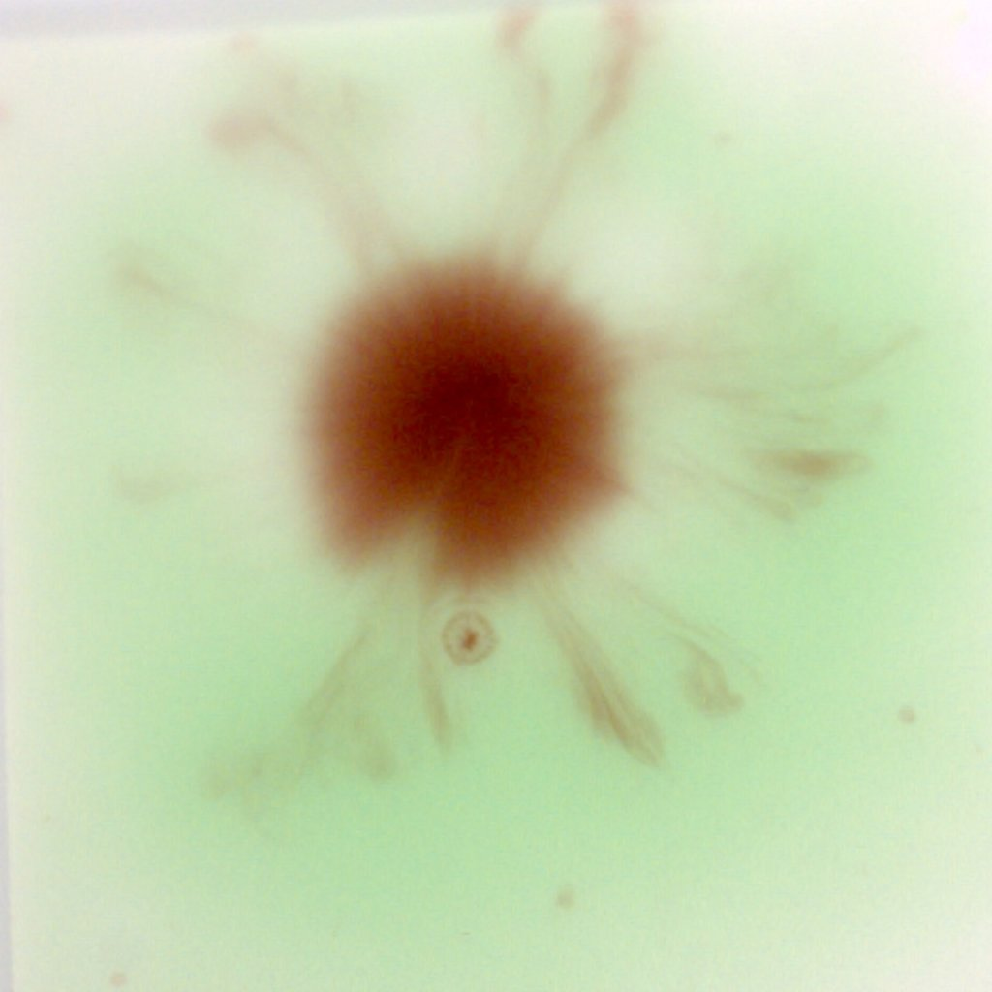
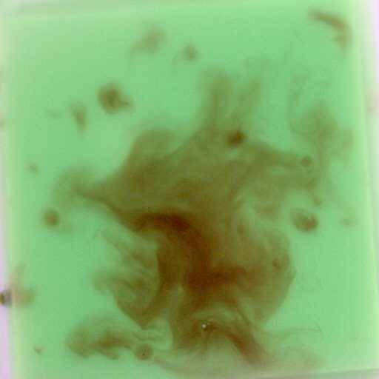
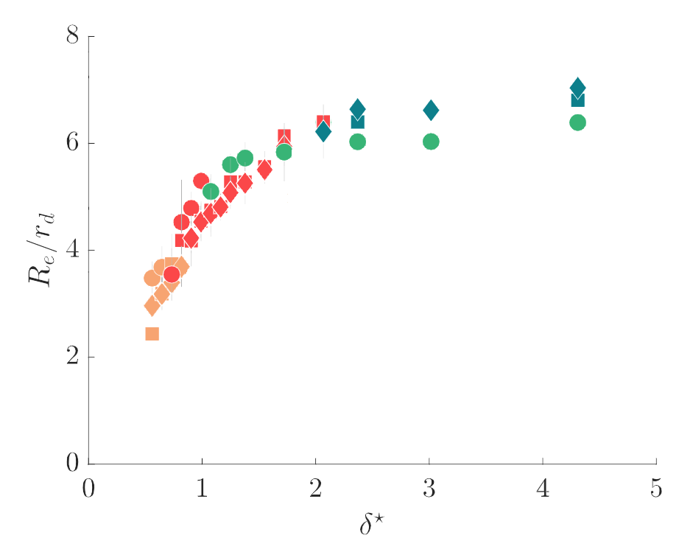
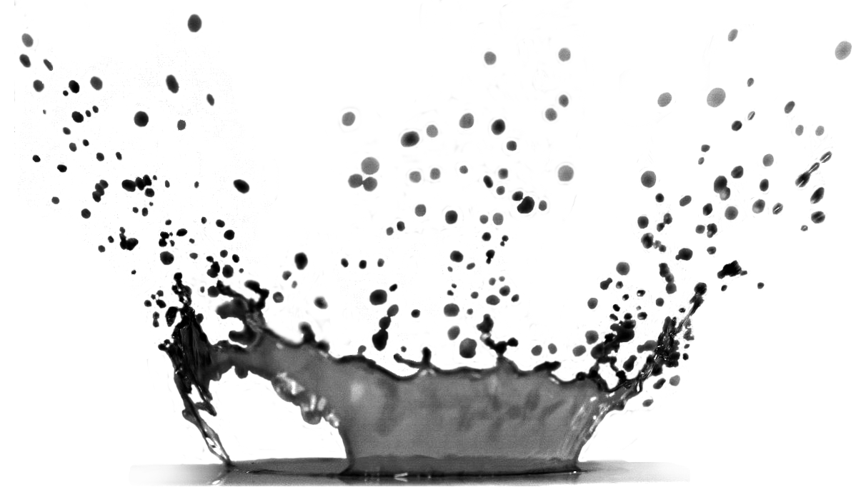
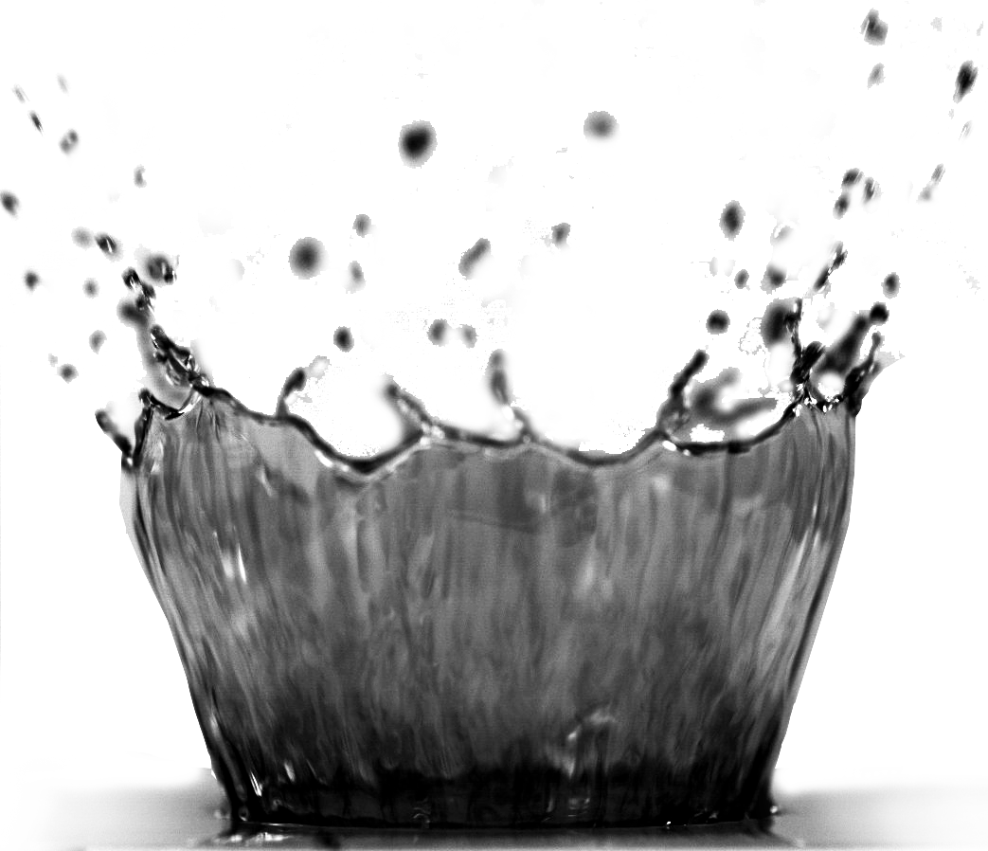
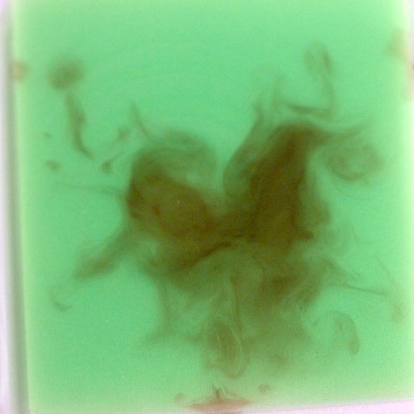
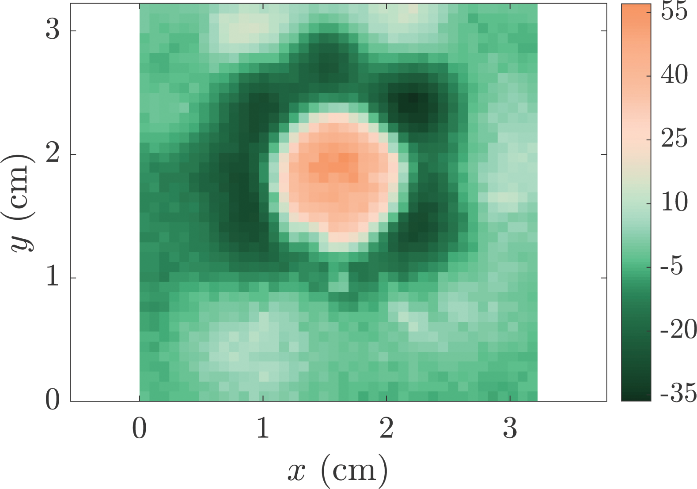
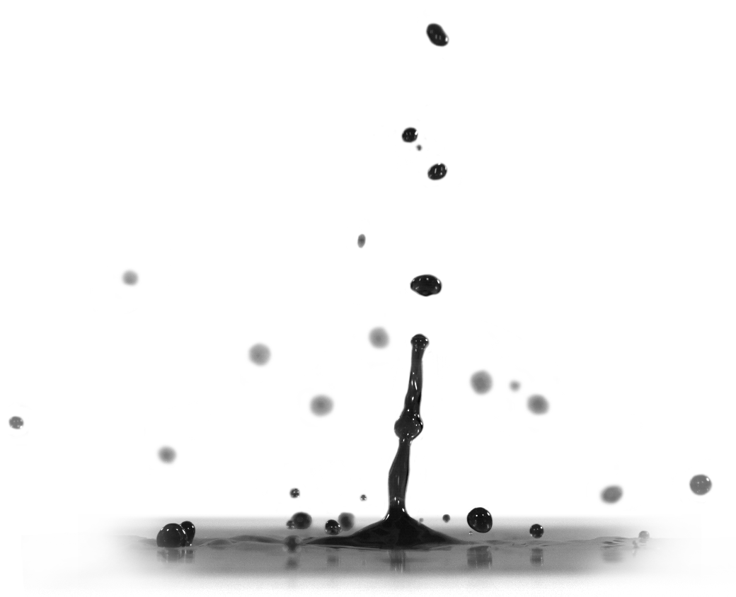
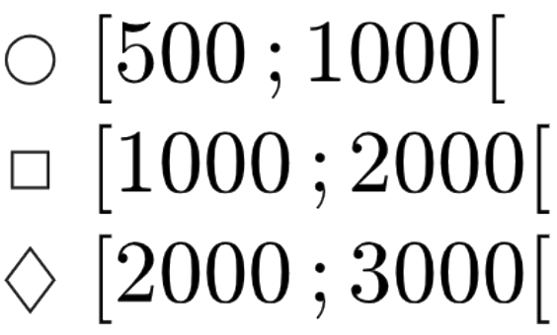
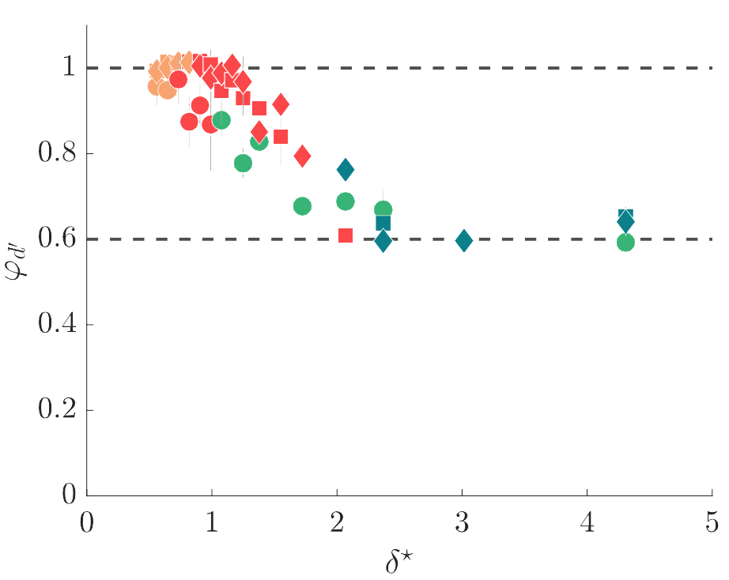
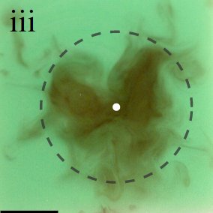
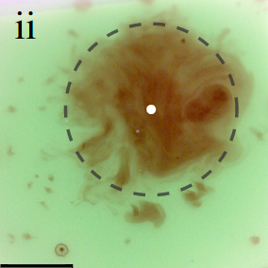
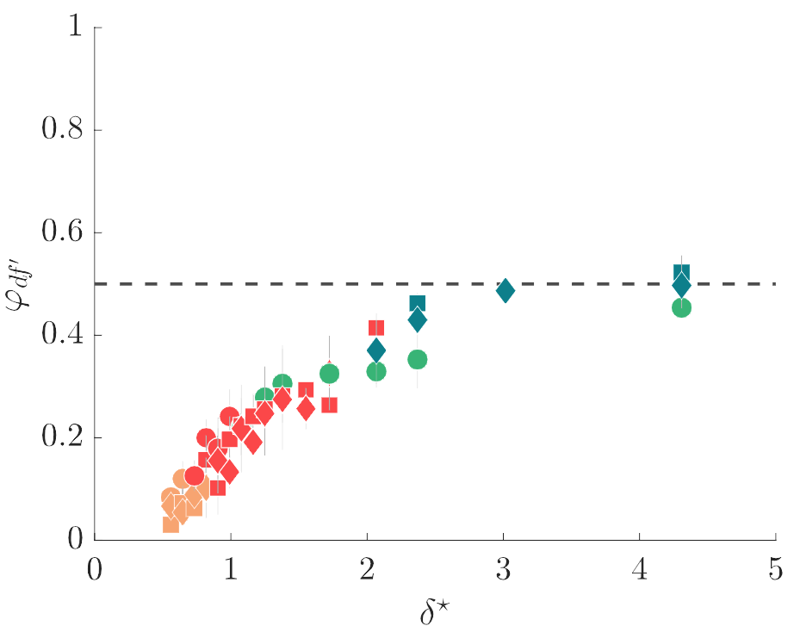
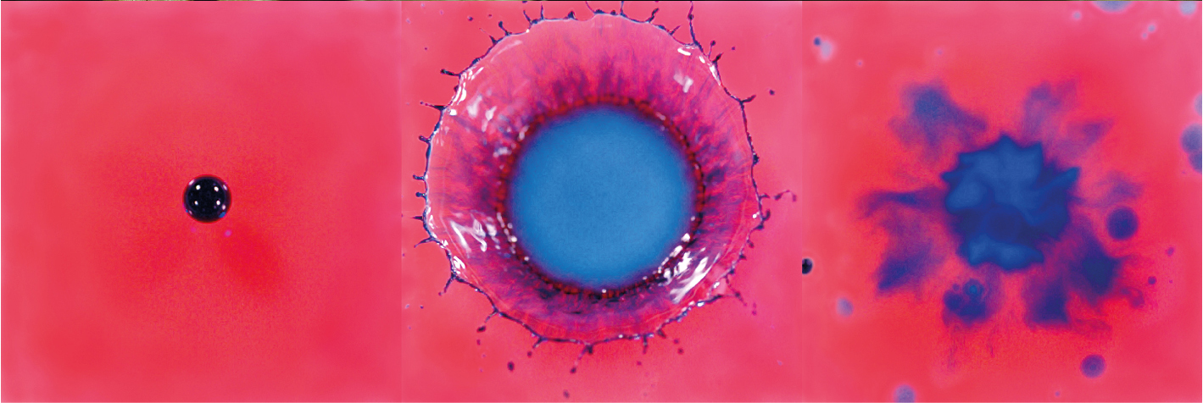
Drop impact on thin film:
mixing, thickness variations and ejections
Justine Parmentier, Vincent Terrapon, Tristan Gilet
Department of Aerospace and Mechanical Engineering, University of Liege
Introduction
Methods
Stalagmite shape varies in response to several competing processes
Such variations could help understand past incoming water flows and paleoclimatic history
1
High-speed movies of
red drops impacting
green thin films
Dripping and falling of drops from the cave ceiling
Before impact
Impact: mixing and distribution of ions
$$\text{p}\text{r}\text{,}\text{d}$$
$$\text{p}\text{g}$$
Gravity-driven drainage
2
How do splash and mixing affect the ion distribution? And potentially stalagmite growth?
3
of residual film on
$$\text{p}\text{g}$$
stalagmite
After impact
Non-dimensional numbers
,
with
Results
Colorimetry algorithm
$(R, G, B)∀x$
$$\text{(}\text{δ}\text{r} \text{,} \text{δ}\text{g} \text{)}∀x$$
Different impact scenarios
Equivalent radius
$$δ=\frac{\text{δ}\text{g}}{\text{p}\text{g}}$$
$$\text{p}\text{r}=\frac{\text{δ}\text{r}}{δ}$$
Red proportion p_{r} /p_{r,d}
Calibration
pictures
$$\text{δ}\text{r}≡\text{p}\text{r} δ$$
$$\text{δ}\text{g}≡\text{p}\text{g} δ$$
Beer-Lambert
law
Film thickness difference ∆δ (μm)
iii
On-screen
variations
ii
Ejected proportion
i
We range
$$(R, G, B)$$
i
ii
Ejected volume Drop volume
Conclusions and
iii
perspectives
h
Drop proportion left in the film
Strong dependence of the impact outcome on
Mixing at impact does not solely explain stalagmite shape variations observed.
Other phenomena to take into account: impact point dispersal and film drainage
Drop volume left in the film Drop volume
Before impact
ii
iii
i
After impact
jparmentier@uliege.be

