Slide 1
Advanced use of technologies based on innovative strategies exploiting immune response to predict heat stress from milk
¹Pauline Lemal*, ¹Martine Schroyen, ¹Nicolas Gengler
¹ULiège - GxABT, 5030 Gembloux – Belgium

Slide 2
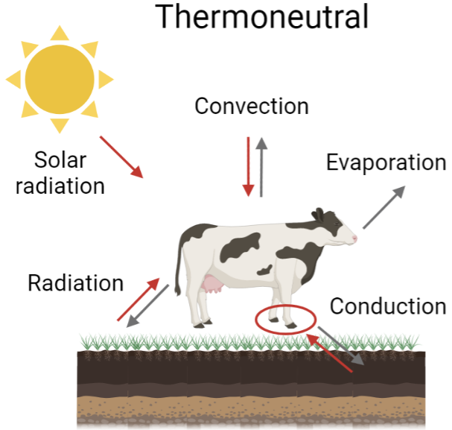
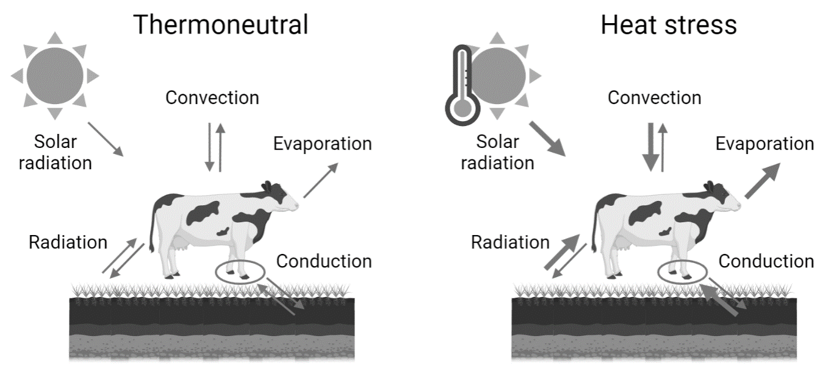
Heat stress
Most and Yates (2021), Animals, 11(12), 3539.

Slide 3
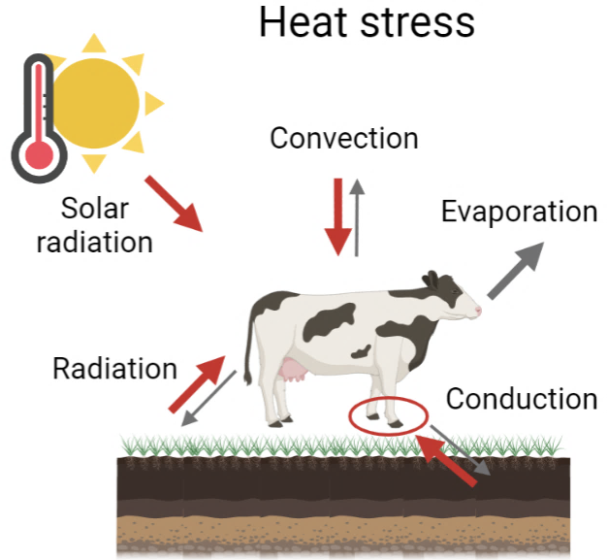
Heat stress
Most and Yates (2021), Animals, 11(12), 3539.

Slide 4
Heat stress
 | Endocrine responses | Physiological responses | Behavioral responses | Metabolic responses (plasma)
↗ | Cortisol Adrenaline Noradrenaline … | Body temperature Respiratory rate Heart rate Sweating | Standing time Shade seeking Agression | Ketone bodies Lactate NEFA …
↘ | Thyroid hormones Growth hormone |  | Dry matter intake Rumination Estrus behavior | Glucose …
→Milk production ↘ and welfare ↘

Slide 5
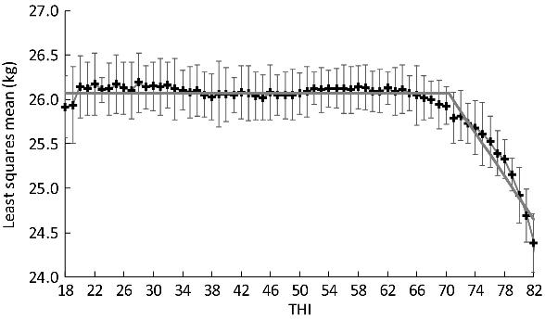
Heat stress detection
Hagiya et al., (2019), Animal Science Journal, 90(5), 613-618.
THI : temperature-humidity index
Variable related to THI (e.g. milk yield)
Heat stress associated with a significant change
of the variable (e.g. decrease of milk yield)
Limitations:
Threshold set and only slope assessed
Threshold vary across countries and regions
THI do not reflect conditions inside the barn → public weather stations
→ A posteriori detection

Slide 6

Heat stress and immunity
Necessity to confirm the heat stress status of individual animals independently of the THI
→ Validation of new indicators
Heat stress also has a negative effect on health
→ Increase somatic cell count and occurrence of diseases
Immune markers → Potential innovative indicators of heat stress

Slide 7
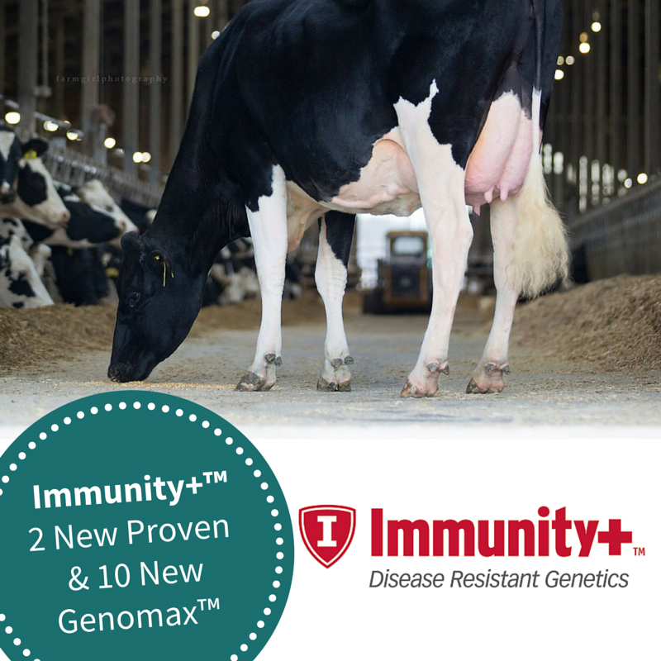
Assessing immunity
intradermal injection:
C. albicans antigen
IM injection:
C. albicans antigen
+ lysozyme
Skin thickness
measurements
Skin thickness
measurements
Day 0
Day 14
Day 21
Day 23
Blood sample
Blood sample
Blood sample
→ Not adapted to routine / real time tracking

Slide 8


Immune markers to detect heat stress
Alternative : MILK
Direct content of milk (cytokines already studied for mastitis)
Gene expression in milk somatic cells
(e.g. HSPs, cytokines, genes affected by cortisol)
MILK
Combination with classical markers
→ Confirm the heat stress status of individuals

Slide 9
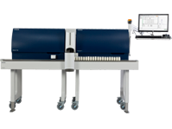
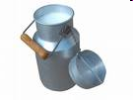

Immune markers to detect heat stress
Milk samples
MIR spectrometry analysis
Quantification:
Fat, protein, urea, lactose…
Prediction
equations
Raw data = MIR spectra

Slide 10
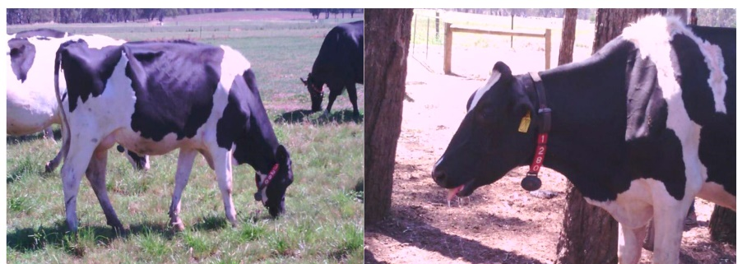
Immune markers to detect heat stress
Milk samples
MIR spectrometry analysis
Quantification:
Fat, protein, urea, lactose….
Prediction
equations
OR
Raw data = MIR spectra
→ Generation of a heat stress prediction equation

Slide 11
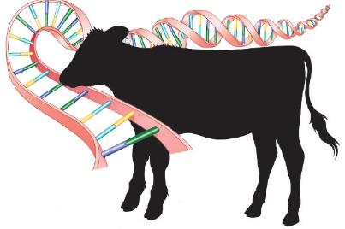
Genomics
GWAS to identify potential candidate genes involved in heat stress resilience
Improve genomic evaluations to predict heat stress resilience through GEBV

Slide 12
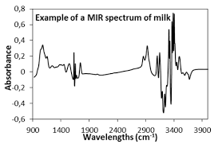

Conclusion
New heat stress
markers
Heat stress
early-warning system
→ IR
Heat stress
early-selection system
→ GEBV
MILK

Slide 13




Acknowledgements
Thank you for your attention!
Questions?
--- Pauline.Lemal@uliege.be ---

