Slide 1
Development of a FE² Multiscale Model of Chloride Ions Transport in Recycled Aggregates Concrete
Presentation at ECCOMAS Congress 2022 (MS146C)
Arthur FANARA – 6 June 2022
A. FANARA, L. COURARD and F. COLLIN University of Liège, ArGEnCo Department, UEE Research Unit
Notes:
Hello Everyone, I’m Arthur Fanara, from the University of Liege in Belgium, and I will present you my PhD Research on multiscale modelling, by the finite element square method, of chloride ions transport inside recycled aggregates concrete.

Slide 2
Background
Environmental Concerns
Concrete: 1 billion tons/year in EU [Eurostat, 2014]
C&D Waste: 374 million tons in EU (2016) [European Commission, 2019]
→ Recycled Concrete Aggregates (RCA) = NA + Residual mortar
[https://www.futurerecycling.com.au/sustainability/circular-economy/,2020]
Notes:
And first of all, by the environmental concerns. Concrete is produced, in the EU, at a rate of 1 billion tons per year (in 2014, maybe more nowadays). On the other hand, the construction and demolition sector produces 374 million tons of waste in the EU. In a spirit of circular economy were then born the recycled concrete aggregates, constituted of Natural aggregates and residual mortar.

Slide 3
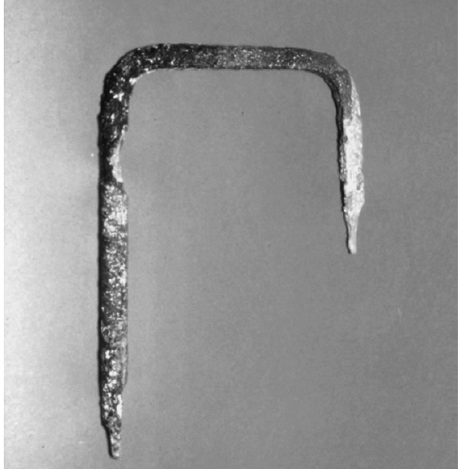
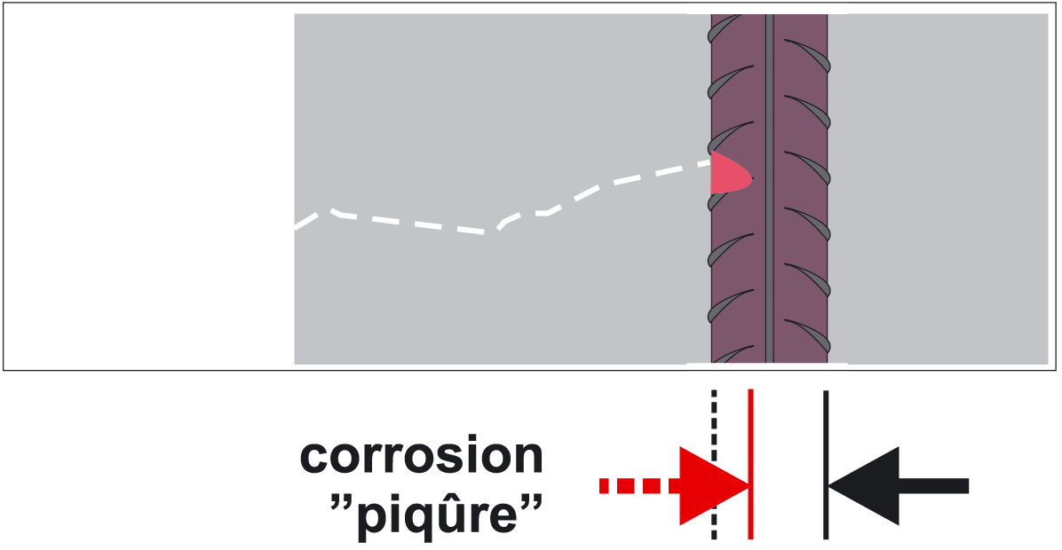
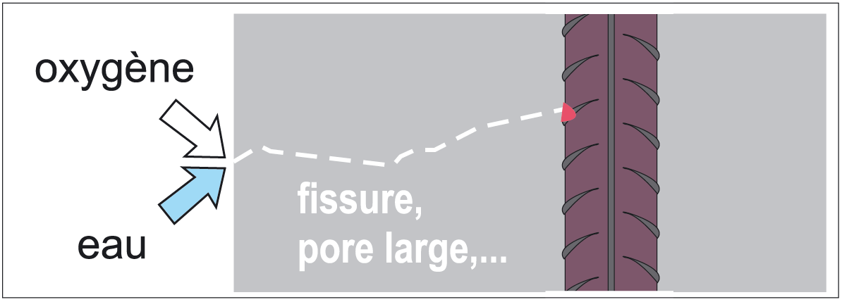
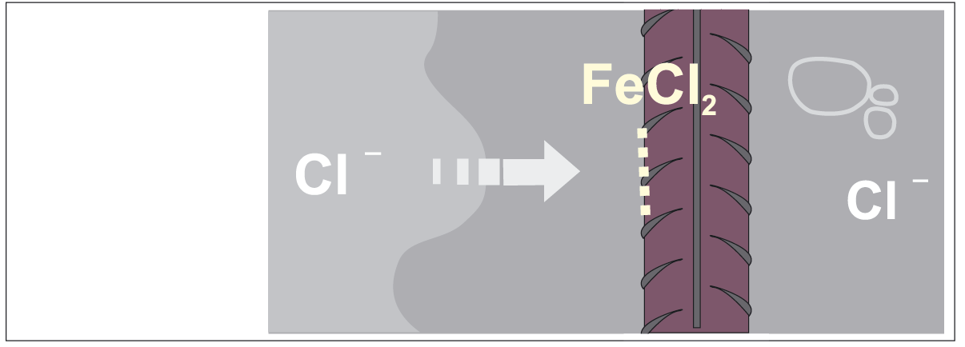
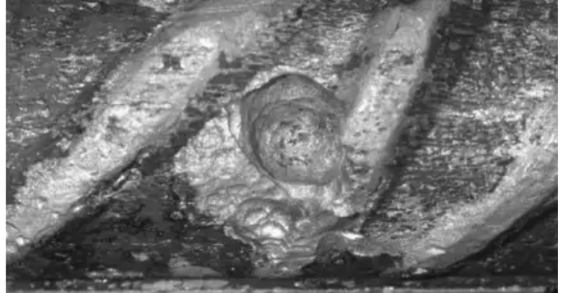
Background
Chlorides Attacks
[Ployaert, 2008]
oxygen
Concrete
Sea water, sea wind, deicing salts, mixing constituents, …
Porosity, Cracks, …
water
Corrosion by
“pitting”
[Raupach & Büttner, 2014]
[Raupach & Büttner, 2014]
Notes:
The other important aspect of my research are the chloride attacks, which are responsible of a high cost of maintenance in reinforced concrete structure. The chloride ions, coming from … penetrate the porous structure of concrete and concentrate near the reinforcements, as well as the oxygen and water. Those chemical elements then create a battery system, inducing pitting corrosion and a rapid loss of section of the reinforcements. An exemple is shown…

Slide 4
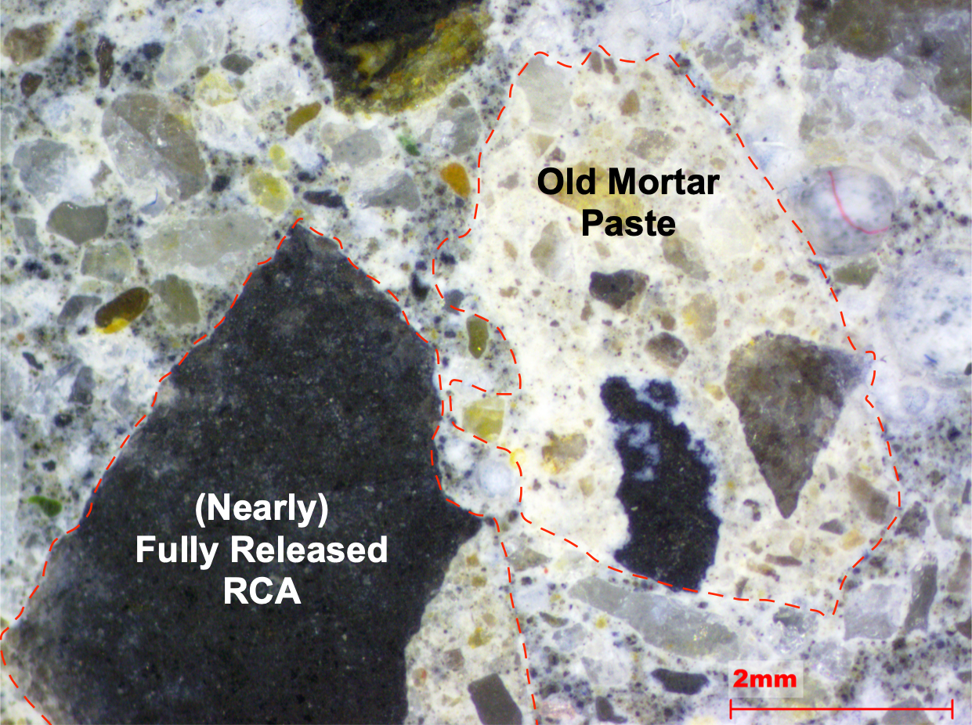
Background
Influence of RCA
RCA: increased porosity and water absorption
Water is the cause of many degradations processes because it favours the penetration of ions
→ Influence of RCA on chloride attacks ?
[Fanara, 2020]
Notes:
Those two problems are deeply linked. On the picture is represented…

Slide 5
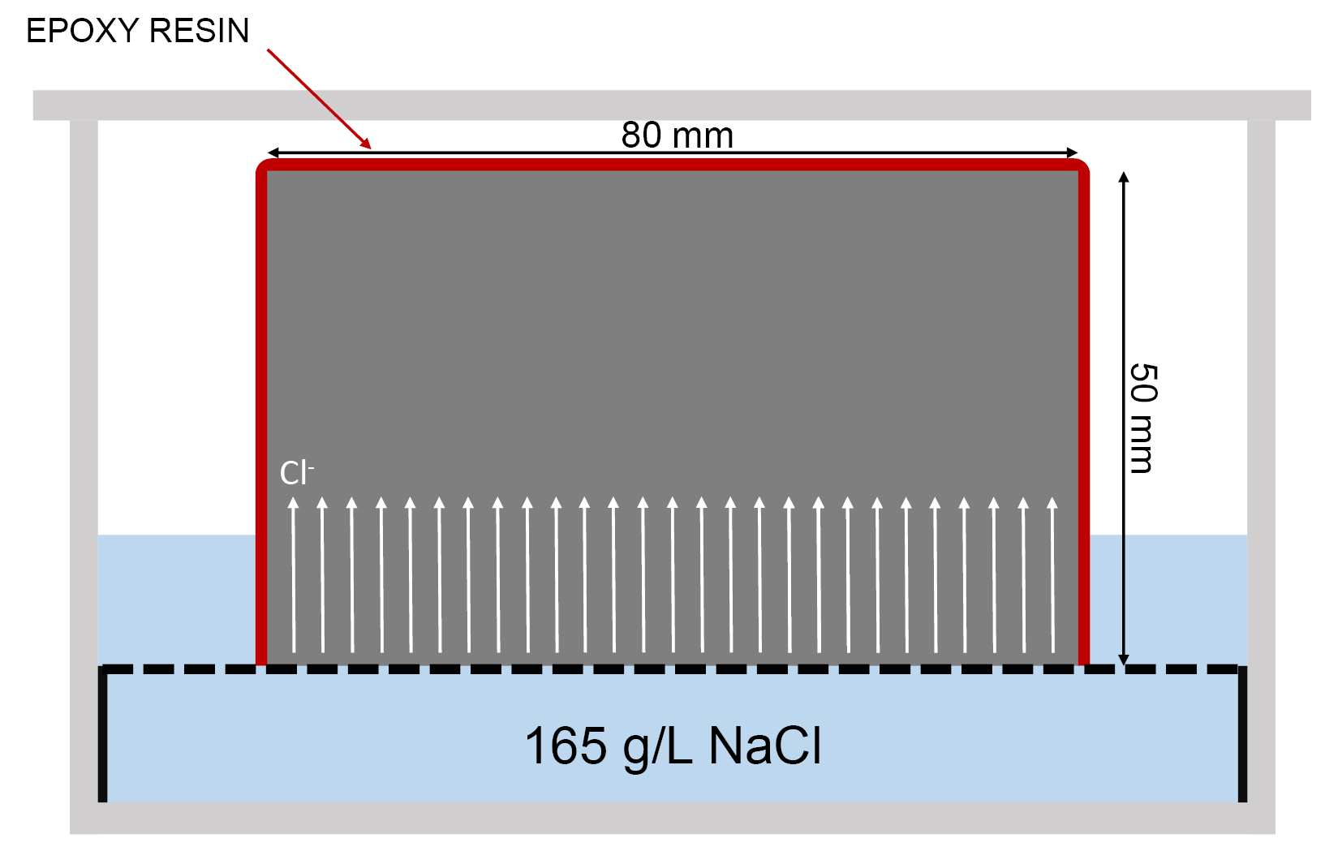
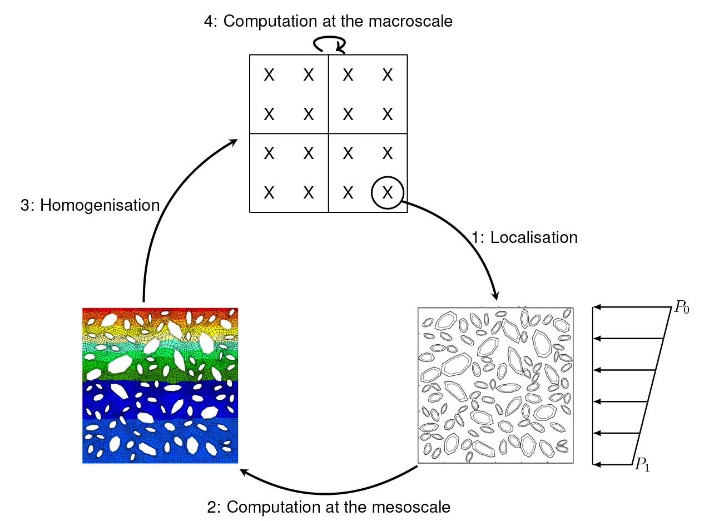
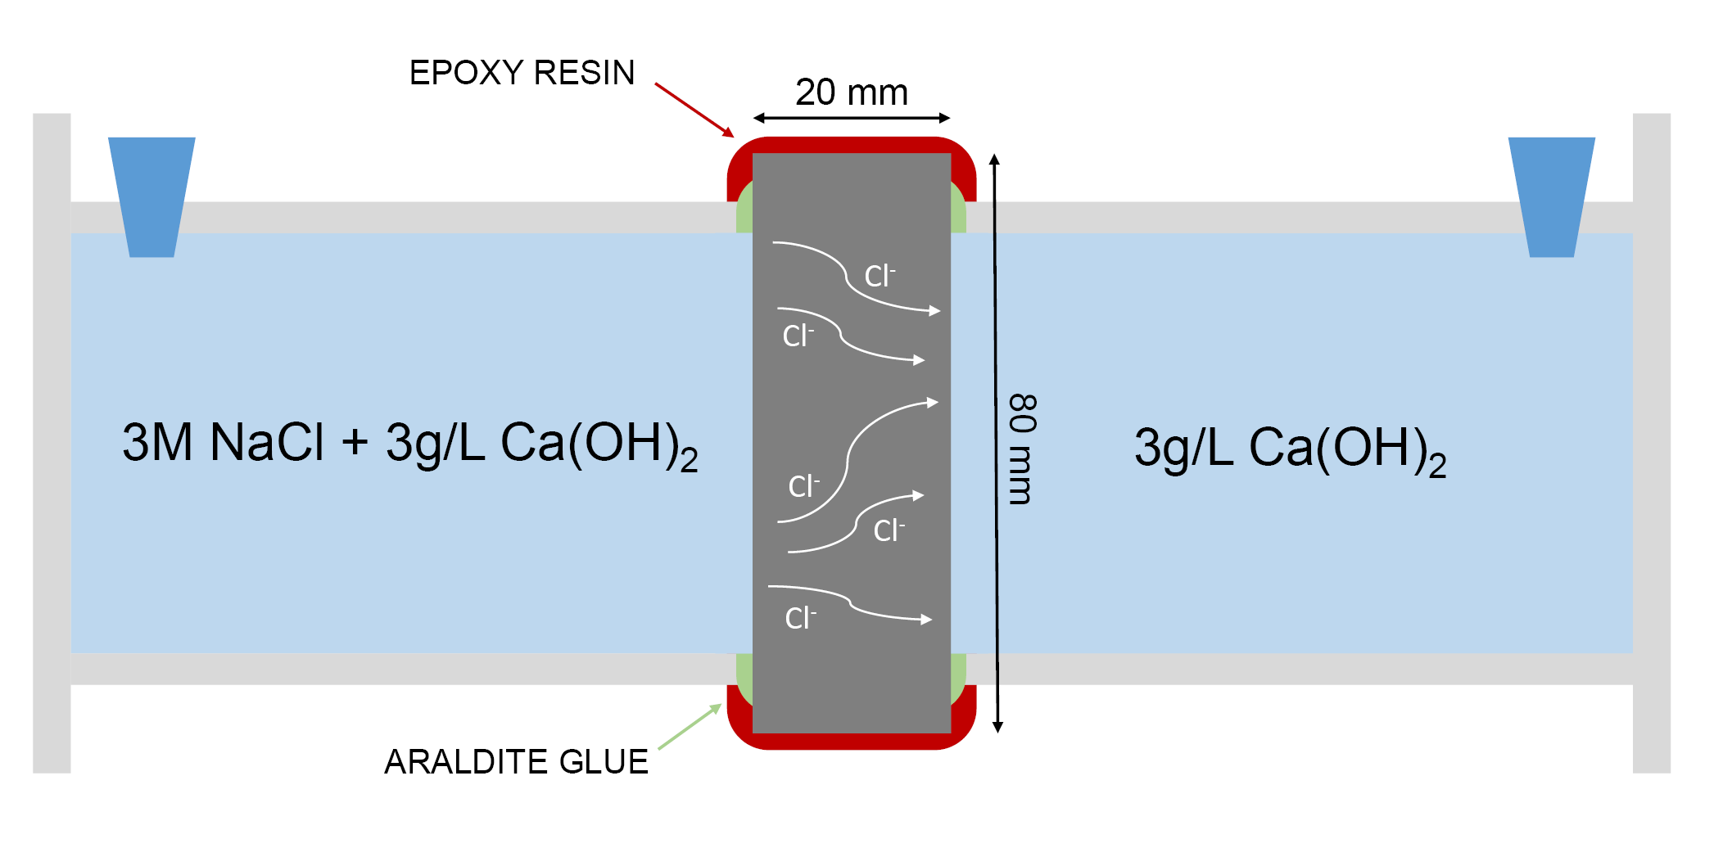
Goals of this study
Experimental | Numerical
Notes:
This PhD research has a complete dual approach, with experimental work to characterize the diffusion of chloride ions inside NAC and RAC, and the development of a numerical model to extrapolate the results over a longer time period.

Slide 6
1. Introduction 2. Description of the model 3. Analytical validation of the model 4. RVE generation and analysis 5. Comparison with some experimental results 6. Conclusion
Notes:
Let me continue with the description of the model developed until now.

Slide 7
Description of the model
2D FE² Multiscale model written in FORTRAN, using the LAGAMINE software from the University of Liège.
Water convection + pollutant diffusion and advection, under saturated conditions
Notes:
The FE² multiscale model is written in FORTRAN…, and it is currently working for water convection and pollutant… under saturated conditions

Slide 8
Multiscale modelling
*Our microscale is in the order of the centimetre
2: Computation at the microscale*,
under permanent flow hypothesis

Slide 9
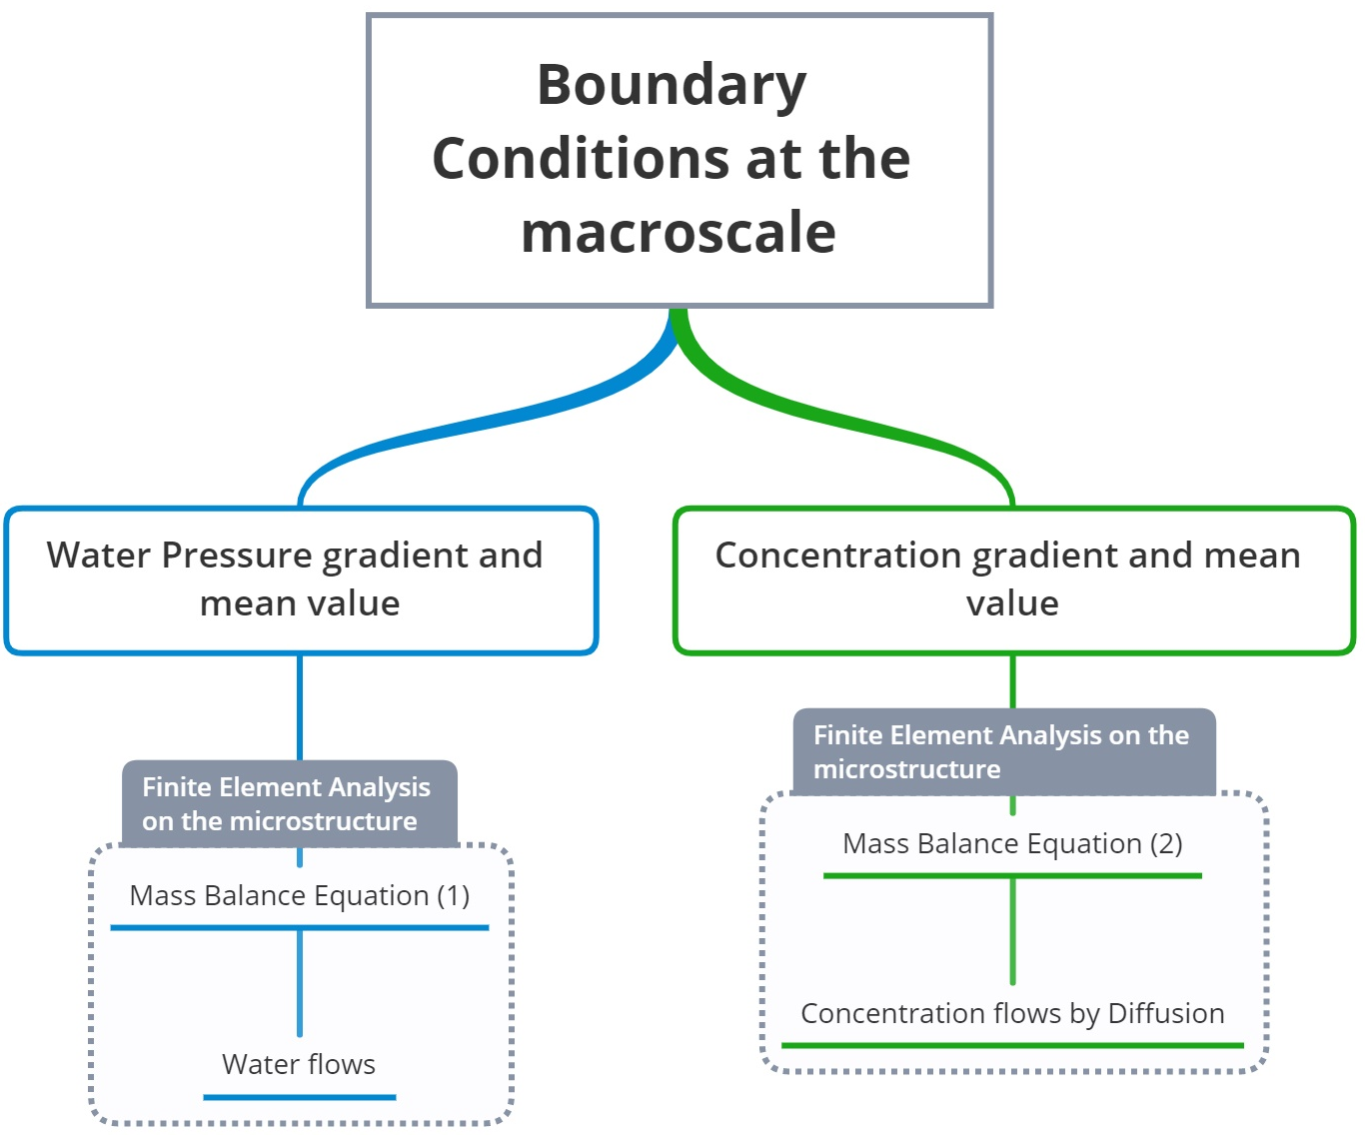
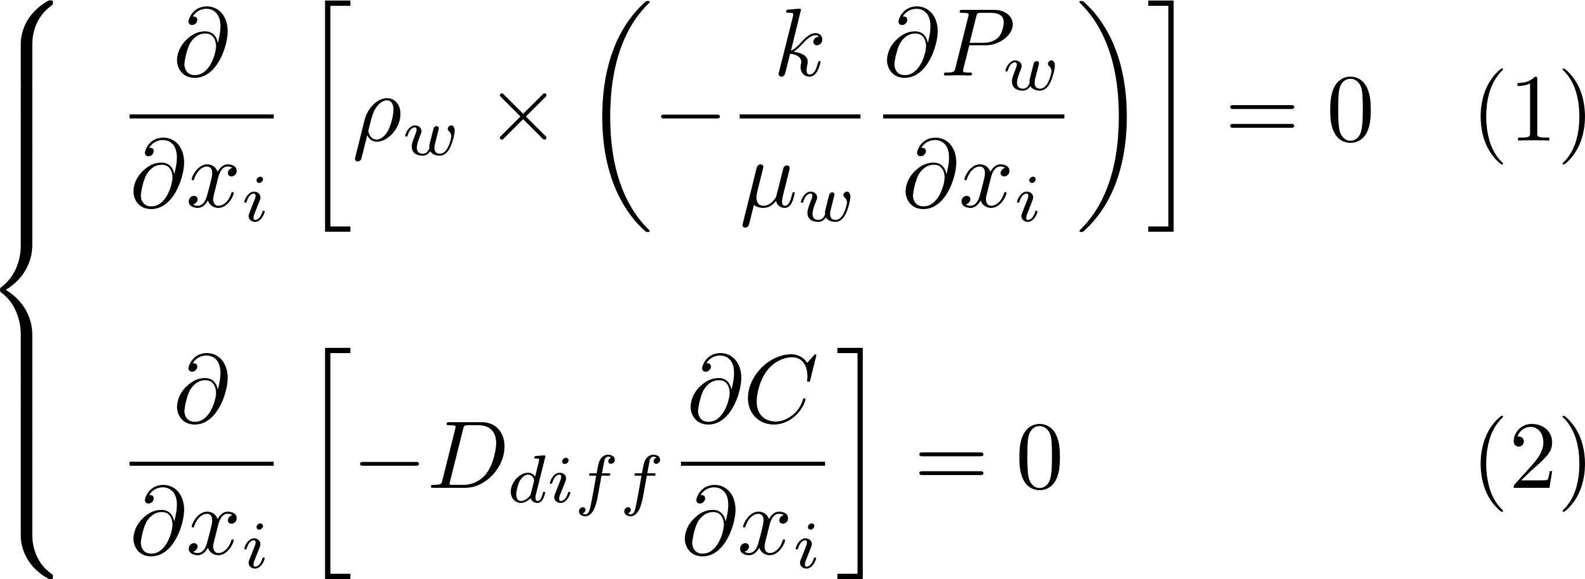
Microscale Equations
Notes:
The model is quite classical. The BC are applied at the macroscale and then a gradient and mean value are calculated for each time step and IP, for both the water pressure and concentration. The FEA on the microstructure is performed thanks to the two mass balance equations you can see here, and a homogenized water flow and concentration flow by diffusion only is obtained. Then, a coupling is performed at the macroscale based on the homogenized water flows.

Slide 10
Macroscale Equations

Slide 11
1. Introduction 2. Description of the model 3. Analytical validation of the model 4. RVE generation and analysis 5. Comparison with some experimental results 6. Conclusion
Notes:
I’ll now show you the analytical validation of the model.

Slide 12
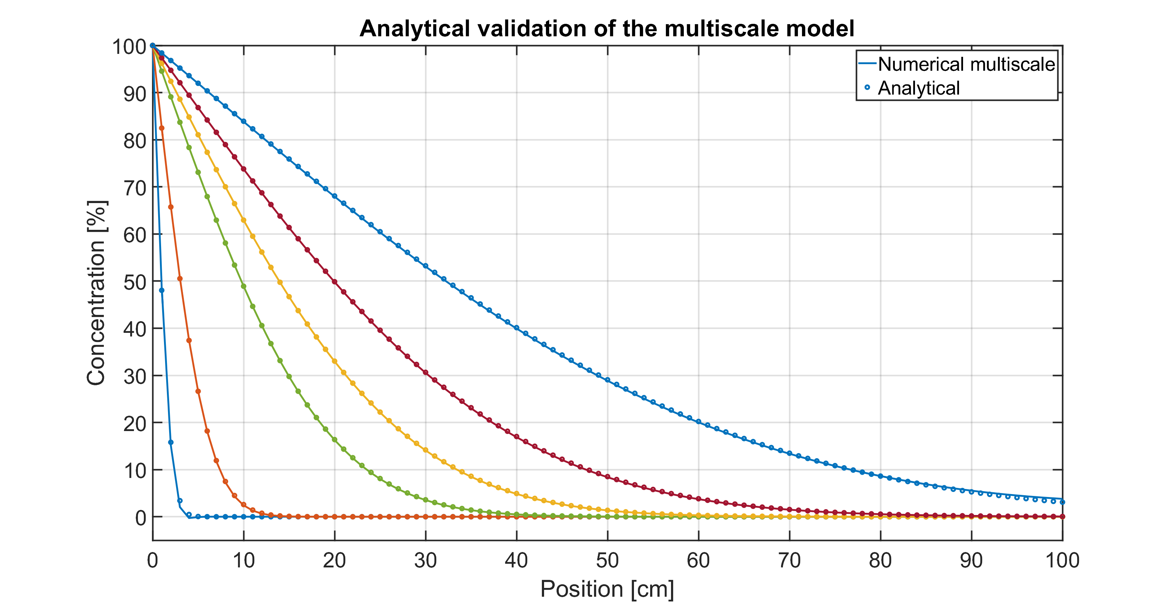
Analytical Validation
Analytical solution for a 1D semi-infinite medium [Biver,1993]:
Homogenized micro.
Diffusion and advection
Notes:
Using this analytical solution for a 1D semi-infinite medium from Biver, for diffusion and advection of pollutant inside a saturated porous medium, we obtain the results below. We can see that our model replicates accurately the analytical solution, validating it.

Slide 13
1. Introduction 2. Description of the model 3. Analytical validation of the model 4. RVE generation and analysis 5. Comparison with some experimental results 6. Conclusion
Notes:
The next thing I’d like to present you is the RVE generation and a little analysis of its influence on the results

Slide 14
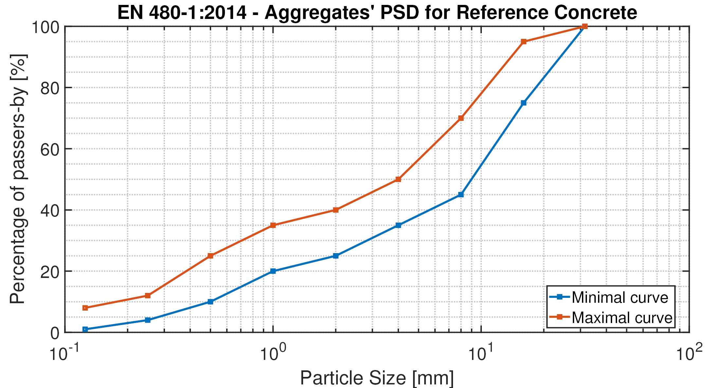
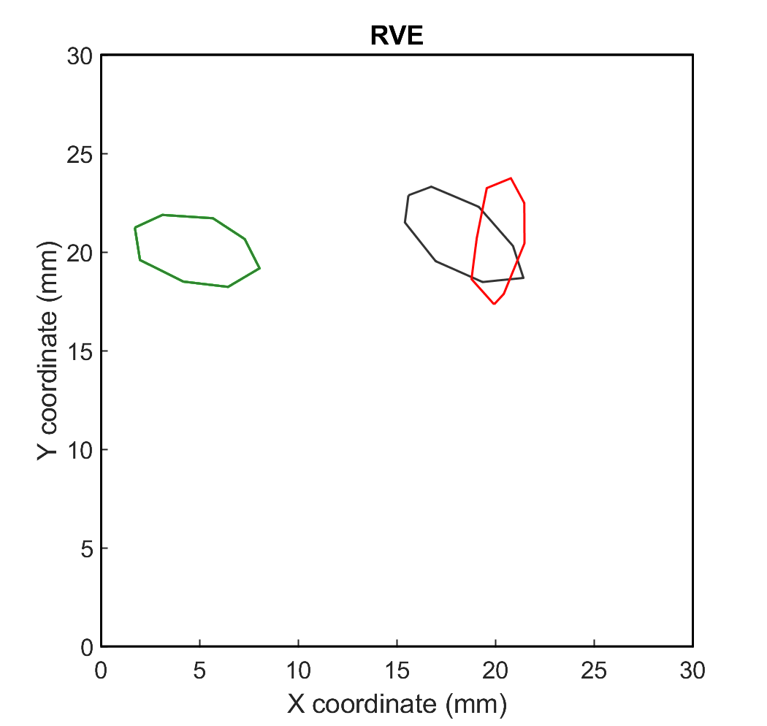
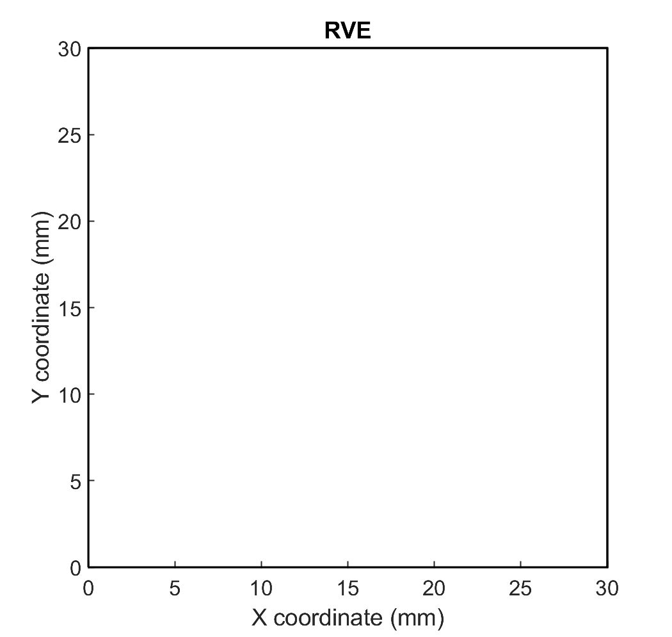
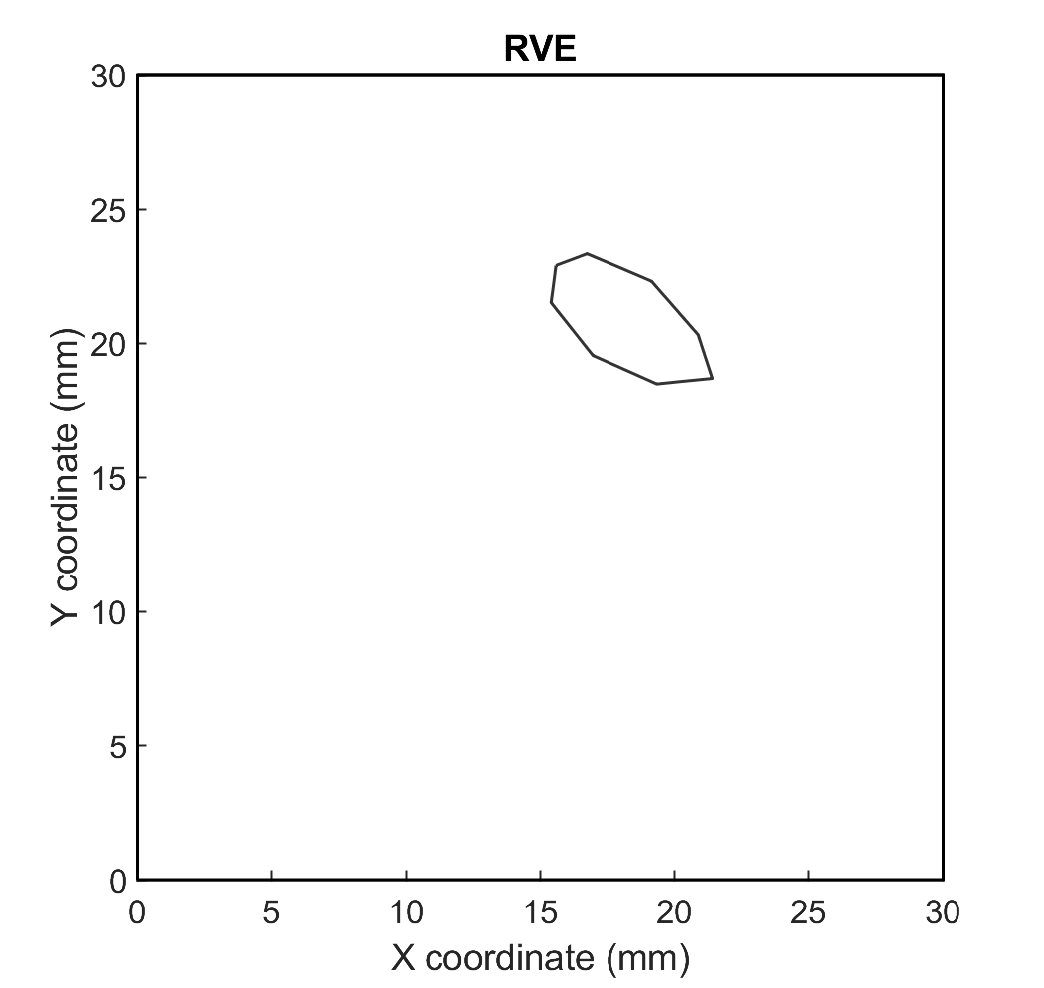
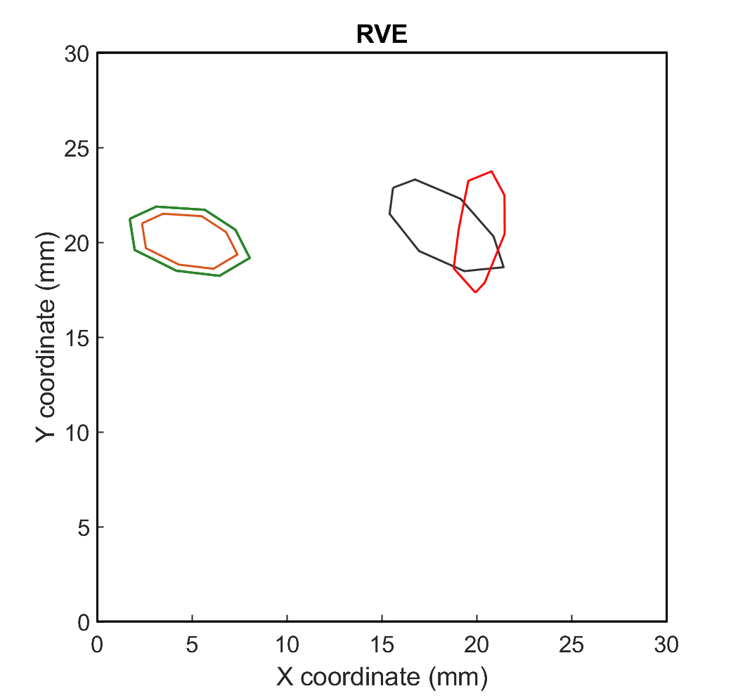
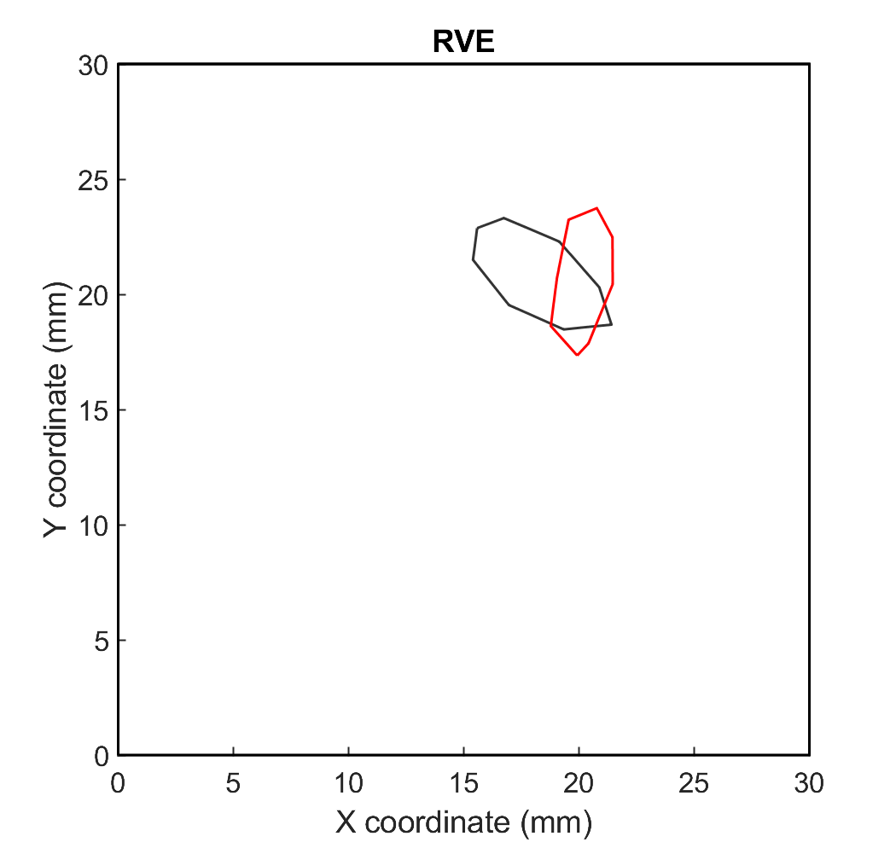
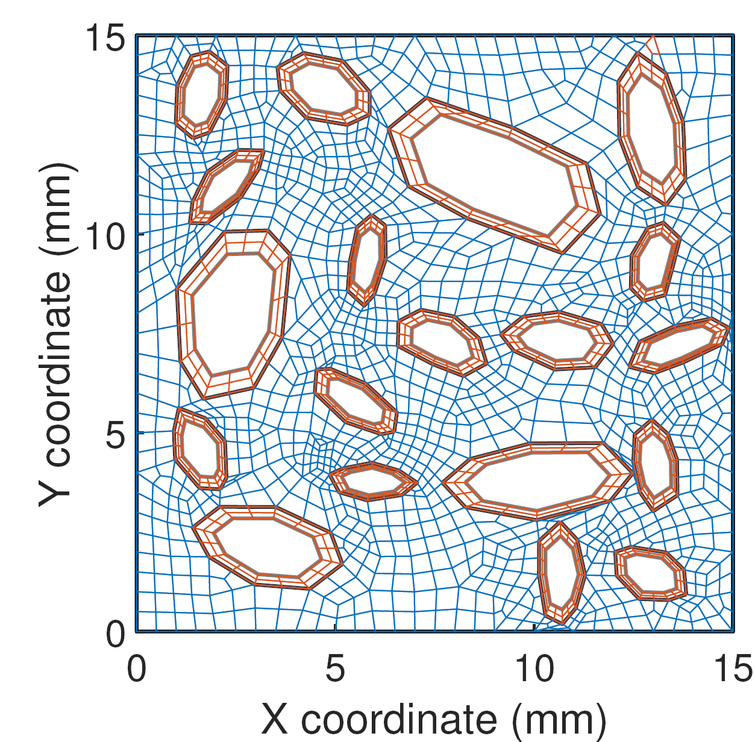
RVE Generation
[Nilenius,2014]
INPUT: Aggregates Particle Size Distribution (PSD),
Surface Fraction (SF) and Aspect Ratio (AR)
Computation of the SF required for each interval of the PSD
Starting from the biggest diameter interval: while [current SF + min (aggregate surface) < required SF]
Generate an aggregate of random size inside the interval, in an elliptical form respecting the AR and then degenerated into an octogone whose vertices are slightly deformed
Change the current diameter interval to a smaller one
Place it randomly and verify a criterion of non-intersection with already placed aggregates
Meshed by GMSH [Geuzaine,2009] with impervious aggregates
Update the SF for the current diameter interval
Is it a NAC or RAC ?
Generate a NA inside the RCA, whose outer layer (adherent mortar) has a surface equal to a given percentage of the RCA.
Notes:
The algorithm is inspired from the work of Nilenius.

Slide 15
Influence of RVE size: diffusion
*Diffusion coefficient of the adherent mortar = 5x greater than the plain mortar

Slide 16
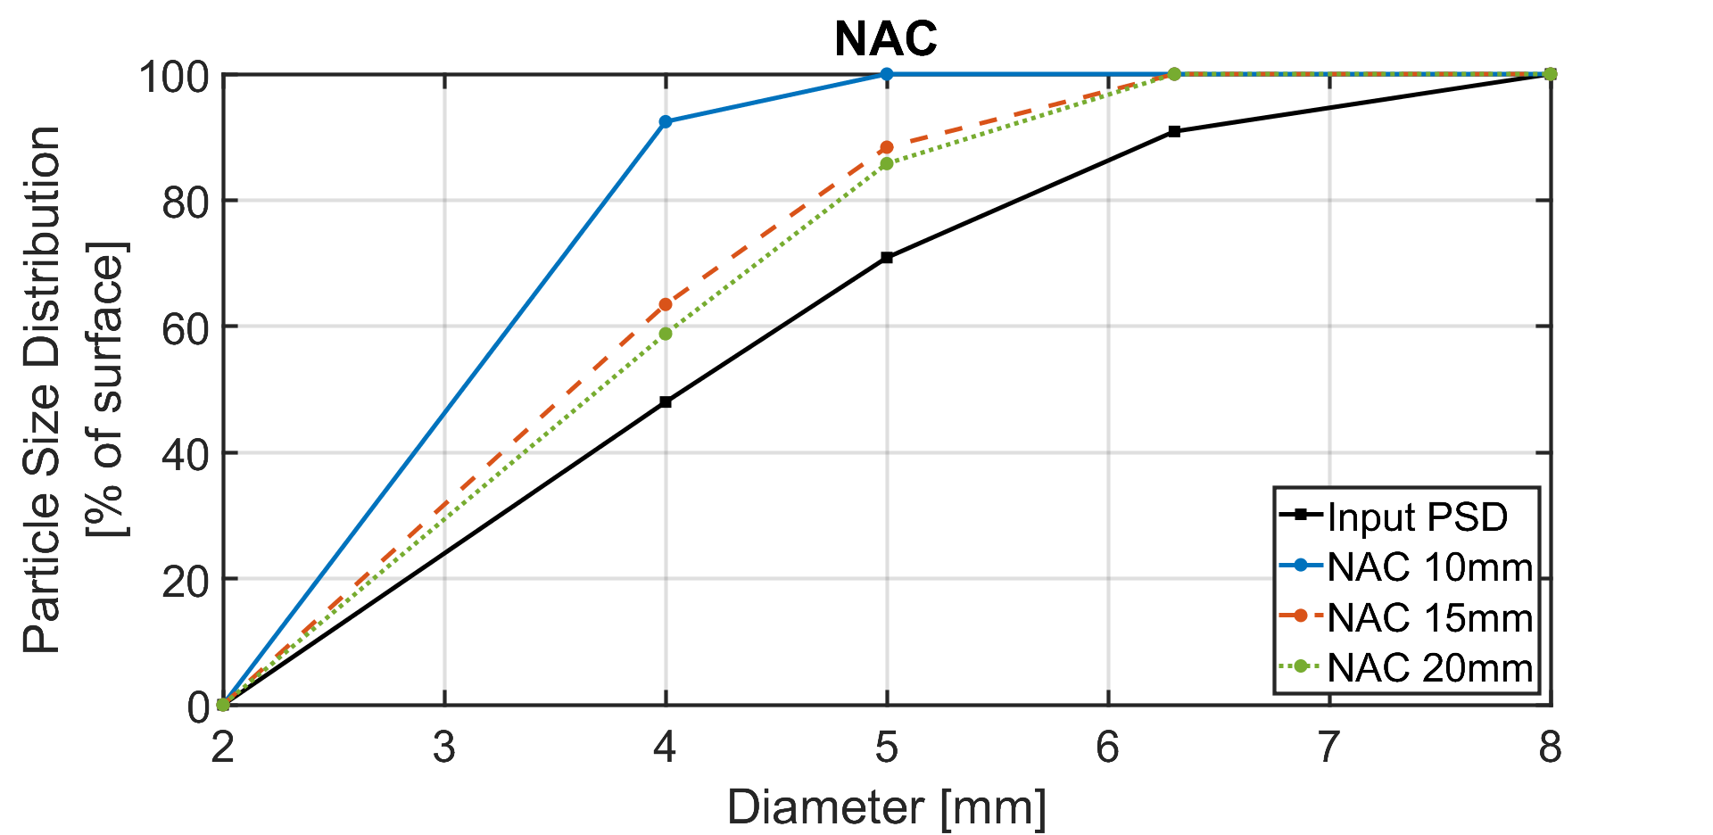
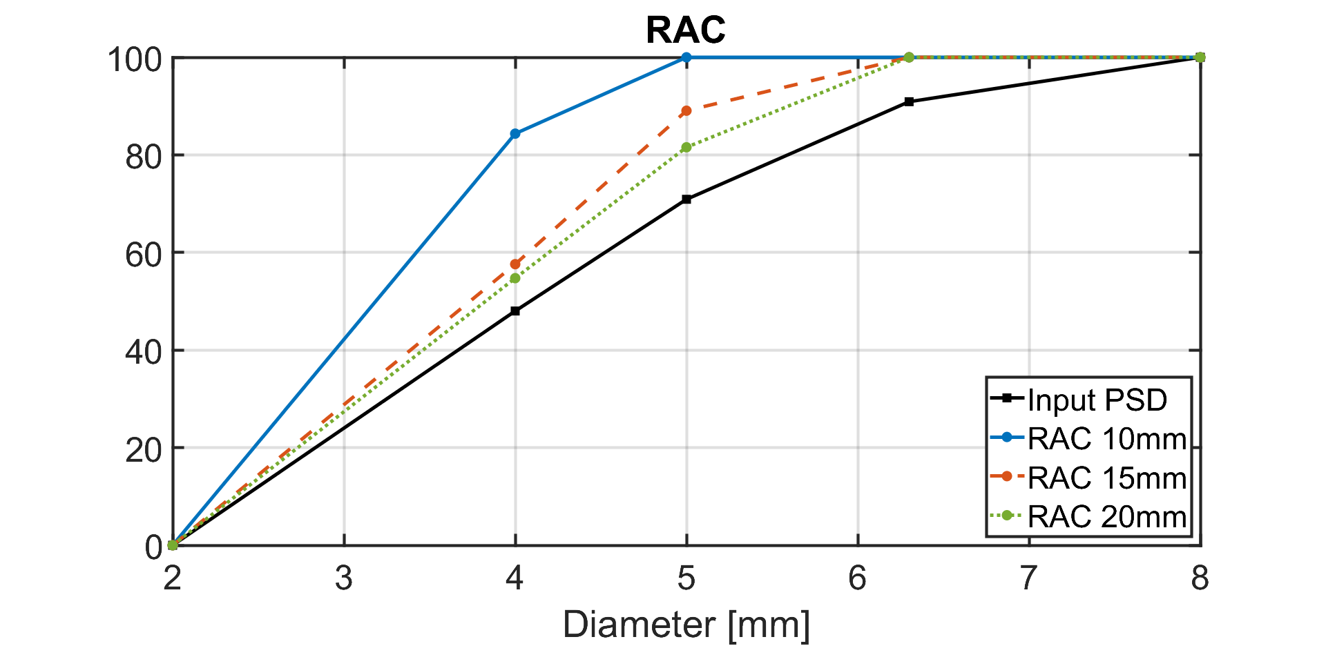
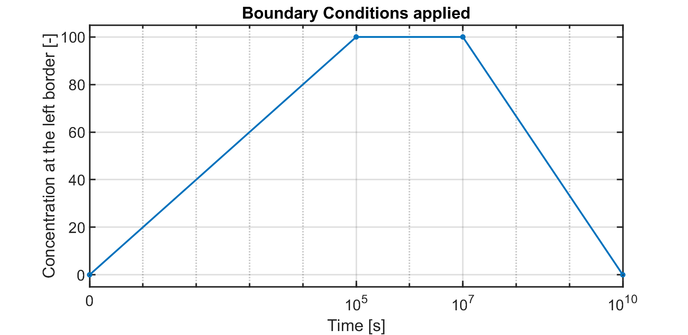
Influence of RVE size: diffusion

Slide 17
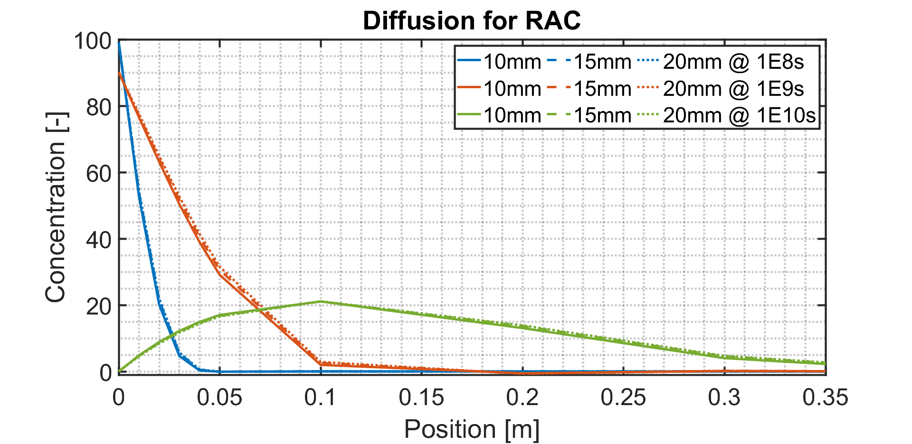
Influence of RVE size: diffusion
RAC: nearly no influence of the RVE size due to the higher diffusion surface

Slide 18
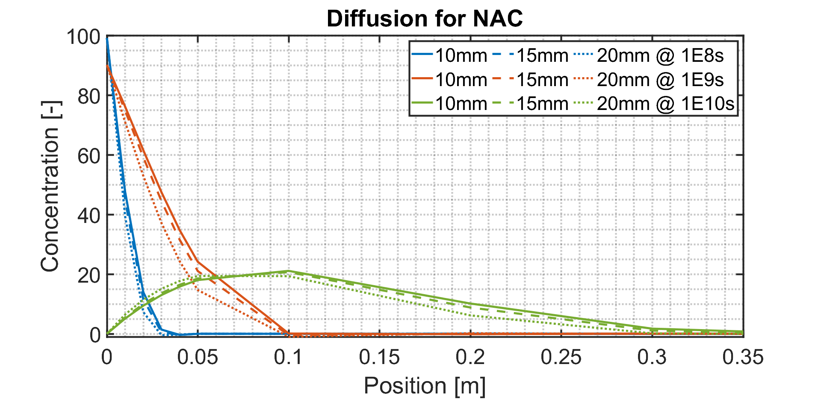
Influence of RVE size: diffusion
NAC: the smaller the RVE, the higher the diffusion → less representative because it can input less aggregates than required.

Slide 19
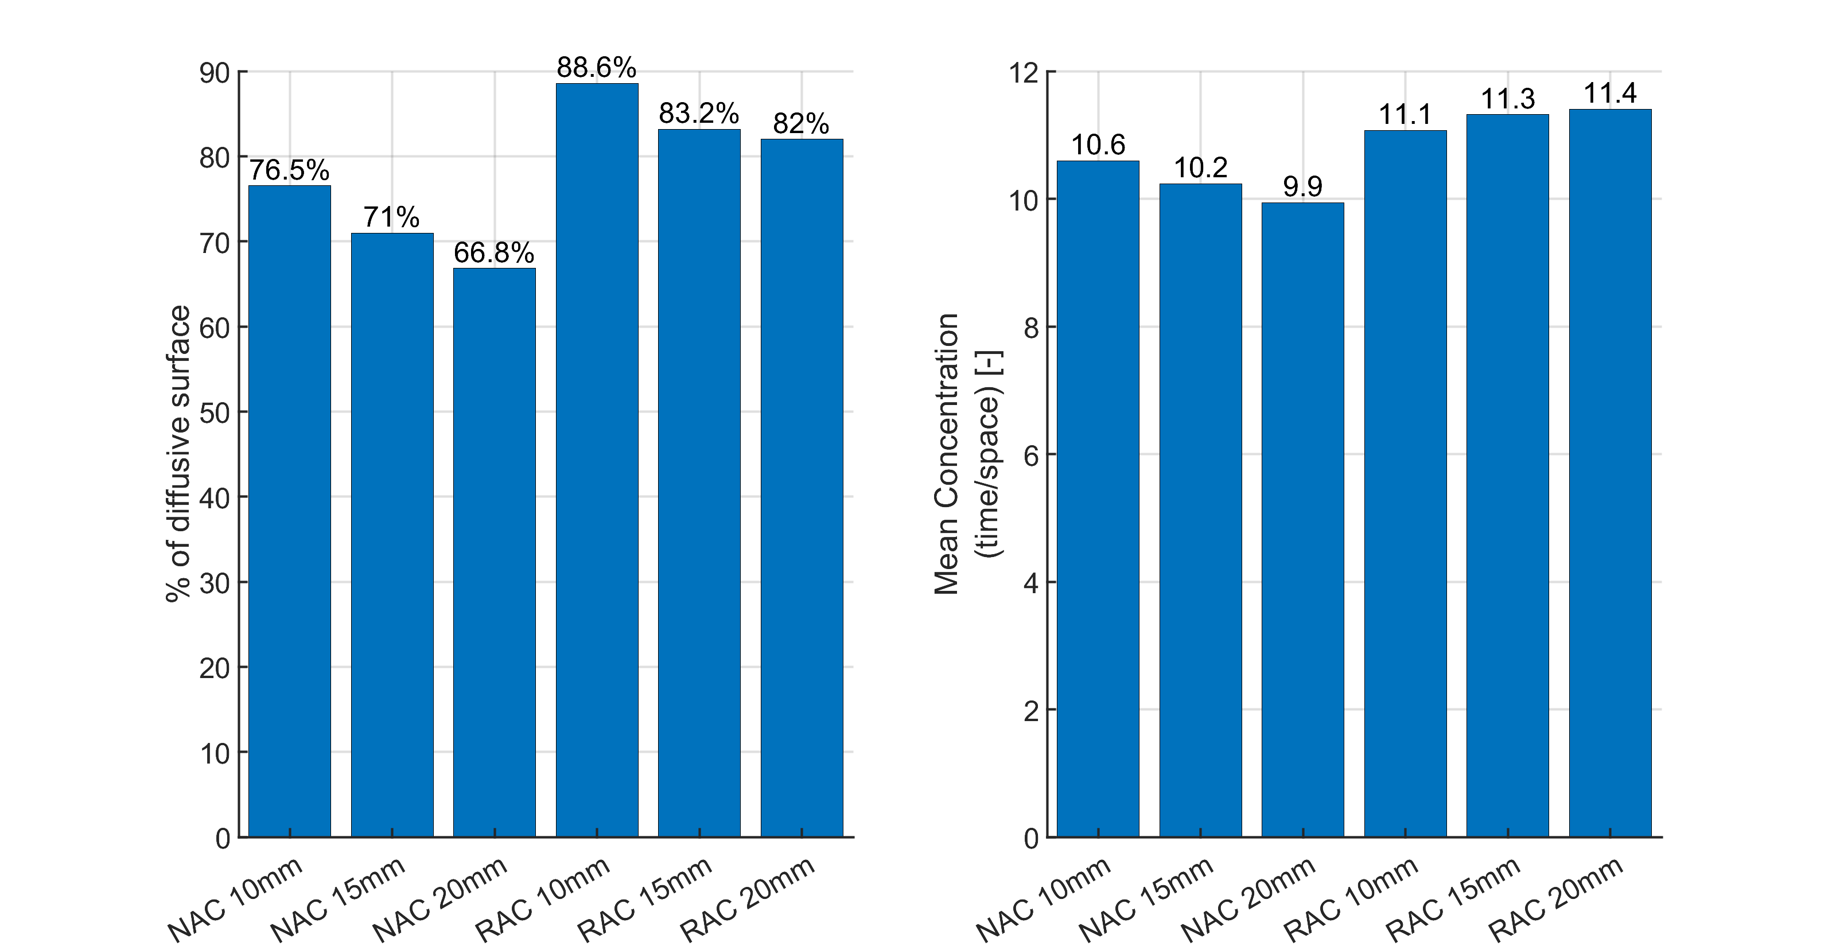
Influence of RVE size: diffusion
The bigger the RVE, the smaller the diffusive surface (with RAC > NAC);
The smaller the diffusive surface in RAC, the bigger the mean concentration

Slide 20
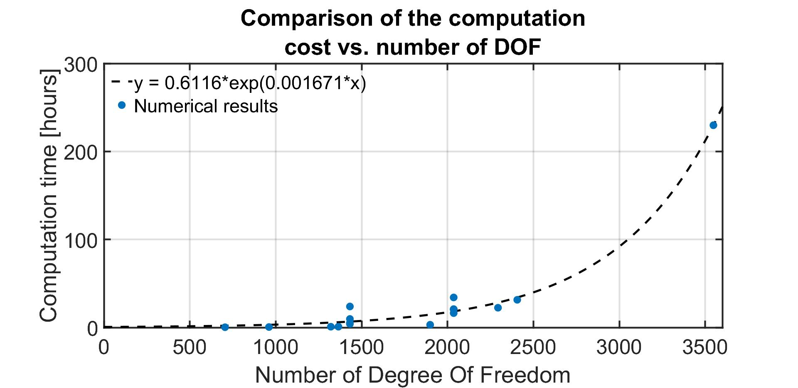
Computation cost

Slide 21
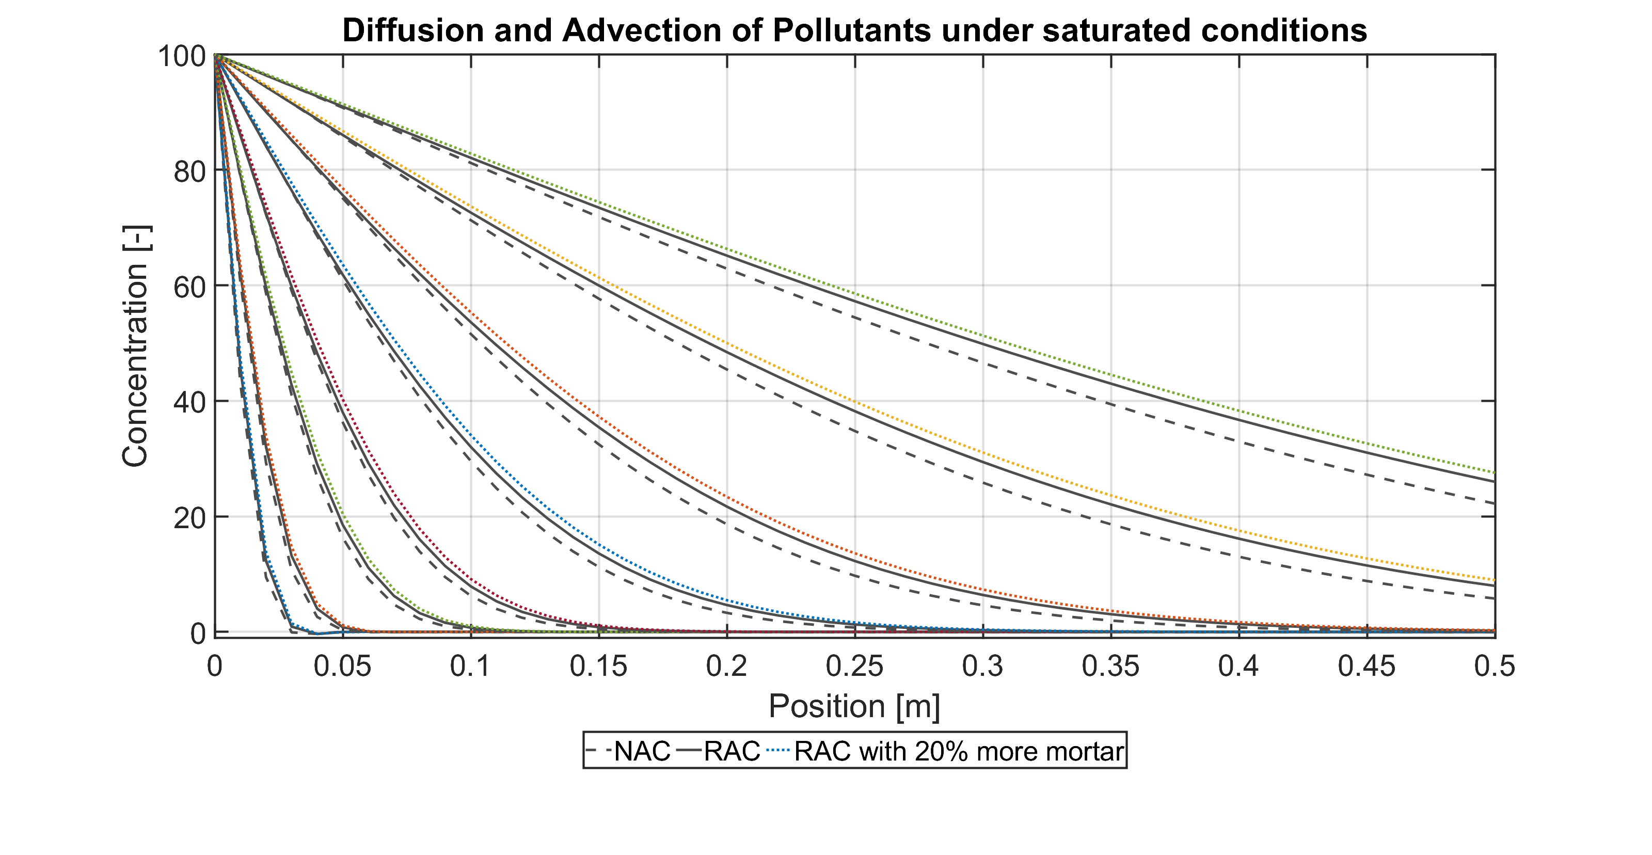
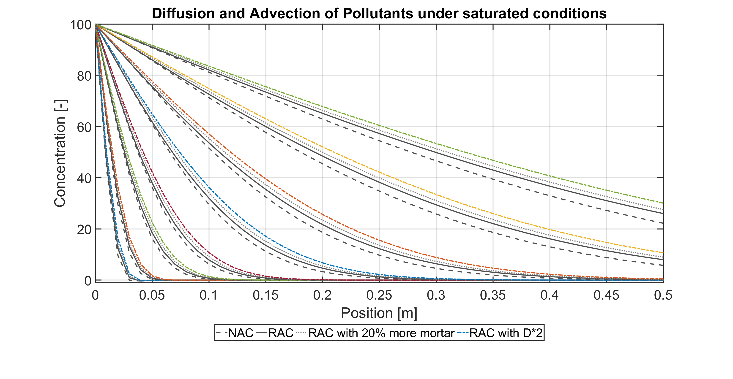
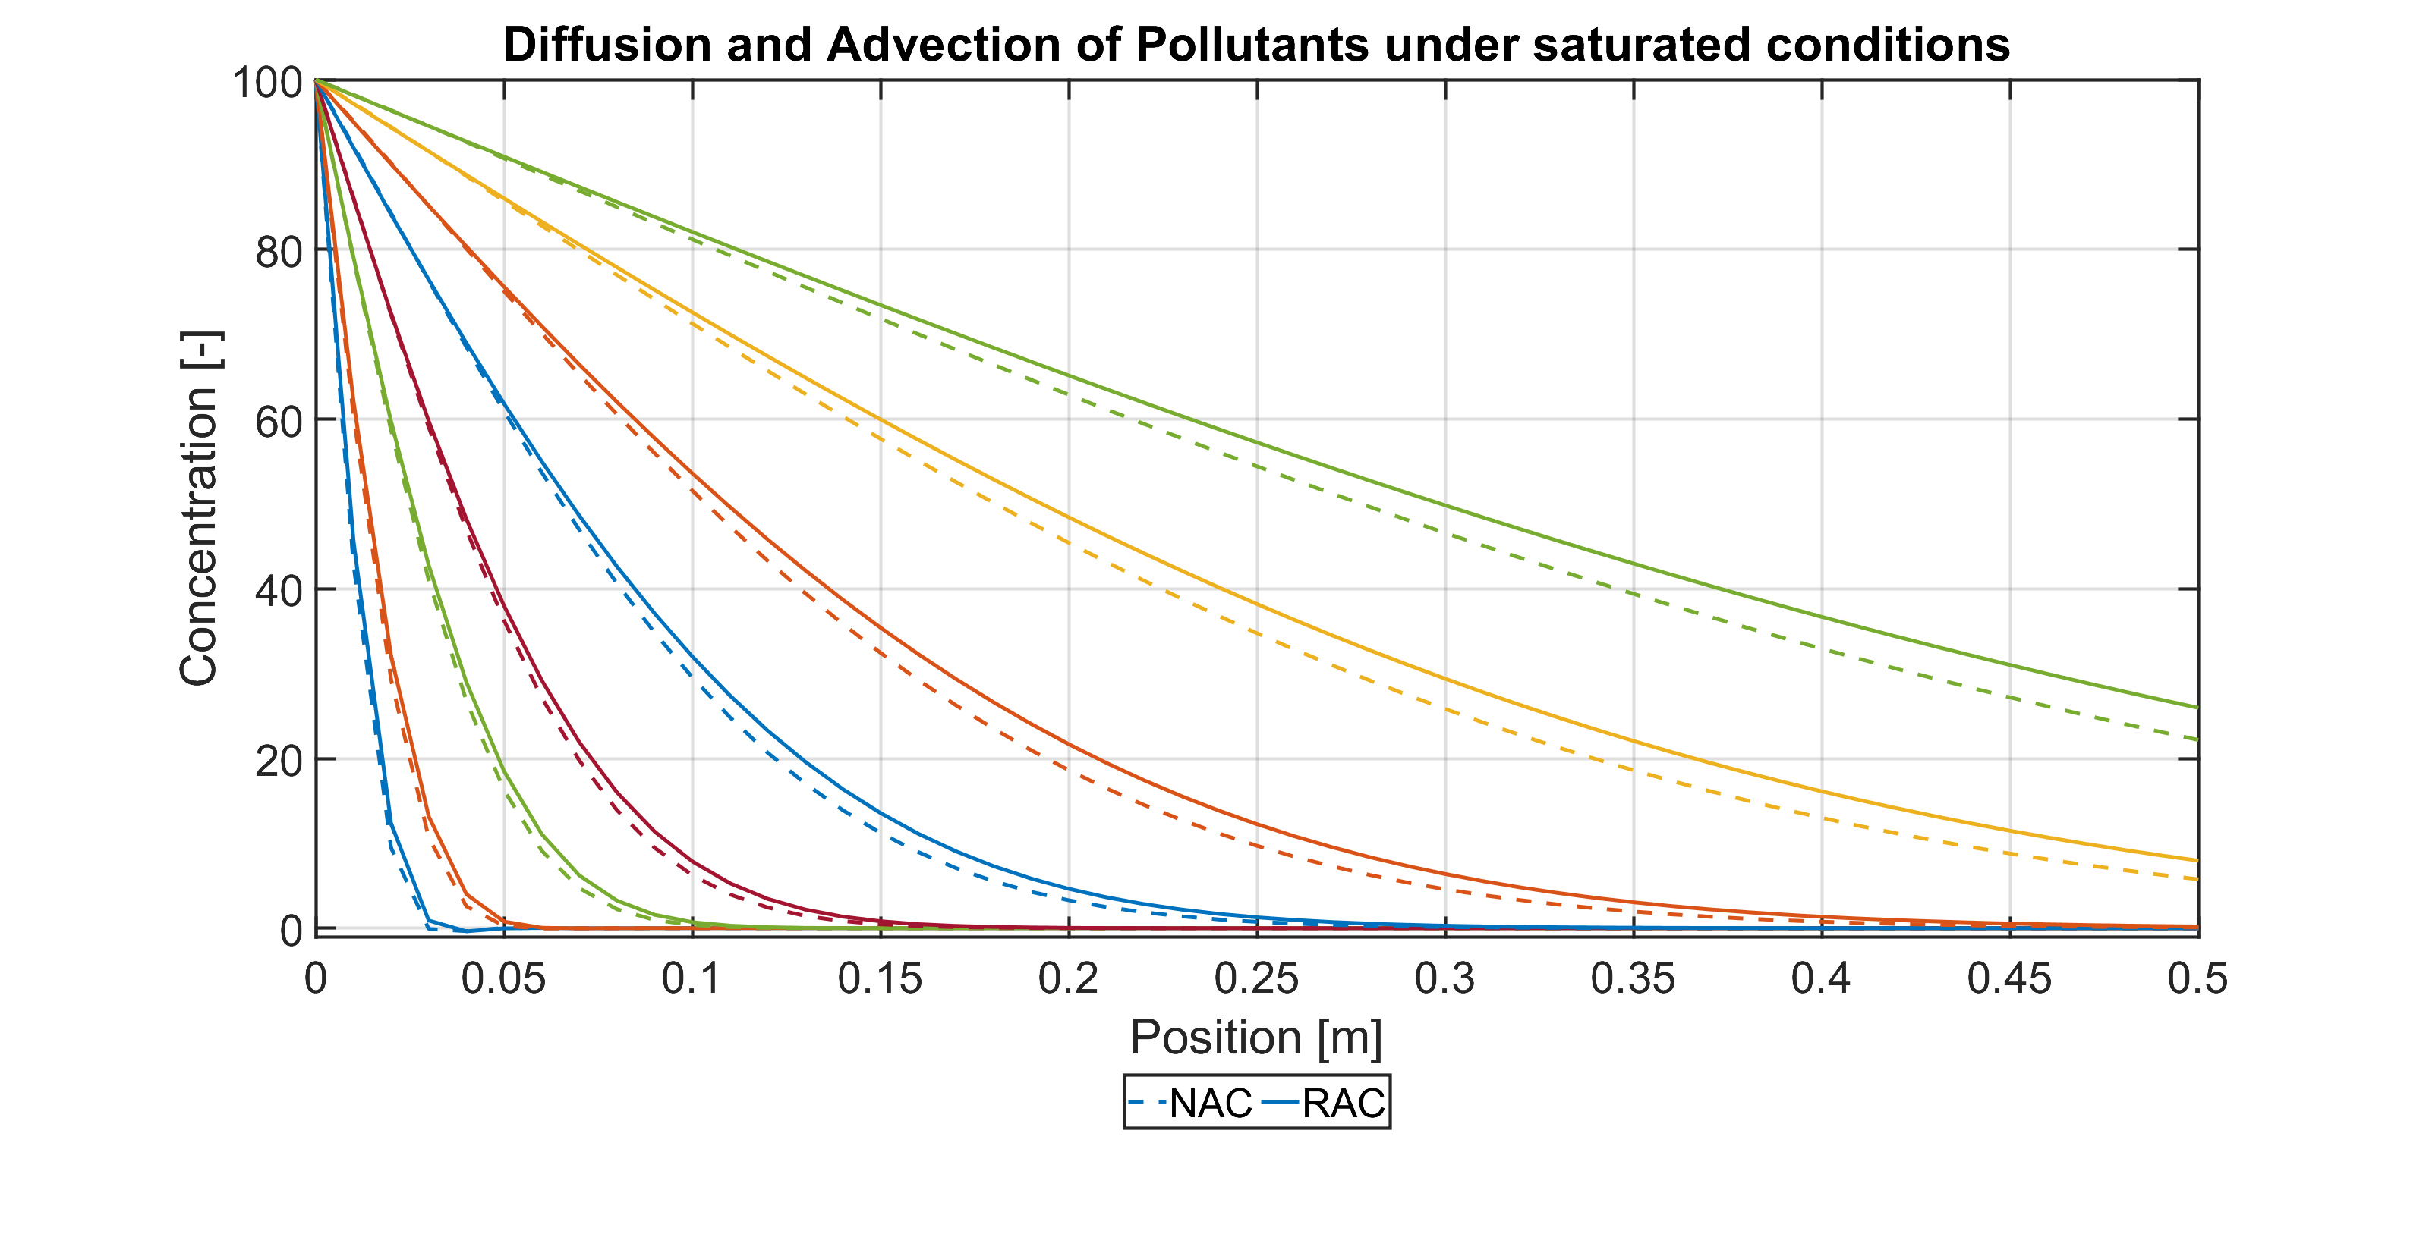
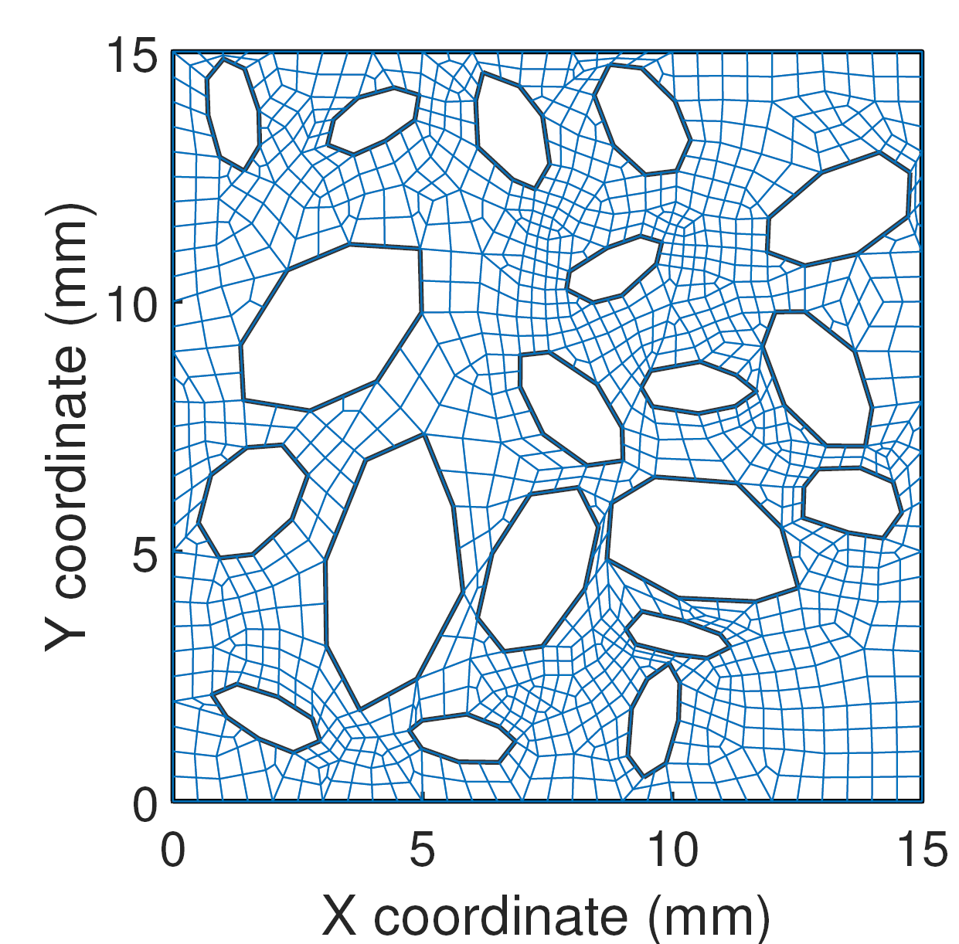
Influence of RVE type
Doubling the diffusion properties of the RCA increases the diffusivity by 23%
At equal properties, the adherent mortar from the RAC increases its diffusivity to chloride ions (+14%).
A 20% increase of the adherent mortar content increases the diffusivity to chloride ions by 17.5%

Slide 22
1. Introduction 2. Description of the model 3. Analytical validation of the model 4. RVE generation and analysis 5. Comparison with some experimental results 6. Conclusion

Slide 23
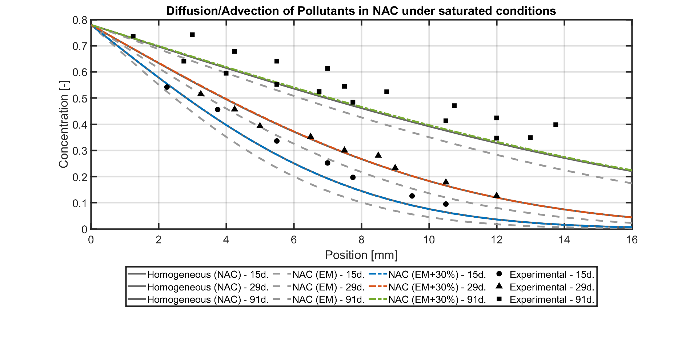
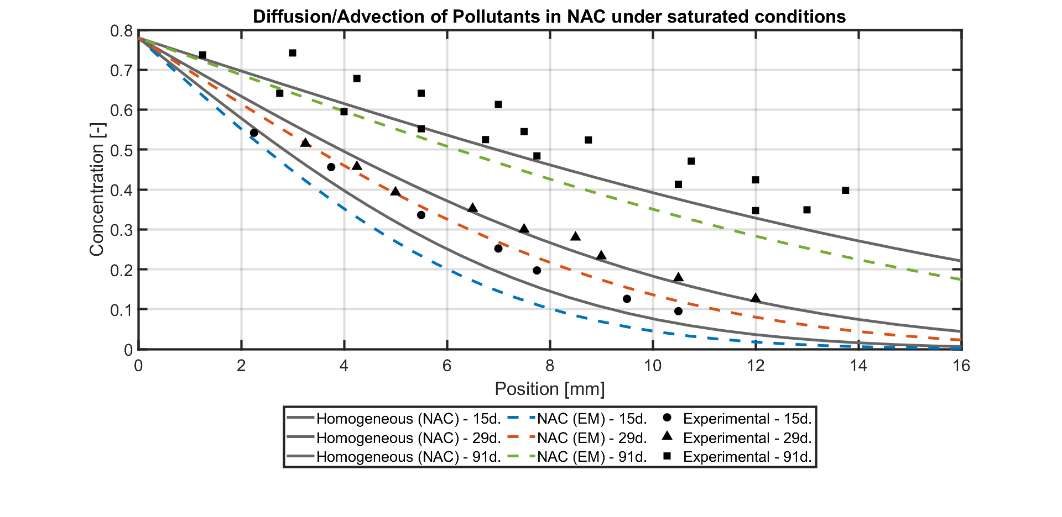
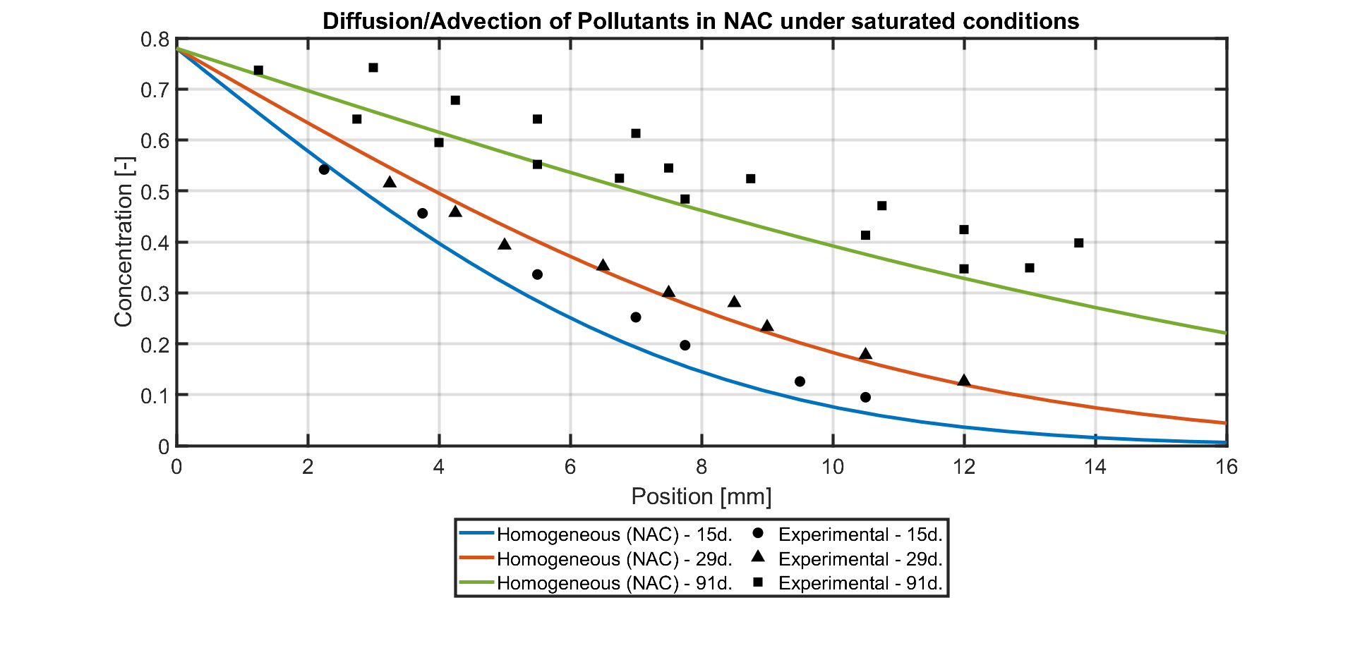
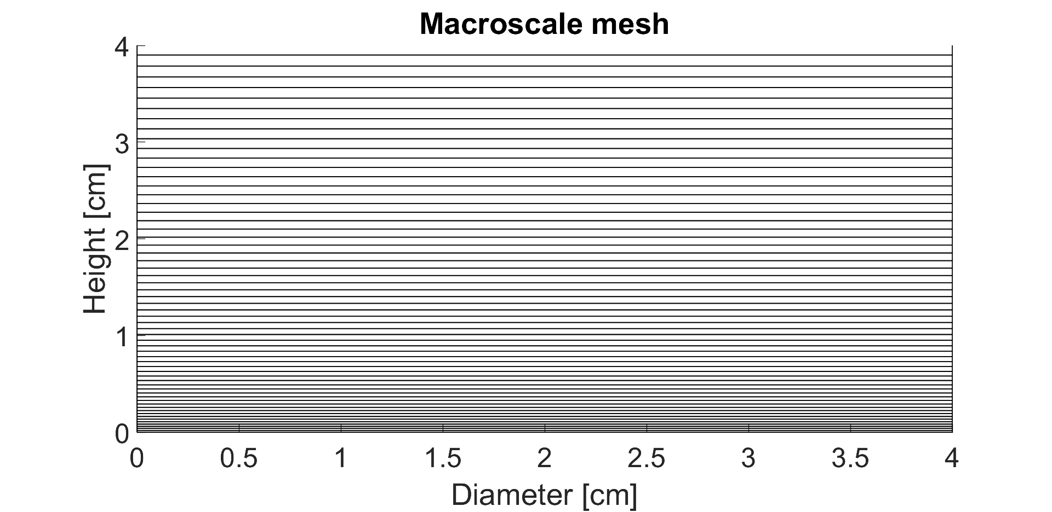
Experimental modelling - NAC
For NAC microstructure with EM+30% Diffusion Coefficient, the numerical results are close enough to the experimental (and analytical) analysis. Other studies have found an increase of up to 40% of the diffusion in 3D compared to 2D [Nilenius, 2014]
Notes:
Microstructure homogène et pas no micro / mettre résultats exp en back up

Slide 24
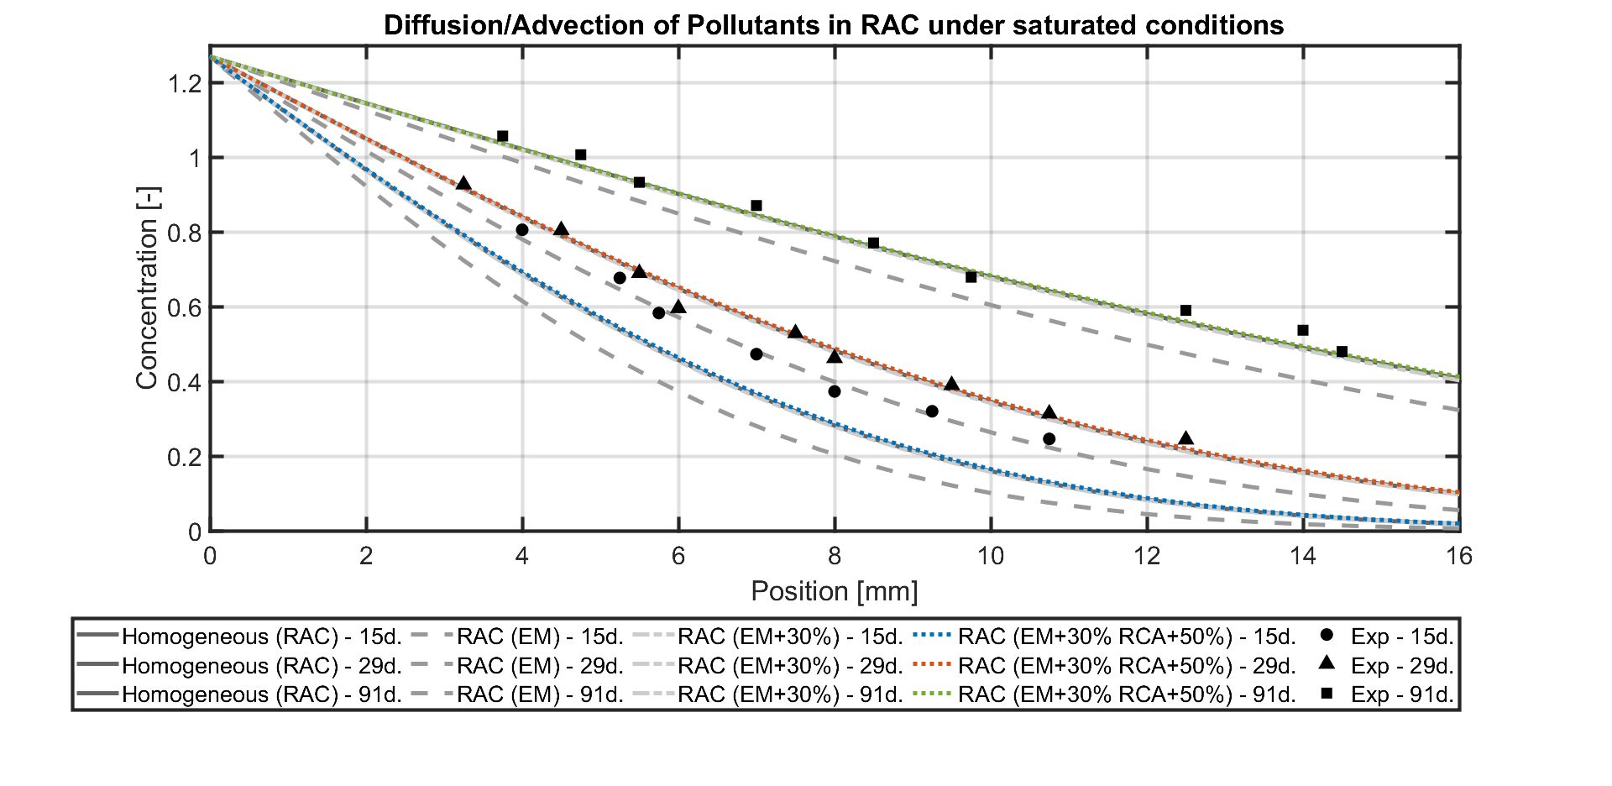
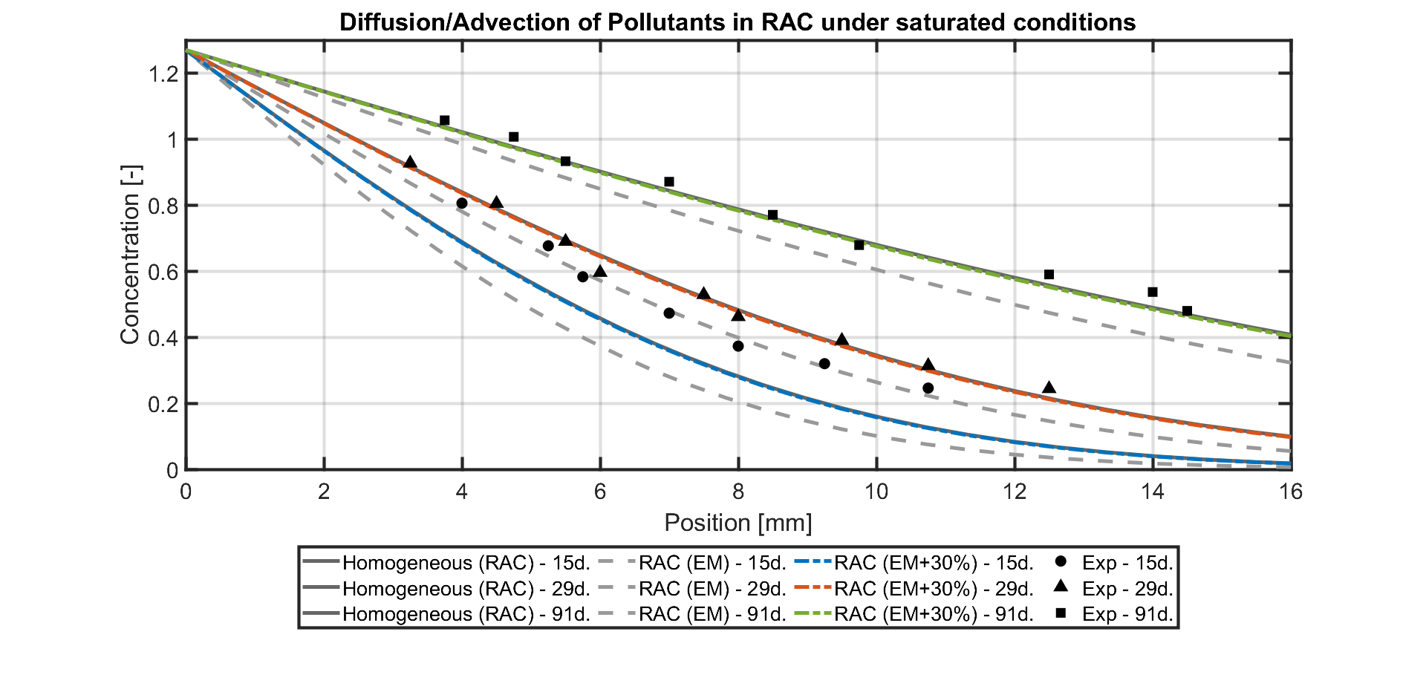
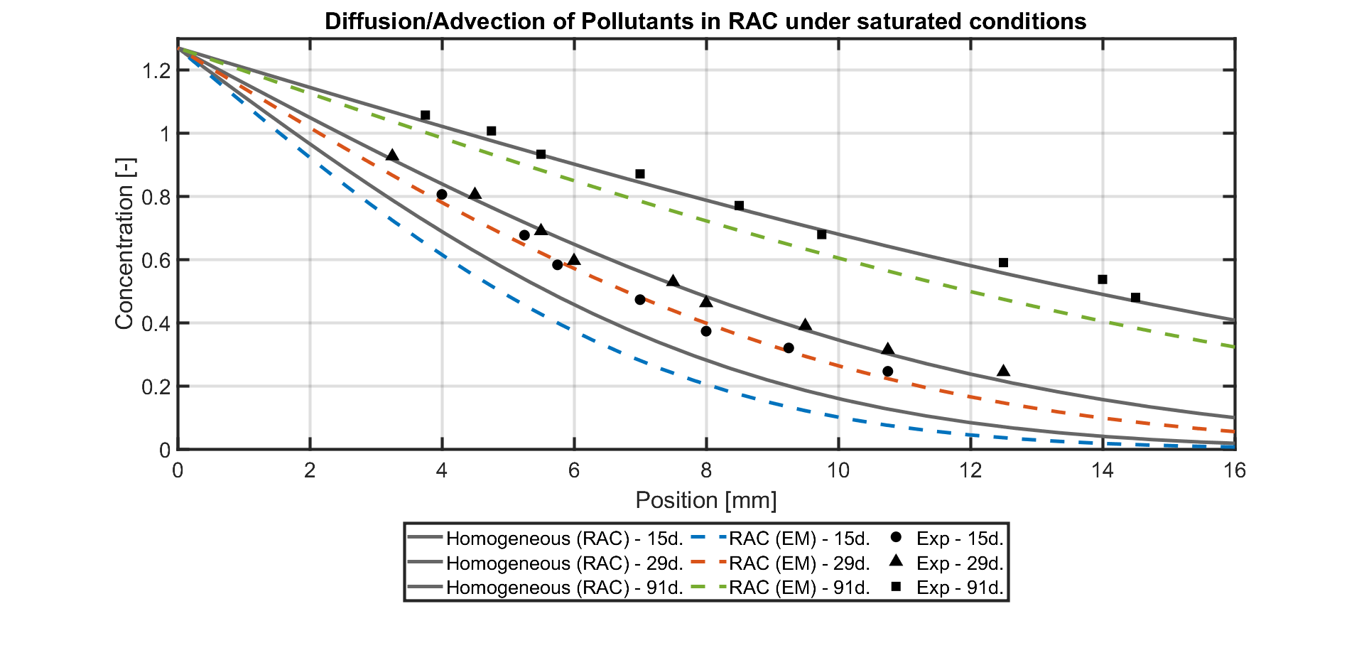
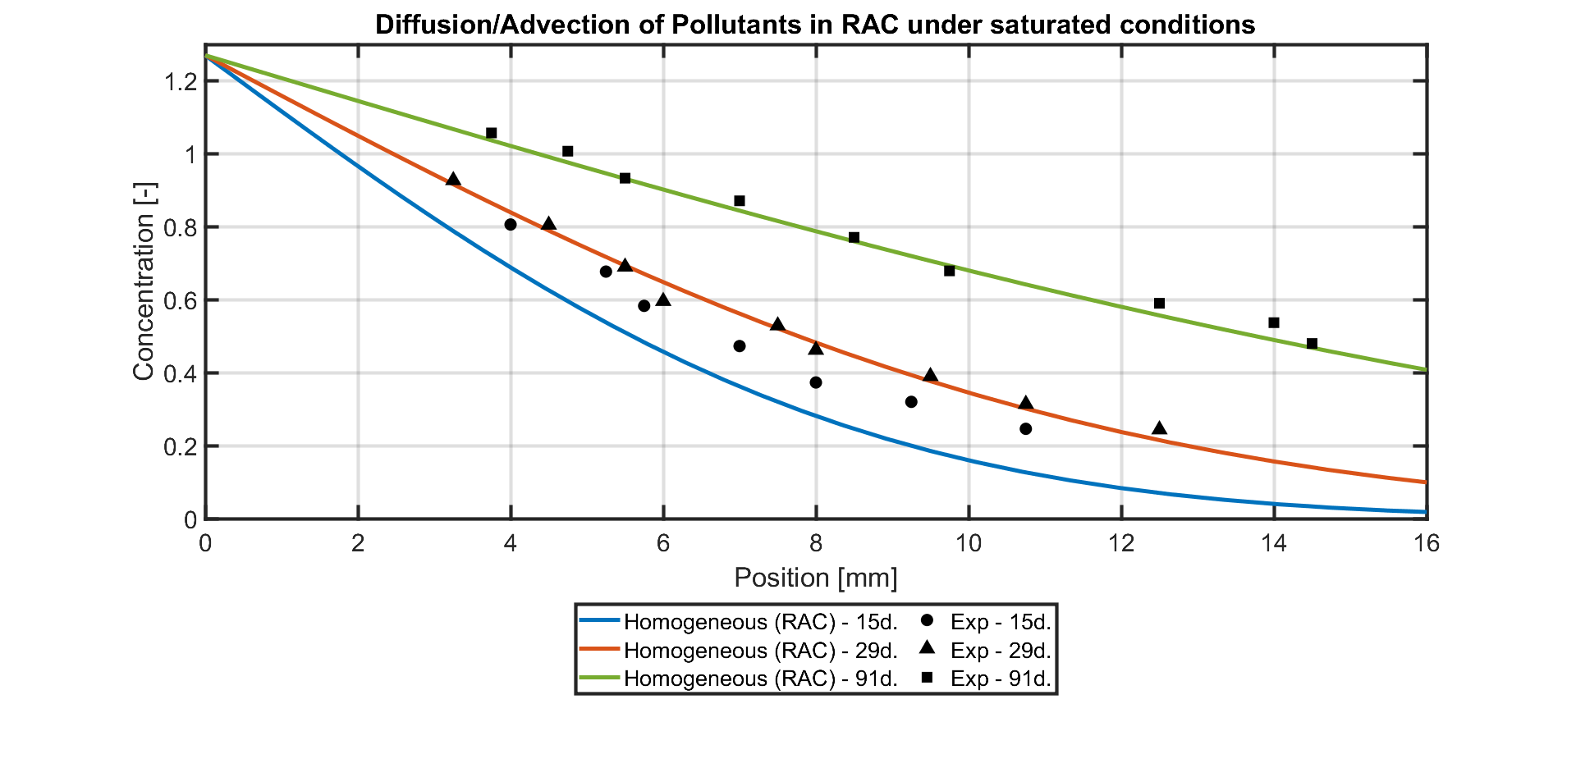
Experimental modelling - RAC
For RAC microstructure with EM+30% Diffusion Coefficient, the numerical results are close enough to the experimental (and analytical) analysis.

Slide 25
1. Introduction 2. Description of the model 3. Analytical validation of the model 4. RVE generation and analysis 5. Results of some simulations 6. Conclusion

Slide 26
Conclusion
The substitution of NA by RCA increases the diffusivity of chloride ions;
The model is analytically validated for the diffusion and advection of pollutants inside a porous structure, under saturated conditions;
The bigger the RVE, the higher the numerical cost but the higher the precision: compromise ?;
2D model underestimates the diffusion process: majoration of the diffusion coefficient could be an answer;
The microstructure can play the role of concrete using mortar properties, allowing easier study of aggregate’s influence.
Thank you for your attention.
This work is co-funded by the FNRS and the Wallonia Regional Government in the framework of a FRIA grant.

Slide 27
RVE: parameters/results
PSD: 2-4mm 48%, 4-5mm 22.9%, 5-6.3mm 20%, 6.3-8mm 9.1%
SF: 41% Volume/Surface for both NAC and RAC (mix hypothesis)
AR: between 1.5 and 2.5
% Adherent mortar in RCA (+-5%) : 50% for 2-4mm, 45% for 4-5mm, 40% for 5-6.3mm, 35% for 6.3-8mm [de Juan & Gutiérrez, 2009][Akbarnezhad et al.,2013][Florea & Brouwers, 2013].

Slide 28
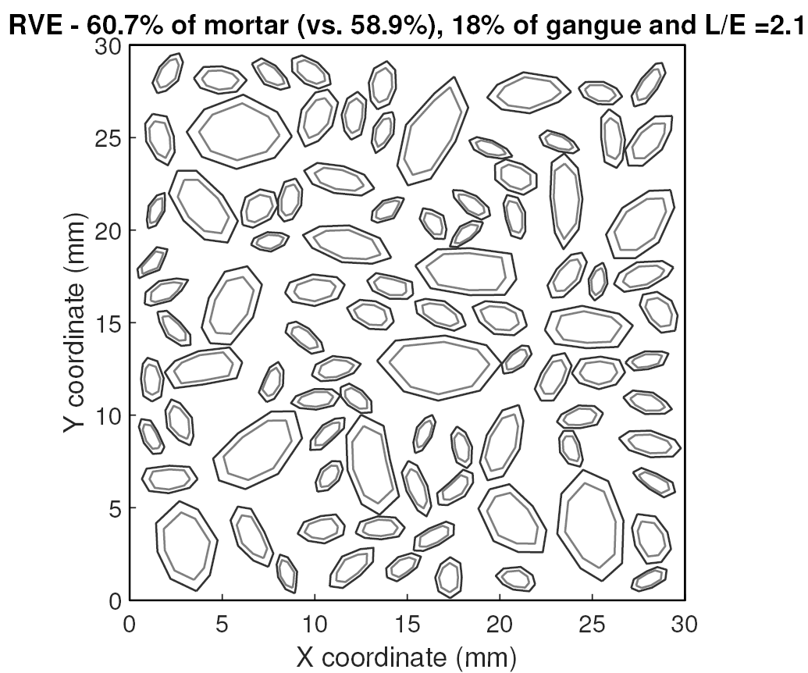
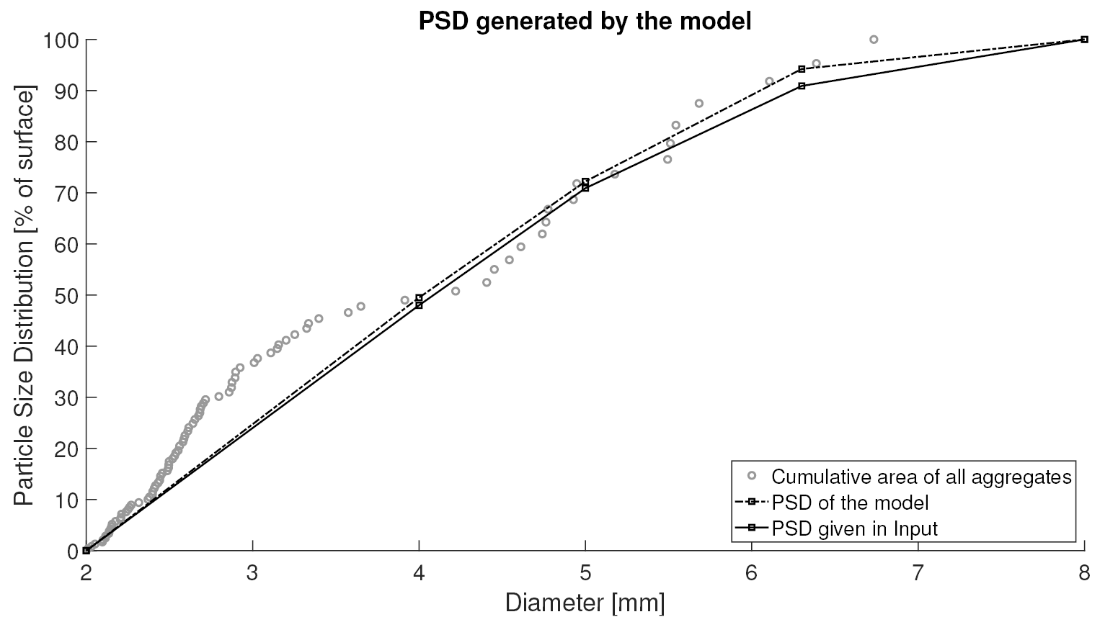
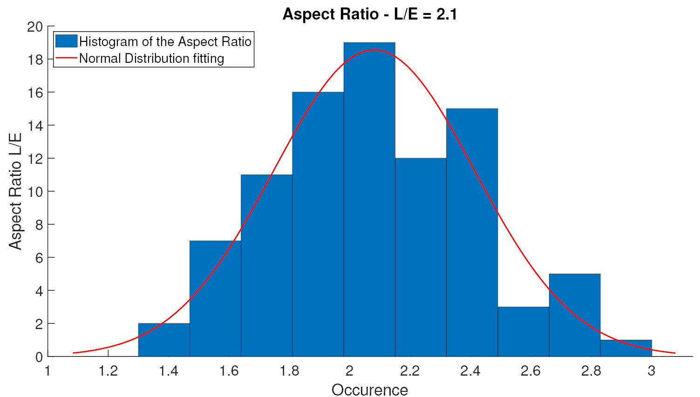
RVE: parameters/results

Slide 29
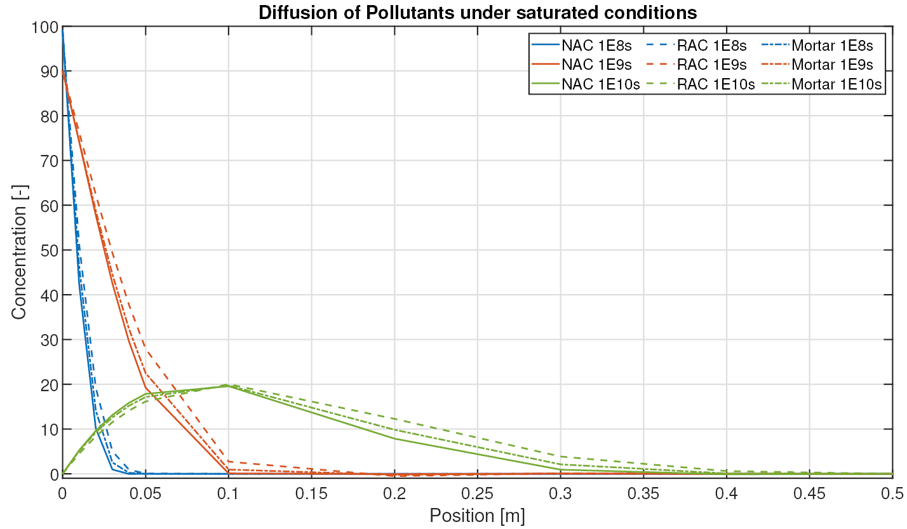
RVE: RCA influence
Equal properties, except for RCA: 5x more diffusive

Slide 30
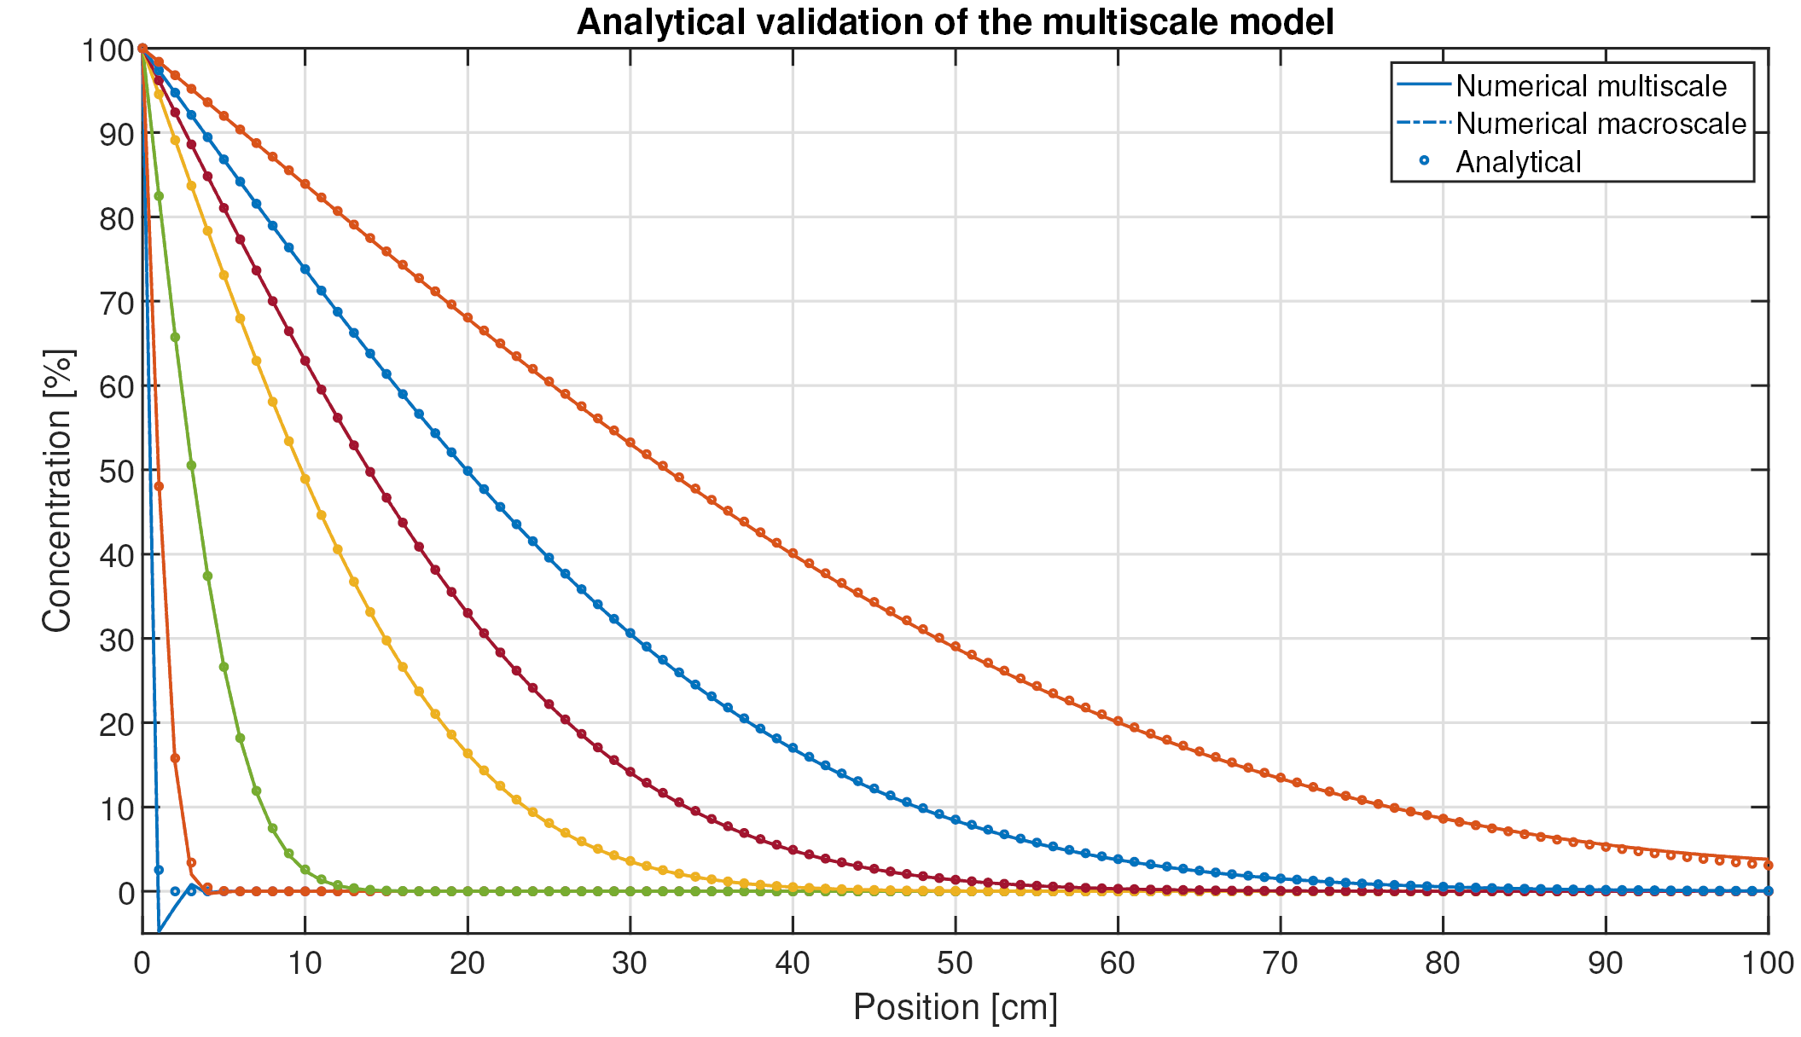
Analytical Validation
Analytical solution for a 1D semi-infinite medium [Biver,1993]:
Notes:
Using this analytical solution for a 1D semi-infinite medium from Biver, for diffusion and advection of pollutant inside a saturated porous medium, we obtain the results below. We can see that our model replicates accurately the analytical solution, validating it.
Enelever oscillation et mettre plus grand, microstructure homogène

Slide 31
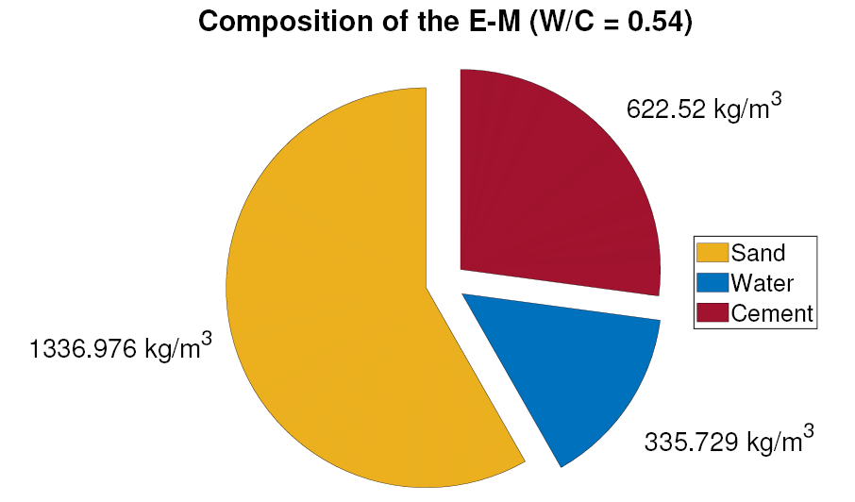
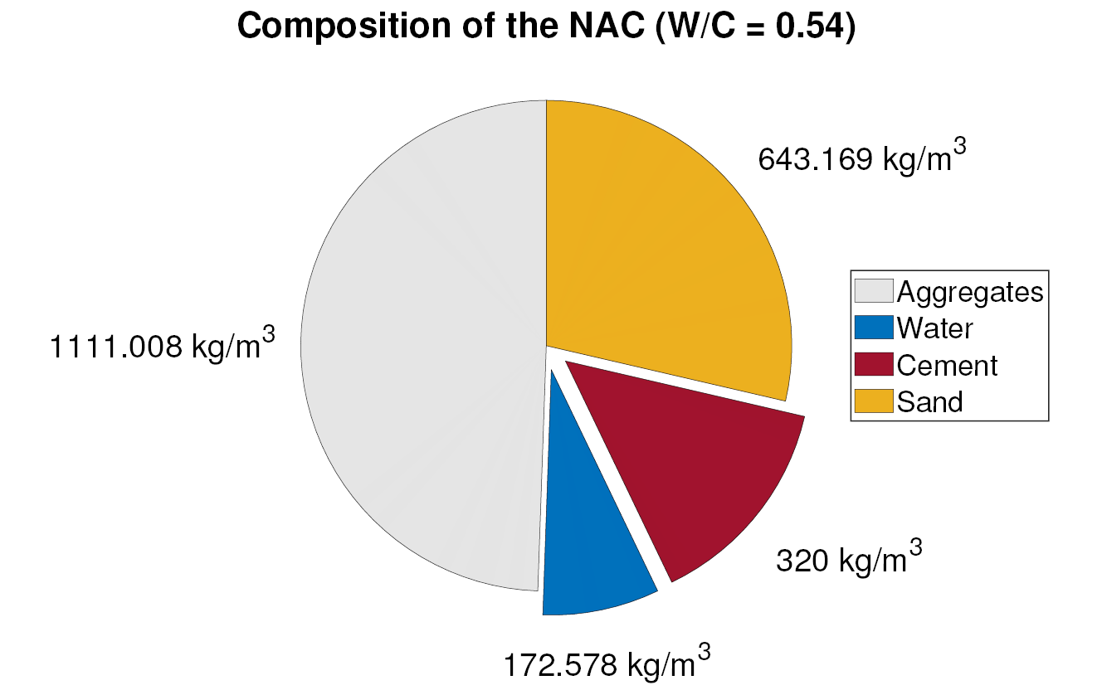
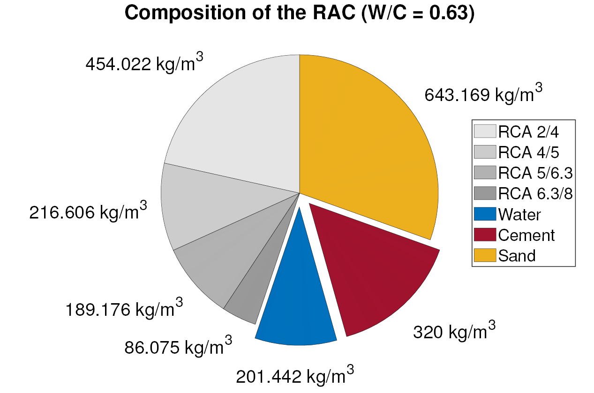
Experimental compositions

Slide 32
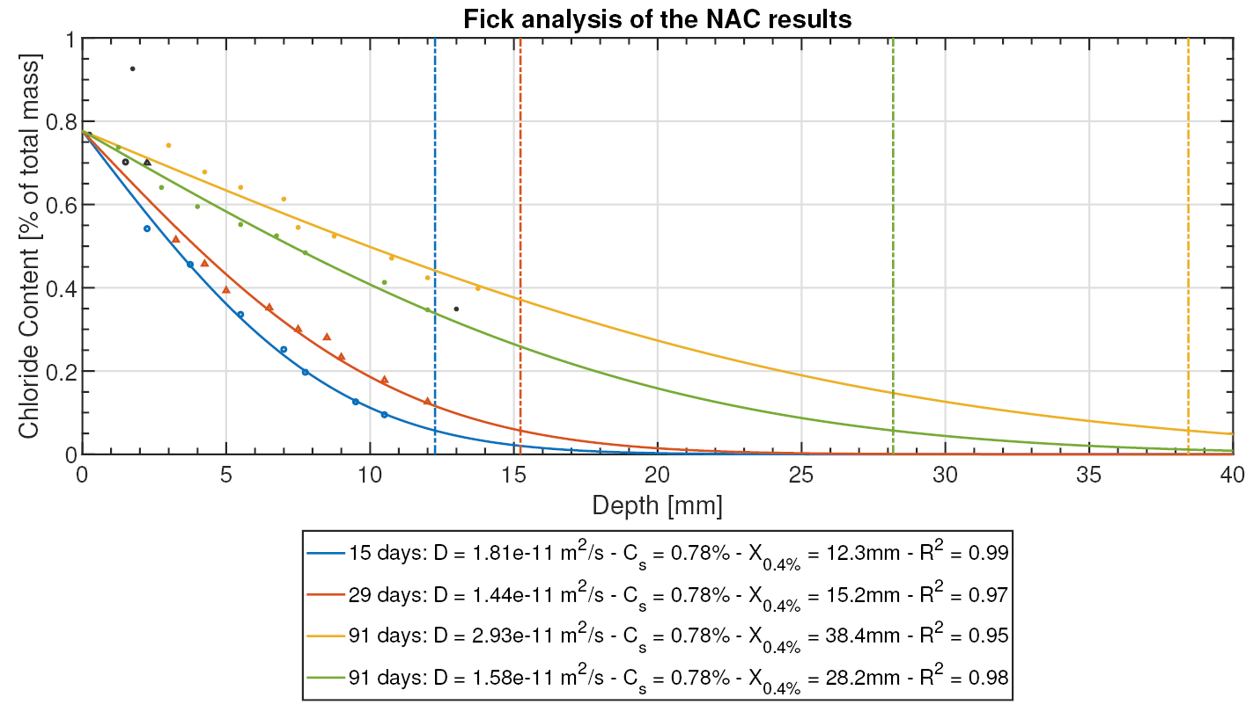
Experimental results

Slide 33
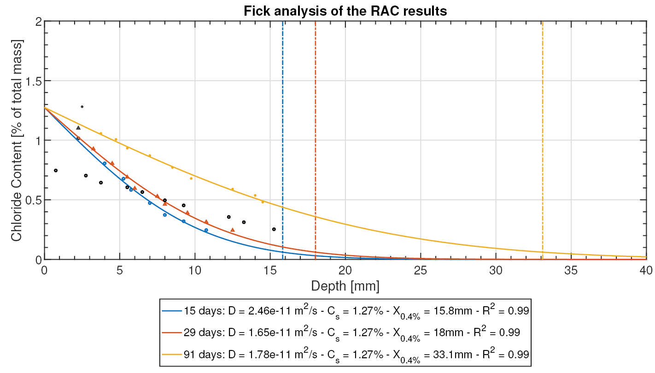
Experimental results

Slide 34
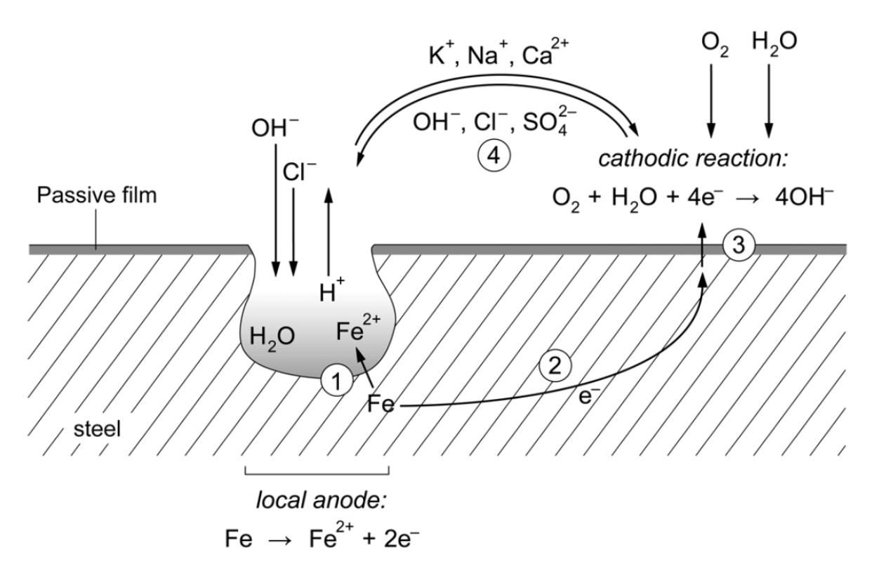
Corrosion process
[Angst, 2011]

Slide 35
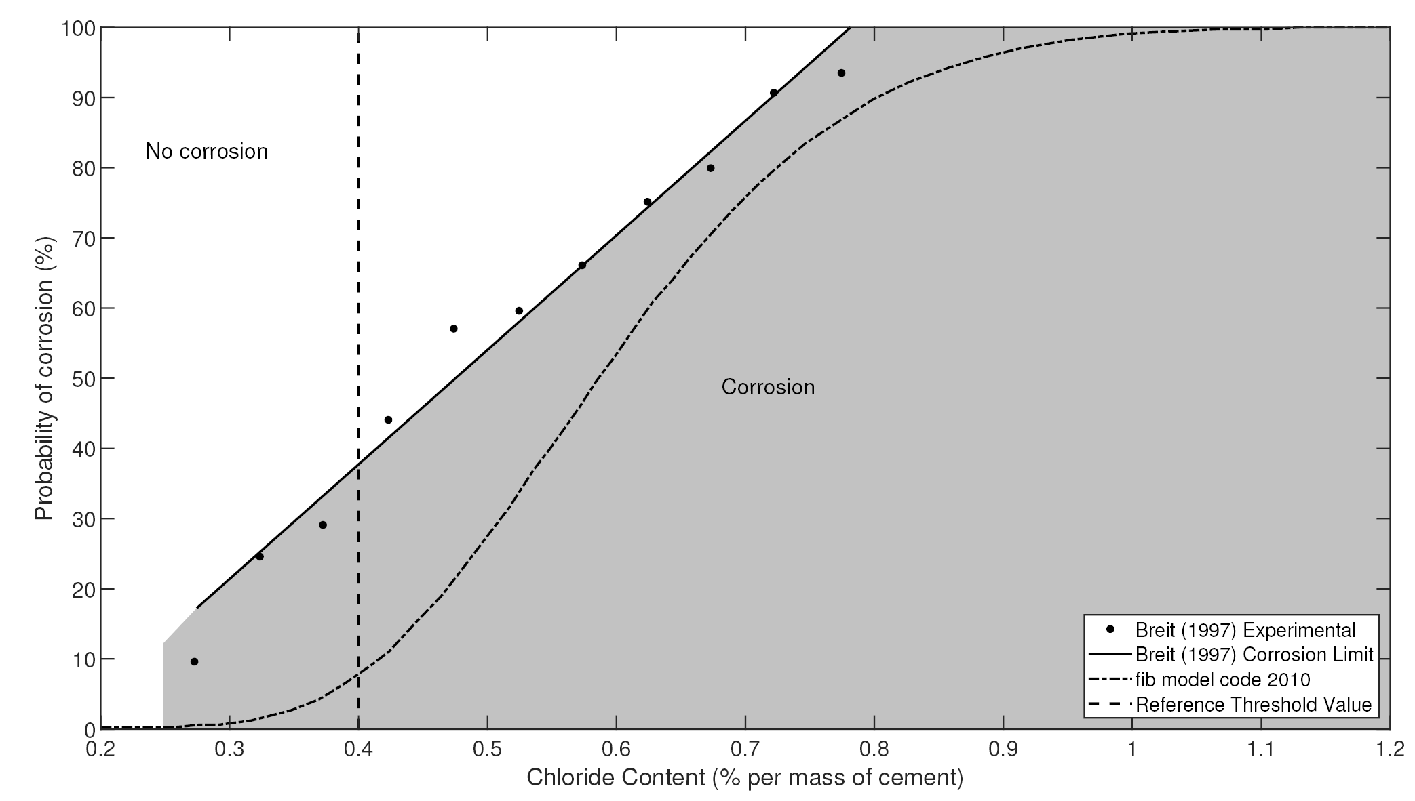
Chloride threshold
[Raupach & Büttner, 2014]
[Broomfield, 2007]

Slide 36
Influence of convection

Slide 37
Bibliography
Eurostat. (2014). Archive: Cement and concrete production statistics - NACE Rev. 1.1. https://ec.europa.eu/eurostat/statistics-explained/index.php/Archive:Cement_and_concrete_production_statistics_-_NACE_Rev._1.1
Commission, E. (2019). Construction and Demolition Waste (CDW). https://ec.europa.eu/environment/waste/construction_demolition.htm
Ployaert, C. (2008). La corrosion des armatures des bétons armés et précontraints [Bulletin - Technologie]. FEBELCEM.
Raupach, M., & Büttner, T. (2014). Concrete Repair to EN 1504: Diagnosis, Design, Principles and Practice. CRC Press, Taylor and Francis Group.
Biver, P. (1993). Phenomenal and Numerical study on the propagation of misicible pollutants in a medium with multiple porosity. University of Liège.
Nilenius, F. (2014). Moisture and Chloride Transport in Concrete - Mesoscale Modelling and Computational Homogenization. Chalmers University of Technology.
Geuzaine, C., & Remacle, J.-F. (2009). Gmsh: a three-dimensional finite element mesh generator with built-in pre- and post-processing facilities. International Journal for Numerical Methods in Engineering, 79(11), 1309–1331.
de Juan, M. S., & Gutiérrez, P. A. (2009). Study on the influence of attached mortar content on the properties of recycled concrete aggregate. Construction and Building Materials, 23, 872–877.
Akbarnezhad, A., Ong., K. C. G., Tam, C. T., & Zhang, M. H. (2013). Effects of the Parent Concrete Properties and Crushing Procedure on the Properties of Coarse Recycled Concrete Aggregates. Journal of Materials in Civil Engineering, 25(12), 1795–1802.
Florea, M. V. A., & Brouwers, H. J. H. (2013). Properties of various size fractions of crushed concrete related to process conditions and re-use. Cement and Concrete Research, 52, 11–21.
Angst, U. (2011). Chloride induced reinforcement corrosion in concrete. Norwegian University of Science and Technology (NTNU).
Broomfield, J. P. (2007). Corrosion of Steel in Concrete: Understanding, investigation and repair. (2 ed.). Taylor and Francis.

